Slide 1
DFM Engineering Detailed Design :
Cryogenic flow scheme & Cool down
V. Gahier on behalf of WP6a
Engineering Design Review of DFM 18.01.2022

Slide 2
Outline
  PFD and interface
  Cryogenic safety : Pressure map
  Operating cases
    Helium requirement
    Controlled cool-down
  Cryo instrumentation

Slide 3
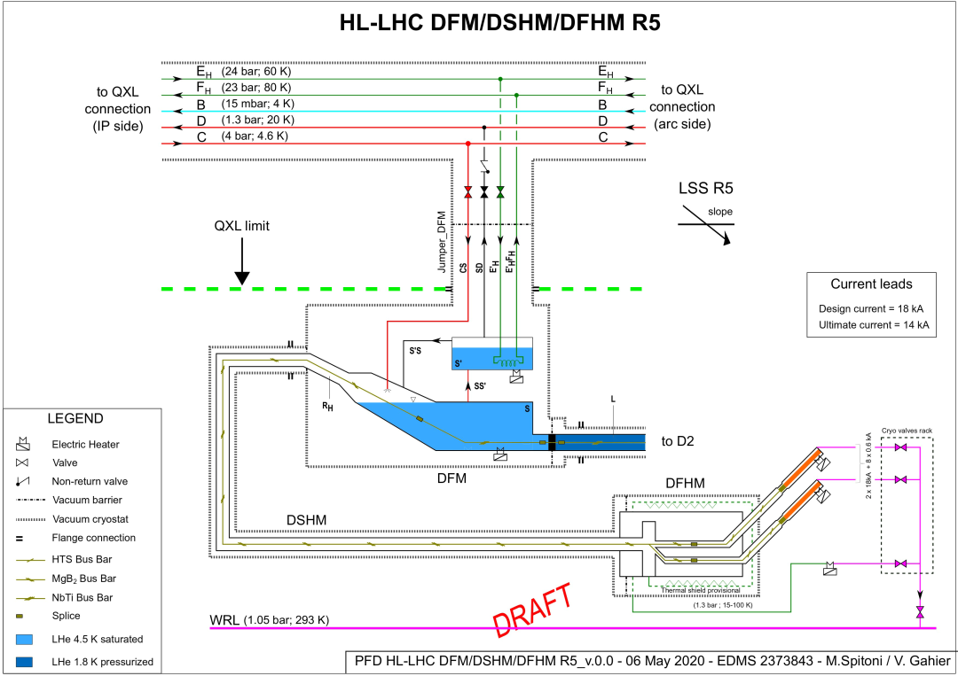
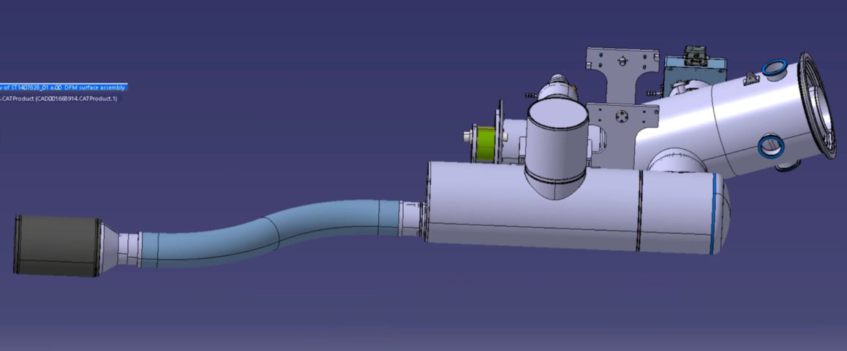
Zoom on Cold Powering for Matching Section cooling architecture
One cooling circuit from 4.5K to 300 K
One Service module feeding in particular supercritical helium to Cold Powering system.
DFm
Nb-Ti < 5 K
Nb-Ti- MgB2 < 5K
Conductor and splices to be maintained in LHe
SC link (DSHm) ~ 117 m
15 cables cooled by gaseous helium
Cryostat at 1 W/m
MgB2 < 17 K
DFHm
MgB2-HTS splice < 17 K by forced gaseous circulation
10 current leads
- HTS- copper transition < 50 K
V. Gahier – DFM DDR : Cryogenic flow scheme & cool down – Jan 2022

Slide 4
Cryogenic safety
All Cold powering systems are designed at 3.5 bara;
Staggered safety protection system to ensure release of helium at safe location similarly to the Triplets system;
In case of Power cut, the SC link will stay thermalized since the DFHM SV willl relieve first.
Normal operating pressure
Design Pressure
Burst disc SP
4
3.5 bara
3
3.5 bara (-0/+10%)
3.2 bara
Burst disc SP (-0/+10%)
3.0 bara
2
SV accumulation pressure (10%)
Line C pressure
2.8 bara
SV SP (+/- 0.15 bar)
SV accumulation pressure (10%)
1
Helium supercritical
SV SP (+/- 0.15 bar)
2.45 bara
2.3 bara
2.3 bara
2 bara
High pressure instrumented protection for line D isolation on DFM
1.95 bara
4.9 K
1.8 bara
Extended operating enveloppe for cool-down /warm-up
1.77 bara*
Normal operating enveloppe
Flowrate : 3-4.5 g/s
1.62 bara*
4.4 K
1.22 bara
1.2 bara
0 bara
1.05 bara
DFM temp
DFM pressure
0 bara
WRL pressure
DFHM pressure
* Considering minimized pressure drop

Slide 5
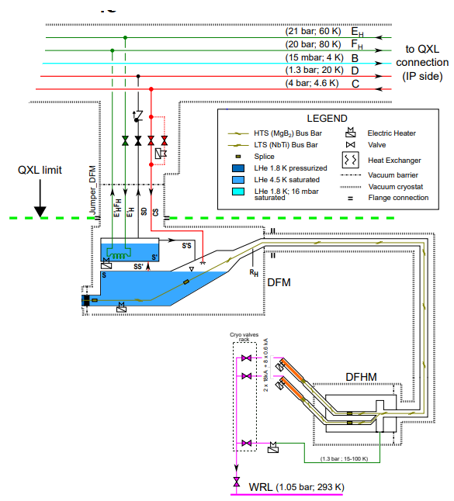
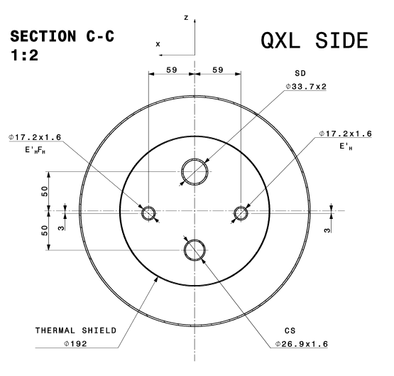
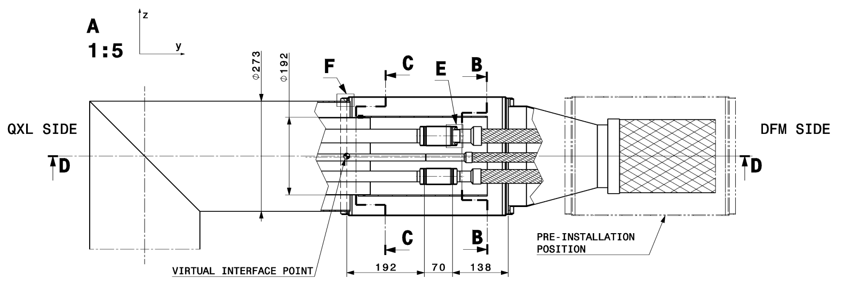
Cryogenic interface and functionality
The cryogenic distribution circuit to the Matching section Cold Powering system (similar at Triplets) → DFM Jumper
  E’H (60K, 19 bar) to E’HFH to feed the coil heater immersed in the liquid bath. Its functionality is to generate gaseous helium to the SC link, acts as a back-up of the immersed electrical heater (and vice-versa). Heat transfer mostly by film boiling.
  CS line (4.6K to 5.3 K, 2.3 to 4 bar) feed the DFM in liquid helium
  SD line relieves any overpressure from the DFM to the line D.
Flexible ~2 m
All hydraulic diameters were confirmed in EDMS 2364324
Diameters standardised with Triplet Cold Powering system

Slide 6
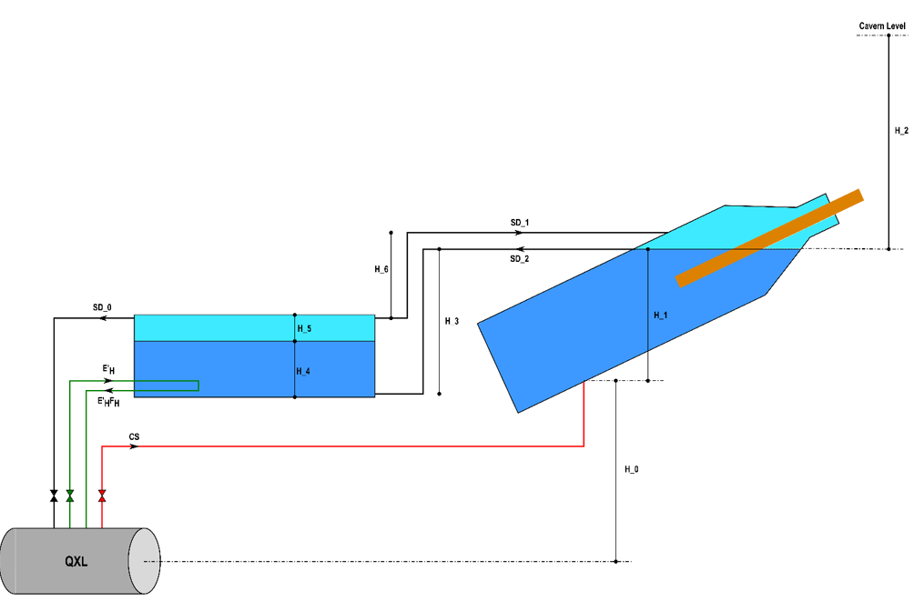
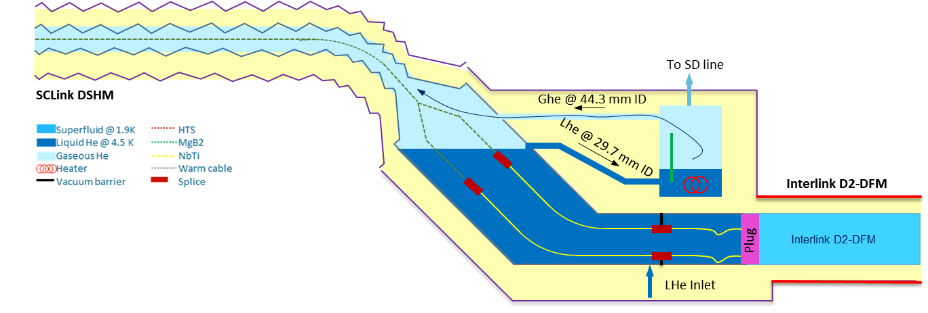

DFM concept
Two helium vessels communicating by gravity :
  One vessel where liquid helium is injecting and where the splices are kept immersed. Electrical heaters are present at the bottom for emptying.
  One vessel where the gaseous helium is generated via heating system (coil or electrical heater)
Similar concept retained and successfully proven on Demo 2.
Static heat loads should be lower than 25 W.
$$∆P_{LHe}+∆P_{GHe}<ρ∙g∙H$$
Height table
Height name | Value [m] | Phase [-] | ΔP [mbar]
H_0 | 1.5 | 0 | 17.51
H_1 | 0.27 | 0 | 3.17
H_2 | 10 | 2 | 5.07
H_3 | 0.39 | 0 | 4.60
H_4 | 0.15 | 0 | 1.76
H_5 | 0.1 | 1 | 0.22
H_6 | 0.33 | 1 | 0.71

Slide 7
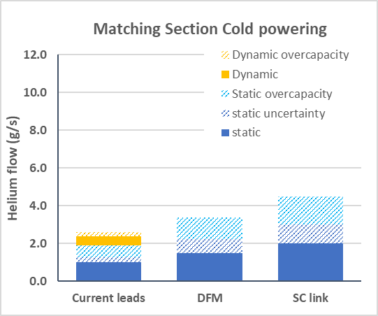
Operating modes and helium flow requirement
Helium flow for the DFM system is governed by the SC link requirement (117 m at 1 W/m) leading to the same required helium flow when the system is powered or not.
For the Cold Powering for the Triplets, the helium flow is determined by the current leads requirements.
After recommendations of the heat load review panel (refer to EDMS 2588891) , the helium installed local capacity for Matching section Cold Powering to 6.5 g/s.
Planned Operation
Warm up
Cool down
Circuit Purging ; Flushing
Cool down from 300 K to 4.5 K
Standby no current during normal operation
Nominal full current (ultimate and nominal)
Standby mode during Technical Stop
Warm up to 300 K
Unplanned Operation
Power cut (with blocked outlet)
Quench / electrical short circuit…
Degraded performance (SC link; current lead…)
Re cool down after unplanned stop
Installed local capacity
4.5 g/s
3.4 g/s
2.6 g/s

Slide 8
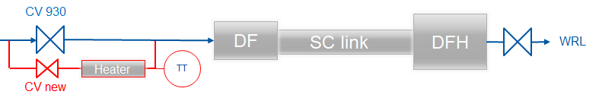
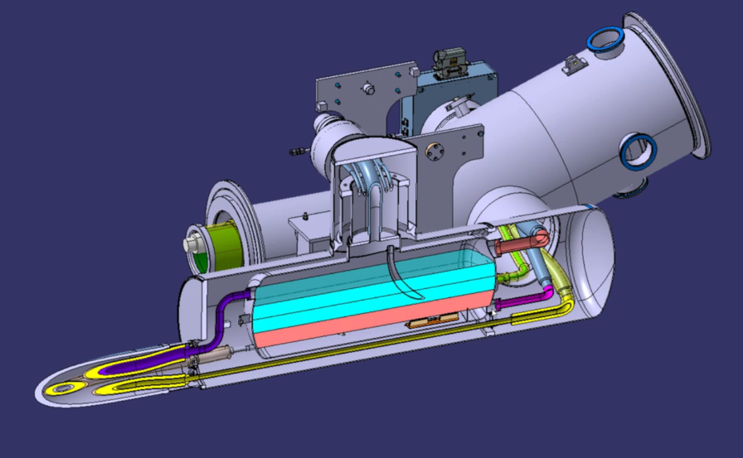
Controlled Cool-down / Warm-up
MgB2 conductor is sensitive to strain, and excessive stress would lead to degradation of its critical current : Requirement of a controlled cooldown for the SC link.
A serie of meetings were held to define the optimum solution according to WP6A contraints : a heater installed in parallel of the nominal feeding line. Solution validated by an approved ECR. (Refer to https://indico.cern.ch/category/13546/)
The constraints are :
  30K maximum DT on the SC link
  Controlled cooldown down to 80 K
  3 to 4 g/s cooldown /warm-up flow rate through the link
Current hydraulic design and safety aspects were also considered for the controlled cool-down / warm-up design
SD line
CS line
(He feeding line)
Flexible ~2 m
Line SD @ 29.6 (rigid) / 34.2(flexible) mm ID
Line CS @ 23.7 (rigid) / 25.5 (flexible) mm ID
Rigid lines
Hydraulic diameter are sufficient for DFM cool-down

Slide 9
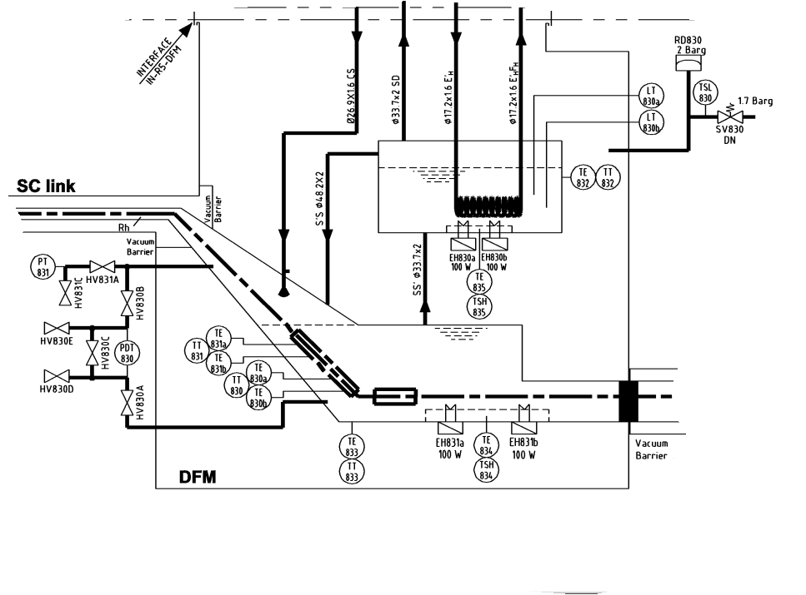
DFM Instrumentation requirement
Instrument | Number | Comment
Thermometer | 2+2S | Temperature measurement on the MgB2-Nb-Ti splices. Short block - Cernox 3 points. No HV potential.
Thermometer | 2 | Temperature measurement for cool-down / warm-up – Long block – Cernox 3 points
Thermometer | 2 | PT-100 to be installed on a copper block for heater protection
Level gauge | 1+1S | Superconducting gauge for liquid/gas level control
Pressure transducer | 1 | To monitor DFM pressure
Electrical heater | 2+2S | Two 100 W electrical heaters in liquid helium for mass flow production; Two 100W electrical heaters at the lowest immersed position for liquid vaporisation during WU. Electrical heaters to be installed on a copper plate to increase global heat exchange area.
Extract of PID lhclsqrg0042-v0 – DPT removed
On contrary of DFX, no Differential Pressure measurement due to the reduced height in the main helium bath. This DPT was forecast to follow the liquid filling phase. Instead, temperature probes can be installed in the vessel vacuum.

Slide 10
Conclusions
The cooling circuit feeds in series the three different components of the Cold Powering System from 4.5 K to 300K. Helium flow is defined by the SC link requirement.
Cryogenic interfaces for are defined and hydraulic diameters are confirmed.
DFM concept is based on two helium vessels communicating by gravity : this concept was successfully proven on Demo 2.
The controlled cooldown and warm-up requirement is considered in the cryogenic design.
DFM cryogenic instrumentation was reviewed. DPT to follow liquid filling on the main helium bath is removed due to the reduced height to be measured.

Slide 11
Spare slides

Slide 12
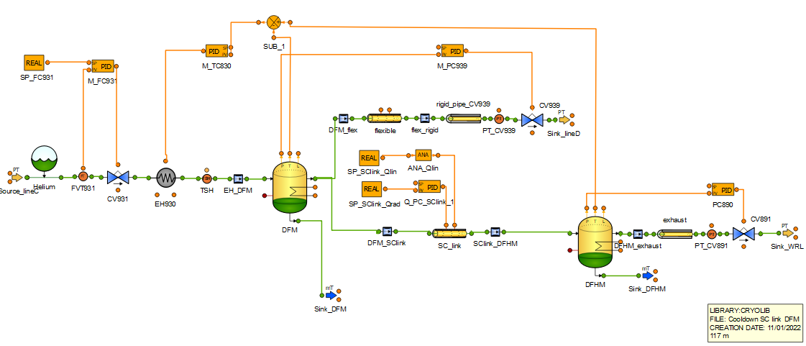
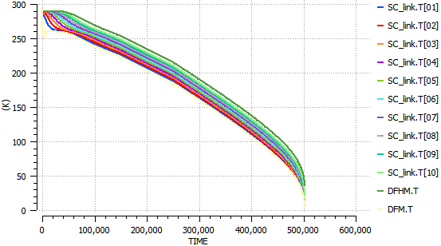
Dynamic simulation of controlled cool-down (Bonus)
  P init : 1.3 bara
  T init : 290 K
  T env = 300 K
  SC link Metal : Copper
  DFM/DFHM metal : SS
  Pressure controlled at DFHM by PC890 at 1.3 bar
  Pressure controlled at DFM by PC839 at 1.7 bar
  DT controlled at 30 K on the SC link
  CD flow increased progressively from 1 to 4 g/s to avoid overpressure at warm conditions
Cooldown modelling performed with Ecosim
 | Mass of metal (kg) | Hydraulic parameters
DFM | 215 | NA
SC Link | 2250 (19 kg/m) | Length : 117 m Dh : 10 mm Friction factor: 0.1
DFHM | 500 | NA
  Modelled Temperature profile along the link during CD
  Cooldown to ~5 K in 5 days

Slide 13
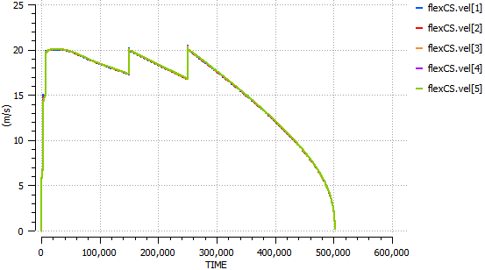
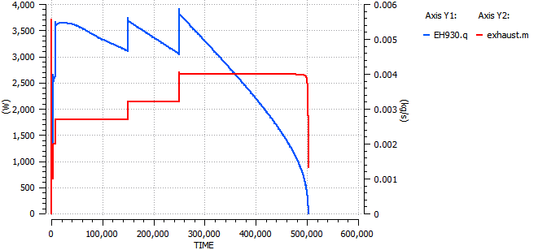
Controlled Cool-down / Warm-up (Bonus)
  Modelled velocity profile in CS flexible during CD
Impact on hydraulic design
Velocity in flexible to be limited to 20 m/s to avoid failure due to Flow Induced Vibrations. This threshold may be increased if limited operation in time.(flow to be limited from 2.7 to 4 g/s according to the temperature)
Impact on integration
Service module lenght is increased of 1 meter with the addition of :
Cool-down / Warm up heater : cartridge type – 5 kW.
A control valve
Advantages of the chosen solution :
Possibility to benefit from the controlled CD of the magnets due to the reduced Kv of new supply valve
No impact during normal operation
Heater impact (potential high temperature) is a known and managed issue (e.g. 600 kW installed in the QUI) → Installation of DO to command the heater, Thermal switch installed at the outlet.
  Modelled heater duty and CD mass flow aret profile in CS flexible during CD

Slide 14
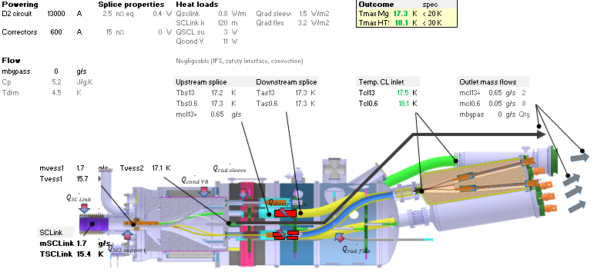
Helium flow requirement and thermal design
DFHM
DFHM : Ultimate current
Gaseous helium feeding DFHM from SC link available at 16 K
DFHM designed for:
  Design : 4.5 g/s
Total Heat load < 30 W
No condensation on external surface and feedthrough
Thermal shield not required

