Slide 1
Recap on DFM Integration in the LHC tunnel
- Activities completed,
- On-going studies,
- Next steps
M. Gonzalez, G. Aparicio
18/01/2021

Slide 2
Outline
Recall on the boundary conditions in the existing LHC tunnels for P1 and P5
Follow-up on the DFM and cryo-line Integration in the LHC tunnel
  Completed activities
  On going studies
  Pending points/ Next Steps
Summary table
Conclusions

Slide 3
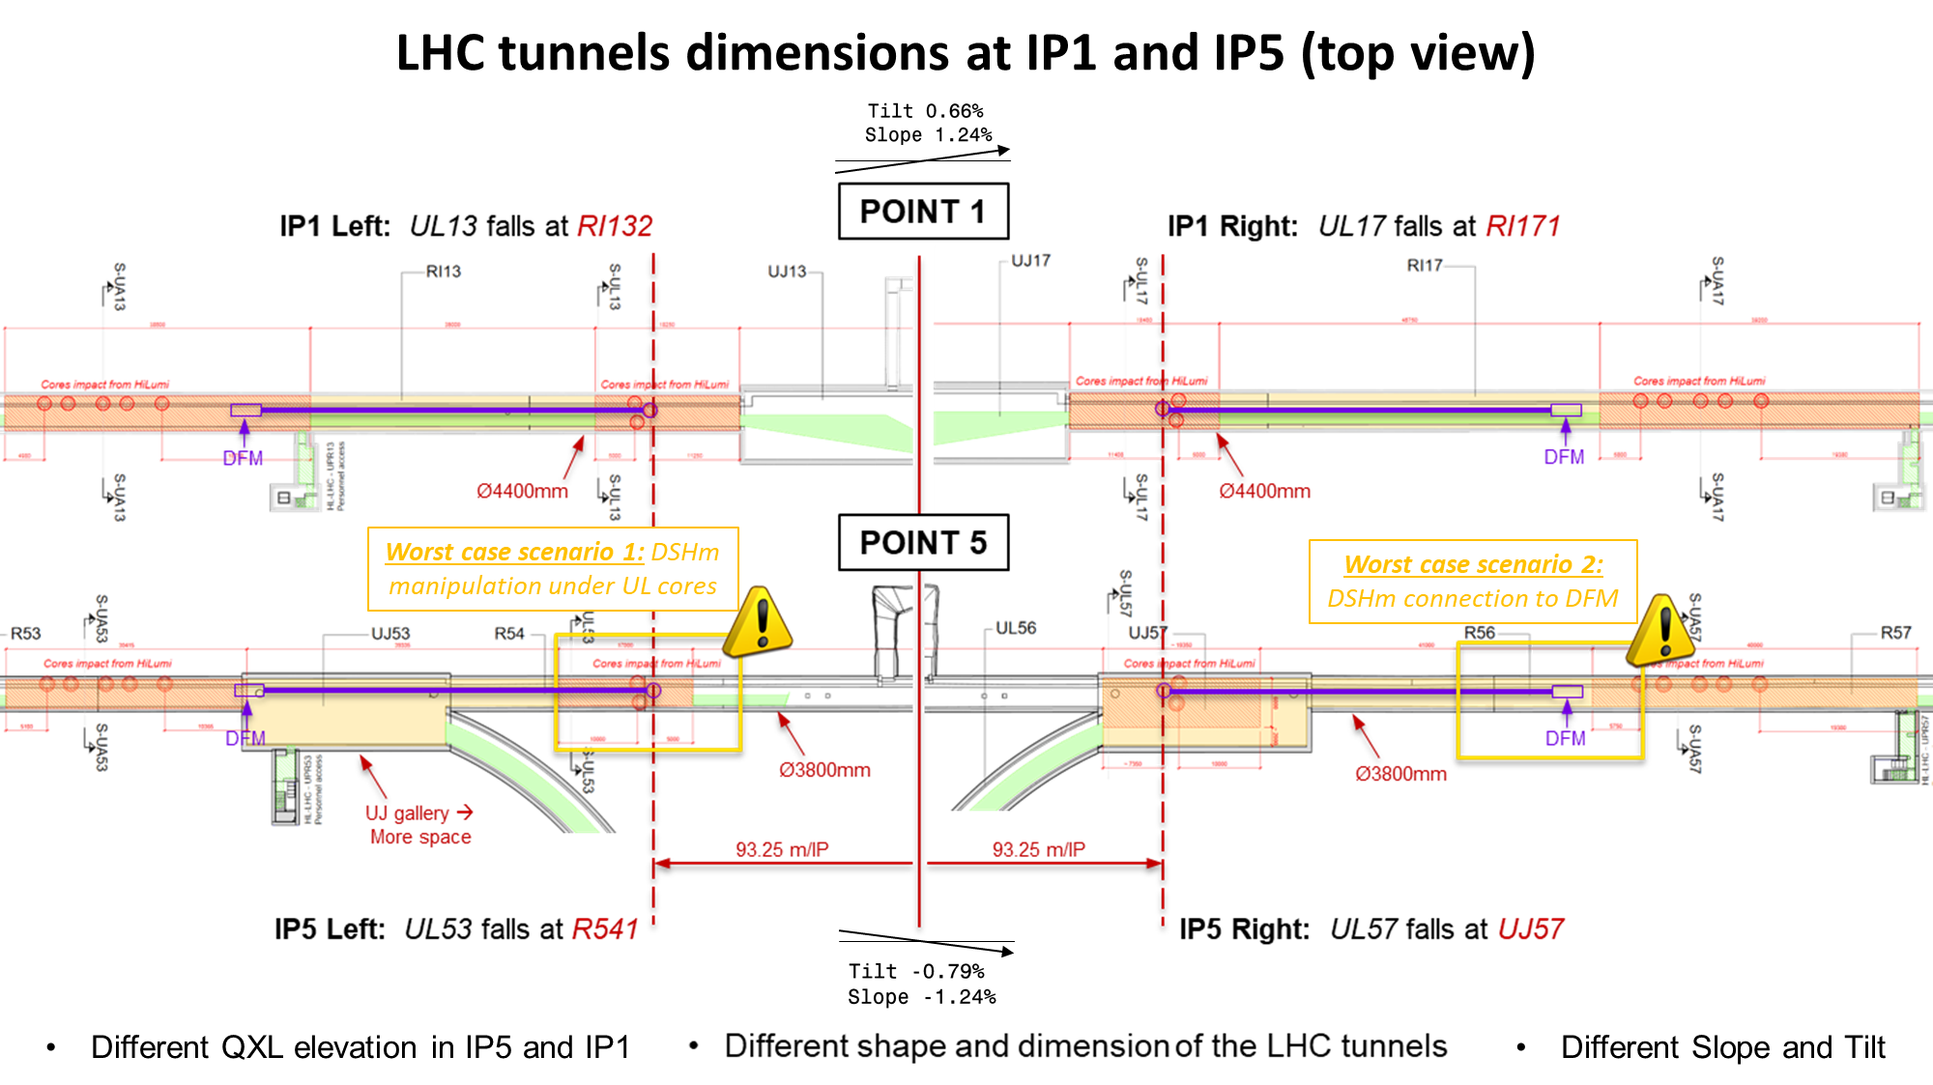
WARNING!
  → Detailed integration has been performed in 5R → considered the worst-case scenario. The other 3 locations have been analysed copying and mirroring the provided models.
  → While we are confident that the main issues have been identified and dealt, the 4 specific integration studies could not be carried out at this point → it is a possible source of uncertainties.

Slide 4
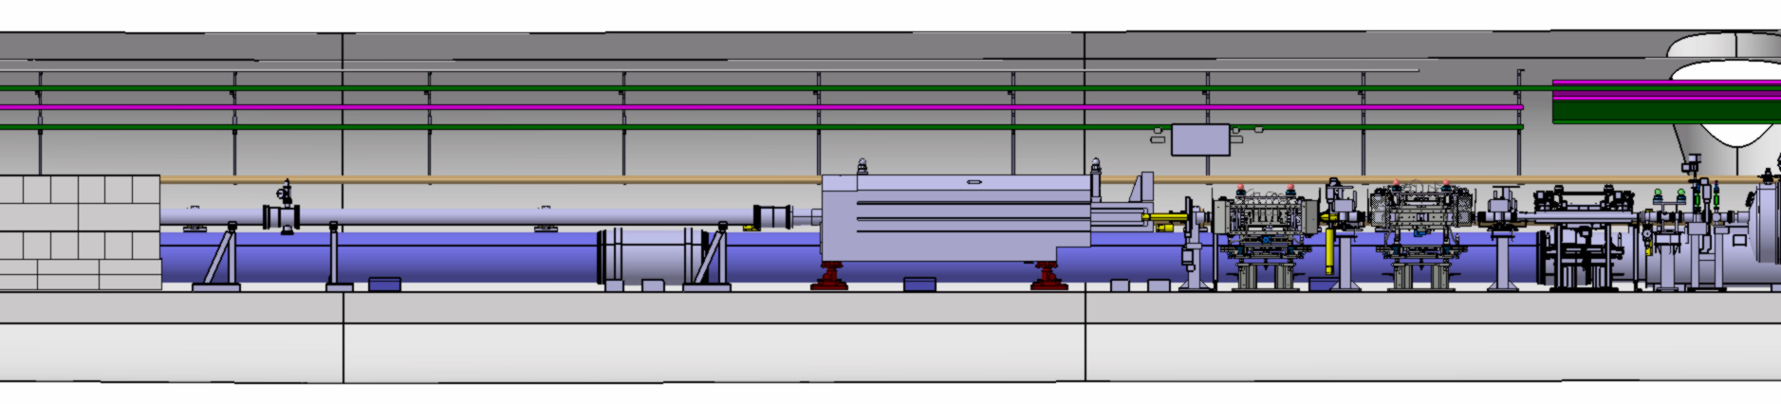
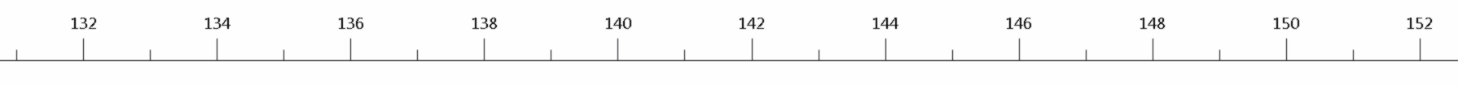
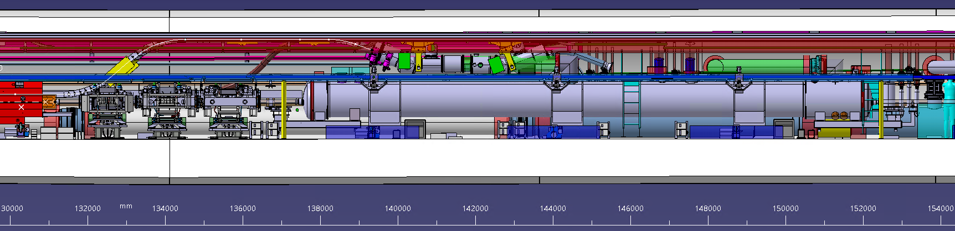
MACHINE LAYOUT: IP5 RIGHT ZONE
!!
LHC
Worst Case Scenario
R571 – Ø 3800 mm
TAN
HL_LHC v.1.5
No major changes for HL-LHC v.1.6
DFM
TAXN
D2
TCTPV
TCTPH
TCLX

Slide 5
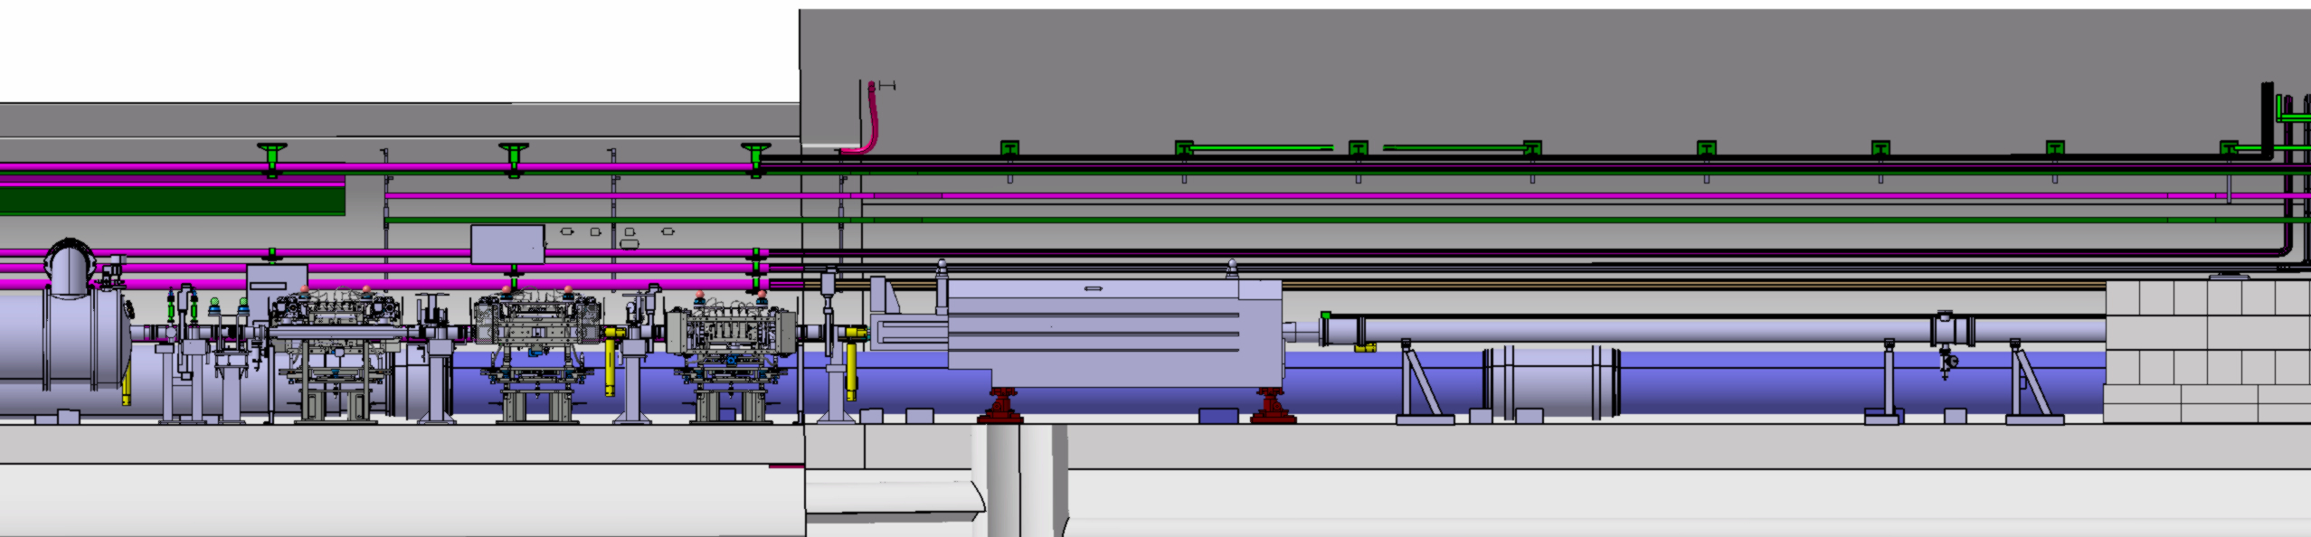
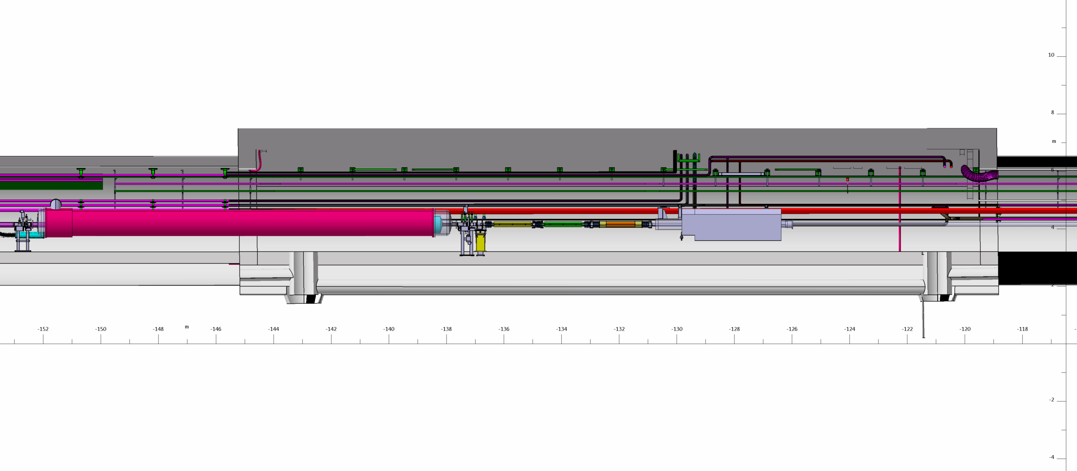
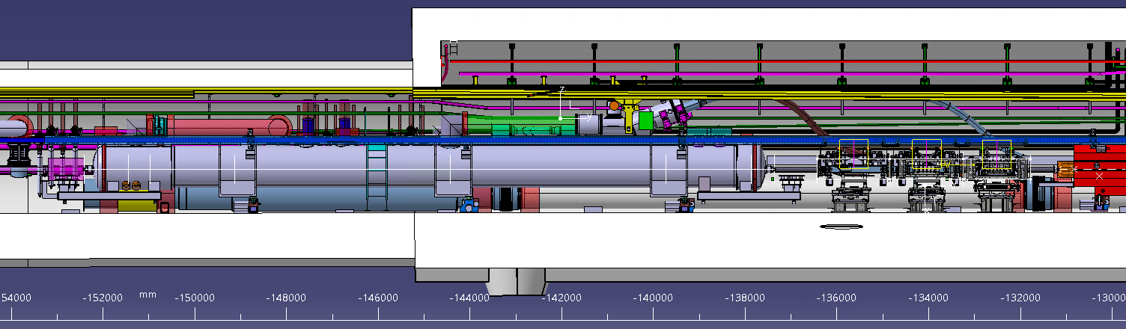
MACHINE LAYOUT: IP5 LEFT ZONE
LHC
UJ53
R532
TAN
HL_LHC v.1.5
No major changes for HL-LHC v.1.6

Slide 6
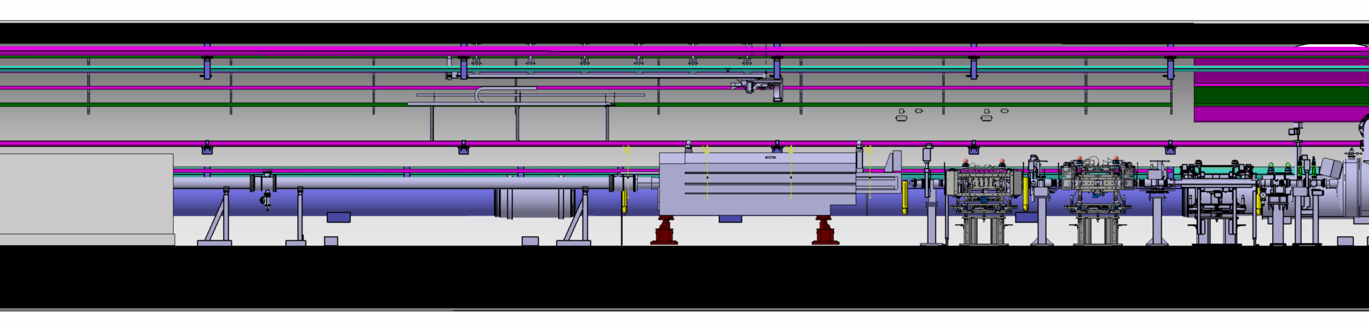
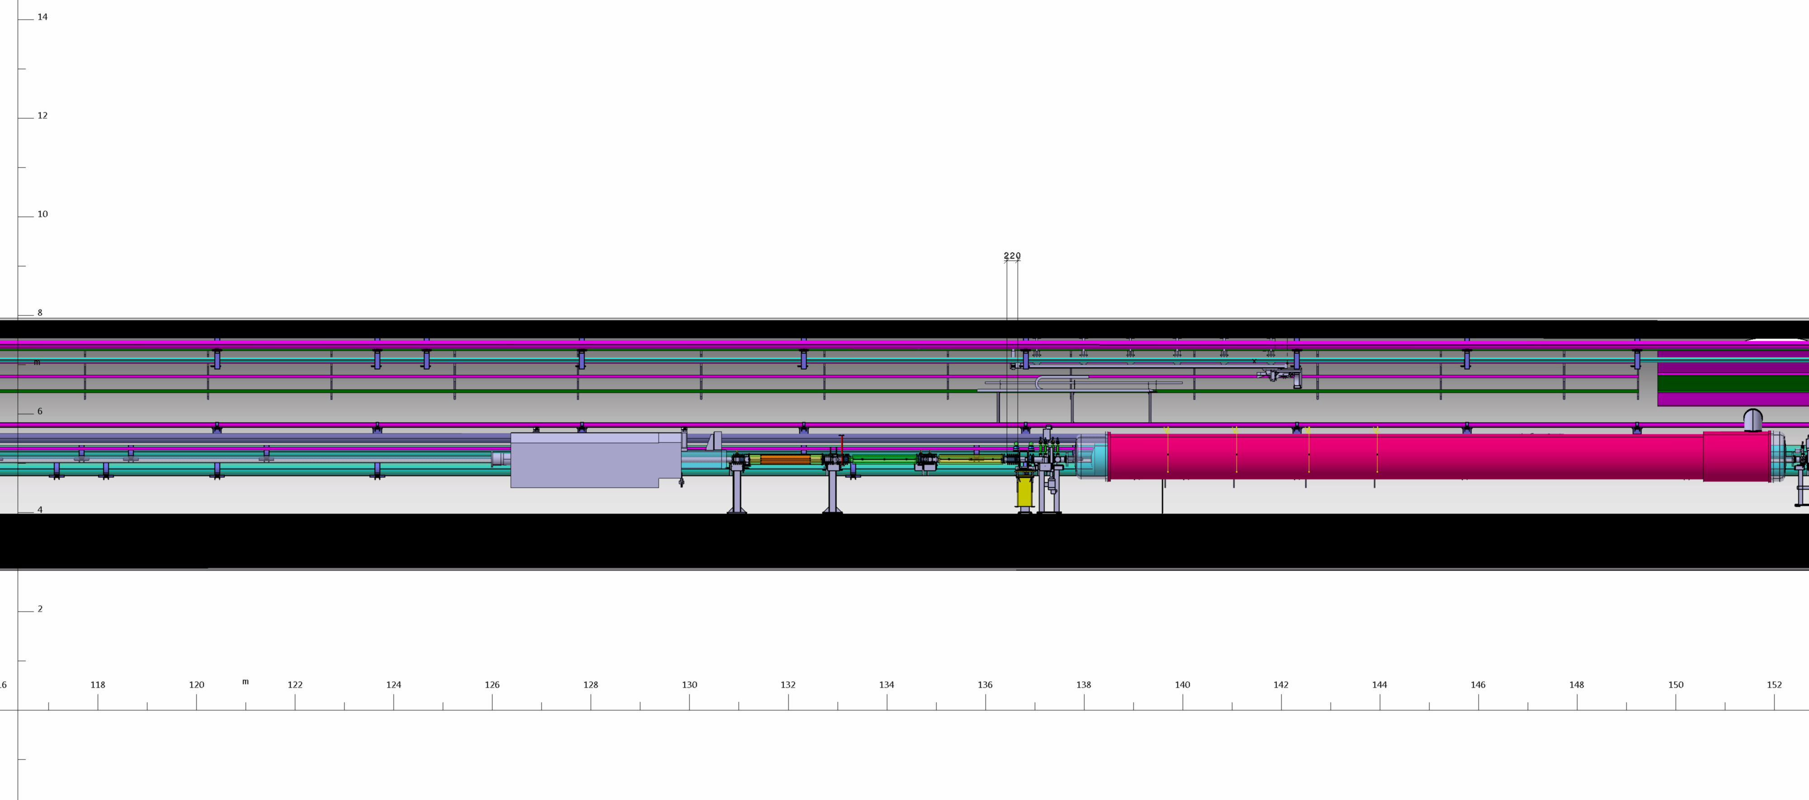
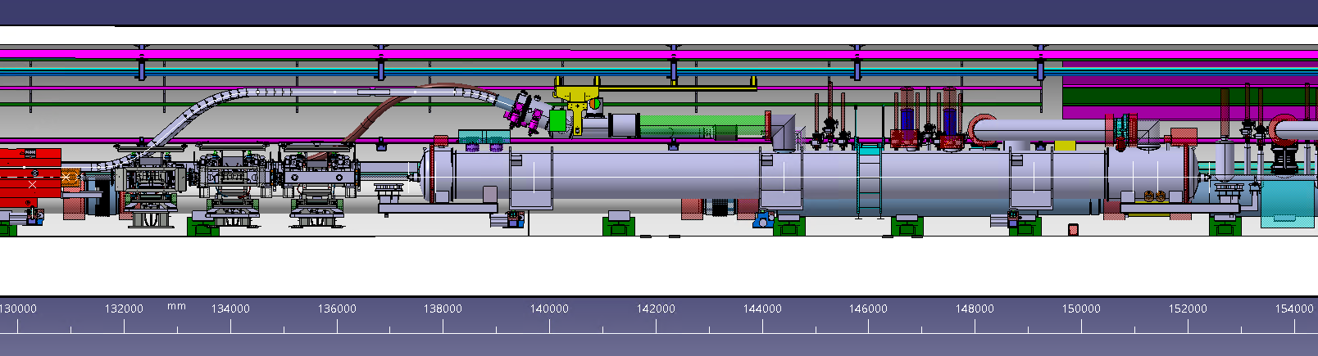
MACHINE LAYOUT: IP1 RIGHT ZONE
LHC
RI171 – Ø 4400 mm
TAN
HL_LHC v.1.5
No major changes for HL-LHC v.1.6

Slide 7
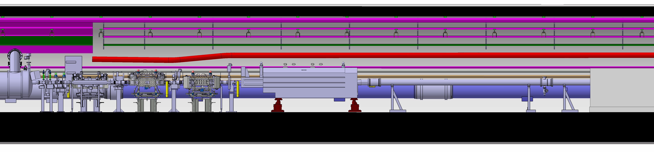
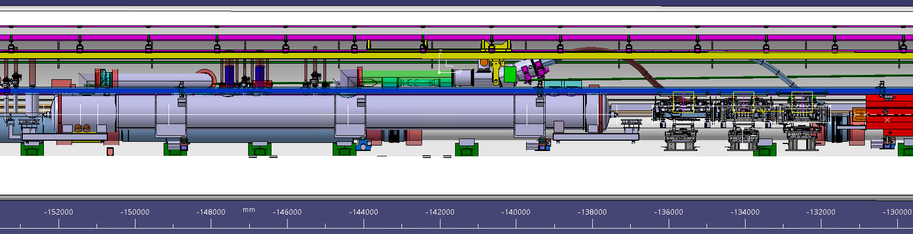
MACHINE LAYOUT: IP1 LEFT ZONE
LHC
RI132 – Ø 4400 mm
TAN
BPMWB
TCL
TCTPH
TCTPV
HL_LHC v.1.5
No major changes for HL-LHC v.1.6

Slide 8
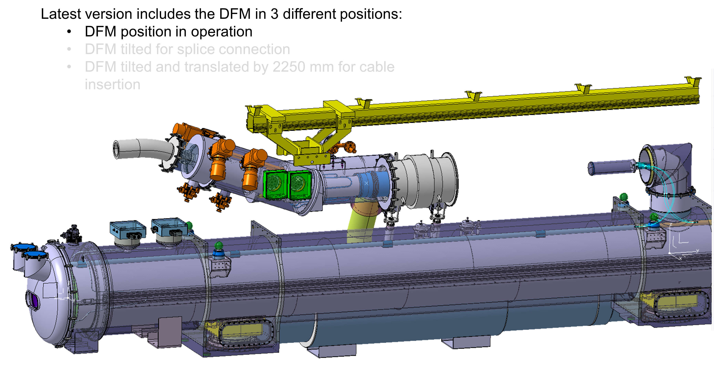
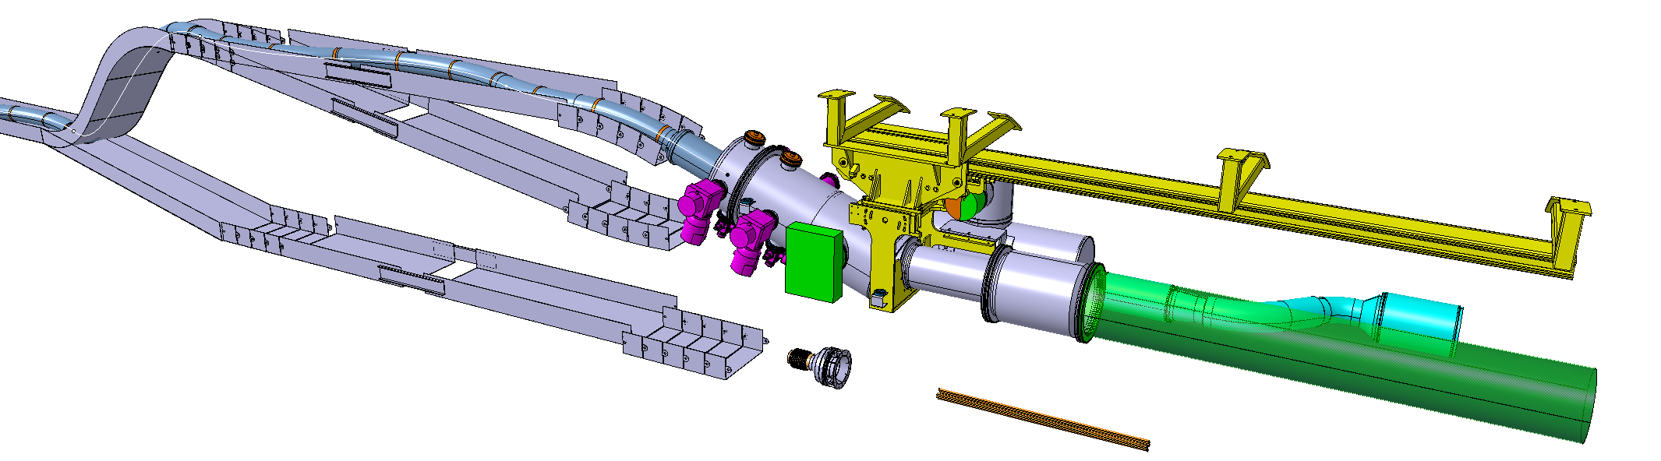
DFM Integration
DFM Integration
Completed activities
  3D Simplified models: only provided for 5R.
  Temporary solution for 5L, 1R and 1L
  Study of boundary conditions in the LHC tunnel
On going studies
  Design of new HL-LHC services in the tunnel (5R)
  Definition of cryo-line flexible extension design / DFM integration solution
  Definition of reference points in the LHC tunnel
Pending points/ Next Steps
  Finalise DFM design (including expected inclination of the cryostat, shorten the beam by 20cm)
  Provide 3D simplified models for 5L, 1R and 1L, and corresponding supporting solutions.
  Consider ancillaries below D2
  Consider QXL current design is NOT the final design
WP6a
WP15
WP15
All WP
WP6a
WP6a
WP15
WP6a
WP6a
WP6a
From Integration point of view:
Reserved space → envelope of the 3 different positions:
First insertion
Approximation to operation’s position
Operation’s position
Latest version of the DFM Simplified model included in the main Integration Assembly of 5R.
--
Including options under study for the installation of the link in the LHC tunnel
ST1426476_02
Courtesy of Paul Schneider

Slide 9
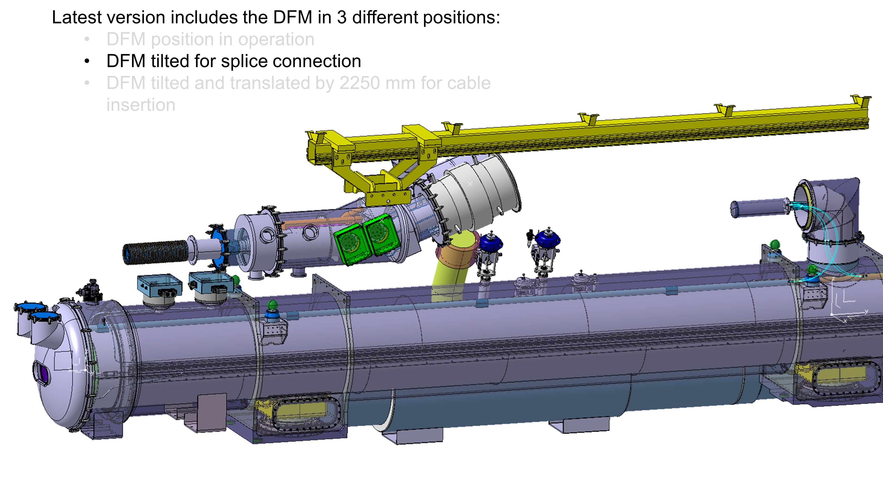
DFM Integration
DFM Integration
Completed activities
  3D Simplified models: only provided for 5R.
  Temporary solution for 5L, 1R and 1L
  Study of boundary conditions in the LHC tunnel
On going studies
  Design of new HL-LHC services in the tunnel (5R)
  Definition of cryo-line flexible extension design / DFM integration solution
  Definition of reference points in the LHC tunnel
Pending points/ Next Steps
  Finalise DFM design (including expected inclination of the cryostat, shorten the beam by 20cm)
  Provide 3D simplified models for 5L, 1R and 1L, and corresponding supporting solutions.
  Consider ancillaries below D2
  Consider QXL current design is NOT the final design
WP6a
WP15
WP15
All WP
WP6a
WP6a
WP15
WP6a
WP6a
WP6a
From Integration point of view:
Reserved space → envelope of the 3 different positions:
First insertion
Approximation to operation’s position
Operation’s position
Latest version of the DFM Simplified model included in the main Integration Assembly of 5R.
--
Including options under study for the installation of the link in the LHC tunnel
ST1426476_02
Courtesy of Paul Schneider

Slide 10
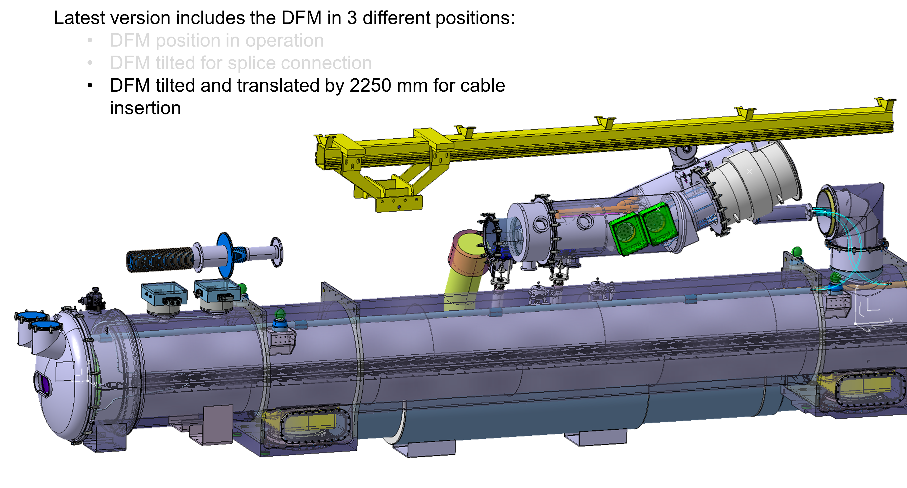
DFM Integration
DFM Integration
Completed activities
  3D Simplified models: only provided for 5R.
  Temporary solution for 5L, 1R and 1L
  Study of boundary conditions in the LHC tunnel
On going studies
  Design of new HL-LHC services in the tunnel (5R)
  Definition of cryo-line flexible extension design / DFM integration solution
  Definition of reference points in the LHC tunnel
Pending points/ Next Steps
  Finalise DFM design (including expected inclination of the cryostat, shorten the beam by 20cm)
  Provide 3D simplified models for 5L, 1R and 1L, and corresponding supporting solutions.
  Consider ancillaries below D2
  Consider QXL current design is NOT the final design
WP6a
WP15
WP15
All WP
WP6a
WP6a
WP15
WP6a
WP6a
WP6a
From Integration point of view:
Reserved space → envelope of the 3 different positions:
First insertion
Approximation to operation’s position
Operation’s position
Latest version of the DFM Simplified model included in the main Integration Assembly of 5R.
--
Including options under study for the installation of the link in the LHC tunnel
ST1426476_02
Courtesy of Paul Schneider

Slide 11
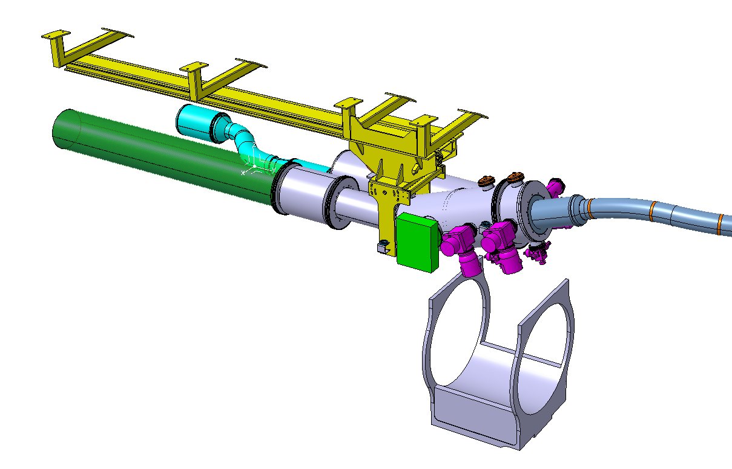
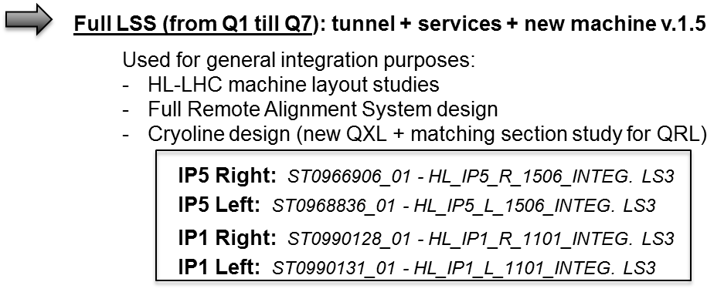
DFM Integration
DFM Simplified model for Left side (Mirrored solution).
ST1426476_03
DFM Integration
Completed activities
  3D Simplified models: only provided for 5R.
  Temporary solution for 5L, 1R and 1L
  Study of boundary conditions in the LHC tunnel
On going studies
  Design of new HL-LHC services in the tunnel (5R)
  Definition of cryo-line flexible extension design / DFM integration solution
  Definition of reference points in the LHC tunnel
Pending points/ Next Steps
  Finalise DFM design (including expected inclination of the cryostat, shorten the beam by 20cm)
  Provide 3D simplified models for 5L, 1R and 1L, and corresponding supporting solutions.
  Consider ancillaries below D2
  Consider QXL current design is NOT the final design
WP6a
WP15
WP15
Boundary Conditions
All WP
WP6a
WP6a
WP15
WP6a
WP6a
WP6a
Latest version of the DFM Simplified model included in the main Integration Assembly of 5R.
--
Including options under study for the installation of the link in the LHC tunnel
ST1426476_02
Courtesy of Paul Schneider

Slide 12
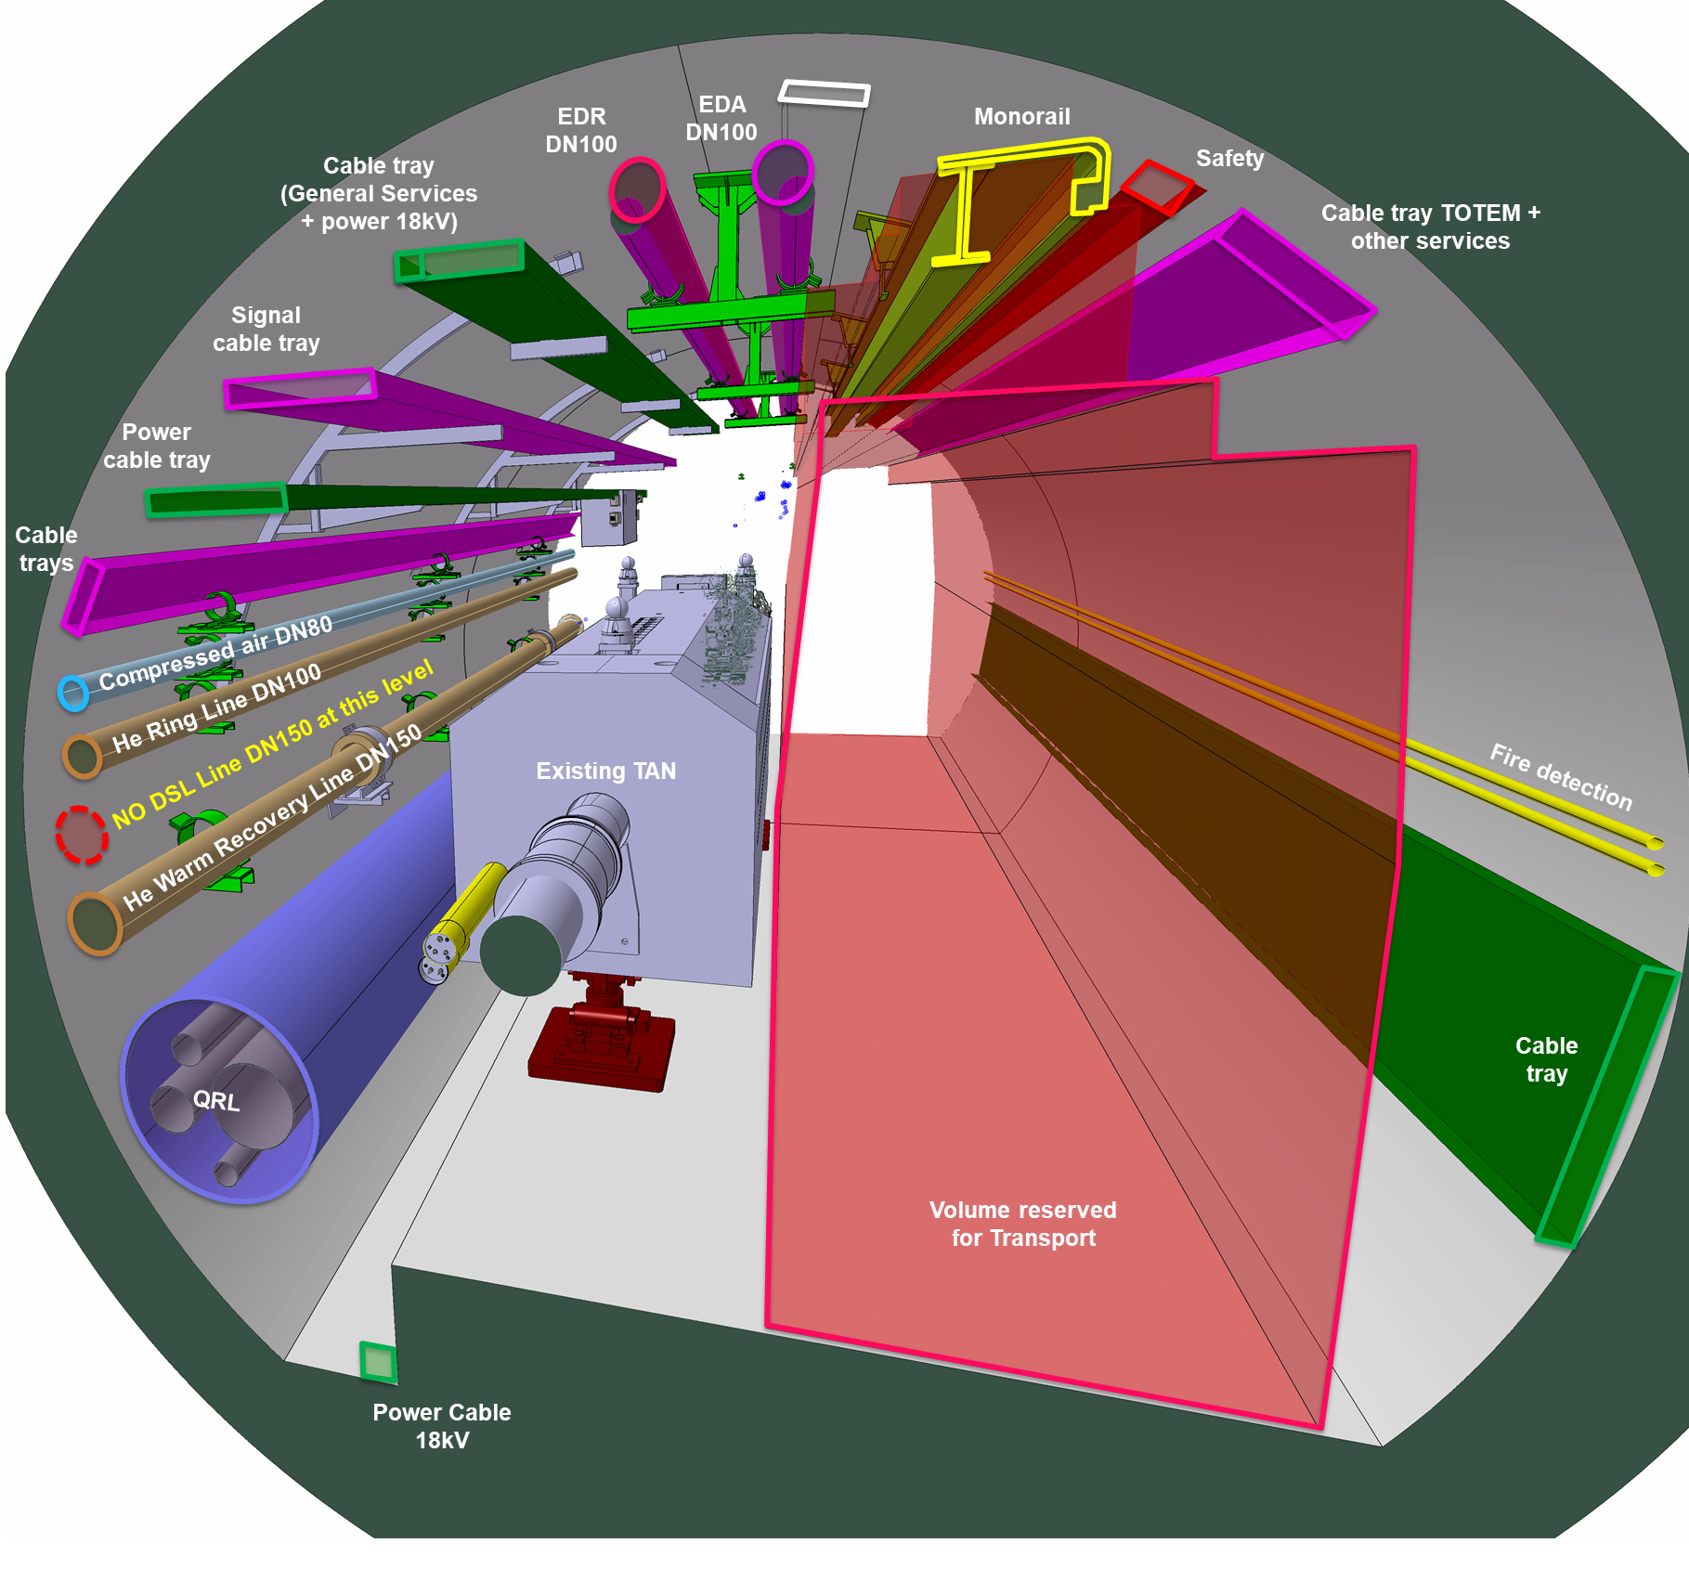
DFM Integration
DFM Integration
Existing LHC Services
Completed activities
  3D Simplified models: only provided for 5R.
  Temporary solution for 5L, 1R and 1L
  Study of boundary conditions in the LHC tunnel
On going studies
  Design of new HL-LHC services in the tunnel (5R)
  Definition of cryo-line flexible extension design / DFM integration solution
  Definition of reference points in the LHC tunnel
Pending points/ Next Steps
  Finalise DFM design (including expected inclination of the cryostat, shorten the beam by 20cm)
  Provide 3D simplified models for 5L, 1R and 1L, and corresponding supporting solutions.
  Consider ancillaries below D2
  Consider QXL current design is NOT the final design
WP6a
WP15
WP15
All WP
WP6a
WP6a
WP15
WP6a
WP6a
WP6a

Slide 13
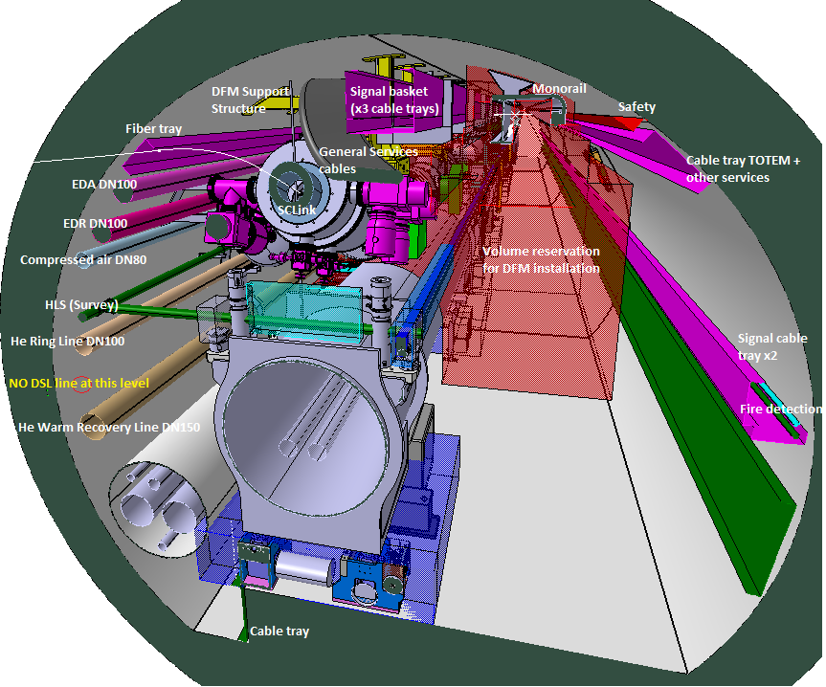
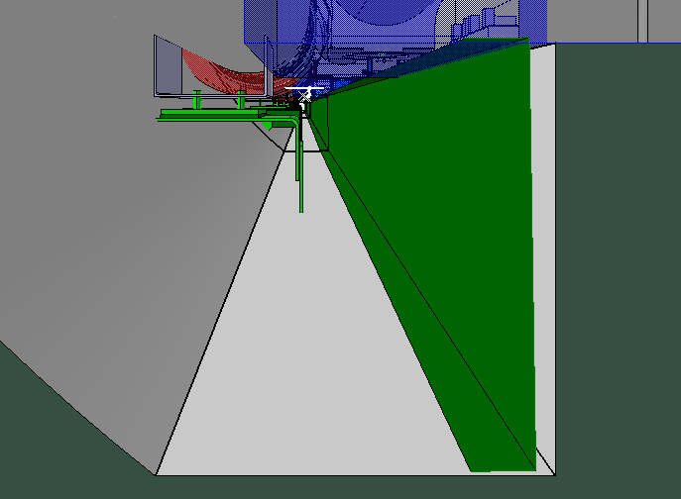
DFM Integration
DFM Integration
Proposed HL-LHC Services (at the present moment)
Completed activities
  3D Simplified models: only provided for 5R.
  Temporary solution for 5L, 1R and 1L
  Study of boundary conditions in the LHC tunnel
On going studies
  Design of new HL-LHC services in the tunnel (5R)
  Definition of cryo-line flexible extension design / DFM integration solution
  Definition of reference points in the LHC tunnel
Pending points/ Next Steps
  Finalise DFM design (including expected inclination of the cryostat, shorten the beam by 20cm)
  Provide 3D simplified models for 5L, 1R and 1L, and corresponding supporting solutions.
  Consider ancillaries below D2
  Consider QXL current design is NOT the final design
WP6a
WP15
WP15
All WP
WP6a
WP6a
WP15
WP6a
WP6a
WP6a
Cable tray strategy → ONGOING
Cable tray strategy is being reviewed by EN/EL and could change in the next couple of months
Volume required for handling and installation has been counted in integration and it is being taken into account for the optimisation of all the services
Solid support

Slide 14
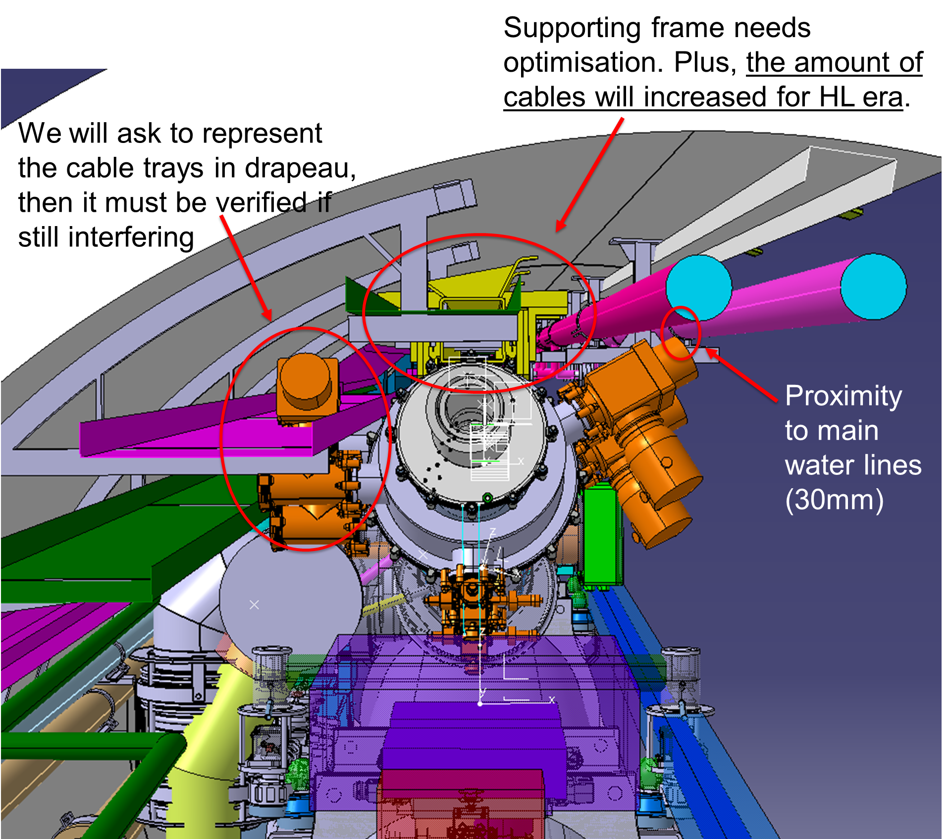
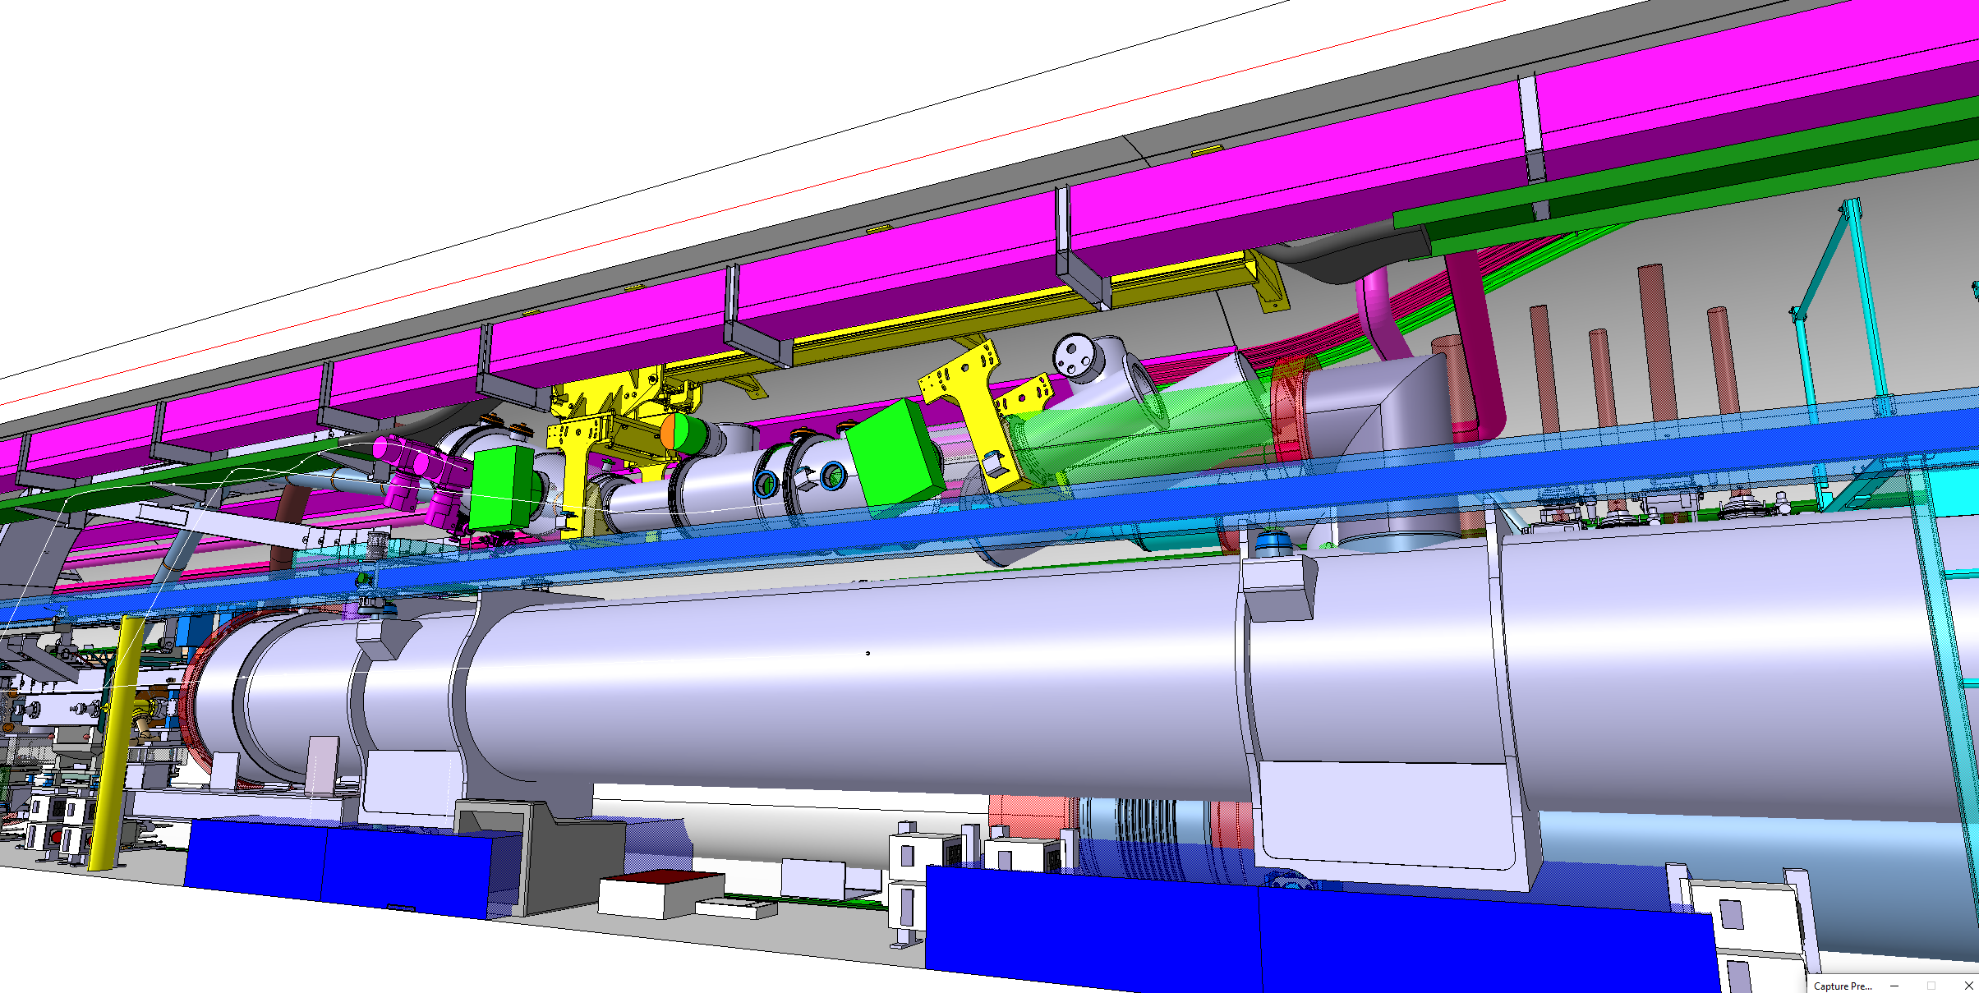
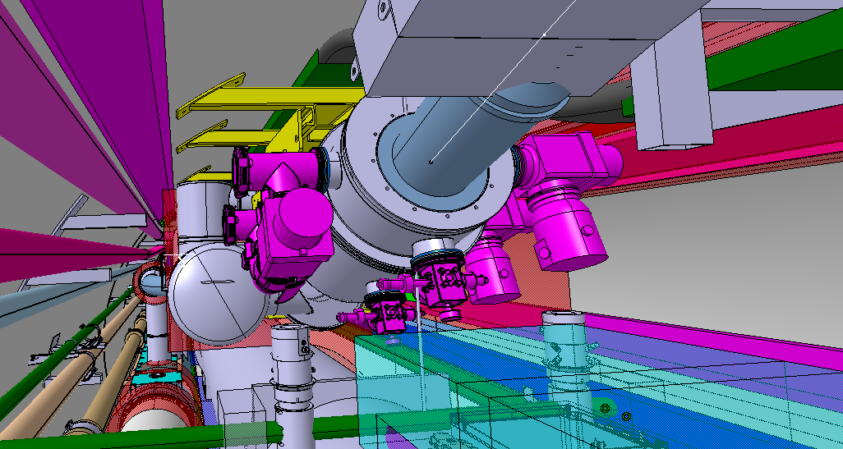
DFM Integration
DFM Integration
Completed activities
  3D Simplified models: only provided for 5R.
  Temporary solution for 5L, 1R and 1L
  Study of boundary conditions in the LHC tunnel
On going studies
  Design of new HL-LHC services in the tunnel (5R)
  Definition of cryo-line flexible extension design / DFM integration solution
  Definition of reference points in the LHC tunnel
Pending points/ Next Steps
  Finalise DFM design (including expected inclination of the cryostat, shorten the beam by 20cm)
  Provide 3D simplified models for 5L, 1R and 1L, and corresponding supporting solutions.
  Consider ancillaries below D2
  Consider QXL current design is NOT the final design
Old picture: several problems have been sorted out
WP6a
WP15
WP15
All WP
WP6a
WP6a
WP15
WP6a
WP6a
WP6a
Current situation: final number of bypass, gauges and pumping groups to be confirmed
Design of new HL-LHC services in the tunnel is currently under development: cables trays routing, piping routing…
NO POSSIBILITY TO FURTHER RESTRICT THE RELOCATION OF THE NEW HL-LHC SERVICES

Slide 15
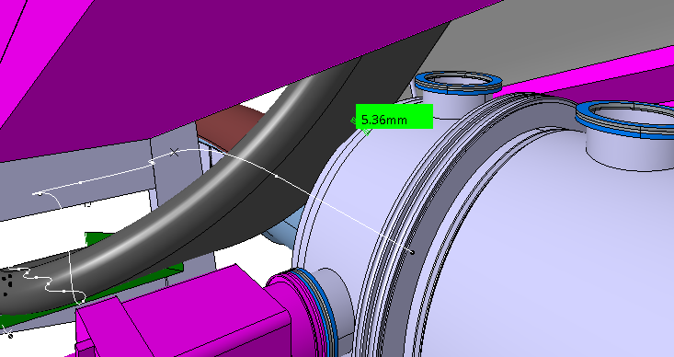

DFM Integration
DFM Integration
Completed activities
  3D Simplified models: only provided for 5R.
  Temporary solution for 5L, 1R and 1L
  Study of boundary conditions in the LHC tunnel
On going studies
  Design of new HL-LHC services in the tunnel (5R)
  Definition of cryo-line flexible extension design / DFM integration solution
  Definition of reference points in the LHC tunnel
Pending points/ Next Steps
  Finalise DFM design (including expected inclination of the cryostat, shorten the beam by 20cm)
  Provide 3D simplified models for 5L, 1R and 1L, and corresponding supporting solutions.
  Consider ancillaries below D2
  Consider QXL current design is NOT the final design
Interference with current General Services cable tray adaptation (5 mm) is being taken into account by EN/EL → ongoing
WP6a
WP15
WP15
All WP
WP6a
WP6a
WP15
WP6a
WP6a
WP6a
Design of new HL-LHC services in the tunnel is currently under development: cables trays routing, piping routing…
NO POSSIBILITY TO FURTHER RESTRICT THE RELOCATION OF THE NEW HL-LHC SERVICES

Slide 16
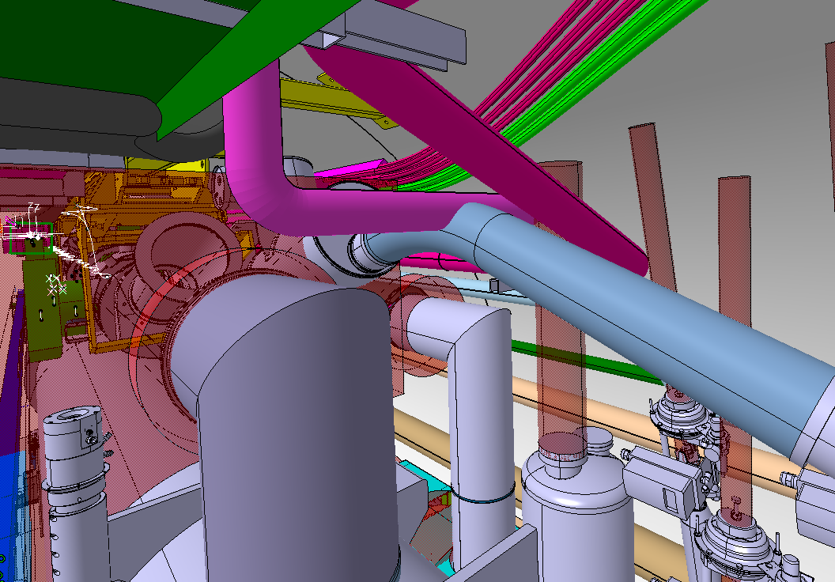
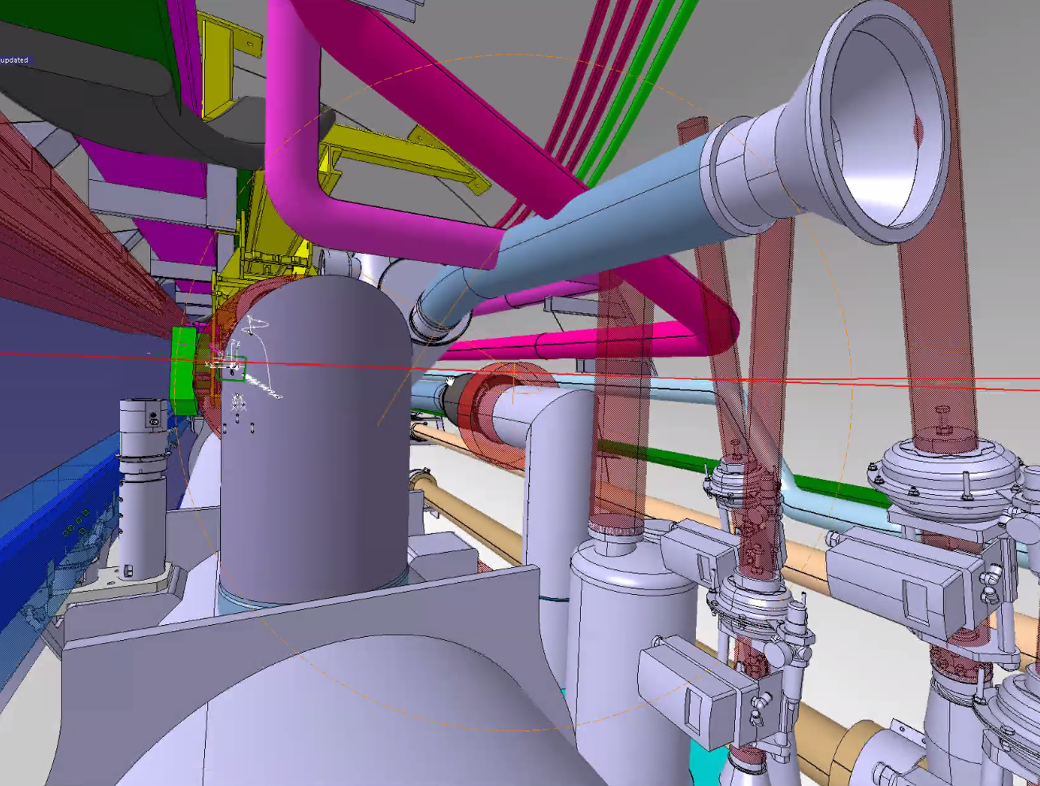
DFM Integration
DFM Integration
Design of new HL-LHC services in the tunnel is currently under development: cables trays routing, piping routing…
NO POSSIBILITY TO FURTHER RESTRICT THE RELOCATION OF THE NEW HL-LHC SERVICES
Completed activities
  3D Simplified models: only provided for 5R.
  Temporary solution for 5L, 1R and 1L
  Study of boundary conditions in the LHC tunnel
On going studies
  Design of new HL-LHC services in the tunnel (5R)
  Definition of cryo-line flexible extension design / DFM integration solution
  Definition of reference points in the LHC tunnel
Pending points/ Next Steps
  Finalise DFM design (including expected inclination of the cryostat, shorten the beam by 20cm)
  Provide 3D simplified models for 5L, 1R and 1L, and corresponding supporting solutions.
  Consider ancillaries below D2
  Consider QXL current design is NOT the final design
WP6a
WP15
WP15
All WP
WP6a
WP6a
WP15
WP6a
WP6a
WP6a
Old picture: clash with both water pipes
Problem: Interference between flexible extension for the connection to the cryo-line and water piping
Possible solution on-going:
Increase the flexibility of the extension → extension below piping
NO POSSIBILITY TO FURTHER RESTRICT THE RELOCATION OF THE NEW HL-LHC SERVICES

Slide 17
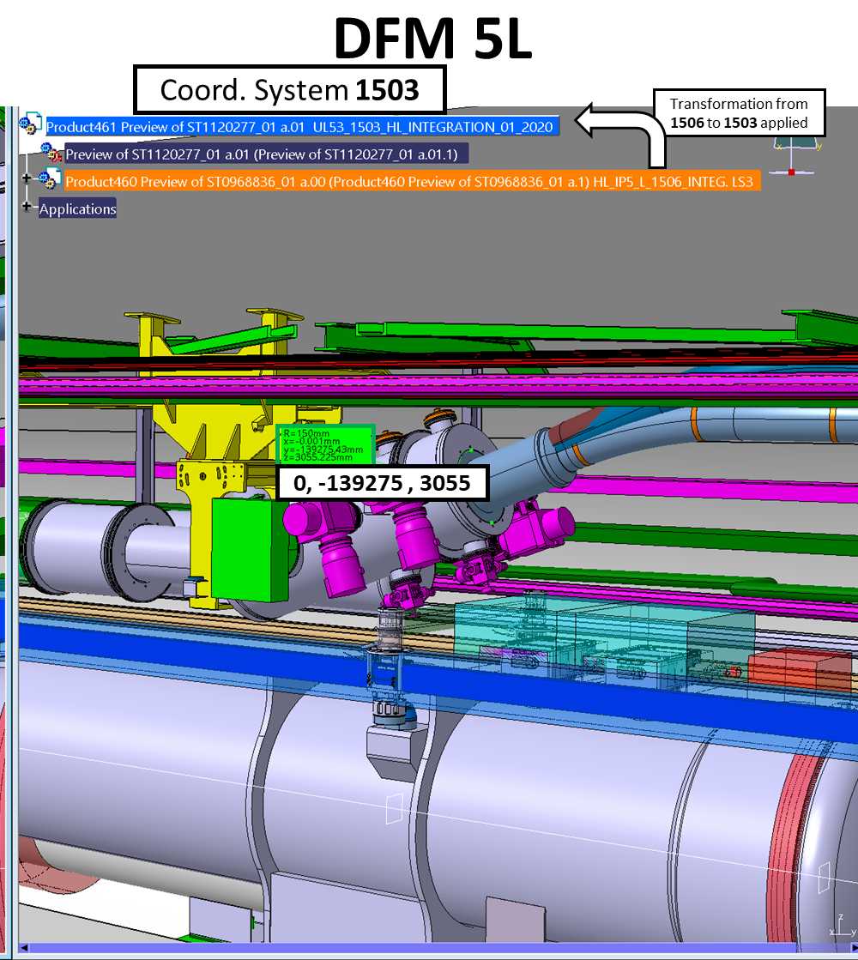
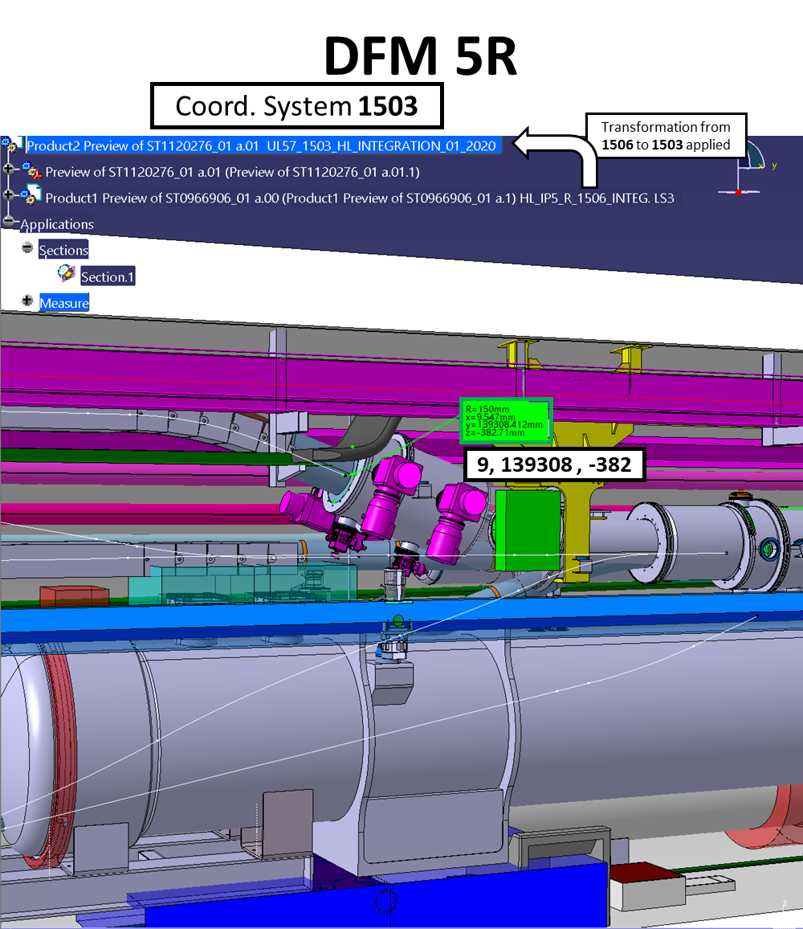
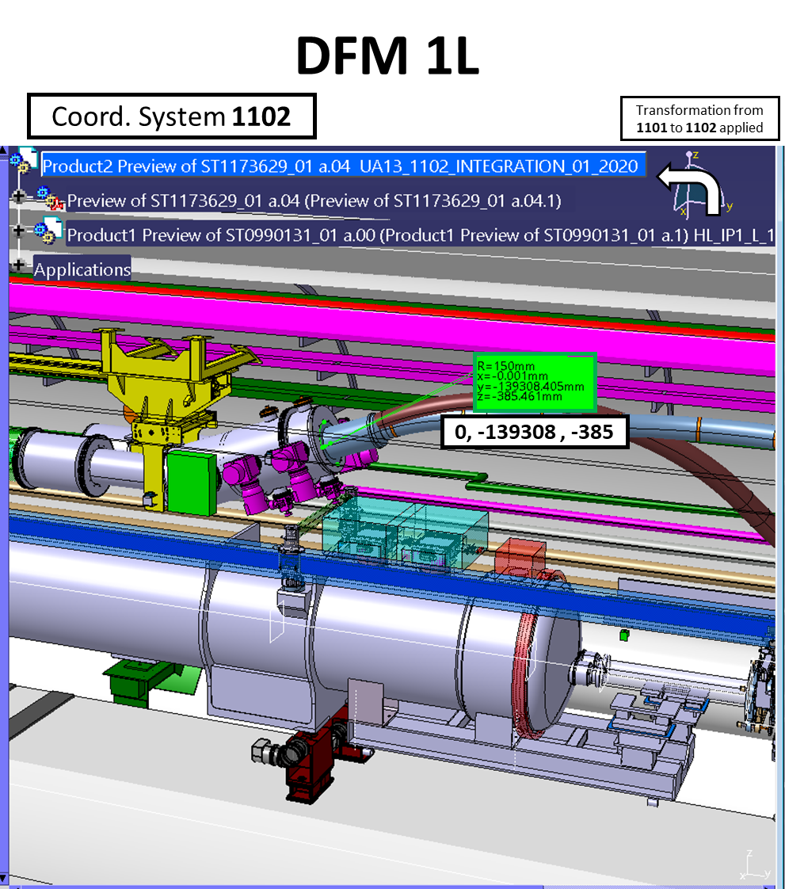
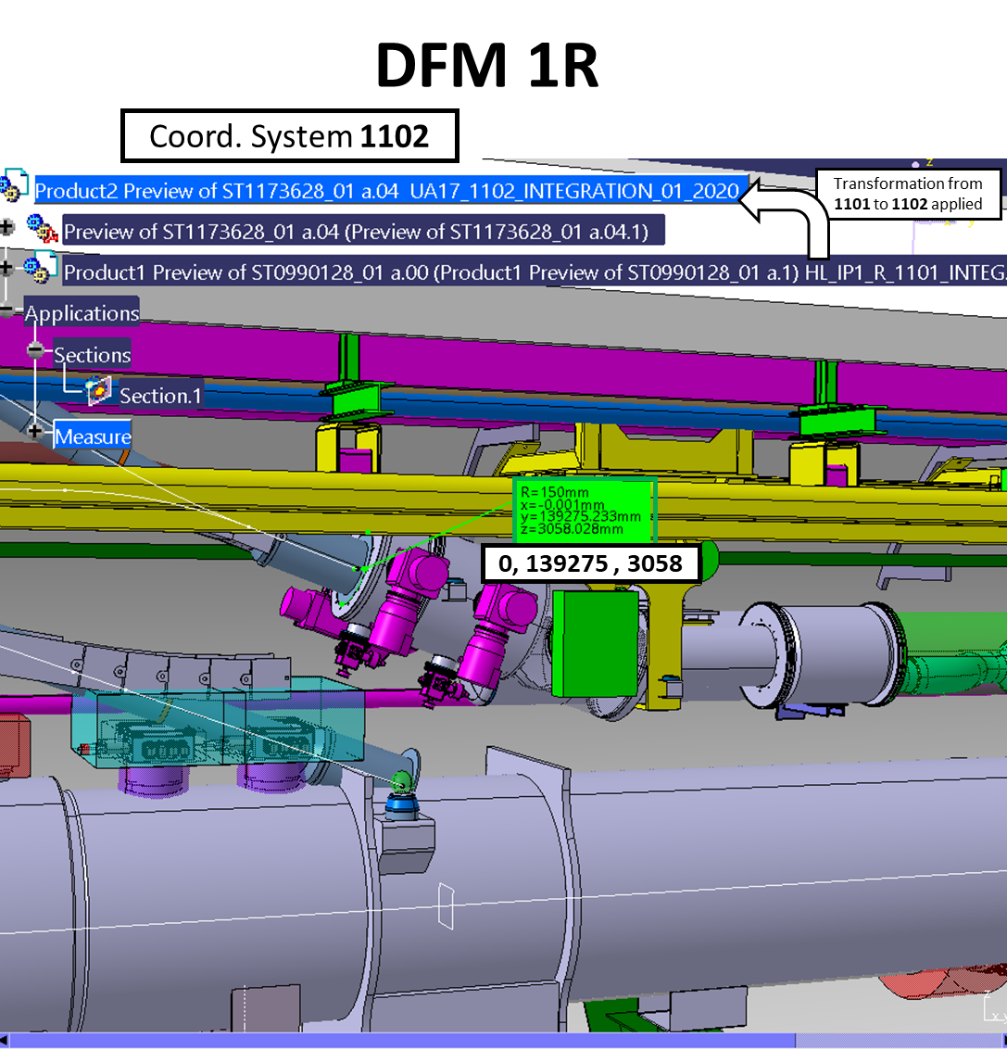
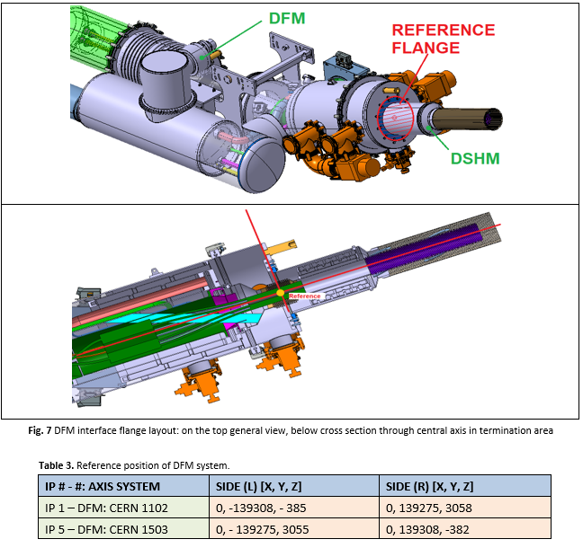
DFM Integration
DFM Integration
Completed activities
  3D Simplified models: only provided for 5R.
  Temporary solution for 5L, 1R and 1L
  Study of boundary conditions in the LHC tunnel
On going studies
  Design of new HL-LHC services in the tunnel (5R)
  Definition of cryo-line flexible extension design / DFM integration solution
  Definition of reference points in the LHC tunnel
Pending points/ Next Steps
  Finalise DFM design (including expected inclination of the cryostat, shorten the beam by 20cm)
  Provide 3D simplified models for 5L, 1R and 1L, and corresponding supporting solutions.
  Consider ancillaries below D2
  Consider QXL current design is NOT the final design
WP6a
WP15
WP15
All WP
WP6a
WP6a
WP15
WP6a
WP6a
WP6a
All WP
Reference points provided in the reference system requested by WP6a were taken from the four Integration Assemblies
(5R, 5L, 1R, 1L).

Slide 18
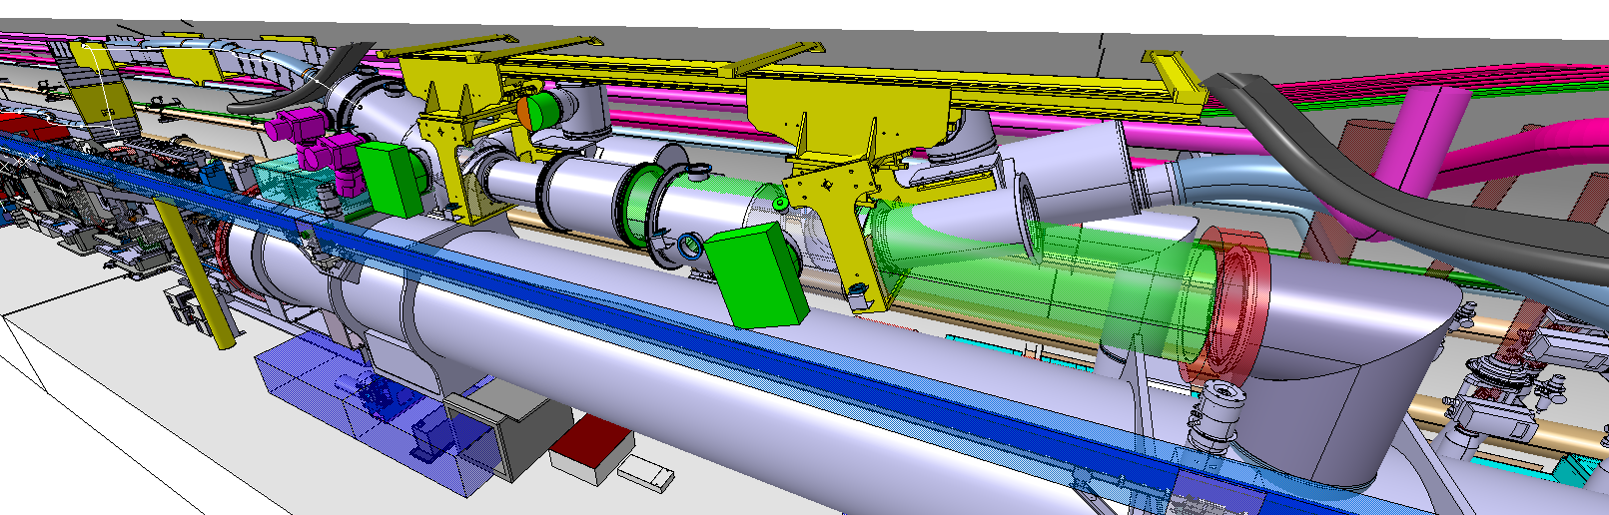
DFM Integration
DFM Integration
Completed activities
  3D Simplified models: only provided for 5R.
  Temporary solution for 5L, 1R and 1L
  Study of boundary conditions in the LHC tunnel
On going studies
  Design of new HL-LHC services in the tunnel (5R)
  Definition of cryo-line flexible extension design / DFM integration solution
  Definition of reference points in the LHC tunnel
Pending points/ Next Steps
  Finalise DFM design (including expected inclination of the cryostat, shorten the beam by 20cm)
  Provide 3D simplified models for 5L, 1R and 1L, and corresponding supporting solutions.
  Consider ancillaries below D2
  Consider QXL current design is NOT the final design
WP6a
WP15
WP15
All WP
WP6a
WP6a
WP15
WP6a
WP6a
In the DFM design there are still points that have to be finalised and optimised as: inclination of the cryostat, shorten the length of the supporting beam, possible final reduction in the number of pumping ports (worst-case scenario considered)…
WP6a
R571

Slide 19
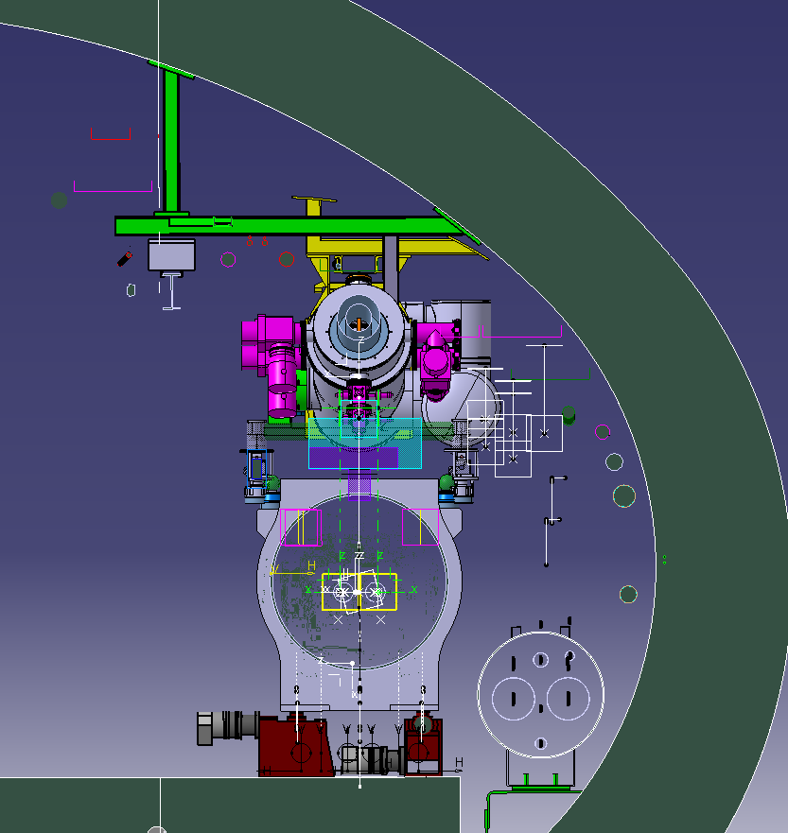
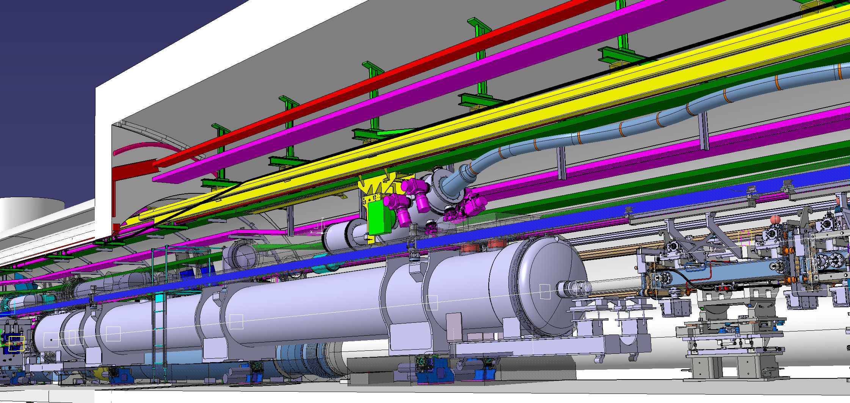
DFM Integration
DFM Integration
Completed activities
  3D Simplified models: only provided for 5R.
  Temporary solution for 5L, 1R and 1L
  Study of boundary conditions in the LHC tunnel
On going studies
  Design of new HL-LHC services in the tunnel (5R)
  Definition of cryo-line flexible extension design / DFM integration solution
  Definition of reference points in the LHC tunnel
Pending points/ Next Steps
  Finalise DFM design (including expected inclination of the cryostat, shorten the beam by 20cm)
  Provide 3D simplified models for 5L, 1R and 1L, and corresponding supporting solutions.
  Consider ancillaries below D2
  Consider QXL current design is NOT the final design
WP6a
WP15
WP15
All WP
WP6a
WP6a
WP15
WP6a
Support frame solutions for the other IP sides.
WP6a
WP6a
LHC Services
UJ53
It is NOT FORESEEN
to MODIFY the
GREEN STRUCTURE
in UJ53
LHC Services
Interference between the SCLink and green cable tray is not representative

Slide 20
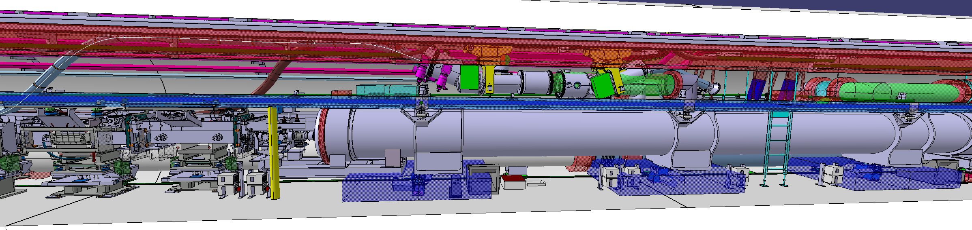
DFM Integration
DFM Integration
Ancillaires distribution currently under study!
Completed activities
  3D Simplified models: only provided for 5R.
  Temporary solution for 5L, 1R and 1L
  Study of boundary conditions in the LHC tunnel
On going studies
  Design of new HL-LHC services in the tunnel (5R)
  Definition of cryo-line flexible extension design / DFM integration solution
  Definition of reference points in the LHC tunnel
Pending points/ Next Steps
  Finalise DFM design (including expected inclination of the cryostat, shorten the beam by 20cm)
  Provide 3D simplified models for 5L, 1R and 1L, and corresponding supporting solutions.
  Consider ancillaries below D2
  Consider QXL current design is NOT the final design
Already integrated in 3D integration models:
To be integrated in 3D integration models:
WP6a
D2 ancilliaries:
Jacks + reserved space
Motors Patch panel + Fiber terminal box + Inclinometer
Primary pump + Vacuum minirack
Mobile pumping group (trolley)
Survey electrical boxes
Electrical plugs
DFM ancilliaries:
2 mobile pumping groups at transport side → 1 extra Trolley needed
WP15
WP15
All WP
WP6a
WP6a
WP15
WP6a
DFM equipment (redundant, simplification would be important to ease installation and integration):
2 bypass at QXL side
2 gauges at the bottom
WP6a
WP6a

Slide 21
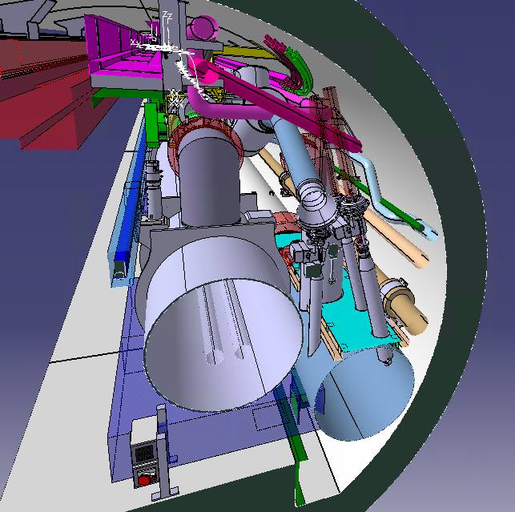
DFM Integration
DFM Integration
Completed activities
  3D Simplified models: only provided for 5R.
  Temporary solution for 5L, 1R and 1L
  Study of boundary conditions in the LHC tunnel
On going studies
  Design of new HL-LHC services in the tunnel (5R)
  Definition of cryo-line flexible extension design / DFM integration solution
  Definition of reference points in the LHC tunnel
Pending points/ Next Steps
  Finalise DFM design (including expected inclination of the cryostat, shorten the beam by 20cm)
  Provide 3D simplified models for 5L, 1R and 1L, and corresponding supporting solutions.
  Consider ancillaries below D2
  Consider QXL current design is NOT the final design
WP6a
WP15
WP15
All WP
WP6a
WP6a
WP15
WP6a
WP6a
WP6a
The position of the DFM jumper on the QXL has been slightly shifted towards the IP, according to the latest version recently provided TE-CRG
(which incorporates 1 extra valve in the service module)
Final QXL→ waiting SUPPLIER DESIGN

Slide 22
Summary table
DFM Integration
ST 3D models
Completed activities
  3D Simplified models: only provided for 5R.
  Temporary solution for 5L, 1R and 1L
  Study of boundary conditions in the LHC tunnel
On going studies
  Design of new HL-LHC services in the tunnel (5R)
  Definition of cryo-line flexible extension design / DFM integration solution
  Definition of reference points in the LHC tunnel
Pending points/ Next Steps
  Finalise DFM design (including expected inclination of the cryostat, shorten the beam by 20cm)
  Provide 3D simplified models for 5L, 1R and 1L, and corresponding supporting solutions.
  Consider ancillaries below D2
  Consider QXL current design is NOT the final design
WP6a
WP15
WP15
All WP
WP6a
WP6a
WP15
WP6a
DFM simplified design:
  IP5 Right: ST1426476_02
  IP5 Left: (temporary 5R mirrored solution) ST1426476_03
  IP1 Right: (temporary 5R solution) ST1426476_02
  IP1 Left: (temporary 5R mirrored solution) ST1426476_03
WP6a
WP6a

Slide 23
Conclusions
The DFM integration is one of the most challenging, if not the most challenging, of HL-LHC. The adopted assembly solution requires to take into account the envelope of the system in 3 different positions creating more constraints to the systems around. At the moment the major issues seems to be tackled but the installation and handling gaps are very limited leading to two considerations.
  Minor changes in the surrounding system, or the DFM itself, (that cannot be excluded) could lead to create interferences.
  On site alignment of the supporting system and its adjustment capabilities are important in order to make possible the assembly.
DFM final design is almost finalised with no major changes foreseen → possible final reduction in the number of bypass, gauges and pumping ports to be confirmed.
Supporting structure to be shortened by 20 cm and more generally optimised DFM supporting structure designs to be provided at points IP5L, IP1R and IP1L.
WP15 cannot provide more space around DFM → services still under design.
Keep in mind QXL design is not definitive → waiting for the supplier’s final design (interfaces and max. envelope are part of the tech specification being issued by WP9).

