Slide 1

Cable splices and instrumentation for DFM system
J. Fleiter and A. Ballarino with contributions from WP6a members
DDR DFM meeting 18th of January 2022

Slide 2
Outline
Cable splices of DFM
List of Instrumentation of DFM
    Electrical Protection
    Cryogenic operation
    Vacuum instrumentation
Instrumentation feedthroughs of DFM

Slide 3
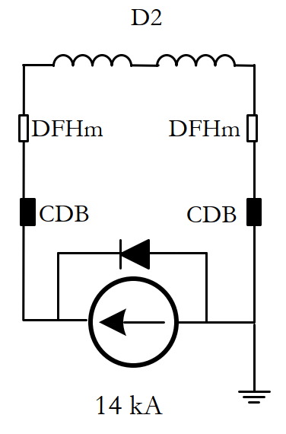
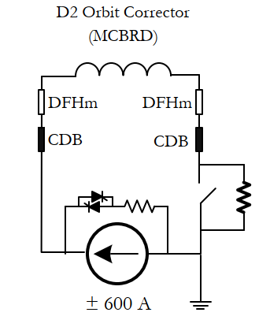
Overview of electrical circuits of MS
5 circuits per MS SC Link
    D2: 2 cables rated for 18 kA
    MCBRD : 8 cables rated for 0.6 kA
Current rating, Circuit Time Constants, Protection and electric insulation tests levels defined in EDMS 2659857

Slide 4
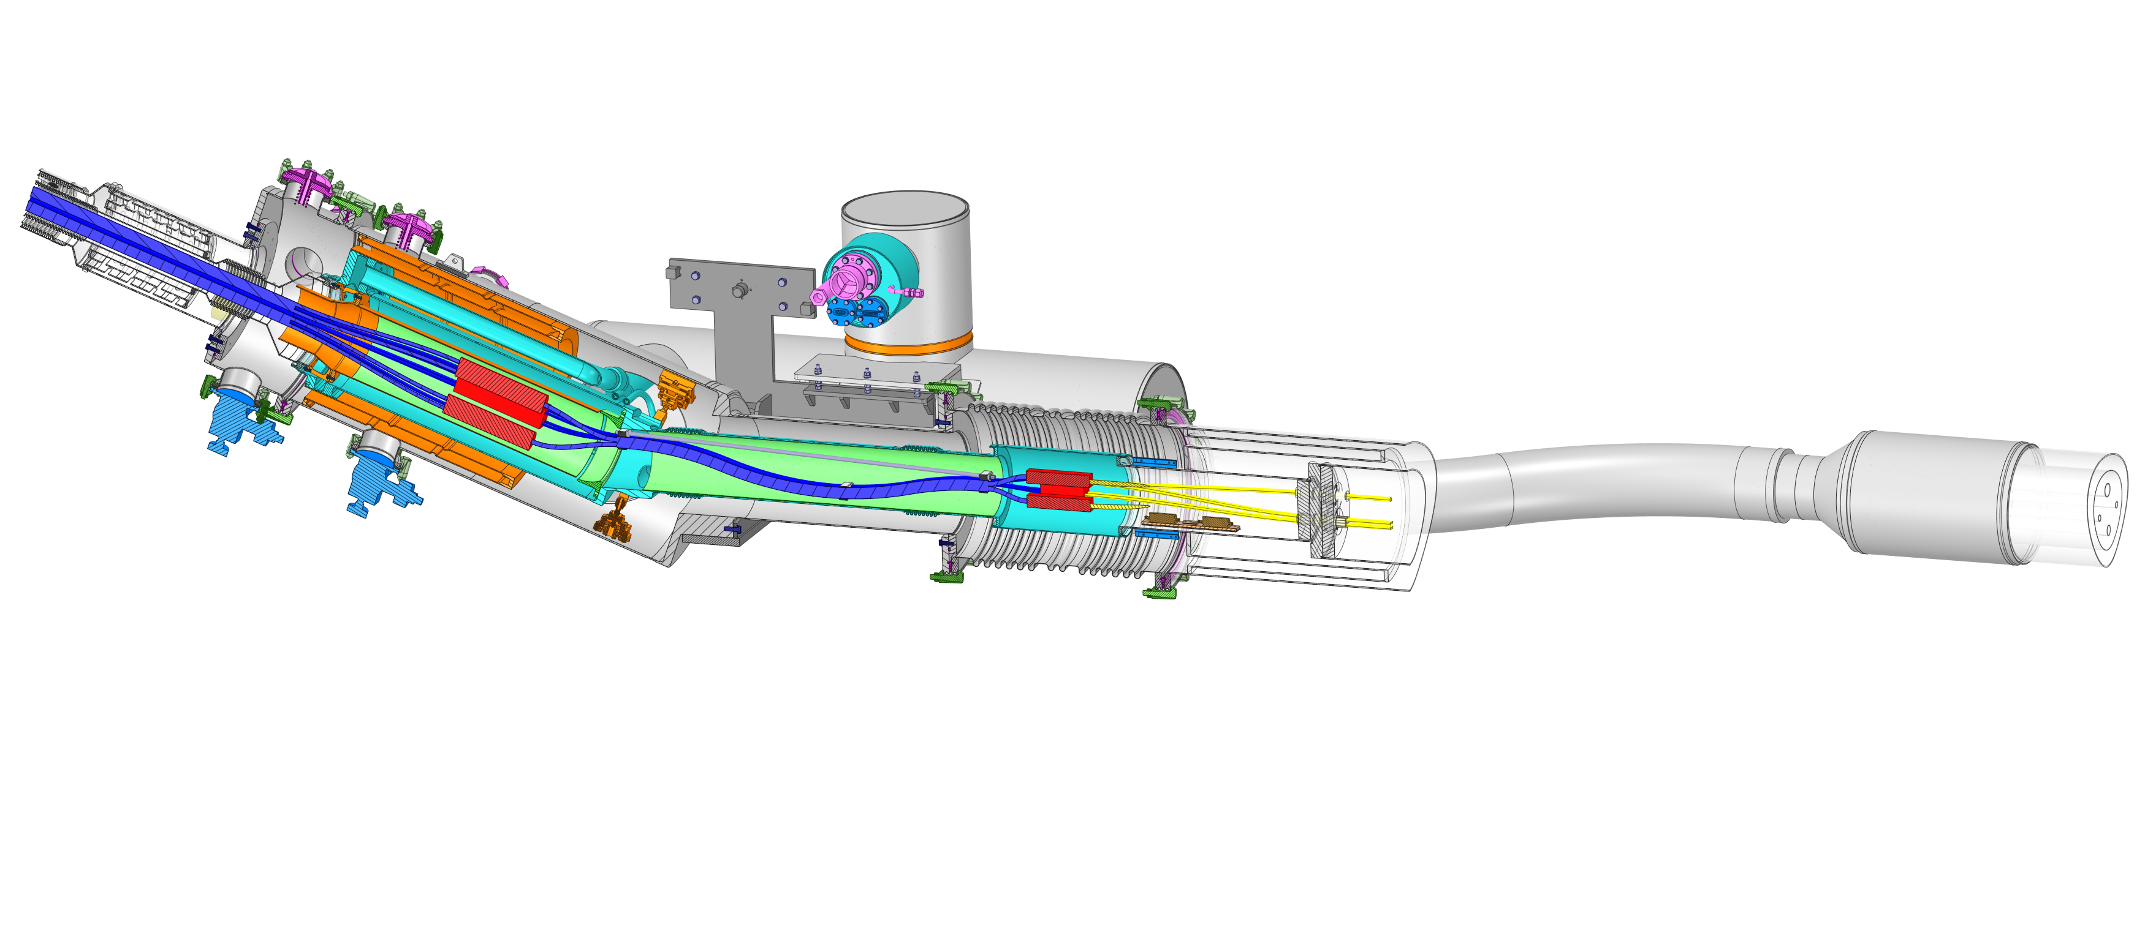
Description of branch of circuit of SC Link
Each branch of circuit of SC Link in DFM consists of:
  Sc cables
    Nb-Ti bus bars
    MgB₂ cable
  Splices
    Nb-Ti/Nb-Ti
    MgB₂/Nb-Ti
MgB₂
MgB₂/Nb-Ti
Splice
NbTi
cables
NbTi/NbTi
Splice
NbTi
cables
Plug
WP3

Slide 5
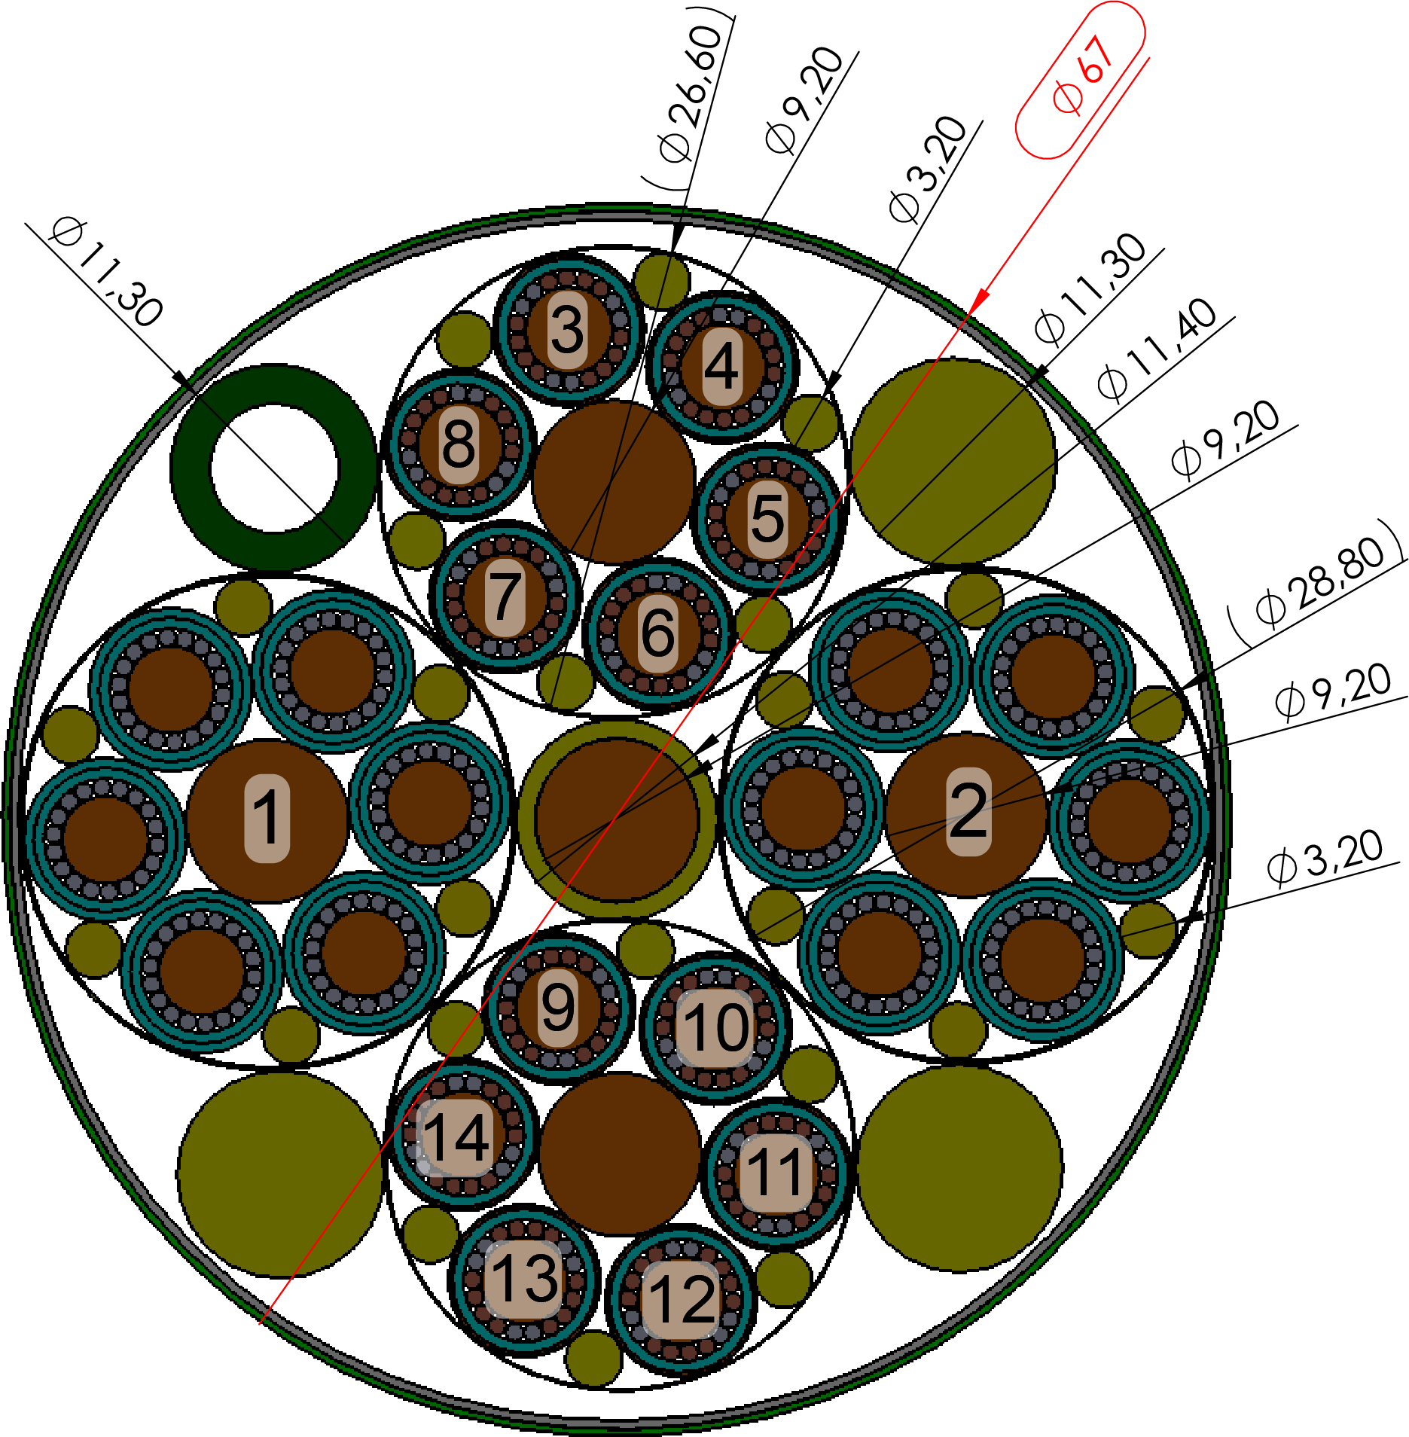

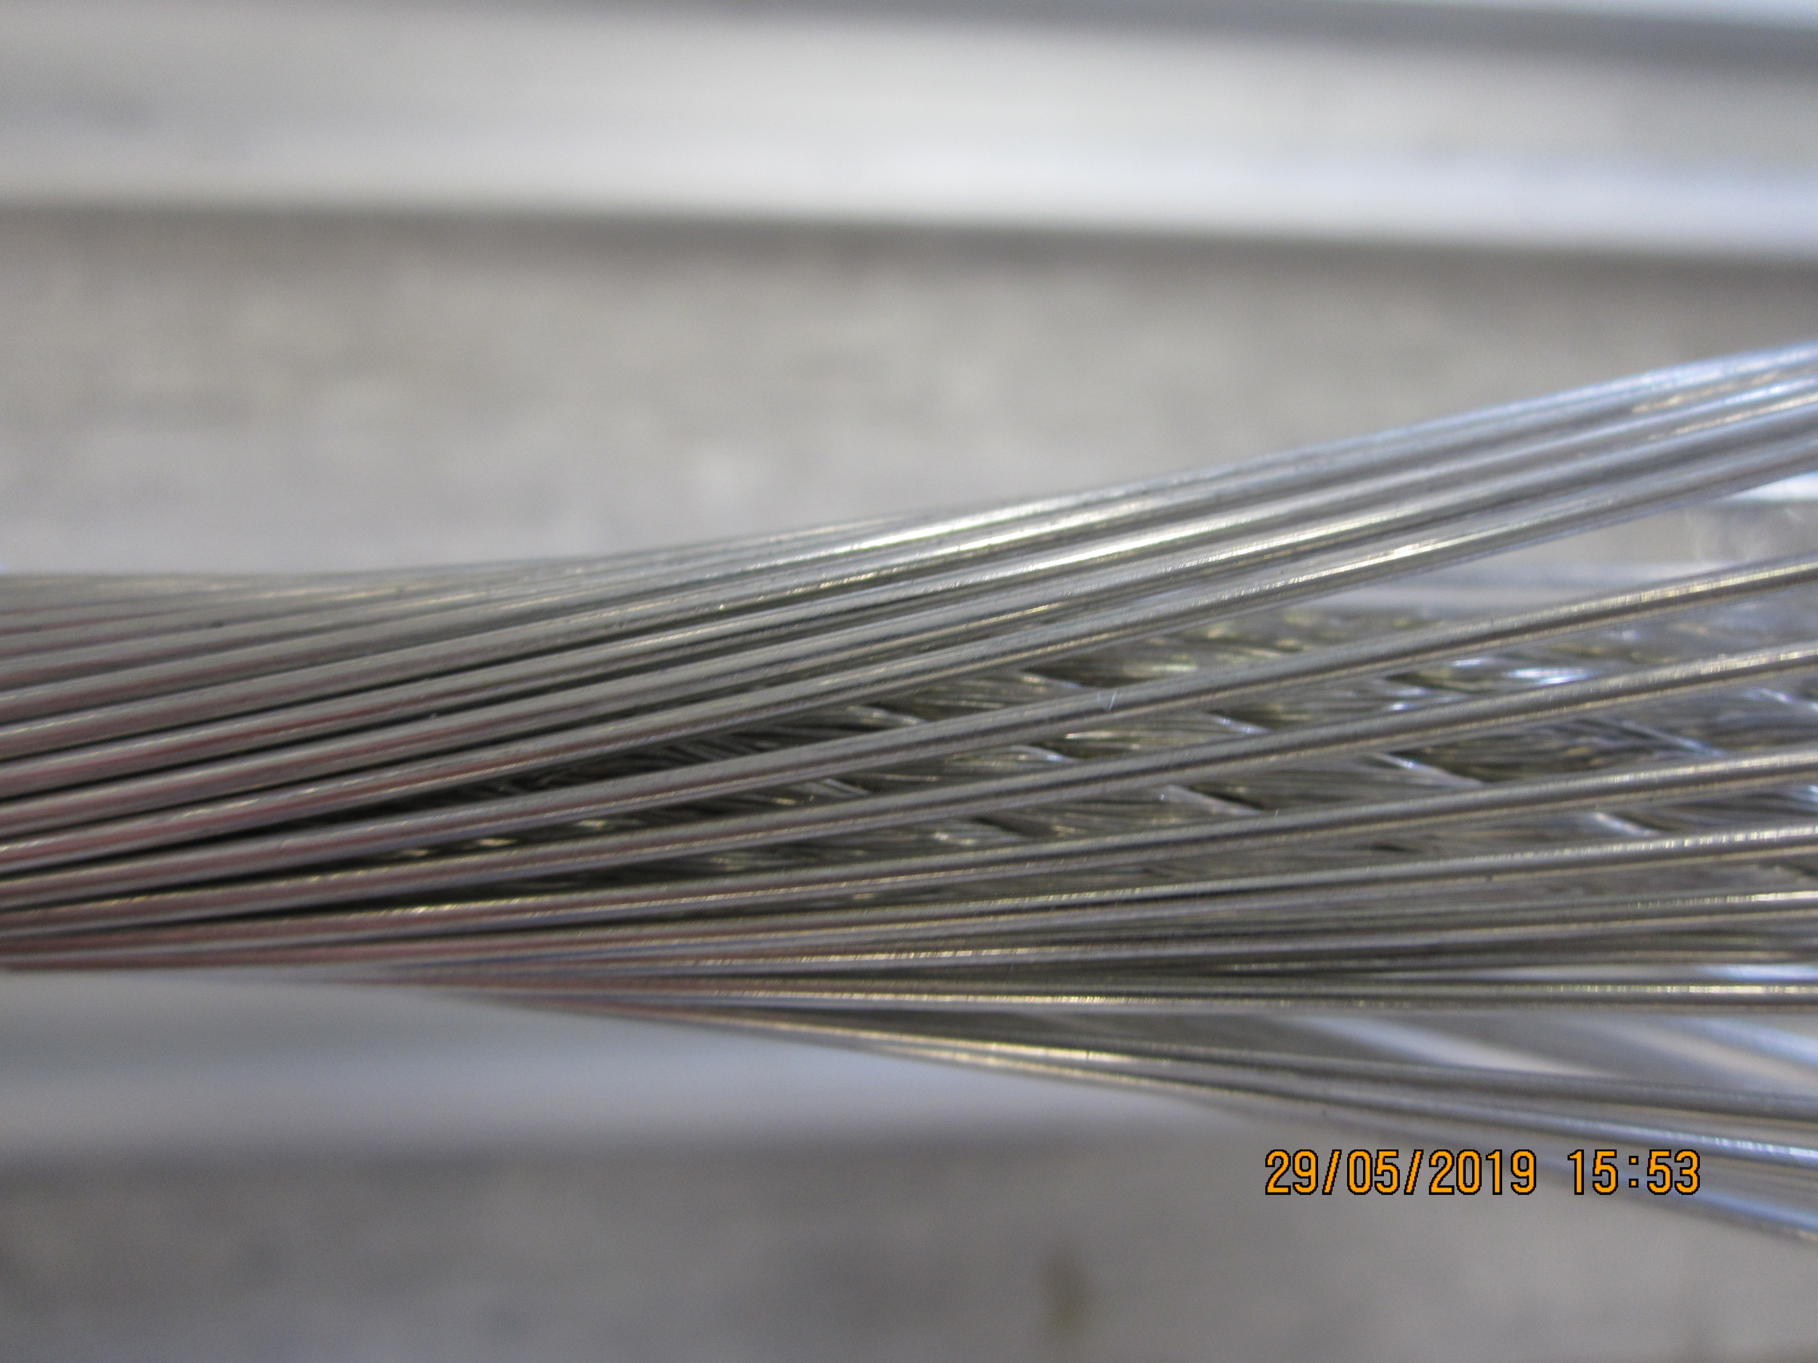
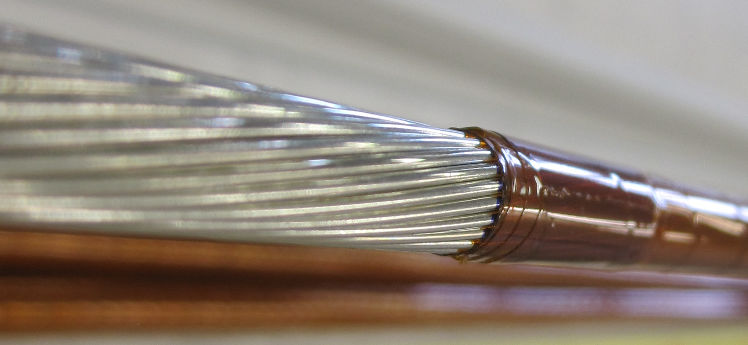

Sc Cables
MgB₂ cable
Nb-Ti cable
Nb-Ti wire, Type 01, 1.07 mm OD
Copper core
18 kA cable
Nb-Ti wire, Type 02, 0.825 mm OD
0.6 kA cable
Bus bar review April 2021 indico 1021628

Slide 6
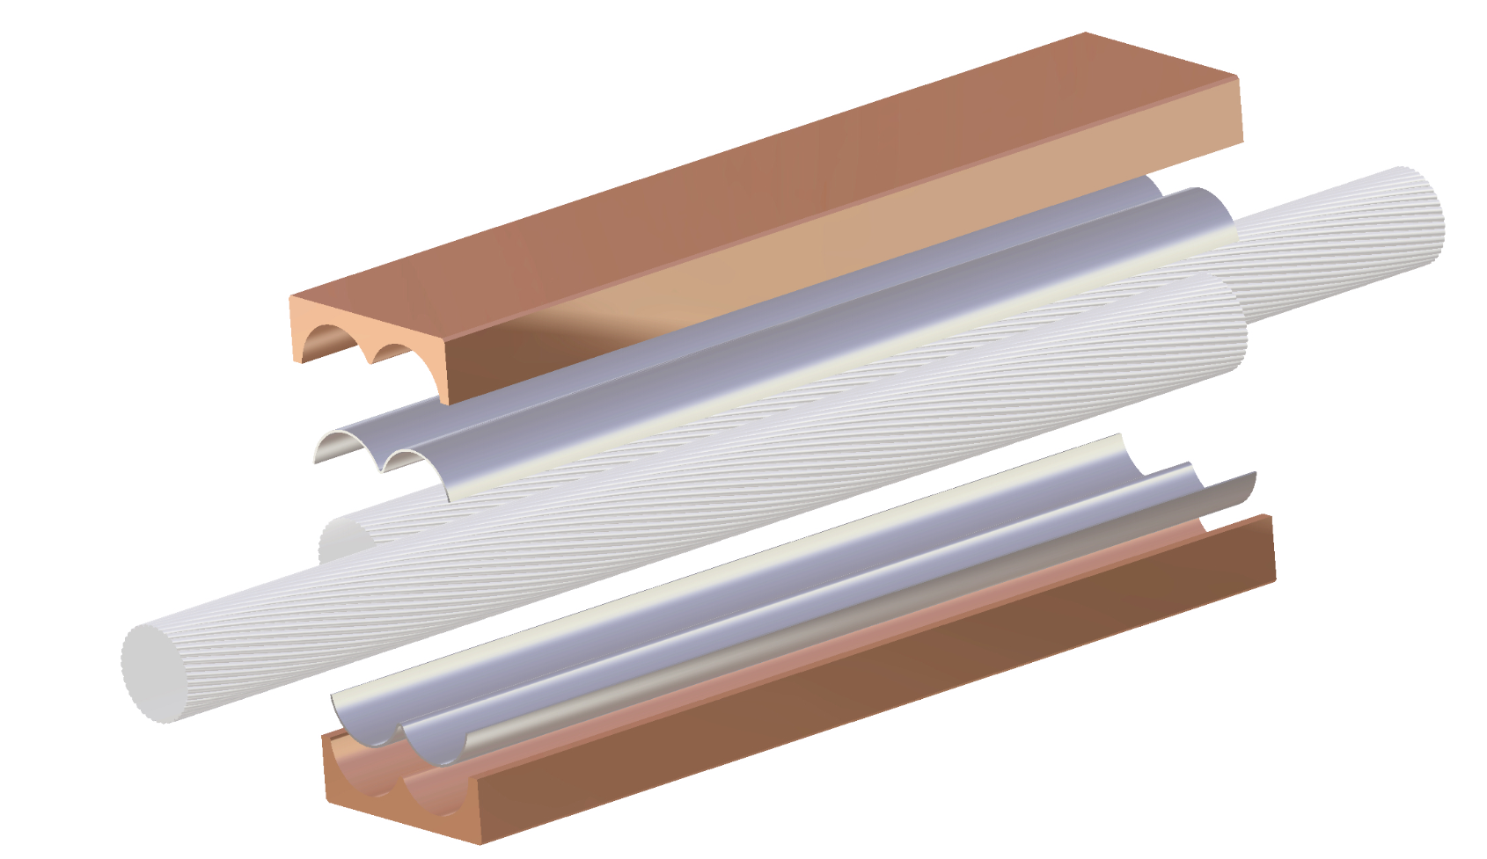
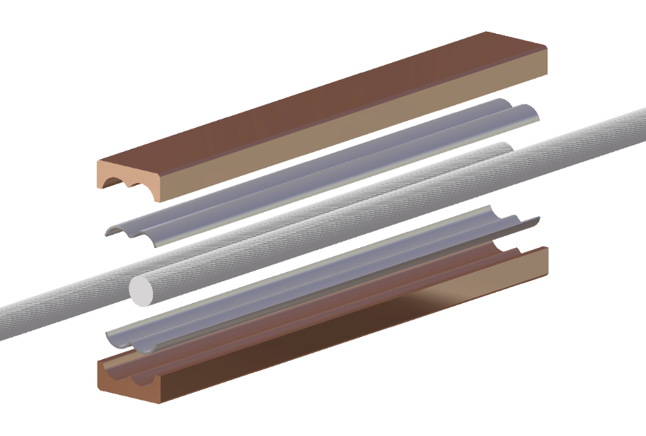
Nb-Ti/Nb-Ti cables splices
Geometry of splices identical to the one defined in Internal review of busbars and splices Apr-14..16, 2021 EDMS@2544721
18 kA splice
  Sn96Ag4 with Pre-tinning (221°C)
  Soldering length 150 mm
  Cu OFE
  Flux MOB39
0.6 kA splice
  Sn96Ag4 with Pre-tinning (221°C)
  Soldering length 100 mm
  Cu OFE
  Flux MOB39

Slide 7
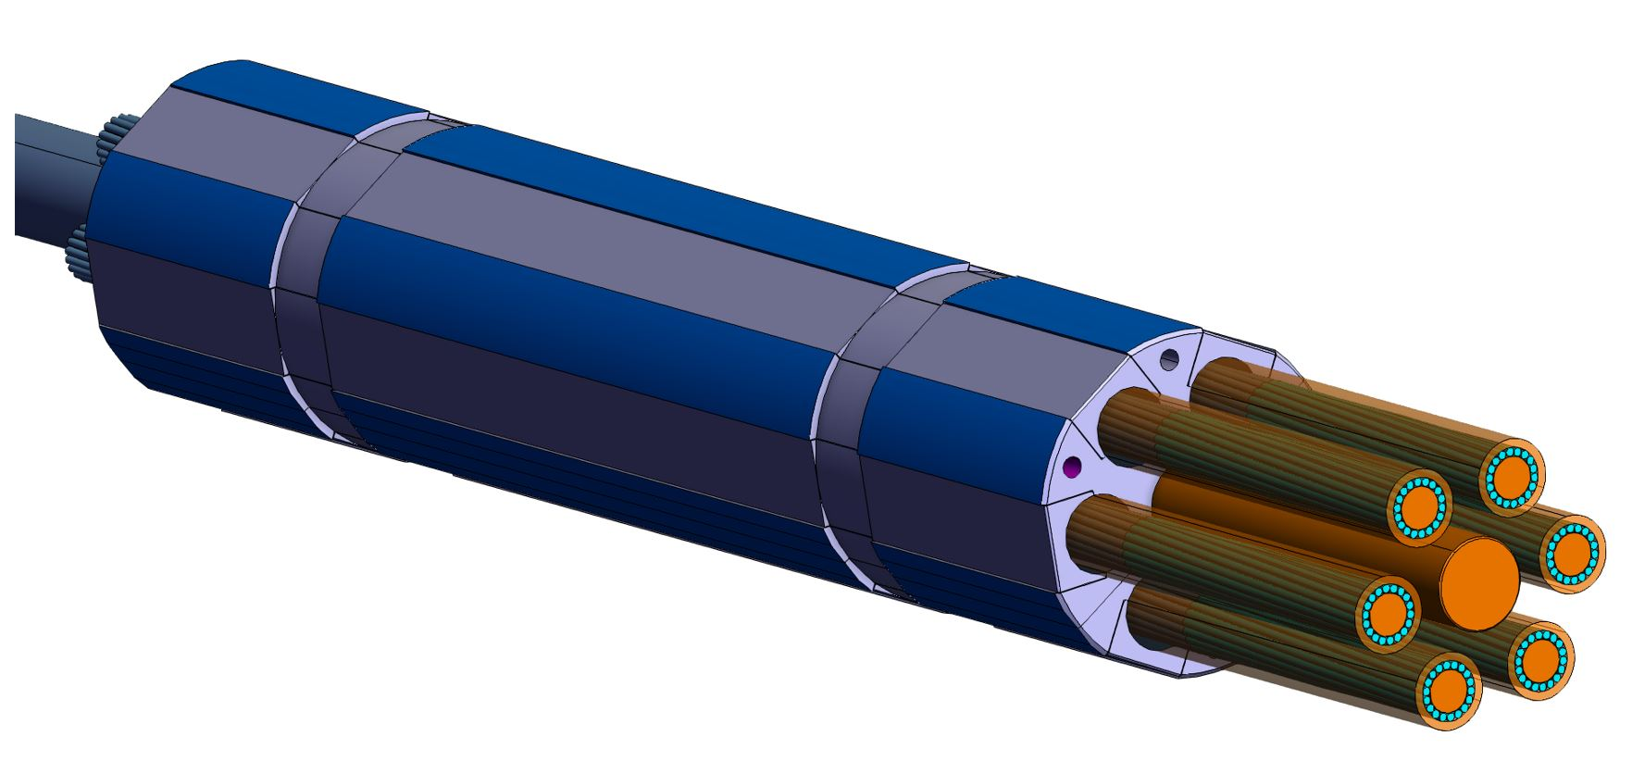
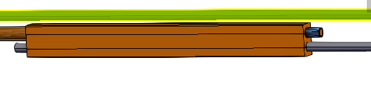
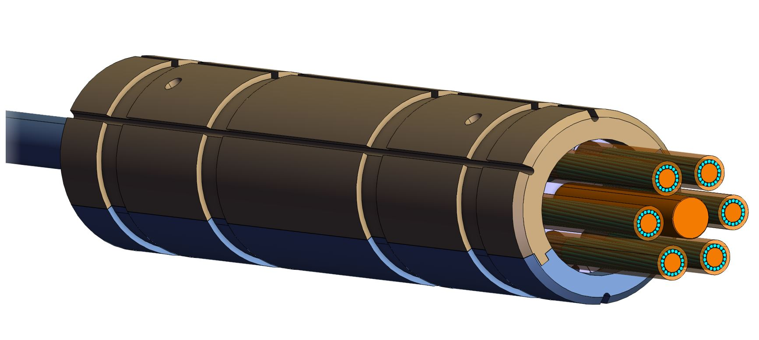
MgB₂/Nb-Ti cables splices
MgB₂/Nb-Ti splices of DFM with same geometry as the one of DFX
18 kA splice
  Sn-Pb (183°C)
  Soldering length 200 mm
  Cu OFE
  Flux MOB39
0.6 kA splice
  Sn-Pb (183°C)
  Soldering length 200 mm
  Cu OFE
  Flux MOB39
NbTi
MgB₂
NbTi
Cu OFE
Insulation of splice

Slide 8
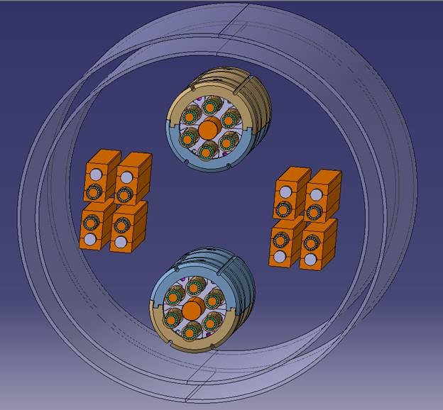
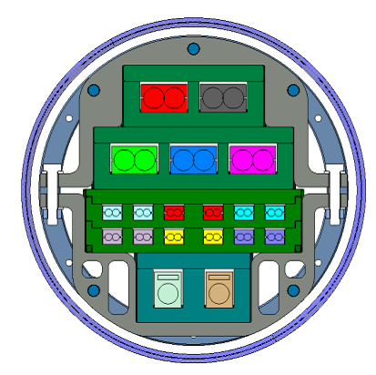
Splices assemblies
MgB₂/Nb-Ti splices
  splices maintained together via insulating structure
  Splice assembly is a sliding point vs cryostat (free to rotate and to slide with amplitude of +/-20 mm)
Nb-Ti/Nb-Ti splices
  splices maintained together via insulating structure
  Splice assembly is a fix point vs cryostat
Assembly of splice inspired from the DFX, exact arrangement under finalization
insulating structure not shown

Slide 9
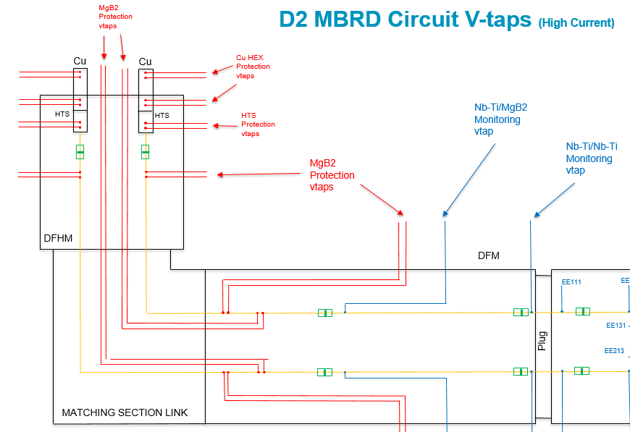
SC Link electrical instrumentation
Each branch of circuits equipped with 14 Vtaps for the protection of:
  Current lead heat exchanger
  SC cables (HTS, MgB₂, NbTi)
  Splices (HTS/MgB₂, MgB₂/NbTi and NbTi/NbTi)
Same layout for all branches of circuits (0.6-18 kA) IT and MS
Requirements for the protection of the SC-Links components presented by A. Ballarino in cold powering review July 2017 (Indico/643197)
4 Vtaps placed in the DFM will be routed out at the level of DFM
HL-LHC Circuit Voltage Taps Layout of SC Link (EDMS 2411822 )
Engineering Specification: Instrumentation of the Cold Powering System EDMS 2512704 and 2591698

Slide 10
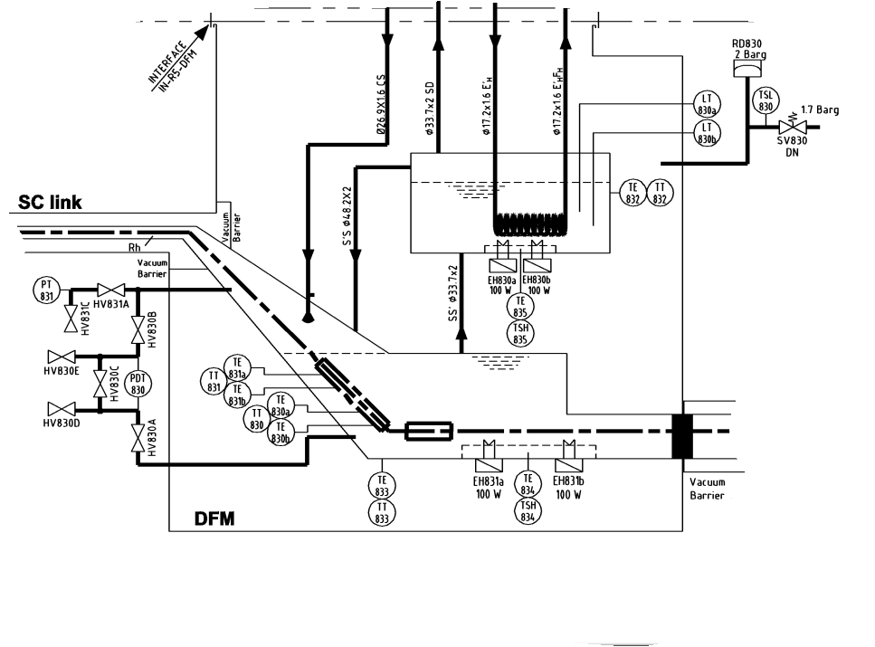
Cryogenic instrumentation of DFM
For a safe operation of SC Link system, during nominal operation but also during transients, dedicated cryo instrumentation is required.
Cryogenic instrumentation of DFM :
8 Thermal transducers (TT)
  Two in vacuum attached to He vessel (Cernox)
  4 in the splice box (He vessel) (Cernox)
  2 temperature sensors attached to the resistive heaters (PT100)
5 Heaters
  1 GHe/LHe Heat exchanger
  2x100 W resistive Heaters in external bath (includes 1 spare)
  2x100W resistive heater in the lower bath (includes 1 spare)
1 He pressure gage
Two LHe level transducers
Cryo control valves are part of cryo jumper
PID LHCLSQRG0042-V0
Engineering Specification: Instrumentation of the Cold Powering System EDMS 2512704 and 2591698

Slide 11
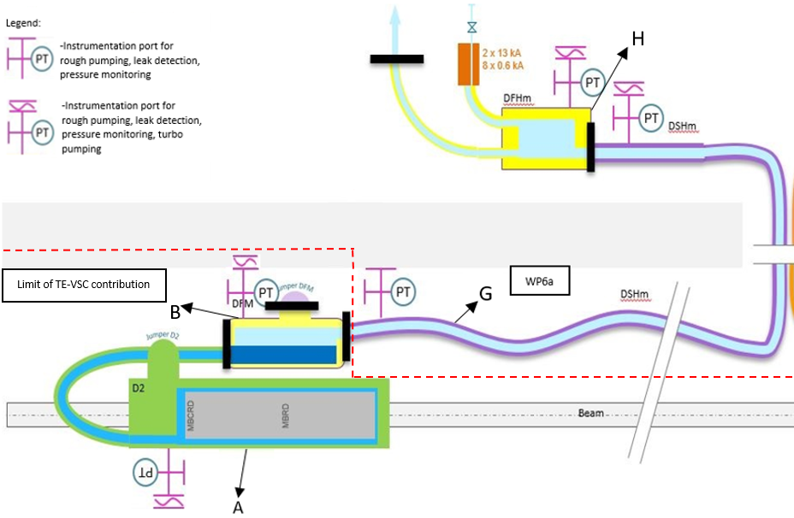
Vacuum instrumentation
Each SC Link system made of three vacuum volumes DFM, DSHM and DFHM (EDMS1824906)
DFM equipped with vacuum ports to plug pumping units and/or vacuum instrumentation
=> no wiring in the vacuum vessel
EDMS 1824906

Slide 12
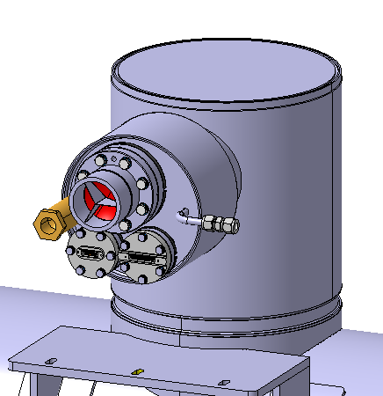
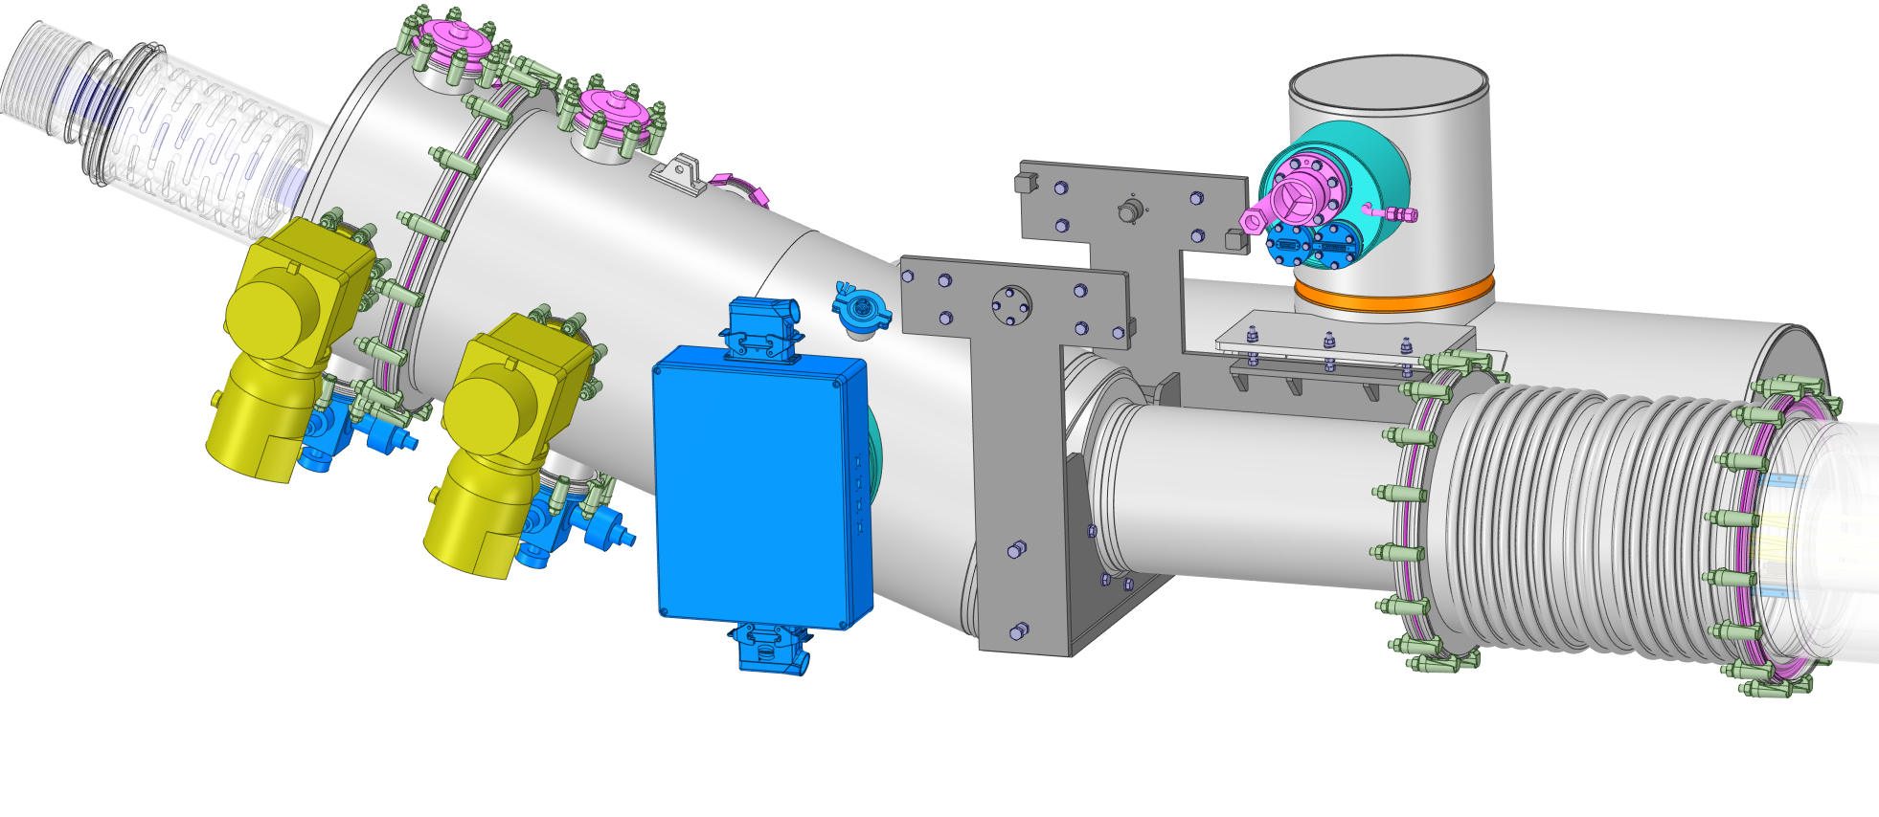
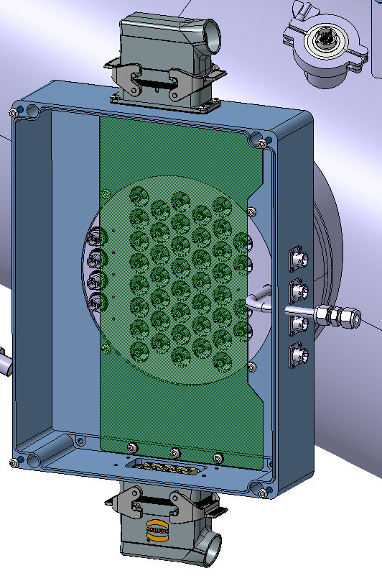
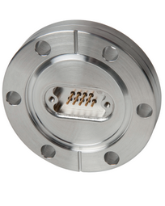
Feedthrough for instrumentation of SC-Link
DFM equipped with four feedthroughs:
  Type 1 vac. temp probes DN ISO-K-SubD connector
  Type 2 LHe level gage DN ISO-K-SubD connector
  Type 3 40 Vtaps IFS L-Type
  Type 4 Heaters and TT DN ISO-K-SubD connector
Type 1
Type 3
Type 4
Type 2
12

Slide 13
Conclusions
  Geometry of splices (including insulation) finalized
  Splices arranged in assemblies per type (NbTi/NbTi and NbTi/MgB₂)
  List of instrumentation for cryo and electric protection defined
  Feedthroughs of instrumentation defined, type of connector to be confirmed together with CRG and MPE

