Slide 1
Equipment safety & safety aspects in the LHC tunnel
N.Grada for the HL-LHC PSO
Engineering Design Review of DFM 18.01.2022

Slide 2
Agenda
Review of CDR close-out recommendations
Conformity compliance strategy
Radiation protection aspects
Cryogenic safety aspects
Electrical safety aspects
Next steps

Slide 3
Recommendations from the DFM CDR
Recommendation #3
  […] the radioprotection aspects make any intervention (apart from the first installation) critical for ALARA considerations.
  The plan for maintenance and reparation must be developed taking into account this aspects.
  More detailed sequence for all these operations are expected at the DDR review.
    Detailed sequence for maintenance & repair will follow F2 test bench to include empirical knowledge (c.f. P.Cruikshank’s talk #1)
Recommendation #4
  The DFM design and its technical documentation has to coherently address the point of the design standard applied (PED) and consequent requirements all along the procurement, assembly and testing phases.
    Design standard will be presented and justified. Requirements will be addressed.
  The exact role of HSE should be identified and clarified.
    HSE guidance used for the conformity compliance strategy. HSE’s role is clear.
  The integration of burst disk, rated valve and relief plates must be done together WP15 and HSE.
    Final integration of pressure safety devices made considering best safety practices.

Slide 4
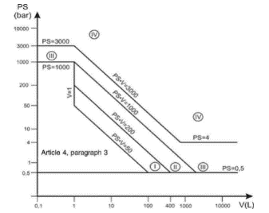
DFM PED category & requirements
PED Category | Conformity Assessment Module | Comment
SEP | N/A | Equipment must be designed and manufactured following sound engineering practice. No involvement of notified body.
Category I | Module A | CE marking with no notified body involvement, self-certifying.
Ps x V = 900 bar.L
Category II | Module A2 | Notified body performs unexpected checks and monitors final assessment.
 | Module D1 | Notified body performs unexpected checks and assesses production QA.
 | Module E1 | Notified body performs unexpected checks and asseses final testing QA.
Category II | Module A2 | Notified body performs unexpected checks and monitors final assessment.
 | Module D1 | Notified body performs unexpected checks and assesses production QA.
 | Module E1 | Notified body performs unexpected checks and asseses final testing QA.
2.5
360
Category III | B1+F | Notified body approves the design, examines and tests the vessel.
Category IV | G | Further involvement of the notified body.

Slide 5
Conformity compliance strategy
Design made by CERN acc. to EN13445-3
Manufacturing by SOTON via UK industrial partner (UK2 agreement)
Manufacturer choses the notified body as per Module A2
Manufacturer responsible for the technical documentation, the final assessment and for drawing up the EU declaration of conformity for CE certification
Notified body will confirm that the final inspection, the proof test and the safety devices are in line with Sec. 3.2 of the ESR (Annex I of the PED)
No involvement of HSE before reception at CERN. Connection to the interfacing equipment in the LHC tunnel (DSHM, QXL, D2) under HSE supervision.

Slide 6
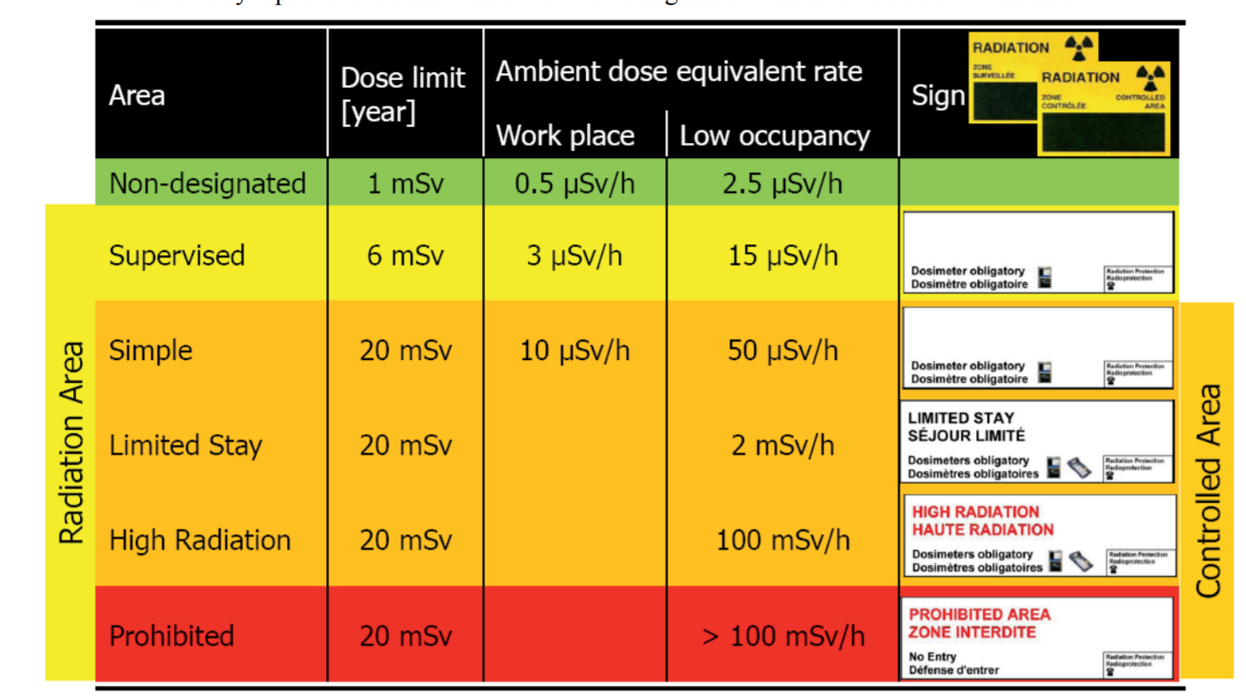
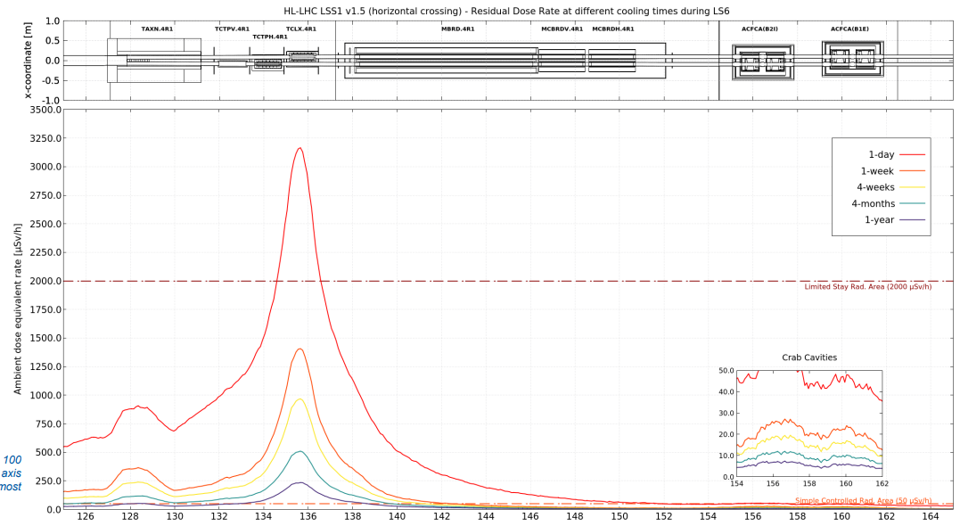
Radiation protection safety
Manufacturing
  Stainless steel cobalt content < 0.1 wt% where possible. Any deviation will be the subject of a derogation request.
Assembly & integration
  Highly integrated zone of the tunnel with no margin to locate DFM elsewhere.
  Assembly procedures will be developed following ALARA recommendations.
Maintenance & repair
  Only very urgent interventions after 1 week cooldown.
  Complex environment above D2 will anyway require a mock-up where intervention procedures (including ALARA) can be optimised.
Dismantling
  Disassembly procedure will be developed following ALARA.
  Collimators removed first, D2 removal prior to DFM dismantling preferred.
  Not very time-critical
Residual dose rate in the D2 area (P1R) at different cooling times during LS6
Courtesy A.Infantino

Slide 7
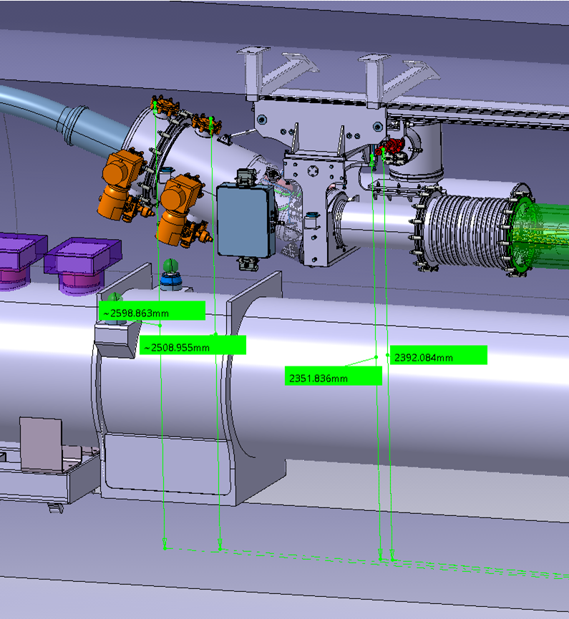
Cryogenic safety
Position of safety devices approved by HSE
  Height of pressure relief devices wrt tunnel’s floor between 2300 mm and
  2600 mm: no risk of direct projection of cold helium gas on transport side.
Safety relief device sizing (by Y.Leclercq)
  Data
    Cold surfaces exposed to Vacuum : 3.5 m2 (2.2 m² wet surface)
    30 layers MLI on helium vessel
    Helium volumes in nominal operation : 210 liters liquid + 150 liters gaseous
  Input
    Vacuum break on 30 MLI layers : 0.2 W/cm2
    Power dissipated in liquid : 7 kW
  Relief device sizing according to ISO21013-3
    Qm = 0.5 kg/s (1.4 kg/s for 10 layers)
    Drelief > 17 mm (28 mm for 10 layers)
    Sizing of DFM burst disk covers the dimensioning scenario with margin.
    Relief plates sizing checked at CDR: 2 DN100 on either side of the VB.
Staggering protection concept (c.f talk of V.Gahier)

Slide 8
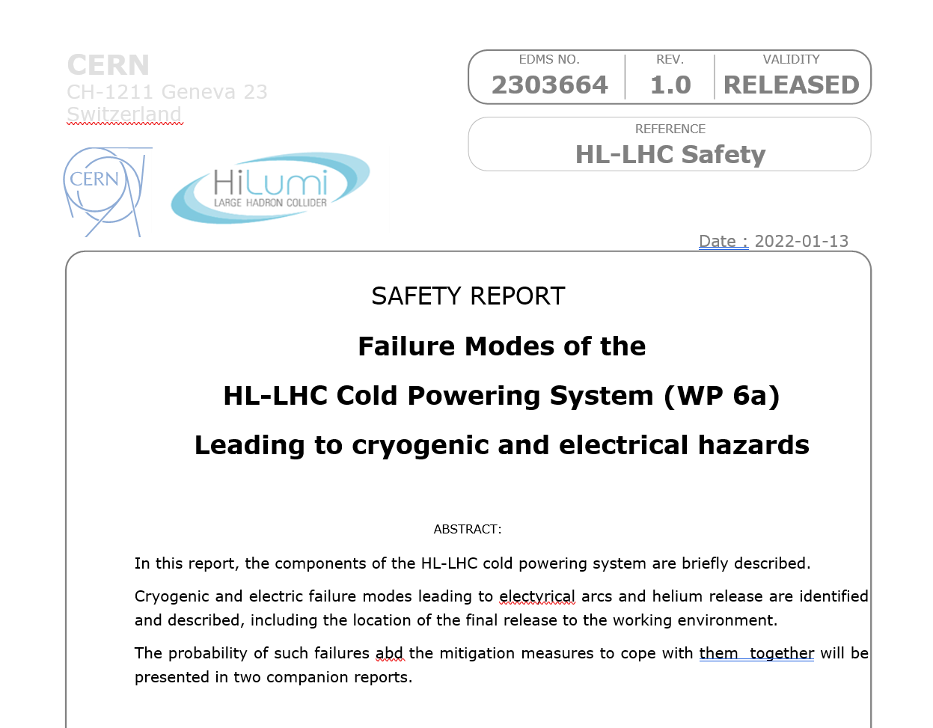
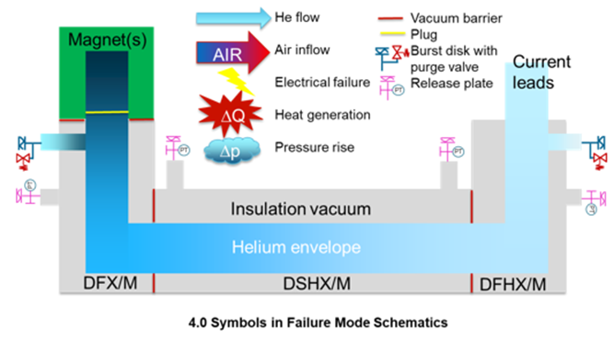
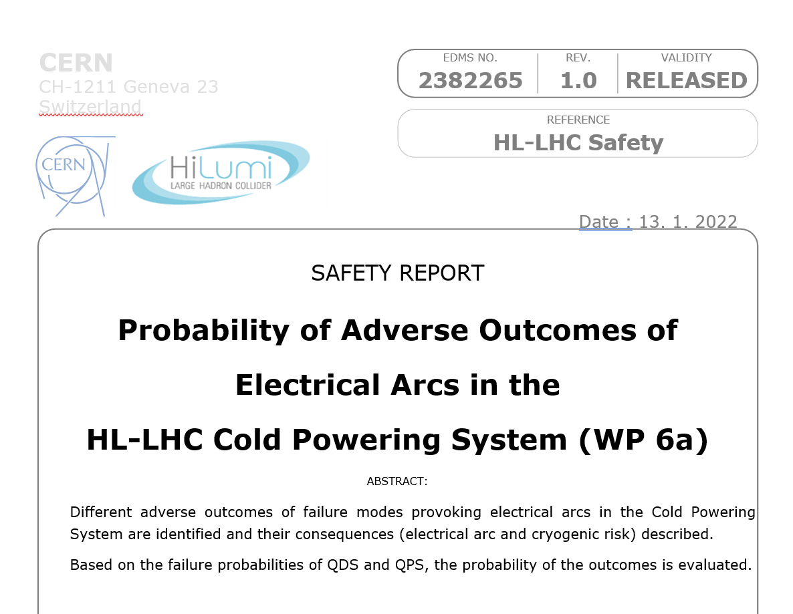
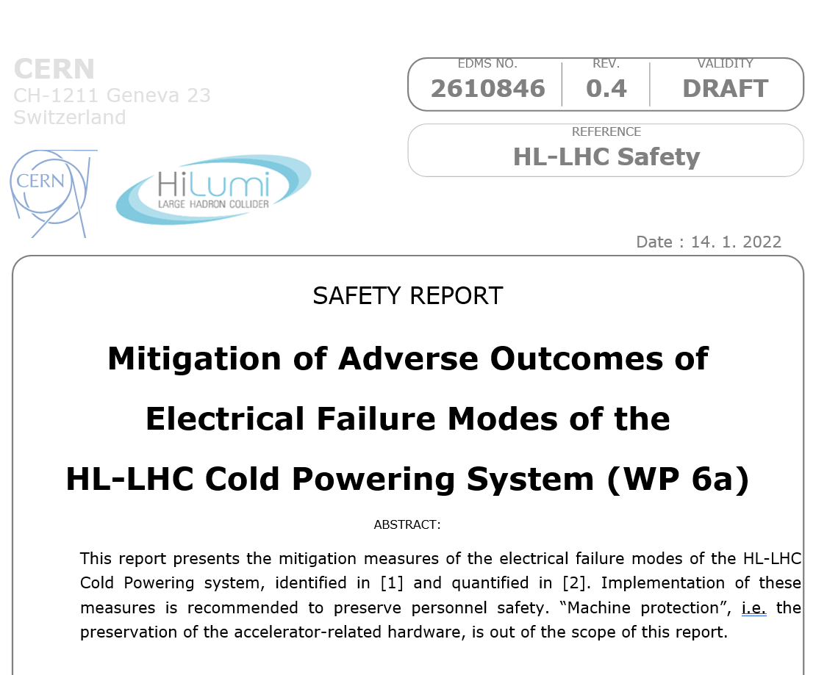
Electrical safety aspects
All failure modes identified & described in edms 2303664
All electrical failure modes quantified in edms 2382265 (risk assessment for DFX conservatively cover those for DFM)
All electrical failure modes mitigated in edms 2610846 (mitigations for DFX conservatively cover those for DFM)

Slide 9
Next steps
Submit technical report with safety device calculation to HSE for approval.
Discuss and agree in advance who will be the designated notified body (e.g SOTON / External contractor).
  Detailed sequence for maintenance & repair to be finalised following F2 test bench.

Slide 10
Thank you for your attention

