Slide 1
DFM : Engineering Detailed Design
F. Di Ciocchis*, Y. Leclercq*, P. Schneider for WP6a
Engineering Design Review of DFM 18.01.2022

Slide 2
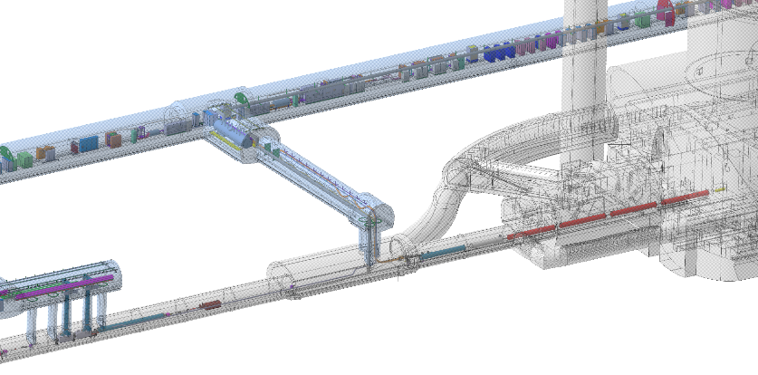
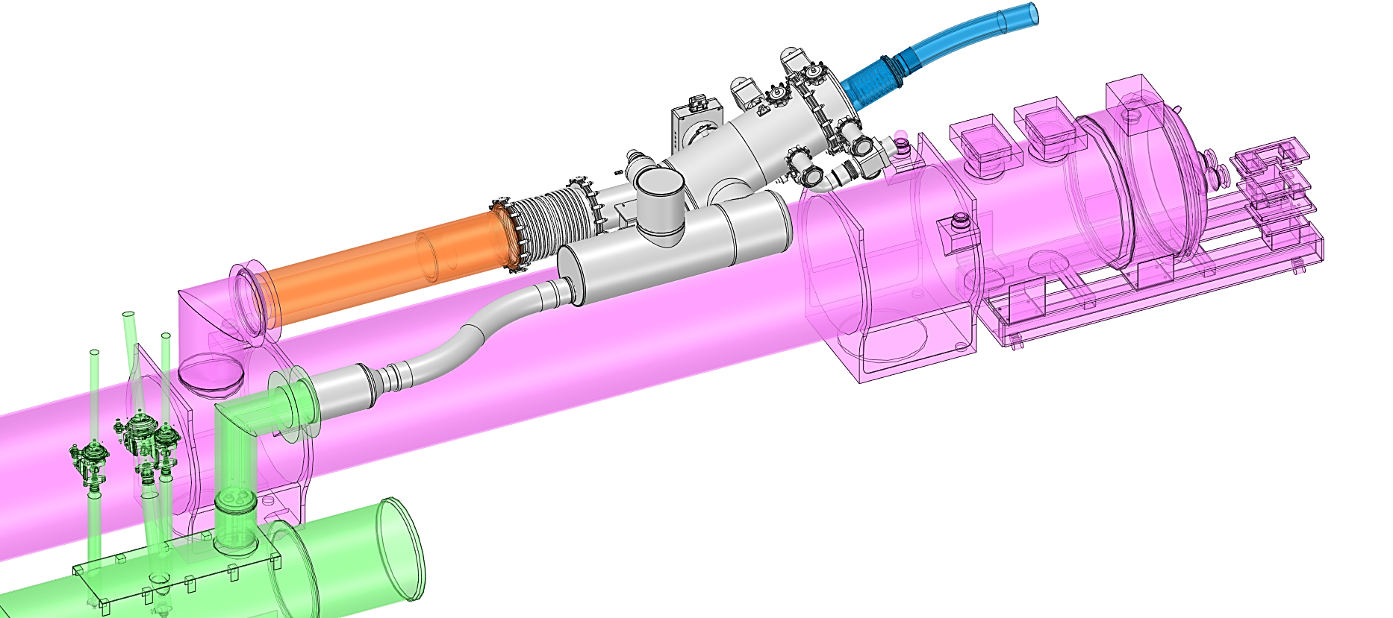
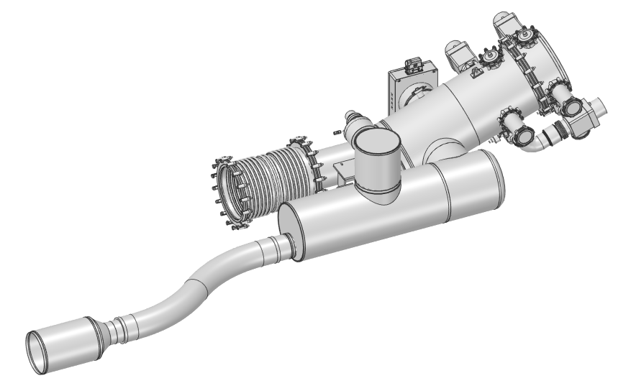
DFM in Cold Powering System
Service Gallery
DFM in HL-LHC Layout
  Part of the WP6a Cold Powering chain
    DFM-DSHM-DFHM
  Installed on either side of ATLAS and CMS
  Interface with DSHM of WP6a, with D2 & QXL of WP3
Components denominations
  DSHm (SCLink D2): from DFHM to DFM
  DFM
    Splice module (SM): electrically connects Interlink to SCLink
    Boiler module (BM) : creates the helium gaseous mass flow
  D2-DFM interlink: connects leads from D2 to DFM leads
  DFM Jumper: connects to cryo-lines
Key Functions
  Electrical interface between DSHM & magnets
  Supply cryogenics to the DSHM
DFHX
DFHM
DSHx
DSHm
IP
89.5 m
Q2a
Q1
Q3
Q2b
140.0 m
D1
CP
DFM
D2
DSHM
DFM: Splice module
D2-DFM Interlink
D2
Jumper
DFM :Boiler module
QXL

Slide 3
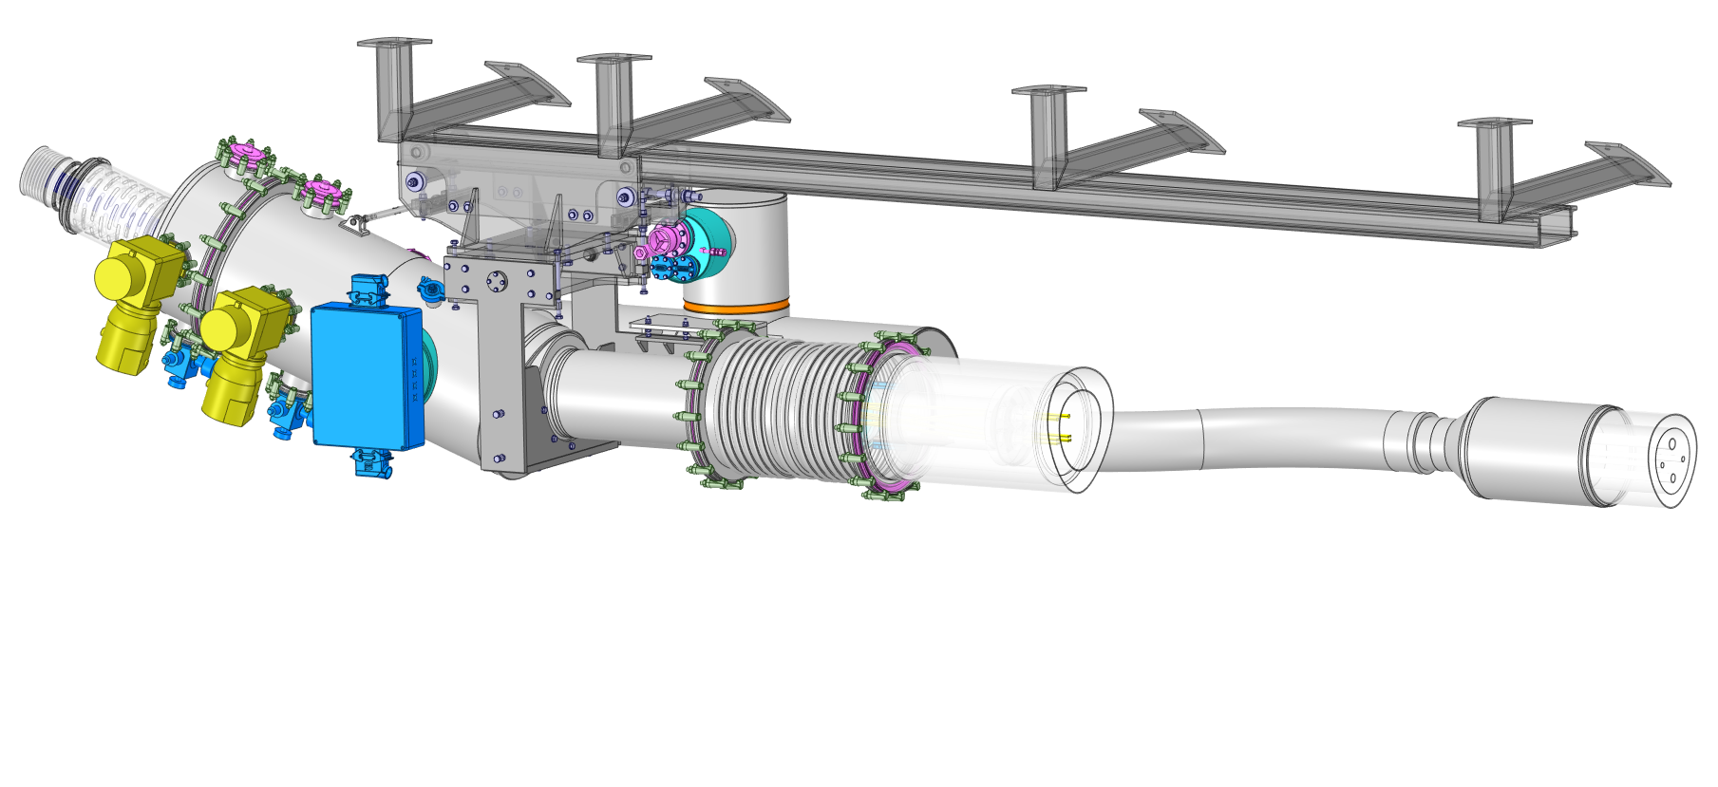
External overview & interfaces distribution
Tunnel interface
  Cryostat suspended from tunnel’s roof
Services
  Vacuum & cryo-instrumentation equipment accessible from transport area
DFHM interface
    Vacuum & helium jacket flanges fixed to DFM
DFM-D2 interlink interface
  Vacuum & helium sleeves to access NbTi-NbTi splices
  Hydraulic barrier (plug) separating LHe (DFM side) from superfluid helium (D2 side)
Jumper interface
  Flexible cryo-interconnections
  Vacuum sleeve to access cryo-interconnections
Cryo-Instrumentation
Box
Tunnel interface
Spring loaded valves
DSHM
Rupture disc
LHe level gauges &
Cryo-instrumentation
Rail
Pumping system
Vac. Valves & Gauges
IFS Panel
External frame
D2-DFM Interlink
Jumper interface
Vacuum sleeve to access cryo-lines
Vacuum instrumentation
(Feedthrough)
Interconnection sleeve
Bellows free to expand in case of cold leak

Slide 4
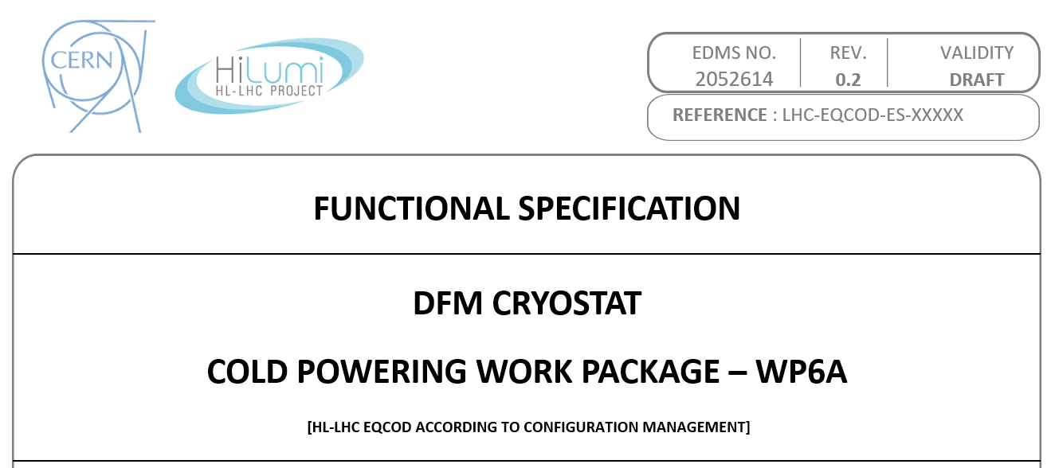
Key design specifications & constraints
Design (nominal) GHe mass flow rate → 6.5 (3) g/s
Autonomy in case of LHE supply stop → 10 min @ nominal
Gas evacuation through SC Link
Maximum static heat load to 4.5 K → 25 W
Absence of condensation → Dew point 12°C
Helium vessel design pressure → 3.5 bar_{a}
PED Category → II
Compliance demonstrated via numerical analyses
Compliance demonstrated via numerical analyses
DFM Boiler Module
DFM Jumper
DSHM
QXL
D2-DFM Interlink
DFM Splice Module
D2

Slide 5

Principle of fluid flow & LHe buffers
  Principle (same as Demo 2, successfully validated)
  LHe injection in splice module
  LHe flows downward in beside boiler module by gravity
  Heating line vaporizes LHe in boiler module
  GHe flows upward to splice module
  Level gauges control LHe inlet valve
  Cryogenic
  Splices are immersed in LHe bath
  5 liters of LHe in SP for 10 min @ 20 W
  15 liters of Lhe in BM for 10 min @ 3g·s⁻¹
Superfluid @ 1.9 K
LHe @ 4.5 K GHe
Heater ops. T sensor
Heater WU
Level gauge
In-vessel supports
He Vessel Vacuum Vessel
MgB₂ cables MgB₂-NbTi Splices
NbTi cables NbTi-NbTi Splices
A-A
Cryo-Instrumentation Box
DSHM
$3 g/s$ →
Burst Disc
Thermal Barrier
Structural Support
Fill reservoir
Boiler Module
IFS Panel
Nominal Level
≈387mm
+50 mm
Thermal Barrier
Structural Support
-50 mm
15 liters
10 min @ 3g.s⁻¹
100mm
Inlet reservoir
Vacuum\Thermal Barrier
Structural Support
Heaters Volume
DSHM
LHe Overflow
A
Cable module
Vacuum\Thermal Barrier
Structural Support
Fill reservoir
Plug
Hydraulic Barrier
10 min @ 20 W
5 liters
Top splices
PLUG
LHe inlet
A

Slide 6
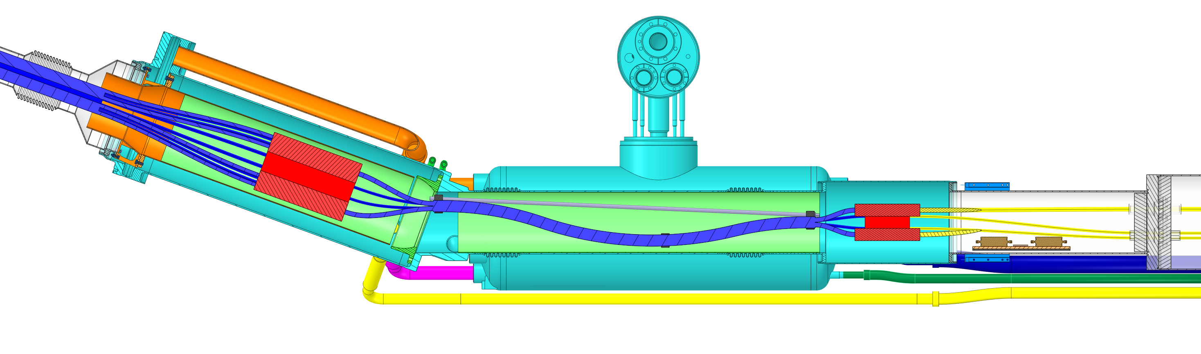
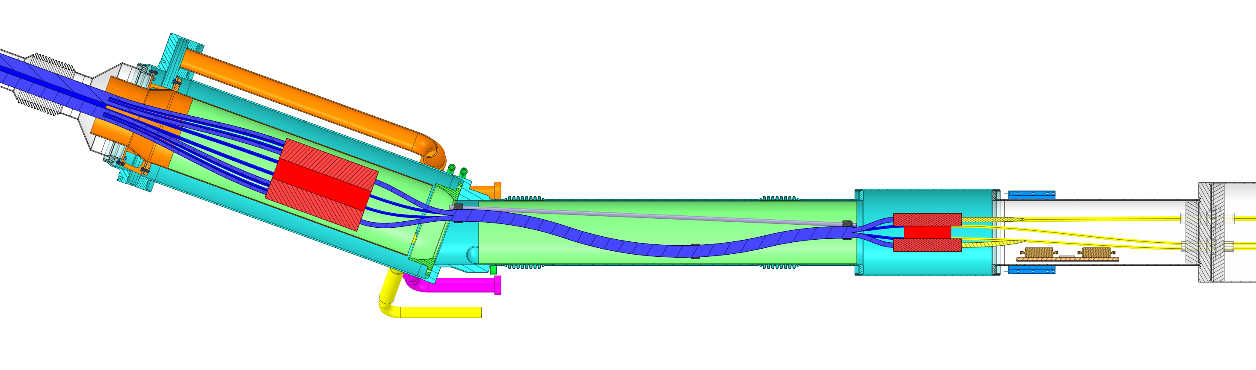
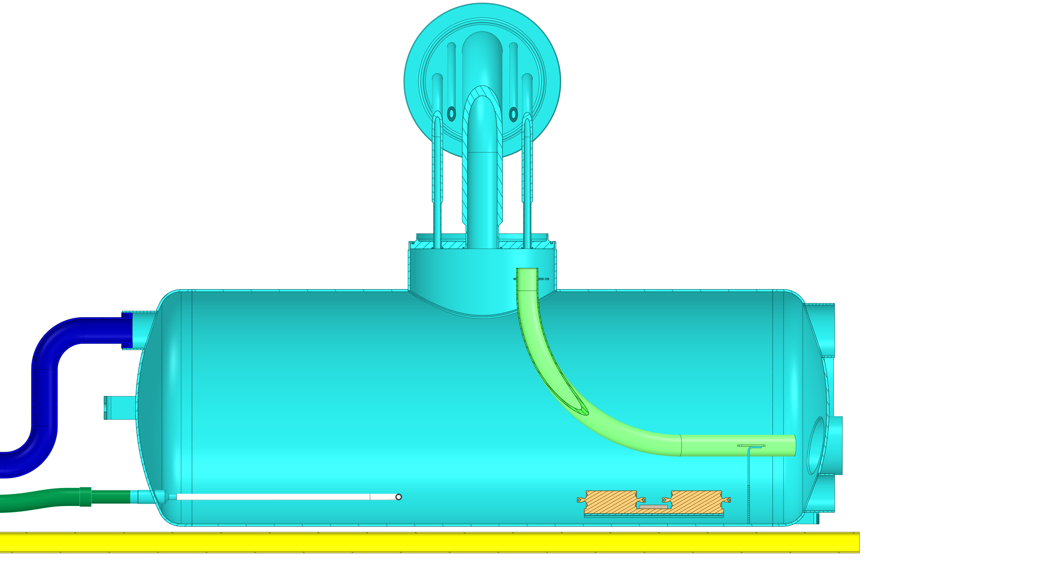
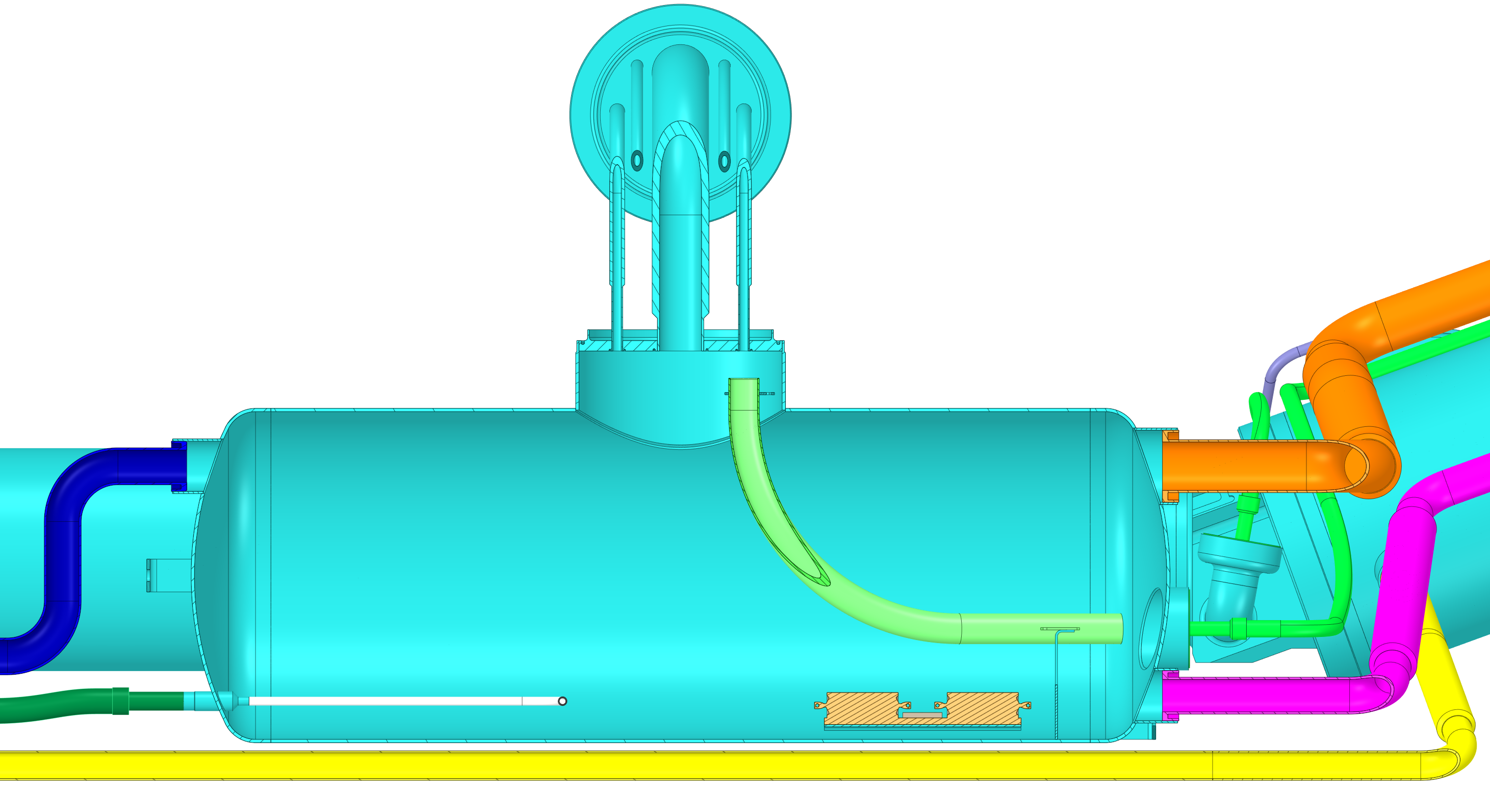
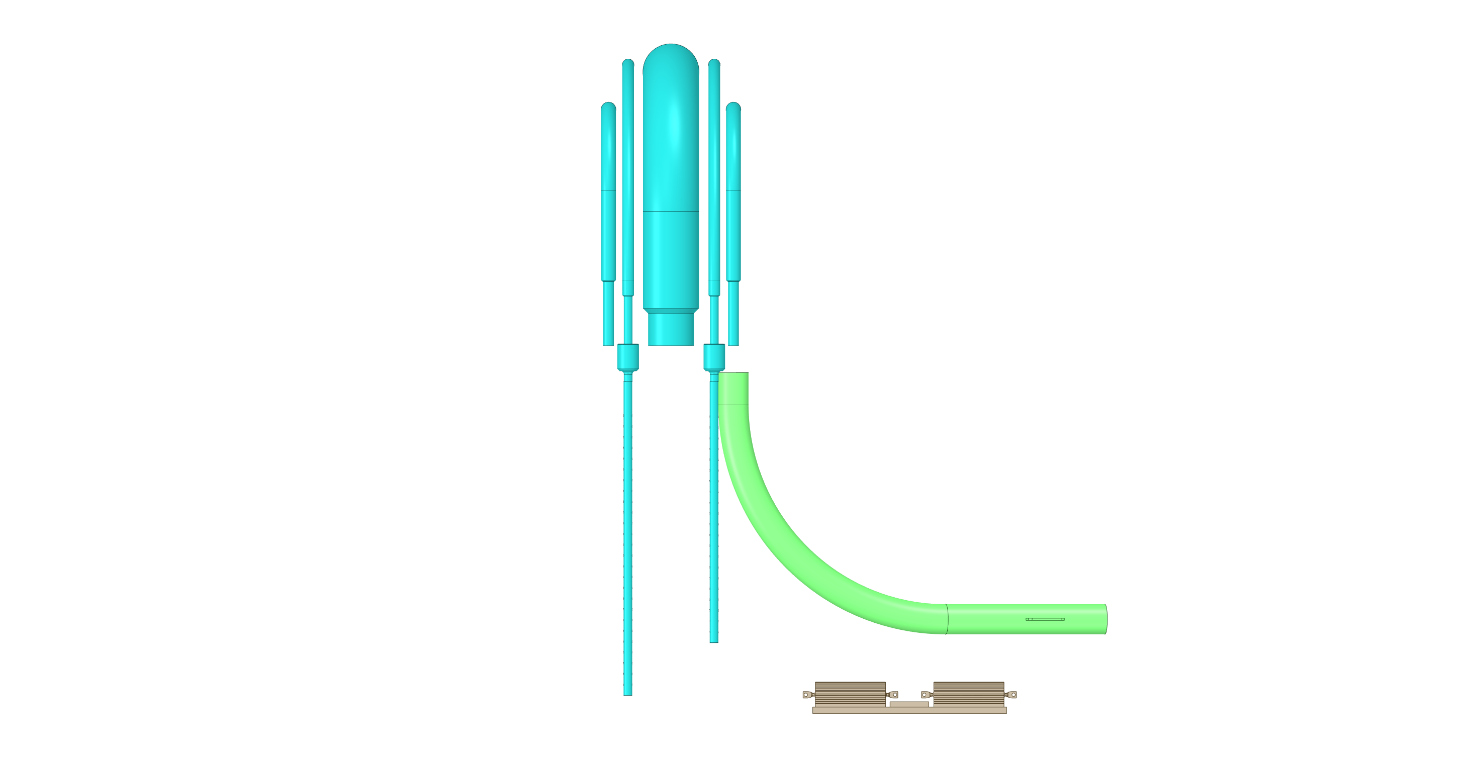
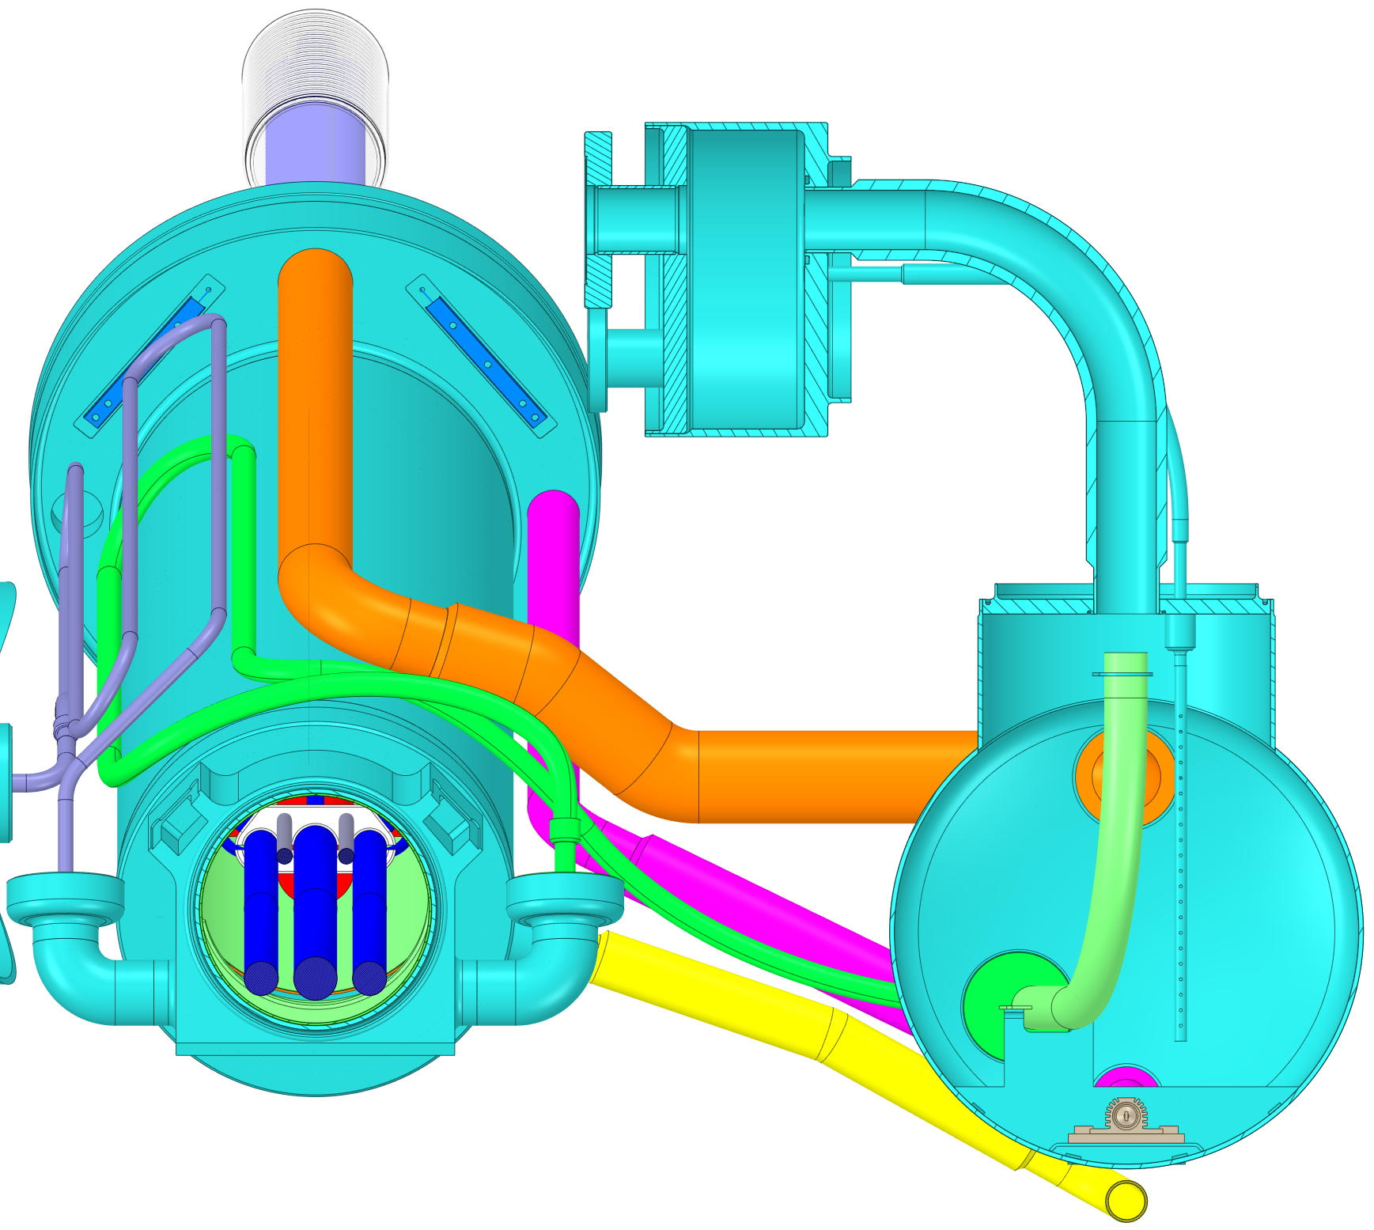
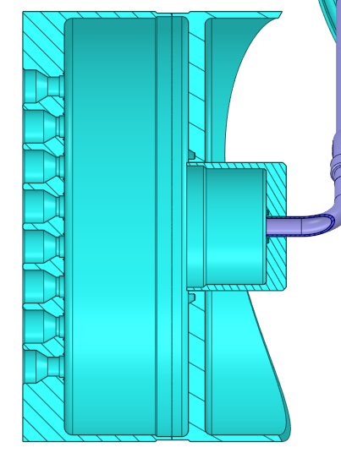
Coldmass design overview
Gas Deflector
  Two helium vessels hydraulically interconnected
  Splice module (cooling splices)
  Inclined design to perform LHe-GHe separation
  Universal expansion joint connection with D2
  He sleeve to access NbTi-NbTi splices
  Hydraulic barrier @ D2
  Boiler module (vaporizing LHe)
    Horizontal helium tank
    Safety & Cryo-Instrumentation outputs
    Cryo-connection lines to jumper
DSHM
Manifold Box
GHe Line
Helium Sleeve
(access NbTi-NbTi splices)
Plug
(hydraulic barrier)
NbTi Cables
CERNOX
MgB₂ cables
MgB₂-NbTi Splices
LHe Supply Line
Helium Universal Expansion joint
NbTi-NbTi Splices
WU Electrical Heaters
LHe Overflow Line
NbTi Cables
Cryo-Instrumentation Box
GHe Line
Cryo-Instrumentation Box
Manifold Box
Safety Line
Safety Line
CERNOX
Level Gauge
GHe Discharge Line
Wires Guide Tube
IFS Bended Pipe
LHe Overflow Line
Instrumentation Flexible
IFS Box
Level Gauge
IFS Output
Cryo-Instrumentation Output
TS Heat Exchanger
WU Electrical Heaters
Helium
Connection Flange
LHe Supply Line

Slide 7
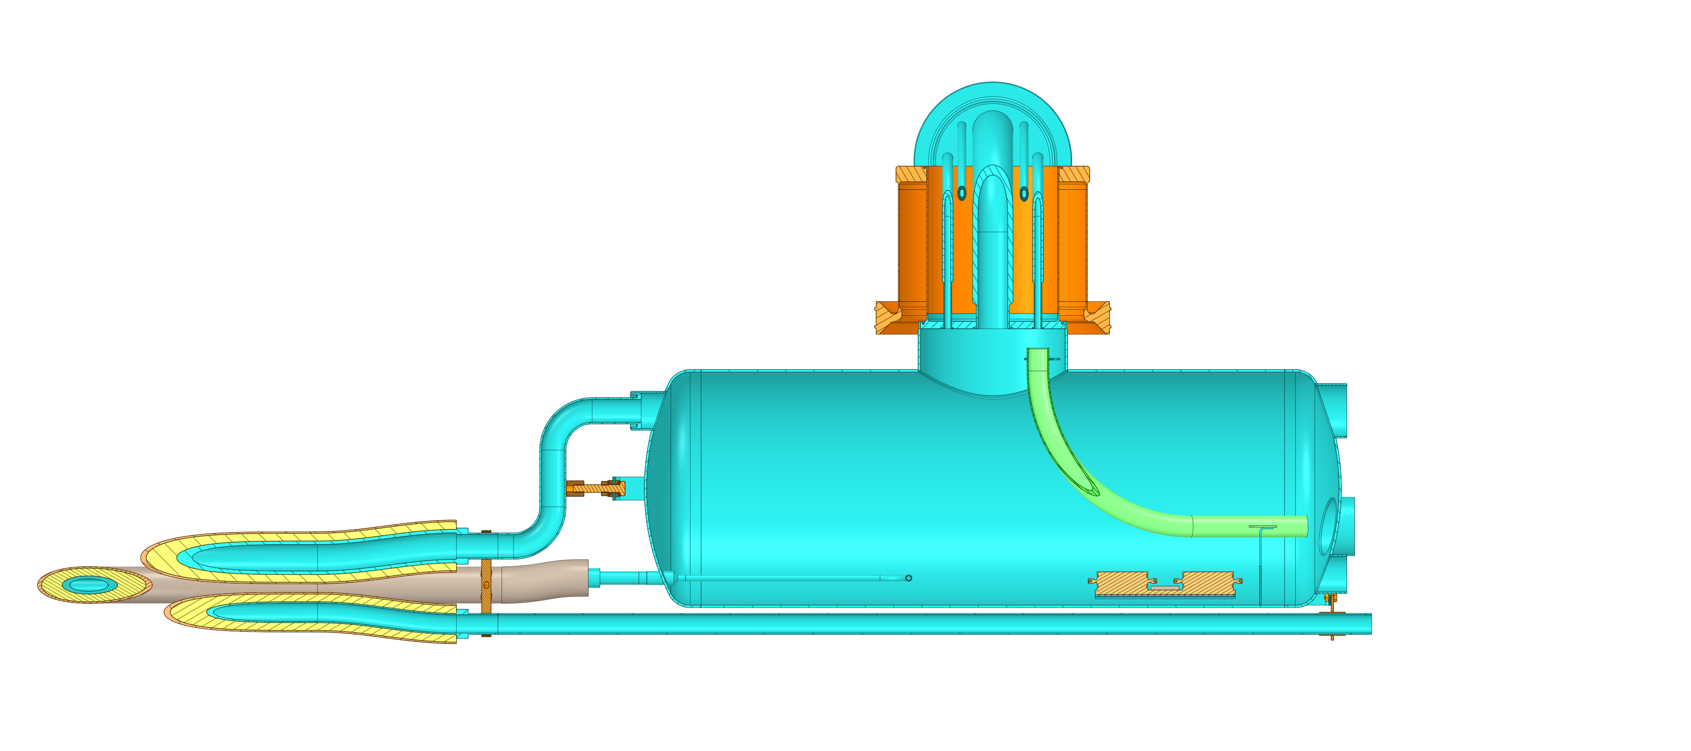
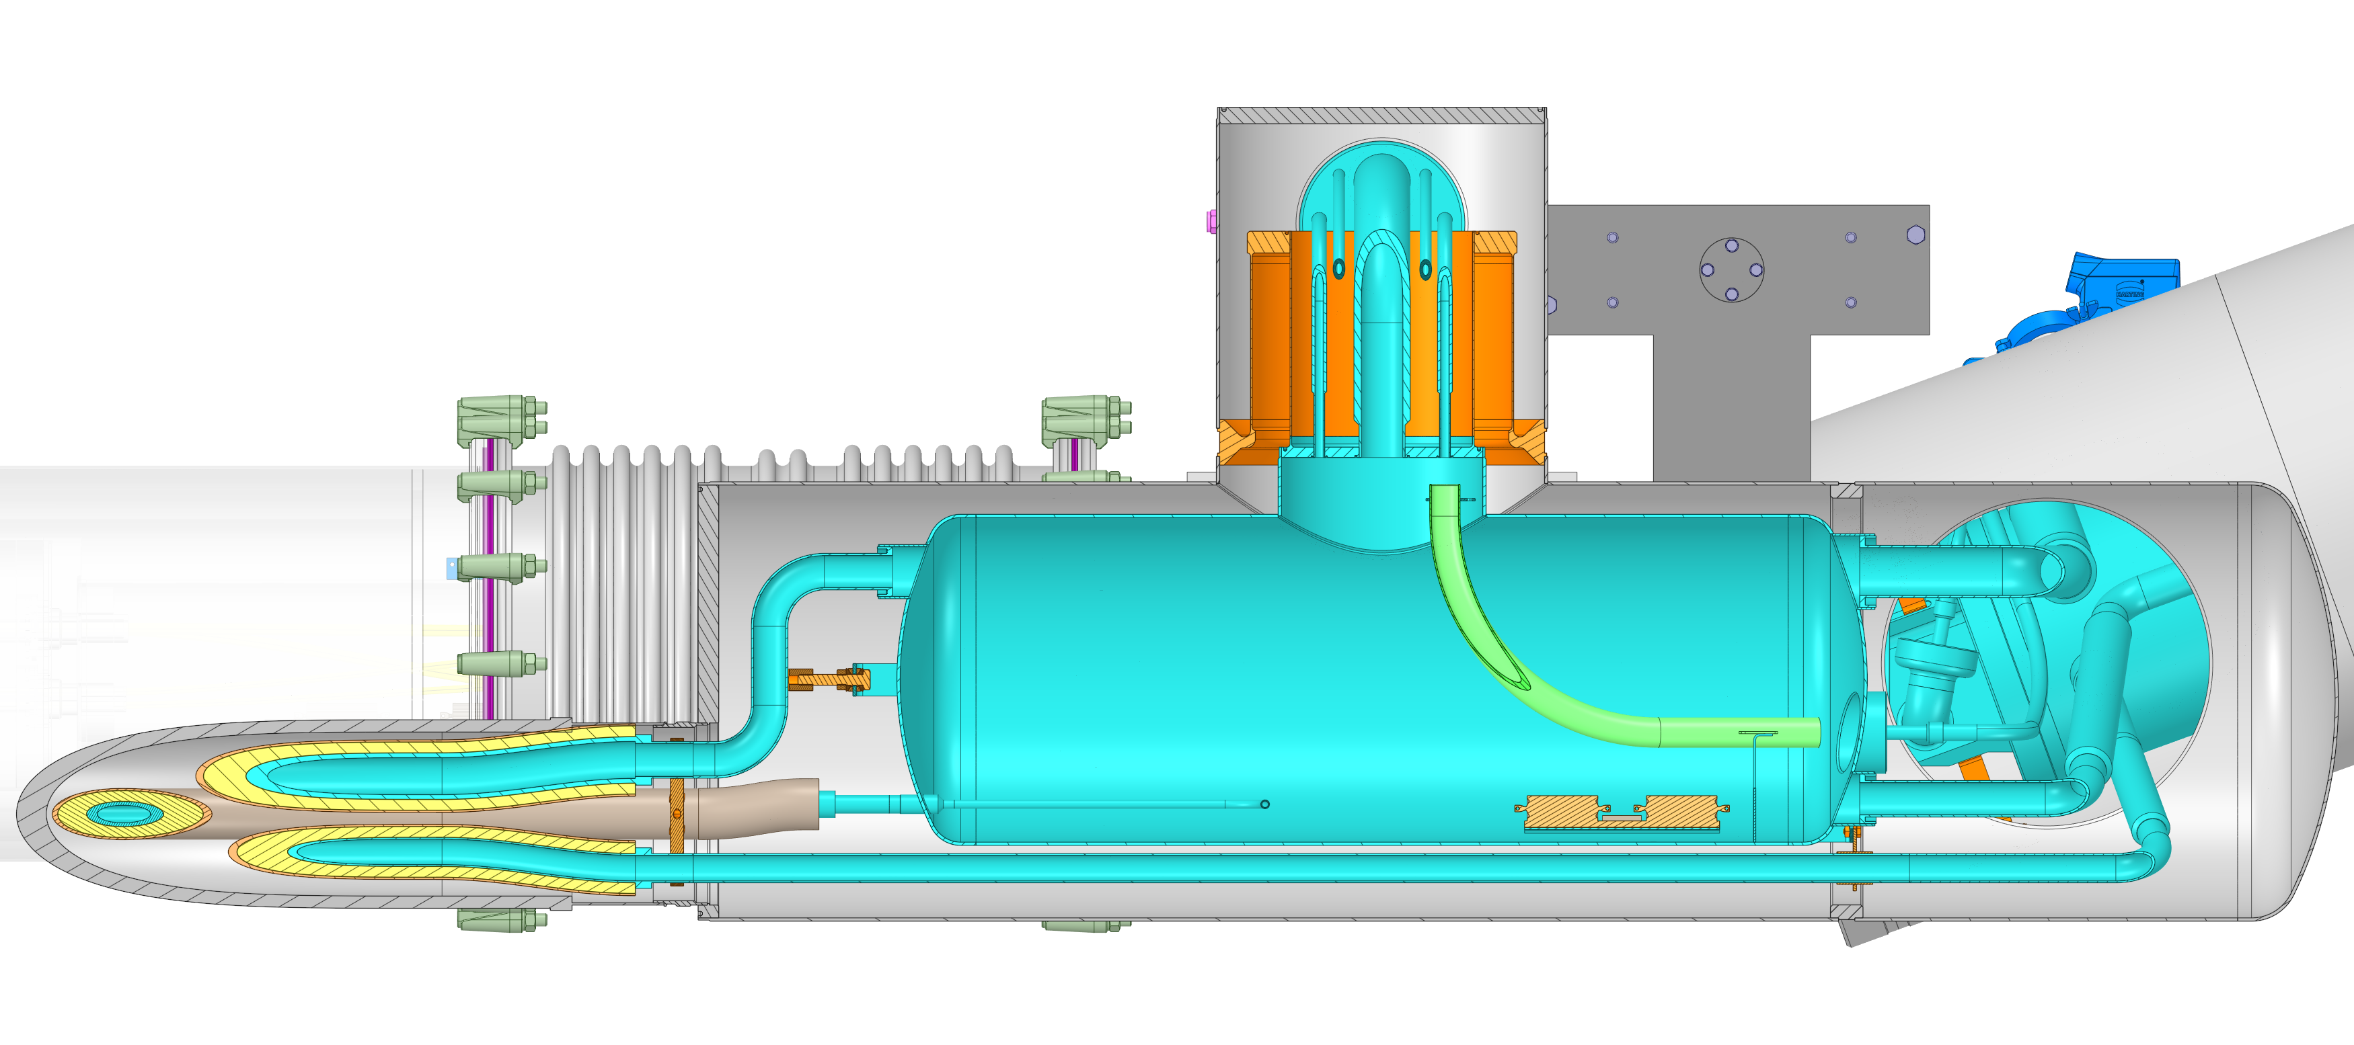
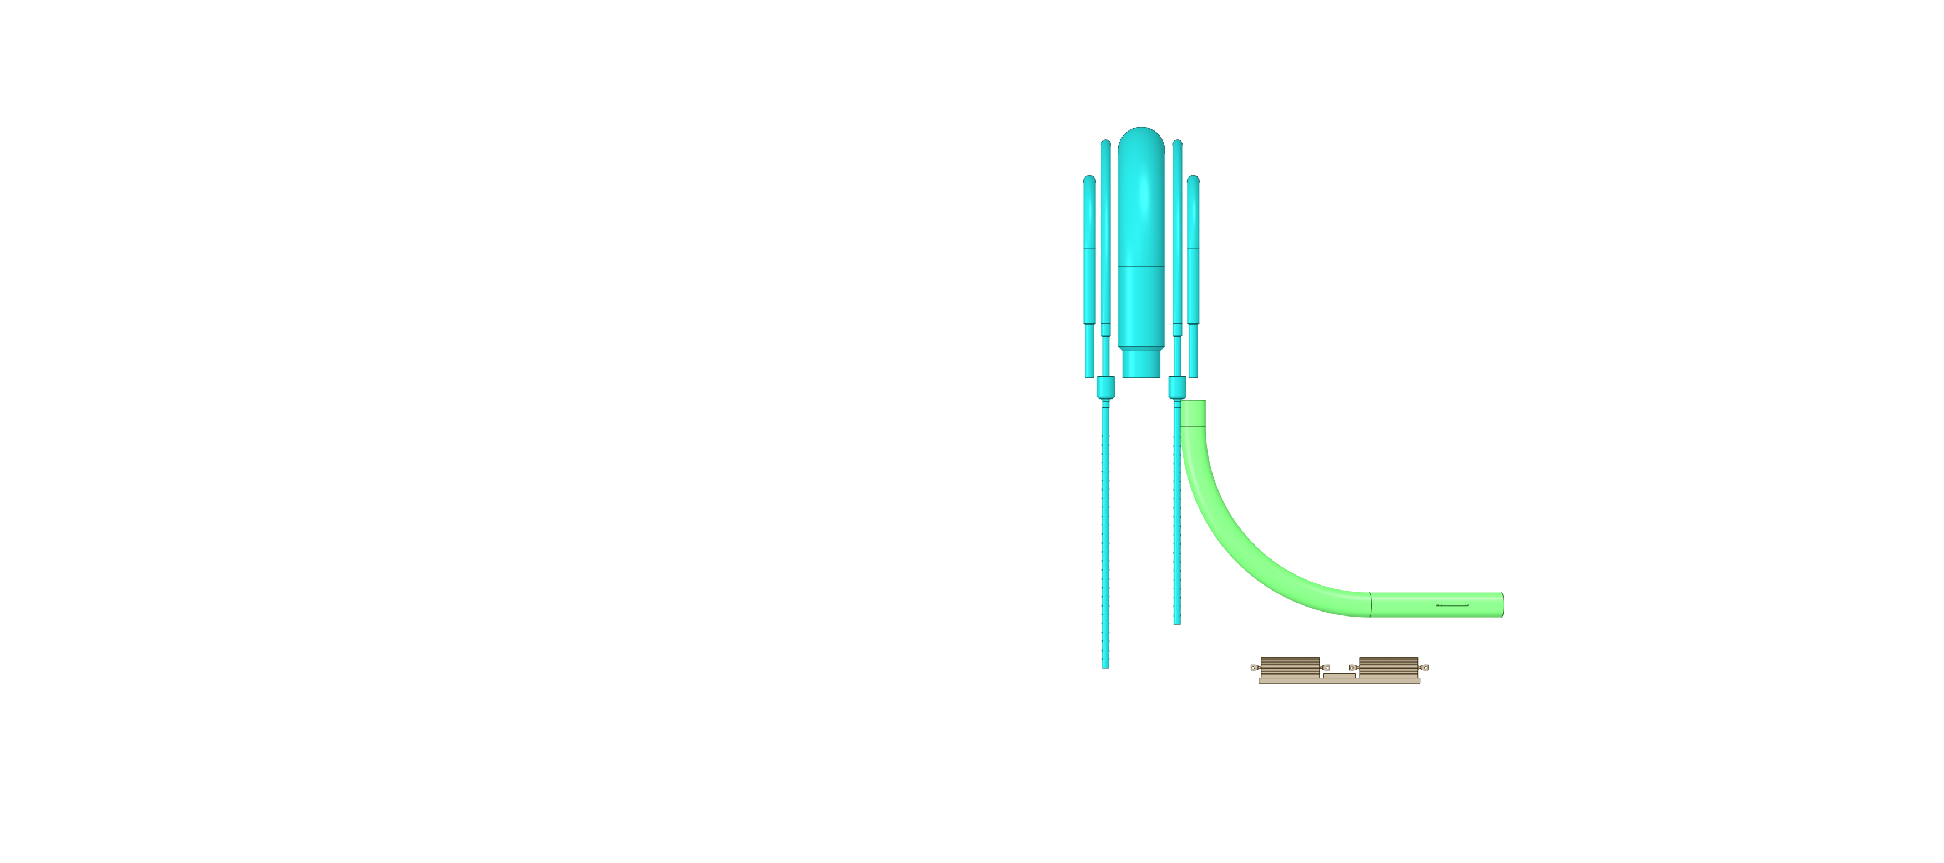
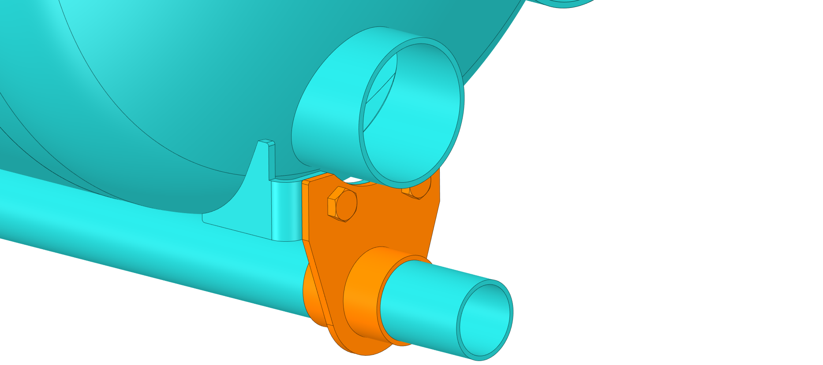
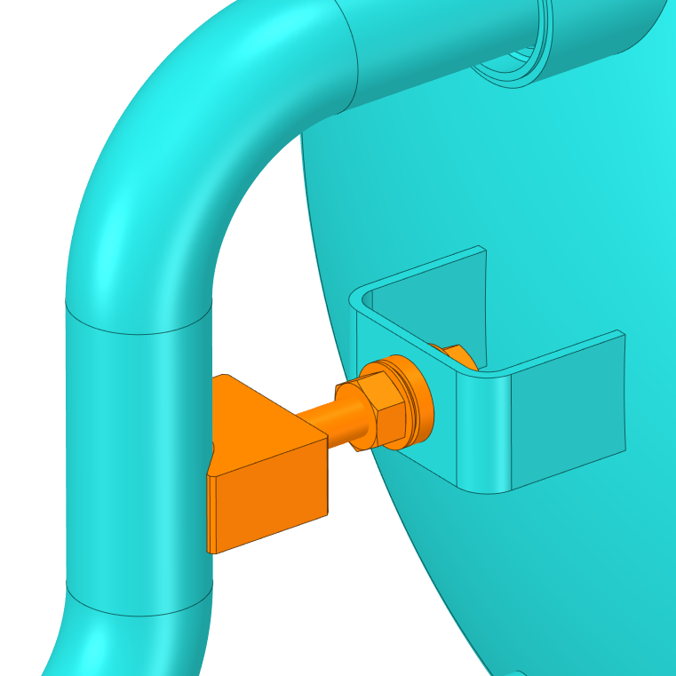
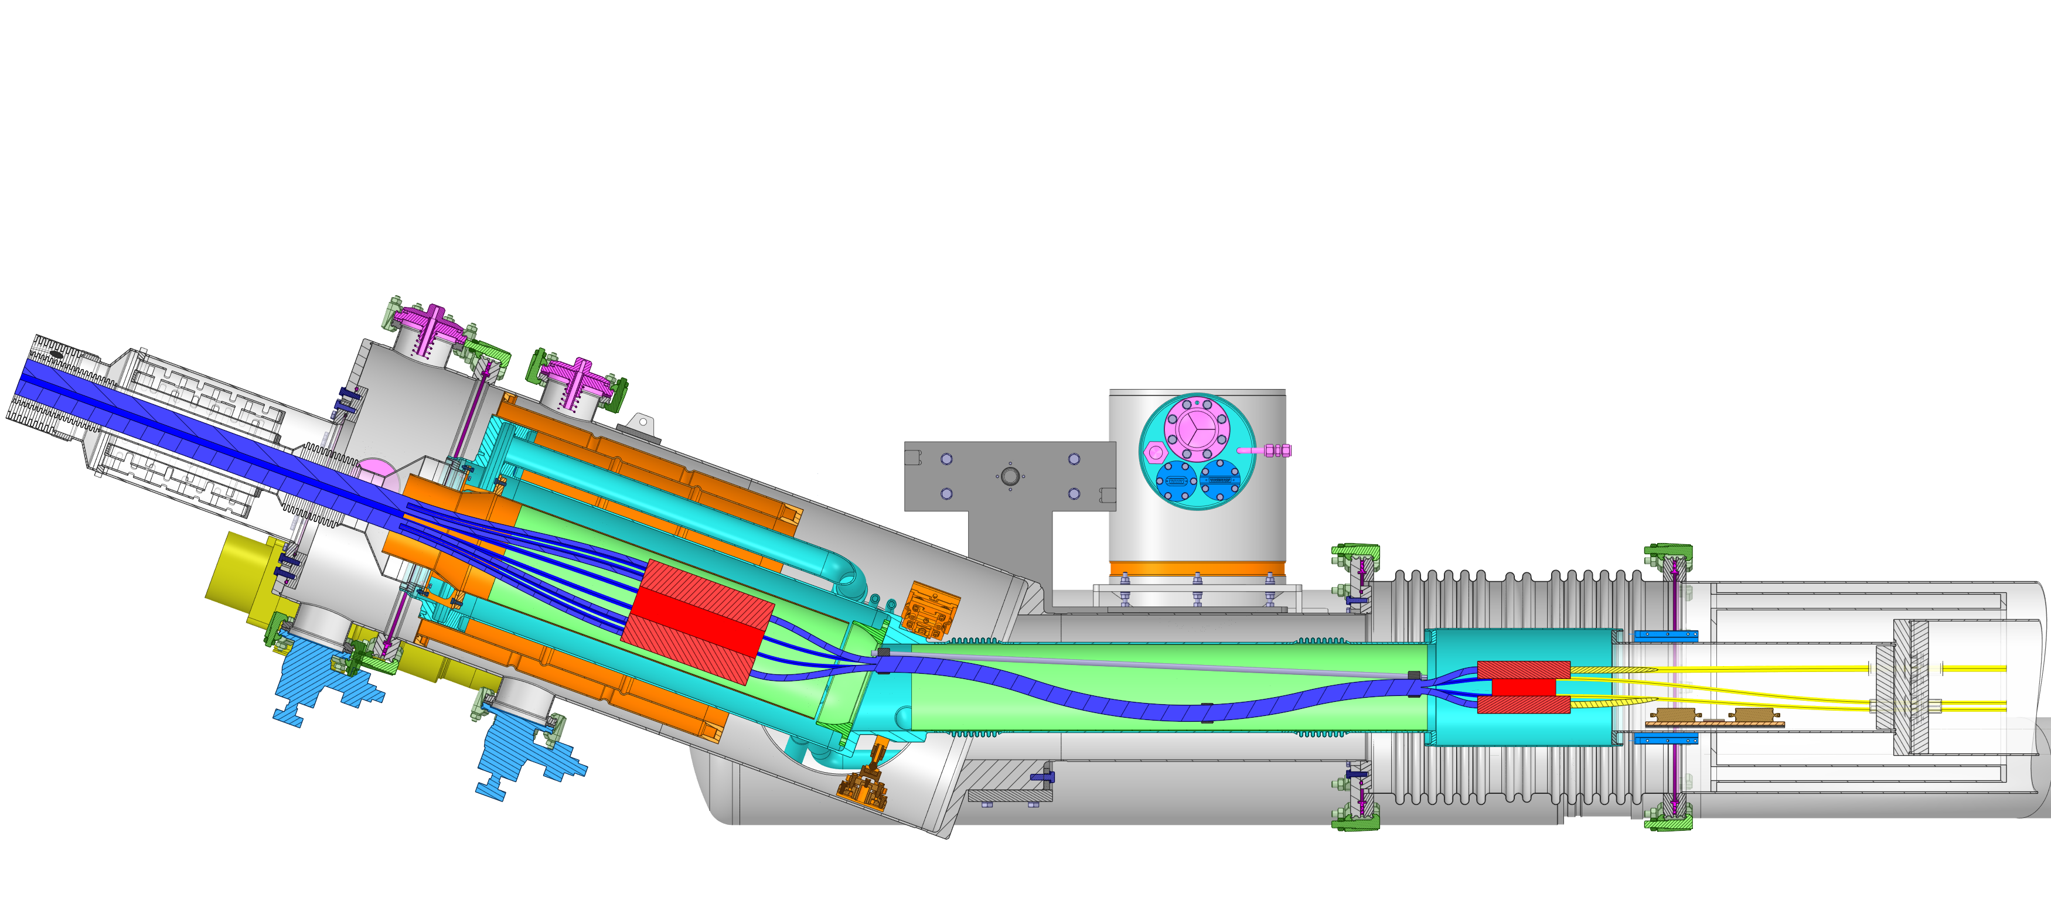

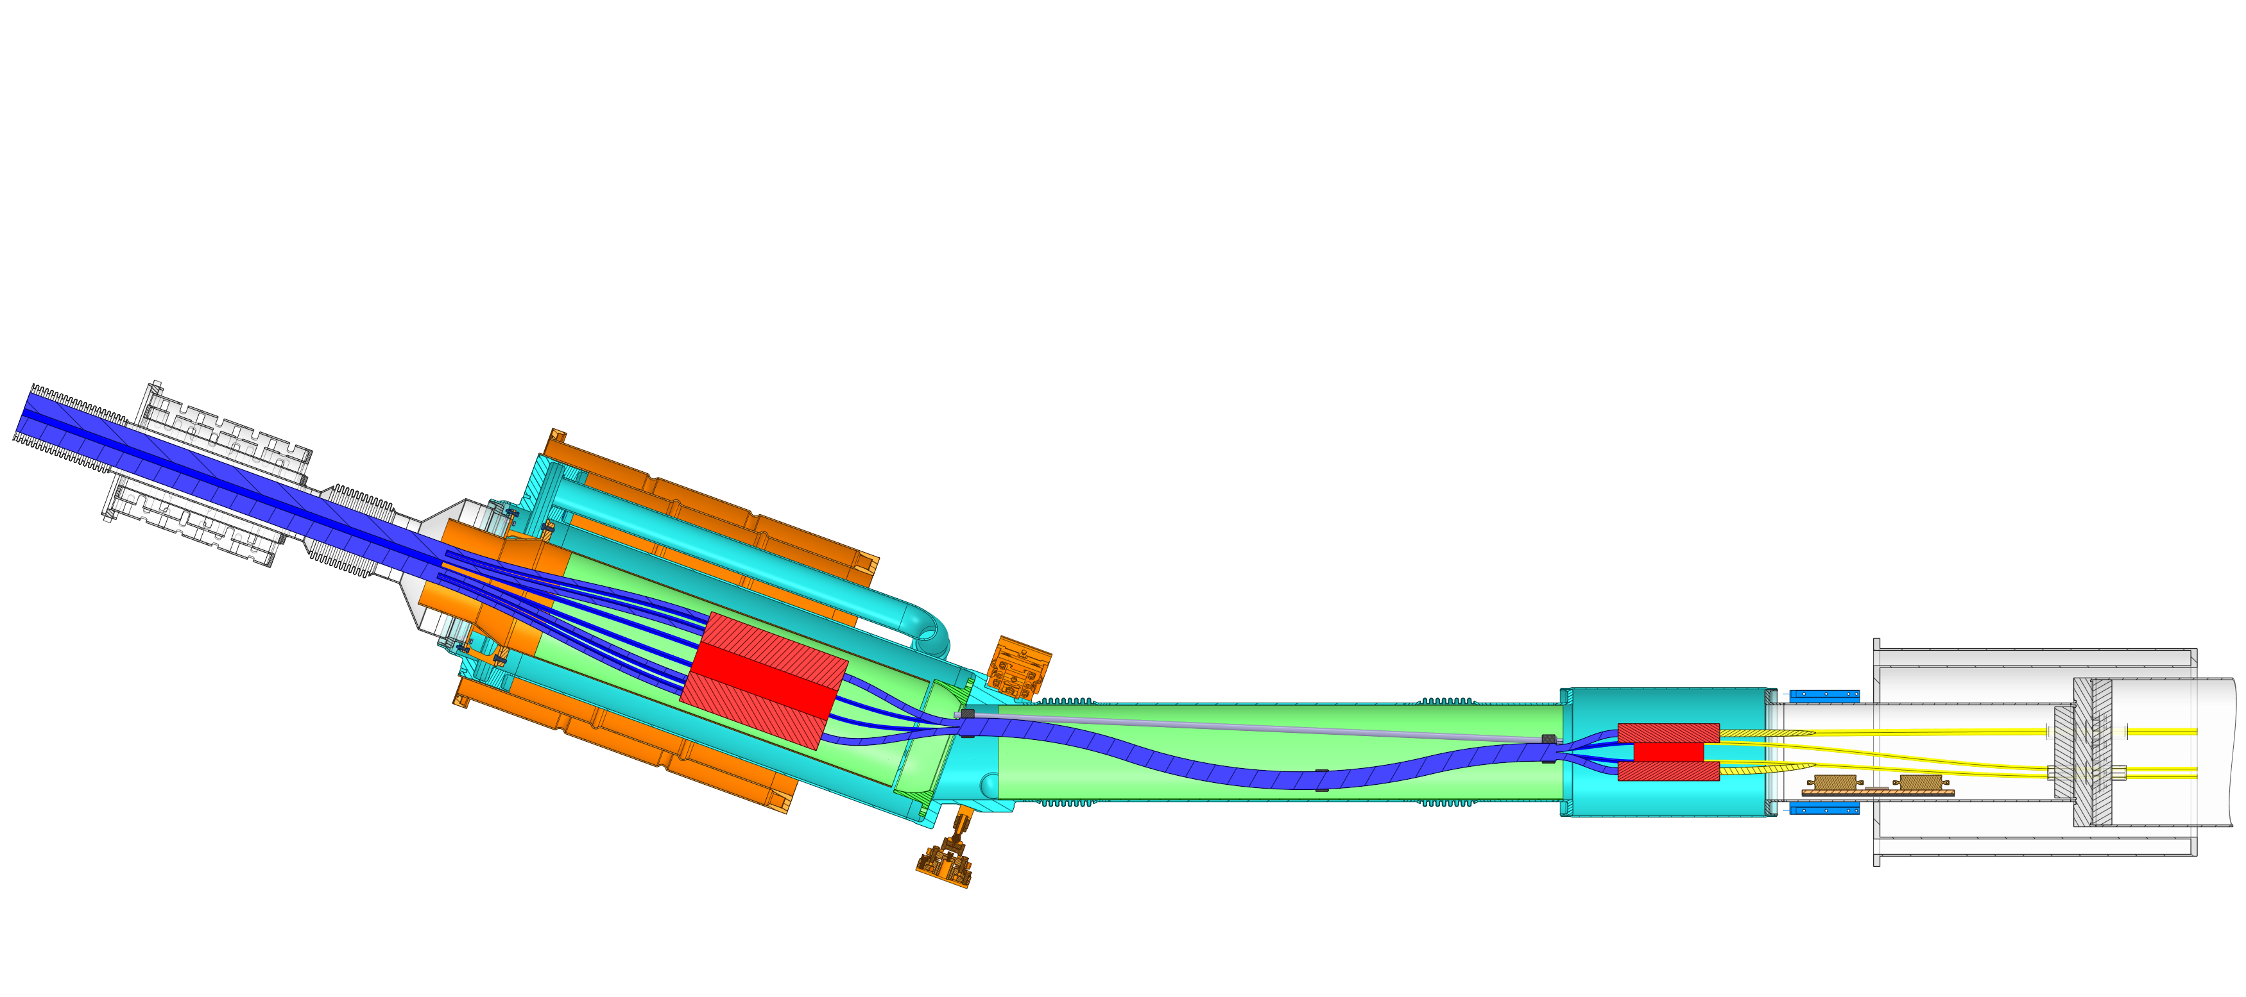
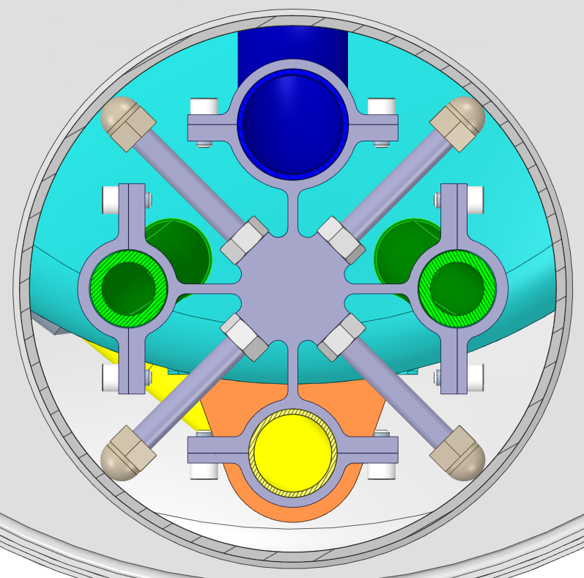
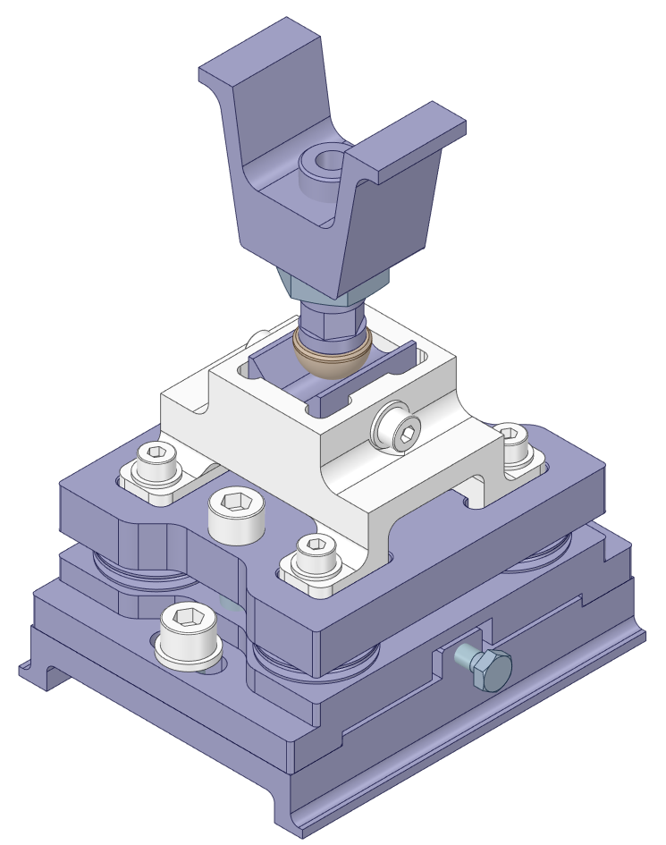
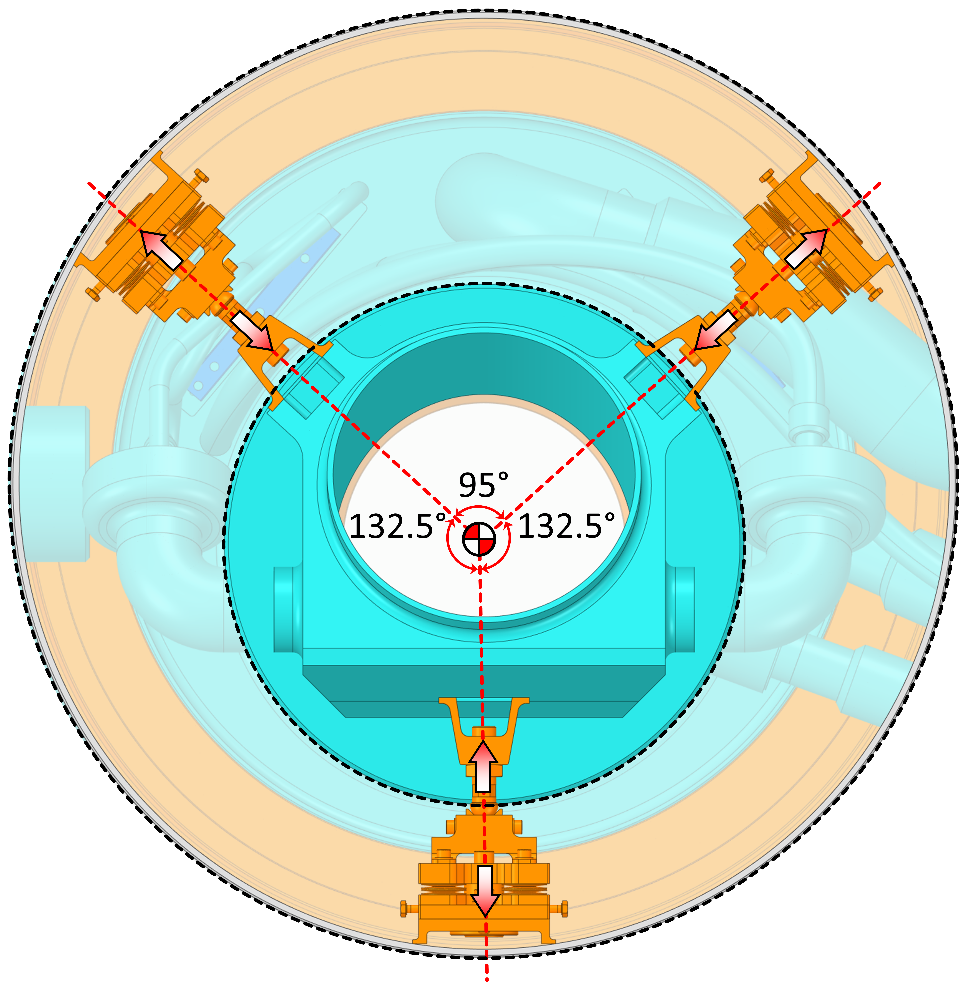
In-vessel support system design overview
  Boiler module
  One point constraint layout
    Fixation point @ the top (suspension layout)
    Dedicated fixtures for supporting cryo-lines
  Splice module
  Two points constraint layout
    Fixation point @ vacuum\thermal barrier
    Slide connection @ helium connection flange
Tie Bracket
Thrust Support
Thermal barrier
Fixed support
Centering ring
Boiler Module
_{A - A}
Slide Support
Helium
Connection Flange
Ghe Deflector
Vacuum\Thermal Barrier
Splice Module
Slide Support
_{A}
Vacuum
Vessel
Cable Entry Guide
Slide Support
Slide Support
_{A}
Electrical Insulator Sleeve

Slide 8
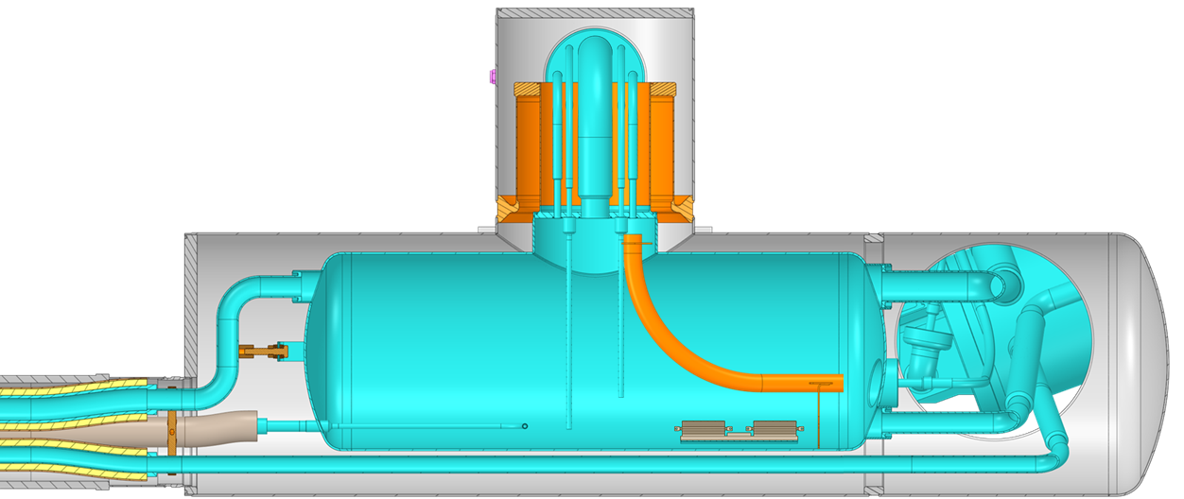
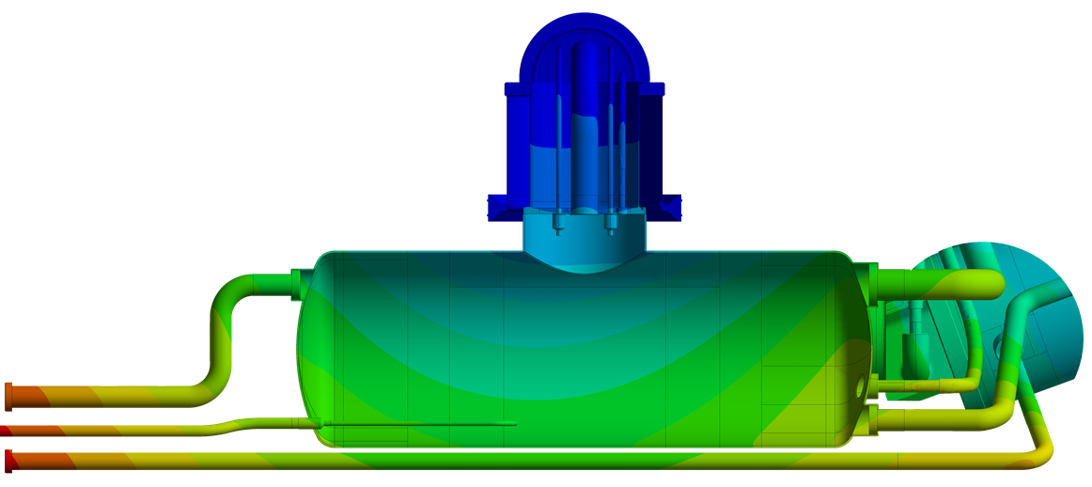
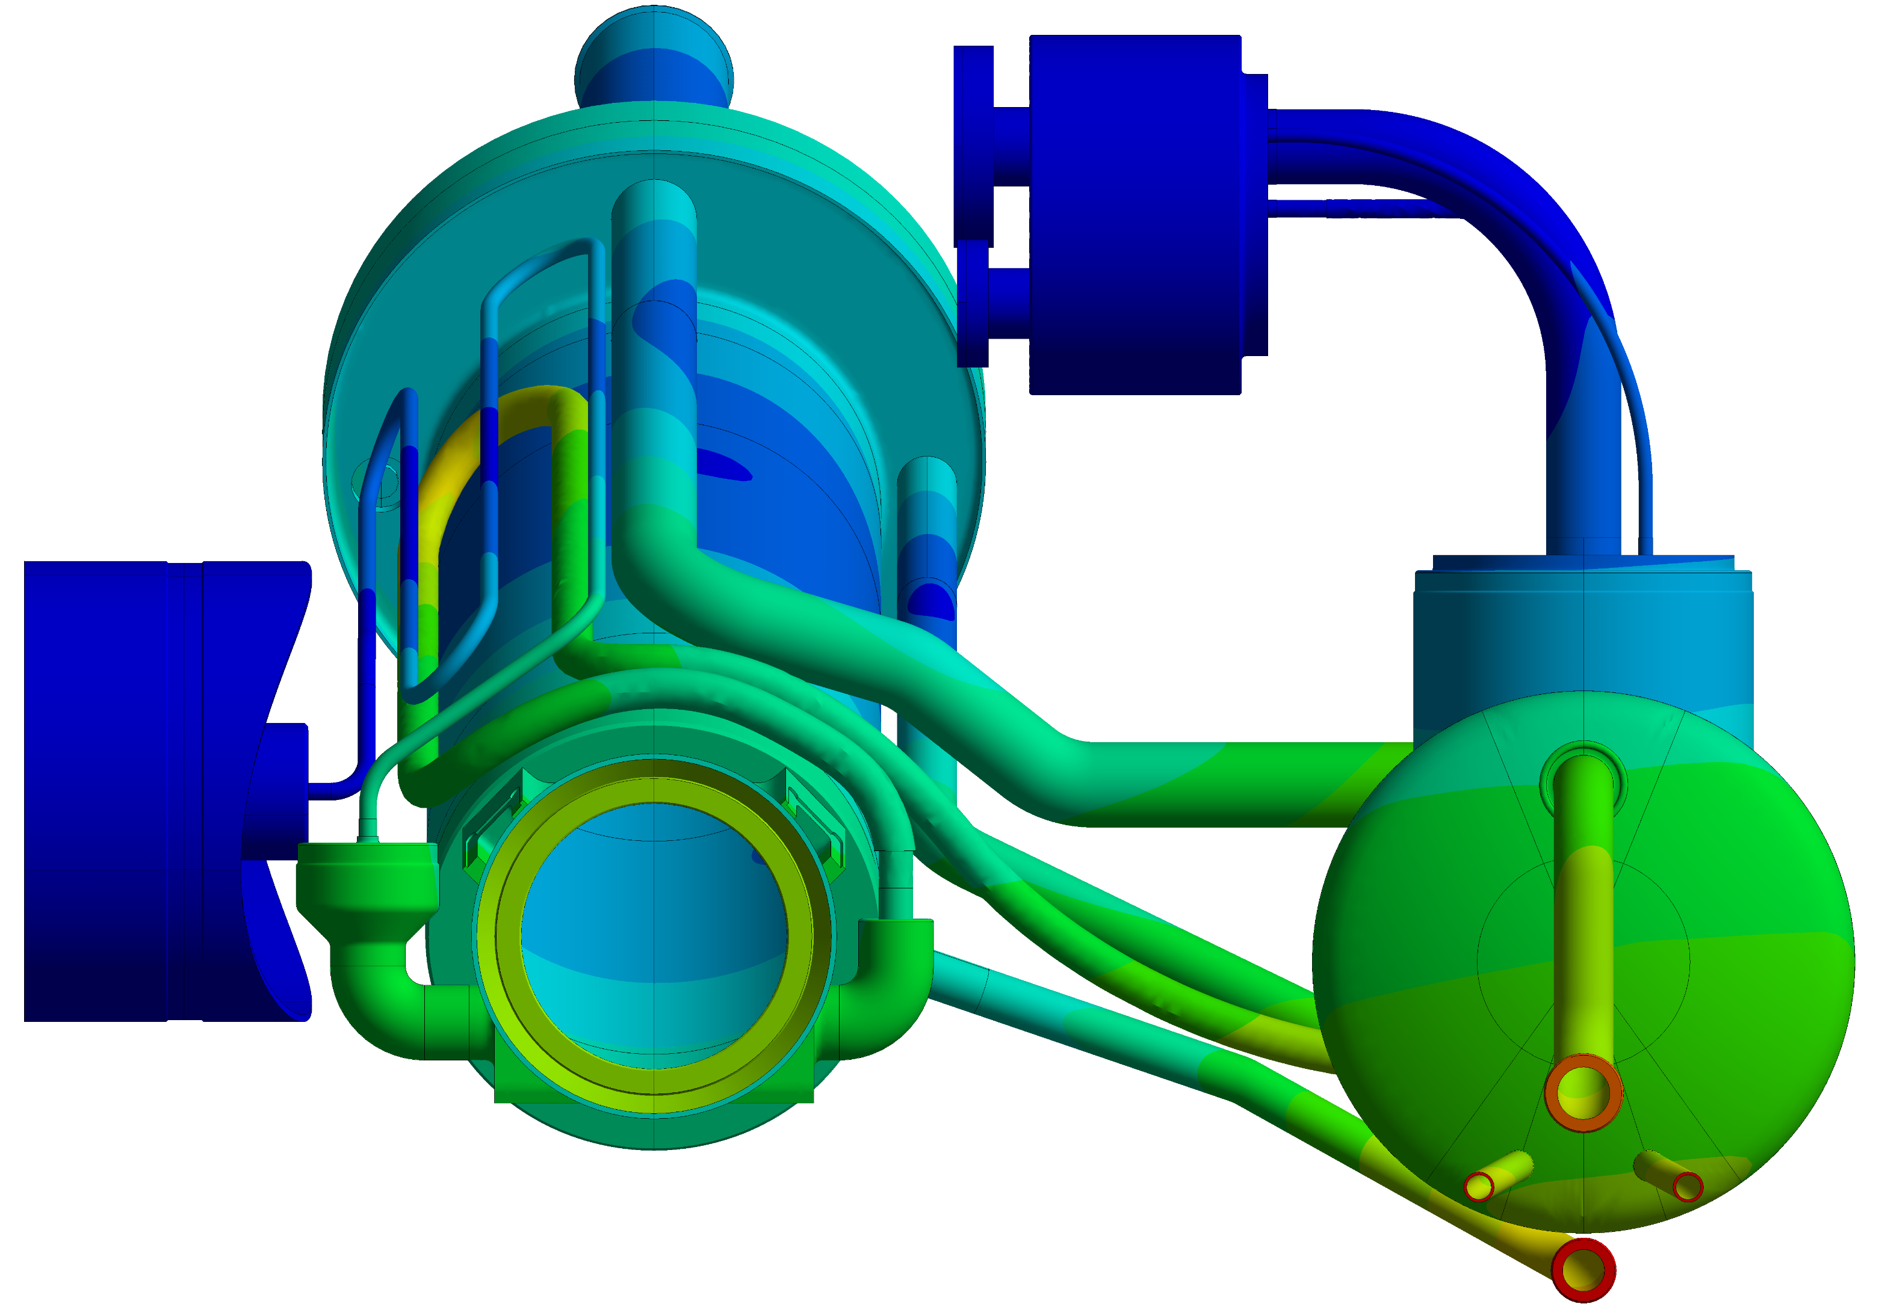
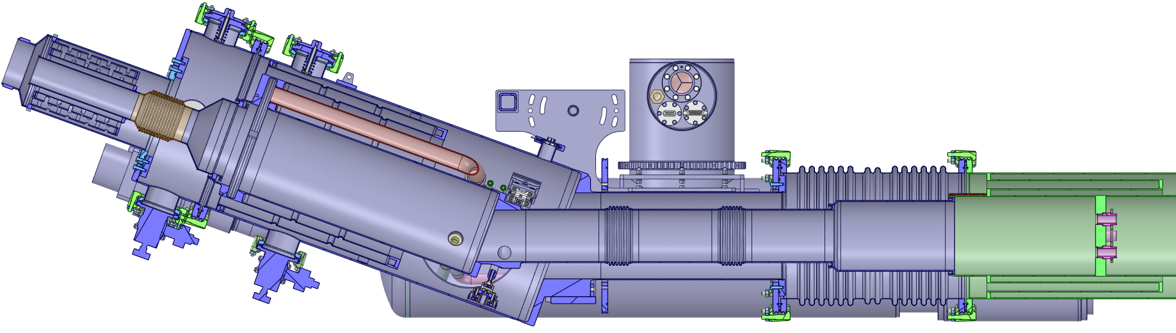
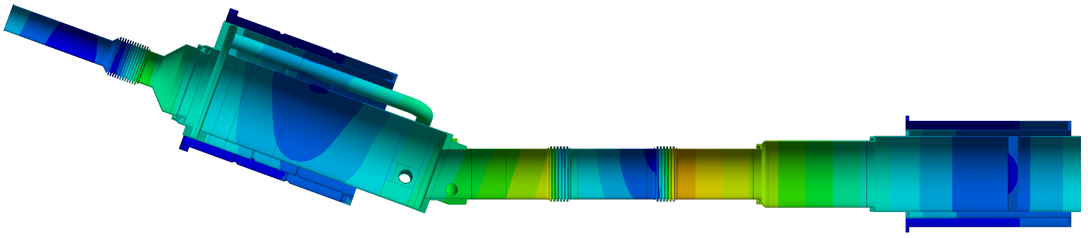
Cryogenic : thermal contraction
Splice Module
  Fixed point @ SM vacuum barrier & D2 vacuum barrier
  Sliding point @ helium connection flange
  Universal expansion joint between SM & D2
    Structurally “decoupling” D2 from DFM
Boiler Module
  Fixed point @ thermal barrier
Cryo-Connections
  Flexibles in between SM & BM containing extra-length
  Flexibles in between BM & QXL containing extra-length
Boiler Module
Thermal barrier
Fixed support
0.6 mm
1.2 mm
1.5 mm
1.2 mm
DFM to QXL
cryo-connections
SM to BM
cryo-connections
Cable Module
DSHM
D2
Thermal\Vacuum barrier
Fixed support
1.8 mm
2.5 mm
0.7 mm
Universal expansion joint
Thermal\Vacuum barrier
Fixed support
0.02 mm

Slide 9
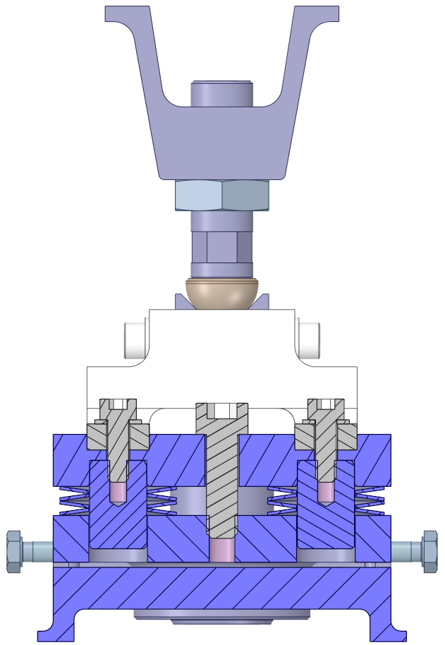
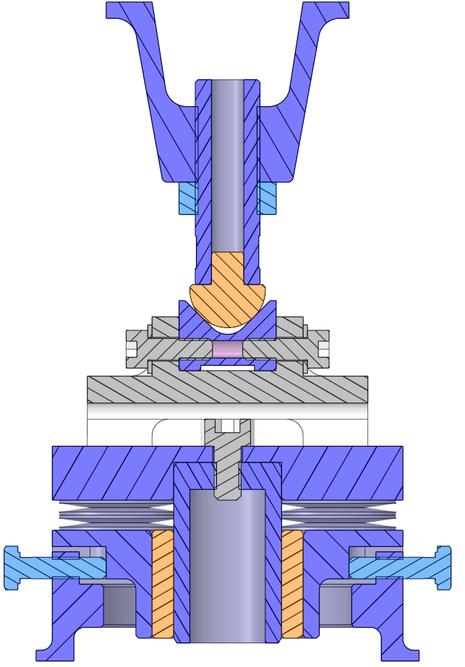
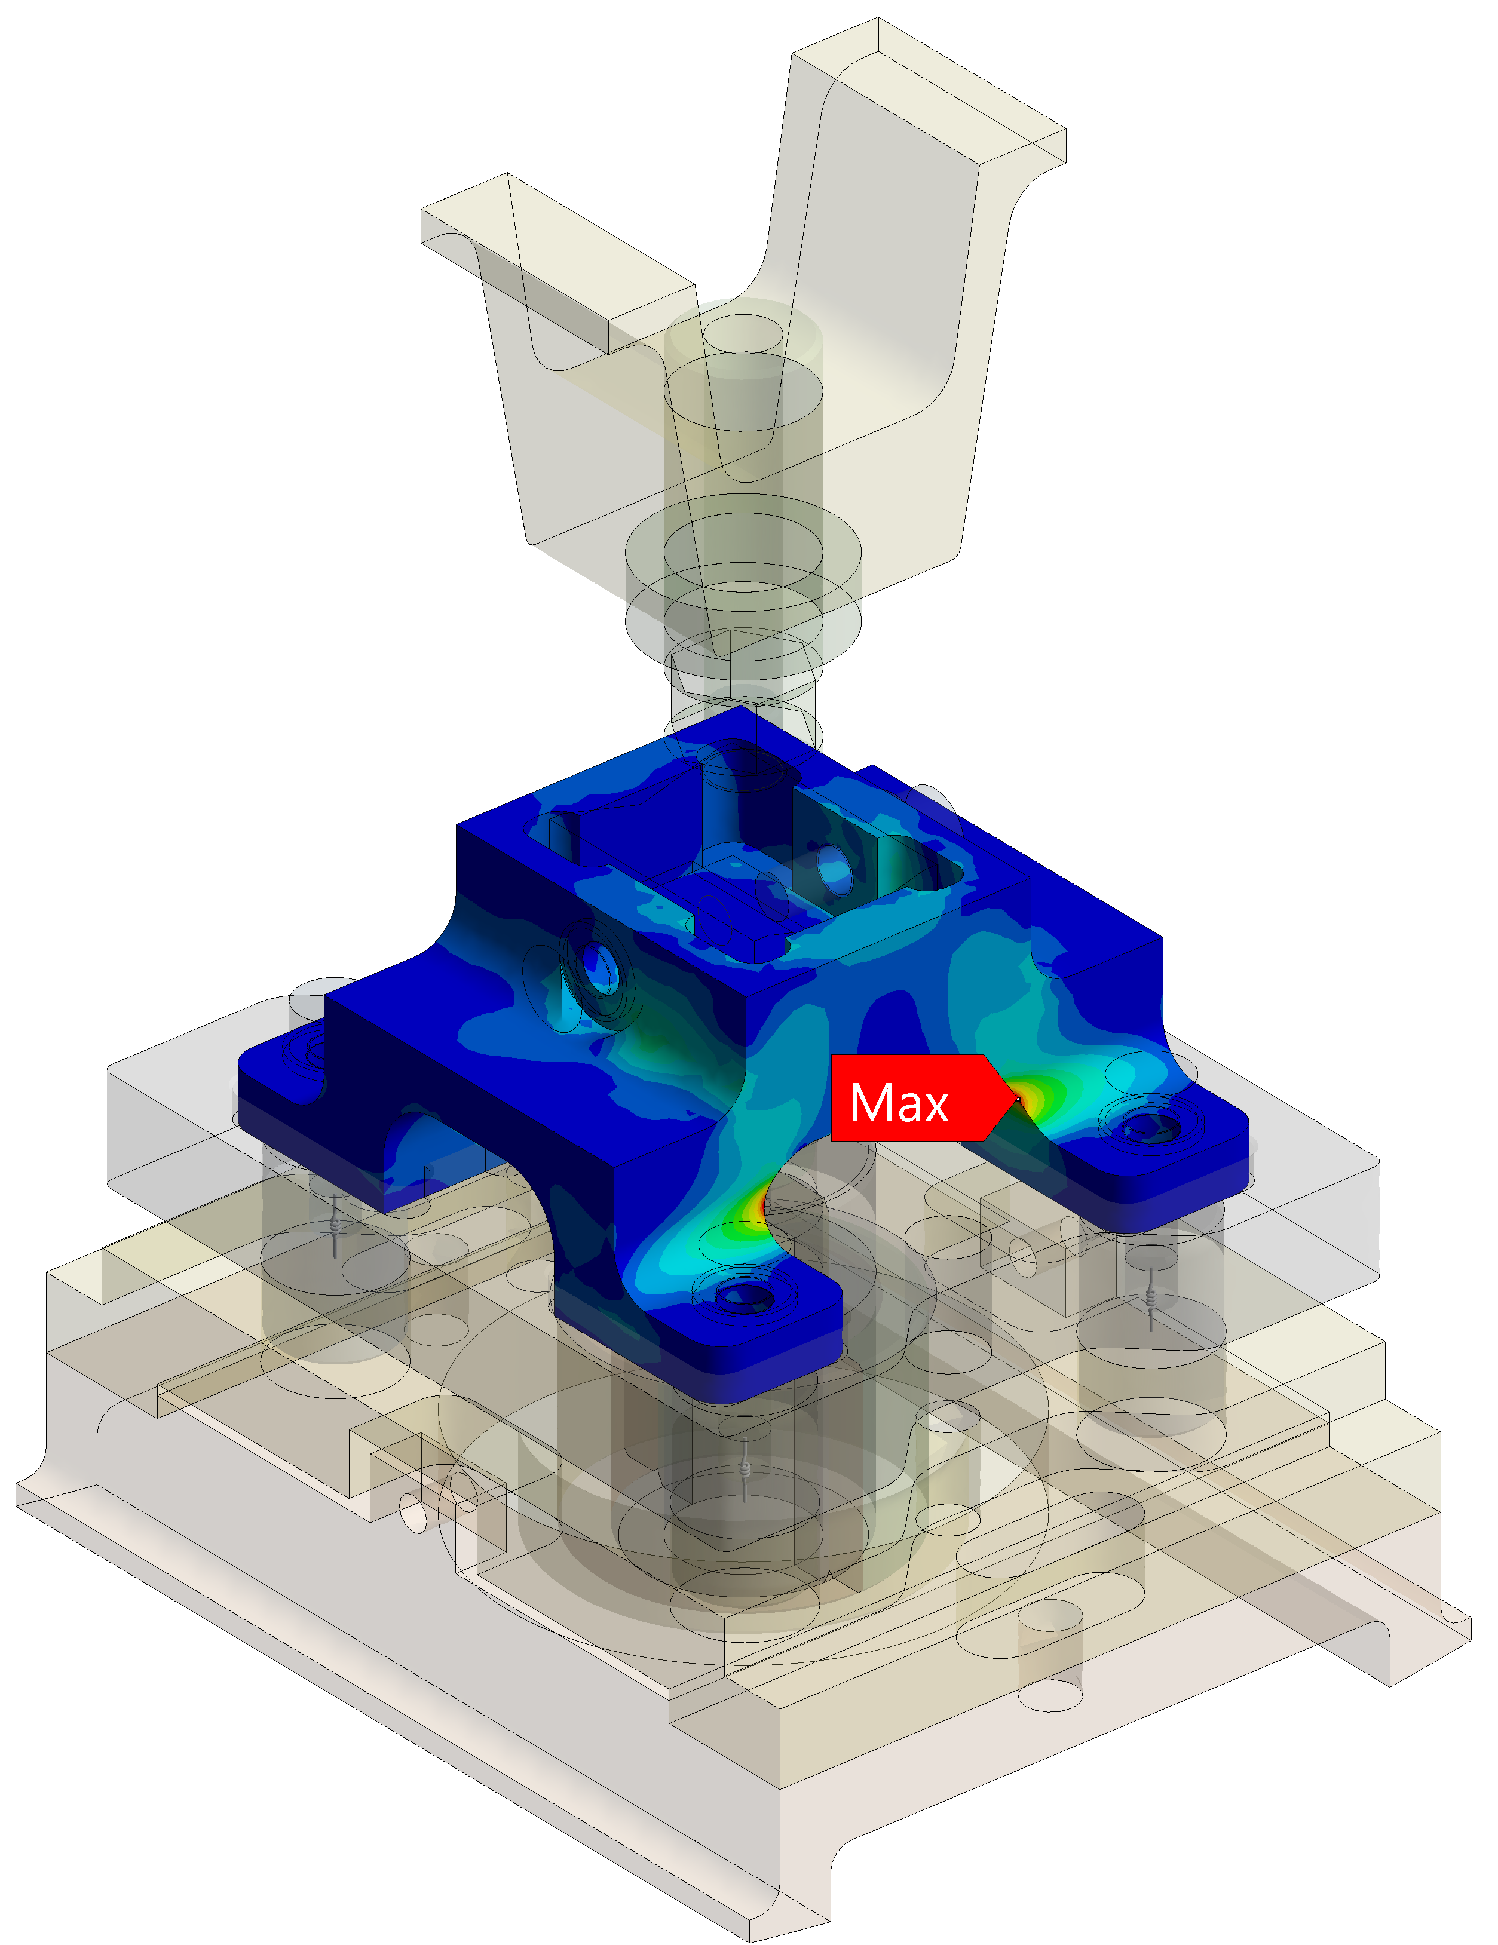
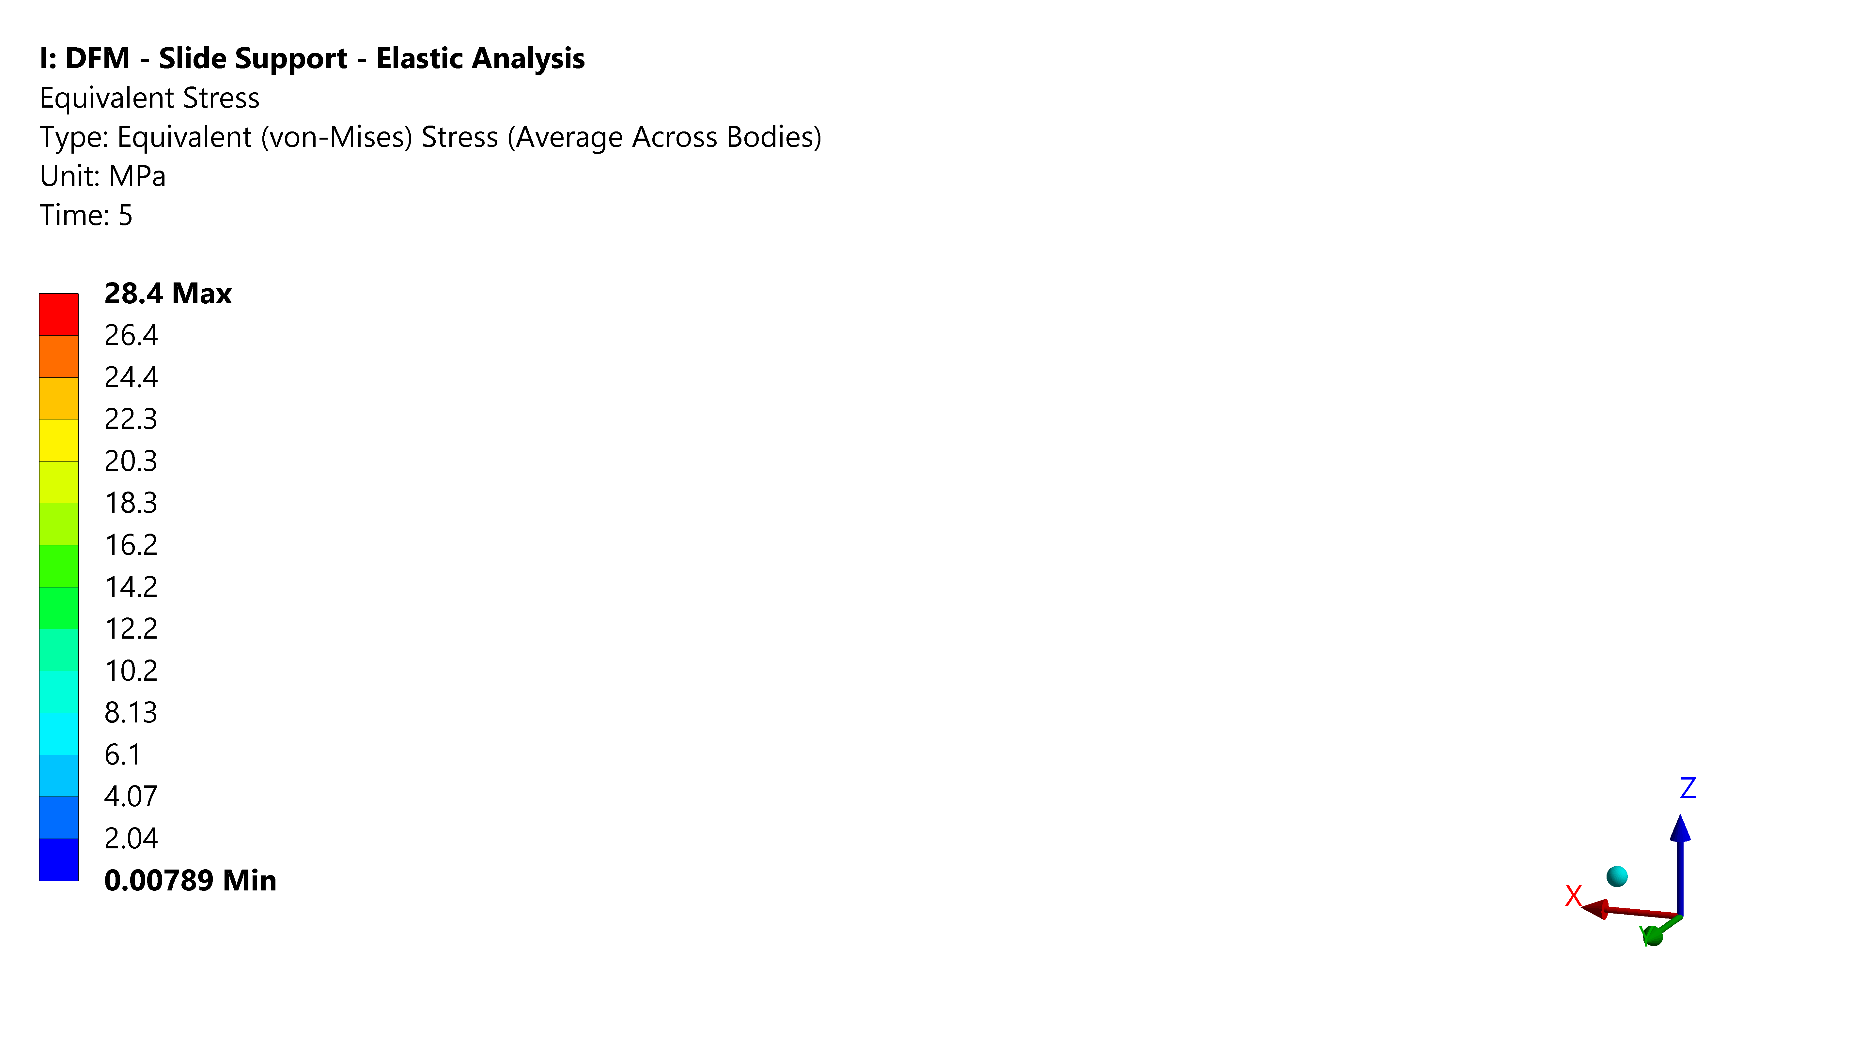
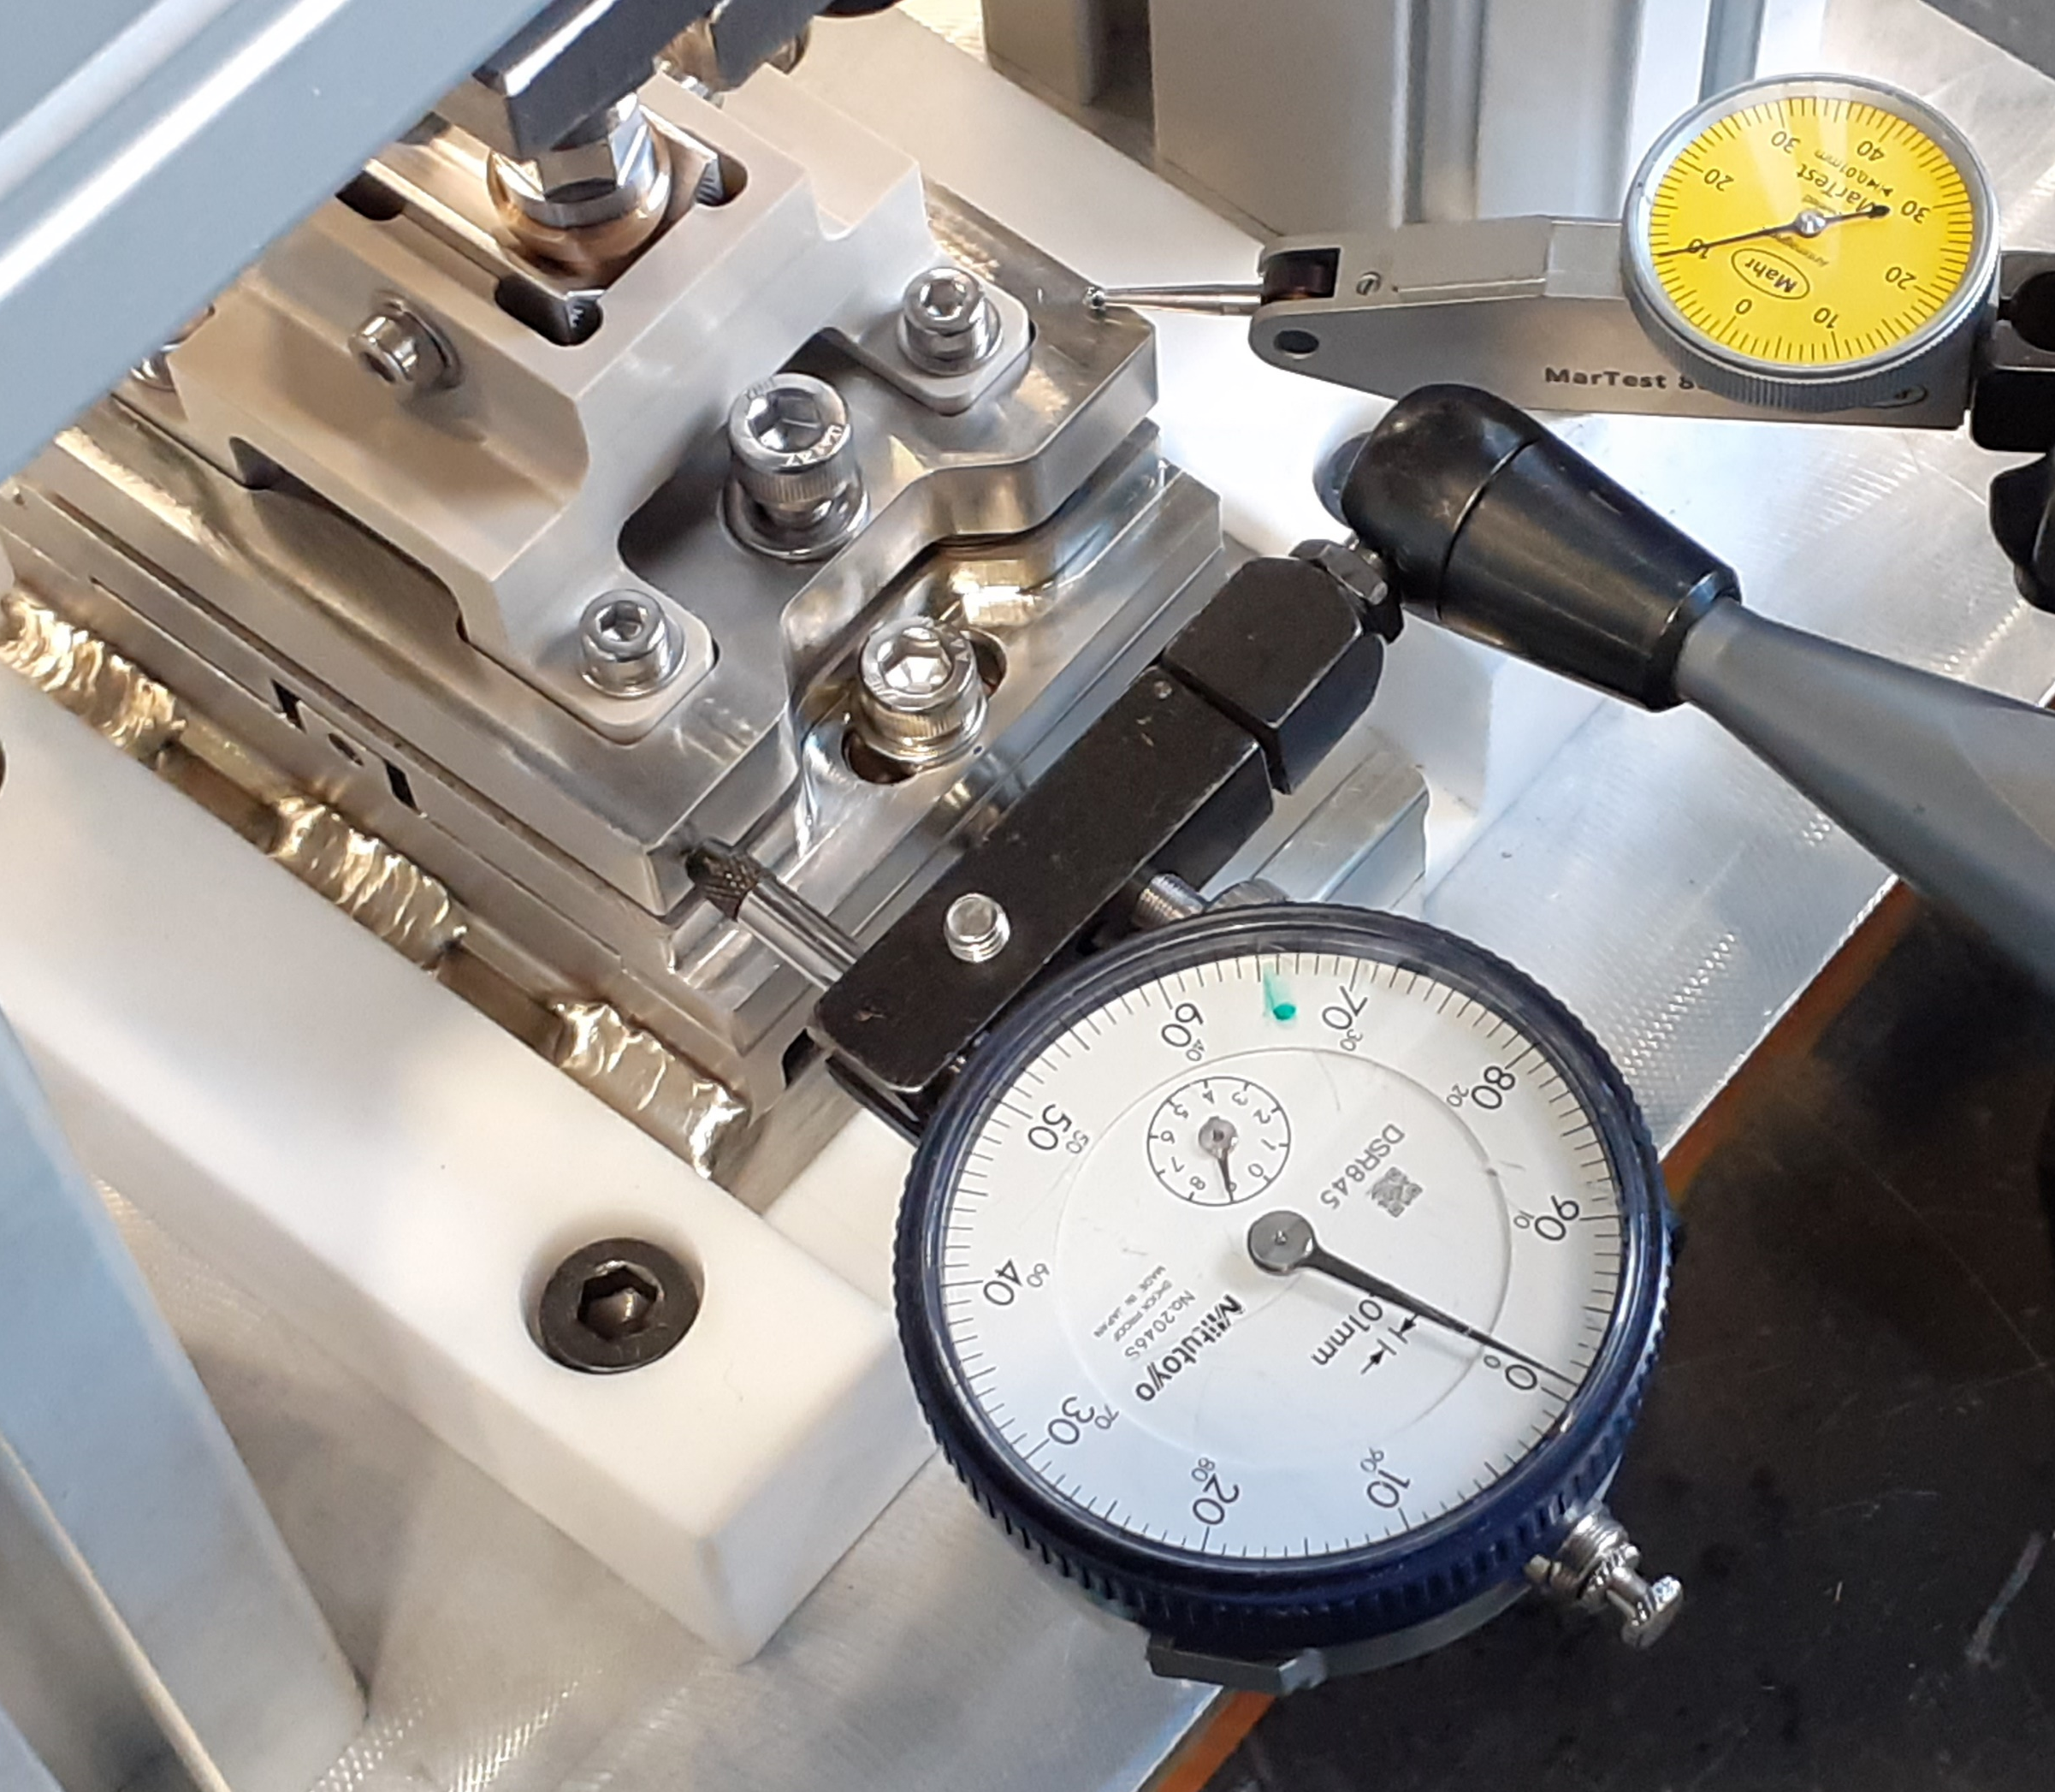
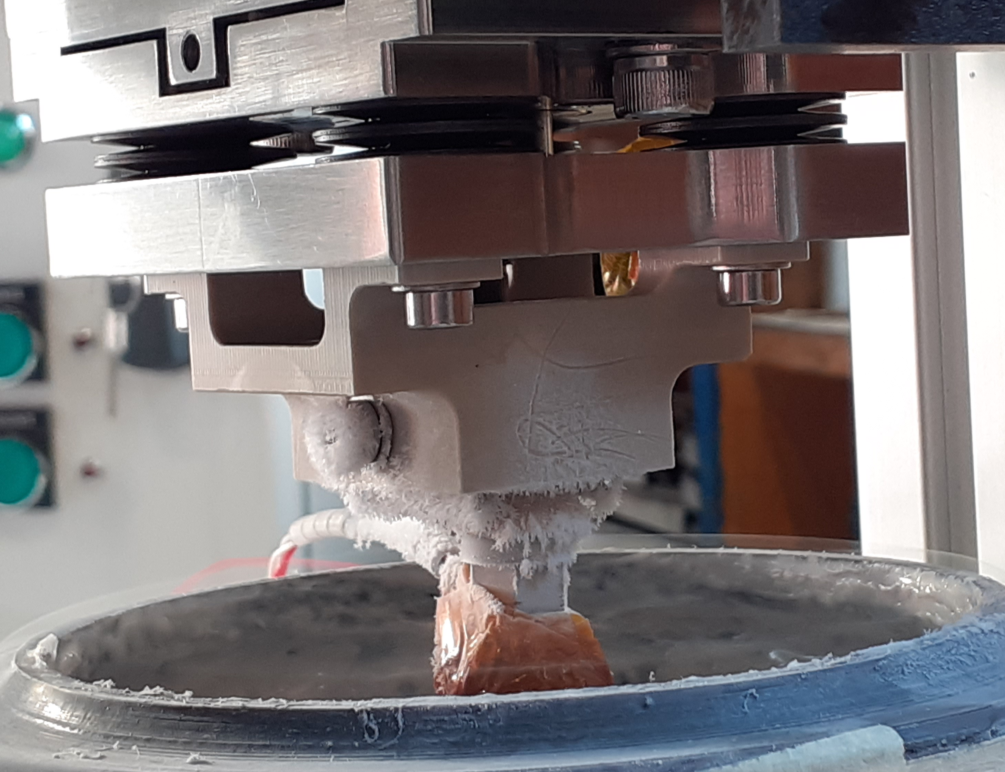
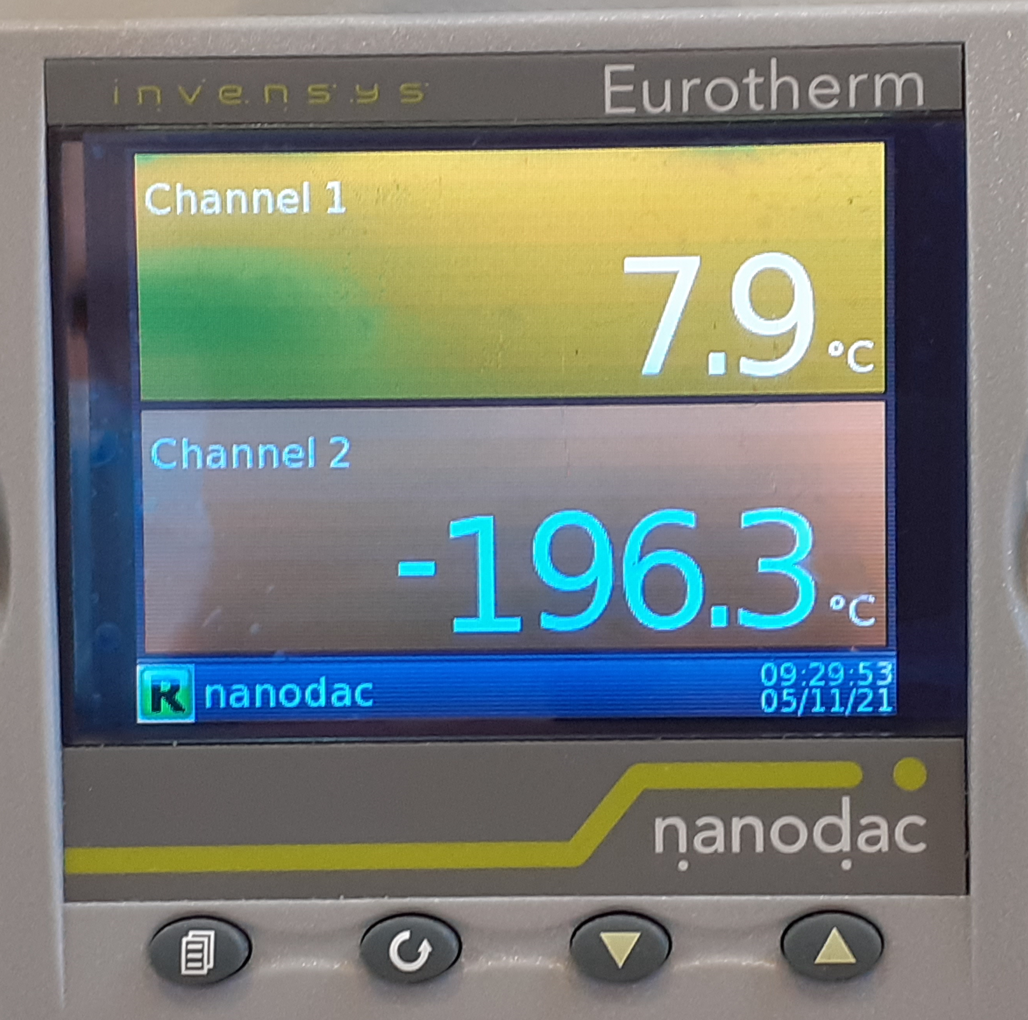
DFM Splice Module : Slide Support Design
Scope : rigidify cold-mass & avoid overstressing the vacuum barrier
Key design features
  Three independent slide supports distributed around CM circumference
  Slide support
    Spring-preloading system to compensate CM thermal contraction
    PEEK block to insulate CM
Design validation
    Measured of PEEK deformation @ warm under design load
    Verified sliding principle under design load
    Verified mechanical strength of PEEK @ cold under design load
Thrust Bracket
welded to cold-mass
Spherical Tip Bronze
Insulation Block
Peek
Anti-Slip V Pad
Preloading Screw
Belleville Washer Stack (x4)
Mobile Plate
Guide Plate
Support Plate
welded to vacuum vessel
Guiding Pin
Bushing
Bronze
Dedicated FEM analysis of the slide support
Test @ warm
Test @ cold

Slide 10
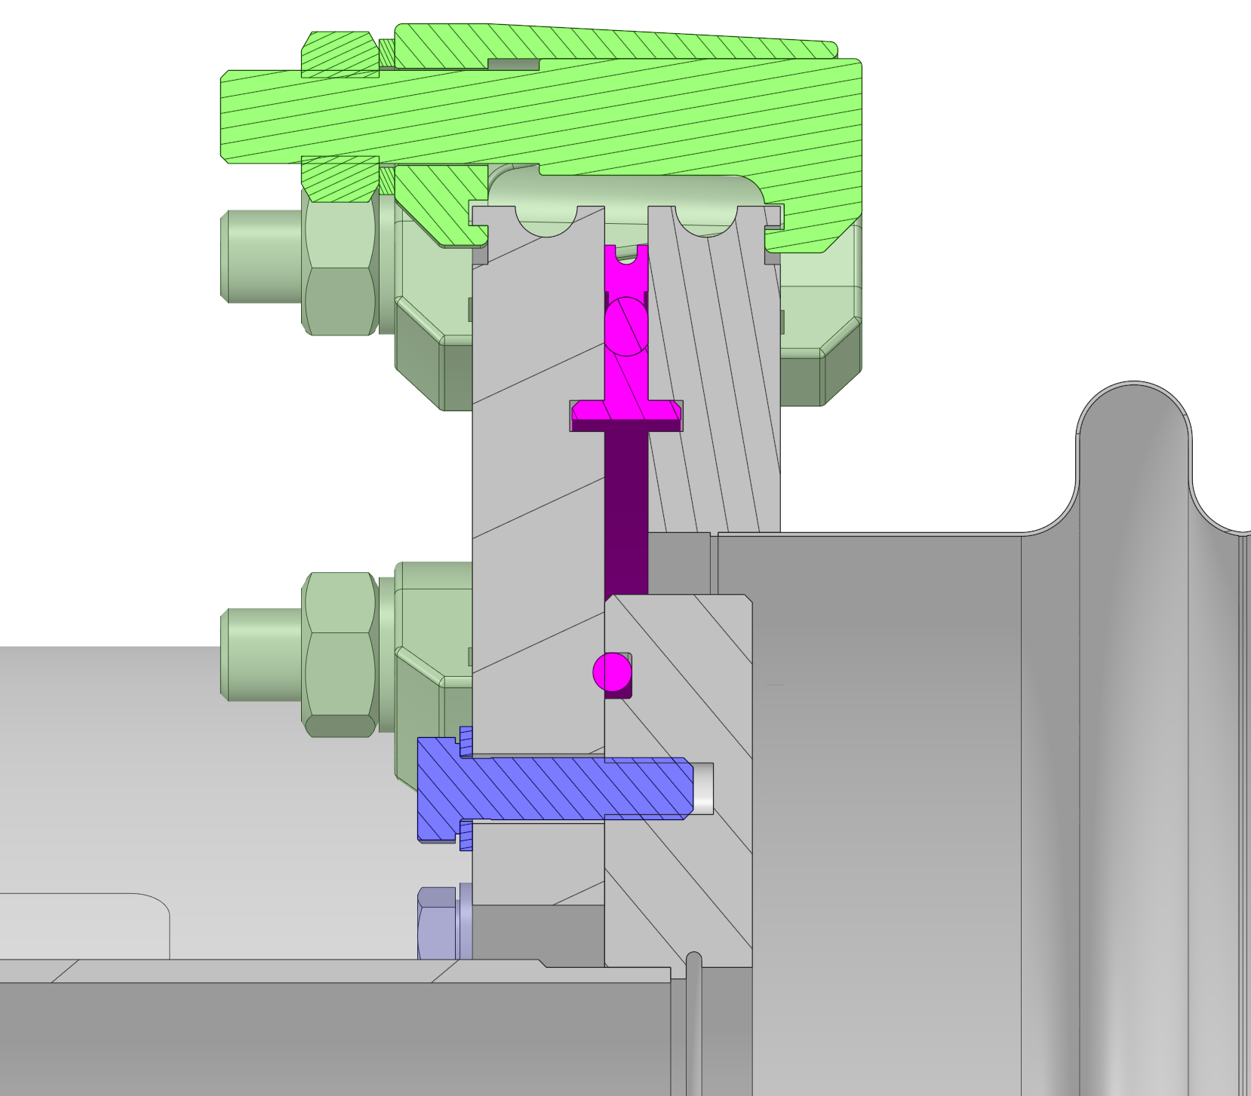
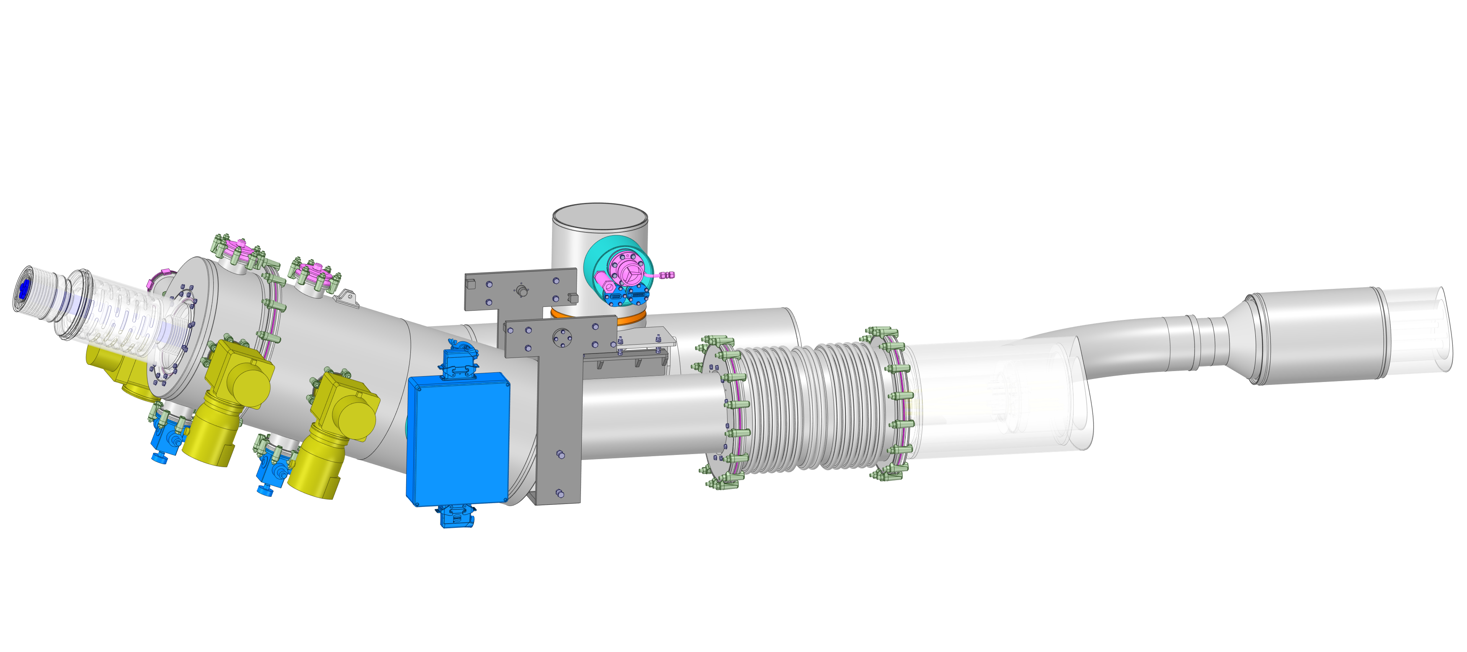
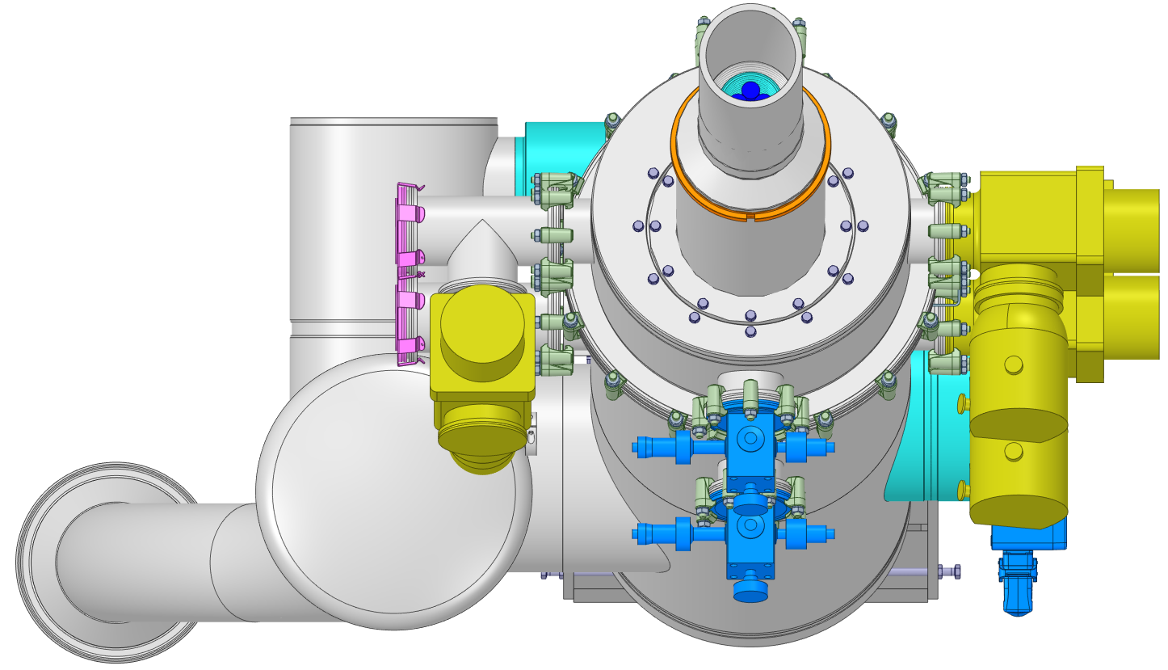
Insulation Vacuum & External Interfaces
Insulation vacuum
  Two insulation vacuum volumes
    One in common with DSHM
    One in common with jumper
  Vacuum Barrier with DSHM & D2
  Vacuum equipment
    Ports for installing pumping system & vacuum gauges
    Ports for installing pressure relief devices
    Port for installing vacuum instrumentation (feedthrough)
  Leak tightness
  O-ring Viton seal compressed to 25% to 30%
  Standard commercial solutions where possible
Mechanical design approach
  Vacuum vessel according to EN 13445-3
  Bellows according to EN 14917+A1
Insulation vacuum specifications | Unit | Value
Nominal pressure | [mbar] | 1.10⁻⁶
Design pressure | [bara] | 1.49
Maximum allowed leak rate at RT acc. to [19] Liquid Helium volume to insulation vacuum Air to insulation vacuum Through DFM-DSHM vacuum barrier | [mbar.l.s⁻¹] | 1.10⁻⁹ 1.10⁻⁸ 1.10⁻⁸
ISO Clamps
Interconnection sleeve
Floating flange with 2nd seal
Viton O-ring Ø5 mm
25-30 % compression
Spring loaded valves
DSHM
Feedthrough
Spring relief plates
Jumper interface
Vacuum sleeve to access cryo-lines
Vac. Valves & Gauges
D2-DFM Interlink
Pumping system
IFS Panel
Interconnection sleeve
Bellows free to expand in case of cold leak

Slide 11
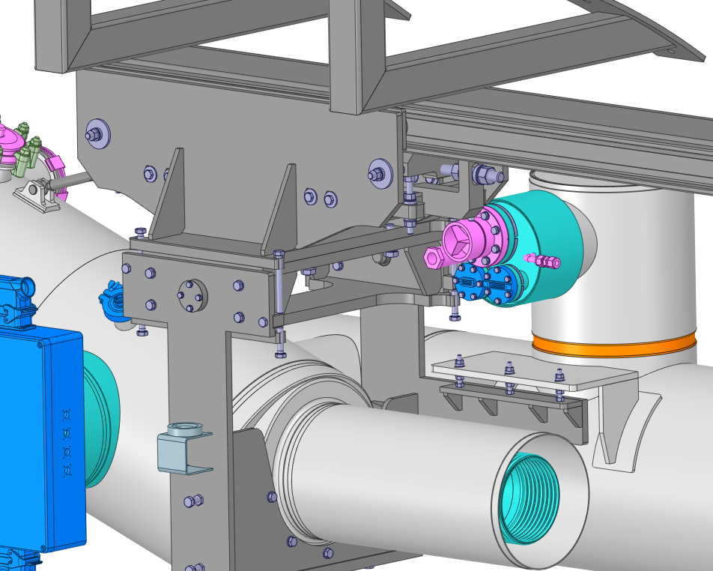
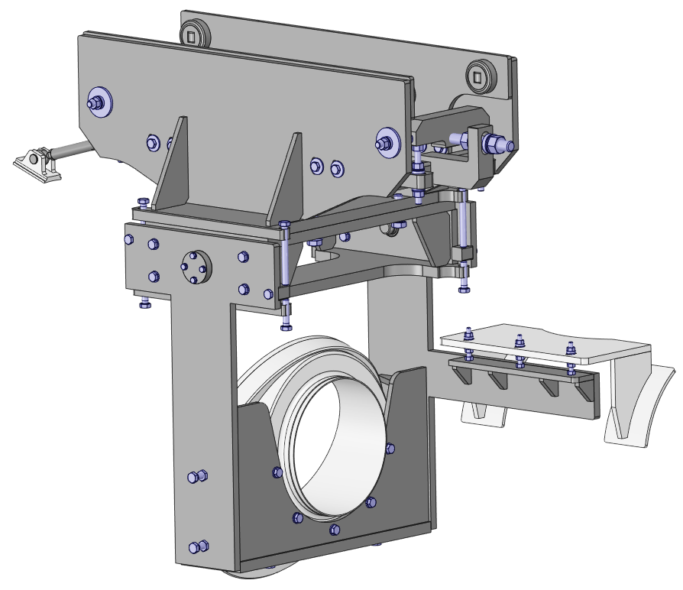
External frame design overview
Tunnel Interfaces
Design 90% for location 5R
Key design features
  Cryostat suspended from tunnel’s surface
  2 DOFs kinematic requirement for DSHM installation
Support system composed of three units
  Rail : Fastened to tunnel surface
    Aligned wrt referential during fixation to tunnel roof
  Trolley : sliding over the rail by means of wheels
    Locking system to hold the cryostat in position along the rail
    Swivel connection (tie rod end) with SM vacuum vessel
  Tilting cradle : connected to cryostat & trolley
    Primary bolted interface at vacuum connection flange of SM
    Bolted interface with the BM through dedicated extension arm
    Rotatable connection with trolley + push-pull locking system
Trolley
Rail
Titling Cradle
Wheel
Trolley
Trolley
locking system
Swivel Connection
Pivoting Axis
Push-Pull
locking system
Titling Cradle
Extension arm
Bolted connection (Connection vacuum flange)
Connection vacuum flange

Slide 12
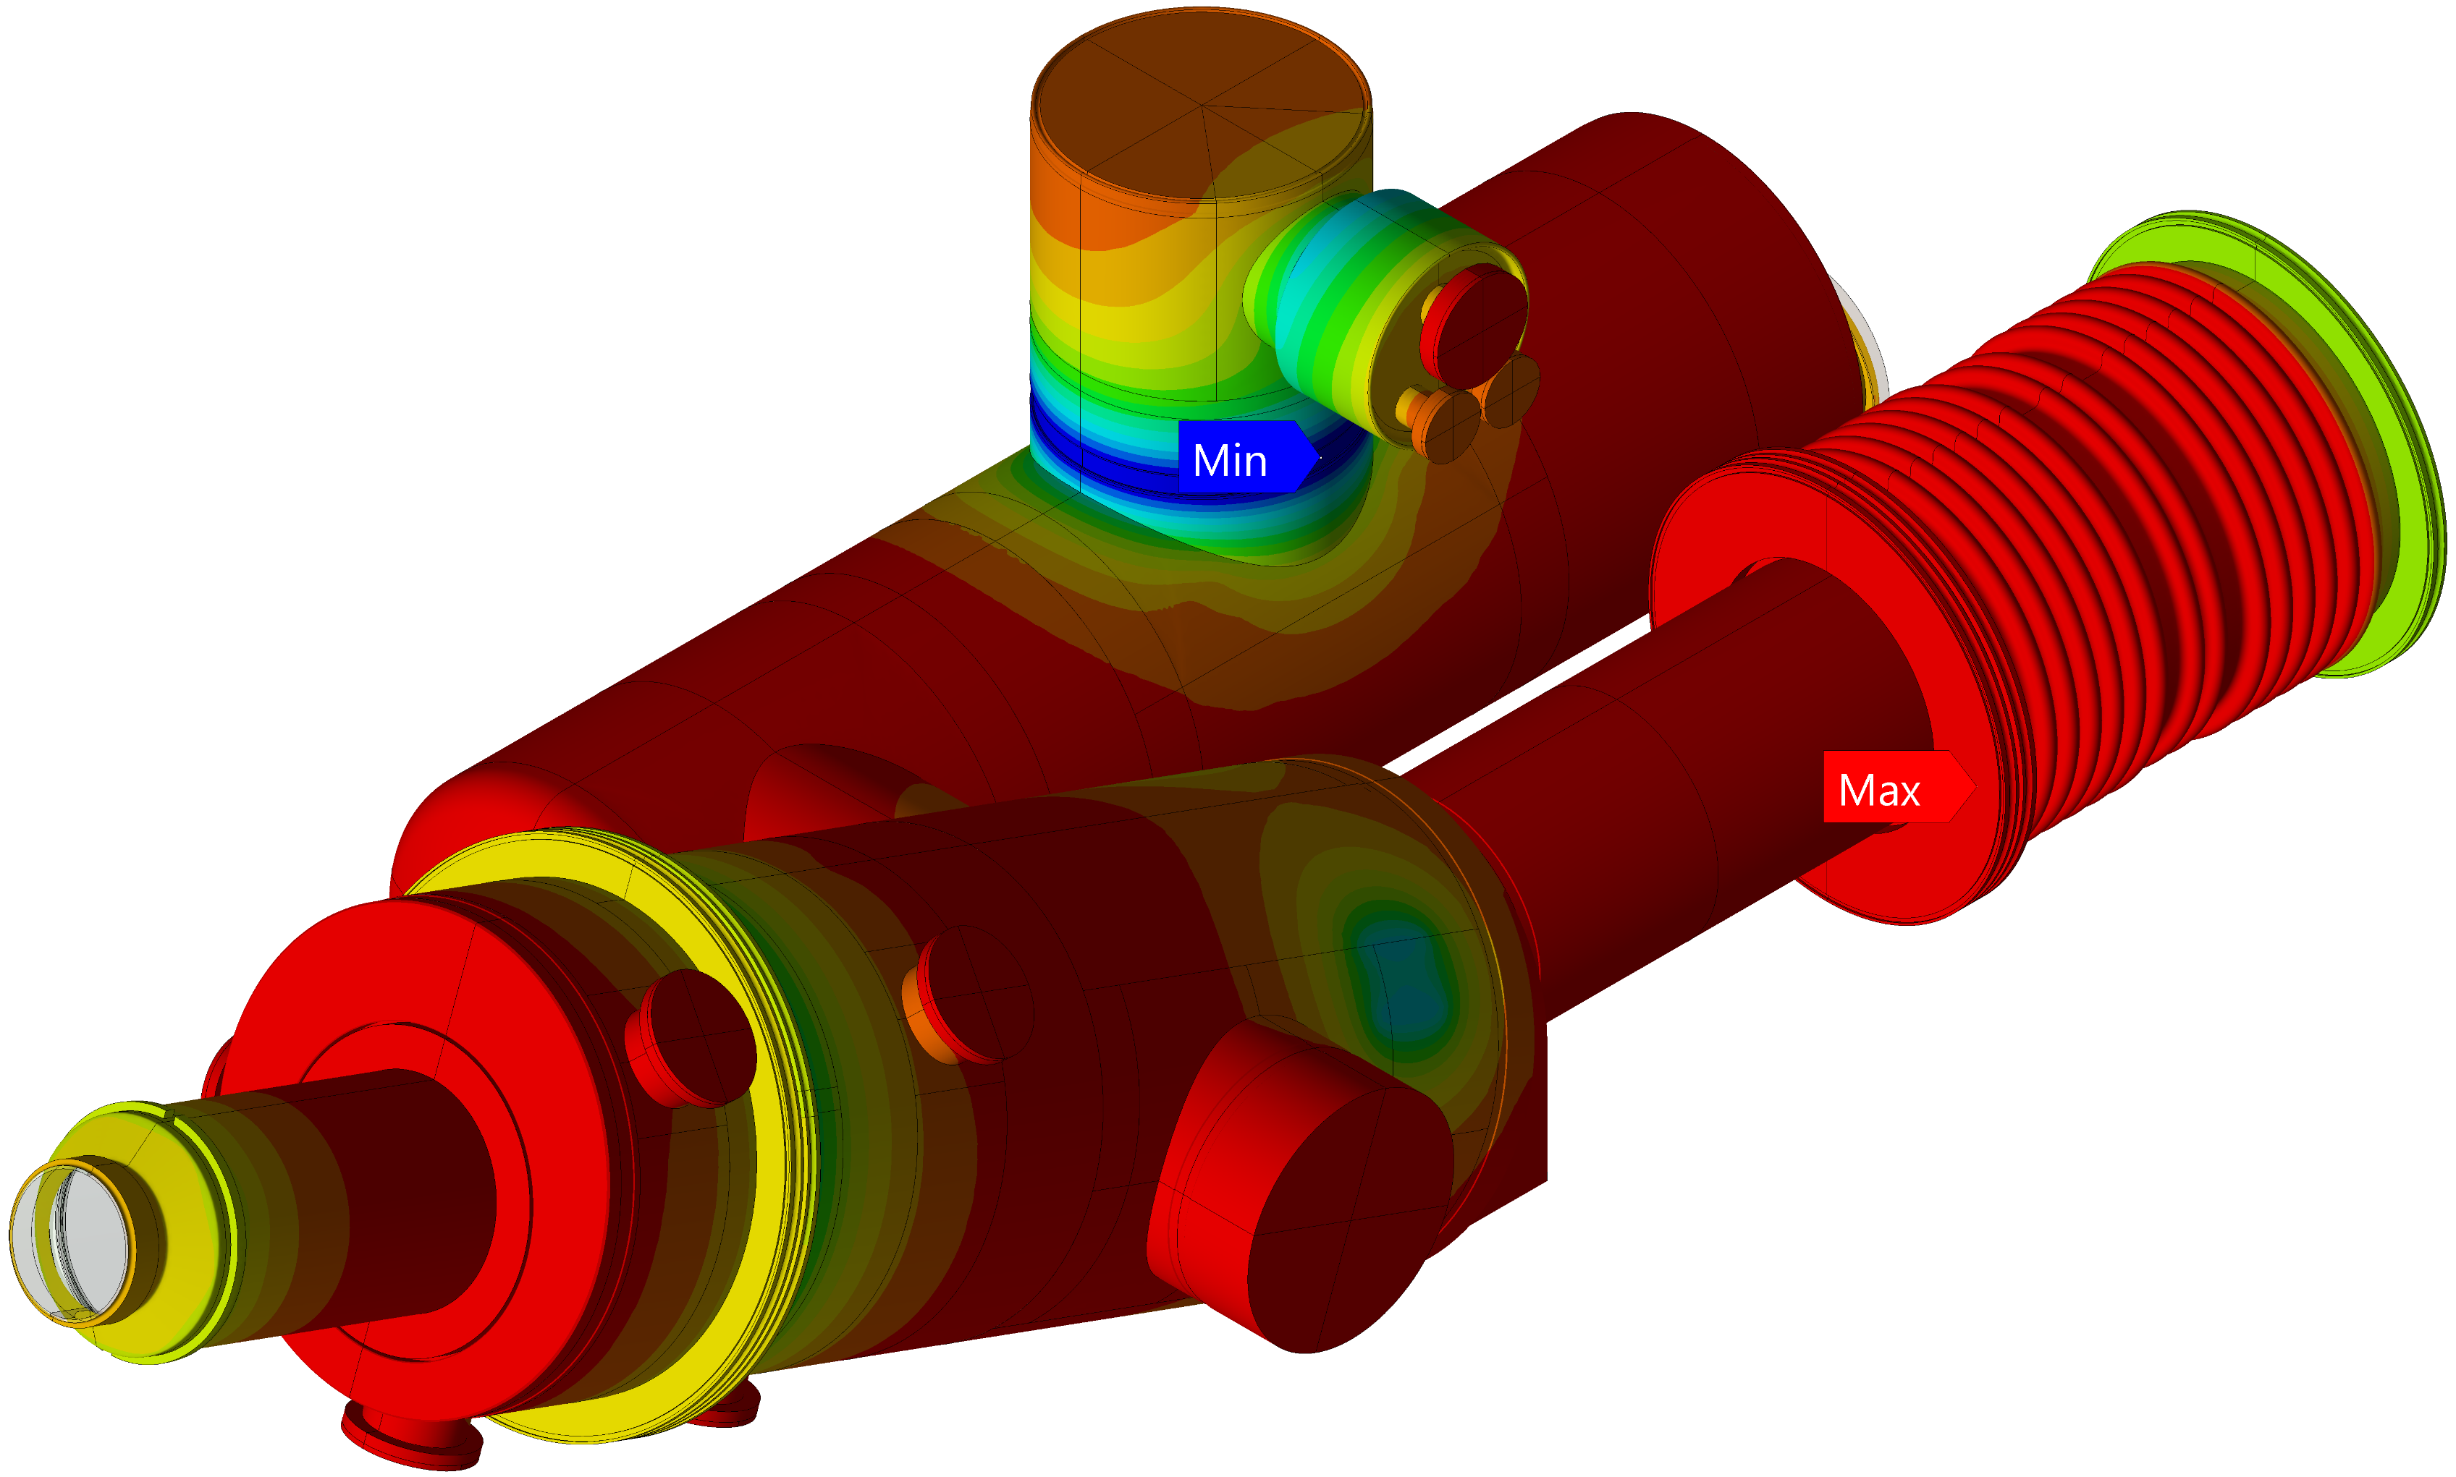
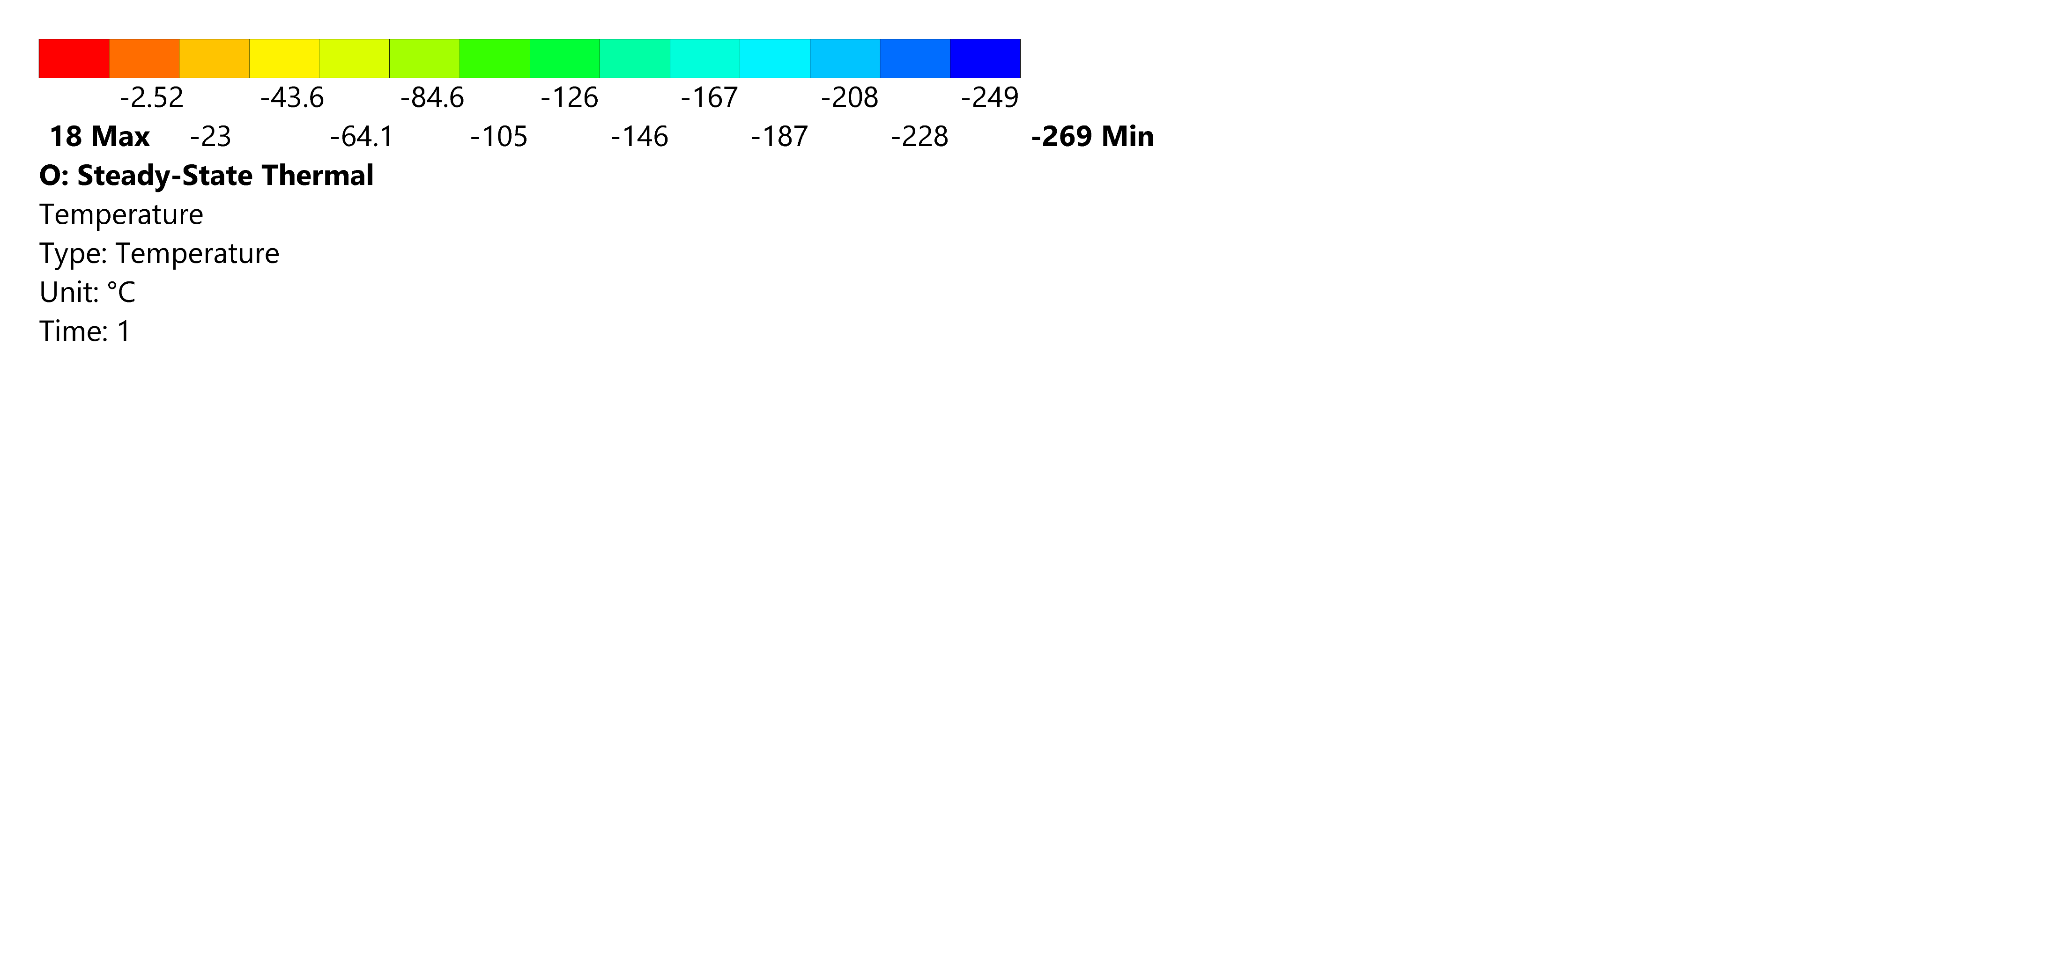
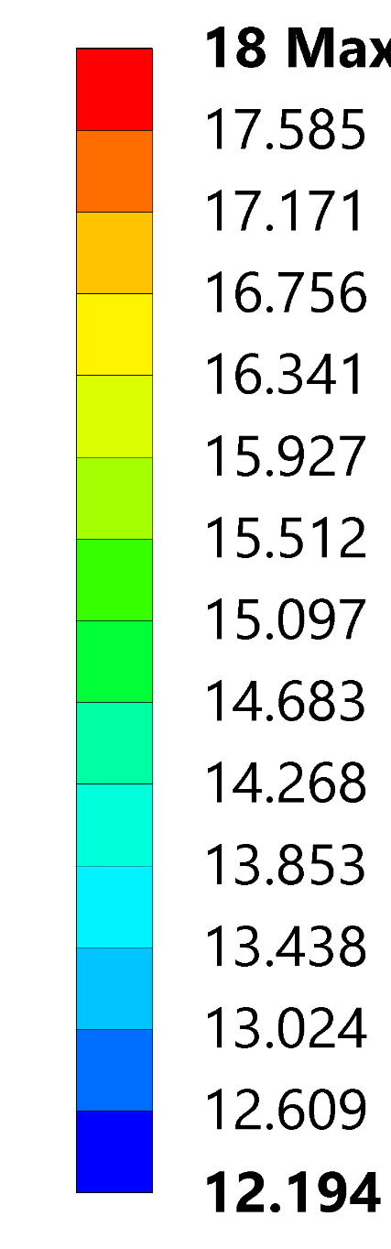
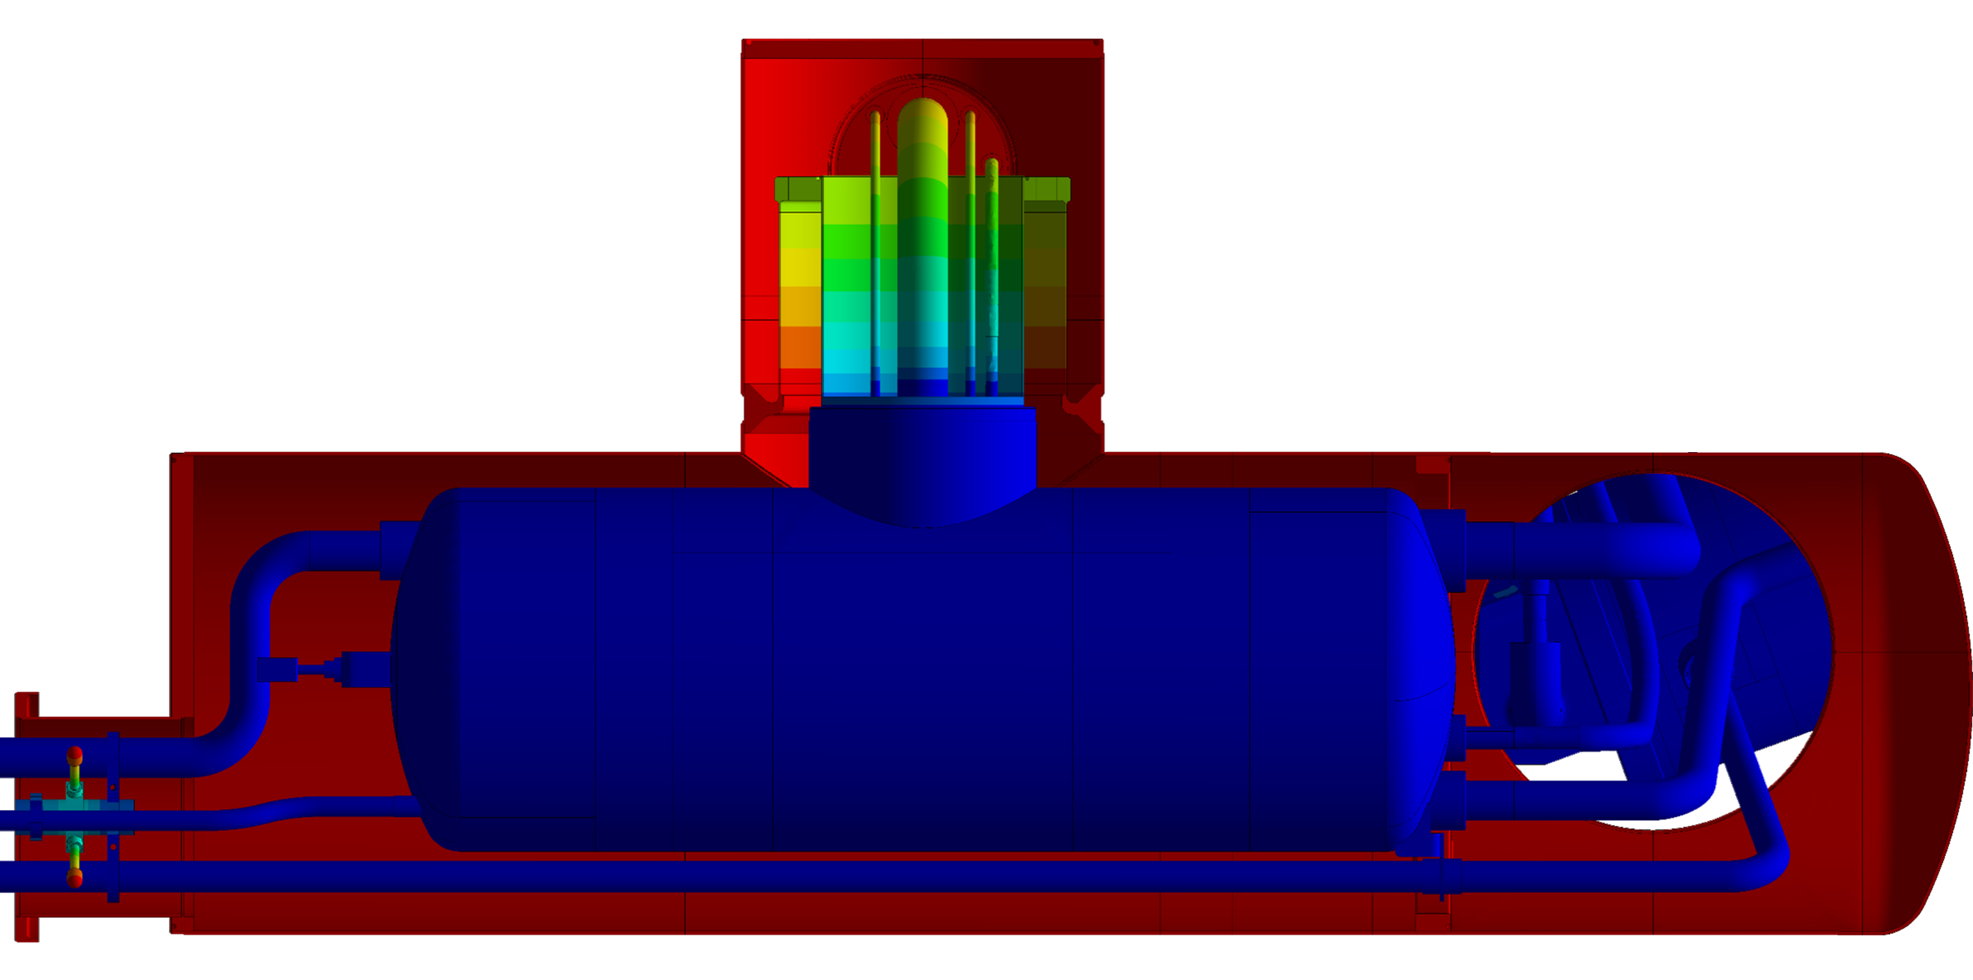
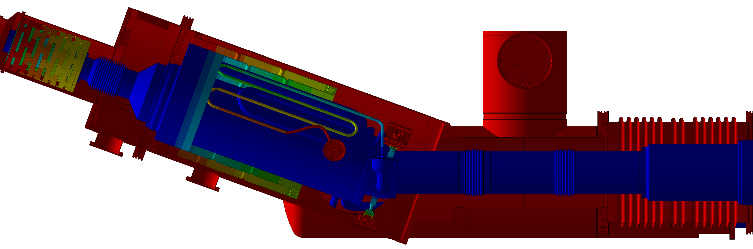
Cryogenic : Thermal Performances
Thermal analysis
Convection over surfaces exposed to atmosphere
Forced T 4.5 K over surfaces exposed to LHe & cold GHe
Conservative assumptions
  Perfect thermal conductance between parts
  Conservative convective coefficient 5 W/m²K, bulk temperature 18°C
  Heat load through lambda plate neglected (EDMS 2642887)
No condensation on surfaces facing atmosphere
Heat in-leaks within budget < 25 W
Extracted conductive resultant heat load ≈18.5 W
Estimated radiative heat load ≈ 4.8 W (cold surfaces ≈4 m²)
Operating temperature distribution of the vacuum vessel envelope
MIN 13.3 °C
MIN 12.2 °C
MIN 14.8 °C
Condensation check
MIN 13.3 °C
Heat in-leak loads
Operating temperature distribution of the Cable Module
Operating temperature distribution of the Boiler Module
0.5 W
6.9 W
1.2 W/m²
6.2 W
1.2 W/m²
0.5 W
0.5 W
3.9 W

Slide 13
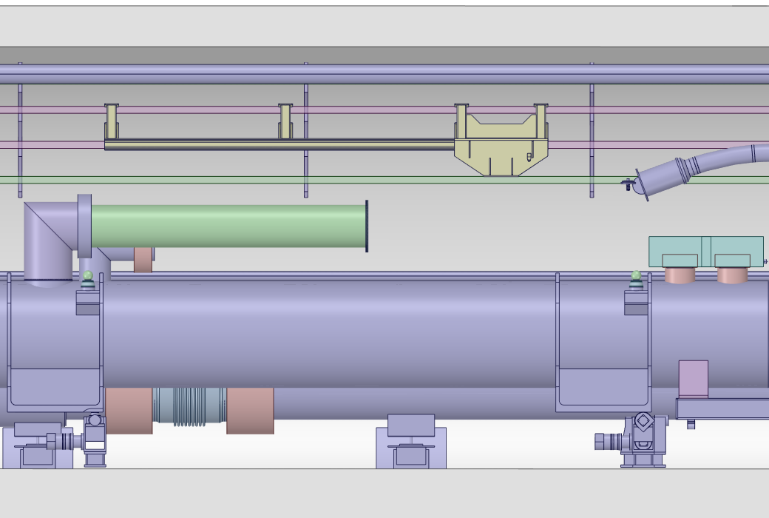
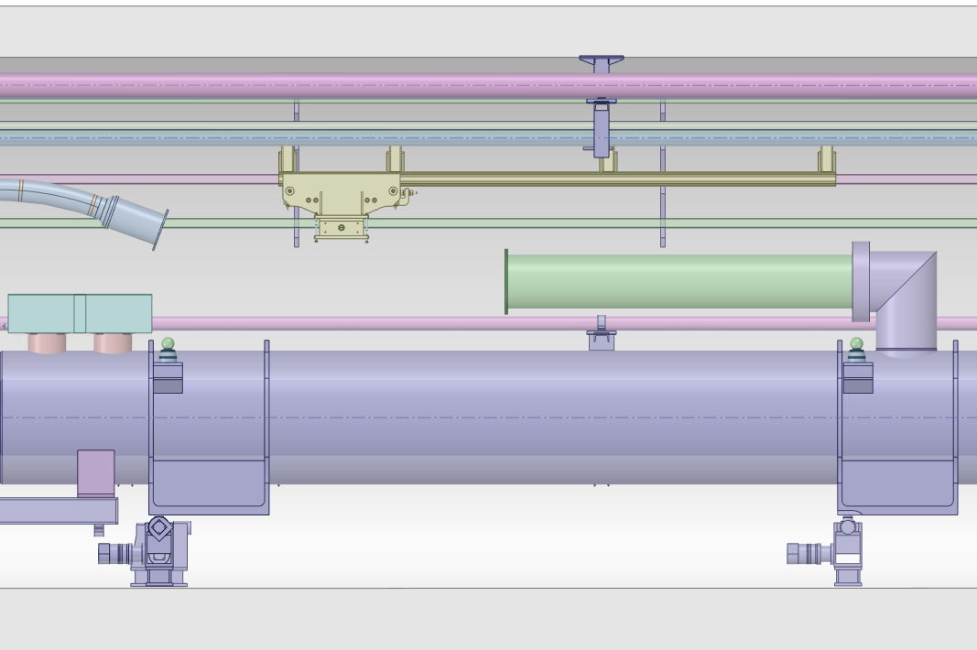
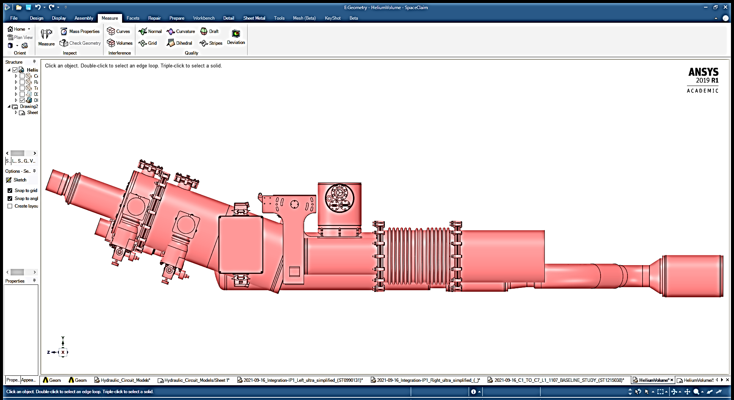
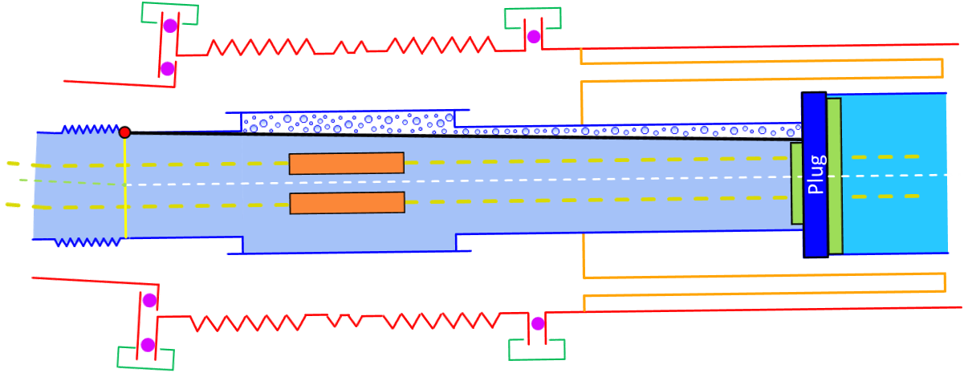
Cryogenic : Gas evacuation
POINT 1
R1
L1
Requirement : gas evacuation towards DSHM
Approach (same as for DFX) :
  Cryostat rotated around frame’s pivot axis
  Rotation of 1.4⁰ @ all the installation’s locations
    Same installation procedure @ all installation’s locations
  Looking from transport area towards DFM
    Clockwise rotation @ locations R1 & R5
    Counterclockwise rotation @ locations L1 & L5
  Resulting slope wrt horizontal reference
    0.7⁰ positive slope @ locations R1 & L5
    2.1⁰ positive slope @ locations L1 & R5
  Relative inclination absorbed by helium\vacuum bellows
1.4⁰
1.4⁰
Slope compensation required
0.7⁰
Horizontal Reference
L5
POINT 5
R5
1.4⁰
1.4⁰
NbTi-NbTi splices
1.4⁰
Frame’s pivot axis
Slope compensation required
0.7 ⁰
Helium bellows
Horizontal Reference
Vacuum bellows
Plug
(Coldest point)

Slide 14
Design compliance with PED
Identification of PED Category → II
  Calculation report in progress
Applicable standard → EN 13445-3
Definition of P-T configurations
  Derivation of load case scenarios
Identifications of design checks according to EN 13445-3
  Thermo-mechanical cycles < 500 (threshold) → not fatigue assessment
  Pre-qualification of non-standard pressure-retaining welds – Annex C
  Verification of structural stability (I-DC) – Annex B
Thermo-structural analyses through FEM
  Methods, safety factors & acceptance criteria according to EN 13445-3
  Application of Finite Element Sub-modeling Technique
    Global model for thermal, buckling & displacement field
    Sub-models for stress distribution at welded connections
P-T Configurations
Transport
Pumping
Pumping insulation vacuum SC Link
Pumping insulation vacuum DFH
Cryogenic circuit purging
Purge of cryogenic circuit without vacuum
Purge of cryogenic circuit with DSHM vacuum
Purge of cryogenic circuit with DFM vacuum
Pressure test
Thermal cycle
Nominal
DESIGN
DFM Cool down
DFM warm up
Non nominal events
Vacuum break DSHM
Vacuum break DFM
Helium break DFM

Slide 15
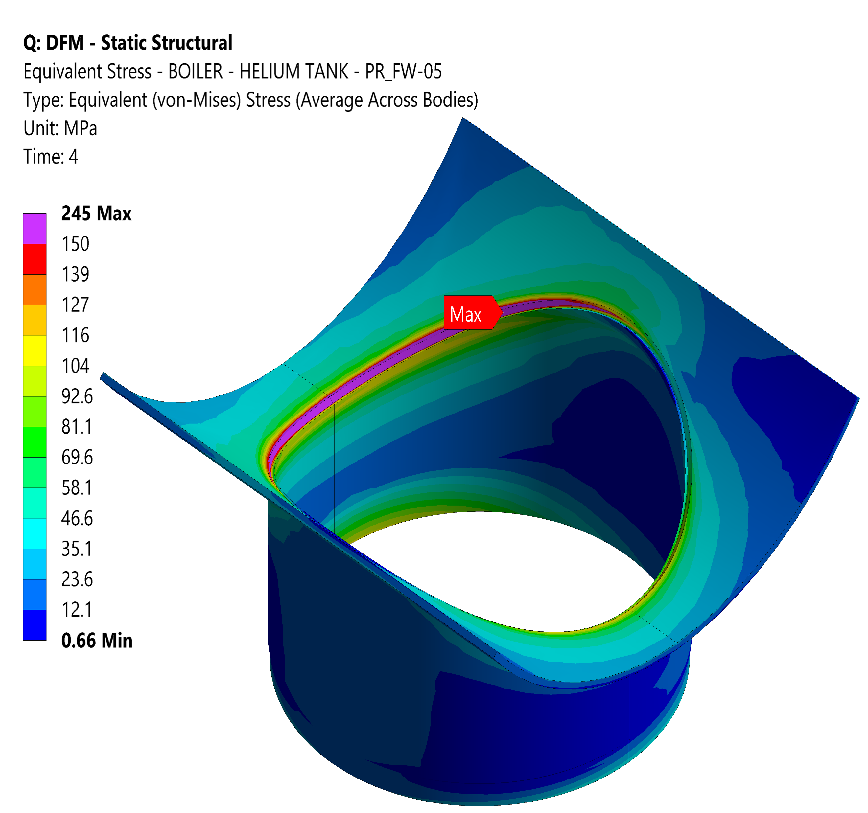
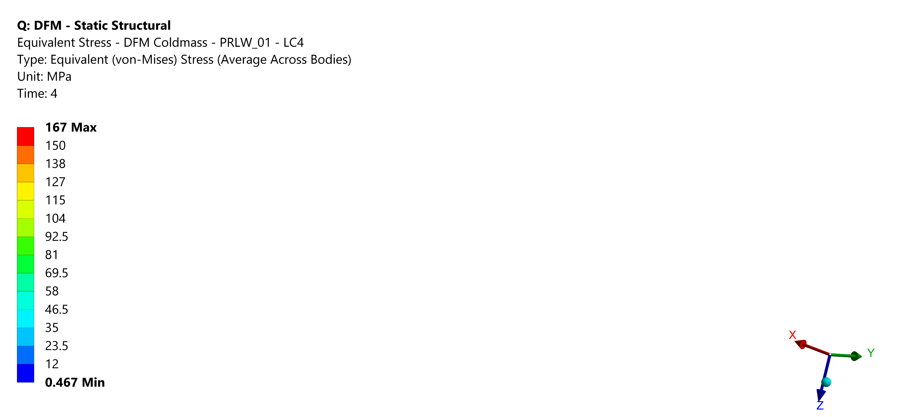















Design compliance with PED
Stress linearization – EN 13445-3 – Annex C
Sub-models @ welded connections
Identification of weld’s critical point
Stress linearization & decomposition
Verification of prescribed material stress limits
All pressure-retaining welds verified
Cable Module
Fillet Weld – Helium Tank Neck
Boiler Module
Fillet Weld – GHe Line
Lip Weld – GHe Line
M = 109 < 150 = f
M+B = 194 < 225 = 1.5·f
M = 62 < 150 = f
M+B = 82 < 225 = 1.5·f
M = 57 < 150 = f
M+B = 154 < 225 = 1.5·f
Fillet Weld – LHe Supply Line
M = 123 < 150 = f
M+B = 202 < 225 = 1.5·f
Instability design check - EN 13445-3 – Annex B
Determination of linear buckling modes
Mesh pre-deformation according to buckling modes
Assessment of non-linear elastoplastic buckling
Verification of prescribed material strain limit
Instability verified for all loading scenarios
Cable Module : Vacuum Barrier
Boiler Module : Vacuum Vessel
Magnification Factor x 60
Load Multiplier ≈ 8.8
Linear Buckling
Magnification Factor x130
Load Multiplier ≈ 11.9
Non-linear
elasto-plastic buckling
ε^{T}_{p,max}% = 0.16%<< 5%
ε^{T}_{p,max}% = 0.13% << 5%

Slide 16
Conclusions
Functional and technical requirements have been studied and associated technical solutions were developed in the detailed design
The design principle is similar to the one of the Demonstrator DFX of Demo2
3D detailed model is ready to start producing manufacturing drawings
Structural calculations required by the PED are completed, report in progress
The detailed design of the supporting frame needs to be finalized and adapted to the four locations

Slide 17
Thank you for your attention

