Slide 1
Kicker and preliminary machine protection studies
Rebecca Ramjiawan, Yann Dutheil
FCC-ee injection meeting, CERN
Tuesday 25th January 2022

Slide 2
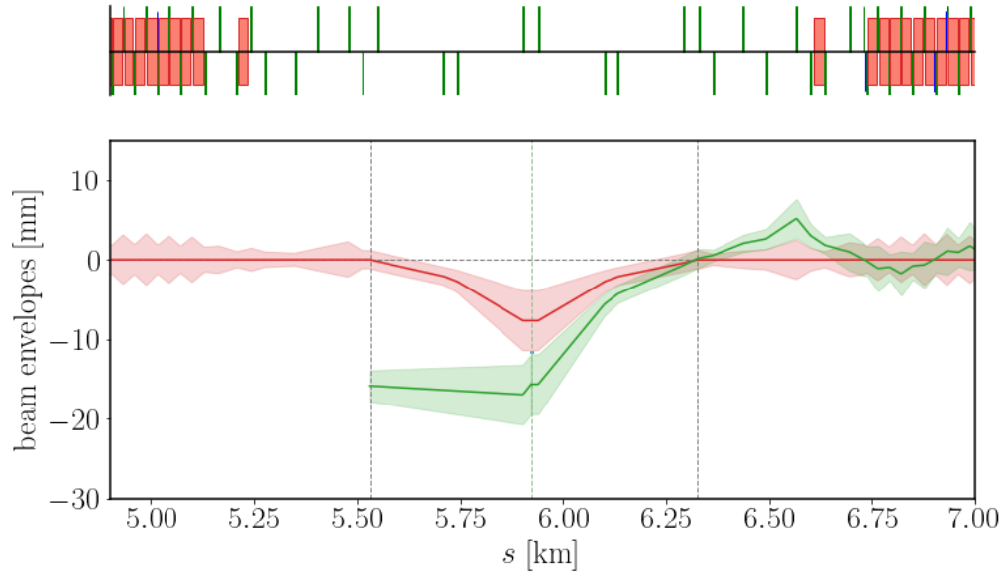
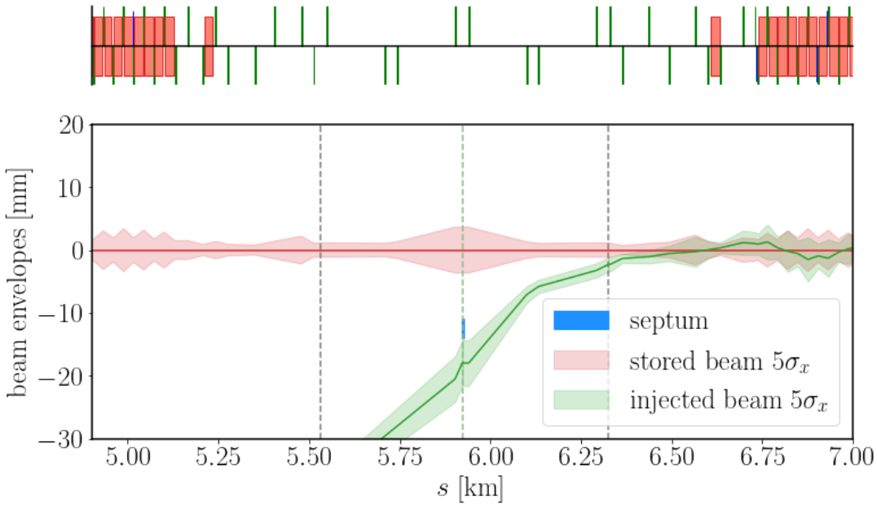
Kicker parameters (recap from last time)
Conventional bump injection
Multipole kicker injection
Dipole kickers
Kick 12.5 μrad
Length 0.5 m
Multipole kickers
Kick 29 μrad for injected beam
Length 0.5 m

Slide 3
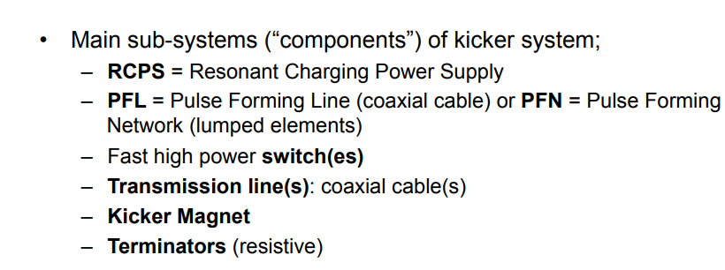
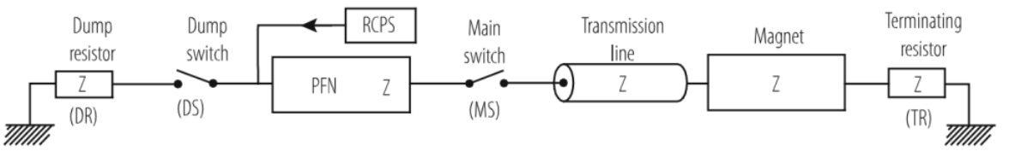
Kicker system elements
[1][2]
Resonant Charging Power Supply (RCPS) charges Pulse Forming Network/Line to a capacitor voltage V. Main Switch closes, sending a pulse with magnitude V/2 through the Kicker Magnet ($$τ_{fill}$$).
Pulse V/2 sent towards the open Dump Switch and reflects back (pulse length $${2×τ}_{p}$$). Once this pulse reaches the kicker, the field starts to decay.
Termination matched impedance or short-circuited (twice the kick, twice the fill-time).
Kicker pulse length can be changed by adjusting the relative timing of dump and main switches
PFL/PFN choice depends on length of pulse needed. Typically, for >3 μs use PFN.

Slide 4
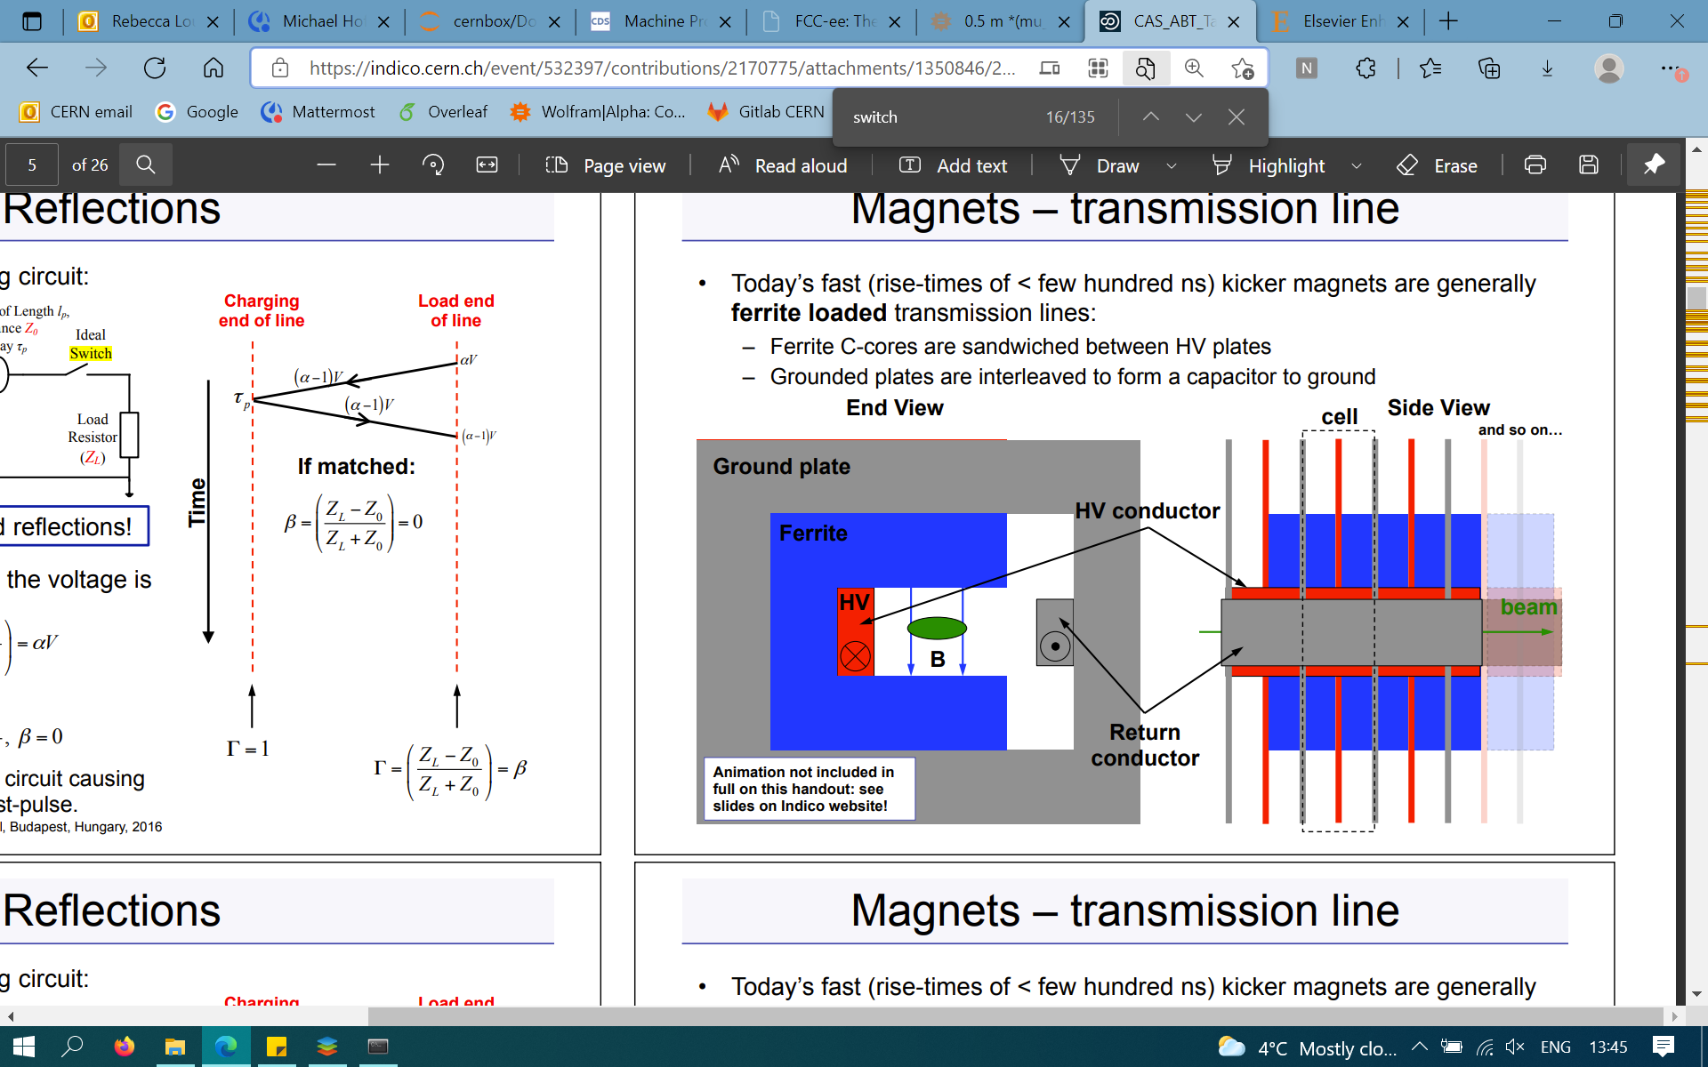
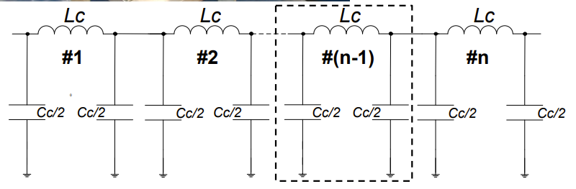
Kicker magnet technology
For rise times of < few 100 ns typically ferrite loaded transmission lines (distributed inductance) kickers. Usually between 5 and 30 cells.
At CERN: 30ns-700ns rise time, currents up to 5 kA, voltages up to 80 kV. E.g PS KFAs 96 ns rise time, 23.6 Ω impedance [3].
Ferrite C-cores sandwiched between HV plates with interleaved ground plates forming capacitor.

Slide 5
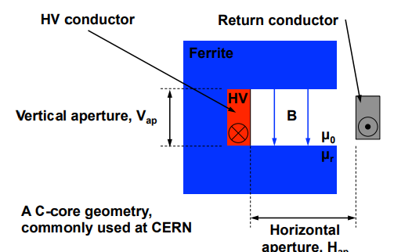
Dipole kicker parameters
Dipole kicker angle: 12.5 µrad
Integrated field (182.5 GeV): 0.015 T
Magnetic length: 0.5 m (assuming 10 cells, length 50 mm)
Beam envelope (5 sigma): 1.176 mm x 0.0367 mm
Aperture: 20 mm x 15 mm
For fast rise-times the inductance must be minimised, typically coil turns N = 1.
I[A]: 179 A
Magnetic inductance (a middle cell): 47.1 nH
C-shaped
$$θ_{B}\left[rad\right]≈\frac{0.2998×l\left[m\right]}{p\left[\frac{GeV}{c}\right]}B[T]$$
$$B[T]≈\frac{μ_{0}\left[\frac{H}{m}\right]NI[A]}{V_{aperture}[m]}$$
$${L_{cell}{{= μ}_{0}l}_{cell}H}_{aperture}/V_{aperture}$$

Slide 6
Rise time
Rise time: field rise time is current pulse rise time + magnet fill time
Lumped inductance kicker typically >1 μs.
Transmission line kickers can achieve even <100 ns, but are more complicated and expensive. Rise time proposed in FCC-ee CDR 94 ns.
Characteristic impedance (Z=LcellCcell) is chosen based on the required field rise/fall time and the available length for the magnet. This should be coherent throughout the system to reduce reflections.
Compromise: The capacitance (area of plates) must increase by a factor of 4 for a factor of 2 reduction in impedance. The minimum separation of the capacitor plates is determined by e.g. voltage breakdown and cost.
Magnet fill time then depends on this as: tm=nLcellCcell=LmagnetZ

Slide 7
Kicker system other elements
Termination
Short-circuit: a way to double the current (and kick strength) but also the filling time. Useful if short on space. More complex, pulses with opposite polarity.
Matched impedance: we are not so short on space but want to reduce rise time so matched impedance seems a better option, also reduced complexity.
Switch
Switch voltage (based on 179 A (slide 4) is 5.9 kV for 16.67 Ω characteristic impedance (CDR).
Thyratron e.g.deuterium gas, insulating when neutral and conducting when ionised. Simple, fast rise-time, occasional self-trigger (depends on duration of high-voltage in thyratron). LHC injection saw 1 erratic trigger in 250,000.
Semiconductor fewer erratic kicks, longer lifetime, less maintenance, more limited in voltage (LHC abort kicker switch up to 30 kV). Cost comparison, depends on initial cost and lifetime.

Slide 8
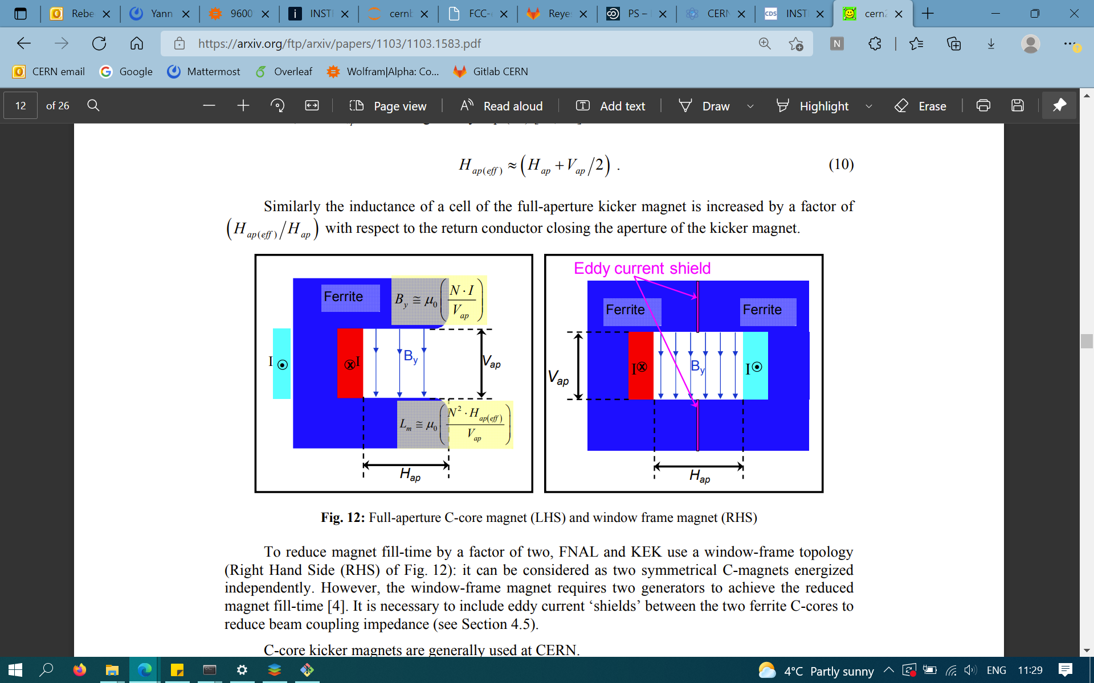
Other considerations
Geometry of magnet core
Window-frame: reduce filling time by factor of two but requires two generators (e.g FNAL or KEK).
C-shaped: For our design, it doesn’t seem like we need such a low a filling time, this should be sufficient.
In-vacuum vs. out-of-vacuum
Pros: In-vacuum allows for a smaller aperture, and so higher fields. Permits magnets to be shorter. Less complicated vacuum chambers.
Cons: all materials must be vacuum compatible.
C-shaped
Window-frame
[4]
two C-shaped with opposite polarity

Slide 9
Cut-off frequency [2]
Cut-off frequency fc=1πLcell+4Lstray×Ccell for the frequency modes which will propagate.
Needs to be high enough not to attenuate the rising edge, if rising edge has frequency components above cut-off frequency will produce flat-top ripple $$∴$$ a key parameter for rise time < 100 ns.
Small cell size, low stray inductance, high impedance Z ⤏ high cut-off frequency... BUT not small enough to cause breakdown or cost excessive amounts.
$$∴$$Compromise between cost, robustness and performance.
Example: rise time of 50 ns had cut-off frequency 39 MHz [5].

Slide 10
Stability
Total injection error is the sum of the errors from transfer line, injection kicker and septum.
We benefit from radiation damping; compare amplitude of disturbance and damping time $${Δxe}^{-t/τ}$$
Emittance increase $${Δϵ}^{2}={γ\left(Δx\right)}^{2}+2αΔxΔx'+{βΔx'}^{2}$$, with $$Δx,$$$$Δx'$$ the position, angle error at injection.
Amplitude increase at waist: ΔxIP=βIPβΔx2+βΔx'2 [6], 1% error on kicker 1 μm offset at IP.
Flat-top ripple and droop
Compare e.g. the angular errors introduced by the injection kicker (deflection 12.5 μrad) to the beam angular divergence at that location (1.2 μrad). E.g 0.5% ripple ⤏ 5% of the beam angular divergence.
Constrained by the tolerable increase in emittance. Stability depends on the length of the pulse.
Shot-to-shot stability
Constrained by the maximum tolerable beam oscillations

Slide 11
MKI kicker parameters
Injected beam kick angle: 29 μrad
Integrated field (182.5 GeV): 0.035 T
Magnetic length: 0.5 m
Beam envelope (5 sigma) 1.176 mm x 0.0367 mm
Aperture: 20 mm x 15 mm
N = 1 (turns)
I[A] = 418 A
Switch voltage: (16.67 Ω impedance): 13.9 kV
$$θ_{B}\left[rad\right]≈\frac{0.2998×l\left[m\right]}{p\left[\frac{GeV}{c}\right]}B[T]$$
$$B[T]≈\frac{μ_{0}\left[\frac{H}{m}\right]NI[A]}{V_{aperture}[m]}$$
$${L_{\frac{mag}{m}}={μ_{0}N}^{2}H}_{aperture}/V_{aperture}$$

Slide 12
Machine Protection (Injection)

Slide 13
Classification of machine failures
Septum failure is slower so would consider active protection, kickers are faster so passive protection (absorbers). Kickers are ultra-fast failures (3 turns or less) as occur on the timescale of the equipment e.g. 100s ns.
No kicker turn-on: injected beam steered onto absorber (MKI, conventional), stored beam orbit bump not closed (conventional)
Erratic turn-on: circulating beam deflection (conventional), emittance increase (MKI)
Vacuum flash-over (short-circuit) in kicker [7] discharge between kicker electrodes while the kicker has high field resulting in short circuit, can result in reduced or increased kick strength, owing to reflection
In terms of the likelihood of these failures, we need to be more progressed with the design choices.

Slide 14
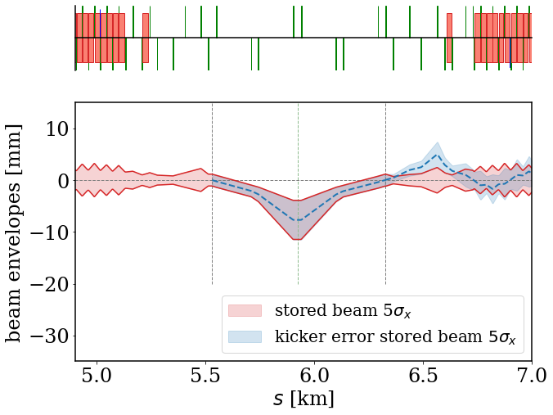
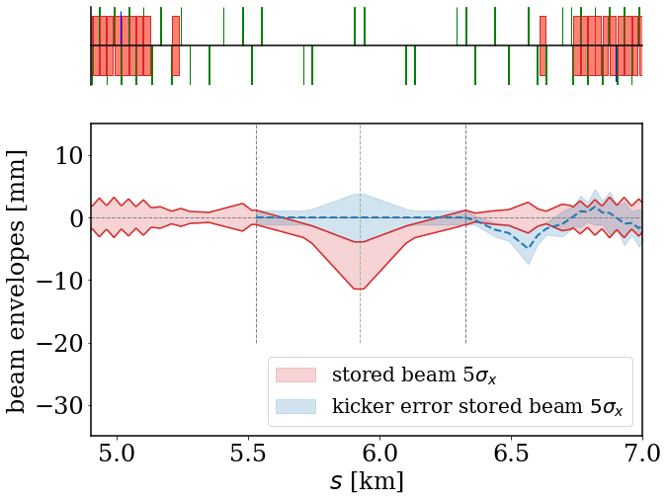
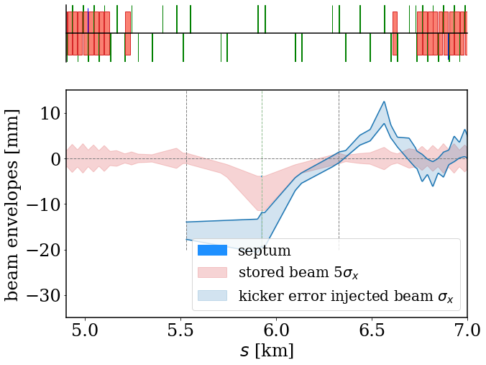
Kicker failure modes (conventional injection)
Beam sizes and energies for each of the failures scenarios.
Septum at risk if the orbit bump amplitude increases, requires study.
Absorbers at 90 degree phase advance from kicker, $$σ_{x}= 468 μm, σ_{y}= 11 μm$$ (Z-mode).
Orbit bump not correctly closed
Erratic kick/no kick
Injected beam, kicker not fired

Slide 15
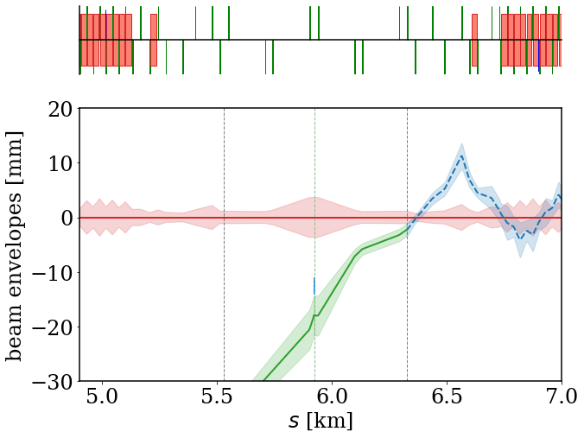
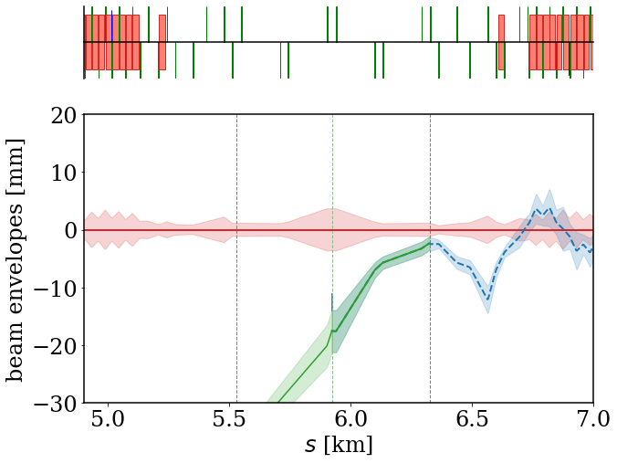
Kicker failure modes (multipole kicker injection)
MKI fail to fire: passive protection required, failure over very short timescale.
MKI erratic fire: emittance increase of stored beam.
Vacuum flashover can cause incorrect kick, range 0-2 times nominal.
Septum not at risk from these kicker failure modes.
Injected beam, kicker not fired
Wrong kick, too high

Slide 16
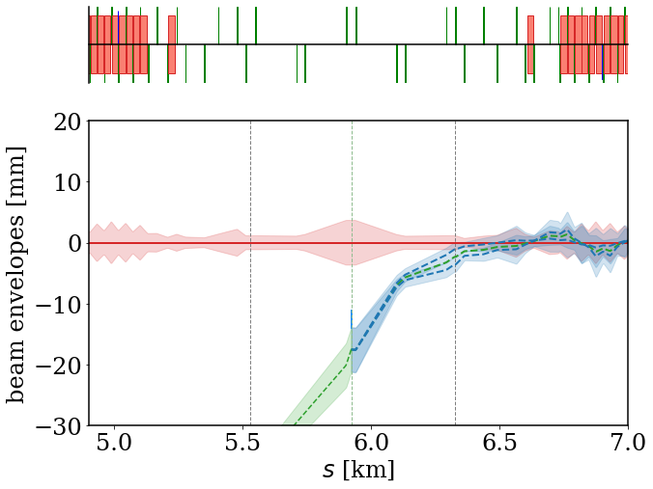
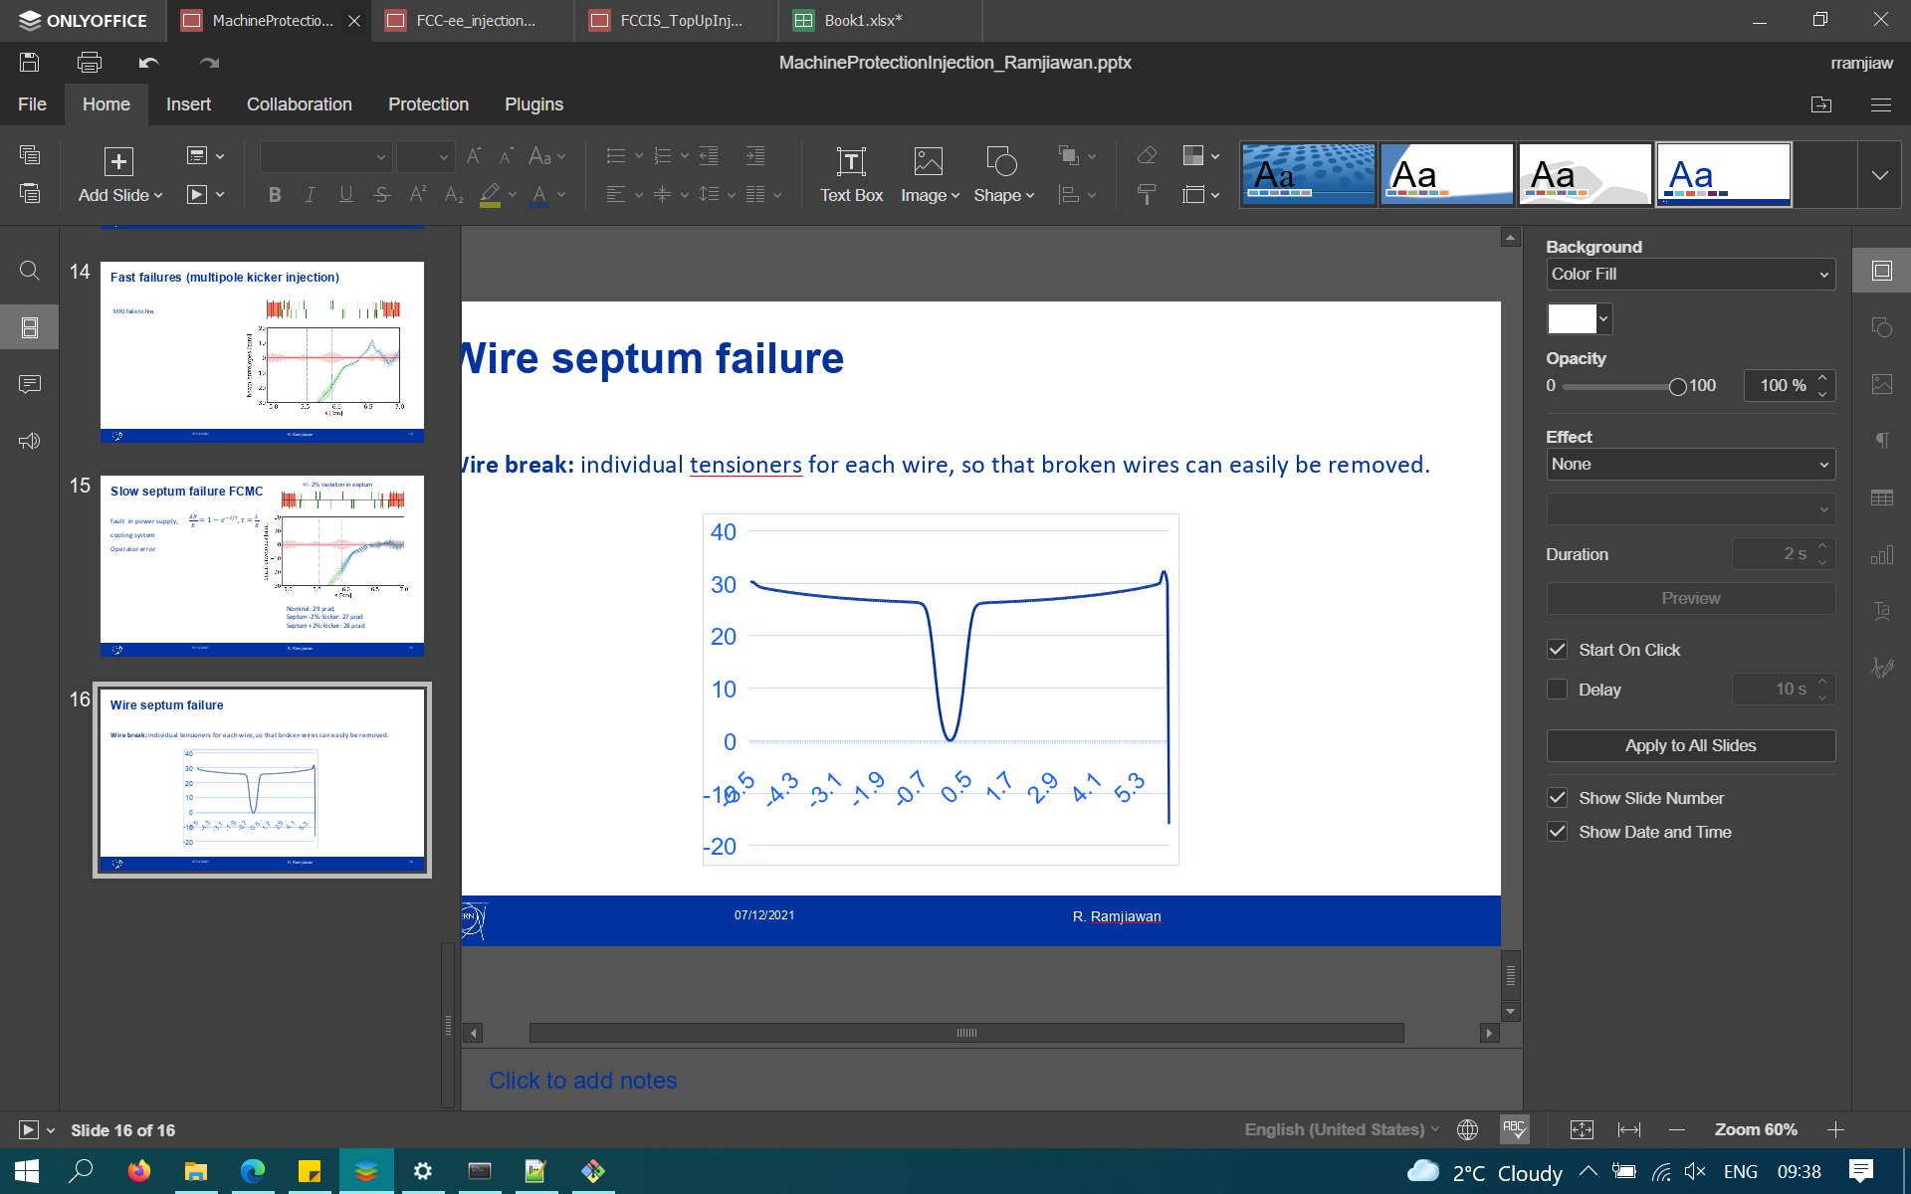
Septum failure
+/- 2% variation in septum
E.g fault in power supply, cooling system, operator error
$$\frac{ΔB}{B}=1-e^{-t/τ}$$, $$τ=\frac{L}{R}$$
Once we have $$τ$$, we should identify tolerable variation in septum strength to get limit on beam abort time.
e.g if $$τ$$= 1 second and we can tolerate 2% change we would need to abort within 0.021 seconds (70 turns).
Deflection [μrad]
- - - Nominal: 29 μrad, 2.3 mm offset
- - - Septum -2%: kicker: 27 μrad, 1.3 mm offset
- - - Septum +2%: kicker: 28 μrad
offset [mm]

Slide 17
Next steps
Off-momentum injection studies, both kickers and septa studies.
More comprehensive comparison between each of the injection methods, evaluating strengths and weaknesses and well as any R&D required.
Ideally, we would like estimates for the likelihood of different equipment failure scenarios but this is difficult without a more formal design of the systems.
Continue machine protection studies for equipment failure scenarios.

Slide 18
Thank you for listening

Slide 19
Injector complex timings
Linac: 2 bunches (100 ns separation) at 100-200 Hz rep rate (5-10 ms train separation)
SPS: 1190 bunches, 3 pairs interleaved injectio so 17.5 ns bunch spacing in trainlets (15-20 ns trainlet separation). SPS is 6.9 km/23 μs, 9240 buckets at 200 MHz. 1190 bunch train (17.5 ns separation = 22.77 μs). Abort gap 230 ns.
14 injections into booster (10 with 1188, 4 with 1190). Booster cycle 326 μs. Fill with 14 SPS trains 317.8 μs.

Slide 20
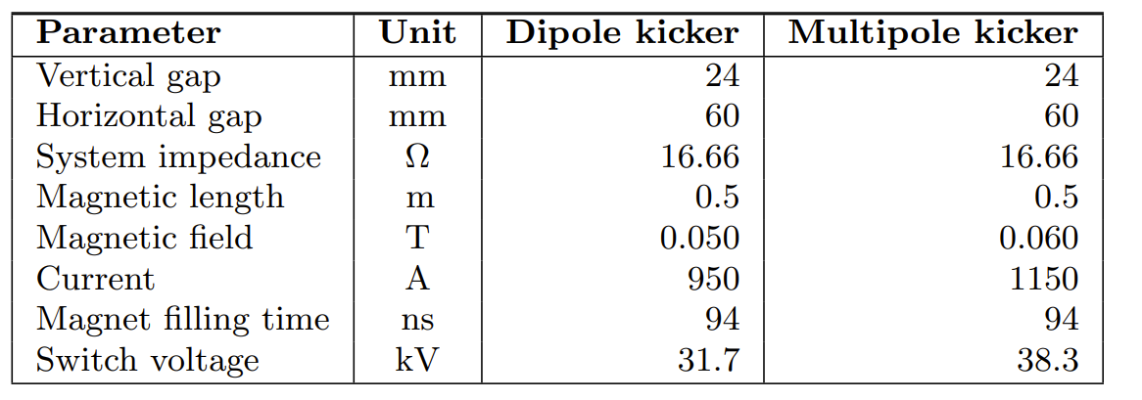
CDR

