Slide 1
Experimental assessment of Nb₃Sn impregnated coil samples in He II: temperature margin evaluation and investigation of aging mechanisms in the impregnation
P. Borges de Sousa & R. van Weelderen, TE/CRG-CL
special thanks to Kirtana Puthran (TE/MSC), Enes Ilbuga (TE/CRG), EN/MME team

Slide 2
Contents
Introduction
Experimental campaign
  Sample preparation
  Set-up description and measurement procedure
Typical results and their interpretation
  Example of 11T coil GE-02
11T virgin coil campaign: thermal cycling / He content
MQXF coil (U.S. and CERN production) campaign: heat transfer
Summary
Outlook

Slide 3
Contents
Introduction
Experimental campaign
  Sample preparation
  Set-up description and measurement procedure
Typical results and their interpretation
  Example of 11T coil GE-02
11T virgin coil campaign: thermal cycling / He content
MQXF coil (U.S. and CERN production) campaign: heat transfer
Summary
Outlook

Slide 4
Introduction
He II Heat Transfer experimental set-up has been established at the Central Cryogenic Laboratory at CERN to qualify the thermal performance of samples of superconducting magnet coils
Adapted to test Nb₃Sn impregnated coil samples in an ongoing test program
Program evolved into experimental campaign + numerical simulations to answer open questions on thermal behaviour of Nb₃Sn impregnated coils, esp. quench limits as function of locally deposited power
Set-up has been recently used for studies on aging effects on the coil samples due to thermal cycling

Slide 5
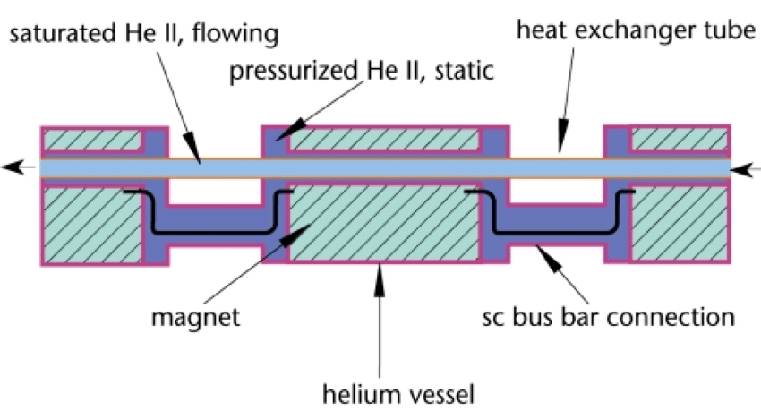
Introduction
The main outputs of the experimental campaign are:
    Thermal interface resistance between the coil surface and the He II bath;
    Temperature gradients generated in cable layers as a function of heat ﬂux;
    Heat deposition regime above 25 mW/cm³ remained unexplored and required assessment
Measurements carried out in a set-up where the coil sample is immersed in a pressurized He II stagnant bath which is in turn in contact with a saturated He II bath for heat extraction.
  Method is complex and time-consuming.
  A complete measurement run in saturated He II conditions was
  carried out to validate whether results are qualitatively and quantitatively
  comparable to the standard method.

Slide 6
Contents
Introduction
Experimental campaign
  Sample preparation
  Set-up description and measurement procedure
Typical results and their interpretation
  Example of 11T coil GE-02
11T virgin coil campaign: thermal cycling / He content
MQXF coil (U.S. and CERN production) campaign: heat transfer
Summary
Outlook

Slide 7
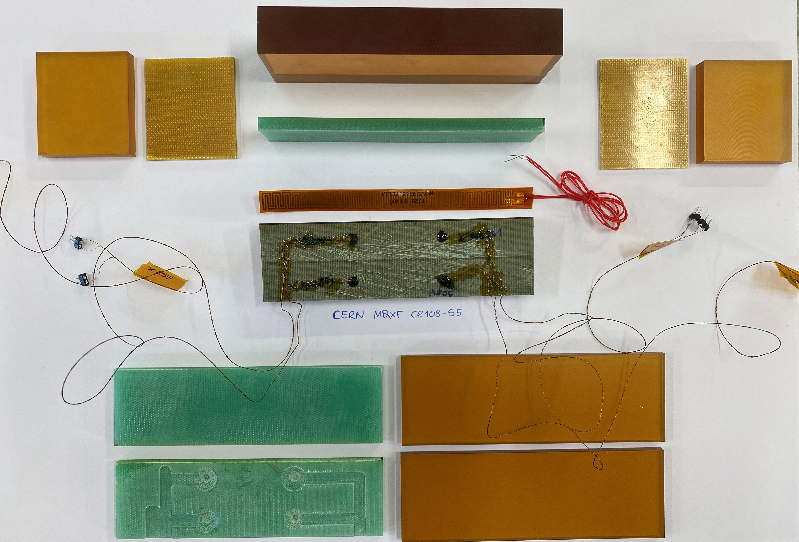
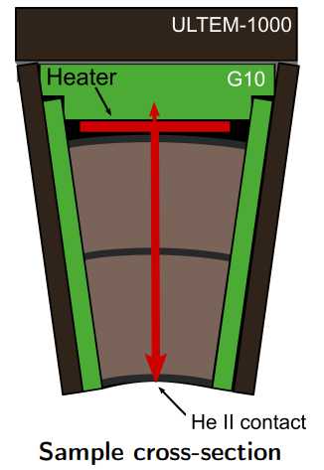
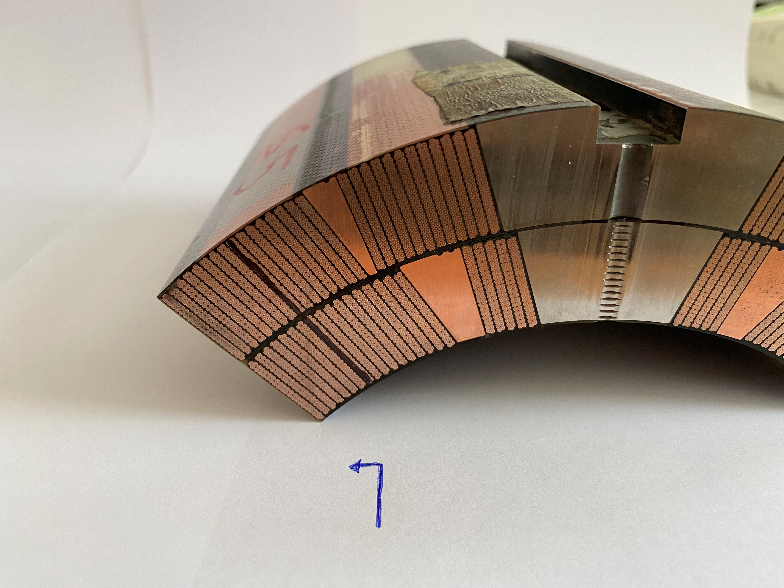
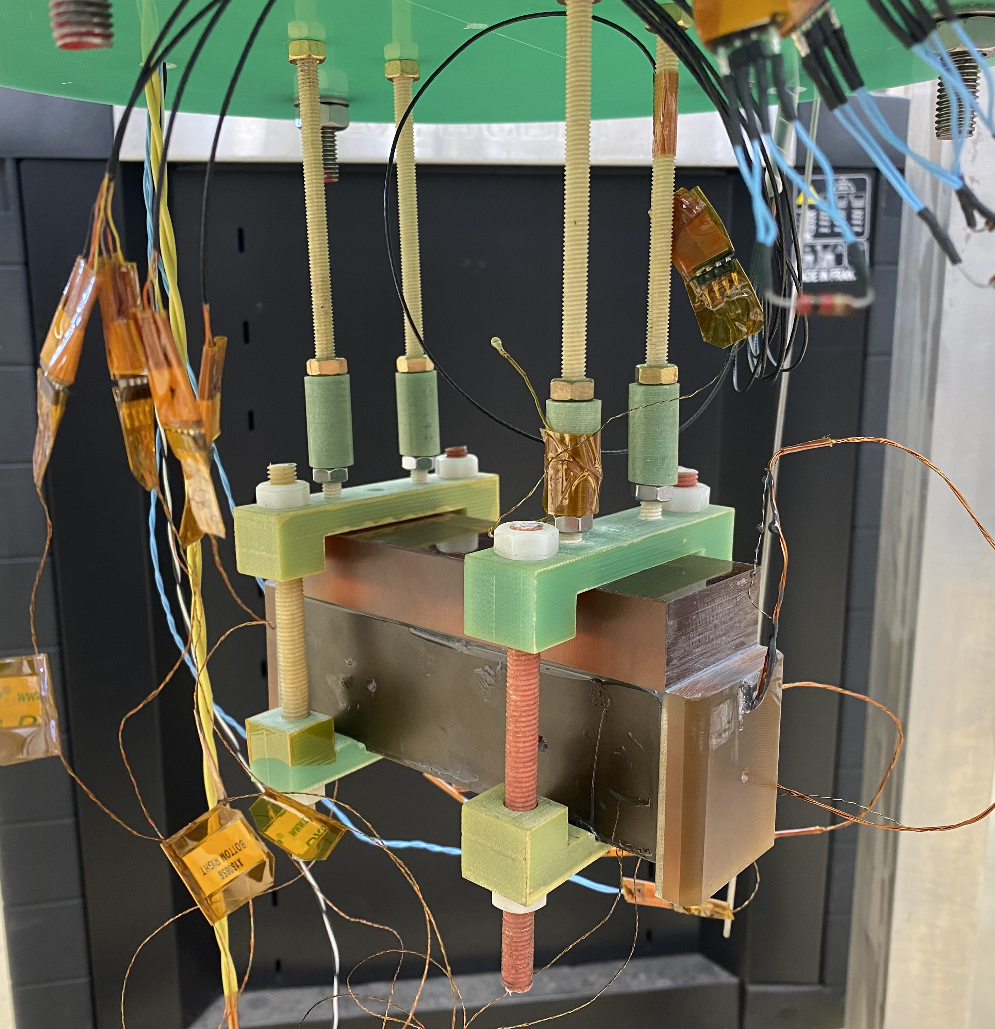
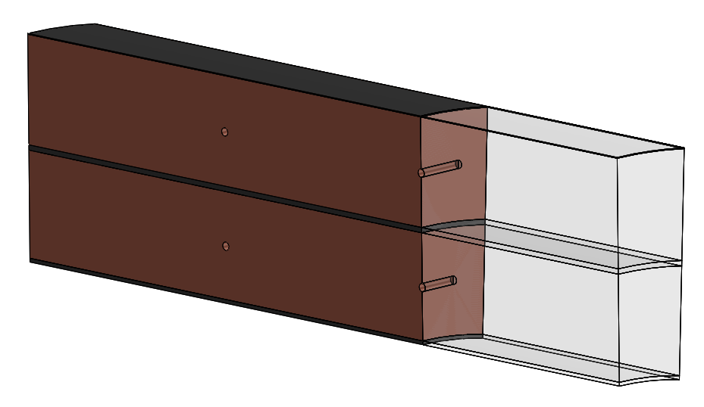
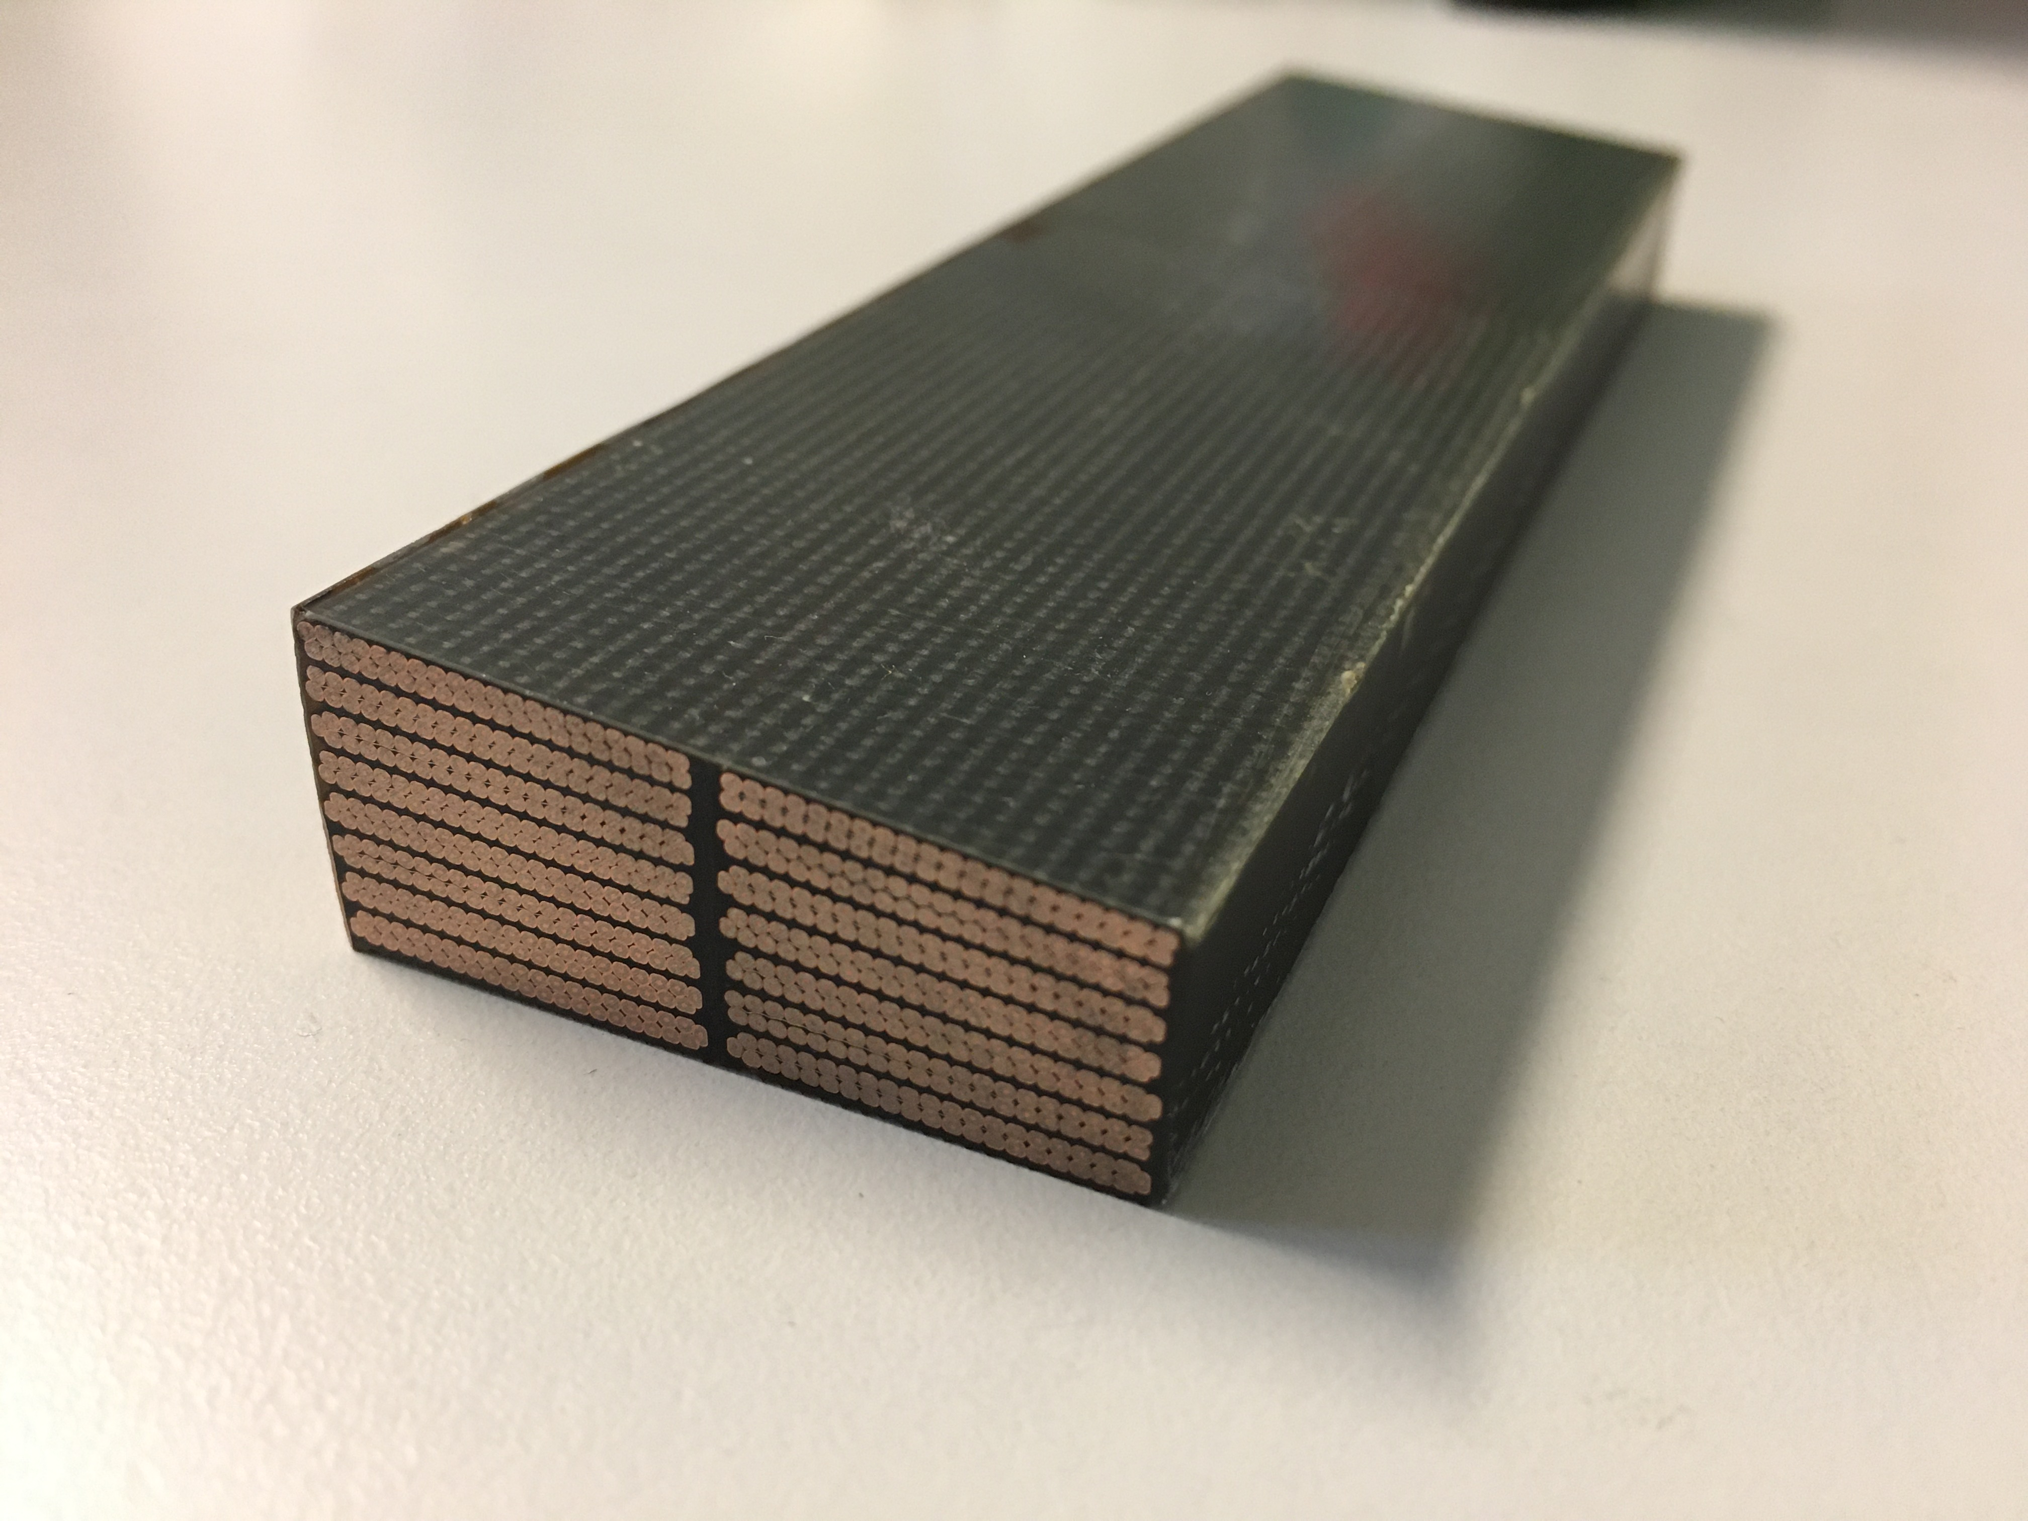
Sample preparation
instrumented sample is encased in 2 layers of insulation on all sides (except for inner surface, He contact)
Sample cut from larger
MQXF/D11T section
(8 cables in outer layer,
7 cables in inner layer)
Polyimide electric heater
bonded to the outer insulation
Sample is mounted on test set-up and ready for measurements in saturated He II
Outer layer
Inner layer
2 temperature sensors per layer (45 mm apart), each probing centre of the cut sample cross-section
* Maximum length allowed by setup ~140 mm, longer than twist pitch

Slide 8
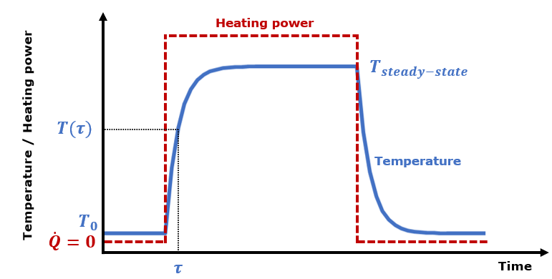
Experimental set-up & measurement procedure
Typical measurement run:
Heat load sweep from 0 to ~ 1000 W/m²
Sweeps done for bath temperatures of 1.8 K, 1.9 K, 2.0 K and 2.1 K
From each measurement point, a steady-state temperature and time constant (with associated temperature) are extracted for each sensor
Typical measurement for each heat input
Experimental set-up
Experiment allows for extraction of:
Steady-state temperature rise as function of applied heat load
Temperature response as function of time
Global and interlayer heat exchange coefficients*
Solid material properties, Kapitza resistance
Qualitative and quantitative* information about He presence in the sample as well as its location within the coil

Slide 9
Contents
Introduction
Experimental campaign
  Sample preparation
  Set-up description and measurement procedure
Typical results and their interpretation
  Example of 11T coil GE-02
11T virgin coil campaign: thermal cycling / He content
MQXF coil (U.S. and CERN production) campaign: heat transfer
Summary
Outlook

Slide 10
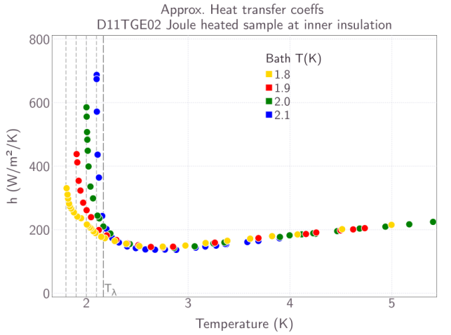
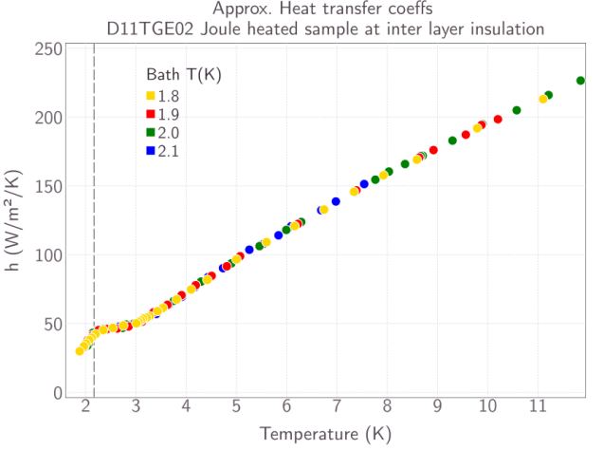
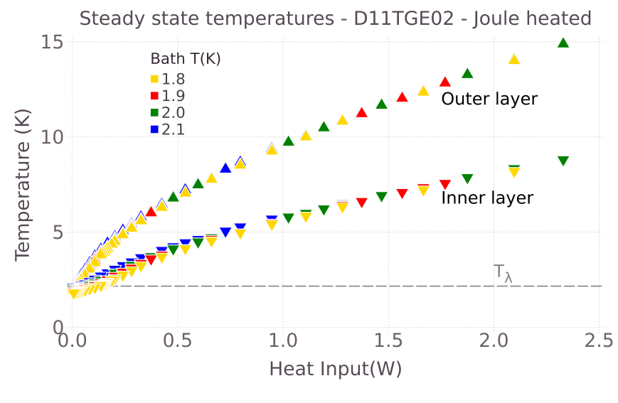
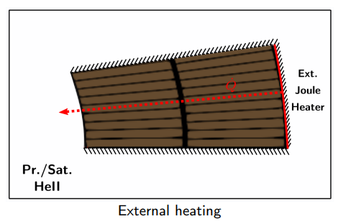
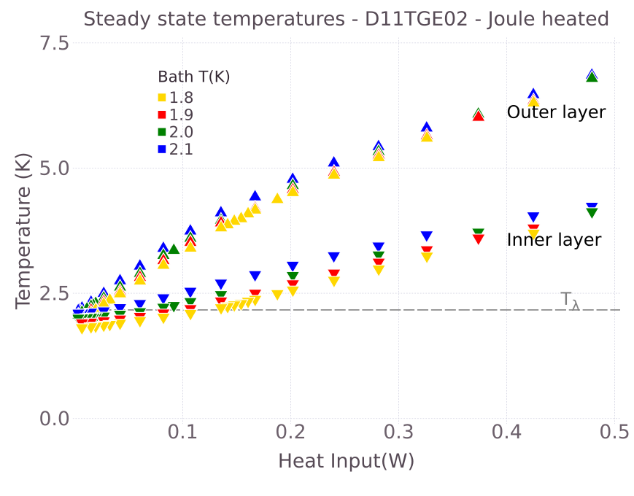
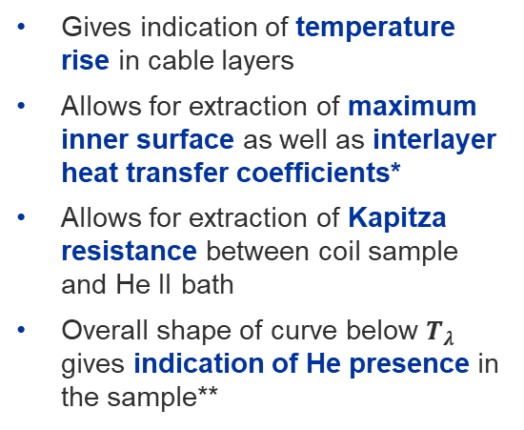
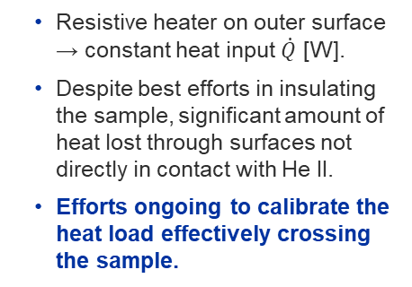
Interpretation of steady-state results
Example: D11T GE-02
Inner layer approx. heat transfer coeffs.
Steady-state results are plotted as steady-state temperature as a function of heat input from the resistive heater
Interlayer approx. heat transfer coeffs.
Steady-state temperature rise
Gives indication of temperature rise in cable layers
Allows for extraction of maximum inner surface as well as interlayer heat transfer coefficients*
Allows for extraction of Kapitza resistance between coil sample and He II bath
Overall shape of curve below $T_{λ}$ gives indication of He presence in the sample**
Resistive heater on outer surface → constant heat input $\dot{Q}$ [W].
Despite best efforts in insulating the sample, significant amount of heat lost through surfaces not directly in contact with He II.
Efforts ongoing to calibrate the heat load effectively crossing the sample.
Courtesy Kirtana Puthran
MSC Seminar Jul 2021
Indico Link

Slide 11
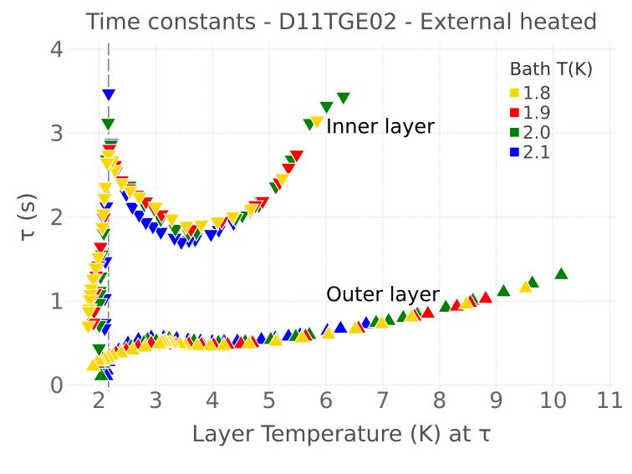
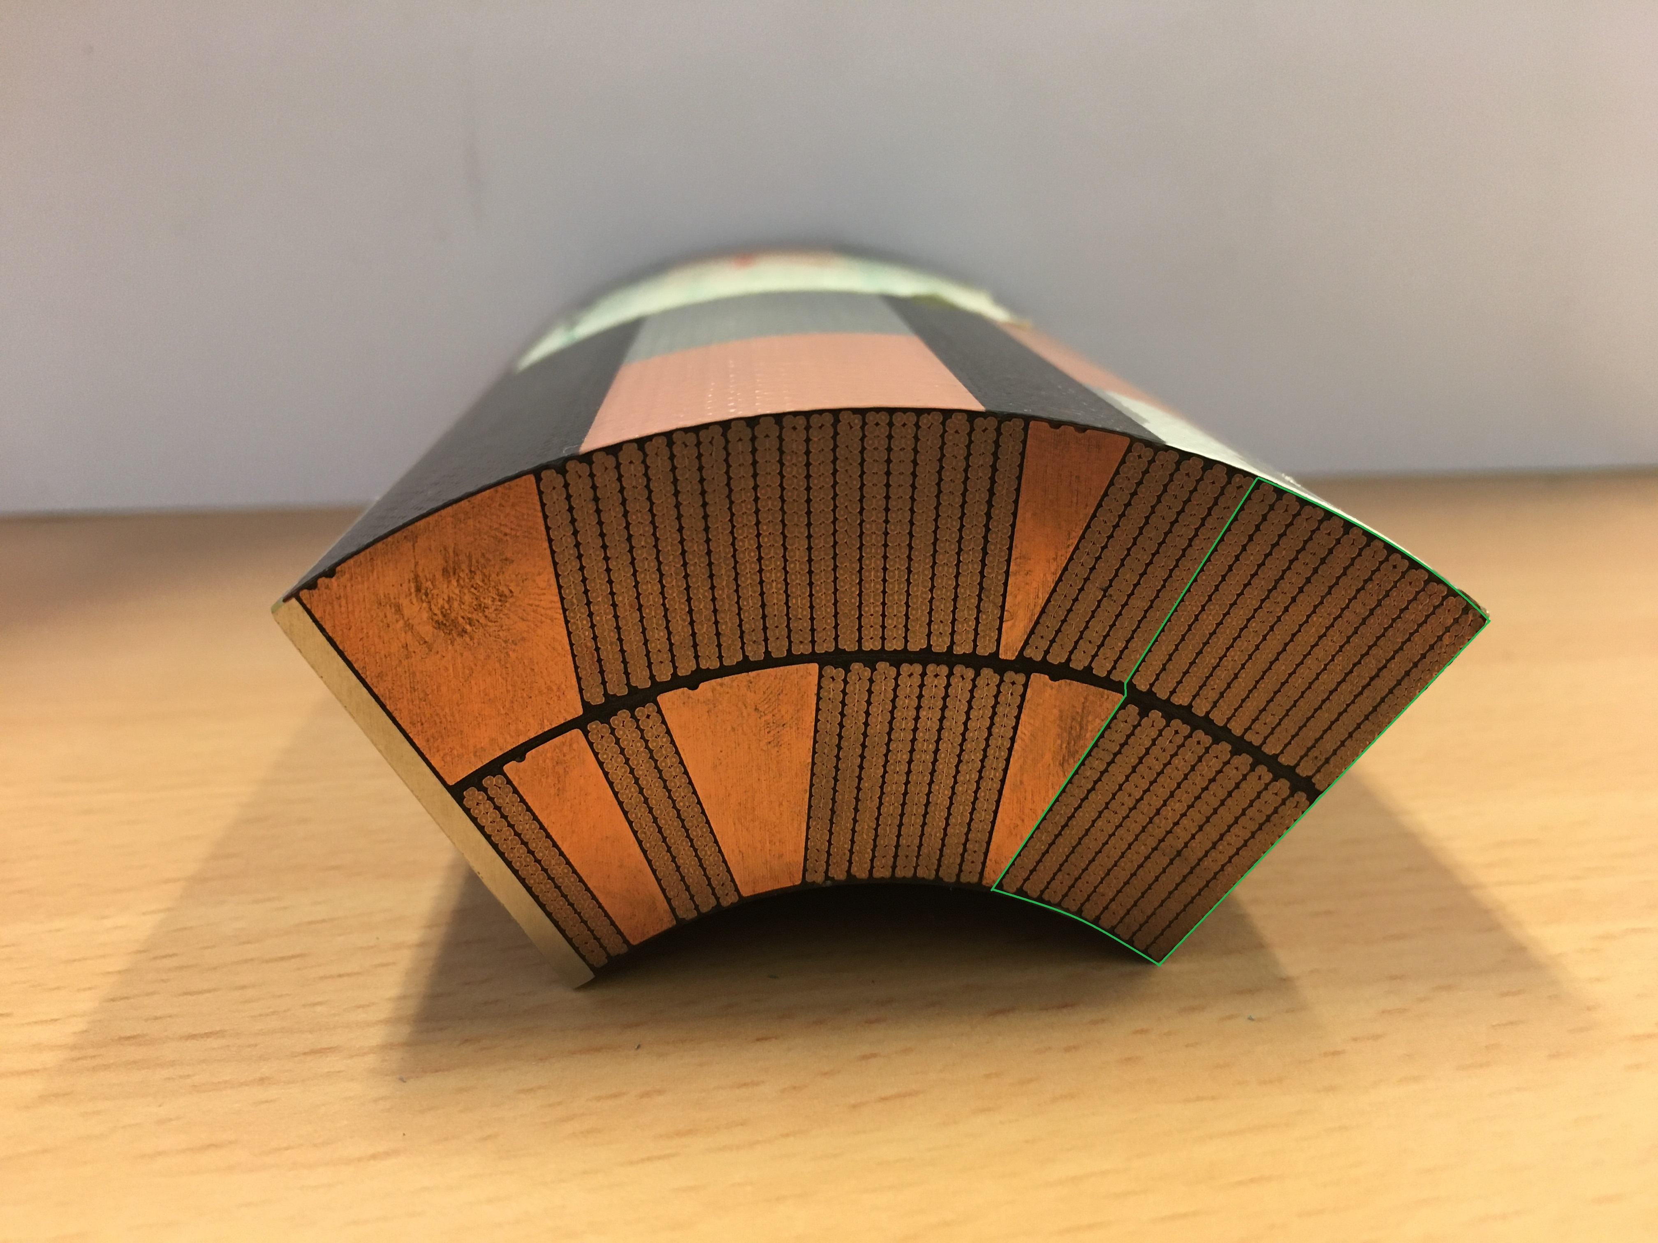
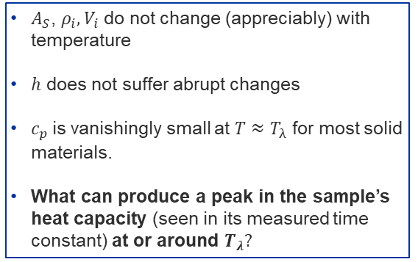

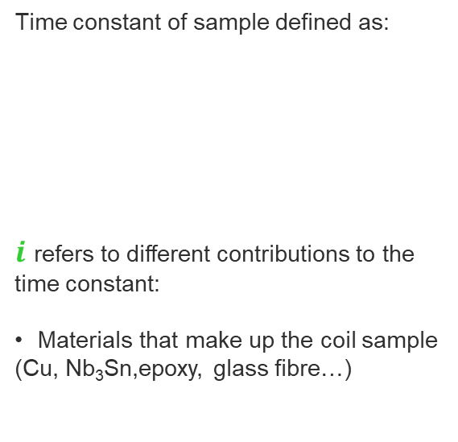
Interpretation of transient results
Example: D11T GE-02
Time constants as function of layer T
Time constant of sample defined as:
$i$ refers to different contributions to the
time constant:
  Materials that make up the coil sample
  (Cu, Nb₃Sn,epoxy, glass fibre…)
$$τ=\sum_{i=0}^{n}{\frac{ρ_{i}{c_{p}}_{i}V_{i}}{hA_{s}}}$$
Courtesy Kirtana Puthran
  $A_{S}$, $ρ_{i}, V_{i}$ do not change (appreciably) with temperature
  $h$ does not suffer abrupt changes
$c_{p}$is vanishingly small at $T≈T_{λ}$ for most solid materials.
What can produce a peak in the sample’s heat capacity (seen in its measured time constant) at or around $T_{λ}?$
11T-GE02
Outer layer
D11T GE-02 inner layer shows unusual behaviour
Inner layer
He II contact

Slide 12
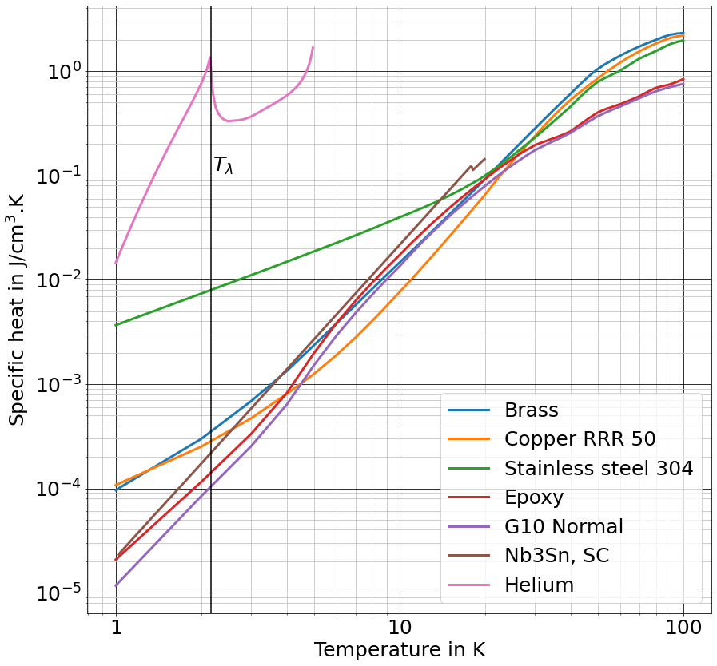
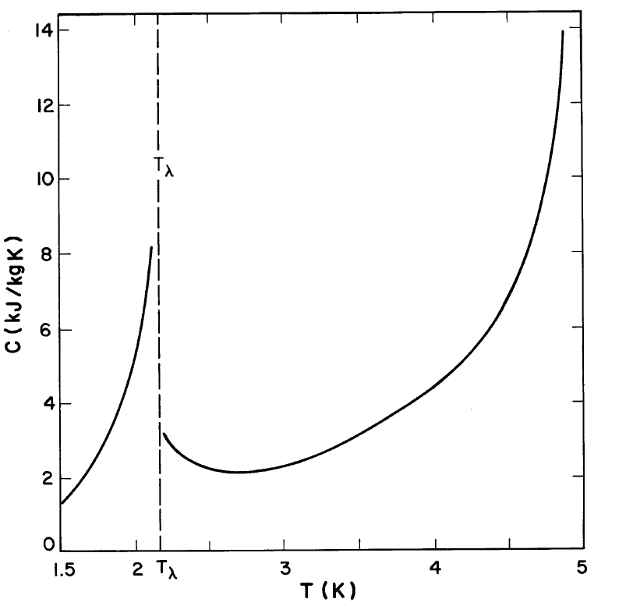
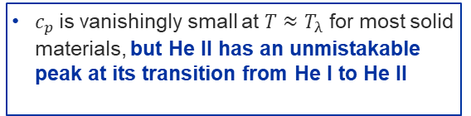

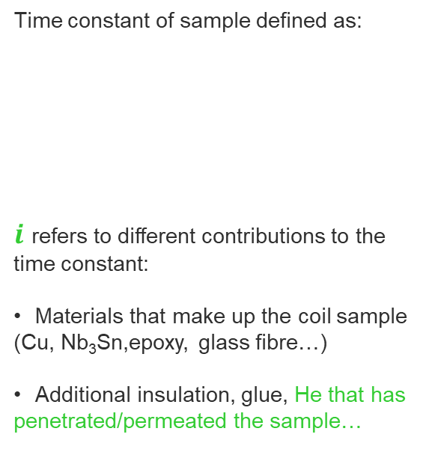

Interpretation of transient results
Example: D11T GE-02
$c_{p}$is vanishingly small at $T≈T_{λ}$ for most solid materials, but He II has an unmistakable peak at its transition from He I to He II
Specific heat of (some) constituent materials of coil sample
Time constant of sample defined as:
$i$ refers to different contributions to the
time constant:
  Materials that make up the coil sample
  (Cu, Nb₃Sn,epoxy, glass fibre…)
  Additional insulation, glue, He that has penetrated/permeated the sample…
$$τ=\sum_{i=0}^{n}{\frac{ρ_{i}{c_{p}}_{i}V_{i}}{hA_{s}}}$$
specific heat of
saturated He around $T_{λ}$
Source: Sciver, S.W. (2012), Helium cryogenics: Second edition
Material data from: HePak, Cryocomp, MATPRO

Slide 13
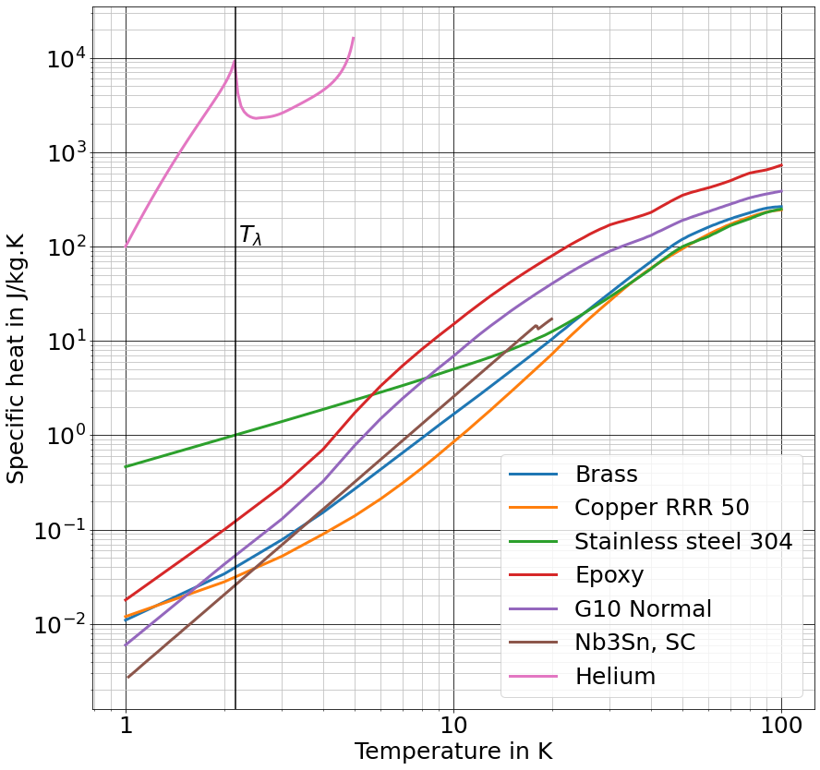
Interpretation of transient results
Example: D11T GE-02
Example: D11T GE-02
Specific heat of (some) constituent materials of coil sample
Time constant of sample defined as:
$i$ refers to different contributions to the
time constant:
  Materials that make up the coil sample
  (Cu, Nb₃Sn,epoxy, glass fibre…)
  Additional insulation, glue, He that has penetrated/permeated the sample…
$$τ=\sum_{i=0}^{n}{\frac{ρ_{i}{c_{p}}_{i}V_{i}}{hA_{s}}}$$
11T-GE02
Outer layer
Inner layer
D11T GE-02 inner layer shows He signature (0.32% by volume fraction estimated)
He II contact
Material data from: HePak, Cryocomp, MATPRO

Slide 14
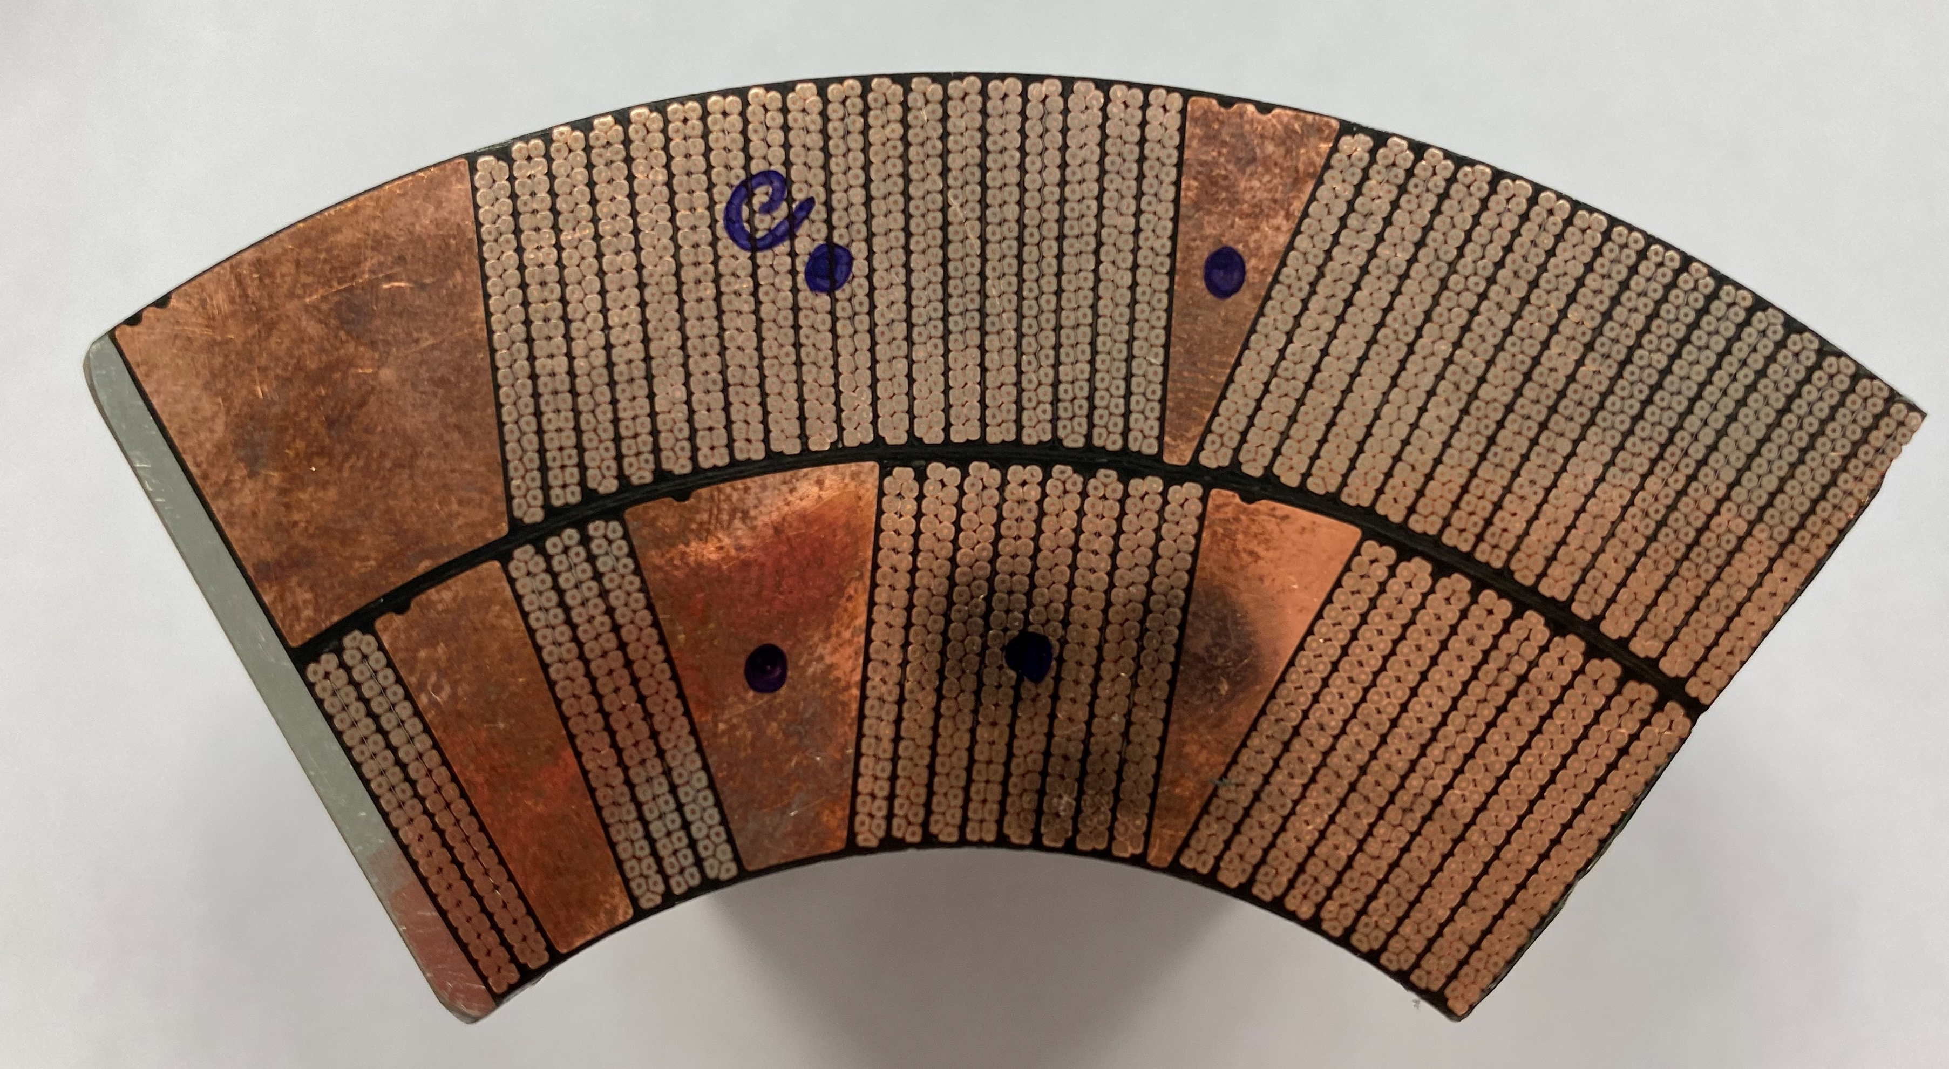
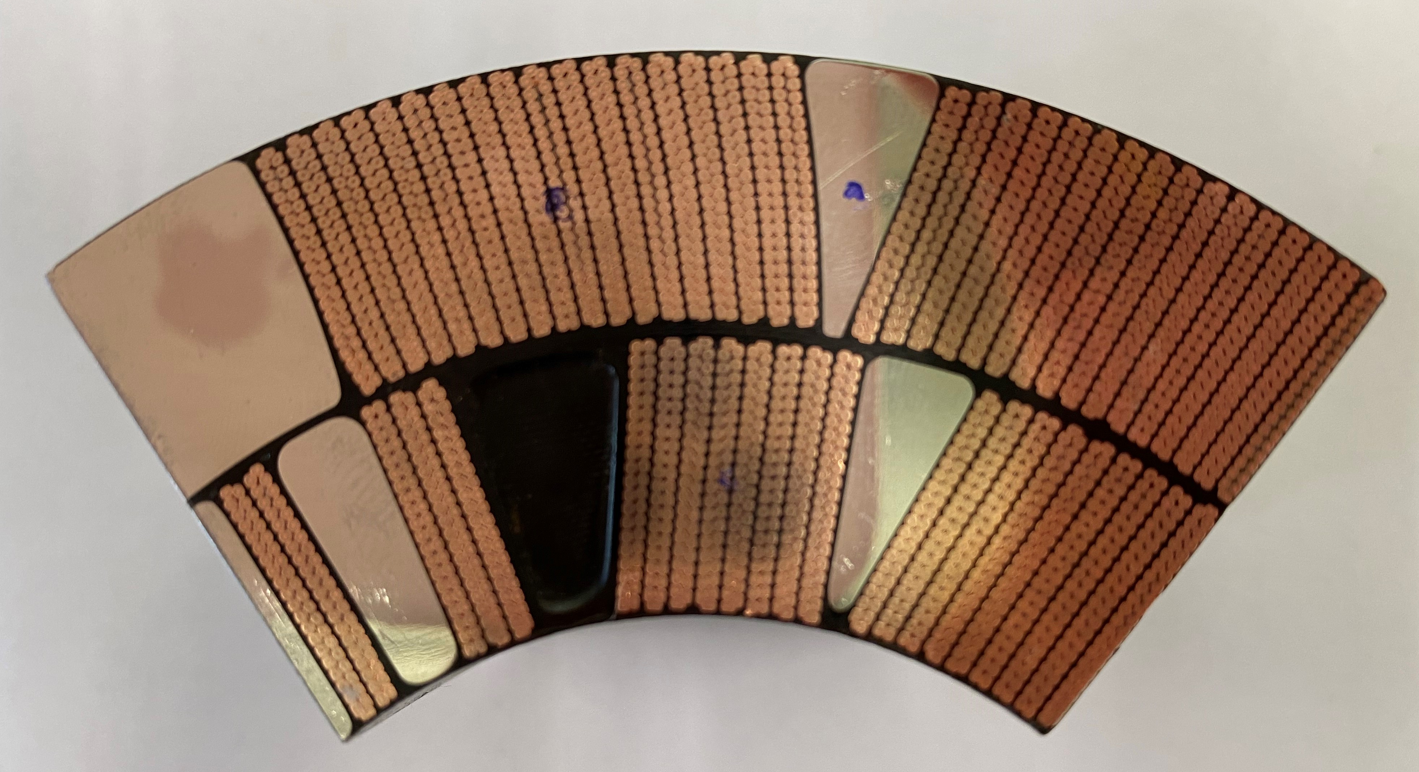
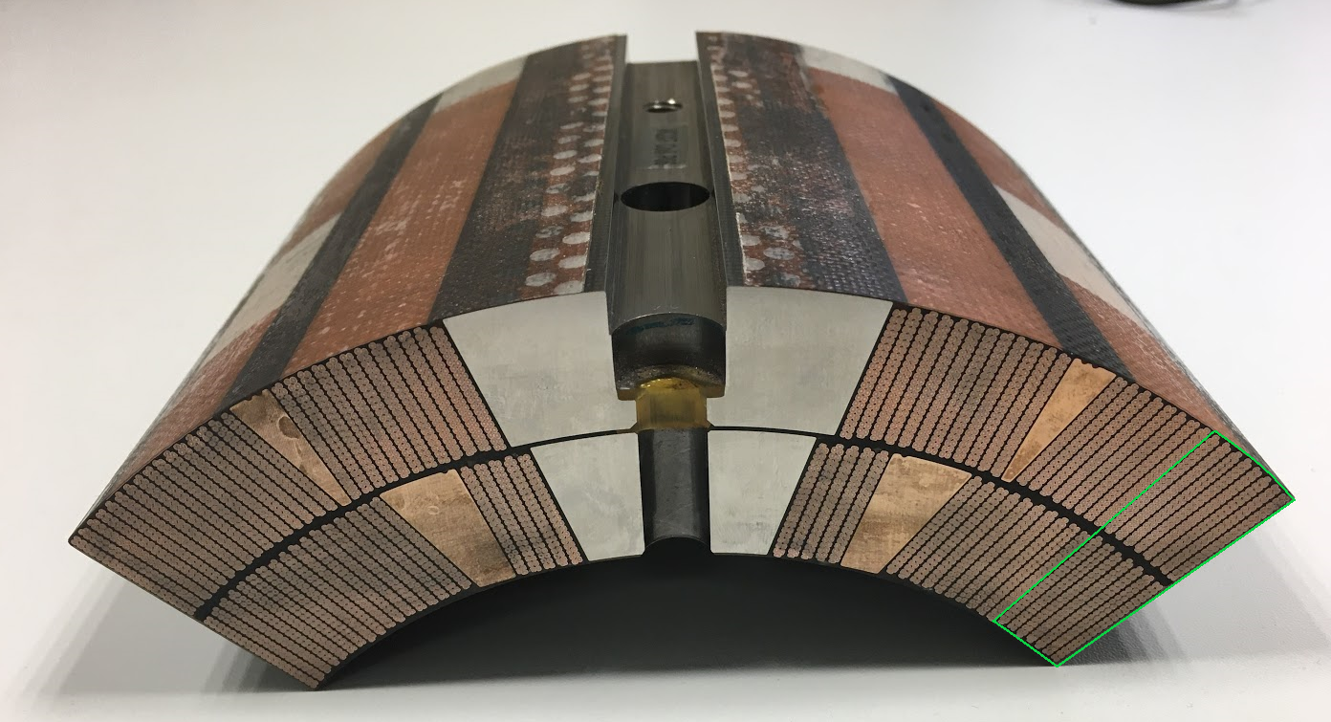
History of measured samples @ the Cryolab
Cryolab Name | MQXF / 11 T | Production / Prototype | Manufacturer | Type of test | Period of testing | # Meas. Runs | He content? | Comments | Coil trace
D11T Proto | 11 T | Prototype | CERN | He II Heat Transfer | 2017 | 1 |  | Induction heating | In-house
MQXF LARP07 | MQXF | Prototype | USA | He II Heat Transfer | 2018/19/20 | 3 |  | Induction heating | LARP (tested in MQXFS3)
D11T GE02 | 11 T | Production | CERN | He II Heat Transfer | 2020 | 1 |  | Induction and Joule Heating | Coil GE02 (HCMBH_C005-01000002)
MQXF P06 | MQXF | Production | USA | He II Heat Transfer | Feb-21 | 2 |  | Joule Heating , Press + Sat conditions | Coil P06, MQXFAP1b
MQXF CR108 | MQXF | Production | CERN | He II Heat Transfer | Oct-21 | 2 |  | Joule Heating, saturated cond. | Coil CR108 S5 cut, CR108-S5-840-975
D11T GE11-LJ | 11T | Production | CERN | He II content / cycling | Summer 2021 | 1 |  | Virgin coil, layer jump | Coil C11, GE11, connection side
D11T GE11-SS | 11T | Production | CERN | He II content / cycling | Summer 2021 | 1 |  | Virgin coil, straight section | Coil C11, GE11, connection side
See link for Kirtana’s presentation
This presentation
11T-GE02
MQXF-P06
11T-GE11-SS
11T-GE11-LJ
MQXF-CR108-S5

Slide 15
Contents
Introduction
Experimental campaign
  Sample preparation
  Set-up description and measurement procedure
Typical results and their interpretation
  Example of 11T coil GE-02
11T virgin coil campaign: thermal cycling / He content
MQXF coil (U.S. and CERN production) campaign: heat transfer
Summary
Outlook

Slide 16
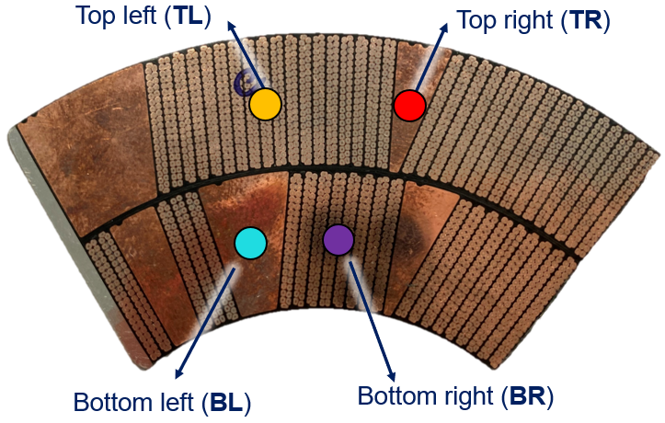
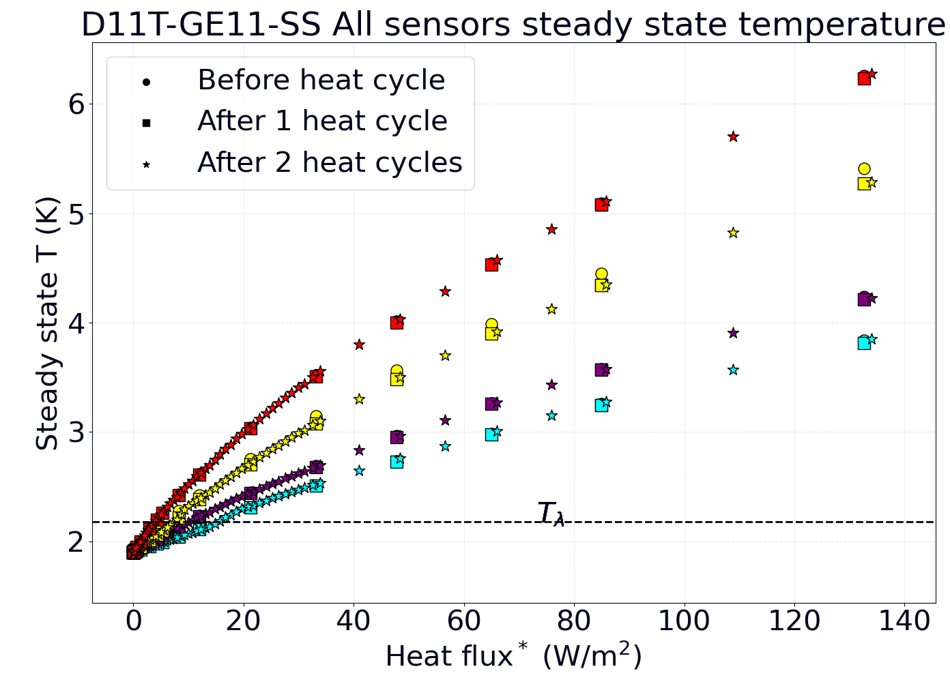
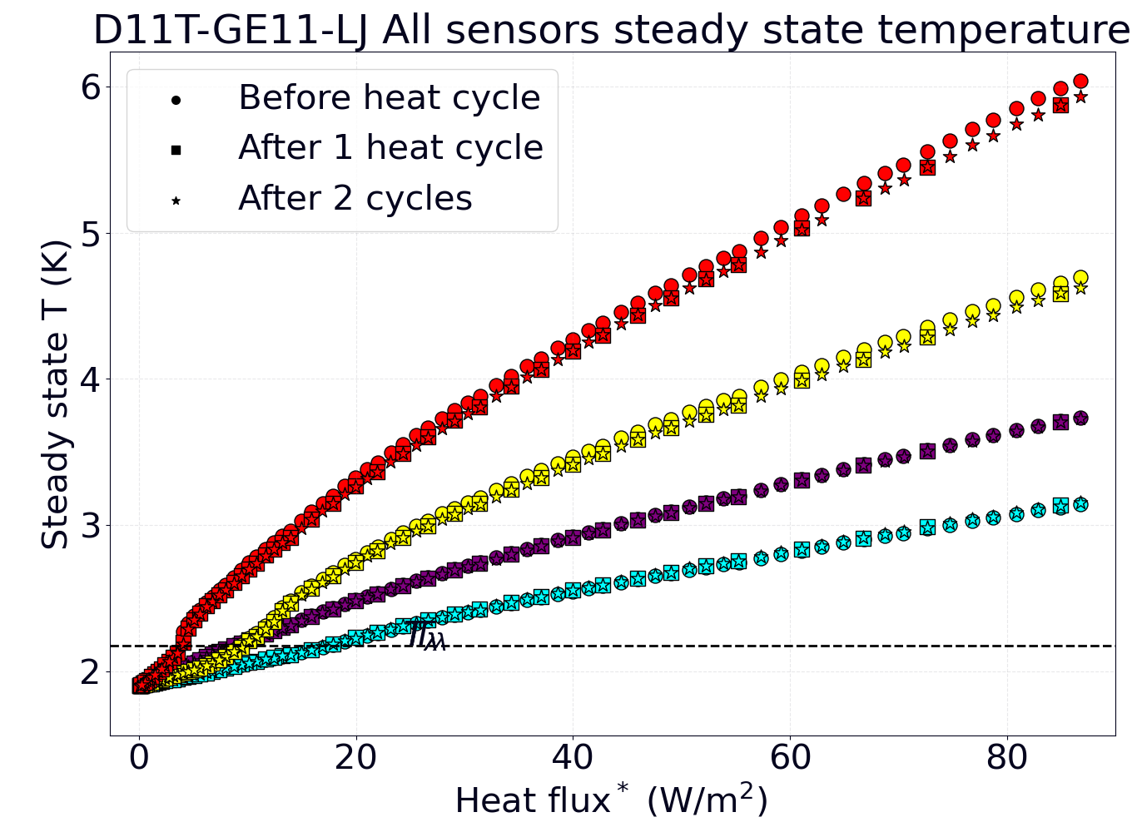
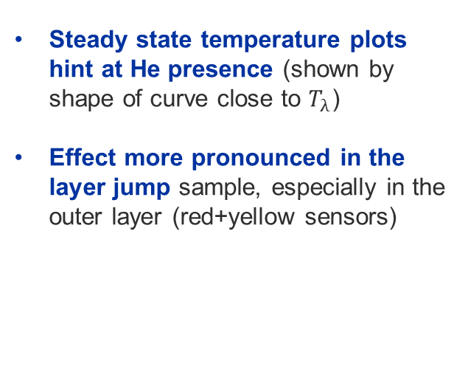
11T virgin coil GE11 – Thermal cycling
Triggered by the 11T Task Force, report in EDMS no. 2649442 (link)
Both samples from connection side of 11T coil GE11 (virgin coil), one from the straight section and one from the layer jump zone
Thermal cycling (from 1.9 K to 25 K): scans pre-cycle, after 35, after 70 cycles.
D11T-GE11-SS (straight section)
D11T-GE11-LJ (layer jump)
Steady state temperature plots hint at He presence (shown by shape of curve close to $T_{λ}$)
Effect more pronounced in the layer jump sample, especially in the outer layer (red+yellow sensors)
After cooldown
After 35 cycles
After 70 cycles
After cooldown
After 35 cycles
After 70 cycles
* Applied heat flux

Slide 17
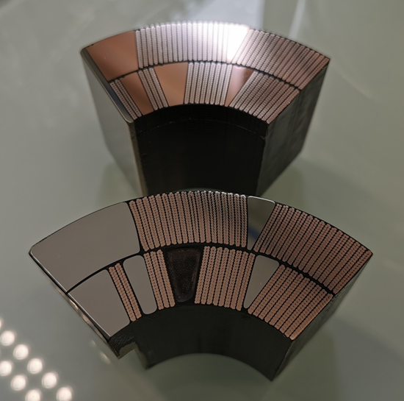
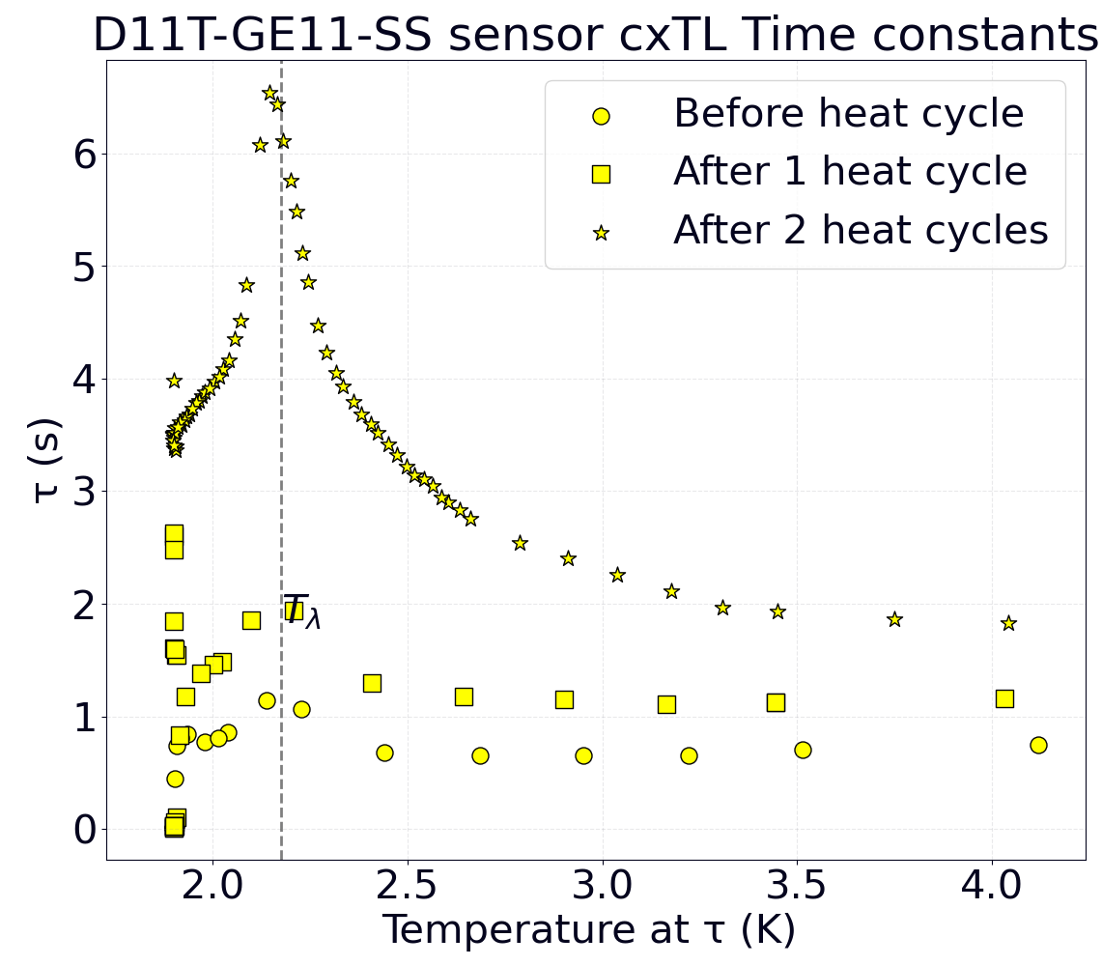
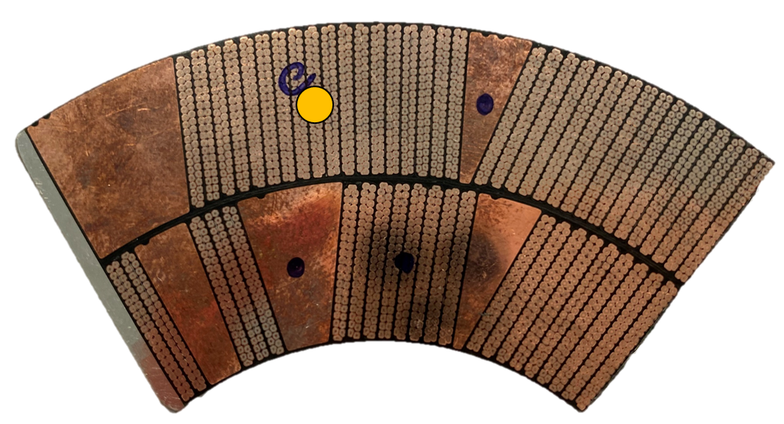
11T virgin coil GE11 – Thermal cycling
Straight section
D11T-GE11-SS
Triggered by the 11T Task Force, report in EDMS no. 2649442 (link)
Both samples from connection side of 11T coil GE11 (virgin coil), one from the straight section and one from the layer jump zone
Thermal cycling (from 1.9 K to 25 K): scans pre-cycle, after 35, after 70 cycles.
Peaks at or near T_{λ} indicate presence of He in the coil
Layer jump
D11T-GE11-LJ
D11T-GE11-SS (straight section)
After cooldown
After 35 cycles
After 70 cycles

Slide 18

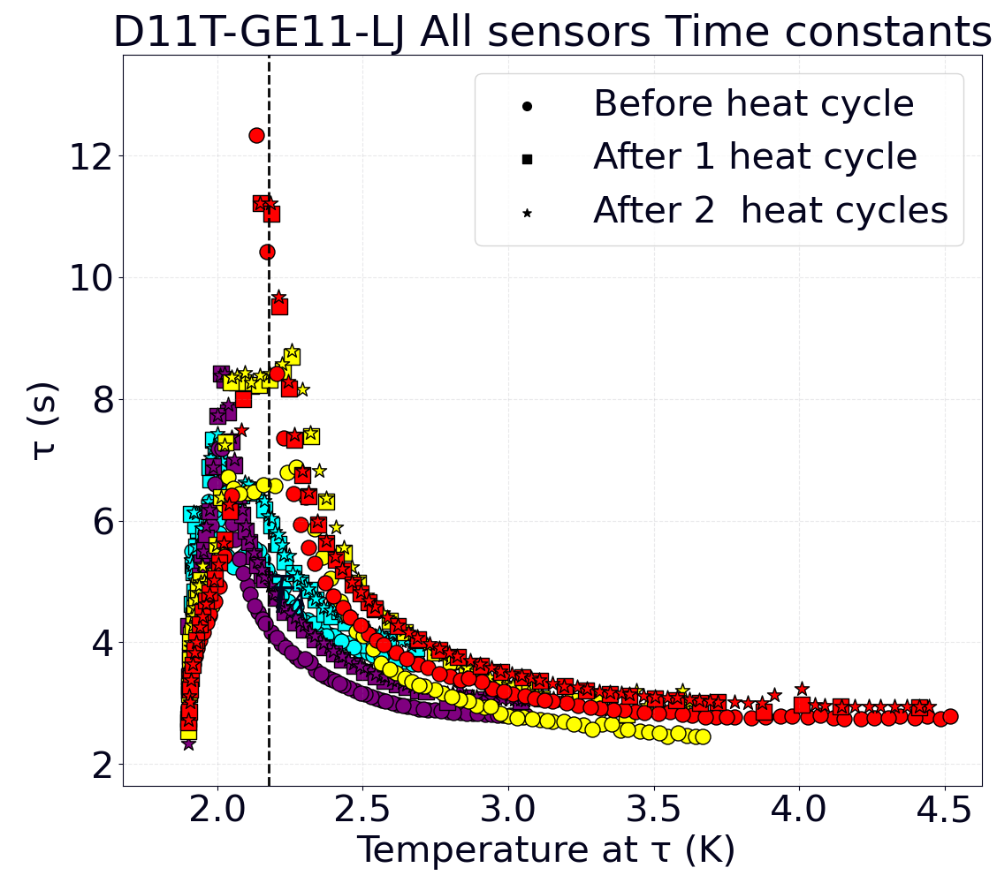
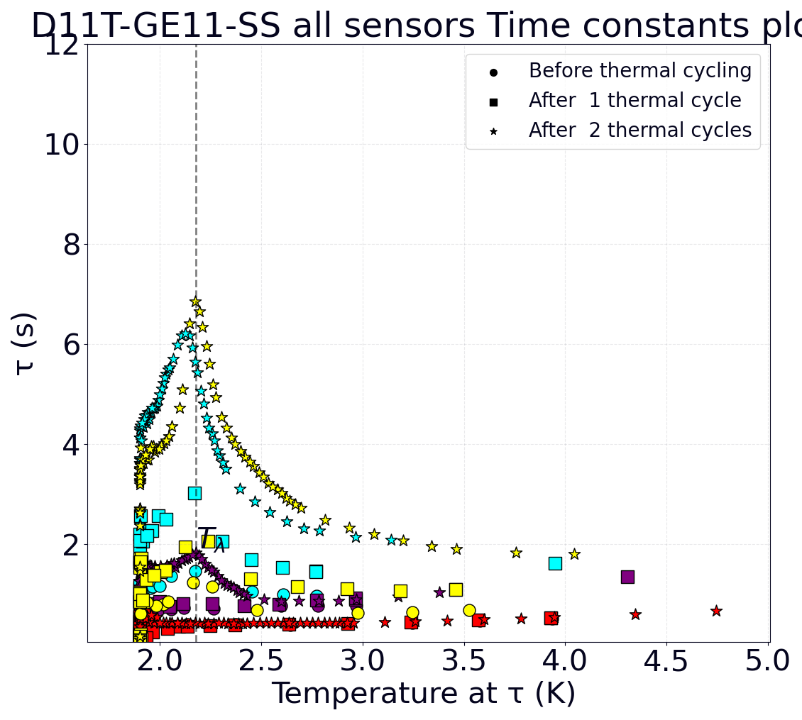
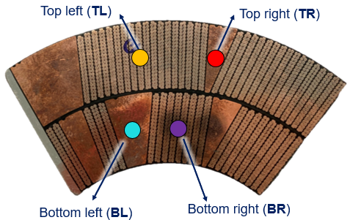
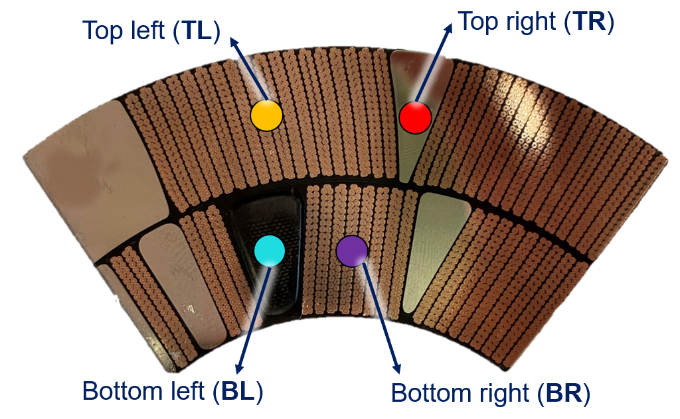
11T virgin coil GE11 – Thermal cycling
Straight section
D11T-GE11-SS
Triggered by the 11T Task Force, report in EDMS no. 2649442 (link)
Both samples from connection side of 11T coil GE11 (virgin coil), one from the straight section and one from the layer jump zone
Thermal cycling (from 1.9 K to 25 K): scans pre-cycle, after 35, after 70 cycles.
Peaks at or near T_{λ} indicate presence of He in the coil
Layer jump
D11T-GE11-LJ
D11T-GE11-SS (straight section)
D11T-GE11-LJ (layer jump)
Results show a clear He signature that is present even before cycling and that evolves dramatically with increased number of (modest) thermal cycles.
In more inhomogeneous parts of the coil, He presence is pronounced from the start but does not noticeably increase further.
After cooldown
After 35 cycles
After 70 cycles
After cooldown
After 35 cycles
After 70 cycles

Slide 19
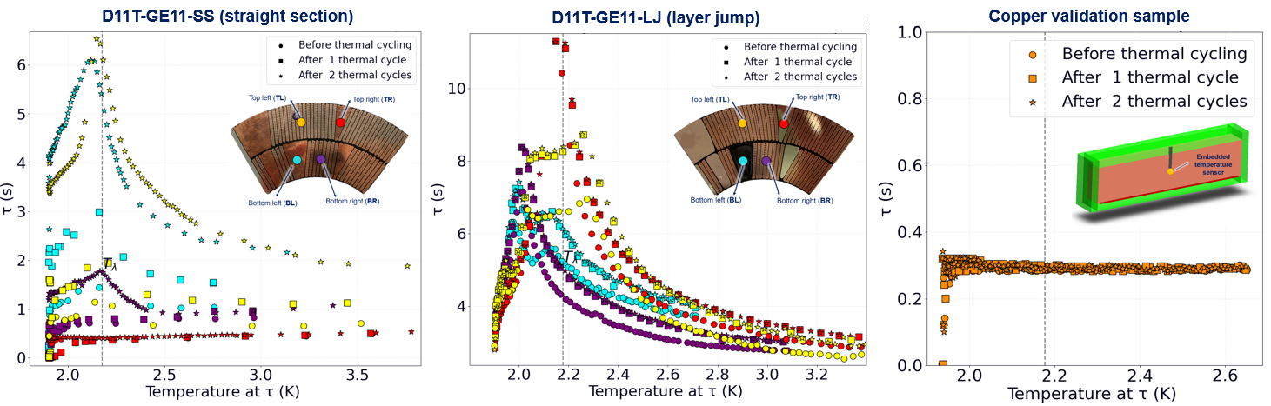
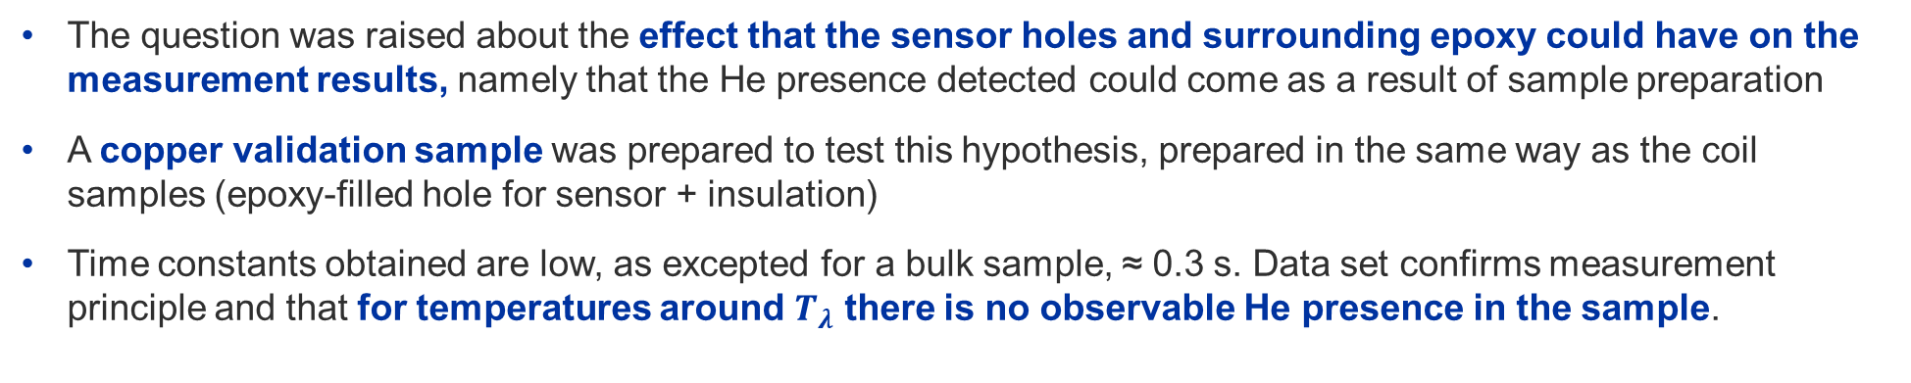
11T virgin coil GE11 – Thermal cycling
The question was raised about the effect that the sensor holes and surrounding epoxy could have on the measurement results, namely that the He presence detected could come as a result of sample preparation
A copper validation sample was prepared to test this hypothesis, prepared in the same way as the coil samples (epoxy-filled hole for sensor + insulation)
Time constants obtained are low, as excepted for a bulk sample, ≈ 0.3 s. Data set confirms measurement principle and that for temperatures around $T_{λ}$ there is no observable He presence in the sample.
Before cycling
After 35 cycles
After 70 cycles
Before cycling
After 35 cycles
After 70 cycles
Before cycling
After 35 cycles
After 70 cycles

Slide 20
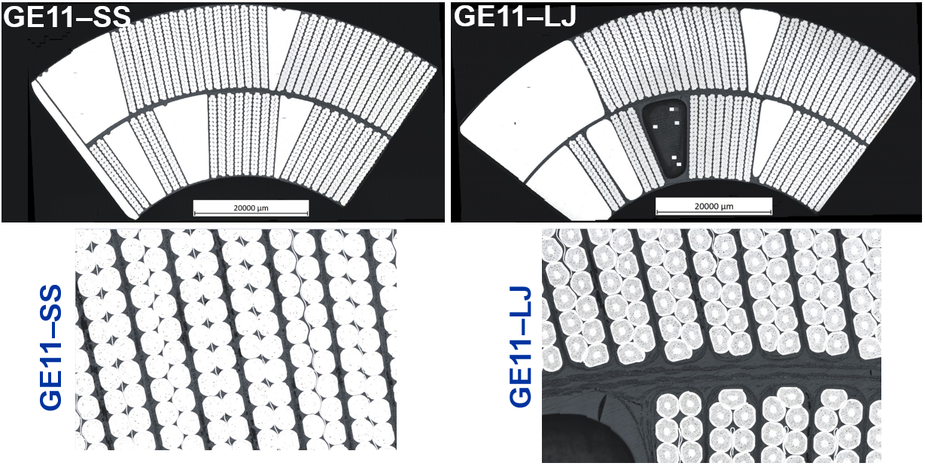
11T virgin coil GE11 – Results EN/MME
Work carried out by EN/MME, their findings reported in EDMS 2646199 (link)
Macro- and micro-optical imaging of samples before the thermal cycling tests
Cavities can be observed in the resin/glass fibre system located in the interlayer and between cables.
Before sample prep + cycling
Courtesy M. Crouvizier, S. Sgobba

Slide 21
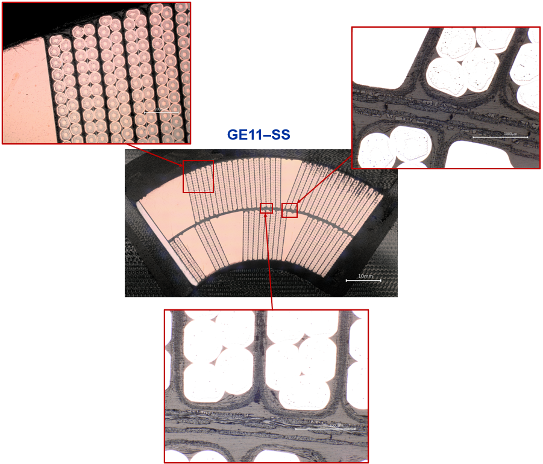
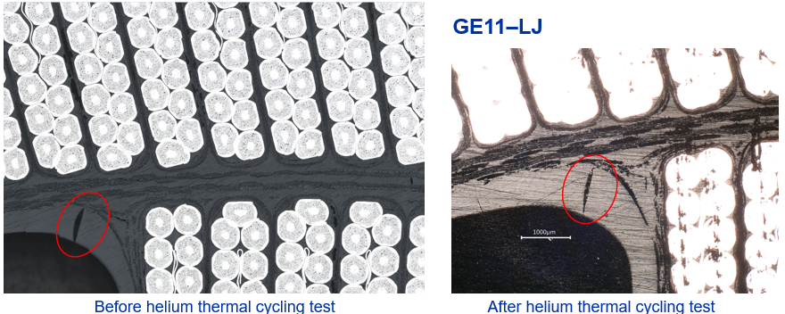
11T virgin coil GE11 – Results EN/MME
Extra machining/preparation required, making one-to-one comparison difficult
GE11-SS: new population of imperfections observed, however the same kind and number of cracks and cavities were observable in the insulation after the test.
GE11-LJ: a deep cavity could still be observed after removal of approx. 150 μm.
To the extent of present examination, thermal cycling in He II seems not to lead to a visible further development of micro-cracks and cavities.
Before → after cycling
After cycling
Courtesy M. Crouvizier, S. Sgobba

Slide 22
Contents
Introduction
Experimental campaign
  Sample preparation
  Set-up description and measurement procedure
Typical results and their interpretation
  Example of 11T coil GE-02
11T virgin coil campaign: thermal cycling / He content
MQXF coil (U.S. and CERN production) campaign: heat transfer
Summary
Outlook

Slide 23
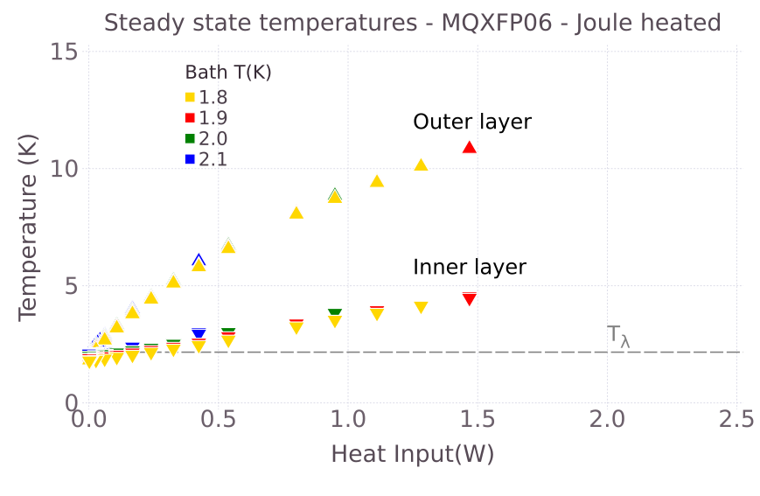
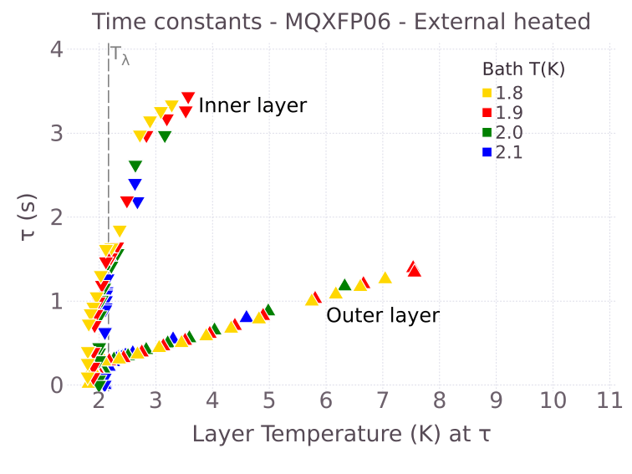
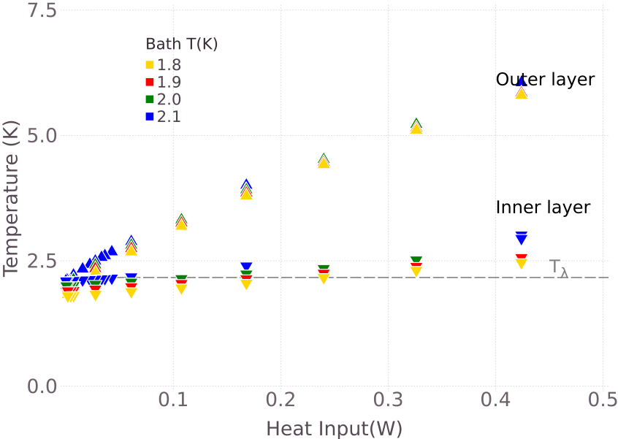
MQXF coil P06 (U.S. production) – Results
MQXF specimen cut from coil P06, which was tested in MQXFAP1b
It is made of the final conductor (RRP108/127)
No signs of He presence
Steady-state behaviour – MQXF P06 (US prod.)
Transient behaviour – MQXF P06 (US prod.)

Slide 24
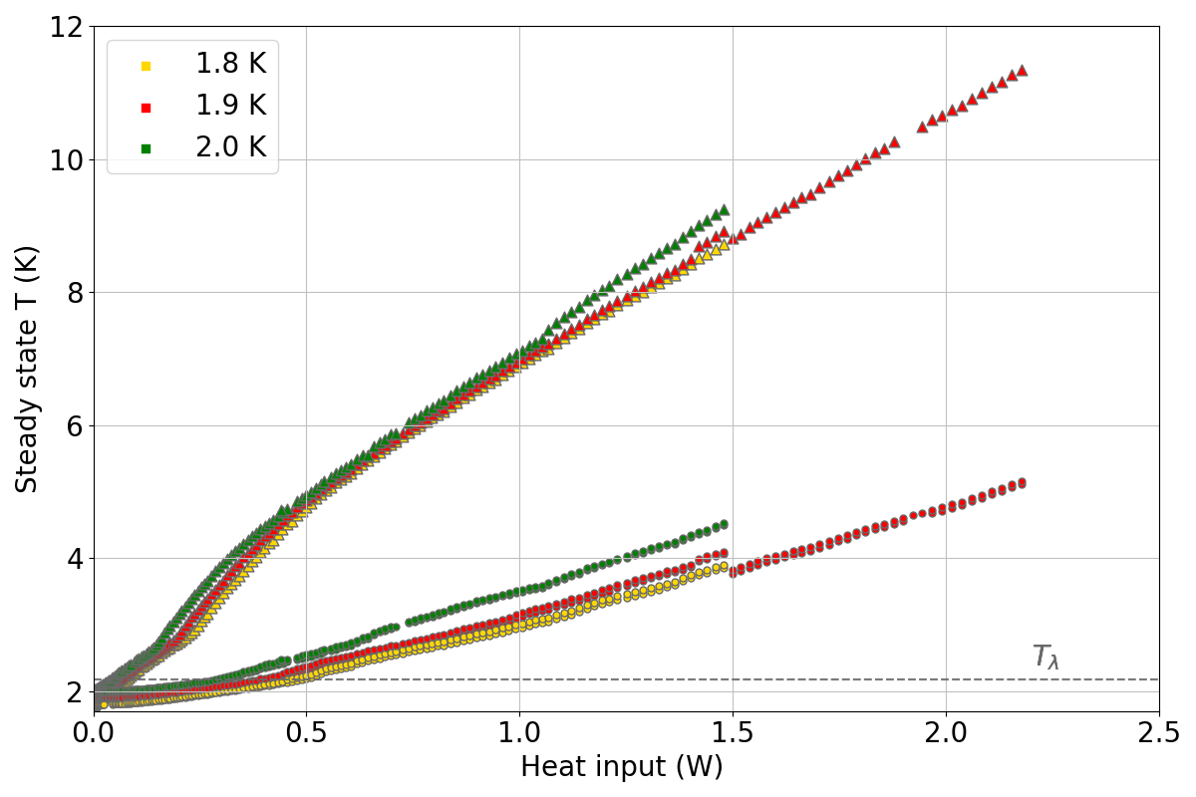
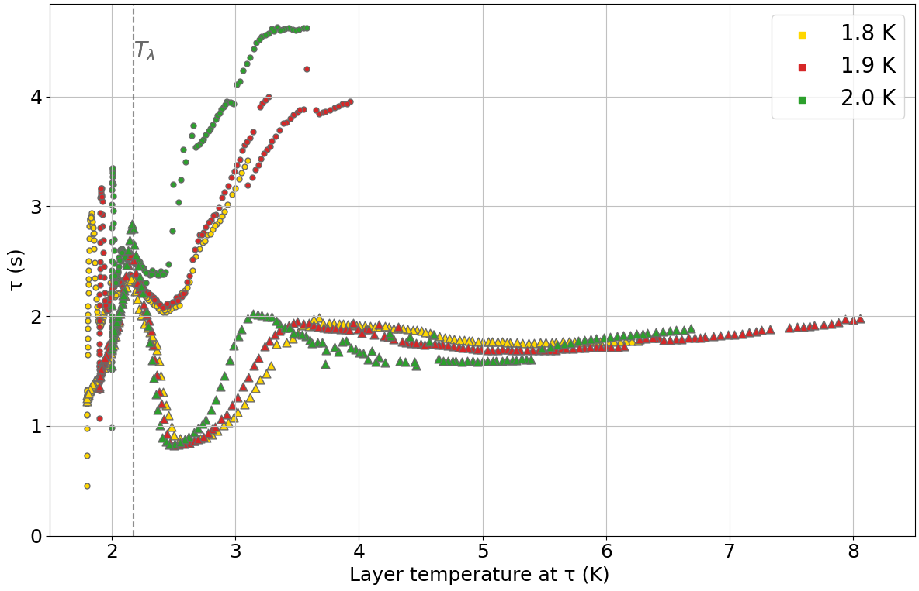

MQXF coil CR108 (CERN production) – Results
MQXF specimen cut from coil CR108, section S5, which was tested in MQXFBP1
Source: https://indico.cern.ch/event/1034788/
He presence signature, i.e. λ-peak shape due to c_{p} of helium
Steady-state behaviour – MQXF CR108-S5 (CERN prod.)
Transient behaviour – MQXF CR108-S5 (CERN prod.)
Inner layer
Outer layer
Inner layer
Outer layer

Slide 25

MQXF coil CR108 (CERN production) – Results
MQXF specimen cut from coil CR108, section S5, which was tested in MQXFBP1
Source: https://indico.cern.ch/event/1034788/
He presence signature, i.e. λ-peak shape due to c_{p} of helium
Steady-state behaviour – MQXF CR108-S5 (CERN prod.)
Transient behaviour – MQXF CR108-S5 (CERN prod.)
Outer layer
Inner layer

Slide 26

Side-by-side comparison: MQXF P06 vs. CR108
Transient behaviour – MQXF P06 (US prod.)
Transient behaviour – MQXF CR108-S5 (CERN prod.)
Inner layer
Outer layer
P06: No signs of He presence
CR108-S5: He presence signature

Slide 27





MQXF: visual inspection of cut samples
MQXF P06 (U.S. production)
Only two cross-sections of whole coils,
Same features may be present on both
MQXF CR108 (CERN production)

Slide 28
Summary of measured samples @ the Cryolab
Cryolab Name | MQXF / 11 T | Production / Prototype | Manufacturer | Type of test | Period of testing | # Meas. Runs | He content? | Comments | Coil trace
D11T Proto | 11 T | Prototype | CERN | He II Heat Transfer | 2017 | 1 | Yes – in both layers | Induction heating | In-house
MQXF LARP07 | MQXF | Prototype | USA | He II Heat Transfer | 2018/19/20 | 3 | Yes – in both layers | Induction heating | LARP (tested in MQXFS3)
D11T GE02 | 11 T | Production | CERN | He II Heat Transfer | 2020 | 1 | Yes - in inner layer | Induction and Joule Heating | Coil GE02 (HCMBH_C005-01000002)
MQXF P06 | MQXF | Production | USA | He II Heat Transfer | Feb-21 | 2 | No indication of He presence | Joule Heating , Press + Sat conditions | Coil P06, MQXFAP1b
MQXF CR108 | MQXF | Production | CERN | He II Heat Transfer | Oct-21 | 2 | Yes – in both layers | Joule Heating, saturated cond. | Coil CR108 S5 cut, CR108-S5-840-975
D11T GE11-LJ | 11T | Production | CERN | He II content / cycling | Summer 2021 | 1 | Yes - in both layers | Virgin coil, layer jump | Coil C11, GE11, connection side
D11T GE11-SS | 11T | Production | CERN | He II content / cycling | Summer 2021 | 1 | Yes - in both layers | Virgin coil, straight section | Coil C11, GE11, connection side
11T-GE02
MQXF-P06
11T-GE11-SS
11T-GE11-LJ
MQXF-CR108-S5

Slide 29

MQXF coil impregnation – CERN process evolution
Tested at Cryolab
Coils on MQXFBP3
Courtesy: D. Tommasini

Slide 30
Contents
Introduction
Experimental campaign
  Sample preparation
  Set-up description and measurement procedure
Typical results and their interpretation
  Example of 11T coil GE-02
11T virgin coil campaign: thermal cycling / He content
MQXF coil (U.S. and CERN production) campaign: heat transfer
Summary
Outlook

Slide 31
Summary I – General
Most CERN-made production samples of both 11T and MQXF show a strong signature of He presence, hinting at differences in the coil impregnation
Measurements on 11T coil samples show that this signature is present even for previously virgin (i.e. non-cooled, non-powered) coils, and that it evolves with thermal cycling. Visual inspections support this observation. Effects are more pronounced in the more inhomogeneous parts of the coil.
US-made production MQXF coil sample (P06) shows no signs of He presence.
Temperature at which resin outgassing is carried out differs between US- and CERN-produced coils (for all measured coil samples): CERN outgassing T = 80 °C (< 3h), for US T = 110 °C (24h)

Slide 32
Summary II – 11T specific
Thermal cycling tests carried out in virgin 11T coil GE11 samples show that there are cracks/pores from the start, and that these evolve with cycling; usually other tested samples have already seen cycling/quenches.
Metallography analysis carried out by EN/MME shows cracks in both resin and cables
Sample from 11T coil GE02 was sent to TE/VSC for investigation of He diffusion/outgassing. Results show that the coil sample is porous, and that He is embedded into the bulk.
TE/VSC comments that the shape of He outgassing rate is unconventional and cannot be explained solely by diffusion. Also observed that there was a significant amount of water outgassing, which TE/VSC attributes to the resin and comments is to be expected.

Slide 33
Outlook
Ongoing efforts to accurately quantify the heat losses through the insulation, exploring new sample preparation / measurement solutions
  Previous and present results provide a maximum heat transfer coefficient
  Further reducing heat losses can provide more accurate values
  Heat transfer coefficients / Kapitza resistance can be highly sample-dependent
Obtained material properties are valuable input for simulations of temperature maps of full coils
  11T presented by Kirtana Puthran (link)
  MQXF ongoing, results expected this spring
Possibility of testing state-of-the-art coil samples (w.r.t. insulation) remains open

