Slide 1
CLIC Drive Beam Decelerator Quadrupoles
Progress on PM option
Ben Shepherd & Neil Marks
2 July 2010

Slide 2
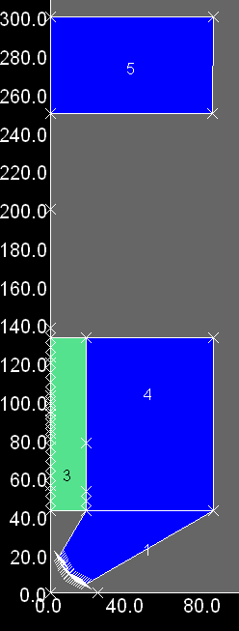
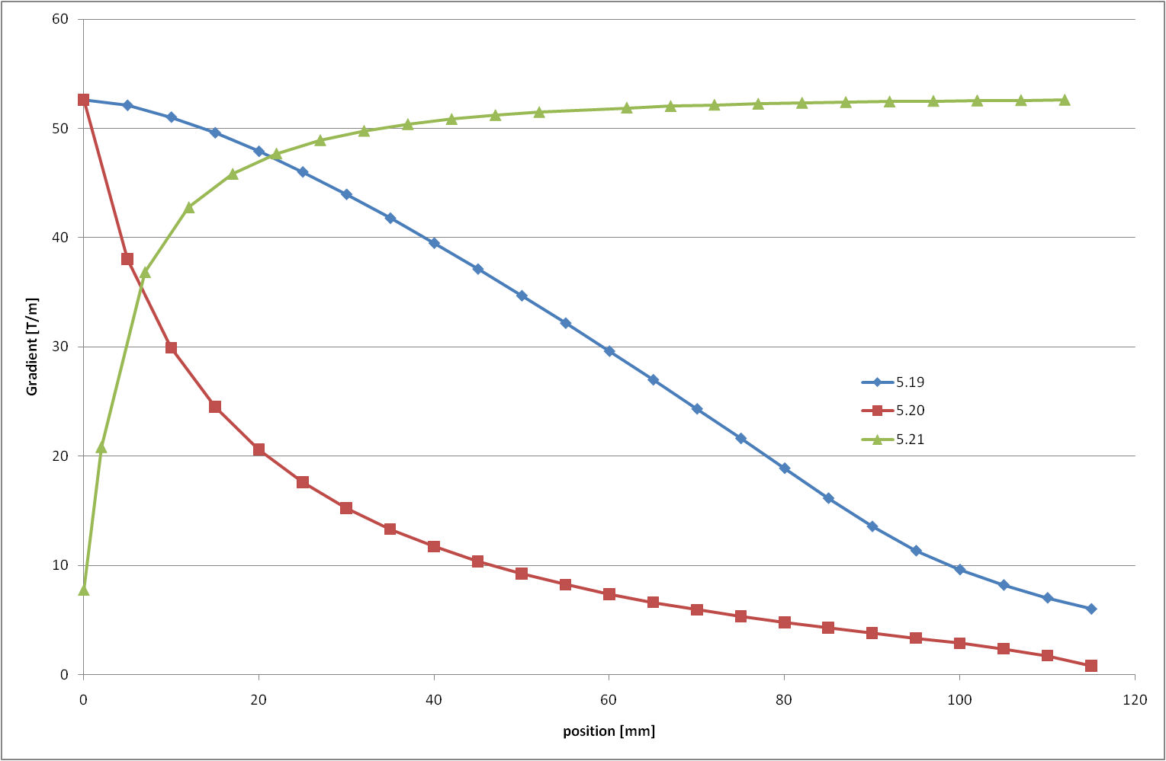
Previously
Three models starting from the same baseline geometry but different moving parts
Gradient variation: 18%...124% of nominal
Bigger than specified envelope (with cap)
120% 14.6T
← envelope limit
100% 12.2T
70% 8.5T

Slide 3
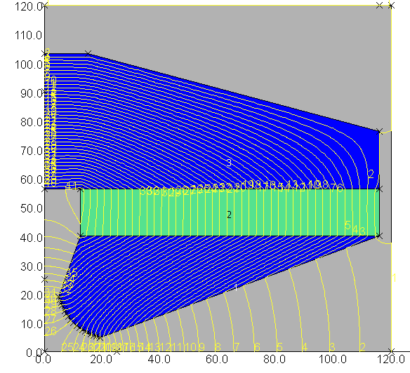
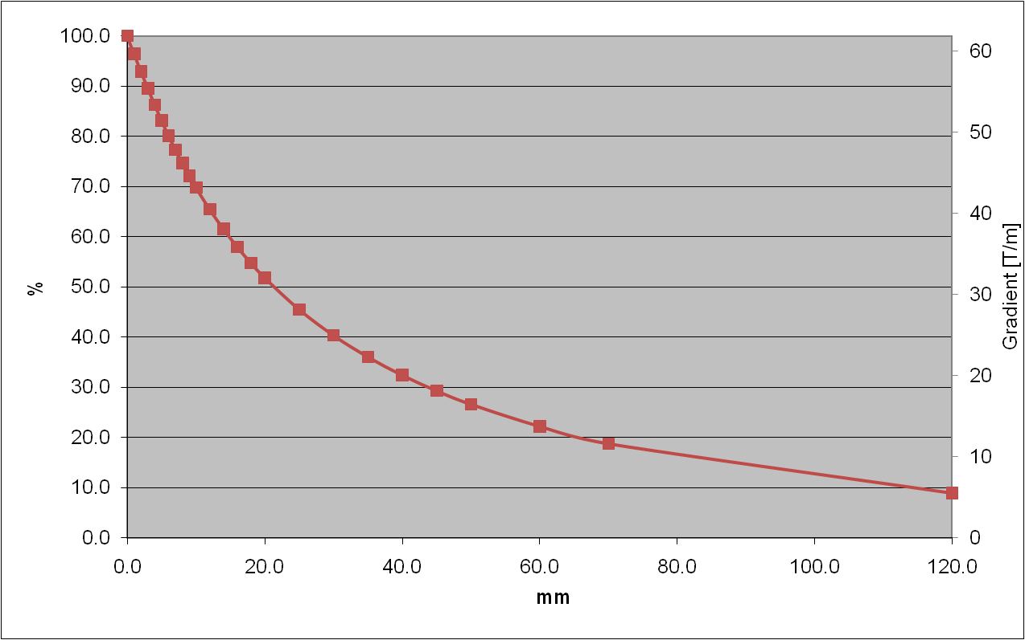
New model: NM11
More options!
Four vertically-magnetised blocks moving vertically
Gradient range: 5.5...62T/m (~10T/m min staying within envelope)
envelope limit →

Slide 4
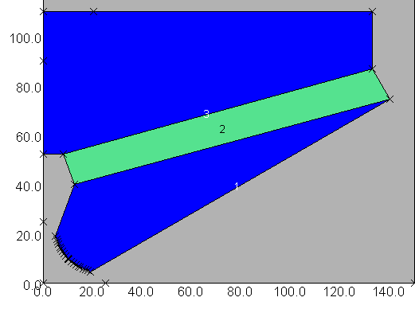
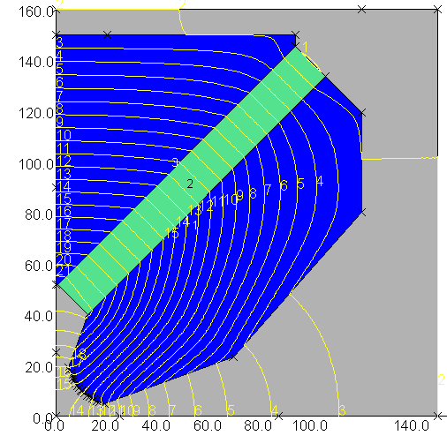
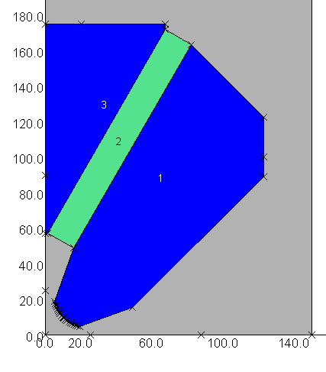
Adjust angle of PM
Working point of PM (in all previous models) was not optimal (B = 0.79T in NM11)
  VACODYM 837 has highest energy density at B = 0.613T
Attempt to improve energy density in PM: place it at an angle to the horizontal
Also helps with forces and sensitivity to movement
NM13: 15° (0.67T)
NM16: 45° (0.78T)
NM18: 60° (0.78T)

Slide 5
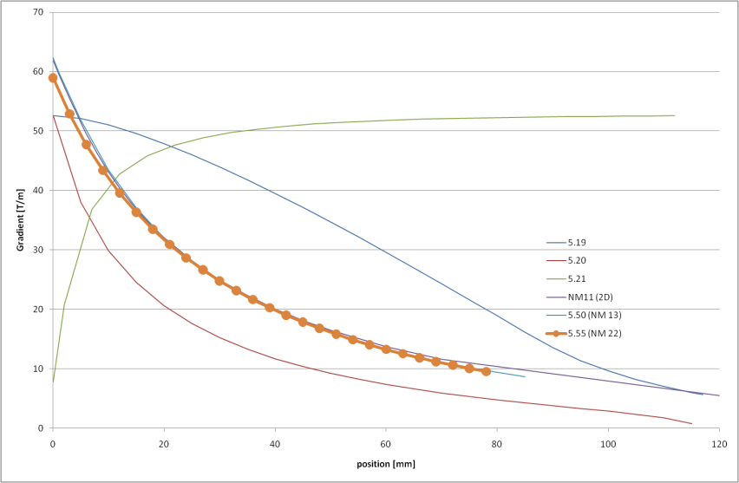
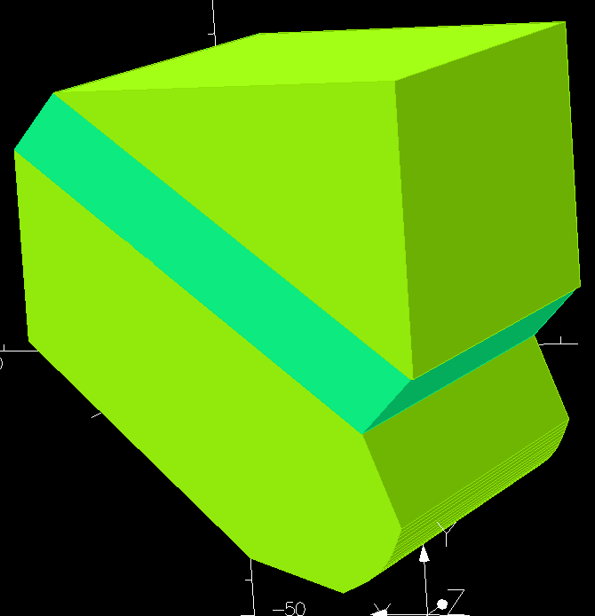
Optimisation of angled PM design
Some adjustment of PM cross-section and angle was carried out in 2D
Best design: 100x16mm PM at 40°
  2D results: 66T/m down to 8T/m (12%)
3D modelling: 59T/m down to 10T/m (16%)

Slide 6
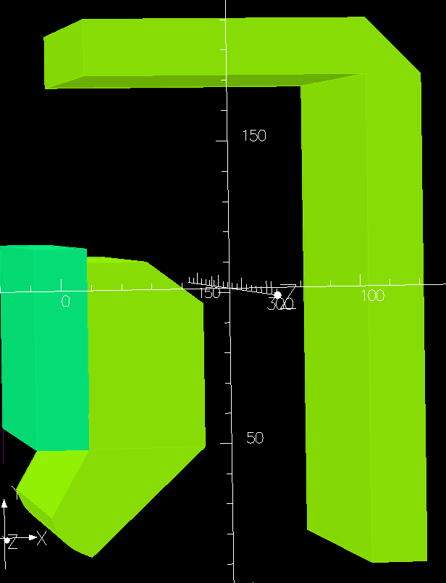
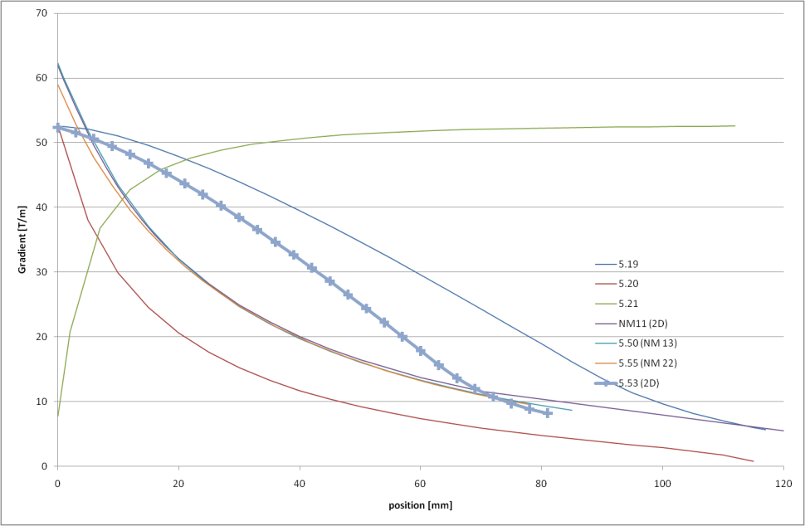
Improvement of 5.19 (moving PM)
5.19 was most promising model last time
Removed cap, tried to reduce height (and flux density in steel) while keeping low minimum gradient
‘Shell’ added to shunt flux at low gradient
In 2D: gradient 52...8T/m (16%)
In 3D: max gradient 49T/m (not enough)
Gradient variation calculated in 2D

Slide 7
Comparison of models
for 15µm movement
 | max gradient [T/m] | length needed to reach 120% [mm] | max height [mm] | min gradient [% of max] | max sensitivity [per 10^4] | max force [kN]
spec | 51.5 | 270 | 390 | 17.2 | 5.0
5.19 PM moves | 52.6 | 263 | 500 | 10.7 | 4.9 | 3.2
5.20 centre section moves | 52.6 | 263 | 500 | 0.6 | 43.8 | 66.4
5.21 cap moves | 52.6 | 263 | 500 | 14.8 | 47.0 | 58.7
5.50 NM's 0° model | 62.3 | 220 | 390 | 13.9 | 5.6 | 16.2
5.53 PM moves, shell | 48.6 | 286 | 390 | 14.4 | 6.5
5.55 NM's 40° model | 59.0 | 234 | 390 | 16.1 | 5.2 | 17.8
not calculated yet, but likely to be similar to 5.19

Slide 8
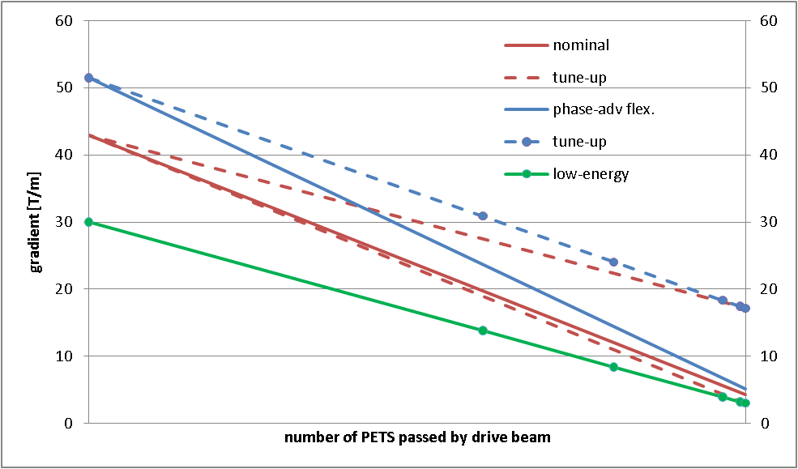
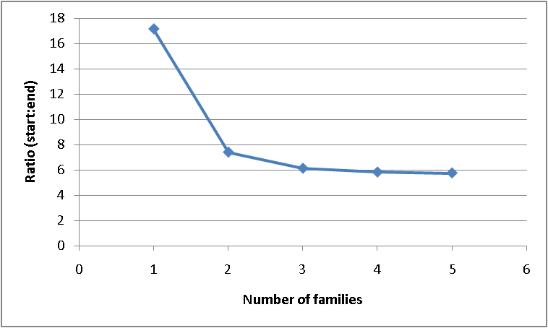
Number of families needed
family | max | min | ratio
1 | 120% | 20% | 6.11
2 | 56% | 9% | 6.11
3 | 43% | 7% | 6.11
56%
97%
Don’t need more than three families
Minimum factor 6.1 comes from low-energy end

