Slide 1

Diagnostics and Prognostics for Power Electronics Converters in Large-scale Accelerator Facilities
Norwegian University of Science and Technology
NorCC: Student Seminar 01.02.2022
Timm Felix Baumann

Slide 2
Content
Self introduction CV
PhD timeline and supervision
Converters for accelerator
Research field condition monitoring
Current work
Discussion

Slide 3



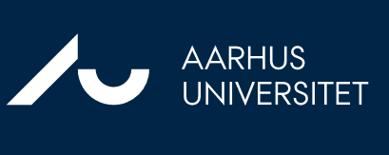

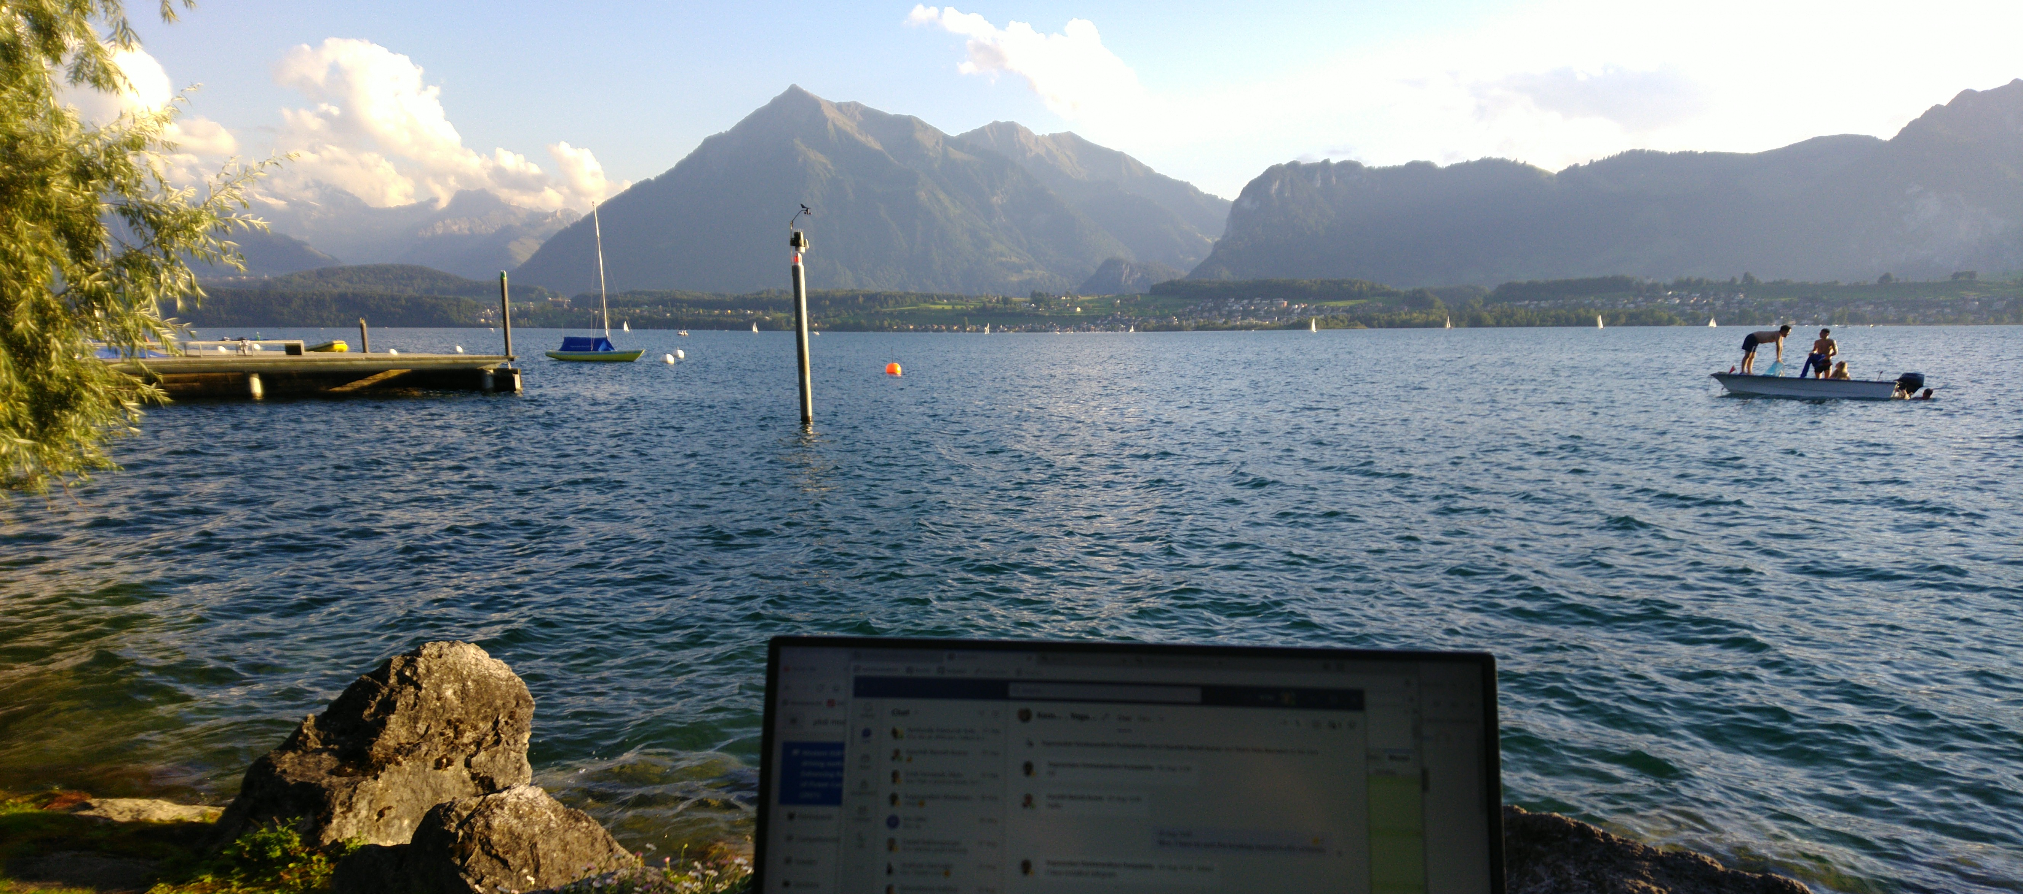

Timm Felix Baumann
Master in Electrical Engineering
Master of Education in Electrical Engineering
Bachelor in Electrical Engineering
Apprenticeship Electronic Technician
Thun Switzerland
Openstreetmap.org

Slide 4
Timeline PhD Project
Collaboration between NTNU and CERN
1 year NTNU (Mai 2021 – April 2022)
1.5 years CERN (Mai 2022 – October 2023)
0.5 – 1 years NTNU (November 2023)

Slide 5
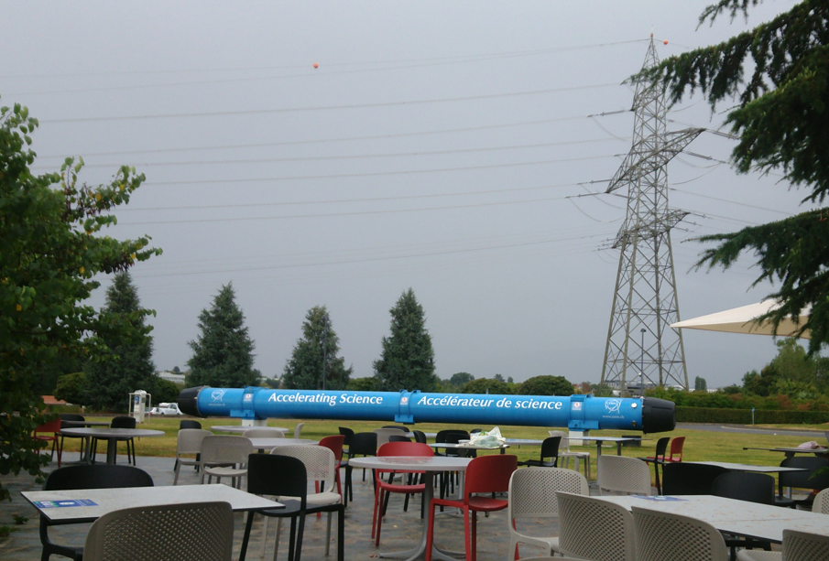
Supervision
NTNU
Dimosthenis Peftitsis
Ole-Morten Midtgård
CERN
Konstantinos Papastergiou
Raul Murillo Garcia

Slide 6
Converter for accelerator
Load: Magnets to focus the particle beam
Single phase high inductive load
High precision current pulse required
Energy storage to enable recovery and minimise grid load

Slide 7


Example output pulse of converter
I
t

Slide 8
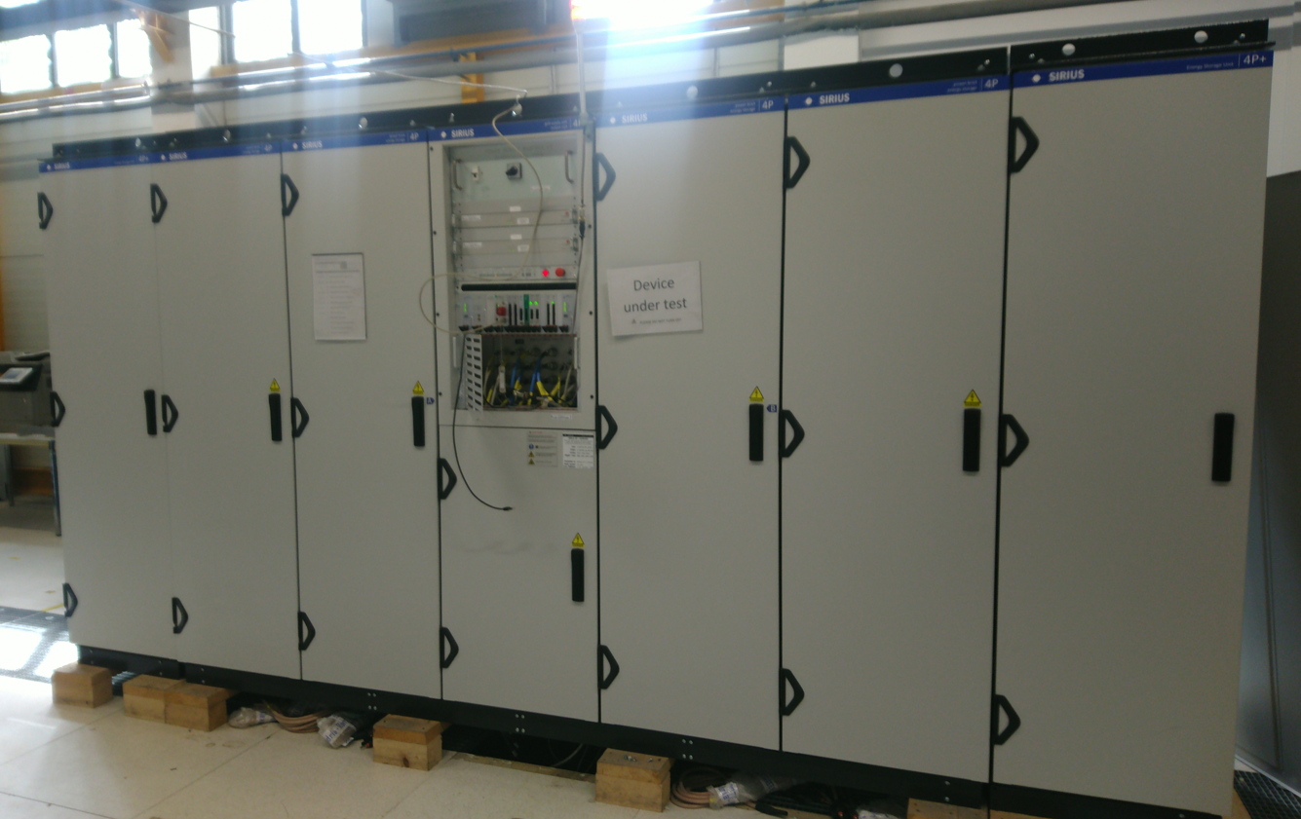
Example SIRIUS converter

Slide 9
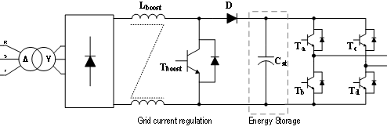
Example SIRIUS converter
450 .. 900V
300V
400V
-450 .. +450V
Capacitor bank 900V down to 450V during cycle!

Slide 10
Converter for accelerator
Not standard requirements (cost, size, reliability) ➔ Accuracy and reliability most relevant
Highly integrated in Network
Components are oversized for better reliability
Good for CERN but even harder to detect degradation

Slide 11
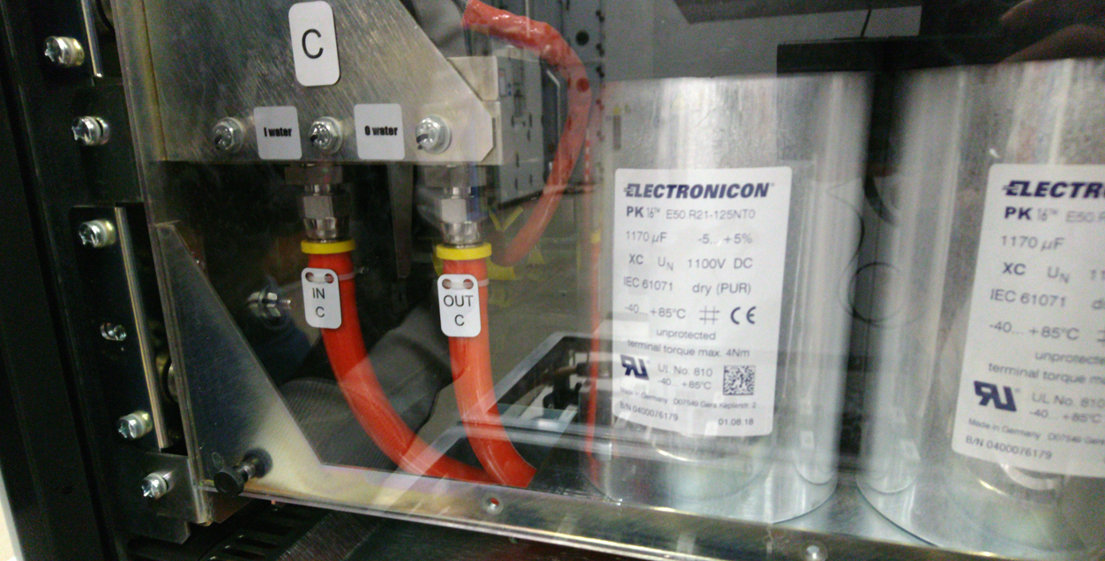
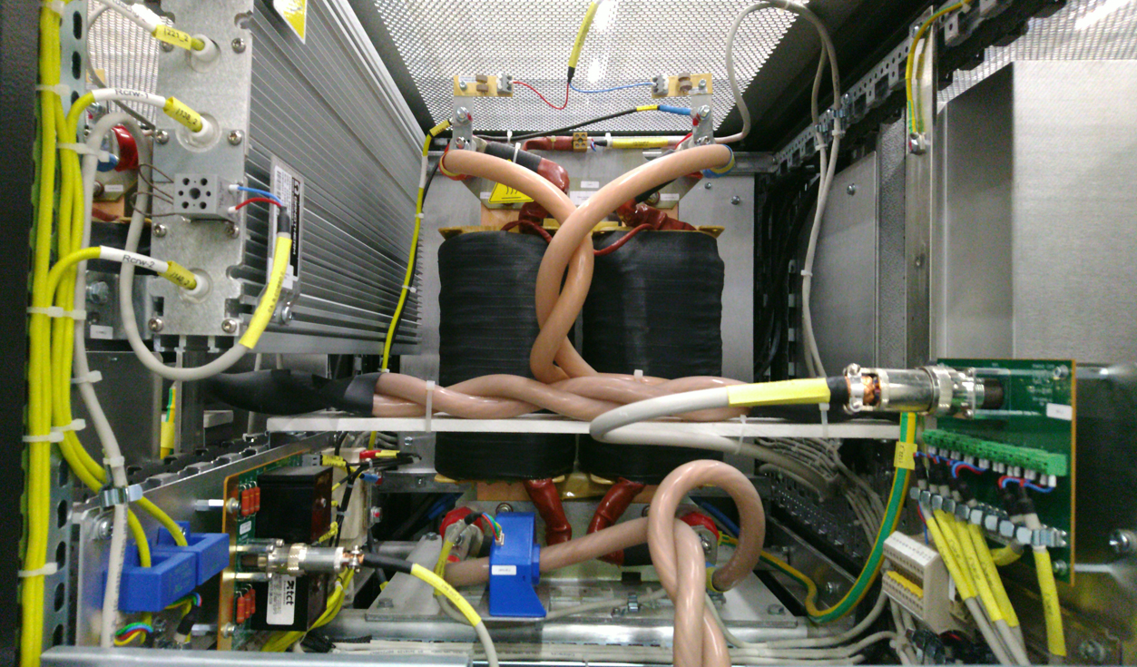
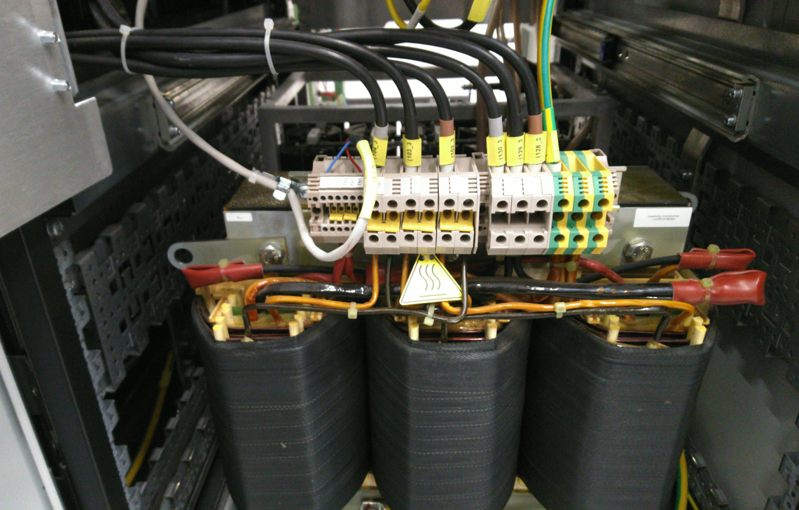
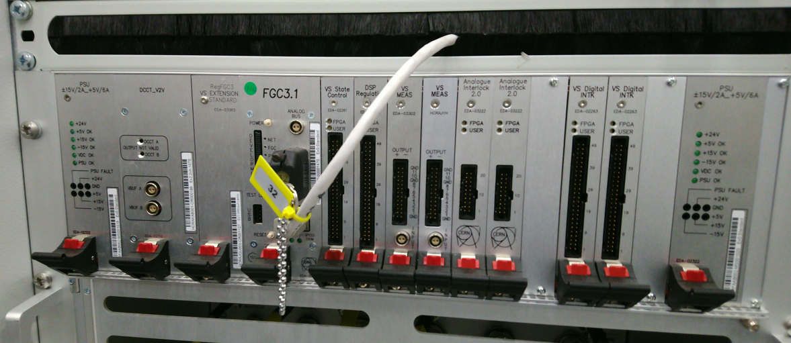

Slide 12
Critical components
Capacitors (electrolytic capacitors)
Semiconductors
Auxiliary (drivers, cooling, …)

Slide 13
Diagnostics and prognosis
Still implemented at CERN: Interlock system / alarms
Digital signals: overtemperature, door contacts, overvoltage, …
Indicates failures and failure points → safety and failure search
New for CERN: condition monitoring (CM) system
Nonbinary information: e.g. temperature actual 95°C (normal 90°C, maximal 110°C)
State of health (SOH) approximation
How will SOH change in future → prognosis

Slide 14
Data acquisition methods for CM
«online measurement»
«offline measurement»
«quasi offline measurement»
Modelling without measurements
converter
measure
SOH calc
converter
measure
SOH calc
converter
measure
SOH calc
load profile
SOH calc

Slide 15
Data acquisition methods for CM
Each additional circuit can fail and moreover can reduce the reliability of the entire system!
Using same system as for control is used
Load profile based simulations (no measurements)
System design to enable CM

Slide 16
Data analysis deterministic vs AI
Deterministic is best → fully understand behaviour 😊
AI output quality depends on training data quality and quantity
Critical point for power electronics
Combinations are possible
Deterministic parameter calculation as input for AI
AI used to predict a parameter which is used in a deterministic model

Slide 17
Capacitor diagnostics project
Ageing effect of capacitor bank is expected decreasing capacity and increasing leakage current
Condition monitoring for the capacitor bank by doing dischargeing curve analyses
Timeconstant R*C calculation ➔ SOH
Use of existing voltage sensor and communication
Use of the turn-off phase of the convertors

Slide 18
SIRIUS converter capacitor analysis
900 .. 0V
All switches are off
Discharge over balancing and discharging resistors

Slide 19
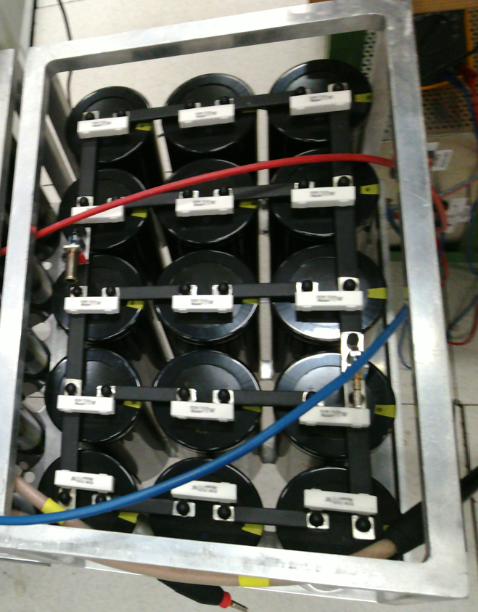
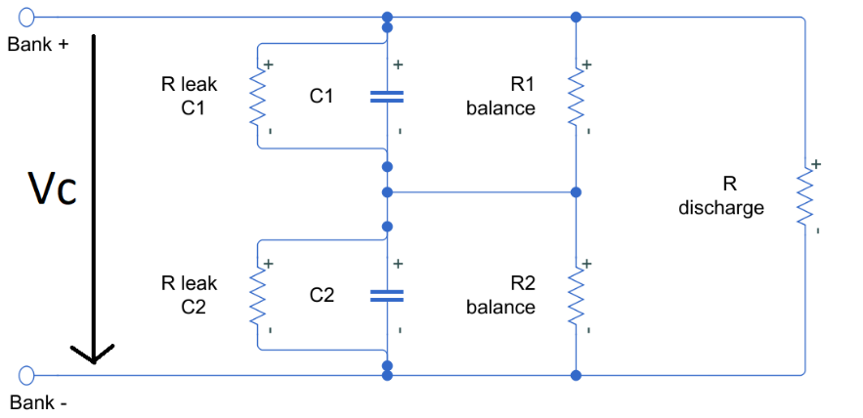
Capacitor bank

Slide 20
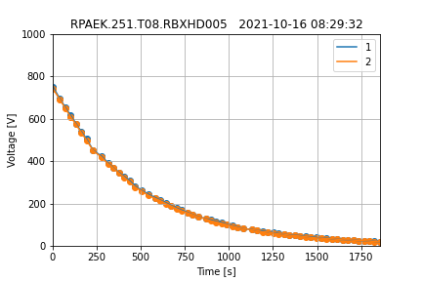
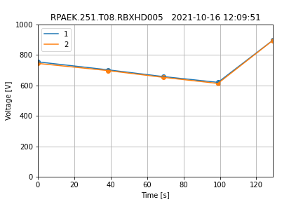
Recorded data

Slide 21
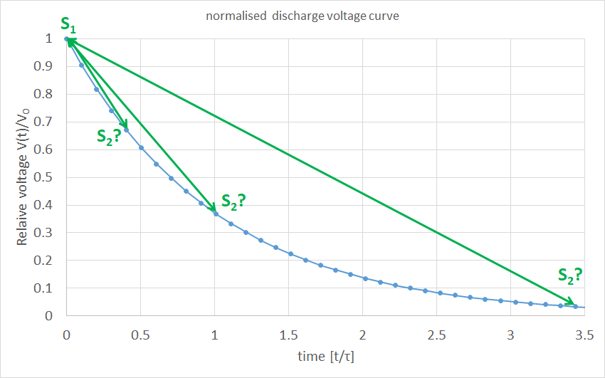

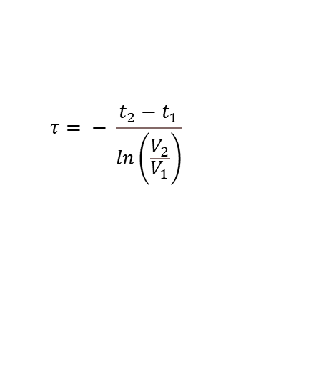
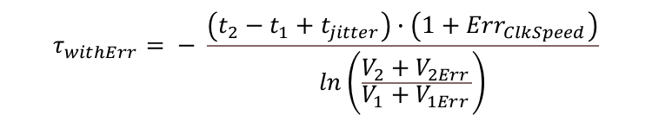
Optimised sampling
$$τ= − \frac{t_{2}−t_{1}}{\left.\ln\left(\frac{V_{2}}{V_{1}}\right.\right)}$$
$$τ_{withErr}= − \frac{\left(t_{2}−t_{1}+t_{jitter}\right)∙\left(1+{Err}_{ClkSpeed}\right)}{\left.\ln\left(\frac{V_{2}+V_{2Err}}{V_{1}+V_{1Err}}\right.\right)}$$
Publication planned for

Slide 22
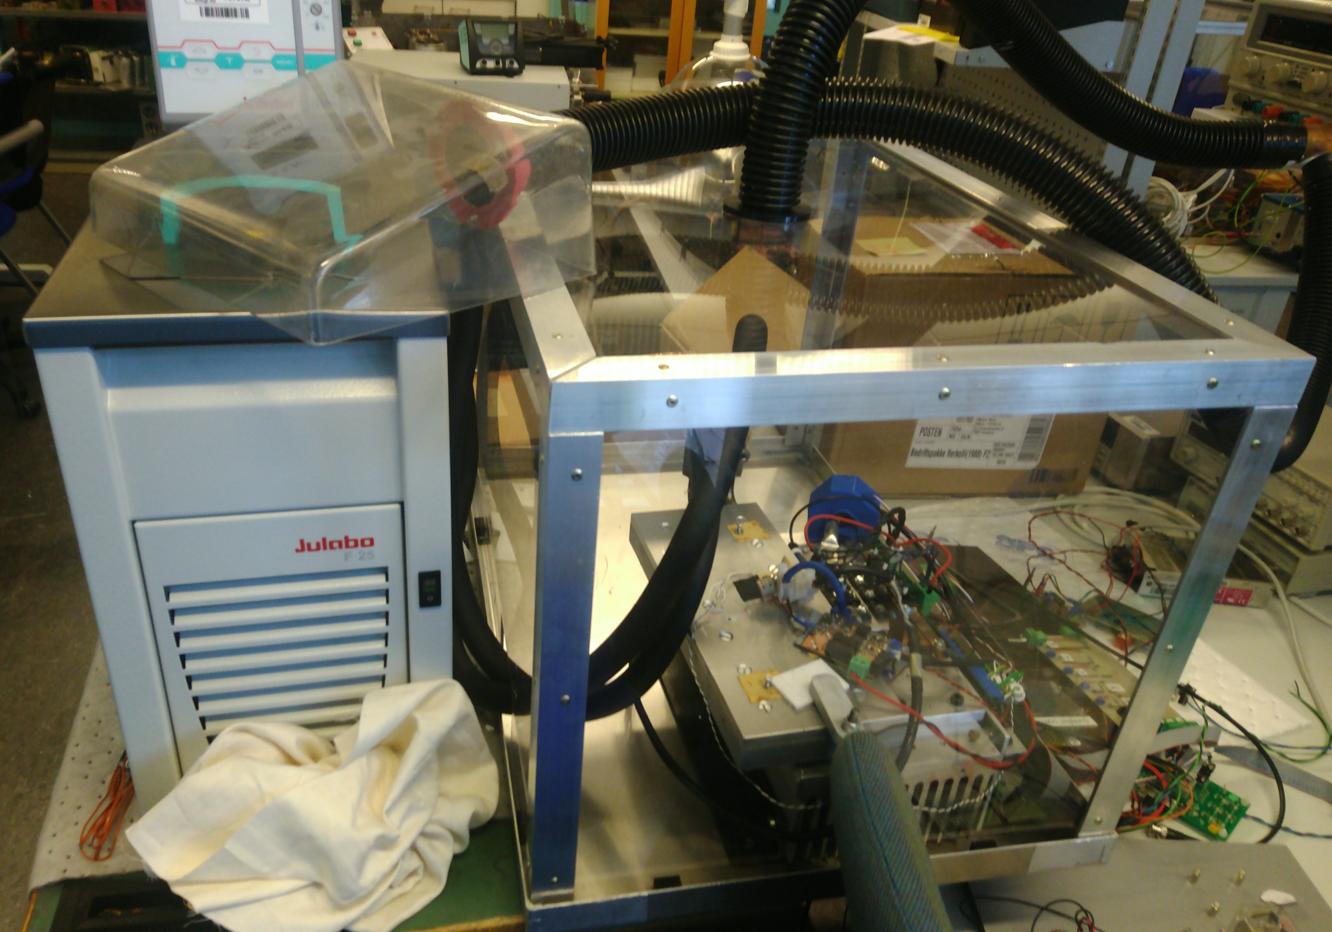
Laboratory MOSFET cycling build up
Verification of ageing mechanisms
Production of aged samples
Reactivate existing build up
Neu build up for parallel cycling

Slide 23
Idea thermal monitoring
T_ambient
Power dissipation (PD)
T_box
Chip
(T_junction)
T_heatsink
(Thermal resistance)
T_in
Water cooling system
T_out
Flow rate
Static behaviour (constant power dissipation)
PD as indicator itself
Thermal leakage (PD, power in cooling water)→ e.g. solder layer degradation
Quality / SOH of water cooling system (T heatsink, in, out, flow rate)
Dynamic behaviour / delay of thermal flow
Reconstruction of thermal network

Slide 24
Transient example normal operation
PD
t
T_junction
t
T_heatsink
t
T_water_out
t

Slide 25
Transient example ageing effects
Increased PD
Increasing thermal resistance
PD
t
T_junction
Faster heat up
Higher temp
Slower cool down
t
T_heatsink
Slower heat up
lower temp due leakage
Cool down both possible
t
T_water_out
t

Slide 26
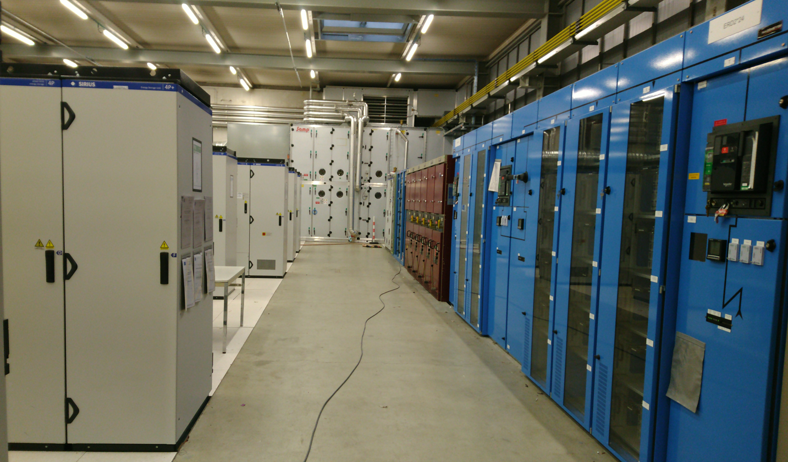
Questions
«risk» of low / hard detectable degradation
Thermal monitoring
Further approaches

Slide 27
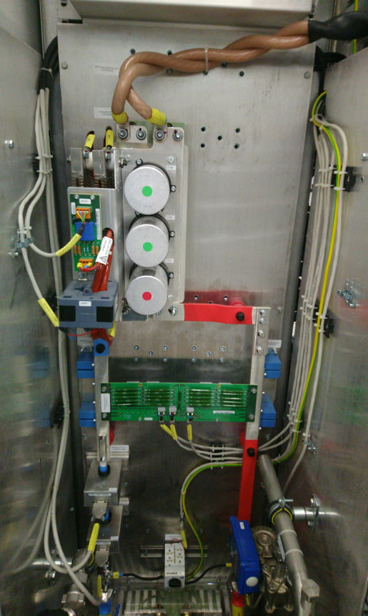
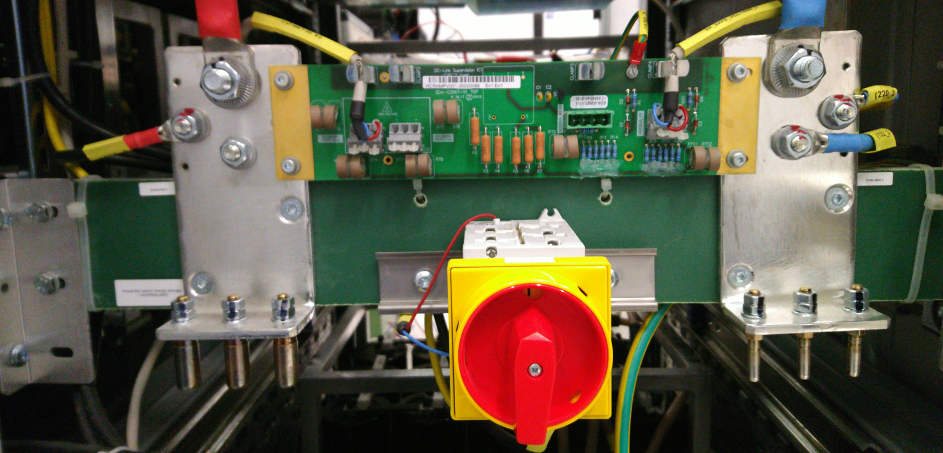
Discussion round

