Slide 1
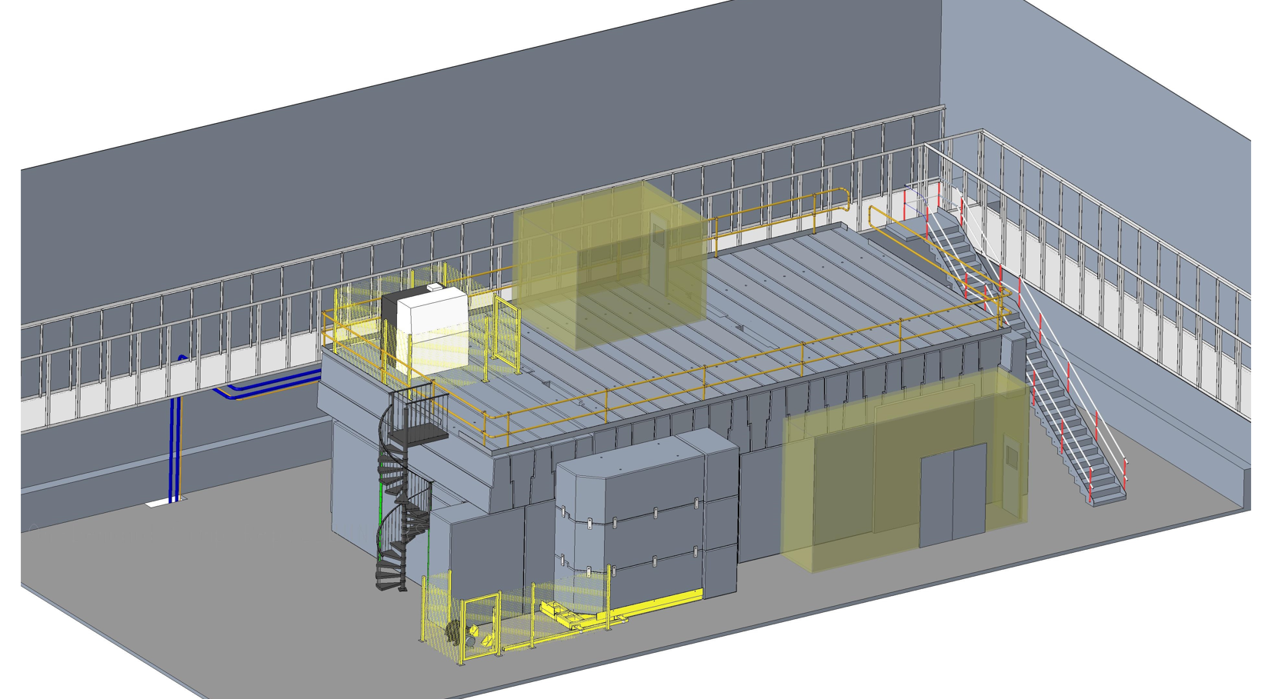
RF test stand at the Cockcroft Institute
Dr Graeme Burt, Lancaster University

Slide 2
UK RF Team
Lancaster: RF testing & cavity design, Klystron design
Strathclyde: Physics of breakdown & cavity design
Southampton: Solenoid Design and construction
STFC: Mechanical design, controls, lower B field testing on CLARA gun

Slide 3
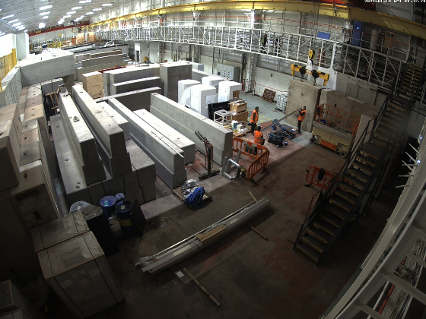
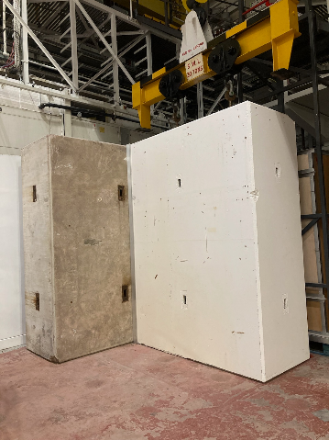
CI RF Bunker
Have started putting the concrete in place with handover expected mid 2022
S-band 7 MW klystron and LLRF control being shipped/procured

Slide 5
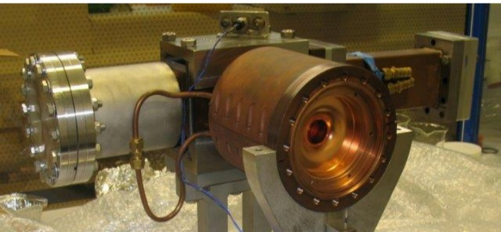
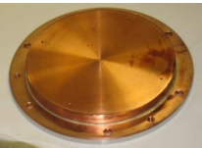
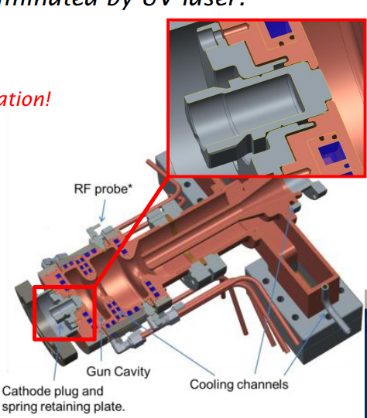
RF sample testing
Plan to replicate something like our RF guns where we have removable back plates or plugs
Can design to maximise peak fields on the removable part while keeping most of the cavity the same
Can test different materials
Possibility to test same sample with DC

Slide 6
Solenoid
Southampton will design a solenoid to go around this cavity
As its only 3 GHz we can use a smaller bore (~10-15 cm)
Can couple via an axial coax line similar to our RF gun to avoid having large waveguide feed go through the coil

Slide 7
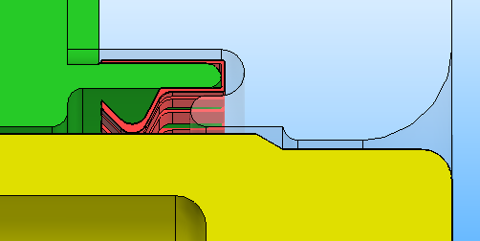
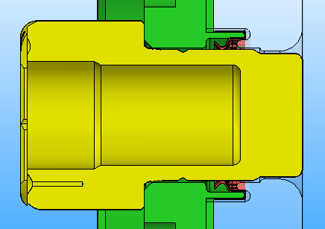
Photocathode plug design
Courtesy S. Schreiber, DESY
New design allows for:
Avoid RF fingers “direct view” to RF cavity
Robust, good contact, avoid fragile copper parts (like the thin rim)
New design with RF fingers
compatible with existing LASA/DESY photocathode design

Slide 8
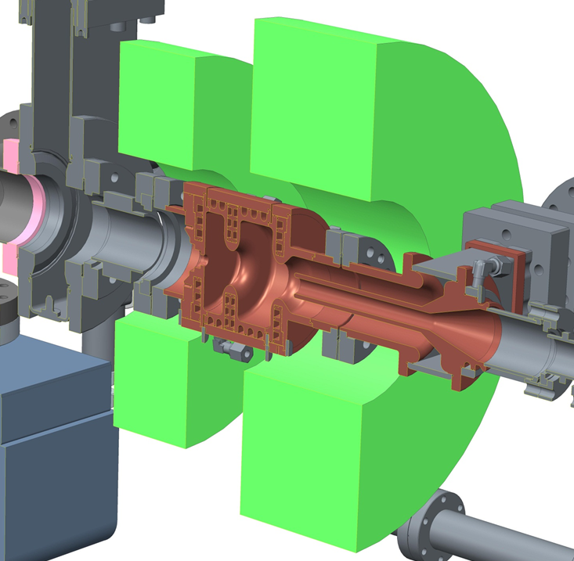
High Repetition Rate RF Gun
ASTeC in collaboration with Lancaster University has developed a High Repetition Rate Gun for CLARA.
The gun has a solenoid on it allowing some testing with lower magnetic fields
May be partially relevant for muons in the short term to validate models.

Slide 9
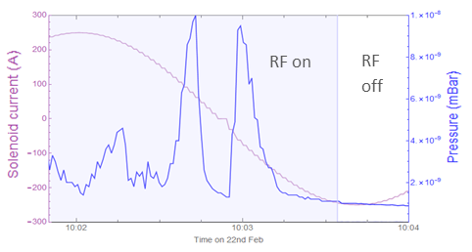
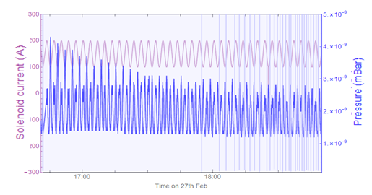
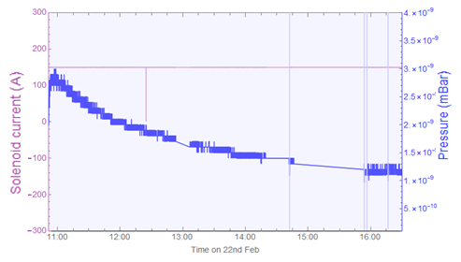
VELA gun Solenoid effects
Oscillation from -250 A to + 250 A caused vacuum spikes up to 1 x 10⁻⁸ mBar.
Solenoid switch on to 150 A caused pressure increase to 2.7 x 10⁻⁹ mBar. Which recovered slowly.
Solenoid oscillation from 100 to 200 A caused decaying oscillation of the pressure.

Slide 10
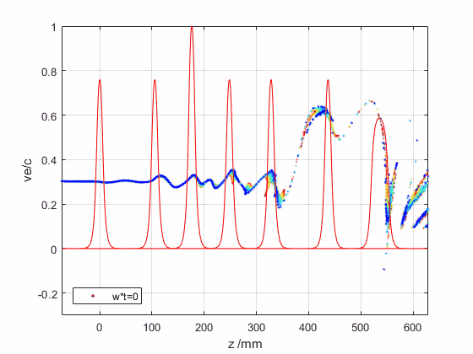
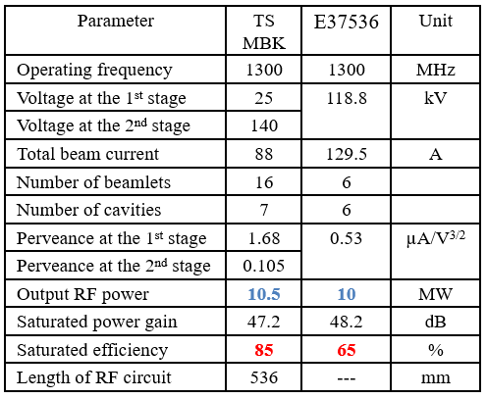
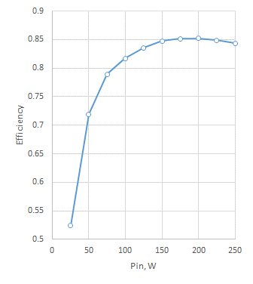
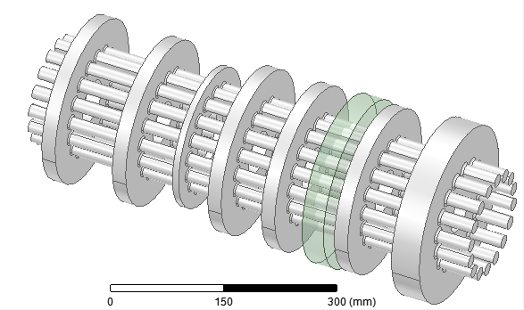
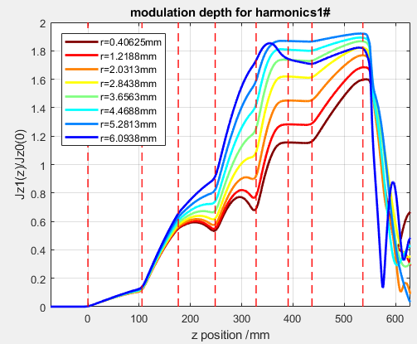
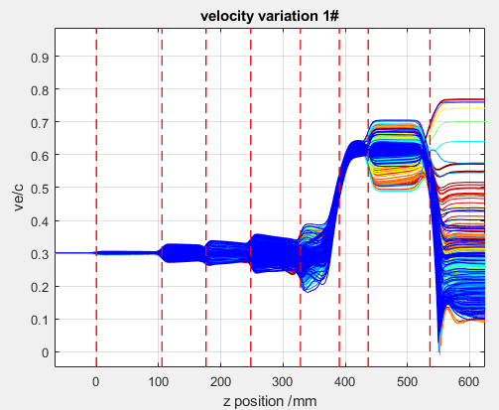
Example High Efficiency Klystron (from Igor Syrathchev CERN)
High Efficiency 10 MW, 1.3 GHz, ILC TS MBK (scaled from TS CLIC MBK+2nd harmonic)
RF circuit length 53.6 cm
DC gap
2nd harmonic
cavity

Slide 11
Muon Collider RF: Lancaster Univ
Constructing a S-band cavity test facility at Cockcroft Institute
  Cavity with removable test plate with E field focussed on the removable part for material studies
  Currently up to 7 MW RF
High Efficiency Klystron Design
  Working with CERN to develop high efficiency klystron designs for FCC, LHC, and CLIC
  Utilising different techniques like two stage, 3rd harmonics and core oscillation
Study surface / breakdown physics at CERN
  Several PhD students based at Xbox in CERN studying breakdown physics
  Both RF and DC breakdown studied
  Have investigated effects of materials, irradiation, light emitted from field emission, superstructures
  Have developed a monte carlo based conditioning model that accurately predicts conditioning behaviour.
RF Electron gun conditioning
  Working with STFC we have been studying the effect of solenoid magnetic field on gun conditioning
Lancaster would be keen to contribute to areas including:
  Cavity design for test stands;
  Test stand construction and operation
  Undertaking and interpreting experimental measurements in test stands;.
  Klystron design

Slide 12
Muon Collider RF: Strathclyde Univ
Strathclyde participated in Muon Ionization Cooling Experiment (MICE).
  Aware of research in MAP programme highlighting impact of B-field on attainable E-field.
Wider background in experiments and simulation relevant to:
  Electron emission processes, plasma flare breakdown, plasma dynamics (K Ronald);
  RF and microwave cavities, field emission (AW Cross).
Opportunity to build on this work:
  Fundamental research to fully understand important physics;
  focussed research directly relevant to muon collider conditions.
Study surface / breakdown physics as a function of:
  Frequency, duty pattern/pulse duration and magnetic field (magnitude/polarisation);
  surface preparation;
  choice of materials for “stressed” walls.
Strathclyde would be keen to contribute to areas including:
  Cavity design/predictive analysis for (a) test stands (b) muon collider;
  undertaking and interpreting experimental measurements in test stands;
  comparison of measurements with predictions and expectations (simulation/theoretical).
Interested in collaboration,
  Including opportunities for experiments using test stands @ Daresbury/Saclay.

Slide 13
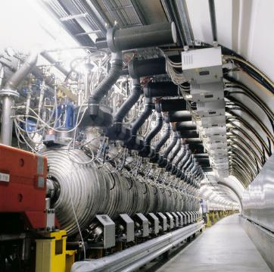
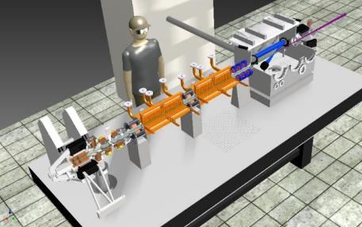
STFC Accelerator Capabilities @ Daresbury
Beam Source
Low Energy Capture
Acceleration
Transport
Delivery
Accelerator Science
& Technology Centre
ASTeC
RF & Cryogenics
Critical for high performance
Engineering
Technology
Centre
Mechanical Design,
Mech Eng & Survey,
Electrical and
Controls
Femtosecond Lasers & Timing
(FLT)
Business, Programmes & Facilities
Engineering
Technology
Design Mechanical Electrical Instrumentation Survey Integration
Technology
Scientists/Engineers/
Technicians/Apprentices
Accelerator Diagnostics & Instrumentation
(ADI)
Accelerator Physics
Magnetics & Radiation Sources
(MARS)
Vacuum Solutions
1

Slide 14
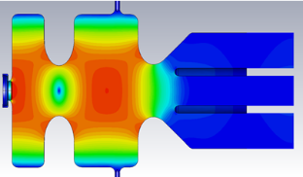
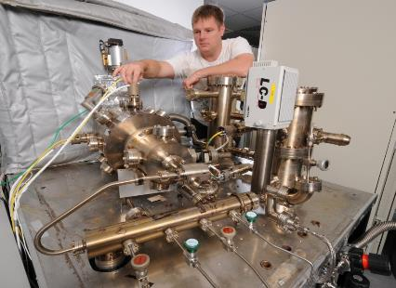
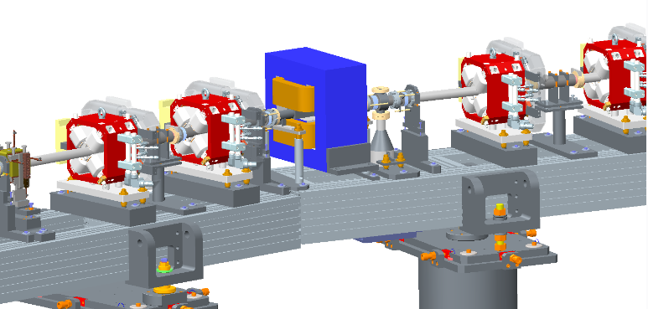
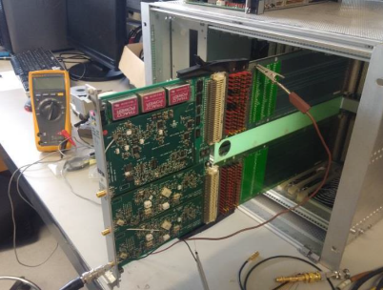
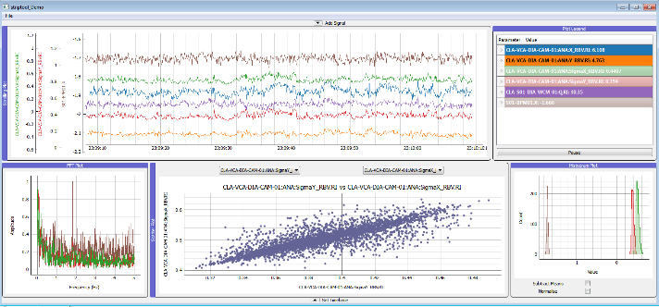
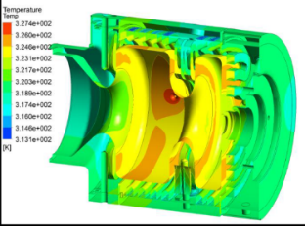
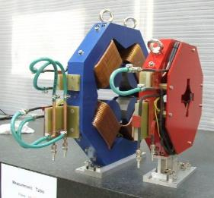
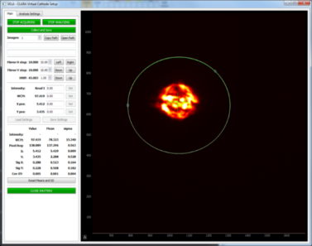
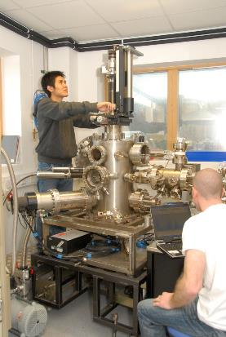
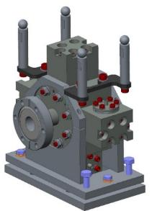
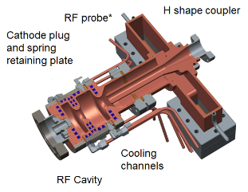
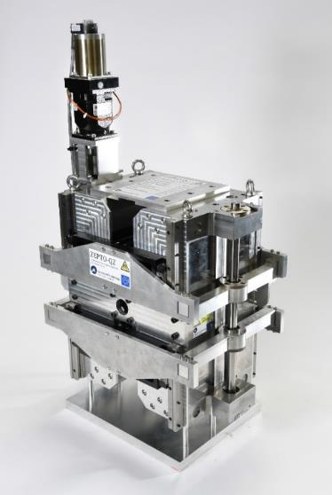
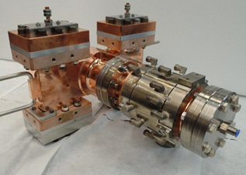
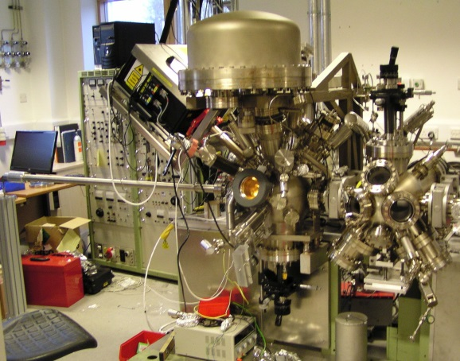
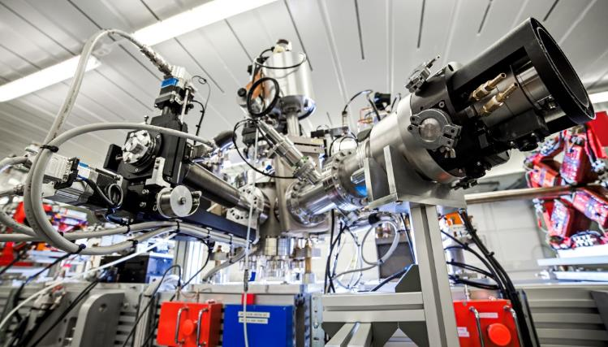
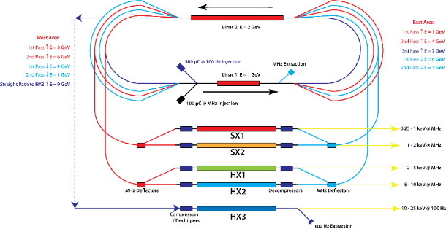
STFC Accelerator Capabilities at Daresbury
RF
Vacuum
Magnets
Diagnostics
Physics

Slide 15
What we need
Need to deign the RF cavity and Solenoid
Need funds to construct both
Need to have upgraded electrical, cryo and control for magnet
Effort to run the experiment
Effort for running low field tests on CLARA
Klystron design effort

