Slide 1
Technology Group
4T magnet
Josef Boehm
January 2022

Slide 2
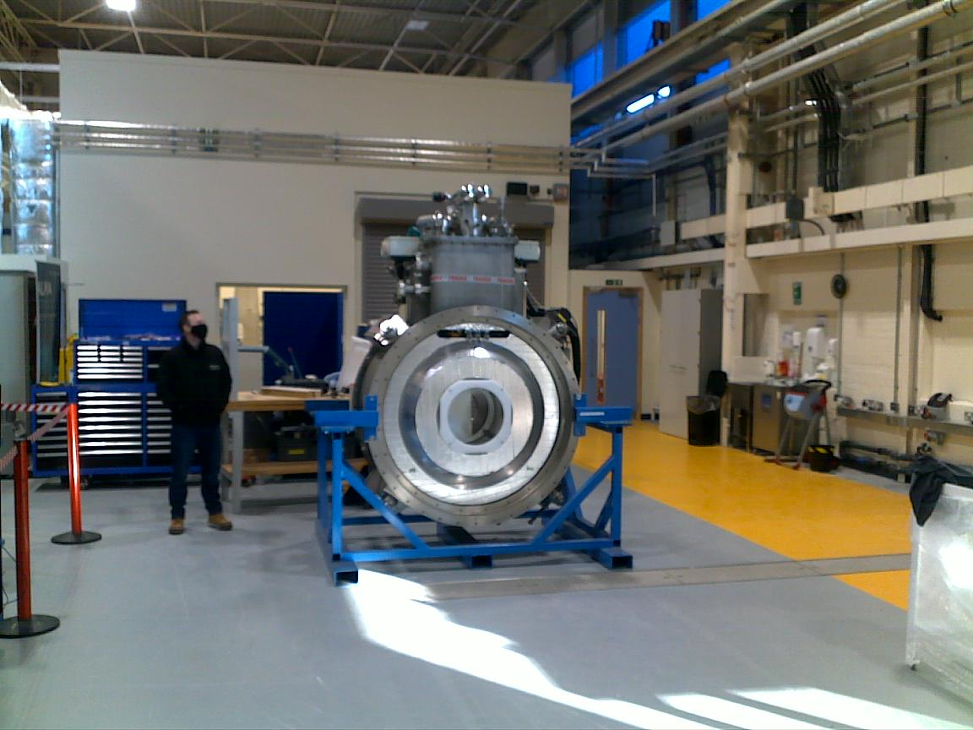
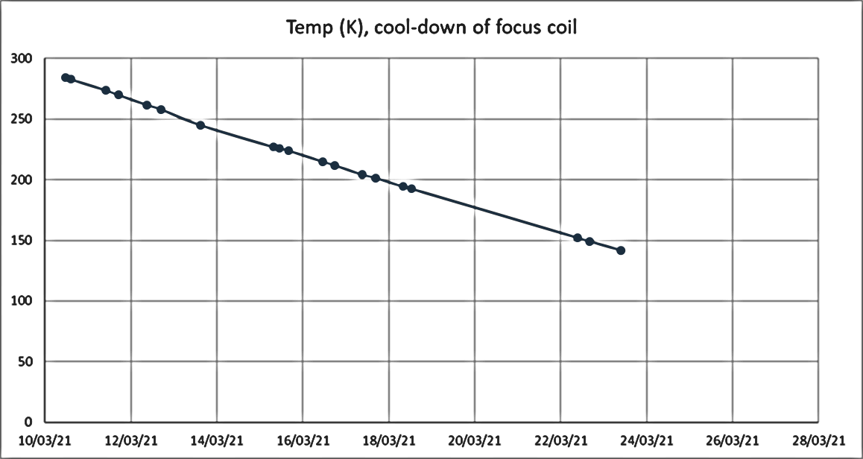
Magnet commissioning at RAL
Bore: ~450mm
Field: 4T
Solenoid or cusp mode
3rd cold head for sample cooling

Slide 3
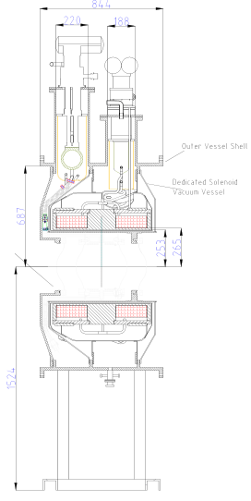
Magnet details
Two internal coils, independent operation
Modes: solenoid / cusp
In solenoid mode ~ 4T
Bore diameter ~ 470mm
Can take large horizontal forces
~ 2MJ, 100H, 180A, ramp-time: ~ 1h
2 pulse tubes / compr., 3rd PT for insert cooling
Dry cool-down ~ 2 weeks, quicker with liquids
Once cold the cryostat is zero boil-off

Slide 4
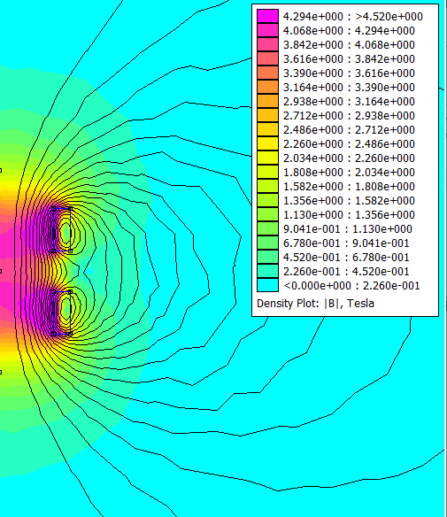
Magnetic flux lines
Magnet in solenoid mode
Centre flux density: 4T

Slide 5
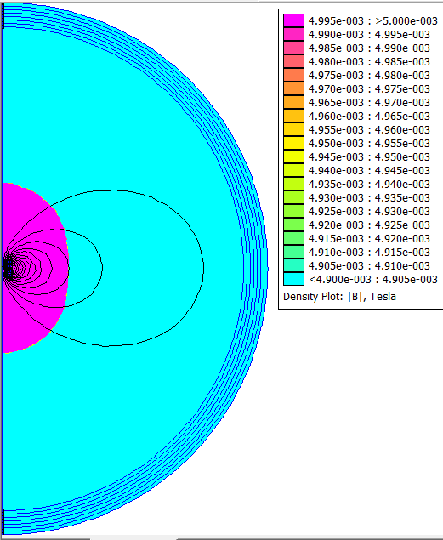
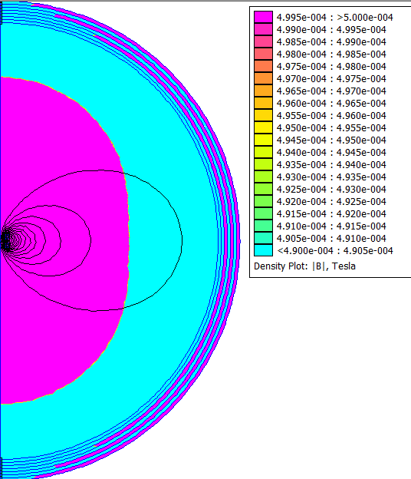
Stray fields
Stray field (4T setting) | @50G | @30G | @5G
from magnet centre
Axial (m) | 3.45 | 4.1 | 7.4
Radial (m) | 2.7 | 3.2 | 5.9

Slide 6
Requirements to operate magnet
Magnet in cryostat with two cryocoolers (pulse tubes)
2 compressors for PT’s, Cryomech CP1000, 13 kW
20m gas lines
Large building to operate the magnet, ~ 15m x 12m
Control cabinet with PSU, temperature monitors, He-level monitor, switch gear
Chilled water for compressors, ~ 15 – 20 l/min @ 15 degC
Helium gas supply (gas cylinders), approx. 4 per run

Slide 7
Requirements to prepare the magnet
The control cabinet will have to be assembled from existing and newly purchased components
The quench protection circuitry will have to be assembled (resistors and diodes, on side of magnet)
The magnet will have to be tested at RAL before shipment

Slide 8
Activity/Equipment | Effort | Material
FC magnet |  | 700k – existing
Checkout in UK | 0.25 | 2k
QPS Refit |  | 10k
Shipping |  | 15k
Checkout in Paris | 0.25 | 2k
Instrument Racks |  | 100k
Cabling and sundries |  | 10k

