Slide 1
MQXFS coil, thermal contraction test
Campagna Guillaume
^{14th} January 2021

Slide 2
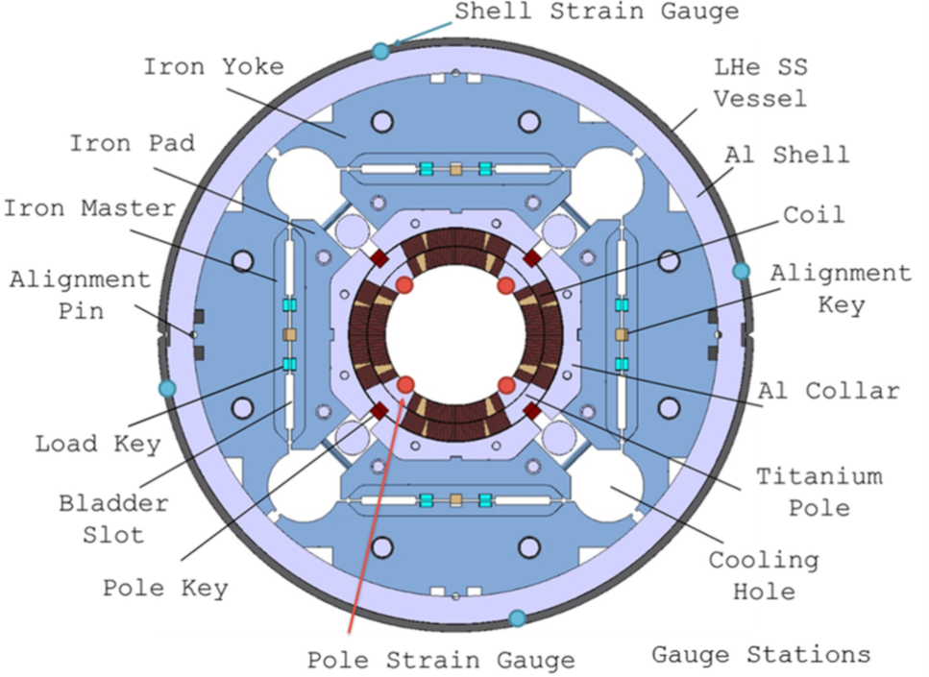
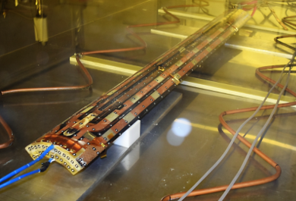
Experimental set-up
Cryogenic pool in the cryolab,
Coil on isostatic supports,
Cooling down at 77K (thermal gradient controlled),
Drain LN2 as fast as possible, open the pool, measurements.
Two acquisition systems:
  Strain Gauges (SG), 12 thermally compensated
  Photogrammetry
Warning from the cryolab: this may not be representative of real magnet conditions (water solidification into coil’s cracks…)

Slide 3
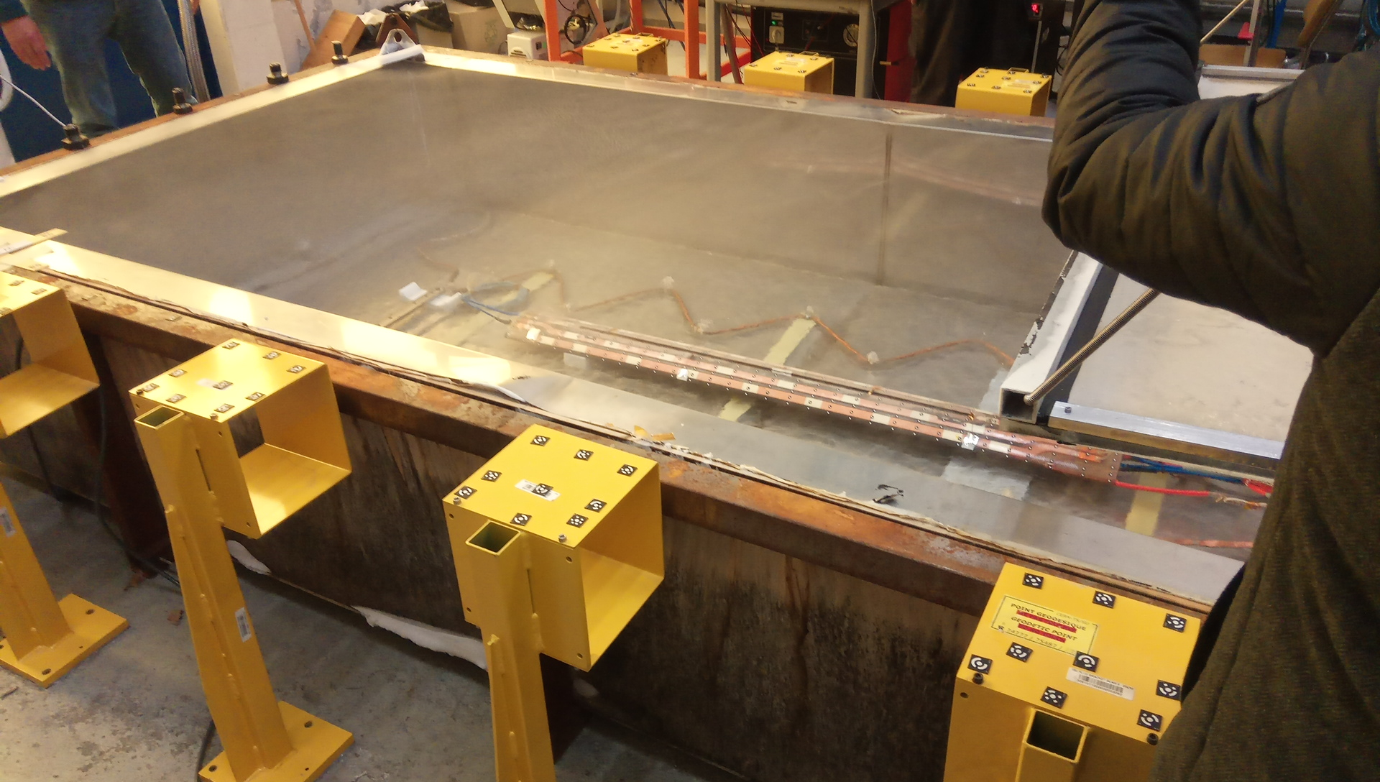
Photogrammetry - warning
Constrains
Consequences
Thin vapour cloud on top of the pool
Ice layer form on the coil (few minutes)
Point distribution on multiple surface
Temperature gradient
Reduced visibility for target measurement
Limited time for acquisition data
Increase of measurement time
Decreased precision of measurement in cold
Report and data from the acquisition team: https://edms.cern.ch/document/2659563/1

Slide 4
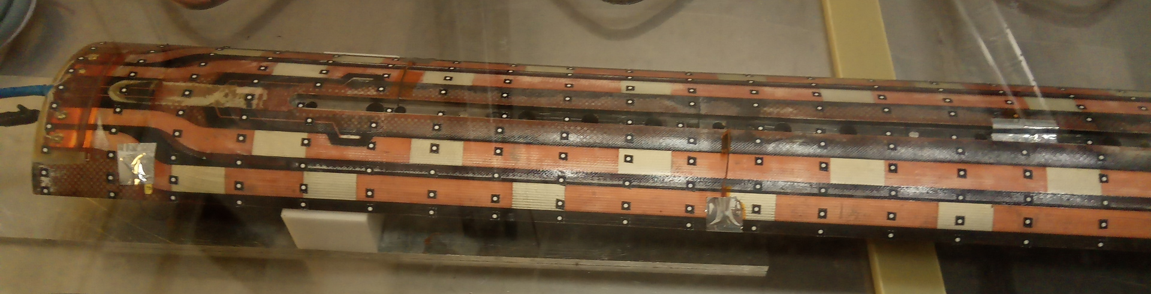
Photogrammetry data
First observations

Slide 5
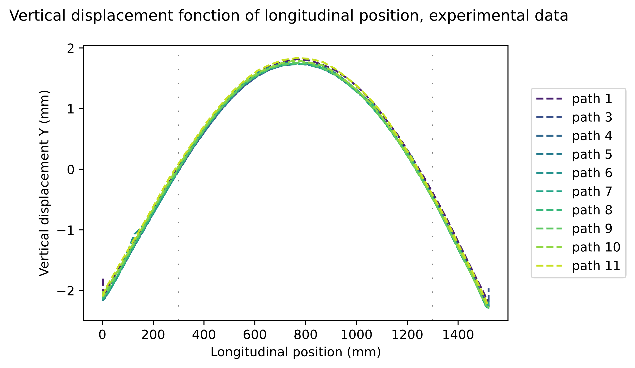
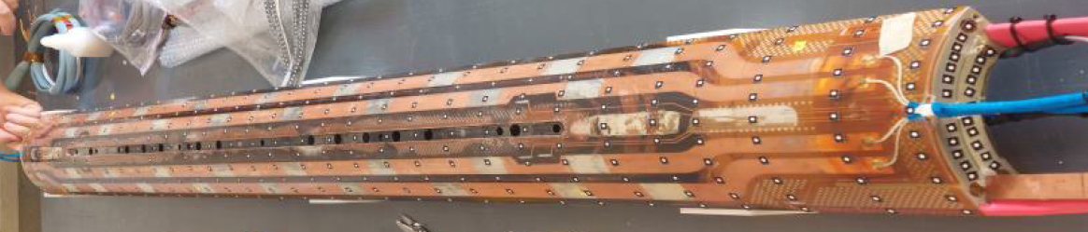
Analysis of photogrammetry data, Y displacement
path 6
path 1
path 11
Observations:
Bending is the same in all paths (bending of 4.1mm).
Comparison between symmetric path (Ex: 1 vs 11) show that the bending is symmetric in plan yOz.
z
y
x

Slide 6
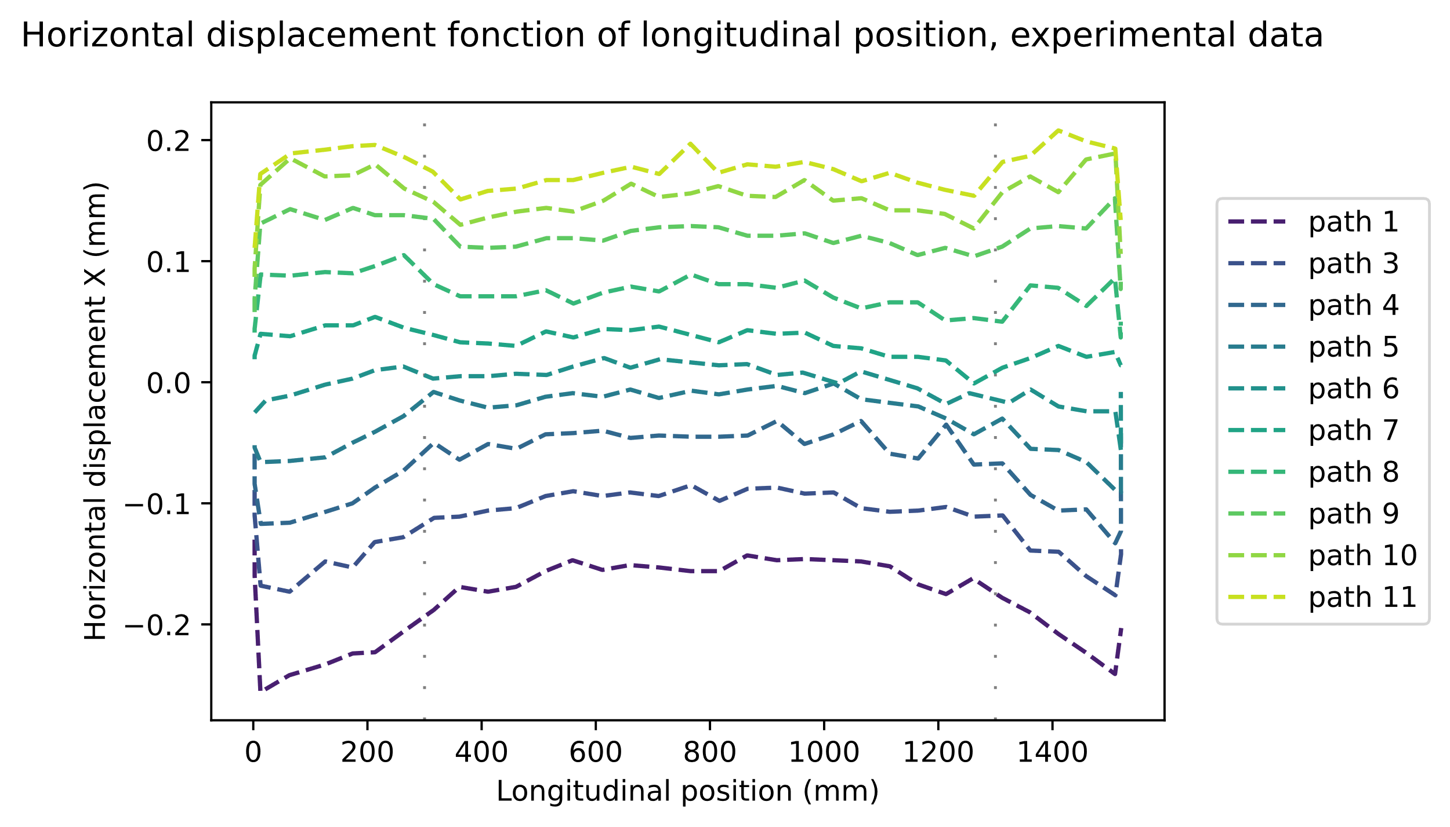
Analysis of photogrammetry data, X displacement
path 6
path 1
path 11
Observations:
See effect of coil heads vs straight section.
Asymmetry between path 1 and 11 (bending around Y? Geometry of coil? Incertitude?)
z
Straight section
y
x

Slide 7
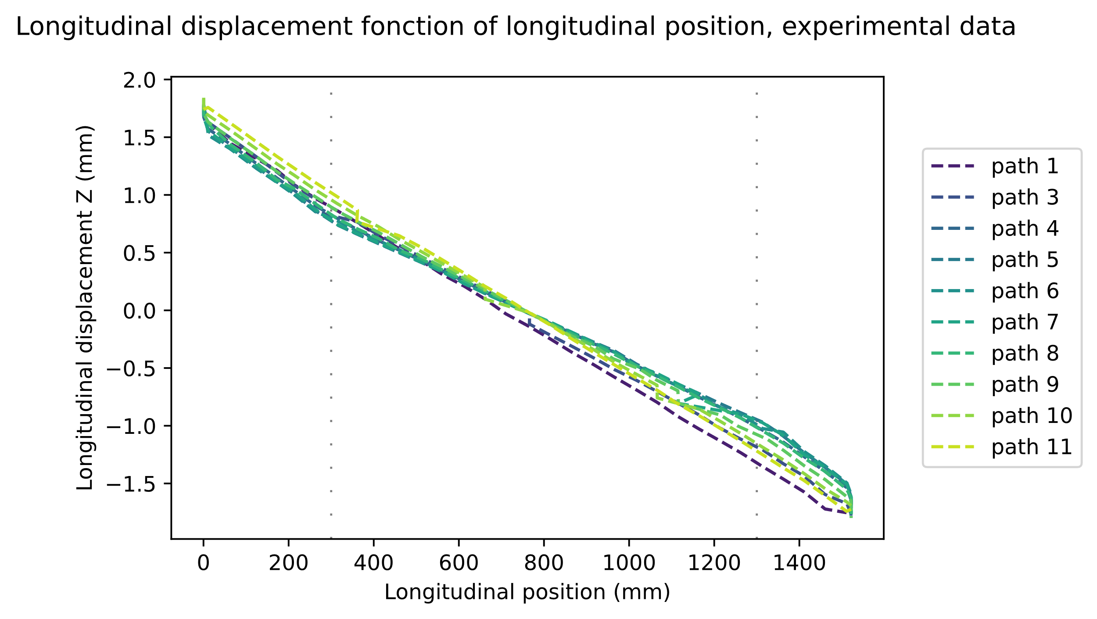
Analysis of photogrammetry data, Z displacement
path 6
path 1
path 11
Observations:
Dispersion is observed between paths.
z
y
x

Slide 8
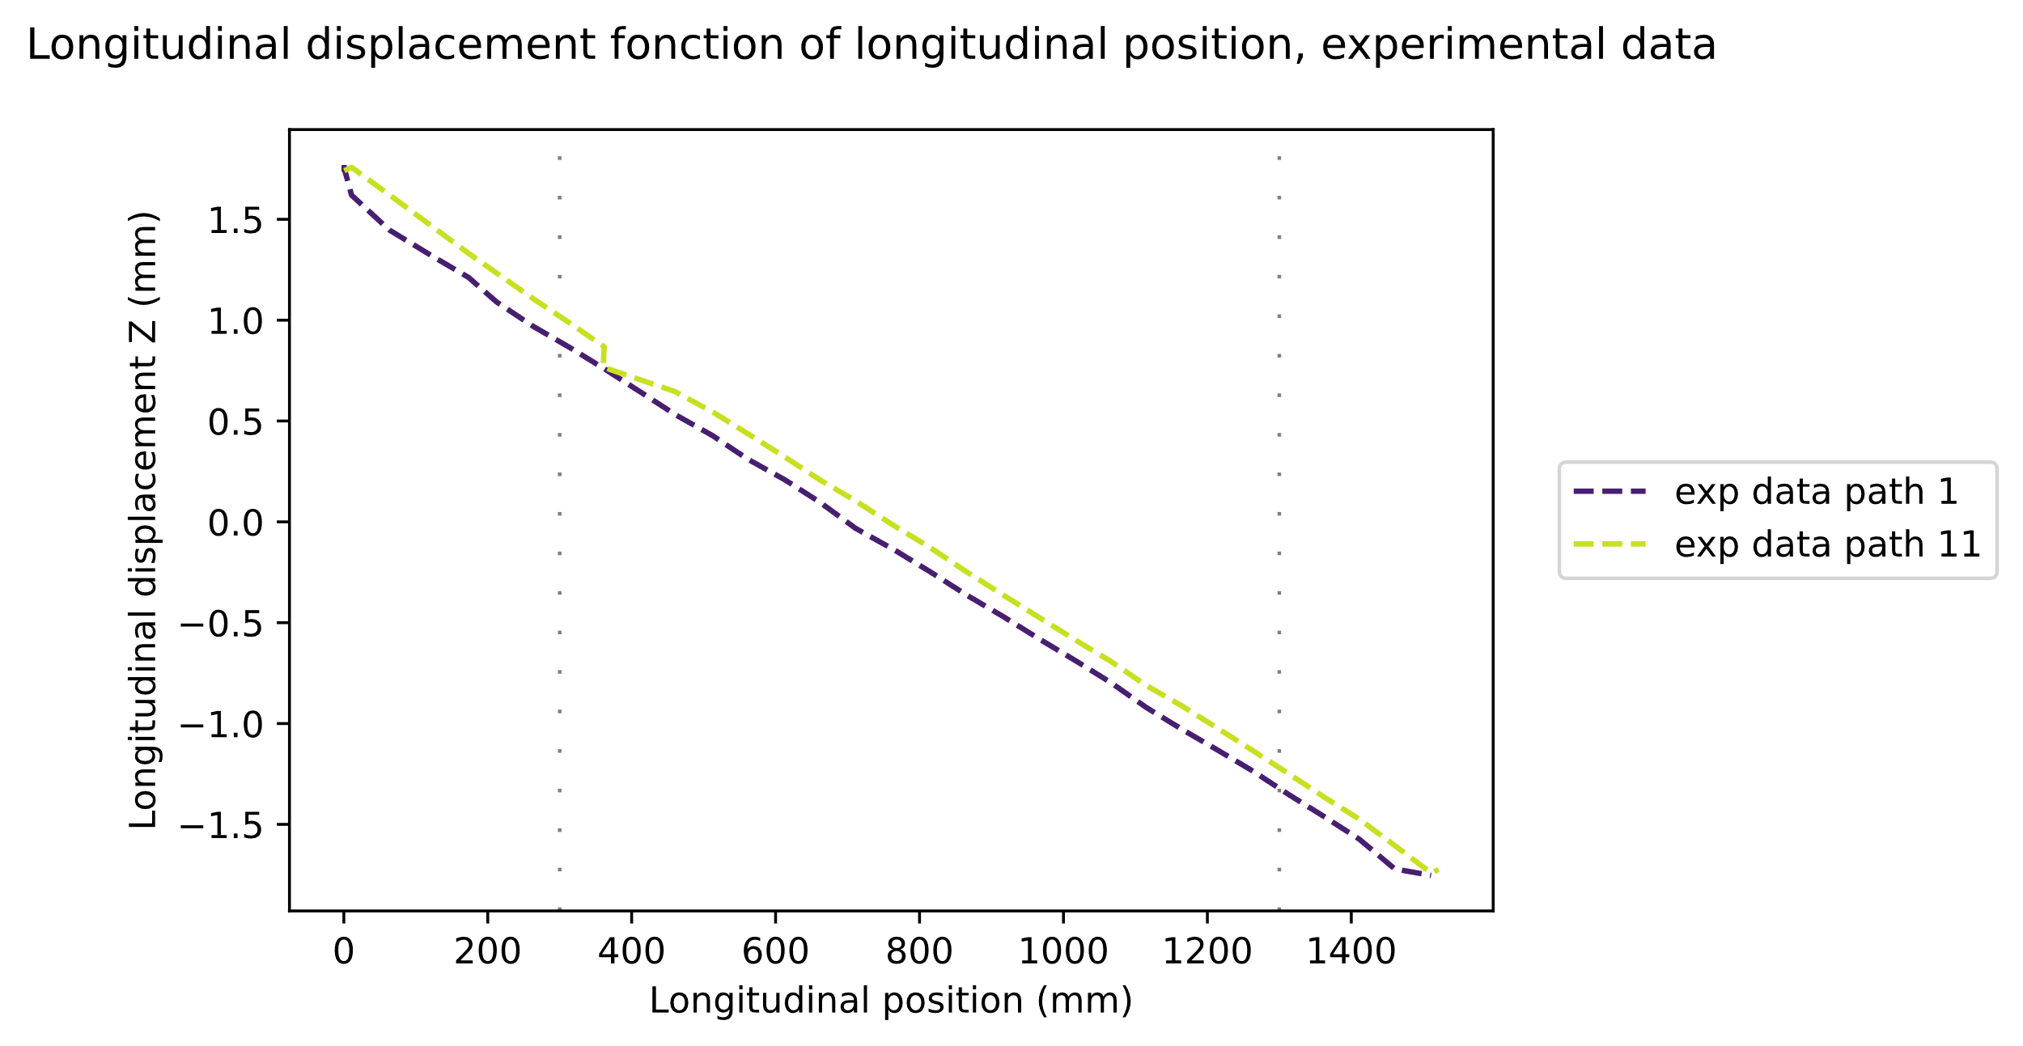
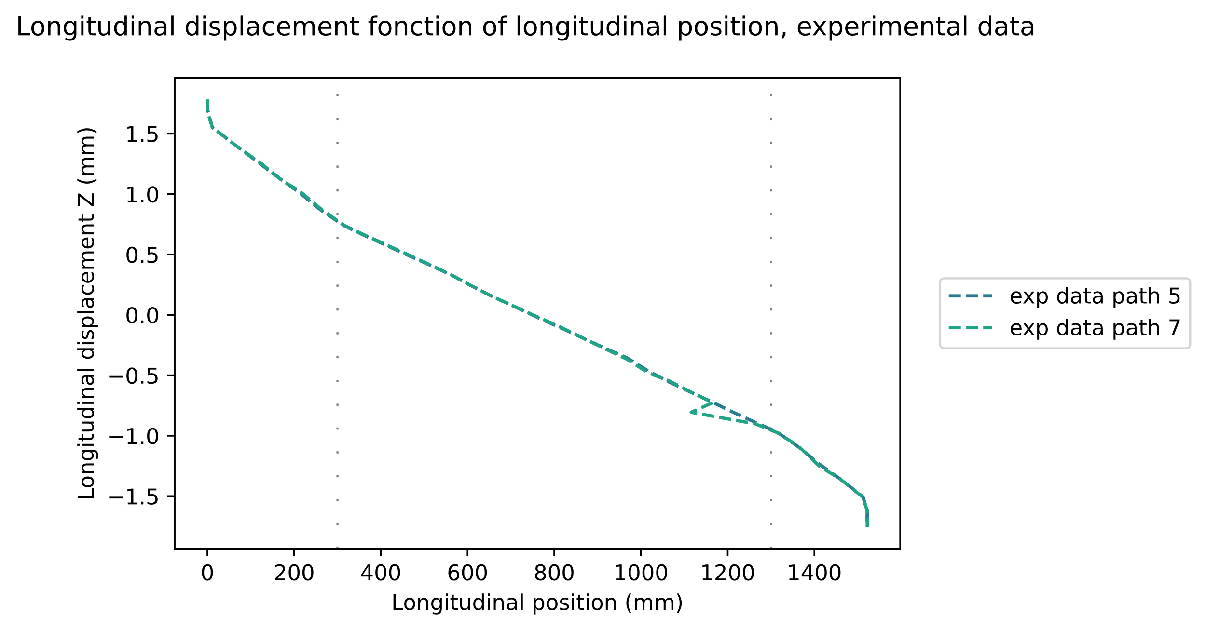
Analysis of photogrammetry data, Z displacement
path 5
path 7
path 1
path 11
Same slopes for symmetric path (1-11, 2-10,…)
See effect of heads vs straight section (path 5 and 7)
z
y
Straight section
x

Slide 9
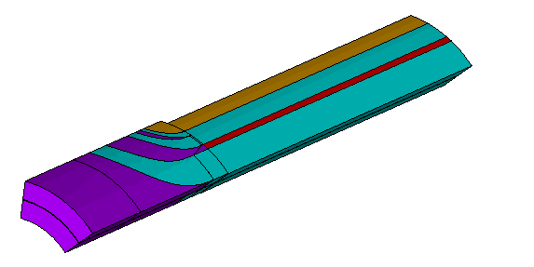
ANSYS main parameters
Material parameters and model definition

Slide 10
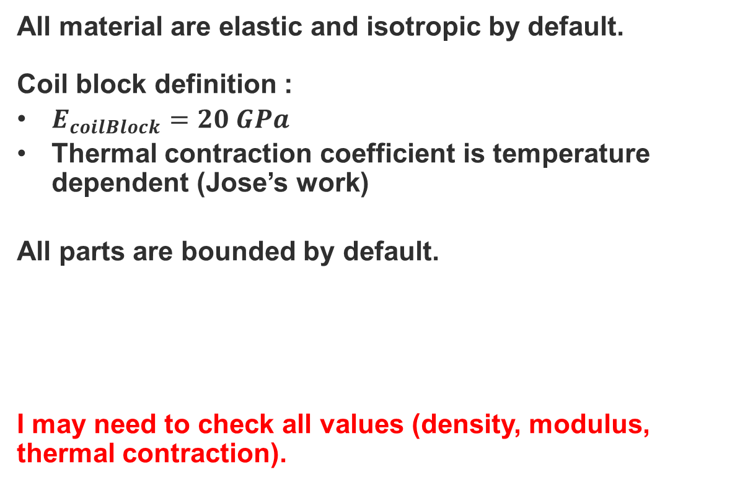
Main material parameters (by default)
All material are elastic and isotropic by default.
Coil block definition :
$E_{coilBlock}=20 GPa$
Thermal contraction coefficient is temperature dependent (Jose’s work)
All parts are bounded by default.
I may need to check all values (density, modulus, thermal contraction).

Slide 11
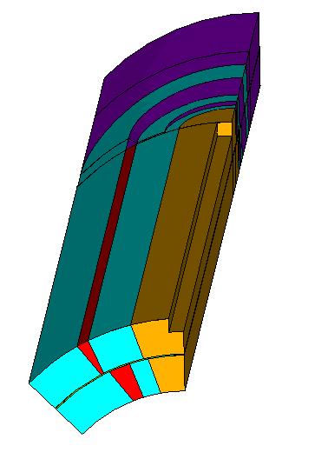
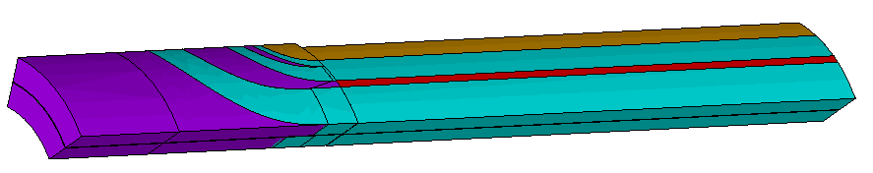
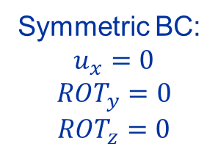
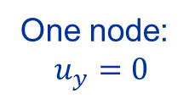
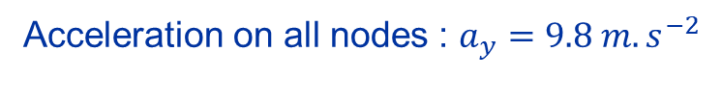
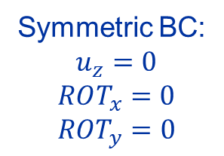
Boundary condition and loading (by default)
Symmetric BC:
$$u_{x}=0$$
$$ROT_{y}=0$$
$$ROT_{z}=0$$
Loading steps:
  Gravity alone,
  Gravity + cool down (77K).
Acceleration on all nodes : $a_{y}=9.8 m.s^{−2}$
y
Symmetric BC:
$$u_{z}=0$$
$$ROT_{x}=0$$
$$ROT_{y}=0$$
z
x
y
One node:
$$u_{y}=0$$
z
x

Slide 12
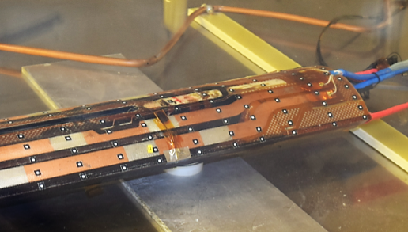
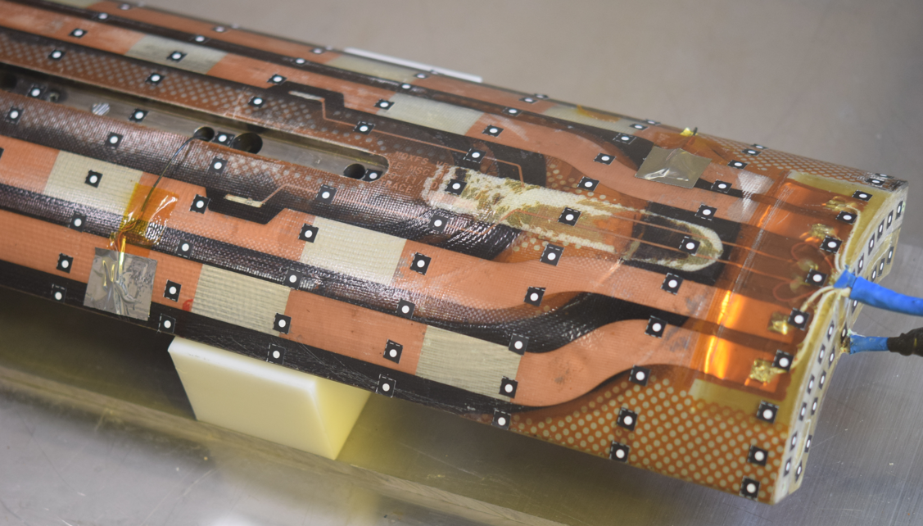
Support position study
FEA in ANSYS

Slide 13
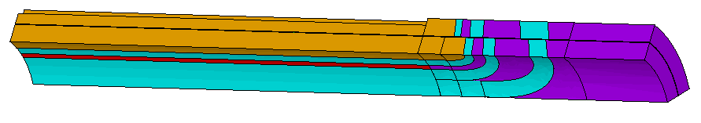
Different support positions
330
500
550
600
650
770

Slide 14
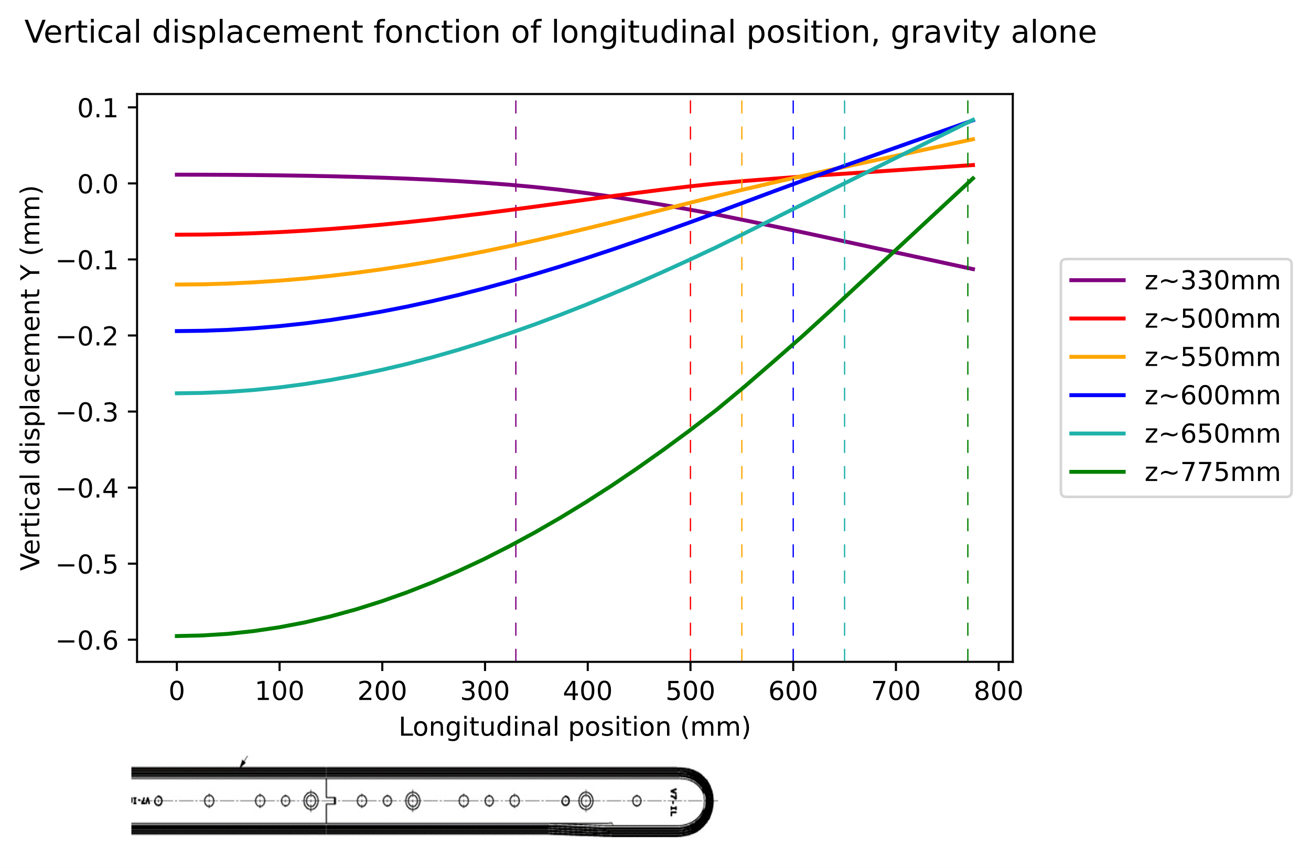
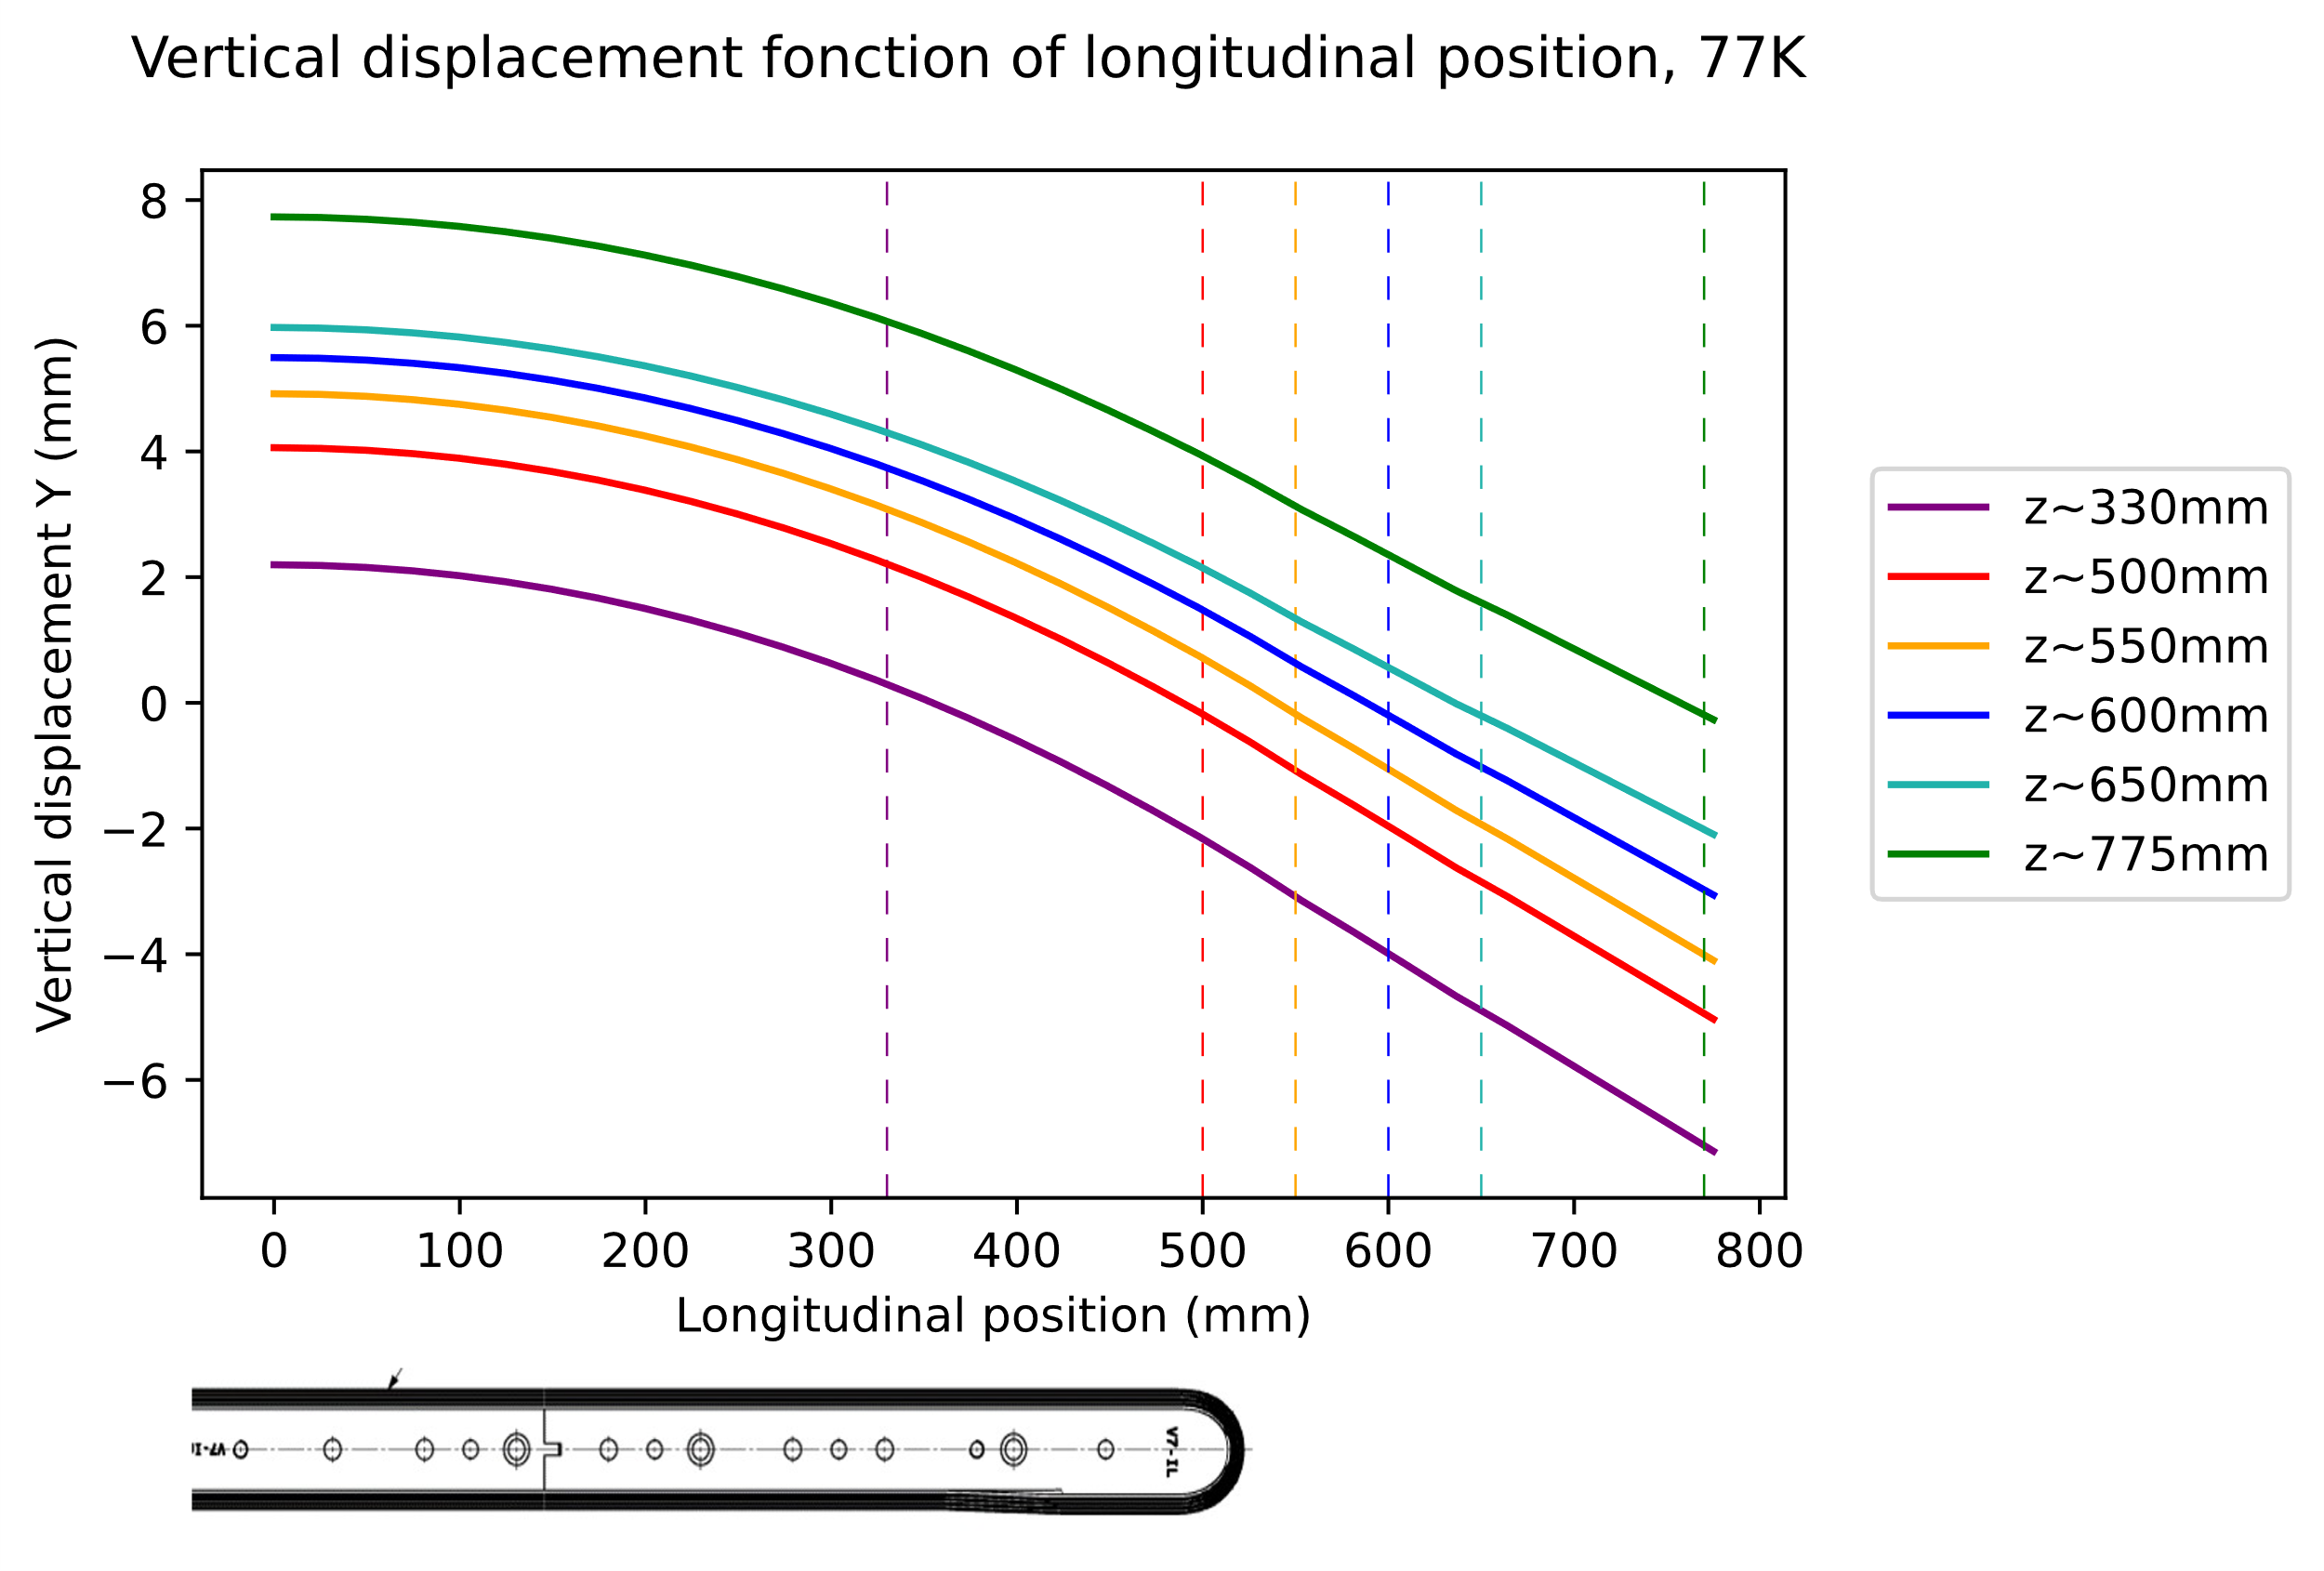
Influence of support position on photogrammetry measurement
Room temperature, visible but negligible
77K, negligible (just offset)

Slide 15
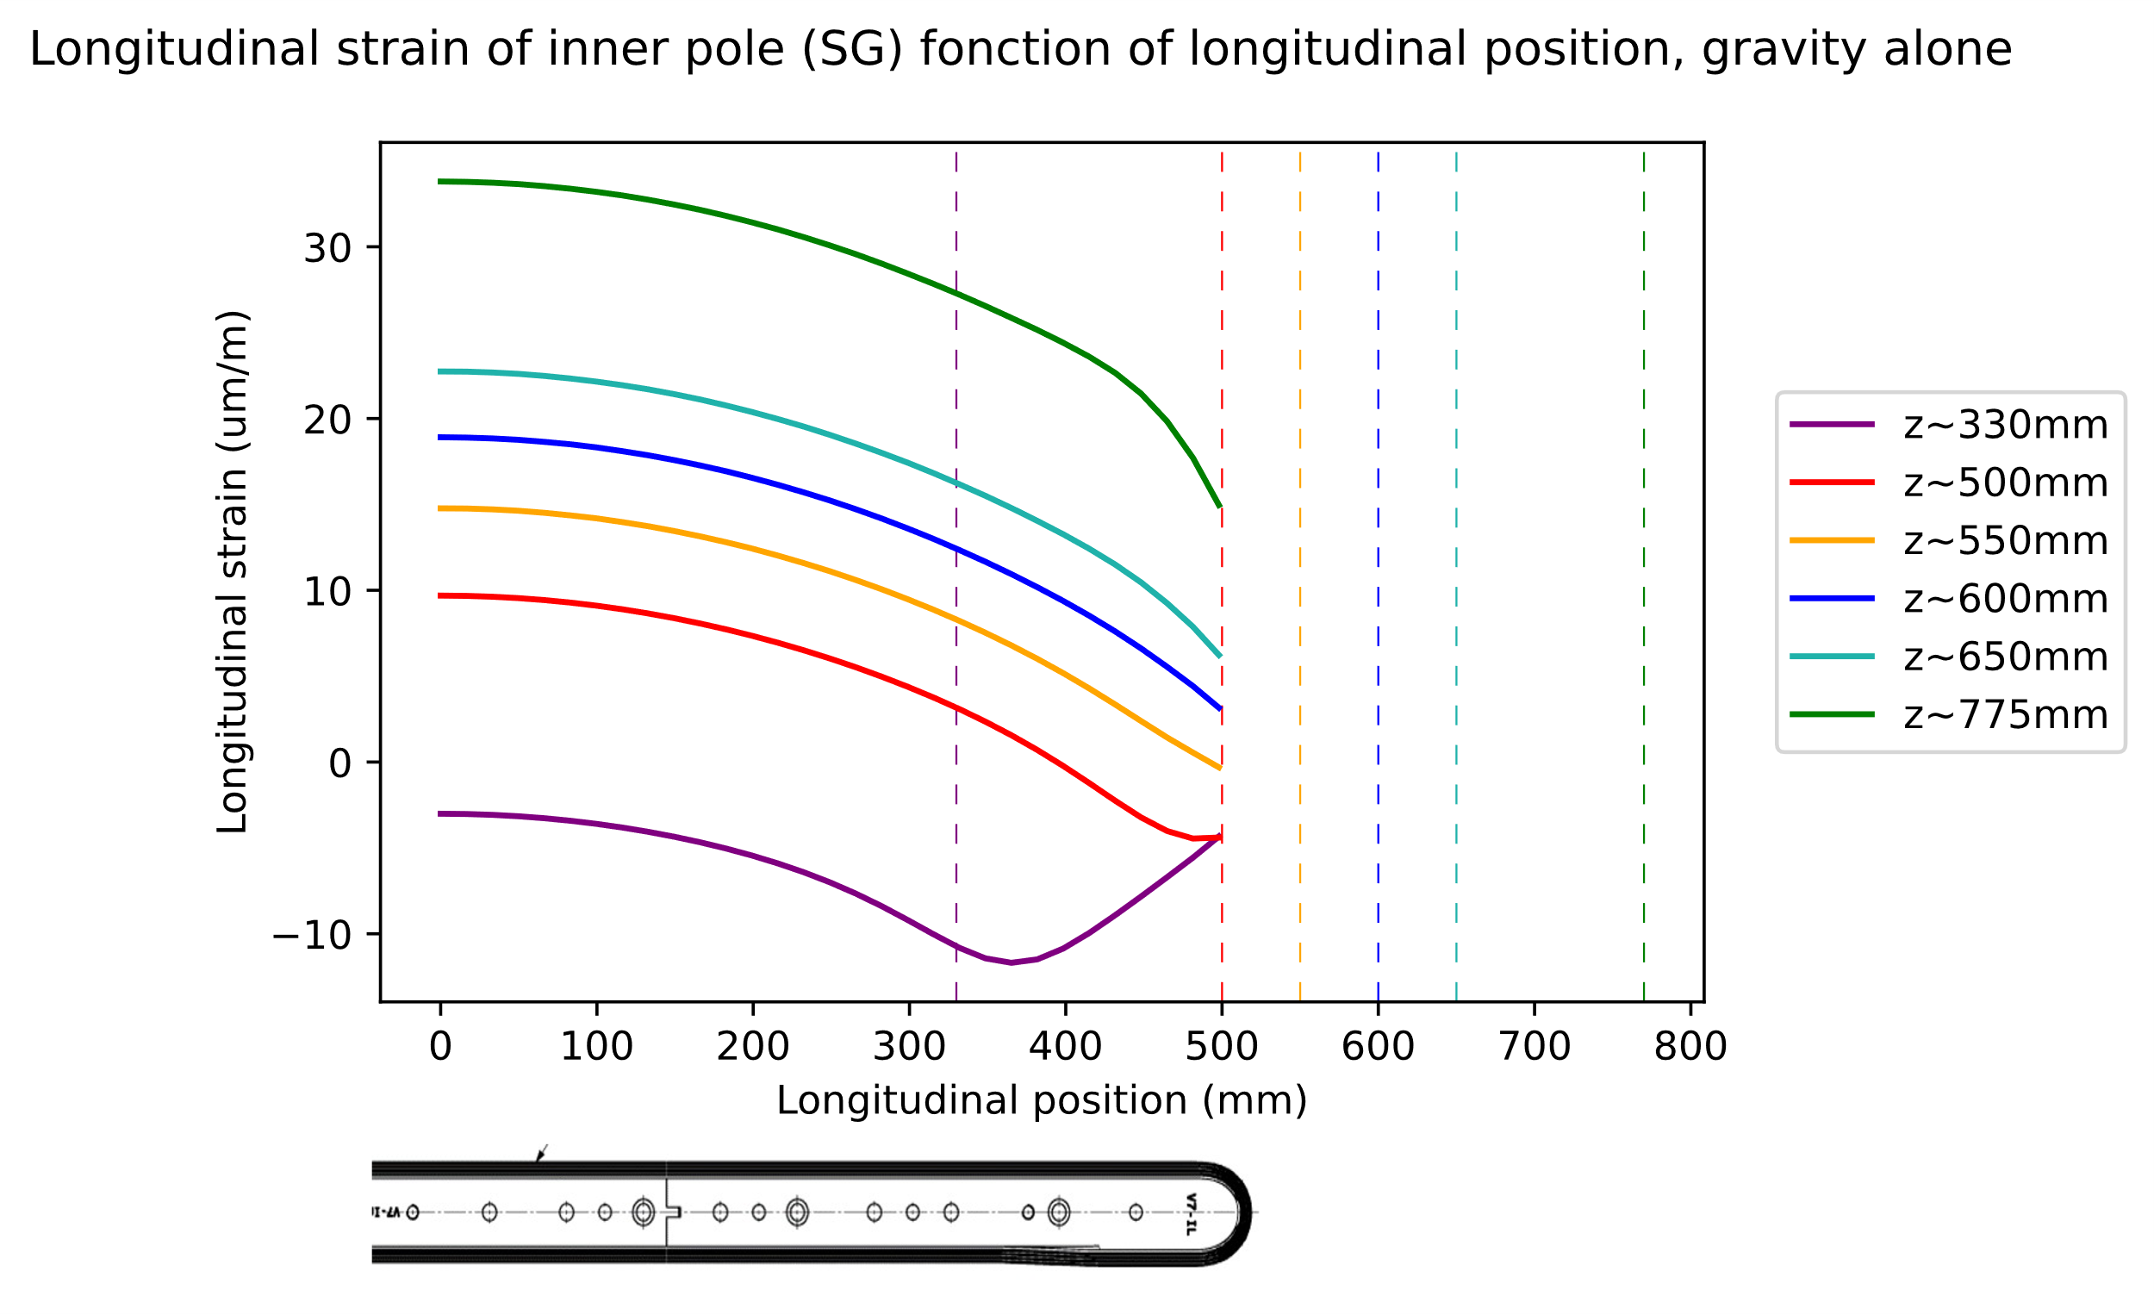
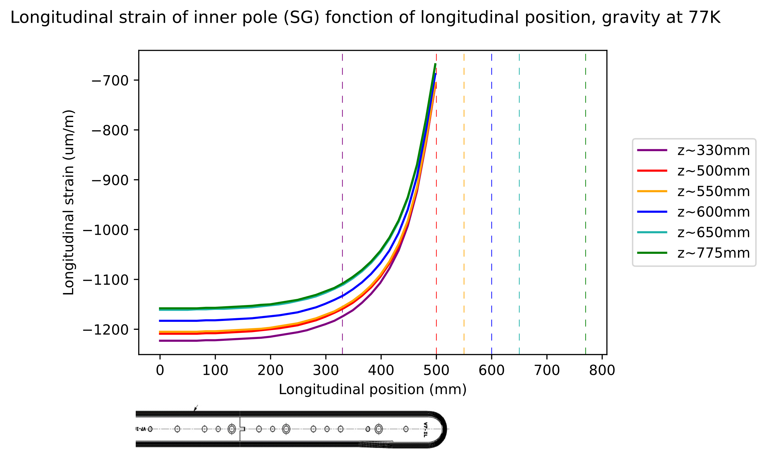
Influence of support position on SG measurement
Room temperature, gravity effect is small on SG
At 77K, difference of the support is: on pole or not pole

Slide 16
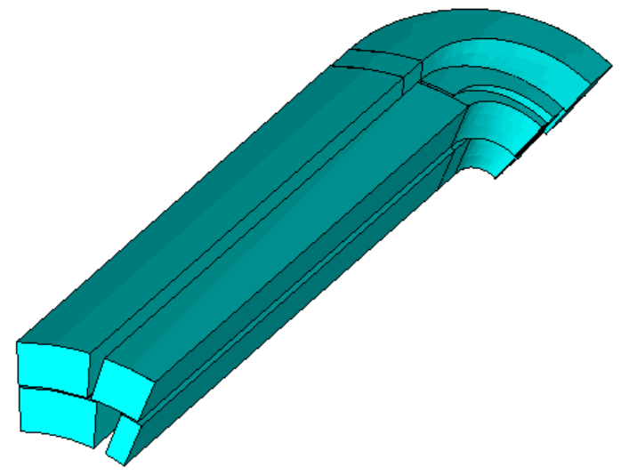
Material change: coil CTE
Study of the effect of CTE variation

Slide 17
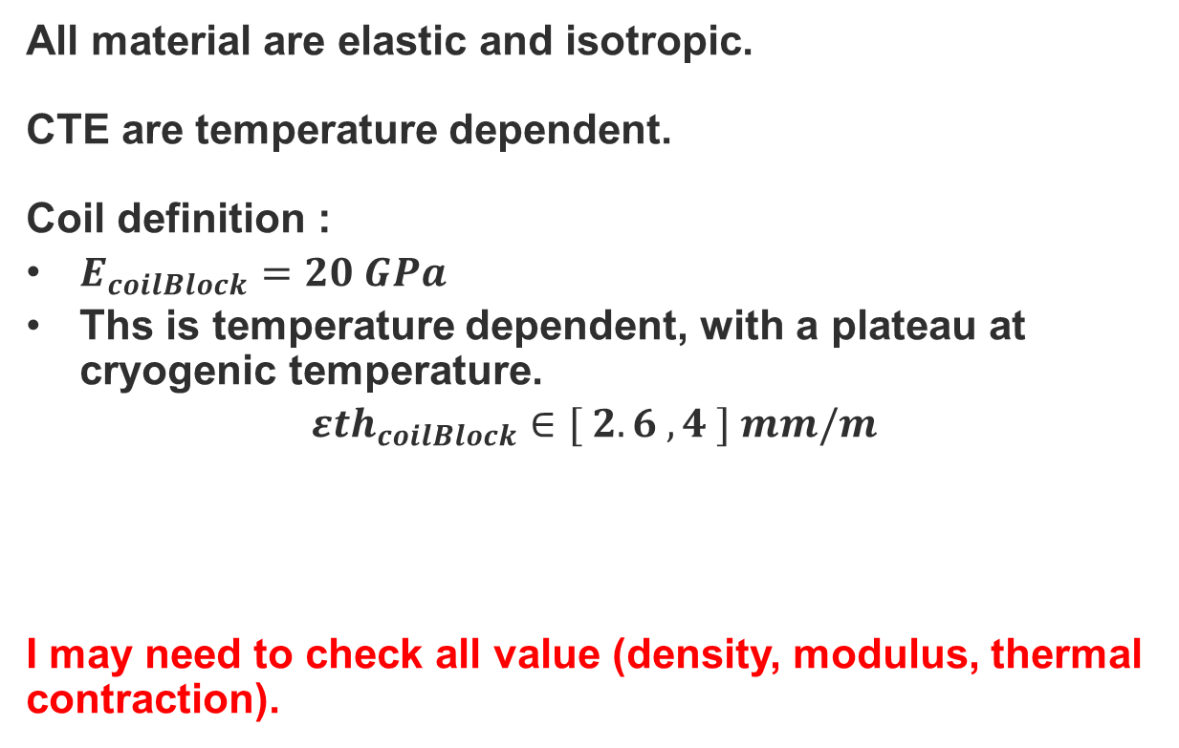
Main parameters
All material are elastic and isotropic.
CTE are temperature dependent.
Coil definition :
$E_{coilBlock}=20 GPa$
Ths is temperature dependent, with a plateau at cryogenic temperature.
$${εth}_{coilBlock}∈[ 2.6 , 4 ] mm/m$$
I may need to check all value (density, modulus, thermal contraction).
εth

Slide 18
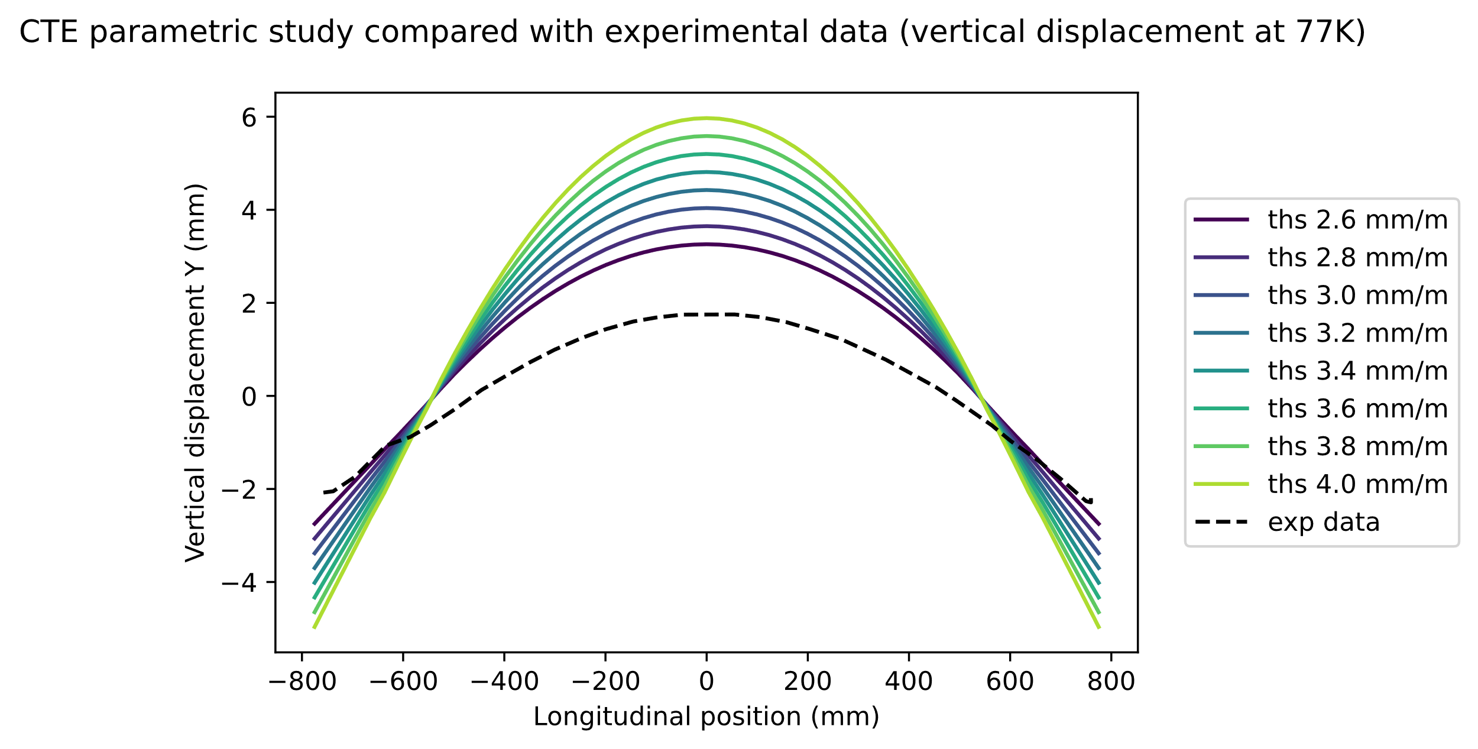
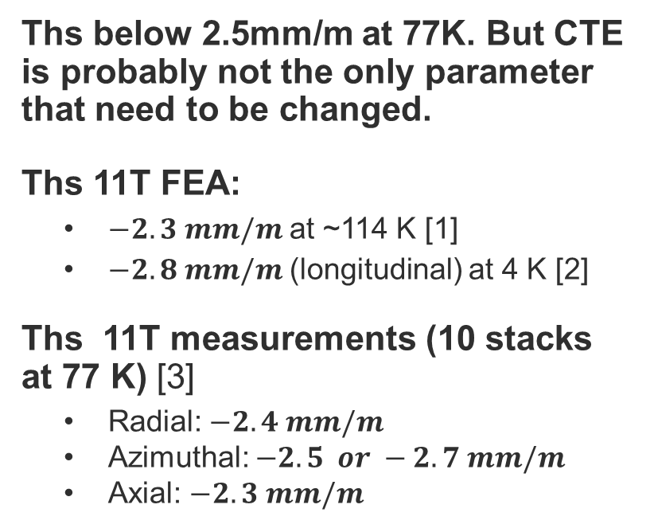
Comparison with photogrammetry data, displacement in Y direction
Ti Pole key slot
Y
Z
Ths below 2.5mm/m at 77K. But CTE is probably not the only parameter that need to be changed.
Ths 11T FEA:
  $−2.3 mm/m$ at ~114 K [1]
  $−2.8 mm/m$ (longitudinal) at 4 K [2]
Ths 11T measurements (10 stacks at 77 K) [3]
  Radial: $−2.4 mm/m$
  Azimuthal: $−2.5 or −2.7 mm/m$
  Axial: $−2.3 mm/m$
X
[1] Cedric Garion, 3D thermo-mechanical modelling, 2021, https://indico.cern.ch/event/1048701/
[2] Cedric Garion, Thermo-mechanical modelling, 2021, https://indico.cern.ch/event/1011517/
[3] R. Kriboo et al., Interferometric Measurement of the Low-Temperature Thermal Expansion of Impregnated Nb3Sn 11 Tesla Dipole Magnet Coils, 2019, EDMS n°???

Slide 19
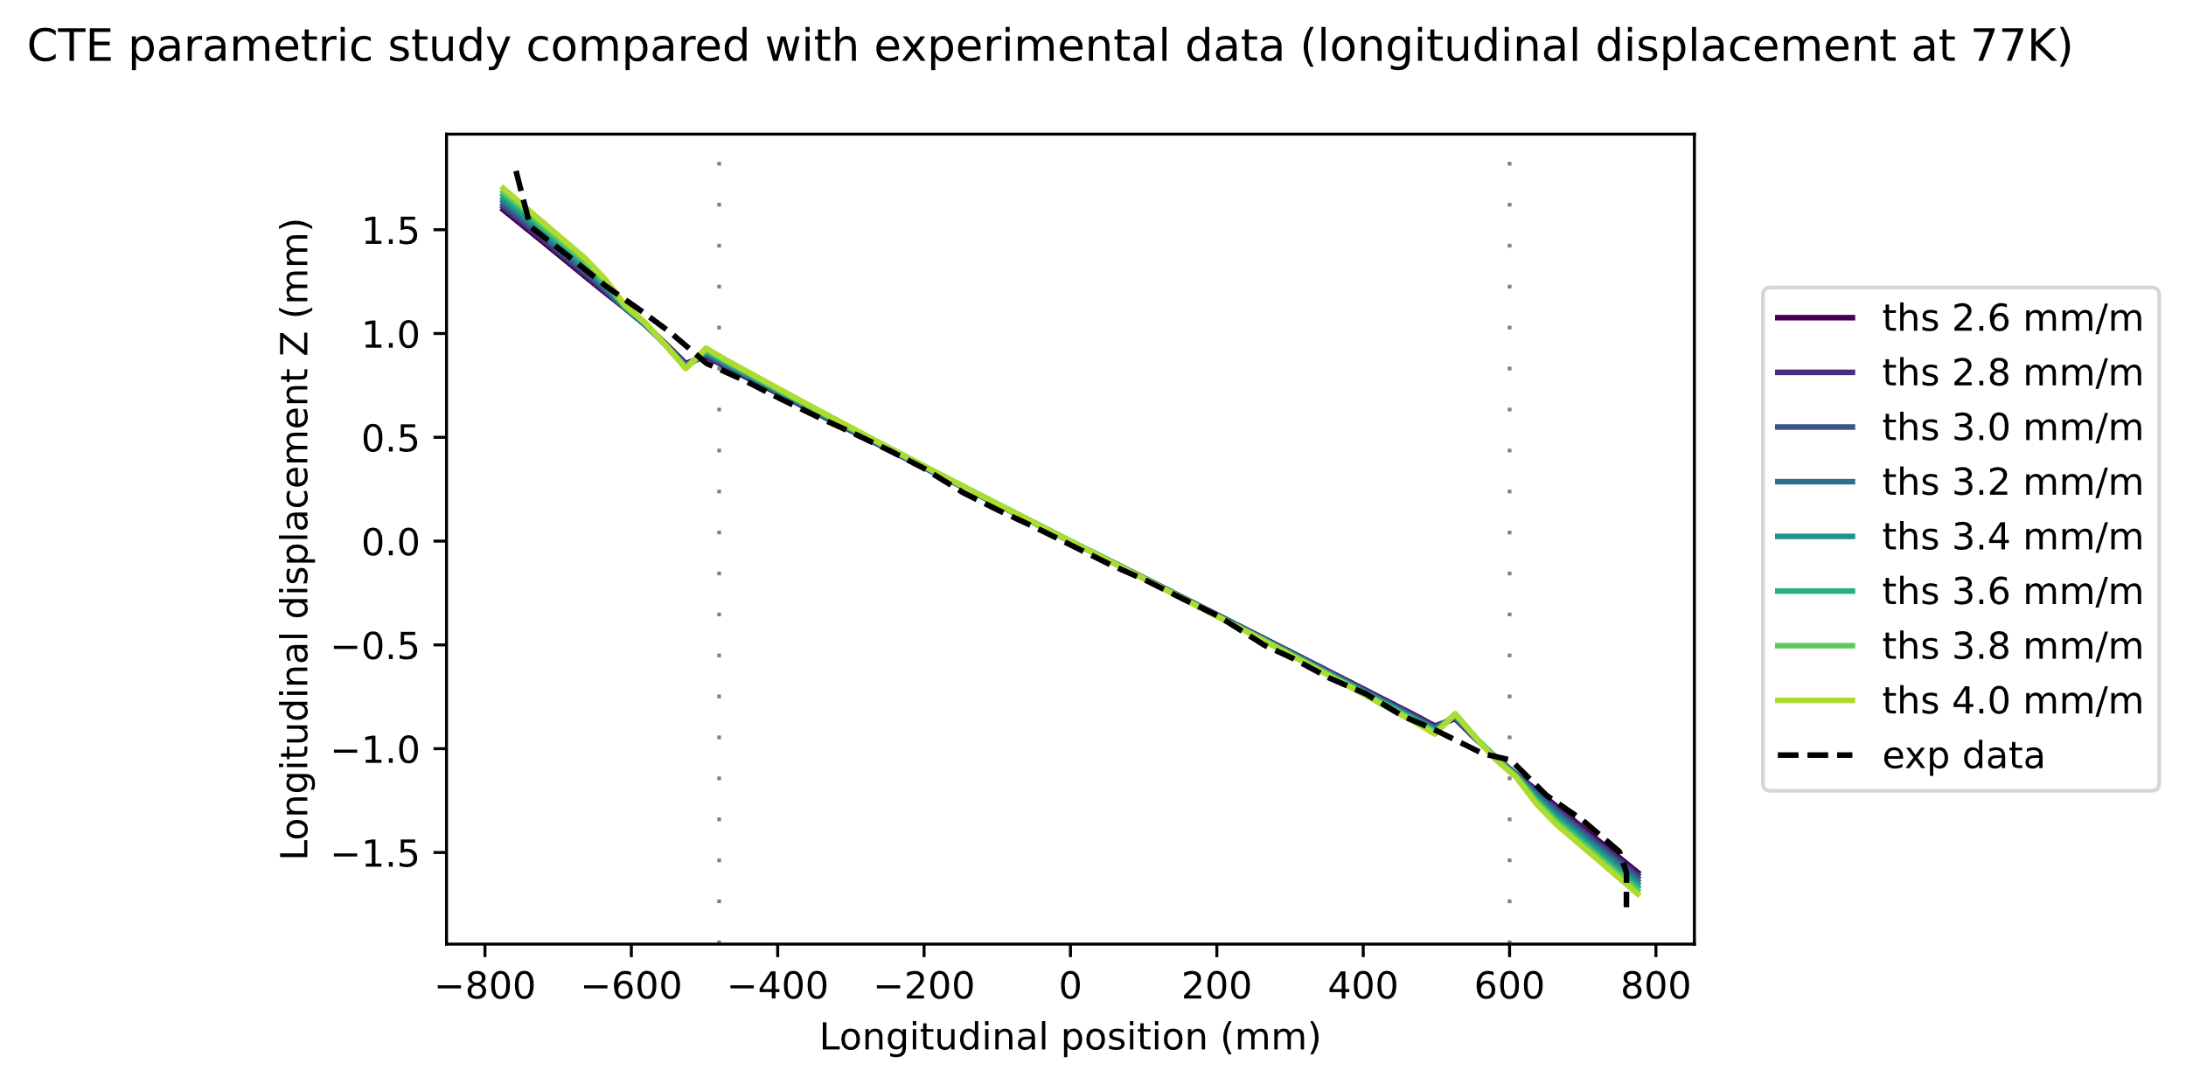
Comparison with photogrammetry data, displacement in Z direction
Ti Pole key slot
Y
Z
Experimental data and FEA results are consistent.
Sanity check: CTE has low influence
Two behaviours: Ti pole in the middle, heads outside.
X

Slide 20
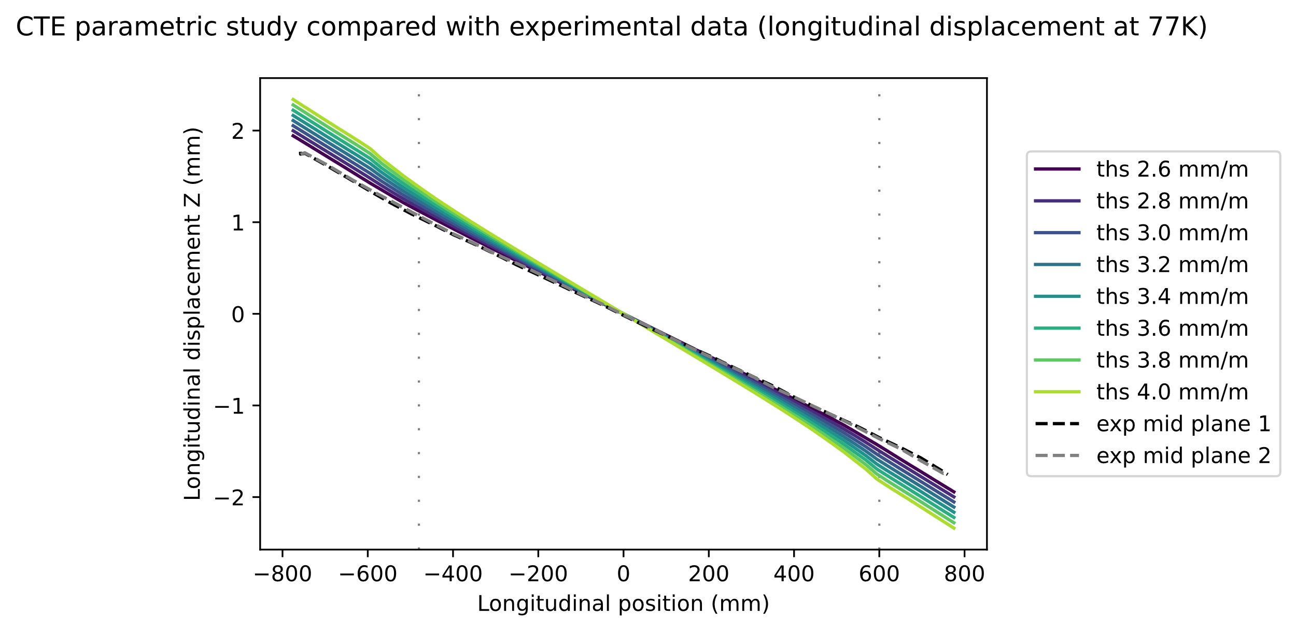
Comparison with photogrammetry data, displacement in Z direction
Mid Plane side 1
Mid Plane side 2
Y
Z
Two behaviour are observed in experimental data:
In the endshoes FEA is consistent with experimental data.
In the centre part, composed of the coil bloc, a low CTE seems closer to experimental data.
X

Slide 21
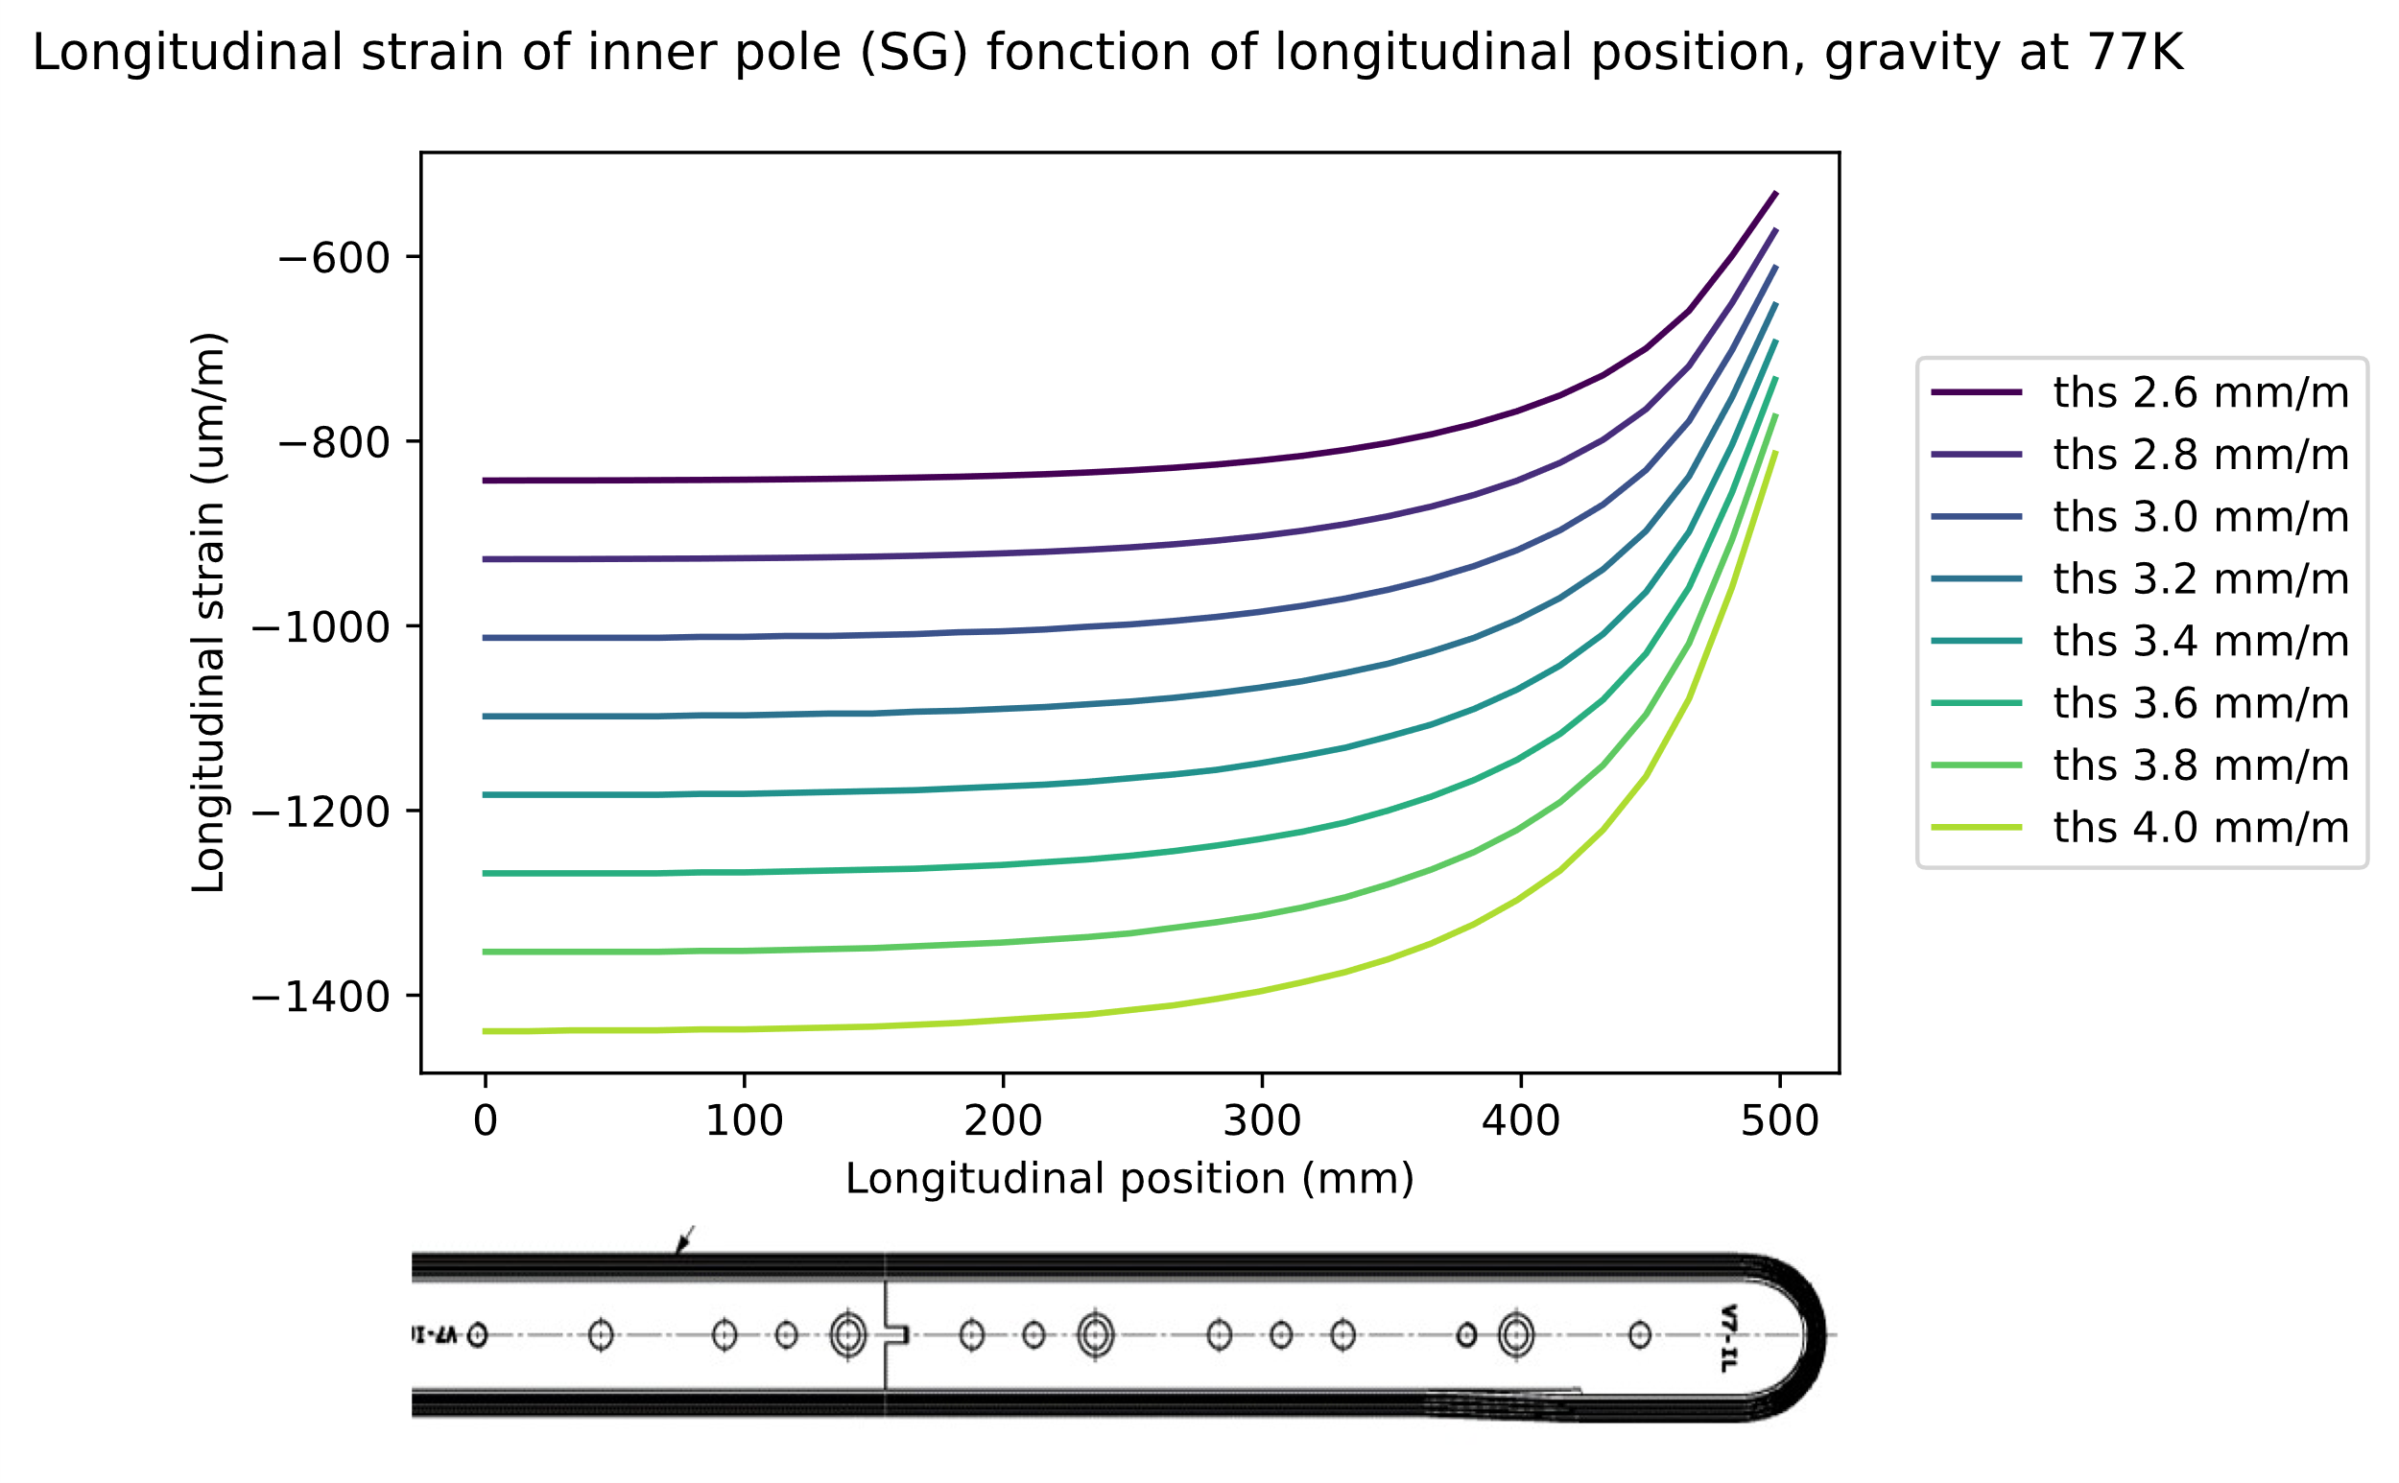
Comparison with SG results
CTE change a lot the strain in the pole.
BUT no exp data…

Slide 22
Material change: coil CTE - orthotropy
Study of the effect of CTE variation

Slide 23
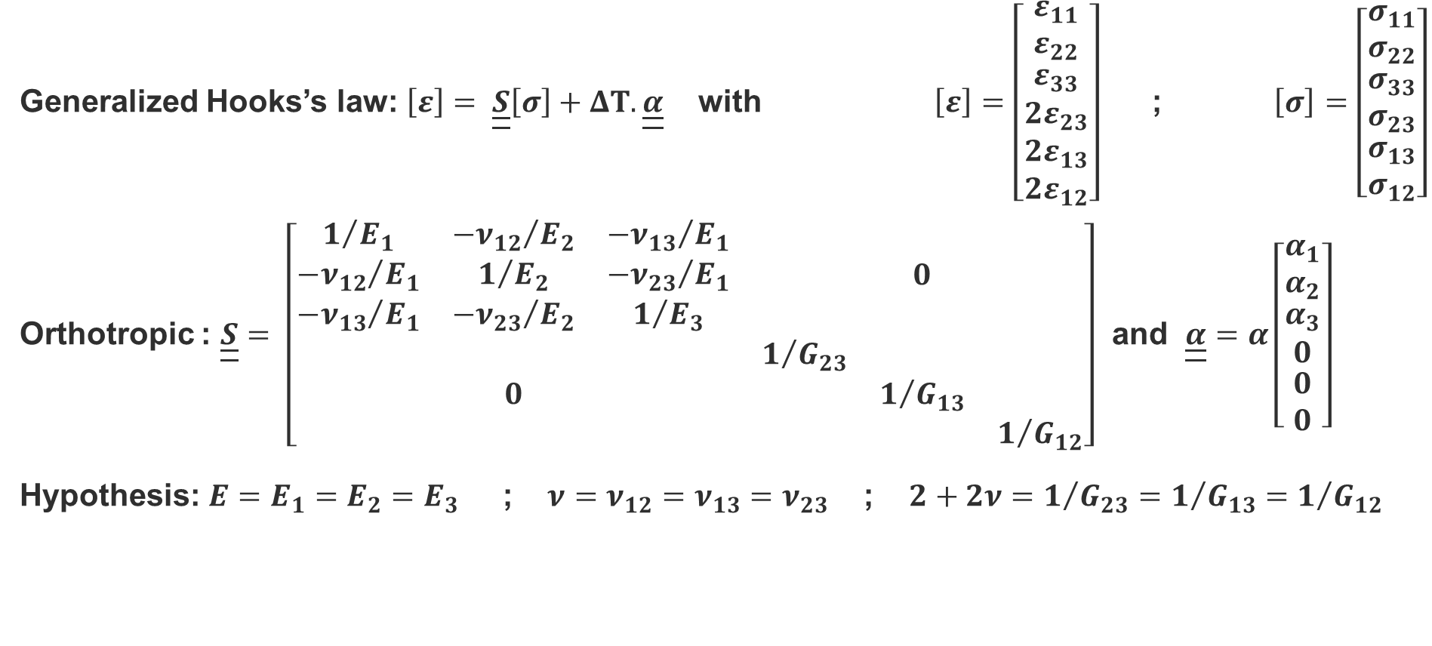
First step: quasi orthotropic CTE
Generalized Hooks’s law: $\left[ε\right]= \underline{\underline{S}}\left[σ\right]+ΔT.\underline{\underline{α}}$ with $\left[ε\right]=\left[\begin{matrix}ε_{11} \\ ε_{22} \\ \begin{matrix}ε_{33} \\ 2ε_{23} \\ \begin{matrix}2ε_{13} \\ 2ε_{12}\end{matrix}\end{matrix}\end{matrix}\right]$ ; $\left[σ\right]=\left[\begin{matrix}σ_{11} \\ σ_{22} \\ \begin{matrix}σ_{33} \\ σ_{23} \\ \begin{matrix}σ_{13} \\ σ_{12}\end{matrix}\end{matrix}\end{matrix}\right]$
Orthotropic : $\underline{\underline{S}}= \left[\begin{matrix}\begin{matrix}1/{E_{1}} & {−ν_{12}}/{E_{2}} & {−ν_{13}}/{E_{1}} \\ {−ν_{12}}/{E_{1}} & 1/{E_{2}} & {−ν_{23}}/{E_{1}} \\ {−ν_{13}}/{E_{1}} & {−ν_{23}}/{E_{2}} & 1/{E_{3}}\end{matrix} & 0 \\ 0 & \begin{matrix}1/{G_{23}} & & \\ & 1/{G_{13}} & \\ & & 1/{G_{12}}\end{matrix}\end{matrix}\right]$ and $\underline{\underline{α}}=α\left[\begin{matrix}α_{1} \\ α_{2} \\ \begin{matrix}α_{3} \\ 0 \\ \begin{matrix}0 \\ 0\end{matrix}\end{matrix}\end{matrix}\right]$
Hypothesis: ${E=E}_{1}=E_{2}=E_{3}$ ; $ν=ν_{12}=ν_{13}=ν_{23}$ ; ${2+2ν=1}/{G_{23}}=1/{G_{13}}=$ $1/{G_{12}}$

Slide 24
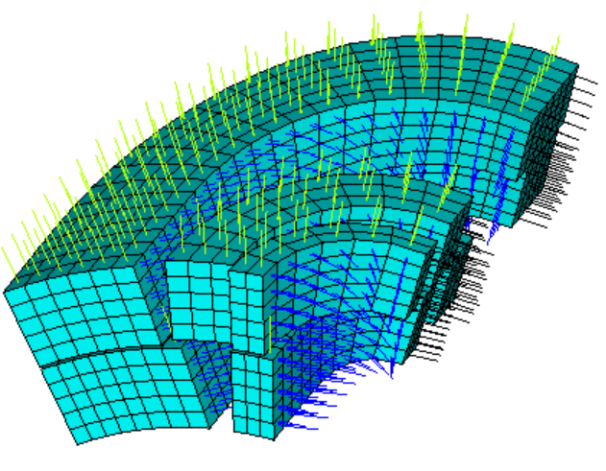
Orthotropy in ANSYS APDL
Macro from G. Vallone: quasi isotropic local coordinate systems (oriented in axial direction).
Adapted it for orthotropic coordinate systems.
Straight section : using cylindrical coordinates system.
Sanity checks:
If 3 equal CTE, give same results that isotropic
Continuity of thermal strain at 77K (straight-head)
Right values of thermal strain at beginning/end of the head

Slide 25
Material change: coil elastic modulus
Study of the effect of elastic modulus variation

Slide 26
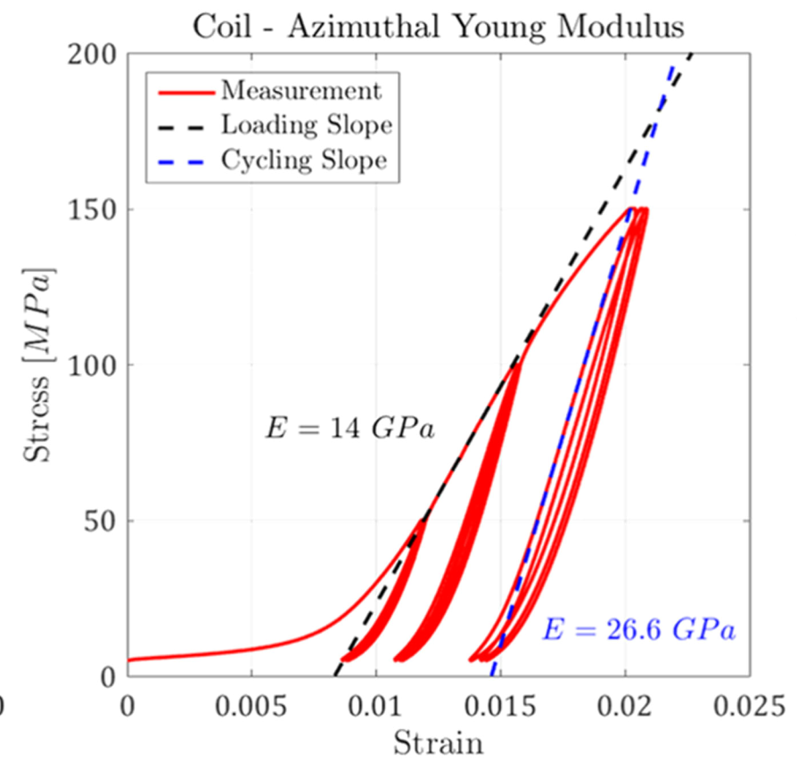
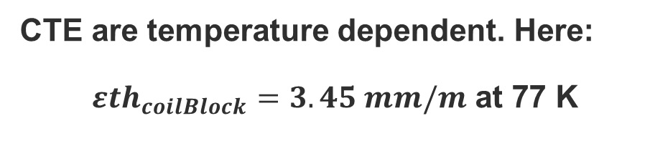
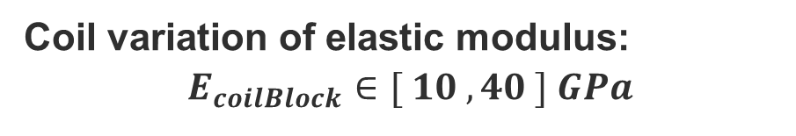
Main parameters
All material are elastic and isotropic.
CTE are temperature dependent. Here:
${εth}_{coilBlock}=3.45 mm/m$ at 77 K
Coil variation of elastic modulus:
$$E_{coilBlock}∈[ 10 , 40 ] GPa$$
Ten stack test on MQXF cables, preliminary test campaign [1]
[1] G. Vallone et al., "Mechanical Performance of Short Models for MQXF, the Nb3Sn Low-β Quadrupole for the Hi-Lumi LHC," in IEEE Transactions on Applied Superconductivity, vol. 27, no. 4, pp. 1-6, June 2017, Art no. 4002906, doi: 10.1109/TASC.2016.2645133.

Slide 27
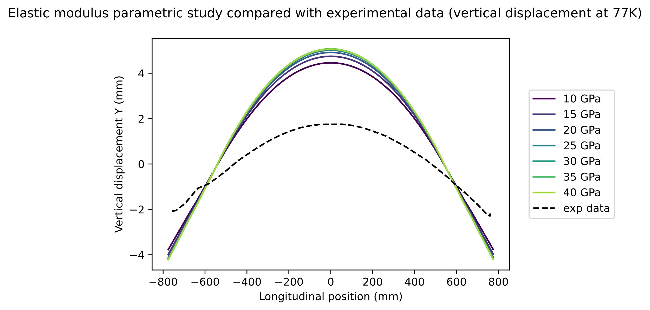
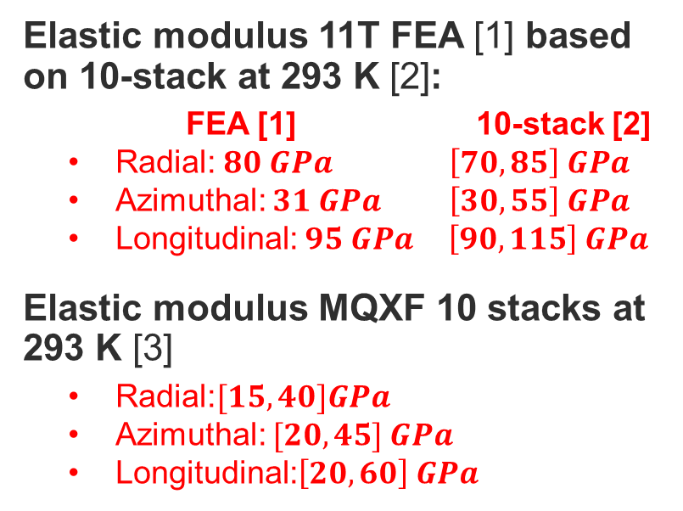
Comparison with photogrammetry data, displacement in Y direction
Ti Pole key slot
Y
Z
Elastic modulus 11T FEA [1] based on 10-stack at 293 K [2]:
  FEA [1] 10-stack [2]
  Radial: $80 GPa$ $\left[70,85\right] GPa$
  Azimuthal: $31 GPa$ $\left[30,55\right] GPa$
  Longitudinal: $95 GPa$ $\left[90,115\right] GPa$
Elastic modulus MQXF 10 stacks at 293 K [3]
  Radial:$[15,40]GPa$
  Azimuthal: $[20,45] GPa$
  Longitudinal:$\left[20,60\right] GPa$
X
[1] C. Garion, Thermo-mechanical modelling, 2021, https://indico.cern.ch/event/1011517/
[2] F. Wolf et al., Effect of Epoxy Volume Fraction on the Stiffness of Nb3Sn Rutherford Cable Stacks, IEEE Transactions on applied superconductivity, vol. 29, no. 5, August 2019.
[3] C. Fichera et al., New Methodology to Derive the Mechanical Behavior of Epoxy-Impregnated Nb3Sn Cables, IEEE Transactions on applied superconductivity, vol. 29, no. 7, October 2019.
Changing elastic modulus has moderate effect on the bending.
Smaller elastic modulus is closer to exp data.

Slide 28
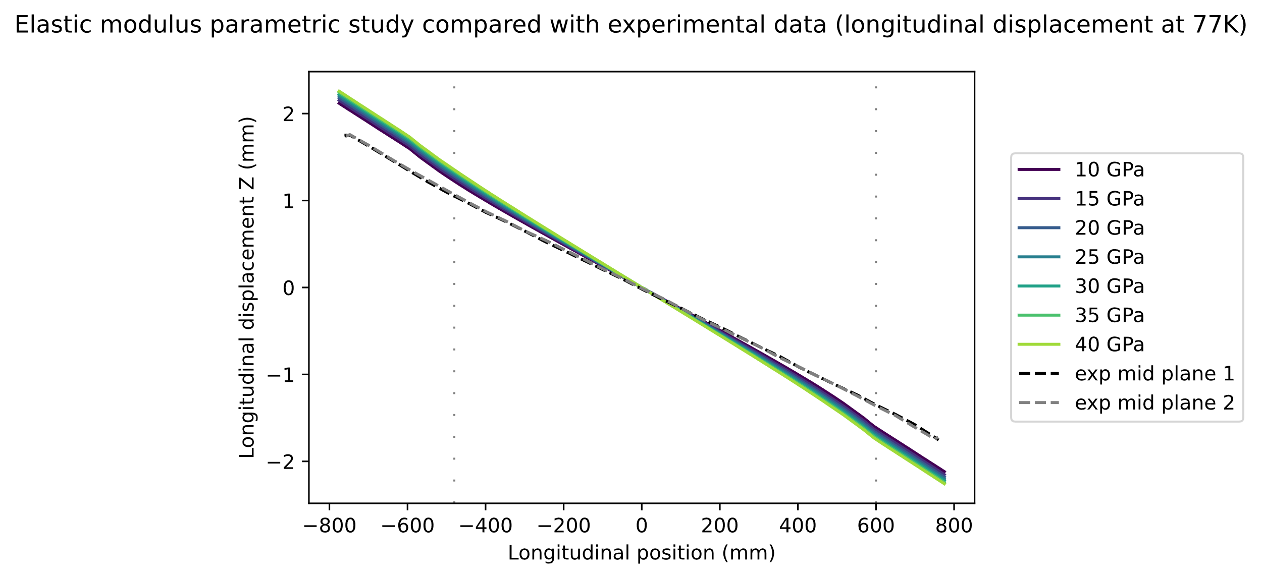
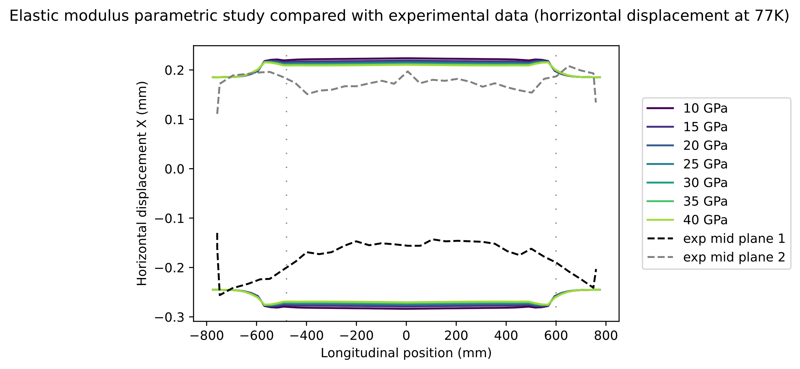
Comparison with photogrammetry data, displacement in X and Z direction
Mid Plane side 1
Mid Plane side 2
Y
Z
Longitudinal displacement Z: small elastic modulus seems to get closer to measured (but small effect).
Horizontal displacement X: high elastic modulus seems to get closer to measured (but small effect).
X
Sanity check: for key slot path the change of elastic modulus has low influence.

Slide 29
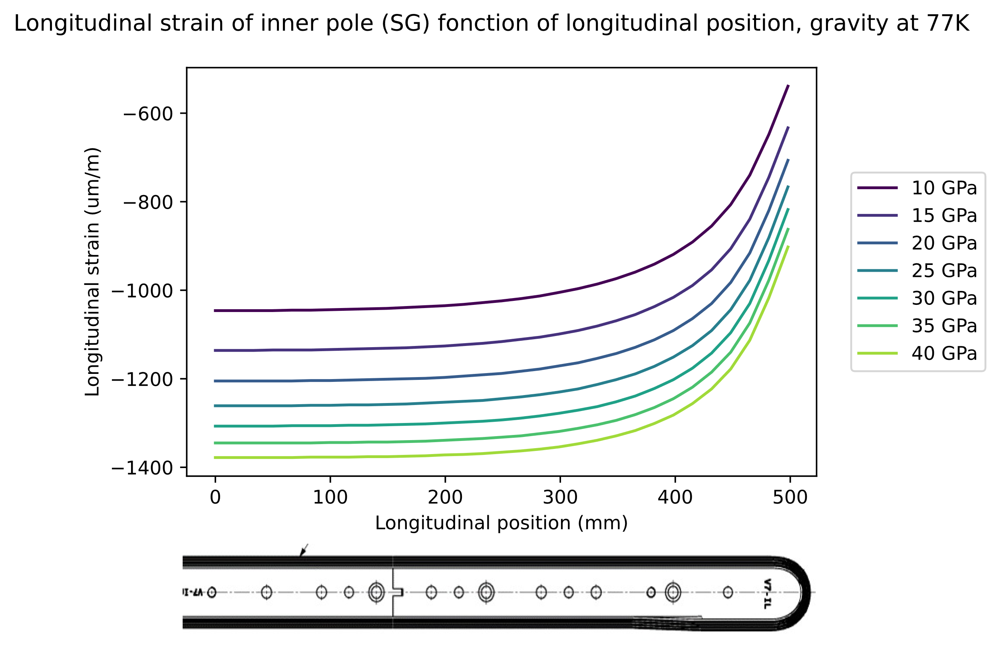
Comparison with SG results
Elastic modulus change a lot the strain in the pole.
BUT no exp data…

Slide 30
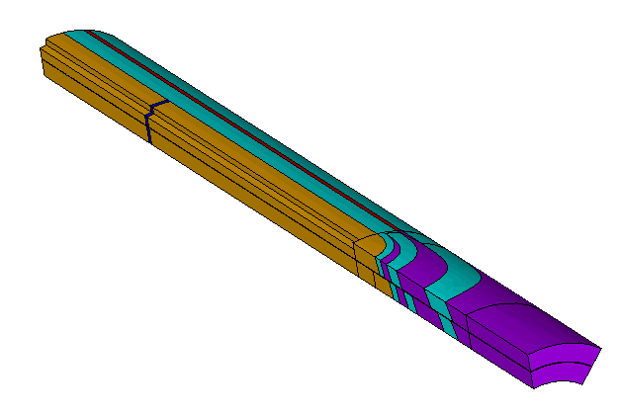
Geometry change: pole cut
Study of the effect of epoxy presence between poles

Slide 31
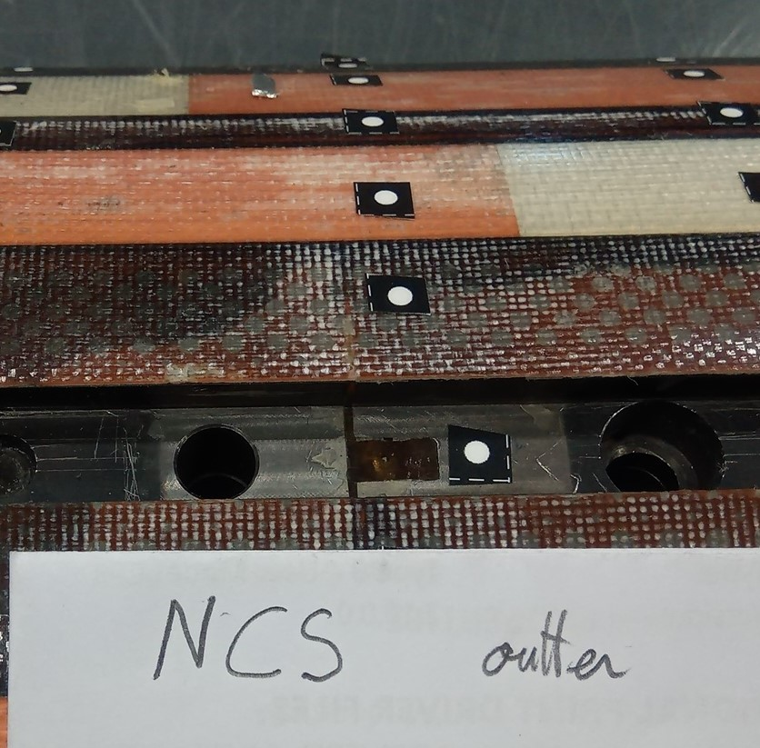
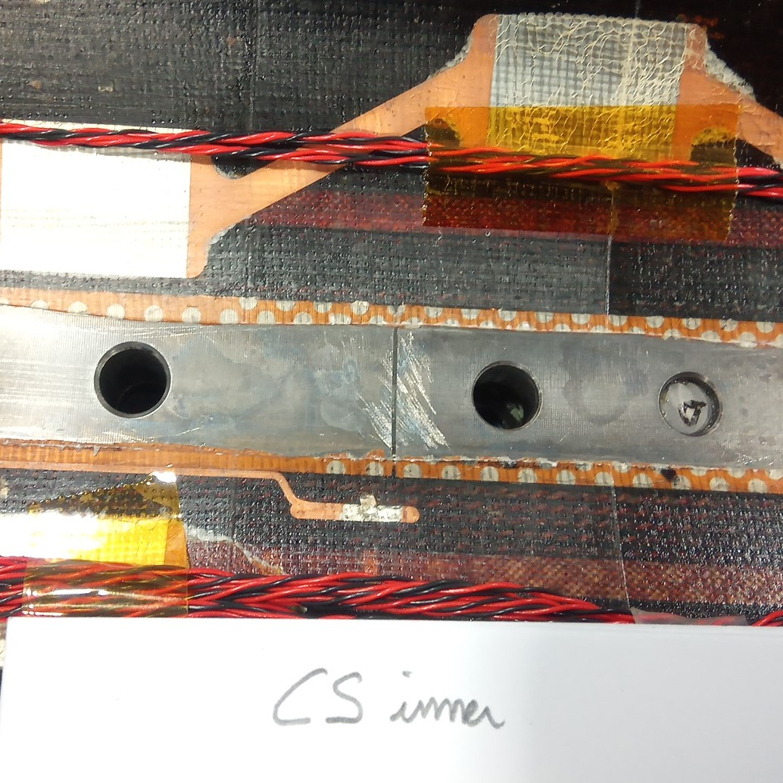
Observed pole cut

Slide 32
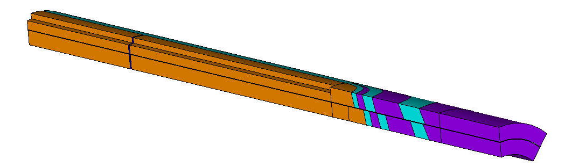

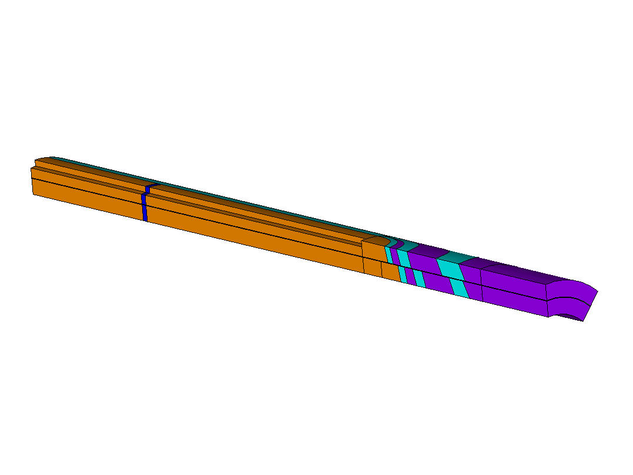
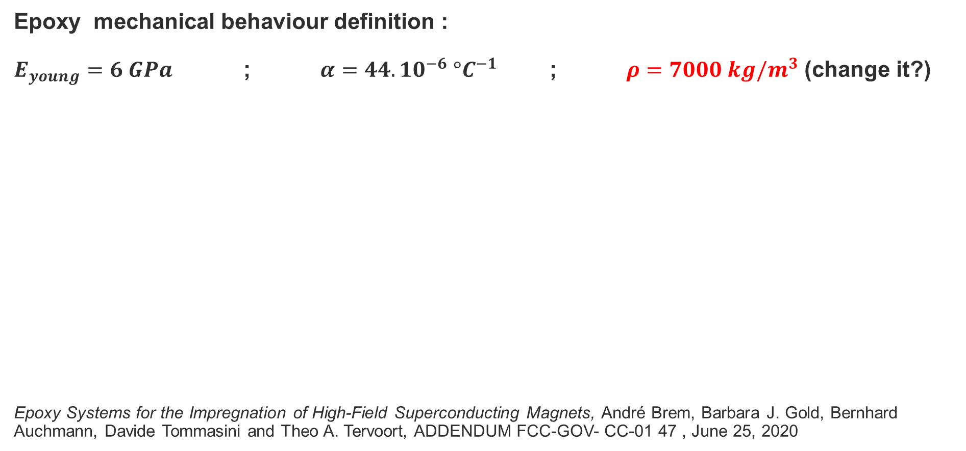
Different thickness of epoxy
Epoxy mechanical behaviour definition :
$E_{young}=6 GPa$ ; $α=44.10^{−6} °C^{−1}$ ; $ρ=7000 kg/m^{3}$ (change it?)
Epoxy Systems for the Impregnation of High-Field Superconducting Magnets, André Brem, Barbara J. Gold, Bernhard Auchmann, Davide Tommasini and Theo A. Tervoort, ADDENDUM FCC-GOV- CC-01 47 , June 25, 2020
2 mm
4 mm
6 mm

Slide 33
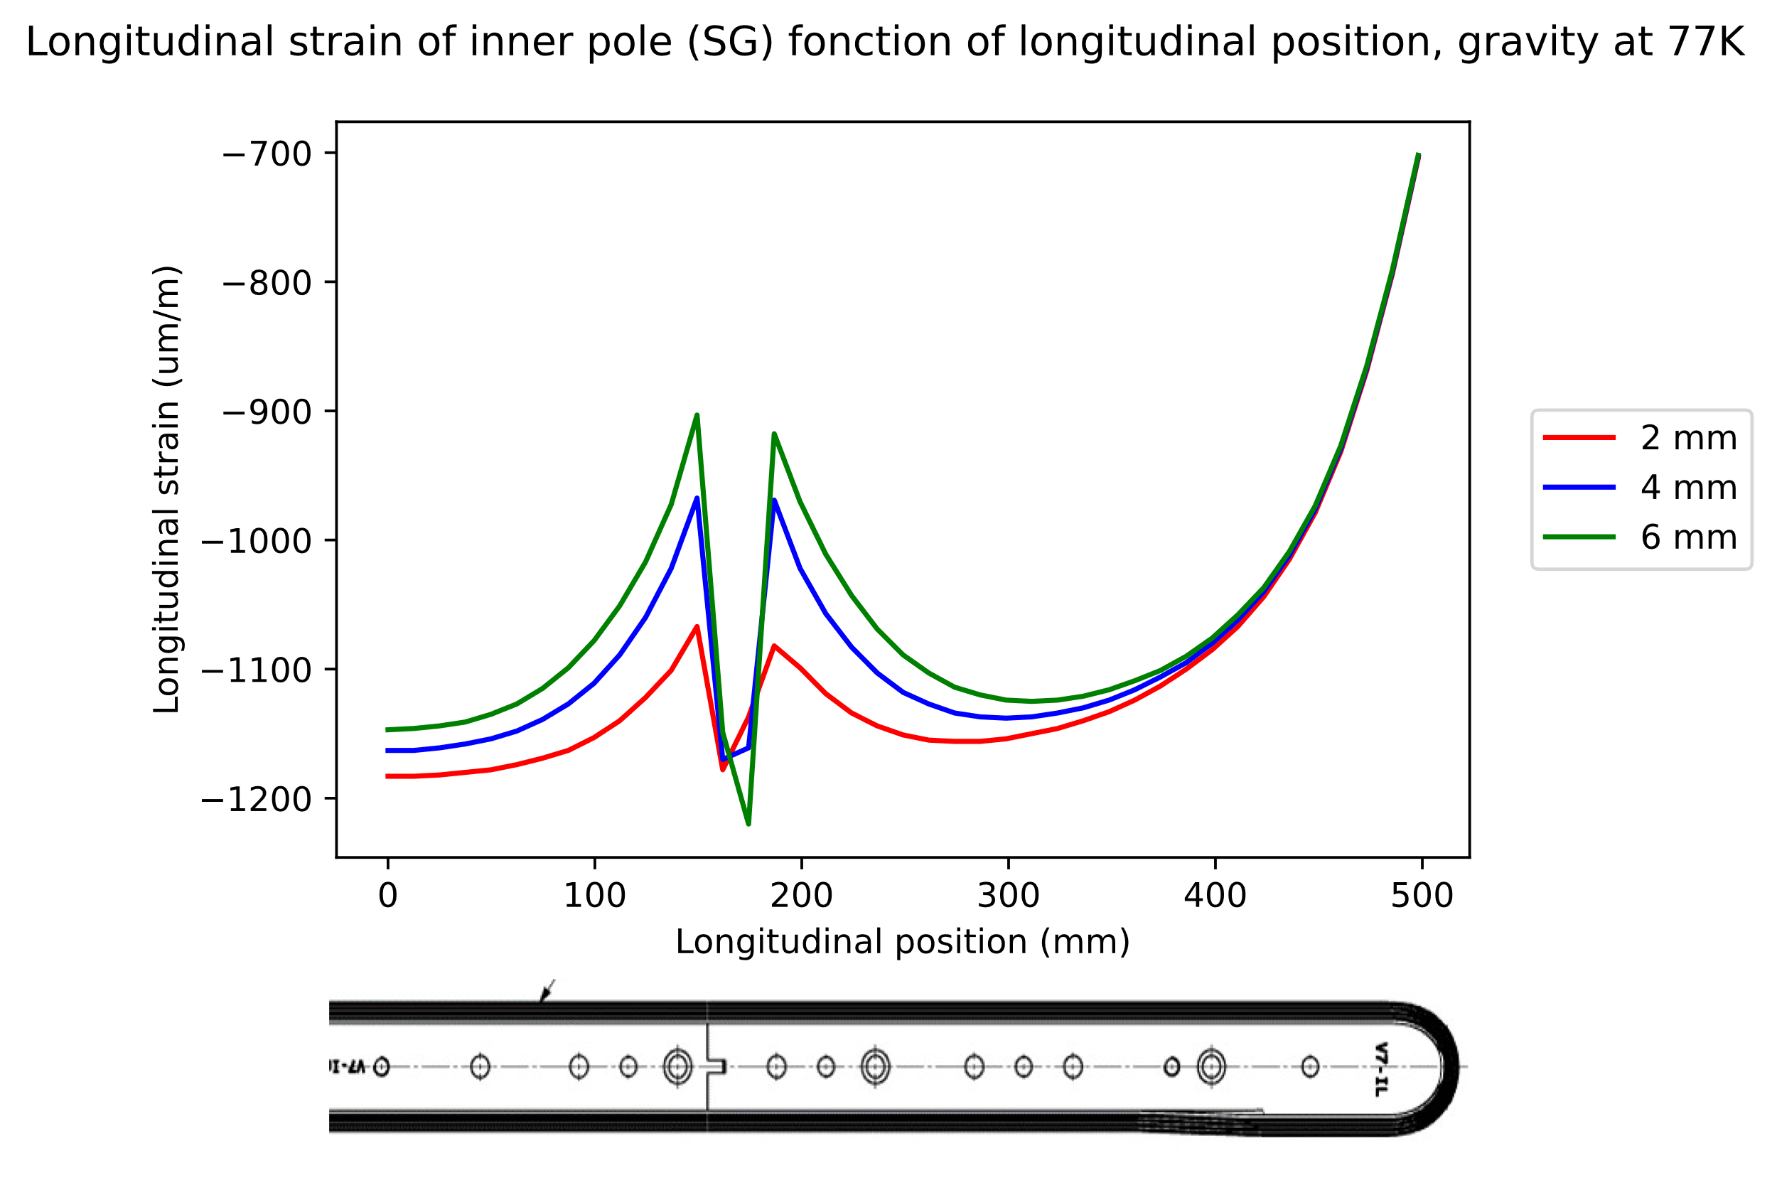
Influence of the layer of epoxy on SG data: 77K
FEA of pole separation effect at 77K has similar tendency observe with SG measurement
2, 4 or 6 mm

Slide 34
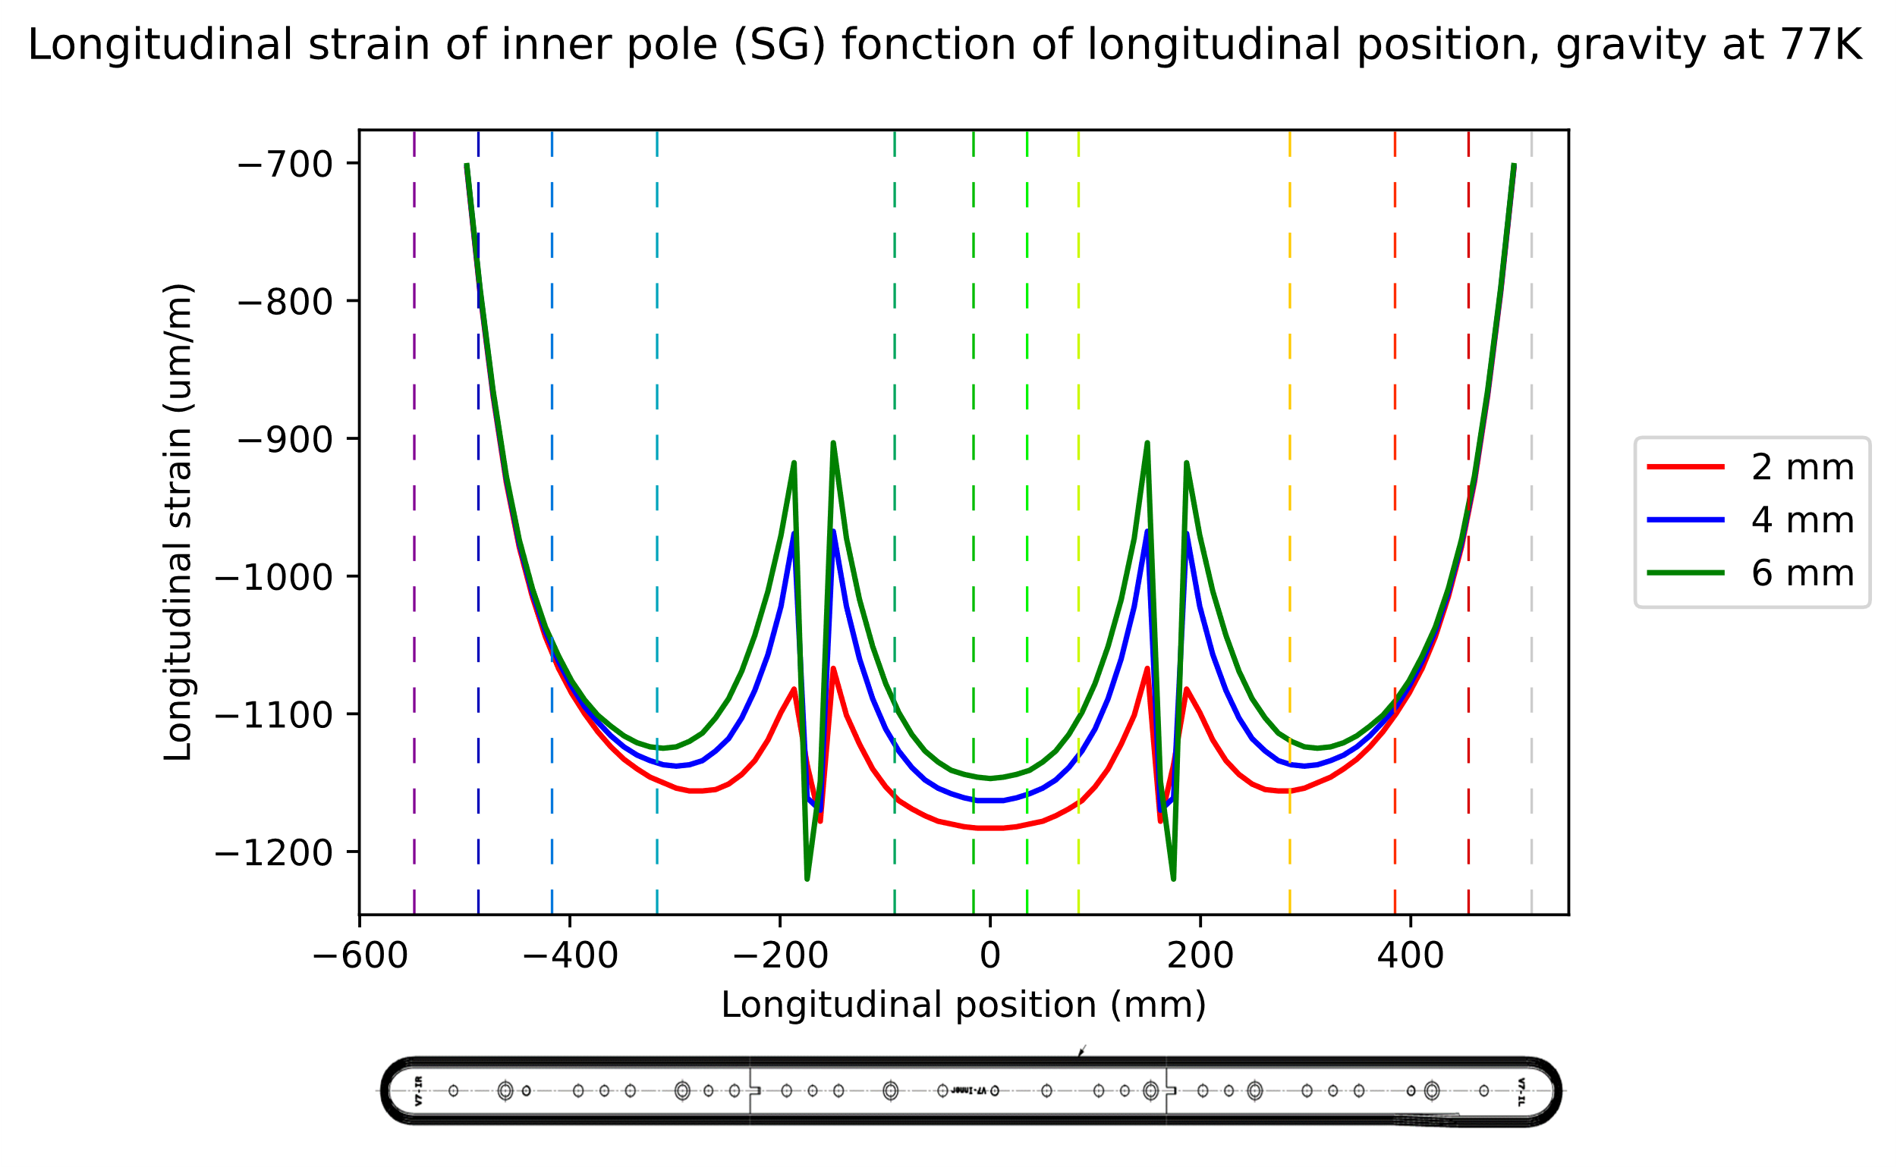
FEA with APPROXIMATE SG position

Slide 35
Contacts
Study of the effect of contacts

Slide 36

Main material parameters (by default)
All material are elastic and isotropic.
Coil definition:
$E_{coilBlock}=20 GPa$
Thermal contraction coefficient is temperature dependent (Jose’s work)
Contact definition:
All bounded.

Slide 37


Sum up of contact stresses
 | Contact number | Contact pressure |  | Contact friction max (MPa)
 |  | min (MPa) | max (MPa)
Inner layer | 210 (coil11-endshoe11) | -3.2 | 5.7 | 4.3
 | 211 (coil11-spacer1) | -1.4 | 9.7 | 5.3
 | 212 (coil11-spacerw1) | -0.6 | 7.2 | 1.6
 | 213 (coil11-wedge11) | 0 | 17 | 4.1
 | 214 (coil12-spacer21) | 1.6 | 23.6 | 7.6
 | 216 (coil..-pole..) | -1.5 | 50.2 | 23.9
Outer layer | 220 (coil21-endshoe2) | -2.7 | 1.3 | 2.2
 | 221 (coil21-spacerw2) | 0.3 | 6.2 | 2.5
 | 222 (coil21-wedge2) | 0.3 | 5.7 | 1.6
 | 223 (coil22-spacerw2) | -0.1 | 13.5 | 5.5
 | 226 (coil22-pole2) | 4.3 | 31 | 8.6
out
in
out
in
Little contact traction
Bigger compression close to poles
Localized shear stress

Slide 38
Conclusion
Photogrammetry give interesting and probably reliable results. But I need to add incertitude.
The lower the CTE, the closer to the measurements. BUT ths = 3.4 mm/m at 77K is overshooting!
Can not conclude for elastic modulus, not without SG data.
Hope for a new cooling down with only SG data…
Orthotropy: a macro is available for APDL and is waiting to be tested in other codes!
Warning: for SG data is influenced close to pole cut.
Contact study still ongoing.

Slide 40


Displacement field, longitudinal cross section
M1: initial warm
M2: cooling down (~77K) → bending 4.04mm
M3: warm up
Ti Pole key slot
Ti Pole
Mid plane side 1
Bending and contraction are observed (few mm)
Residual bending is observed (tens of μm)

Slide 41


Displacement field, longitudinal cross section TCgaz
M1: initial warm
M2: cooling down (~115K)
M3: warm up
Looking for better way to plot…?
Limited trust in temperature homogeneity in M2.
Ti Pole key slot
Ti Pole
Mid plane side 1

Slide 42

Experiment results: SG
Strain gauges data post-process, quick reminder

Slide 43



SG data post process (1)

Slide 44

SG data post process (2)

