Slide 1
Synchrotron Radiation Progress
(RR-setup, GEANT4 and IRSYN*)
High Luminosity Option**
Nathan Bernard
Rob Appleby
26-10-10
*developed by R. Appleby
**based on the optics of L.Thompson

Slide 2
Agenda
Benchmarking of GEANT4 and IRSYN.
Options for Detector Dipole
Plans for the future (Absorber and Masks)

Slide 3
GEANT4
GEANT4 utilizes the Runge-Kutta method for integration in order to track particle trajectories in magnetic fields.
GEANT4 utilizes a Monte Carlo model to simulate synchrotron radiation.
IRSYN
IRSYN integrates the particle trajectory from the magnetic field using time-reversal velocity verlet method.
IRSYN utilizes a Monte Carlo model to simulate synchrotron radiation. (developed by Helmut B).
IRSYN has been benchmarked against previous synchrotron radiation calculations made by B. Nagorny.

Slide 4
Comparison of Results with GEANT4 and IRSYN
Below is a comparison of the power distribution found in the IR for the new 10 degree optics using the two codes.
All measurements are in Watts unless otherwise marked.
Element | DL | QL3 | QL2 | QL1 | QR1 | QR2 | QR3 | DR | Total (kW)
GEANT4 | 397.40 | 5029.78 | 3968.90 | 233.36 | 235.64 | 3979.92 | 5016.71 | 397.40 | 18.87
Robs Code | 410.74 | 4937.52 | 4082.75 | 219.06 | 239.8 | 4153.31 | 5159.28 | 406.22 | 19.63
These results show promise in the two codes as methods of reliably calculating synchrotron light.
Since both codes utilize Monte Carlo methods, statistical deviations are expected and experienced.

Slide 5
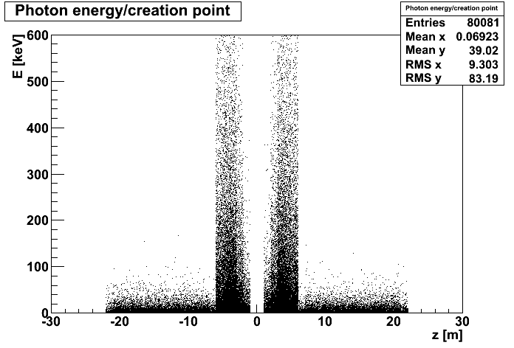
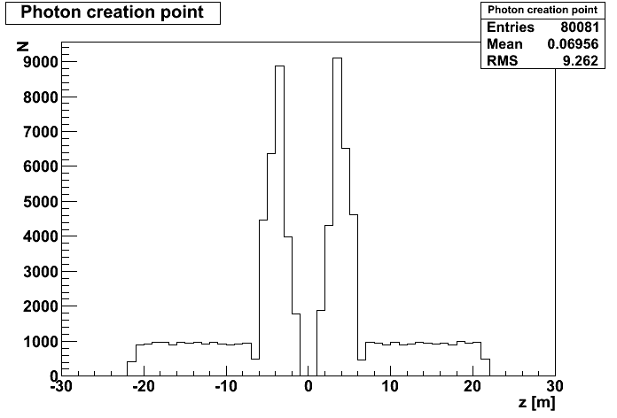
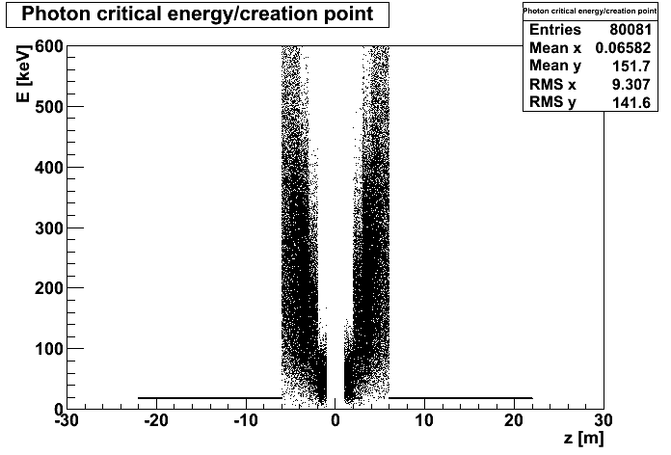
Photon development
in terms of Z*
Photon creation structure makes it clear that the quadrupoles dominate photon creation for the 10 degree RR optics, in terms of number, critical energy, and energy.
*All Plots done by R. Appleby with IRSYN and ROOT

Slide 6
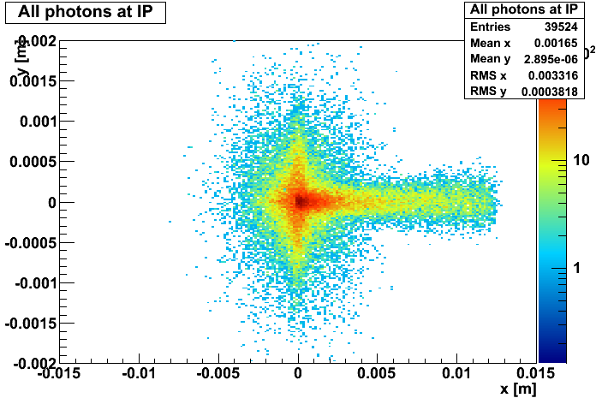
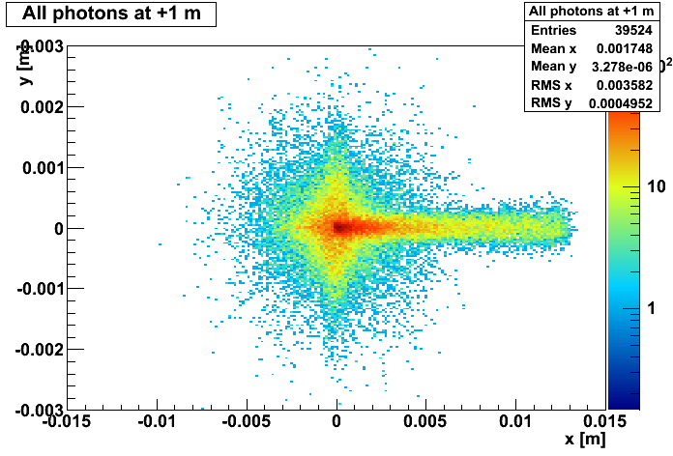
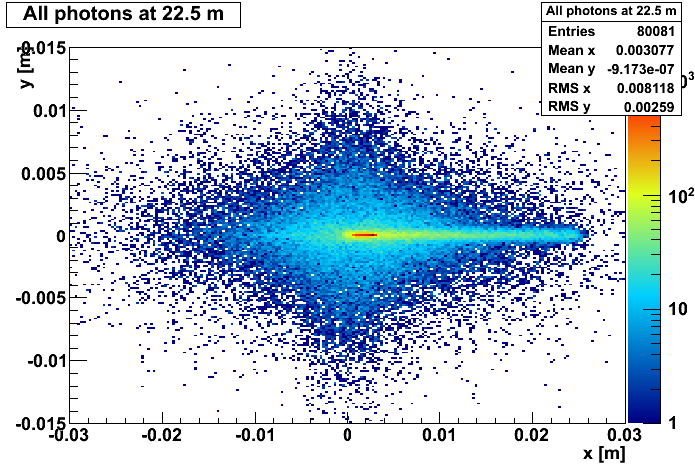
Transverse Slices
of Photon development in Z*
Photon creation structure makes it clear that the majority of the photons are near to the origin.
*All Plots done by R. Appleby with IRSYN and ROOT

Slide 7
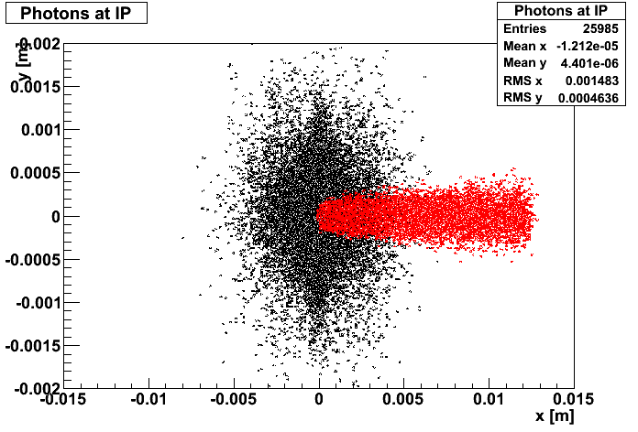
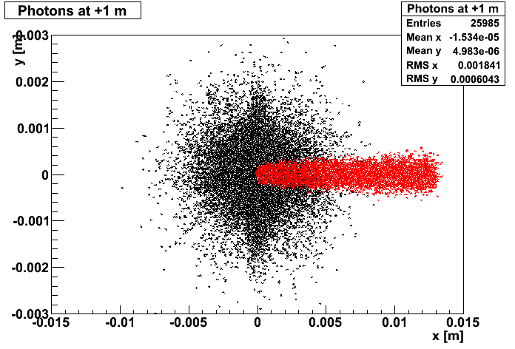
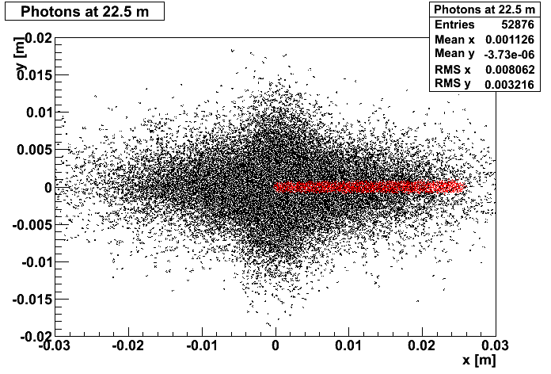
Transverse Slices
of Photon development in Z*
Photons from the dipole are shown in Red.
Photons from the quadrupoles are shown in Black.
Shows how the spread of the photons in Y is dominated by the quadrupoles.
*All Plots done by R. Appleby with IRSYN and ROOT

Slide 8
New 10 Degree Option
The new option has shorter quadrupoles. These quads are used as effective dipoles. This gives us less effective dipole length in the detector region.
The new option contains a smaller crossing angle (1 mrad) which requires more bending to achieve.
The result of these two changes is that higher dipole fields must be used to achieve the desired separation (~50 mm) at the entrance of the downstream proton quadrupoles.

Slide 9
Two Options
Start
Absorber
-6.25
-6
IP
6
-21.25
-1.2
1.2
6.25
21.25
Detector Dipoles
(0.021 T)
No Detector Dipole
(0.026 T)
Legend :
Note: All Measurements in Meters Unless Specified
X Focusing Quad
Dipole
X Defocusing Quad
In the above diagram two options are presented. Both options obtain a separation of ~50 mm of the interacting proton beam and electron beam at the entrance of the downstream proton quadrupoles.
First Case:
2.5 m of dipole incorporated into the detector (on each side of the IP)
Field of 0.021 T throughout all dipoles
-6
-5.4
-4.4
-4
-2.5
-2.2
-1.2
Second Case:
No dipole in detector region
Field of 0.026 T throughout all dipoles
Length:
0.6
1.0
0.4
1.5
0.3
1.0

Slide 10
SR Characteristics using GEANT4 Simulations
Characteristic | Detector Dipole | No Detector Dipole
E [GeV] | 60 | 60
I [mA] | 100 | 100
Detector Dipole Length* [m] | 5 | 0
B [T] | 0.021 | 0.026
θInitial** [mrad] | 32.03 | 34.01
θCrossing** [mrad] | 1 | 1
Ec [keV] | 183.69 | 188.34
Eμ [keV] | 56.56 | 57.99
P [kW] | 26.16 | 29.28
Separation*** [mm] | 50.05 | 49.84
*Length is total amount of dipole within the 12 m detector
**θ is the angle between the electron and proton momentum vectors
*** The separation is the displacement between the proton and electron centroids at the proton quadrupole entrance

Slide 11
Absorber Design
We need to design an absorber to remove synchrotron light from the beam pipe.
We will model the absorber after the one used in Hera which was able to absorb ~30 kW.
We need to compare the critical energies experienced at Hera with those predicted for the LHeC to know whether we can compare to Hera.
The absorber should have a cone like shape to help dissipate the heat and to keep photons from backscattering into the detector.
ϒ
Mask Design
Detector
Once the backscattering from the absorber has been simulated we will be able to optimize mask placement to limit synchrotron light from entering the detector.
ϒ

Slide 12
Conclusions
The GEANT4 results agree with the IRSYN results.
The quadrupoles dominate the generation of synchrotron radiation.
The option without a dipole in the detector region is attractive however causes an increase in the power of 10.66 %.
Backscattering still needs to be simulated for collimator design.
We need to analyze critical energies experienced at Hera to know whether comparing it to the LHeC is meaningful.
The shape of the absorber still needs to be optimized.

