Slide 1
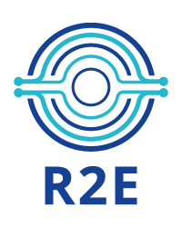
R2E Annual meeting opening
Brennan Goddard
Tuesday 1 March 2022

Slide 2
Radiation to Electronics annual meeting: Introduction
First of all, welcome to this R2E annual meeting
The R2E project is housed in the Accelerator Systems (SY) Department of the CERN Accelerator and Technology Sector (ATS)
Crucial presence also in the BE (Beams) department, especially for electronics testing and facility operation
As SY Department Head, I have the pleasure to open this annual meeting.

Slide 3
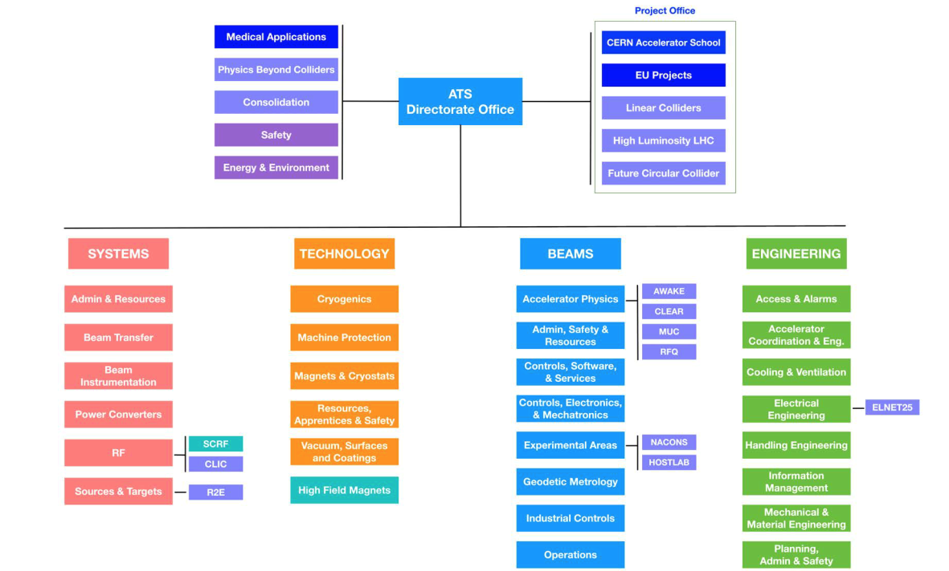
CERN Accelerator Technology Sector (ATS)
ATS responsible for operation and exploitation of the whole accelerator complex including LHC, and for the development of new projects and technologies.
It comprises Beams, Engineering, Accelerator Systems and Technology departments, plus ATS-DO

Slide 4
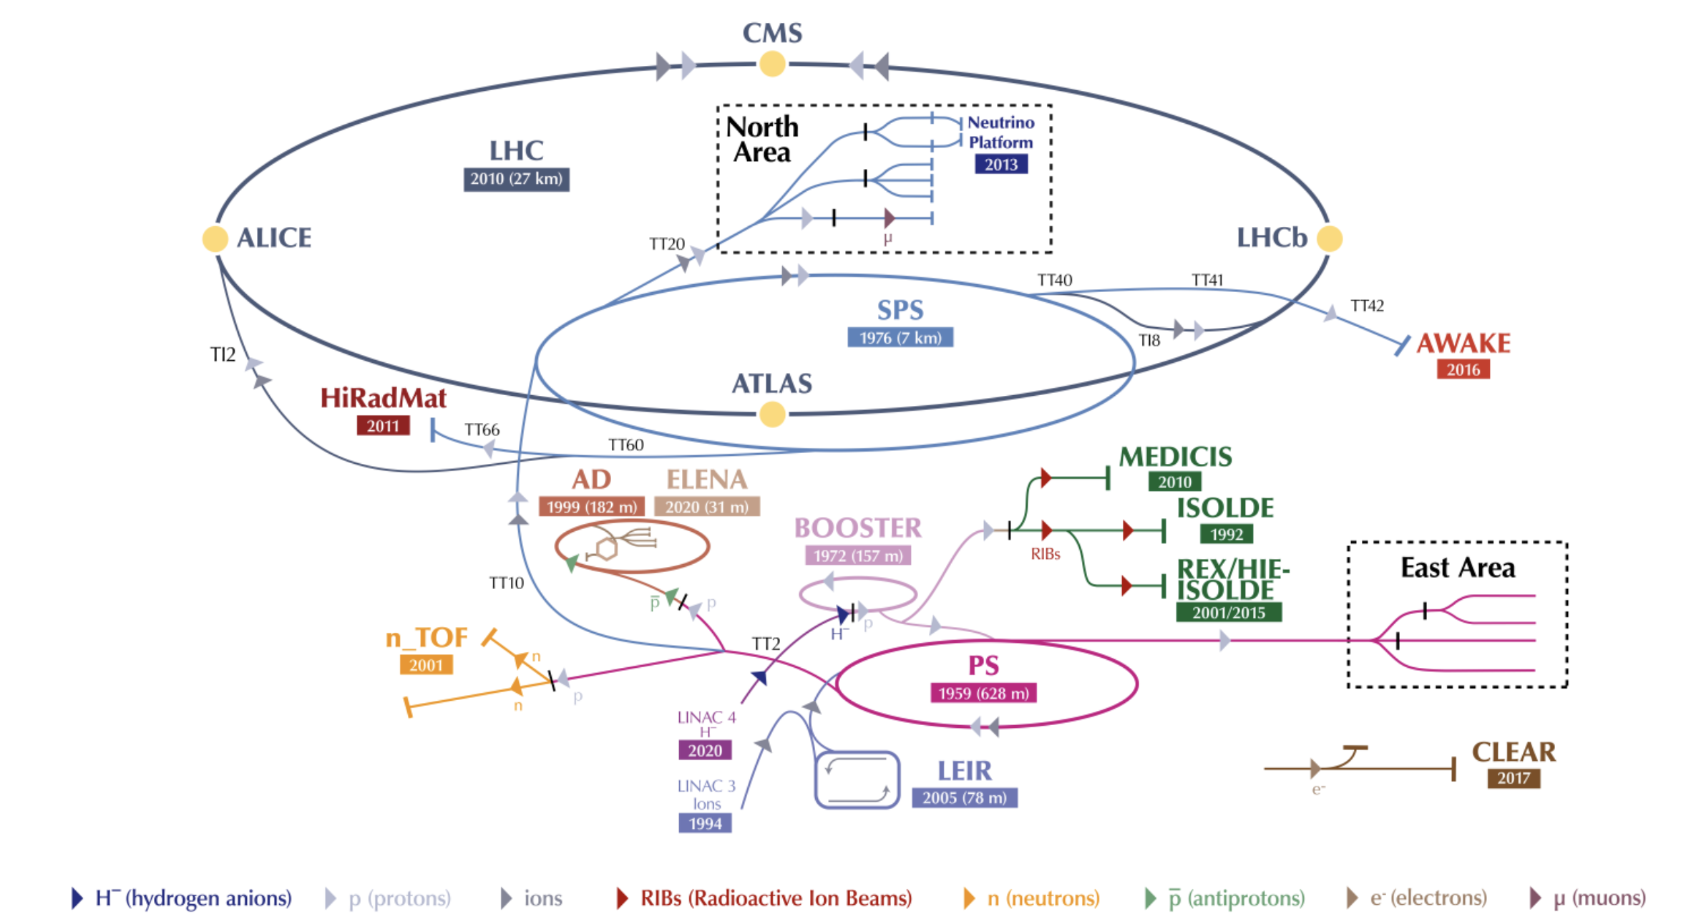
CERN accelerator complex
A multitude of accelerators with a huge range of conditions and beam types
CHARM
. 2021 .

Slide 5
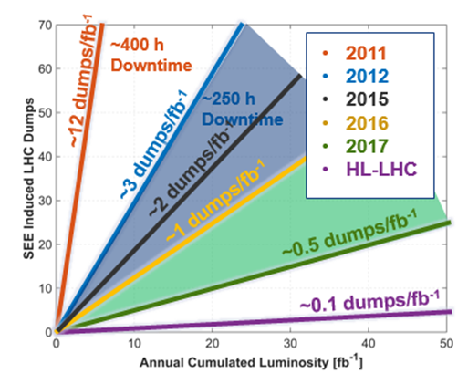
R2E annual meeting
R2E was launch at CERN in 2010, following the LHC start and radiation issues with electronics.
Since then many studies, mitigations, actions, projects, were launched and performed.
LS1 was the first period where many actions took place, like shielding…
Which led to a very successful Run2 of the LHC.
For HL-LHC, 0.1 dump/fb⁻¹ is the (challenging) goal

Slide 6
Main R2E building blocks
The development process is complex and long and needs many components to succeed.
Building blocks from Rubén, R2E meeting 2018.
Radiation Monitoring and Calculation
Rad-tol system development (mainly) based on COTS
Radiation Hardness Assurance
Qualification Approach
Radiation Test Facilities
mitigation → prevention

Slide 7
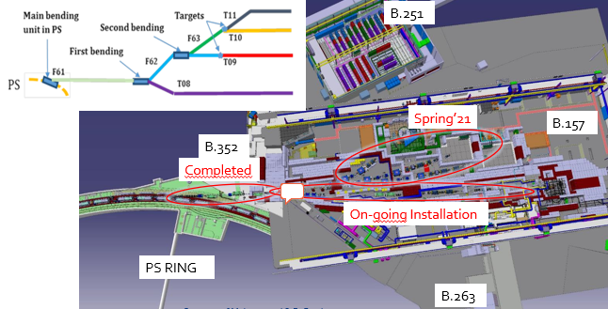
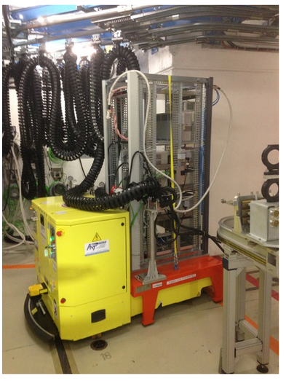
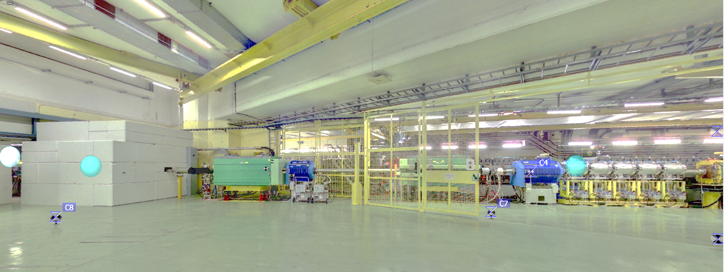
Radiation tests facility
2021 new EAST area commissioning, CHARM confirmed as a major radiation test facility
Initial T8 commissioning teething troubles ironed out
IRRAD and CHARM successfully operated for 8 weeks

Slide 8


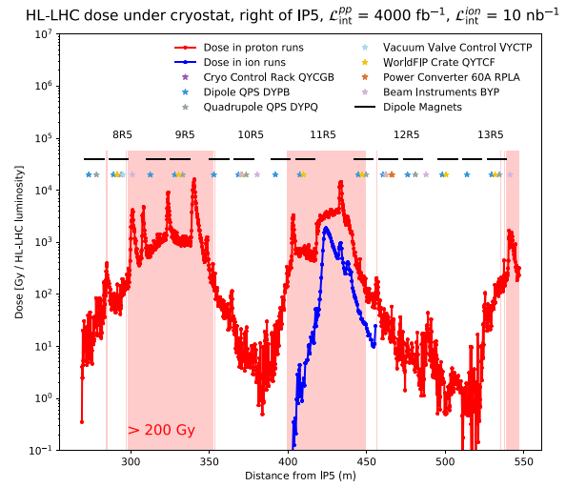
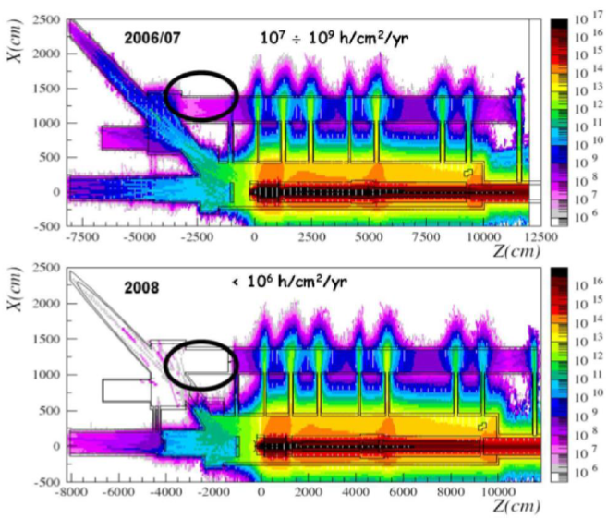
Radiation calculation, FLUKA
Deep involvement in preparation for HL-LHC
Key in determining radiation levels for LIU and HL-LHC configuration and operational conditions
Efficiently covering large majority of HL-LHC (WP10) areas of concern for equipment groups:
  Shielded areas (UJ, UL, RR) around IP1, 5 and 7
  DS in IP1, 5 and 7 (including possible cell 9 location for 11T/TCLD)

Slide 9
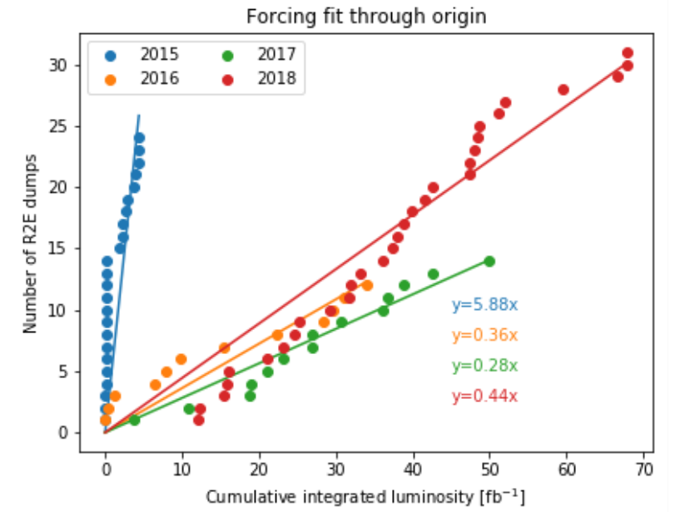
R2E vigilance
Many mitigations and many upgrades have already been performed.
However, we need to stay vigilant, changes can go very fast with beam settings and especially with the new LIU beams → see example of SPS operation in 2021
Ideally all new electronics devices must be qualified by R2E
2015:
Start of the year: nQPS SEEs (introduced in LS1)
Rest of the year: mainly FGC2 in the arc
2016:
SEE rate reduction mainly due to lower arc radiation levels (vacuum conditioning)
2017:
Further improvement thanks to FGClite deployment in ARC; most R2E events in power converters in RR (upgraded in LS2 with radiation tolerant versions)
2018:
Increased radiation levels in DS of IP1 and IP5 due to TCL6 opening → impact on QPS equipment (possibly lifetime related, i.e. no longer linear versus integrated luminosity)

Slide 10
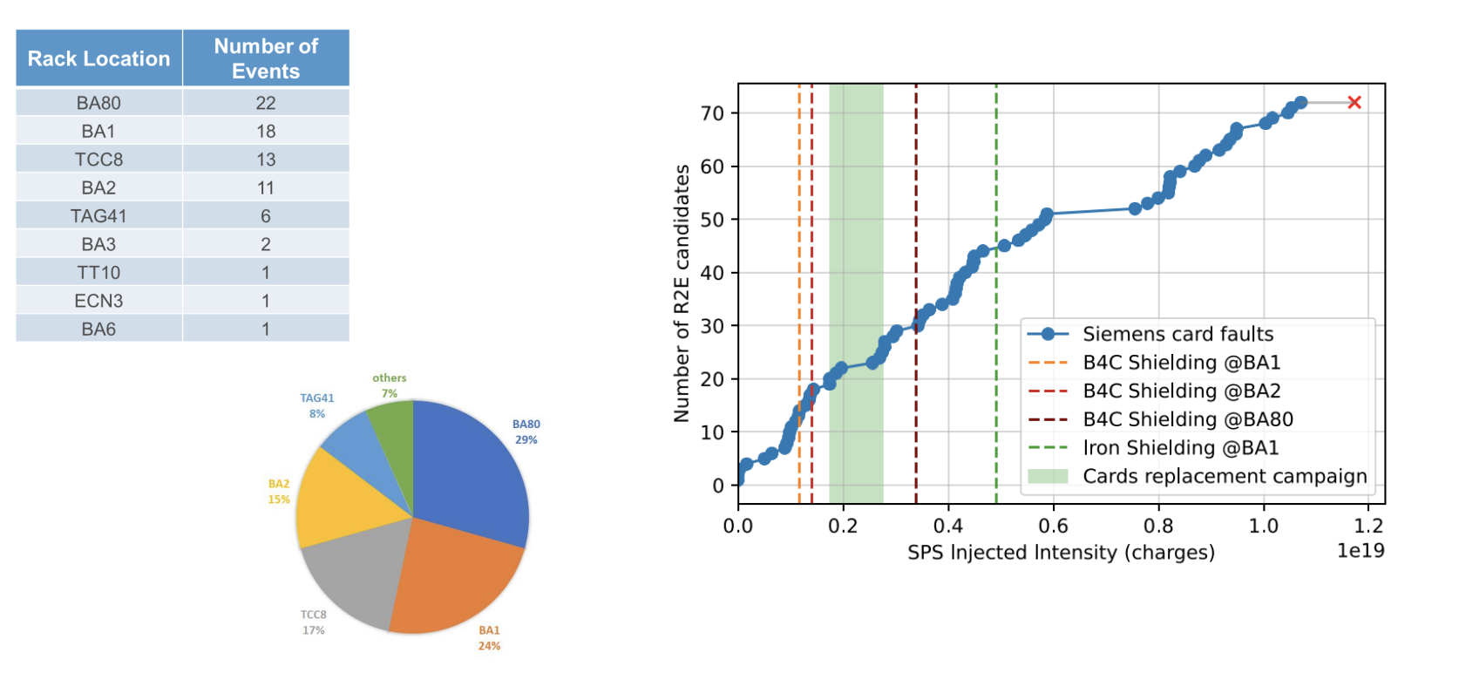
Illustration: SPS access system SEU issues in 2021
Racks located in 10 locations, initial project proposal with racks on surface was changed
Installation of COTS failsafe I/O modules: major source of SPS downtime in 2021 → SEUs

Slide 11
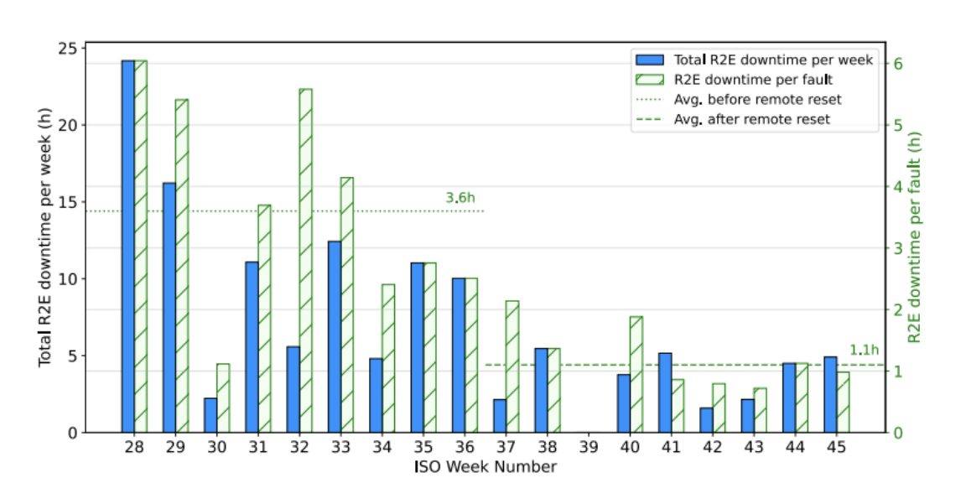
Illustration: SPS access system SEU issues in 2021
Short-term mitigations reduced effects x5 with shielding, remote reset, card replacement
Rack re-location crash program to cure, just completed in Year End Technical Stop
25h per week →

Slide 12
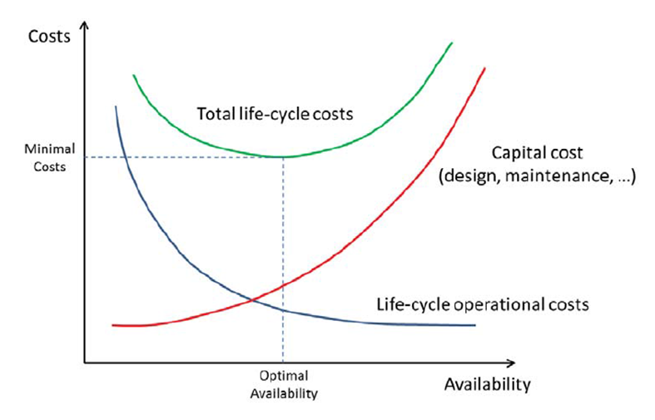
R2E within ATS
The project is strongly supported by ATS
R2E activities will continue to run at least until LS3 to prepare LHC for High Luminosity operation, and should be progressively migrated to regular support for exploitation
R2E is an excellent example of collaboration inside CERN but also outside CERN with other labs and companies.
Long-lasting efforts have been made to develop competencies and to build infrastructure for R2E. All need to continue to be secured

Slide 13
Conclusions
R2E is an important and successful project at CERN
Crucial for Injector and LHC operation, as well as the HL-LHC upgrade
Sensitivity of COTS electronics remains a critical topic: cost vs performance
CHARM is fully operational and ambitious plans are in progress to add heavy ion irradiation capacity CHIMERA
Looking forward to LHC operation this year to see all the improvements done during LS2
The future R2E activity is fully supported by the management of the Accelerator and Technology Sector
These R2E days are an important contribution to R2E continuing success – I hope everyone enjoys this stimulating event

