Slide 1


RHA guidelines for electronic equipment for meeting HL-LHC requirements
Andrea Coronetti (CERN, UM)
R2E Annual Meeting – 1-2 March, 2022
https://indico.cern.ch/event/1116677/

Slide 2
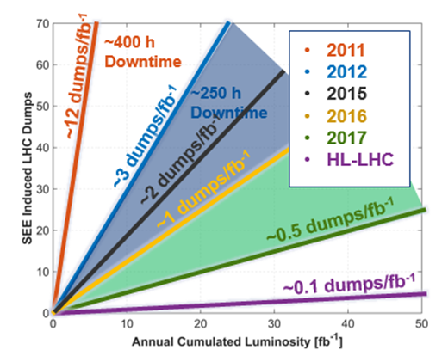
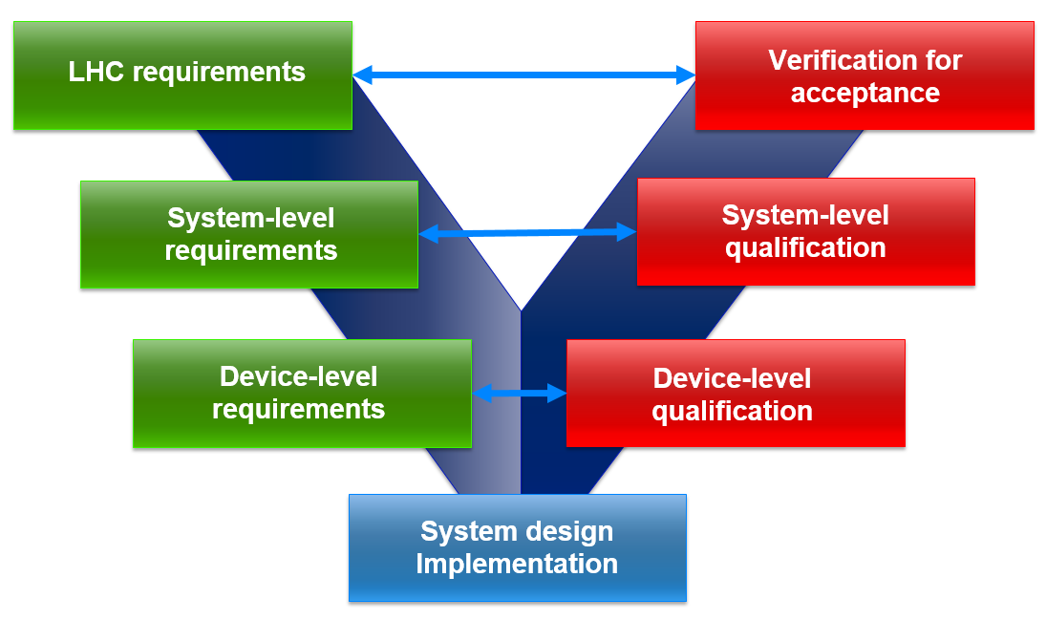
Introduction
Radiation hardness assurance process for CERN
Goal: achieve the availability target requirements for operation of HL-LHC in terms of R2E-related failures
How to achieve it?
  Need to establish links and responsibilities within R2E project (MCWG, RADWG, R2E Leader) and equipment groups
  Need for a traceable development process that allows backtracing R2E-related design choices to the requirements

Slide 3
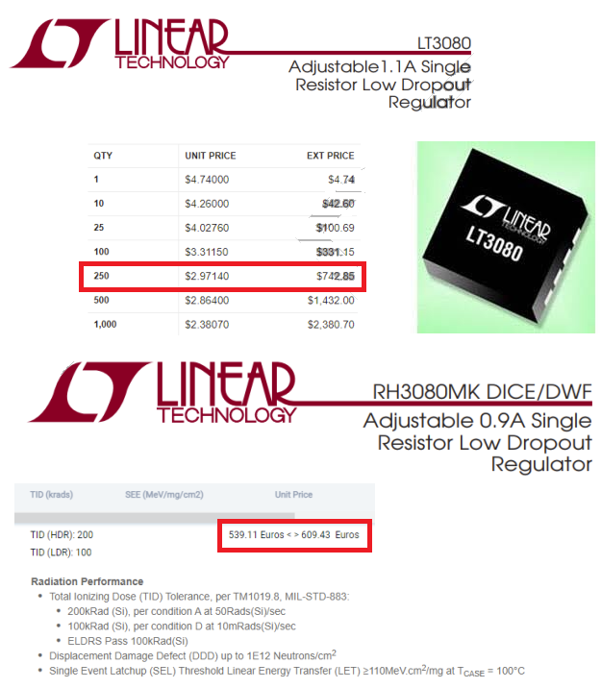
Targeted systems
CERN systems are distributed
Cost leverage prevents widespread use of rad-hard parts
COTS preferred
  Shorter lead time
  Higher performance
  Bring significant challenges to the RHA process
    Traceability
Generally ‘Rad-hard’ means TID-tolerant and does not necessarily apply to CERN rad-tolerance

Slide 4
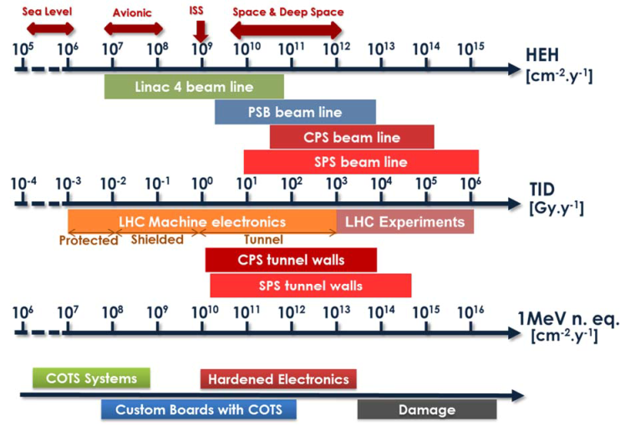
Targeted systems
Two types of systems are of concern for HL-LHC in the scope of this guideline
Custom-designed systems based on COTS components
  Design within the equipment group
  Full control over architecture and part selection
Fully commercial systems
  Procured externally
  No control over architecture and part selection
  Best scenario: units from same production lot/series

Slide 5
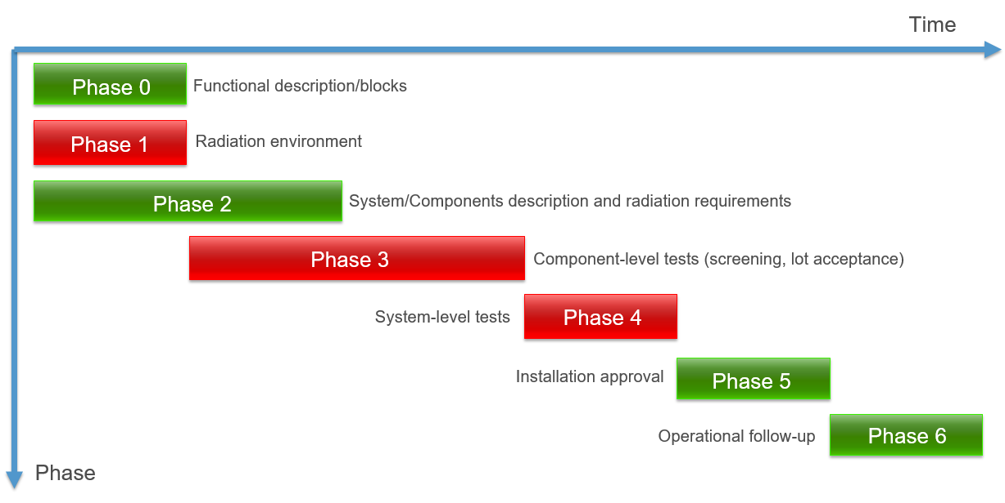
RHA process for custom-built systems
Functional Specification
Request to MCWG for assessment of radiation environment(s)
System-level testing guideline
Engineering Specification
Radiation environment and requirements info in RHAPV
Radiation level specifications for HL-LHC (EDMS 2302154)
Selected parts radiation qualification info in RHAPV
Request to RADWG for component-level selection strategy and testing
Request to RADWG for system-level test
System-level radiation qualification info in RHAPV
Engineering Change Request
R2E fault tracking (AFT) and mitigation
Best Practices for Radiation Design of Accelerator Equipment
Radiation Hardness Assurance Project Validation (RHAPV) accompanies the radiation-related development of a system throughout the entire lifecycle (EDMS 2028777)
It ensures traceability and compliance with respect to initial requirements
The RHA process document defines the various phases of a radiation-tolerant development (EDMS 2066950)
Red phases directly concern involvement of R2E working groups
Three documents tackle these three topics (only environment doc already published)
Engineering and R2E requests to be submitted to the various groups

Slide 6
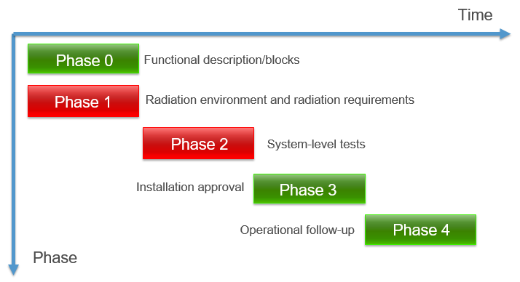
RHA process for COTS systems
Unless employed in R2E-safe areas (< 3 x 10⁶ HEH/cm²/year and < 3 x 10⁷ n_{th}/cm²/year, EDMS 2389056), COTS systems have to be qualified due to the SEE risk
RHA process has less phases
Dealt with in the same documents as for custom-built systems
Need to include relevant information about qualification in the RHAPV

Slide 7
Radiation requirements
From HL-LHC availability to the single device radiation response
LHC availability goals for R2E
ID | Requirement
SYS-A001 | The target beam dump rate for the system unit is 10⁻⁵ dumps/fb⁻¹, for the environment under consideration this will correspond to a system-level cross-section of 10⁻¹² cm².
DEV-A001 | Device A can suffer from SEFI that can propagate to the system-level forcing a beam dump with a cross-section below 4 x 10⁻¹³ cm².
DEV-A002 | Device A can suffer from SEU that can propagate to the system-level forcing a beam dump with a cross-section below 2 x 10⁻¹³ cm².
DEV-A003 | Device B can suffer from SEL that can propagate to the system-level forcing a beam dump with a cross-section below 1 x 10⁻¹³ cm².
R2E Failure Budget given to the equipment
Design margins if too low
Number of units
System-level SEE cross-sections
Number of parts, technology and use
Part-level SEE cross-sections
Radiation Environment
Target lifetime of system and parts (TID, TNID)

Slide 8
Part criticality and test strategy
Devices can be classified based on criticality within the system
Credit: S. Uznanski
Class | Radiation response | Sourcing | Part types
C0 | Resistant to radiation or with moderate sensitivity | Easily replaceable with many alterative on the market | Diodes, transistors
C1 | Susceptible to radiation, but not on system critical path | Limited amount of replacements available | Voltage regulators/references, DAC, memory
C2 | Susceptible to radiation and on system critical path | No equivalents on the market | ADC, FPGA, power electronics
Radiation test at system-level
Radiation test at part-level for the various radiation effects of concern based on requirements and technology (TID, TNID, SEEs, synergistic effects)
Part-level tests can be requested to RADWG
Uncompliant C1 part can be replaced for another COTS part with better radiation performance
Uncompliant C2 part may require re-design
  Mitigation (e.g., derating, ECC, filtering, watchdog)
  Review of functional block architecture
System-level tests done by equipment group with RADWG support

Slide 9
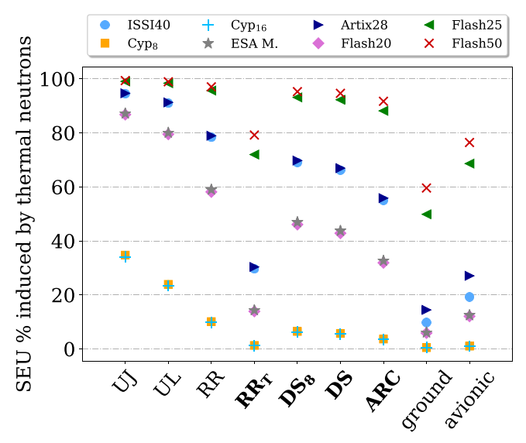
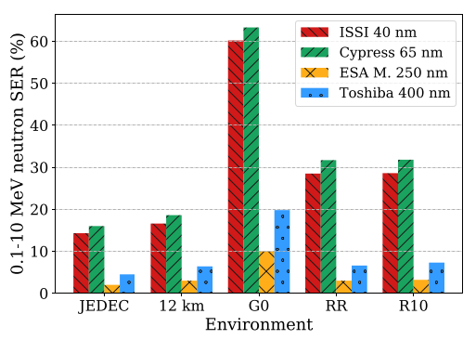
Part-level testing
Mature practice, but many details to bear in mind to get relevant data
Facility to be used
Testing parameters (bias, temperature, etc.)
Setup preparation
# of units to be tested for good level of confidence
Best candidate may depend on specific critical parameter for the system
Testing for each of TID, TNID and SEEs may require applying different entries to the previous parameters
In addition, R2E R&D work shows that standard qualification with HEH may not always suffice, and extra tests or safety margins may need to be applied
Thermal neutrons
Intermediate-energy neutrons
HEH fission with high-Z materials
Low-energy protons
Credit: M. Cecchetto

Slide 10
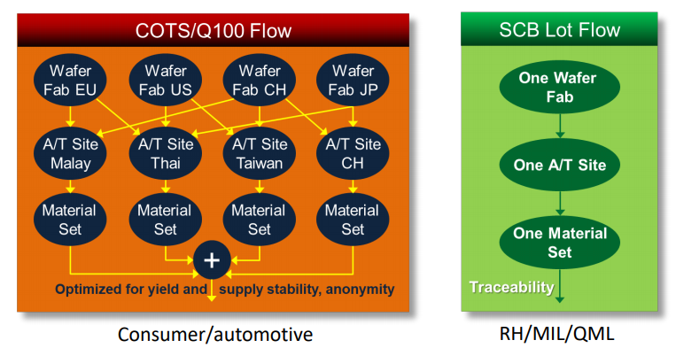
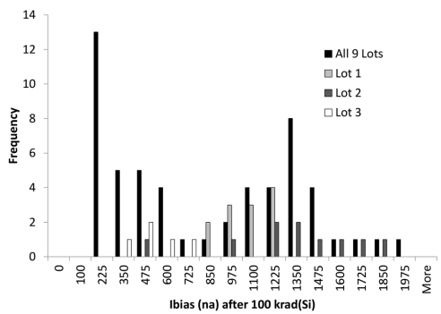
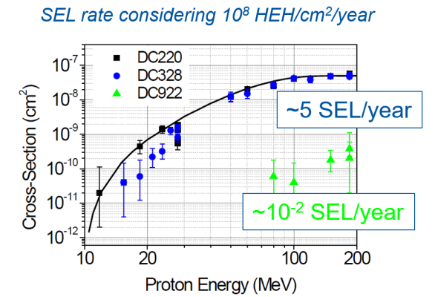
Traceability
Credit: R. Baumann
Credit: R. Ladbury
Part variability exists even for the same reference
Lot-to-lot, Fab-to-fab, Wafer-mask-to-wafer-mask
Intra-lot variability is typically acceptable
Need to ensure that tested parts and parts used in the accelerator belong to the same lot
  May need to re-test also parts in the RADWG database
Need to have units from same production series for COTS systems
Credit: M D’Alessio

Slide 11
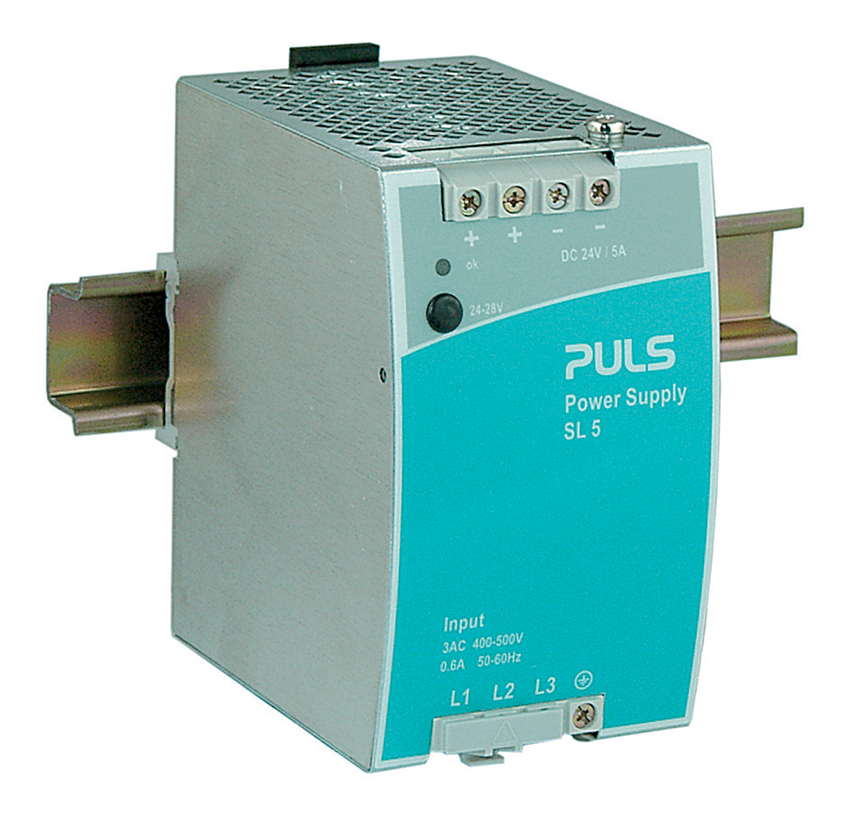
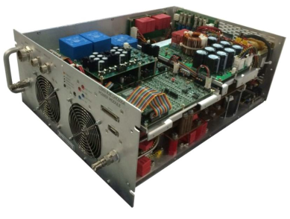
System-level testing
Less mature and harder to interpret, unless everything works
Stand-alone system-level testing is used for COTS systems
For custom-built systems it is used after the part-level qualification to verify those radiation effects that could not be verified at part-level
Limitations of
stand-alone
system-level
testing
TID worst case analysis
Part-to-part and module-to-module variability
Data portability
ELDRS
Worst case test conditions?
Pass/fail outcome on a system
Limited level of confidence
Tough to apply mitigations/redesigns
Benefits of system-level
testing
Fault propagation assessment
Dependent faults/failures
Synergistic effects of radiation
Verification of existing radiation mitigations
Implementation of additional radiation mitigations

Slide 12
R2E development status review
SY/BI
Beam Loss Monitors
Beam Position Monitor
Beam Gas Ionization Monitor
Rad-tol camera
TE/MPE
CIBU, PIC, WIC
QDS, QPS
Rad-tol fieldbus
Current lead heating controller
600A /13kA energy extraction
Rad-tol AC/DC supply
SY/EPC
60A/120A power unit
FGC power unit
TE/VSC
Vacuum gauge electronics
BE/CEM
Distributed I/O Tier
TE/CRG
DC Heater
EDA-03296
DI/DO
EP/CMU
CMS low voltage supply
Closed session of the R2E annual meeting on March 3rd

Slide 13
Conclusions
Radiation hardness assurance process for CERN
Built upon the strong collaboration between the R2E project (and its working groups) and the equipment groups
Practices are now mature enough to be tailored into a standard RHA process to be followed also for future developments
  First draft of documents in preparation and soon to be reviewed by relevant stakeholders
  But radiation effects bring continuous challenges
    No real limit to extension/revision of current best practices
Equipment groups already implementing the backbone of the RHA process for HL-LHC with careful monitoring of R2E working groups

Slide 14
Thank you for
your attention!

