Slide 1
Benchmark between FLUKA and radiation detectors at LHC IR4
Daniel Prelipcean (SY-STI-BMI)
with input from
Giuseppe Lerner, Kacper Biłko, Rubén García Alía, Anton Lechner (SY-STI-BMI)
Bernadette Kolbinger, Helene Guerin, James Storey (SY-BI-XEI)
Roberto Kersevan (TE-VSC-VSM)
R2E Annual Meeting – 1-2 March, 2022
https://indico.cern.ch/event/1116677/

Slide 2
Outline
Understanding the beam-gas interactions mechanism
Radiation Level Data
LHC Run 2 Benchmark between Measured and FLUKA Simulated values
HL-LHC Predictions of Radiation Levels and Heat Loads
Preliminary: Possible BGV placements on beam 1

Slide 3
Introduction
Discuss the radiation levels caused by Beam Instrumentation (BI) elements operation in IR4, with particular focus on the operation of the Beam Gas Vertex (BGV).
Key ingredients of the analysis:
  Measurements from LHC Run 2 with the BGV demonstrator.
  FLUKA simulations of beam gas interactions for LHC Run 2 and HL-LHC scenarios.
Main goal is to determine whether the operation of these devices can lead to R2E issues or excessive heat loads on cryogenics systems.
Some previous work already existed:
  Simulation: mainly concerning the Beam Gas Ionisation (BGI) [1, 2].
  Radiation level measurements per year in Run 2 [3].

Slide 4
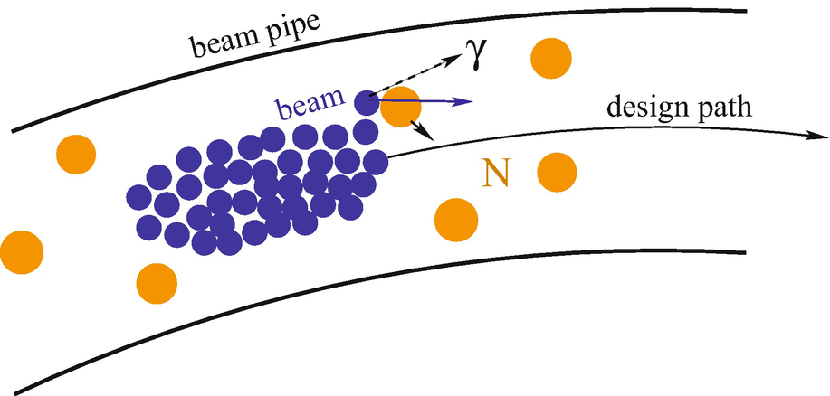
Beam-gas interaction instruments
Any residual gas will lead to beam-gas interactions causing local radiation showers.
This effect can be used to measure the beam profile/position, if there are sufficient secondaries produced.
Beam Gas elements in IR4: inject gas (typically Ne) to increase the local density and measure the secondaries for beam profile reconstruction.
Drawback: Higher radiation levels possibly impacting the other elements along the beamline.
Main concern covered in this contribution is:
  Radiation to Equipment and Electronics
Fig. from [4]

Slide 5
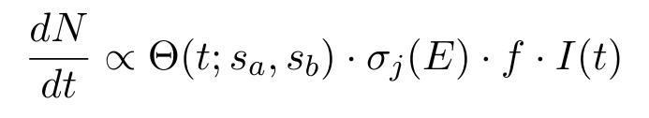
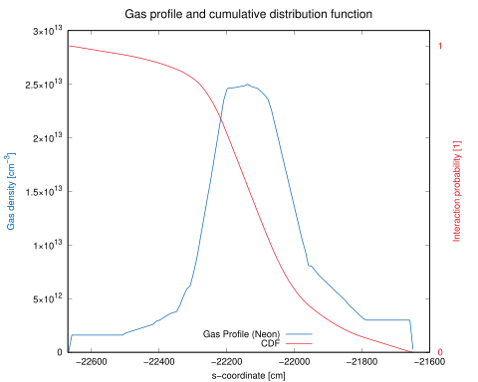
Normalization factors
The radiation level rates presented here scale as follows:
BGV operation
(HL-)LHC operation
Injected gas density profile
Interaction cross section - Gas species (Neon)
Beam intensity
LHC revolution frequency (constant)
Beam energy

Slide 6
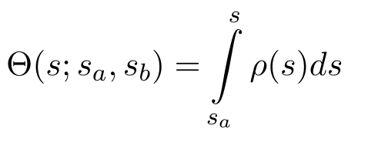
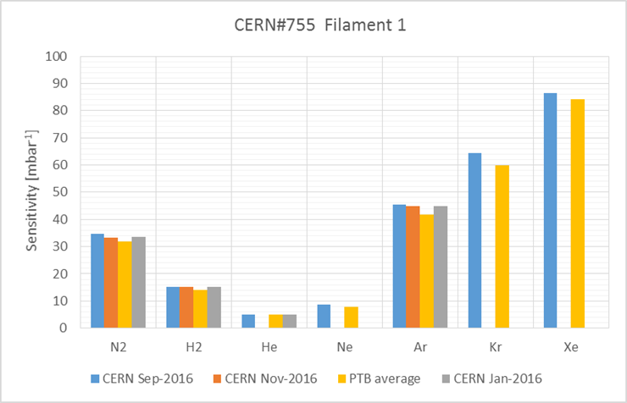
Radiation source: Injected gas density profile
Simulations:
  The FLUKA simulated values depend on the s-integral of the gas profile.
  The gas density profile is based on simulations from Roberto Kersevan
  (TE-VSC-VSM), specific to the BGV demonstrator.
Measurements:
  The amount of injected gas is not constant throughout a single fill -> time dependent gas profile.
  Just one data point available via a pressure gauge located at the assumed peak -> no measured information on the distribution width.
  The pressure gauge measurement has to be calibrated to the gas species measured.
Courtesy of
@Roberto Kersevan
Notes:
Rephrase italic

Slide 7

Radiation source: Gas species (Neon)
Beam gas interactions:
  Elastic: Not considered in this work.
  If one or more protons in the bunch are deviated from the ideal trajectory, then they are lost somewhere along the path of the accelerator, ideally in the collimators of IR7.
  Inelastic: The main source considered in this work:
  σ_{inel pNe}=382 mb (FLUKA estimate for a 6.5 TeV proton on a Neon at rest).
  A shower of secondary particles is generated around the interaction vertex leading to local losses.
The Monte Carlo code FLUKA is used to simulate the radiation levels in the vicinity of the BGV by forcing a nuclear interaction of the beam protons with the gas elements (for the BGV, Neon).
The inelastic scattering is the main contributor (~2/3) to the total cross section.
Notes:
Diffractive -> seems not be an issue

Slide 8
Radiation source: Beam energy and intensity
 | LHC Run 2 | HL-LHC
revolution frequency [Hz] | 11245
number of bunches | 2500 | 2760
protons per bunch [1e11] | 1.20 | 2.30
total_charges [1e14] | 3.00 | 6.35
charge/s [1e18] | 3.37 | 7.14
energy [TeV] | 6.50 | 7.00
The radiation level rate caused by beam-gas interaction depends on the total number of charges passing through the gas.
Measured by BCT instruments, in charges, for both beams.
During LHC Run 2, the top energy was 6.5 TeV, but during HL-LHC it will increase to 7 TeV.
Moreover, there is interest in using the BGV during energy ramp from 450 GeV (injection) to top energy.
The inelastic cross section increases with energy, with 8% (0.5%) from 450 GeV (6.5 TeV) to 7 TeV, implying more inelastic collisions.
With higher beam energies, the secondary showers will be larger, leading to higher radiation levels.

Slide 9
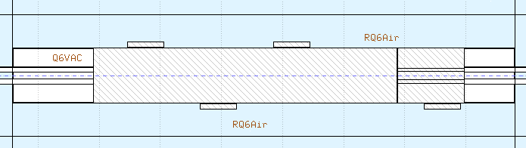
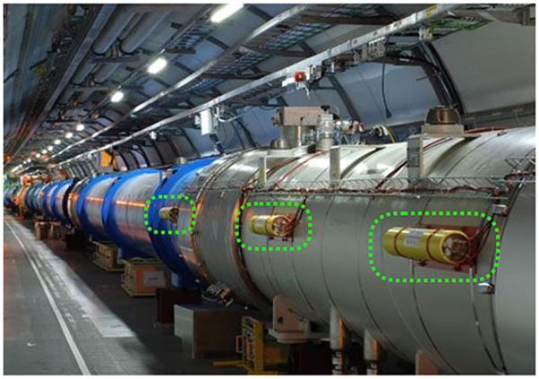
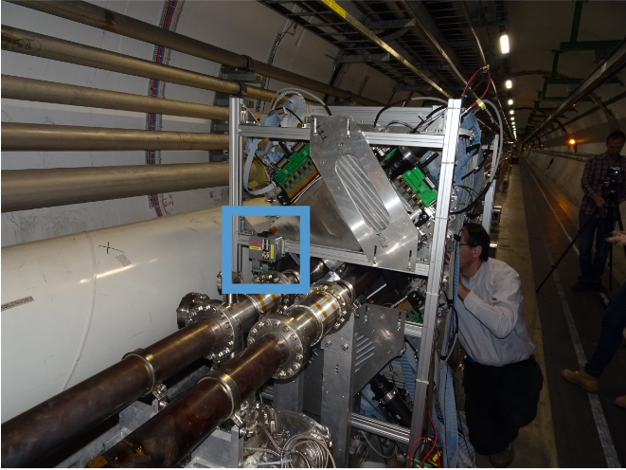
Available radiation level data measurements
Radiation level data consists of:
  Beam Loss Monitor (BLM) - Total Ionizing Dose (TID)
    Radiation detectors (mostly Ionization Chambers), that detect particle showers caused by the beam losses.
    Capable of measuring dose rates with good time resolution.
    Approximately 4 000 detectors placed along the accelerator.
  Radiation Monitor (RadMON) - High Energy Hadron (HEHeq) fluence
    Capable of measuring the HEH-eq fluence (plus other R2E-relevant quantities) by counting the number of Single Event Upsets (SEU) in calibrated SRAM memories.
    Roughly 400 RadMONs placed in strategic locations.
Most measured data is taken using NXCALS (New CERN Accelerators Logging Service), except the BLMs dose rates which are post-processed “in-house” (Courtesy @Kacper Bilko).
Courtesy BE-BI [5]

Slide 10
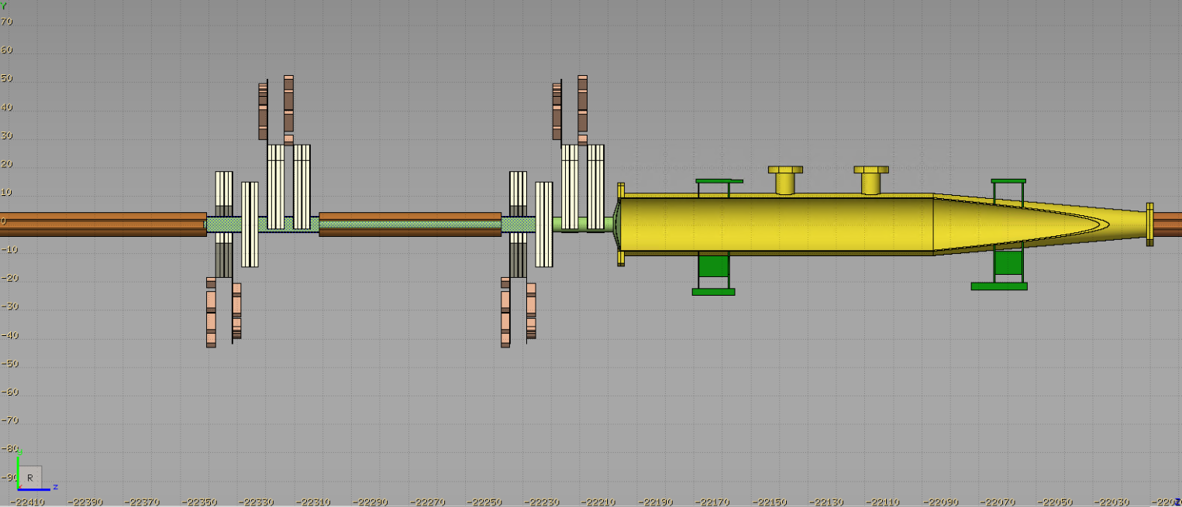
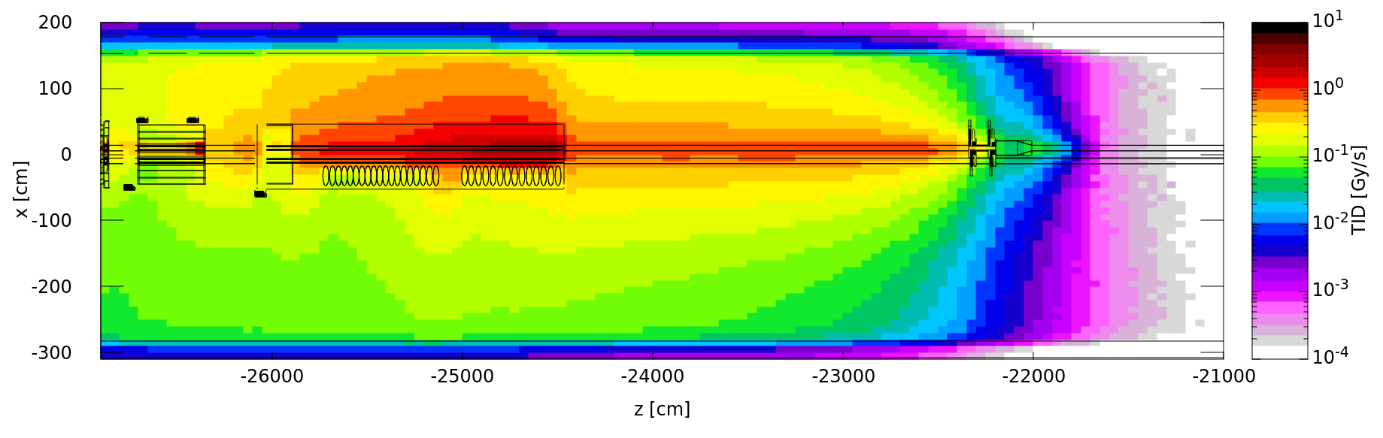
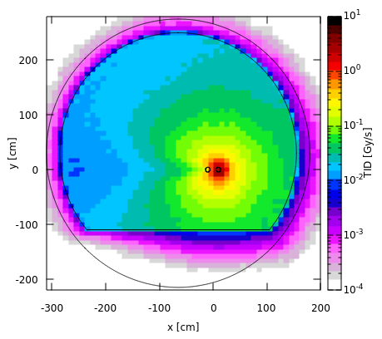
Simulated radiation level data
FLUKA is capable of simulating the radiation shower caused by the beam-gas interactions.
The beam pipe of the other beam acts as local shielding.
The shower extends longitudinally over several tens of meter, reaching downstream to:
  magnets -> estimate heat load on cryogenics,
  BLMs and RadMON -> radiation levels in the tunnel.
IR4

Slide 11
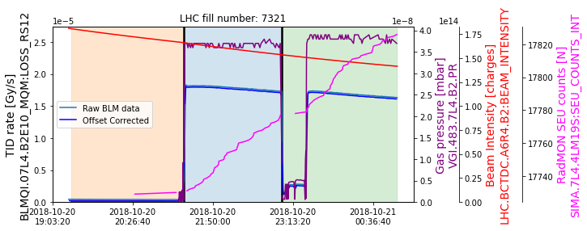
Time periods with (rather) constant operational parameters
During a fill, when gas is injected in the BGV, one expects:
  the BLM TID rate signal to be proportional to the product of pressure and intensity,
  the RadMON SEU counts to increase.
For the analysis, we have identified time periods (up to ~1h):
  with rather constant gas pressure, and higher than a predefined threshold of 2×10⁻⁸ mbar,
  within different beam modes (PRERAMP, FLATTOP, STABLEBEAMS, etc.)

Slide 12
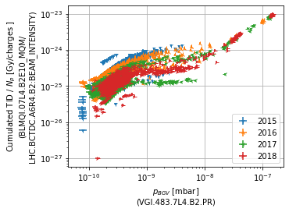
Radiation level correlation with beam intensity and gas pressure:
Signal vs. Background
When there is significant (>2×10⁻⁸ mbar) gas injected in the BGV gas chamber, the radiation levels downstream of the BGV correlate very well with beam intensity and the gas pressure.
This indicates that the BGV is the main source of radiation.
In this linear region, the BLM dose per unit charge and pressure is expected to be constant.
SIGNAL PERIODS
To compute the radiation levels, time periods with at less than 2×10⁻⁸ mbar are removed, such that we preserve only the linear part.
BACKGROUND PERIODS
As background, we consider time periods with less than 1×10⁻⁹ mbar.
The values presented in the next slides are Signal - Background.

Slide 13
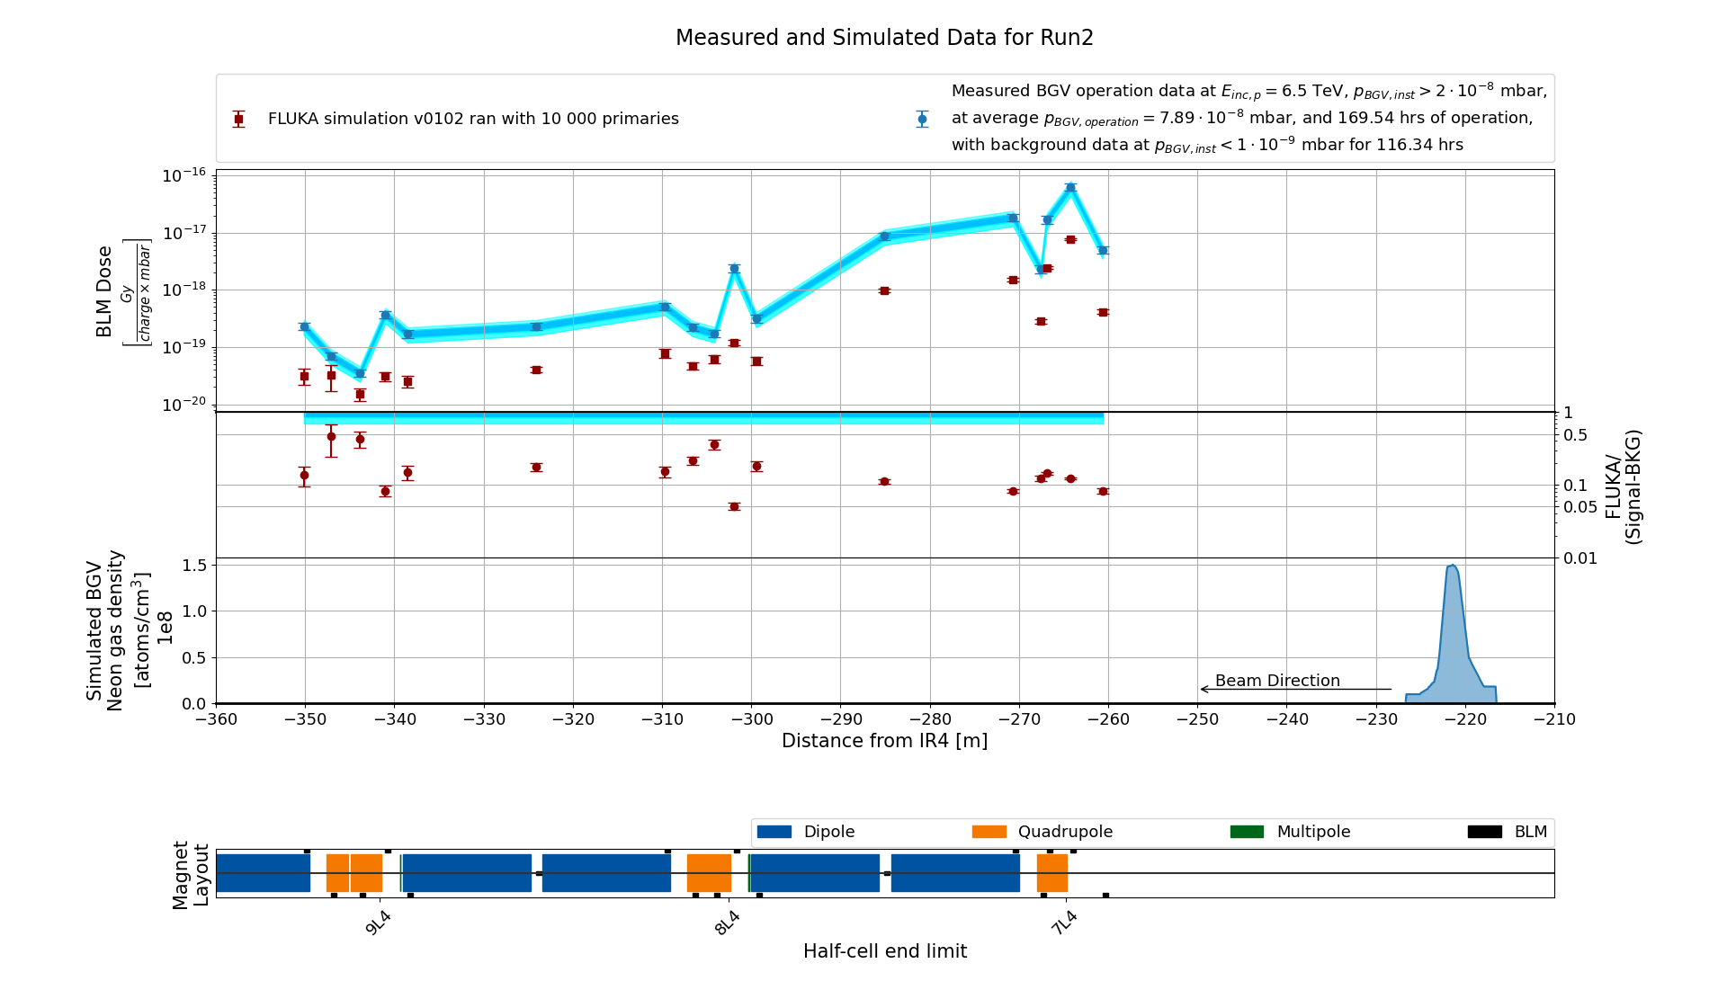
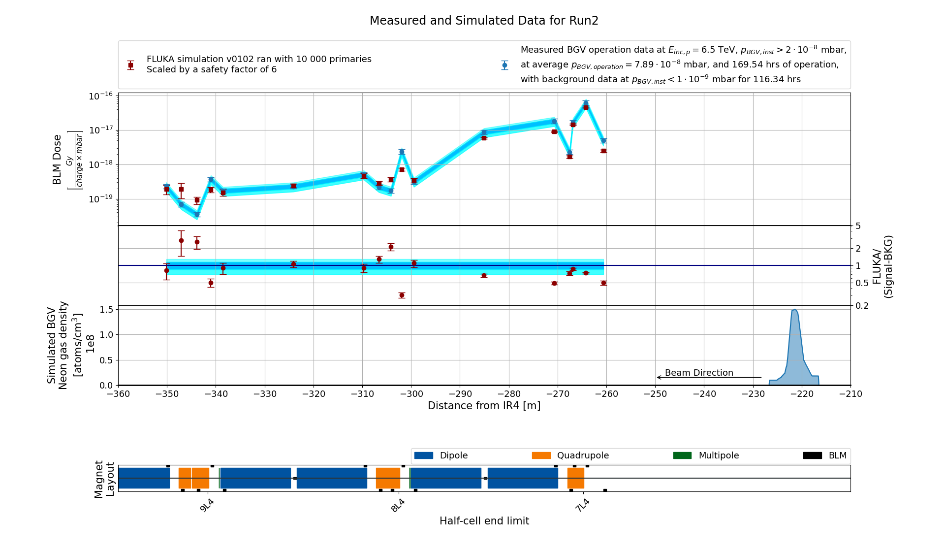
BLM Benchmark at top energy 6.5 TeV
The shape of the BLM profile is well reproduced, but there is a systematic disagreement of a factor 5.6.
This points to an underestimation of the total number of inelastic collisions in the BGV (likely due to uncertainties on the gas pressure and profile).
Usually what we can achieve in a well controlled situation is a few ten percent agreement level [6, 7].
This disagreement will propagate in HL-LHC specifications, and we shall apply a conservative safety factor of 6 to future predictions.

Slide 14
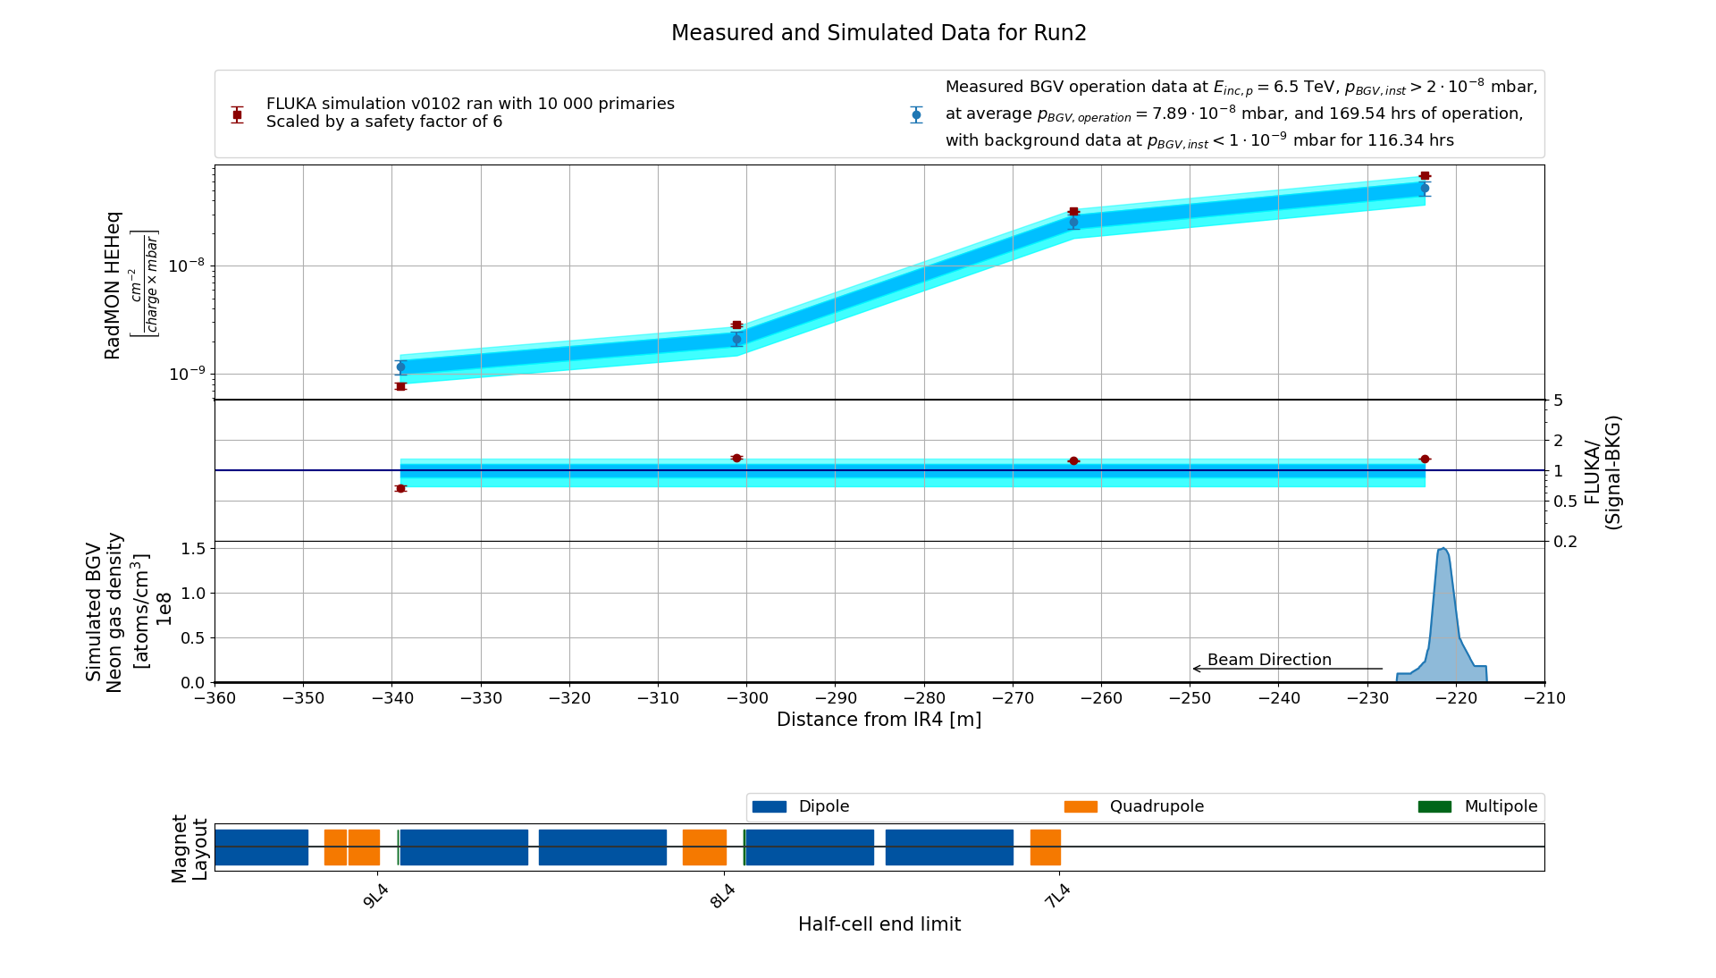
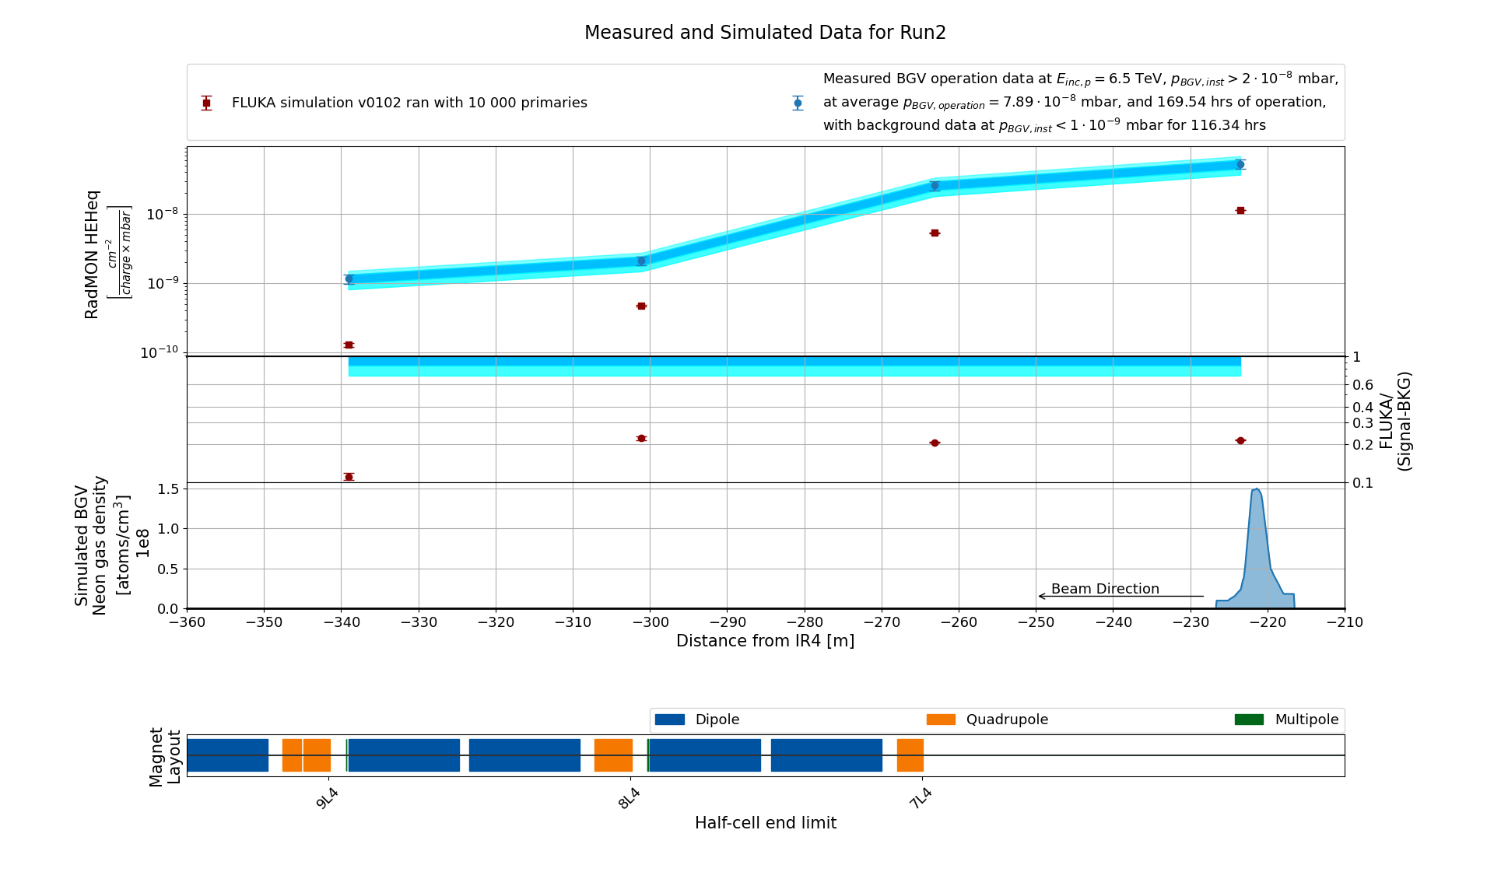
RadMON Benchmark at top energy 6.5 TeV
Similar underestimation of a factor 5.3.
  Another strong indicator of a systematic normalization shift rather than an erroneous analysis.

Slide 15
From LHC Run 2 benchmark to HL-LHC specifications
From comparing measurement data and simulation results for Run 2, we identify a factor 6 of systematic disagreement excess in measured values compared to FLUKA expectations.
Specifications for HL-LHC can nevertheless be obtained from FLUKA, via scaling by this safety factor.
BGV operation:
  During Run 2 (2015-2018), there was significant gas injected for
  approx. 170 h.
  For HL-LHC, the BGV is ideally foreseen to be operated for
  200 h per year, during energy ramp up.
 | LHC Run 2 | HL-LHC
revolution frequency [Hz] | 11245
number of bunches | 2500 | 2760
protons per bunch [1e11] | 1.20 | 2.30
total_charges [1e14] | 3.00 | 6.35
charge/s [1e18] | 3.37 | 7.14
energy [TeV] | 6.50 | 7.00
Simulations are used to define both the:
  radiation levels in the tunnels,
  heat loads on the cryogenics in the magnets.
 | LHC Run 2 | HL-LHC
pressure [1e-7 mbar] | 0.77 | 1
operational time [hrs] | 169.80 | 200

Slide 16
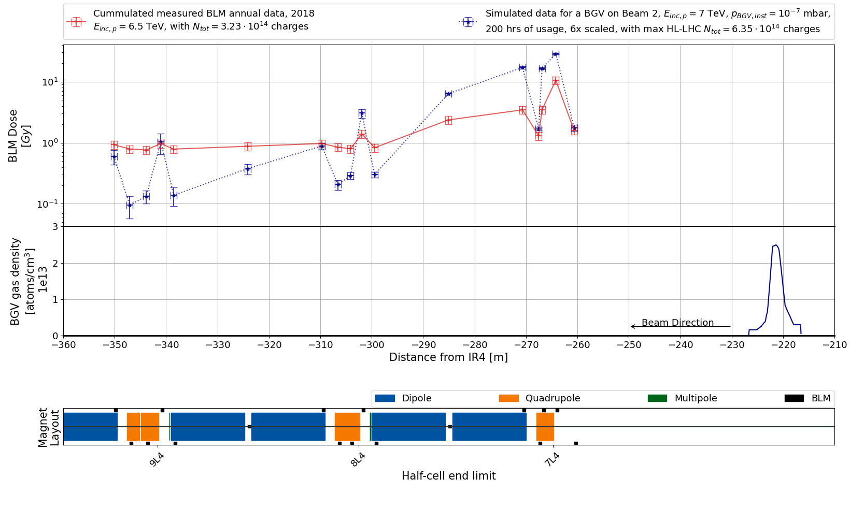
BGV induced radiation levels in the tunnel
The measured cumulated BLM annual data for 2018 (red line) includes the entire year of operation, with TID coming from other radiation sources, background and BGV usage.
The simulated values (blue line) considers just the BGV as a radiation source:
  A safety factor of 6 has been applied on the simulated data.
  Key Message: Even without considering the extra radiation sources, the (HL-)LHC BGV operation will lead to higher TID levels compared to Run 2
The instantaneous radiation levels depend on the: BGV gas pressure and HL-LHC configuration.
  Whenever used a peak pressure above 2×10⁻⁸ mbar, locally the main source of
  radiation.
The integrated radiation levels
depend additionally on the:
total operational time.
  Already for Run 2, the main contributor for integrated yearly radiation levels.

Slide 17
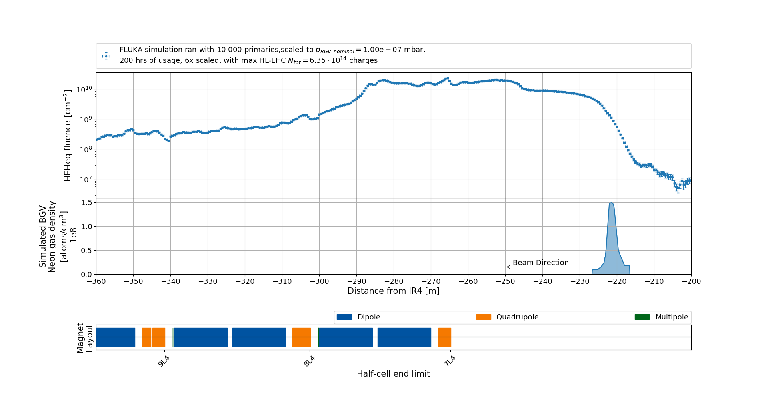
R2E related concerns
The HEHeq fluence at floor level reveals a plateau of ~10¹⁰cm⁻²/year from the BGV to the second DS dipole.
From an R2E perspective:
  Levels of ~10 Gy/year are a threat in terms of TID lifetime of electronic systems.
  HEHeq fluences of 3×10¹⁰ cm⁻²/year may lead to stochastic electronic failures.
  Both significantly (i.e. orders of magnitude):
    larger than the arc level “baseline”,
    smaller than the high luminosity experiments at IP1/5.

Slide 18
Possible BGV placements on beam 1
Symmetrically on the Right side of IR4 -> the same radiation levels apply.
Next to the existing one at roughly -220m L4, showering towards the center of IR4: some preliminary results are presented here
At +142.5 m right of IP4, between Q5 and Q6, showering towards the DS/ARC: main issue is the proximity to Q6 leading to possible excessive heat loads.

Slide 19
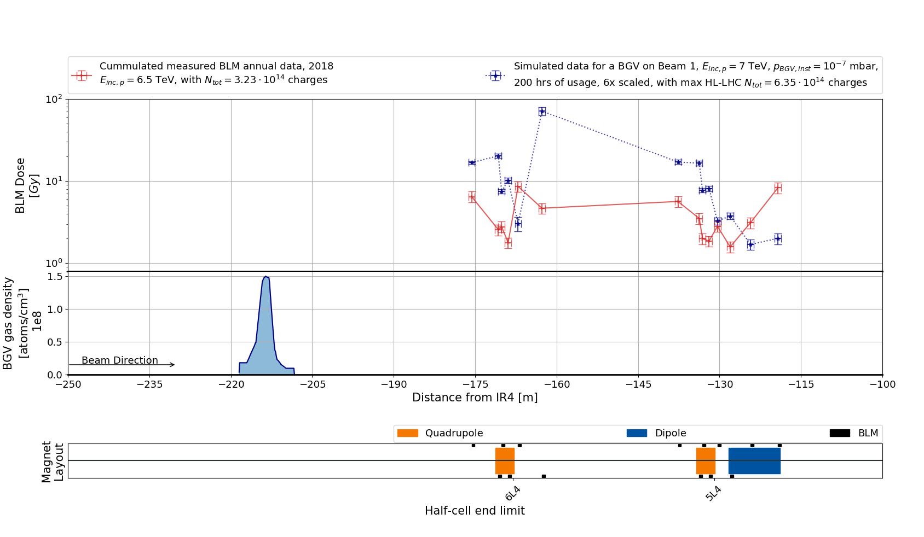
Beam 1 BGV induced radiation levels PRELIMINARY
The BGV on beam 1 would become the main source of radiation for the quadrupoles in cells 6 and 5.

Slide 20
Summary
When used, BGV becomes locally the main source of radiation.
From the Run 2 LHC benchmark with measured data, a safety factor 6 for future preliminary HL-LHC predictions using FLUKA is applied.
Known future improvements:
  the gas profile could be further improved via iterations with Roberto Kersevan,
  more components (i.e. material budget) in the simulations -> extend the simulations of beam 1 towards the center of IR4.
General radiation levels impact:
  to check with each element/equipment owner if the additional radiation levels are not too large,
  to investigate what other sources could cause significant radiation levels,
    e.g. hollow e-lens (?).
Notes:
Double check with Roberto the statement about the gas profile

Slide 21

Thank you for your attention!
Questions?
daniel.prelipcean@cern.ch

Slide 22
References
Christian Buhl Soerensen, Measuring abort gap population with beam-gas interactions in the BGI: https://indico.cern.ch/event/1097265/contributions/4617018/attachments/2353783/4016099/Abort%20gap%20monitoring%20with%20the%20BGI.pdf
Oliver Stein in MD456: Monitoring of abort gap population with diamond particle detectors at the BGI in IP4: https://cds.cern.ch/record/2131864/files/CERN-ACC-2016-0011.pdf
Kacper Bilko, in the 41st MCWG meeting: Radiation levels in IR4 and impact of BE-BI instrumentation https://indico.cern.ch/event/916577/
M. Brugger et al., Interactions of Beams with Surroundings, https://link.springer.com/chapter/10.1007/978-3-030-34245-6_5
TWiKi BGV https://twiki.cern.ch/twiki/bin/view/BGV/Radiation
Anton Lechner et al, Validation of energy deposition simulations for proton and heavy ion losses in the CERN Large Hadron Collider, https://journals.aps.org/prab/pdf/10.1103/PhysRevAccelBeams.22.071003
Daniel Prelipcean, Comparison between measured radiation levels and FLUKA simulations at CHARM and in the LHC tunnel of P1-5 within the R2E project in Run 2 https://cds.cern.ch/record/2777059?ln=en

Slide 23
Backup slides

Slide 24
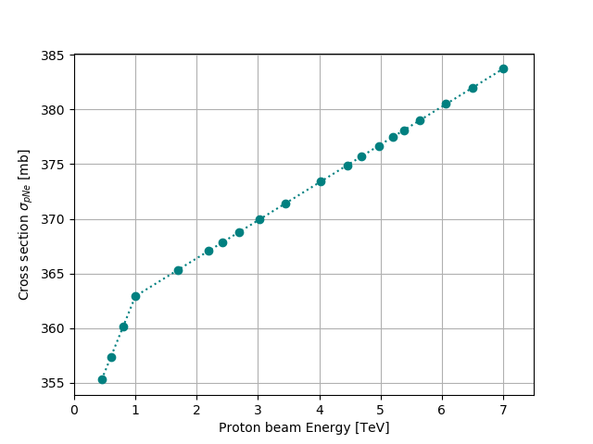
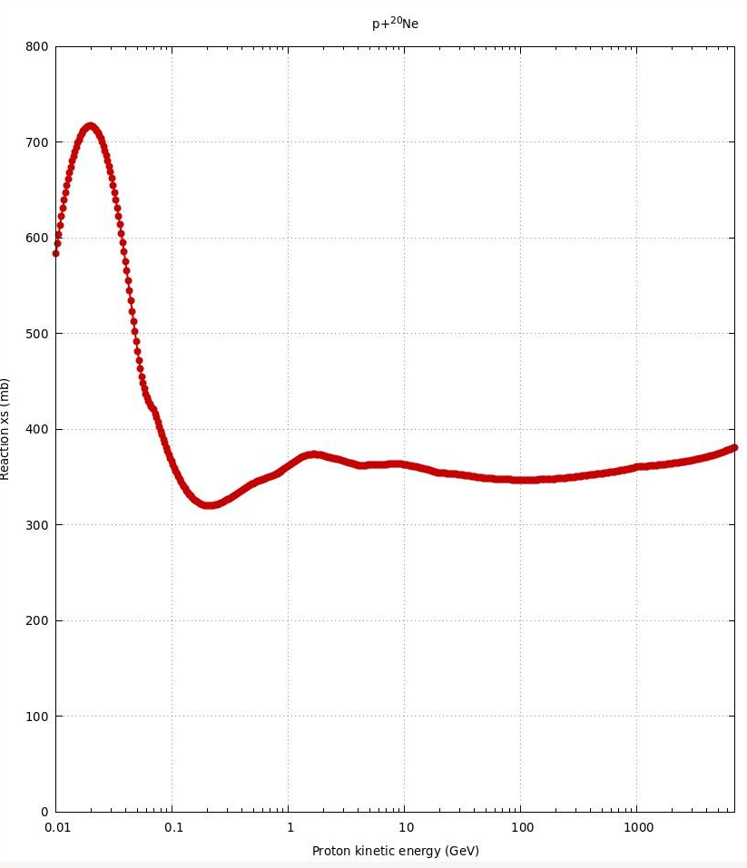
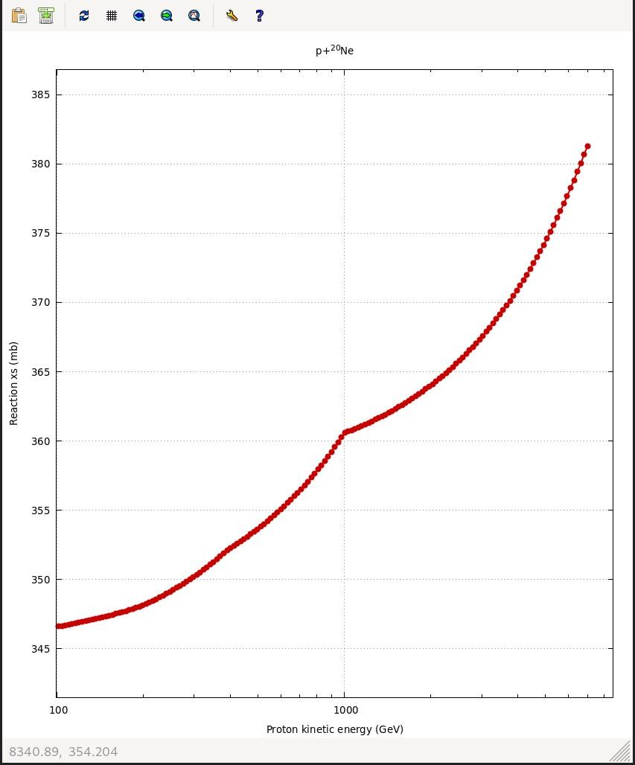
Radiation source: Beam energy
During LHC Run 2, the top energy was 6.5 TeV, but during HL-LHC it will increase to 7 TeV.
Moreover, there is interest in using the BGV during energy ramp from 450 GeV (injection) to top energy.
The inelastic cross section as estimated by FLUKA increases with energy, 10% over the energy range.
implying more radiation showers.
With higher beam energies,
the secondary particles will
lead to larger radiation levels.
Notes:
=

Slide 25
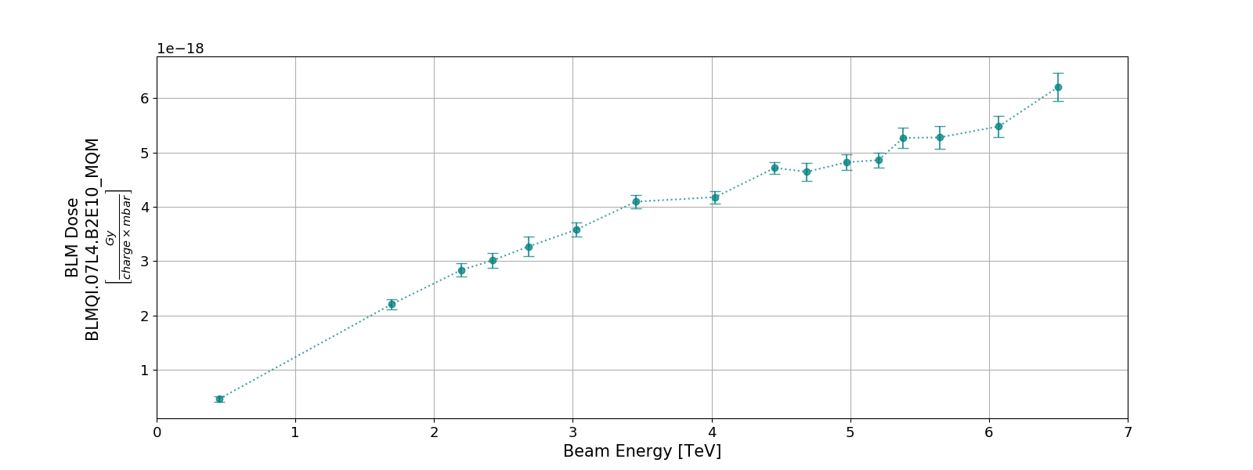
Energy Ramp Up
Due to the short time at intermediate energies of the measured data, the radiation levels as recorded by the radiation monitors are reliably available only for injection (450 GeV) or top (6.5/7 TeV) energy.
There is interest in using the BGV during energy ramp for Run 3/HL-LHC era, so we were curious to quantify the scaling of the radiation levels induced by the BGV with beam energy.
The plot indicates an almost linear increase in the radiation levels with energy, with an average at 0.65 of the TID rate at top energy.

Slide 26
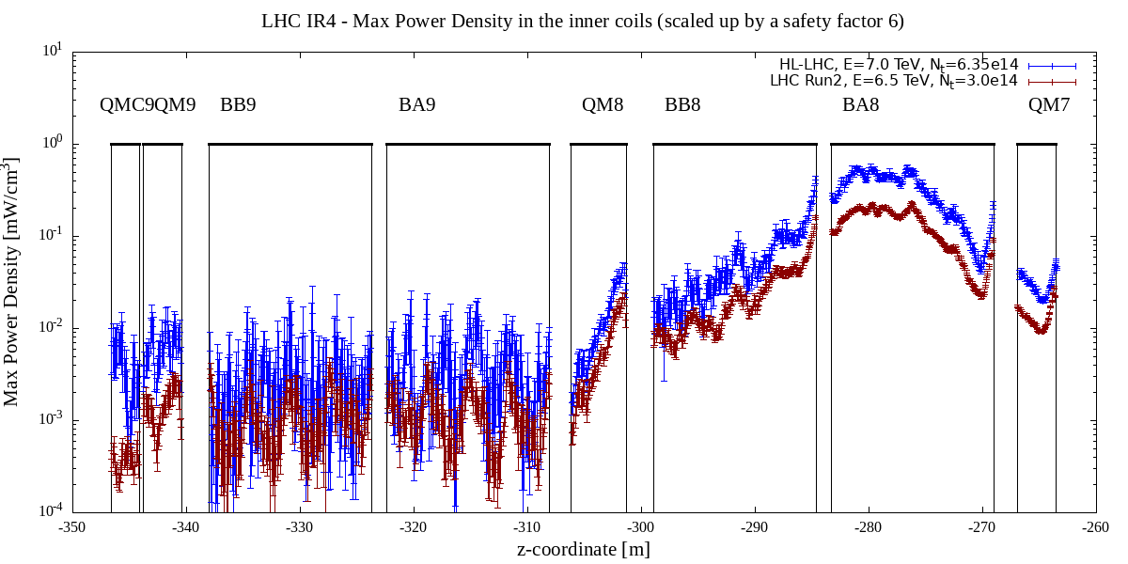
Heat loads on cryogenic system: Power Dissipation
Heat loads:
  Max Power Density Distribution in the inner coils.
  Total Power Dissipated on the entire magnet.
No risk of quenching in the magnets for:
  a peak pressure of 1×10⁻⁷ mbar and for the assumed gas profile,
  max HL-LHC beam intensity.
 |  | LHC | HL-LHC
Magnets | dIP [m] | Total Power [W]
QM7 | -265.27 | 0.407 | 0.890
BA8 | -276.15 | 3.087 | 7.199
BB8 | -291.81 | 0.563 | 1.277
QM8 | -303.77 | 0.030 | 0.067
BA9 | -315.21 | 0.029 | 0.081
BB9 | -330.87 | 0.027 | 0.062
QM9 | -342.13 | 0.009 | 0.030
QMC9 | -346.49 | 0.007 | 0.016
Notes:
Steady state case losses 15-20 mW/cm3 in the dipole

Slide 27
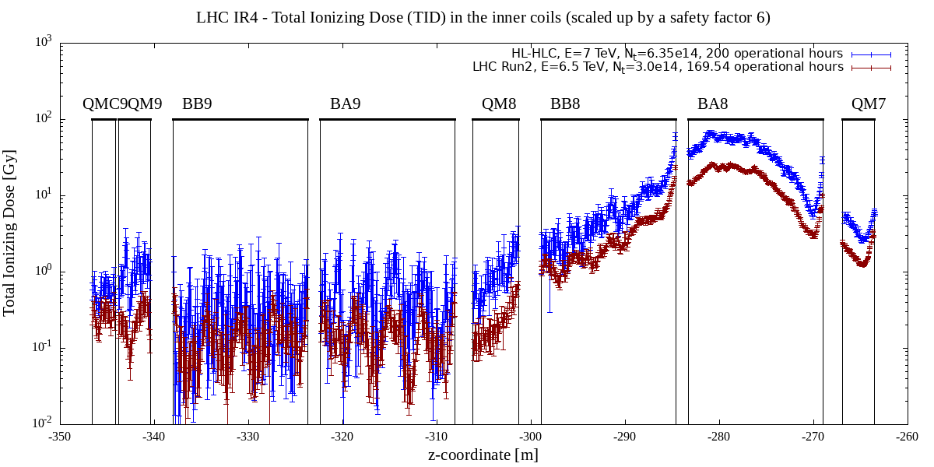
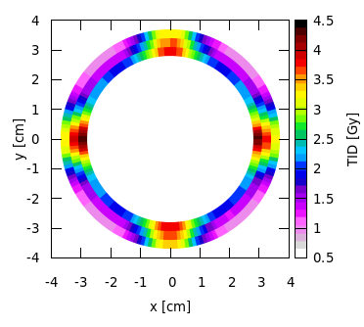
Heat loads on cryogenic system: TID
The TID levels, even at the peak, do not rise concerns.
Radial TID distribution on the inner coil of Q7, averaged along Z on the entire magnet length

Slide 28
Summary for HL-LHC: Maxima for Beam 2 BGV
 | Value | Location
Max Power Density [mW/cm3] | 0.5 | Dipole MB.A8L4
Total Power [W/year] | 6 | Dipole MB.A8L4
TID [Gy/year] | 50 | Dipole MB.A8L4
 | 20 | BLMQI.07L4.B2E10_MQM
HEHeq [1e10 cm-2/year] | 3 | Near Quadrupole MQM.7L4

