Slide 1
MP3 report : W44
(9 slides, 10’)
Since:
Extensive presentation at LMC on 29th of September
Oral report last week 20th of October
J.Ph Tock for the MP3 team

Slide 2
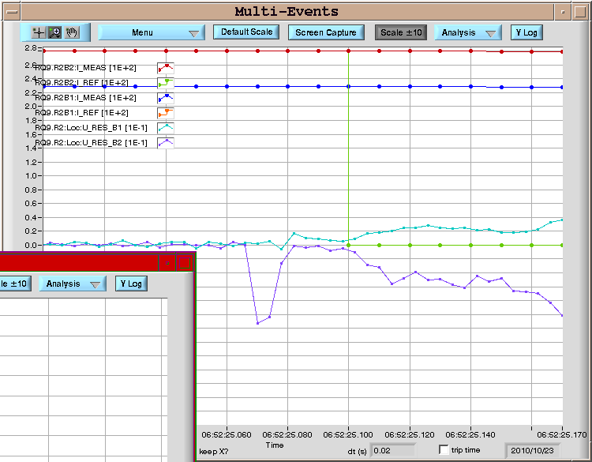
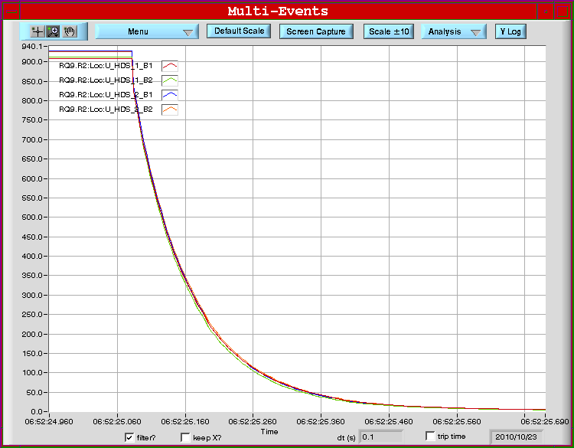
Technical stop and restart
Technical stop from 19th till 22nd of October
  Measurement of IPQ splices (see next slide)
A few shifts organised at the end of the TS, a few actions but not critical ; quiet restart from MP3 point of view
On 23rd of October @ 9:52, trip of RQ9.R2B2
  QPS has started a mitigation
  campaign for all IPQ's to reduce
  sensitivity from noise. RQ10.R2
  is already done. The others will
  follow, starting with Q9s & Q10s
  during the Christmas break.
  MP3 presentation @LMC 29/09
JPhT – LMC 27th of October 2010

Slide 3
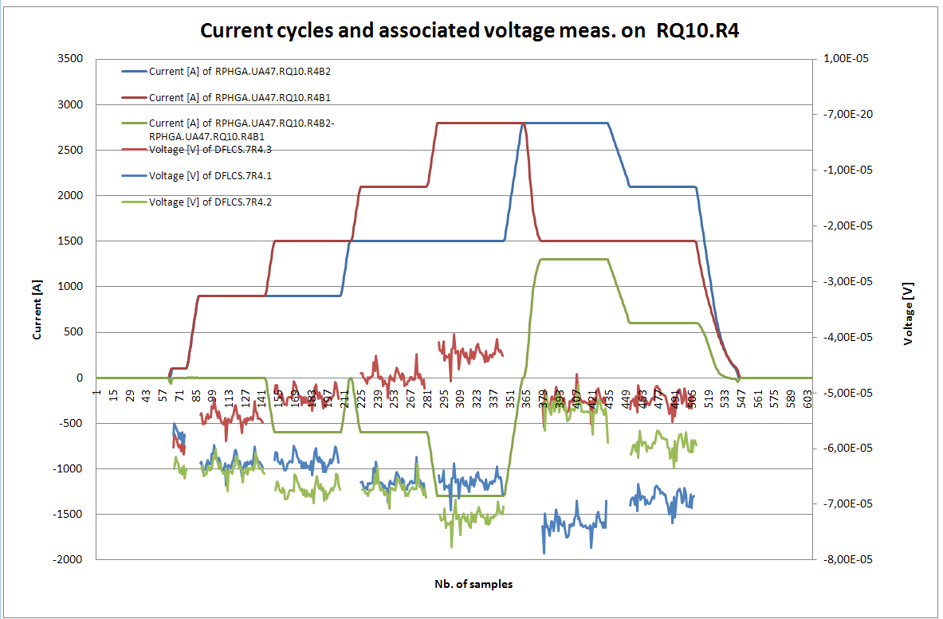
IPQ splices (BB segments) measurements (1/3)
So far 3 points are measured / IR1 & 5 were measured during the TS
Data under analysis for these two last IRs
JPhT – LMC 27th of October 2010
From Richard Mompo

Slide 4
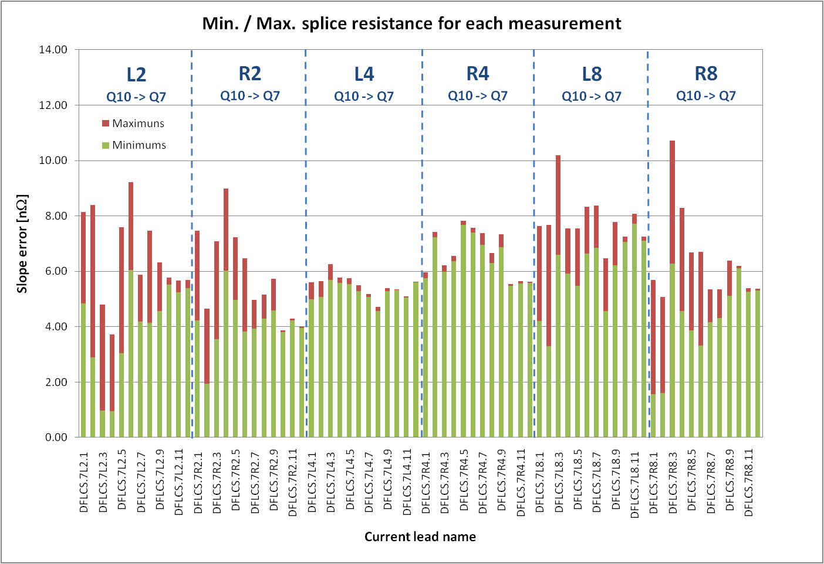
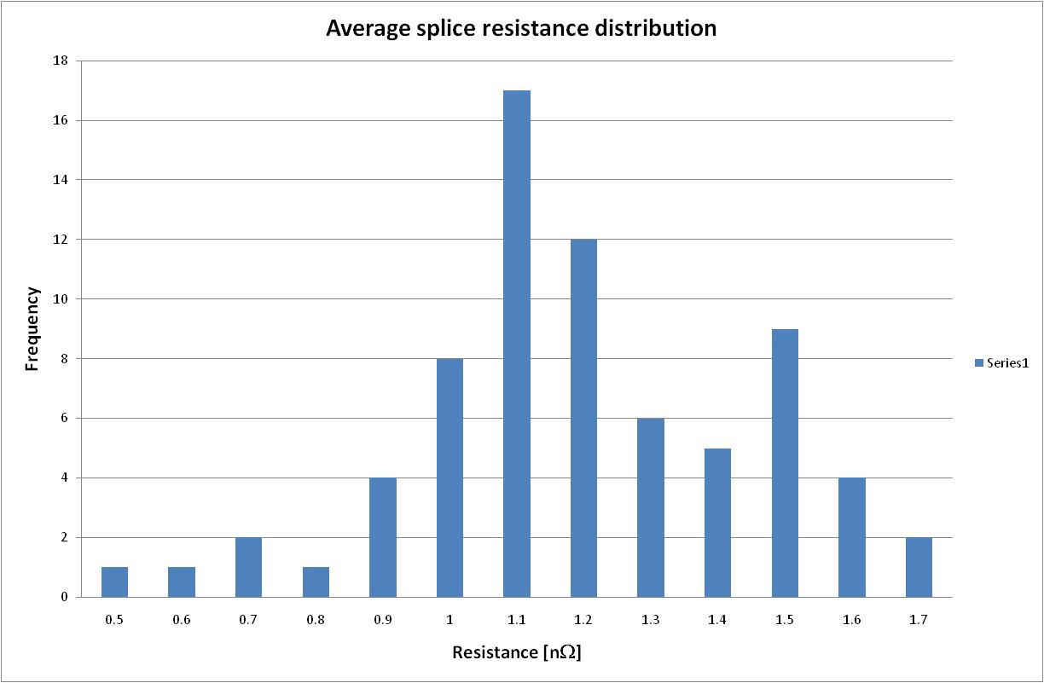
IPQ splices (BB segments) measurements (2/3)
Average splice resistance : 1.14 nOhm
No outlier
Max splice resistance [Segment-(n-1)average] = 3.9 nOhm
Different types of splices
Expected: 1-1.1 nOhm / Specified < 1.5 nOhm
Confirmation of first measurements presented at Chamonix 2010
JPhT – LMC 27th of October 2010
From Richard Mompo

Slide 5
IPQ splices (BB segments) measurements (3/3)
Status :
It was recommended by MP3 (30/09/2009) and endorsed by TEMB (05/10/2009), to commission the circuits to reduced currents to 3.5 TeV level so not requiring splice mapping [IPQs and IPDs = 94 circuits].
Now a qualified measurement method is available
MP3 (27/10/2010):
  What about possible outliers ? Interest to find them early
  What about energy > 3.5 TeV ? 4 TeV ?
  Different strategies for IPQs in the continuous cryostat and for IPQ/Ds in (S)SAM as collateral damages are different
  Could time be available before/during Christmas break to complete splice mapping outside normal working hours ?
JPhT – LMC 27th of October 2010

Slide 6
Minor actions
24/10: QPS not OK on RCO.A56B2
Removed from SOC then switch board cured the issue
Happened again;
To be power cycled when appropriate
25/10: QPS not OK on RQF.A12
Send logging cured the issue
25/10: QPS not OK on RB/RQF&D in 78
Send logging cured the issue
25/10: Trip of RQS.A34B2
Not a quench, happened during SPA following loss of cryo OK in S34
26/10: QPS not OK on RCS.A45B1 & RQTL11.L5B1
Switch board cured the issues
27/10: QPS not OK on RB/RQF&D in 23 (nQPS B23L3)
Remote reset worked ; Under investigation to find the origin and
possibly cure it at the source.
Low occurrence rate : About once a month
Protection is still ensured
JPhT – LMC 27th of October 2010

Slide 7
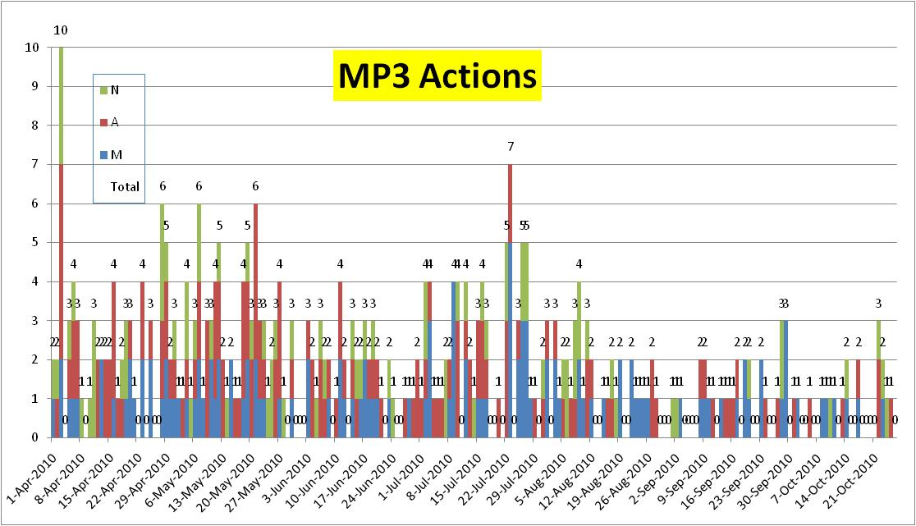
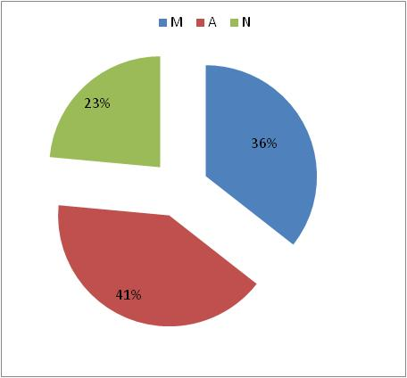
Average: 1.7/day, decreasing
Technical Stops – Recovery from TS
JPhT – MP3 27th of October 2010

Slide 8
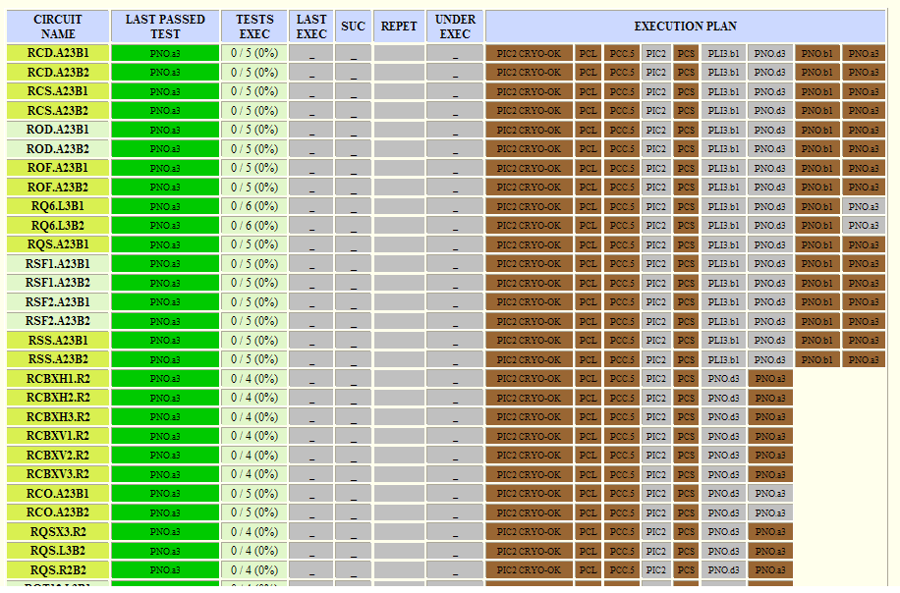
Parallel activities
Review of procedures for re-commissioning
Presentation on the 600 A circuits this morning
Proposal to (re)enable MCBX & MS for feedback during operation [squeeze, ramp] (R Steinhagen)
  No objection from MP3
  QPS expert on-site to assess margin
  To be approved/coordinated by LHC operation
JPhT – LMC 27th of October 2010

Slide 9
Conclusions
Relatively quiet week for MP3
Relatively straight forward recovery from TS
Limited downtime due to QPS
Parallel work on-going
Thank you for your attention
JPhT – LMC 27th of October 2010

