Slide 1
Serial powering at system level
RD53 serial powering working group meeting Feb. 11 2022

Slide 2
Serial powering: System issues
Pixel chip / SLDO Power dissipation and cooling
SLDO hot spots (depends strongly on configuration, failures, etc.)
Typically ~20-40% of power (~0.2v voltage drop, 10-20% shunt current)
Absolute extreme worst case: ~100% power.
Margins and head rooms for typical conditions: 10 – 25% ?. (system decision/optimization)
Pixel module power losses (HDI)
Cabling and connectors with power losses
Monitoring:
Extensive monitoring in RD53 chip: input current, shunt current, input voltage, regulated voltages, temperature sensors, etc.
System monitoring: Power supplies, DSS temp monitoring (on selected modules ?), etc.
Grounding
Where is system grounding reference ? (entry to faraday cage).
AC coupled links
Grounding faults problematic in SP
EMC and noise coupling
Use of low power mode
Failure scenarios
Among chips in parallel on module, Between modules
Reliability of SLDO/chip. Test to failure: Input voltage, current, temperature, etc.
HV biasing for sensors (that is parallel powering)
HV biasing difference along SP chain
Reverse biasing in certain cases.
Noise coupling and HV filter, etc.
Power supplies
Power specs, Grounding, EMC, Monitoring, Safety features , ,
Real constant current supplies or normal Voltage supplies in current compliance mode.
Safety systems: DSS
And for sure lots of other stuff

Slide 3
Serial powering issues and optimization of its use in a system
Slides from 2019 but nothing has changed (significantly) since.

Slide 4

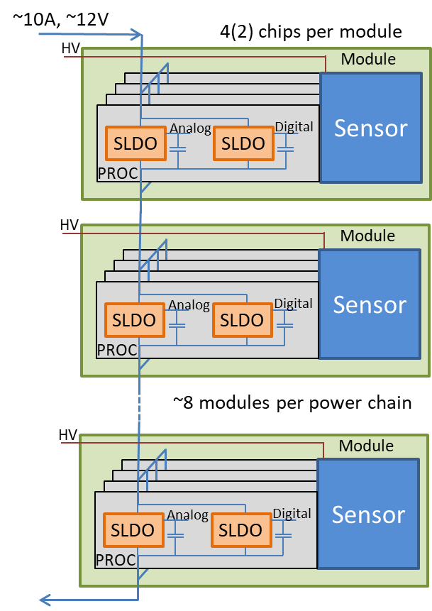
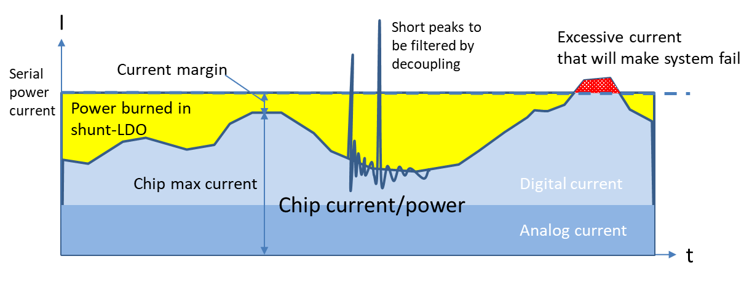
Serial power in a
Constant current injected
But chips needs constant/stable voltage and have varying current consumption (digital).
Serial powering can tolerate large voltage drops on power cables
Re-use injected current across many (~10) pixel modules.
Enables significant power cabling reduction (factor ~10).
Critical to prevent noise coupling and keep current flowing in case of chip failures
No local grounds as all modules on different potential.
HV issues: Bias of each module, Leakage currents, Noise coupling, grounding.
Share current between parallel chips on pixel module
4 chip modules, and is some cases 2 chip modules (inner barrel).
Allows to pass current in case one chip fails (open)
Same local “ground” potential as shared DC coupled pixel sensor.
Requires appropriate current sharing with well controlled resistive behavior of SLDO
Convert injected current locally on chip to a stable voltage for chip circuitry.
Separate SLDOs for analog and digital to minimize noise coupling: current sharing between the two !
Hide all current variations in the chip to the outside world:
Shunt current in SLDO when not consumed by active chip circuitry
SLDO hot spot issue as ~30% of total power injected “lost” here. More in case of chip failures. SLDO: 1W -> 3W (quad) -5W (dual)
Only viable with efficient CO₂ cooling for SLDO hot-spot cooling
Local decoupling capacitances critical (external for input and output of SLDO, on-chip capacitance) to filter out fast and large current peaks from digital logic. Current averaging with time constant of ~1us (comparable to trigger rate).
SLDO looks from outside as simple constant voltage “source” with a well defined resistance, as long as kept in valid operation range.
Startup is a “separate” (delicate) issue
Requires current head room and operation margins to assure always being in valid operation range: Current fluctuations, chip to chip variations, current sharing mis-match, radiation effects, margins for required changes of chip configuration, etc.
Delicate system optimization to minimize power and assure long term reliable operation

Slide 5
Faults and system effects
Broken power connection: On any cable, connector or module
Not possible to deliver power to serial power chain
Option: Wire to serial power chain middle point could be used to restore power to half serial power chain.
Chip/module short-circuit
Chips on same pixel module will not work but serial power chain can be kept running
Chip open:
Quad module: Other three chips can work and carry required current
Double module: To be seen what can be done
Partial chip open (analog or digital SLDO): Current can be maintained in serial power chain.
Chip mis-configuration or chip failure:
Zero power: SLDO will get hot, but chip/module/system remains functional
Excessive chip load:
Pixel module voltage will collapse. Serial power chain can be kept running.
Overload/Under-shunt protection: Other chips on module can be kept functional
Local ground fault: Module ground shorted to mechanics ground
Serial power chain must be turned off (or central connection to system ground must be removed for this chain, May not be allowed according to safety rules)
Excessive HV current (or pixel sensor short)
Shared HV: Pixel sensors in serial power chain can not be biased.
HV filter resistor ( or “fuse” ) on module could possibly be made large enough that excessive HV current/short on one sensor will not prevent other sensors in same serial power chain to be HV biased.
Option of HV per module for critical modules (inner barrel layer)
HV on and LV off
Should normally not occur. To be checked that this does not kill chips and sensors ( e.g. via sensor leakage) if occurring for limited time periods (minutes)
Bad thermal contact of pixel chip/module
Power down serial power chain, as chips/module will over heat/burn
Let local chip/module overheat/burn and keep serial power flowing until breaking.
Other ?

Slide 6
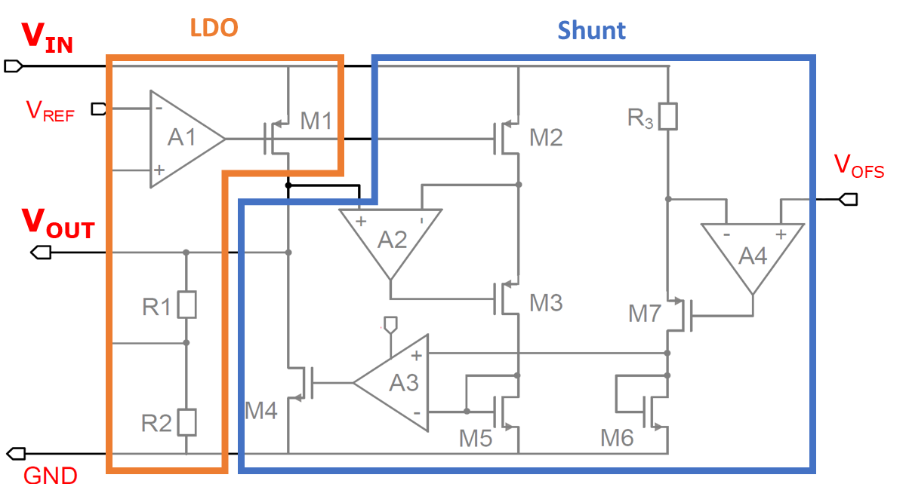
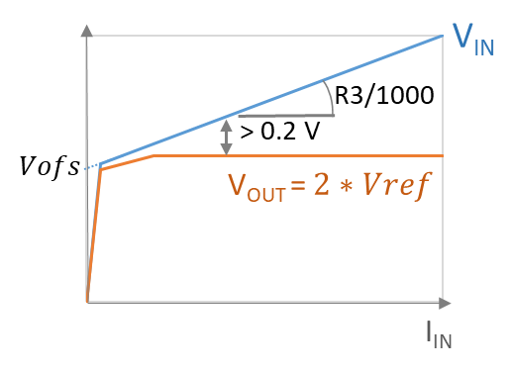
SLDO principle
LDO power MOS
At zero load
With load
Shunt power MOS
Appropriate input impedance + output voltage regulator to translate injected current to constant voltage
Input:
“Zener-diode like voltage clamp” to make voltage “independent” of current.
Restive slope to enable current sharing between analog/digital SLDOs and chips
Output:
Constant voltage independent of load current (and injected current): LDO
Combined input resistive shunt with LDO
Implementation: LDO + shunt (with V_{in} dependent current)

Slide 7
Issues and optimization
Hide internal power fluctuations in chip to outside world: Simulations. Chip, module and system tests
SLDO design and required local decoupling on module
Current head room: 10 – 30% ?: Chip, module and system tests
What is needed and what happens when getting close to limit ?: Noise increase, functional failure, coupling between chips, ?
Voltage head room (required LDO voltage): Simulations. Chip, module and system tests
Noise coupling: Simulation. Chip, module and system tests
Between Analog – Digital: Separate SLDOs
Between chips on same module
Between modules on same serial power chain
Power supply ( LV and HV) noise immunity: EMC
Output overload: Simulation. Chip, module and system tests
Vin collapse single/multi-chip chip,
Overcurrent (under-shunt) protection
Current sharing: Defined by module resistors (V_{off}, R_{eff}): Evaluation, Simulations, chip & module tests
Between analog – Digital : Current ratio and mis-match
Between chips on same module: Mismatch
Failure scenarios: Evaluation. Simulations. Chip, module and system test. Cooling test
Quad modules, Dual modules, Partial chip failure
Effects on system, Effects on local module
Power dissipation on chip/module: Evaluation and module/system tests
SLDO hot spot in normal operation and failure/startup/misconfiguration cases
Low power mode: System connectivity test without CO₂ Cooling
Start-up: Simulations, chip, module and system tests
Start up delicate as many chips in series/parallel needs to startup
Dynamic voltage peaks: On-chip protection voltage clamp.

Slide 8
Analog – Digital current sharing
Separate Analog - Digital SLDOs for noise isolation
Have shown itself to be very efficient
Analog and digital fully decoupled on chip using triple well option of 65nm.
Current sharing
Determined by separate R_{eff} (common V_{off})
Optimized for normal operation
Typical case: 60% analog, 40% digital
Mismatch will be very small:
Common Voff
SLDOs on same chip (same process/wafer, temperature)
External resistor mismatch very small ( ~1%)
What if analog/digital ratio changes ?
Changing AFE biasing, affecting analog power
Hit rates affects on digital (small)
Radiation effects
During start up
(low power mode)
Will have to increase shared current according to largest increase of the two
The other will have to burn more power in its shunt
Extreme case: Digital + 50%, Analog –50%
Nominal ratio analog/digital : 60/40 = 0.6A/0.4A = 1A, Vin: 1.5V Nominal Power: 1.5v * 1A = 1.5W
Extreme case: 0.4A/0.6A = 1A (“same power”)
Will have to increase Digital 0.4A -> 0.6A (50% increase). Must increase shared injected current by 50%: 1A -> 1.5 A
At increase current, input voltage will increase: Vin = ~ 1.0v * 1.5A(1.5v-1.0v) = 1.75V
Power: 1.5A * 1.75V = 2.63 W 75% power increase ! (in the SLDOs)
Realistic case1: Analog +20%
0.6A/0.4A - > 0.7A/0.4A (power increase of 10%)
Required to increased injected current 20%. Current: 1.0A -> 1.2A Voltage: 1.0V + 1.2A(1.5V – 1.0V) = 1.6V Power: 1.2A * 1.6V = 1.9W (25% increase)
Realistic case2: Analog -20%
Digital needs the same so shared current can not be decreased so no power savings
Options:
Assure that analog/digital ratio will not have significant change (or at least no increase)
Make SLDO reconfigurable
Worries about SEU, startup, etc. Wanted to keep it simple and stupid

Slide 9
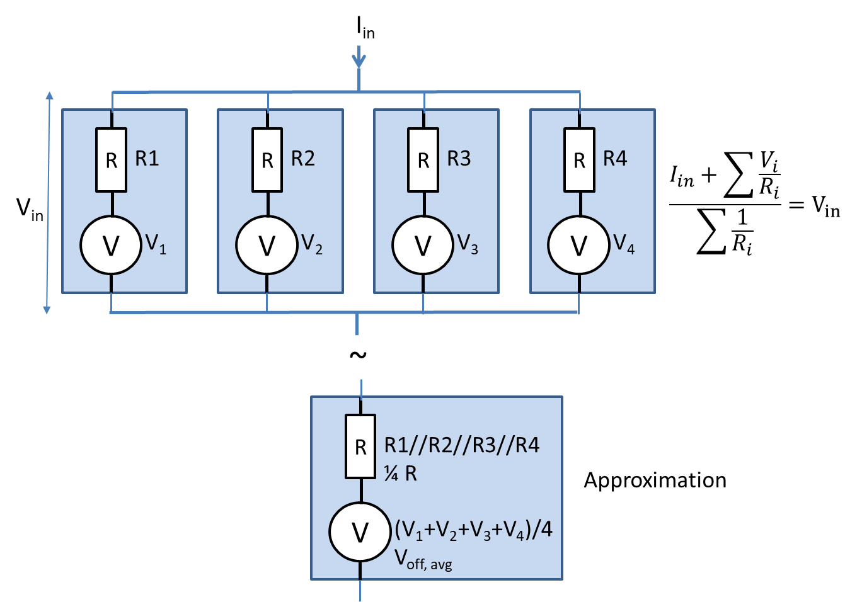
Current sharing mis-match
Mis-match of SLDO parameters between chips on same module
V_{off}: Common between analog/digital, Defined by external resistor Individual V_{off} (no tuning): +/- 50mv (TBC). (Can if needed be tuned via resistors) Shared on module V_{off}: +/- 20mv (TBC) Tuned via Iref: +/- 10mv (TBC)
4 bit tuning via wirebonding (not config)
R_{eff}: +/- 5% (TBC), Individual per SLDO, Defined by external resistor
Defines current sharing between analog and digital
Current sharing mis-match determined by chip to chip variations. (Not by external resistors, assumed to be high precision: 1% ).
Default: No tuning of external resisters per chip.
Alternative options:
Resistor tuning per chip based on wafer level test (not so practical in a production).
Grouping chips into lots with “same” effective V_{off}, R_{eff\}
(on-chip reconfig option enabled via wire-bond pads ?)
Wire-bond (I_{ref}) and/or resistor tuning per chip: To be determined what is most practical/viable
Affects local current sharing between chips on module
No (significant) effect on serial power chain
Does mis-match affect V_{in} of module ?: Not much
Defined by average across 4 (2) chips, each with 2 SLDOs.
Allows simplified analysis, assuming V_{in} constant,
V_{off} mismatch indicated as light blue band around baseline SLDO working line (later slide). R_{eff} mismatch indicated as dashed lines from SLDO working line.

Slide 10
Current head room
Needed to absorb multiple effects:
Dynamic variations in digital power: Local decoupling
Clocking, Hits, Trigger, Readout, clears and resets
Mismatch between chips
Changes in current ratio between analog – digital
Changes from radiation damage
Other ?
What can happen if too low ? (trying to minimize power)
Increased noise in analog front-end
Noise hits
Fluctuating thresholds
Oscillations
PLL gets too much jitter and control and readout links gets unreliable
Functional errors
How much needed ?: Risky to be too optimistic
Optimistic: 10%
“Realistic”: 20%
Pessimistic: 30 – 50%
Current head room for analog and digital can be chosen differently.
Extensive chip, module and system tests under realistic conditions required

Slide 11
Chip current overload
No overload protection: What happens if load (chip) needs/takes more current than it should ?
OK as long as below injected current in chip (current sharing), taking into account current headroom.
Then output voltage collapse ?: Not directly. Propagates to input voltage collapse, that will then affect all chips on module.
What happens when having multiple SLDOs in parallel ? (analog/digital, multiple chips).
Current sharing will not anymore be respected: Shut will be out of action, and chip will behave as simple LDO.
Overload chip takes more than is fair share of current (e.g. takes from the current head room available for whole chip/module )
Vin will decrease in a controlled fashion until consuming current head-room of the other chips, and will then collapse “completely”.
Static issue versus dynamic issue:
Current peaks below ~1us taken care of by local decoupling. Otherwise serial powering does simply not work
Can voltage collapse on a pixel module lead to dangerous/problematic situations on other modules in serial power chain:
Static: Should not be an issue as currents naturally limited in a serial power system.
Dynamic: Voltage clamp to protect chips/modules from possible over voltage spikes
LDO output current limitation can localize overload problem to single chip
Direct output current limitation on LDO poses implementation issues.
Under shunt protection: Decreasing LDO output voltage when shunt running dry ( < ~10mA) of current.
Auto scales to defined working point. No need to define max output current.
Prevents Input voltage collapse
Power dissipation moves into LDO power MOS
LDO voltage drop limited to ~0.6V, because of voltage constraints of LDO power MOS
In case current still too high then Vin will collapse (e.g. power short).
Causes of chip overload:
Chip mis-configuration: Will happen when debugging systems
Chip failure ( e.g. power short or partial power short): Will happen
SEU induced: Will hopefully not happen, but can not be excluded
Latch up: Will hopefully not happen, but can not be excluded (signs of partial Latch-up seen in LPGBTia, at higher voltages than 1.2v)
Possible system causes: Ground failure, ?

Slide 12
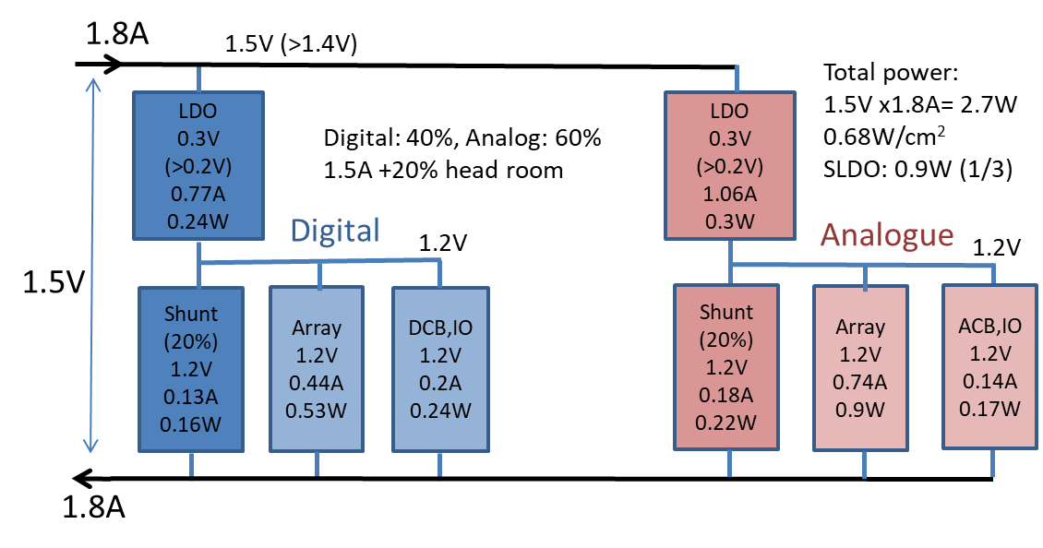
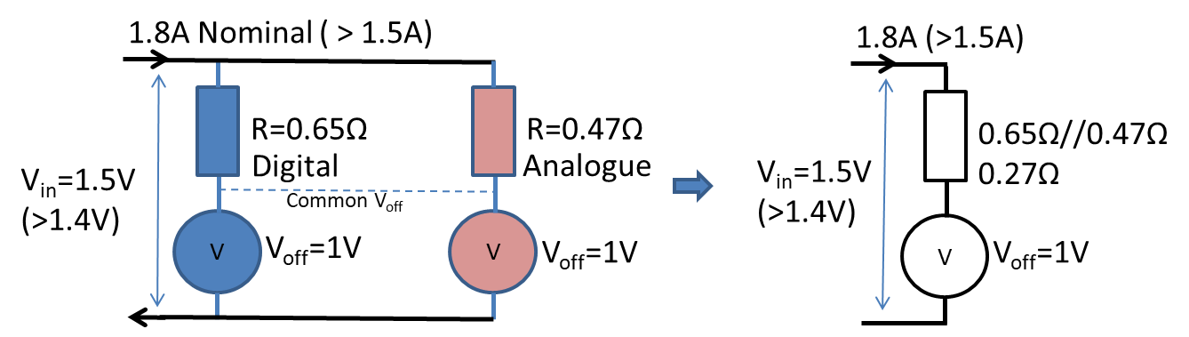
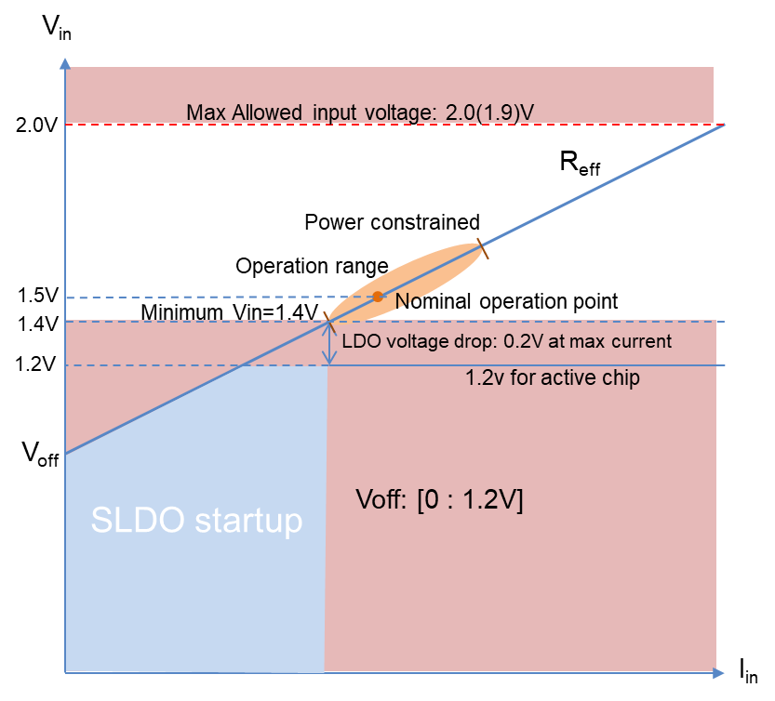
CMS: Chip – SLDO power Model
Estimated active operation current: I_{active} = ~1.5A
Analog: ~60%, Digital ~40% (details in backup slides)
From simulations with hits, triggers, averaging, etc.
Outer layers possibly 10-20% lower
Merged into one SLDO equivalent for simplification, ignoring analog/digital current sharing issues
Current headroom: 20%
Total current: 1.5A * 1.2 =1.8A
V_{in} Constraints: 1.4V < Vin < 2.0V, to assure 1.2V internal
0.1V Margin to 1.4V minimum: 1.5V
LDO min drop will depend on current 0.2V at 2A, ? at 1A, ? at 0.5A TBC
Operation point: 1.8A, 1.5V
SLDO V_{off}: 1.0V, good compromise (next slide)
Power dissipation
Total chip power: Iin * V_{in} = I_{in} * (V_{off}+I_{in}*R_{eff}) 1.8A * 1.5v = 2.7W normal operation
Active power: 1.2V * I_{active} 1.2V * 1.5A = 1.8W “uniform” across chip
SLDO Losses: 0.9W (30%), can be more
LDO: I_{in} * (V_{in} – 1.2V) = I_{in} * ((I_{in}*R_{eff} + V_{off}) –1.2V) 1.8A * (1.5V – 1.2V) = 0.54W
Shunt: 1.2V * I_{shunt} = 1.2V * (I_{in} – I_{active}) 1.2V *(1.8A – 1.5A) = 0.36W
Good if +/- 25% input current remains valid operation points (next slide)

Slide 13
Normal operation
Vin (V)
2.0
V_{in} max=2.0(1.9)V
P: 1.8W+2.2W=4.0W
P: Chip power: Active + SLDO = Total
1.83V
P: 1.8W+1.74W=3.54W
P: 1.8W+0.14W=1.94W
1.61V
P: 1.8W+1.65W=3.45W
1.5
1.57V
V_{in} min=1.4V
P: 1.8W+0.9W=2.7W
V_{off} = 1.2V, R_{eff}=0.3V/1.8A= 0.166Ohm Low-slope
R_{eff} mis-match=+/- 5%
V_{off} mis-match=+/- 50mV
1.0
V_{off} = 1.0V, R_{eff}=0.5V/1.8A= 0.278Ohm Baseline
SLDO startup
0.5
-25%
+25%
V_{off} = 0V, R_{eff}=1.5V/1.8A= 0.833Ohm
1.4A
2.2A
1.8A
I (A)
0.5
1.0
1.5
2.0

Slide 14
Single Chip failure (V_{off} = 1.0V or 1.2V)
P: 1.8W+5.4W=7.2W
Module P: 5.4W -> 7.2W
Vin (V)
2.0
V_{in} max=2.0(1.9)V
2.00V
1.67V
P: 1.8W+2.21W=4.01W
Module P: 10.8W -> 12.0W
1.80V
P: Chip power: Active + SLDO = Total
P: 1.8W+4.7W=6.5W
Module P: 5.4W -> 6.5W
1.60V
P: 1.8W+2.04W=3.84W
Module P: 10.8W -> 11.5W
1.5
P: 1.8W+3.6W=5.4W
Module P: 5.4W -> 5.4W
V_{in} min=1.4V
V_{off} = 1.2V, R_{eff}=0.3V/1.8A= 0.166Ohm
P: 1.8W+0.9W=2.7W
R_{eff} mis-match=+/- 5%
V_{off} mis-match=+/- 50mV
1.0
V_{off} = 1.0V, R_{eff}=0.5V/1.8A= 0.278Ohm
V_{off} = 3/4
0.5
V_{off} = 1/2
1 of 4 failure
1 of 2 failure
-25%
+25%
+33%
+100%
1.4A
2.2A
2.4A
3.6A
1.8A
2.4A
3.6A
I (A)
0.5
1.0
1.5
2.0

Slide 15
Chip power: different cases
Condition | Active power | SLDO losses | Total per chip
Baseline: I_{active}=1.5A, 20% head, V_{off}=1.0V, Operating point: 1.8A; 1.5V
Normal | 1.8W | 0.9W | 2.7W
Power up (reduced current) | ~0.5W | ~2.2W (~1.5W) | 2.7W (~2.0W)
¼ failing | 1.8W | 2.2W | 4.0W
½ failing | 1.8W | 5.4W | 7.2W
Low slope: V_{off}=1.2V, Operating point: 1.8A; 1.5V
Normal | 1.8W | 0.9W | 2.7W
Power up (reduced current) | ~0.5W | ~2.2W (~1.5W) | 2.7W (~2.0W)
¼ failing | 1.8W | 2.0W | 3.8W
½ failing | 1.8W | 4.7W | 6.5W

Slide 16
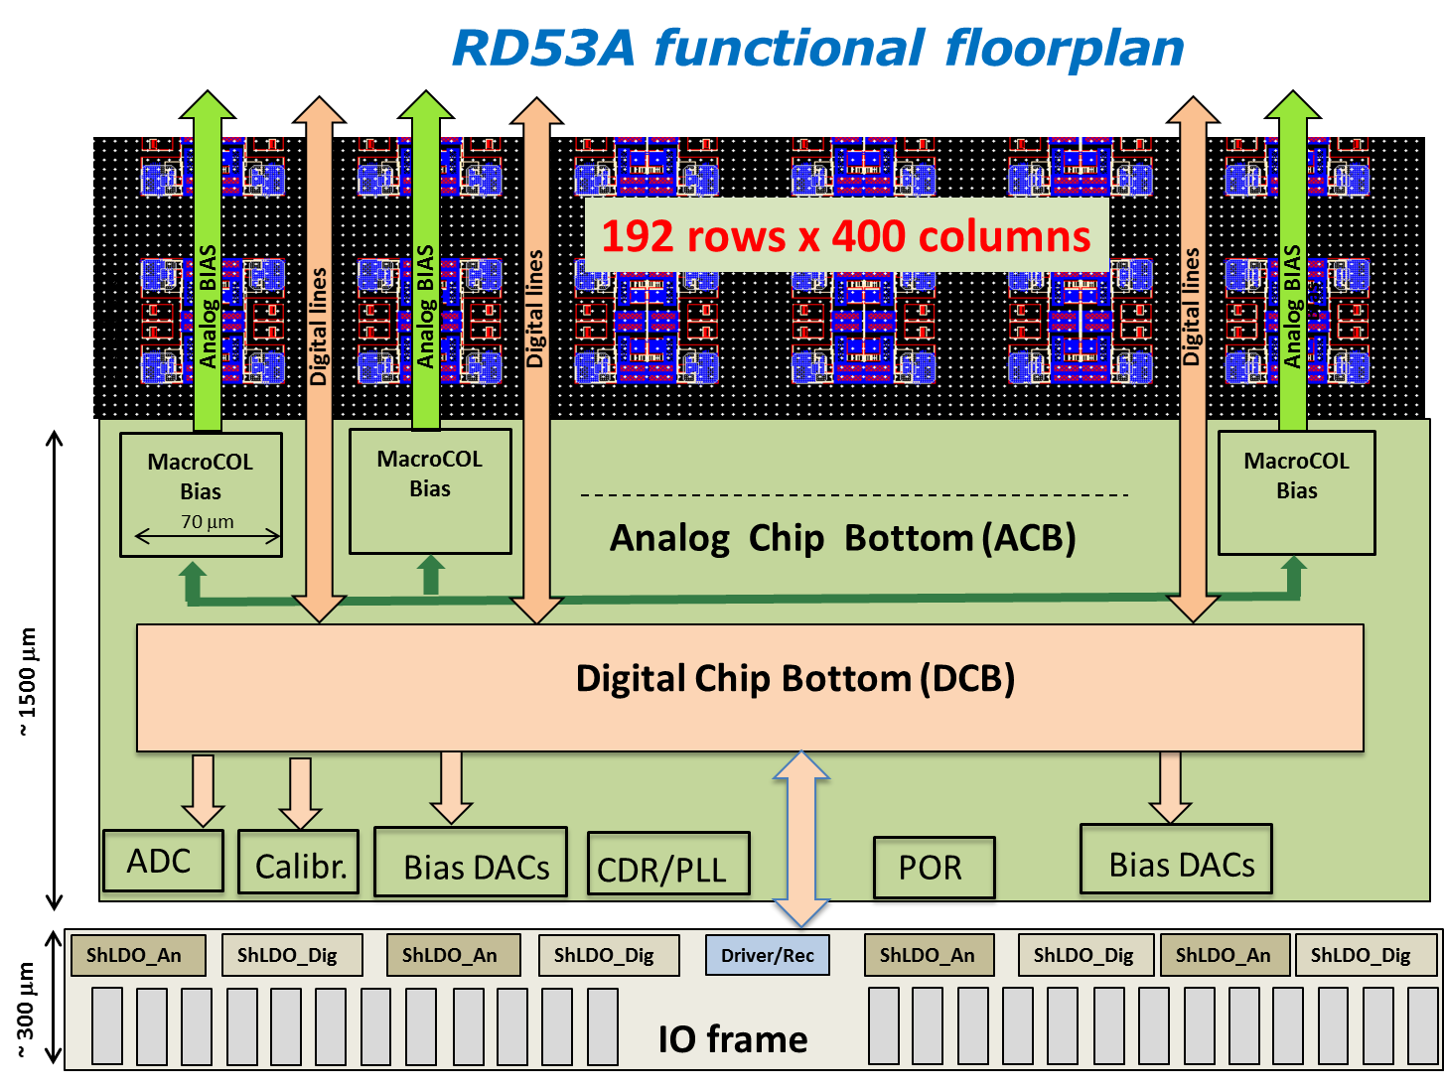
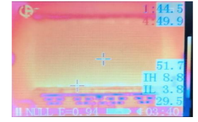
SLDO hot spot
SLDO power dissipation hot spots
Two separate SLDOs per chip: Analog & digital
Losses in both LDO and Shunt (see SLDO power model)
Each SLDO split in 4 power blocks, distributed along width of chip
Under normal operation: Optimal performance required
~1/3 of chip power dissipated in SLDO’s: ~1W
Other cases: Optimal performance not required, but no damage
Chip configured for minimal power (at power up or if mis-configured) then more power dissipated in SLDOs: ~2W (pixel module power is not increased)
No HV sensor power at startup, as HV not yet turned on.
Possible options to circumvent this (none attractive):
At power up, chip in normal operation/power state (hardwired): Low power mode problematic.
Gradual power up, which is not so trivial (assure SLDO startup).
Failing chip on quad module: Should be made feasible
SLDO hot-spot on non-failing chips during normal operation: 2.2W (operational with deteriorated performance)
If chips configured for minimal power, then SLDO hot-spot per chip: 3-4W
(Increasing AFE biasing can help to distribute power over chip)
Possibly decrease serial chain current, eating into current headroom.
Failing chip on double module: Extremely difficult requirements
SLDO hot-spot on remaining chip during normal operation: 5.4W
Full chip SLDO (analog and digital) failure should (hopefully) be very unlikely
If some chips hot (e.g. >25degC) for extended periods then severe radiation damage above ~100Mrad (1 year running for inner layer).
CO₂ cooling pipes below SLDO’s, when possible.

Slide 17
Thermal/radiation constraints
Sensor: Leakage, Radiation damage, Thermal runaway, etc.
Mechanical: Deformations, Breaking (de gluing), Wire bond potting, etc.
Pixel uniformity: Temperature gradient over pixel array: +/- 5ºC (TBC)
Radiation effects in pixel chip: Complex issue
Radiation damage in 65nm depends strongly on temperature (above 100Mrad)
TID effects
Detrimental annealing versus Good annealing (depending on biasing/powered)
Low dose rate effect
Depends strongly on transistor type, transistor size, biasing condition, etc.
Pixel chip should be kept as cold as possible when being irradiated
-20ºC will be ideal to get radiation tolerance to ~500Mrad (possibly 1Grad) (low dose rate effect also strongly temperature dependent)
0ºC can possibly be OK for large / non critical structures ( e.g. power transistors of SLDO). More tests required to confirm this (e.g. low dose rate effect).
Particular critical for inner layers with very high radiation levels: 500Mrad (replacement after ~5 years) – 1Grad (~10 years) Can be relaxed for outer layers ( e.g. TID below 100 – 200 Mrad)
When chips not biased/powered, they can be allowed to reach room temperature for limited time periods (weeks - months)
Detrimental annealing occurs at room temperature if powered (DSS must prevent this)
Most critical is timing of digital circuits, based on very small gate/FF transistors
Analog/SLDO using large transistors will be less affected, but can be an issue for critical circuits.
On-chip radiation effects monitoring at both transistor level and logic level (ring oscillators) Chip failures can be “predicted” before they occur.
Radiation effects could change between fabs and over time (processing changes)

Slide 18
Update on SLDO location
SLDO locations and sizes: Next slide
2 SLDOs per chip: Analog and Digital
Can for simplification assume that analog and digital has ~same power dissipation
Each SLDO split in 4 layout groups to spread power dissipation
Analog and Digital SLDO mirrored within group
“Maximum” distance to pixel array, so close to chip edge (wire bond pads).
Each group has a LDO and a SHUNT power transistor
LDO transistor: 401um; 27um (total of 2 x 4 LDO transistors per chip)
SHUNT transistor: (87+257)um ; 27um (two cascoded transistors, assume uniform power for simplification) (Total of 2 x 4 SHUNT transistors per chip)
Active power dissipation volume:
Thousands of arrayed transistors uniformly over power transistor regions
Assume uniform power over transistor region for simplification (in reality active transistor area ~25%)
Active power dissipation depth:
Active transistor depth: 10nm – 50nm ( guesstimate as we do not really have this info)
Si below: 100 – 300um, to be chosen from material budget, Bump-bonding, and thermal issues
Wiring + isolation + passivation on top: ~10um. ~80% SiO₂, ~20% Cu
Heat conductivity in silicon so good that 3D (depth) can normally be ignored.

Slide 19
SLDO location and sizes
21670um
Power MOS | Size (um) X,Y | Location (um) X,Y, lower left
Ana_SHUNT_1 | 87+257; 27 | 1346; 237
Ana_LDO_1 | 401; 27 | 1690; 237
Digi_SHUNT_1 | 87+257; 27 | 3113; 237
Digi_LDO_1 | 401; 27 | 2709; 237
Ana_SHUNT_2 | 87+257; 27 | 6545; 237
Ana_LDO_2 | 401; 27 | 6890; 237
Digi_SHUNT_2 | 87+257; 27 | 8313; 237
Digi_LDO_2 | 401; 27 | 7909; 237
Ana_SHUNT_3 | 87+257; 27 | 11745; 237
Ana_LDO_3 | 401; 27 | 12089; 237
Digi_SHUNT_3 | 87+257; 27 | 13513; 237
Digi_LDO_3 | 401; 27 | 13109; 237
Ana_SHUNT_3 | 87+257; 27 | 17045; 237
Ana_LDO_3 | 401; 27 | 17389; 237
Digi_SHUNT_3 | 87+257; 27 | 18813; 237
Digi_LDO_3 | 401; 27 | 18409; 237
Pixel array: 432x336 pixels
18600um
Analog and digital Chip bottom
1740um
A
D
A
D
A
D
A
D
237um
Wirebond pads
940um
Shunt
LDO
Analog and Digital Mirrored

Slide 20
Thermal “cases”
Normal operation: Chip power estimate: 1.8A, 1.5V = 2.7W, 20% current headroom, simplification analog/digital: 50/50
HV: On
Chip: Active power: 1.8W (2/3), SLDO: 0.9W (1/3) Each LDO transistor: (1.5V-1.2V)*1.8A/2 *1/4= 68mW Each SHUNT transistor: 1.2V * 1.8A/2 *0.2 *1/4 = 54mW (cross check: SLDO = 8*68mW + 8*54mW = 976mW)
Chip thermal requirements:
Limited temp gradient over active array (~+/-5ºC) General chip temp below -20ºC (possibly -10ºC, TBC) to limit long term radiation effects SLDOs below -10ºC (possibly 0ºC, TBC)
At power up: Chip active circuits starts up in low power, so SLDO SHUNT will be hot
Occurs for limited time (seconds/minutes) infrequently, until chip configured to be in operation mode.
HV: Off, until chip configured for normal operation
Chip: Active power: ~0.5W, SLDO: ~2.2W Each LDO transistor: (1.5V-1.2V)*1.8A/2 *1/4= 68mW Each SHUNT transistor: 1.2V * (1.8A – 0.5A)/2 *1/4 = 200mW (cross check: SLDO = 8*68mW + 8*200mW = 2144mW)
Chip thermal requirements:
SLDOs below 0ºC (possibly 25ºC, TBC) as detrimental annealing may otherwise occur when biased (time constant: ~hours)
Comment: CMS chip could possibly start up in “normal operation power state“, but prevents use of lower power mode
Chip failure scenarios: Worst case as full chip open failure “unlikely” as having two SLDOs per chip.
HV: On as shared HV must be on to have other modules in chain operational (unless per module HV, not baseline)
Hot chip thermal requirements (other chips on module with failing chip):
SLDOs should be below 0ºC (possibly 10ºC) to pass current to other modules until possible repair (1year) Remaining part of chip could also be as high as 0ºC as not absolutely required to be in operation condition. Main problem could be sensor thermal runaway, as HV will be on.
Hot chips power: (Notice that in chip failure scenarios, module voltage increases, see previous slides)
Quad module (3 out of 4 chips): Active power: 1.8W, SLDO: 2.2W LDO transistor: (1.67V-1.2V)*1.8A/2 * 4/3 *1/4= 141mW SHUNT transistor: 1.2V * (1.8A*0.2 + 1.8A/3)/2 *1/4 = 144mW (cross check: SLDO = 8*141mW + 8*144mW = 2280mW)
Double module (1 out of 2 chips) : Active power: 1.8W, SLDO: 5.5W LDO transistor: (2.0V-1.2V)*1.8A/2 * 2/1 *1/4= 360mW, SHUNT transistor: 1.2V * (1.8A*0.2 + 1.8A)/2 *1/4 = 324mW (cross check: SLDO = 8*360mW + 8*324mW = 5472mW)

Slide 21
SLDO startup
SLDO startup is a delicate issue: SLDO is not in its normal regulation range.
SLDO itself depends on critical voltages:
Bandgap reference
Powering of its amplifiers
Avoiding oscillations to the extent possible
Current ramp can not be too slow ( <100ms)
Interactions between chips on same module (current sharing) and between modules (voltage sharing)
System simulations and tests
RD53A experience:
Some chips needed relative large startup current (larger that nominal operation current), Others start up without problems.
Related to start up of internal bandgaps and derived references
Kick start effect: When one chip starts up correctly, it then enables other chips in parallel to take more current that then gets a kick to start up.
If no chip starts up easily/early then significant current can be required to get all (8) SLDOs to start up
Very slow startup can get the SLDOs into a strange state without appropriate regulated output voltage.
Has so far not been seen to be “destructive”.
RD53B: SLDO startup circuitry completely changed
Special Pre regulator for power and references to the SLDO itself:
With dedicated early startup bandgap reference
Used to drive high precision core bandgap (driving Iref from which all voltage/current references derived)
Dedicated early pull up of Voff reference until SLDO has started up
Prevents Vin being “forced” Low until startup has occurred
Verified in chip and system simulations and test chips

Slide 22
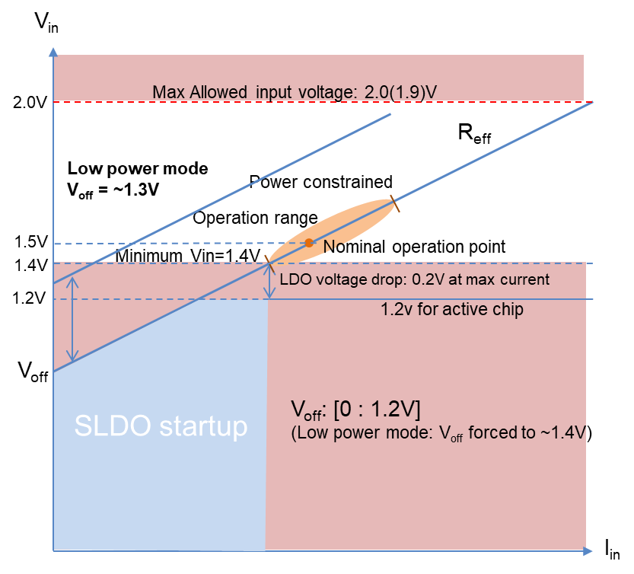
Low power mode
Electrical check/verification of pixel module/stave/detector without CO₂ cooling.
Forced air cooling assumed required
Pixel chip power: 2.7W -> 0.5W (possibly lower ?).
Serial powering issue: Total chip power defined by operation parameters of SLDO ( V_{off} & R_{eff}), not by actual power consumed.
SLDO in dedicated low power mode: Increase V_{off} to ~1.3V to assure enough V_{in} voltage, even with low injected current.
Active chip power must be low:
Control, monitoring and readout must be functional
Pixel array (analog and digital) powered down (no hit injection possible). (can possibly be configured to allow digital hit injection in single column)
Analog and digital current ratio not the same as for normal operation: Normal operation: Analog: ~60%, ~Digital 40% Lower power mode: Analog ~40%, Digital ~60% (can be decreased ?) Will have to inject enough current to power both analog and digital
Forcing SLDO into dedicated low power mode (high V_{off})
SLDO determines from low/high injected current to be in low/high power mode.
Delicate current level detection circuit during power up
Implemented on test chip and seems to work
External signal forces SLDO into low power mode:
Dedicated signal to be routed to all pixel modules (not very practical)
Signal must be AC coupled because of serial powering: 100KHz – 1MHz
Simple (low risk) so has been chosen by ATLAS for the ATLAS chip
Via configuration: Danger of SEU/SET and requires chip to always start up in low power mode and transition to high power mode will be delicate.
CMS to determine if needing low power mode and if we want to take risks to change.
Side effect: Chip is by default in low power state, even when SLDO starting up in high power (normal) mode (large SLDO dissipation): To be determined if this is a problem

Slide 23
Conclusions
Non trivial optimization.
Cooling aspects/limitations critical.
SLDO hot-spots
Engineering margins to be included to cover many effects: chip to chip variations, Radiation effects, AFE biasing optimization, Failures, Dynamic current variations, startup, etc.
Power working point defined by V_{off}, R_{eff} determined by external resistors
V_{off} tuning via I_{ref} to be tested
Shared V_{off} to be analyzed/tested for failure scenarios (Can possibly be used to automatically lower V_{off} when having chip failure)
Future option of V_{off} and R_{eff} reconfiguration needed ?
Initial baseline working point: 1.8A, 1.5V, V_{off} = 1.0V
Current head room of 20% for mis-match and required current variations.
1 chip full failure out of 4: ~OK. Cooling of SLDO hot spot to be verified.
1 chip full failure out of 2: Problematic. (over pessimistic failure case ?)
How hot does the hot chips hot spots really become ? ( thermal/mechanical damage and accelerated radiation damage)
Detailed chip study required to see if we can relieve this:
Configurable Voff: New feature
Shared Voff: How it works in different failure modes
Reduce serial current: Can chips on other modules be kept in appropriate operation range.
2 modules in parallel: Complicates power routing, requires even number of modules per chain.
Disable serial power chain ( ~10 modules)
Re-optimization when final chip current defined/measured ( +/- 25% ?)
System tests with final CMS pixel chip (with CMS AFE) for final verification. Will occur 2020/2021.

Slide 24
Backup, sketches, more details:
Detailed chip power estimate Optimistic power scenario.
Possible ways to relieve dual module chip failure hot spot issue

Slide 25
Chip power estimate
 | ANALOG (mA)
 | Per pixel | Pixel array | Periphery (ACB+ShLDO) | CDR/PLL | CMD rcvr | CML drivers | ACB+ IO | subtotal | Headroom (20%) | Total | % of total
TBPX L1 | 0.005 | 726 | 55 | 10 | 2.5 | 75 | 143 | 868 | 174 | 1042 | 56
TBPX L4 | 0.005 | 726 | 55 | 10 | 2.5 | 25 | 93 | 818 | 164 | 982 | 58
LP | 0.0005 | 73 | 25 | 10 | 2.5 | 25 | 63 | 135 | 27 | 162 | 43
 | DIGITAL (mA)
 | Per pixel | Pixel array | Periphery logic DCB | LVDS RX | LVDS TX | DCB+IO | subtotal | Headroom (20%) | Total | % of total
TBPX L1 | 0.003 | 435 | 250 | 0 | 1.2 | 251 | 687 | 137 | 824 | 44
TBPX L4 | 0.0025 | 363 | 230 | 2.5 | 1.2 | 234 | 597 | 119 | 716 | 42
 |  |  |  |  |  |  | 0
LP | 0 | 0 | 179 | 0 | 1.2 | 180 | 180 | 36 | 216 | 57
 | All (mA) |  |  | Power (mW)
 | Active current | Shunts (20%) | Total with head-room | Active | SLDO | Total
TBPX L1 | 1555 | 311 | 1866 | 1866 | 933 | 2799
TBPX L4 | 1415 | 283 | 1698 | 1698 | 849 | 2547
LP | 315 | 63 | 379 | 379 | 189 | 568

Slide 26
Delicate optimization
SLDO characteristics (V_{off}, R_{eff}) defined by external resistors, mounted when pixel modules produced.
Consumed power depends on AFE biasing settings (analog) and hit/trigger rates (digital)
Critical parameters and uncertainties:
Required active chip current: Design not finalized/tested, Hit rate effects ( ~10%), Drive currents for E-links, Radiation effects, Chip to chip variations, Required power to minimize time walk (AFE biasing), etc.
Nominal active current: 1.5A (may change until final CMS chip has been well characterized on pixel modules: 2020/2021 !)
Assure that system can work if required current increased/decreased: +/- 25% if/when needed.
In case chip mis-configured, required current can be higher (V_{in} voltage collapse or use of under-shut protection)
Current sharing between analog and digital part of chip
Defined by separate R_{eff} between the two SLDOs: Now common V_{off}
Currently: ~60/40
If current ration between analog and digital changes after module production, then input current may have to be increased to assure enough current to part with current increase (e.g. AFE biasing). Paralleled analog and digital SLDOs considered as one SLDO equivalent per chip for simplification.
Current sharing between chips:
Assuming same external resistors for all chips on pixel module (no resistor tuning per chip)
Mis-match of V_{off} and R_{eff} between chips
Current head room to assure stable/reliable system operation: 20%
Can possibly be reduced, but too early to do this before serious system tests made with final CMS pixel chip.
V_{in} operation range: 1.4V – 2.0V (max voltage),
Protection voltage clamp at ~2.0V (mainly to limit possible dynamic peaks)
0.2V minimal LDO drop voltage (can possibly be a bit smaller at smaller current)
Initial base line working point: 1.5V (some margin to minimum of 1.4V, allows to decrease current and still be operational).
Power up: SLDO will burn more power during power up until chip configured for operation. HV will be off.
Injected current can possibly be ~25% less, still keeping Vin at required 1.4V, as optimal performance not needed.
Chip failure scenarios:
2 and 4 chip pixel modules. 1 chip fully dead/off. 1 chip with Analog SLDO off. 1 chip with digital SLDO off
1 chip with excessive load current
Short: nothing can be done (but current will be passed to other modules in serial power chain)
<50% overload: Under-shunt protection (if we want to use this). Can keep other chips on module operational if chip mis-configured.
Must be solid and reliable, so need some margins !.

Slide 27
Basic assumptions and checks
Required active chip current: 1.5A
Active chip power: 1.5A x 1.2V = 1.8W
Current head room to accommodate all issues: ~20% (I_{in} = 1.8A)
Solid nominal operation point: V_{in} = 1.5V
Total power: 2.7W = 1.8W active + 0.9W SLDO losses
V_{off}: See curves on slide 7
0.0V : Too high sensitivity to injected current
1.0V : Reasonable baseline compromise
1.2V : Requires very low R_{eff}: To be tested/verified (Advantageous for failure modes and running at lower current)
(1.3V: Low power mode)
Define cooling needs (hot spot) across operation range and with chip failures to verify if viable.
Check that this looks viable/solid on paper (now)
Additional chip/SLDO features needed in CMS chip ?
Check that this works with realistic system simulations (on-going)
Check that this works with RD53A chips and pixel modules (on-going)
Check that this works with ATLAS chip, submitted 3-6 months before CMS chip (2020)
Check that this works with final CMS chip at module and system level (2020/2021)

Slide 28
Optimistic scenario
Required active chip current: 1.35A.
Active chip power: 1.35A x 1.2V = 1.6W, rest dissipated in SLDOs.
Current head room: 10%
To cover all mismatches, dynamic fluctuations, etc.
Total current: 1.5A
Working point: 1.5A, 1.35V
Assumes 1.35V OK at 1.5A/2 = 0.75A per SLDO (0.15V LDO drop)
Optimistic guess: LDO drop at 1A: 0.1v
V_{off}: 1.2V, No-mismatch (common Voff)
R_{eff} tuned with resistors per chip: (1.35–1.2)V/1.5A = 0.1 Ohm (combined analog + Digital)
V_{in-min} = 1.3V at 0.5A per SLDO (0.1V LDO drop)

Slide 29
Optimistic scenario
Vin (V)
2.0
V_{in} max=2.0(1.9)V
P: Chip power: Active + SLDO = Total
1.5V
1.5
P: 1.6W+2.9W=4.5W
1.35
V_{in} min=1.3V
1.5A, 1.35v
1.4V
P: 1.6W+0.4W=2.0W
P: 1.6W+1.2W=2.8W
V_{off} = 1.2V, R_{eff}=0.15V/1.5A= 0.100Ohm
V_{off} mis-match= 0
1.0
R_{eff} mis-match=0
0.5
Current head room: 10%
+100%
+33%
3A
2.0A
0.5
1.0
1.5
2.0
I (A)

Slide 30
Chip power
Condition | Active power | SLDO losses | Total per chip
Baseline: V_{off}=1.0V, Operating point: 1.8A; 1.5V
Normal | 1.8W | 0.9W | 2.7W
¼ failing | 1.8W | 2.2W | 4.0W
½ failing | 1.8W | 5.4W | 7.2W
Low-slope: V_{off}=1.2V, Operating point: 1.8A; 1.5V
Normal | 1.8W | 0.9W | 2.7W
¼ failing | 1.8W | 2.0W | 3.8W
½ failing | 1.8W | 4.7W | 6.5W
Optimistic: V_{off}=1.2V, Operating point: 1.5A; 1.35V
Normal | 1.6W | 0.4W | 2.0W
¼ failing | 1.6W | 1.2W | 2.8W
½ failing | 1.6W | 2.9 | 4.5W

Slide 31
Relieving SLDO hot spot
Dual chip module: Problematic case. Quad module: ~OK
Cooling: How hot does the hot chip actually become ? -10, 0, 20 50 ?
Cooling pipes below/close to SLDO: Problematic for discs
High thermal conductivity in module: Thicker chip and/or carbon fibre -> Material !
Decrease SLDO losses in hot chip
Reconfigure V_{off} (R_{eff}): Requires V_{off} , (R_{eff}) to be re-configurable. Currently not the case for SEU and startup reasons
Does shared Voff between chips give a Voff reduction when chip failure (failure modes is a non trivial issue)
Decrease injected serial current to decrease SLDO hot spot in hot chip: e.g. 20%
Decrease analog biasing, but cannot reduce digital
Reduced current head room
Serial power working point fixed by resistors so Vin will drop (should not get below 1.4V)
Increase active power of hot chip so less power in SLDO hot spot (better power distribution)
Increase analog biasing: Changes analog – digital power ratio so can only be done in limited range
Increase active chip voltage (+/- 100mv): If it can be configuration tuned. Power scales with Vdd², ~17% increase

Slide 32
V_{in}
2.0V
Max Allowed input voltage: 2.0(1.9)V
R_{eff}
Power constrained
Operation range
1.5V
Minimum Vin=1.4V
Nominal operation point
1.4V
LDO voltage drop: 0.2V at max current
1.2V
1.2v for active chip
SLDO startup
V_{off}
Voff: [0 : 1.2V]
I_{in}

Slide 33
V_{in}
2.0V
Max Allowed input voltage: 2.0(1.9)V
R_{eff}
Low power mode V_{off} = ~1.3V
Power constrained
Operation range
1.5V
Minimum Vin=1.4V
Nominal operation point
1.4V
LDO voltage drop: 0.2V at max current
1.2V
1.2v for active chip
SLDO startup
V_{off}
V_{off}: [0 : 1.2V]
(Low power mode: V_{off} forced to ~1.4V)
I_{in}

