Slide 1
Shunt-LDO Regulator
System Aspects
11-February-2022
Michael Karagounis

Slide 2




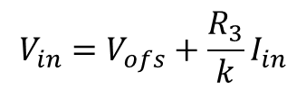

Design Concept
The Shunt-LDO regulator combines the functionality of an LDO voltage regulator with the capability of a shunt regulator to drain a constant current
Two control loops: 1) constant output voltage 2) constant current flow through the regulator
$$≈k\frac{V_{in}−V_{ofs}}{R_{3}}$$
$$I_{in}≈kI_{Ref}$$
$$I_{Ref}$$
$$I_{Ref}≈\frac{V_{in}−V_{ofs}}{R_{3}}$$
$$V_{in}=V_{ofs}+\frac{R_{3}}{k}I_{in}$$
k : 1
$$V_{out}=2V_{ref}$$

Slide 3






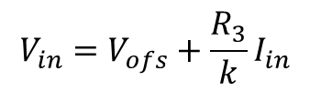


V/I Characteristic
$$V_{in}=V_{ofs}+\frac{R_{3}}{k}I_{in}$$
$$I_{in}$$
$$R_{in}$$
$$V_{in}$$
$$V_{ofs}$$
$$I_{in}$$
$$R_{in}$$
$$V_{in}$$
$$V_{ofs}$$
Ideal curve neglecting startup behavior with small Vofs

Slide 4
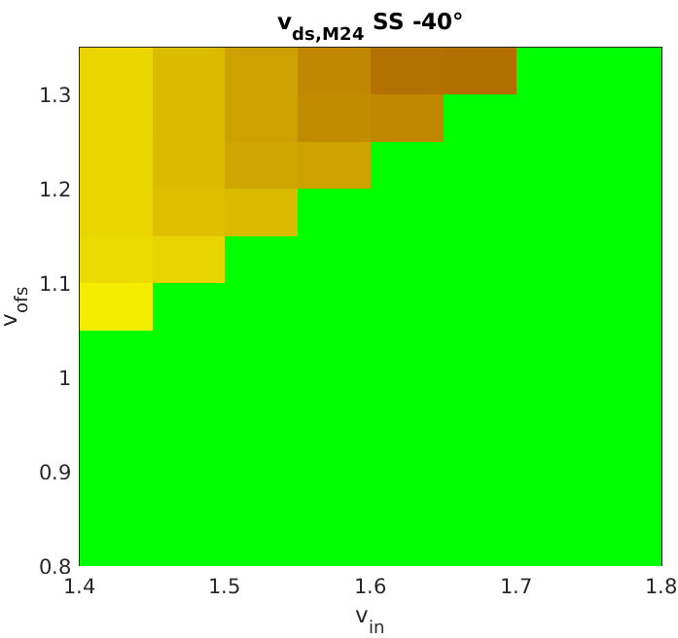
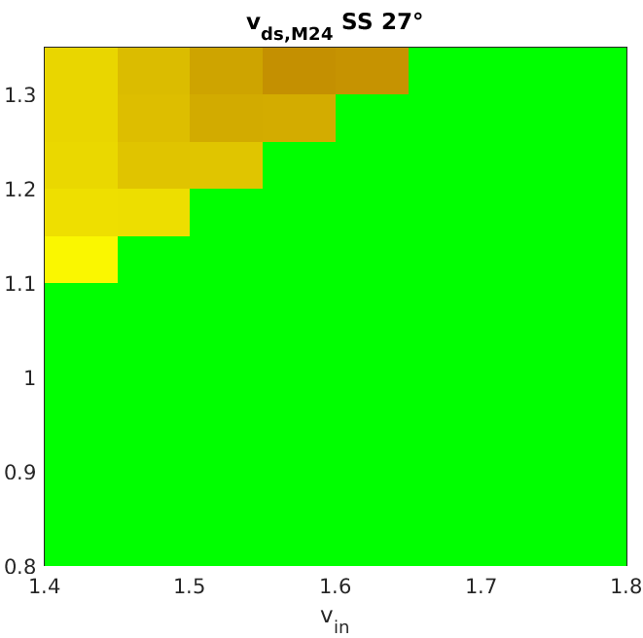
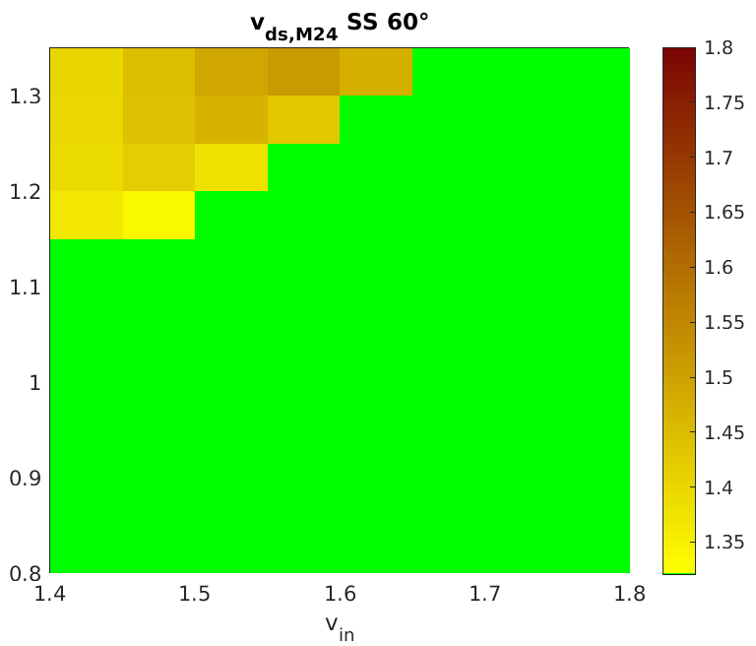
Forbidden Vin/Vofs Combinations (Worst Case)

Slide 5
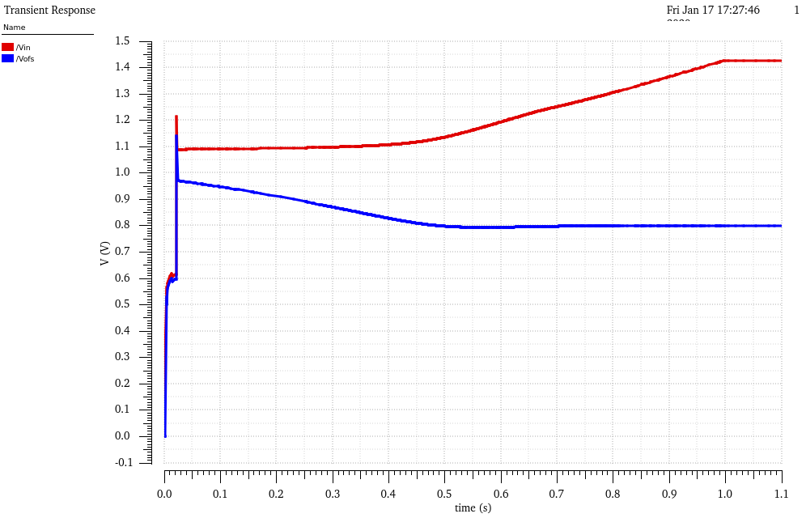
Simulation at 1A/1s start-up ramp & small load
startup-circuit
active
startup-circuit
switched-off
Startup at very
low currents

Slide 6
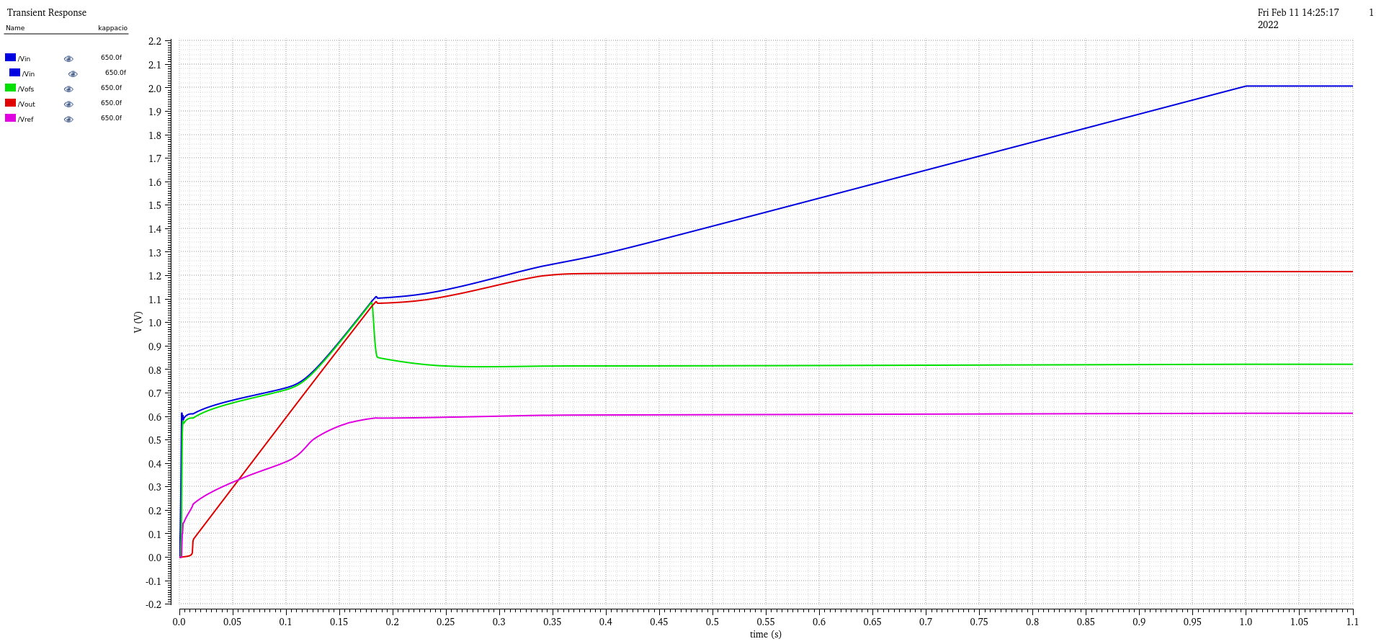
Startup behavior with 3Ohm load
overvoltage
protection
limit
pass-device
non saturated
pass-device
threshold
startup–sircuit
deactivated
linear behavior of Vout
due to ohmic load

Slide 7
Protection Feature:
Overvoltage Protection Voltage Clamp
voltage clamp implemented as shunt regulator
  operated in parallel to SLDO
takes all excess current in case Vin =>2v
limits the voltage to 2V
can absorb up to 2A additional current per chip
OVP threshold defined by untrimmed bandgap
  voltage limit can vary +/- 5%

Slide 8
Protection Feature: Overload Protection
With RD53A overload currents lead to collapse of regualtor input voltage
  This lead to overvoltages at other modules in the serial chain
RD53B protects against overloads which are considered as undershunt current scenarios
  high load current reduces shunt current
In undershunt current case Vout is reduced
  Vout is lowered by lowering Vref
Activation Threshold Ishunt < 10 mA
Vout minimimum value 700mV → Vref minimum value 350 mV

Slide 9
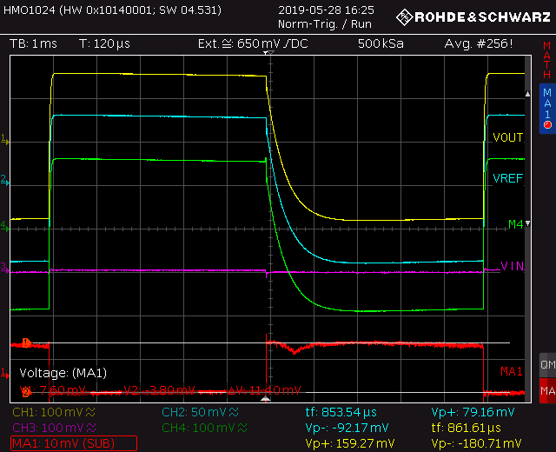
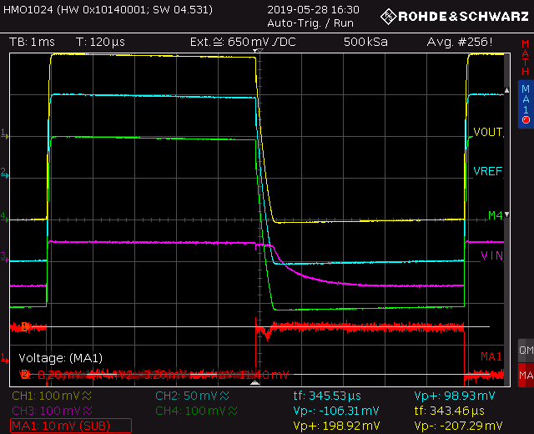
Measurement of Overload/Undershunt Protection

Slide 10
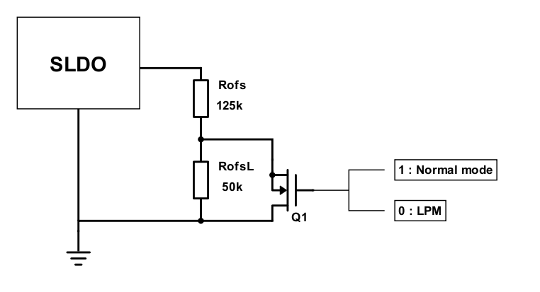
Low Power Mode
during installation the detector will be operated without active cooling
  to test connectivity
detector operation mode at lower power consumption required
SLDO has to reach the nominal operating point Vin=1.4V at lower input current
configurable offset-voltage Vofs required
  low Vofs for high power mode
  high Vofs for low power mode
switch introduce to enable/disable additional resistor in Vofs generation circuit
switch is controlled by rectified AC signal
Vofs_half
I_ref=20µA
Biasing
20k
13.7k

Slide 11
Rectification Circuit and Low Power Mode Interface
rectification circuit with 2x multiplication
AC signal is inverted and applied to a transistor in parallel two one of the Rofs resistors
  Inverter is supply by Vpre using a resistor instead of PMOS to avoid SEU issues
C1=100nF
C2=1pF
C3=1pF
C4=10pF
R2=10MΩ
R4=10MΩ

Slide 12
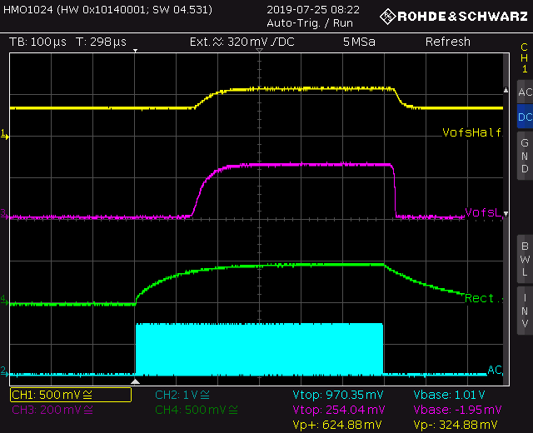
Measurement AC Rectifier interaction with Vofs

Slide 13
Known Problems
current mirror factor k deviates from expected value (input impedance)
  Fixed: IR drop issues in layout
shunt current monitoring behaves nonlinear
  Fixed: STI spacing issue in layout
preregulator non sufficiently damped
  Modified shunt current monitoring current adds extra loads to the preregulator
  especially critical in the CMS chip
  WILL BE FIXED in upcoming submission
Overvoltage VOFS generation circuit for some VIN/VOFS combinations
  WILL BE FIXED in upcoming submission

Slide 14
Conclusion
SLDO seems to work reliable
  weaknesses spotted and corrected
  improvements may introduce new problems with unsufficient verification
If you observe potential problems please contact me asap

