Slide 1
ATLAS Serial powering system and power supplies
Roy Wastie
University of Oxford
February 11th, 2022

Slide 2
Services Overview
No PP4

Slide 3
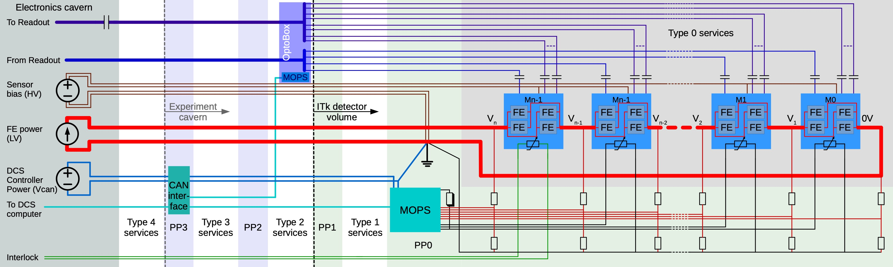
Detector Overview – Powering Concept
Detector Layout features 7976 quad chip modules and 396 triplets
  assuming 5 A per quad chip module: parallel powering of FE chips not reasonable: > 250 kW power dissipation on LV cables (assuming AWG 14 from module to services cavern)
  Serial Powering concept of choice: modules on one local support are connected in series
    FE chips on the same module are powered in parallel
    either one bias voltage line for a single module or one bias line distributed to several modules in parallel
    all readout lines need to be AC-coupled
    on-detector Monitoring of Pixel System: voltage drops and temperature of individual modules measured

Slide 4
Detector Overview – Powering Numerology
Layout of Local Supports dictates Serial Powering Chain Modularity
SP chains do not cross z = 0
maximum permissible length of SP chain: 16 (availability of detector and monitoring capabilities)
Barrel Section:
  L0 and L1: 1 SP chain per half-stave
  L2-L4: 2 SP chains per half-longeron
Inclined Section:
  1 SP chain (2 faces) of half of a half-ring
Rings
  1 SP chain per face of the ring in L0 and L1
  1 SP chain per face of half-ring in L2-L4
Layer | Section | SP chains | FE per Power Unit | Power Units per SP chain | # FE chips
L0 | Barrel | 24 | 3 | 4 | 288
L1 | Barrel | 40 | 4 | 6 | 960
L2 | Barrel | 64 | 4 | 6 or 12 | 2,304
L3 | Barrel | 88 | 4 | 6 or 12 | 3,168
L4 | Barrel | 112 | 4 | 6 or 12 | 4,032
L0 | Barrel Rings | 60 | 3 | 3 | 540
L1 | Barrel Rings | 60 | 4 | 10 | 2,400
L2 | Inclined | 48 | 4 | 8 | 1,536
L3 | Inclined | 64 | 4 | 11 | 2,816
L4 | Inclined | 72 | 4 | 14 | 4,032
L0 | Rings | 24 | 3 | 5 | 360
L1 | Rings | 32 | 4 | 10 | 1,280
L2 | Rings | 88 | 4 | 8 | 2,816
L3 | Rings | 64 | 4 | 11 | 2,816
L4 | Rings | 72 | 4 | 13 | 3,744
 | Full Detector | 912 |  | Average: 9.2 | 33,092
A total of 912 SP chains
  comparing to parallel powering: significantly lower power dissipation on LV cables
  30 kW compared to 250 kW in naive model

Slide 5
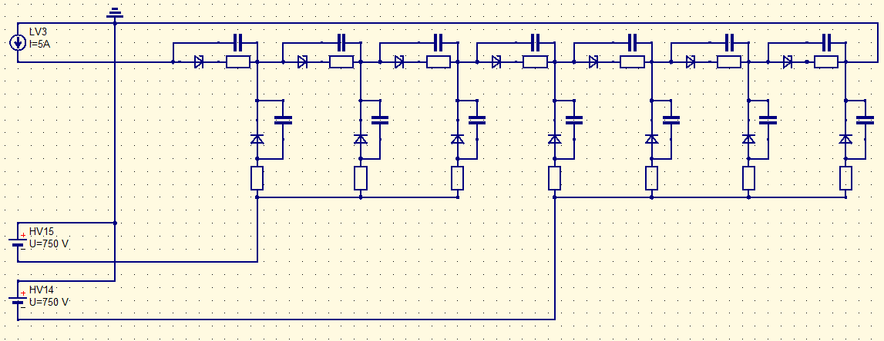
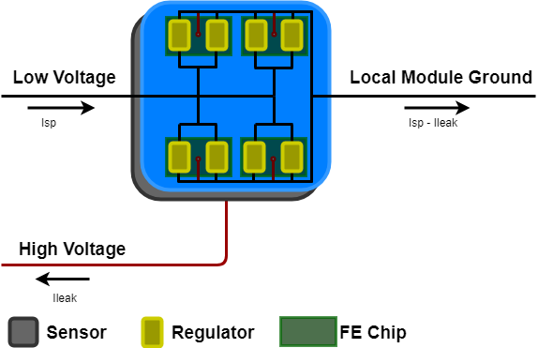
Detector Overview – Serial Powering Architecture in L1 to L4
Serial Powering Chains in L1 to L4 consist of modules with planar sensors
  low-ohmic HV PSU when off → effective reverse bias on all sensors when LV is on, HV is off
  for planar sensors, can accept this bias as long as it is small (detector safety for unstable beams)
  sensors connected in parallel → high leakage current that needs to be supplied from HV modules at the end of life-time
  limited space in services gaps and in services caverns
  using 2 HV lines per serial powering chain in L1-L4
  common return line for HV and LV

Slide 6
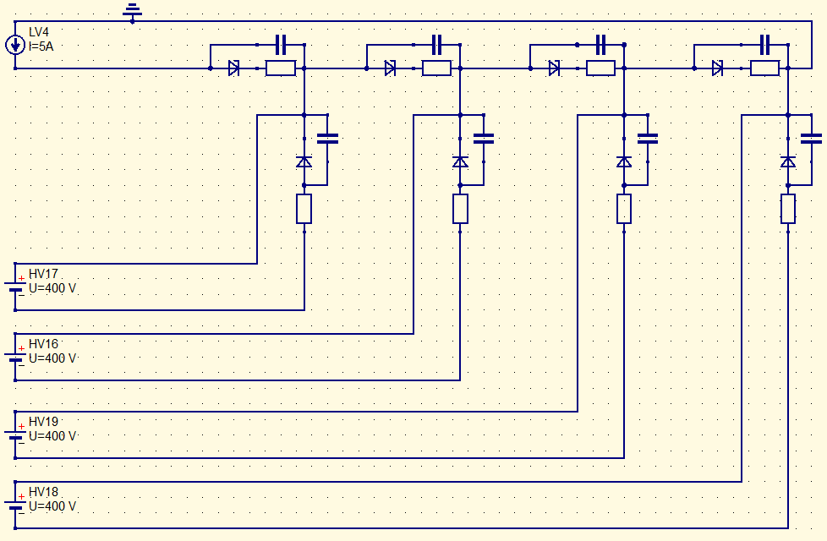
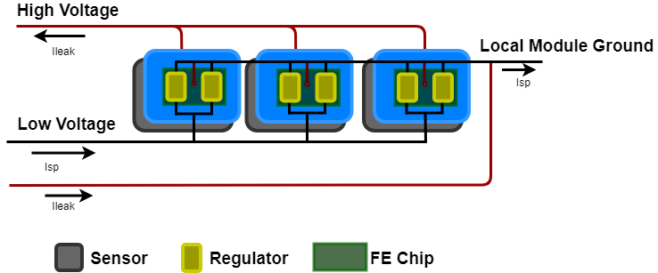
Detector Overview – Serial Powering Architecture in L0
Serial Powering Chains in L0 consist of modules with 3D sensors
  same architecture as in L1-L4 would lead to reverse bias on 3D sensors when HV is off
  potentially fully depleted sensors in L0 with unstable beams
  potential issues with bias voltage exceeding breakdown voltage at beginning of life-time
  small number of serial powering chains and small number of power units per serial powering chain → can afford to have a single HV line per triplet in L0

Slide 7
Serial Power Supply Specifications 1
Current Parameters Configurable per channel
  Set Current 0.3 to 10.0A resolution 0.5% / 8bit
  Current ramp rate 1A/s to 10000A/s resolution 1A/s
  Separate configuration for ramp up and down
  Lower Current Limit for Channel switch Off 0.03A to 10A
  Ripple noise BW <= 20MHz < 4mA pp
  Ripple noise BW > 20MHz and < 100MHz <150uA pp
Output Voltage Limit 0 to 48V resolution 0.5% / 8bits Settable per channel
  Maximum Overvoltage for fast Load Change -> 400 mV for a change of 0.3 Ohms over 5µs, independent of output voltage
Output Power 300W per channel
Efficiency min 80% (AC to DC), above 40% of nom. load Average per crate
10-12 outputs per 3U crate
OPC-UA Control and Monitoring

Slide 8
Serial Power Supply Specifications 2
Long Term Stability 0.2% / K (output current)
Protection all parameters software configurable:-
  Over temperature
    Channel switches of if exceeds the threshold
  Over Voltage
    Channel switches to constant voltage source if exceeds the threshold
  Over Current
    Channel switches of if exceeds the threshold
Warranty: 2 years
Maintenance: 15 years

Slide 9
Open Issues
Specifications that do require further testing:
  Set Current and Lower Current Limit for Channel Switch-Off
  Current Ramping
  Ripple and noise requirements
  Maximum Overvoltage for fast Load Change
Further details see ATLAS ITK-Pixel Project AT2-IP-ER-0007 Section 2.3

Slide 10
Vbias Power Supply Specifications 1
Output Voltage Limit 5 to 750V precision 200mV resolution 100mV Settable per channel
Parameters Configurable per channel
  Current Limit 0.01mA to 24mA in 0.01mA steps
  Hardware current limit 24mA
  Current ramp Up rate 1V/s to 50V/s resolution 1V/s
  Emergency ramp down rate 100V/s to 750V/s
  Ripple noise BW <= 20MHz < 20mV pp
  Ripple noise BW > 20MHz and < 100MHz <1mV pp
  Off-Mode low-Ohmic < 10Ω
Output Power 0W to 18W per channel
Efficiency min 80% (AC to DC), above 40% of nom. load Average per crate
8,16,24 or 32 outputs per 3U crate
OPC-UA Control and Monitoring

Slide 11
Vbias Power Supply Specifications 2
Long Term Stability 0.2% / K (output current)
Protection all parameters software configurable:-
  Over temperature
    Channel switches of if exceeds the threshold
  Low Voltage Limit
    If the output voltage goes below that threshold due to the current
    limit, the channel should switch off automatically.
  Over Current Limit
    If that current limit is reached, the power supply should changes its behaviour from a voltage source to a current source and reduce the output voltage until the output current stabilizes below said current limit.
Warranty: 2 years
Maintenance: 15 years

Slide 12
Important features
HV safety loop is mandatory with 24mA
  Hard wired in the output supply cables
Interlock in per channel and Global Interlock per crate
Vbias power supplies must provide an outgoing signal to the DCS. A single signal per module or crate is sufficient
Low ohmic off mode

Slide 13
ITk Pixel Grounding Scheme
ATLAS G&S requirements are summarized in a long document
highlighting a few of the key requirements for the ITk pixel system here:
  the ITk is connected to the ATLAS ground through a single tie, establishing the ‘ITk reference voltage’ at PP1
  all power supplies must have individual floating channels
  the return lines of all power supplies must be DC tied to the ITk reference voltage
  unused wires and pins must be connected to a well defined potential, nothing can be left floating
  cable shields must be tied to the ITk reference voltage at PP1, and they must not be connected to the ATLAS ground through the chassis of the power supplies in the service caverns
this has some relevant consequences for serial powering
  LV and HV return lines need to be tied together at a common grounding point (PP0)
  the optoboards are tied to the same ITk reference voltage outside of the detector
  FE chips from different modules are connected to the same optoboards in many cases
  → the data transmission lines must be AC coupled to the readout chips

Slide 14
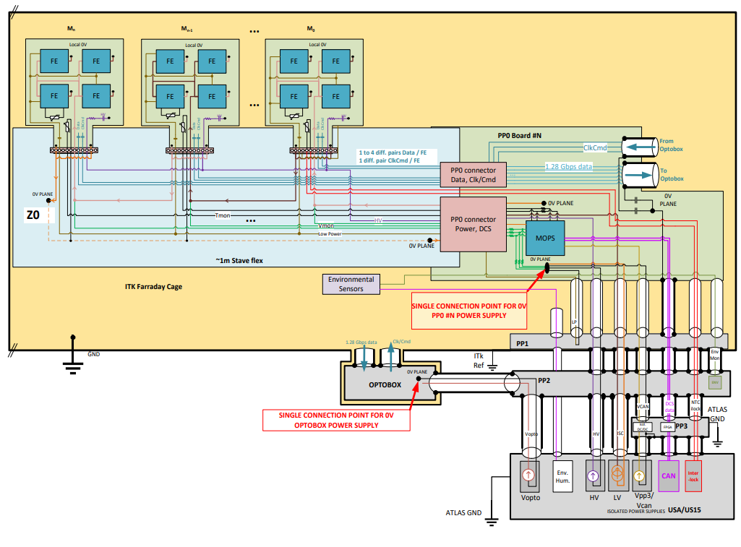
ITk Pixel Grounding Scheme
local module grounds are AC coupled to 0V plane on Type-0 services
ITk reference connected to 0V plane on PP0 through twinax shields
all return lines tied together
drawing is not entirely up to date, some details require updates
all signals are AC coupled upon entry into the Faraday Cage at PP1
Type-2 and Type-3 Cable shields connected to ITk reference at PP1 and floating in service caverns or PP3
no dedicated HV return line, but a shared LV/HV return line (strictly speaking, LV in is the HV return line)
chassis and some cable shields are tied to the ATLAS ground in the service caverns

Slide 15
ITk Pixel Grounding Scheme
the three subsystems have different G&S implementations
  Inner System:
    L0 HV lines are not tied to the ITk reference other than through the connecting modules
    dedicated HV return lines, but no direct referencing of HV supplies
    in some cases, multiple SP chains share a common referencing point on PP0
  Outer Endcaps:
    PP0 is referenced through Type-1 CANbus cable shields, not through the twinax shields
    there is a dedicated data PP0 that aggregates the electrical data transmission lines from several modules
    local supports are referenced through the electrical services mounted on those local supports
  Outer Barrel:
    local supports are fully isolated from the electrical components mounted on them
    all carbon structures are tied together and connected to the ITk reference on one side

Slide 16
References
https://indico.cern.ch/event/881276/contributions/3791219/attachments/2005785/3349746/ITkPixelServicesPDR_25032020_SystemOverview_mhamer.pdf
EDMS No. AT2-IP-CD-0015 Group Code: EP/ATLAS
DO-32328/EP/ATLAS
The ATLAS Phase II Upgrade Project
Price Enquiry
Technical Specification
Supply of extra low and low voltage power supply prototypes
for the ATLAS Inner Tracker Phase II Upgrade Project

