Slide 1
Photo-detection
Principles, Performance and Limitations
Nicoleta Dinu (LAL Orsay)
Thierry Gys (CERN)
Christian Joram (CERN)
Samo Korpar (JSI Ljubljana)
Yuri Musienko (Fermilab/INR)
Veronique Puill (LAL, Orsay)
Dieter Renker (TU Munich)

Slide 2
OUTLINE
Basics
Requirements on photo-detectors
Photosensitive materials
‘Family tree’ of photo-detectors
Detector types
Applications

Slide 3
Basics
  Photoelectric effect
  Solids, liquids, gaseous materials
  Internal vs. external photo-effect, electron affinity
  Photo-detection as a multi-step process
  The human eye as a photo-detector

Slide 4
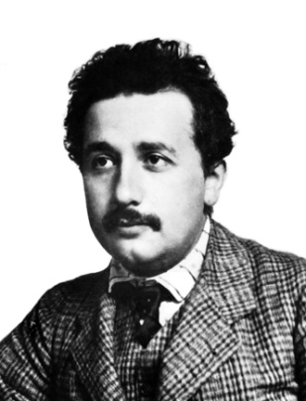
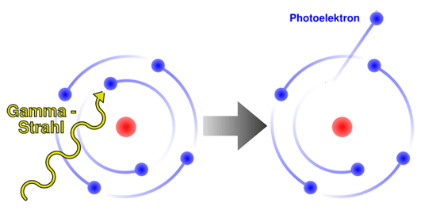
Basics of photon detection
Purpose: Convert light into detectable electronic signal
(we are not covering photographic emulsions!)
Principle:
Use photoelectric effect to ‘convert’ photons (γ) to photoelectrons (pe)
Details depend on the type of the photosensitive material (see below).
Photon detection involves often materials like K, Na, Rb, Cs (alkali metals). They have the smallest electronegativity → highest tendency to release electrons.
Most photo-detectors make use of solid or gaseous photosensitive materials.
Photo-effect can in principle also be observed from liquids.
A. Einstein.
Annalen der Physik 17 (1905) 132–148.

Slide 5
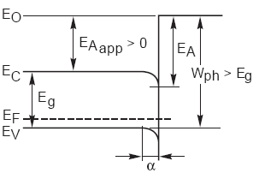
Basics of photon detection
Solid materials (usually semiconductors)
Multi-step process:
absorbed γ’s impart energy to electrons (e) in the material; If E_{γ} > E_{g}, electrons are lifted to conductance band.
→ In a Si-photodiode, these electrons can create a photocurrent. → Photon detected by Internal Photoeffect.
semiconductor →← vacuum
e⁻
E_{A} = electron
affinity
E_{g} = band gap
E_{γ}
However, if the detection method requires extraction of the electron, 2 more steps must be accomplished:
h
(Photonis)
energized e’s diffuse through the material, losing part of their energy (~random walk) due to electron-phonon scattering. ΔE ~ 0.05 eV per collision. Free path between 2 collisions λ_{f} ~ 2.5 - 5 nm → escape depth λ_{e} ~ some tens of nm.
only e’s reaching the surface with sufficient excess energy escape from it
→ External Photoeffect

Slide 6
Basics of photon detection
Opaque photocathode
Light absorption in photocathode
γ
N = N₀·exp(αd)
0.4
λ_{A} = 1/α
substrate
e⁻
Red light (λ ≈ 600 nm)
α ≈ 1.5 · 10⁵ cm⁻¹
λ_{Α} ≈ 60 nm
Blue light (λ ≈ 400 nm)
α ≈ 7·10⁵ cm⁻¹
λ_{Α} ≈ 15 nm
PC
d
Semitransparent photocathode
γ
Detector window
Blue light is stronger absorped than red light !
PC
e⁻
→ Make semitransparent photocathode just as thick as necessary!

Slide 7
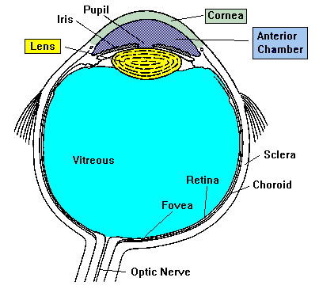
The human eye as photosensor
The first proto-eyes evolved among animals 540 million years ago.
Light passes through the cornea, pupil and lens before hitting the retina. The iris controls the size of the pupil and therefore, the amount of light that enters the eye. Also, the color of your eyes is determined by the iris.
The vitreous is a clear gel that provides constant pressure to maintain the shape of the eye.
The retina is the area of the eye that contains the receptors (rods for low light contrast and cones for colours) that respond to light. The receptors respond to light by generating electrical impulses that travel out of the eye through the optic nerve to the brain.
The optic nerve contains 1.2 million nerve fibers. This number is low compared to the roughly 100 million photoreceptors in the retina.

Slide 8
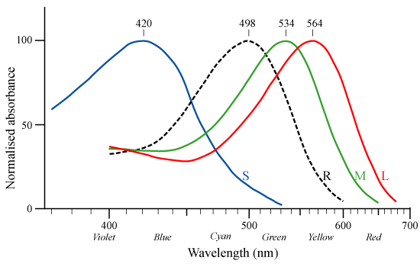
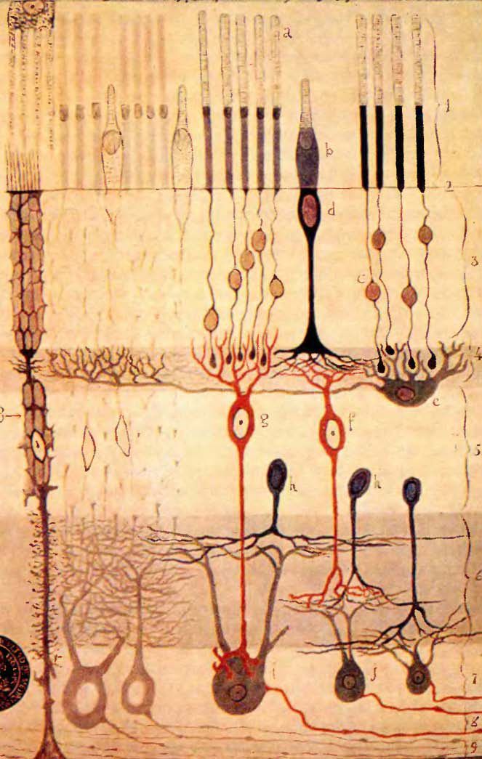
Rods & cones. Spectral sensitivity
Rods
~100·10⁶ cells
Cones
~5·10⁶ cells
3 types of cone cells: S, M, L
1 type of rod cells: R
The human eye can detect light pulse of 10-40 photons. Taking into account that absorption of light in retina is ~10-20% and transparency of vitreous is ~50% →~2-8 photons give detectable signal.

Slide 9
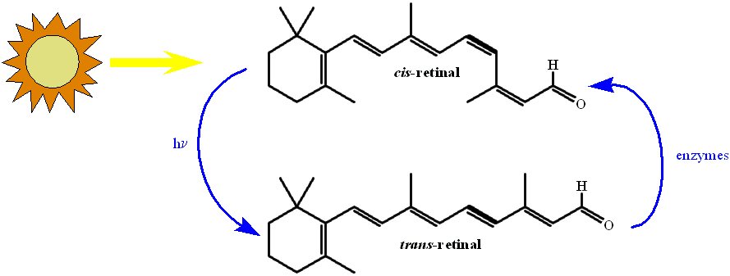
Visual photo-transduction is a VERY COMPLEX process by which light is converted into electrical signals in the rod and cone cells of the retina of the eye.
See e.g. http://en.wikipedia.org/wiki/Phototransduction

Slide 10

After having built it many billion times, the eye can be considered as a very successful and reliable photo-detector.
It provides…
Good spatial resolution. <1 mm, with certain accessories even <0.01 mm
Very large dynamic range (1:10⁶)
+ automatic threshold adaptation
Energy (wavelength) discrimination → colours
Long lifetime. Performance degradation in second half of lifecycle
can be easily mitigated.
Weak points
Modest sensitivity: 500 to 900 photons must arrive at the eye every second for our brain to register a conscious signal
Modest speed. Data taking rate ~ 10Hz (incl. processing)
Trigger capability is very poor. “Look now’’ → Time jitter ~1 s.
→ There is room for improvement

Slide 11
2 Requirements on photo-detectors
  Sensitivity
  Linearity
  Signal fluctuations
  Time response
  Rate capability / aging
  Dark count rate
  Operation in magnetic fields
  Radiation tolerance

Slide 12
2.1. Sensitivity
Probability that the incident photon (N_{γ}) generates a photoelectron (N_{pe})
N_{γ}
Quantum efficiency
P [W]
photodet
photodet
Radiant sensitivity
N_{pe}
I [A]
PDE = ε_{geom}· QE · P_{trig} for a SiPM (ε_{geom}: geometrical factor, P_{trig}: triggering probability)
PDE[%] = QE · CE for a PMT (CE: collection efficiency)
Photo detection efficiency : combined probability to produce a photoelectron and to detect it
High sensitivity required in:
UV- blue : water Cherenkov telescope, Imaging Atmospheric Cherenkov Telescopes (HESS II, CTA)
Blue-green : HEP calorimeters (CMS, ILC HCAL)

Slide 13
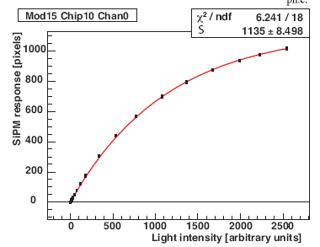
2.2 Linearity
Requirement: Photocurrent response of the photo-detector is linear with incident radiation over a wide range. Any variation in responsivity with incident radiation represents a variation in the linearity of the detector
IDEAL
Flux (photons/s)
I_{det} = α Flux
Example for PMT : non linearity curves
Example for SiPM
I_{det} (A)
at UCLA PMT Test Facility
arXiv:0902.2848v1 [physics.ins-det] 17 Feb 2009
 | PMT | HPD | MCP-PMT | APD | SiPM
Dynamic range (p.e.) | 10⁶ | 10⁷ | 10⁷ | 10⁷ | 10³
Example of dynamic range required : HCAL of ILC
Min: 20 photons/mm² (µ for calibration)
Max: 5.10³ photons/mm² (high-energy jet)
(C. Cheshkov et al., NIM A440(2000)38)

Slide 14
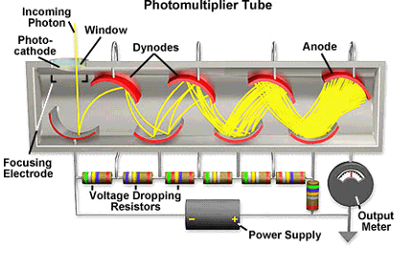
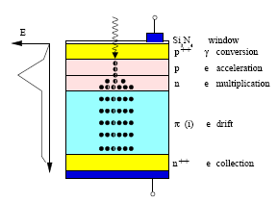
2.3 Signal fluctuations
PMT
Photo-detectors with internal gain
APD
statistical fluctuation of the
avalanche multiplication widen the response of a photo-detector to a given photon signal beyond what would be expected from simple photoelectron statistics (Poissonian distribution)
fluctuations characterized by the excess noise factor ENF
general definition
Approximate values for photodetectors
detector | ENF
PMT | 1 - 1,5
APD | 2 @ gain=50
HPD | ~1
SiPM | 1 - 1,5
MCP-PMT | ~1
M = gain
quality of energy measurement
impacts the photon counting capability for low light measurements
deteriorates the stochastic term in the energy resolution of a calorimeter

Slide 15
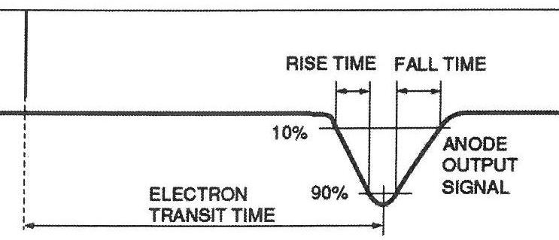

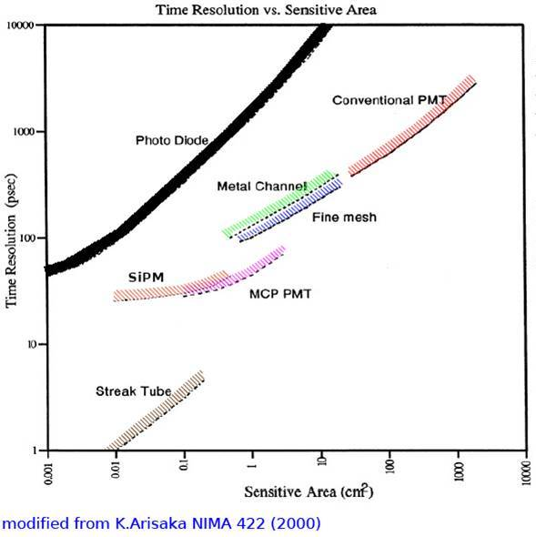
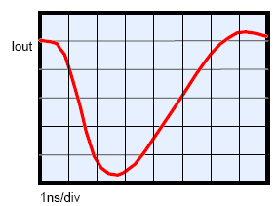
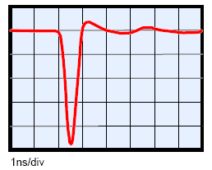
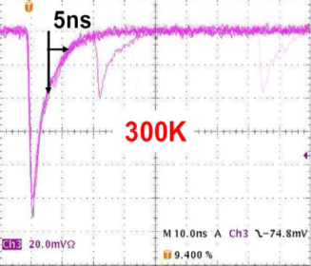
2.4 Time response
★ light travels 300μm in 1 ps
photons
Dirac light
Rise time, fall time (or decay time)
Duration
Transit time (Δt): time between the arrival of the photon and the electrical signal
Transit time spread (TTS): transit time variation between different events timing resolution
photodet
Δt
Electrical signal
TRANSIT TIME Δt
to the readout electronics used !
Example of signal shapes
standard PMT
MCP- PMT
SiPM
Good time resolution required in :
Particle identification in SuperB : 30 ps for the π/K separation (arXiv:1007.4241v1 [physics.ins-det] 24 Jul 2010)
Diffractive physics at the LHC (search for the Higgs Boson at low mass) : 15 ps (B. Cox, F. Loebinger, A. Pilkington, JHEP 0710 (2007) 090)

Slide 16
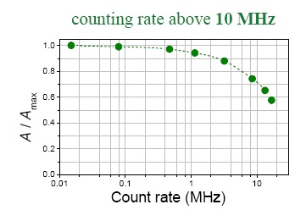
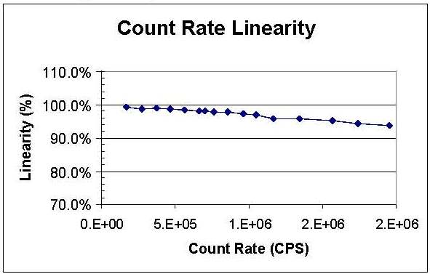
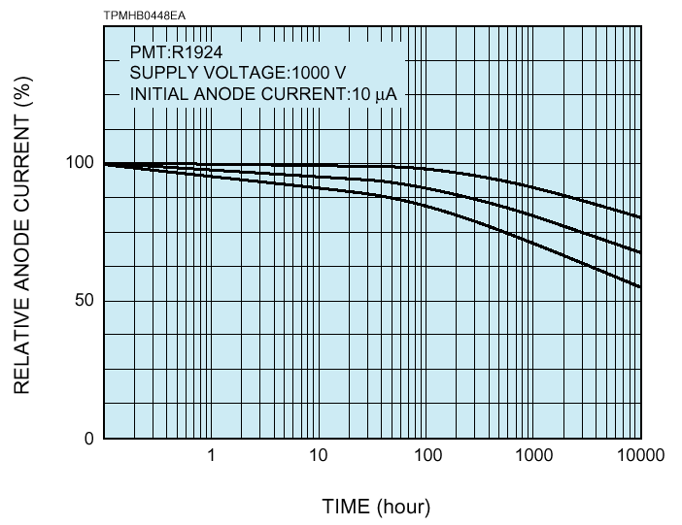
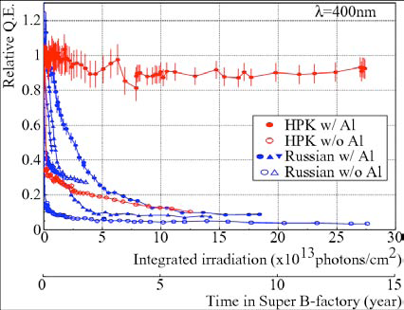
2.5 Rate capability/aging
Rate capability: inversely proportional to the time needed, after the arrival of one photon, to get ready to receive the next
SiPM
MCP-PMT
Requirements in calorimeters:
100 kHz → few MHz
MPPC S10362-33-050C
Single photoe- events Gain = 5x10⁵
A. Stoykov, µSR at PSI
Aging (long-term operation at high counting rates): how is the photo-detector behavior changed when operated at high counting rate during several years ?
MCP-PMT
Parameter affected (generally in a negative way):
gain
quantum efficiency
dark current
PMT
I.Adachi, et al., Nagoya University, SuperB workshop at SLAC

Slide 17
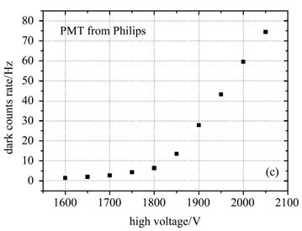
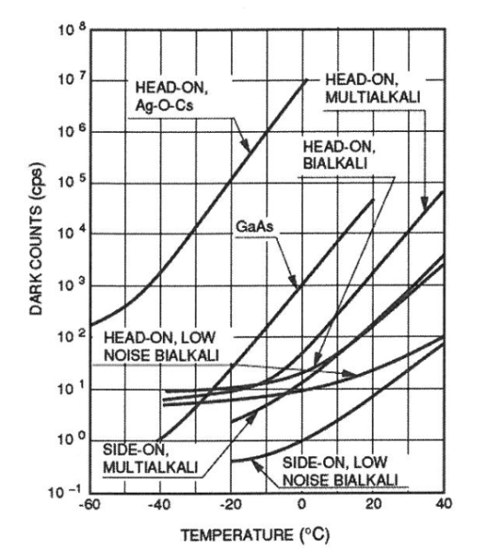
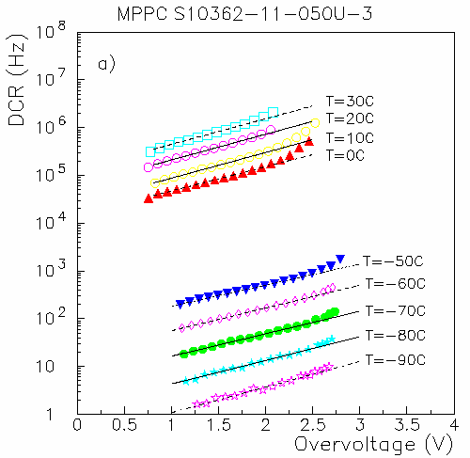
2.6 Dark count rate (DCR)
Dark noise: the electrical signal when there is no photon
DCR of different photocathodes
DCR of a PMT
depends on the cathode type, the cathode area, and the temperature.
few kHz (threshold = 1 p.e)
is highest for cathodes with high sensitivity at long wavelengths.
increases considerably if exposed to daylight
DCR of a SiPM
DCR of a SiPM (S10362-11-050)
depends on the pixel size, the bias voltage, the temperature
quite high (0.3–2MHz/mm² at room temp, threshold = 1 p.e)
DCR depends a lot on the threshold → not a big issue when we want to detect hundreds or thousands of photons.
The most efficient way to keep the DCR low is cooling.
N. Dinu, IEEE NSS 2010

Slide 18
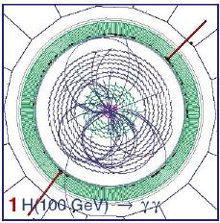
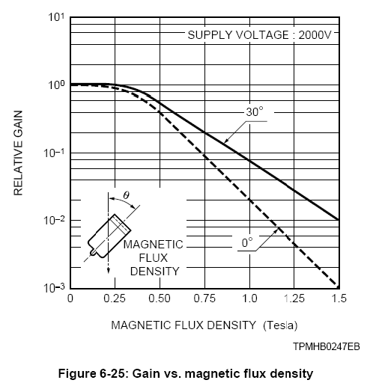
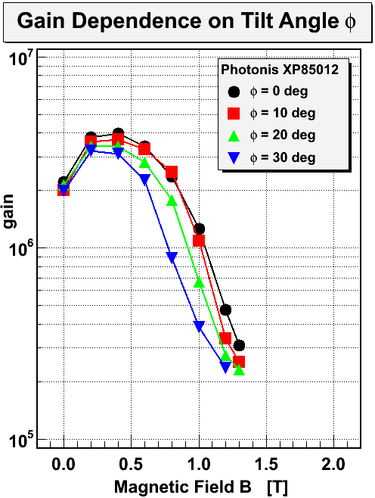
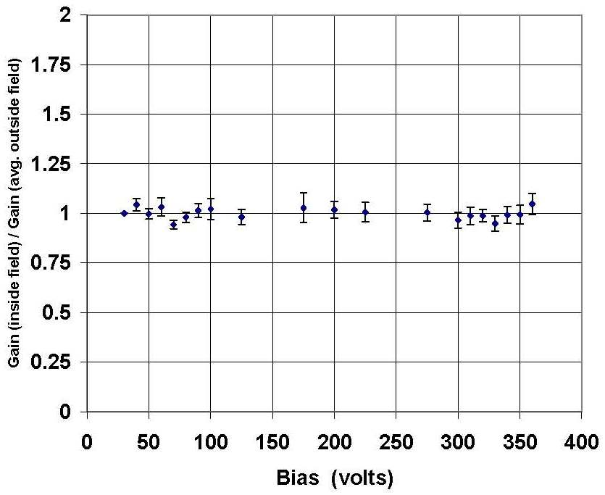
  2.7 Operation in magnetic fields
★ Earth’s magnetic field = 30-60 µT
curves the trajectory
of charges
particles
separate the particles
reduce the detector size
easier analysis
B
reduce the detector price
MCP-PMT
APD
B = 7.9 T
φ
APD surface // magnetic field
PMT
NJ. Marler, IM. A449 (2000) 311-313
PMT very sensitive to magnetic
field shielding required (µ metal)
APD, SiPM no sensitive to magnetic field
Albert Lehmann RICH 2010
Requirements : detection in magnetic fields up to 2T (PANDA, SuperB factory) or more (4 T in CMS ECAL,
ILC HCAL)

Slide 19
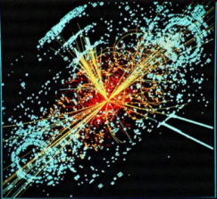
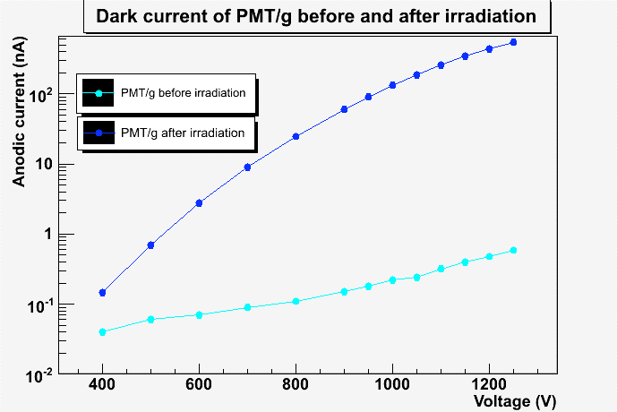
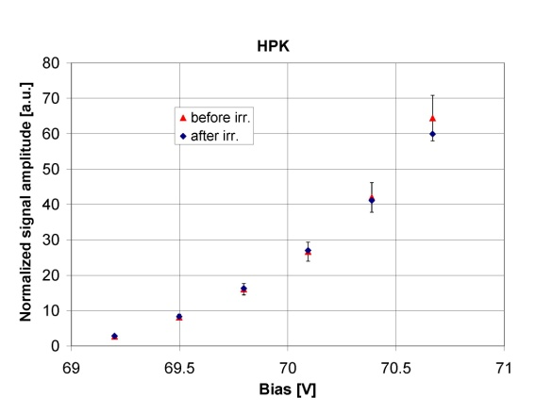
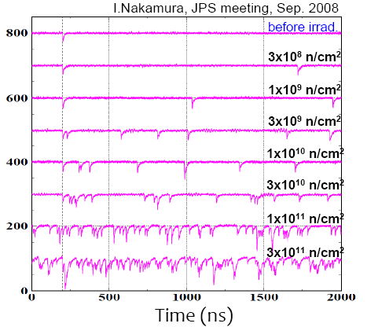
  2.8 Radiation tolerance
Electromagnetic calorimeter: very hostile environment for photo-detectors
Damages caused by:
→ ionizing radiation: energy deposited by particles in the detector material (the unit of absorbed dose is Gray (Gy) ==> 1 Gy = 1 J/kg = 100 rad ) and by photons from electromagnetic showers
→ neutrons created in hadronic shower, also in the forward shielding of the detectors and in beam collimators
degradation of the dark current, gain, quantum efficiency ….
Dark current of PMT (quartz window)
SiPM amplitude proton irradiation
DCR of SiPM neutron irradiation
Equivalent to 2*10¹⁰ 1 MeV neutrons/cm²
γ: 60Co, E = 1.22 MeV
Dose = 20±1 Mrad
increase due to scintillation of the glass window
A. Sbrizzi LUCID in ATLAS
Y. Musienko, AMPDs for Frontier Detector Systems
At LHC, the ionizing dose is ~ 2 x10⁶ Gy / r_{T}² / year (rT (cm): transverse distance to the beam)
Exemple in LHC for the CMS ECAL (10 years) 2.10¹³ n/cm2 + 250 kRad

Slide 21
3 Photosensitive materials
  Classical photocathodes (bialkali, S20), super/ultra bialkali
  UV sensitive, solar blind (CsTe, CsI)
  Crystalline cathodes (GaAs etc.)
  Silicon
  Exotics: TMAE, TEA
  Windows/substrates

Slide 22
Frequently used photosensitive materials / photocathodes
begin of arrow indicates threshold
Ultra Violet (UV)
Visible
Infra Red
(IR)
Si
(1100 nm)
TMAE,
CsI
Bialkali
K₂CsSb
GaAs
Multialkali
NaKCsSb
TEA
12.3 4.9 3.1 2.24 1.76 1.45 E [eV]
100 250 400 550 700 850 λ [nm]
Remember :
E[eV] ≅ 1239/λ[nm]
NaF, MgF₂, LiF, CaF₂
borosilicate glass
normal
window glass
quartz
Almost all photosensitive materials are very reactive (alkali metals). Operation only in vacuum or extremely clean gas.
Exception: Silicon, CsI.
Cut-off limits of window materials

Slide 23
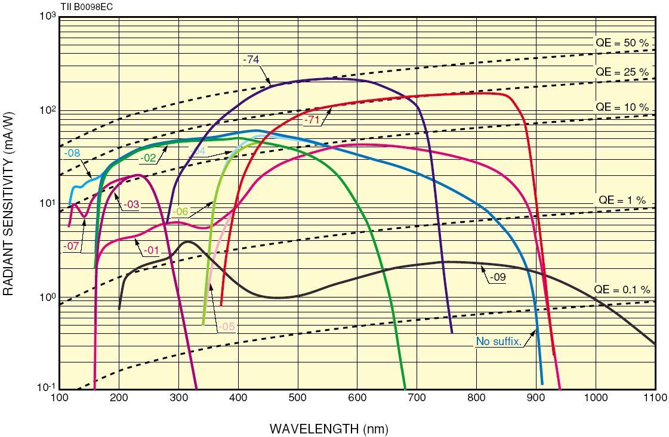
(External) QE of typical semitransparent photo-cathodes
Photon energy E_{g} (eV)
12.3 3.1 1.76 1.13
GaAsP
GaAs
Ag-O-Cs
CsTe
(solar blind)
Multialkali
Bialkali
(Hamamatsu)
Bialkali: SbKCs, SbRbCs Multialkali: SbNa₂KCs (alkali metals have low work function)

Slide 24

Latest generation of high performance photo-cathodes
QE Comparison of semitransparent bialkali QE
50
UBA:43%
x1.6
Ultra Bialkali available only for small metal chanel dynode tubes
40
30
Super Bialkali available for a couple of standard tubes up to 5”.
SBA:35%
x1.3
Quantum Efficiency [%]
20
STD:26%
Example Data for
UBA : R7600-200
SBA : R7600-100
STD : R7600
10
0
200
300
400
500
600
700
Wavelength [nm]

Slide 25
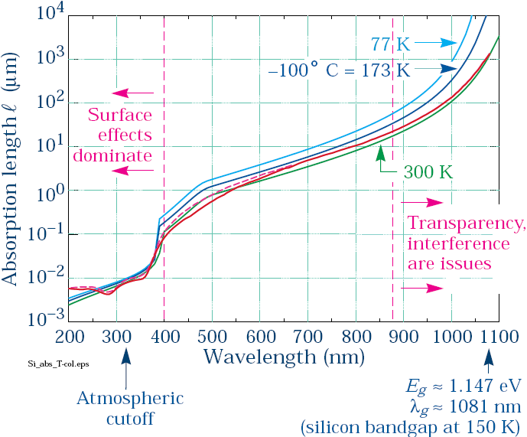
Light absorption in Silicon
At long λ, temperature effects dominate
(http://pdg.ge.infn.it/~deg/ccd.html)

Slide 26
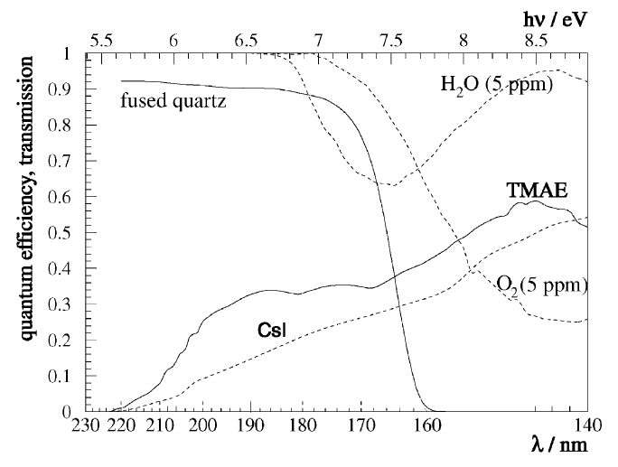
‘Exotics:’ Photosensitive vapours used in LEP/SLC generation of Cherenkov detectors
These detectors were based on MWPCs or TPCs.
TEA + He
Detection of
UV / VUV light
only!
T
TEA + CH₄
Photosensitive agent was admixed to the counting gas of a MWPC by bubbling the gas through the liquid agent at a given temperature.

Slide 27
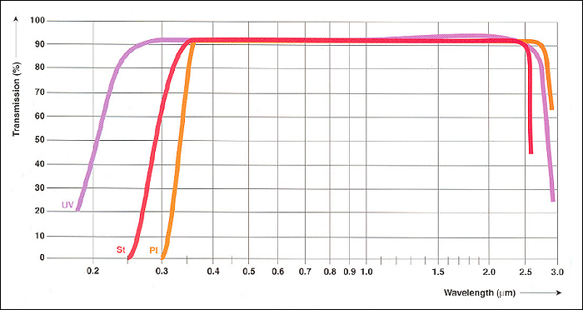
Optical transmission of typical window materials
2 types of losses:
Fresnel reflection at interface air/window and window/photocathode
R_{Fresnel} = (n-1)² / (n+1)² n = refractive index (wavelength dependent!)
n_{glass} ~ 1.5 R_{Fresnel} = 0.04 (per interface)
Bulk absorption due to impurities or intrinsic cut-off limit. Absorption is proportional to proportional to window thickness
ΔT = 8% = 2·4%
Optical transmission of various glass types
Schott

Slide 28
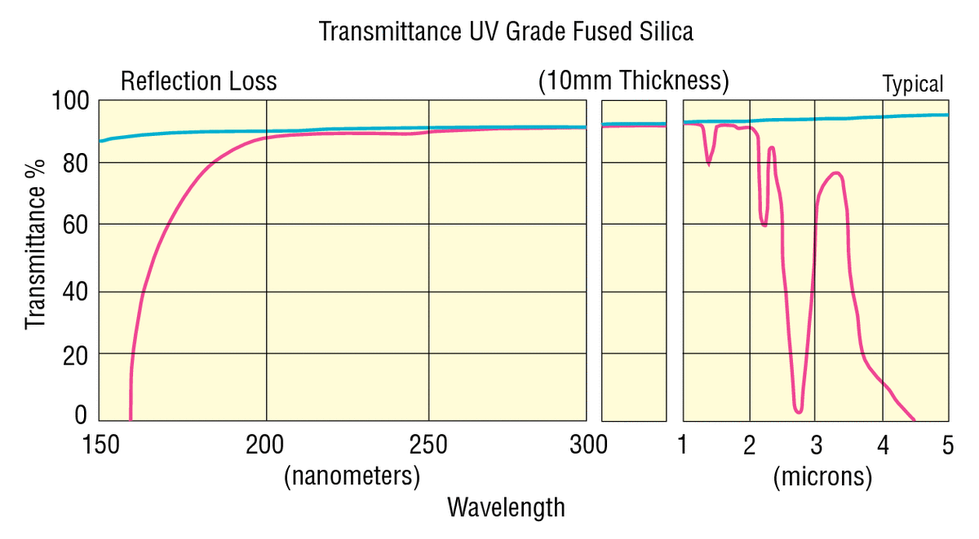
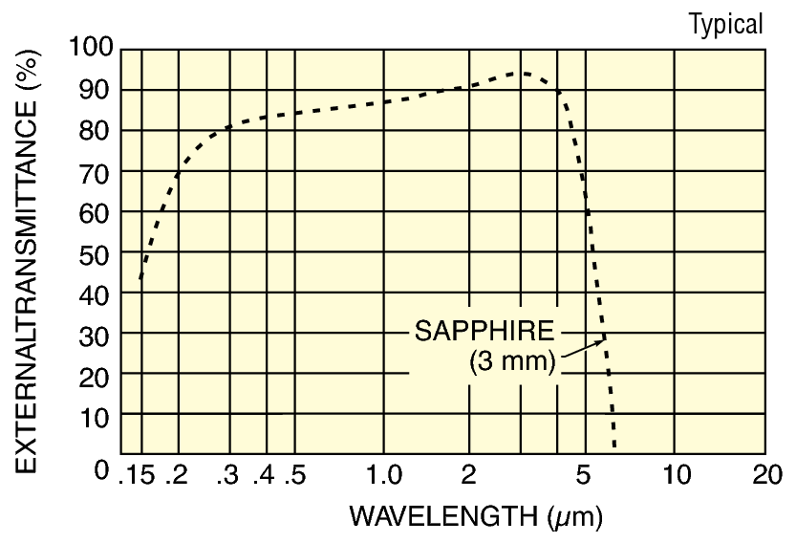
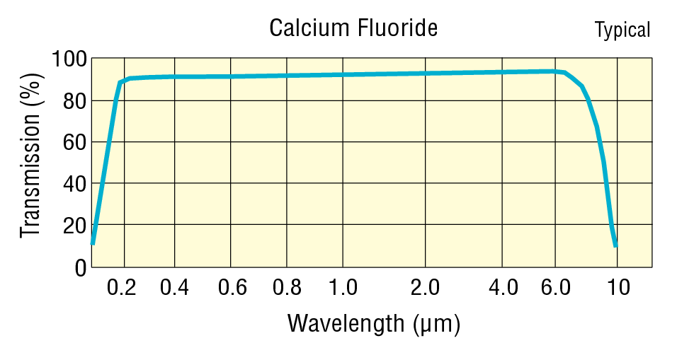
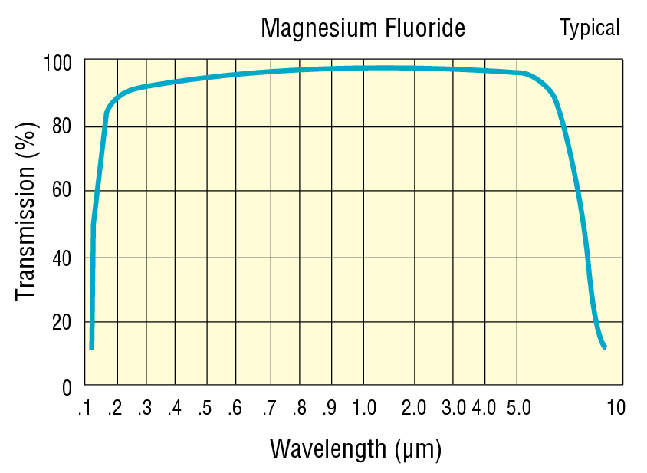
Windows/substrates
Newport

Slide 30
‘Family tree’ of photo-detectors
Detector types
  PMT
  MAPMT
  MCP-PMT
  HPD, HAPD
  Photosensitive gas detectors (MWPC / MPGD)
  PIN diode (design)
  APD
  G-APD / SiPM

Slide 31
Applications
  Readout of scintillators / fibres with PMT/MAPMT
  Ultrafast timing for TOF with MCP-PMT
  Readout of RICH detectors with HPD
  Readout of RICH detector with gas-based detectors
  Readout of inorganic crystals with APD
  Readout of scintillators with G-APD

Slide 32
Family tree of photo-detectors
photo-detectors
Gas
External photoeffect
Vacuum
External photoeffect
Solid state
Internal photoeffect
TMAE MWPC
TEA + GEM
CsI …
Avalanche gain
Process
Dynodes → PMT
Continuous dynode
Channeltron, MCP
Multi-Anode devices
Other gain process
= Hybrid tubes
Silicon Luminescent
anodes
HPD SMART/Quasar
HAPD X-HPD
G-APD-HPD
PIN-diode
APD
G-APD (SiPM)
CMOS
CCD
Proposed by G. Barbarino et al., NIM A 594 (2008) 326–331
Proof of principle by C. Joram et al., NIM A 621 (2010) 171-176

Slide 34
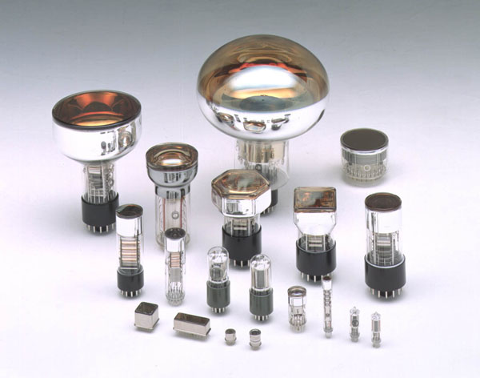
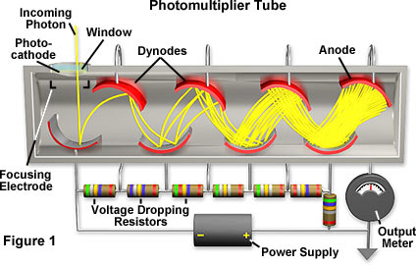
Photo-multiplier tubes (PMT’s)
Basic principle:
Photo-emission from photo-cathode
Secondary emission (SE) from N dynodes:
  dynode gain g≈3-50 (function of
  incoming electron energy E);
  total gain M:
Example:
  10 dynodes with g=4
  M = 4¹⁰ ≈ 10⁶
(Hamamatsu)
http://micro.magnet.fsu.edu/
pe
(http://micro.magnet.fsu.edu)

Slide 35
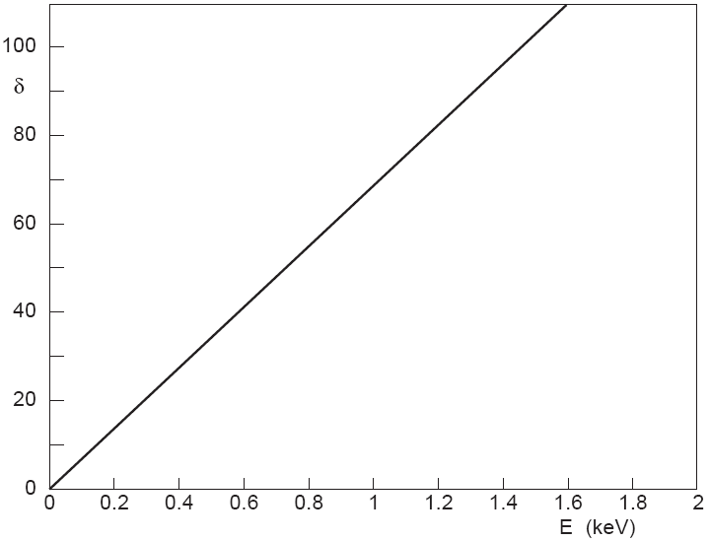
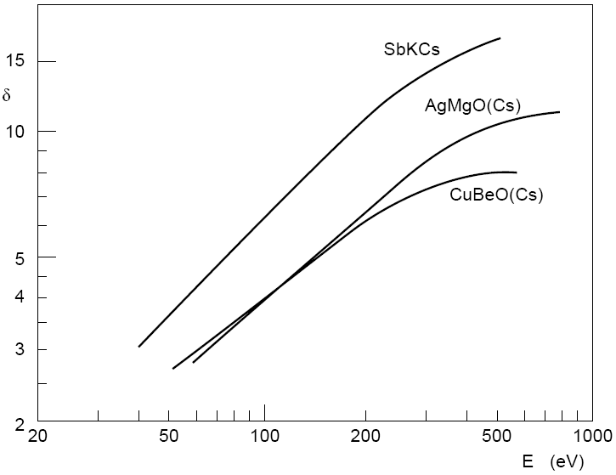
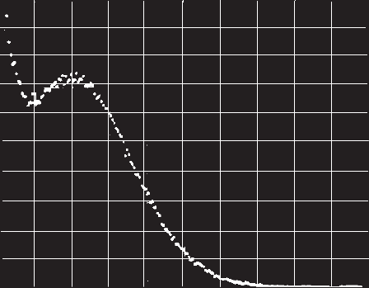
Gain fluctuations of PMT’s
Mainly determined by the fluctuations of the number m(δ) of secondary e’s emitted from the dynodes;
Poisson distribution:
Standard deviation:
⇒ fluctuations dominated by 1st dynode gain;
GaP(Cs) dynodes E_{A}<0
SE coefficient δ
(Photonis)
e energy
CuBe dynodes E_{A}>0
0 pe
1 pe
1 pe
SE coefficient δ
Counts
Counts
2 pe
(Photonis)
Pedestal noise
3 pe
(Photonis)
(H. Houtermanns,
NIM 112 (1973) 121)
e energy
Pulse height
Pulse height

Slide 36
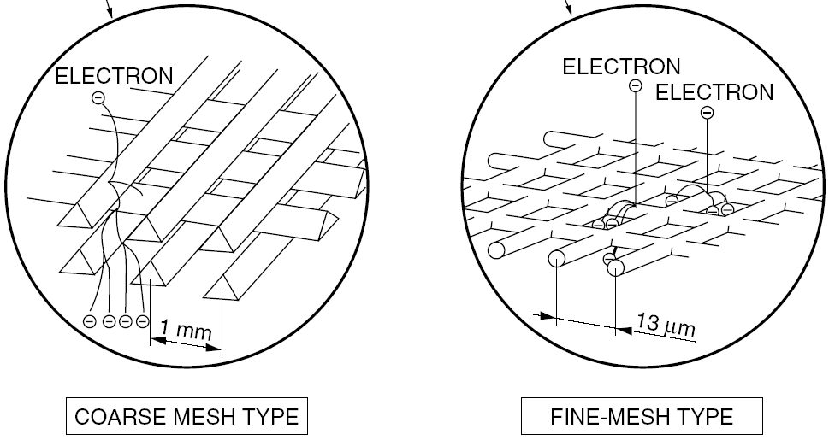
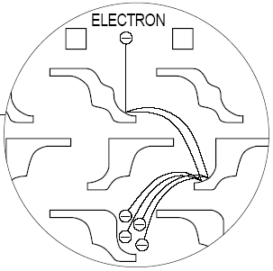
Dynode configurations of PMT’s
Traditional
Position-sensitive
Mesh
(Hamamatsu)
(Photonis)
Venetian blind
Box
Metal-channel
(fine-machining
techniques)
(Hamamatsu)
Linear focussing
(Photonis)
Circular cage
The design of a dynode structure is a compromise between
collection efficiency (input optics: from cathode to first dynode)
gain (minimize losses of electrons during passage through structure)
transit time and transit time spread (minimize length of path and deviations)
immunity to magnetic field
Modern micro-machining techniques allow fabricating fine dynode structures. Avalanche is confined in a narrow channel. → Multi-anode designs.

Slide 37
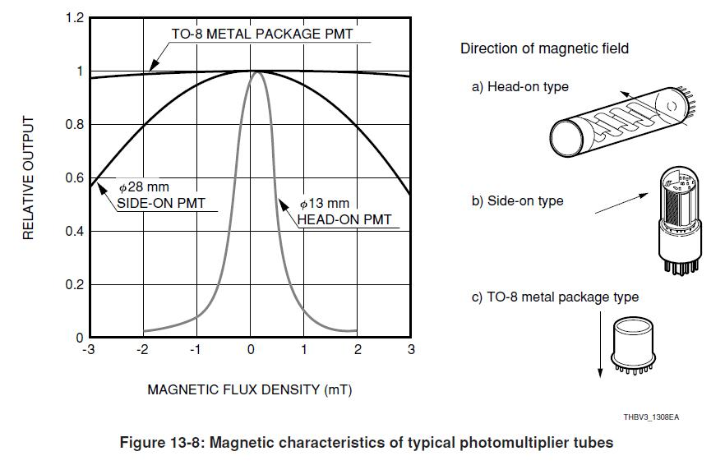
Dynode configurations of PMT’s
Estimate transit time:
Compact construction (short distances between dynodes) keeps the overall transit time small (~10 ns).
“Fast” PMT’s require well-designed input electron optics to limit (e) chromatic and geometric aberrations → transit time spread < 100 ps;
PMT’s are in general very sensitive to magnetic fields, even to earth field (30-60 μT = 0.3-0.6 Gauss).
Magnetic shielding required.

Slide 38
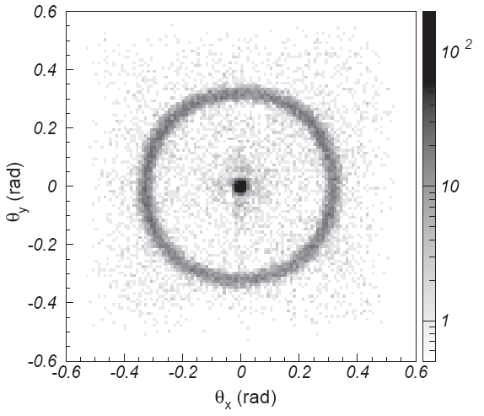
Multi-anode and flat-panel PMT’s
Multi-anode (Hamamatsu H7546)
Up to 8 × 8 channels (2 × 2 mm² each);
Size: 28 × 28 mm²;
Active area 18.1 × 18.1 mm² (41%);
Bialkali PC: QE ≈ 25 - 45% @ λ_{max} = 400 nm;
Gain ≈ 3 10⁵;
Gain uniformity typ. 1 : 2.5;
Cross-talk typ. 2%
Flat-panel (Hamamatsu H8500):
8 x 8 channels (5.8 x 5.8 mm² each)
Excellent surface coverage (89%)
(Hamamatsu)
Cherenkov rings from
3 GeV/c π– through aerogel
50 mm
(Hamamatsu)
(T. Matsumoto et al., NIMA 521 (2004) 367)

Slide 39
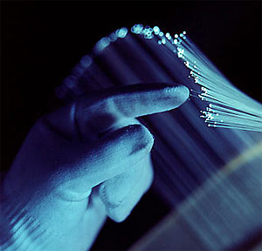
Readout of Scintillating fibres with MAPMTs
  Working principle of scintillating plastic fibres :
typ. 25
μ
m
cladding
light transport by
total internal reflection
(PMMA)
n=1.49
scintillating
core
θ
polystyrene
n
n=1.59
1
n
typically <1 mm
2
Double cladding system (developed by CERN RD7)
cladding
(PMMA)
(per
side)
n=1.49
25
μ
m
core
polystyrene
n=1.59
fluorinated
outer cladding
n=1.42
25
μ
m

Slide 40
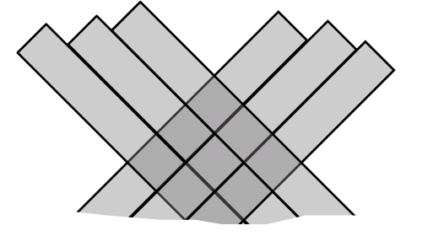
Example: ATLAS ALFA – A fibre tracker (for luminosity measurement)
Technology: Scintillating plastic fibres, square cross-section,
500 μm overall width, single cladded (10 μm). Type: Kuraray SCSF-78.
Geometry: UV (45°)
10 UV layers,
staggered by 70.7 μm
1 UV layer
500 μm
y
x
50 μm
707 μm
Expect:
σ_{x} = σ_{y} ~ 707 / √24 μm
= 144 μm
70.7 μm
ultimately: σ_{x} = σ_{y}
~ 70.7/ √24 μm
= 14.4 μm
remember: triangular
distribution function

Slide 41
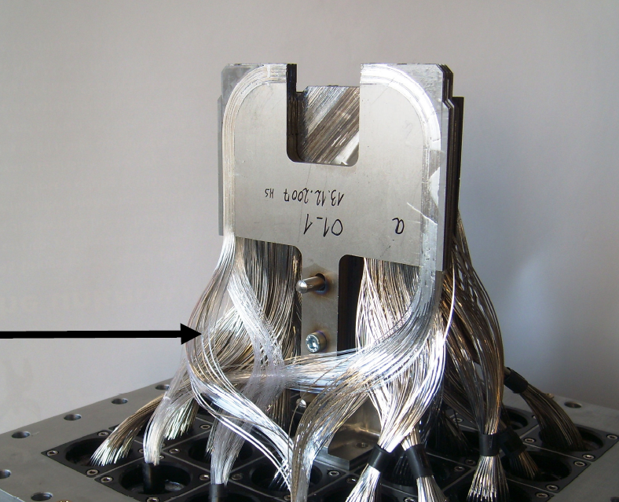
ATLAS ALFA
photo assembly!
LHC
~2 x 1400 fibres

Slide 42



ATLAS ALFA
64 Fibres are glued in a 8x8 matrix ‘connector’ .
The pitch of 2.2 mm corresponds exactly to the
one of the MAPMT.
2.2 mm
2.2 mm
2.2 mm
2.2 mm
4 shims centre the MAPMT w.r.t. the fibre connector → Maximize light coupling and minimize cross-talk!

Slide 43



ATLAS ALFA
Beam test
CERN SPS
November 2009
plot shows difference of x-coordinates, measured with the two half detectors (5 layers).
x₁ - x₂
Expect σ_{ALFA} ~ 32 μm

Slide 45




Micro Channel plate PMT (MCP-PMT)
Similar to ordinary PMT – dynode structure is replaced by MCP.
Basic characteristics:
Gain ~ 10⁶ → single photon
Collection efficiency ~ 60%
Small thickness, high field →
small TTS
Works in magnetic field
Segmented anode →
position sensitive
φ~10μm
MCP is a thin glass plate with an array of holes (<10-100 μm diameter) - continuous dynode structure
~400μm
MCP gain depends on
L/D ratio – typically 1000
For L/D=40
~200V
L
~2kV
HAMAMATSU
~200V
PHOTONIS
Anodes – can be segmented according to application needs
D

Slide 46



MCP-PMT: Single photon pulse height and timing
Pulse height distribution
Gain in a single channel saturates at high gains due to space charge effect →
peaking distribution for single photoelectron
Typical single photon timing distribution with narrow main peak (σ ~ 40 ps) and contribution from photoelectron back-scattering.
Timing distribution
Photoelectron backscattering produces rather long tail in timing distribution and position resolution.
Range equals twice the photocathode-MCP distance (2l).

Slide 47




MCP-PMT: Charge sharing
Secondary electrons spread when traveling from
MCP out electrode to anode and can hit more
Than one anode → Charge sharing
Can be used to improve spatial resolution.
Fraction of the charge detected by left pad as a function of light spot position (red laser)
RED
LASER
BLUE
LASER
Slices at equal charge sharing for red and blue laser) – pad boundary. Resolution limited by photoelectron energy.

Slide 48

MCP-PMT: Operation in magnetic field
Narrow amplification channel and proximity focusing electron optics allow operation in magnetic field (~ axial direction).
Amplification depends on magnetic field strength and direction.
Effects of charge sharing and photoelectron backscattering on position resolution are strongly reduced while effects on timing remain
K. Inami @ PD07
Gain vs. Magnetic field for MCP-PMT samples with different pore diameter.
TTS vs. Magnetic field for MCP-PMT samples with different pore diameter.

Slide 49

MCP-PMT: Ion feedback and aging
During the amplification process atoms of residual gas get ionized → travel back toward the photocathode and produce secondary pulse
Ion bombardment damages the photocathode reducing QE
Thin Al foil (few μm) blocks ion feedback but also about half of the electrons → placed between the MCPs
Sample with Al protection
Change of relative QE during the typical aging test. MCP-PMTs without Al protection show rapid reduction of QE.
K. Inami @ PD07

Slide 50




MCP-PMT: TOF applications
Excellent timing properties require fast light source → Cherenkov radiator directly attached to the MCP-PMT
Can be used as dedicated TOF (SuperB end-cap PID option) or part of the proximity focusing RICH (Belle-II end-cap PID option)
Quartz
radiator
MCP-PMT
K. Inami @ PD07
Proximity focusing aerogel RICH with TOF capability
Separation of 2 GeV pions and protons with 0.6 m flight length (start counter σ ~ 15 ps).

Slide 51



MCP-PMT: RICH with timing information
DIRC concept (BaBar) – 2D imaging
TOP (Time-Of-Propagation) counter based on DIRC concept (Belle-II). Using linear array of MCP-PMTs to measure one coordinate and time of propagation (length of photon path) to obtain 2D image → compact detector.
Focusing DIRC with chromatic correction (SuperB) uses measured time of propagation to correct chromatic error.

Slide 53
Hybrid Photon Detectors (HPD’s) – Basic Principles
Combination of vacuum photon detectors and solid-state technology;
Input: collection lens, (active) optical window, photo-cathode;
Gain: achieved in one step by energy dissipation of keV pe’s in solid-state detector anode; this results in low gain fluctuations;
Output: direct electronic signal;
Encapsulation in the tube implies:
compatibility with high vacuum technology (low outgassing, high T° bake-out cycles);
internal (for speed and fine segmentation) or external connectivity to read-out electronics;
heat dissipation issues;
(C.A. Johansen et al., NIM A 326 (1993) 295-298)
Photon
Optical input window
Photoelectron
ΔV
Energy loss eV_{th} in (thin) ohmic contact
n+
n
p+
+
+ -
+ -
Typical stopping range 3-5μm

Slide 54
Energy resolution of HPD’s - Basic Properties
Photo-emission from photo-cathode;
Photo-electron acceleration to ΔV ≈ 10-20kV;
Energy dissipation through ionization and phonons (W_{Si}=3.6eV to generate 1 e-h pair in Si) with low fluctuations (Fano factor F ≈ 0.12 in Si);
Gain M:
Intrinsic gain fluctuations σ_{M} :
⇒ dominated by electronics
Example: ΔV = 20kV
⇒ M ≈ 5000 and σ_{M} ≈ 25
suited for single photon detection with high resolution;
2 pe
3 pe
1 pe
4 pe
5 pe
6 pe
7 pe
(C.P. Datema et al., NIM A 387 (1997) 100-103)
Background from electron back-scattering
at Si surface

Slide 55



Multi-pixel proximity-focussed HPD – CMS HCAL
B=4T ⇒ proximity-focussing with 3.35mm gap and HV=10kV;
Minimize cross-talks:
  pe back-scattering: align with B;
  capacitive: Al layer coating;
  internal light reflections: a-Si:H AR coating optimized @ λ = 520nm (WLS fibres);
Results in linear response over a large dynamic range from minimum ionizing particles (muons) up to 3 TeV hadron showers;
Possible cross-talks
(P. Cushman et al.,
NIM A 504 (2003) 502)
(http://cmsinfo.cern.ch/Welcome.html/
CMSdetectorInfo/CMShcal.html)
(http://cmsinfo.cern.ch/Welcome.html/
CMSdetectorInfo/CMShcal.html)

Slide 56




Various kinds of commercial HPD’s
Single-diode cross-focussing
Multi-pixel
proximity-focussing
DEP-LHCb development:
Multi-alkali photo-cathode;
Commercial anode with 61 2mm-pixels; vacuum feed-throughs to external analog (VA2) readout electronics;
Proximity-focussing electron optics;
Poor intrinsic active area coverage (~50%);
(DEP-LHCb)
(DEP-LAA)
18mm ∅
(R. DeSalvo et al.,
NIMA A 315 (1992) 375-384)
(E. Albrecht et al.,
NIMA A 411 (1998) 249-264)
Single avalanche diode HPD
(Hamamatsu)

Slide 57



Various kinds of commercial HPD’s
extra slide
not shown
Multi-pixel,
cross-focussing
DEP-LHCb development:
Commercial anode;
Cross-focussing electron optics (de-magnification by ~5);
High intrinsic active area coverage (83%);
(DEP-LHCb)
(DEP-LHCb)
72mm ∅
(E. Albrecht et al., NIMA A 442 (2000) 164-170)

Slide 58




Electron-bombarded CCD (EBCCD)
EBCCD
proximity-focussed
extra slide
not shown
(Hamamatsu)
Commercial 2/3” CCD
Hamamatsu N7640
EB-CCD
Object illuminance: 0.1lx

Slide 59



ISPA-tube – Pioneering Work on Pixel-HPD’s
Imaging with Silicon Pixel Array:
Pixel array sensor bump-bonded to binary electronic chip, originally developed for tracking (CERN-RD19);
Flip-chip assembly encapsulated inside vacuum tube using standard parts, commercial ceramic carriers and packaging techniques;
First ISPA prototype (1994) used to read small-diameter scintillating fibres developed for tracking (CERN-RD7);
Spin-off applications for beta- and gamma-detection (quartz and YAP-crystal windows)
extra slide
not shown
γ
(T. Gys et al., NIMA 355 (1995) 386-389)
Cosmic muon track through 60μm ∅ scintillating fibres
500μm
1mm
(F. Cindolo et al., IEEE TNS , Vol. 50, No. 1, February 2003, 126-132)
Am g source through a 2-hole lead collimator

Slide 60


Hybrid MCP for adaptive optics (AO)
Development of next-generation astronomical AO:
Alternative to replace more conventional high-speed CCD’s;
Aim for IR response, ultra-low noise and several kHz frame-rates;
GaAs photo-cathode;
Proximity-focussing electron optics;
High-gain wide dynamic range MCP;
Anode: Medipix2 photon-counting chip used both as direct electron detector (55mm pixels) and FE readout electronics;
(J. Vallerga et al., Proc. SPIE, vol. 5490 (2004) 1256-1267)
Images of USAF test pattern,
100ms (left) and 100s (right) exposures,
50k MCP gain

Slide 61



Pixel-HPD’s for LHCb RICHes
Industry-LHCb development:
LHCb-dedicated pixel array sensor bump-bonded to binary electronic chip (in close collaboration with ALICE-ITS), specially-developed high T° bump-bonding;
Flip-chip assembly encapsulated inside vacuum tube using full-custom ceramic carrier;
72mm ∅
(M. Campbell et al., IEEE TNS Vol. 53,
No. 4, August 2006, 2296-2302)
(M. Moritz et al., IEEE TNS Vol. 51,
No. 3, June 2004, 1060-1066)
50mm
Pixel-HPD anode
(K. Wyllie et al., NIMA 530 (2004) 82-86)

Slide 62




Pixel-HPD’s for LHCb RICHes
Single photon sensitivity over 200nm-600nm (aerogel response and scattering, and chromatic dispersion in gases)
Detection area of 3.3m² (500 HPD’s) with active area fraction of ~65% and position resolution 2.5mm (optimum of pixel vs chromatic vs emission point errors)
Fast response for LHC bunch-crossing rate of 40MHz with good signal-to-noise ratio
Radiation tolerant (3krad per year)
RICH2 H X-section
LHCb data
(preliminary)
K ring in RICH1
Upper RICH1 HPD plane

Slide 64

Gaseous photo-detectors
Possible Principles:
A) Ionize photosensitive molecules, admixed to the counter gas (TMAE, TEA);
B) release photoelectron from a solid photocathode (CsI, bialkali...);
Then use free p.e. to trigger a Townsend avalanche → Gain
e.g. CH₄ + TEA
TEA, TMAE, CsI work only in deep UV region.
Bialkali works in visible domain, however requires VERY clean gases.
Long term operation in a real detector not yet demonstrated.
Thin CsI coating
on cathode pads
Usual issues: How to achieve high gain (10⁵) ? How to control ion feedback and light emission from avalanche? How to purify gas and keep it clean? How to control aging ?
EDIT 2011
N. Dinu, T. Gys, C. Joram, S. Korpar, Y. Musienko, V. Puill, D. Renker
64

Slide 65




Gaeous photo-detectors: A few implementations...
Proven technology:
Cherenkov detectors in ALICE, HADES, COMPASS,
J-LAB…. Many m² of CsI photocathodes
Built, just starting up:
HBD (RICH) of PHENIX.
R&D:
Thick GEM structures
Visible PC (bialkali)
Sealed gaseous devices
HV
Sealed gaseous photo-detector with bialkali PC. (Weizmann Inst., Israel)
photocathode
CsI on readout pads
CsI on multi-GEM structure
EDIT 2011
N. Dinu, T. Gys, C. Joram, S. Korpar, Y. Musienko, V. Puill, D. Renker
65

Slide 66


The High Momentum Particle ID (HMPID) Detector of ALICE
Radiator
15 mm liquid C₆F₁₄, n ~ 1.2989 @ 175nm, β_{th} = 0.77
Photon converter
Reflective layer of CsI QE ~ 25% @ 175 nm.
Photoelectron detector
- MWPC with CH₄ at atmospheric pressure (4 mm gap) HV = 2050 V.
- Analogue pad readout
Expansion gap
(8cm)
The ALICE Collaboration et al 2008 JINST 3 S08002
EDIT 2011
N. Dinu, T. Gys, C. Joram, S. Korpar, Y. Musienko, V. Puill, D. Renker
66

Slide 67

7 modules, each ~1.5x1.5 m²
EDIT 2011
N. Dinu, T. Gys, C. Joram, S. Korpar, Y. Musienko, V. Puill, D. Renker
67

Slide 68

3 radiators/module, 8l each
EDIT 2011
N. Dinu, T. Gys, C. Joram, S. Korpar, Y. Musienko, V. Puill, D. Renker
68

Slide 69

6 CsI photo-cathodes/module, total area > 10 m²
EDIT 2011
N. Dinu, T. Gys, C. Joram, S. Korpar, Y. Musienko, V. Puill, D. Renker
69

Slide 70

Typical single photo-electron spectra in a MWPC
A₀ = 47.1
A₀ = 36.8
A₀ = 43.5
A₀ = 38.7
A₀ = 41.2
Here: fit with m = 1
→ exponential distribution
A₀ = 41.1
A₀ = 46.9
EDIT 2011
N. Dinu, T. Gys, C. Joram, S. Korpar, Y. Musienko, V. Puill, D. Renker
70

Slide 71

December 2009, typical event
EDIT 2011
N. Dinu, T. Gys, C. Joram, S. Korpar, Y. Musienko, V. Puill, D. Renker
71

Slide 72

EDIT 2011
N. Dinu, T. Gys, C. Joram, S. Korpar, Y. Musienko, V. Puill, D. Renker
72

Slide 73
EDIT 2011
N. Dinu, T. Gys, C. Joram, S. Korpar, Y. Musienko, V. Puill, D. Renker
73

Slide 74


Internal photoelectric effect in Si
Band gap (T=300K) = 1.12 eV (~1100 nm)
More than 1 photoelectron can be created by light in silicon
Notes:
74

Slide 75

PIN photodiode
One of the simplest kind of photodiodes is the p-i-n photodiode in which an intrinsic piece of semiconductor is sandwiched between two heavily (oppositely) doped regions.
The two charge sheets (on the n+ and p+) sides produce a field which, even without an external field supplied, will tend to separate charges produced in the depleted region.
The separated charges will be swept to either terminal and can be detected as a current provided that they did not recombine.

Slide 76


Semiconductor devices: PIN photodiodes
The PIN diode is a very successful device. It is used in many big calorimeters in high energy physics (Cleo, L3, Crystal Barrel, Barbar, Belle ....)
The PIN diode is the simplest, most reliable and cheapest photo sensor.
It has high quantum efficiency (80%), very small volume and is insensitive to magnetic fields

Slide 77


APDs in the CMS ECAL
36 supermodules with 1700 crystals each
PbWO₄ crystal
2 APD’s/crystal
→ 122.400 APD’s

Slide 78

PIN photodiodes – nuclear counter effect
sensor
rear leakage
Geant simulation: each dot stands for an energy deposition of more than 10 keV
A MIP in a PIN diode creates ~30,000 e-h pairs (the diode thickness of 300 μ x 100 pairs/μ). A photon with an energy of 7 GeV produces in PbWO4 + PIN diode the same number of e-h pairs.
80 GeV e⁻ beam in a 18 cm long PbWO₄ crystal

Slide 79


Basic APD Structure (CMS version)
Photons create electron-hole pairs in the thin p-layer on top of the device and the electrons induce avalanche amplification in the high field at the p-n junction.
Holes created behind the junction contribute little because of their much smaller ionization coefficient.
Electrons produced by ionizing particles traversing the bulk are not amplified. The effective thickness for the collection and amplification of electrons which have been created by a MIP is therefore about 6 μm
~(5 x 50 + 45 x 1)/50.
The NCE is 50 times smaller than in a PIN diode.
50 μm
Ionization coefficients α for electrons and β for holes
Notes:
79

Slide 80

APD Impact on Energy Resolution
ECAL energy resolution:
CMS design goal : a ~ 3%, b ~ 0.5%, c ~ 200 MeV
APD contributions to:
a: photo statistics (area, QE) and avalanche fluctuations (excess noise factor)
b: stability (gain sensitivity to voltage and temperature variation, aging and radiation damage)
c: noise (capacitance, serial resistance and dark current)

Slide 81
Gain and Dark Current
dM/dV*1/M = const * M
⇒ M ∼ 1/(V_{breakdown} - V)
Near the breakdown voltage, where we get noticeable amplification, the gain is a steep function of the bias voltage.
Consequently we need a voltage supply with a stability of few tens of mV.

Slide 82


The gain of an APD is limited
The breakdown voltage depends on the temperature due to energy loss of the electrons in interactions with phonons.
Consequently the gain depends on the temperature and the dependence increases with the gain.
At gain 50 the temperature coefficient is - 2.3% per degree C.
Good energy resolution can only be achieved when the temperature is kept stable (in CMS the temperature is regulated with a 0.1 degree C precision).
At high gain the fluctuations of the gain become large and the excess noise factor ENF increases:
ENF = k_{eff} • M + (2-1/M) • (1-k_{eff})
for M > 10: ENF ~ 2 + k_{eff} • M
k_{eff} ≈ k = β/α
α and β are the ionization coefficients for electrons and holes (α >> β)
Notes:
82

Slide 83



Quantum efficiency (QE)
In the APDs selected for CMS (Hamamatsu S8148) the p-n junction is at a depth of about 5 micron. Behind the junction is a 45 micron thick layer of n-doped silicon.
Blue light is absorbed close to the surface. The electrons from the generated e-h pairs drift to the high field of the junction and are amplified
Light with long wavelength penetrates deep into the region behind the p-n junction. Only the generated holes will drift to the junction. They will be much less amplified due to the smaller ionization coefficient.
Notes:
83

Slide 84


Radiation hardness
Neutrons: Displacement of Si atoms => defects in the bulk which generate currents. Slow and never complete recovery at room temperature.
Ionizing radiation (γ): breakup of the SiO₂ molecules and very little effect in the bulk (10⁻⁴) => the surface currents increase. Fast and almost complete recovery for good APD‘s. There can be a strong reduction of the breakdown voltage if there is a weakness on the surface due to an imperfection in the production process (dust particles, mask misalignment ...).
Two APD’s have been irradiated at PSI in a 70 MeV proton beam for 105 minutes
9x10¹² protons/cm² corresponds to 2x10¹³ neutrons/cm² with an energy of 1MeV
(10 years fluence expected in CMS barrel)
Infrared microscope
Normal microscope
defect
The mean bulk current after 2x10¹³ neutrons/cm² is I_{d} ≈ 280 nA (non-amplified value).
This corresponds to 14 μA at gain 50 and
~ 80 MeV noise contribution (no recovery considered).

Slide 86

From Photodiode to GM-APD
GM-APD
V_{bias} > V_{BD} (V_{bias}-V_{BD} ~ few volts)
G ⇨ ∞
Geiger-mode operation
Can operate at single photon level
APD
V_{APD} < V_{bias} < V_{BD}
G = M (50 - 500)
Linear-mode operation
Photodiode
0 < V_{bias} < V_{APD} (few volts)
G = 1
Operate at high light level
(few hundreds of photons)

Slide 87


Geiger Mode – Avalanche Photodiode (GM-APD)
The first single photon detectors operated in Geiger-mode
R.H. Haitz
J. Appl. Phys.,
Vol. 36, No. 10 (1965) 3123
J.R. McIntire
IEEE Trans. Elec. Dev.
ED-13 (1966) 164
R_{s}=50Ω
Standard output signal
Q = 10⁵-10⁶e
output
hν
R_{q}
Current (a.u.)
n+ (K)
Q
Q
Q
GM-APD
p++ (A)
-V_{bias}
Time (a.u.)
Passive quenching circuit
S. Cova & al.
Appl. Opt., Vol. 35, No 12 (1996) 1956
Binary device
If one or more simultaneous photons fire the GM-APD,
the output is anytime a standard signal: Q~C(V_{bias} - V_{BD})
GM-APD does not give information on the light intensity

Slide 88

What is a Silicon Photomultiplier (SiPM)?
matrix of n pixels connected in parallel (e.g. few hundreds /mm² ) on a common Si substrate
each pixels = GM-APD in series with R_{quench}
V_{out}
R_{quench}
V_{out}
Al electrode
Al electrode
Q_{tot} = 2Q
1 pixel fired
R_{q}
2 pixels fired
Q
Q
3 pixels fired
2-4µ
GM-APD
300µ
p-Si substrate
SiO₂+Si₃N₄
substrate
p-epi layer
V_{bias}(-)
n⁺/p junctions
V_{bias}> V_{BD}
Quasi-analog device:
If simultaneously photons fires different pixels,
the output is the sum of the standard signals: Q~ΣQ_{i}
SiPM gives information on light intensity
Key personalities in this development:
V. Golovin, Z. Sadygov
Different producers give different names: SiPM, MRS-APD, SPM, MPPC…

Slide 89
Silicon Photomultiplier (SiPM)
Advantages
  high gain (10⁵-10⁶) with low voltage (<100V)
  low power consumption (<50μW/mm²)
  fast (timing resolution ~ 50 ps RMS for single photons)
  insensitive to magnetic field (tested up to 7 T)
  high photon detection efficiency (30-40% blue-green)
  Possible drawbacks
  high dark count rate (DCR) at room temperature
    100kHz – 1MHz/mm²
    thermal carriers, cross-talk, after-pulses
  temperature dependence
    V_{BD}, G, R_{q}, DCR

Slide 90

















SiPM designs (examples)
Hamamatsu HPK (http://jp.hamamatsu.com/)
25x25µm², 50x50µm², 100x100µm² pixel size
FBK-IRST
50x50µm² pixel size
4x4mm²
3x3mm²
1x1mm²
2x2mm²
1x1mm²
3x3mm²
Arrays
4x4mm²
2x2 channels
3x3 cm²
8x8 channels
1x4mm²
1x4 channels
6x6 mm²
2x2 channels
SensL (http://sensl.com/)
20x20µm², 35x35µm², 50x50µm², 100x100µm² pixel size
3.16x3.16mm²
4x4 channels
3.16x3.16mm²
4x4 channels
6 x 6 cm²
16x16 channels

Slide 91

Gain
Defined as the charge developed in one pixel by a primary charge carrier:
G increases linearly with the V_{bias}
  G: 5x10⁵ – 5x10⁶ ⇒ simple or no amplifier required
The slope of the linear fit of G v.s. V_{bias} ⇒ pixel capacitance
  C_{pixel} : tens to hundreds of fF
The G and C_{pixel} increase with the pixel geometrical dimensions
  C_{pixel} ~ ε₀ε_{r}S/d
    S - pixel junction surface
    d - pixel depletion thickness
N. Dinu & al, NIM A 610 (2009) 423–426

Slide 92


SiPM noise
The number of counts/s registered by the SiPM in the absence of the light
It limits the SiPM performances (e.g. single photon detection)
Three main contributions:
  Thermal/tunneling – thermal/ tunneling carrier generation in the bulk or in the surface depleted region
  around the junction ⇔ looks the same as a photon pulse
  After-pulses – carriers trapped during the avalanche discharging and then released triggering a new
  avalanche during a period of several 100 ns after the breakdown
  Optical cross-talk – 10⁵ carriers in an avalanche breakdown emit in average 3 photons with an energy higher than 1.14 eV (A. Lacaita et al. IEEE TED 1993)
  – these photons can trigger an avalanche in an adjacent µcell
th=0.5pe
N. Dinu & al, NIM A 572 (2007) 422–426
FBK-irst device
2007 production
ΔV=0.5V
ΔV=3 V
ΔV=1V
ΔV=2V
ΔV=2.5 V
ΔV=1.5V

Slide 93

Photon detection efficiency (1)
QE = Quantum Efficiency
probability for a photon to generate a carrier in the high field region
b) Intrinsic quantum efficiency
P₀₁ = Triggering probability
probability for a carrier traversing the high field to generate an avalanche
ε_{geom} = Geometrical fill factor
fraction of dead area due to structures between the pixels e.g. guard rings, trenches, R_{quench}

Slide 94

Photon detection efficiency (2)
PDE of HPK devices
  p+/n pixels on n-type substrate
  PDE_{max} ~ 20-40% optimized for blue light (420nm)
Devices of 1mm² area
2007 year production
PDE of FBK, SensL
  n+/p pixels on p-type substrate
  PDE_{max} ~ 6-10% for green light (500-600nm)
N. Dinu & al, NIM A 610 (2009) 423–426
PDE is depending on the SiPM structure
  p+/n is more blue sensitive than n+/p
  electron triggering probability is higher than hole triggering

Slide 95

Dynamic range
The output signal is proportional to the number of fired pixels as long as the number of photons on a very short laser pulse (N_{photon}) times the photon detection efficiency PDE is significantly smaller than the number of the pixels N_{total}
Pixels nr.
Two or more photons in one pixel look like a 1 single photon
NIM A 540 (2005) 368
When 50% of the pixels are fired, the deviation from linearity is 20%

Slide 96



Temperature dependence
Some SiPM parameters exhibits temperature variations:
  V_{BD} increases with T (S. M. Sze and Kwok K. Ng, Physics of semiconductor devices, 2007)
    (dV_{BD}/dT)_{MPPC Hamamatsu} ∼ 59 mV/°C
    (dV_{BD}/dT)_{SiPM} _{FBK-IRST} ∼ 80 mV/°C
  G shows small variations with T if the overvoltage ΔV=V_{bias}-V_{BD} is keep constant
  DCR decreases with decreasing T over many orders of magnitude
    DCR @ ΔV=1.5V @ 30°C_{MPPC Hamamatsu} ≅ 500 kcounts/s
    DCR @ ΔV=1.5V @ -100°C_{MPPC Hamamatsu} ≅ few counts/s
T=38°C
T=-107.5°C
N. Dinu & al, IEEE NSS 2010 Proceedings
Notes:
96

Slide 97



SiPM timing resolution
Two components :
  fast component of gaussian shape with σ O(100ps)
    due to photons absorbed in the depletion region
      its width depends on the statistical fluctuations of the avalanche build-up time (e.g. photon impact position → cell size)
  slow component: minor non gaussian tail with time scale of O(ns)
      due to minority carriers, photo-generated in the neutral regions beneath the depletion layer that reach the junction by diffusion
SPTR
MePhI/Pulsar
FBK-irst SiPM single photon timing resolution
Poisson statistics:
σ ∝ 1/√Npe

Slide 98




Radiation damage
Radiation damage effects on SiPM:
  increase of dark count rate due to introduction of generation centers
  increase of after-pulse rate due to introduction of trapping centers
  may change V_{BD}, leakage current, noise, PDE….

Slide 99




SiPM in the ILC HCAL
HCAL: steel/scintillator sandwich calorimeter
e⁺ e⁻ collider (1 TeV)
High granularity hadronic calorimeter optimised for the Particle Flow measurement of multi-jets final state at the ILC
photo-detector requirements:
insensitive to magnetic field (~ 5T)
coupling with a scintillator (blue emission)
photo-detectors: tests with MePHI/PULSAR SiPM , HAMAMATSU MPPC
SiPM
1 mm²
PROTOTYPE
3 x 3 cm² plastic scintillator tile
with embedded WLS fiber + SiPM
Readout of SiPMs by the SPIROC ASIC (LAL)
216 tiles/layer (38 layers in total) ~8000 channels

Slide 100





SiPM in the ILC HCAL
On-going R&D
Calibration
2 ways:
LED monitoring system
test beam
Different SiPM couplings to scintillator tile
with WLS fiber (for MEPHI SiPM)
DESY 3 GeV electron testbeam
direct coupling (for MPPC)
- Channel energy calibration by ~3 GeV electrons,
which are minimum ionizing particles (MIPs).
- Crosstalk determination.
hole to integrate the SiPM
IEEE Nuclear Science Symposium, Oct. 30th - Nov. 6th, 2010, Knoxville, TN, USA

Slide 101




Example: Tokai to Kamioka (T2K)
study of ν oscillations
ND280 : off axis neutrino beam flux and SuperK backgrounds measurements
Two Fine Grain Detectors (FGDs):
- X,Y planes of fine segmented scintillator bars
wavelength shifting fibers collect the light from scintillators
MPPC’s detectors read-out the light from fibers
8448ch of MPPC were installed

Slide 102




ECAL :
Light produced in scintillator bar is readout using a Y11 WaveLength Shifting (WLS) fibre coupled to a SiPM.
1.3 mm
Total number of SiPMs in T2K = 56000 →first large experiment to use this type of sensor.
Electromagnetic calorimeter
Side muon range detector
Pi zero detector
Fine grain detector
On-axis detector

