Slide 1
Characterization of the static and dynamic
properties of a SiPM
Task1: study of the static (DC) properties of SiPM
SiPM in the dark; measurement of the current-voltage (IV) reverse characteristic; determination of the breakdown voltage V_{BD} and the Geiger-mode V_{bias} range
Task2: study of the dynamic (AC) properties of the SiPM
SiPM in the dark; measurement of the dark count rate (DCR) as a function of V_{bias} and threshold; analysis of different SiPM noise contributions: thermal generated carriers, afterpulses, cross-talk
SiPM in the dark or light conditions; measurement of the charge histogram; gain calculation as a function of V_{bias}

Slide 2

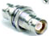
Set-up of DC measurements (TASK1):
- SiPM: Hamamatsu MPPC S10362-11-050C_499 (1mm² area, 50μm pixel size)
- Temperature sensor Pt100
- Keithley 2611 source-meter
- Keithley 2000 multimeter
- PC (Labview)
BOX
SiPM
K (n-type)
Keithley 2611
Pt100
A (p-type)
Hi
Lo
V_{bias}
GPIB-USB
GPIB
Keithley 2000
Hi
Lo

Slide 3

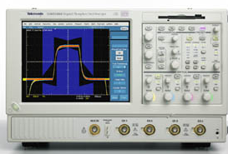
Set-up of AC measurements TASK 2A (SiPM in the dark):
- SiPM : Hamamatsu MPPC S10362-11-050U_3 (1mm² area, 50μm pixel size)
- CAEN SP5600 power supply & amplification unit & discriminator & counter
Tektronix TDS 5054 Digital oscilloscope (digitization and visualization of SiPM signals)
PC (LabView)
CAEN PSAU SP5600
Microcontroller
USB
USB
SiPM head
Temp.
Sensor
Bias generator 0-120V
K
OUT0
Analog signal
SiPM
A
Digital oscilloscope
Amp
Wide bandwidth
Variable G: 0-50dB
Discriminator
(Th)
DOUT0
Counter

Slide 4

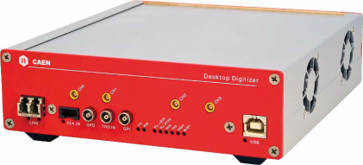
Set-up of AC measurements TASK 2B (SiPM in dark or light conditions):
- SiPM : Hamamatsu MPPC S10362-11-050U_3 (1mm² area, 50μm pixel size)
- CAEN SP5600 power supply & amplification unit (PSAU)
Tektronix TDS 5054 Digital oscilloscope (digitization and visualization of SiPM signals)
CAEN DT5720A desktop digitizer (digitization and analysis of SiPM signals; memory control)
light source: green LED
light transmission to the SiPM surface: optical fiber of FC type connectors
Tektronix AFG 3252 pulse generator for LED pulsing
PC (LabView)
Pulse generator
LabView
Graphical User Interface
Power supply
& amplification
USB
Trigger
OUT
USB
Bias LED
Digitizer (ADC and memory control)
Ch0 input
Digital oscilloscope (ADC)
LED
SiPM
Optical fiber
Trigger
IN
SiPM analog signal

Slide 5
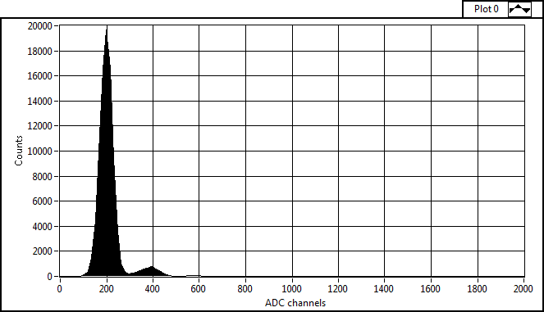
Principle of the G determination from the charge histogram
Hamamatsu MPPC S10362-11-050U_3

Slide 6
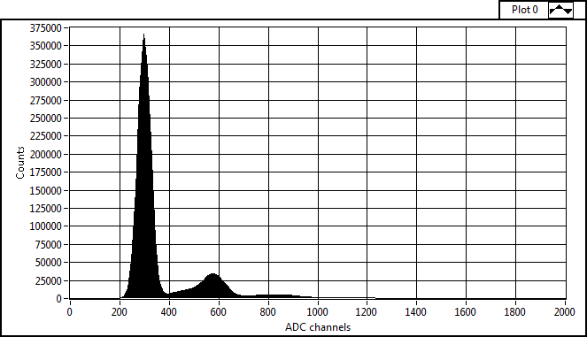
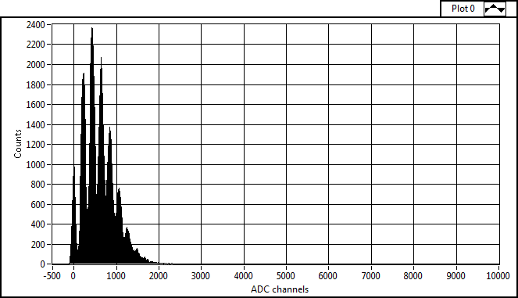
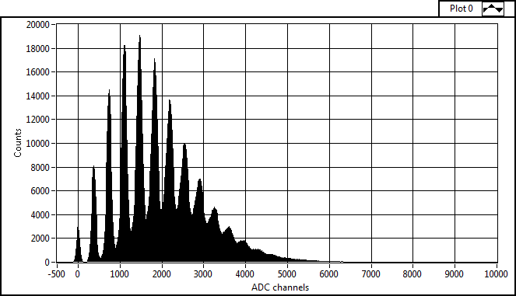
SiPM charge histograms in the dark (self-trigger)
MPPC S10362-11-050U_3
Vbias=69,5V
Vbias=70,03V
Charge of 1 pixel (Q₁)
Charge of 2 pixels (Q₂ =2Q₁)
SiPM charge histograms with pulsed LED (external trigger)
Vbias=69,5V
Vbias=70,03V

