Slide 1
Characterization of the MCP-PMT
The aim of the exercise is to study the timing properties of the MCP-PMT and to observe effects of photoelectron backscattering and charge sharing.
First check the connections in the set-up
Apply the height voltage (-2400V) and setup the oscilloscope to observe the PiLas trigger signal and signals from two lower channels of the MCP-PMT. Adjust the light intensity to single photon level.
Set-up the charge and delay measurement (leading edge and constant fraction) on one of the MCP-PMT signals with respect to the PiLas trigger signal.
Estimate the gain and single photon timing resolution.
From the measured timing distribution determine the distance between the photocathode and MCP entrance surface.
Observe the signals when you move from one channel to the other
Measure the timing distribution for multiphoton pulses

Slide 2
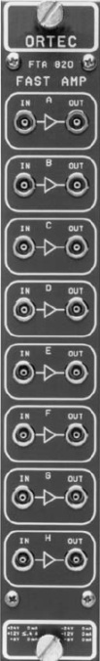
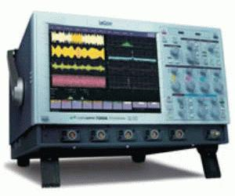
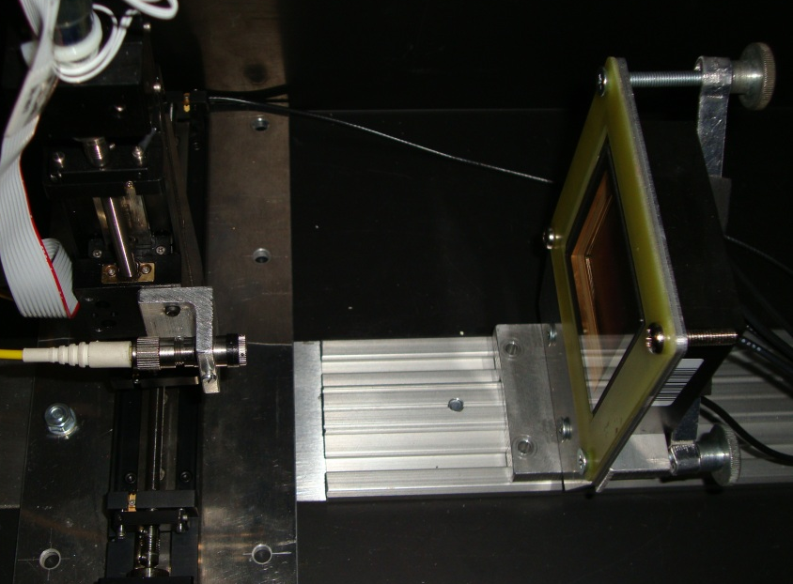
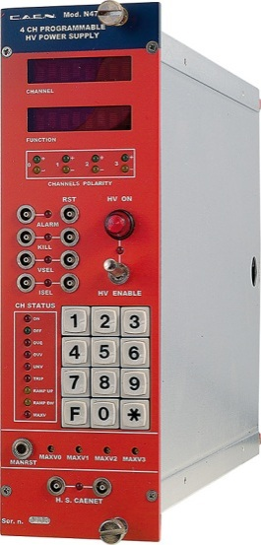
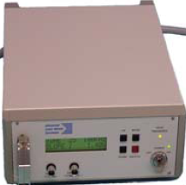
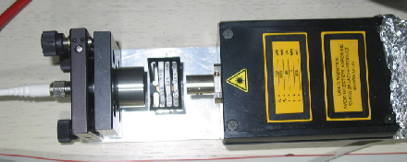
Set-up for MCP-PMT study:
MCP-PMT, Photonis(BURLE) 10 um, 4 channel prototype
HV power supply CAEN
Amplifier ORTEC FTA820A: gain 200, bandwidth 350MHz, neg./neg.
LeCroy WawePro 7300A oscilloscope
PiLas laser with 630 nm laser head
2D stage with focusing element
2

Slide 3
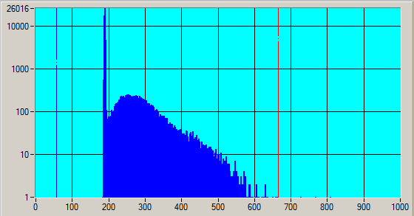
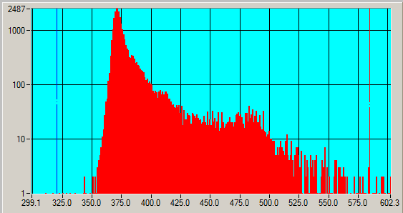
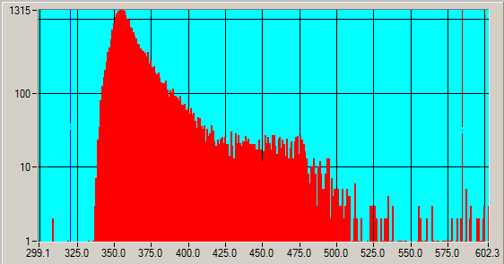
Single photon level – large fraction of single photoelectron signals
ADC
Number of photoelectrons follows
Poisson distribution
Fraction of pedestal events
Fraction of single photoelectron signals
P(0) | η
0.5 | 0.7
0.8 | 0.9
0.9 | 0.95
TDC – constant fraction
TDC – leading edge
Maximal travel time of a backscattered photoelectron can be estimated from the timing distribution of single photoelectron signals.

Slide 4
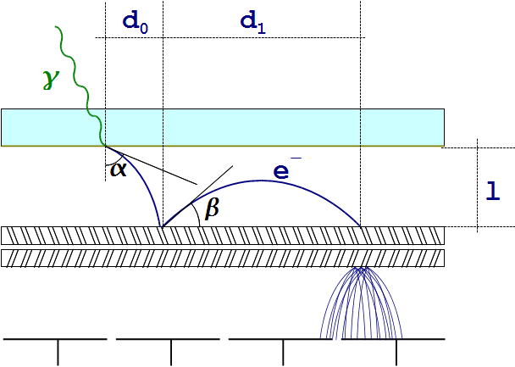
Travel time and range of photoelectron
Delay and range of backscattered photoelectrons
Parameters used:
U = 200 V
l = 6 mm
E₀ = 1 eV
m_{e} = 511 keV/c²
e₀ = 1.6 10⁻¹⁹ As
Photoelectron:
d_{0,max} ~ 0.8 mm
t₀ ~ 1.4 ns
Δt₀ ~ 100 ps
Backscattering:
d_{1,max} ~ 12 mm
t_{1,max} ~ 2.8 ns

Slide 5
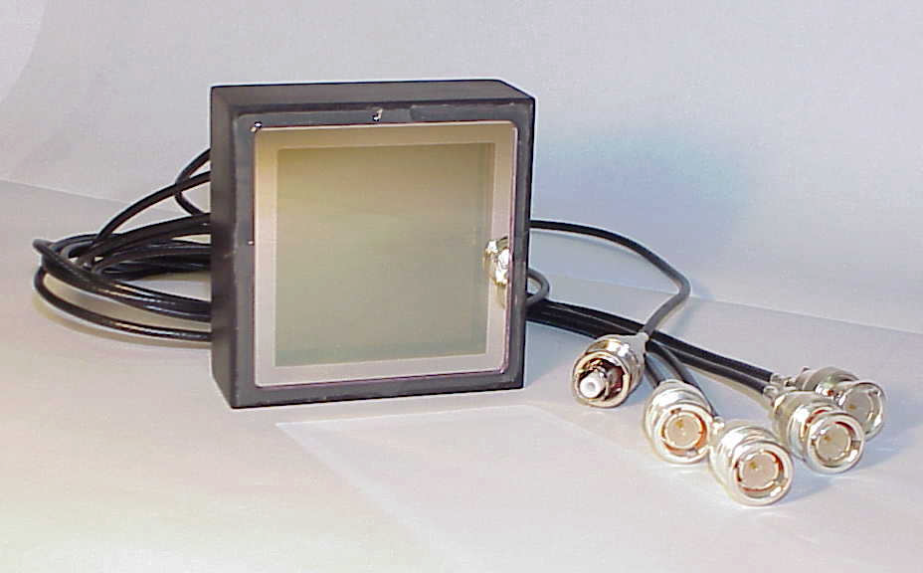
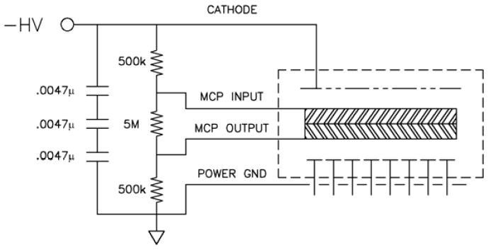
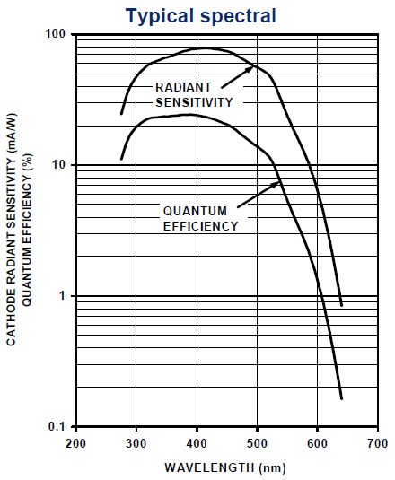
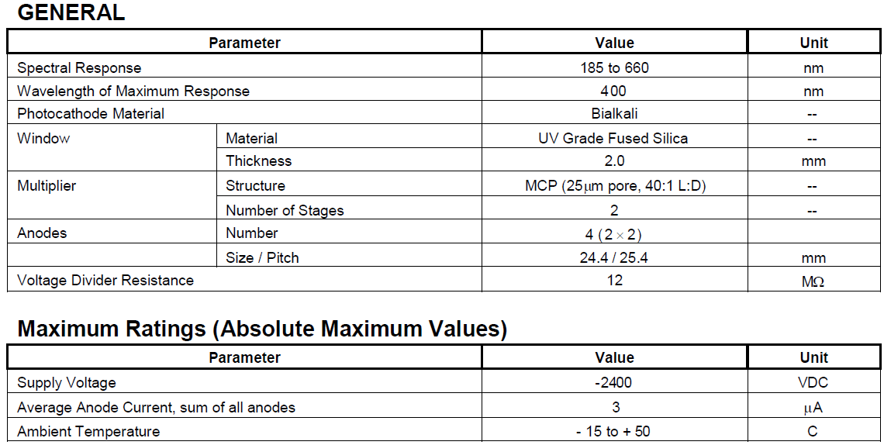
MCP-PMT characteristics:
10
6
5

