Slide 1
Absolute Measurement of the Quantum Efficiency of a Classical PMT
Task: measure the QE of a PMT in the wavelength interval 200 to 800 nm. Discuss the result, its precision and possible error sources.
Set-up:
- PMT
- Xe-lamp
- monochromator
- reference photodiode
- Keithley picoampere meter
- PC (Labview)

Slide 2
Principle of the QE determination
Photon flux, unknown !
Use a reference detector with known (calibrated) ε_{Q} to determine the photon flux
(DUT = Detector Under Test
REF = Reference Detector)

Slide 3
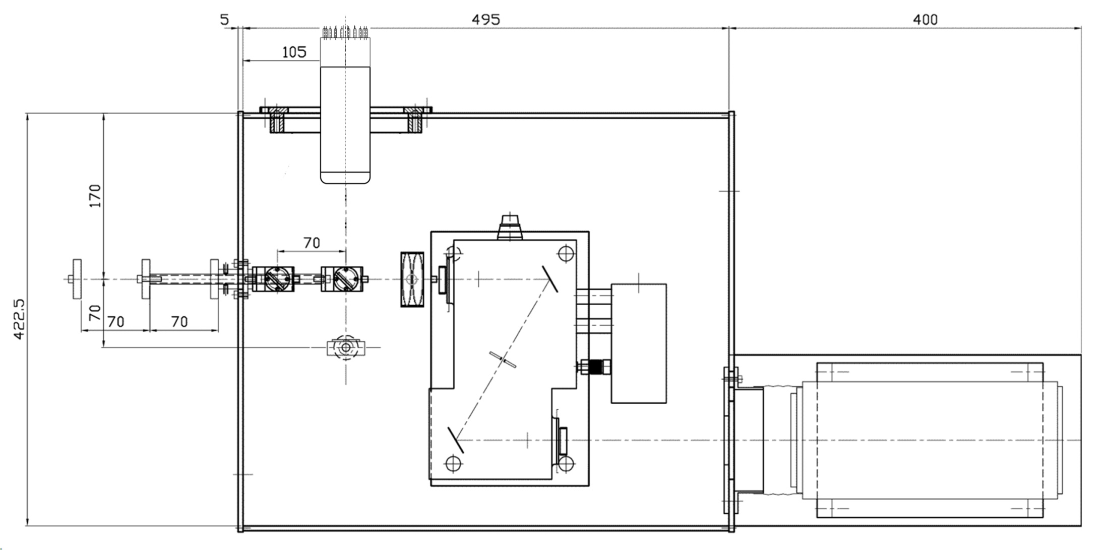
PMT under test
mirror
Calib. PD
Xe lamp
monochromator

Slide 4
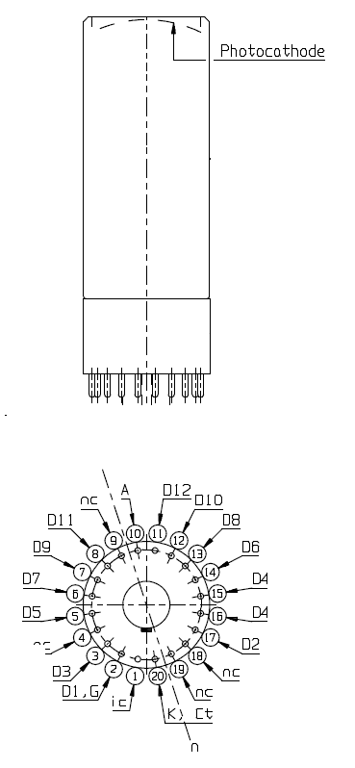
K
D1
K
Schematic representation of dynode structure
I_{photo}
D1
+V

Slide 5
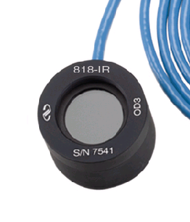
The 818-UV Low-Power UV Enhanced Silicon (Si) Photodetector is supplied with a NIST traced calibration report that details individual detector responsivity measured with and without attenuator over the 200 to 1100 nm wavelength range.
Model | 818-UV
Detector Type | Semiconductor
Spectral Range | 200 to 1100 nm
Active Diameter | 1.13 cm
Detector Active Area | 1 cm²
Material | Silicon-UV Enhanced
Power Density, Average Max w/ Attenuator | 0,2 W/cm²
Power Density, Average Maximum w/o Attenuator | 0,2 W/cm²
Pulse Energy, Maximum - w/ Attenuator | 0,1 µJ/cm²
Pulse Energy, Maximum - w/o Attenuator | 0.1 nJ/cm²
Uniformity | ±2 %
Shunt Resistance | ≥10 MΩ
Calibration Uncertainty | 4% @ 200-219nm 2% @ 220-349nm 1% @ 350-949nm 4% @ 950-1100 nm
Calibration Uncertainty, w/ Attenuator | 8% @ 200-219nm 2% @ 220-349nm 1% @ 350-949nm 4% @ 950-1100nm
NEP | 0.45 pW/√Hz
Reverse Bias, Maximum | 5 V
Linearity | ±0.5 %
Connector Type | BNC

