Slide 1
Estimate the Cross talk of a MAPMT
Task: Measure the cross talk of a MAPMT. Illuminate one channel and measure the induced signal on the neighboring channels. Use low light levels (few photoelectrons).
Set-up:
- MAPMT
- blue LED
- pulse generator
- fibre lightguide
- oscilloscope (with histogramming capability)

Slide 2
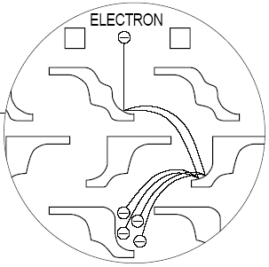
Sources of cross-talk in a MAPMT
light
electrons
Glass window
Photocathode
Dynode structure
Metal-channel dynodes (requires fine-machining techniques)
(Hamamatsu)

Slide 3
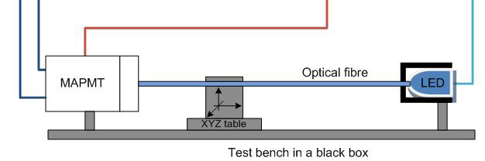
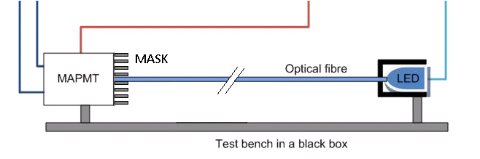
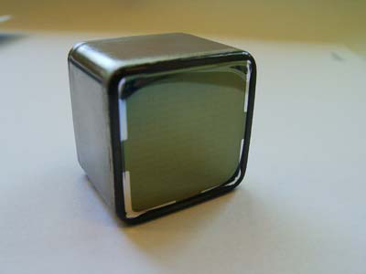
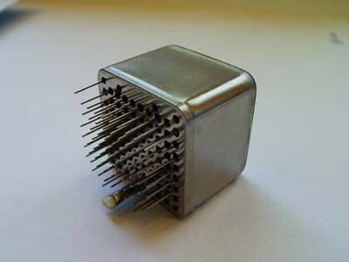
analog signals
to scope
HV
pulser

Slide 4
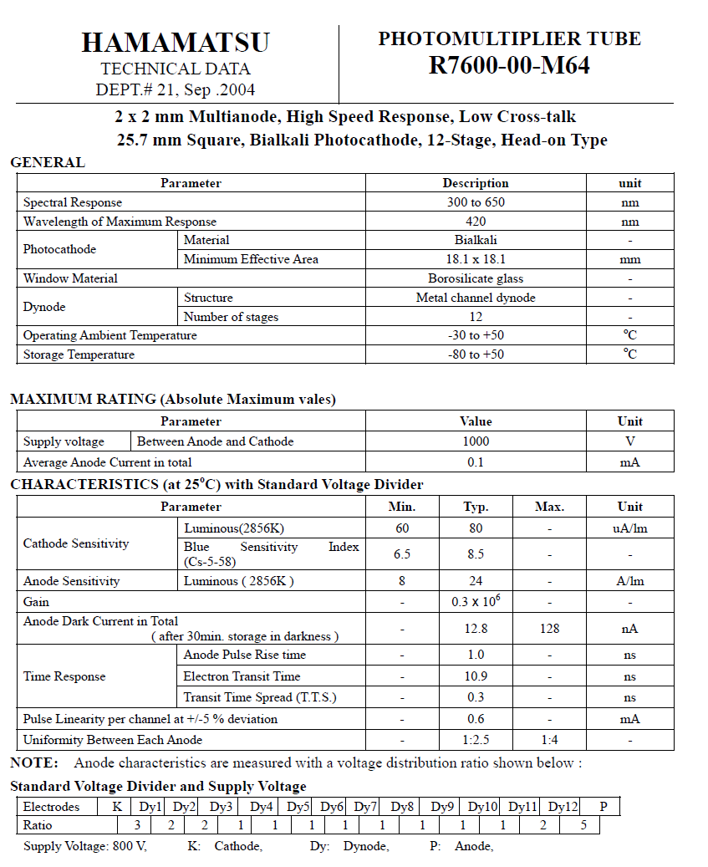

Slide 5
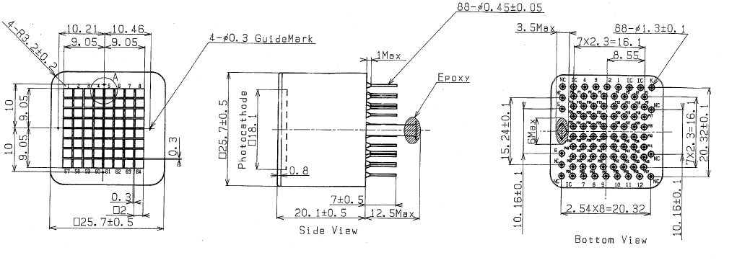
Channel and pin layout of the Hamamatsu R7600 MAPMT

Slide 6
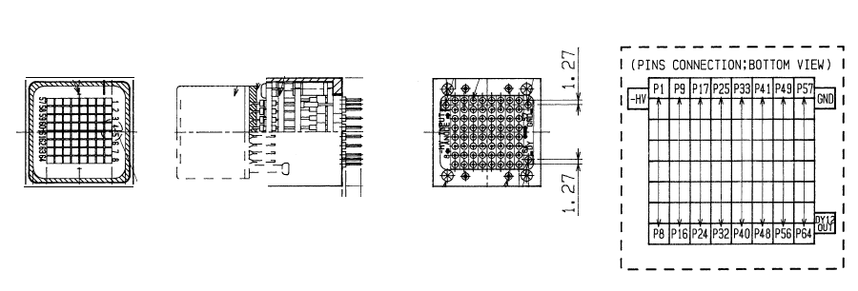
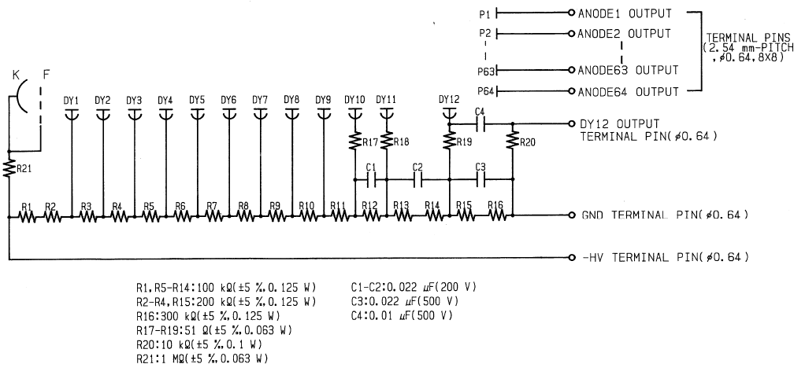
Voltage divider of the R7600

Slide 7
Example of a result from a quantitative measurement
A (scintillating) fiber (0.5 mm square) is positioned at the centre of a pixel in mechanical contact with the MAPMT window. No optical grease of gel is used. Low intensity light pulses from a LED are coupled into the fibre. The light intensity is chosen such that the average intensity corresponded to 0.2 photoelectrons per pulse, i.e. the probability for pulses with 2 photoelectrons is negligible. The MAPMT is operated at U_{C} = -950V. The figures below show the results of the measurement of the signals on the scope (area under pulse) on the illuminated pixel and the adjacent eight pulses. The cross-talk on the direct neighbours is of the order of 2% while diagonal neighbours show a signal of about 0.5%. The relative strength of the cross-talk varies with the applied bias.

