Slide 1
Photodetection
Principles, Performance and Limitations
Nicoleta Dinu (LAL Orsay)
Thierry Gys (CERN)
Christian Joram (CERN)
Samo Korpar (JSI Ljubljana)
Yuri Musienko (Northwestern U, USA)
Veronique Puill (LAL, Orsay)
Dieter Renker (TU Munich)

Slide 2
OUTLINE
Basics
Requirements on photodetectors
Photosensitive materials
‘Family tree’ of photodetectors
Detector types
Applications

Slide 3
Basics
  Photoelectric effect
  Solids, liquids, gaseous materials
  Internal vs. external photoeffect, electron affinity
  Photodetection as a multi-step process
  The human eye as a photodetector

Slide 4
Formatting guidelines for preparing slides
Use Calibri as default font
Default color: white (avoid text in red, difficult to read for many people)
Main title: 24 pts
Normal text: 16 pts
References: 10 pts

Slide 6
Requirements on photodetectors
  Sensitivity
  Linearity
  Signal fluctuations
  Time response
  Rate capability
  Dark count rate
  Operation in magnetic fields
  Radiation tolerance / aging

Slide 8
Photosensitive materials
  Classical photocathodes (bialkali, S20), super/ultra bialkali
  UV sensitive, solar blind (CsTe, CsI)
  Crystalline cathodes (GaAs etc.)
  Silicon
  Exotics: TMAE, TEA
  Windows/substrates

Slide 10
‘Family tree’ of photodetectors
Detector types
  PMT
  MAPMT
  MCP-PMT
  HPD, HAPD
  PIN diode (design)
  APD
  G-APD / SiPM
  CCD / CMOS
  Photosensitive gas detectors (MWPC / MPGD)

Slide 11
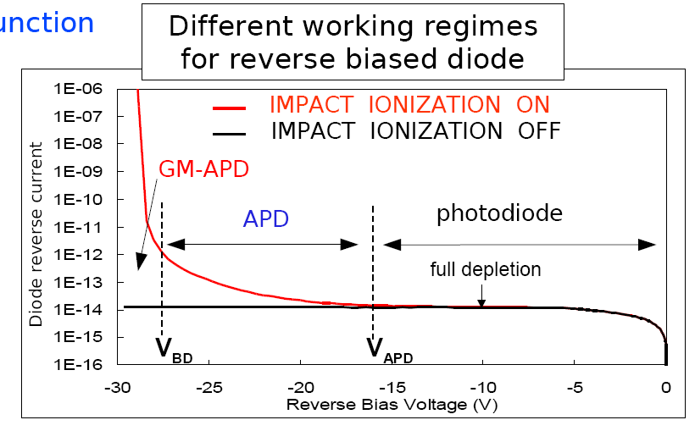
Geiger Mode – Avalanche Photodiode (GM-APD)

Slide 12
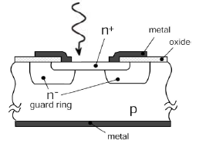
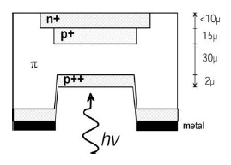
The first 2 single photon detectors operated in Geiger-mode
R.H. Haitz
J. Appl. Phys.,
Vol. 36, No. 10 (1965) 3123
J.R. McIntire
IEEE Trans. Elec. Dev.
ED-13 (1966) 164
Standardized
output signal
Q=C_{GM-APD} (V_{bias} - V_{BD})
Q=10⁵-10⁶e
R_{s}=50Ω
output
hν
R_{q}
Current (a.u.)
n+ (K)
GM-APD
p++ (A)
Q
Q
Q
-V_{bias}
Time (a.u.)
Passive quenching circuit
S. Cova & al.
Appl. Opt., Vol. 35, No 12 (1996) 1956
Binary device
no proportionality with
no. of incident photons

Slide 13
Applications
  Readout of scintillators / fibres with PMT/MAPMT.
  Readout of RICH detectors with HPD.
  Readout of RICH detector with gas based detectors
  Readout of inorganic crystals with APD. Example: CMS ECAL.
  Readout of scintillators with G-APD.
  Ultrafast timing for TOF with MCP-PMT

