Slide 1
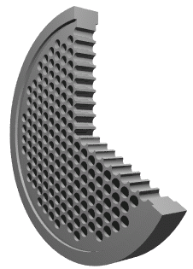
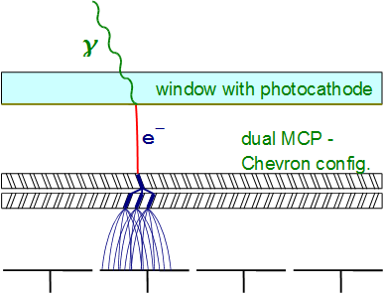
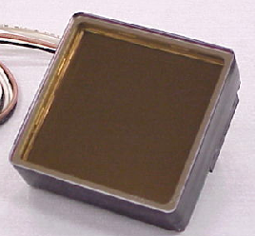
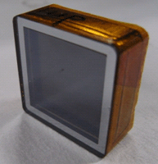
Micro Channel plate PMT (MCP-PMT)
Similar to ordinary PMT – dynode structure is replaced by MCP.
Basic characteristics:
Gain ~ 10⁶ → single photon
Collection efficiency ~ 60%
Small thickness, high field →
small TTS
Works in magnetic field
Segmented anode →
position sensitive
φ~10μm
MCP is a thin glass plate with an array of holes (<10-100 μm diameter) - continuous dynode structure
~400μm
MCP gain depends on
L/D ratio – typically 1000
For L/D=40
~200V
L
~2kV
HAMAMATSU
~200V
PHOTONIS
Anodes – can be segmented according to application needs
D

Slide 2
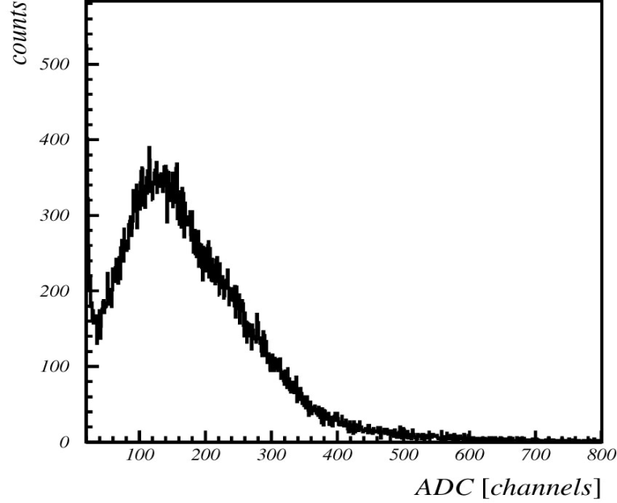
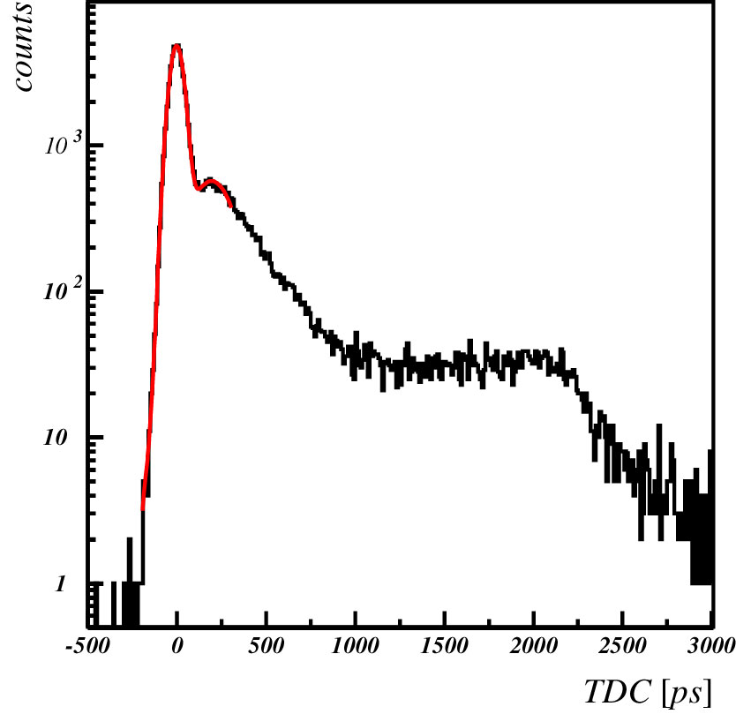
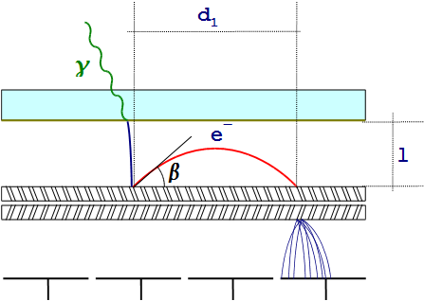
MCP-PMT: Single photon pulse height and timing
Pulse height distribution
Gain in a single channel saturates at high gains due to space charge effect →
peaking distribution for single photoelectron
Typical single photon timing distribution with narrow main peak (σ ~ 40 ps) and contribution from photoelectron back-scattering.
Timing distribution
Photoelectron backscattering produces rather long tail in timing distribution and position resolution.
Range equals twice the photocathode-MCP distance (2l).

Slide 3
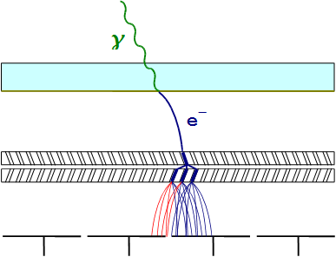
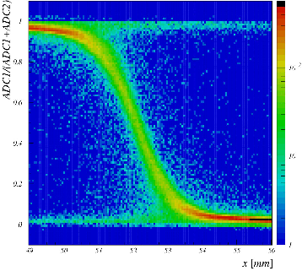
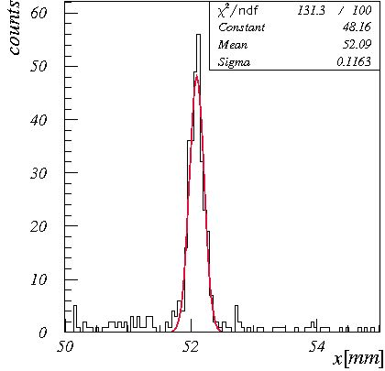
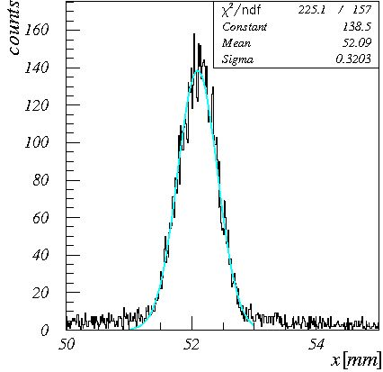
MCP-PMT: Charge sharing
Secondary electrons spread when traveling from
MCP out electrode to anode and can hit more
Than one anode → Charge sharing
Can be used to improve spatial resolution.
Fraction of the charge detected by left pad as a function of light spot position (red laser)
RED
LASER
BLUE
LASER
Slices at equal charge sharing for red and blue laser) – pad boundary. Resolution limited by photoelectron energy.

Slide 4
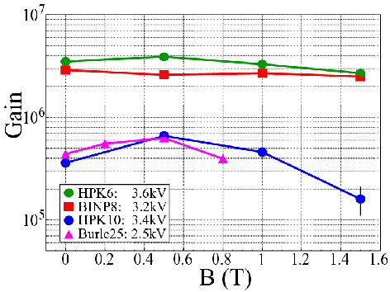
MCP-PMT: Operation in magnetic field
Narrow amplification channel and proximity focusing electron optics allow operation in magnetic field (~ axial direction).
Amplification depends on magnetic field strength and direction.
Effects of charge sharing and photoelectron backscattering on position resolution are strongly reduced while effects on timing remain
K. Inami @ PD07
Gain vs. Magnetic field for MCP-PMT samples with different pore diameter.
TTS vs. Magnetic field for MCP-PMT samples with different pore diameter.
K. Inami @ PD07

Slide 5
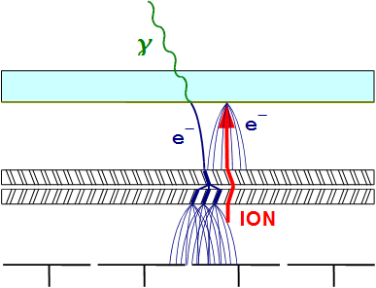
MCP-PMT: Ion feedback and aging
During the amplification process atoms of residual gas get ionized → travel back toward the photocathode and produce secondary pulse
Ion bombardment damages the photocathode reducing QE
Thin Al foil (few μm) blocks ion feedback but also about half of the electrons → placed between the MCPs
Sample with Al protection
Change of relative QE during the typical aging test. MCP-PMTs without Al protection show rapid reduction of QE.
K. Inami @ PD07

Slide 6
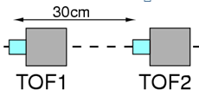
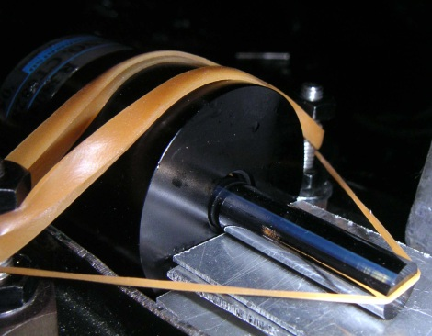
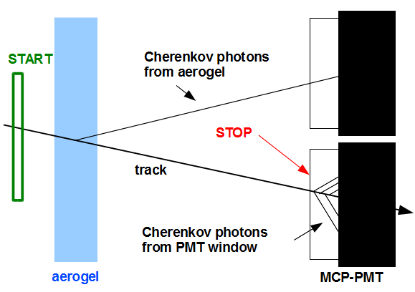
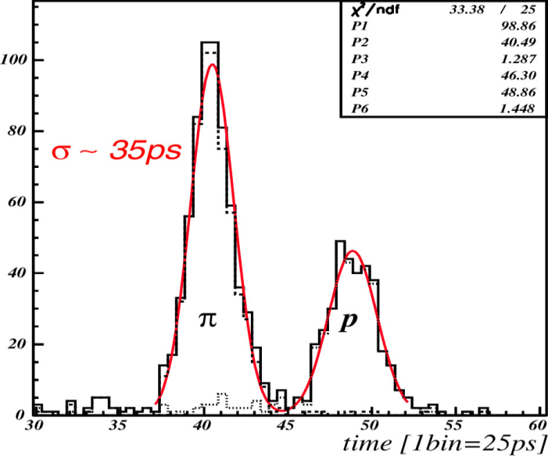
MCP-PMT: TOF applications
Excellent timing properties require fast light source → Cherenkov radiator directly attached to the MCP-PMT
Can be used as dedicated TOF (SuperB end-cap PID option) or part of the proximity focusing RICH (Belle-II end-cap PID option)
Quartz
radiator
MCP-PMT
K. Inami @ PD07
Proximity focusing aerogel RICH with TOF capability
Separation of 2 GeV pions and protons with 0.6 m flight length (start counter σ ~ 15 ps).

Slide 7
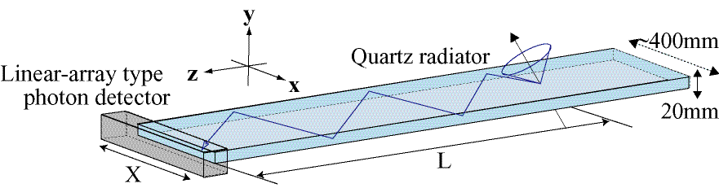
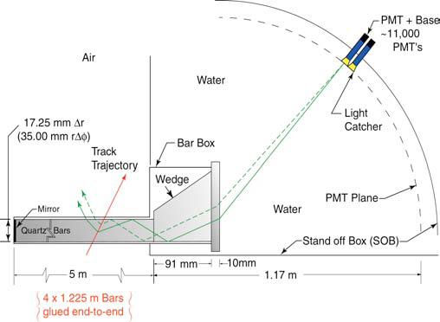
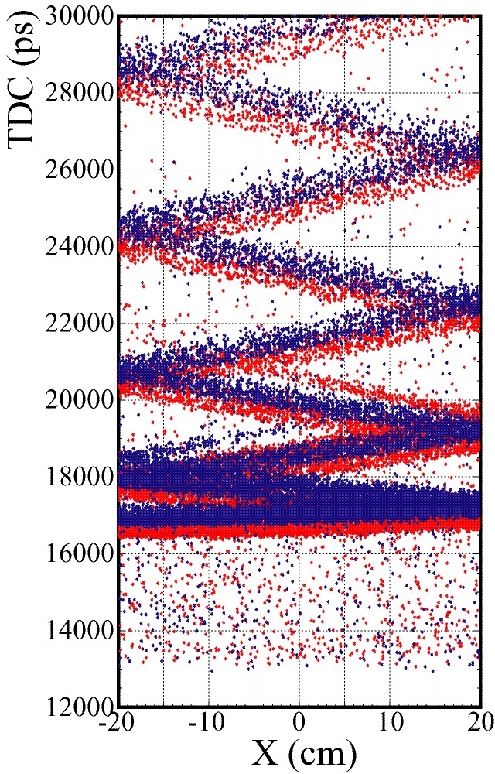
MCP-PMT: RICH with timing information
DIRC concept (BaBar) – 2D imaging
TOP (Time-Of-Propagation) counter based on DIRC concept (Belle-II). Using linear array of MCP-PMTs to measure one coordinate and time of propagation (length of photon path) to obtain 2D image → compact detector.
Focusing DIRC with chromatic correction (SuperB) uses measured time of propagation to correct chromatic error.

