Slide 1
Quench Detection and Energy Extraction Systems
R. Denz (Quench Detection), K. Dahlerup-Petersen (Energy Extraction Systems), TE-MPE-CP

Slide 2
Protection of superconducting wigglers in the CLIC damping rings
Elements requiring protection:
  Current leads, superconducting bus-bars, wiggler magnets
Protection devices (active and passive):
  Cold parallel extraction resistors (passive)
  Active energy extraction systems
  Quench heaters and power supplies (to be decided)
  Quench detection systems
  Crowbar for decoupling of power converter in case of fast discharge (part of power converter)
  Earth fault detection (part of power converter)
Supervision and interlocks for protection systems
  Hardwired interlock loops linking quench protection, power converters and machine protection
  Supervision system providing link to accelerator / test bench controls

Slide 3
Protection of superconducting wigglers in the CLIC damping rings
Boundary conditions (as known when preparing the talk ...)
  Maximum current: 1 kA
  Maximum voltage (differential and to ground): 1 kV
  Detection thresholds and maximum reaction time to be defined by equipment designers
    Current leads: to be defined (LHC HTS: 3 mV / 100 ms, RES: 100 mV / 100 ms)
    Magnets: to be defined (LHC: 100 mV / 20 ms)
    Superconducting bus-bars: to be defined (LHC: 600A circuits 100 mV / 20 ms, 13 kA circuits 300 μV, 10s)
  All protection electronics and energy extraction systems to be fed by redundant (source and line) UPS system (autonomy to be defined, typically 10 minutes)
  All protection electronics and energy extraction systems to be installed in radiation free areas

Slide 4
Protection of superconducting wigglers in the CLIC damping rings
Dedicated protection systems for magnet, bus-bars and HTS leads
Proposed instrumentation scheme allows easy compensation of inductive voltages and enhanced diagnostics in case of faults
  All voltage taps and instrumentation wires must be redundant
  Routing of wires to be studied in detail
The optional current sensor would allow the implementation of graded, i.e. energy dependent detection thresholds

Slide 5
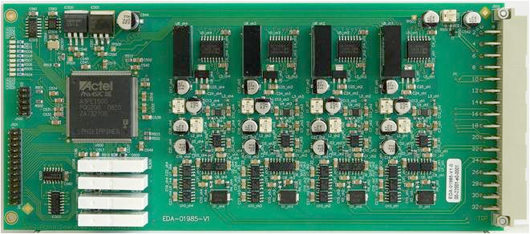
Protection of superconducting wigglers in the CLIC damping rings – magnet protection
Magnet protection system will compare the coil voltages for timely detection of transition to the resistive state
  Compensation of inductive voltages and eventual saturation effects
  The system can be based on LHC solutions, e.g. the symmetric quench detection systems for the LHC main magnets
  Mixed signal system with analog input stage, analog to digital conversion and digital evaluation combining protection and diagnostics
  Analog part of the detection systems is always on the magnet potential, electrical insulation is provided by digital isolators for the signal and DC-DC converters for the power part
The number of individual detection boards depends on the final wiggler layout
All systems will be redundant using two independent detection systems
  Hardwired OR for the interlock configuration

Slide 6
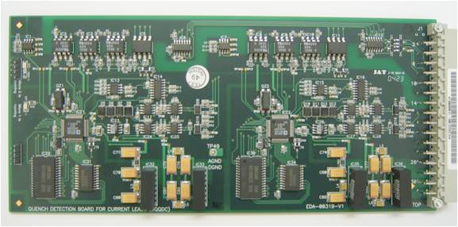
Protection of superconducting wigglers in the CLIC damping rings – HTS lead and bus-bar protection
Protection of HTS leads requires normally a high precision system with a slower reaction time (LHC: 3 mV, 100 ms). The systems developed for the LHC can be used for this purpose.
  Type of current lead (resistive or HTS) still to be confirmed
Depending on quench calculations the protection of bus-bar segments may be included into the magnet protection or a dedicated high precision system with slower reaction time (e.g. LHC main circuits 300μV, 10 s) can be deployed. It is also feasible to use both solutions in parallel.
  High precision systems allow measurement of splice resistances with a resolution of about 1 nΩ
  In case individual splices shall be measured, adequate instrumentation must be foreseen

Slide 7
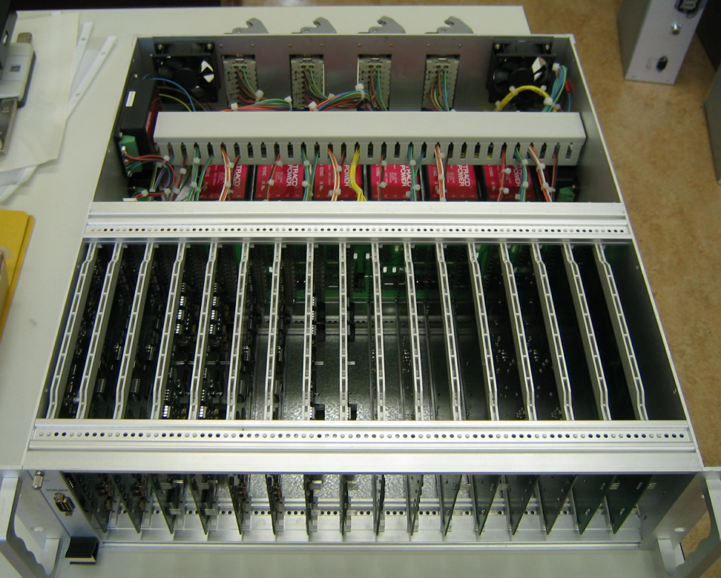
Protection of superconducting wigglers in the CLIC damping rings – integration of protection systems
Various protection systems to be integrated into common crate
  Signal distribution to various protection systems
  Bundling of interlocks
  Supervision of protection systems and link to accelerator controls (via field-bus or Ethernet)
Possibility to install additional independent DAQ systems in parallel to protection unit(s) but compatibility must be checked carefully
  Concerns basically prototype test
  Electrical insulation, EMC, input stages
Example of an LHC style protection system integrating individual protection and supervision systems

Slide 8
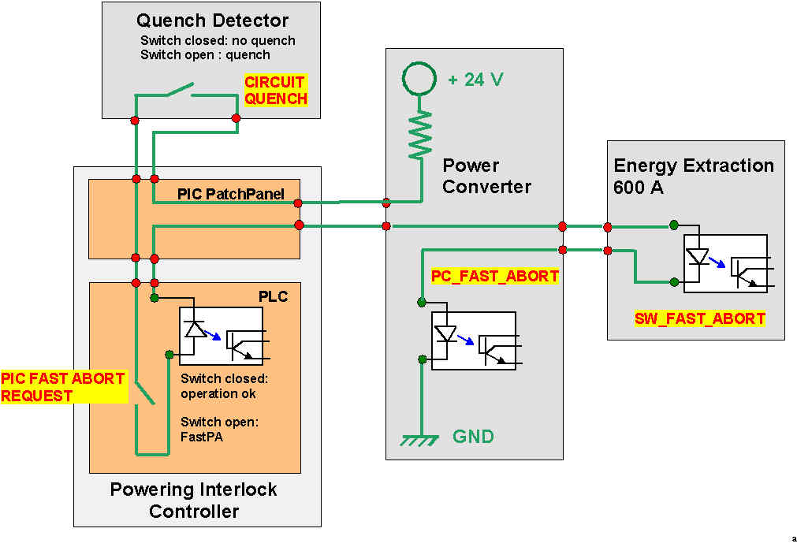
Protection of superconducting wigglers in the CLIC damping rings –interlocks
Hardwired interlocks (typically current loops) for the link between quench protection, energy extraction, power converter and machine protection)
  Short reaction time, reliable operation, EMC immunity
Example of and hardwired interlock loop linking quench protection,
power converters and machine protection.

Slide 9
Protection of superconducting wigglers in the CLIC damping rings –supervision
Supervision of quench protection and energy extraction systems plus data acquisition system for super-conducting circuits
  Permanent supervision of protection equipment status (basic task)
    Software interlocks on top of the hardwired abort loops in case of problems
  Remote setting of detection parameters
  Potential remote firmware upgrade of protection systems
  Logging of device status, generation of alarms
Supervision system expected to be significantly different form the LHC implementation
  No need for field-bus – Ethernet preferred, enhanced computing capabilities of local systems
  To be adapted to user requirements especially for prototype testing (integration into existing controls infrastructure)

Slide 10
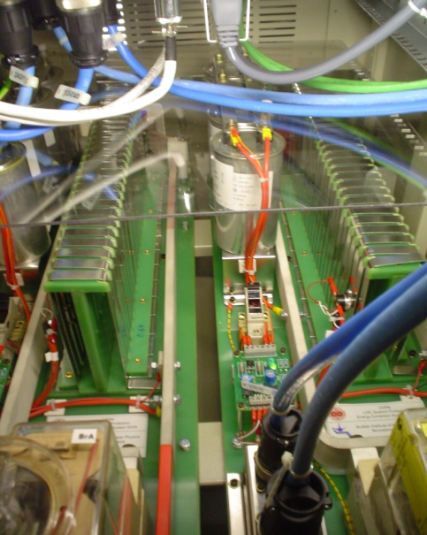
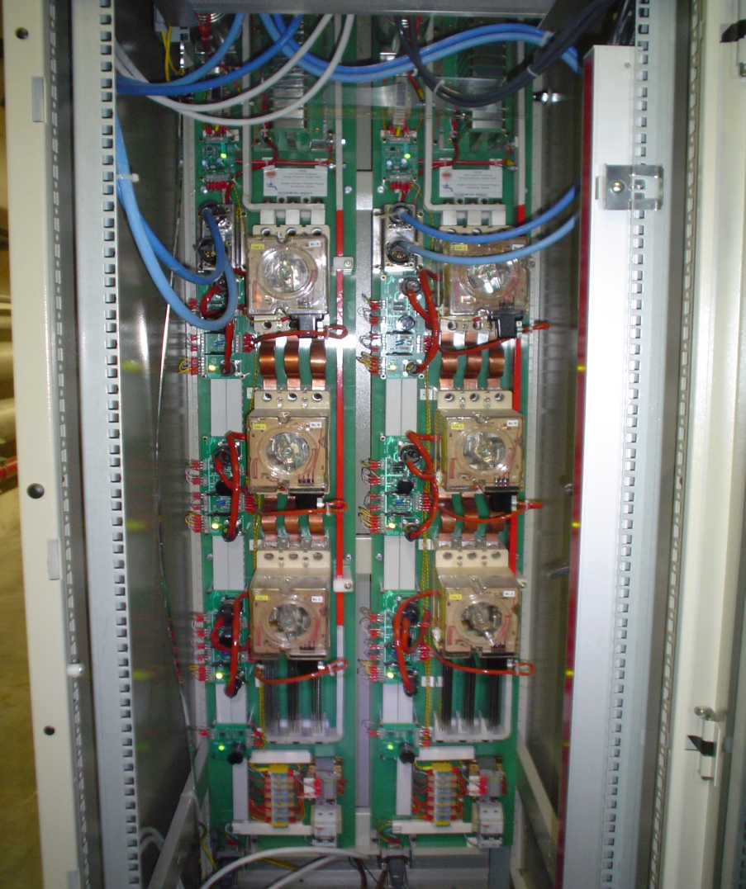
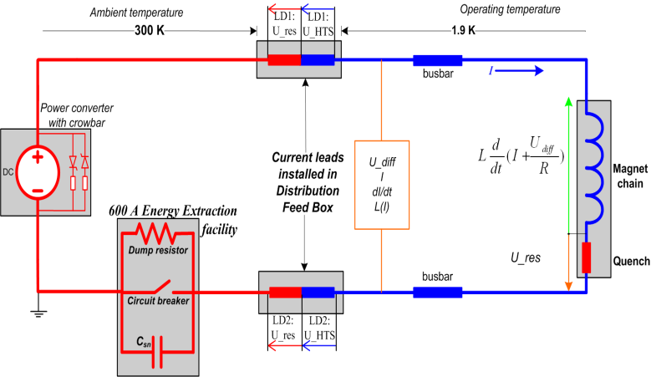
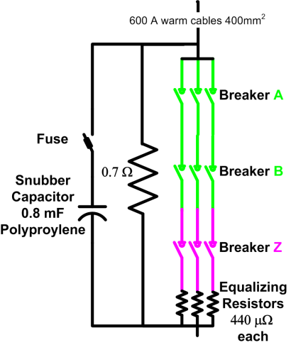
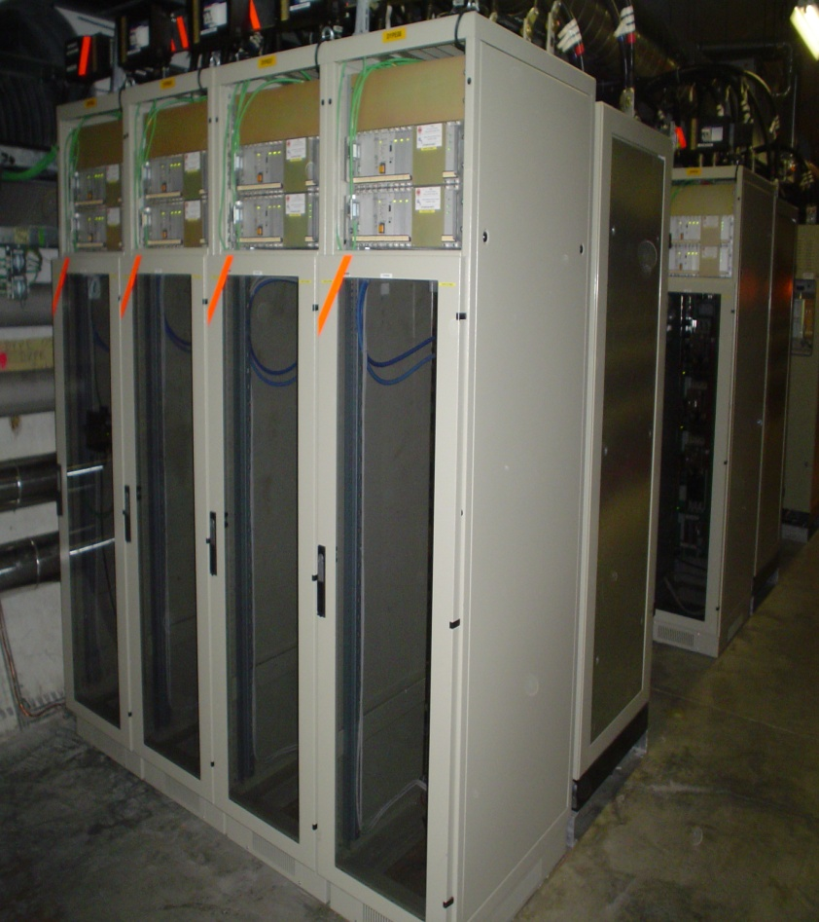
Energy Extraction for the s.c. Wigglers of the CLIC Damping Rings – a first Approach.
- A most obvious first approach for an initial design would be an attempt to profit from the LHC (or other existing developments) by re-employing already elaborated and proven layouts, topologies and component selections.
Parameter-wise the LHC corrector chains come closest to the Wiggler powering circuits.
202 EE systems have been designed and built for these LHC circuits (a joint QPS/BINP project) – see pictures below. The design parameters of these systems do not exceed: 600 A total DC current, 450 VDC extraction voltage, 154 kJ of stored energy and minimum 15 ms total opening time.
The extraction switches are electro-mechanical devices based on modified, 3-phase a.c circuit breakers, equipped with snubber capacitors for commutation aid and current equalizing resistors.
Three such switches (one used as back-up in the opening process) are series-inserted in the circuit and operate often in combination with ‘internal’ (cold) parallel resistors. However, the external system is always dimensioned for the full energy dump.
Dump resistors for 150 kJ
Circuit lay-out
Two, 600A extraction systems in a common rack

Slide 11
Energy Extraction for the s.c. Wigglers of the CLIC Damping Rings
Basic Extraction Requirements for CLIC SINGLE PROTOTYPE s.c. Wiggler Protection:
With Nb-Ti wire: up to 790 ADC, 1.6 H, 392 kJ stored energy, discharge time constant τ < 1s. Total dump resistance to be shared between internal and external resistors.
With Nb₃Sn wire: up to 1000 ADC, stored energy may be a factor of 2 higher than for Nb-Ti. Also here use of internal and external extraction resistors are foreseen.
To this comes a request for a total opening time not exceeding 10 ms for both coil wire types and a wish to foresee a ‘Nb₃Sn-ready’ design from the beginning.
FIRST CONSIDERATIONS :
Important modifications would be needed in order to adapt the LHC systems to the Wiggler requirements. Whereas the current capability of the LHC systems would just match the need for Nb-Ti technology, it is not the same with the voltage capability of the switches, for which the maximum voltage (450 V) is determined by the arc chamber design (special for DC arc extinction).
The requirement for very short release times, below 10 ms, is not compatible with the electro-magnetic driver of the mechanical contacts. The LHC switches are already equipped with ultra-fast pulsed coils for active opening and the arcing time is reduced by optimized capacitive snubbers. Further improvements will be difficult.
The dump resistor energy capability, however, is easily extendable. There exist already a design with adequate rating for a single Nb₃Sn Wiggler. For the final damping ring circuits with 13 series-connected magnets, a compact, liquid-cooled extraction resistor design is presently being considered. It features a resistor body immersed in a dielectric, heat transfer liquid, in-turn cooled through a built-in liquid-to-water heat exchanger for short cycling time.
CONCLUSION:
The only type of switch, which is rapid enough to satisfy the CLIC Wiggler commutation rate, will be based on power semi-conductor technology.
QPS is suggesting the use of IGCT’s (Integrated-Gate Commutated Thyristors). An IGCT operates like a GTO (Gate Turn-Off Thyristor), however, having lower conduction losses and higher dV/dt capability (therefore no snubbers needed). Developments of high-current, medium-voltage IGCT’s has advanced considerably over the last years. For other CERN applications, such as HIE-ISOLDE and possible upgrades of LHC equipment, a prototype IGCT switch is already in the design phase at QPS.
Although a RADTOL version of the gate drive will be required for other applications at CERN, the CLIC Wiggler extraction facilities can use traditional electronics. Gate drives for IGCT’s used as static switches already exist (on-pulse to gate, off-pulse to cathode). Furthermore, the CLIC system can be mono-polar.

Slide 12
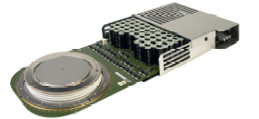
Energy Extraction for the s.c. Wigglers of the CLIC Damping Rings
The proposed IGCT and its integrated drive electronics.
The IGCT will only operate correctly with a dedicated gate drive which is designed for the application.
With a gate turn-off current exceeding the anode current, the minority carrier injection from the lower PN-junction is being totally eliminated. This results in a faster turn-off time than in the GTO.
In the IGCT the gate connection is designed for a minimum inductance of the gate drive circuit. The high gate currents and high dI/dt rise of the gate current prevents the use of normal wires for connecting the gate drive to the semiconductor press-pack. The design features a drive circuit in which the PCB is integrated into the package of the device. The drive circuit surrounds the IGCT with a circular conductor attaching the edge of the puck. The inductance and resistance of the connection is minimized by the large contact area and short distance.
A complete prototype switch (bi-polar) with non-RADTOL drives shall be ready for testing in May 2011.
A contract with ABB, Lenzburg is being prepared for a joint development with CERN of a RADTOL version of the g-drive.
Knud 1 Dec 2010

Slide 13
Summary and outlook
Protection of the superconducting wigglers in the CLIC damping rings can be realized with systems based on LHC designs
  New developments (hard and software) nevertheless required
From past experience it is considered as very useful to use the protection systems foreseen for the final installation as well for the prototype protection
Timeline including the definition of deliverables and milestones still missing
  Detailed information concerning the magnet and the super-conducting circuit as well not yet complete
Very fast reaction time of energy extraction systems cannot be realized with electro-mechanical devices
  New development of semiconductor based systems necessary
System integration (instrumentation, interlocks, infrastructure, supervision) to be started soon

