Slide 1

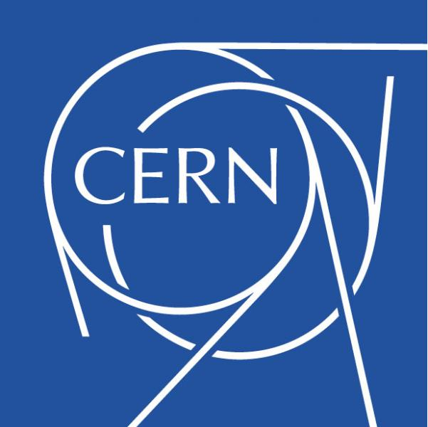
History of Accelerators
CERN Introductory Accelerator School
Kaunas, 2022
Dr. Suzie Sheehy
University of Melbourne
University of Oxford
Notes:
What are accelerators used for?

Slide 2
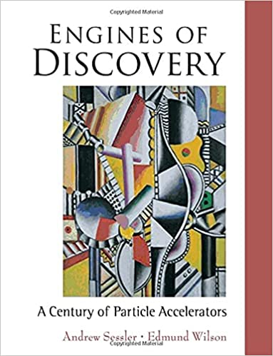

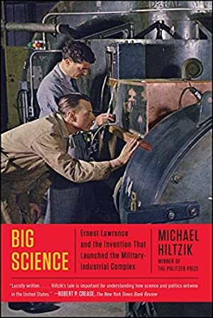
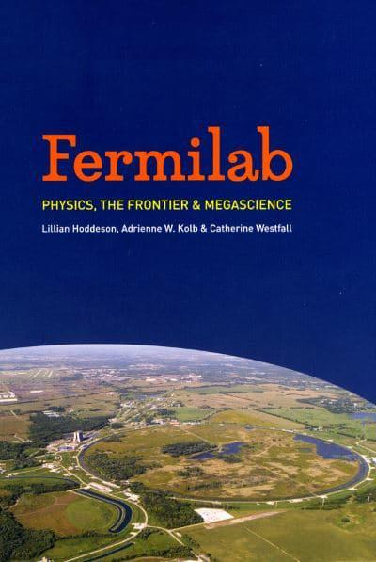

Sources and Recommended Books:
Engines of Discovery,
Andy Sessler, Edmund (Ted) Wilson, 2014
The Fly in the Cathedral, Brian Cathcart, 2004
Big Science: Ernest Lawrence and the Invention that Launched the Military-Industrial Complex, Michael Hiltzik, 2016
Fermilab Physics, the Frontier, and Megascience, Lillian Hoddeson, Adrienne W. Kolb, Catherine Westfall, 2011
The Matter of Everything: Twelve Experiments that Changed Our World, Suzie Sheehy, 2022

Slide 3
Outline
The scientific case for particle accelerators
The early days: the first accelerators up to 1930s
      Electrostatic accelerators, Cyclotron, early LINACs
A creative boom: the 1940s to 1960s
      Betatron, Synchrotron, FFAs
An established field and powerful tool: 1970s to today
      LINACs, superconducting technology, colliders and advances
    A few loose ends:
      The microtron, rhodotron

Slide 4
The scientific case for particle accelerators

Slide 5
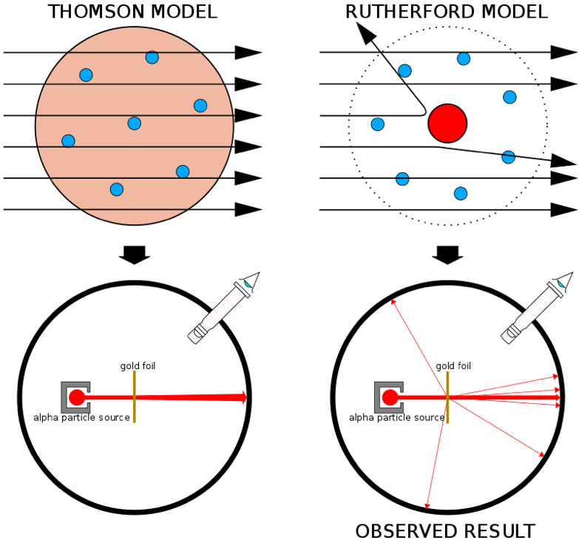
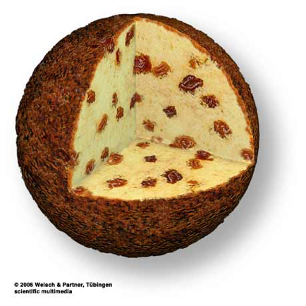
The early 1900’s…

Slide 6
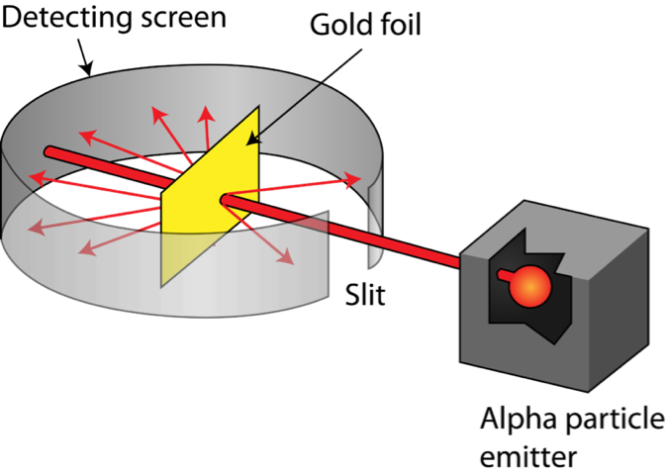
Rutherford* gold foil experiment, 1911
*Actually Ernest Marsden and Hans Geiger
E=4.78 MeV

Slide 7
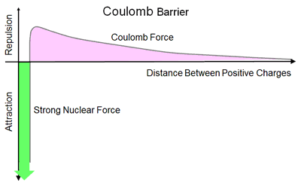
What is the nucleus?
What is inside? (protons/neutrons not known)
How is it held together?
Why don’t electrons spiral in? (N. Bohr solved this w. QM)
Question: what were the limitations of using natural radioactive sources?

Slide 8
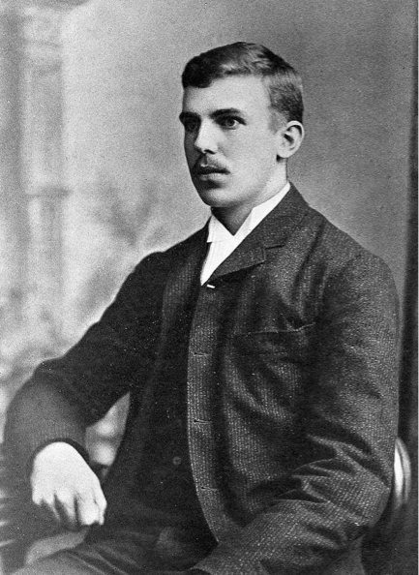
“it has long been my ambition to have available for study a copious supply of atoms and electrons which have an individual energy far transcending that of the alpha- and beta-particles from radioactive bodies”
Ernest Rutherford
Address to the Royal Society, 1927
Notes:
- Why couldn’t they just use radioactive sources?

Slide 9
The early days: the first accelerators up to 1930s

Slide 10
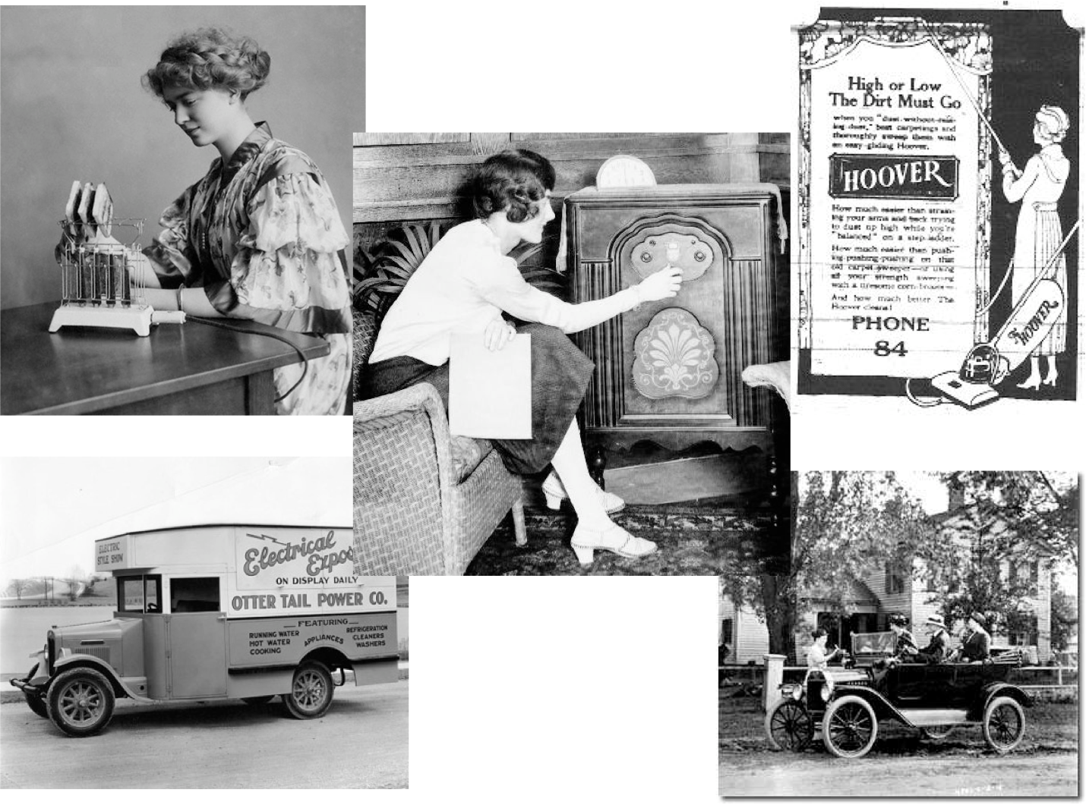
The 1920’s
Notes:
Put the 1920’s in context!
35% of all homes had electricity, which increased to about 70% at the end of it.
Modern convenience - electric irons, toasters, refrigerators, air-conditioners, radio, television and vacuum cleaners.
In 1922 the BBC began radio broadcasting in the UK and in 1926 Robert Goddard made the first flight of a liquid fuelled rocket.

Slide 11
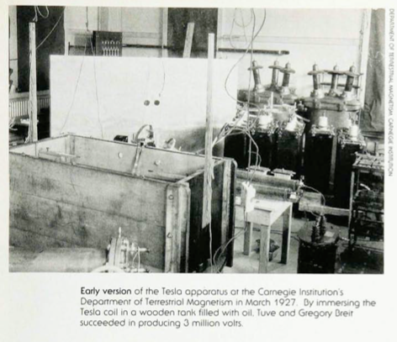
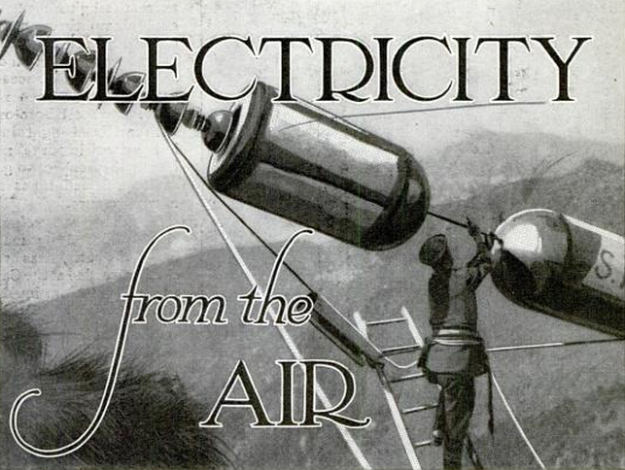
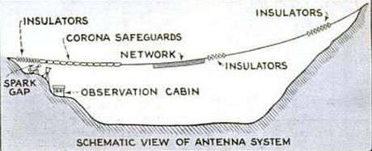
Attempts at Electrostatic Accelerators
Tesla Coil
Lightning
Arno Brasch, Fritz Lange, Kurt Urban, in Italian Alps 1927-28
Thomas D. Cornell, Physics Today 41, 1, 57 (1988)
Merle Tuve – Carnegie – 3MV Tesla Coil. Allibone also at Cambridge.
http://lateralscience.blogspot.com/2012/10/alpine-air-to-produce-30-million-volts.html?m=0
Notes:
They achieved 15MV and were going to move up to 30 MV when Kurt Urban was killed in a fall. They went back to lab-based transformers instead.

Slide 12
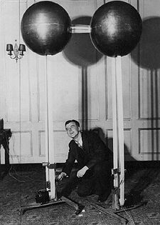
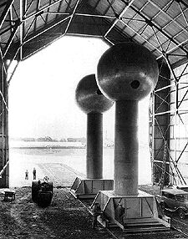
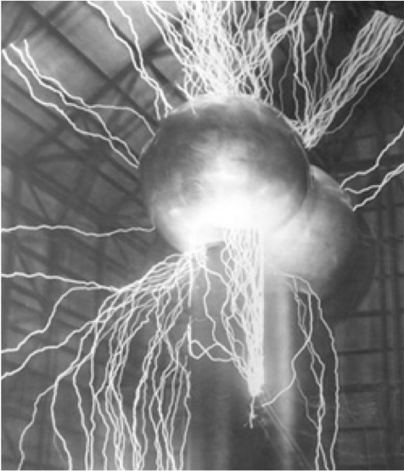
Van de Graaff accelerator
1930
1933 – 7MV
"Van de Graaff Generator" by Omphalosskeptic
Licensed under CC BY-SA 3.0 via Commons
http://chem.ch.huji.ac.il/~eugeniik/history/graaff.html
Notes:
Merle Tuve jumped on the ideas of Van de Graaff as the answer to his dreams!

Slide 13
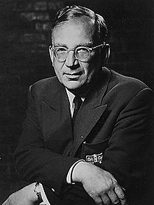
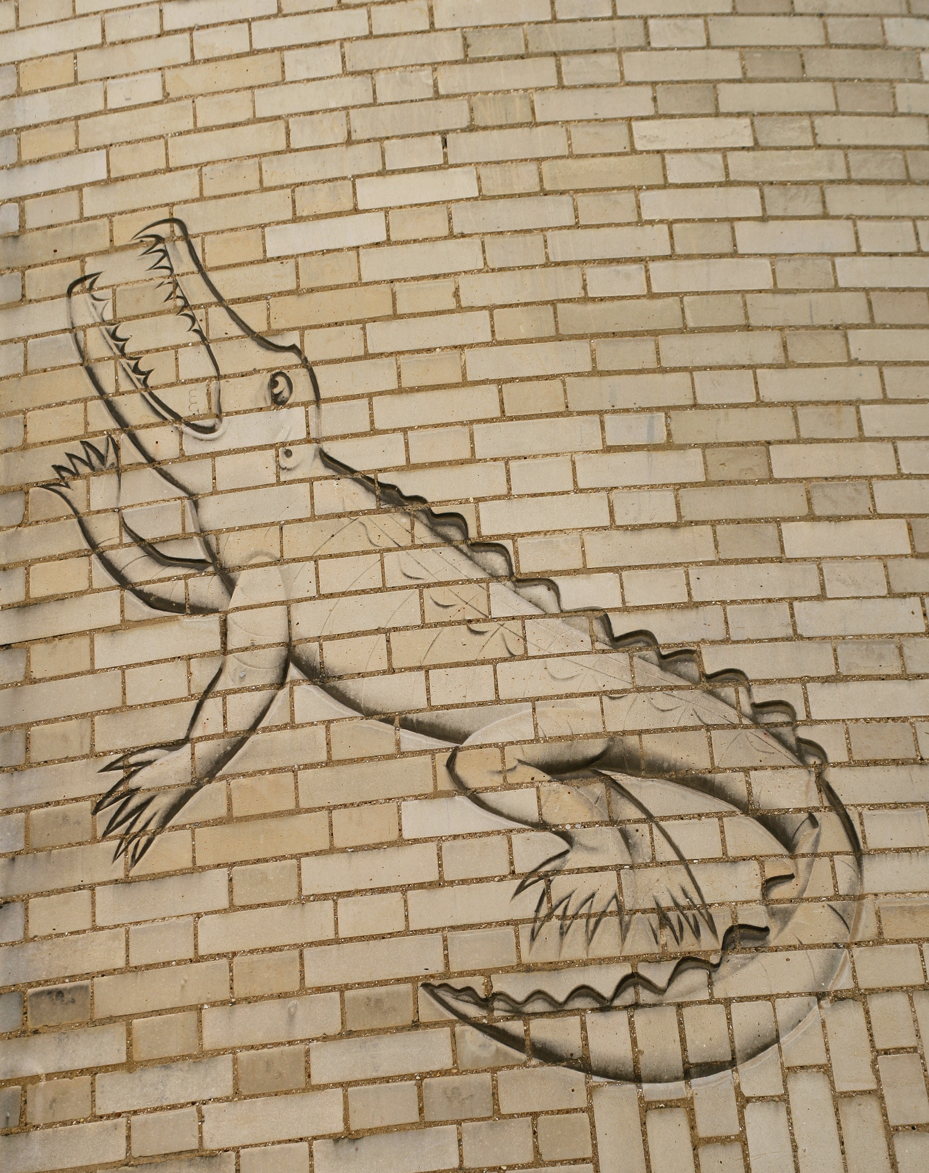
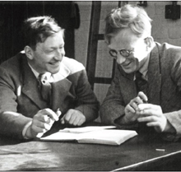
Gamow changes the game
George Gamow arrives at Cambridge, UK, 1929 armed with two plots
Predicts < 1MeV and as low as 200 keV sufficient based on quantum tunnelling
John Cockcroft pushes ahead

Slide 14
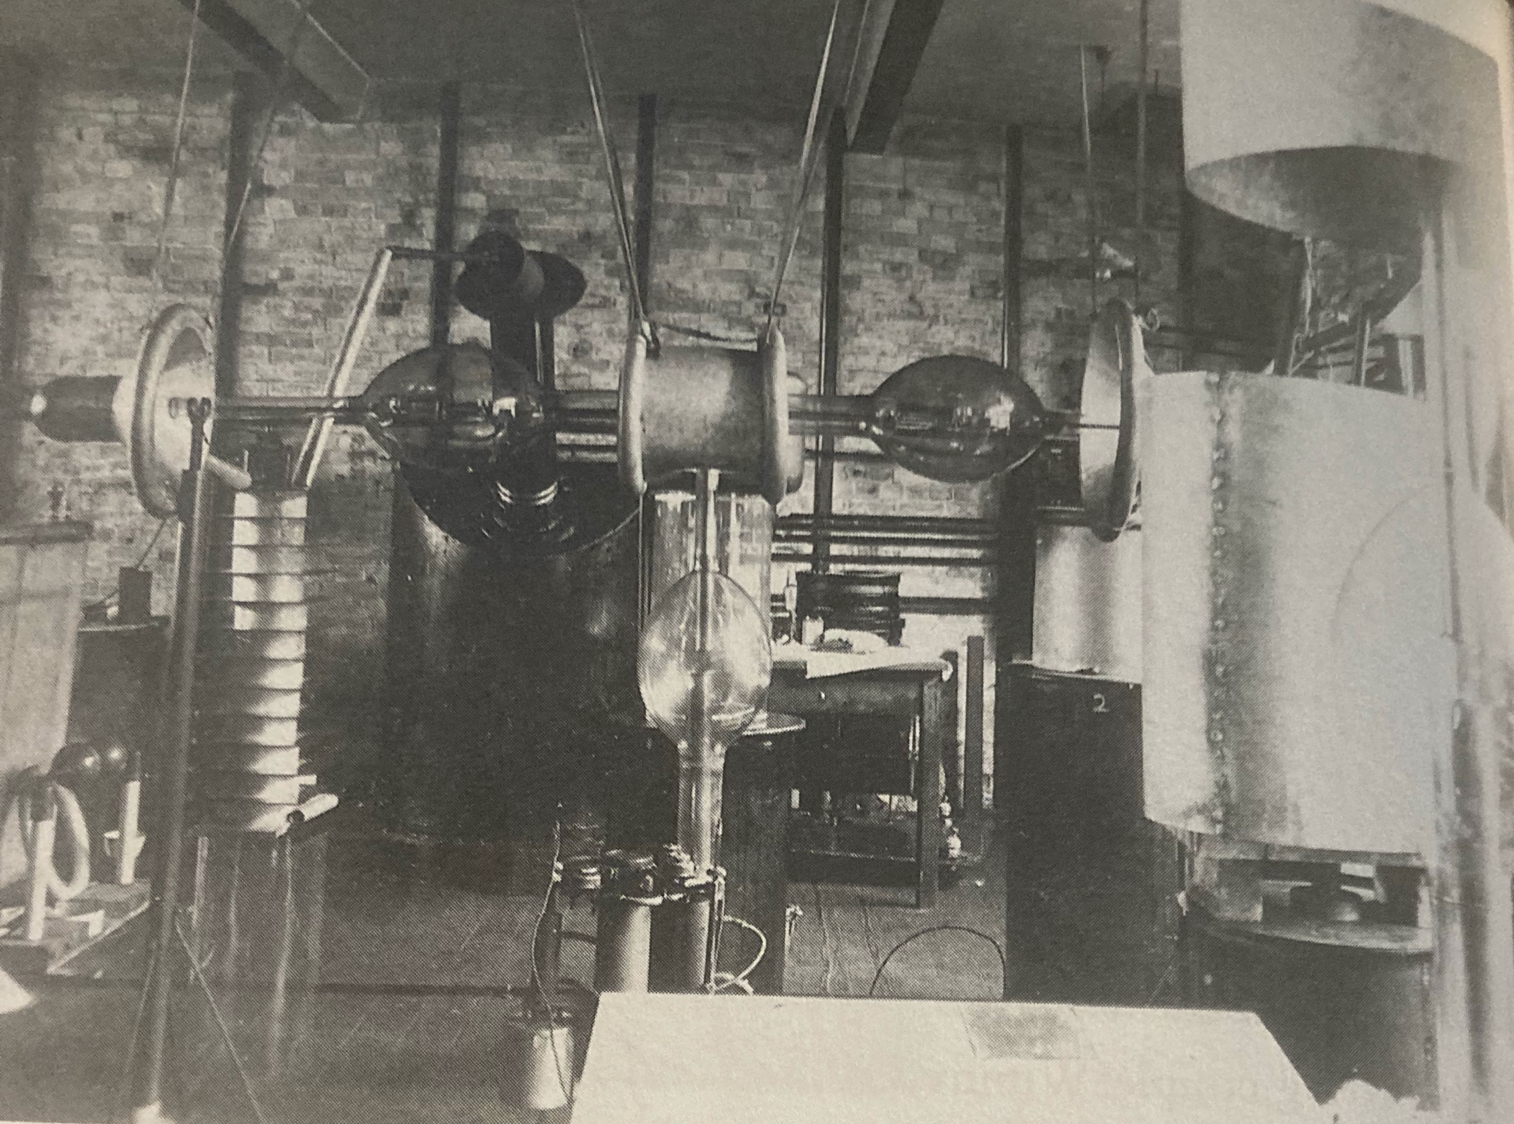
The first accelerator at Cambridge
Rectifier
Transformer
Acceleration tube
Burch pump
Notes:
1930 version of the accelerator. Up to 200kV.

Slide 15
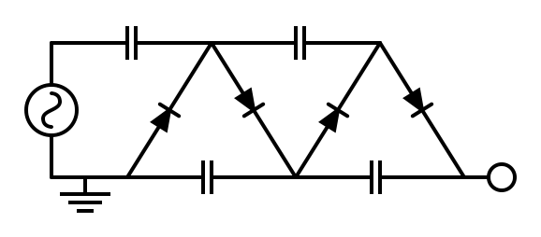
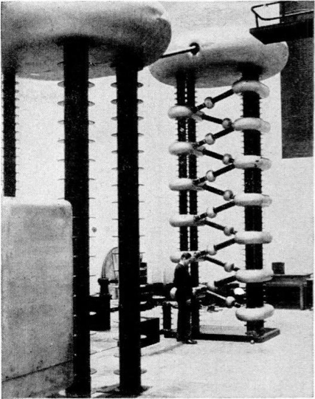
Cockcroft-Walton accelerator: 1932
±V
2V
4V
Voltage multiplier circuit
https://www.youtube.com/watch?v=ep3D_LC2UzU
1.2 MV 6 stage Cockcroft-Walton accelerator at Clarendon Lab, Oxford University in 1948.
Cavendish Lab, Cambridge
Notes:
AC signal at a point to above the source before the capacitor. Assume capacitor is charged (1V), have another 1V from the source (at +ve side of cycle). On -ve cycle, diode lets the voltage through and goes to 0 total. So this gives 2V (AC). By adding another capacitor/diode it acts as a rectifier and we get a steady 2V DC.

Slide 16
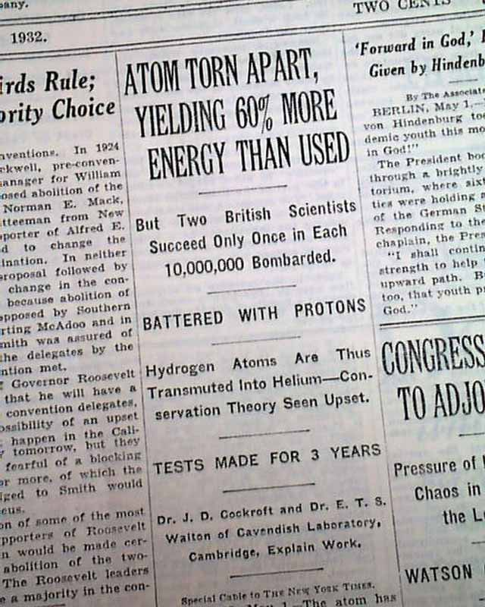
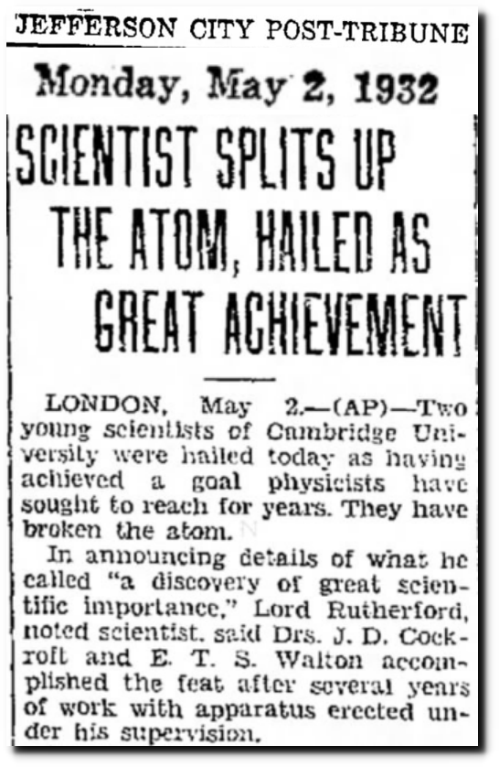
Science context
Image: http://ck12.org.uk
Proton: 1909(?) Rutherford
Neutron: 1932, Chadwick
Splitting the atom was announced at same meeting!
NEW YORK TIMES, May 2, 1932
Notes:
Shortly after, the positron was found by Carl Anderson in Cosmic Rays

Slide 17
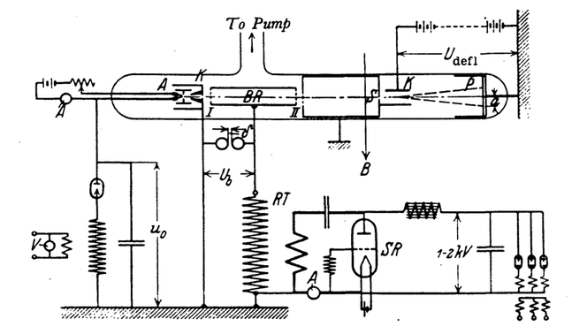
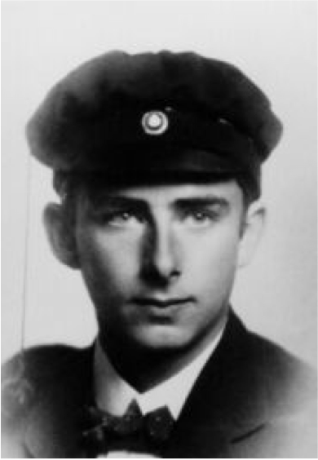

We missed one…
Linear Accelerators (very early)
Rolf Widerøe, 1924
His PhD thesis was to realise a single drift tube with 2 gaps. 25kV, 1MHz AC voltage produced a 50keV kinetic energy beam.
First resonant accelerator (patented)
The linear accelerator & it’s AC powering circuit
Historical note: He was influenced by Gustav Ising’s work, which was never realised in practise as Ising didn’t use an AC source.
Ising, Gustav. Arkiv Fuer Matematik, Astronomi Och Fysik 18 (4), 1928

Slide 18
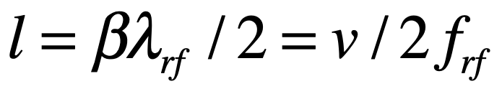
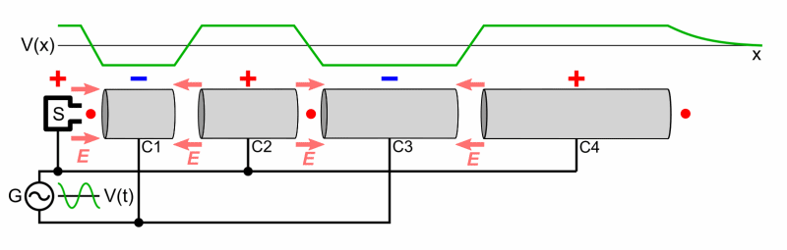
Linear Accelerators (2/3)
Remember: there is no field inside a conductor
For high energy, need high frequency RF sources
Weren’t available until after WWII
But Wideroe’s idea was not quite an RF cavity, Alvarez introduced that…
Notes:
Higher frequency microwave sources were unavailable until after WWII, a benefit of radar developments for the war.

Slide 19
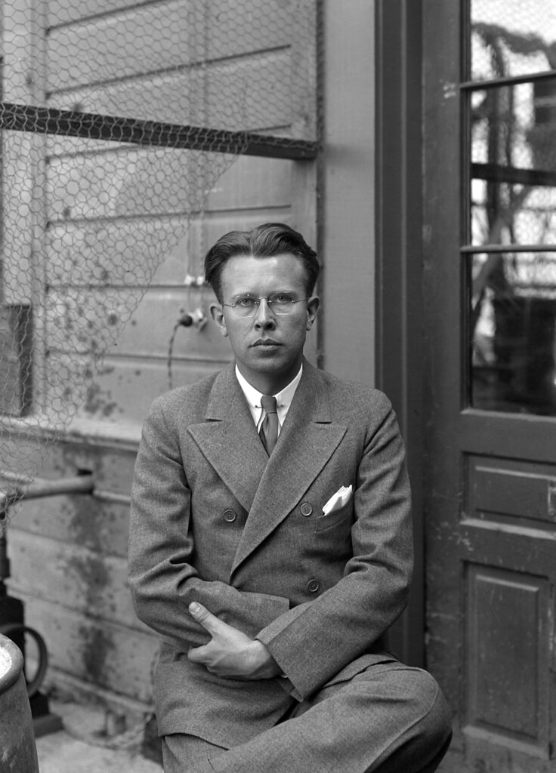
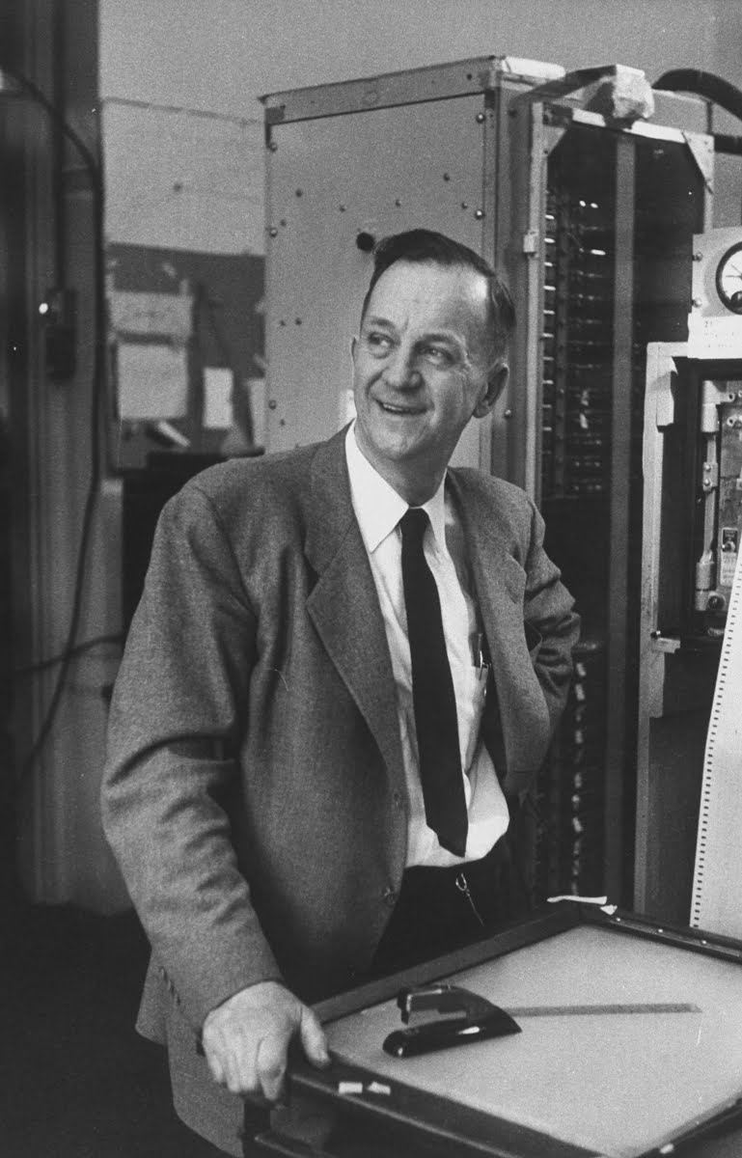
Boyhood friends…
Ernest Lawrence and Merle Tuve

Slide 20
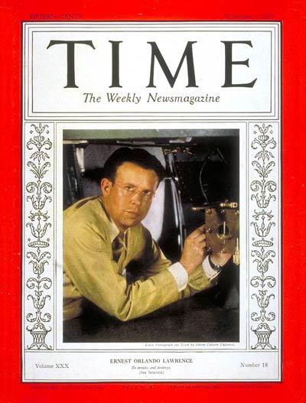
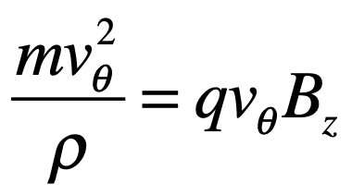
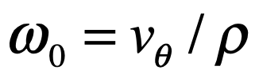

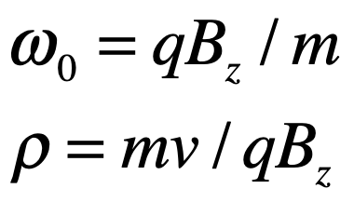

Cyclotrons (1)
Centrifugal force = magnetic force
Revolution frequency
Cancelling out rho gives:
Ernest Orlando Lawrence
Lawrence: “R cancels R!”
ie. for constant charge q and mass m, and a uniform magnetic field B, the angular frequency is constant. ie. the rf frequency can be constant. The orbit radius is proportional to speed, v.
Q. What is the issue with this statement?
Notes:
Lawrence came across Wideoe’s paper in a German journal and saw the diagrams, inspired with an idea.
Checked the maths: R cancels R! Found the nearest mathematician who couldn’t see a problem with it. Ran across campus screaming how he was going to be famous.
Answer: relativity! relativistic mass breaks this equality.

Slide 21
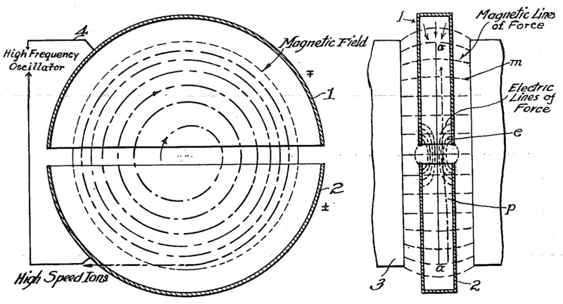
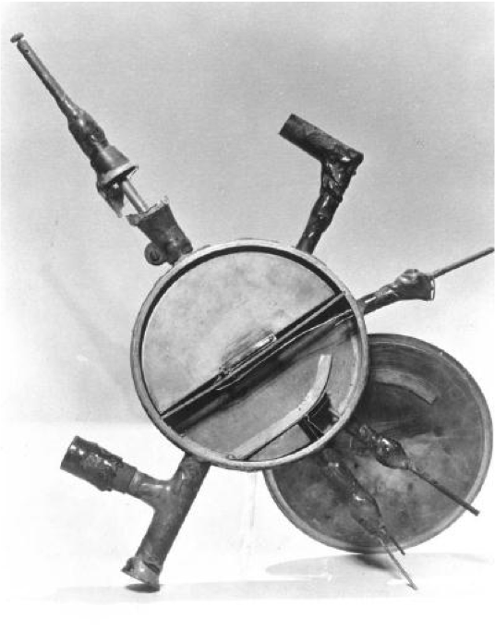
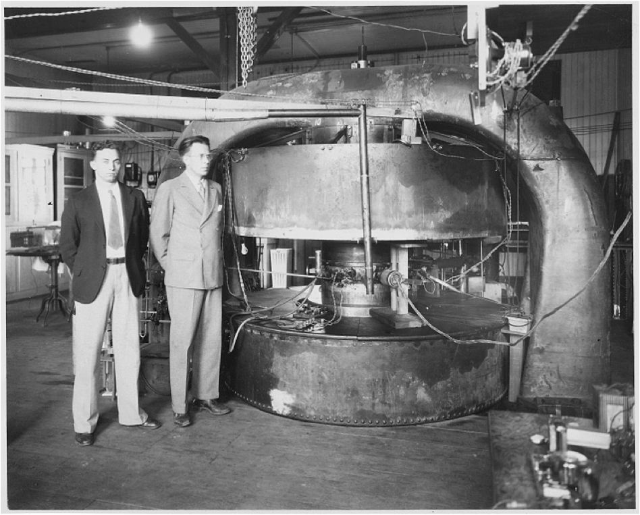
Cyclotrons (2)
The Cyclotron, from E. Lawrence’s 1934 patent
The first cyclotron
E. Lawrence & M. Stanley Livingston
Notes:
First attempt was by Niels Edelfsen

Slide 22
A creative boom: the 1940s to 1960s

Slide 23
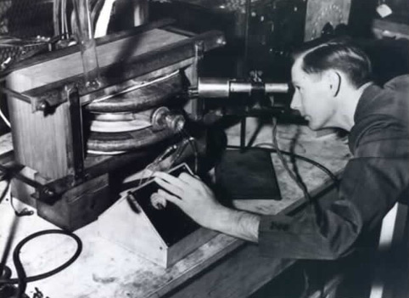
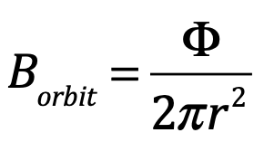

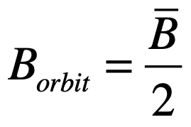
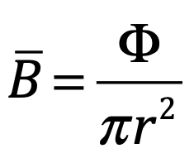
Betatron
D.W. Kerst, Phys. Rev. 58, 841 (1940)
Like a transformer with the beam as a secondary coil
Usually used for relativistic electrons (so different from a cyclotron).
Max energy achieved 300 MeV
Accelerating field produced by a changing magnetic field that also serves to maintains electrons in a circular orbit of fixed radius as they are accelerated
Equate Faradays law on induction & Lorentz force law gives…
since
Image: http://mysite.du.edu/~jcalvert/phys/partelec.htm#Tron
http://physics.princeton.edu/~mcdonald/examples/betatron.pdf

Slide 24
Blewett raises a problem: do electrons radiate?
Ivanenko & Pomeranchuk: upper limit to betatron energy around 500MeV! (1944)
Shwinger also predicted radiation (1945)
Opposing views: electrons in wires don’t radiate?
GE team searched in the radio spectrum… found nothing?

Slide 25
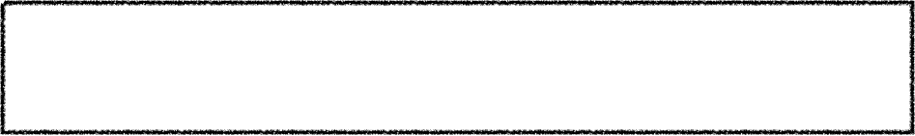
Synchrotrons
“Particles should be constrained to move in a circle of constant radius thus enabling the use of an annular ring of magnetic field … which would be varied in such a way that the radius of curvature remains constant as the particles gain energy through successive accelerations” - Marcus Oliphant, 1943
B(t)
Extract
Inject
t
Typical synchrotron magnet cycle
Notes:
Ernest Lawrence arrived at GE and told them of the idea for the synchrotron

Slide 26






Synchrotrons - Phase stability
Vladimir Veksler & Ed McMillan
a - synchronous
b - arrives early, sees higher voltage, goes to larger orbit -> arrives later next time
c - arrives late, sees lower voltage, goes to smaller orbit -> arrives earlier next time
V
b
a
c
t

Slide 27
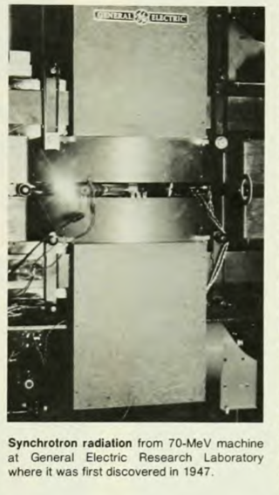
Discovery of Synchrotron Light
GE, 1947
Astrophysical relevance: majority of radio sources in the universe emit via synchrotron processes!
NB. GE team were beaten to ‘first synchrotron’ by a month:
Goward and Barnes (UK) converted a small betatron into an 8 MeV electron synchrotron

Slide 28
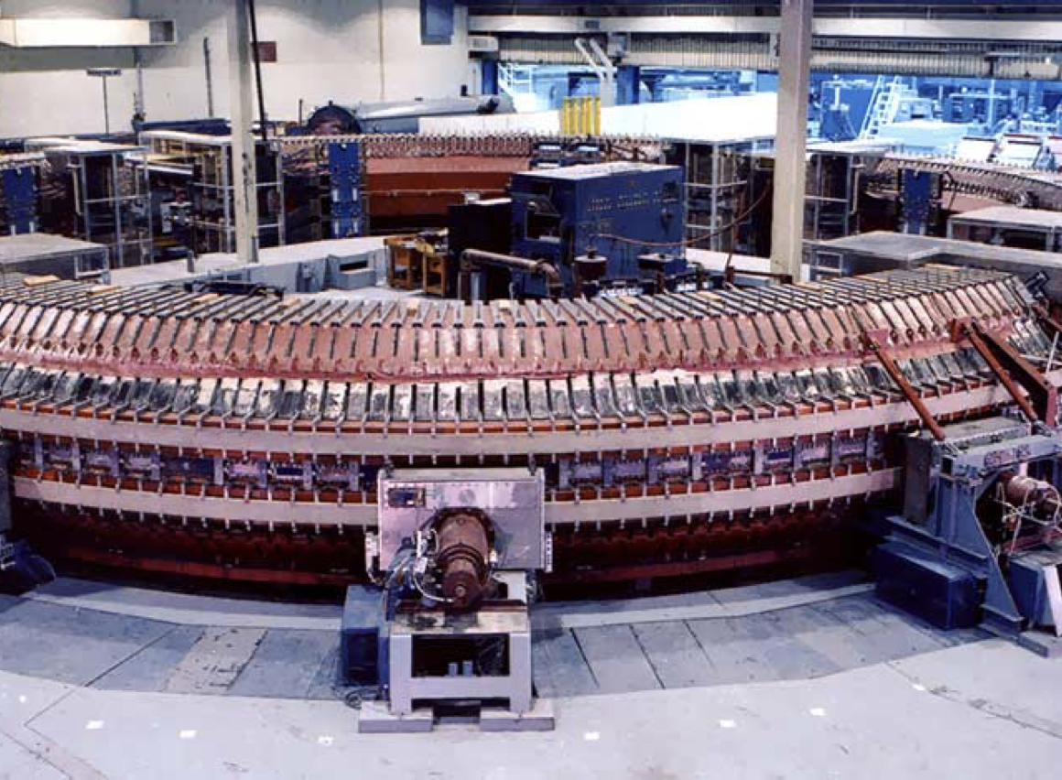
Proton Synchrotrons
The Cosmotron, BNL

Slide 29
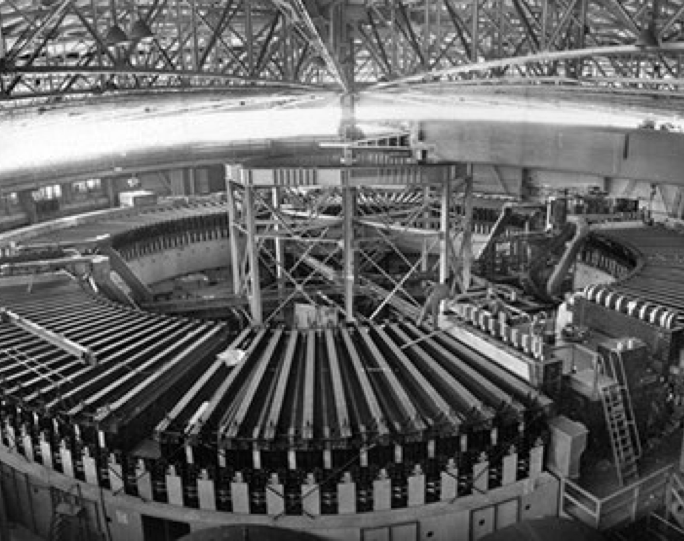
The Bevatron, Berkeley: discovered the antiproton

Slide 30
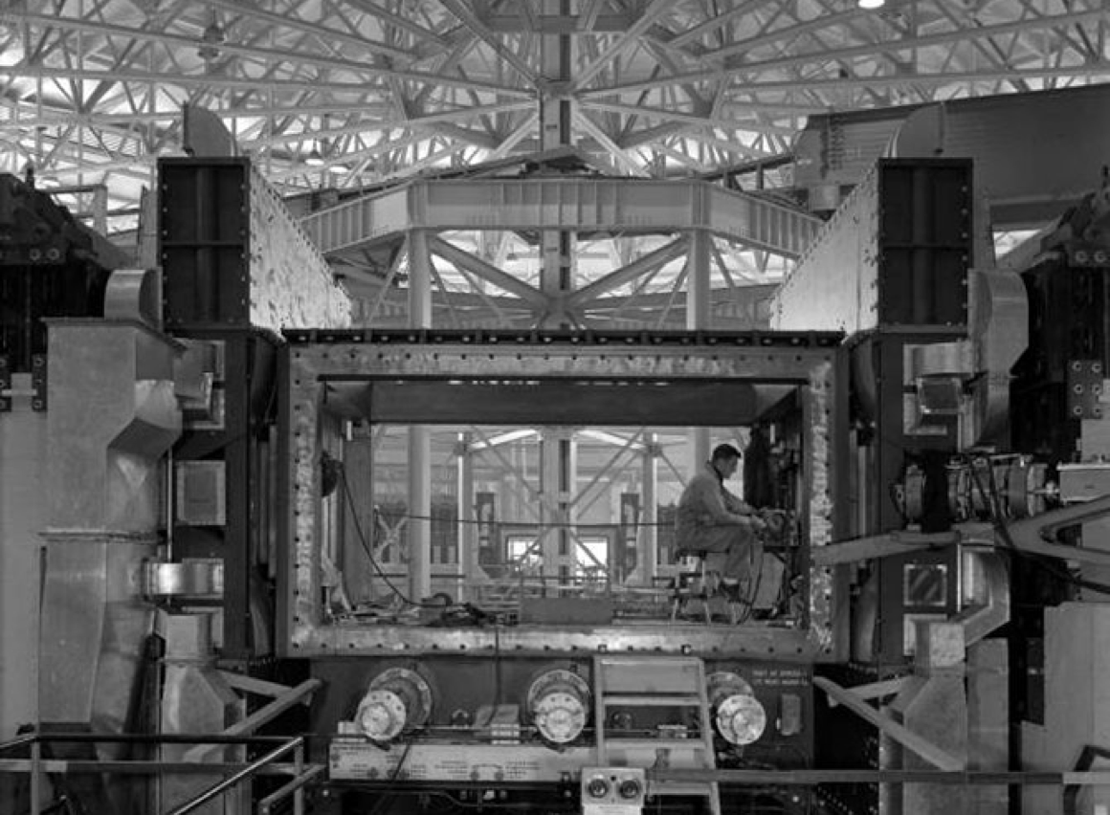

Slide 31
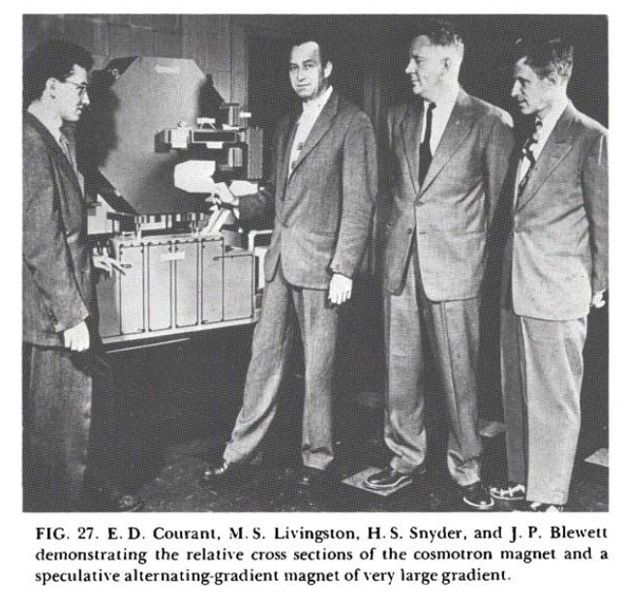
Strong Focusing
Brookhaven, 1952, Livingston: Can we turn around some Cosmotron magnets?
It turned out Nikolas Christophilos (Greek engineer) had got there first and patented the idea: they later hired him.
E. Courant & H. Snyder worked out the theory…
Notes:
It turned out Nikolas Chrisophilos had got there first and patented the idea: they later hired him.

Slide 32
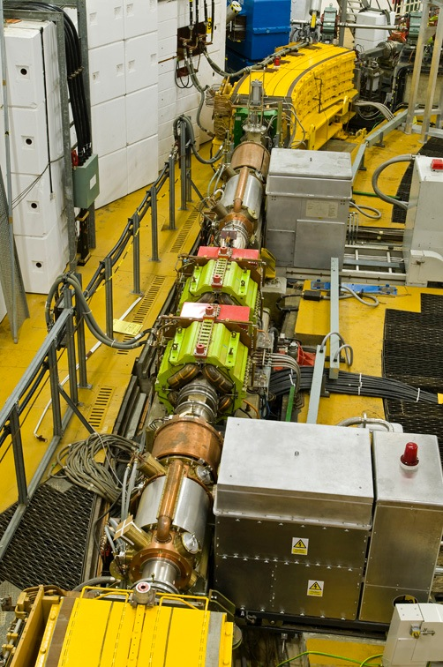
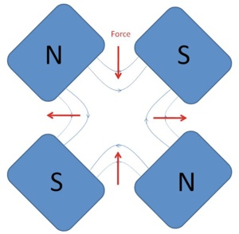
Strong Focusing Synchrotrons
dipole
magnets
quadrupole
magnets
rf cavity
Image courtesy of ISIS, STFC
Notes:
We also ramp the quadrupoles in a synchrotron to retain focusing
In 1953, M.G. White and T. Kitigaki separately invented the separated-function strong focusing
accelerator, in which the functions of bending and focusing are done in separate magnets.

Slide 33
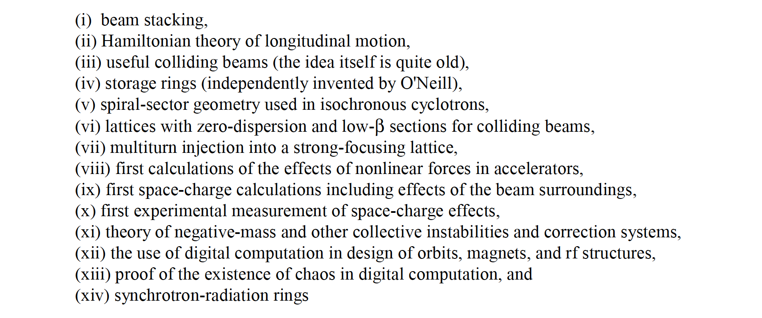
“What about the Midwest?”
The tale of MURA

Slide 34




Fixed Field Alternating Gradient Accelerators (FFAs)
Formerly ‘FFAG’
If the field profile is of a particular form, we call this type of FFA* a ‘scaling’ type
Alternating magnets have opposite bending fields
Beam moves radially with energy
Note that this field profile does NOT satisfy isochronicity

Slide 35


1956
L. W. Jones, AIP Conference Proceedings, 237, 1 (1991)

Slide 36


LINACs & klystrons: from radar to accelerators
Russ & Sigurd Varian
Bill Hansen & team

Slide 37



Linac Structures
Images thanks to Ciprian Plostinar, RAL
DTL: Drift Tube Linac
CCL: Coupled Cavity Linac
F. Gerigk, CERN

Slide 38
An established field and a powerful tool:
1970s to today

Slide 39

‘Livingston plot’
M. Stanley Livingston:
advances in accelerator technology increase in energy record by a factor of 10 every six years.
Image: http://www.slac.stanford.edu/pubs/beamline/27/1/27-1-panofsky.pdf

Slide 40

Colliders
From: G. Pancheri, L. Bonolis, in History of Particle Colliders,
IOP History of Physics Group, 2018

Slide 41


ISR – first hadron collider
1971 to 1984, CoM energy
62GeV
Also: stochastic cooling invented by Simon Van de Meer

Slide 42





The Tevatron & superconducting magnets
Alvin Tollestrup
Helen Edwards
“Tevatron”= 1 TeV beam energy

Slide 43


Slide 44

Accelerators: Nobel-winning pursuit
“28% of the research in physics between 1939 and 2009 has been influenced by accelerator science and that on average accelerator science contributed to a Nobel Prize for Physics every 2.9 years”*
*Haussecker, E.F., Chao, A.W. The Influence of Accelerator Science on Physics Research. Phys. Perspect. 13, 146 (2011).

Slide 45


Slide 46
My contact details:
suzie.sheehy@physics.ox.ac.uk
suzie.Sheehy@unimelb.edu.au
Twitter: @suziesheehy
www.suziesheehy.com

Slide 47
Further Reading:
Engines of Discovery,
Andy Sessler, Edmund (Ted) Wilson, 2014
The Fly in the Cathedral, Brian Cathcart, 2004
Big Science: Ernest Lawrence and the Invention that Launched the Military-Industrial Complex, Michael Hiltzik, 2016
Fermilab Physics, the Frontier, and Megascience, Lillian Hoddeson, Adrienne W. Kolb, Catherine Westfall, 2011
The Matter of Everything: Twelve Experiments that Changed Our World, Suzie Sheehy, 2022

Slide 48
Betatrons: http://web.mit.edu/course/22/22.09/ClassHandouts/Charged%20Particle%20Accel/CHAP11.PDF
FFA history: K. R. Symon, 'The Mura Days’ https://accelconf.web.cern.ch/accelconf/p03/PAPERS/WOPA003.PDF

Slide 49
A few loose ends:

Slide 50
Microtron
Images: wikimedia commons
Uses a linear accelerator structure instead of the dee electrodes of the cyclotron
Mostly used for electrons as assumes constant frequency RF & B field in the ultra relativistic limit.
Veksler, I. V. (1944). "A New Method of the Acceleration of Relativistic Particles". Doklady Akad. Nauk SSSR (in Russian) 43: 346.

Slide 51
Rhodotron
Invented 1989
S: particle source
C: coaxial cavity
D: bending magnets
L: focusing lens
Energy gain ~ 1 MeV per crossing

Slide 52

FFAs
In the late 90’s and in 2000’s, the FFA idea was re-awakened in Japan,
Particular focus on hadron FFAs of scaling type
Recently non-scaling type driven by UK collaboration
Scaling (zero-chromatic)
Non-Scaling (chromatic)
Proof of Principle machine built in 1999 at KEK, demonstrated 1kHz rep. rate
EMMA, Daresbury Lab, UK

