Slide 1


Beam Instrumentation & Diagnostics Part 1
CAS Introduction to Accelerator Physics
Kaunas, 23rd of September 2022
Peter Forck
Gesellschaft für Schwerionenforschnung (GSI)
p.forck@gsi.de
Beam Instrumentation: Functionality of devices & basic applications
Beam Diagnostics: Usage of devices for complex measurements
For peace
and freedom

Slide 2
Copyright statement and speaker’s release for video publishing
The author consents to the photographic, audio and video recording of this lecture at the CERN Accelerator School. The term “lecture” includes any material incorporated therein including but not limited to text, images and references.
The author hereby grants CERN a royalty-free license to use his image and name as well as the recordings mentioned above, in order to post them on the CAS website.
The material is used for the sole purpose of illustration for teaching or scientific research. The author hereby confirms that to his best knowledge the content of the lecture does not infringe the copyright, intellectual property or privacy rights of any third party. The author has cited and credited any third-party contribution in accordance with applicable professional standards and legislation in matters of attribution.

Slide 3
Demands on Beam Diagnostics
Diagnostics is the ’sensory organs’ for a real beam in a real environment.
(Referring to lecture by Volker Ziemann: ‘Detecting imperfections to enable corrections’)
Different demands lead to different installations:
Quick, non-destructive measurements leading to a single number or simple plots
Used as a check for online information. Reliable technologies have to be used
Example: Current measurement by transformers
Complex instruments for severe malfunctions, accelerator commissioning & development
The instrumentation might be destructive and complex
Example: Emittance determination, tune measurement
General usage of beam instrumentation:
Monitoring of beam parameters for operation, beam alignment & accel. development
Instruments for automatic, active beam control
Example: Closed orbit feedback at synchrotrons using position measurement by BPMs
Non-invasive ( = ’non-intercepting’ or ‘non-destructive’) methods are preferred:
The beam is not influenced ⇒ the same beam can be measured at several locations
The instrument is not destroyed due to high beam power

Slide 4
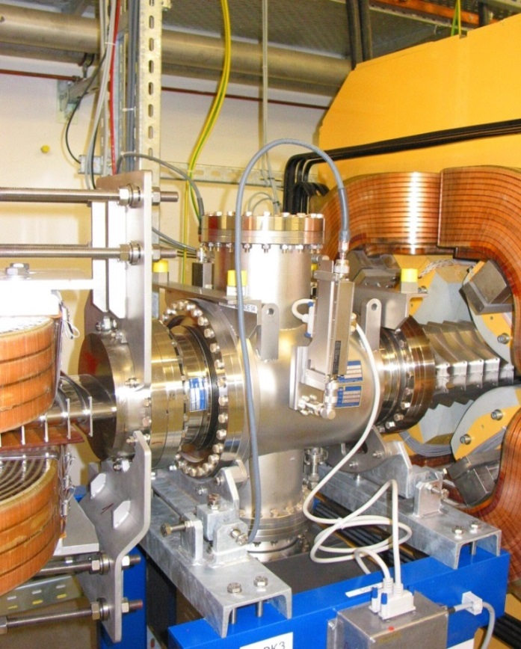
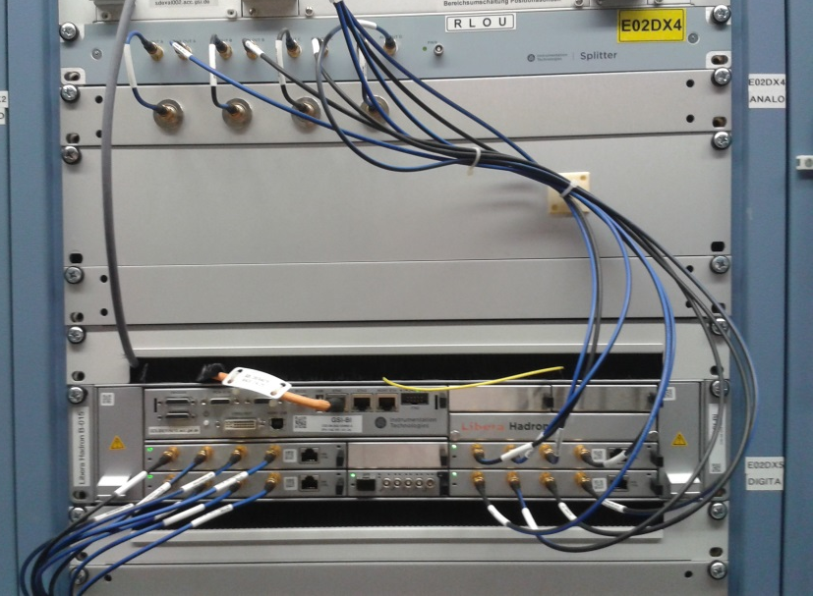
Typical Installation of a Beam Instrument
Quadrupole
Linear Ampl.
‘long cable’ out
LAN
ADCs
Beam
Long cable
‘long cable’
typ. ≈ 100 m
concrete wall
Accelerator tunnel:
→ action of the beam to the detector
→ low noise pre-amplifier and first signal shaping
Local electronics room:
→ analog treatment, partly combining other parameters
→ digitalization, data bus systems (GPIB, VME, cPCI, µTCA...)

Slide 5
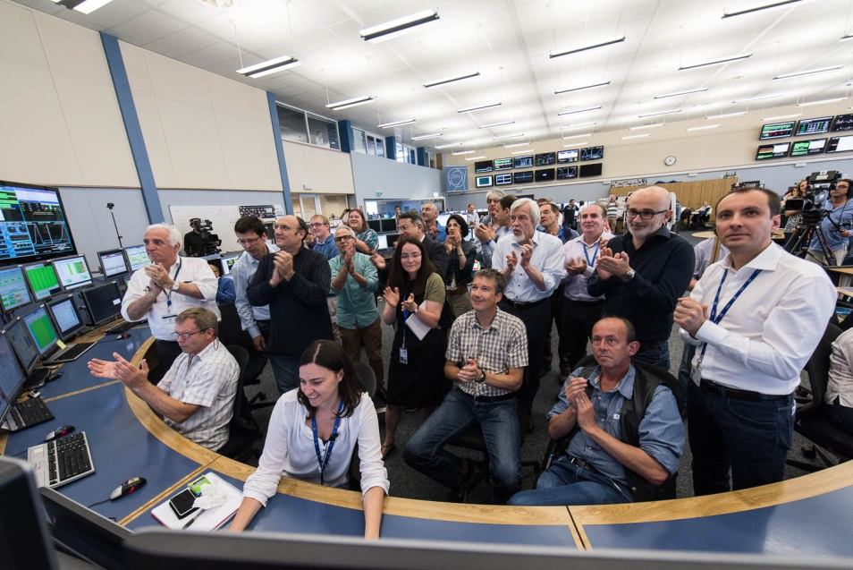
Typical Installation of a Beam Instrument
Modern trend:
High performance ADC
& digital signal processing
‘long cable’
typ. ≈ 100 m
Happy people at
LHC Sept. 10, 2008
concrete wall
Accelerator tunnel:
→ action of the beam to the detector
→ low noise pre-amplifier and first signal shaping
Local electronics room:
→ analog treatment, partly combining other parameters
→ digitalization, data bus systems (GPIB, VME, cPCI, µTCA...)
Beam alignment
by ‘turning knobs’
Control room:
→ visualization and storage
→ parameter setting
http://www.lhc-facts.ch/

Slide 6
Outline of the Lectures
The ordering of the subjects is oriented by the beam quantities:
Part 1 of the lecture on electro-magnetic monitors:
Current measurement
Beam position monitors for bunched beams
Part 2 of the lecture on transverse and longitudinal diagnostics:
Profile measurement
Transverse emittance measure
Measurement of longitudinal parameters
Lecture on Machine Protection System on Saturday:
Beam loss detection as one subject
Instruments could be different for:
Transfer lines with single pass ↔ synchrotrons with multi-pass
Electrons are mostly relativistic ↔ protons are at the beginning non-relativistic
Remark:
Most instrumentation is installed outside of rf-cavities to prevent for signal disturbance

Slide 7
Measurement of Beam Current
The beam current and its time structure the basic quantity of the beam:
It this the first check of the accelerator functionality
It has to be determined in an absolute manner
Important for transmission measurement and to prevent for beam losses.
Different devices are used:
Transformers: Measurement of the beam’s magnetic field
Non-destructive
No dependence on beam type and energy
They have lower detection threshold.
Faraday cups: Measurement of the beam’s electrical charges

Slide 8


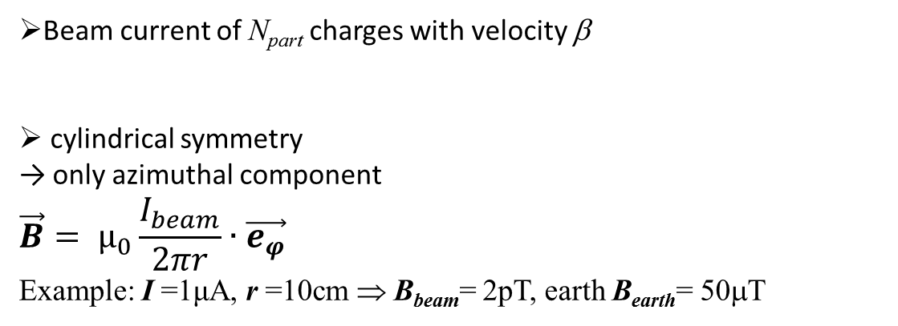
Magnetic Field of the Beam and the ideal Transformer
Beam current of N_{part} charges with velocity β
cylindrical symmetry
→ only azimuthal component
$$\vec{B}= µ_{0}\frac{I_{beam}}{2πr}∙\vec{e_{φ}}$$
Example: I =1μA, r =10cm ⇒ B_{beam}= 2pT, earth B_{earth}= 50μT
Idea: Beam as primary winding and sense by secondary winding
⇒ Loaded current transformer
I₁/I₂= N₂/N₁ ⇒ I_{sec} = 1/N · I_{beam}
Inductance of a torus of μ_{r}
Goal of torus: Large inductance L
and guiding of field lines.
Definition: U = L · dI/dt
Torus to guide the magnetic field
I_{beam}
v_{out}
R

Slide 9
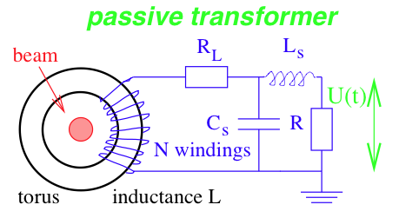
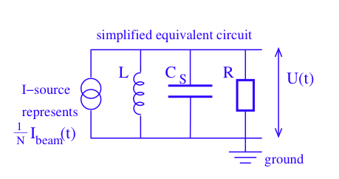
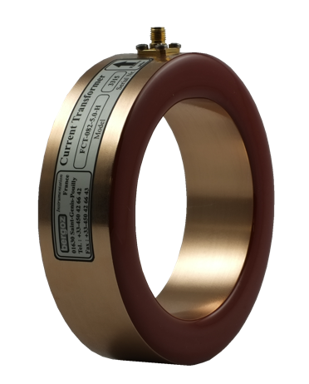
Fast Current Transformer FCT (also called Passive Transformer)
Simplified electrical circuit of a passively loaded transformer:
A voltages is measured: U = R · I_{sec} = R /N · I_{beam} ≡ S · I_{beam}
with S sensitivity [V/A],
equivalent to transfer function or transfer impedance Z
beam
Equivalent circuit for analysis of sensitivity and bandwidth
(disregarding the loss resistivity R_{L})

Slide 10
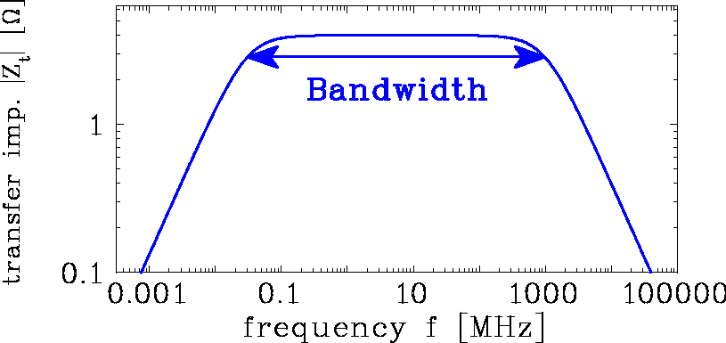
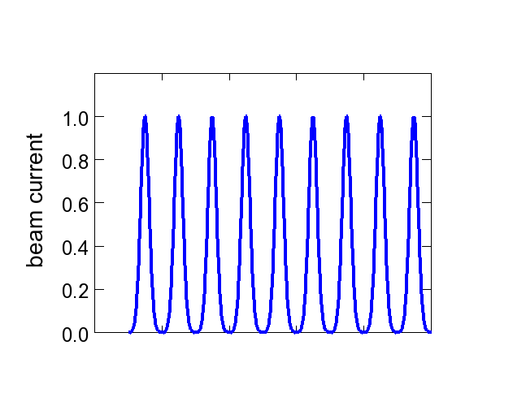
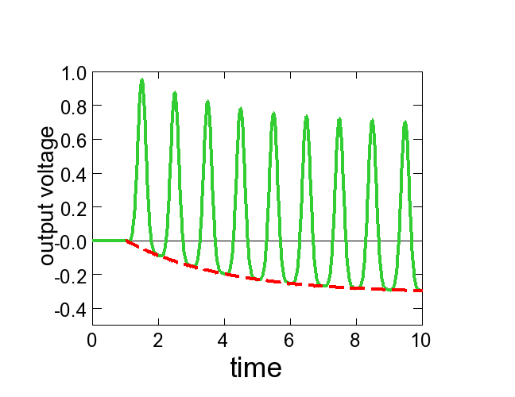


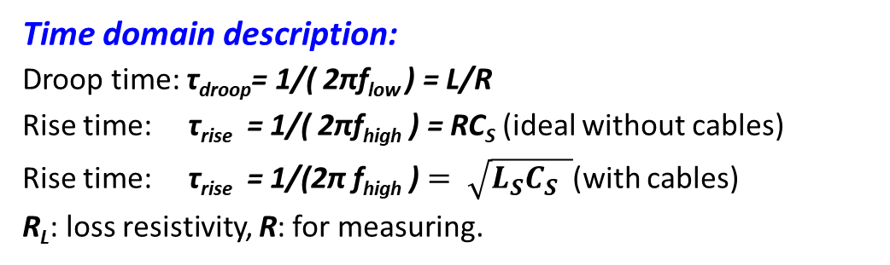
Response of the Passive Transformer: Rise and Droop Time
Time domain description:
Droop time: τ_{droop}= 1/( 2πf_{low} ) = L/R
Rise time: τ_{rise} = 1/( 2πf_{high} ) = RC_{S} (ideal without cables)
Rise time: τ_{rise} = 1/(2π f_{high} ) $= \sqrt{L_{S}C_{S} }$(with cables)
R_{L}: loss resistivity, R: for measuring.
beam current
beam bunch
Bunch train:
test
pulse
beam current
time
time
output volt.
$$τ_{droop}=L/R$$
time
time
signal
$$τ_{rise}=\sqrt{L∙C_{S}}$$
2π f_{low}
=R/L
2πf_{high}
=1/RC_{S}
baseline
Baseline: U_{base} ∝ 1 - exp(-t/τ_{droop})
positive & negative areas are equal

Slide 11
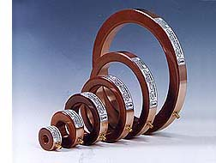
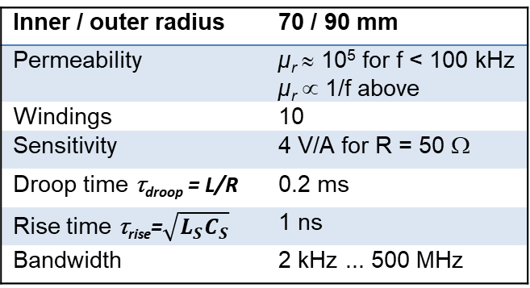
Example for Fast Current Transformer
From
Company Bergoz
For bunch beams e.g. during accel. in a synchrotron
typical bandwidth of 2 kHz < f < 1 GHz
⇔ 10 ns < t_{bunch} < 1 μs is well suited
Example: GSI Fast Current Transformer FCT:
Inner / outer radius | 70 / 90 mm
Permeability | µ_{r} ≈ 10⁵ for f < 100 kHz µ_{r} ∝ 1/f above
Windings | 10
Sensitivity | 4 V/A for R = 50 Ω
Droop time τ_{droop} = L/R | 0.2 ms
Rise time τ_{rise}=$\sqrt{L_{S}C_{S}}$ | 1 ns
Bandwidth | 2 kHz ... 500 MHz
∅ 200 mm
Numerous application e.g.:
Transmission optimization
Bunch shape measurement
Input for synchronization
of ‘beam phase’
synchrotron
FCT
injection
extraction

Slide 12
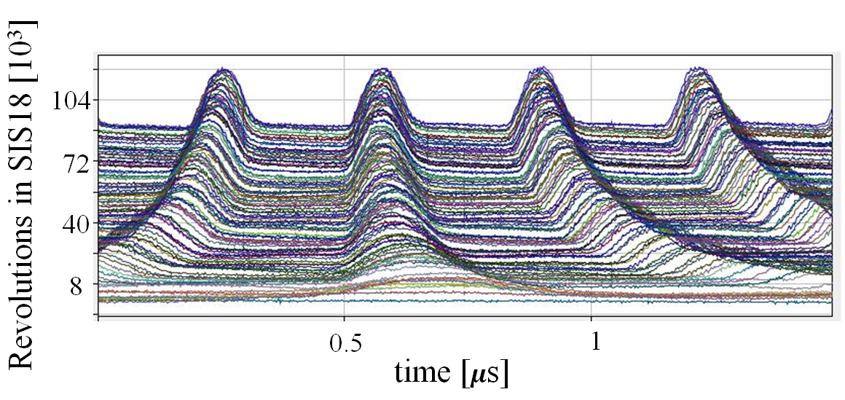
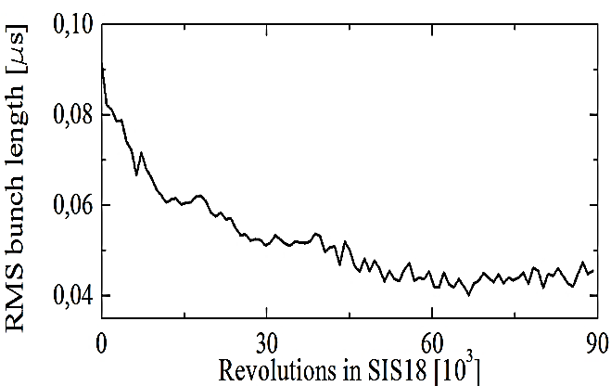
Example for Fast Current Transformer
From
Company Bergoz
For bunch beams e.g. during accel. in a synchrotron
typical bandwidth of 2 kHz < f < 1 GHz
⇔ 10 ns < t_{bunch} < 1 μs is well suited
Example GSI type:
Inner / outer radius | 70 / 90 mm
Permeability | µ_{r} ≈ 10⁵ for f < 100 kHz µ_{r} ∝ 1/f above
Windings | 10
Sensitivity | 4 V/A for R = 50 Ω
Droop time τ_{droop} = L/R | 0.2 ms
Rise time τ_{rise}=$\sqrt{L_{S}C_{S}}$ | 1 ns
Bandwidth | 2 kHz ... 500 MHz
∅ 200 mm
Example: U⁷³⁺ from 11 MeV/u (β = 15 %) to 350 MeV/u within 300 ms (displayed every 0.15 ms)
More examples see lecture
‘Longitudinal Beam Dynamics’ by Frank Tecker, Christine Völlinger & Alexandre Lasheen
FCT
synchrotron
0
1.5
injection
extraction

Slide 13
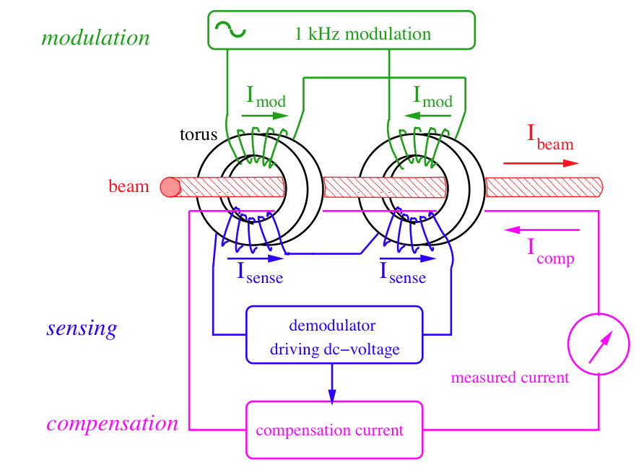
The dc Transformer DCCT
How to measure the DC current? The current transformer discussed sees only B-flux changes.
The DC Current Transformer (DCCT) → magnetic saturation of two torii.
Depictive statement:
A single transformer needs varying beam. The trick is to ‘switch two transformers’!
Modulation of the primary windings forces both torii into saturation
twice per cycle
Sense windings measure the modulation signal and cancel each other.
But with the I_{beam}, the saturation is shifted and I_{sense} is not zero
Compensation current adjustable until I_{sense} is zero once again
Remark:
Same principle installed in power supplier
Notes:
13

Slide 14
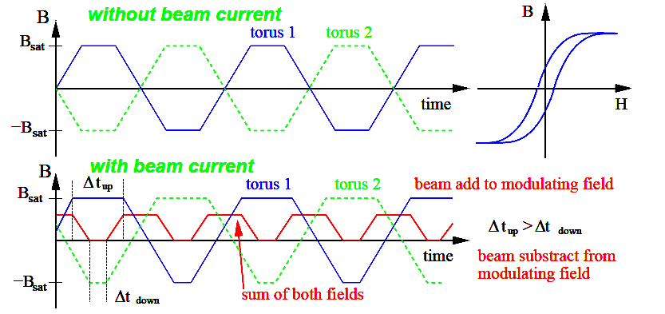
The dc Transformer
Modulation without beam:
typically about 9 kHz to saturation → no net flux
Modulation with beam:
  saturation is reached at different times, → net flux
Net flux: double frequency than modulation
Feedback: Current fed to compensation winding
for larger sensitivity
Two magnetic cores: Must be very similar.
Remark: Same principle used for power suppliers
Notes:
14

Slide 15
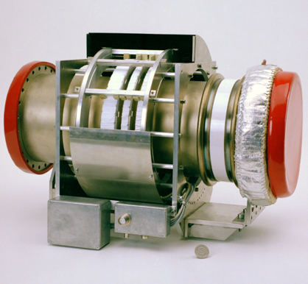
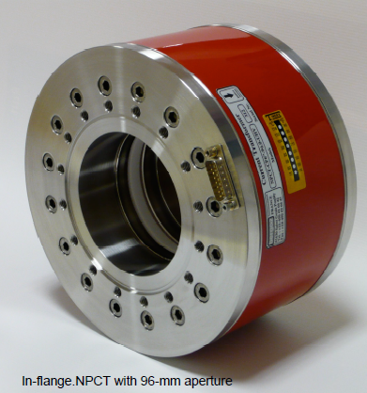
The dc Transformer Realization
Example: The DCCT at GSI synchrotron
dc transformer
2 cores mounted
ac transformers
(two types)
Torus radii | r_{i} = 135 mm r_{o}=145 mm
Torus thickness | d = 10 mm
Torus permeability | µ_{r} = 10⁵
Saturation inductance | B_{sat} = 0.6 T
Number of windings | 16 for modulation & sensing 12 for feedback
Resolution | I^{min}_{beam} = 2 µA
Bandwidth | Δf = dc .... 20 kHz
Rise time constant | τ_{rise} = 10 µs
Temperature drift | 1.5 µA/ºC
ceramic gap
magnetic shield
∅200 mm flange
15
Notes:
15

Slide 16
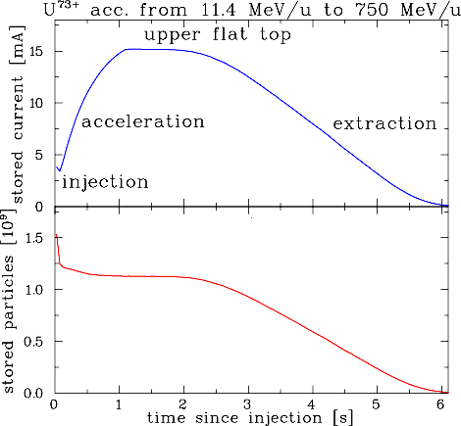
Measurement with a dc Transformer
Application for dc transformer:
Observation of beam behavior with typ. 20 µs time resolution → the basic operation tool
Example: The DCCT at GSI synchrotron
U⁷³⁺ accelerated from
11. 4 MeV/u (β = 15.5%) to 750 MeV/u (β = 84 %)
Important parameter:
Detection threshold: ≈ 1 µA
(= resolution)
Bandwidth: Δf = dc to 20 kHz
Rise-time: t_{rise} = 20 µs
Temperature drift: 1.5 µA/⁰C
⇒ compensation required.
DCCT
synchrotron
injection
extraction
Notes:
16

Slide 17
Measurement of Beam Current
Transformers: Measurement of the beam’s magnetic field
Non-destructive
No dependence on beam type and energy
They have lower detection threshold.
Faraday cups: Measurement of the beam’s electrical charges
They are destructive
For low energies only
Low currents can be determined.

Slide 18
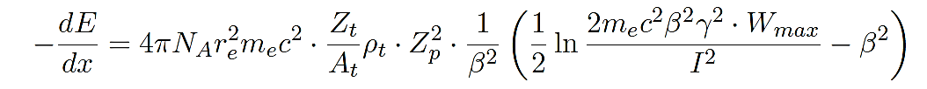
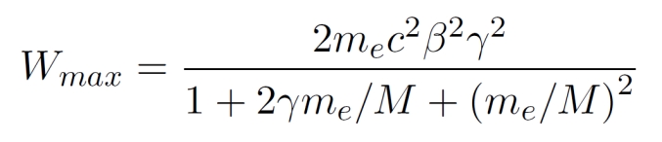
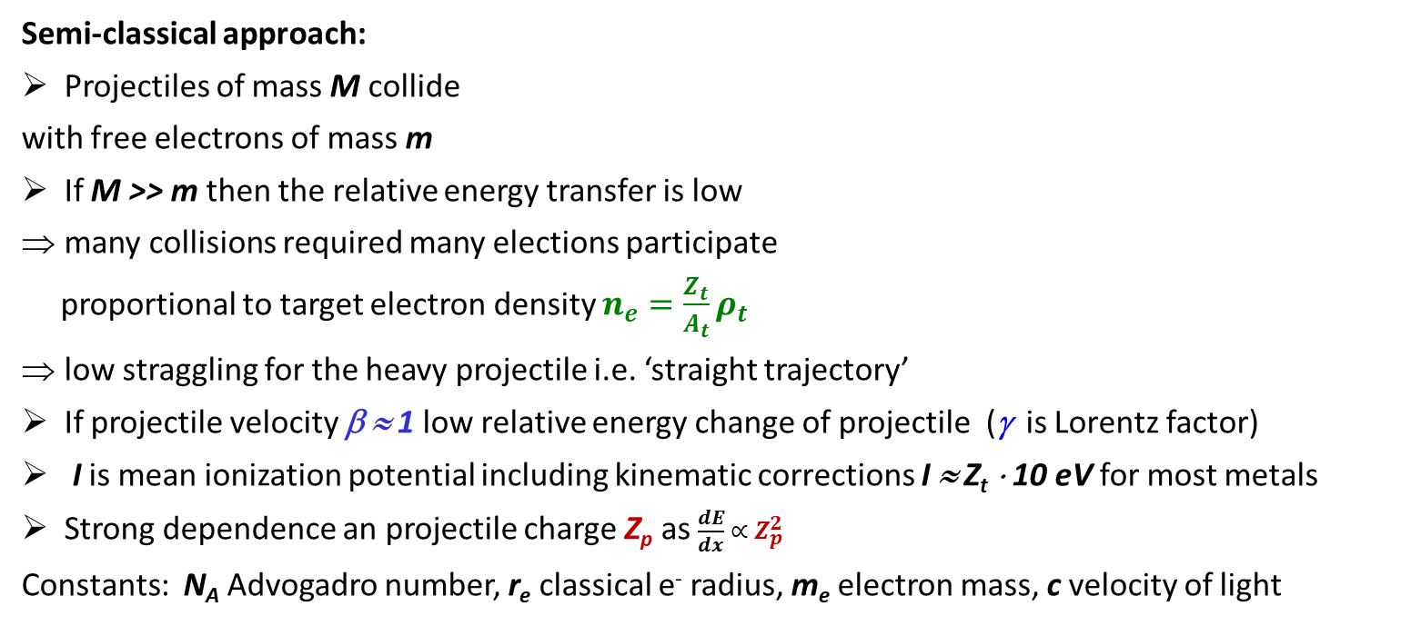
Excurse: Energy Loss of Protons & Ions
Bethe-Bloch formula:
(simplest formulation)
Semi-classical approach:
Projectiles of mass M collide
with free electrons of mass m
If M >> m then the relative energy transfer is low
many collisions required many elections participate
proportional to target electron density $n_{e}=\frac{Z_{t}}{A_{t}}ρ_{t}$
low straggling for the heavy projectile i.e. ‘straight trajectory’
If projectile velocity β ≈ 1 low relative energy change of projectile (γ is Lorentz factor)
I is mean ionization potential including kinematic corrections I ≈ Z_{t} ⋅ 10 eV for most metals
Strong dependence an projectile charge Z_{p} as $\frac{dE}{dx} ∝ Z_{p}^{2}$
Constants: N_{A} Advogadro number, r_{e} classical e⁻ radius, m_{e} electron mass, c velocity of light
e⁻
beam, charge Z_{p}
`δ-ray’
mass M
e⁻
Material
Z_{t} , A_{t} , ρ_{t}
Maximum energy transfer from projectile M to electron m_{e}:
Notes:
18

Slide 19
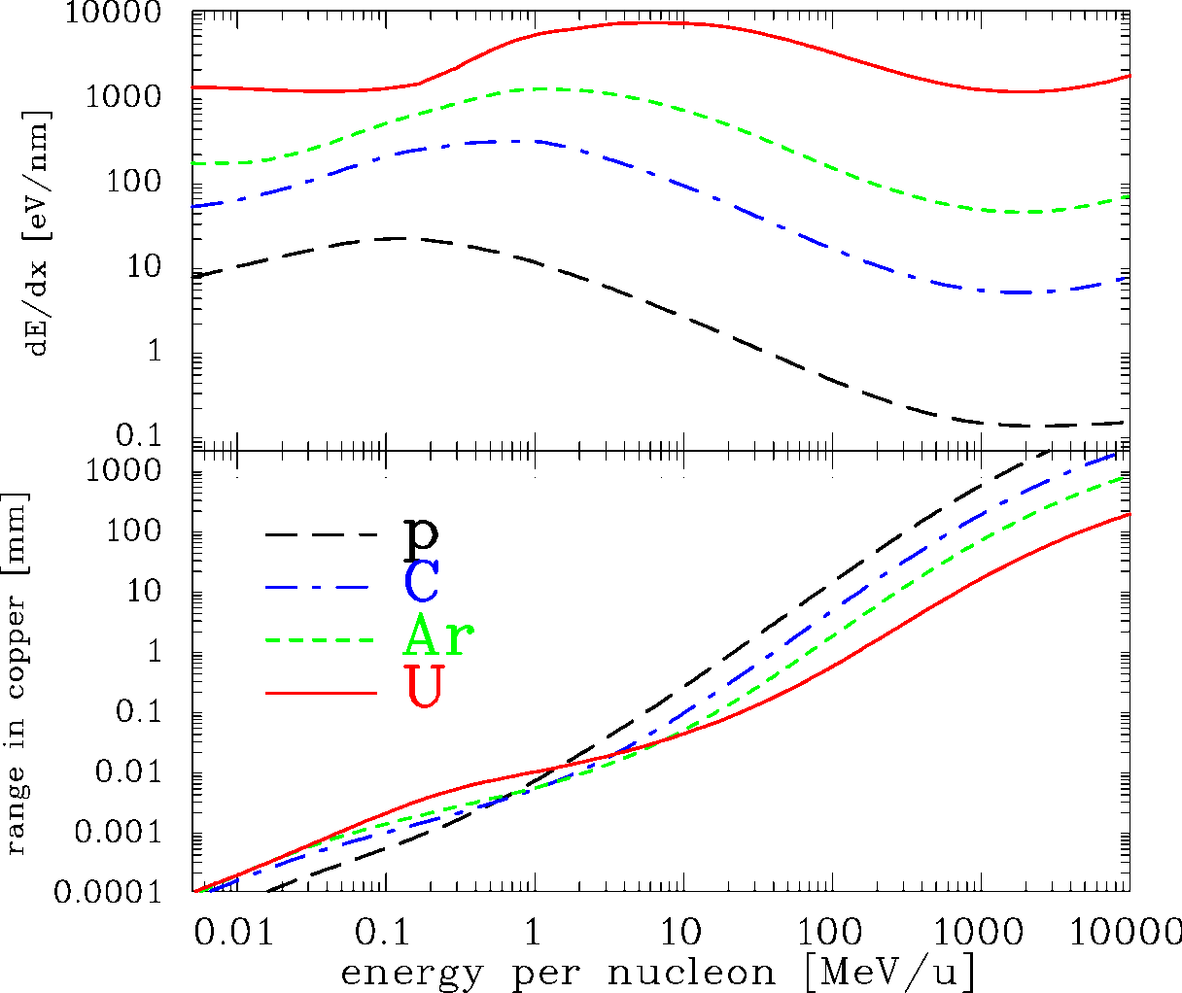
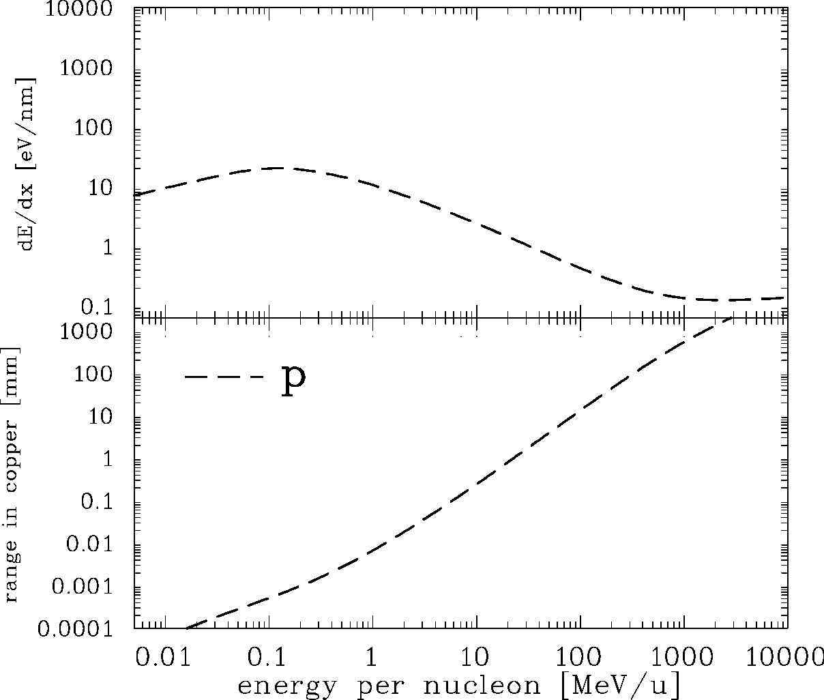
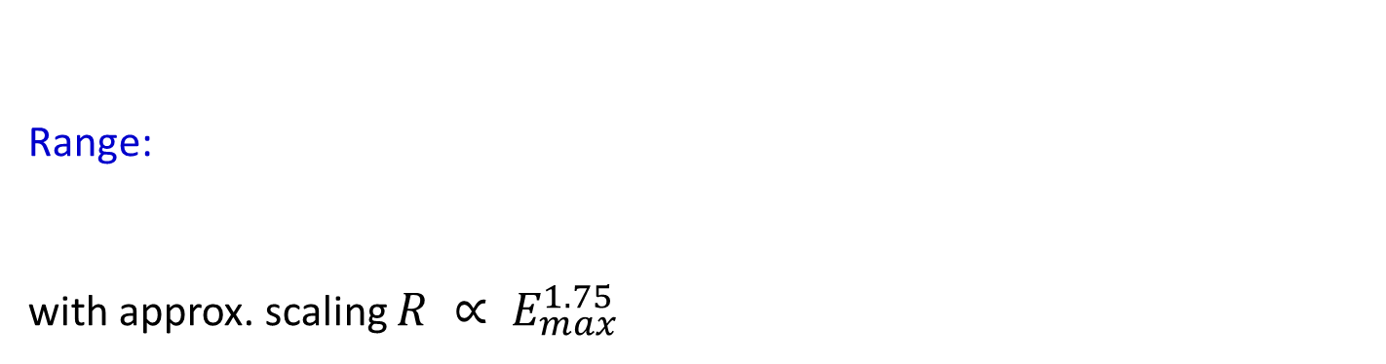
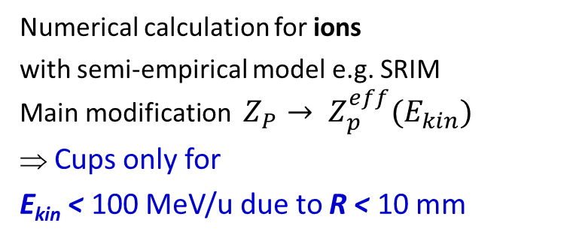
Excurse: Energy Loss of Protons & Ions in Copper
Bethe-Bloch formula:
(simplest formulation)
Range:
with approx. scaling $R ∝ E_{max}^{1.75}$
Synchrotron
LINAC, Cycl.
Source
Numerical calculation for ions
with semi-empirical model e.g. SRIM
Main modification $Z_{P}→ Z_{p}^{eff}(E_{kin})$
⇒ Cups only for
E_{kin} < 100 MeV/u due to R < 10 mm
Approximation e.g. $Z_{p}^{eff} ≈Z_{p} \left[1−\exp\left(−Z_{p}^{−2/3}cβ / V_{Bohr} \right)\right]$
Notes:
19

Slide 20
Excurse: Secondary Electron Emission caused by Ion Impact
Energy loss of ions in metals close to a surface:
Closed collision with large energy transfer: → fast e⁻ with E_{kin} > 100 eV
Distant collision with low energy transfer → slow e⁻ with E_{kin} ≤ 10 eV
‘diffusion’ & scattering with other e⁻: scattering length L_{s} ≈ 1 - 10 nm
at surface ≈ 90 % probability for escape
Secondary electron yield and energy distribution comparable for all metals!
⇒ Y = const. * dE/dx (Sternglass formula)
Different targets:
e⁻
beam
`δ-ray’
Electrons per ion
e⁻
Material
Z_{t} , A_{t} , ρ_{t}
L_{s} ≈ 10 nm
E.J. Sternglass, Phys. Rev. 108, 1 (1957)
20
Notes:
20

Slide 21
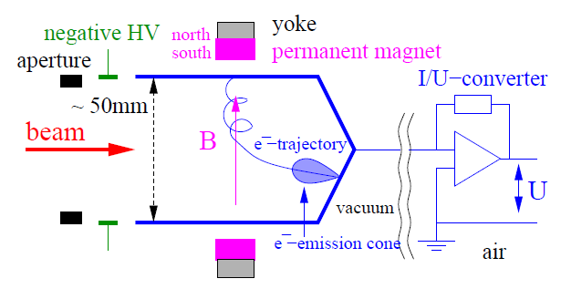
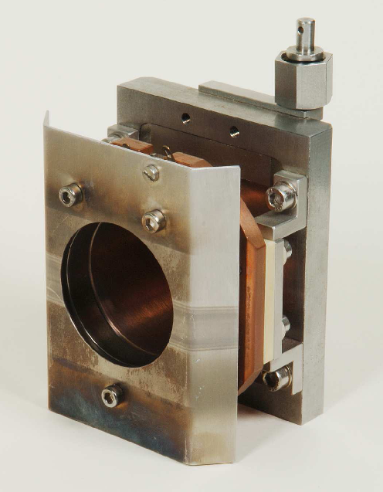
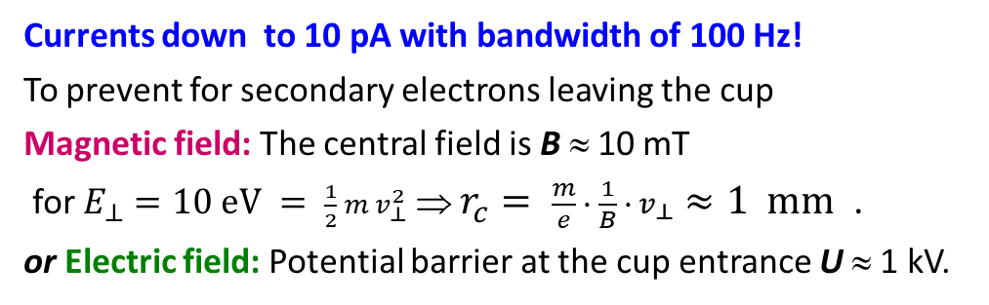
Faraday Cups for Beam Charge Measurement
The beam particles are collected inside a metal cup
⇒ The beam’s charge are recorded as a function of time.
The cup is moved in the beam pass → destructive device
perm. magnet
radius r_{c}
50mm
Currents down to 10 pA with bandwidth of 100 Hz!
To prevent for secondary electrons leaving the cup
Magnetic field: The central field is B ≈ 10 mT
for $E_{⊥}=10 eV = \frac{1}{2} m v_{⊥}^{2}$ ⇒ $r_{c}= \frac{m}{e} ∙ \frac{1}{B} ∙ v_{⊥}≈1 mm$ .
or Electric field: Potential barrier at the cup entrance U ≈ 1 kV.
HV electrode

Slide 22
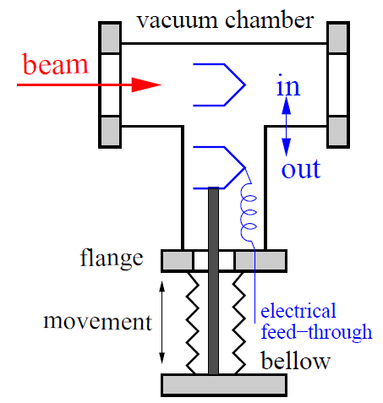
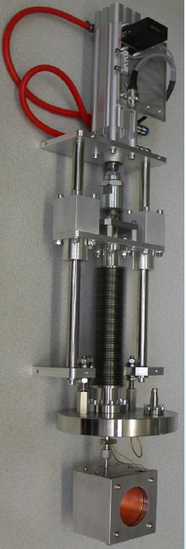
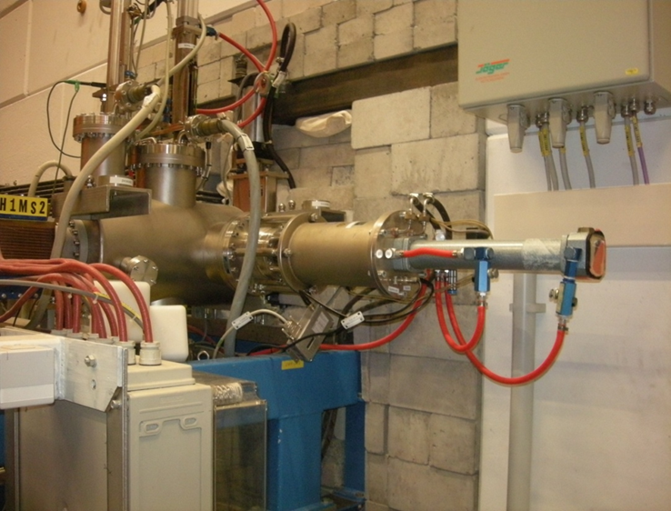
Realization of a Faraday Cup at GSI LINAC
The Cup is moved into the beam pass.
Faraday Cup
∅60 mm
beam
vacuum flange
here ∅150 mm
bellow
compression
for movement
≈ 1m
pneumatic
drive
source
Cup: beam stopped
RFQ
LINAC

Slide 23

The Artist View of a Faraday Cup
Graphics by company Bergoz

Slide 24
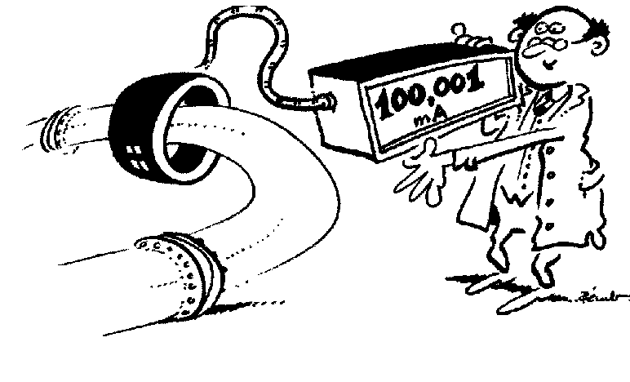
Summary for Current Measurement
Transformer: → measurement of the beam’s magnetic field
➢ Magnetic field is guided by a high μ toroid
➢ Types: FCT → large bandwidth, I_{min}≈ 30 µA, BW = 10 kHz ... 500 MHz
[ACT : I_{min}≈ 0.3 µA, BW = 10 Hz .... 1 MHz, used at proton LINACs ]
DCCT: two toroids + modulation, I_{min}≈ 1 µA, BW = dc ... 20 kHz
➢ non-destructive, used for all beams
Faraday cup: → measurement of beam’s charge,
➢ low threshold by I/U-converter: I_{beam} > 10 pA
➢ totally destructive, used for low energy beams only
Resolution limit
Fast Transformer FCT
Active transformer ACT
DC transformer DCCT
Company Bergoz
24
Notes:
24

Slide 25
Pick-Ups for bunched Beams
Outline:
Signal generation → transfer impedance
Capacitive button BPM for high frequencies
Capacitive linear-cut BPM for low frequencies
Electronics for position evaluation
BPMs for measurement
Summary
A Beam Position Monitor is an non-destructive device for bunched beams
It delivers information about the transverse center of the beam:
Trajectory: Position of an individual bunch within a transfer line or synchrotron
Closed orbit: Central orbit averaged over a period much longer than a betatron oscillation
Single bunch position: Determination of parameters like tune, chromaticity, β-function
Remarks: - BPMs have a low cut-off frequency ⇔ dc-beam can’t be monitored
- The abbreviation BPM and pick-up PU are synonyms

Slide 26
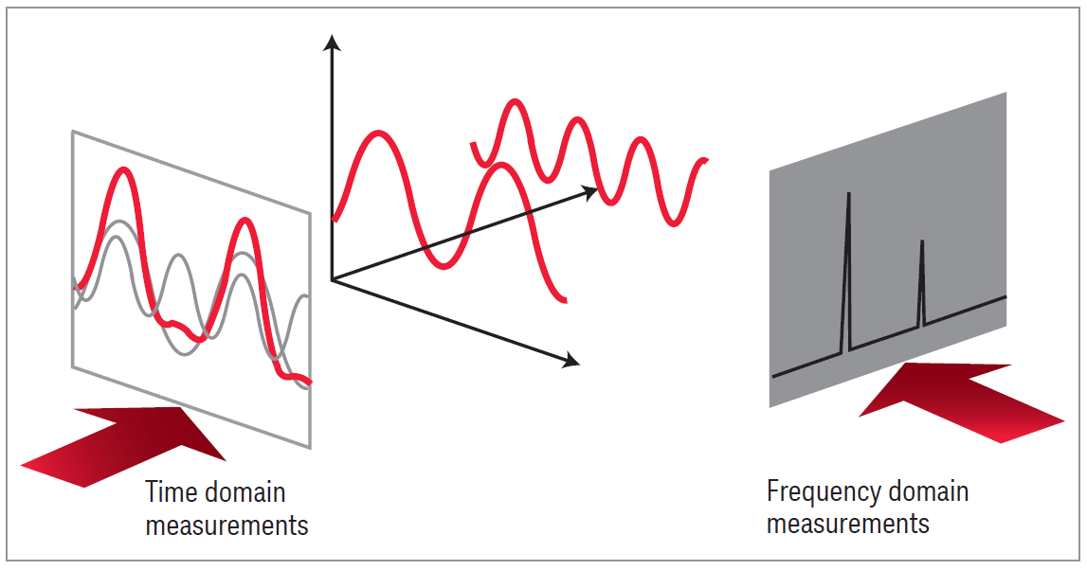
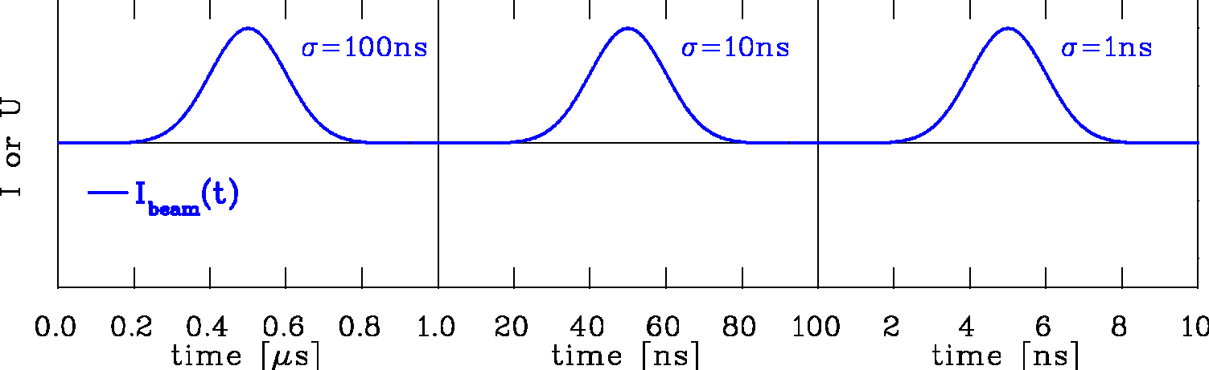
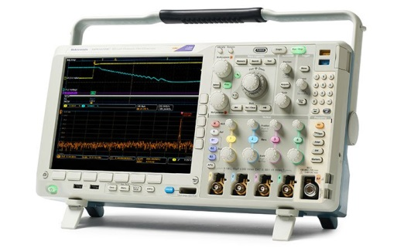
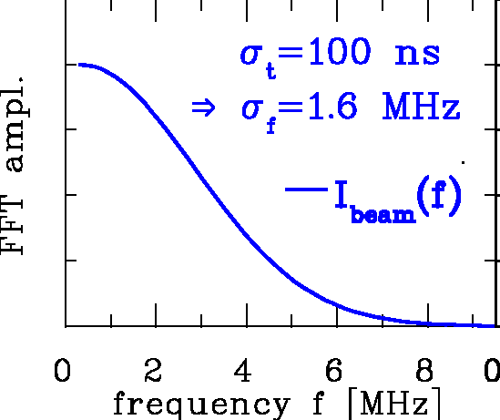
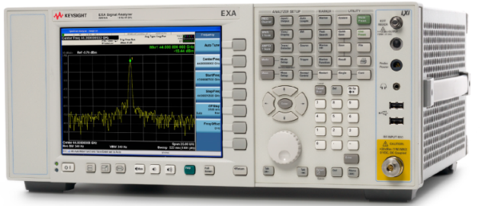
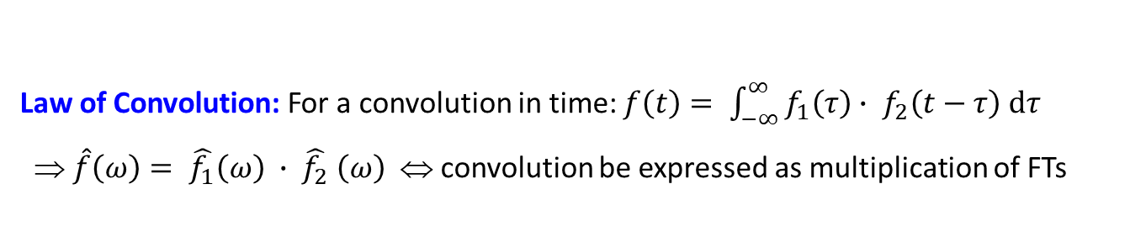
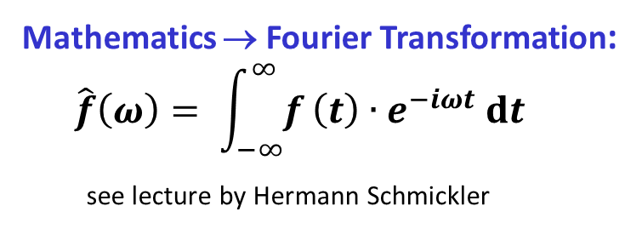
Time Domain ↔ Frequency Domain
Time domain: Recording of a voltage as a function of time:
Instrument:
Oscilloscope
voltage
Mathematics → Fourier Transformation:
$$\hat{f}\left(ω\right)= \int_{−∞}^{∞}{f}\left(t\right)∙e^{−iωt} dt$$
see lecture by Hermann Schmickler
I_{beam}
frequency
time
Frequency domain: Displaying of a voltage as a function of frequency:
courtesy company Keysight
Instrument:
Spectrum Analyzer
Fourier Transformation:
Contains amplitude & phase
The same information
is displayed differently
Law of Convolution: For a convolution in time: $f\left(t\right)= \int_{−∞}^{∞}{f_{1}\left(τ\right)∙ f_{2}\left(t−τ\right) dτ}$
⇒ $\hat{f}\left(ω\right)= \hat{f_{1}}\left(ω\right) ∙ \hat{f_{2}} \left(ω\right)$ ⇔ convolution be expressed as multiplication of FTs
See lecture ‘Time and Frequency Domain Signals’ by Hermann Schmickler

Slide 27
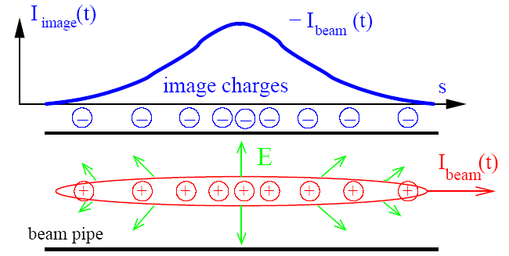
Pick-Ups for bunched Beams
The image current at the beam pipe is monitored on a high frequency basis
i.e. the ac-part given by the bunched beam.
Beam Position Monitor BPM is the most frequently used instrument!
For relativistic velocities,
the electric field is transversal:

Slide 28
Principle of Signal Generation of a BPMs, centered Beam
The image current at the wall is
monitored on a high frequency basis
i.e. ac-part given by the bunched beam.
V
-
+
-
+
-
-
+
-
+
-
+
-
-
+
-
+
-
+
-
+
-
-
+
-
+
-
+
-
+
-
+
-
+
-
-
-
+
+
-
-
+
+
-
-
-
-
+
-
+
-
+
-
-
+
-
+
-
+
-
-
+
-
-
-
-
-
+
-
+
+
-
+
-
-
+
-
+
-
+
-
+
-
+
+
+
+
-
+
-
-
+
-
+
+
+
+
+
+
+
+
+
+
+
+
+
+
+
+
+
+
+
+
+
+
+
+
+
+
+
+
+
+
+
+
+
+
+
+
+
+
+
+
+
+
+
+
+
+
+
+
+
+
+
+
+
+
+
+
+
+
+
+
+
+
+
+
+
+
+
+
+
+
+
+
+
+
+
+
+
+
Animation by Rhodri Jones (CERN)

Slide 29
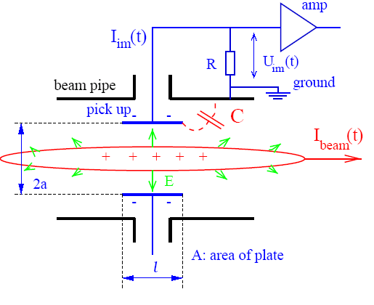

Model for Signal Treatment of capacitive BPMs
The wall current is monitored by a plate or ring inserted in the beam pipe:
Equivalent circuit
C_{C}
I_{beam}
C
R
U_{im}
U_{beam}
capacitive coupling
→ image current
ground
electronics elements
At a resistor R the voltage U_{im} from the image current is measured.
Goal: Connection from beam current to signal strength by transfer impedance Z_{t} (ω )
in frequency domain: U_{im}(ω) = R · I_{im}(ω) = Z_{t}(ω) · I_{beam}(ω)
Result: $Z_{t}\left(ω\right)= \frac{A}{2π a} ∙ \frac{1}{βc}∙\frac{1}{C} ∙ \frac{iωRC}{1+iωRC} ∈ℂ$ i.e. complex function
geometry
stray capacitance
frequency response

Slide 30
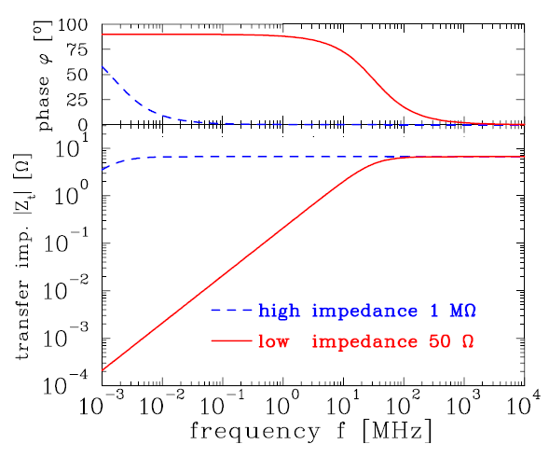
Example of Transfer Impedance for Proton Synchrotron
The high-pass characteristic for typical synchrotron BPM:
U_{im}(ω)=Z_{t}(ω)·I_{beam}(ω)
Parameter linear-cut BPM at proton synchr.:
C = 100pF, l = 10cm, β = 50%
f_{cut} = ω/2π = (2πRC)⁻¹
for R = 50 Ω ⇒ f_{cut} = 32 MHz
for R = 1 MΩ ⇒ f_{cut} = 1.6 kHz
Large signal strength for long bunches → high impedance
Smooth signal transmission important for short bunches → 50 Ω
Remark: For ω → 0 it is Z_{t} → 0 i.e. no signal is transferred from dc-beams e.g.
➢ de-bunched beam inside a synchrotron
➢ for slow extraction through a transfer line

Slide 31
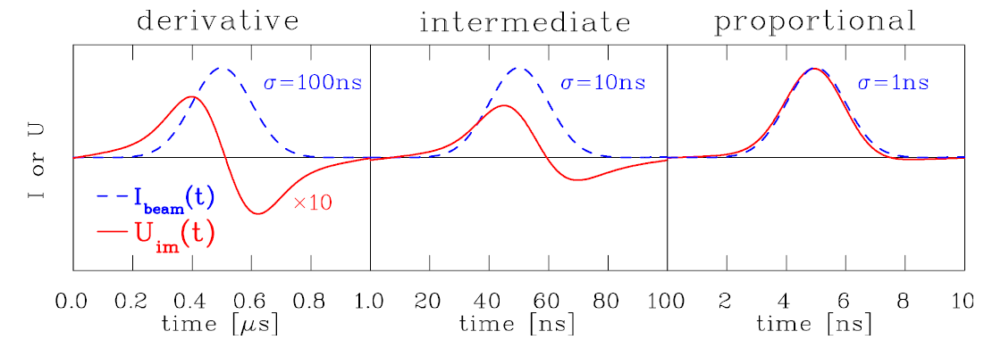
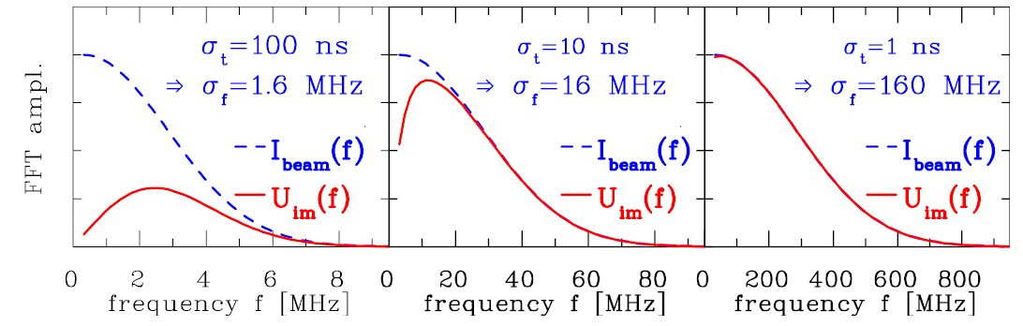
Calculation of Signal Shape (here single Bunch)
The transfer impedance is used in frequency domain! The following is performed:
1. Start: Time domain Gaussian function I_{beam}(t) having a width of σ_{t}
inverse Fourier trans.
Fourier trans.
2. FFT of I_{beam}(t) leads to the frequency domain Gaussian I_{beam}(f) with $σ_{f}={\left(2πσ_{t}\right)}^{−1}$
3. Multiplication with Z_{t}(f) with f_{cut} = 32 MHz leads to U_{im}(f) = Z_{t}(f) ∙ I_{beam}(f)
4. Inverse FFT leads to U_{im}(t)
Remark: Time domain processing via convolution or filters (FIR and IIR) are possible

Slide 32
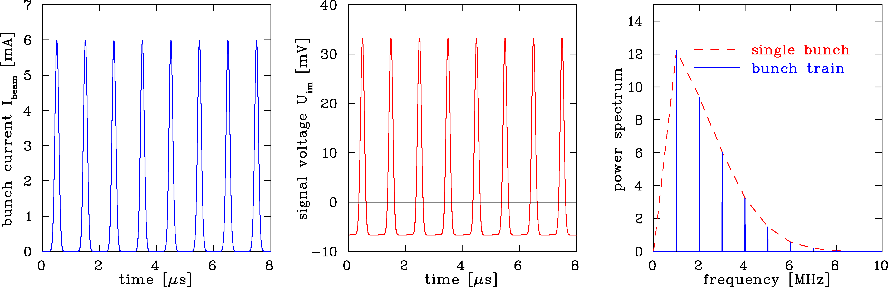
Calculation of Signal Shape: repetitive Bunch in a Synchrotron
Synchrotron filled with 8 bunches accelerated with f_{acc}=1 MHz
BPM terminated with R= 1 MΩ ⇒ f_{acc} >> f_{cut} :
Parameter: R = 1 MΩ ⇒ f_{cut} = 2 kHz, Z_{t} = 5 Ω , all buckets filled
C=100pF, l=10cm, β =50%, σ_{t}=100 ns ⇒ σ_{l}=15m
Fourier spectrum is composed of lines separated by acceleration f_{rf}
Envelope given by single bunch Fourier transformation
Baseline shift due to ac-coupling
Remark: 1 MHz< f_{rf} <10MHz ⇒ Bandwidth ≈100MHz=10 * f_{rf} for broadband observation
See lecture ‘Time and Frequency Domain Signals’ by Hermann Schmickler

Slide 33
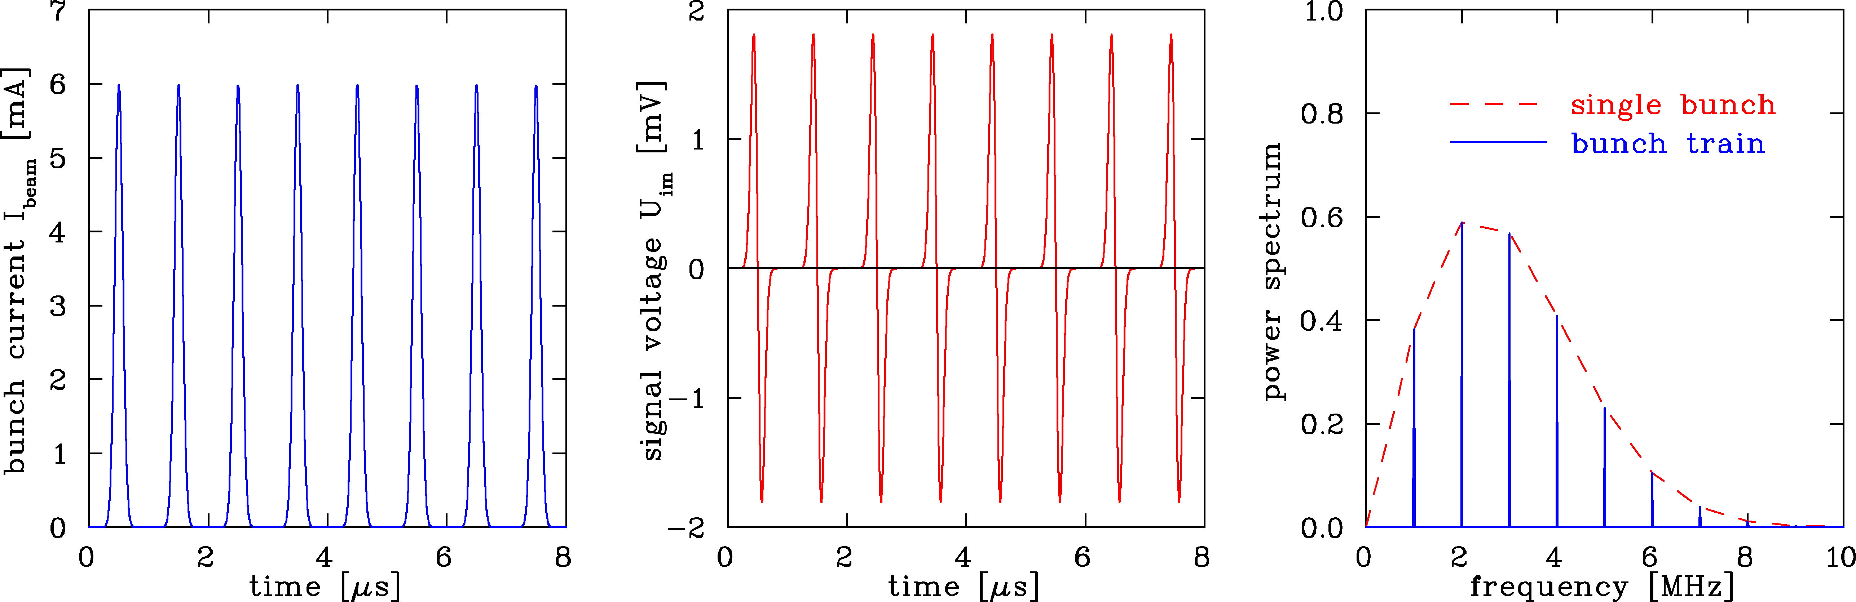
Calculation of Signal Shape: repetitive Bunch in a Synchrotron
Synchrotron filled with 8 bunches accelerated with f_{acc}= 1 MHz
BPM terminated with R=50 Ω ⇒ f_{acc}<< f_{cut} :
Parameter: R=50 Ω ⇒ f_{cut}=32 MHz, all buckets filled
C=100pF, l=10cm, β =50%, σ_{t}=100 ns ⇒ σ_{l}=15m
Fourier spectrum is concentrated at acceleration harmonics
with single bunch spectrum as an envelope.
Bandwidth up to typically 10*f_{acc}

Slide 34
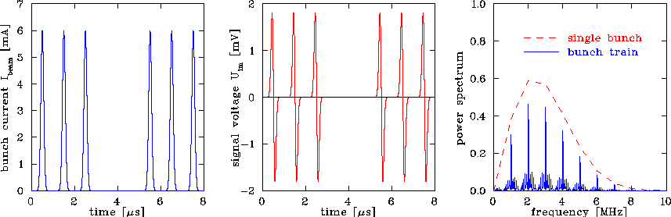
Calculation of Signal Shape: Bunch Train with empty Buckets
Synchrotron during filling: Empty buckets, R=50 Ω:
Parameter: R=50 Ω ⇒ f_{cut}=32 MHz, 2 empty buckets
C=100pF, l=10cm, β =50%, σ_{t}=100 ns ⇒ σ_{l}=15m
Fourier spectrum is more complex, harmonics are broader due to sidebands

Slide 35
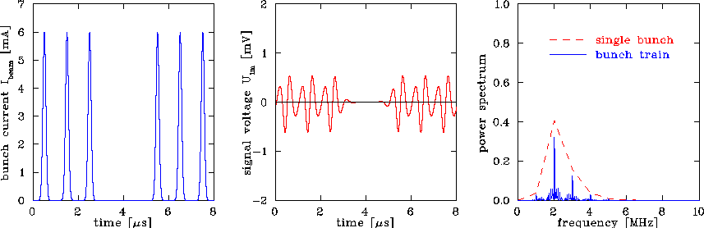
Calculation of Signal Shape: Filtering of Harmonics
Effect of filters, here bandpass:
Parameter: R=50 Ω, 4th order Butterworth filter at f_{cut}=2 MHz
C=100pF, l=10cm, β=50%, σ=100 ns
n^{th} order Butterworth filter, math. simple, but not well suited:
Ringing due to sharp cutoff
Other filter types more appropriate
Generally: Z_{tot}(ω) = H_{cable}(ω) ∙ H_{filter}(ω) ∙ H_{amp}(ω) ∙ … ∙Z_{t}(ω)
Remark: For numerical calculations, time domain filters (FIR and IIR) are more appropriate

Slide 36
Principle of Signal Generation of a BPMs: off-center Beam
The image current at the wall is
monitored on a high frequency basis
i.e. ac-part given by the bunched beam.
V
-
+
-
+
-
-
+
-
+
-
+
-
-
+
-
+
-
+
-
+
-
-
+
-
+
-
+
-
+
-
+
-
-
+
-
+
+
-
-
-
-
+
-
+
-
-
-
-
+
+
-
+
-
-
+
-
+
-
-
-
-
-
-
-
-
-
+
-
+
+
-
+
+
-
+
-
-
+
-
+
-
+
-
+
-
+
+
+
+
-
+
-
-
+
-
+
+
+
+
+
+
+
+
+
+
+
+
+
+
+
+
+
+
+
+
+
+
+
+
+
+
+
+
+
+
+
+
+
+
+
+
+
+
+
+
+
+
+
+
+
+
+
+
+
+
+
+
+
+
+
+
+
+
+
+
+
+
+
+
+
+
+
+
+
+
+
+
+
+
+
+
+
+
+
+
-
+
+
-
+
+
-
-
-
-
+
-
-
+
-
-
+
+
+
-
-
+
-
+
+
-
-
-
+
-
+
-
-
-
-
-
-
+
-
+
+
+
+
-
+
-
-
+
Animation by Rhodri Jones (CERN)

Slide 37



Principle of Position Determination by a BPM
The difference voltage between plates gives the beam’s center-of-mass
most frequent application
y from ΔU = U_{up} - U_{down}
S(ω,x) is called position sensitivity, sometimes the inverse is used k(ω,x)=1/S(ω,x)
S is a geometry dependent, non-linear function,
Units: S=[%/mm], sometimes S=[dB/mm] or k=[mm].
Example: One turn = 4 bunches @ 35 MeV/u
U_{right}
U_{reft}
Typical desired position resolution:
Δx ≈ 0.1 ... 0.3 ⋅ σ_{x} of beam width
It is at least: $∆U ≪ \frac{1}{10} ΣU$

Slide 38
The Artist View of a BPM

Slide 39
Pick-Ups for bunched Beams
Outline:
Signal generation → transfer impedance
Capacitive button BPM for high frequencies
used at most proton LINACs and electron accelerators
Capacitive linear-cut BPM for low frequencies
Electronics for position evaluation
BPMs for measurement of closed orbit, tune and further lattice functions
Summary

Slide 40


2-dim Model for a Button BPM
‘Proximity effect’: larger signal for closer plate
Ideal 2-dim model: Cylindrical pipe → image current density
via ‘image charge method’ for ‘pencil’ beam:
a
button
φ
α
r
θ =0
Image current: Integration of finite BPM size:
, θ = 0º

Slide 41



2-dim Model for a Button BPM
a
Ideal 2-dim model: Non-linear behavior and hor-vert coupling:
Sensitivity S is converts signal to position $x=\frac{1}{S}∙\frac{ΔU}{ΣU}$
with S [%/mm] or [dB/mm]
i.e. S is the derivative of the curve $S_{x}=\frac{∂(\frac{ΔU}{ΣU})}{∂x}$ , here S_{x} = S_{x}(x, y) i.e. non-linear.
For this example: central part S=7.4%/mm ⇔ k=1/S=14mm
button
φ
α
θ
r
Horizontal plane
Position Map
button
○ real position
• measured position

Slide 42



Button BPM Realization
LINACs, e⁻-synchrotrons: 100 MHz < f_{rf} < 3 GHz → bunch length ≈ BPM length
→ 50 Ω signal path to prevent reflections
Example: LHC-type inside cryostat:
24 mm, half aperture a = 25 mm, C = 8 pF
⇒ f_{cut}= 400 MHz, Z_{t} = 1.3 Ω above f_{cut}
N-Connector
Ceramic vacuum insulation
Button electrode
Ø24 mm
∅
5cm
Courtesy C. Boccard (CERN)

Slide 43




Simulations for Button BPM at Synchrotron Light Sources
Example: Simulation for ALBA light source for 72 x 28 mm² chamber
Horizontal: $x∝ \frac{1}{S_{x}} \left(left −right\right)$ ⇔ $x=\frac{1}{S_{x}} ∙ \frac{\left(U_{2}+ U_{3}\right)−\left(U_{1}+U_{4}\right) }{U_{1}+U_{2}+U_{3}+U_{4}}$
Vertical: y$∝ \frac{1}{S_{y}} \left(top −bottom\right)$ ⇔ y$=\frac{1}{S_{y}} ∙ \frac{\left(U_{1}+ U_{2}\right)−\left(U_{3}+U_{4}\right) }{U_{1}+U_{2}+U_{3}+U_{4}}$
button 2
button 1
y = 20 mm
y = 10 mm
y = 0 mm
y = 20 mm
y = 10 mm
y = 0 mm
1 mm steps
S_{x}(center) = 7.8 %/mm
for |x|<5mm & y=0mm
S_{y}(center) = 7.2 %/mm
for |y|< 5mm & x=0mm
button 3
button 4
30
20
position x [mm]
real beam position x [mm]
button 2
button 1
18 mm
Optimization:
Horizontal distance
Size of buttons
button 2
button 1
1 mm
steps
y
∅ 7 mm
x
28 mm
button 3
button 4
A.A. Nosych et al.,
IBIC’14
button 3
button 4
72 mm
30
position x [mm]
Result: - Non-linearity and xy-coupling occur in dependence of button size and position
- Can be corrected by polynomial interpolation for beams much smaller than chamber

Slide 44
Pick-Ups for bunched Beams
Outline:
Signal generation → transfer impedance
Capacitive button BPM for high frequencies
used at most proton LINACs and electron accelerators
Capacitive linear-cut BPM for low frequencies
used at most proton synchrotrons due to linear position reading
Electronics for position evaluation
BPMs for measurement of closed orbit, tune and further lattice functions
Summary

Slide 45



Linear-cut BPM for Proton Synchrotrons
Frequency range: 1 MHz < f_{rf} < 100 MHz ⇒ bunch-length >> BPM length.
Signal is proportional to actual plate length:
In ideal case: linear reading
Size: 200x70 mm²
Linear-cut BPM:
Advantage: Linear, i.e. constant position sensitivity S
⇔ no beam size dependence
Disadvantage: Large size, complex mechanics
high capacitance

Slide 46


Technical Realization of a linear-cut BPM
Technical realization at HIT synchrotron of 46 m length for 7 MeV/u→ 440 MeV/u
BPM clearance: 180x70 mm², standard beam pipe diameter: 200 mm.
Quadrupole
Linear Ampl.
Linear Ampl.
70
Beam
Right
channel
180

Slide 47


Technical Realization of a linear-cut BPM
Technical realization at HIT synchrotron of 46 m length for 7 MeV/u→ 440 MeV/u
BPM clearance: 180x70 mm², standard beam pipe diameter: 200 mm.
Linear Ampl.
70
Right
channel
180

Slide 48
Comparison linear-cut and Button BPM
 | Linear-cut BPM | Button BPM
Precaution | Bunches longer than BPM | Bunch length comparable to BPM
BPM length (typical) | 10 to 20 cm length per plane | ∅1 to 5 cm per button
Shape | Rectangular or cut cylinder | Orthogonal or planar orientation
Bandwidth (typical) | 0.1 to 100 MHz | 100 MHz to 5 GHz
Coupling | 1 MΩ or ≈1 kΩ (transformer) | 50 Ω
Cutoff frequency (typical) | 0.01… 10 MHz (C=30…100pF) | 0.3… 1 GHz (C=2…10pF)
Linearity | Very good, no x-y coupling | Non-linear, x-y coupling
Sensitivity | Good, care: plate cross talk | Good, care: signal matching
Usage | At proton synchrotrons, f_{rf} < 10 MHz | All electron acc., proton Linacs, f_{rf} > 100 MHz
Remark: Other types are also some time used: e.g. strip-line, wall current monitors,
inductive antenna, BPMs with external resonator, cavity BPM, slotted wave-guides etc.
→stripline BPM

Slide 49
Pick-Ups for bunched Beams
Outline:
Signal generation → transfer impedance
Capacitive button BPM for high frequencies
used at most proton LINACs and electron accelerators
Capacitive linear-cut BPM for low frequencies
used at most proton synchrotrons due to linear position reading
Electronics for position evaluation
analog signal conditioning to achieve small signal processing
BPMs for measurement of closed orbit, tune and further lattice functions
Summary

Slide 50
Broadband Signal Processing
Hybrid or transformer close to beam pipe for analog ΔU & ΣU generation or U_{left} & U_{right}
Attenuator/amplifier
Filter to get the wanted harmonics and to suppress stray signals
ADC: digitalization → followed by calculation of of ΔU /ΣU
.
Advantage: Bunch-by-bunch observation possible, versatile post-processing possible
Disadvantage: Resolution down to ≈ 100 µm for shoe box type , i.e. ≈0.1% of aperture,
resolution is worse than narrowband processing, see below
Challenge: Precise analog electronics with very low drift of amplification etc.

Slide 51

General: Noise Consideration
1. Signal voltage given by:
2. Position information from voltage difference:
3. Thermal noise voltage given by:
Signal-to-noise ΔU_{im}/U_{noise} is influenced by:
Input signal amplitude
Thermal noise from amplifiers etc.
Bandwidth Δf
⇒ Restriction of frequency width
as the power is
concentrated at harmonics n⋅ f_{rf}
Example: GSI-LINAC with f_{rf}=36 MHz

Slide 52
Narrowband Processing for improved Signal-to-Noise
Narrowband processing equals heterodyne receiver (e.g. AM-radio or spectrum analyzer)
Attenuator/amplifier
Mixing with accelerating frequency f_{rf} ⇒ signal with difference frequency
Bandpass filter of the mixed signal (e.g at 10.7 MHz)
Rectifier: synchronous detector
ADC: digitalization → followed calculation of ΔU/ΣU
Digital
correspondence:
I/Q demodulation
Advantage: Spatial resolution about 100 time better than broadband processing
Disadvantage: No turn-by-turn diagnosis, due to mixing = ’long averaging time’

Slide 53


Comparison: Filtered Signal ↔ single Turn
Example: GSI Synchr.: U⁷³⁺, E_{inj} = 11.5 MeV/u→ E_{out} = 250 MeV/u within 0.5 s, 10⁹ ions
Position resolution < 30 μm (BPM diameter d=180 mm)
average over 1000 turns corresponding to ≈1 ms
or ≈1 kHz bandwidth
1000 turn average for closed orbit
Variation < 10 μm (sufficient for application)
Turn-by-turn data have much larger variation
Single turn e.g. for tune
Variation ≈ 150 μm
However: Not only noise contributes but additionally beam movement by betatron oscillation
⇒ broadband processing i.e. turn-by-turn readout for tune determination.

Slide 54
Analog versus Digital Signal Processing
Modern instrumentation uses digital techniques with extended functionality.
Traditional analog processing
BPM analog
signal
Analog frequency
translator
Analog demodulator
and filter
ADC
digital
output
Analog
Digital
Modern digital processing
BPM analog
signal
Analog frequency
translator
ADC
Digital
filter
Digital
Signal Proc.
digital
output
Digital receiver as modern successor of super heterodyne receiver
Basic functionality is preserved but implementation is very different
Digital transition just after the amplifier & filter or mixing unit
Signal conditioning (filter, decimation, averaging) on FPGA
Advantage of DSP: Versatile operation, flexible adoption without hardware modification
Disadvantage of DSP: non, good engineering skill requires for development, expensive

Slide 55
Comparison of BPM Readout Electronics (simplified)
Type | Usage | Precaution | Advantage | Disadvantage
Broadband | p-sychr. | Long bunches | Bunch structure signal Post-processing possible Required for transfer lines with few bunches | Resolution limited by noise
Narrowband | all synchr. | Stable beams >100 rf-periods | High resolution | No turn-by-turn Complex electronics
Digital Signal Processing | all | ADC sample typ. 250 MS/s | Very flexible & versatile High resolution Trendsetting technology for future demands | Basically non! Limited time resolution by ADC → under-sampling Man-power intensive
→ Stripline BPM

Slide 56
Pick-Ups for bunched Beams
Outline:
Signal generation → transfer impedance
Capacitive button BPM for high frequencies
used at most proton LINACs and electron accelerators
Capacitive linear-cut BPM for low frequencies
used at most proton synchrotrons due to linear position reading
Electronics for position evaluation
analog signal conditioning to achieve small signal processing
BPMs for measurement of closed orbit, tune and further lattice functions
frequent application of BPMs
Summary

Slide 57
Trajectory Measurement with BPMs
Trajectory:
The position delivered by an individual bunch within a transfer line or a synchrotron.
Main task: Control of matching (center and angle), first-turn diagnostics
Example: LHC injection 10/09/08 i.e. first day of operation !
10
horizontal
0
x [mm]
-10
-10
10
vertical
0
y [mm]
-10
-10
Monitor number (530 BPMs on 27 km)
Courtesy R. Jones (CERN)
Tune values at LHC: Q_{h} = 64.3, Q_{v} = 59.3

Slide 58
Closed Orbit Feedback: Typical Noise Sources
Beam movement:
Short term (min to 10 ms):
Traffic
Machine (crane) movements
Water & vacuum pumps
50 Hz main power net
Medium term (day to min):
Movement of chambers
due to heating by radiation
Day-night variation
tide, moon cycle
Long term ( > days):
Ground settlement
Seasons, temperature variation
Power spectral density [mm²/Hz]
0.01
0.1
1
10
100
1000
Frequency [Hz]
Courtesy M. Böge, PSI, N. Hubert, Soleil

Slide 59


Close Orbit Feedback: BPMs and magnetic Corrector Hardware
Orbit feedback: Synchrotron light source → spatial stability of light beam
Example: SLS-Synchrotron at Villigen, Switzerland
From M. Böge, PSI
Feedback loop:
1. Position from all BPMs
2. Calculation of corrector setting via
Orbit Response Matrix
3. Change of magnet setting
1.’ New positon measurement …..
⇒ regulation time down to 10 ms
⇒ Role od thumb: ≈ 4 BPMs per betatron wavelength
feedback
Acc. optics
Position from all BPMs
Calculation of corrector strength
Uncorrected orbit: typ. ${\left\langle x\right\rangle }_{rms }≈1 mm$
Corrected orbit: typ. ${\left\langle x\right\rangle }_{rms }≈1 µm$up to ≈ 100 Hz bandwidth!
Setting of correctors
Orbit Response Matrix: See lecture by Volker Ziemann

Slide 60


Tune Measurement: General Considerations
Coherent excitations are required for the detection by a BPM
Beam particle’s in-coherent motion ⇒ center-of-mass stays constant
Excitation of all particles by rf ⇒ coherent motion
⇒ center-of-mass variation turn-by-turn i.e. center acts as one macro-particle
Graphics by R. Singh, GSI
Notes:
Beam with several particles with randomly distributed phases and amplitude will give only very small fluctuations due to finite number of particles (schottky fluctuations) proportional to sqrt(N)
Beam excitation aligns the particle phases, and allows to measure center-of-mass before the beam decohores due to finite spread in frequency. Thus regular excitation needed. Types of excitation were studied as part of this work, Kick excitation (a wide band, or single time impulse excitation), requires high power, and significantly dilutes the phase space.
Chirp excitation, slow method, difficult to use in day to day operations, BTF excitation, to study the amplitude and phase response of the beam.
A compromise of the both the above methods, band limited (or pseudo random noise) for regular excitation without significant blow-up, usable along the ramp.

Slide 61



Tune Measurement: The Kick-Method in Time Domain
The beam is excited to
coherent betatron oscillation:
→ Beam position measured
each revolution (’turn-by-turn’)
→ Fourier Trans. gives non-integer tune q.
Short kick compared to revolution.
The de-coherence time limits the resolution:
N non-zero samples
⇒ General limit of discrete FFT:
Decay is caused by de-phasing,
not by decreasing
single particle amplitude.
Here: N = 200 turn ⇒ Δq > 0.003
(tune spreads can be Δq ≈ 0.001!)
See lecture ‘Time and Frequency Domain Signals’ by Hermann Schmickler

Slide 62

Tune Measurement: Gentle Excitation with Wideband Noise
Instead of a sine wave, noise with adequate bandwidth can be applied
→ beam picks out its resonance frequency:
Broadband excitation with white noise
of ≈ 10 kHz bandwidth
Turn-by-turn position measurement
Fourier transformation of the recorded data
⇒ Continues monitoring with low disturbance
Example: Vertical tune within 4096 turn
duration ≃ 15 ms
at GSI synchrotron 11 → 300 MeV/u in 0.7 s
vertical tune versus time
vertical tune at fixed time ≈ 15ms
0.3
δQ_{y} ≈ 0.02
amplitude [a.u.]
vert. fractional tune q_{y}
excitation
noise band
δQ ≈ 0.05
0.25
0.2
0.25
0.3
0.35
vertical fractional tune q_{y}
0.2
Advantage:
Fast scan with good time resolution
0
200
400
600
750
time [ms]
U. Rauch et al., DIPAC 2009
→Conclusion

Slide 63
β-Function Measurement from Bunch-by-Bunch BPM Data
Excitation of coherent betatron oscillations:
→ Time-dependent position reading results the phase advance between BPMs
The phase advance is:
β - function from
Remark: Determination of β-function with 3 BPMs:
$$β_{meas}\left({BPM}_{1}\right)=β_{model}\left({BPM}_{1}\right)∙\frac{ cot{[ μ}_{meas}(1→2)] − cot{[(μ}_{meas}(1→3) ]}{ cot{[ μ}_{model}(1→2)] − cot{[μ}_{model}(1→3) ]}$$
See e.g.: R. Tomas et al., Phys. Rev. Acc. Beams 20, 054801 (2017)
A. Wegscheider et al., Phys. Rev. Acc. Beams 20, 111002 (2017)
See lecture ‘Imperfections and Corrections’ by Volker Ziemann
→Conclusion

Slide 64


Chromaticity Measurement from Closed Orbit Data
Chromaticity ξ: Change of tune for off-momentum particle
Two step measurement procedure:
1. Change of momentum p by detuned rf-frequency $\frac{∆p}{p}=η^{−1}∙\frac{∆f_{acc}}{ f_{acc} }$
2. Excitation of coherent betatron oscillations
and tune measurement
(kick-method, BTF, noise excitation):
Example: Measurement at LEP:
Plot of ΔQ/Q as a function of Δp/p
⇒ slope is dispersion ξ.
From M Minty, F. Zimmermann,
Measurement and Control of charged Particle Beam,
Springer Verlag 2003
→Conclusion

Slide 65


Dispersion Measurement from Closed Orbit Data
Dispersion D(s_{i} ): Change of momentum p by detuned rf-cavity
→ Position reading at one location $x_{i}=D\left(s_{i}\right) ∙\frac{∆p}{p}$:
→ Result from plot of x_{i} as a function of Δp/p ⇒ slope is local dispersion D(s_{i} )
Example: Dispersion measurement D(s) at BPMs at CERN SPS
green histogram: measurement
Theory-experiment correspondence
after correction of
BPM calibration
quadrupole calibration
×: model expectation
6.9 km
See lecture ‘Imperfections and Corrections’ by Volker Ziemann
From J. Wenninger: CAS on BD, CERN-2009-005 & J. Wenninger CERN-AB-2004-009
→Conclusion

Slide 66



Intra-Bunch Observation
High band-width measurements delivers:
Bunch shape given by the sum $ΣU\left(t\right)= U_{right}(t)+ U_{left}(t)$ of two plates
Intra-bunch movement of the center by $x_{center}(t)∝ΔU(t)= U_{right}(t)− U_{left}(t)$
Example: Single bunch observation on turn-by-turn basis with beam excitation at SPS
Goal: Monitoring instabilities
$$ΔU offset$$
A single trace corresponds to one bunch passage
$$ΣU$$
Time 4.25 ns
See lecture ‘Collective Effects’ by Kevin Li
Courtesy Kevin Li, CAS Proceedings 2021
→stripline BPM
→Conclusion

Slide 67

Summary Pick-Ups for bunched Beams
The electric field is monitored for bunched beams using rf-technologies
(’frequency domain’). Beside transformers they are the most often used instruments!
Differentiated or proportional signal: rf-bandwidth ↔ beam parameters
Proton synchrotron: 1 to 100 MHz, mostly 1 MΩ → proportional shape
LINAC, e⁻-synchrotron: 0.1 to 3 GHz, 50 Ω → differentiated shape
Important quantity: Transfer impedance $Z_{t}\left(ω, β\right)$.
Types of capacitive pick-ups:
Linear-cut (p-synch.), button (p-LINAC, e⁻-LINAC and synch.)
Position reading: Difference signal of two or four pick-up plates (BPM):
Non-intercepting reading of center-of-mass → online measurement and control
Synchrotron: Fast reading, ‘bunch-by-bunch’→ trajectory, slow reading → closed orbit
➢ Synchrotron: Excitation of coherent betatron oscillations ⇒ tune q, ξ , β(s), D(s)...
Remark: BPMs have high pass characteristic ⇒ no signal for dc-beams
Thank you for your attention!

Slide 68
Backup slides

Slide 69



Shielding of a Transformer
Task of the shield:
The image current of the walls have to be bypassed by a gap and a metal housing.
This housing uses µ-metal and acts as a shield of external B-field
(remember: I_{beam} = 1 μA, r = 10 cm ⇒ B_{beam} = 2pT, earth field B_{earth} = 50 µT)
magnetic shield &
current bypass
transformer
torus
ceramic gap
beam
vacuum pipe ∅ 150 mm
beam
ceramic
gap
∅ 200 mm
courtesy Company Bergoz

Slide 70


Stripline BPM: General Idea
For short bunches, the capacitive button deforms the signal
Relativistic beam β ≈ 1 ⇒ field of bunches nearly TEM wave
Bunch’s electro-magnetic field induces a traveling pulse at the strips
Assumption: Bunch shorter than BPM, Z_{strip} = R₁ = R₂=50 Ω and v_{beam} = c_{strip}
LHC stripline BPM, l = 12 cm
From C. Boccard, CERN

Slide 71





Stripline BPM: General Idea
For relativistic beam with β ≈ 1 and short bunches:
Bunch’s electro-magnetic field induces a traveling pulse at the strip
Assumption: l_{bunch}<< l, Z_{strip}=R₁=R₂=50 Ω and v_{beam}=c_{strip}
Signal treatment at upstream port 1:
t=0: Beam induced charges at port 1:
→ half to R₁, half toward port 2
t=l/c: Beam induced charges at port 2:
→ half to R₂, but due to different sign,
it cancels with the signal from port 1
→ half signal reflected
t=2∙l/c: reflected signal reaches port 1
If beam repetition time equals 2∙l/c: reflected preceding port 2 signal cancels the new one:
→ no net signal at port 1
Signal at downstream port 2: Beam induced charges cancel with traveling charge from port 1
⇒ Signal depends on direction ⇔ can distinguish between counter-propagation beams

Slide 72


Stripline BPM: Transfer Impedance
The signal from port 1 and the reflection from port 2 can cancel ⇒ minima in Z_{t .}
For short bunches I_{beam}(t) → Ne ∙ δ(t):
Stripline length l=30 cm, α=10⁰
Z_{t} show maximum at l=c/4f=λ/4 i.e. ‘quarter wave coupler’ for bunch train
⇒ l has to be matched to v_{beam}
No signal for l=c/2f=λ/2 i.e. destructive interference with subsequent bunch
Around maximum of |Z_{t}|: phase shift φ=0 i.e. direct image of bunch
f_{center}=1/4 ∙ c/l ∙ (2n-1). For first lope: f_{low}=1/2∙f_{center}, f_{high}=3/2 ∙ f_{center} i.e. bandwidth ≈1/2∙f_{center}
Precise matching at feed-through required t o preserve 50 Ω matching.

Slide 73


Stripline BPM: Transfer Impedance
The signal from port 1 and the reflection from port 2 can cancel ⇒ minima in Z_{t .}
For bunches of length σ:
Stripline length l=30 cm, α=10⁰
Z_{t}(ω) decreases for higher frequencies
If total bunch is too long ±3σ_{t} > l destructive interference leads to signal damping
Cure: length of stripline has to be matched to bunch length
Further advantage: Linear phase propagation ⇒ good for coupled bunch feedback

Slide 74


Comparison: Stripline and Button BPM (simplified)
FlASH BPM inside quadrupole
 | Stripline | Button
Idea | traveling wave | electro-static
Requirement | Careful Z_{strip} = 50 Ω matching
Signal quality | Less deformation of bunch signal | Deformation by finite size and capacitance
Bandwidth | Broadband, but minima | Highpass, but f_{cut} < 1 GHz
Signal strength | Large Large longitudinal and transverse coverage possible | Small Size <∅3cm, to prevent signal deformation
Mechanics | Complex | Simple
Installation | Inside quadrupole possible ⇒improving accuracy | Compact insertion
Directivity | YES | No
→ Tune etc.
From . S. Vilkins, D. Nölle (DESY)
→ Beam measurements

Slide 75


Estimation of finite Beam Size Effect for Button BPM
Ideal 2-dim model:
Due to the non-linearity, the beam size enters in the position reading.
Finite beam size:
Calculation of signal response
at different location
‘Averaging’ of image position
⇒ Cannot be corrected !
button
Beam envelope
Image envelope
Image center
beam center
Remark: For most LINACs: Linearity is less important, because beam has to be centered
Position correction as feed-forward for next macro-pulse.

Slide 76

Button BPM at Synchrotron Light Sources
Due to synchrotron radiation, the button insulation might be destroyed
buttons only in vertical plane possible ⇒ increased non-linearity
HERA-e
realization
PEP-realization: N. Kurita et al., PAC 1995

Slide 77


Close Orbit Feedback: Results
Orbit feedback:
Example: 12 beam positions at GSI-SIS during ramping from 8.6 to 500 MeV/u for Ar¹⁸⁺
20
feedback off
20
feedback on
10
10
position [mm]
position [mm]
0
0
-10
position x(t) at 12 BPMs
-10
0
100
200
300
400
0
100
200
300
400
time [ms]
time [ms]
Procedure:
1. Position from all 12 BPMs
2. Calculation of corrector setting on fast (FPGA-based) electronics
3. Submission to corrector magnets
4. New position measurement
⇒ regulation time down to 10 ms
Role of thumb:
Movement related to tune i.e. ‘natural oscillations by periodic focusing’
To determine the ‘sine-like’ oscillation 4 BPMs per oscillation are required
⇒ 4 BPMs per tune value (but detailed investigation required to determine the # of BPMs)
→ conclusion

Slide 78

‘Beta-beating’ from Bunch-by-Bunch BPM Data
Example: ‘Beta-beating’ at BPM $∆β=β_{meas}− β_{model}$with measured β_{meas} & calculated β_{model}
for each BPM at BNL for RHIC (proton-proton or ions circular collider with 3.8 km length)
Result concerning ‘beta-beating’:
Model doesn’t fit reality completely
e.g. caused by misalignments
Corrections executed
Increase of the luminosity
Remark:
Measurement accuracy depends on
BPM accuracy
Numerical evaluation method
From X. Shen et al.,
Phys. Rev. Acc. Beams 16, 111001 (2013)
See lecture ‘Imperfections and Corrections’ by Volker Ziemann
→Conclusion

Slide 79

Close Orbit Measurement with BPMs
Single bunch position averaged over 1000 bunches → closed orbit with ms time steps.
It differs from ideal orbit by misalignments of the beam or components.
Example: GSI-synchrotron at two BPM locations, 1000 turn average during acceleration:
Closed orbit:
Beam position
averaged over many turns
(i.e. betatron oscillations).
The result is the basic tool
for alignment & stabilization
6
horizontal
5
0
0
horizontal position at 2 BPMs
position [mm]
vertical
position [mm]
-5
-6
along synchrotron
-5
-10
time t = 0 ... 600 ms
-12
4
vertical position at 2 BPMs
signal strength
2
0
position [mm]
time t = 0 ... 600 ms
time t = 0 ... 600 ms
-2

