Slide 1


Beam Instrumentation & Diagnostics Part 2
CAS Introduction to Accelerator Physics
Kaunas, 23rd of September 2022
Peter Forck
Gesellschaft für Schwerionenforschnung (GSI)
p.forck@gsi.de
2nd part of this lecture covers:
Transverse profile techniques
Emittance determination at transfer lines
Diagnostics for bunch shape determination
For peace
and freedom

Slide 2
Copyright statement and speaker’s release for video publishing
The author consents to the photographic, audio and video recording of this lecture at the CERN Accelerator School. The term “lecture” includes any material incorporated therein including but not limited to text, images and references.
The author hereby grants CERN a royalty-free license to use his image and name as well as the recordings mentioned above, in order to post them on the CAS website.
The material is used for the sole purpose of illustration for teaching or scientific research. The author hereby confirms that to his best knowledge the content of the lecture does not infringe the copyright, intellectual property or privacy rights of any third party. The author has cited and credited any third-party contribution in accordance with applicable professional standards and legislation in matters of attribution.

Slide 3
Measurement of Beam Profile
The beam width can be changed by focusing via quadruples.
Transverse matching between ascending accelerators is done by focusing.
→ Profiles have to be controlled at many locations.
Synchrotrons: Lattice functions β (s) and D(s) are fixed ⇒ width σ and emittance ε are:
Transfer lines: Lattice functions are ‘smoothly’ defined due to variable input emittance.
Typical beam sizes:
e⁻-beam: typically Ø 0.01 to 3 mm, protons: typically Ø 1 to 30 mm
A great variety of devices are used:
Optical techniques: Scintillating screens (all beams),
synchrotron light monitors (e⁻), optical transition radiation (e⁻, high-energetic p),
ionization profile monitors (protons)
➢ Electronics techniques: Secondary electron emission SEM grids, wire scanners (all)
Notes:
bla

Slide 4
Measurement of Beam Profile
Outline:
Scintillation screens:
emission of light, universal usage, limited dynamic range
Optical Transition Radiation
SEM-Grid
Wire scanner
Ionization Profile Monitor
Synchrotron Light Monitors
Summary

Slide 5
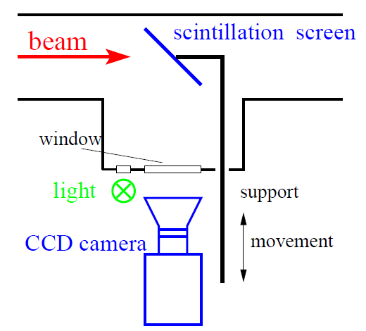
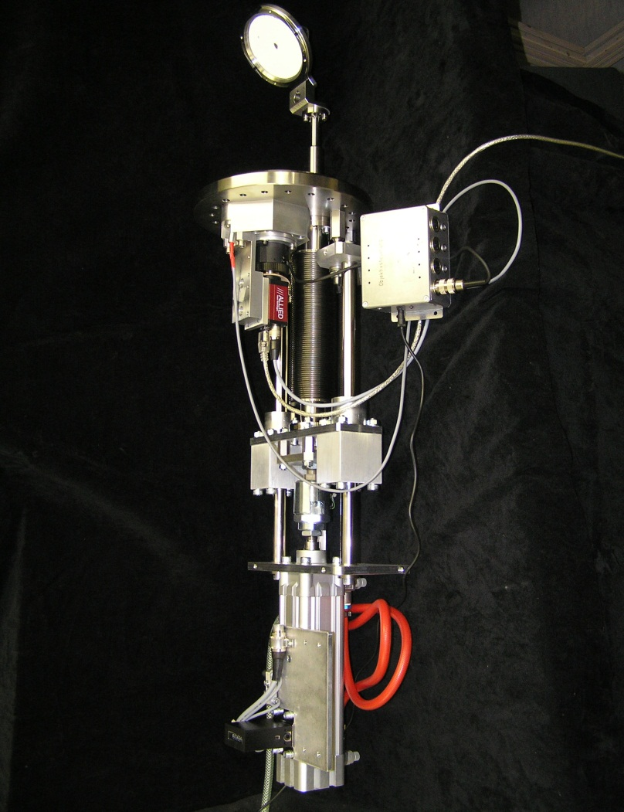
Scintillation Screen
Scintillation: Particle’s energy loss in matter causes emission of light
the most direct way of profile observation as used from the early days on!
Pneumatic drive with Ø70 mm screen:
beam
Screen
∅ 70 mm
Flange
∅200 mm
& window
Camera
≈ 1 m
Pneumatic
drive

Slide 6
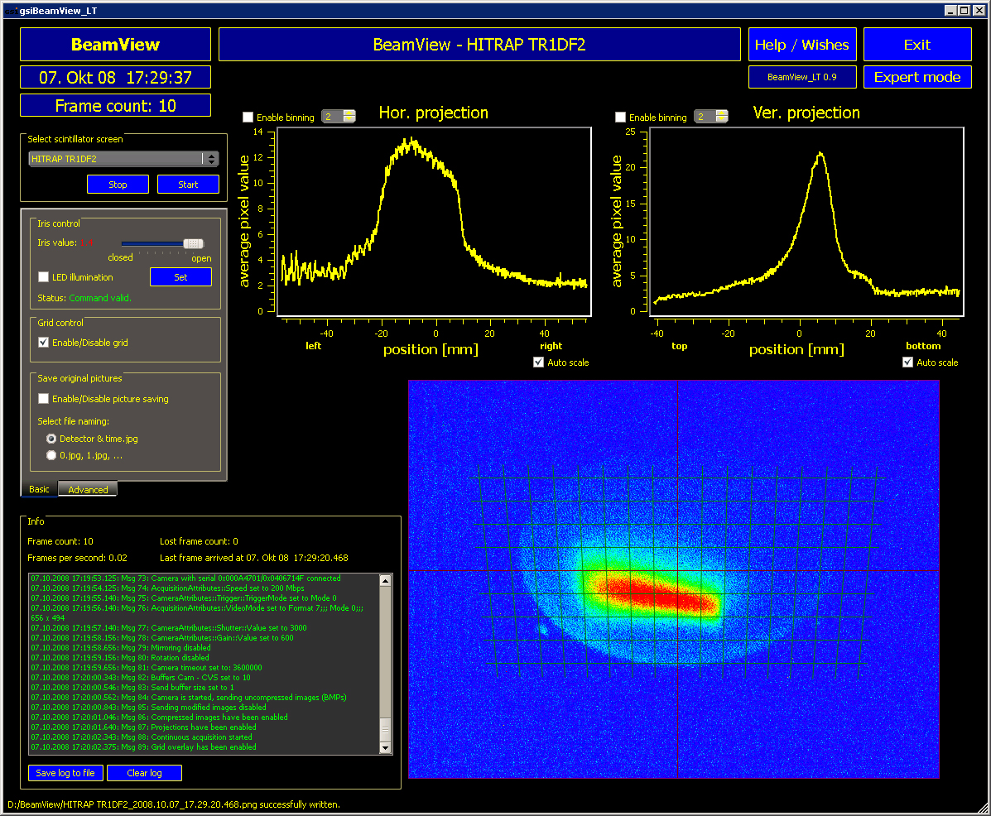
Example of Screen based Beam Profile Measurement
Example: GSI LINAC, 4 MeV/u, low current, YAG:Ce screen
Advantage of screens:
Direct 2-dim measurement
High spatial resolution
Cheap realization
⇒ widely used at transfer lines
Disadvantage of screens:
Intercepting device
Some material might be brittle
Possible low dynamic range
Might be destroyed
by the beam (radiation demage)
b/w CCD:
artificial false-color
Observation with CMOS camera
Scintillation Screen (beam stopped)
LINAC
LINAC

Slide 7
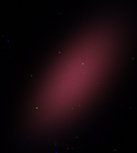
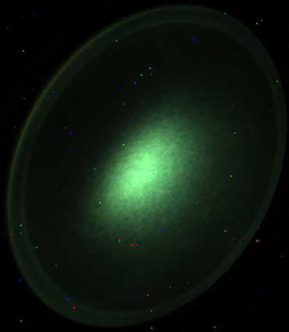
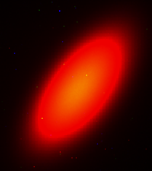
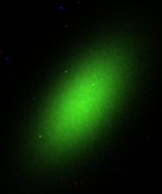
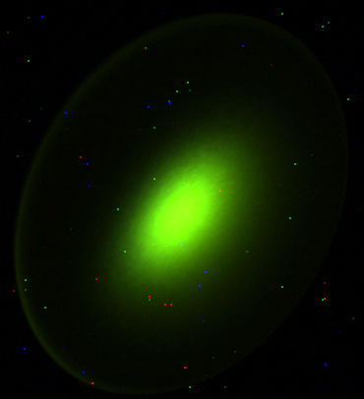
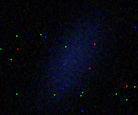
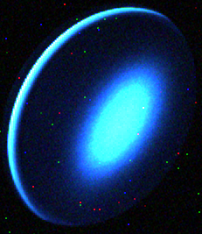
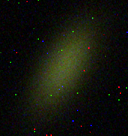
Light output from various Scintillating Screens
Example: Color CCD camera: Images at different particle intensities determined for U at 300 MeV/u
Alumina: Al₂O₃
CsI:Tl
Chromox: Al₂O₃:Cr
P43
Quartz
Quartz:Ce
ZrO₂:Mg
YAG:Ce
Very different light yield i.e. photons per ion‘s energy loss
Different wavelength of emitted light

Slide 8
Material Properties for Scintillating Screens
Some materials and their basic properties:
Standard drive with P43 screen
Name | Type | Material | Activ. | Max. λ | Decay
Chromox | Cera- mics | Al₂O₃ | Cr | 700nm | ≈ 10ms
Alumina |  | Al₂O₃ | Non | 380nm | ≈ 10ns
YAG:Ce | Crystal | Y₃Al₅O₁₂ | Ce | 550nm | 200ns
 |  | Lu_{1.8}Y_{.2}SiO₅ | Ce | 420nm | 40ns
LYSO
P43 | Powder of gains Ø≈10μm on glass | Gd₂O₃S | Tb | 545nm | 1ms
P46 |  | Y₃Al₅O₁₂ | Ce | 530nm | 300ns
P47 |  | Y₂SiO₅ | Ce&Tb | 400nm | 100ns
beam
Screen
∅ 70 mm
Flange
∅200 mm
& window
Camera
≈ 1 m
Properties of a good scintillator:
Large light output at optical wavelength
→ standard CCD camera can be used
Large dynamic range → usable for different currents
Short decay time → observation of variations
Radiation hardness → long lifetime
Good mechanical properties → typ. size up to Ø 10 cm
(Phosphor Pxx grains of Ø ≈ 10 μm on glass or metal).
Pneumatic
drive

Slide 9
Measurement of Beam Profile
Outline:
Scintillation screens:
emission of light, universal usage, limited dynamic range
Optical Transition Radiation:
light emission due to crossing material boundary, mainly for relativistic beams
SEM-Grid
Wire scanner
Ionization Profile Monitor
Synchrotron Light Monitors
Summary

Slide 10
Optical Transition Radiation: Depictive Description
Optical Transition Radiation OTR for a single charge e:
Assuming a charge e approaches an ideal conducting boundary e.g. metal foil
image charge is created by electric field
dipole type field pattern
field distribution depends on velocity β and Lorentz factor γ due to relativistic trans. field increase
penetration of charge through surface within t < 10 fs: sudden change of source distribution
emission of radiation with dipole characteristic
θ _{max}≈ 1/γ
vacuum
perfect
metal
vacuum
perfect
metal
vacuum
perfect
metal
charge e
velocity β
charge e
velocity β
θ
β
‘dipole
radiation’
image
charge -e
velocity -β
image
charge -e
velocity -β
charge e
inside
metal
E-field
pattern of
dipole type
sudden change charge distribution
rearrangement of sources ⇔ radiation
Other physical interpretation: Impedance mismatch at boundary leads to radiation

Slide 11
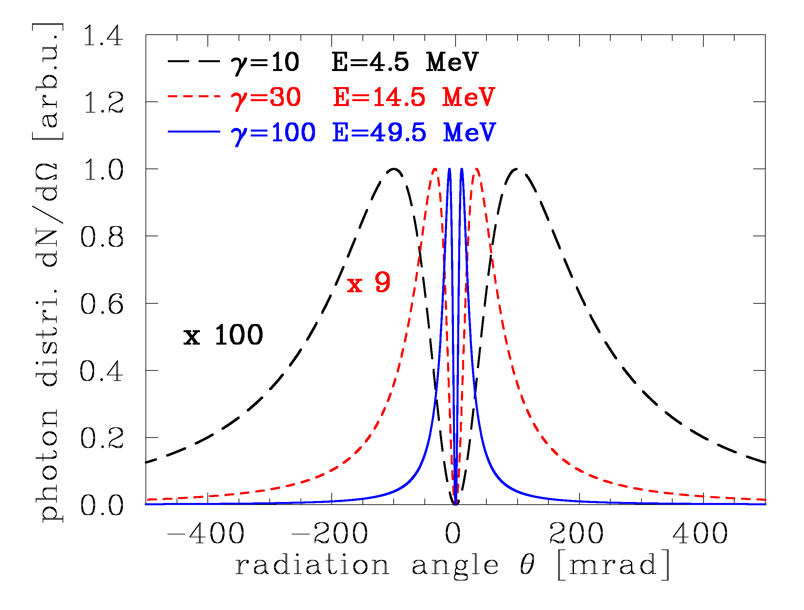
Optical Transition Radiation: Depictive Description
Optical Transition Radiation OTR can be described in classical physics:
approximated formula
for normal incidence
& in-plane polarization:
W: radiated energy
ω: frequency of wave
θ _{max}≈ 1/γ
vacuum
perfect
metal
θ
β
‘dipole
radiation’
charge e
inside
metal
Angular distribution of radiation in optical spectrum:
lope emission pattern depends on velocity or Lorentz factor γ
peak at angle θ ≈ 1/γ
emitted energy i.e. amount of photons scales with W ∝ β ²
broad wave length spectrum (i.e. no dependence on ω)
→ suited for high energy electrons
sudden change charge distribution
rearrangement of sources ⇔ radiation

Slide 12
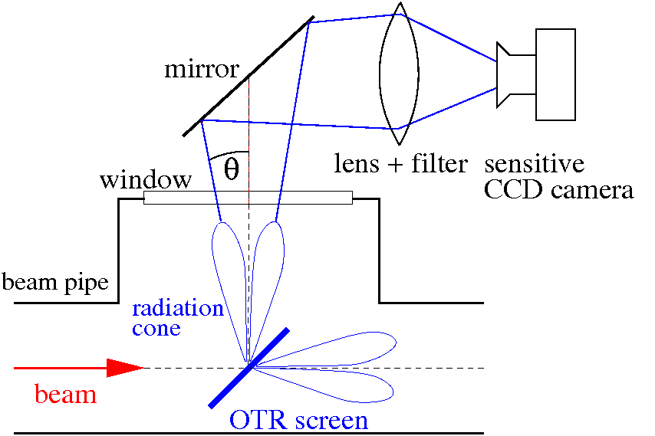
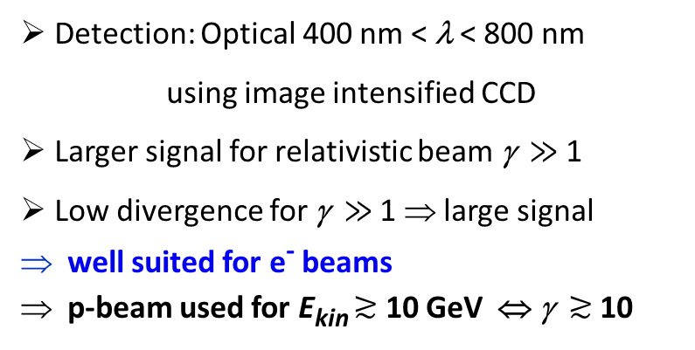
Technical Realization of Optical Transition Radiation OTR
OTR is emitted by charged particle passage through a material boundary.
Photon distribution:
within a solid angle dΩ and
Wavelength interval λ_{begin} to λ_{end}
Detection: Optical 400 nm < λ < 800 nm
using image intensified CCD
Larger signal for relativistic beam γ $≫$ 1
Low divergence for γ $≫$ 1 ⇒ large signal
well suited for e⁻ beams
p-beam used for E_{kin} $≳$ 10 GeV ⇔ γ $≳$ 10
Insertion of thin Al-foil under 45º
Observation of low light by CCD.

Slide 13
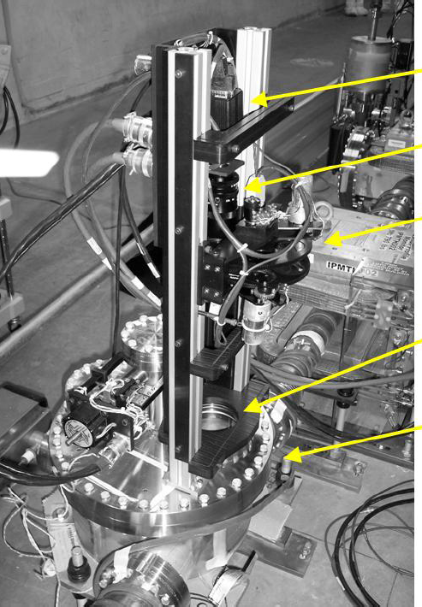
OTR-Monitor: Technical Realization and Results
Example of realization at TERATRON:
Insertion of foil
e.g. 5 μm Kapton coated with 0.1μm Al
Advantage: thin foil ⇒ low heating & straggling
2-dim image visible
Results at FNAL-TEVATRON synchrotron
with 150 GeV proton
Using fast camera: Turn-by-turn measurement
rad-hard
camera
σ = 1.03 mm
Lens
Filter wheel
σ = 0.66 mm
Window
Beam pipe
Courtesy V.E. Scarpine (FNAL) et al., BIW’06

Slide 14
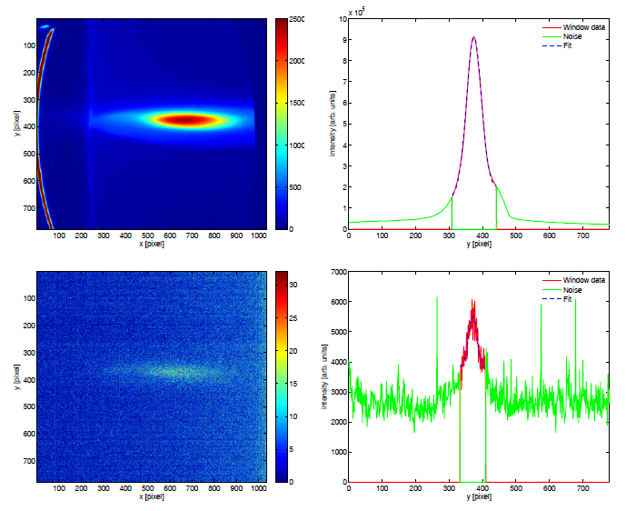
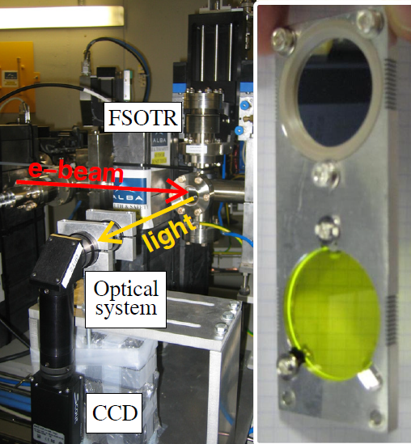
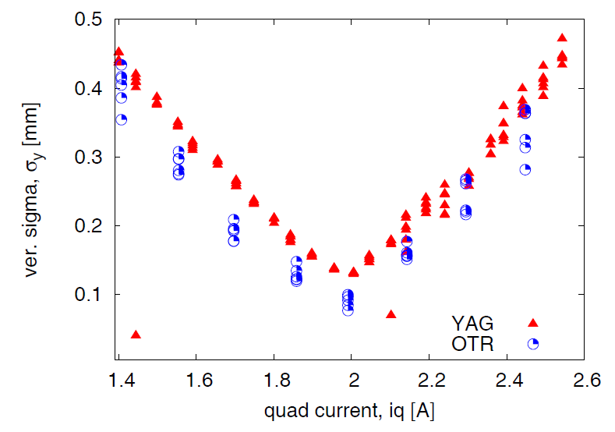
Optical Transition Radiation compared to Scintillation Screen
Installation of OTR and scintillation screens on same drive:
YAG:Ce
YAG:Ce
projection
Example: ALBA LINAC 100 MeV
OTR
OTR
OTR projection
Results:
Much more light from YAG:Ce
for 100 MeV (γ =200) electrons
light output I_{YAG} ≈ 10 ⁵ I_{OTR}
Broader image from YAG:Ce
due to finite YAG:Ce thickness
Courtesy of U. Iriso et al., DIPAC’09

Slide 15
Comparison between Scintillation Screens and OTR
OTR: electrodynamic process → beam intensity linear to # photons, high radiation hardness
Scint. Screen: complex atomic process → saturation possible, for some low radiation hardness
OTR: thin foil Al or Al on Mylar, down to 0.25 μm thickness
→ minimization of beam scattering (Al is low Z-material e.g. plastics like Mylar)
Scint. Screen: thickness ≈ 1 mm inorganic, fragile material, not always radiation hard
OTR: low number of photons → expensive image intensified CCD
Scint. Screen: large number of photons → simple CCD sufficient
OTR: complex angular photon distribution → resolution limited
Scint. Screen: isotropic photon distribution → simple interpretation
OTR: large γ needed → e⁻-beam with E_{kin} > 100 MeV, proton-beam with E_{kin} > 100 GeV
Scint. Screen: for all beams
Remark:
1. OTR: beam angular distribution measurable → beam emittance
2. OTR not suited for LINAC-FEL due to coherent light emission (not covered here)
but scintillation screens can be used.

Slide 16
Measurement of Beam Profile
Outline:
Scintillation screens:
emission of light, universal usage, limited dynamic range
Optical Transition Radiation:
light emission due to crossing material boundary, mainly for relativistic beams
SEM-Grid:
emission of electrons, workhorse, limited resolution
Wire scanner
Ionization Profile Monitor
Synchrotron Light Monitors
Summary

Slide 17
Secondary Electron Emission by Ion Impact
Energy loss of ions in metals close to a surface:
Closed collision with large energy transfer: → fast e⁻ with E_{kin} >> 100 eV
Distant collision with low energy transfer : → slow e⁻ with E_{kin} ≤ 10 eV
‘diffusion’ & scattering with other e⁻: scattering length L_{s} ≈ 1 - 10 nm
at surface ≈ 90 % probability for escape
Secondary electron yield and energy distribution comparable for all metals!
⇒ Y = const. * dE/dx (Sternglass formula)
Different targets:
e⁻
beam
δ-ray
Electrons per ion
e⁻
L_{s} ≈ 10 nm
From E.J. Sternglass, Phys. Rev. 108, 1 (1957)
17
Notes:
17

Slide 18
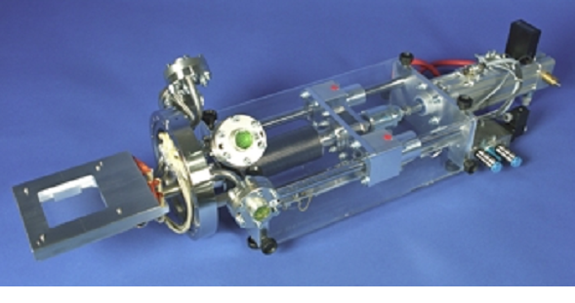
Secondary Electron Emission Grids = SEM-Grid
Beam surface interaction: e⁻ emission → measurement of current.
Example: 15 wire spaced by 1.5 mm:
SEM-Grid drive on ∅ 200 mm flange:
wire
feedthrough
beam
SEM-Grid
≈ 1 m
Parameter | Typ. value
# wires per plane | 10 ...100
Active area | (5...20 cm) ²
Wire ∅ | 25....100 μm
Spacing | 0.3...2 mm
Material | e.g. W or Carbon
Max. beam power | 1 W/mm
5 cm

Slide 19
Secondary Electron Emission Grids = SEM-Grid
Beam surface interaction: e⁻ emission → measurement of current.
Example: 15 wire spaced by 1.5 mm:
5 cm
Each wire is equipped with one I/U converter
different ranges settings by R_{i}
→ very large dynamic range up to 10⁶.

Slide 20
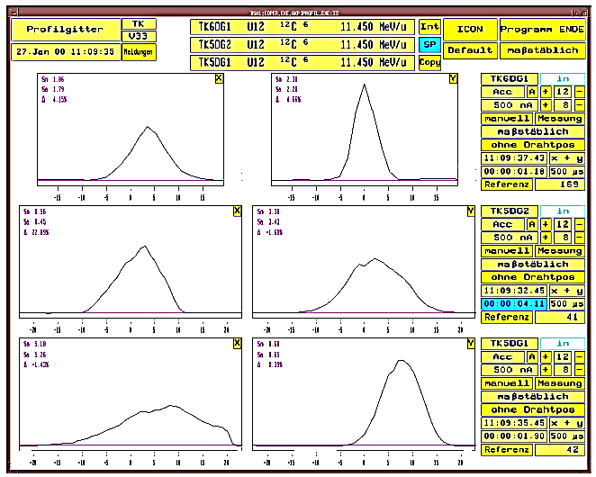
Example of Profile Measurement with SEM-Grids
Even for low energies, several SEM-Grid can be used due to the ≈ 80 % transmission
⇒ frequently used instrument beam optimization: setting of quadrupoles, energy….
Example: C⁶⁺ beam of 11.4 MeV/u at different locations at GSI-LINAC
horizontal
vertical
synchrotron
SEM-Grids
beam
injection
extraction

Slide 21
The Artist view of a SEM-Grid = Harp

Slide 22
Measurement of Beam Profile
Outline:
Scintillation screens:
emission of light, universal usage, limited dynamic range
Optical Transition Radiation:
light emission due to crossing material boundary, mainly for relativistic beams
SEM-Grid:
emission of electrons, workhorse, limited resolution
Wire scanner:
emission of electrons, workhorse, scanning method
Ionization Profile Monitor
Synchrotron Light Monitors
Summary

Slide 23
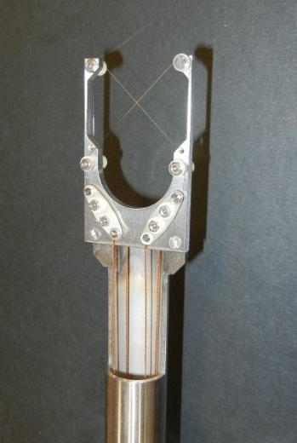
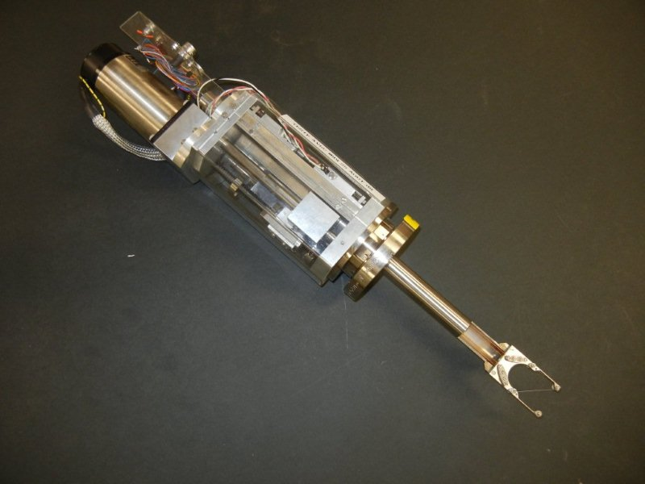
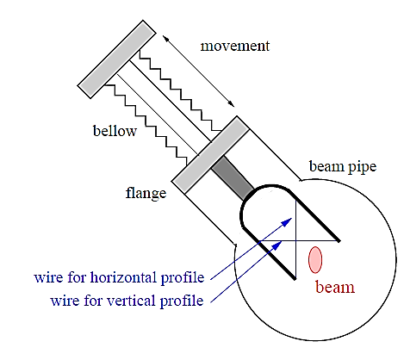
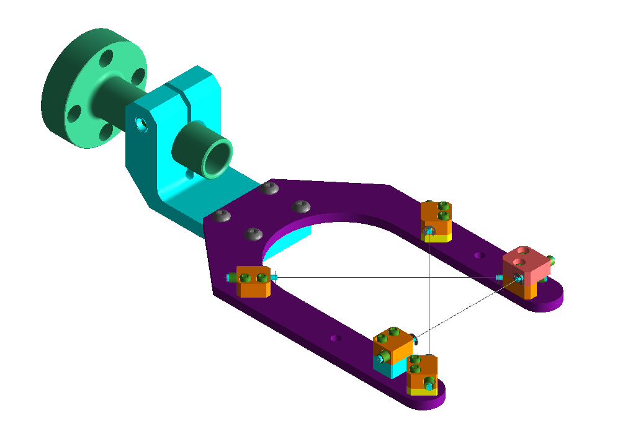
Slow, linear Wire Scanner
Idea: One wire is scanned through the beam!
Wire diameter 100 µm < d_{wire} < 10 µm
Slow, linear scanner are used for:
Low energy protons
High resolution measurements for e⁻ beam
by de-convolution σ²_{beam}=σ²_{meas}−d²_{wire}
⇒ resolution down to 1 μm range can be reached
Detection of beam halo
Example: Wires scanner at CERB LINAC4
5 cm

Slide 24

The Artist view of a Beam Scraper or Scanner

Slide 25
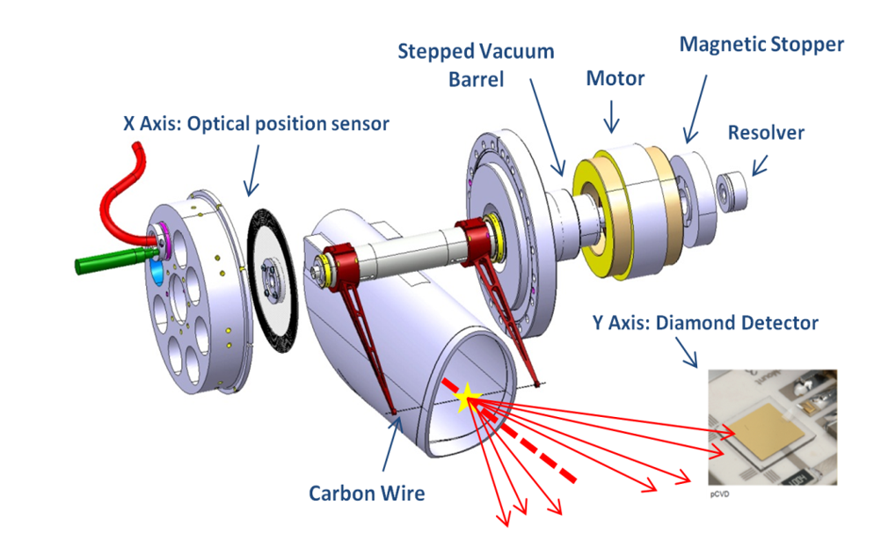
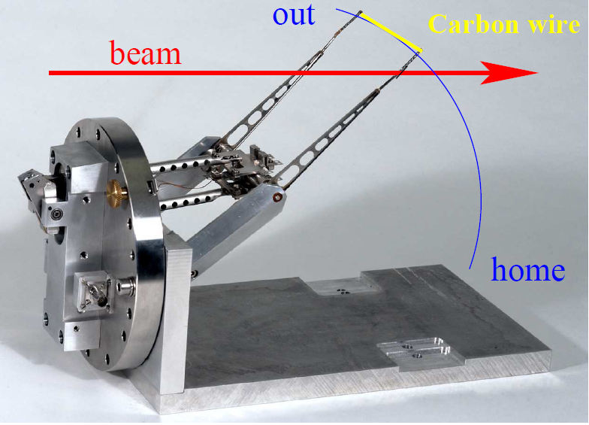
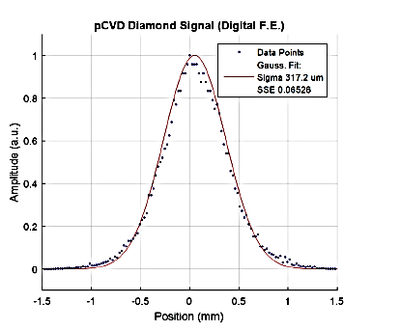
Fast, Flying Wire Scanner
In a synchrotron one wire is scanned though the beam as fast as possible.
Fast pendulum scanner for synchrotrons; sometimes it is called ’flying wire’:
particle
detector
synchrotron
From https://twiki.cern.ch/twiki/
bin/viewauth/BWSUpgrade/
injection
extraction

Slide 26
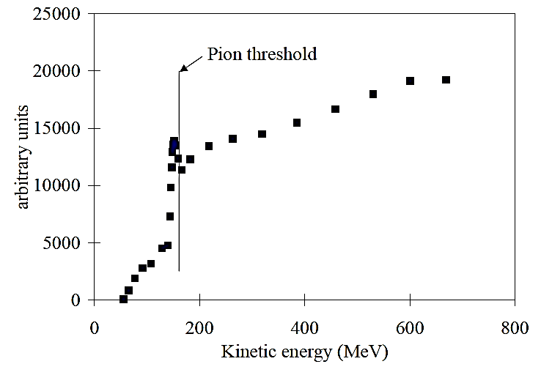
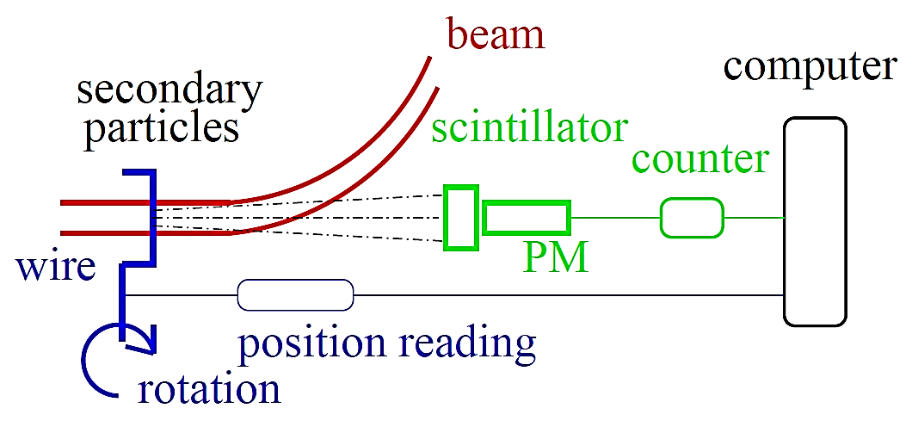
Usage of Flying Wire Scanners
Material: carbon or SiC → low Z-material for low energy loss and high temperature.
Thickness: down to 10 μm → high resolution.
Detection: High energy secondary particles with a detector like a beam loss monitor
Secondary particles:
Proton beam → hadrons shower (π, n, p...)
Electron beam → Bremsstrahlung photons.
Proton impact on
scanner at CERN-PS Booster:
Rest mass:
m_{π±} = 140 MeV/c²
m_{π0} = 135 MeV/c²
Kinematics of flying wire:
Velocity during passage typically 10 m/s = 36 km/h and
typical beam size ∅ 10 mm ⇒ time for traversing the beam t ≈ 1 ms
Challenges: Wire stability for fast movement with high acceleration
U. Raich et al., DIPAC 2005

Slide 27
The Artist View of a Wire Scanner

Slide 28
Comparison between SEM-Grid and slow linear Wire Scanners
Grid: Measurement at a single moment in time
Scanner: Fast variations can not be monitored
→ for pulsed LINACs precise synchronization is needed
_______________________________________________________________________
Grid: Resolution of a grid is fixed by the wire distance (typically 1 mm)
Scanner: For slow scanners the resolution is about the wire thickness (down to 10 μm)
→ used for e−-beams having small sizes (down to 10 μm)
__________________________________________________________________________
Grid: Needs one electronics channel per wire
→ expensive electronics and data acquisition
Scanner: Needs a precise movable feed-through → expensive mechanics.
__________________________________________________________________________
Flying wire:
Grid: Not adequate at synchrotrons for stored beam parameters
Scanner: At high energy synchrotrons: flying wire scanners are nearly non-destructive

Slide 29
Measurement of Beam Profile
Outline:
Scintillation screens:
emission of light, universal usage, limited dynamic range
Optical Transition Radiation:
light emission due to crossing material boundary, mainly for relativistic beams
SEM-Grid:
emission of electrons, workhorse, limited resolution
Wire scanner:
emission of electrons, workhorse, scanning method
Ionization Profile Monitor:
secondary particle detection from interaction beam-residual gas
Synchrotron Light Monitors
Summary

Slide 30
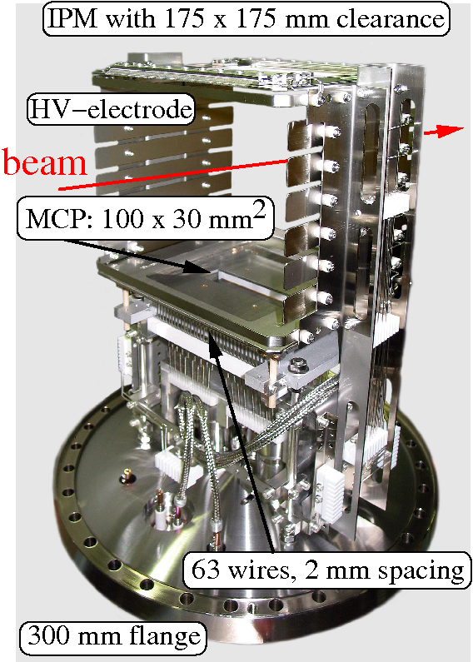

Ionization Profile Monitor at GSI Synchrotron
Non-destructive device for proton synchrotron:
Beam ionizes the residual gas by electronic stopping
Gas ions or e⁻ accelerated by E -field ≈1 kV/cm
Spatial resolved single particle detection
Realization at GSI synchrotron:
One monitor per plane
HV electrode
voltage divider
+ 6 kV
R
+ 5 kV
beam
+ 4 kV
$$\vec{E}$$
+ 3 kV
ion
e.g. H⁺
+ 2 kV
+ 1 kV
0 kV
MCP
anode
position readout
Typical vacuum pressure:
Transfer line: N₂ 10⁻⁸...10⁻⁶ mbar ≅ 3⋅10⁸...3⋅10¹⁰cm⁻³
Synchrotron: H₂ 10⁻¹¹...10⁻⁹ mbar ≅ 3⋅10⁵...3⋅10⁷cm⁻³

Slide 31
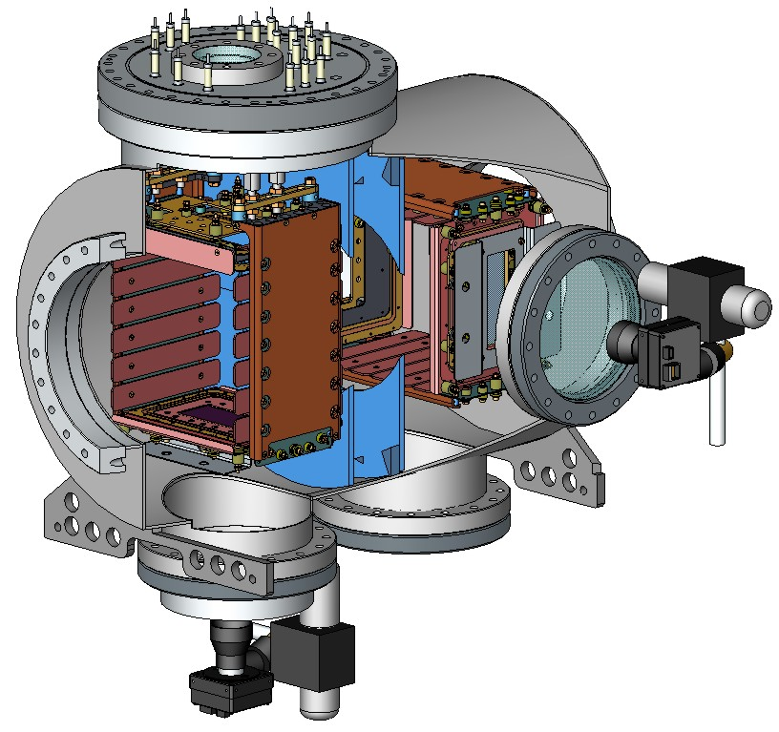
Ionization Profile Monitor Realization
The realization for the heavy ion storage ring ESR at GSI:
Realization at GSI synchrotron:
One monitor per plane
Insertion 650 mm
IPM support
& UV lamp
Ø250 mm
Horizontal IPM:
Vertical IPM
E-field box
electrodes
beam
175mm
Vertical camera
MCP
E-field separation disks
View port Ø150 mm
Horizontal camera
Typical vacuum pressure:
Transfer line: N₂ 10⁻⁸...10⁻⁶ mbar ≅ 3⋅10⁸...3⋅10¹⁰cm⁻³
Synchrotron: H₂ 10⁻¹¹...10⁻⁹ mbar ≅ 3⋅10⁵...3⋅10⁷cm⁻³

Slide 32
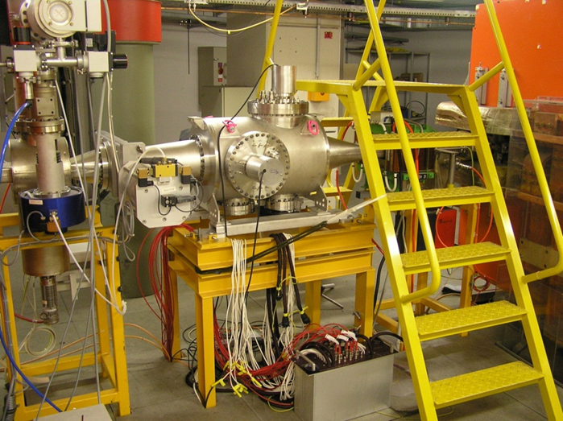
Ionization Profile Monitor Realization
The realization for the heavy ion storage ring ESR at GSI:
Insertion 650 mm
IPM support
& UV lamp
Ø250 mm
Horizontal IPM:
Vertical IPM
E-field box
Realization at COSY synchrotron for one plane:
electrodes
beam
175mm
Vertical camera
MCP
E-field separation disks
View port Ø150 mm
Horizontal camera

Slide 33
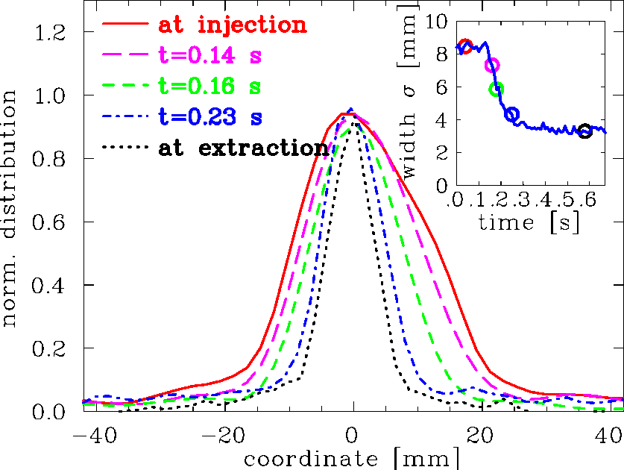
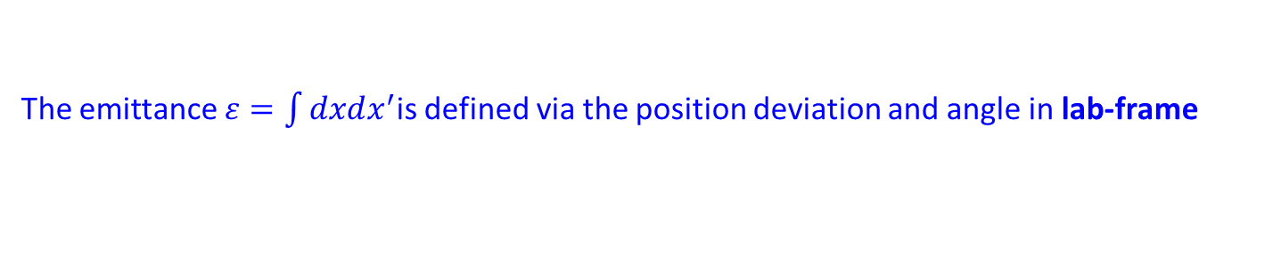

‘Adiabatic’ Damping during Acceleration
The emittance $ε=\int{dxdx^{′}}$is defined via the position deviation and angle in lab-frame
before acceleration
after acceleration
v⊥
v
v⊥
v
ϕ_{slow}
ϕ_{fast}
v||
v||
After acceleration the longitudinal velocity is increased ⇒ angle ϕ is smaller
The angle is expressed in momenta: x’ = p⊥ / p|| the emittance is <xx’> = 0 : ε = x ⋅ x’ = x ⋅ p⊥ / p||
under ideal conditions the emittance can be normalized to the momentum p || = γ ⋅ m⋅ β c
normalized emittance ε_{norm} = β γ⋅ ε is preserved with the Lorentz factor γ and velocity β =v/c
Example: Acceleration in GSI-synchrotron for C⁶⁺ from
6.7 → 600 MeV/u (β = 12 → 79 %) observed by IPM
theoretical width: ${\left\langle x\right\rangle }_{f}=\sqrt{\frac{β_{i} ∙ γ_{i}}{β_{f} ∙ γ_{f}}}{∙\left\langle x\right\rangle }_{i}$
$=0.33∙{\left\langle x\right\rangle }_{i}$
measured width: ${\left\langle x\right\rangle }_{f}≈0.37∙{\left\langle x\right\rangle }_{i}$
acc.
IPM
synchrotron with acceleration
IPM is well suited
for long time observations
without beam disturbance
→ mainly used at proton synchrotrons.
injection
extraction
→magnetic field

Slide 34
Measurement of Beam Profile
Outline:
Scintillation screens:
emission of light, universal usage, limited dynamic range
Optical Transition Radiation:
light emission due to crossing material boundary, mainly for relativistic beams
SEM-Grid:
emission of electrons, workhorse, limited resolution
Wire scanner:
emission of electrons, workhorse, scanning method
Ionization Profile Monitor:
secondary particle detection from interaction beam-residual gas
Synchrotron Light Monitors:
photon detection of emitted synchrotron light in optical and X-ray range
Summary

Slide 35
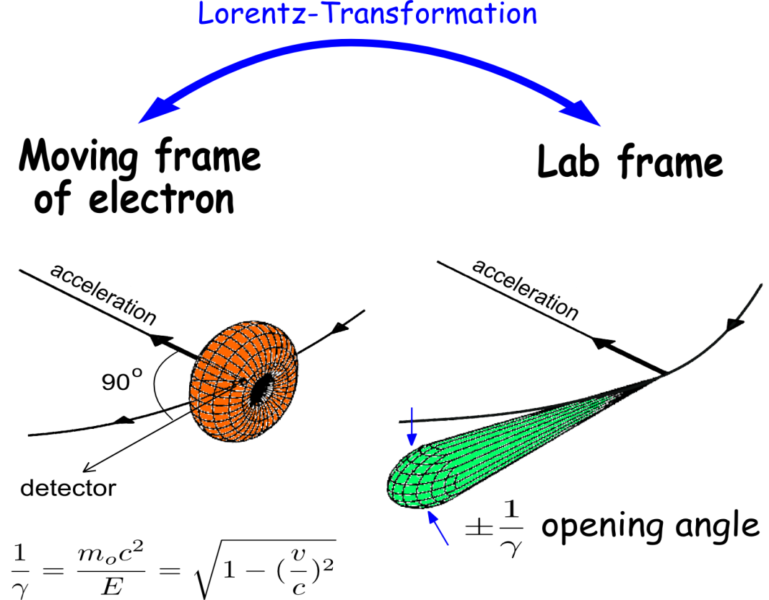
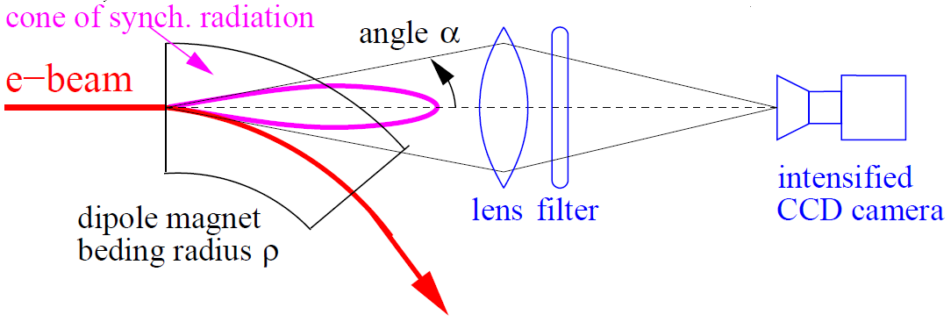
Synchrotron Radiation Monitor
An electron bent (i.e. accelerated) by a dipole magnet emit synchrotron light
see lecture ‘Electron Beam Dynamics’ by Lenny Rivkin
This light is emitted
into a cone of
opening 2/γ in lab-frame.
Well suited for rel. e⁻
For protons:
Only for energies E_{kin} > 100 GeV
Rest frame of electron:
Laboratory frame:
orbit of electrons
orbit of electrons
dp/dt
dp/dt
radiation field
radiation field
power: P∝ γ ⁴/ ρ ²
The light is focused to a intensified CCD.
Advantage:
Signal anyhow available!

Slide 36
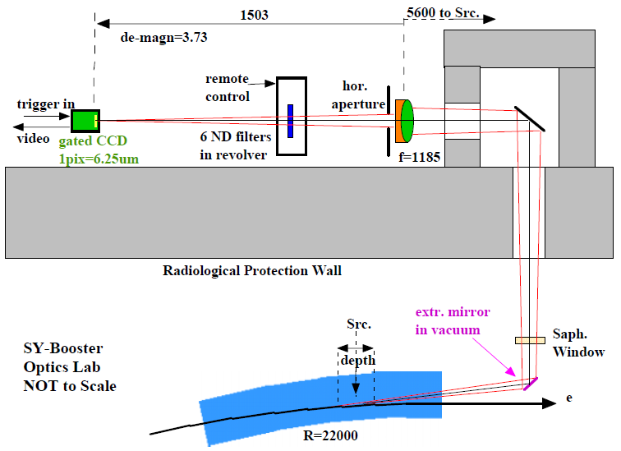
Realization of a Synchrotron Radiation Monitor
Extracting out of the beam’s plane by a (cooled) mirror
→ Focus to a slit + wavelength filter for optical wavelength
→ Image intensified CCD camera
Example: ESRF monitor from dipole with bending radius 22 m (blue or near UV)
optical table
SRM
synchrotron
injection
extraction
γ beam
e⁻ beam
dipole
Courtesy K. Scheidt et al., DIPAC 2005

Slide 37
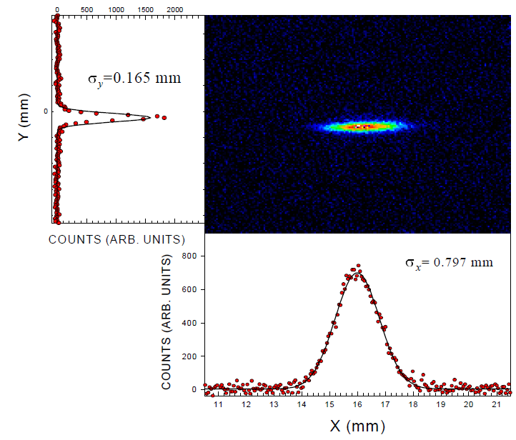
Result from a Synchrotron Light Monitor
Example: Synchrotron radiation facility APS accumulator ring and blue wavelength:
SRM
B.X. Yang (ANL) et al. PAC’97
synchrotron
injection
extraction
Advantage: Direct measurement of 2-dim distribution, good optics for visible light
Realization: Optics outside of vacuum pipe
Disadvantage: Resolution limited by the diffraction due to finite apertures in the optics.

Slide 38
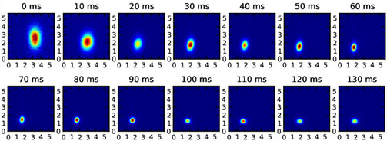
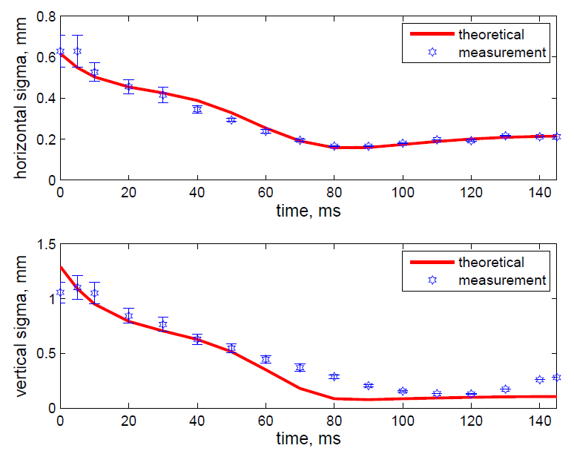
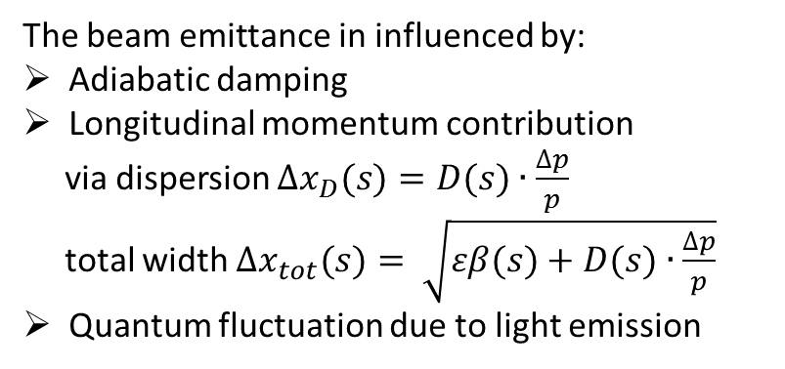
‘Adiabatic Damping’ for an Electron Beam
Example: Booster at the light source ALBA acceleration from 0.1 → 3 GeV within 130 ms
Profile measure by synchrotron radiation monitor:
The beam emittance in influenced by:
Adiabatic damping
Longitudinal momentum contribution
via dispersion $∆x_{D}(s)=D(s)∙\frac{∆p}{p}$
total width $Δx_{tot}(s)= \sqrt{εβ(s)+D(s)∙\frac{∆p}{p}}$
Quantum fluctuation due to light emission
vert. y [mm]
hor. x [mm]
SRM
synchrotron
Courtesy U. Iriso & M. Pont (ALBA) et al. IPAC 2011
injection
extraction

Slide 39
The Artist View of a Synchrotron Light Monitor

Slide 40
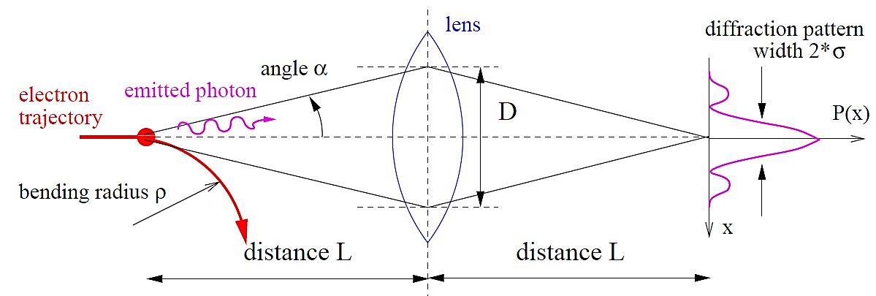
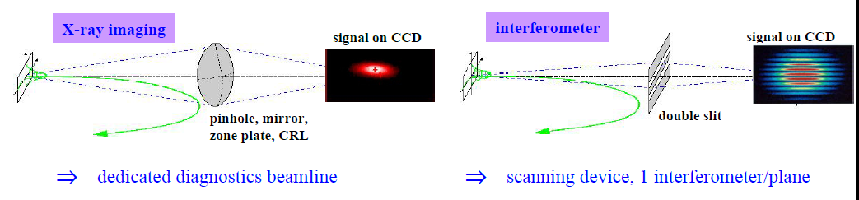
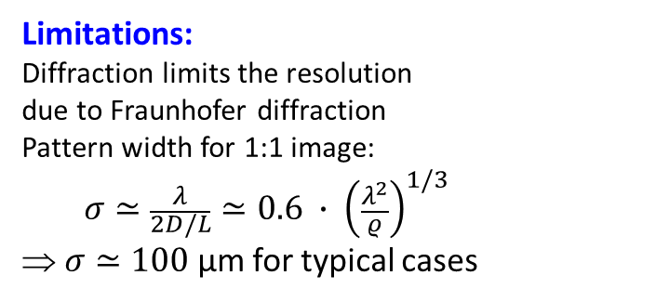
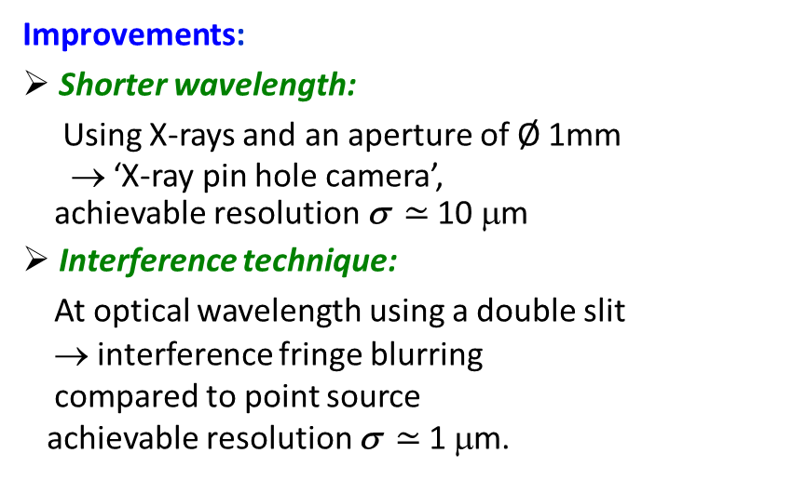
Diffraction Limit of Synchrotron Light Monitor
Limitations:
Diffraction limits the resolution
due to Fraunhofer diffraction
Pattern width for 1:1 image:
$$σ≃\frac{λ}{2D/L}≃0.6 ∙ {\left(\frac{λ^{2}}{ρ}\right)}^{1/3}$$
⇒ $σ≃100$µm for typical cases
with wavelength λ
Improvements:
Shorter wavelength:
Using X-rays and an aperture of Ø 1mm
→ ‘X-ray pin hole camera’,
achievable resolution σ $≃$ 10 μm
Interference technique:
At optical wavelength using a double slit
→ interference fringe blurring
compared to point source
achievable resolution σ $≃$ 1 μm.

Slide 41
Summary for Beam Profile Measurement
Different techniques are suited for different beam parameters:
e⁻-beam: typically Ø 0.01 to 3 mm, protons: typically Ø 1 to 30 mm
Intercepting ↔ non-intercepting methods
Direct observation of electrodynamics processes:
Optical synchrotron radiation monitor: non-destructive, for e⁻-beams, complex, limited res.
X-ray synchrotron radiation monitor: non-destructive, for e⁻-beams, very complex
OTR screen: nearly non-destructive, large relativistic γ needed, e⁻-beams mainly
Detection of secondary photons, electrons or ions:
Scintillation screen: destructive, large signal, simple setup, all beams
Ionization profile monitor: non-destructive, expensive, limited resolution, for protons
Wire based electronic methods:
SEM-grid: partly destructive, large signal and dynamic range, limited resolution
Wire scanner: partly destructive, large signal and dynamics, high resolution, slow scan.

Slide 42
Measurement of transverse Emittance
The emittance characterizes the whole beam quality, assuming linear
behavior as described by second order differential equation.
It is defined within the phase space as:
The measurement is based on determination of:
Either profile width σ_{x} and angular width σ_{x}′ at one location
Or profile width σ_{x} at different locations and linear transformations.
Different devices are used at transfer lines:
Lower energies E_{kin} < 100 MeV/u: slit-grid device, pepper-pot
(suited in case of non-linear forces).
All beams: Quadrupole variation method using linear transformations
(not well suited in the presence of non-linear forces)
Synchrotron: lattice functions results in stability criterion
⇒ beam width delivers emittance:

Slide 43
Trajectory and Characterization of many Particles
Single particle trajectories are forming a beam
They have a distribution of
start positions and angles
Characteristic quantity is
the beam envelope
Goal:
Transformation of envelope
behavior of whole ensemble
single particles
trajectory
envelope of all particles
Focus. quad.
drift
Focus. quad.
drift
see lecture
‘Transverse linear Beam Dynamics’
by Wolfgang Hillert
Courtesy K.Wille

Slide 44
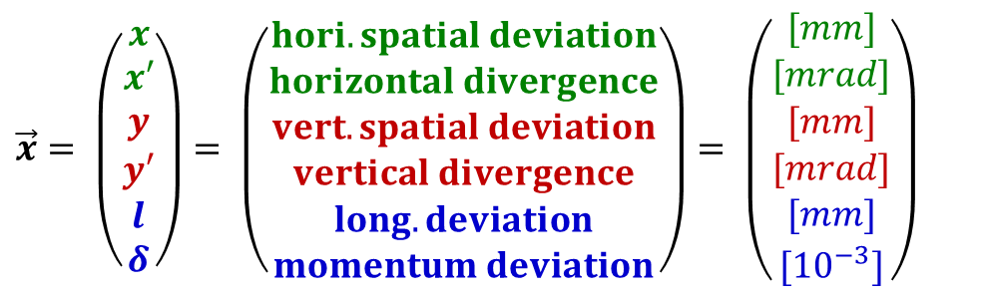
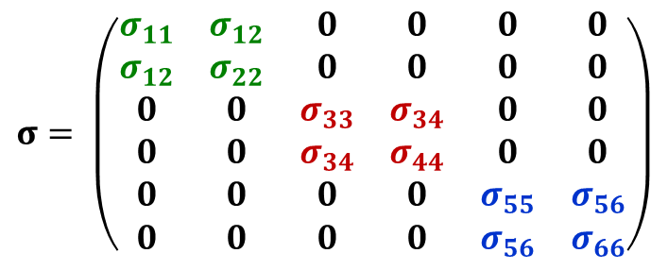
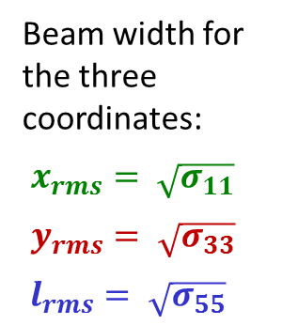

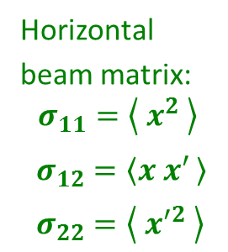

Definition of Coordinates and basic Equations
$$\vec{x}= \left(\begin{matrix}x \\ x′ \\ y \\ y′ \\ l \\ δ\end{matrix}\right)= \left(\begin{matrix}hori. spatial deviation \\ horizontal divergence \\ vert.spatial deviation \\ vertical divergence \\ long. deviation \\ momentum deviation\end{matrix}\right)= \left(\begin{matrix}[mm] \\ [mrad] \\ [mm] \\ [mrad] \\ [mm] \\ {[10}^{−3}]\end{matrix}\right)$$
The basic vector is 6 dimensional:
The transformation of a single particle from a location s₀ to s₁ is given by the Transfer Matrix R:
$$\vec{x}\left(s_{1}\right)=R\left(s\right)∙\vec{x}\left(s_{0}\right)$$
The transformation of a the envelope from a location s₀ to s₁ is given by the
Beam Matrix σ :
$σ\left(s_{1}\right)=R\left(s\right)∙σ\left(s_{0}\right)∙R^{T}\left(s\right)$
6-dim Beam Matrix with decoupled hor., vert. and long. plane:
Beam width for
the three
coordinates:
$x_{rms}= \sqrt{σ_{11}}$
$y_{rms}= \sqrt{σ_{33}}$
$l_{rms}= \sqrt{σ_{55}}$
$$σ= \left(\begin{matrix}σ_{11} & σ_{12} & 0 & 0 & 0 & 0 \\ σ_{12} & σ_{22} & 0 & 0 & 0 & 0 \\ 0 & 0 & σ_{33} & σ_{34} & 0 & 0 \\ 0 & 0 & σ_{34} & σ_{44} & 0 & 0 \\ 0 & 0 & 0 & 0 & σ_{55} & σ_{56} \\ 0 & 0 & 0 & 0 & σ_{56} & σ_{66}\end{matrix}\right)$$
Horizontal
beam matrix:
$$σ_{11}=\left\langle { x}^{2} \right\rangle$$
$σ_{12}=\left\langle x x′ \right\rangle$
$σ_{22}=\left\langle { x′}^{2} \right\rangle$
horizontal
vertical
longitudinal
hor.-long. coupling
→ 9 values

Slide 45

The Emittance for Gaussian and non-Gaussian Beams
The beam distribution can be non-Gaussian, e.g. at:
➢ Beams behind ion source
Space charged dominated beams at LINAC & synchrotron
Cooled beams in storage rings
General description of emittance
using terms of 2-dim distribution:
It describes the value for 1 standard derivation
Variances
Covariance
i.e. correlation
For Gaussian beams only: ε_{rms} ↔ interpreted as area containing a fraction f of ions:
Emittance ε (f) | Fraction f
1 ⋅ ε_{rms} | 15 %
π ⋅ ε_{rms} | 39 %
2π ⋅ ε_{rms} | 63 %
4π ⋅ ε_{rms} | 86 %
8π ⋅ ε_{rms} | 98 %
Care:
No common definition
of emittance concerning
the fraction f

Slide 46
The Slit-Grid Measurement Device
Slit-Grid: Direct determination of position and angle distribution.
Used for protons with E_{kin} < 100 MeV/u ⇒ range R < 1 cm.
Slit: position P(x) with typical width: 0.1 to 0.5 mm
Distance: typ. 0.5 to 5 m (depending on beam energy 0. 1 ... 100 MeV)
SEM-Grid: angle distribution P(x′)
Slit
SEM-Grid
RFQ
LINAC
0.5...5 m

Slide 47

Display of Measurement Results
The distribution is depicted as a function of
position [mm] & angle [mrad]
The distribution can be visualized by
Mountain plot
Contour plot
Calc. of 2nd moments <x²> , <x’²> & <xx’>
Emittance value ε_{rms} from
⇒ Problems:
Finite binning results in limited resolution
Background → large influence on <x²>, <x’²> and <xx’>
Or fit of distribution with an ellipse
⇒ Effective emittance only
Beam: Ar⁴⁺, 60 keV, 15 μA
at Spiral2 Phoenix ECR source.
P. Ausset, DIPAC 2009
Remark: Behind a ion source the beam might very non-Gaussian
due to plasma density and aberration at quadrupoles

Slide 48
Measurement of transverse Emittance
Outline:
Definition and some properties of transverse emittance
Slit-Grid device: scanning method
scanning slit → beam position & grid → angular distribution
Quadrupole strength variation and position measurement
emittance from several profile measurement and beam optical calculation

Slide 49

Emittance Measurement by Quadrupole Variation
From a profile determination, the emittance can be calculated via linear transformation,
if a well known and constant distribution (e.g. Gaussian) is assumed.
Measurement of beam width
x²_{max} = σ₁₁(s₁, k)
matrix R(k) describes the focusing.
With the drift matrix the transfer is
R(k_{i} ) = R_{drift} ⋅ R_{focus}(k_{i} )
Transformation of the beam matrix
σ(s₁,k_{i}) = R(k_{i} ) ⋅ σ(s₀) ⋅ R^{T} (k_{i} )
Task: Calculation of σ(0)
at entrance s₀ i.e. all three elements

Slide 50
Measurement of transverse Emittance
Using the ‘thin lens approximation’ i.e. the quadrupole has a focal length of f:
Measurement of matrix-element $σ_{11}\left(s_{1},K\right)$ from matrices σ(s₁,K_{i}) = R(K_{i} ) ⋅ σ(s₀) ⋅ R^{T} (K_{i} )
Example: Square of the beam width at
ELETTRA 100 MeV e⁻ Linac, YAG:Ce:
For completeness: The relevant formulas
The three matrix elements at the quadrupole:
Focusing strength K [m⁻¹]
G. Penco (ELETTRA) et al., EPAC’08

Slide 51

Summary for transverse Emittance Measurement
Emittance is the important quantity for comparison to theory.
It includes absolute value (value of ε) & orientation in phase space (σ_{ij} or α, β and γ)
three independent values $ε_{rms}= \sqrt{σ_{11}∙σ_{22}− σ_{12}}≡\sqrt{\left\langle x^{2}\right\rangle \left\langle {x′}^{2}\right\rangle − {\left\langle xx′\right\rangle }^{2} }$
assuming no coupling between horizontal, vertical and longitudinal planes
Transfer line, low energy beams → direct measurement of x- and x′-distribution:
➢ Slit-grid: movable slit → x-profile, grid → x′-profile
Transfer line, all beams → profile measurement + linear transformation:
➢ Quadrupole variation: one location, different setting of a quadrupole
Assumptions: ➢ well aligned beam, no steering
➢ no emittance blow-up due to space charge
Remark: Non-linear transformation possible via tomographic reconstruction
Important remark: For a synchrotron with a stable beam storage,
width measurement is sufficient using $x_{rms}= \sqrt{ε_{rms}∙β}$

Slide 52
Measurement of longitudinal Parameters
Measurement of longitudinal parameter:
Bunch length measurement at
Synchrotron light sources
Linear light sources
Summary
Longitudinal ↔ transverse correspondences:
position relative to rf ↔ transverse center-of-mass
bunch structure in time ↔ transverse profile
momentum or energy spread ↔ transverse divergence
longitudinal emittance ↔ transverse emittance.

Slide 53


The Bunch Position measured by a Pick-Up
The bunch position is given relative to the accelerating rf.
e.g. φ_{ref}=-30º inside a rf cavity
must be well aligned for optimal acceleration
Transverse correspondence: Beam position
Example: Pick-up signal for f_{rf} =36 MHz rf at GSI-LINAC:
source
ADC
acc. f_{rf}
RFQ
LINAC
BPM
pick-up

Slide 54

Bunch Length Measurement for relativistic Electrons
Electron bunches are too short (σ_{t} < 100 ps) to be covered by the bandwidth of
pick-ups (f < 3 GHz ⇔ t_{rise} > 100 ps) for structure determination.
→ Time resolved observation of synchr. light with a streak camera: Resolution ≈ 1 ps.
Scheme of a streak camera
Streak camera
e⁻ synchrotron
acc.
freq. f_{rf}
rf cavity
injection
extraction

Slide 55


Technical Realization of a Streak Camera
acceleration
focusing
deflection
Hardware of a streak camera
Time resolution down to 0.5 ps:
≈ 30 cm
Streak tube
CCD
camera
Input optics
≈ 60 cm

Slide 56
Technical Realization of a Streak Camera
acceleration
focusing
deflection
Hardware of a streak camera
Time resolution down to 0.5 ps:
≈ 30 cm
Streak tube
CCD
camera
Input optics
≈ 60 cm

Slide 57

Results of Bunch Length Measurement by a Streak Camera
The streak camera delivers a fast scan in vertical direction (here 360 ps full scale)
and a slower scan in horizontal direction (24 μs).
Example: Bunch length at the synchrotron light source SOLEIL for U_{rf} = 2 MV
for slow direction 24 μs and scaling for fast scan 360 ps: measure σ_{t} = 35 ps.
Slow Scan:
bunch length
2σ_{t} = 70 ps
Fast Scan:
Streak camera
Short bunches are desired by
the users
Example: Bunch length σ_{t}
as a function of stored current
(i.e. space charge de-focusing)
at SOLEIL
e⁻ synchrotron
acc.
freq. f_{rf}
rf cavity
injection
extraction
Courtesy of M. Labat et al., DIPAC’07

Slide 58
The Artist View of a Streak Camera
→ conclusion

Slide 59


Bunch Length Measurement by electro-optical Method
For Free Electron Lasers → bunch length below 1 ps is achieved
Below the resolution of streak camera
Short laser pulses with t ≈ 10 fs and electro-optical modulator
Electro optical modulator: Birefringent, rotation angle depends on external electric field
Relativistic electron bunch: transverse ele. field $E_{⊥, lab}= γE_{⊥, rest}$ carries the time information
Scanning of delay between bunch and laser → time profile after several pulses.
Bunch compressor
EO monitor
LINAC
LINAC
Undulator
Courtesy S.P.Jamison et al., EPAC 2006

Slide 60

Bunch Length Measurement by electro-optical Method
For Free Electron Lasers → bunch length below 1 ps is achieved
Short laser pulse ⇔ broad frequency spectrum (property of Fourier Transformation)
Optical stretcher: Separation of colors by different path length
⇒ different colors at different time ⇒ single-shot observation
Bunch compressor
EO monitor
LINAC
LINAC
Undulator
Courtesy S.P.Jamison et al., EPAC 2006

Slide 61

Hardware of a spectral-decoded EOSD Scanning Setup
Laser: Commercial Ti:Sa or Yb-fibre,
10 fs duration, near IR,
Crystal: GaP or ZnTe, 100 µm thickness
Example: Bunch length at FLASH
100 fs bunch duration = 30 µm length !
S. Funkner et al., arXiv1912.01323 (2019)
vacuum flange
crystal
2σ = 110 fs
beam
B. Steffen et al, DIPAC 2009
B. Steffen et al., Phys. Rev. AB 12, 032802 (2009)
→proton BSM

Slide 62
Summary of longitudinal Measurements
Devices for bunch length at light sources:
Streak cameras:
➢ Time resolved monitoring of synchrotron radiation
→ for relativistic e⁻-beams, 10 ps < t_{bunch} < 1 ns
Time resolution limit of streak camera ≈ 1 ps
Laser-based electro-optical modulation:
➢ Electro-optical modulation of short laser pulse
→ very high time resolution down to some fs time resolution
Technical complex installation

Slide 63
Conclusion for Beam Diagnostics Course
Diagnostics is the ’sensory organ’ for the beam.
It required for operation and development of accelerators
Several categories of demands leads to different installations:
Quick, non-destructive measurements leading to a single number or simple plots
Complex instrumentation used for hard malfunction and accelerator development
Automated measurement and control of beam parameters i.e. feedback
The goal and a clear interpretation of the results is a important design criterion.
General comments:
Quite different technologies are used, based on various physics processes
Accelerator development goes parallel to diagnostics development
Thank you for your attention!

Slide 64
General Reading on Beam Instrumentation
H. Schmickler (Ed.) Beam Instrumentation, Proc. CERN Accelerator School, Tuusula 2018 in prep.
D. Brandt (Ed.), Beam Diagnostics for Accelerators, Proc. CERN Accelerator School, Dourdan,
CERN-2009-005, 2009;
Proceedings of several CERN Acc. Schools (introduction & advanced level, special topics).
V. Smaluk, Particle Beam Diagnostics for Accelerators: Instruments and Methods,
VDM Verlag Dr. Müller, Saarbrücken 2009.
P. Strehl, Beam Instrumentation and Diagnostics, Springer-Verlag, Berlin 2006.
M.G. Minty and F. Zimmermann, Measurement and Control of Charged Particle Beams,
Springer-Verlag, Berlin 2003.
S-I. Kurokawa, S.Y. Lee, E. Perevedentev, S. Turner (Eds.), Proceeding of the School on Beam
Measurement, Proceedings Montreux, World Scientific Singapore (1999).
P. Forck, Lecture Notes on Beam Instrumentation and Diagnostics, JUAS School, JUAS Indico web-site.
Contributions to conferences, in particular to International Beam Instrumentation Conference IBIC.

Slide 65
Backup slides

Slide 66


Broadening due to the Beam’s Space Charge: Ion Detection
Influence of the residual gas ion trajectory by :
External electric field E_{ex}
Electric field of the beam’s space charge E_{space}
e.g. Gaussian density distribution for round beam:
Estimation of correction:
With the measured beam width is given by convolution:
Example: U⁷³⁺, 10⁹ particles per 3 m bunch length, cooled beam with σ _{true} = 1 mm FWHM.
HV electrode
voltage divider
+ 6 kV
R
beam
+ 5 kV
$$\vec{E}$$
+ 4 kV
+ 3 kV
ion
e.g. H⁺
+ 2 kV
+ 1 kV
MCP
0 kV
anode
position readout

Slide 67




Electron Detection and Guidance by Magnetic Field
Ion detection mode:
Electron detection mode:
⇒ broadening by beam’s electric field
e⁻ detection in an external magnetic field
cyclotron radius $r_{C}= \frac{mv_{⊥}}{eB}$
for $E_{kin,⊥}=10$eV & B = 0.1 T ⇒ r_{c} ≈ 100 µm
E_{kin} from atomic physics, ≈100 µm resolution of MCP
7⋅ 10¹⁰ charges
per 10 m bunch
Time-of-flight: ≈1 - 2 ns ⇒ 2 - 3 cycles.
B-field: Dipole with large aperture
→ IPM is expensive & large device!

Slide 68

IPM: Magnet Design
Magnetic field for electron guidance:
Corrector
Maximum image distortion:
5% of beam width ⇒ ΔB/B < 1 %
Challenges:
High B-field homogeneity of 1%
Clearance up to 500 mm
Correctors required
to compensate beam steering
Insertion length 2.5 m incl. correctors
Vertical IPM
300mm
Horizontal IPM
Corrector
Insertion length
2.5 m
480mm
beam
corrector 1
IPM magnet
corrector 2
beam
l_{corr}
l_{IPM}
l_{corr}
B_{cor} ⋅ l_{corr} = - ½ B_{IPM} ⋅ l_{IPM}
Remark: For MCP wire-array readoutlower clearance required

Slide 69

IPM: Magnet Design
Magnetic field for electron guidance:
Maximum image distortion:
5% of beam width ⇒ ΔB/B < 1 %
Challenges:
High B-field homogeneity of 1%
Clearance up to 500 mm
Correctors required
to compensate beam steering
Insertion length 2.5 m incl. correctors
J-PARC: Horizontal IPM & comp.
IPM magnet
corrector
corrector
corrector 1
IPM magnet
corrector 2
beam
Magnet: B = 250 mT, Gap 220 mm
IPM: Profile 32 strips, 2.5 mm width
l_{corr}
l_{IPM}
l_{corr}
Remark for electron beams:
Resolution of 50 µm is insufficient,
but sometimes used for photon beams
B_{cor} ⋅ l_{corr} = - ½ B_{IPM} ⋅ l_{IPM}
Remark: For MCP wire-array readout lower clearance required
→back: SRM

Slide 70






Emittance Enlargement by Injection Mis-steering
Emittance conservation requires
precise injection matching
Wrong angle
of injected beam:
injection into outer
phase space → large
β-amplitude i.e. large beam
might result in
‘hollow’ beam
filling of acceptance
i.e. loss of particles
Hadron beams: larger
emittance after acceleration
Example: Variation of vertical injection angle by magnetic steerer
Beam: C⁶⁺ at 6.7 MeV/u acc. to 600 MeV/u, up to 6⋅10⁹ ions per fill
with multi-turn injection, IPM integration 0.5 ms i.e. ≈ 100 turns
Vertical profile at injection:
Horizontal profile at injection:
before
acc.
Vertical profile after acc.:
Horizontal profile after acc.:
after acc.
injection:angle
mismatch
IPM
synchrotron
misplace injection
filamentation
larger emittance
vertical
steerer
x’
Schematic simulation:
Courtesy M. Syphers
x
injection
extraction

Slide 71
Coherent Optical Transition Radiation
Observation of coherent OTR for compressed bunches at LINAC based light sources
Reason: Coherent emission if bunch length ≈ wavelength (t_{bunch}=2 fs ⇔ l_{bunch} =600 nm)
or bunch fluctuations ≈ wavelength
in-coherent emission
coherent emission
Parameter reach
for most LINAC-based FELs!
photons
photons
Beam parameter: FLASH, 700 MeV,
0.5 nC, with bunch compression
beam
beam
OTR screen
OTR screen
OTR screen
scint. screen
prompt emission for OTR and scint. screen
→ coherent and in-coherent OTR
100 ns delayed emission
no OTR as expected (classical process)
emission by scint. screen due to lifetime
⇔ correct profile image!
Contrary of M. Yan et al., DIPAC’11 & S. Wesch, DIPAC’11

Slide 72



X-ray Pin-Hole Camera
The diffraction limit is ⇒ shorter wavelength by X-rays.
Example: PETRA III
Courtesy K. Wittenburg, DESY
Example: PETRA III result:
X-ray beam
Monochromator
σ = 32µm
CCD
X-ray optics
electron beam
σ = 44 µm

Slide 73



Double Slit Interference for Radiation Monitors
The blurring of interference pattern due to
finite size of the sources
⇒spatial coherence parameter γ delivers rms beam size
i.e. ‘de-convolution’ of blurred image!
→ highest resolution, but complex method
Ideal double slit interference pattern:
x
P(x)
Typical resolution for three methods:
Direct optical observation: σ ≈ 100 µm
Direct x-ray observation : σ ≈ 10 µm
Interference optical obser: σ ≈ 1 µm
Blurring by finite source size:
x
P(x)
Courtesy of V. Schlott PSI

Slide 74
Bunch Length Measurement for relativistic Electrons
Electron bunches are too short (σ_{t} < 100 ps) to be covered by the bandwidth of
pick-ups (f < 3 GHz ⇔ t_{rise} > 100 ps) for structure determination.
→ Time resolved observation of synchr. light with a streak camera: Resolution ≈ 1 ps.
Scheme of a streak camera
Streak camera
e⁻ synchrotron
acc.
freq. f_{rf}
rf cavity
injection
extraction

Slide 75


Realization of EOS Scanning
Setup of a scanning EOS method.
Delay line
Using 12fs pulses from
Ti:A_{l2}O₃ laser at 800nm and
ZnTe crystal 0.5mm thick
with a e⁻ - beam 46MeV of 200pC
X. Yan et al, Phys. Rev. Lett. 85, 3404 (2000)

Slide 76


Bunch Structure at low E_{kin}: Not possible with Pick-Ups
Pick-ups are used for:
precise for bunch-center relative to rf
course image of bunch shape
But:
For β << 1 → long. E-field significantly modified:
Example: Comparison pick-up – particle counter:
Ar beam of 1.4 MeV/u (β = 5.5%) , f_{rf} = 108 MHz
σ ≈ R / γ
R
ampl.
1/ f_{rf} = 9.2 ns
⇒ the pick-up signal is insensitive
to bunch ’fine-structure’

Slide 77

Bunch Structure using secondary Electrons for low E_{kin} Protons
Secondary e⁻ liberated from a wire carrying the time information.
→ Bunch Shape Monitor (BSM)
Working principle:
insertion of a 0.1 mm wire at ≈ 10 kV
emission of secondary e⁻ within less than 10 ps
secondary e⁻ are accelerated
toward an rf-deflector
rf-deflector as ’time-to-space’ converter
detector with a thin slit
slow shift of the phase
resolution ≈ 10 ps ≈ 1º @ 280 MHz
Measurements are comparable
to that obtained with particle detectors.
SEM: secondary electron multiplier

Slide 78

Realization of Bunch Shape Monitor at CERN LINAC2
Example: The bunch shape behind RFQ with120 keV/u:
rf-deflector
movable
HV wire
electron detector
electrons
ion beam
Flange Ø 150 mm
→back: Conclusion

