Slide 1


RF Systems
Christine.Vollinger@cern.ch
CAS - Introduction to Accelerator Physics
26 September 2022

Slide 2
Copyright statement and speaker’s release for video publishing
The author consents to the photographic, audio and video recording of this lecture at the CERN Accelerator School. The term “lecture” includes any material incorporated therein including but not limited to text, images and references.
The author hereby grants CERN a royalty-free license to use his image and name as well as the recordings mentioned above, in order to post them on the CAS website.
The author hereby confirms that to his best knowledge the content of the lecture does not infringe the copyright, intellectual property or privacy rights of any third party. The author has cited and credited any third-party contribution in accordance with applicable professional standards and legislation in matters of attribution. Nevertheless the material represent entirely standard teaching material known for more than ten years. Naturally some figures will look alike those produced by other teachers.

Slide 3
Outline
Introduction
Choice of parameters for an RF system
  Frequency and voltage
RF cavity parameters
  Shunt impedance, beam loading, power coupling
Power amplifiers
  Tube or solid state
Summary

Slide 4
Introduction

Slide 5
Introduction
Beam
The radiofrequency (RF) system does the actual acceleration - it transforms a string of magnets into an accelerator
Cavity is the most visible part of an RF system
  On top of the RF system food chain
  Interacts directly with beam
  Also RF gymnastics!
Waveguide & Cavity
Power amplifier
Low-level RF
system
What is below?
How are RF signals generated which make the beam feel comfortable?
Beam

Slide 6
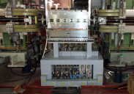
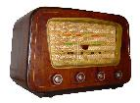
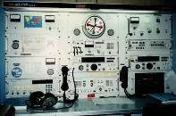
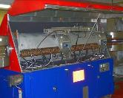
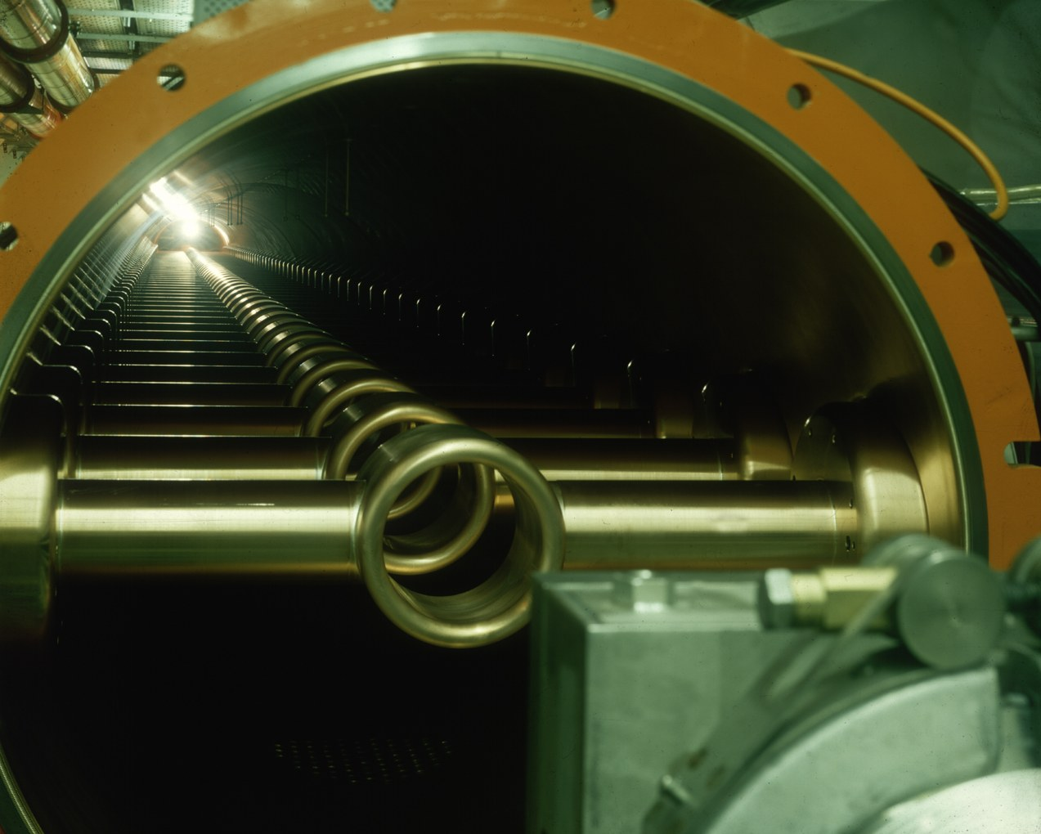
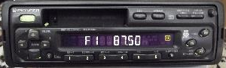

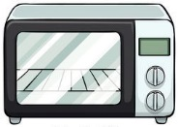
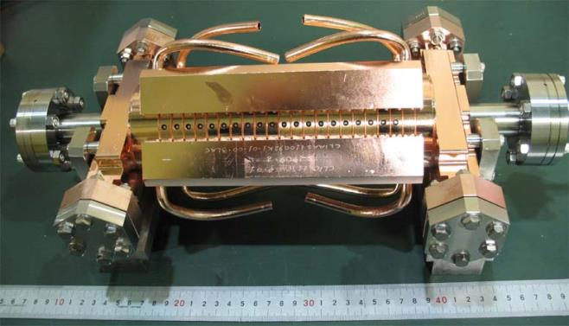

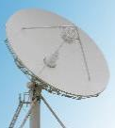
Frequency and wavelength ranges
PS longitudi- nal damper
100 kHz
3 km
Long wave
1 MHz
300 m
PS main RF system
Medium/ short wave
10 MHz
30 m
100 MHz
3 m
SPS 200 MHz
1 GHz
30 cm
VHF
10 GHz
3 cm
100 GHz
3 mm
Microwave links
CLIC 12 GHz

Slide 7
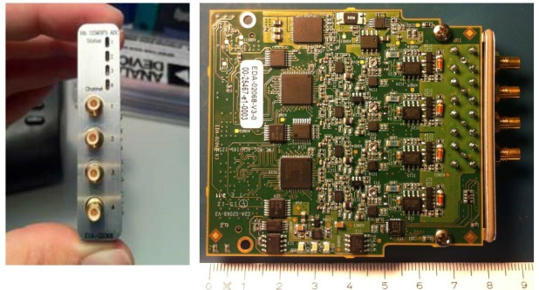
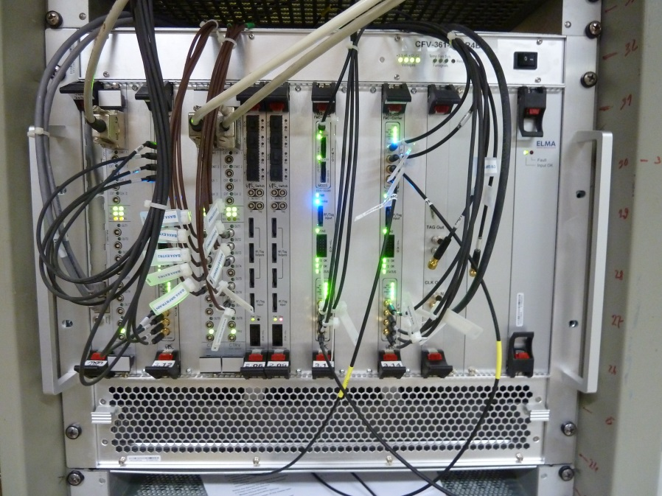
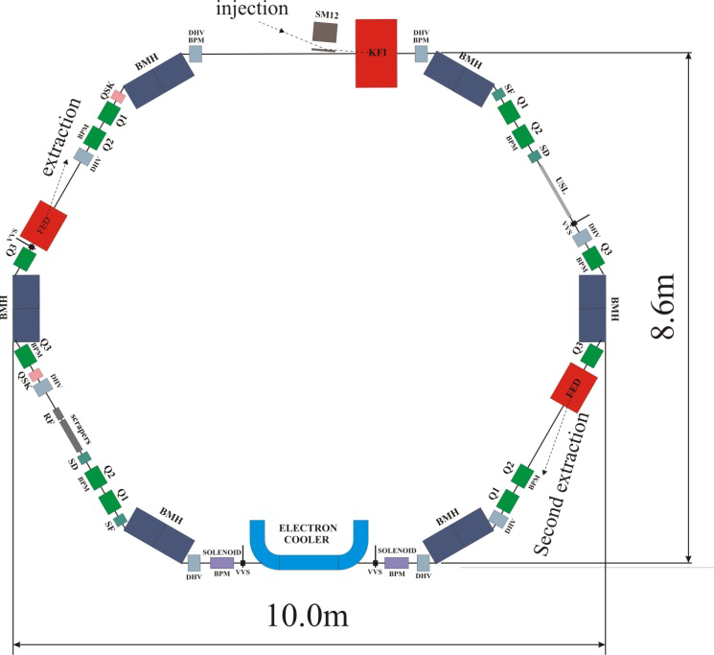
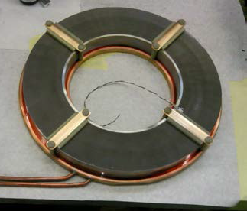
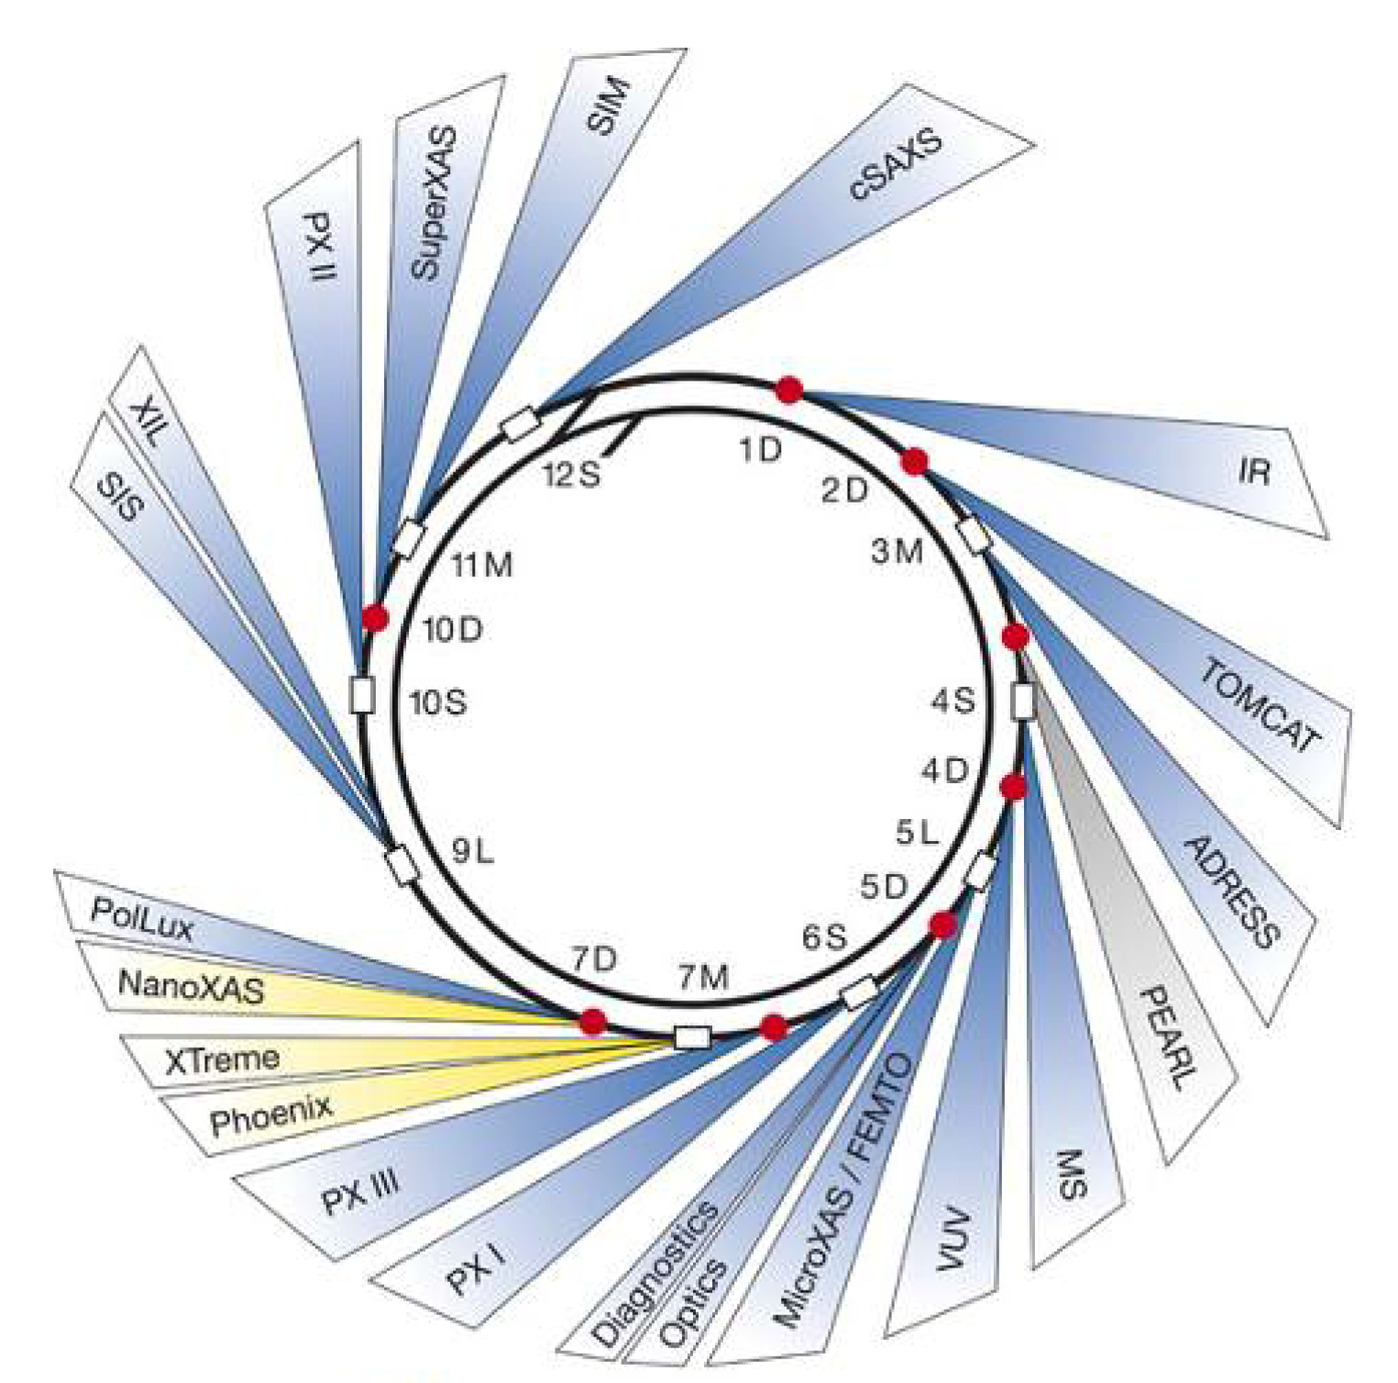
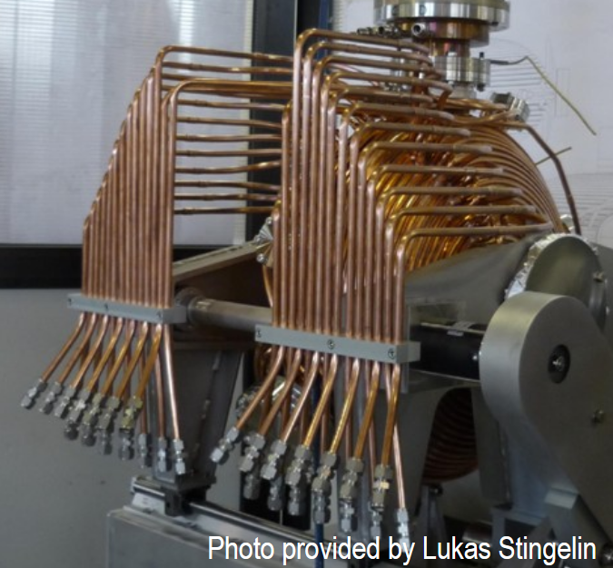
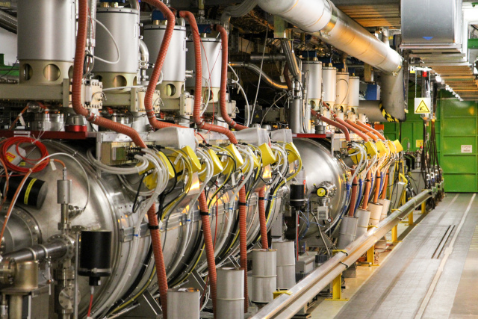
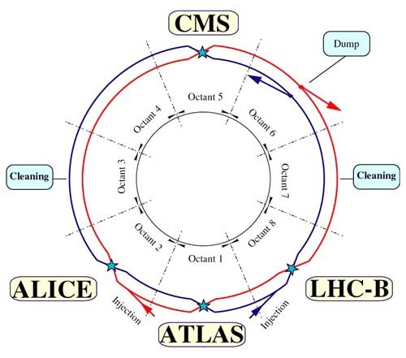
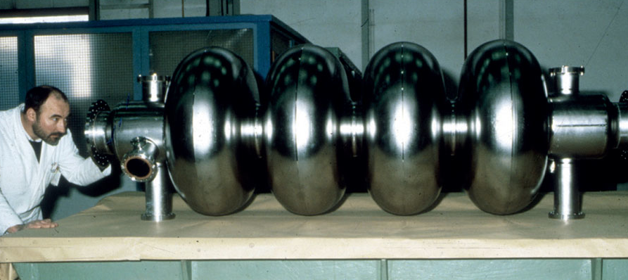
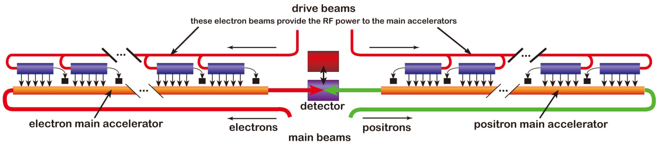
Amplitude ranges
Signals from beam pick-ups
1 μV
1 mV
Cooled hadron beams (ELENA)
LLRF systems
Low/Medium energy hadron RF
1 V
Electron light
sources
SLS
1 kV
1 MV
LHC: 16 MV
LHC
1 GV
LEP: 3.6 GV total
ILC and CLIC: several TV

Slide 8
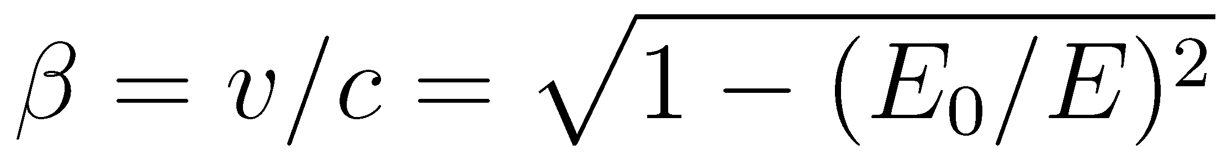
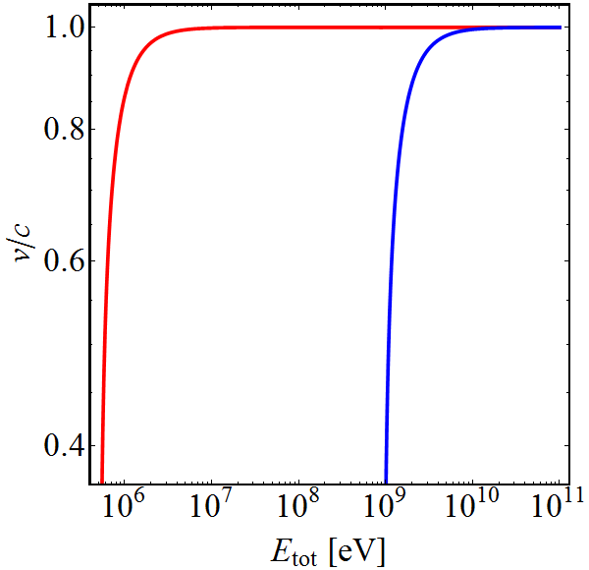
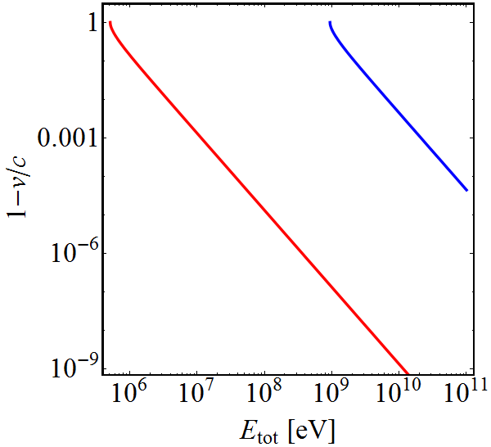

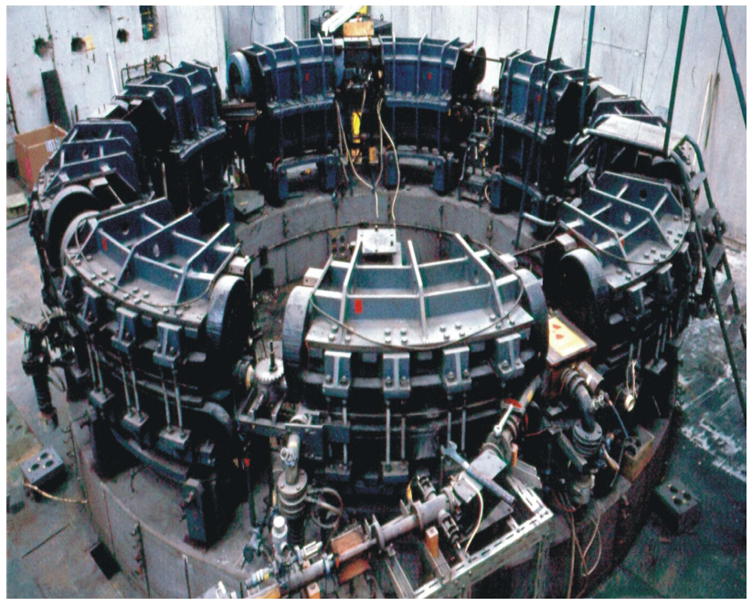
Particle velocity
Particle velocity depends on its type:
Old television set (30 kV): Electrons at 30% of c₀
            Protons just at 0.7%
Small synchrotron (500 MeV): Electrons at 99.99995%
              Protons at 75.8%
Most electron accelerators at ‘fixed’ frequency
(example here: accelerator in Bonn, 1996)
e⁻
p⁺
e⁻
p⁺

Slide 9
Parameter choices

Slide 10
RF system for high-energy accelerators
Accelerator type
Linear
Circular
(single pass)
(multi-pass)
Electron
Hadrons
Electron
Hadrons
Maximum RF voltage, constant velocity
Maximum RF voltage, variable velocity
Compensate synchrotron radiation losses
Sweep frequency with beam
*
L_{i} = v_{i} · T_{RF}
f_{RF} = h · f_{rev}
*Exceptions (rare) exist,
e.g. “fixed frequency” acceleration in SPS
L_{i} = Distance between two adjacent gaps

Slide 11
Choice of frequency (range), or: shall we try high or low RF frequency?

Slide 12
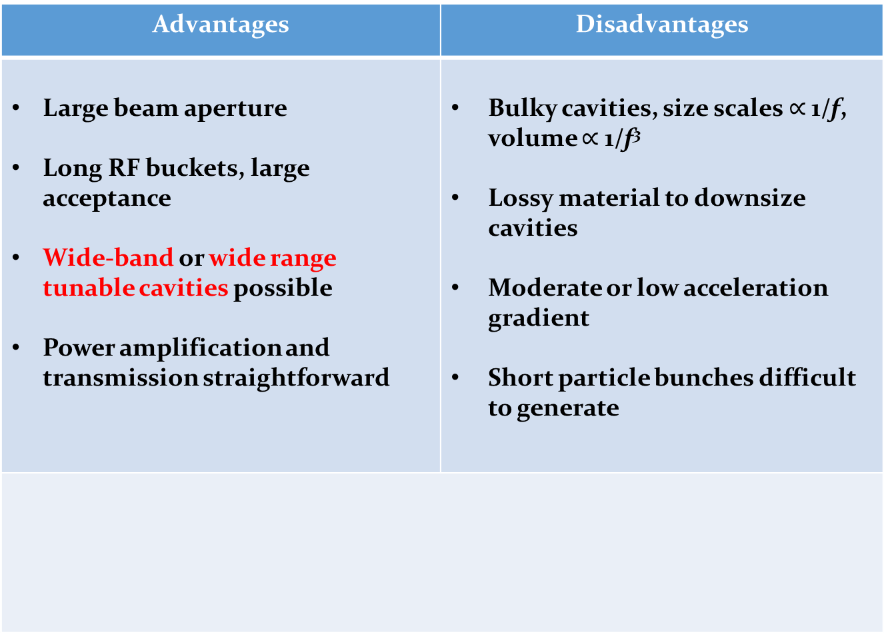
Why choose a low RF frequency?
Advantages | Disadvantages
Large beam aperture Long RF buckets, large acceptance Wide-band or wide range tunable cavities possible Power amplification and transmission straightforward | Bulky cavities, size scales $∝$ 1/f, volume $∝$ 1/f³ Lossy material to downsize cavities Moderate or low acceleration gradient Short particle bunches difficult to generate
Mainly electrons, some hadron linear accelerators
Cyclotrons
Low- and medium energy hadron synchrotrons
  RF frequencies
  below ~200 MHz for

Slide 13
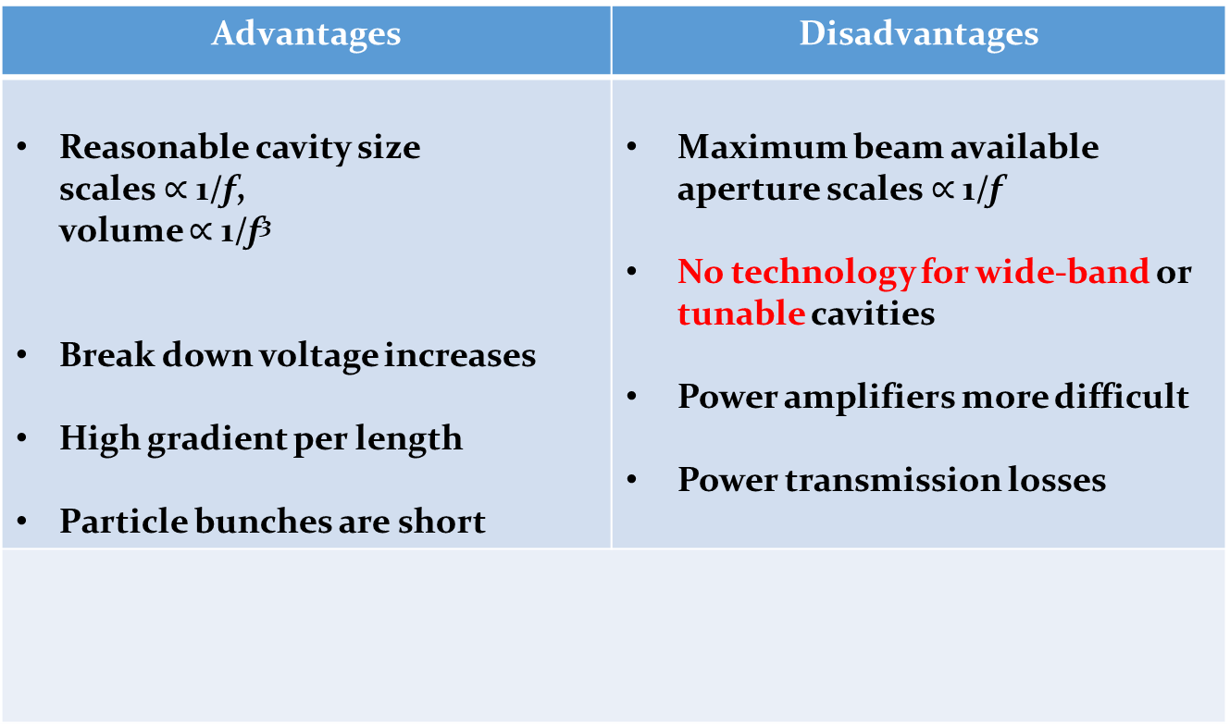
Why choose a high RF frequency?
Advantages | Disadvantages
Reasonable cavity size scales $∝$ 1/f, volume $∝$ 1/f³ Break down voltage increases High gradient per length Particle bunches are short | Maximum beam available aperture scales $∝$ 1/f No technology for wide-band or tunable cavities Power amplifiers more difficult Power transmission losses
  Linear accelerators
  Electron storage rings
  High energy hadron storage rings
  RF frequencies above
  ~200 MHz used for

Slide 14
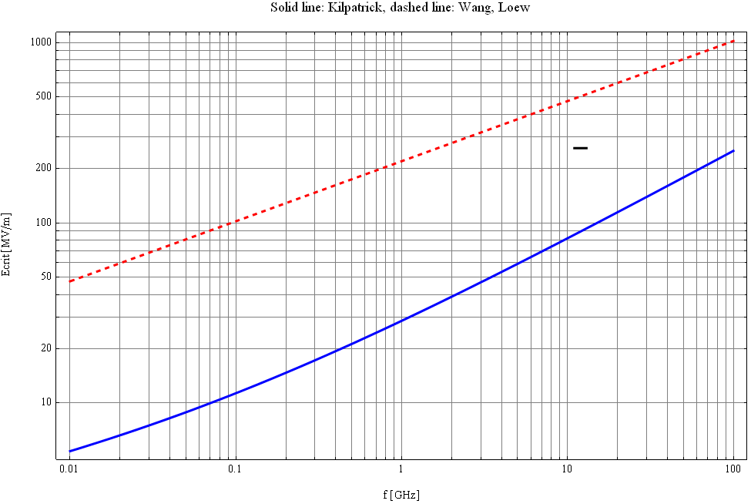
Limits to maximum gradient
Surface electric field in vacuum
1000
E. Jensen
500
Wang & Loew,
SLAC-PUB-7684, 1997
200
100
E_{crit} [MV/m]
50
Kilpatrick 1957,
f in GHz, E_{crit} in MV/m
20
10
0.01
0.1
1
10
100
f [GHz]
…
High frequencies preferred for large gradient.
Today also other criteria are used, e.g. considering local field quantity,
see: Grudiev et al., PRAB #102001 , 2009, [1] & Wuensch [2]

Slide 15
Some standard frequencies = your choice
If exact RF frequency not critical, choose standard value
Off-the-shelf RF components easily available in frequency ranges used by industry.
Exchange of developments and equipment amongst research laboratories.
Exchange expertise with colleagues from other labs!
Accelerator | Frequency
Hadron synchrotrons (PSB, PS, JPARC RCS, MR) | <10 MHz
Hadron accelerators and storage rings (RHIC, SPS) | ~200 MHz
Electron storage rings (LEP, ESRF, Soleil) | 352 MHz
Electron storage rings (DORIS, BESSY, SLS,…) | 499.6…499.8 MHz
Superconducting electron linacs and FELs (X-FEL, ILC) | 1300 MHz
Normal conducting electron linacs (SLAC) | 2856 MHz
High-gradient electron linac (CLIC) | 11.99 GHz

Slide 16
Required RF voltage

Slide 17

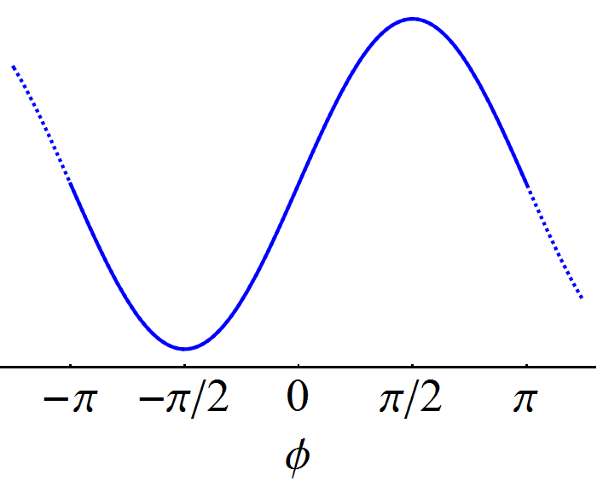


Minimum voltage requirement
RF system expected to provide certain energy gain
On-crest acceleration
Used mostly in linear accelerators
Insufficient in a circular accelerator,
(stable phase condition)
More voltage provided to avoid on-crest acceleration
Off-crest acceleration
Needed for circular accelerator
Higher voltage for given energy gain
→

Slide 18
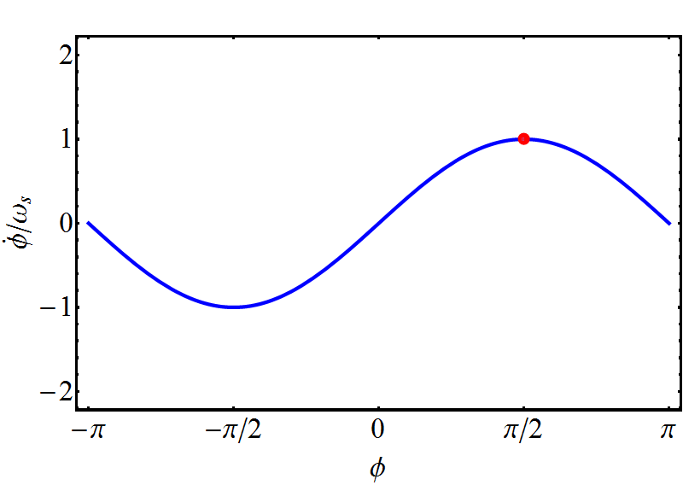
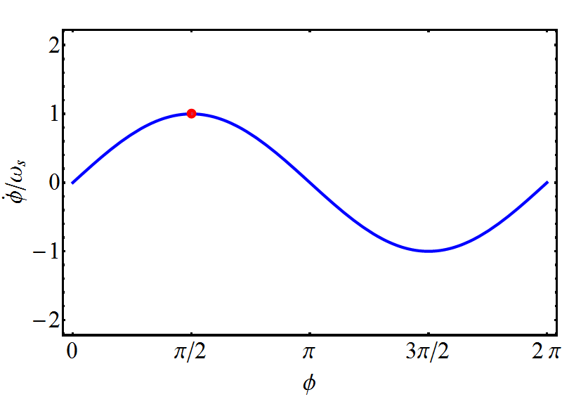
Bucket area dependence on stable phase
In a circular accelerator the area in energy-time phase space (bucket area) depends on the stable phase
Below transition, φ_{S} = 0…90°
Above transition, φ_{S} = 90°…180°
H. Damerau
Typical synchronous phase with respect to 0° or 180°
  Hadron accelerators: < 40°
  Electron storage rings: ~ 20°

Slide 19
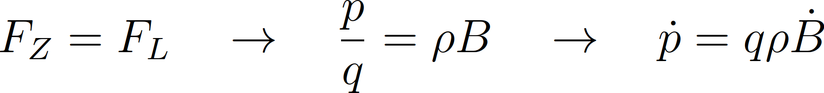
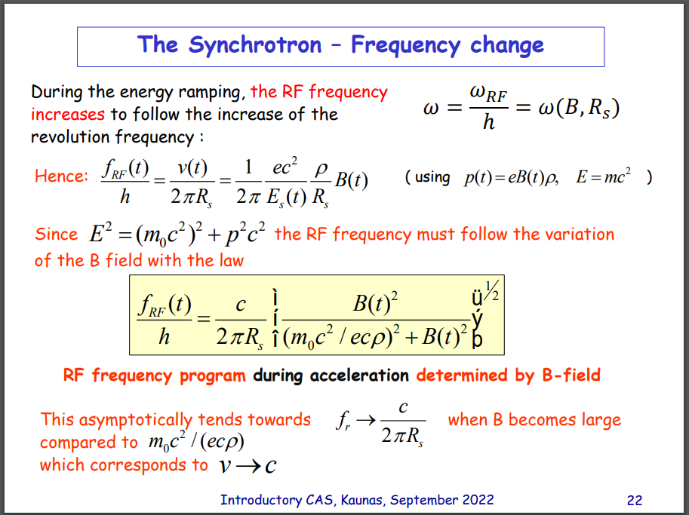

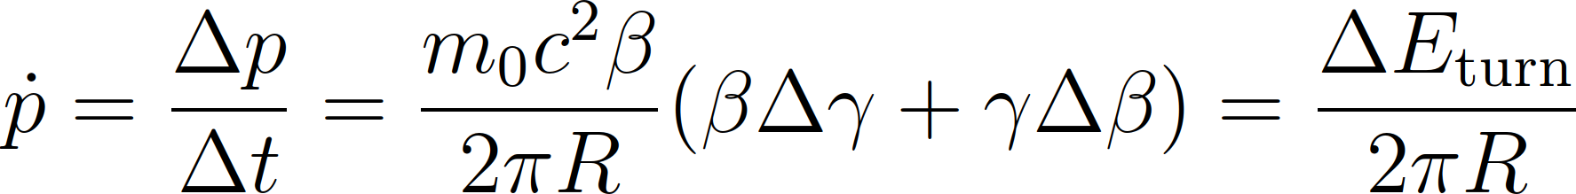
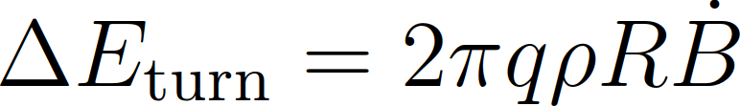
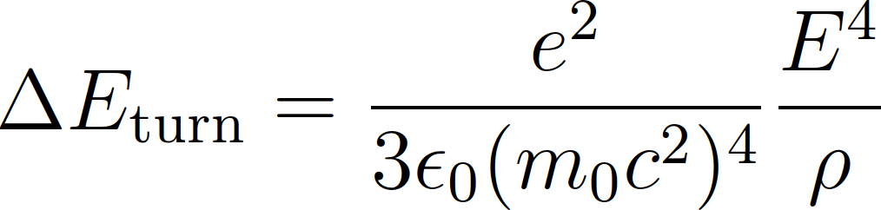
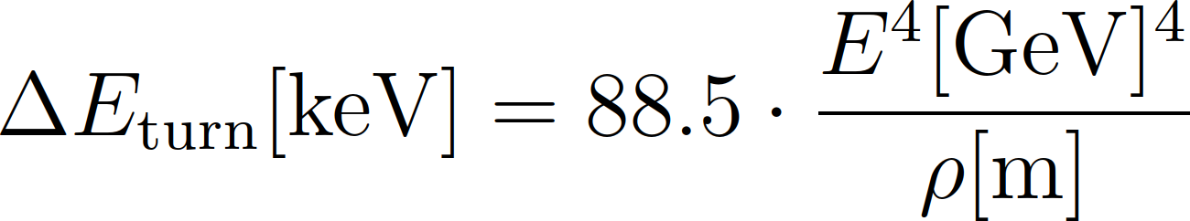
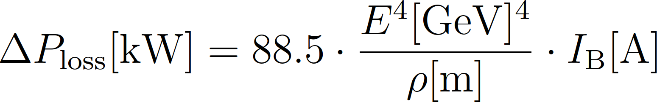
Minimum voltage requirement (circular)
The RF system must compensate
Energy gain per turn due to changing magnetic field
Energy loss, e.g., due to synchrotron radiation (electrons)
Recall talk of F. Tecker
Particle energy
Recall talk of L. Rivkin
(m_{p}/m_{e})⁴ = 1836⁴ ~ 1.1 ∙ 10¹³ times less for protons

Slide 20
RF system overview
Beam
Waveguide & Cavity
Convert RF power into longitudinal electric field
Amplify low-power signal from beam control to kW, MW or GW
Provide RF signals with correct frequency, amplitude and phase
Power amplifier
Low-level RF
system
Beam

Slide 21
RF system overview
Beam
Waveguide & Cavity
Convert RF power into longitudinal electric field
Amplify low-power signal from beam control to kW, MW or GW
Provide RF signals with correct frequency, amplitude and phase
Power amplifier
Low-level RF
system
Beam

Slide 22
RF components:
Waveguide and Cavity

Slide 23
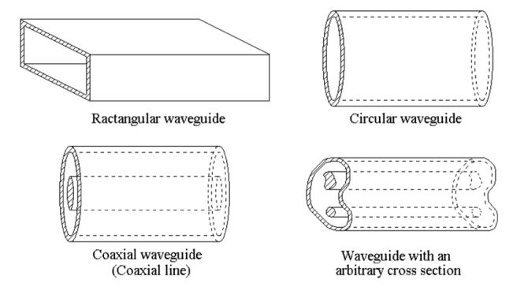
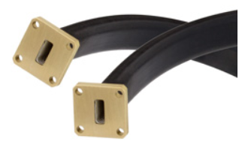
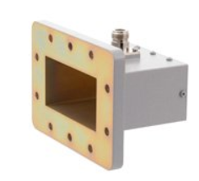
Waveguides
Circular waveguide
Arbitrarly shaped
cross-section waveguide
Rectangular waveguide
Source: Zhang, Electromagnetic Theory for Microwaves and Optoelectronics, 2nd ed., Springer
Waveguides are hollow metallic tubes with uniform cross-sections of different shapes.
The metallic waveguide is a completely enclosed system without any radiation loss.
Waveguides present a one-conductor system, so no TEM-mode propagation is possible.
Propagation happens in TE-mode (Transverse-Electric) and TM-mode (Transverse-Magnetic). These modes have a lower frequency limit, the so-called cut-off frequency below which propagation is not possible. The cut-off frequency depends on the dimensions of the waveguide cross-section.
Waves are following the waveguide shape, even if it is bend.
Propagating waves need to fulfill boundary conditions on the waveguide walls.
Picture source: www.pasternak.com

Slide 24
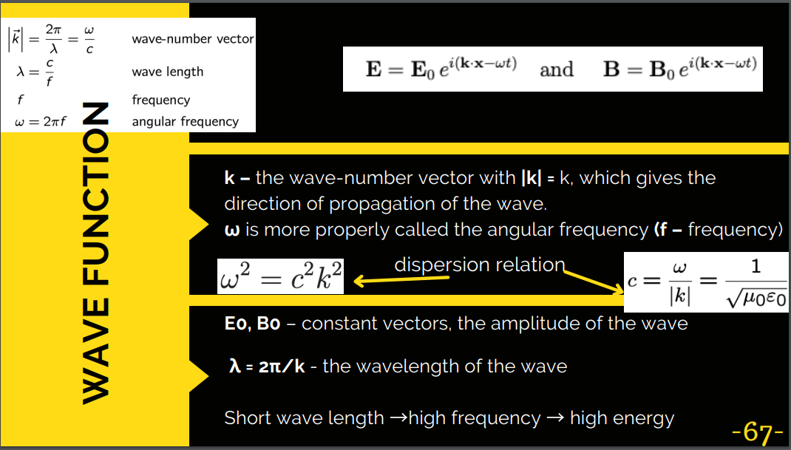
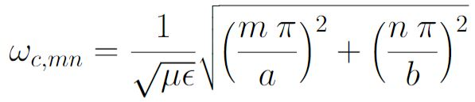
Rectangular Waveguide
b
a > b
a
z
Source: Zhang, Electromagnetic Theory for Microwaves and Optoelectronics, 2nd ed., Springer
The rectangular waveguide is characterized by a propagation constant, attenuation constant and characteristic impedance.
TE-modes
TM-modes
TE-modes are characterized by a zero electric field in propagation direction. The electric field is in the transverse plane, only.
TM-modes are characterized by a zero magnetic field in propagation direction. The magnetic field is in the transverse plane, only.
Modes have a cut-off frequency (no propagation below this frequency), identical for TE or TM:
The mode with the lowest cut-off frequency is called the dominant mode.
Hybrid mode happens when TE- and TM-modes start to couple.
A waveguide is called overmoded, if more than one mode is propagating in the waveguide at the same time.

Slide 25
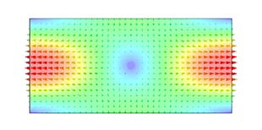
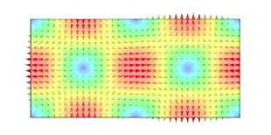
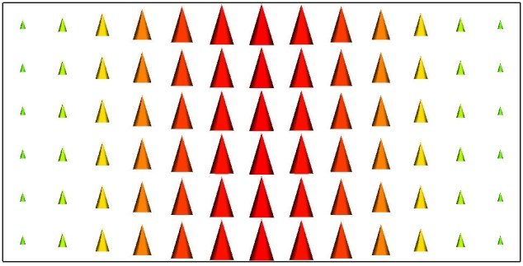
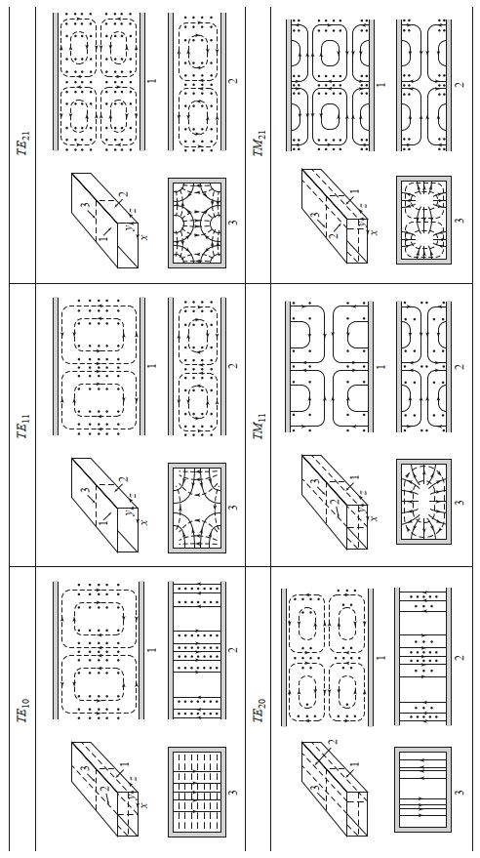
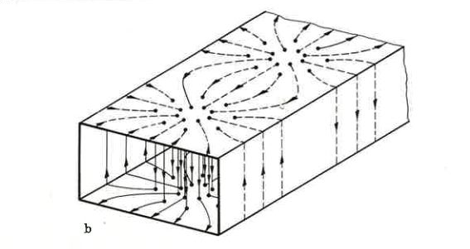
Rectangular Waveguide
Fundamental and higher waveguide modes and field patterns for TE-modes
TE₁₀-mode
TE₁₁-mode
TE₂₁-mode
Simulaton pictures: courtesy E. Jensen, field pattern source: Pozar, Microwave engineering, 4th ed., Wiley
E-field ---H-field
source: Zinke/Brunswig, Hochfrequenztechnik, 5th ed., Springer

Slide 26
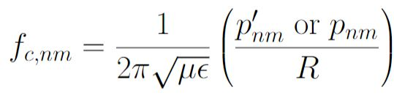



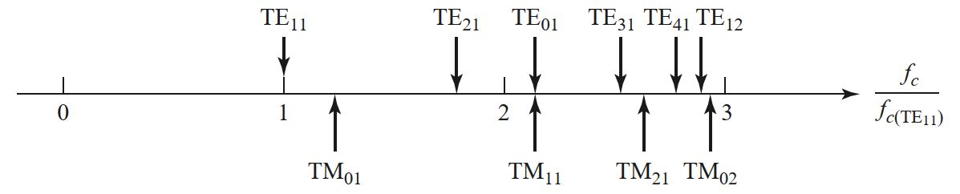
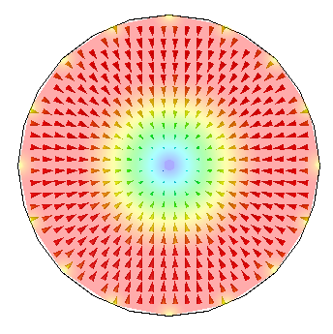
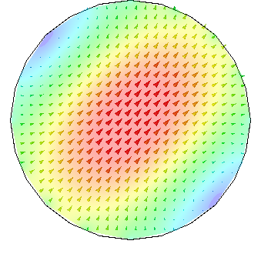


Circular Waveguide
We know the cut-off frequencies for the different modes:
TE-mode
TM-mode
R
z
→ Roots of the Bessel-function for TM-mode
→ Roots of the derivative of the B.F. for TE-mode
Chart of cut-off frequencies relative to f_{c} of TE₁₁-mode:
Source: Pozar, Microwave engineering, 4th ed., Wiley
1st mode is TE₁₁. Electric field is transverse.
Mode has 2 polarisations (orientations of the electrical field).
2nd mode is TM₀₁. Magnetic field is transverse.
Simulaton pictures: courtesy E. Jensen, source pictures and chart: Pozar, Microwave engineering, 4th ed., Wiley
Notes:
In 1897, the physicist John William Strutt, better known as Lord Rayleigh gave the mathematical proof that wave propagation in waveguides must be possible. This was a novum as until then, people believed that two conductors would be necessary for the transfer of electromagnetic energy. Rayleigh also gave the theory of the TE- and TM-mode patterns and the cut-off frequency, he was, however, not able to provide experimental proof at the time. The waveguide was then essentially forgotten again until the 1930s.

Slide 27


Pillbox Cavity Resonator
A cylindrical cavity resonator can be seen as a section of circular waveguide shorted at both ends.
z
From the TE₁₁-mode (dominant mode for circular waveguide)
→ TE₁₁₁-mode is the dominant TE-mode for a cylindrical cavity.
TM₀₁₀-mode is the dominant TM-mode for a cylindrical cavity.
TM₀₁₀-mode mode is used for acceleration as it has a large electric field along the z-axis.
Electric field is described by Besselfunction J_{0.}
E_{z}
-B_{θ}
Pillbox cavity is flat compared to a “long” cylindrical cavity.
Also, beam-pipe connection is needed.
Simulation: P. Kramer

Slide 28

Pillbox Cavity Resonator
For the case of the TM₀₁₀-mode,
we have no dependence on cavity height,
so we get a very simple formulae:
0.383 λ_{TM,010} = R
Resonant chart for a general cylindrical cavity shows the excited modes as a function of cavity dimensions.
1st TE-mode is TE₁₁₁
1st TM-mode is TM₀₁₀, and shows up for ratios (2R/h)2 > 1
(2Rf)²
(2R/h)²
E_{z}
Source: Pozar, Microwave engineering, 4th ed., Wiley
h
R

Slide 29



Example “true” Pillbox Cavity
Electric field, TM₀₁₀-mode
Magnetic field, TM₀₁₀-mode
E. Jensen
Cavity from DORIS Storage ring (1970-ish, very early electron/positron collider)

Slide 30



Pillbox Cavity Design Feature
In practice, a “pure” pillbox cavity is not very efficient for acceleration.
A simple shape modification can be done by using so-called “nose cones”.
Nose cone is a protrusion on the cavity wall that causes a concentration of the electrical field in the gap.
Source: Puglisi,
RF-CAS 92, CERN
Enhancement of E-field
Nose cones also help to improve the Transit-time factor…
Source: Puglisi,
RF-CAS 92, CERN
PS 80 MHz cavity

Slide 31

Cavity Resonators and Q-value (1/2)
Resonators are classified by their quality factor Q.
The quality factor (or Q-value) can be used as a measure of “how well the cavity is resonating” (more details will come).
define
= unloaded Q
High Q-value is desired in accelerating cavities; Q-value is one of the accelerator efficiency figures-of-merit.
Q-value reduces e.g. due to the power dissipated in the metallic walls or other loss mechanisms.
The connection of the cavity resonator to the outer world will reduce its Q-value as well (we say “it loads” the cavity with an additional loss mechanism).

Slide 32



Cavity Resonators and Q-value (2/2)
Example: measurements taken on the PS 80MHz pillbox cavity
We tested this cavity for Q-deterioration and shifting of its fundamental mode (~80 MHz).
Q-values obtained from 3-dB-measurement (see dashed red lines).
→ Plot on the top has a higher Q-value than the plot below.

Slide 33



Transit Time Factor (1/2)
accelerating gap
particle with velocity v
transit-time factor:
energy gained in time-varying RF-field
T =
energy gained in a DC field of voltage V₀
Particle in the harmonic time-varying field will see less energy gain compared to a constant DC field.
This is called transit-time effect and is described by a factor T
(so-called transit-time factor).
Distance the particle travelled in one RF-period

Slide 34

Transit Time Factor (2/2)
gap length
Transit time factor
= constant
(as it is for an ideal pillbox cavity!)
To achieve max. energy gain from this formulae, we want that T = 1 → g = 0
Leads to design request: gap as small as possible.
But other considerations as: risk of RF electric breakdown also impact on optimum gap geometry.
Note that it is assumed that the particle does not change velocity along the gap length.

Slide 35




Accelerator efficiency figures-of-merit (1/2)
Several figures-of-merit are commonly used to characterize accelerating cavities:
energy stored in the resonator
Q-value
unloaded Q₀ - measure of the resonance quality
energy dissipated in the resonator
Shunt impedance [MΩ]
measure of effectiveness to produce an
axial voltage V₀
Design goal is a high shunt impedance
Effective Shunt impedance [MΩ/m]
Measure of effectiveness per unit power loss to deliver
energy to a particle
“R-over-Q” [Ω]
Measure of cavity acceleration efficiency
at a given frequency – geometry dependent only!

Slide 36
Accelerator efficiency figures-of-merit (2/2)
Typical values for different cavities:
Cavity type | R/Q | Q₀ | R
Ferrite loaded cavity (low frequency, rapid cycling) | 4 kΩ | 50 | 200 kΩ
Room temperature copper cavity (type 1 with nose cone) | 192 Ω | 30 * 10³ | 5.75 MΩ
Superconducting cavity (type 2 with large iris) | 50 Ω | 1 * 10¹⁰ | 500 GΩ

Slide 37







Cavity equivalent circuit (1/4)
At frequency near resonance, the cavity resonator can be modeled by a lumped-element circuit.
For a cavity with the desired high shunt impedance, only a parallel resonant circuit is suited → require to model a large voltage.
V
R
C
L
power to the resonator
circuit
input impedance
lossless resonator
lossy resistor
Power dissipated in the resistor:
Energy stored in capacitor:
Energy stored in inductor:

Slide 38






Cavity equivalent circuit (2/4)
At frequency near resonance, the cavity resonator can be modeled by a lumped-element circuit.
For a cavity with the desired high shunt impedance, only a parallel resonant circuit is suited → require to model a large voltage.
resonance case is:
V
R
C
L
power to the resonator
circuit
Power dissipated in the resistor:
3 Parameters are sufficient
to describe the cavity

Slide 39

Cavity equivalent circuit (3/4)
The resonance of a cavity can be understood as simple parallel resonant circuit described by R, L, C
Resonant circuit can also be described by R, R/Q, ω₀ or any other set of three parameters – and this is what cavity designers use.
L
R
C
Z(ω)
Δω

Slide 40




Pillbox Cavity Resonators
E_{z}
TM₀₁₀
For the case of the TM₀₁₀-mode in a pillbox, where we have no dependence on cavity height, we get a very simple formulae:
E_{z}
h
a
Gives an idea of expected Q for a normal-conducting, single-gap cavity.
Remember? skindepth is:
frequency
permeability
conductivity

Slide 41
Cavity equivalent circuit (4/4) - Summary
Most common choice by cavity designers ω₀, R, R/Q – why?
Resonance frequency, ω₀
  Exactly defined for given application, e.g.,: h · f_{rev}
Shunt impedance, r_{sh} or R
  High shunt impedance required to produce a given voltage without beam.
“R-upon-Q”, R/Q
  Defined only by the cavity geometry
  Criterion to optimize a geometry
  Detuning with beam proportional to R/Q

Slide 42




What about this R/Q-criteria?
Charged particle experiences cavity gap as capacitor
Goal: cavity geometry with small R/Q to reduce beam loading
Cavity
Beam induced voltage
q

Slide 43



Example: 400 MHz cavities in LHC
Very high beam currents, need to reduce beam loading in RF cavities
Shunt impedance, R is high but small R/Q is needed
→ Possible with superconducting cavities in LHC
Bell shape: R/Q ~ 44 Ω, 400 MHz
2×8 cavities, 5.3 MV/m
~o

Slide 44


What is Cavity loading…
resonance frequency
unloaded Q
z
E_{z}
parallel capacitance
and inductance
B_{θ}
Z_{shunt} ⇨
ideal transformer
Generator impedance
(generally complex due to matching requirement)
Z_{g}
R
C
L
So-called: Inductive loading
⇦ Z_{i}
coupling loop
to generator (RF amplifier)
Beam is usually modelled as a current source and sees a (generally complex) Z_{shunt}.
Via the transformer, the coupling to the cavity can be adjusted to “matching” / in practice, we would rotate our coupling loop to modify the coupling strength.

Slide 45
Principles of coupling power
into a cavity

Slide 46


Coupling power into a cavity
Attach inductivity or capacitance of resonator, or combined
Coupling loop forms transformer with resonator inductivity
L
R
C
RF power
L_{c}
M
Main coupler
PSI cyclotron
~1 MW at 50 MHz
By far the most common method, allows also to adopt the matching.
L. Stigelin

Slide 47

Coupling power into a cavity
Attach inductivity or capacitance of resonator, or combined
Capacitive divider to gap to
transform generator impedance
to cavity shunt impedance
Advantage: allows to DC isolate the
coupler (if required by amplifier).
Disadvantage: coupling is fixed.
Beam also couples
capacitively via the gap
L
R
C
C_{c}
Beam
RF power
Coupler of CERN PS 40 MHz
Coupler forms one half of capacitor with the gap

Slide 48


Capacitive (electric) coupling
Coupling through an electric antenna
Electrical coupler to space
Power coupler of LHC cavities
300 kW at 400 MHz
https://en.wikipedia.org/wiki/Transmitter_Solt
2 MW at 540 kHz
Used to transmit radio broadcast in Hungarian language around the world.
*claims to have reached Michigan…
Coupler antenna transmits directly into the cavity

Slide 49
Cavity Design Issues

Slide 50

RF cavities in low frequency range
RF wavelength large below ~10 MHz: >30 m
With a pillbox design, we would need huge cavities → too large for accelerators
Line resonators: λ/4 resonator
  Short circuit on one side → Voltage is zero
  Open end on other → No current but voltage
Why is this resonator so common in particle accelerators?
Voltage
Current
Electric Open side
Z_{in}(ω)
Transmission line, impedance Z_{L}
Short-
circuit
λ/4 length

Slide 51
RF cavities in low frequency range
Coaxial structure with inner conductor as beam pipe
E-field
---H-field
Z_{in}(ω)
Beam axis
Short-
circuit
This side acts like a capacitor, we speak of capacitive loading.
Beam axis
Ceramic gap = electric Open
Still rather long geometry, 7.5 m at 10 MHz

Slide 52


RF cavities in low frequency range
Coaxial structure with inner conductor as beam pipe
Add more capacitive or inductive loading
Plate
capacitor
Ferrite
inductivity
resonance frequency

Slide 53




Capacitive loading in real world
Add capacitor at gap of cavity to shorten the resonator
NSLS, 52.88 MHz
DESY PIA, 10.4 MHz, inner cond.
Outer cond.
~1 m
M. Nagl
ACOL, 9.53 MHz
Significantly reduces cavity size
Fixed frequency only
Adds small losses due to capacitor
Advantage: entire cavity in vacuum

Slide 54


Inductive loading in real world
Inductive loading with magnetic material shortens resonator from tens of meters to a device, lossy though
CERN PSB Finemet cav., 0.6-18 MHz
CERN PS, double gap, 2.8-10 MHz
M. Paoluzzi
Additional advantage: permeability of ferrite can be controlled by DC bias current → variable inductivity
  Cavity with programmable resonance frequency
  Essential for hadron acceleration in low-energy accelerators

Slide 55

Tunable cavities – the PSB
Booster Cavity, below 20 MHz

Slide 56


Tunable cavities at higher frequencies
Remove inductive or capacitive loading
SSC Low Energy Booster,
~47 MHz to 60 MHz
FNAL Booster 2nd harmonic,
76 MHz – 106 MHz, 100 kV
R. L. Madrak, IPAC16, p. 130
C. C. Friedrichs et al., PAC91, p. 1020
Upper frequency limit for cavities with large tuning range

Slide 57

Tunable cavities at higher frequencies
From: Smythe, IEEE, TNS [3]
Parallel bias
(= H_{mag,bias} is parallel H_{RF})
Perpendicular bias
(= H_{mag,bias} is perpendicular H_{RF})
Garnets are ferrites with a magnetic field-dependent relative permeability.
Exposed to a (slowly varying) magnetic field, their µ-value covers a certain range until they saturate.
Problems are the garnet losses (cannot be in vacuum) and the limited Q-value of the material (reduces the cavity Q).

Slide 58



Can that also work on a single-gap cavity?
Perp. bias
Par. bias

Slide 59






Can that also work on a single-gap cavity?
tuning range

Slide 60


Applying the tuning principle to a single-gap cavity
Coupler to cavity
Ferrite-filled part
(makes use of area of homogeneous magnetic field)
Support structure

Slide 61



RF cavities in linear accelerators
Beam only passes once → Maximize gradient
Many accelerating cells to best reuse RF voltage
Cavity is the contrary to ‘one size fits all’
Many, many more variants
SuperHILAC, ~70 MHz, Berkley
CLIC, 12 GHz, ~100 MV/m

Slide 62
RF system overview
Beam
Cavity
Convert RF power into longitudinal electric field
Amplify low-power signal from beam control to kW, MW or GW
Provide RF signals with correct frequency, amplitude and phase
Power amplifier
Low-level RF
system
Beam

Slide 63
Power amplifiers

Slide 64





How much power is required?
Power to accelerate beam → Wanted
Compensate beam-induced voltage → Refl. P
Compensate electrical losses in cavity → Heat
Compensate electrical losses in distribution → Heat
(ideally)

Slide 65

Power amplifiers
Basically
P_{out} = g ∙ P_{in} or V_{out} = $\sqrt{g}$ ∙ V_{in}
The ideal power amplifier
  Large bandwidth: amplifies all frequencies equally
  No saturation, infinite power
  Zero delay
  No added noise
  Unconditionally stable and resistant to reverse power
  Radiation-hard
Unfortunately such a device has not been invented yet
Let us have a look at some real amplifiers

Slide 66
Basics of grid tube
From diode to tetrode amplifier
Vacuum tube
Heater + Cathode
  Heated cathode
    Coated metal, carbides, borides,…
  thermionic emission
  Electron cloud
Anode
Diode
U_{a}*
anode
e-
e-
e-
e-
I_{a}
e-
e-
e-
e-
e-
e-
e-
Cathode and filament
*For tube amplifier designs voltages are named U instead of V
E. Montesinos

Slide 67
Basics of grid tube
From diode to tetrode amplifier
Vacuum tube
Heater + Cathode
  Heated cathode
    Coated metal, carbides, borides,…
  thermionic emission
  Electron cloud
Anode
Diode! (but no amplification …yet)
U_{a}
anode
I_{a}
e-
e-
e-
Cathode and filament
E. Montesinos

Slide 68
Basics of grid tube
From diode to tetrode amplifier
From Diode to Triode
  Adding a negatively charged control grid (e- won’t catch)
  Modulating the grid voltage proportionally modulates the anode current
  Transconductance
    By changing the voltage at grid
    steering current at anode
  Limitations
    Parasitic capacitor from anode to control grid (g1)
    Tendency to oscillate
U_{a}
anode
e-
e-
e-
e-
U_{g1}
control grid
e-
e-
e-
Cathode and filament
E. Montesinos

Slide 69
Basics of grid tube
From diode to tetrode amplifier
Tetrode
  To avoid oscillation, add a screen grid (g2)
    Positive (lower anode)
    decouples anode from control grid g1
    Higher gain
  Limitations
    Secondary electrons due to anode bombardement
    To avoid this the anode is treated to reduce secondary emission
U_{a}
anode
e-
e-
e-
e-
U_{g2}
Screen grid
U_{g1}
Control grid
e-
e-
e-
e-
e-
Cathode and filament
E. Montesinos

Slide 70
Tetrode based power amplifier
Example of SPS 200 MHz amplifier, tetrode RS2004
Very simplified block diagram
small signal RF going in and amplified RF coming out
Grounded screen grid
RF out
U_{a}
Anode
RF in
U_{g2}
Screen grid
U_{g1}
Control grid
Cathode and filament
E. Montesinos

Slide 71



Example: Tetrode amplifier driving SPS RF
Two transmitters, 2 × 1 MW at 200 MHz (almost continuous)
Eight tetrodes per amplifier
RS2004 tetrode
Amplifier trolley
Complete transmitter
Consists of 8 individual amplifiers.
In operation since 1976
E. Montesinos

Slide 72


Example: Tetrode amplifier driving SPS RF
and transfer to the cavity
Amplifiers of the 200 MHz travelling wave system in the CERN SPS and their coaxial power lines leading to the underground installation (feeder lines)
Having the amplifiers on the surface and the cavity underground is only possible because no strict matching from amplifier to cavity is needed.

Slide 73

Tetrode amplifier driving PS RF
Frequency range 2.8…10 MHz, ~60 kW per cavity, 11 units
Space constraints to have amplifier installed below cavity
Tetrode is obvious choice
  High power in small volume is needed
  Operates in radioactive environment (consists of ceramics and metal parts)
Amplifier trolley underneath cavity

Slide 74
Basics of RF solid state amplifiers
In a push-pull circuit the RF signal is applied to two devices
  One of the devices is acting on the positive voltage swing and off during the negative voltage swing
  The other device works in the opposite manner so that the two devices conduct half the time
  The full RF signal is then amplified and need to be recombined.
Needs two different type of devices that work as “ matched pairs” - and this cannot be obtained in RF.
V_{DC}
NPN BJT
V_{in}
V_{out}
PNP BJT
BJT: Bipolar Junction Transistor
E. Montesinos

Slide 75

Basics of RF solid state amplifiers
BJT: Bipolar Junction Transistor
Another push-pull configuration is to use two identical transistors and a balun (balanced-unbalanced “transformer” )
  Power splitter, equally dividing the input power between the two transistors
  Balun keeps one port in phase and inverts the second port in phase (sign flip!)
Since the signals are out of phase only one device is on at a time
This configuration is easier to manufacture since only one type of BJT is required
Vdc
0 ⁰
NPN BJT
0 ⁰
Input balun
(Unbalanced-Balanced)
Output balun
(Balanced-Unbalanced)
V_{in}
V_{out}
180 ⁰
180 ⁰
NPN BJT
Two semincoductor BJTs on one ceramic.
NXP Semi-
conductors AN11325
2-way Doherty amplifier with BLF888A
E. Montesinos

Slide 76




Example: Soleil 45 kW (1st Generation)
For the electron storage ring running at 352 MHz
Set of splitters and combiners.
330 W for one amplifier module
Modules are mounted into towers.
600 W, 300 V_{DC}/30 V_{DC} converter
Converters need to be near by to avoid transport of high currents over long distance.
Problem: Solid state amplifiers has high current requirement → heating and high losses.

Slide 77



Example: Soleil for 352 MHz
Large scale solid state amplifier installations
45 kW per tower (2004 and 2007)
150 kW per tower (2012)
Requires a series of power combiners to moderate power per amplifier module to several tens of kilowatts
E. Montesinos

Slide 78



Example: BESSY II (more tranditional looks…)
500 MHz solid state amplifiers: 4 × 80 kW for storage ring,
40 kW for booster synchrotron
Amplifier modules
80 kW unit
Combiner
Power per module limited by RF transistors
Increasing with modern semiconductor devices
B. Schriefer

Slide 79

Example: SPS
200 MHz solid state amplifiers: 2 amplifiers with 1.6 MW peak power,
16 towers per amplifier
From LLRF
1.6 MW at cavity input
1/16 splitter
80 modules per tower, 1280 modules with 5120 transistors
per amplifier
Presently the largest RF installation in a particle accelerator
E. Montesinos

Slide 80
All these slides were from Eric Montesinos – BIG thanks!
AND to Heiko Damerau for giving additional explanations.

Slide 81
RF power amplifier
Power capability of commercially available amplifier types
E. Jensen

Slide 82
How to choose the right RF amplifier?
Prefer tube amplifier, when | Prefer solid-state amplifier, when
Amplifier must be installed in the accelerator tunnel Expecting important spikes from beam induced voltage Large output power of a single device is required, without combiners Not much space is available High peak power in pulsed mode Amplifier must be compact and/or close to cavity | Amplifier can be located in non-radioactive environment Circulator can be installed to protect the amplifier Delay due to unavoidable combiner stages is little issue Sufficient space can be made available Continuous operation Amplifier can be separate from the cavity
Mostly no hard criteria → decide on case by case basis

Slide 83
Summary
RF system parameters
  Choose frequency and voltage wisely
Parameters of RF cavities
  R, R/Q
  No ‘one-size fits’ all
Power amplifier
  Ideal amplifier does not (yet) exist
  Tube or solid-state based

Slide 84
References and Recommended Literature
[1] A. Grudiev, S. Calatroni, W. Wuensch: New local field quantity describing the high gradient limit of accelerating cavities,
Physical Review Special Topics – Accelerators and Beams, vol. 12, no. 102001, 2009.
[2] W. Wuensch: High Gradient Breakdown in Normal-Conducting RF Cavities, CERN/PS 2002-028 (RF), http://cds.cern.ch/record/2833138/files/CERN-PS-2002-028-RF.pdf
[3] Smythe: Reducing Ferrite Tuner Loss by Bias-Field Rotation, IEEE, Trans Nuclear Science, Vol 30, no. 4, 1983.
J. W. Wang, G. A. Loew, Field Emission and RF Breakdown in High-Gradient Room-Temperature Linac Structures, SLAC-PUB-7684, 1997, http://www.slac.stanford.edu/cgi-wrap/getdoc/slac-pub-7684.pdf
W. D. Kilpatrick, Criterion for vacuum sparking designed to include both rf and dc, Rev. Sci. Instrum. 28 (1957), 1957, http://inspirehep.net/record/44645
Books:
POZAR, David M., “Microwave Engineering”, 4th edition, Wiley and sons.
ZHANG, Keqian, “Electromagnetic Theory for Microwaves and Optoelectronics”, 2nd edition, Springer.

Slide 85
References and Recommended Literature
Walk through the CERN acceleratos by using Google street view!
PS machine
https://home.cern/science/accelerators/proton-synchrotron
Use an electronic Smith-chart!
Smith-Chart Software “Dellsperger”
https://www.fritz.dellsperger.net/smith.html

Slide 86
Thank you very much for your attention!

Slide 87








Dispersion Diagram
From waveguide to slow wave structure…
general dispersion relation
dispersion relation
of waveguide
Tangent at point on the dispersion curve
Source: Zhang, Electromagnetic Theory for Microwaves and Optoelectronics, Springer
v_{g} is zero at cut-off frequency
v_{g} is smaller than c₀
v_{p} can be larger than c₀
From origin to point on the dispersion curve
NOTE that “we”, the RF engineers often use BETA for the imaginary part of the propagation constant (formerly “k”).

Slide 88

RF-systems
source: F. Caspers et al., JUAS 2021
RF systems
Single gap cavity
“Pillbox type”
Multiple cell cavities
Standing wave cavities
Travelling wave cavities
RF load
Typically used in applications with low beam loading,
e.g. ring accelerators (storage rings)
Typically used in applications with high beam loading, e.g. linear accelerators (linacs)
Multiple cell cavities
Notes:
There are MANY ways to implement an RF system..it first good to know what we have in our toolbox and then select the best tool for the job to be done..what is beam loading? in short: how much energy stored in the cavity is taken out by the beam..per passage..

Slide 89
Disc-loaded circular waveguide (1/2)
Disc-loaded waveguide is a circular metallic waveguide with periodically added metallic discs and holes for particle passage and for coupling of the cells.
We speak of a coupled-cavity chain structure.
EM-fields need to fulfill boundary conditions on the metallic discs.
Disc-loaded waveguide can operate in travelling-wave as slow wave structure or in standing-wave mode.
In standing wave mode, the cells present a “concatenation” of TM₀₁₀-mode “pillbox”-type cavities.

Slide 90

Disc-loaded circular waveguide (2/2)
Source: Kramer, Studies of HOM-couplers for the Upgrades Travelling Wave Acceleration System in the CERN SPS, PhD, CERN-THESIS-2019-371
Different coupling mechanisms between the individual cells exits, either on the side or in the center.
We speak of iris-coupled-structure and slot-coupled-structure.
For slot-coupled-structures, the center opening for the beam can be very small and is often ignored in the EM-calculations.
Example: Pi-mode structure in standing wave (SW) … can be derived from pillbox TM₀₁₀-mode.
The name of the resonant mode is given by the phase advance between two consecutive cells.

Slide 91


Example of Pi-mode Cavities (SW, 1/3)
How does this work?
source: F. Gerigk, CAS Ebeltoft, Cavity Types, 2010
Alvarez-type linac (= drift-tube-linac)
Wideroe-type linac (= drift-tube-linac)
0-mode structure
Pi-mode structure
Remember: The name of the resonant mode is given by the phase advance between two consecutive cells.

Slide 92





Example of Pi-mode Cavities (SW, 2/3)
How does this look in reality?
Slot-coupled-structure (PIMS)
at CERN
Drift tube structure, CERN
Picture of Linac1, CERN
Note that a ‘cell’ is not necessarily a pillbox-type shape. In drift tube structures, a cell is the area between two drifttubes and looks in principle like a pillbox with nose cones.
sources: P. Bourquin et al., Development Status of the Pi-mode Accelerating Structure (PIMS) for LINAC4, Proc. Of LINAC08, Canada.
C. Plostinar (ed.), Comparative Assessment of HIPPI Normal Conducting Structures, CARE-report-2002-0771

Slide 93


Example of Pi-mode Cavities (SW, 3/3)
Slot-coupled-structure (PIMS) at CERN
PIMS cell
PIMS test set-up
Completed LINAC4, CERN
Picture sources: CERN cds
R. Wegner et al., Linac4 PIMS Construction and First Operation, IPAC2017, Copenhagen.
P. Bourquin et al., Development Status of the Pi-mode Accelerating Structure (PIMS) for LINAC4, Proc. Of LINAC08, Canada

Slide 94

Waveguide becomes Slow Wave Structure
To get power transferred to the beam, the accelerating field needs to be kept in phase with the charged particle.
For single gap cavities, this means that the resonance needs to be synchronous with the particle phase. We can then concatenate many “pillbox cavities” to one multi-cell pattern.
Another way to reduce phase velocity is to build the disc-loaded waveguide where discs are added in a periodic pattern (schematic pictures look the same).
As for the concatenated “pillbox cavities”, a multi-cell pattern builds up. The addition of discs inside the cylindrical waveguide induces multiple reflections between the discs and results in a change of the dispersion curve. The structure can then be used in travelling wave mode.
If the wave is travelling with speed-of-light, and we slow down this wave (=reduce phase velocity), we obtain so-called slow wave structures (SWS).
Slow wave structures are known from dielectrics (where the EM-wave slows down due to permittivity ), but here we will discuss slow-wave structures with metallic boundaries used for particle acceleration.

Slide 95


Slow wave structure (1/7)
source: G. Dome, RF Systems: Waveguides and Cavities, aip-conf-proc.153-1296
Slow wave structures work in the range of v_{p}< c₀.
The addition of discs inside the cylindrical waveguide induces multiple reflections between the discs and results in a change of the dispersion curve.
The disc-loaded structure can then be used in travelling wave mode.
The dispersion curve changes from continuous to splitting up into different modes which are slowed down. We speak of pass-bands. These modes are separated by stopbands.

Slide 96

Slow wave structure (2/7)
Dispersion Curves, phase- and group velocity for FW and BW wave in periodic structure.
Forward wave (FW)
v_{g} and v_{p} point in the same direction.
Backward wave (BW)
v_{g} and v_{p} point in the opposite direction.
For the advanced RF-fans:
1. All guides modes in common transmission lines, metallic and dielectric waveguides are forward waves.
2. For transmission lines of “high-pass filter” type, the phase constant β decreases with increasing frequency.
3. “High-pass filter” type lines are modelled with a distributed series capacitance and a shunt inductance
(i.e., opposite of what is usually done in the transmission line modelling!).
4. Forward and backward type of waves – this makes no difference for the direction of the beam.
Source: Zhang, Electromagnetic Theory for Microwaves and Optoelectronics, Springer

Slide 97

Slow wave structure (3/7)
Dispersion diagram of periodic structure (uniform waveguide is shown for orientation)
Dispersion diagram shows the periodicity of the structure.
For a given mode, there is a limited pass band of possible frequencies.
The passbands are separated by
stopbands where the specific
mode cannot propagate.
At both ends of the passband, the group velocity is zero and wave propagation stops.
source: M. Weiss, Introduction to RF Linear Accelerators.
When group velocity and phase velocity are in the same direction, we speak about forward waves, if they are in different direction, we speak about backward waves. This has nothing to do with the direction of the particle travelling.

Slide 98

Slow wave structure (4/7)
The request to fulfill the periodic boundary conditions leads to the concept of space harmonics (instead of wave modes).
Space harmonics are closely connected the so-called Floquet Theorem (we will not cover this here).
The Floquet Theorem describes the relation between the phase constant of the n-th space harmonic and is a fundamental theorem of periodic structures.
Source: Zhang, Electromagnetic Theory for Microwaves and Optoelectronics, Springer

Slide 99


Slow wave structure (5/7)
As was shown before, drift tubes can be used instead of separating discs to slow down the EM-field. The theory for drift tubes is very similar to calculating a slot-coupled structure. Just imagine that the slot is very large.
Inside view of the SPS travelling wave structure © CERN.
In travelling wave (TW) mode, the field propagates through each cell.
The phase advance per cell (distance between the discs, or periodic spacing of drift tubes) determines the length of the cell:
Remember? Is distance that a particle travels during one RF-period.

Slide 100

Slow wave structure (6/7)
The only missing component for our travelling wave system are the input and output couplers.
These have to be matching the structure to avoid that standing waves are building up inside the periodic structure.
Often, higher order modes (HOMs) are building up in the structure due to the finite length
(end covers are put there).
Note that a matching network is used to obtain the travelling state. This network is only matching the fundamental mode and not the HOMs!
I.e. the fundamental mode is travelling, others might be travelling, partially travelling or standing modes.

Slide 101

Slow wave structure (7/7)
SPS 200 MHz travelling wave cavity (16m long).
Backward wave structure
Water cooled coaxial load
RF OUT side
RF IN side
Drift tube
with water cooling
beam direction
© CERN

Slide 102




200 MHz TWC of SPS (1/2)
courtesy: E. Montesinos, CERN
Cavity is part of the LHC injector chain and was upgraded recently and equipped with new power amplifiers to reach a higher accelerating voltage.
The cavity was entirely modelled in CST, so that we could well see the fields of the fundamental and the HOMs.
Modelling in CST
(P. Kramer, CERN)
Single cell CST model with symmetries
(no HOM coupler)
Electric field of fundamental mode in the
Cross-section
Surface currents on the
Drift tube
E-field in a cell with HOM-coupler (22π/33 mode)

Slide 103

200 MHz TWC of SPS (2/2)
courtesy: E. Montesinos, CERN
Cavity is part of the LHC injector chain and was upgraded recently and equipped with new power amplifiers to reach a higher accelerating voltage.
A number of HOMs are developing, mostly as standing wave and these were taken out by HOM-couplers.
Most harmful was the mode at 630 MHz, each section of the cavity has a number of these Hom couplers installed:
Modelling in CST
(P. Kramer, CERN)
Schematic illustration
E-field pick-up probe

