Slide 1
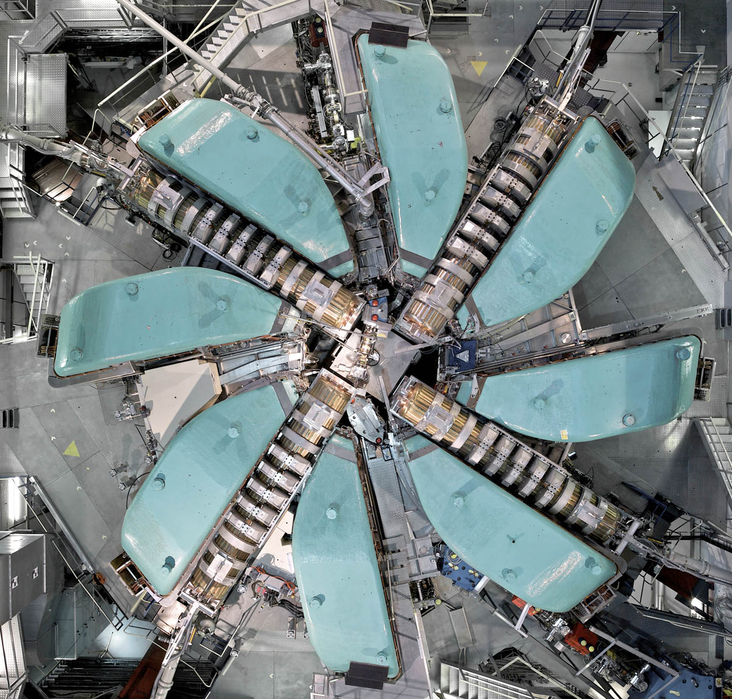
Cyclotrons – II
& FFA
CERN Accelerator School – Introductory Course
September 26, 2022
Kaunas
Mike Seidel
Paul Scherrer Institut

Slide 2

Copyright statement and speaker’s release for video publishing
The author consents to the photographic, audio and video recording of this lecture at the CERN Accelerator School. The term “lecture” includes any material incorporated therein including but not limited to text, images and references.
The author hereby grants CERN a royalty-free license to use his image and name as well as the recordings mentioned above, in order to post them on the CAS website.
The material is used for the sole purpose of illustration for teaching or scientific research. The author hereby confirms that to his best knowledge the content of the lecture does not infringe the copyright, intellectual property or privacy rights of any third party. The author has cited and credited any third-party contribution in accordance with applicable professional standards and legislation in matters of attribution.

Slide 3
Cyclotrons II - Outline
brief review of the previous lesson
cyclotron subsystems
  Injection/extraction schemes, RF systems/resonators, magnets, vacuum issues, instrumentation
FFA = Fixed Field Alternating Gradient Accelerators
  conceptual, scaling vs non-scaling, specific FFA technologies
discussion
  classification of circular accelerators, Pro’s and Con’s of cyclotrons/FFA for different applications

Slide 4
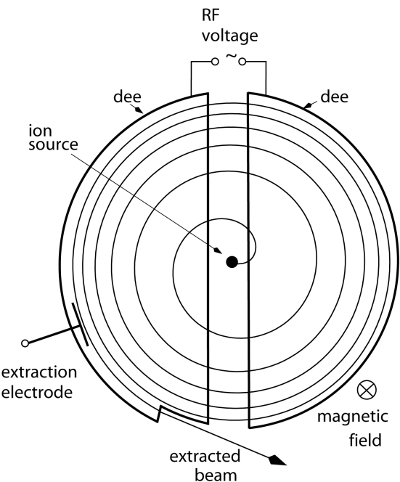
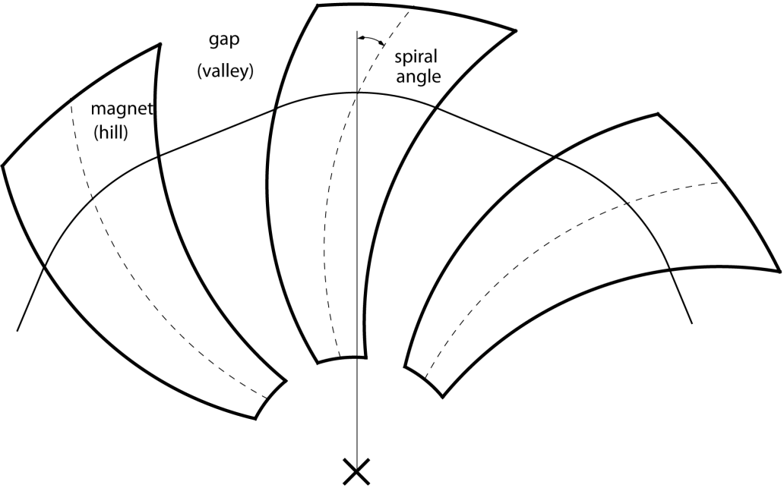
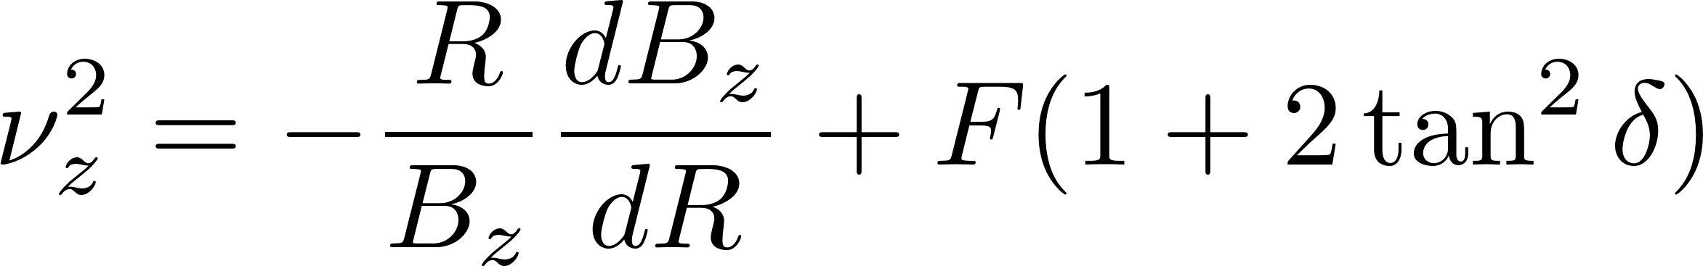

review of Cyclotrons-I
classical cyclotron
sector cyclotron
flutter
spiral angle
  simplicity, compactness
  continuous injection/extraction
  multiple usage of accelerating voltage
  but:
  insufficient vertical focusing
  limited energy reach

Slide 5
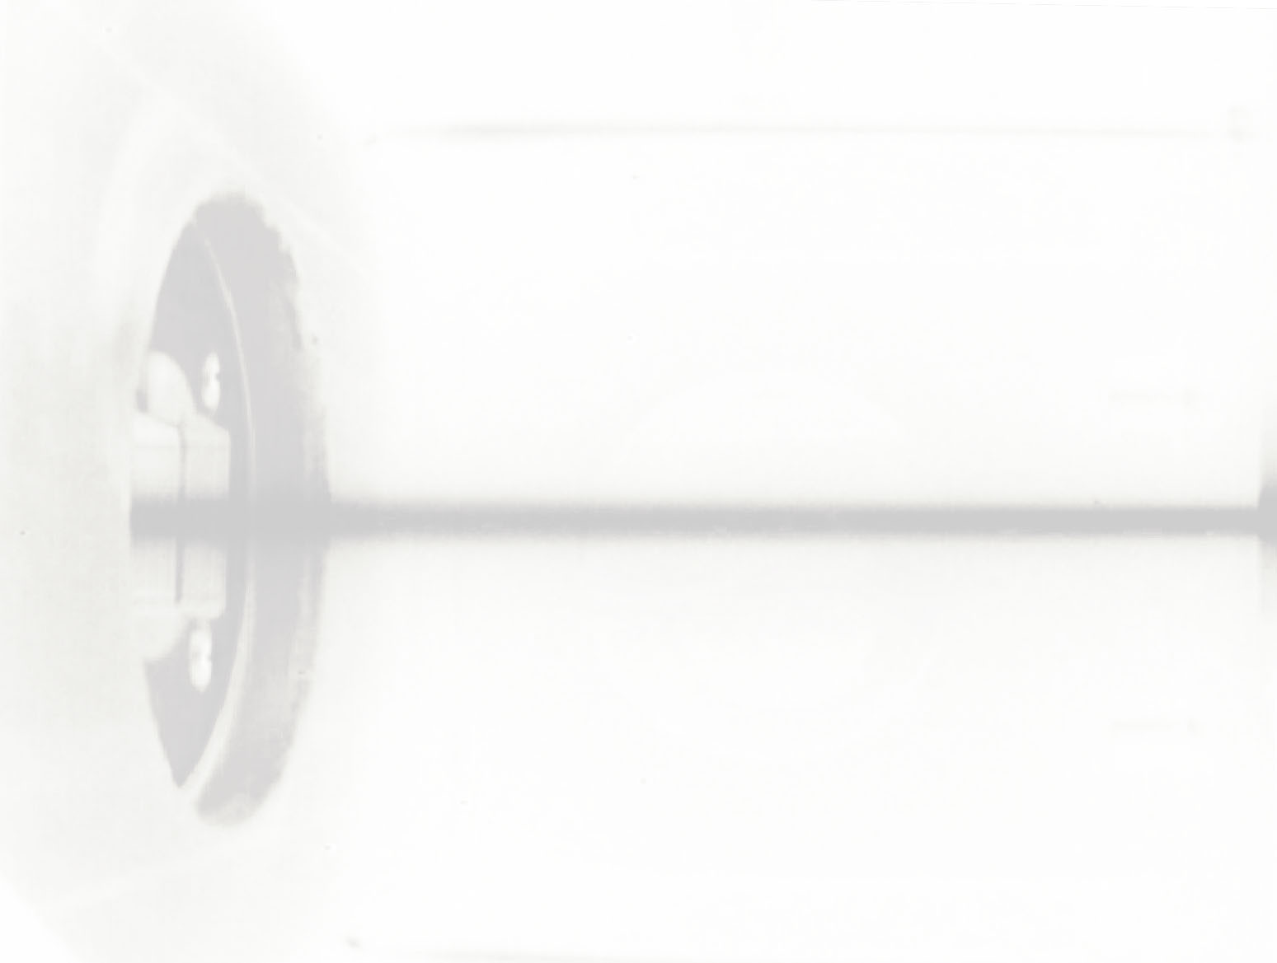
next: cyclotron injection & extraction
  spiral inflector, internal source, electrostatic deflectors, stripping
Notes:
next I show you a few pictures and really basic information from selected existing cyclotrons

Slide 6
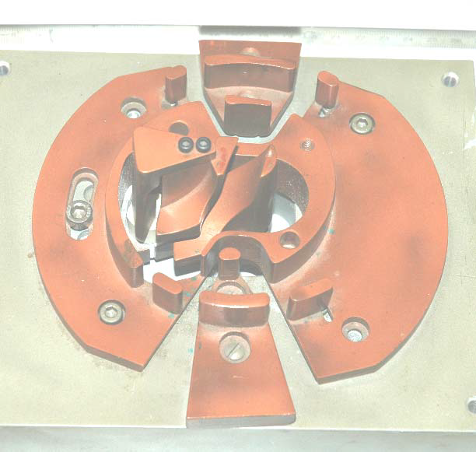
cyclotron injection schemes – spiral inflector
an electrostatic component, basically a capacitor
E-field arranged perpendicular to orbit, particles move on equipotential surfaces
simulation of orbits injected through a spiral inflector
[inflector IBA Cyclone 30 cyclotron]
[courtesy: W.Kleeven (IBA)]

Slide 7
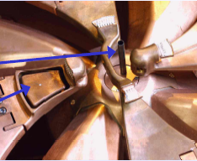
internal ion source
→ example COMET Cyclotron
Dee 4
Hydrogen is injected and ionized through chimney
first acceleration by puller, connected to one Dee (80kV)
Protons
in first turn
Dee 1
H⁻
puller
chimney
Protons that
started
too late
H²⁺
chimney
= ion source
deflector
electrode
for intensity regulation
Dee 3
slit
Dee 2
[courtesy M.Schippers (PSI), VARIAN]

Slide 8
electrostatic septum and charge exchange extraction
deflecting element should affect just one turn, not neighboured turn → critical, cause of losses
often used: electrostatic deflectors with thin electrodes
alternative: charge exchange, stripping foil; accelerate H⁻ or H₂⁺ to extract protons (problem: significant probability for unwanted loss of electron; Lorentz dissociation: B-field low, scattering: vacuum 10⁻⁸mbar)
binding | energies
H⁻ | H₂⁺
0.75eV | 15eV
-
foil
0
HV
extraction electrode
placed between turns
extraction by charge exchange in foil
eg.: H⁻ → H⁺
H₂⁺ → 2H⁺
Notes:
two major schemes exist to realize the extraction of high intensity beams from cyclotrons; I mentioned many times the scheme that utilizes an electrostatic deflector
an alternative is to accelerate ions that carry electrons and strip these electrons using an extraction foil; with H- the charge can be changed to H+ which reverses the deflection angle in a magnetic field; H2+ has the advantage of a higher binding energy of the electron and thus lower random losses; however the charge to mass ratio is ½ requiring stronger magnets and the extraction scheme is more difficult since the bending radius changes by two but dos not change polarity when this electron is stripped

Slide 9
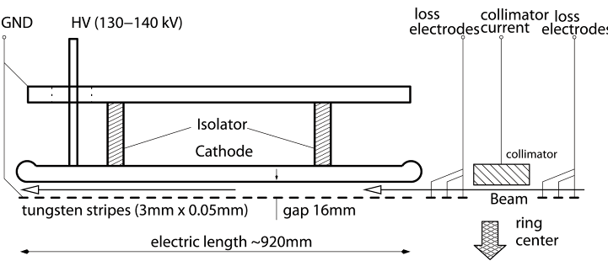
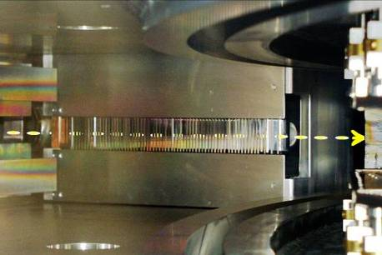
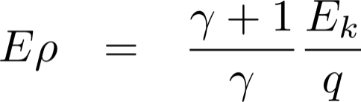
injection/extraction with electrostatic elements
parameters extraction chan.:
E_{k}= 590MeV
E = 8.8 MV/m
= 8.2 mrad
= 115 m
U = 144 kV
principle of extraction channel
major loss mechanism is scattering in 50μm electrode!
electrostatic rigidity:
injection element in Ring
Tungsten stripes
Notes:
the conceptional drawing shows the electrostatic extraction channel in the PSI Ring cyclotron; we have a cathode which is negatively charged against ground; the anode is made from thin tungsten stripes, 50um; tungsten can withstand high temperatures, that is when the electrode is accidentally hit by the beam; the gap is 16mm, the voltage 140kV and the deflection angle 8mrad; in addition the element has s mall collimator and several stripes for diagnostic purposes
the foto shows the injection element that exhibits a similar layout

Slide 10
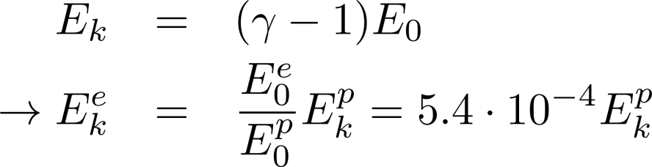
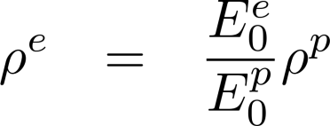
extraction foil
thin foil, for example carbon, removes the electron(s) with high probability
new charge state of ion brings it on a new trajectory → separation from circulating beam
lifetime of foil is critical due to heating, fatigue effects, radiation damage
conversion efficiencies, e.g. generation of neutrals, must be considered carefully
electrons removed from the ions spiral in the magnetic field and may deposit energy in the foil
How much power is carried by the electrons?
→ velocity and thus γ are equal for p and e
foil
B
e
Bending radius of electrons?
H⁺
H⁻
→ typically mm
Notes:
for the stripping scheme one needs an extraction foil and here I give a few comments on that
of course also the extraction foil undergoes a high thermal stress; fatigue effects, sublimation and radiation damage are issues
also the conversion efficiency is not perfect; the small probabilities for the generation of unwanted charge states must be considered

Slide 11
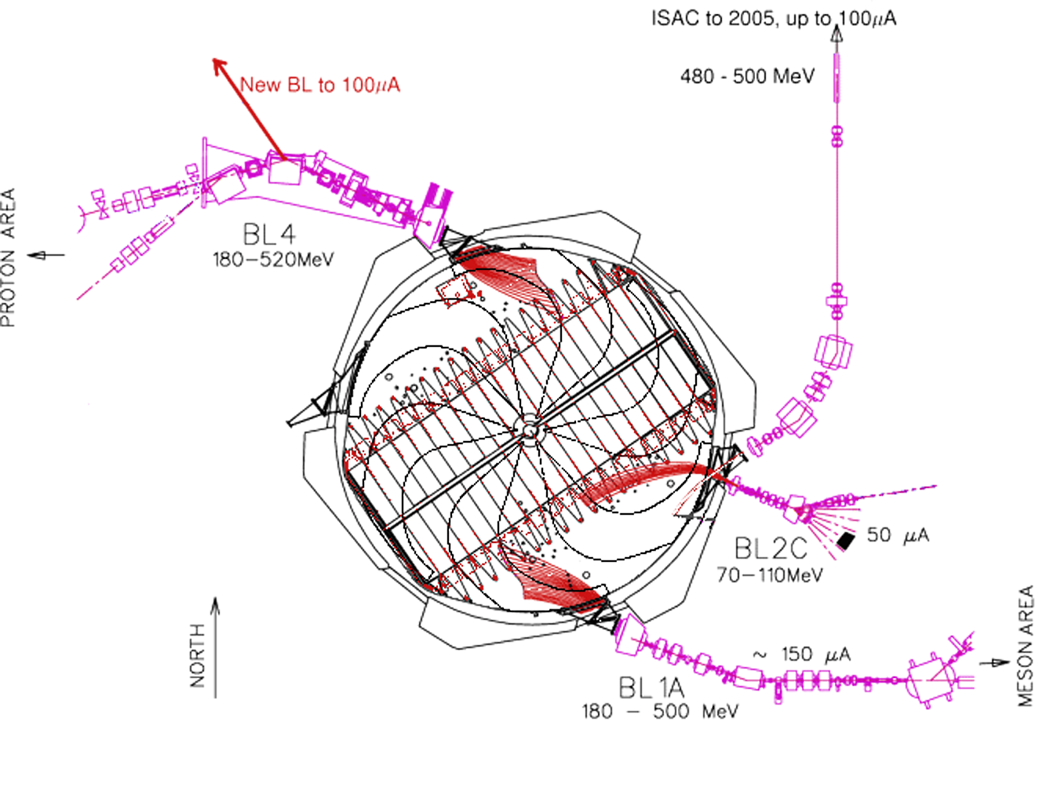
example: multiple H⁻ stripping extraction at TRIUMF
[R.Baartman]
Notes:
here you see a sketch of the multiple extraction paths in the TRIUMF cyclotron; this machine accelerates H- ions which can be extracted at different radii, that means energies, and locations; you see how the bending radius changes polarity

Slide 12
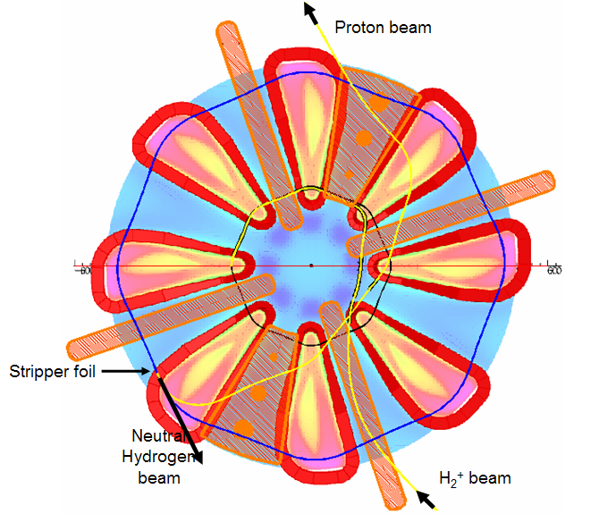
example: H₂⁺ stripping extraction in planned Daedalus cyclotron [neutrino source]
purpose: pulsed high power beam for neutrino production
800MeV kin. energy
5MW avg. beam power
[L.Calabretta, A.Calanna et al]
Notes:
the DAEDALUS cyclotron is presently planned to drive neutrino production targets; H2+ is chosen due to advantages in space charge effects, and the possibility of stripping extraction
here is an example for H2+ stripping extraction; by stripping the sign of the charge does not change, however the bending radius is halved at the foil

Slide 13
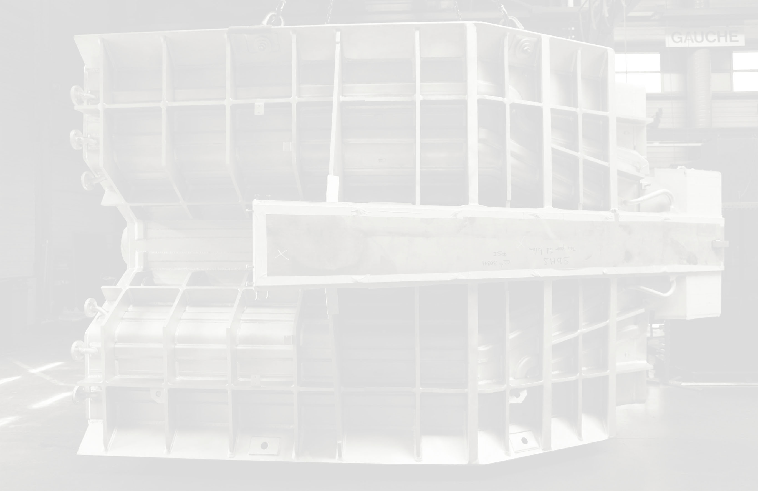
next: RF, magnets, vacuum, diagnostics
Notes:
next I show you a few pictures and really basic information from selected existing cyclotrons

Slide 14

RF acceleration
acceleration is realized in the classical way using 2 or 4 “Dees”
or by box resonators in separated sector cyclotrons
frequencies typically around 50…100MHz, harmonic numbers h = 1…10
voltages 100kV…1MV per device
RF frequency can be a multiple of the cyclotron frequency:
dual gap cavity
box resonator
Notes:
now I switch from the extraction problem to the problem of acceleration; in separated sector cyclotrons we use closed box resonators that are installed inbetween the magnets
the concept is shown here; frequency depends not on the width of the resonator; note the sine like voltage dependence

Slide 15
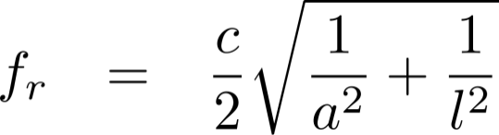
box resonator
cyclotron resonators are basically box resonators
resonant frequency:
beam passes in center plane; accelerating voltage varies as sin(r)
Notes:
now I switch from the extraction problem to the problem of acceleration; in separated sector cyclotrons we use closed box resonators that are installed inbetween the magnets
the concept is shown here; frequency depends not on the width of the resonator; note the sine like voltage dependence

Slide 16
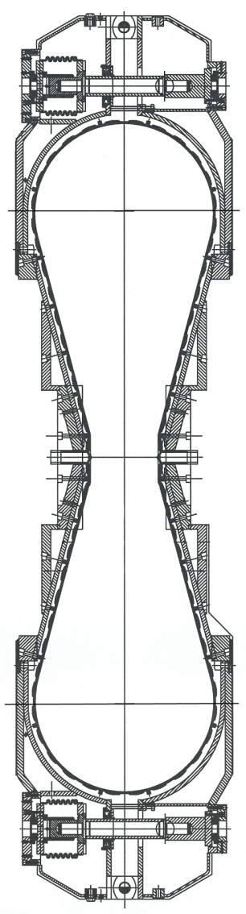
cross sections of PSI resonators
hydraulic tuning
old
new
4m
loop coupler @ 50MHz
beam(s)
2m
original Al-Resonator
Oper. freq. = 51 MHz
Max. gap voltage = 760 kV
Power dissipation = 320 kW
Q0 = 32'000 (meas. value)
new Cu-Resonator
Oper. freq. = 51 MHz
Max. gap voltage > 1MV
Power dissipation = 500 kW
Q0 ≈ 48'000
0m
Notes:
here you see cross sections of the original aluminum resonators of the psi ring from the 70’s and the newer Cu resonators right; we save power and achieve higher gap voltages; loop coupler are robust and allow high power transfer; tuning against outer air pressure changes is necessary; hydraulic devises achieve a 20um resolution

Slide 17
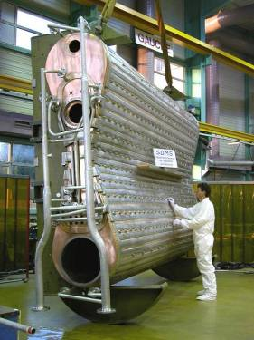
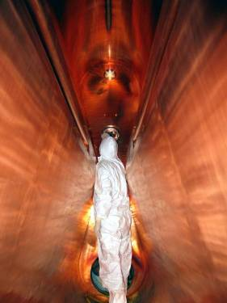
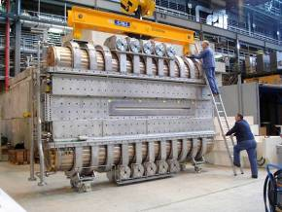
copper resonator in operation at PSI’s Ring cyclotron
f = 50.6MHz; Q₀ = 4,8⋅10⁴; U_{max}=1.2MV (presently 0.85MV)
transfer of up to 400kW power to the beam per cavity
Wall Plug to Beam Efficiency (RF Systems): 32%
resonator inside
hydraulic tuning devices (5x)
Notes:
pictures of the resonators during production and in finalized condition

Slide 18
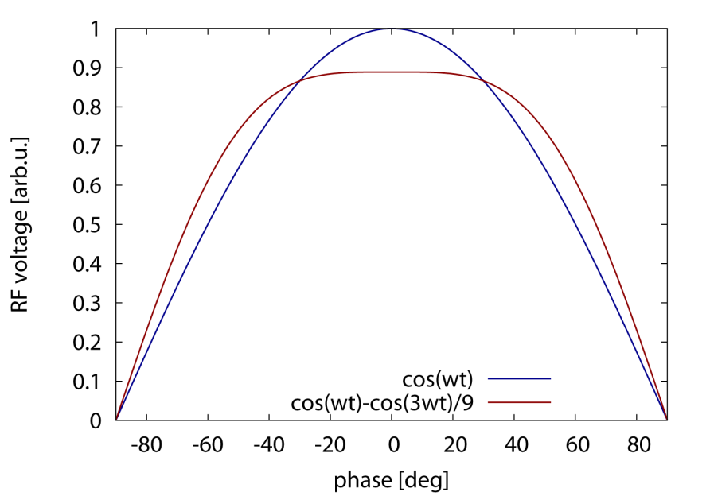

RF and Flattop Resonator
for high intensities it is necessary to flatten the RF field over the bunch length
→ use 3rd harmonic cavity to generate a flat field (over time)
optimum condition: $U_{tot}=\cos{ωt−\frac{1}{9}}\cos{3ωt}$
broader flat region for bunch

Slide 19
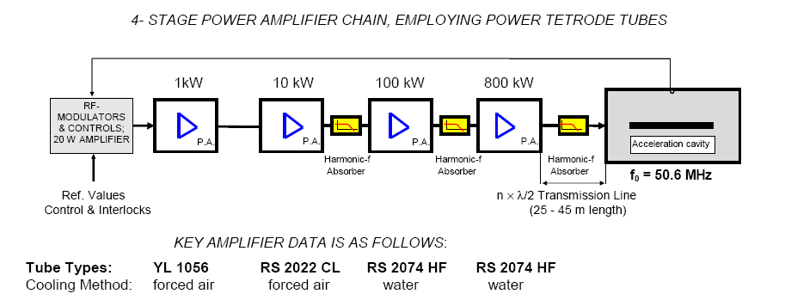
50 MHz 1 MW amplifier chain for Ring cyclotron
1 MW
Wall Plug to Beam Efficiency (RF Systems): 32%
[AC/DC: 90%, DC/RF: 64%, RF/Beam: 55%]
[L.Stingelin et al]
Notes:
we use tube amplifiers; up to 10kW solid state is possible and under development
efficiency is a very important issue; especially under todays boundary conditions; cyclotron efficiency is rather high with 1/3

Slide 20
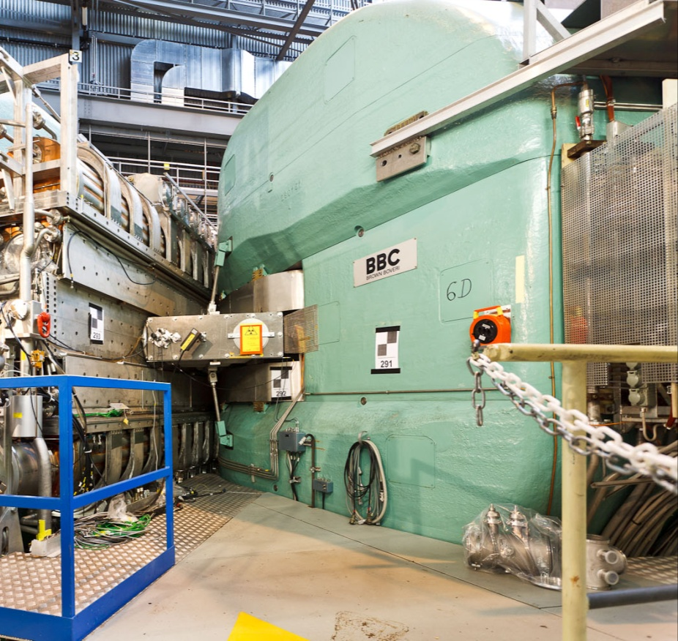
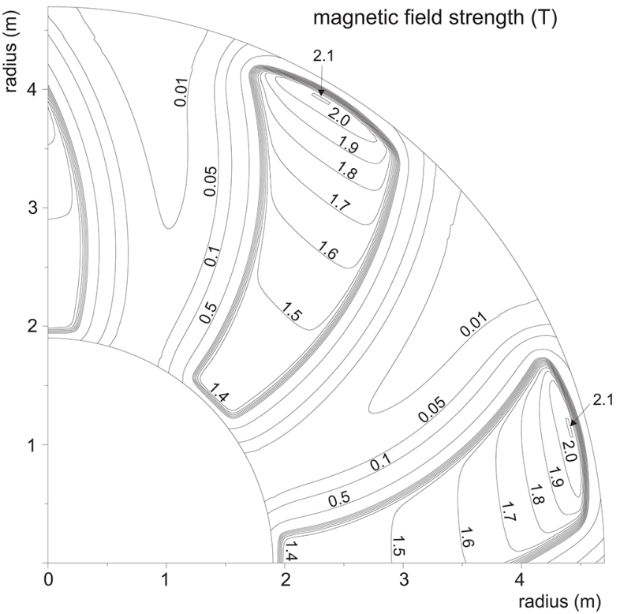
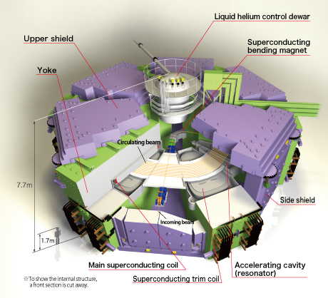
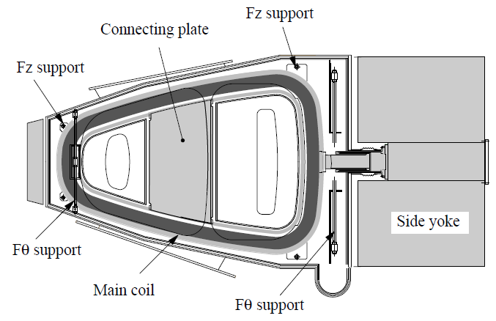
cyclotron technology: sector magnets
cyclotron magnets typically cover a wide radial range → magnets are heavy and bulky, thus costly
PSI sector magnet
iron weight: 250 tons
coil weight: 28 tons
Field: 2.1T
orbit radius: 2.1…4.5 m
spiral angle: 35 deg
field map
Riken SRC sector magnet
weight: 800 tons
Field: 3.8T, 5000A
orbit radius: 3.6…5.4m

Slide 21
Magnets – Fine-tuning with trim coils
isochronicity depends critically on exact field distribution
circulation time is measured with phase probes and field shape is adjusted using radially distributed trim coil circuits
example: AGOR cyclotron in Groningen NL

Slide 22
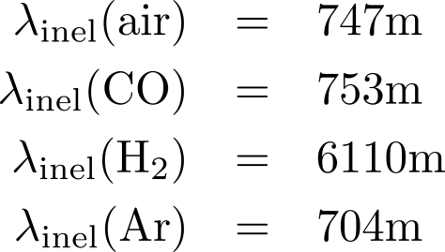
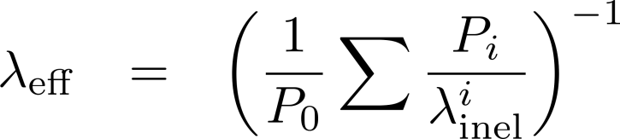
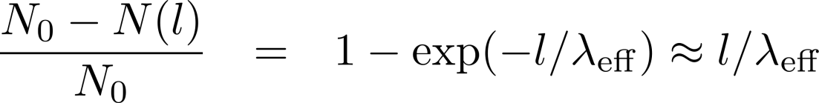
vacuum in cyclotrons – proton losses from scattering
losses are caused by inelastic scattering at residual gas molecules, use inelastic reaction cross section to estimate losses, convert to mean free path
compute pressure for 10⁻⁵ relative loss
common gases, protons :
(atmospheric conditions)
mean free path:
beam loss:
pressure for loss < 10⁻⁵:
P_{i}(air) < 10⁻³ mbar → easy, vacuum no problem for p losses!

Slide 23
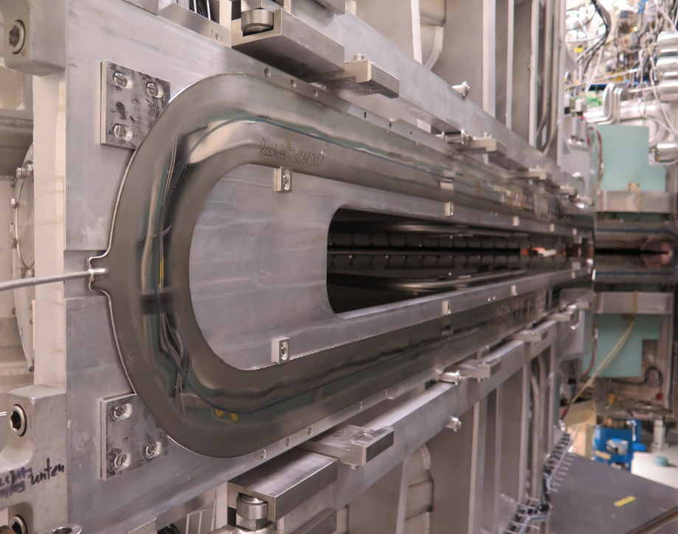
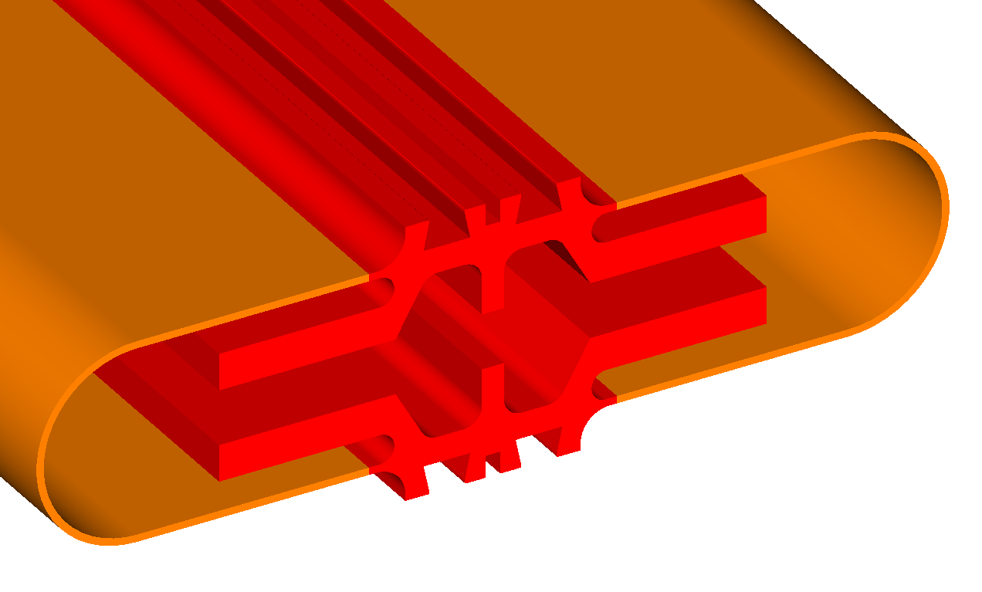
comments on cyclotron vacuum system
vacuum chamber with large radial width → difficult to achieve precisely matching sealing surfaces→ noticeable leak rates must be accepted
use cryo pumps with high pumping speed and capacity
≈10⁻⁶mbar for p, ≈10⁻⁸mbar for ions (instability! e.g. AGOR at KVI)
design criterion is easy access and fast mountability (activation)
example: inflatable seals installed between resonators
inflatable seals installed between resonators
O-ring grooves
evacuated intermittent volume
Notes:
few comments on vacuum
one difficulty for cyclotrons is large radial width of the vacuum chamber, for example in comparison to synchrotrons or FFAG’s; I explained to you that on the other hand the continuous acceleration feature is essential for high power operation
the wide and complicated chamber with tight space requirements and in addition activation makes the design of the vacuum system rather special and difficult….
example inflating seals; small space; simply and quickly removable; activation!

Slide 24
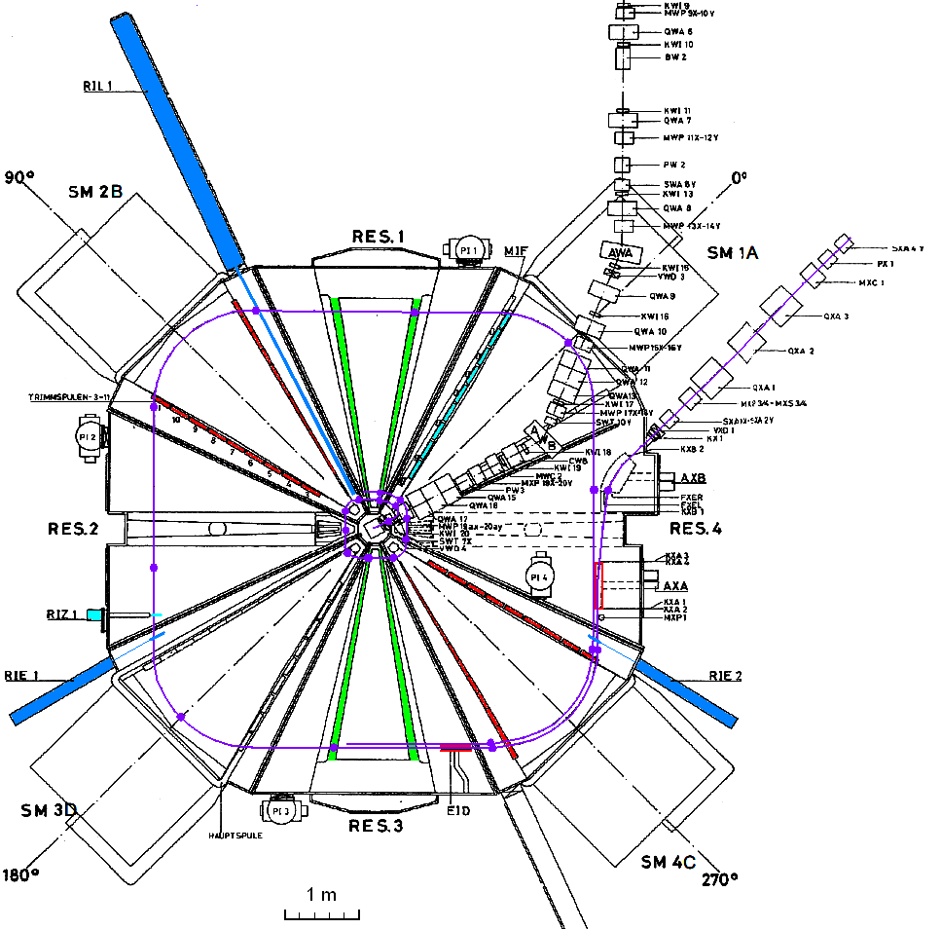
cyclotron instrumentation example: PSI 72MeV injector cyclotron
phase probes
«RF pickups»
injection channel
transverse probes
«wire scanners»
extraction channel

Slide 25
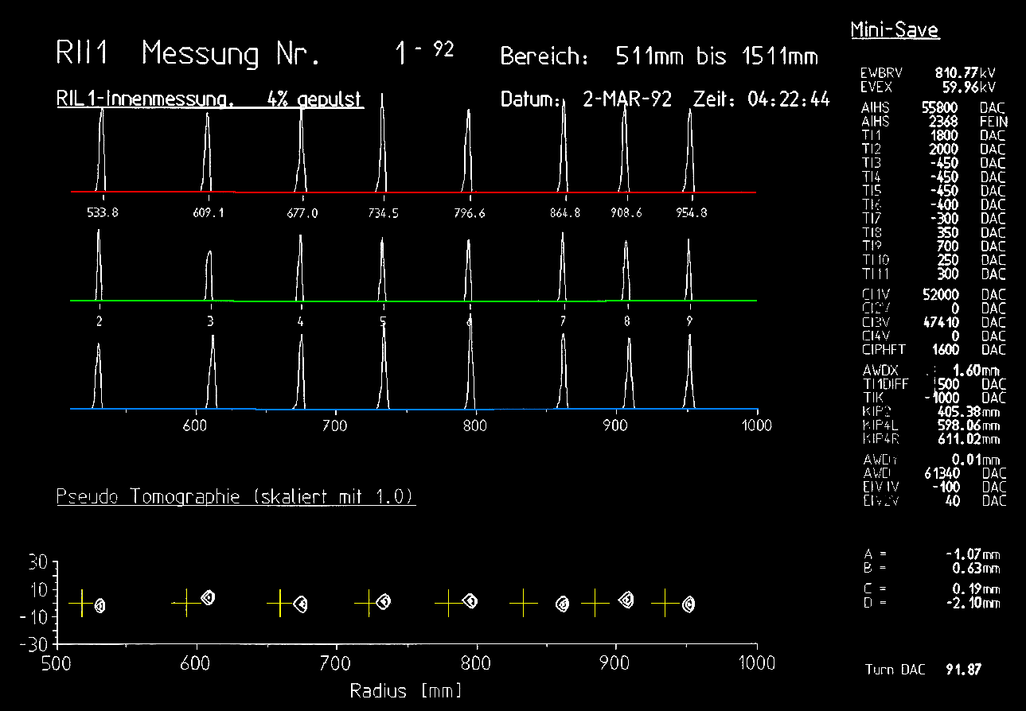
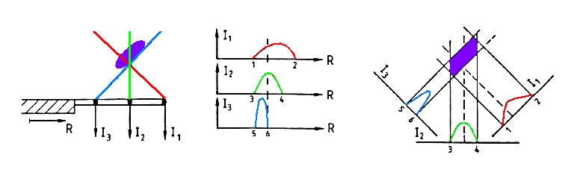
instrumentation: radial probe for turn counting / orbit analysis
wire scanner with three tilted wires delivers radial beam profile and some vertical information
radial: positions of individual turns
vertical/radial orbit positions and stored reference orbit (crosses)
«pseudo tomography» with tilted wires

Slide 26
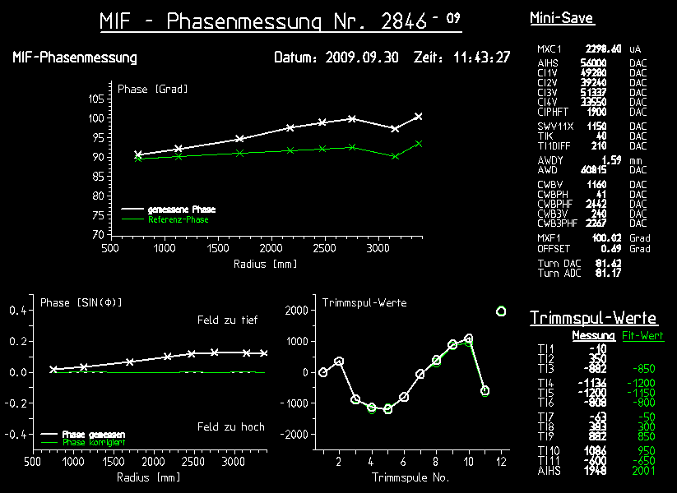
instrumentation: phase probes
phase probes are radially distributed RF pickups that detect the arrival time (phase) of bunches vs radius
→ adjustment of isochronicity
measured phase vs. radius; green: reference phase for «good conditions»
trim coil settings (12 circuits across radius)
green: predicted from phase measurement

Slide 27

next: Fixed Field Alternating Gradient Accelerator FFA
conceptual, scaling vs non-scaling, specific FFA technologies
materials & support by Suzie Sheehy et al, ASTeC/STFC
S. Machida et. al.
Nature Physics 8, 243–247 (2012)
Notes:
next I show you a few pictures and really basic information from selected existing cyclotrons

Slide 28
Fixed Field Alternating Gradient Accelerator (FFA)
isochr. cyclotron: no cycling, intense CW beam
repetition rate
FFA: fast cycling of RF frequency ∼ kHz
synchrotron: slow cycling of magnets, ≤ 50Hz
FFA:
… a concept in-between cyclotron and synchrotron; FFA = FFAG
strong focusing (a. gradient) compared to cyclotrons (flutter & edge focusing)
constant magnet strength over time, but frequency needs ramp
types of FFA: different scaling of field index k with particular implications …
applications: particle therapy, muon acceleration, high intensity

Slide 29
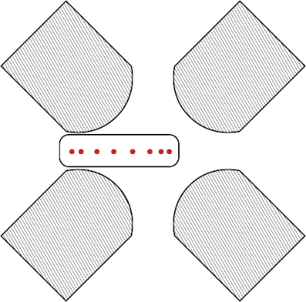
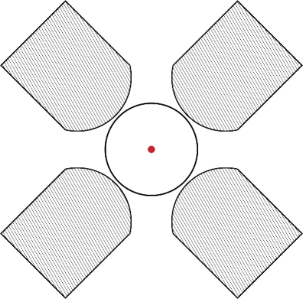
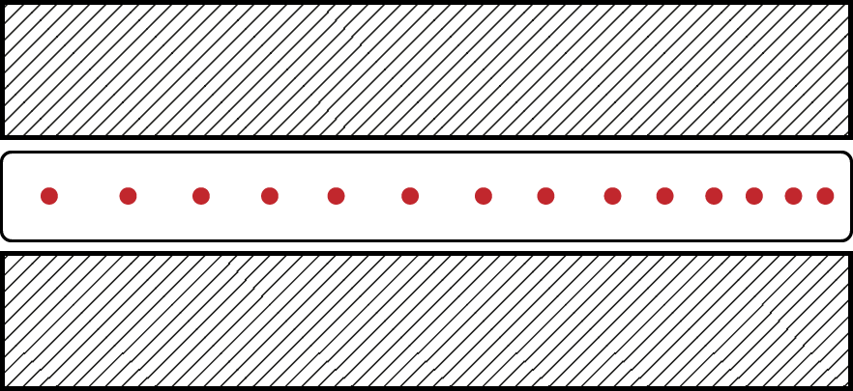
Cyclotron, FFA, Synchrotron – Qualitative Comparison
 | AVF Cyclotron | FFA | Synchrotron
orbit variation? | large | small | none
main focusing mechanism? | edge focusing | alternate gradient | alternate gradient
magnets ramped? | no | no | yes
frequency ramped? | no | yes, no in some designs | no
section sketch

Slide 30
FFA developments over time
1956: Symon, Kerst et al (US), Ohkawa (JP), Kolomensky (SU)
1950-60: MURA Group (Mid-western Universities Research Association), electron models
from 2003: Y.Mori et al, Univ. Kyoto proton accelerators
recently: EMMA electron model non-scaling FFA in Daresbury
MURA 50 MeV electron model
20 MeV booster & 150MeV main ring, Kyoto University
EMMA: 10-20 MeV electron linear non-scaling FFA

Slide 31

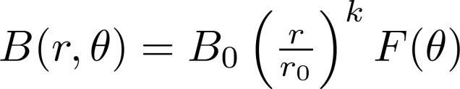
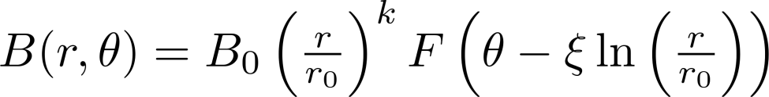
scaling FFA
idea: keep field index k constant
no resonance crossing
zero chromaticity, large acceptance
self similar orbits
but not isochronous, need f-sweep !
[courtesy M.Craddock]
field index
sector type
spiral type

Slide 32
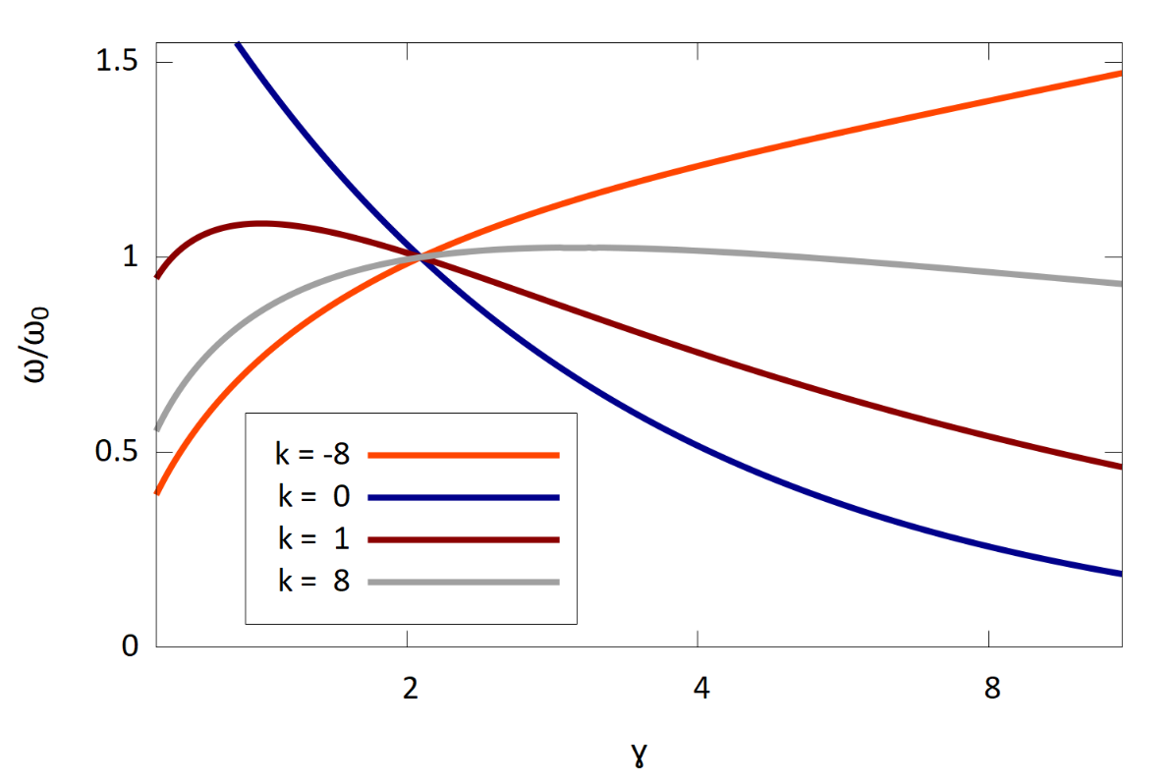
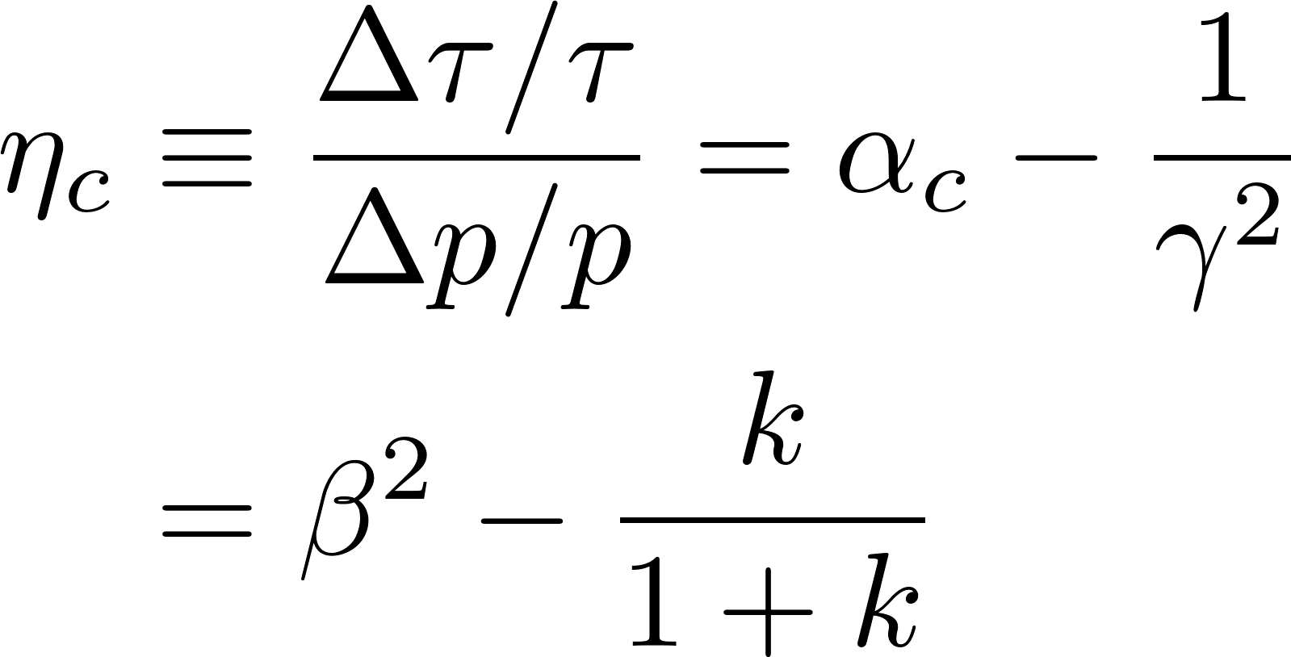
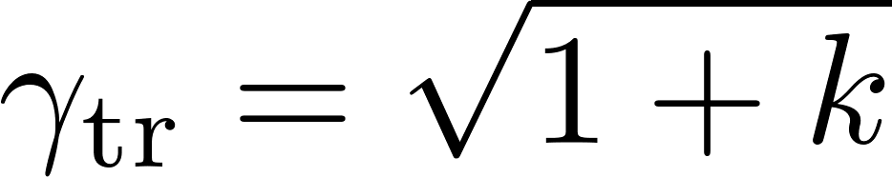
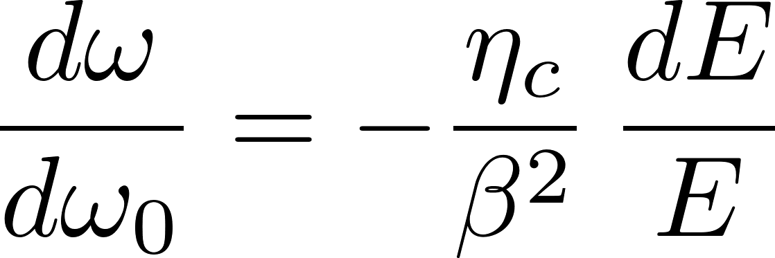
Revolution Frequency Variation in Scaling FFA
slip factor (as for synchrotrons):
sign change during acceleration for k > 0 !
transition energy:
Revolution frequency variation as a function of γ in a scaling FFA for several field indices k. A reference energy is chosen at 1 GeV.
differential rev. frequency:

Slide 33
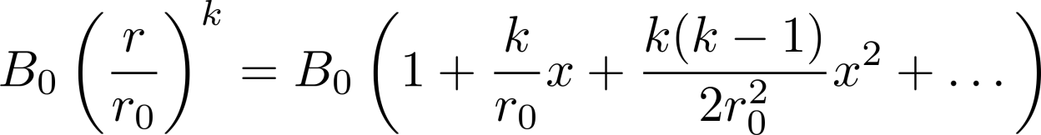
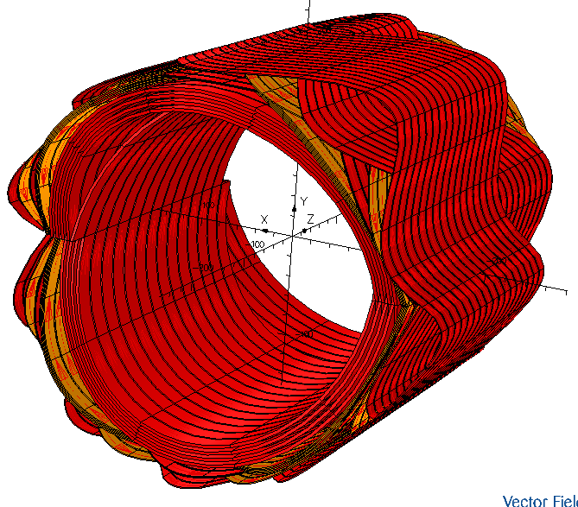
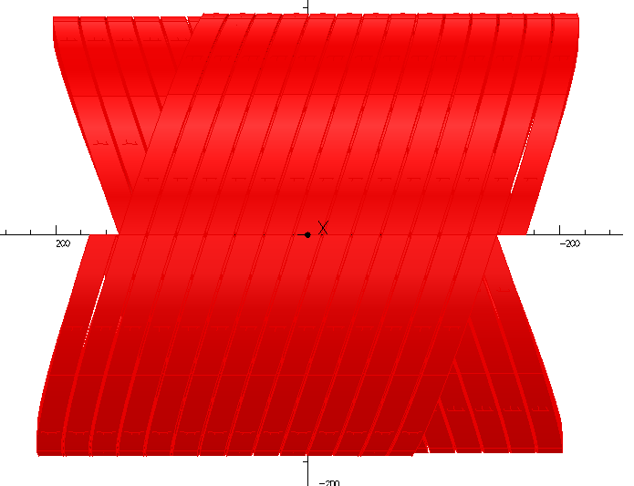
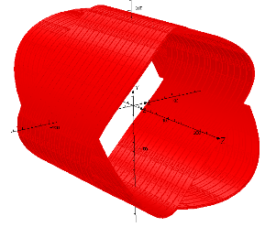
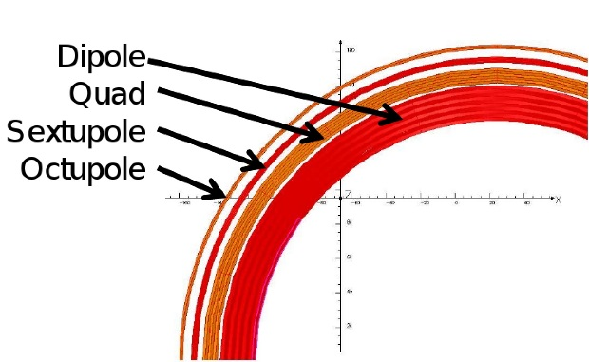
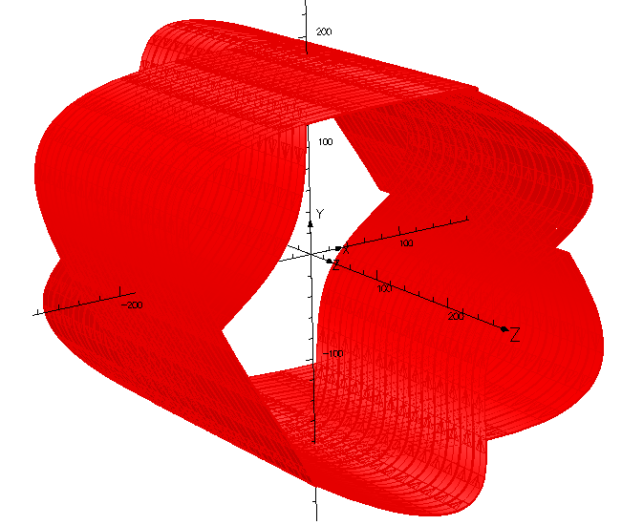

scaling FFA magnet design
helical coils, known as Canted Cosine Theta (CCT), can provide pure multipole fields
in superposition truncated Taylor expansion of r^{k} scaling → compact FFA magnet
55cm
Dipole
Quadrupole
~23cm
Sectapole
By H. Witte,
courtesy T.Yokoi, FFAG´09
Octapole

Slide 34



Variable Frequency RF for scaling FFA
example RF system:
Kyoto University FFA, 150MeV
high-permeability soft magnetic alloy (MA) core
low Q = 0.47 @ 2.7 MHz
high power broadband amplifier
Number of Cavities | 2
Gap Voltage | 4.0 kV/cavity
RF frequency | 1.5 – 4.2 MHz
RF output power | 200 kW
Core material | FINEMET (FT-3M)
repetition rate | 100 Hz
kinetic energy (p) | 10 – 125 MeV
radius variation | 4.47 - 5.20 m
Image credit: A.Takagi, Y.Mori

Slide 35


non-scaling FFA
k ≠ const. , but fast resonance crossing
simpler magnets, flexible optics
solutions with fixed RF frequency
linear scaling with k=1 is important sub-class, but many proposals
example: EMMA electron model
Energy | 10-20 MeV
Circumference | 16.57 m
Cells | 42
F quad length | 5.88 cm
D quad length | 7.57 cm
RF frequency | 1.3 GHz
Cavities | 19 x 120 kV

Slide 36


LNS FFA: serpentine acceleration
acceleration can be done within a few turns (no long-term stability required)
  → Fixed frequency!
along a serpentine path in long. phase space (ensure acceleration at all times)
path length varies little, but limited overall energy gain compared to synchrotron, e.g. factor 4 maximum
→ concept demonstrated in EMMA

Slide 37

finally: discussion
  comparison of circular accelerators
  suitability of cyclotrons and FFA for applications
  some literature

Slide 38
classification of circular accelerators
 | bending radius vs. time | bending field vs. time | bending field vs. radius | RF frequency vs. time | operation mode (pulsed/CW)
betatron |  |  |  |  |  | induction
classical cyclotron |  |  |  |  |  | simple, but limited E_{k}
isochronous (AVF) cyclotron |  |  |  |  |  | suited for high power!
synchro- cyclotron |  |  |  |  |  | higher E_{k}, but low P
FFA |  |  |  |  |  | strong focusing!
a.g. synchrotron |  |  |  |  |  | high E_{k}, strong focus
Notes:
this table shows a classification of circular accelerator with respect to several features of the bending field and the temporal behaviour
for example the betatron in the first line is an induction accelerator, which means the acc voltage is generated by the time variation of the bending field; the radius stays constant; the radial slope of the bending field provides stability; however the field must be cycled which strongly limits the attainable average beam current
I cannot go through all concepts, but what you can keep from this slide is that the isochronous cyclotron is best suited, since it allows CW operation, has sufficient focusing to reach reasonably high energies, and can achieve low losses in the 10e-4 region

Slide 39
pro and contra cyclotron / FFA
limitations of cyclotrons | typical utilization of cyclotrons
energy ≤1GeV (relat. effects) weak focusing: space charge, 10mA? tuning difficult; field shape; many turns; limited diagnostics wide vacuum vessel (radius variation) | medical applications; plenty intensity isotope production: several 10MeV acceleration of heavy ions (e.g. RIKEN) very high intensity proton beams (PSI:1.4MW, TRIUMF: 100kW )
Fixed Focus Alternating Gradient Accelerator (FFA)
strong focusing, compact magnets & chamber
large acceptance, e.g. 10.000 mm mrad
but:
CW operation difficult (serpentine, HNJ …)
low loss extraction difficult (high rep., fast kicker ?)
no demonstrator for high intensity after many years of discussion …
Notes:
one slide with some selected arguments pro and contra cyclotrons…
injection and extraction are critical since typically one has to place material close to the beam, which causes losses by scattering; in a sc linac in comparison the aperture is large and you have no extraction issues

Slide 40


cyclotron conferences – a valuable source of knowledge
old cyclotron conferences have been digitized for JACOW (effort of M.Craddock!)
intl. cyclotron conference every 3 years; 2019 edition this month in Cape Town; in-between European Cyclotron Progress Meeting (ECPM)
Jacow conferences
cyclotrons
first PAC

Slide 41
some literature w.r.t. cyclotrons & FFA
comprehensive overview on cyclotrons | L.M.Onishchenko, Cyclotrons: A Survey, Physics of Particles and Nuclei 39, 950 (2008) http://www.springerlink.com/content/k61mg262vng17411/fulltext.pdf
50 Years of Cyclotron Development | L. Calabretta, M. Seidel IEEE Transactions on Nuclear Science, Vol. 63, No. 2, 965 – 991(2016) http://ieeexplore.ieee.org/stamp/stamp.jsp?tp=&arnumber=7410111
space charge effects and scalings | W.Joho, High Intensity Problems in Cyclotrons, Proc. 5th intl. Conf. on Cyclotrons and their Applications, Caen, 337-347 (1981) http://accelconf.web.cern.ch/AccelConf/c81/papers/ei-03.pdf
ICFA BDN Nr 43 | series of high level FFA articles (2007) https://www-bd.fnal.gov/icfabd/Newsletter43.pdf
FFA Optics | M. Craddock, FFA Optics (2011) https://www.cockcroft.ac.uk/events/ffag11/FFAG_talks/11/5.Craddock.pdf
comparison of cyclotron and FFA | M. Craddock, Was the Thomas cyclotron of 1938 a proto-FFAG? https://www.cockcroft.ac.uk/events/FFAG08/presentations/Craddock/Thomas-FFAG.pdf

Slide 42

Thank you for your attention !

