Slide 1


Longitudinal
Hands-on Calculations
Longitudinal Tracking
S. Albright, H. Damerau,
A. Lasheen, F. Tecker
CERN
Introduction to Accelerator Physics
27 September 2022

Slide 2
Copyright statement and speaker’s release for video publishing
The author consents to the photographic, audio and video recording of this lecture at the CERN Accelerator School. The term “lecture” includes any material incorporated therein including but not limited to text, images and references.
The author hereby grants CERN a royalty-free license to use his image and name as well as the recordings mentioned above, in order to post them on the CAS website.
The author hereby confirms that to his best knowledge the content of the lecture does not infringe the copyright, intellectual property or privacy rights of any third party. The author has cited and credited any third-party contribution in accordance with applicable professional standards and legislation in matters of attribution. Nevertheless the material represent entirely standard teaching material known for more than ten years. Naturally some figures will look alike those produced by other teachers.

Slide 3
Agenda of the afternoon
15h00 – 15h30 Introduction to exercises
15h00 – 16h00 Longitudinal tracking
Legstretch
16h30 – 17h45 Longitudinal tracking
17h45 – 18h30 Discussion on solutions of exercises

Slide 4
Outline
Introduction
  Interaction between beam and RF system
Longitudinal particle tracking
  Basic tracking equations
  Single and multiple particle tracking
Summary

Slide 5
Introduction

Slide 6
Study interaction between beam and RF
Complementary approaches for the same problem
(Semi-)Analytical | Numerical: tracking
Describe particle motion by differential equations Continuous trajectories of particle motion Deduce useful parameters for stable acceleration: RF bucket Synchrotron frequency Stable phase ... | Track particle parameters from turn to turn Profit from discretization of motion: turn-by-turn No notion of RF bucket, synchrotron, stable phase, etc. Follow ensemble of particles to study evolution of bunch
Classical introduction of longitudinal beam dynamics | Flexible brute-force approach

Slide 7
Study interaction between beam and RF
Complementary approaches for the same problem
(Semi-)Analytical | Numerical: tracking
Describe particle motion by differential equations Continuous trajectories of particle motion Deduce useful parameters for stable acceleration: RF bucket Synchrotron frequency Stable phase ... | Track particle parameters from turn to turn Profit from discretization of motion: turn-by-turn, RF station-by-RF station No notion of RF bucket, synchrotron frequency, stable phase, etc. Follow ensemble of particles to study evolution of bunch
Classical introduction of longitudinal beam dynamics | Flexible brute-force approach

Slide 8
Study interaction between beam and RF
Complementary approaches for the same problem
(Semi-)Analytical | Numerical: tracking
Describe particle motion by differential equations Continuous trajectories of particle motion Deduce useful parameters for stable acceleration: RF bucket Synchrotron frequency Stable phase ... | Track particle parameters from turn to turn Profit from discretization of motion: turn-by-turn, RF station-by-RF station No notion of RF bucket, synchrotron frequency, stable phase, etc. Follow ensemble of particles to study evolution of bunch
Classical introduction of longitudinal beam dynamics | Flexible brute-force approach
Today

Slide 9
Objectives of longitudinal hands-on
Design RF system (upgrade)
  LongitudinalHandsOnRFSystemCalculations_empty.ipynb
  Study boundary constraints
  Derive requirements for RF system
  Choose main components
  Compare with existing facilities
Play with longitudinal beam dynamics
  LongitudinalHandsOnTracking_empty.ipynb
  Build your own particle tracker
  Understand motion of particles in
  longitudinal phase space
  Transition from single particle motion to evolution
  of an entire bunch

Slide 10
Longitudinal tracking

Slide 11
Tracking simulation flow
Accelerator parameters
RF system parameters
Generate initial distribution
Tracking
Plot and analyse results
Compare with measurements
Follow the coordinates of one or more particles determine its behaviour

Slide 12
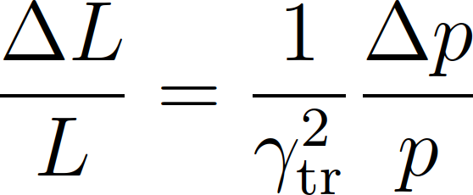
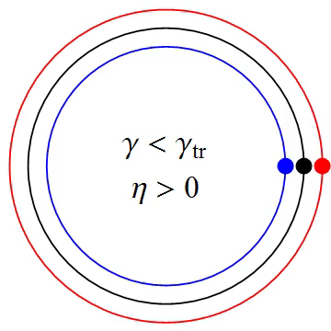
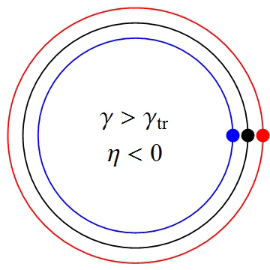
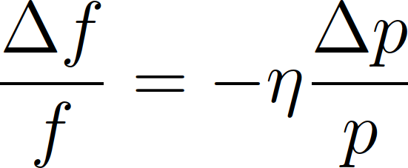
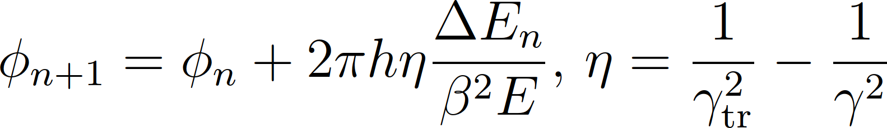
Circular accelerator without RF system
ring
Particles with higher or lower momentum have a different orbit compared to a reference particle
Arrival time/phase depends on energy
, phase slip factor:

Slide 13
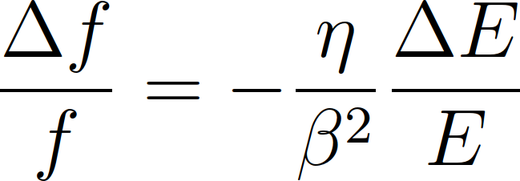
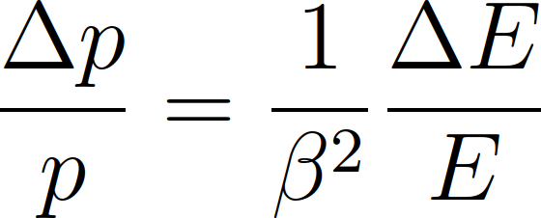
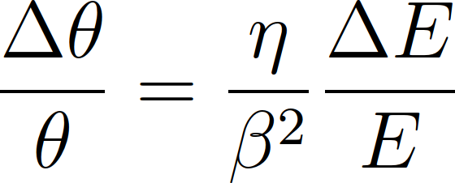
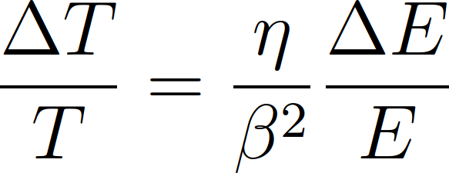
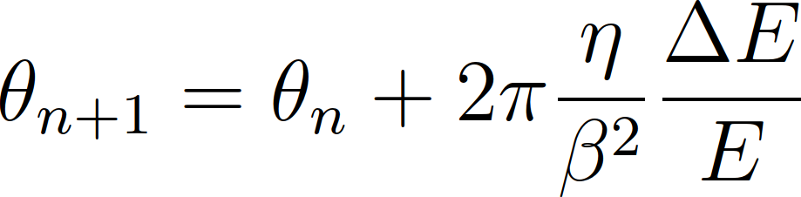
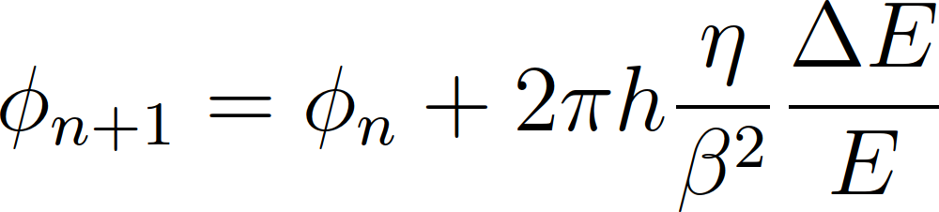
Arrival phase of a particle at next turn
Turn-by-turn drift equation
Azimuth, θ or phase, φ a particles arrives next turn

Slide 14

Circular accelerator with RF station
Particle energy changes at passage through cavity
For sinusoidal RF voltage:
With acceleration:
Reference particle:
General energy change:

Slide 15
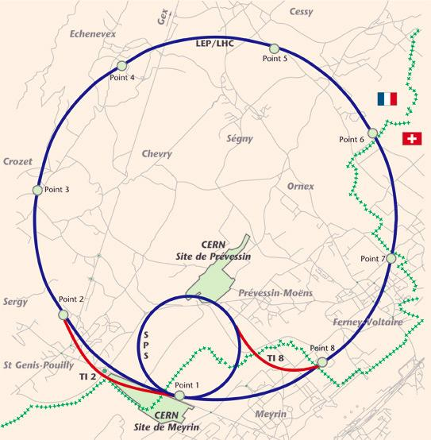
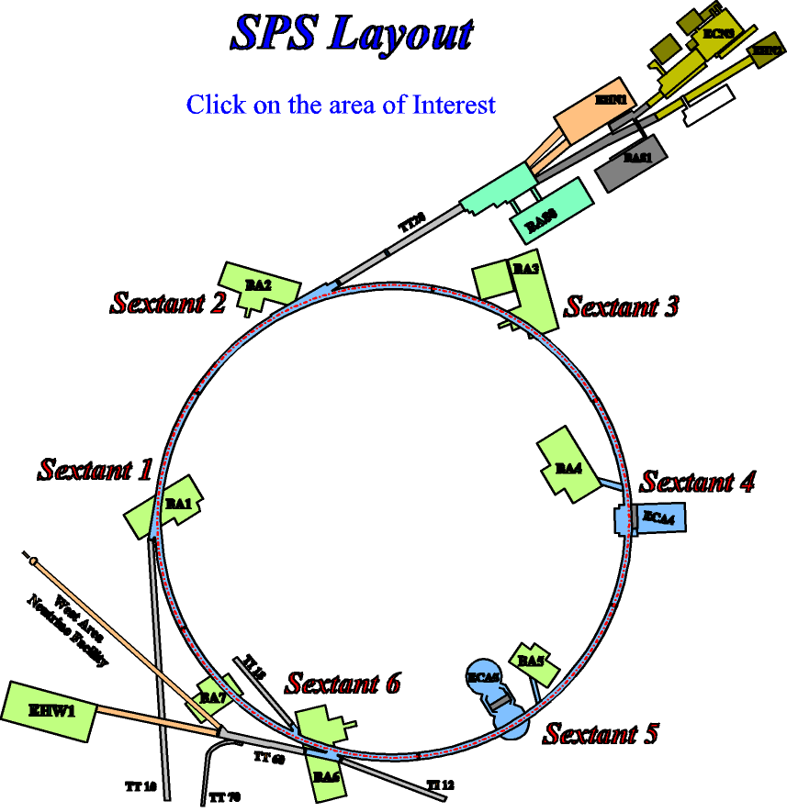
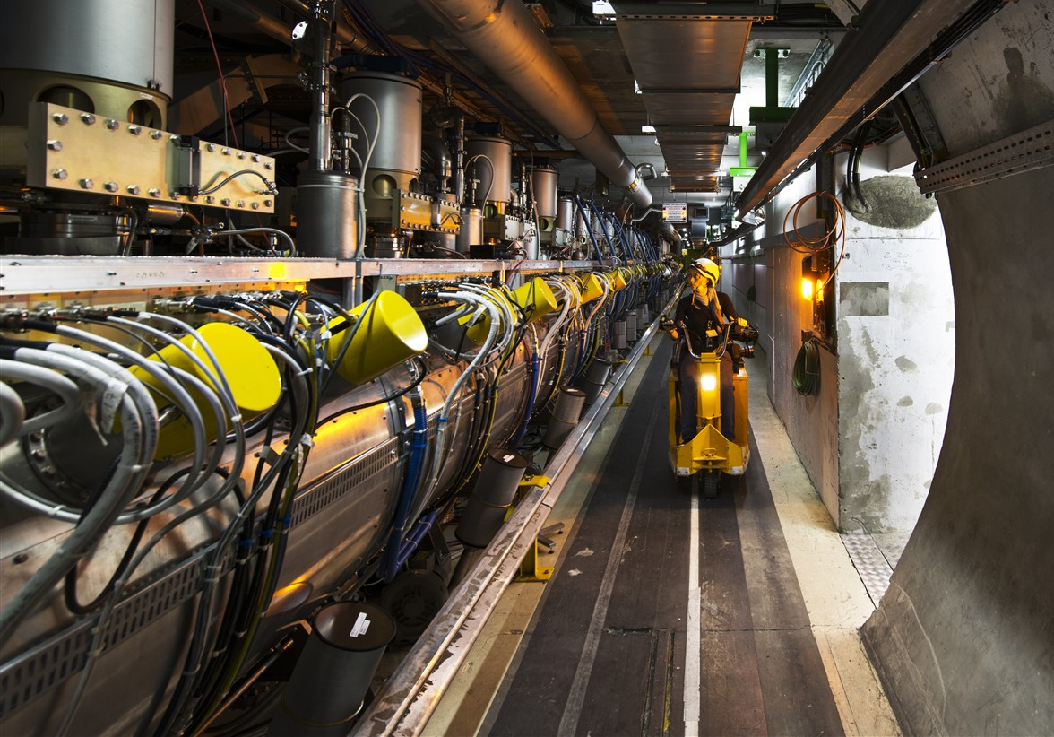
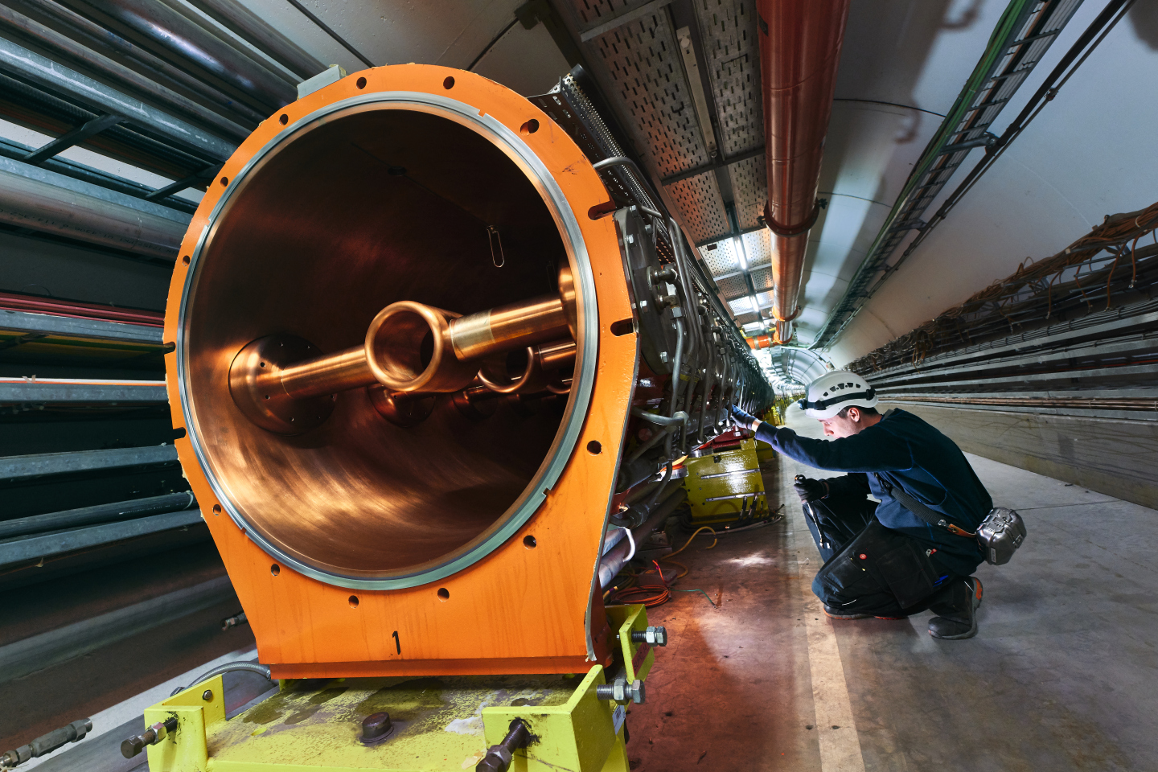
Multiple RF stations
RF systems modelled point-like mostly valid approximation
Valid in most cases
Exceptions:
  Large synchrotron tune f_{S}/f_{rev}
  Strong intensity effects: interaction within one turn
  Beam energy changing during turn
LHC
SPS

Slide 16
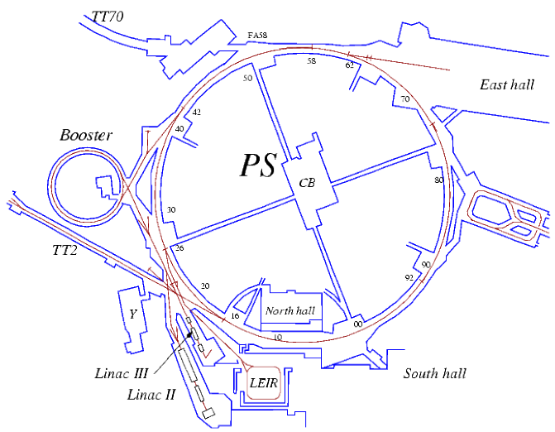
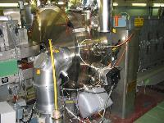
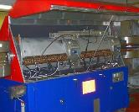
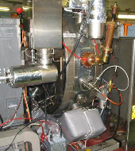
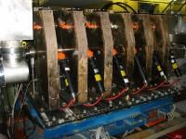
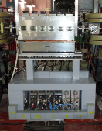
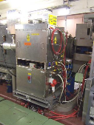
Multiple RF stations
RF Manipulations
2.8 – 10 MHz
51
56
46
66
40 MHz
Acceleration
76
77
36
78
80
to SPS
81
86
88
89
91
96
92
80 MHz
11
8
6
2
200 MHz
Longitudinal blow-up
0.4 – 5 MHz
20 MHz
Small Q_{S} = f_{S}/f_{rev}: Single kick per turn fully sufficient

Slide 17
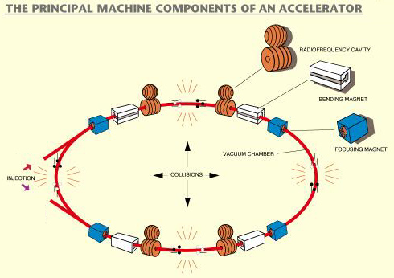
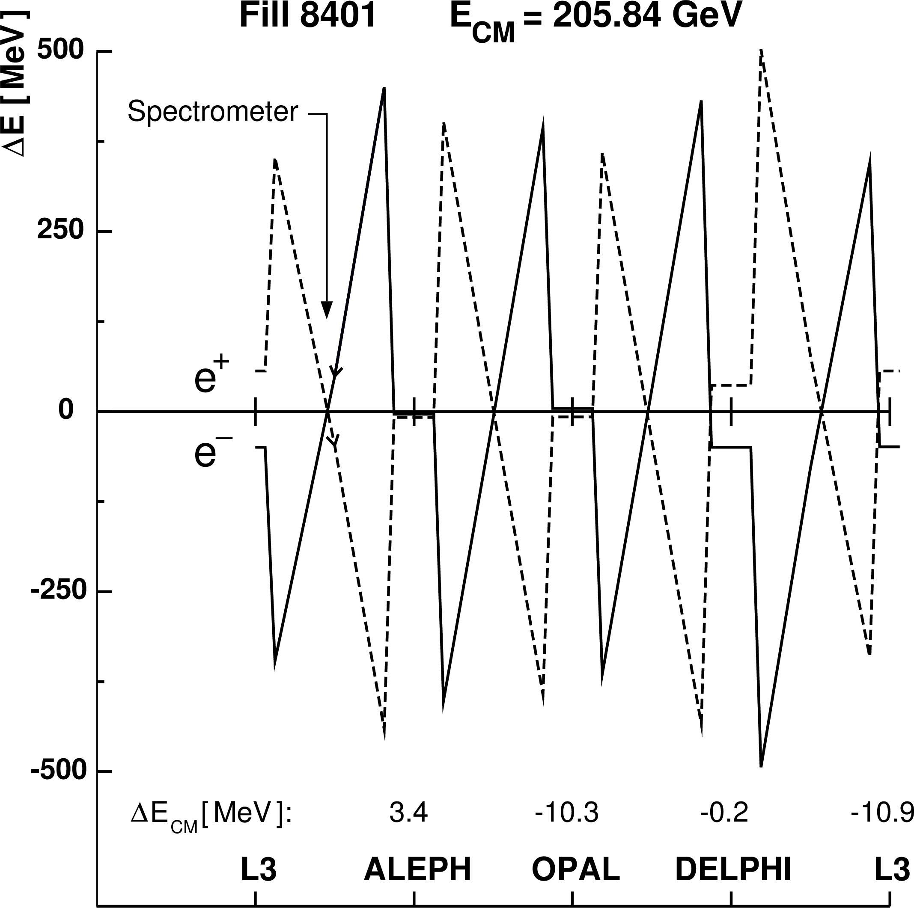
Example: Electrons and positrons in LEP
Beam energy changed in LEP along turn due to strong synchrotron radiation
Positrons
4 × 2 RF sections
Energy loss in bending magnets
Track from RF section to RF section
Electrons

Slide 18
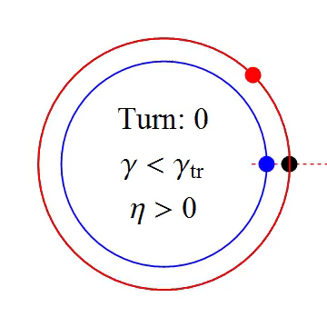
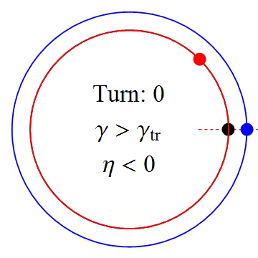

Combining both tracking equations
Observe phase and energy error at each turn with respect to reference particle
Test particles:
Δφ = φ – φ_{S} = 0 | ΔE = 0
Δφ ≠ 0 | ΔE = 0
Δφ = 0 | ΔE ≠ 0

Slide 19
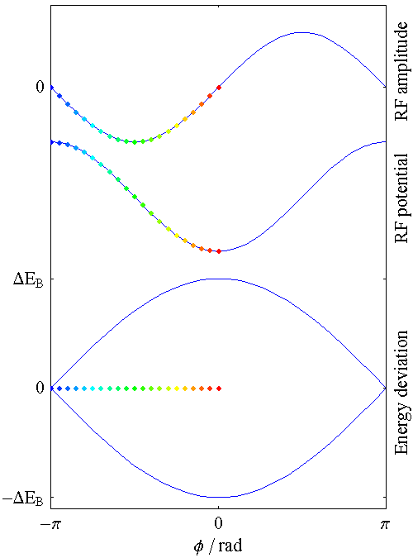
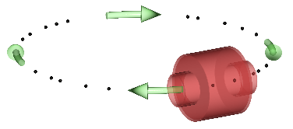
Longitudinal phase space
Simple accelerator model:
Energy dependent phase advance, φ:
Phase dependent energy gain, ΔE:
Works for arbitrary shape of acceleration amplitude g(φ)

Slide 20
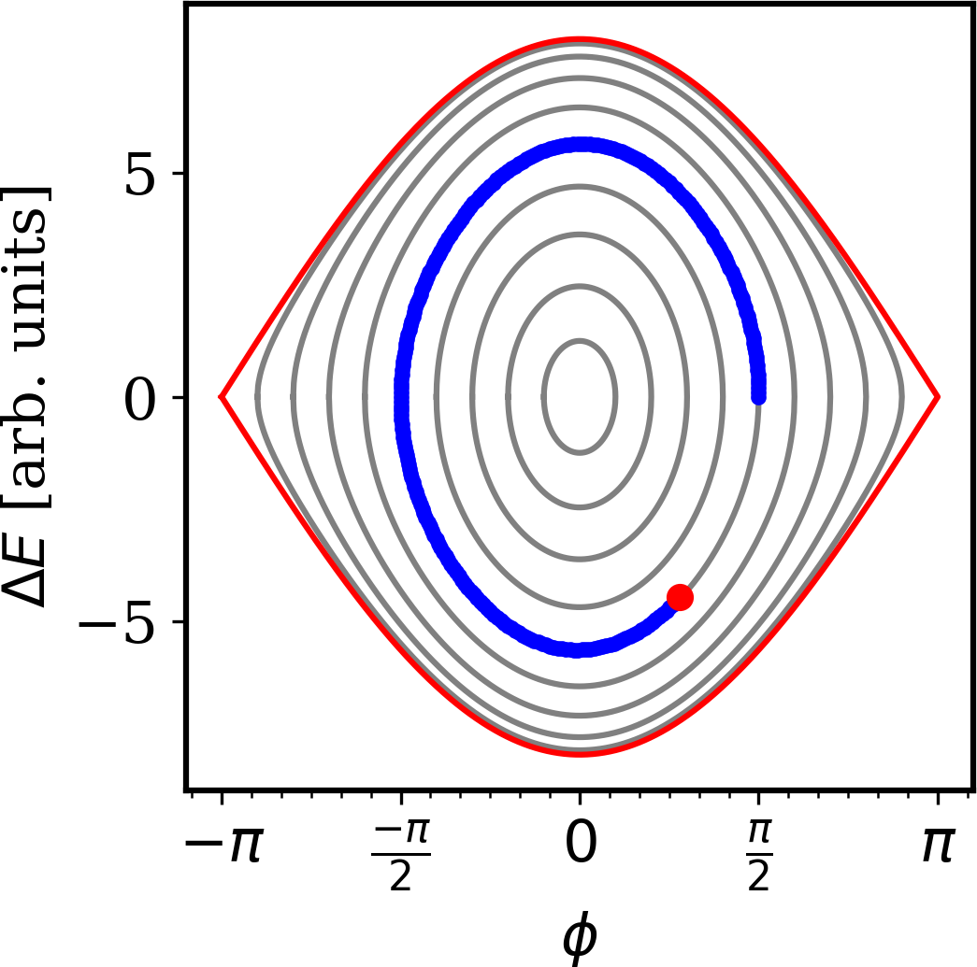
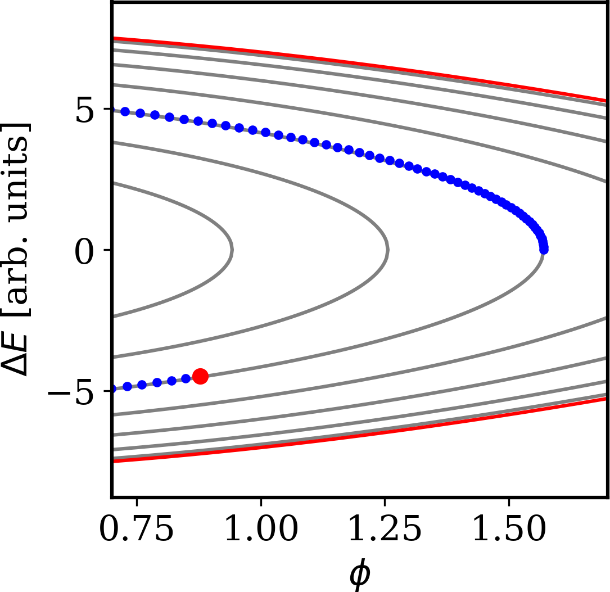
Continuous versus discrete
Analytical solution describes static condition
No notion of turn-by-turn evolution
Same result with both approaches for Q_{S} = f_{S}/f_{rev} << 1

Slide 21
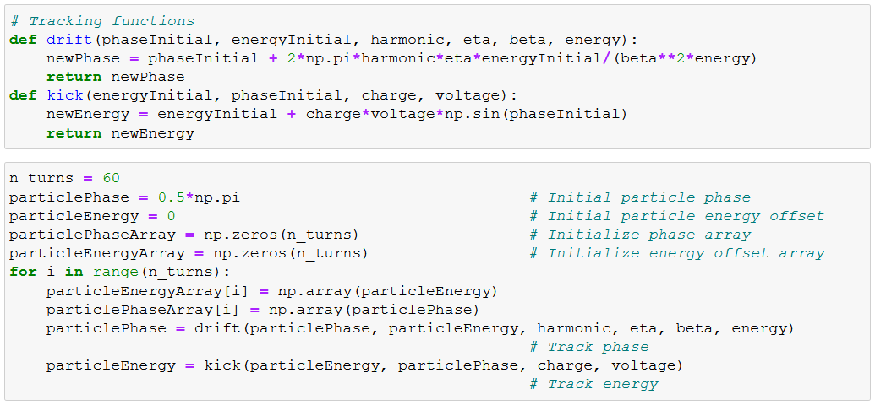
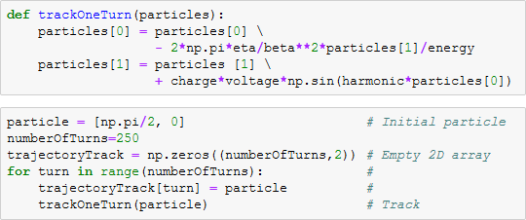
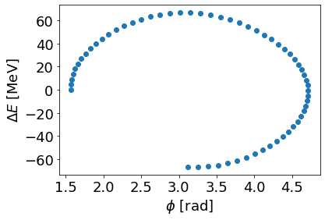
Example: simple tracking in Python
Follow the trajectory of a single particle
Turn n → n+1

Slide 22
Choice of particle coordinates
Time or phase? Momentum or energy?
Absolute or relative coordinates
 |  | Advantages | Disadvantages
t | E | Most universal Suitable for any tracking Canonically conjugated | Numerical precision: large absolute value Relative bunch motion more difficult to follow
Δt | ΔE | Relevant deviations only Canonically conjugated Most suited for multiple h | Required synchronous particle as reference Duration of turn may change
Φ | Ε, ΔE | Turn length always 2π Relevant deviations only | Requires synchronous particle as reference Not canonically conjugated
φ | Ε, ΔE | RF bucket length always 2π Relevant deviations only Most suited for single h | Requires synchronous particle as reference Not canonically conjugated

Slide 23
Tracking simulation flow
Accelerator parameters
RF system parameters
Generate initial distribution
Tracking
Plot and analyse results
Compare with measurements

Slide 24
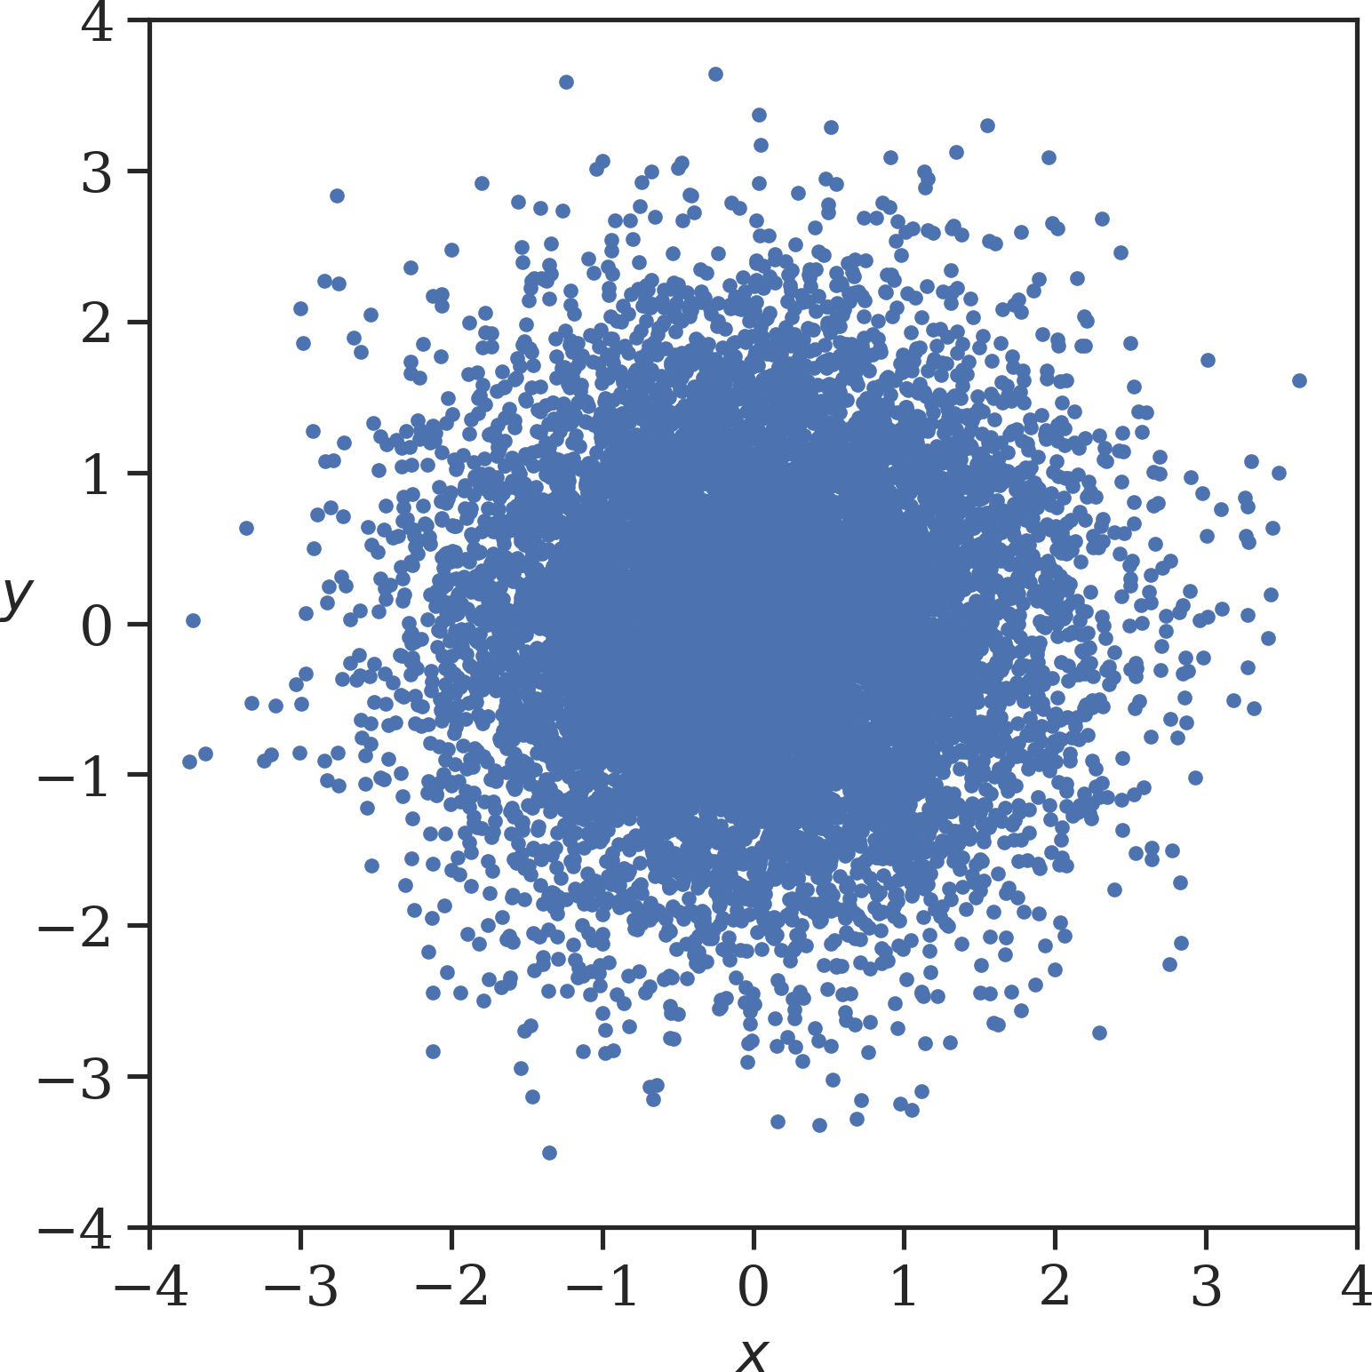
Distributions and projections
From single particle tracking to distribution
10¹⁰…10¹² particles per bunch → too much computing power
Macro-particles to reduce → up to few 10⁶ per bunch
Normal distribution in x, y

Slide 25
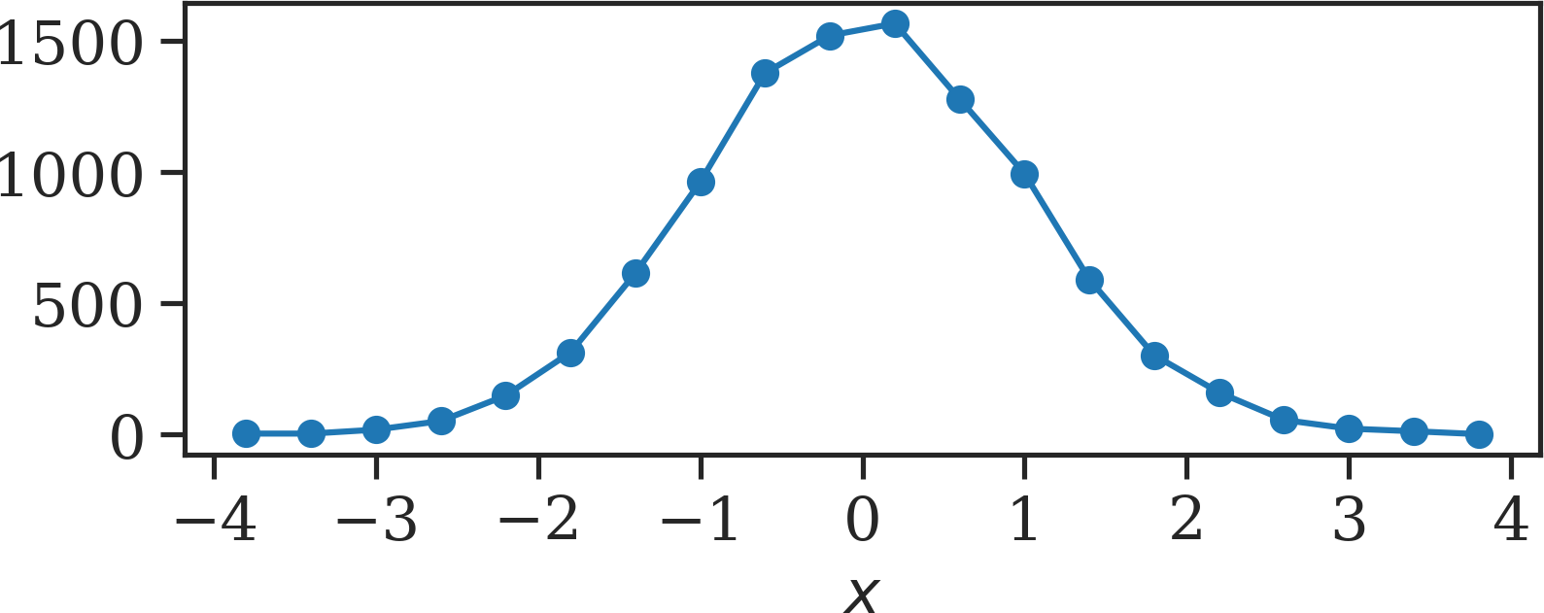
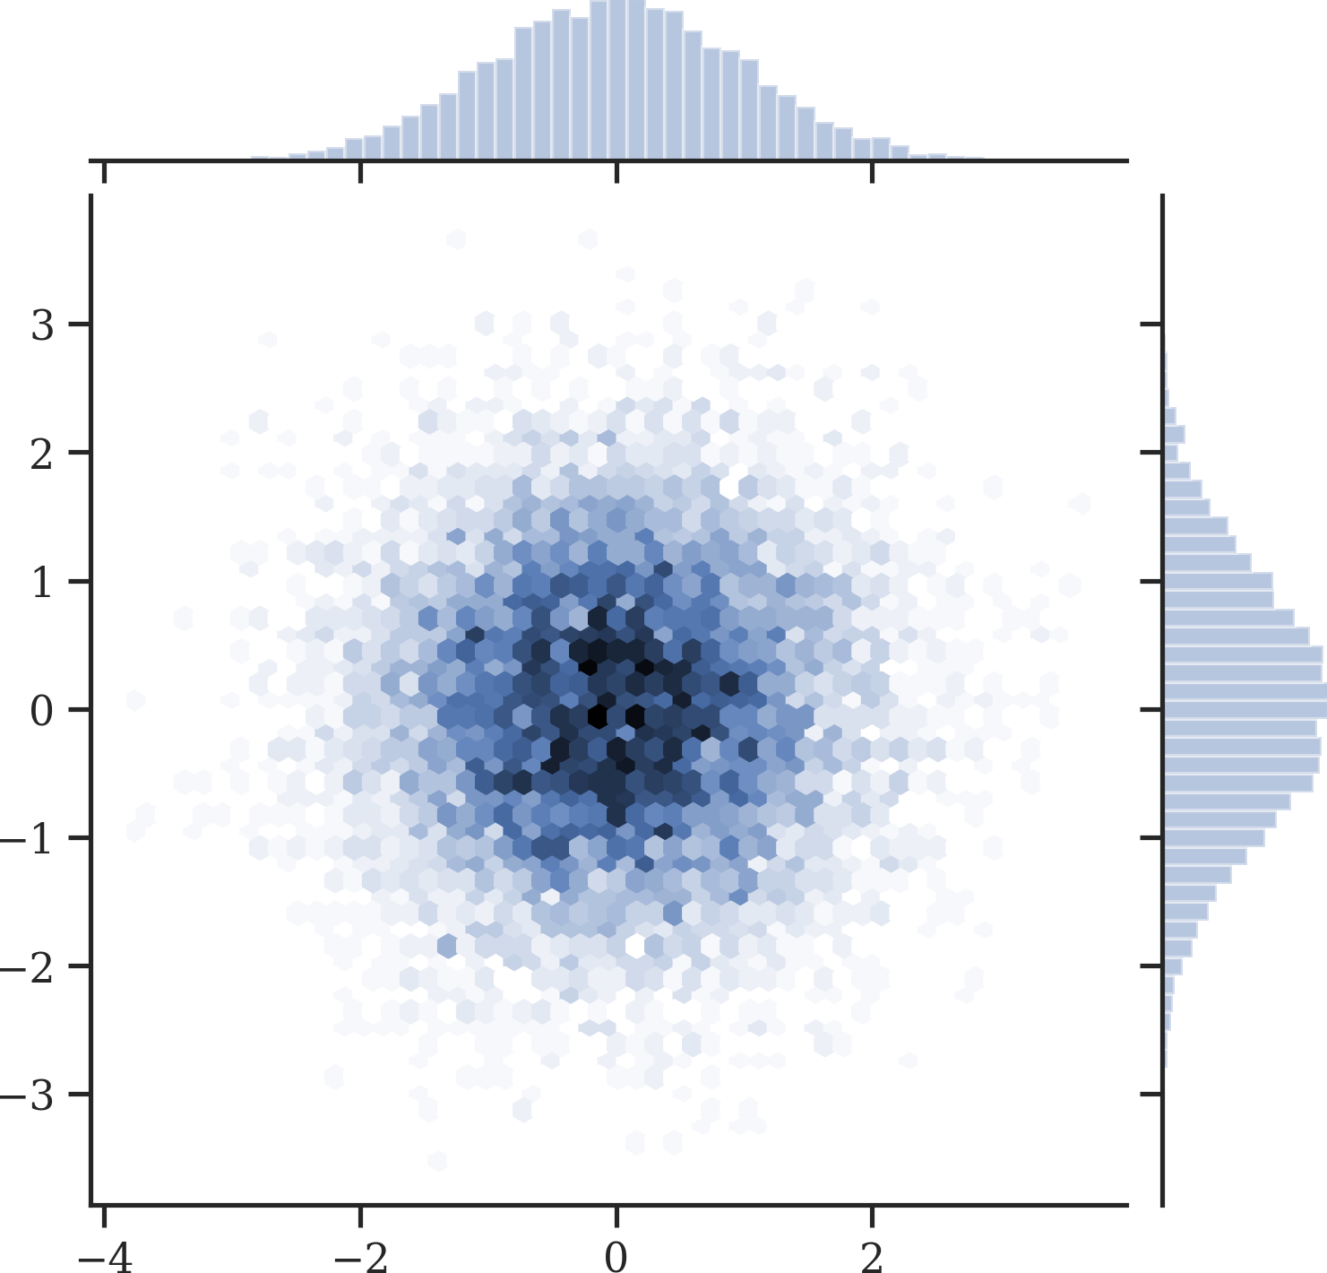
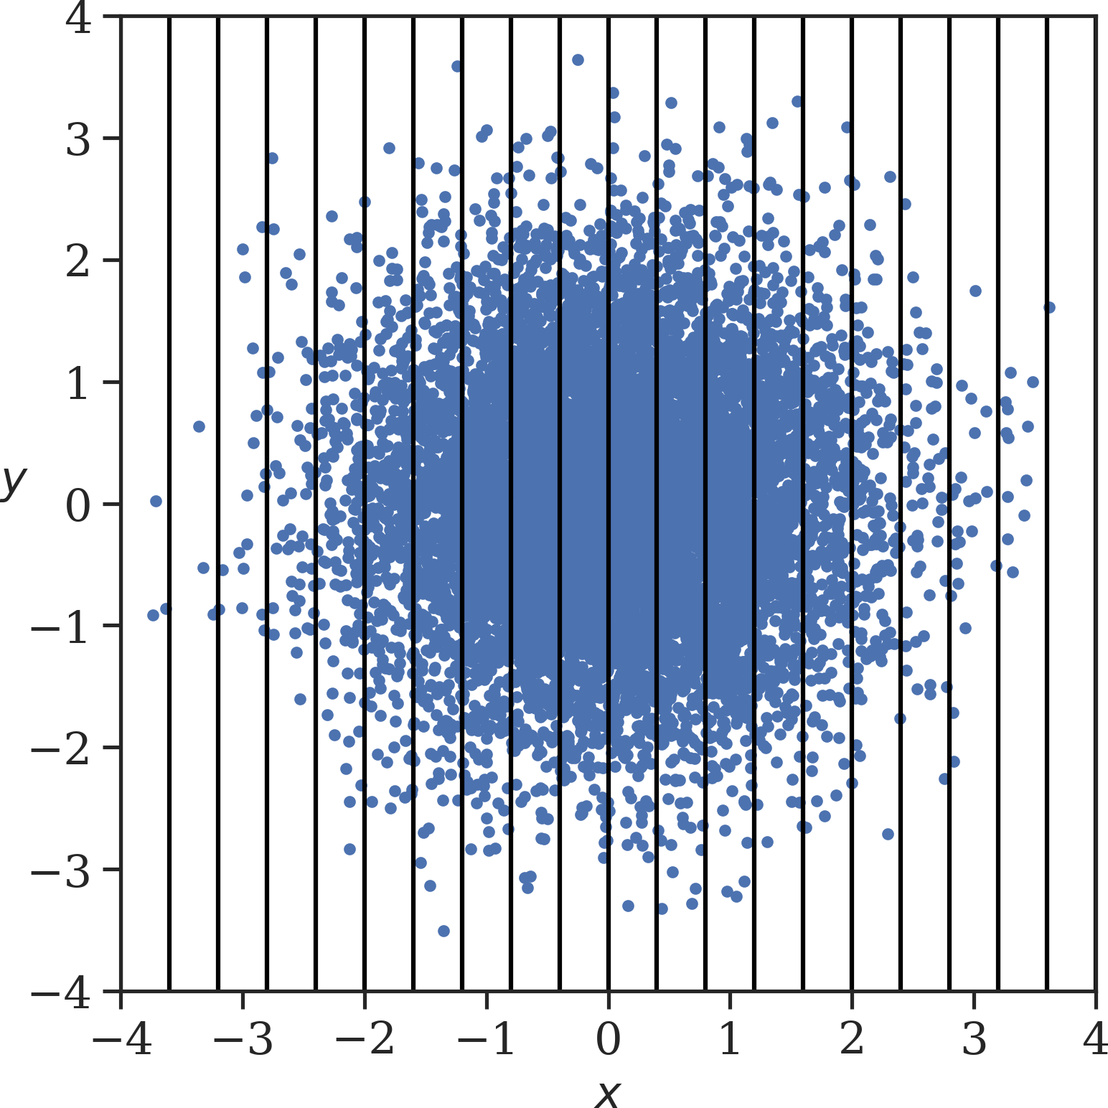
Projections of distributions
Very common task:
  e.g. Python seaborn
  plot_phase_space_
  distribution
Time projection directly observable: bunch profile

Slide 26
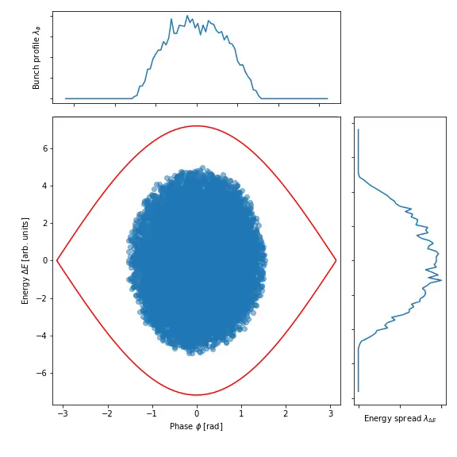
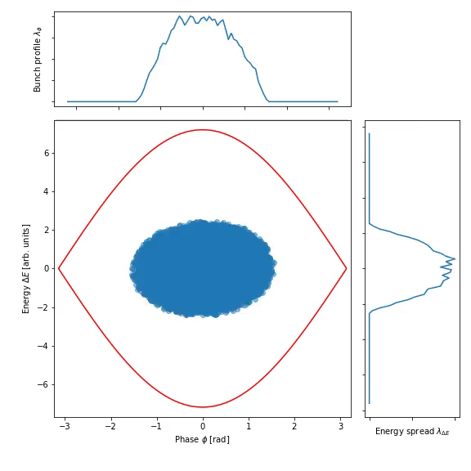
Example: Tracking of a single bunch
Set-up bunch with parabolic distribution: generate_bunch
Most simple case: single harmonic RF without acceleration
Correct voltage at correct phase
Wrong voltage at correct phase
Matched bunch
Breathing bunch (quadrupole)

Slide 27
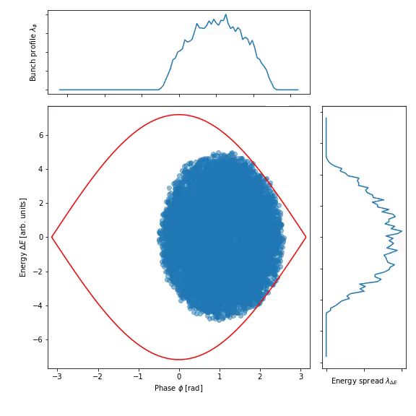
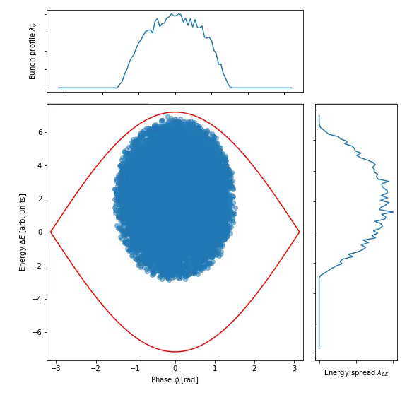
Example: Tracking of a single bunch
Set-up bunch with parabolic distribution: generate_bunch
Most simple case: single harmonic RF without acceleration
Correct voltage at wrong phase
All correct, but wrong energy
Dipole oscillations
Phase and energy offset for example at injection

Slide 28
Getting closer to reality
State-of-the-art tracking may include much more
Non-linear phase slip factor, e.g. transition
Beam induced
voltage
Energy loss: synchrotron radiation or impedances
Multiple RF systems with
changing parameters
Global regulation loops for beam phase and radial position
Acceleration
Feedbacks
around cavities

Slide 29

Longitudinal tracking codes
Dedicated to longitudinal dynamics: fast and focussed on RF aspects
Combined transverse and longitudinal tracking
Name | Remarks
BLonD | Widely used at CERN Complex RF manipulations and feedbacks Longitudinal intensity effects http://blond.web.cern.ch/
ESME | Longitudinal work horse code for many years RF manipulations with multiple RF systems Intensity effects esme.fnal.gov
PyHeadTail | Longitudinal and transverse combined simulation https://twiki.cern.ch/twiki/bin/view/ABPComputing/PyHEADTAIL
PyOrbit | Longitudinal and transverse combined simulation https://twiki.cern.ch/twiki/bin/view/ABPComputing/PyORBIT
elegant | Longitudinal and transverse combined simulation Mainly used for electron accelerators https://ops.aps.anl.gov/elegant.html
… | …
Longitudinal, 1D
Combined, 3D

Slide 30
Summary
Longitudinal simulations using particle tracking
  Complementary approach to longitudinal beam dynamics
  Flexibility to change parameters during tracking
  Powerful technique to study
    Multi-harmonic RF systems
    Complicated intensity effects
    Longitudinal dynamics with feedbacks and RF loops

Slide 31


…is your friend!
(small)
You will build a
longitudinal tracking code

Slide 32
A big Thank You
to all colleagues providing support, material and feedback
Simon Albright, Maria-Elena Angoletta, Philippe Baudrenghien, Thomas Bohl, Wolfgang Höfle,
Erk Jensen, Alexandre Lasheen,Elena Shaposhnikova, Frank Tecker, Daniel Valuch, Evin Vinten,
Manfred Wendt, Jörg Wenninger, J. Wulff
and many more…

Slide 33
Thank you very much for your attention!

Slide 34
References
D. Boussard, Design of a Ring RF System, CERN SL/91-2 (RFS, rev.), 1991, http://cds.cern.ch/record/1023436/files/CM-P00065157.pdf
E. Regenstreif, The CERN Proton Synchrotron, pt. 1, CERN-59-26, https://cds.cern.ch/record/214352/files/CERN-59-29.pdf
CERN, The 300 GeV Programme, CERN/1050, 1972, https://cds.cern.ch/record/104068/files/CM-P00077738-e.pdf
G. Arduini, E. Shaposhnikova, J. Wenniger, Acceleration Cycles for the LHC Proton Beams in the SPS, CERN AB-Note-2006-018, 2006, http://cds.cern.ch/record/951985/files/ab-note-2006-018.pdf
R. W. Assmann, M. Lamont, S. Myers, A Brief History of the LEP Collider, CERN-SL-2002-009-OP, 2002, https://cds.cern.ch/record/549223/files/sl-2002-009.pdf

