Slide 1
CAS – Introduction to Accelerator Physics
Collective effects
Part III: Wake fields and impedances – instabilities

Slide 2

Copyright statement and speaker’s release for video publishing
The author consents to the photographic, audio and video recording of this lecture at the CERN Accelerator School. The term “lecture” includes any material incorporated therein including but not limited to text, images and references.
The author hereby grants CERN a royalty-free license to use his image and name as well as the recordings mentioned above, in order to post them on the CAS website.
The author hereby confirms that to his best knowledge the content of the lecture does not infringe the copyright, intellectual property or privacy rights of any third party. The author has cited and credited any third-party contribution in accordance with applicable professional standards and legislation in matters of attribution. Nevertheless the material represent entirely standard teaching material known for more than ten years. Naturally some figures will look alike those produced by other teachers.

Slide 3
In the previous lecture we discussed space charge effects and showed how these can limit the machine performance in that they can lead to incoherent and coherent tune shifts. We then moved on the a more general treatment of electromagnetic fields in simple structures where we were able to identify yet another type of induced fields originating from the electromagnetic properties of the surrounding material – the wall wake.
We then saw some animations of more general examples of induced fields in complex structures.
We now want to see how to treat such structures more formally to help us model these types of collective effects better. For this, we introduce the concept of wake fields and impedances and will talk about their impact on the machine and on the beam.
Part 3: Wake fields and impedances – impacts
  Concept of wake fields
  Longitudinal and transverse wake fields and impedances
  Impact of wake fields and impedance on the accelerator environment
  Description of a coherent beam instability and the instability loop

Slide 4
By now we should be able to understand that solving the full electrodynamics in complex structures become a huge simulation effort and virtually impossible for large accelerators.
For this reason, one reverts to the concept of the wake function as the electromagnetic impulse response of any structure. One obtains wake fields and impedances which can be used to formally study the electromagnetic interaction of structures with a passing beam.
Part 3: Wake fields and impedances – impacts
  Concept of wake fields
  Longitudinal and transverse wake fields and impedances
  Impact of wake fields and impedance on the accelerator environment
  Description of a coherent beam instability and the instability loop

Slide 5
Wake function – general definition
How can we treat these phenomena effectively in our models?
We will use a little trick: we consider two point particles – one source, one probe
The forces will be a function of the locations of both the source and the probe particles:
L
Source, q₁
Witness, q₂
Δx₁ (or Δy₁)
2b
z
Δx₂ (or Δy₂)
Wake force measured by the witness particle
Note that:

Slide 6
Wake function – general definition
How can we treat these phenomena effectively in our models?
The rigid beam approximation
The impulse approximation
We will use a little trick: we consider two point particles – one source, one probe
The forces will be a function of the locations of both the source and the probe particles:
L
Source, q₁
Witness, q₂
Δx₁ (or Δy₁)
2b
z
Δx₂ (or Δy₂)
Wake force measured by the witness particle
Note that:

Slide 7
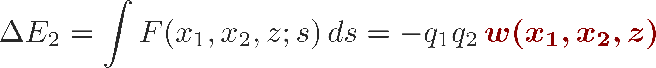
Wake function – general definition
L
Source, q₁
Witness, q₂
Δx₁ (or Δy₁)
2b
z
Δx₂ (or Δy₂)
Note that:
We define the wake function as the integrated force on the witness particle (associated to a change in energy):
Let’s focus on the horizontal plane. In general, for two point-like particles, we have

Slide 8
Wake function – general definition
L
Source, q₁
Witness, q₂
w is proportional to the integrated forces felt by the witness particle:
It is an intrinsic property of any given device, representing its electromagnetic impulse response.
It is a function of the transverse offsets and the longitudinal separation of the source and the witness particles.
Δx₁ (or Δy₁)
2b
z
Δx₂ (or Δy₂)
Note that:
We define the wake function as the integrated force on the witness particle (associated to a change in energy):
Let’s focus on the horizontal plane. In general, for two point-like particles, we have

Slide 9
Wake potential for a distribution of particles
L
Source, q₁
Witness, q₂
Δx₁ (or Δy₁)
2b
Δx₂ (or Δy₂)
z
z₁
We define the wake function as the integrated force on the witness particle (associated to a change in energy):
For an extended particle distribution this becomes (superposition of all source terms)
  Forces become dependent on the particle distribution function

Slide 10
We have introduced the concept of the wake function and have seen how these can simplify our handling of induced electromagnetic fields within complex structures. The wake function is the electromagnetic response of a structure and is in fact an intrinsic property of any such structure.
In practice, we will never compute the full wake function but we will separate between longitudinal and transverse wake fields. We then treat these in an expansion which significantly simplifies our treatment. Complementary to the wake fields one can also move to frequency domain and use the impedance.
Part 3: Wake fields and impedances – impacts
  Concept of wake fields
  Longitudinal and transverse wake fields and impedances
  Impact of wake fields and impedance on the accelerator environment
  Description of a coherent beam instability and the instability loop

Slide 11
Wake function – general definition
L
Source, q₁
Witness, q₂
Δx₁ (or Δy₁)
2b
z
Δx₂ (or Δy₂)
Note that:
We define the wake function as the integrated force on the witness particle (associated to a change in energy):
Let’s focus on the horizontal plane. In general, for two point-like particles, we have

Slide 12
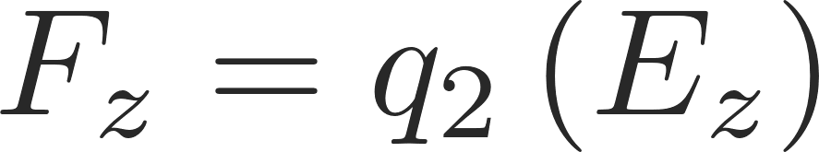
Longitudinal wake function
L
Source, q₁
Witness, q₂
Δx₁ (or Δy₁)
2b
z
Δx₂ (or Δy₂)
Note that:
Can be simulated or measured
Longitudinal wake fields
Zeroth order with source and test centred
usually dominant
Higher order terms
Usually negligible for small offsets

Slide 13
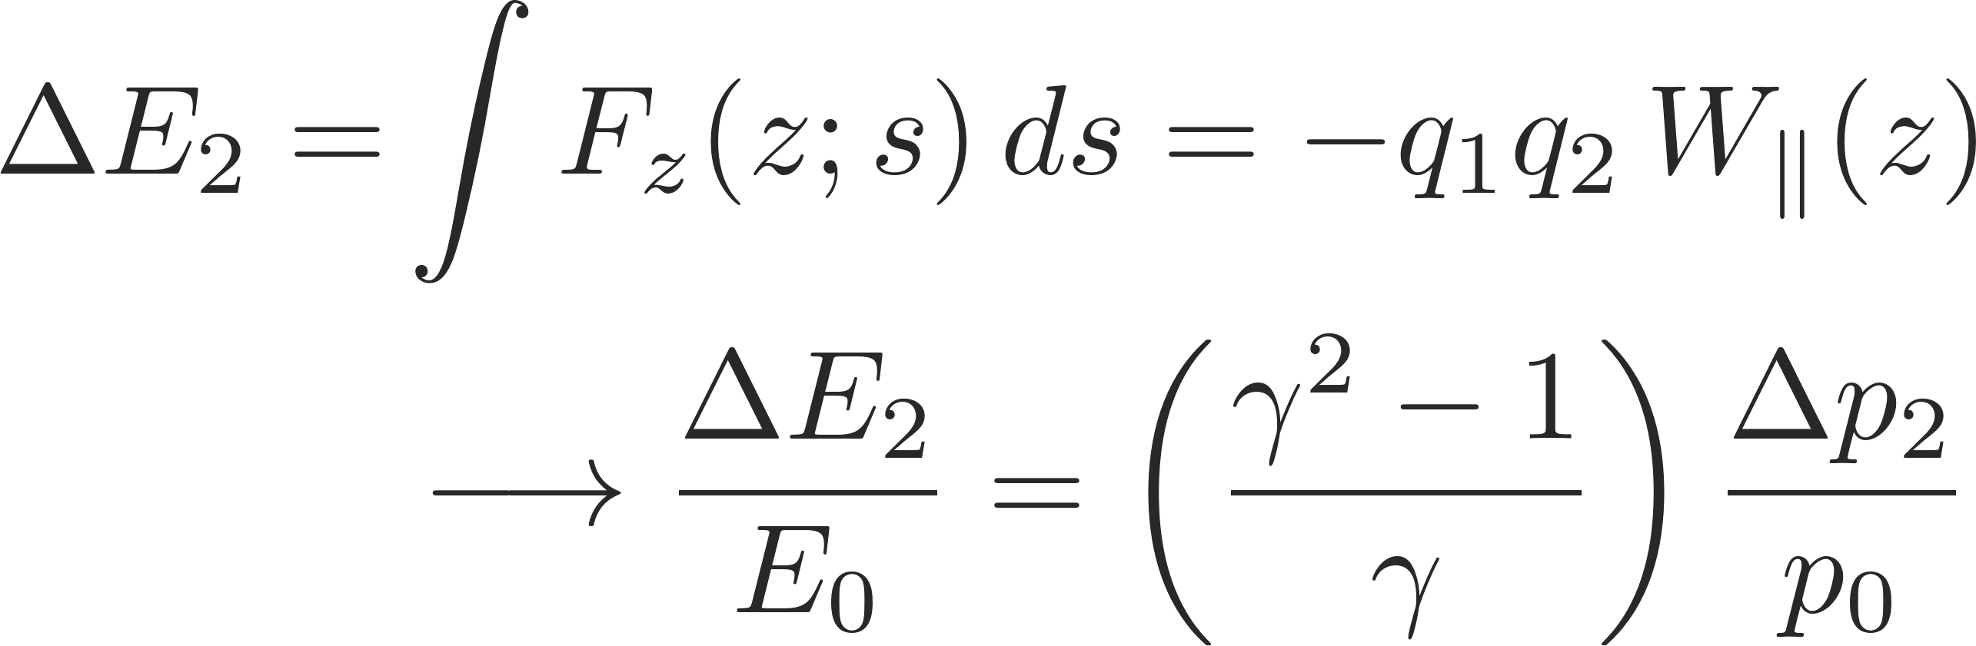
Longitudinal wake function
L
Source, q₁
Witness, q₂
Δx₁ (or Δy₁)
2b
z
Δx₂ (or Δy₂)
Note that:
Longitudinal wake fields
Energy kick of the witness particle from longitudinal wakes

Slide 14
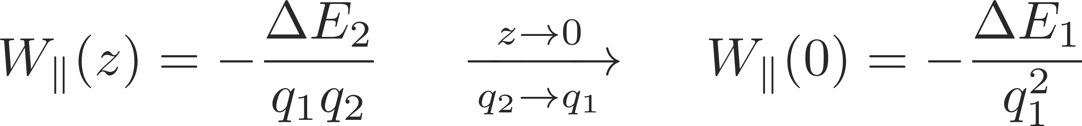
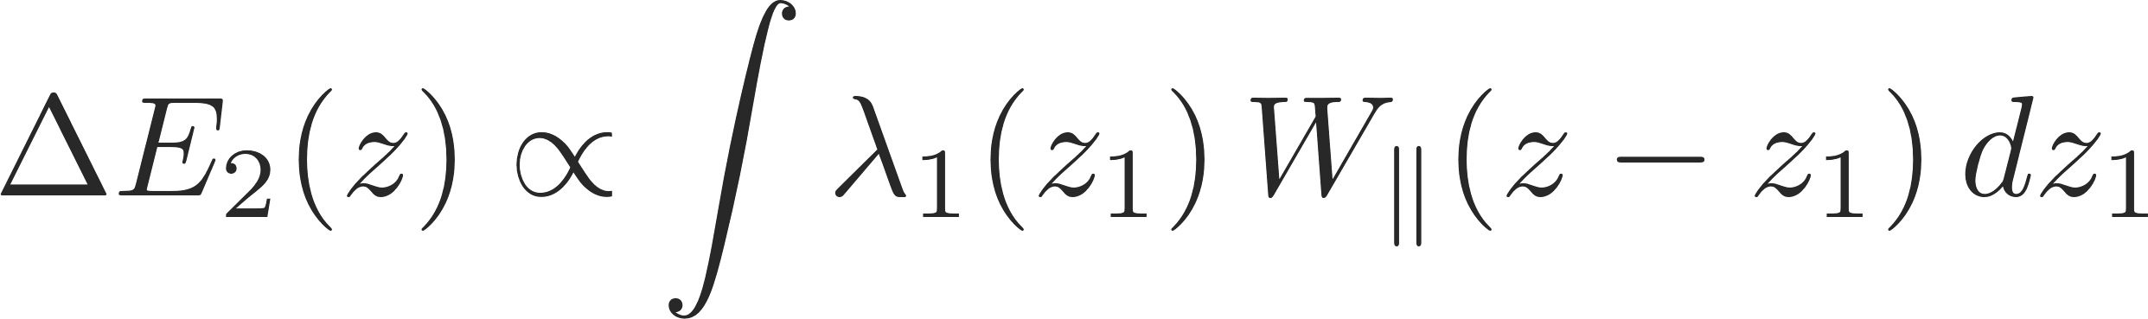
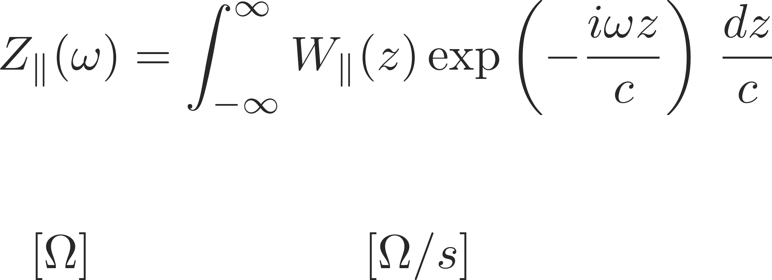
Longitudinal wake function
  The value of the wake function in z=0 is related to the energy lost by the source particle in the creation of the wake
  The wake function of an accelerator component is basically its Green function in time domain (i.e., its response to a pulse excitation)
    Very useful for macroparticle models and simulations, because it can be used to describe the driving terms in the single particle equations of motion!
  We can also describe it as a transfer function in frequency domain
    This is the definition of transverse beam coupling impedance of the element under study

Slide 15
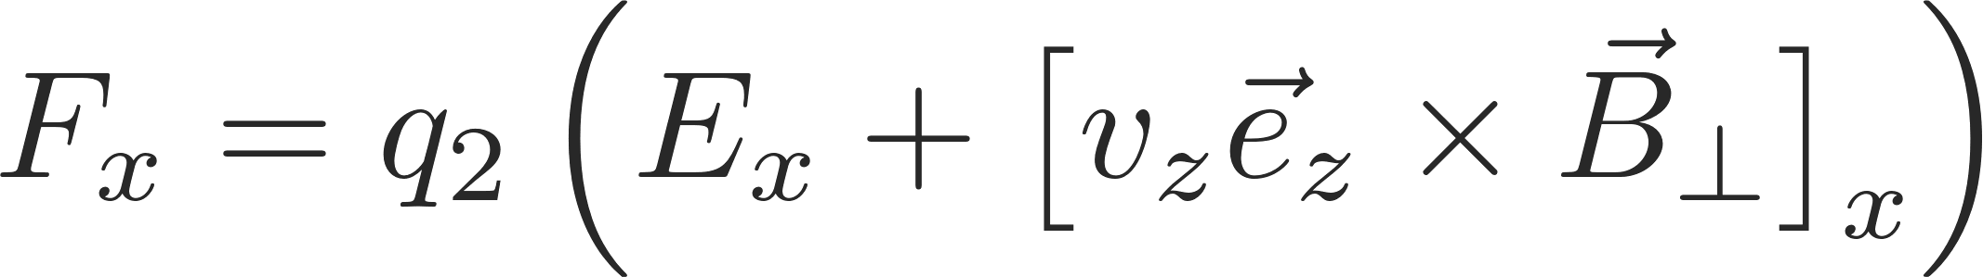
Transverse wake functions
L
Source, q₁
Witness, q₂
Δx₁ (or Δy₁)
2b
z
Δx₂ (or Δy₂)
Note that:
Transverse wake fields

Slide 16
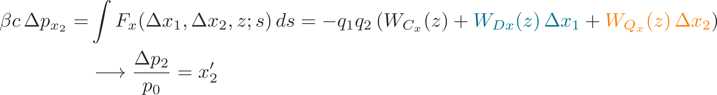
Transverse wake functions
L
Source, q₁
Witness, q₂
Δx₁ (or Δy₁)
2b
z
Δx₂ (or Δy₂)
Note that:
Transverse wake fields
First order expansion in transverse coordinates of source and witness particles
Transverse deflecting kick of the witness particle from transverse wakes

Slide 17
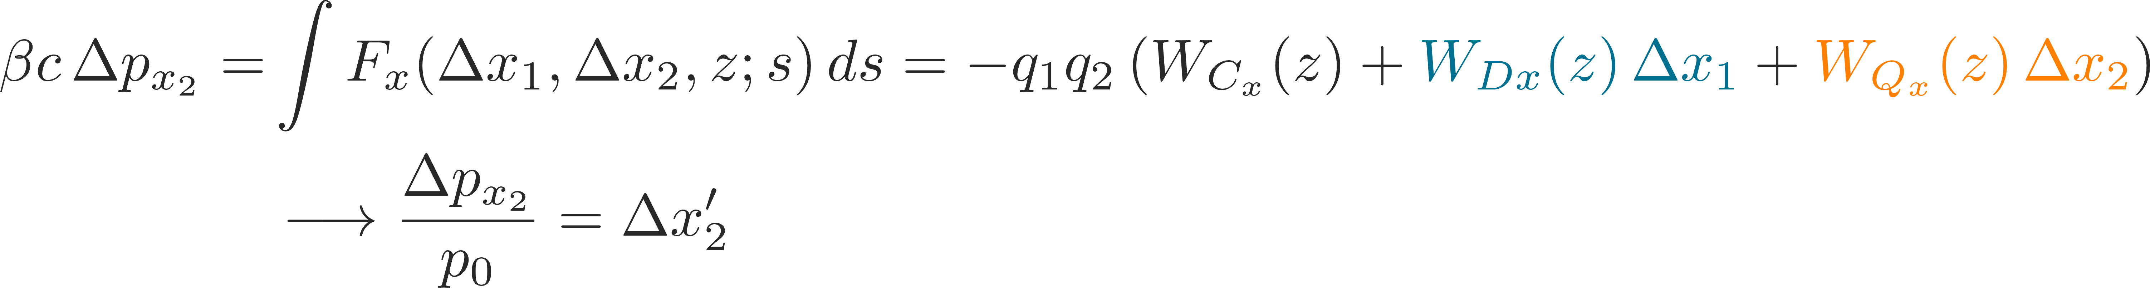
Transverse wake functions
L
Source, q₁
Witness, q₂
Δx₁ (or Δy₁)
2b
z
Δx₂ (or Δy₂)
Note that:
Transverse wake fields
First order expansion in transverse coordinates of source and witness particles
Transverse deflecting kick of the witness particle from transverse wakes

Slide 18
Transverse wake functions
L
Source, q₁
Witness, q₂
Δx₁ (or Δy₁)
2b
z
Δx₂ (or Δy₂)
Note that:
Can be simulated or measured
Transverse wake fields
Zeroth order for
asymmetric structures
→ Orbit offset
Dipole wakes –
depends on source particle
→ Orbit offset & detuning
Quadrupole wakes –
depends on witness particle
→ Detuning

Slide 19
Transverse wake functions
L
Source, q₁
Witness, q₂
  We have truncated to the first order, thus neglecting
    First order coupling terms between x and y planes
    All higher order terms in the wake expansion (including mixed higher order terms with products of the dipolar/quadrupolar offsets)
Δx₁ (or Δy₁)
2b
z
Δx₂ (or Δy₂)
Note that:
Transverse wake fields
Zeroth order for
asymmetric structures
→ Orbit offset
Dipole wakes –
depends on source particle
→ Orbit offset & detuning
Quadrupole wakes –
depends on witness particle
→ Detuning

Slide 20
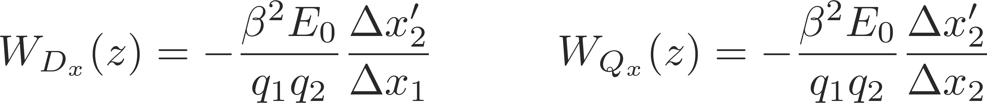
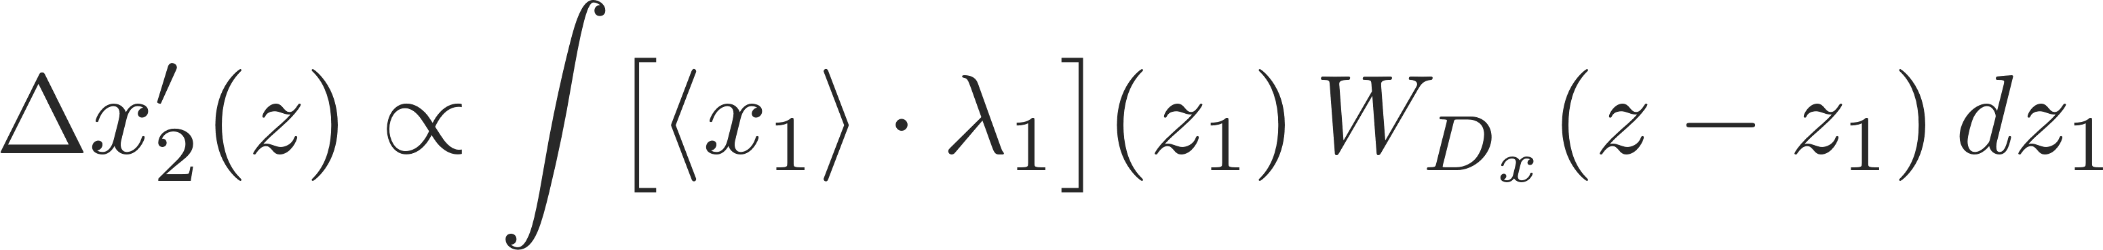
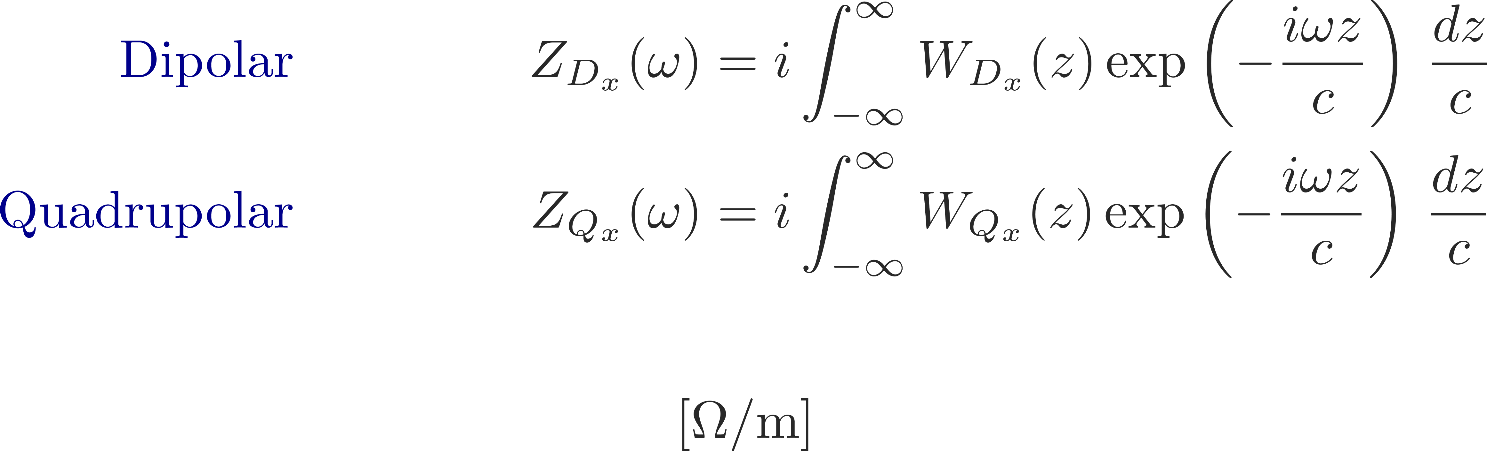
Transverse impedance
  The wake function of an accelerator component is basically its Green function in time domain (i.e., its response to a pulse excitation):
    Very useful for macroparticle models and simulations, because it can be used to describe the driving terms in the single particle equations of motion!
  We can also describe it as a transfer function in frequency domain
    This is the definition of transverse beam coupling impedance of the element under study

Slide 21
We have used the concept of wake fields in the longitudinal and the transverse planes, respectively. We have found that we usually do a decomposition of the wake function to obtain only the leading orders, namely, constant, dipolar and quadrupolar wake fields. We have also introduced the impedance of the frequency domain representation of the wake function.
Before actually looking at the impact of wake fields and impedances on the beam, we will now first study their impact on the environment – in particular, beam induced heating which can be dangerous and even destructive for poorly designed machine elements.
Part 3: Wake fields and impedances – impacts
  Concept of wake fields
  Longitudinal and transverse wake fields and impedances
  Impact of wake fields and impedance on the accelerator environment
  Description of a coherent beam instability and the instability loop

Slide 22
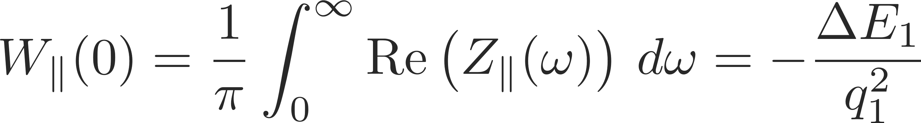
The energy balance
What happens to the energy lost by the source?
  In the global energy balance, the energy lost by the source splits into:
    Electromagnetic energy of the modes that remain trapped in the object
      Partly dissipated on lossy walls or into purposely designed inserts or HOM absorbers
      Partly transferred to following particles (or the same particle over successive turns), possibly feeding into an instability!
    Electromagnetic energy of modes that propagate down the beam chamber (above cut-off), eventually lost on surrounding lossy materials

Slide 23
The energy balance
What happens to the energy lost by the source?
  The energy loss of a particle bunch
    causes beam induced heating of the machine elements (damage, outgassing)
    feeds into both longitudinal and transverse instabilities through the associated EM fields
    is compensated by the RF system determining a stable phase shift
  In the global energy balance, the energy lost by the source splits into:
    Electromagnetic energy of the modes that remain trapped in the object
      Partly dissipated on lossy walls or into purposely designed inserts or HOM absorbers
      Partly transferred to following particles (or the same particle over successive turns), possibly feeding into an instability!
    Electromagnetic energy of modes that propagate down the beam chamber (above cut-off), eventually lost on surrounding lossy materials

Slide 24
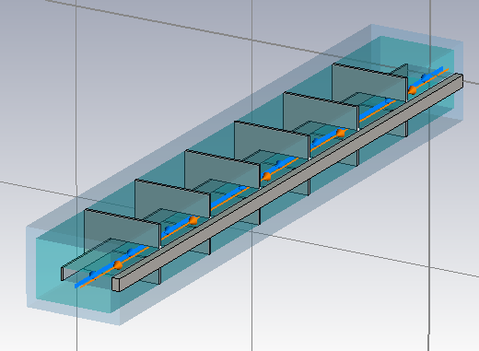
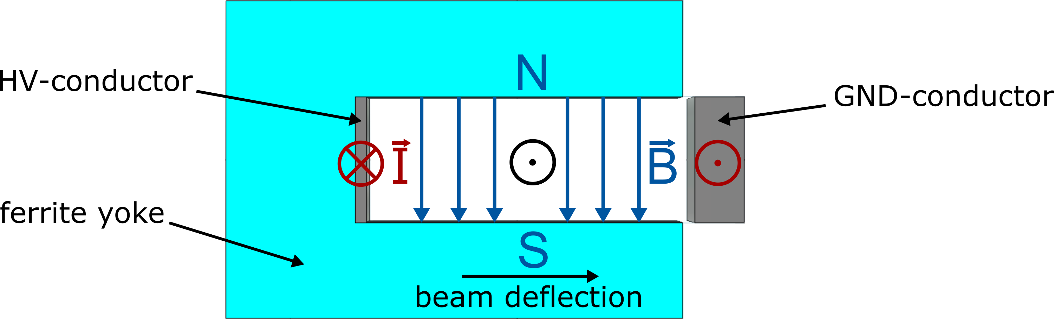
Example: SPS extraction kickers
Problem with SPS extraction kickers (MKE)
  Extraction elements through which the beam passes every turn
    Based on a fast pulsed magnet capable of deflecting the whole beam over one turn
    Active only on turn in which beam has to be extracted, otherwise passive but with all its elements (ferrite, conductors) exposed to the beam
  Use of beam for LHC filling (4x 200-ns spaced trains of 72x 25-ns spaced bunches) led to inacceptable heating of these elements)
    Heating above Curie temperature leads to ferrite degradation → Beam cannot be extracted anymore from the SPS
    Heating causes outgassing and strong pressure rise in the kicker sector, with consequent beam interlocking due to poor vacuum

Slide 25
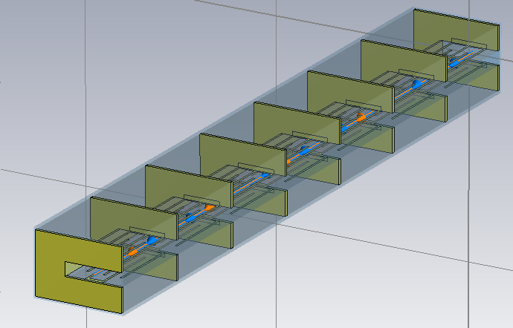
Example: SPS extraction kickers
Two types of SPS extraction kickers (MKE):
  Original design: several modules separated by conductor stripes (segmentation) with bare ferrite blocks, fed by an inner and an outer conductor
  New design: like original, but modules have ‘serigraphed’ ferrite blocks (i.e. with patterns of silver paste screen printed on the ferrite surface exposed to the beam)
Original kicker Serigraphed kicker

Slide 26
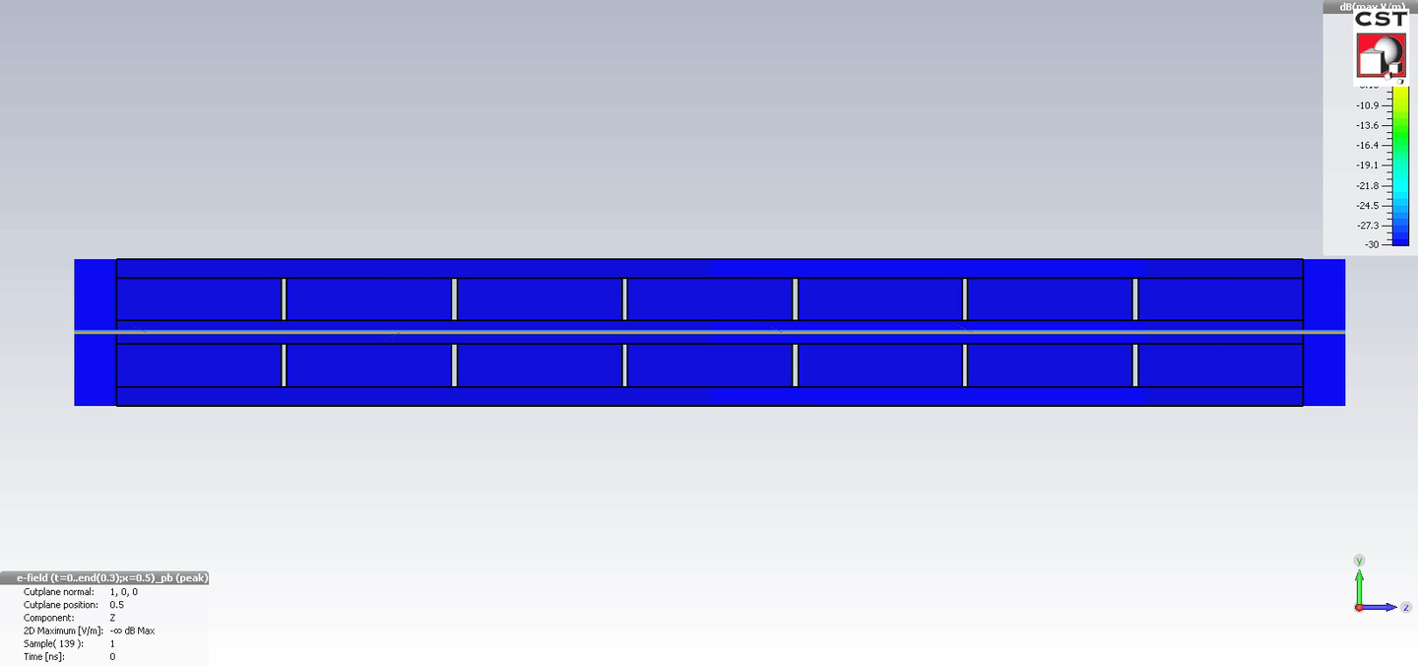
Examples: ferrite kicker – simple model
  Original kicker without serigraphy, typical broad-band behaviour, here some ringing is due to the longitudinal segmentation

Slide 27
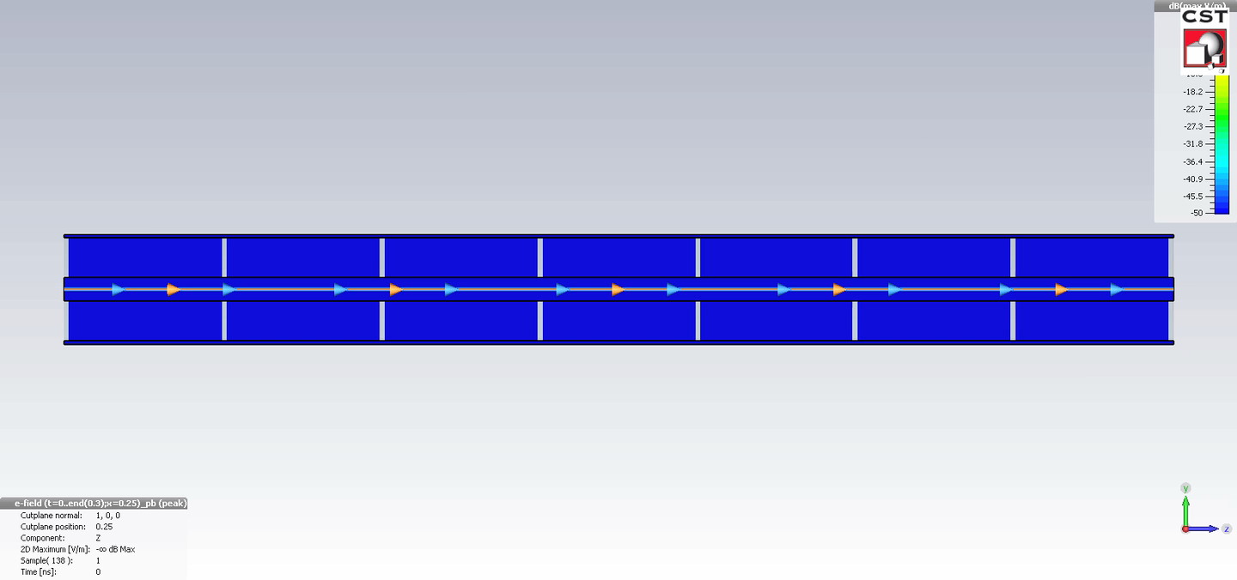
Examples: serigraphed kicker – simple model
  Serigraphed kicker exhibits strong ringing due to the EM trapping along the serigraphy fingers

Slide 28
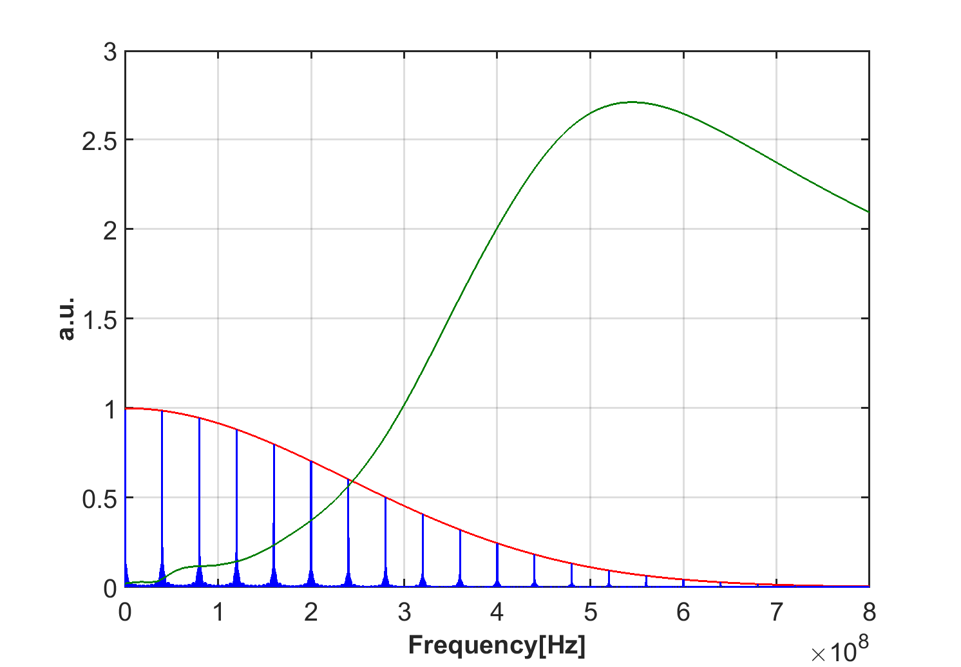
Examples: Serigraphy impact
The energy loss of the beam to the kicker structure is given by the overlap of the impedance with the power beam spectrum
Kicker impedance already becomes significant at frequencies for which the beam spectrum has not fully decayed, causing the undesired heating
We need to lower the kicker impedance → Impedance dominated by losses in ferrite → ferrite shielding

Slide 29
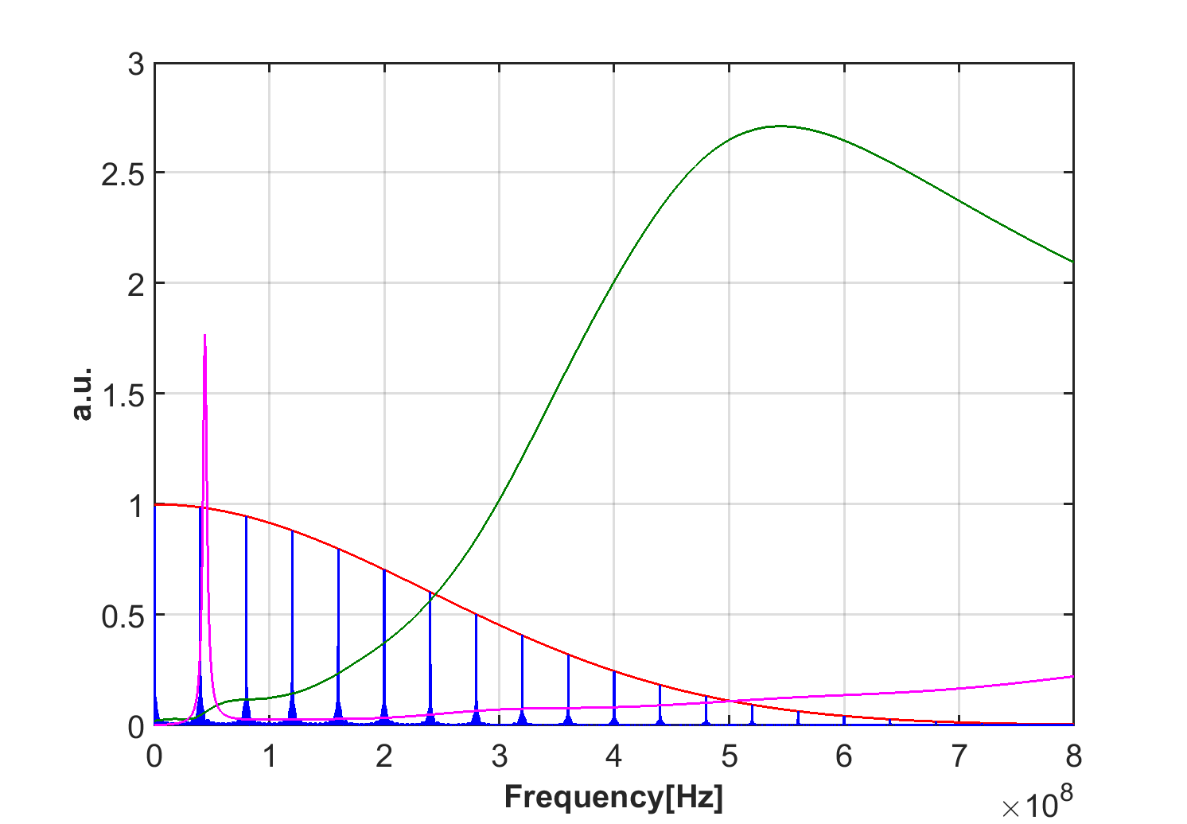
Examples: Serigraphy impact
Print striped pattern of good conductor on ferrite (serigraphy)
The energy loss of the beam to the kicker structure is given by the overlap of the impedance with the power beam spectrum
This almost suppresses the impedance over the bunch spectrum
It however introduces a low frequency peak, which needs to be kept far from beam spectral lines → pay attention to do that for all needed bunch spacing

Slide 30
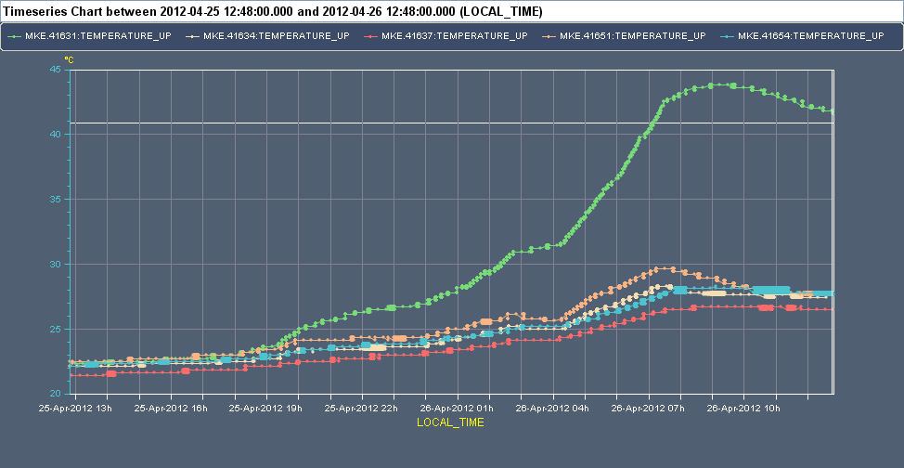



Examples: Serigraphy impact
~ 17h run with 25 ns beams at 26 GeV after technical stop

Slide 31
How are wakes and impedances computed?
Analytical or semi-analytical approach, when geometry is simple (or simplified)
  Solve Maxwell’s equations with the correct source terms, geometries and boundary conditions up to an advanced stage (e.g. resistive wall for axisymmetric chambers)
  Find closed expressions or execute the last steps numerically to derive wakes and impedances
Numerical approach
  Different codes have been developed over the years to solve numerically Maxwell’s equations in arbitrarily complicated structures
  Examples are CST Studio Suite (Particle Studio, Microwave Studio), ABCI, GdFidL, HFSS, ECHO2(3)D. Exhaustive list can be found from the program of the ICFA mini-Workshop on “Electromagnetic wake fields and impedances in particle accelerators”, Erice, Sicily, 23-28 April, 2014
Bench measurements based on transmission/reflection measurements with stretched wires
  Seldom used independently to assess impedances, usefulness mainly lies in that they can be used for validating 3D EM models for simulations

Slide 32
We have seen how the impedance of a device can have an impact on the machine environment and cause, for example, beam induced heating. This can lead to outgassing or damage of a device. Therefore, devices need to be carefully designed in order to minimize their impedance.
Impedances also have a direct impact on a passing beam. This can lead to impedance induced beam instabilities. We will now first understand the basic concept and mechanism of beam instabilities.
Part 3: Wake fields and impedances – impacts
  Concept of wake fields
  Longitudinal and transverse wake fields and impedances
  Impact of wake fields and impedance on the accelerator environment
  Description of a coherent beam instability and the instability loop

Slide 33
Why worry about beam instabilities?
Why study beam instabilities?
  The onset of a beam instability usually determines the maximum beam intensity that a machine can store/accelerate (performance limitation)
  Understanding the type of instability limiting the performance, and its underlying mechanism, is essential because it:
    Allows identifying the source and possible measures to mitigate/suppress the effect
    Allows dimensioning an active feedback system to prevent the instability

Slide 34
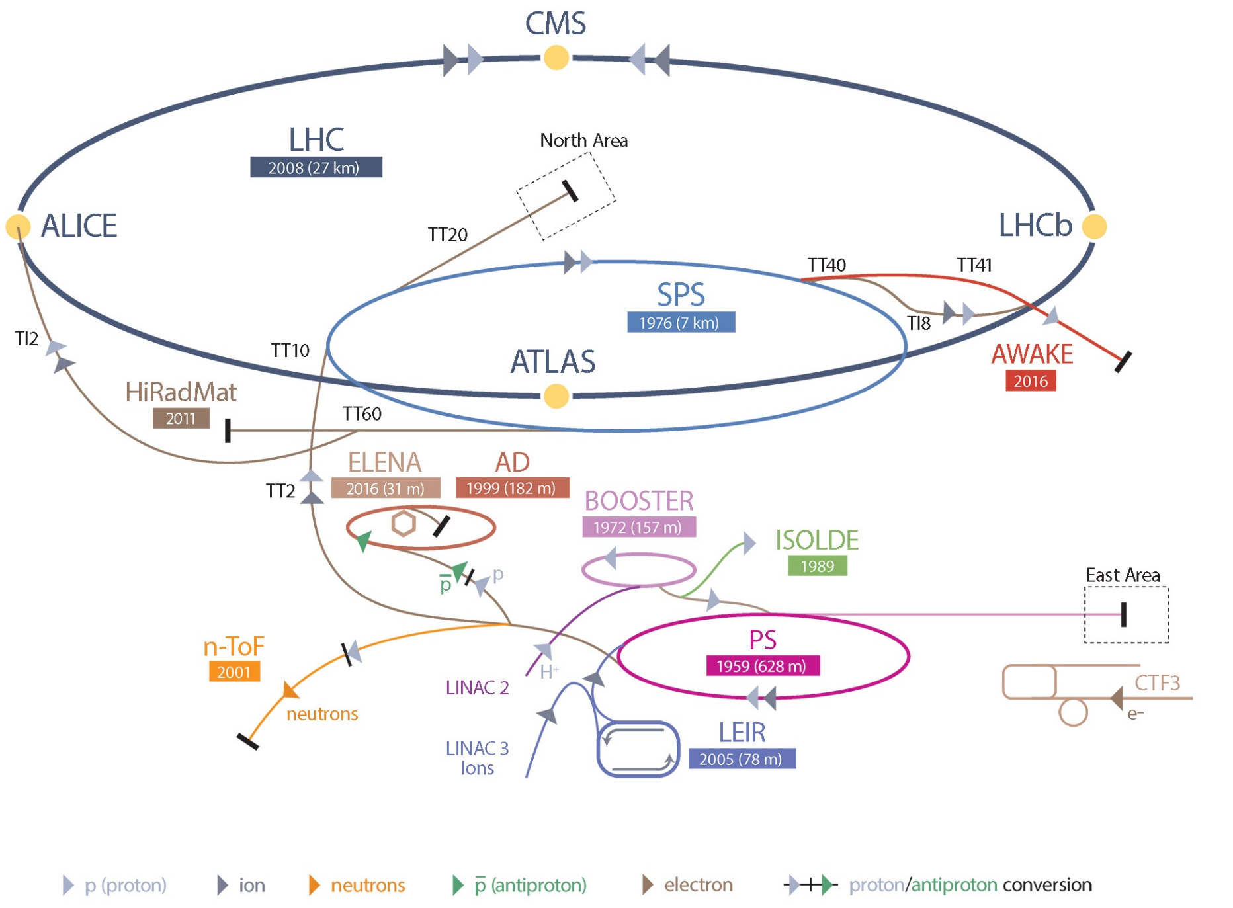
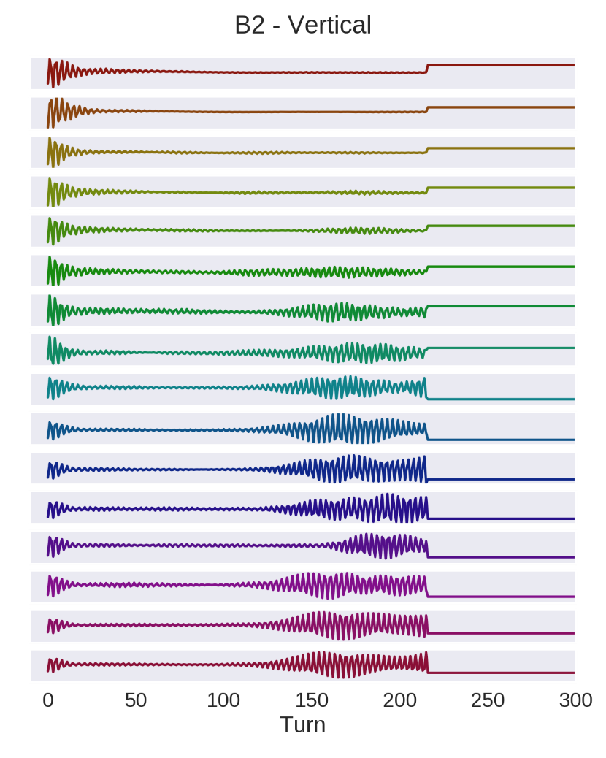
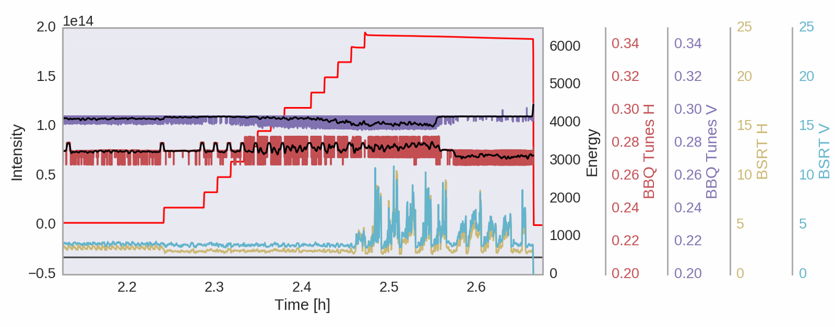
Instabilities seen from the control room
2015 – scrubbing run
2015 – coupling correction

Slide 35
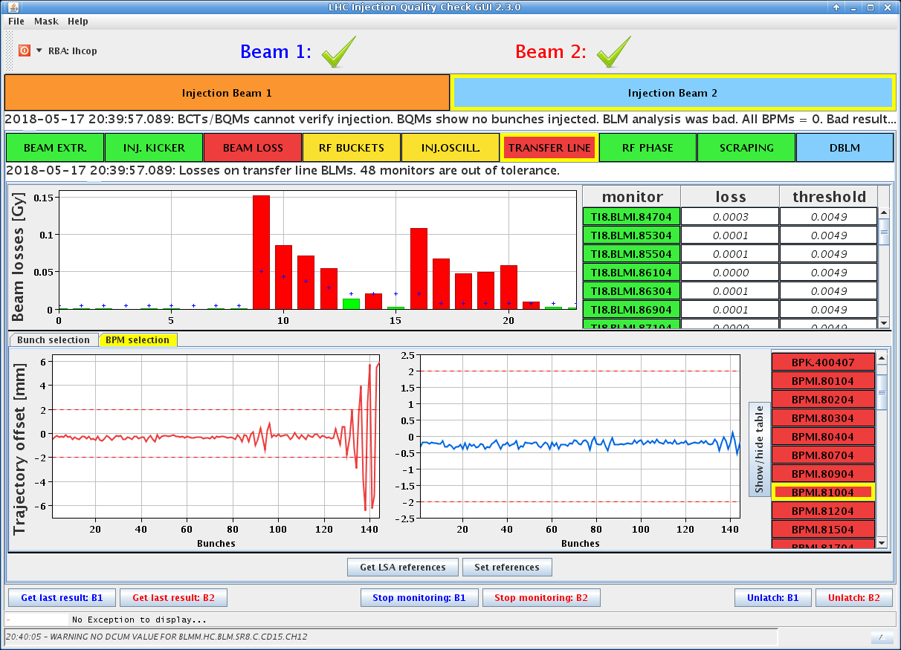
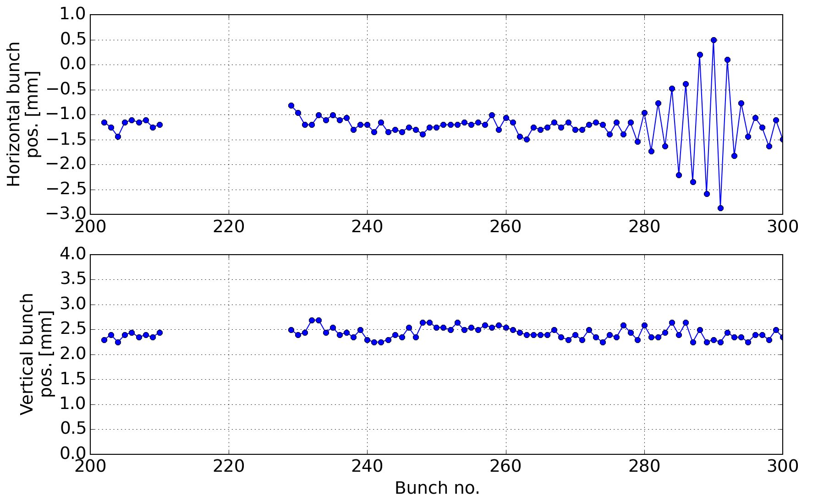
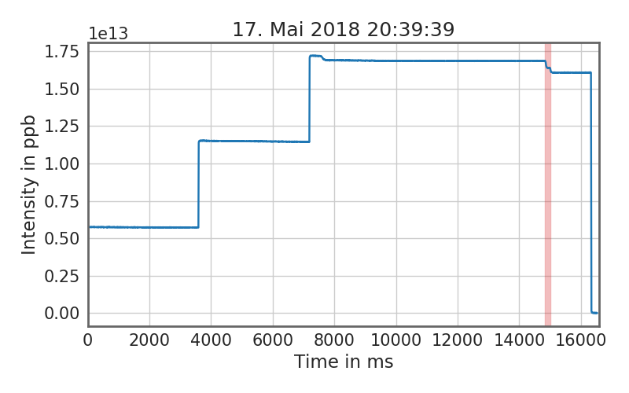
Instabilities seen from the control room
2018 – operations; TL instability

Slide 36

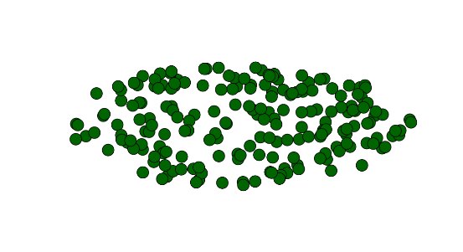
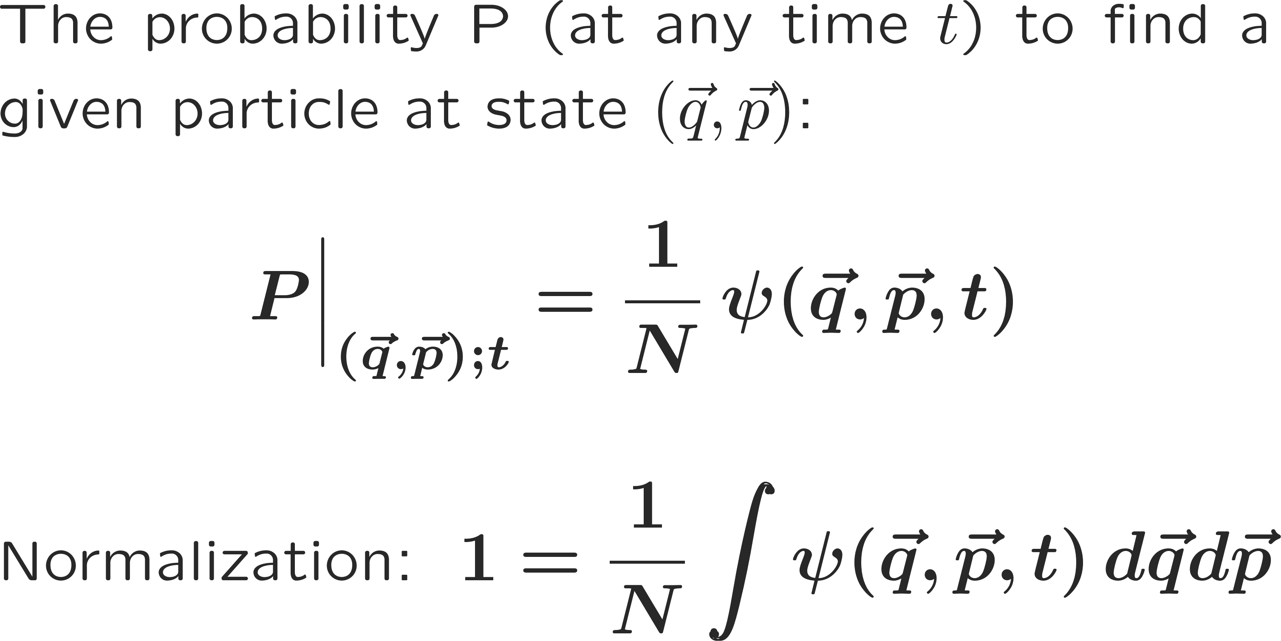


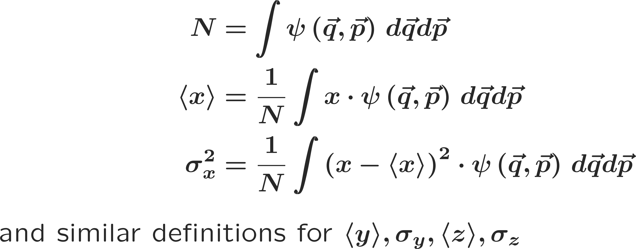
What is a beam instability?
A beam becomes unstable when a moment of its distribution exhibits an exponential growth (e.g. mean positions, standard deviations, etc.), resulting into beam loss or emittance growth!

Slide 37
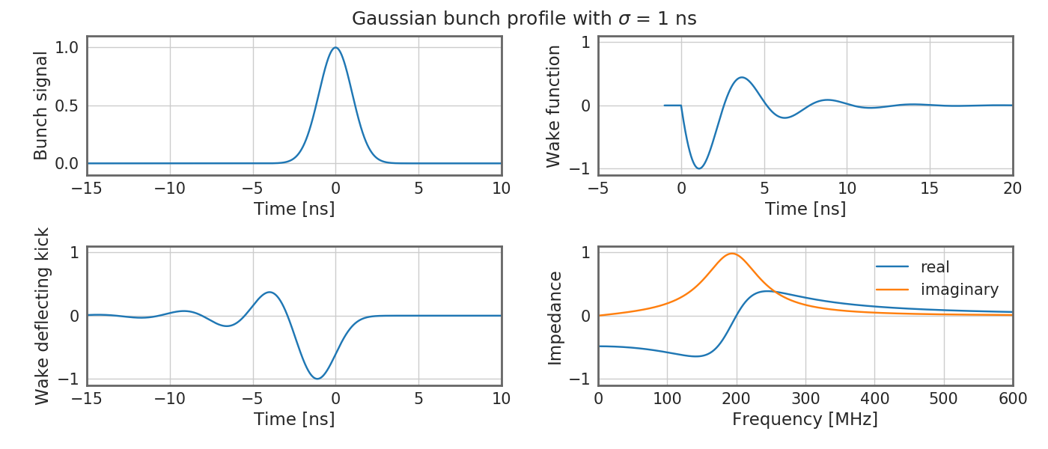
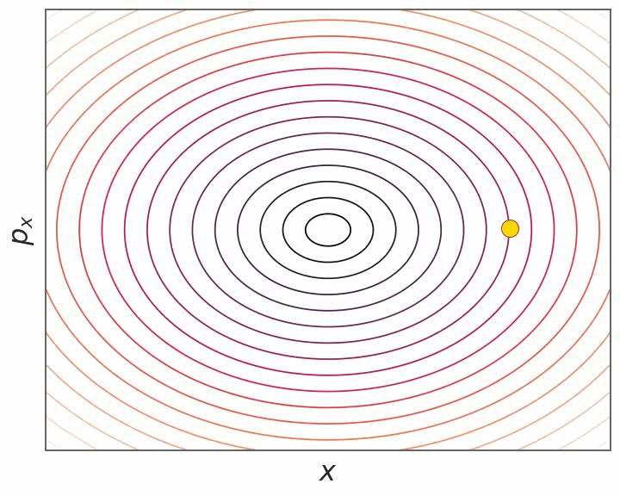
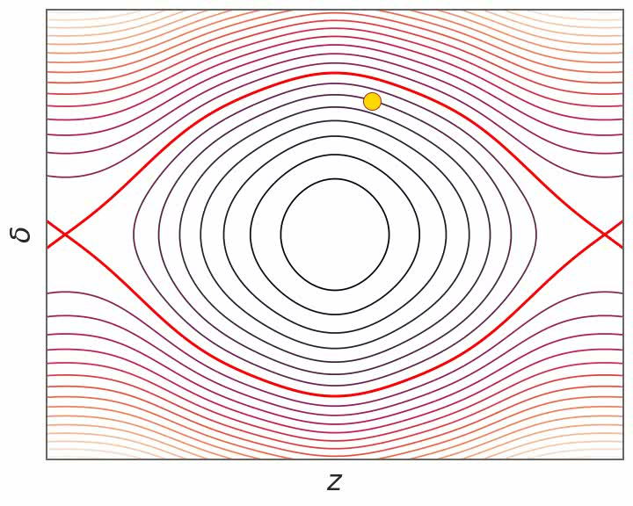
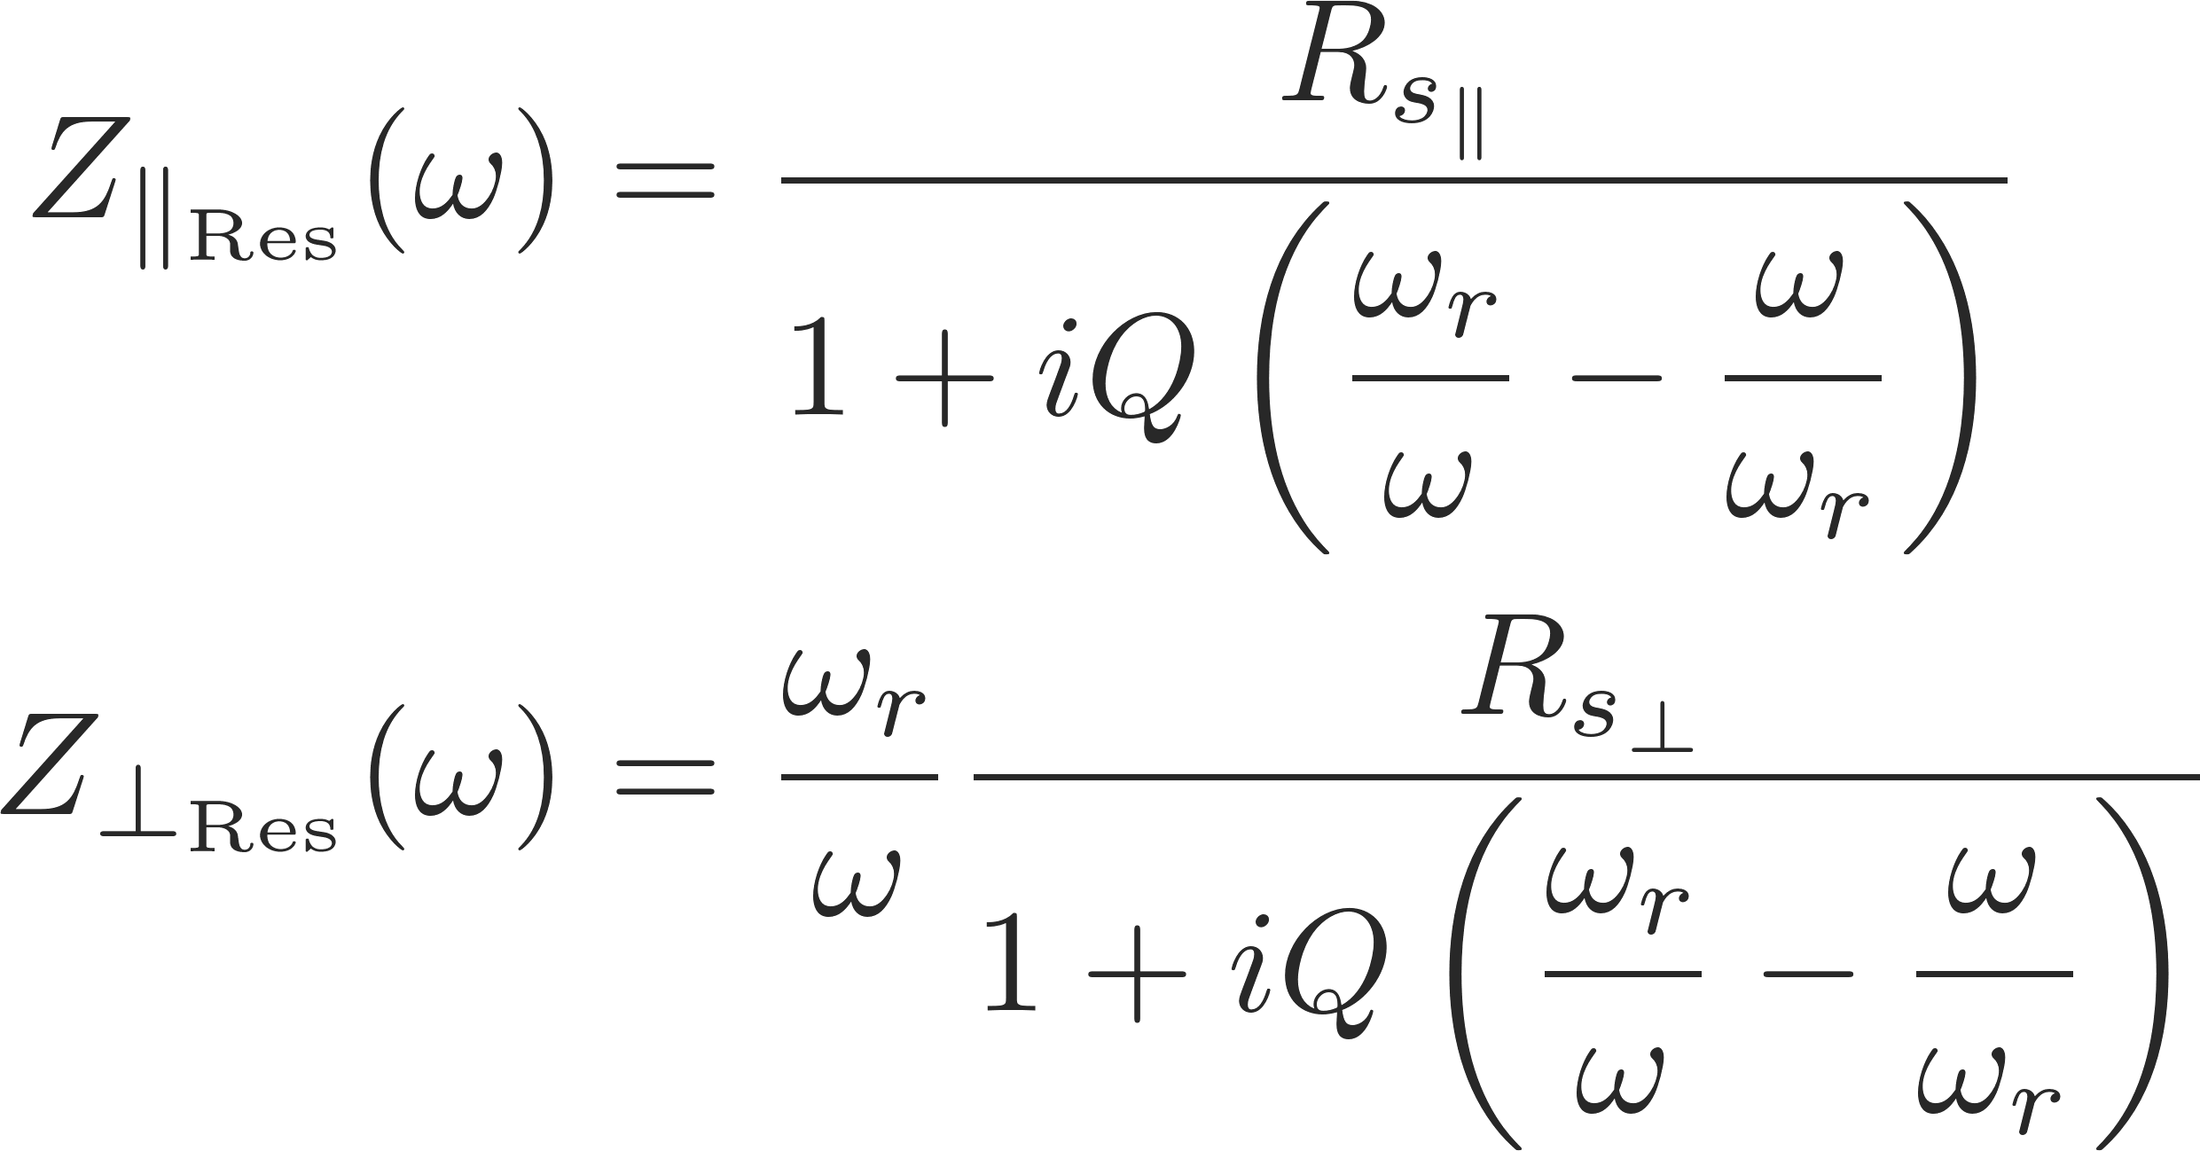
Examples: broadband resonator
Wakefields and/or impedances can be computed by using Maxwell’s equations to compute the impulse response for a given structure either in time domain or in frequency domain respectively.
Some examples of impedances computed in the ultra-relativistic limit are:
  Resonator impedance
  If betatron and synchrotron motion and wakefields manage to synchronize such that they get into resonance, a distinct bunch oscillation pattern will be excited – a so called bunch mode. The coherent bunch/beam signal will grow exponentially.
  This can be either a single bunch mode…

Slide 38
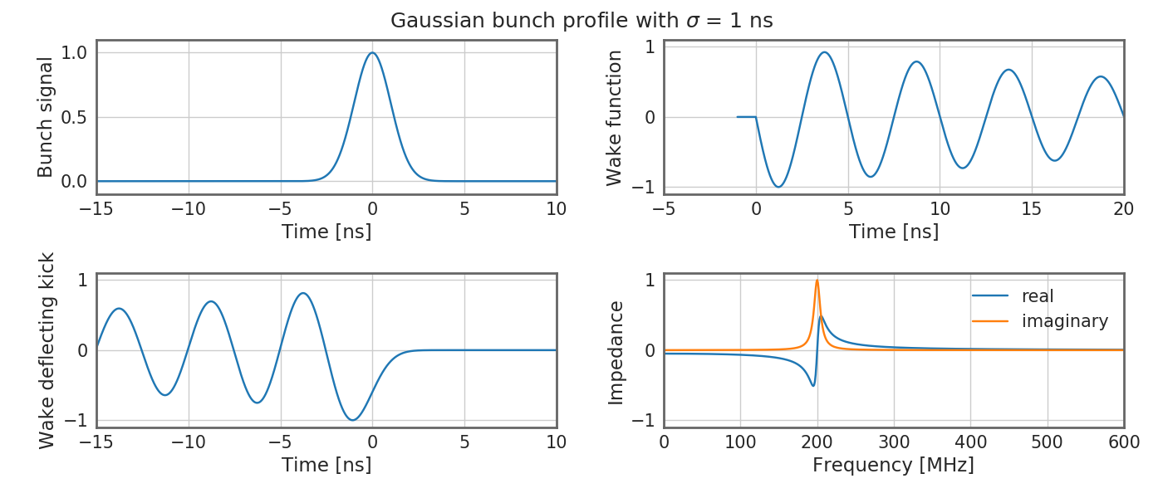
Examples: narrowband resonator
Wakefields and/or impedances can be computed by using Maxwell’s equations to compute the impulse response for a given structure either in time domain or in frequency domain respectively.
Some examples of impedances computed in the ultra-relativistic limit are:
  Resonator impedance
  If betatron and synchrotron motion and wakefields manage to synchronize such that they get into resonance, a distinct bunch oscillation pattern will be excited – a so called bunch mode. The coherent bunch/beam signal will grow exponentially.
  This can be either a single bunch mode…
  … or a coupled bunch mode

Slide 39
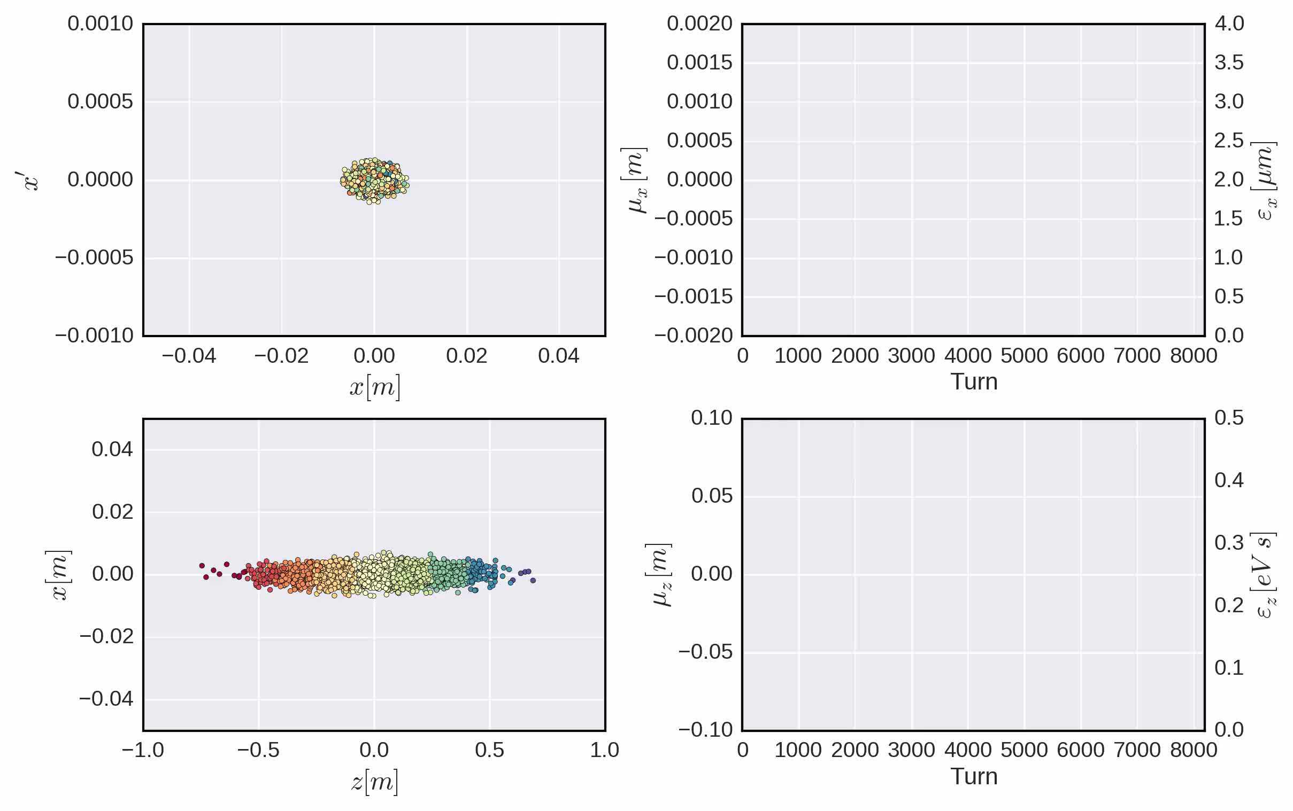
What is a beam instability?
A beam becomes unstable when a moment of its distribution exhibits an exponential growth (e.g. mean positions, standard deviations, etc.), resulting into beam loss or emittance growth!

Slide 40
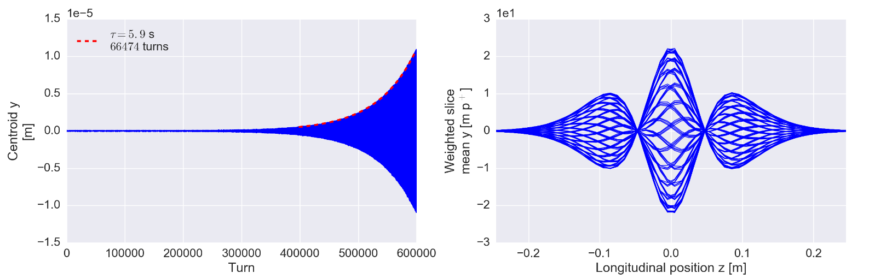
What is a beam instability?
A beam becomes unstable when a moment of its distribution exhibits an exponential growth (e.g. mean positions, standard deviations, etc.), resulting into beam loss or emittance growth!

Slide 41
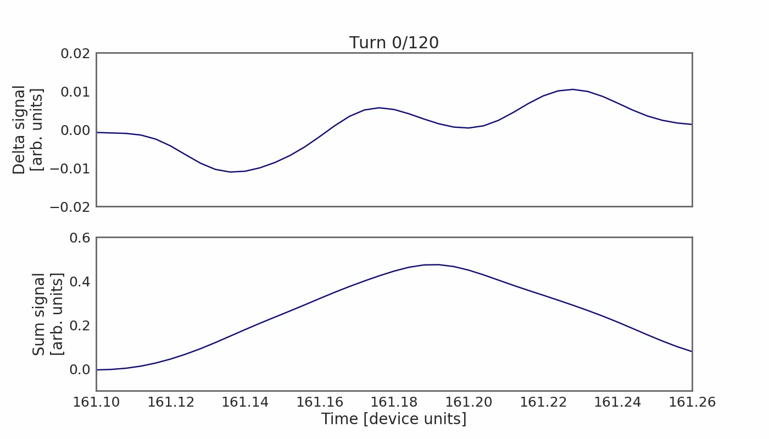
Examples: narrowband resonator
Wakefields and/or impedances can be computed by using Maxwell’s equations to compute the impulse response for a given structure either in time domain or in frequency domain respectively.
Some examples of impedances computed in the ultra-relativistic limit are:
  Resonator impedance
  If betatron and synchrotron motion and wakefields manage to synchronize such that they get into resonance, a distinct bunch oscillation pattern will be excited – a so called bunch mode. The coherent bunch/beam signal will grow exponentially.
  This can be either a single bunch mode…
  … or a coupled bunch mode

Slide 42
The instability loop
Multi-bunch beam
s
Equations of motion of the beam particles
Interaction with the external environment
Additional electromagnetic field acting on the beam, besides RF and external magnetic fields

Slide 43
The instability loop
Multi-bunch beam
s
Equations of motion of the beam particles
Interaction with the external environment
Additional electromagnetic field acting on the beam, besides RF and external magnetic fields
When the loop closes, either the beam will find a new stable equilibrium configuration …

Slide 44
The instability loop
Multi-bunch beam
s
Equations of motion of the beam particles
Interaction with the external environment
Additional electromagnetic field acting on the beam, besides RF and external magnetic fields
… or it might develop an instability along the bunch train …

Slide 45
The instability loop
Multi-bunch beam
s
Equations of motion of the beam particles
Interaction with the external environment
Additional electromagnetic field acting on the beam, besides RF and external magnetic fields
… or also an instability affecting different bunches independently of each other

Slide 46
The instability loop – knobs to preserve beam stability…
Act on the right side of the loop
→ Minimise the creation of EM fields potentially detrimental to the beam
Multi-bunch beam
s
Equations of motion of the beam particles
Interaction with the external environment
This will translate eventually into reducing/controlling/optimising the impedance of the single components of an accelerator ring
Additional electromagnetic field acting on the beam, besides RF and external magnetic fields

Slide 47
The instability loop – knobs to preserve beam stability…
Act on the left side of the loop
→ Introduce stabilising terms in the equations of motion
Multi-bunch beam
s
Equations of motion of the beam particles
Interaction with the external environment
This will translate eventually adding cooling/damping terms or nonlinear driving terms that can provide stabilisation of the system
Additional electromagnetic field acting on the beam, besides RF and external magnetic fields

Slide 48
The instability loop – knobs to preserve beam stability…
Multi-bunch beam
s
… or we actively create another loop in which we first detect a selected moment of the beam distribution and we then kick the particles accordingly to cancel deviations from the desired steady state
Equations of motion of the beam particles
Interaction with the external environment
Additional electromagnetic field acting on the beam, besides RF and external magnetic fields
Kick beam particles
Detect
moments

Slide 49
We have seen some examples of analytically expressible wake fields and impedances, namely resonator and resistive wall wakes. We have learned that impedances can have a detrimental impact on both the machine environment as well as the beam itself. In the first case, impedances can lead to beam induced heating, in the latter to coherent beam instabilities.
A careful design of machine elements to minimize the impedance is therefore necessary.
After having introduced the instability loop, in the next lecture we will be looking more in detail at examples of different types of instabilities.
Part 3: Wake fields and impedances – impacts
  Concept of wake fields
  Longitudinal and transverse wake fields and impedances
  Impact of wake fields and impedance on the accelerator environment
  Description of a coherent beam instability and the instability loop

Slide 50

End part 3

Slide 52
Backup slides

Slide 53
We have used the concept of wake fields in the longitudinal and the transverse planes, respectively. We have found that we usually do a decomposition of the wake function to obtain only the leading orders, namely, constant, dipolar and quadrupolar wake fields. We have also introduced the impedance of the frequency domain representation of the wake function.
We will now study some more properties of wake fields and show some typical examples of wake fields and impedances for which an analytical expression exists.
Part 3: Wake fields and impedances – impacts
  Longitudinal and transverse wake fields and impedances
  Panofsky-Wenzel theorem
  Examples of analytically expressible wake functions and impedances
  Impact of wake fields and impedance on the accelerator environment
  Description of a coherent beam instability and the instability loop

Slide 54
We have briefly discussed the Panofsky-Wenzel theorem and looked at analytical expressions for the resistive wall and resonator impedances. We have seen the different between short range and long range wake fields and understood how these can lead to single or coupled bunch instabilities.
Before actually looking at the impact of wake fields and impedances on the beam, we will now first study their impact on the environment – in particular, beam induced heating which can be dangerous and even destructive for poorly designed machine elements.
Part 3: Wake fields and impedances – impacts
  Longitudinal and transverse wake fields and impedances
  Panofsky-Wenzel theorem
  Examples of analytically expressible wake functions and impedances
  Impact of wake fields and impedance on the accelerator environment
  Description of a coherent beam instability and the instability loop

Slide 55
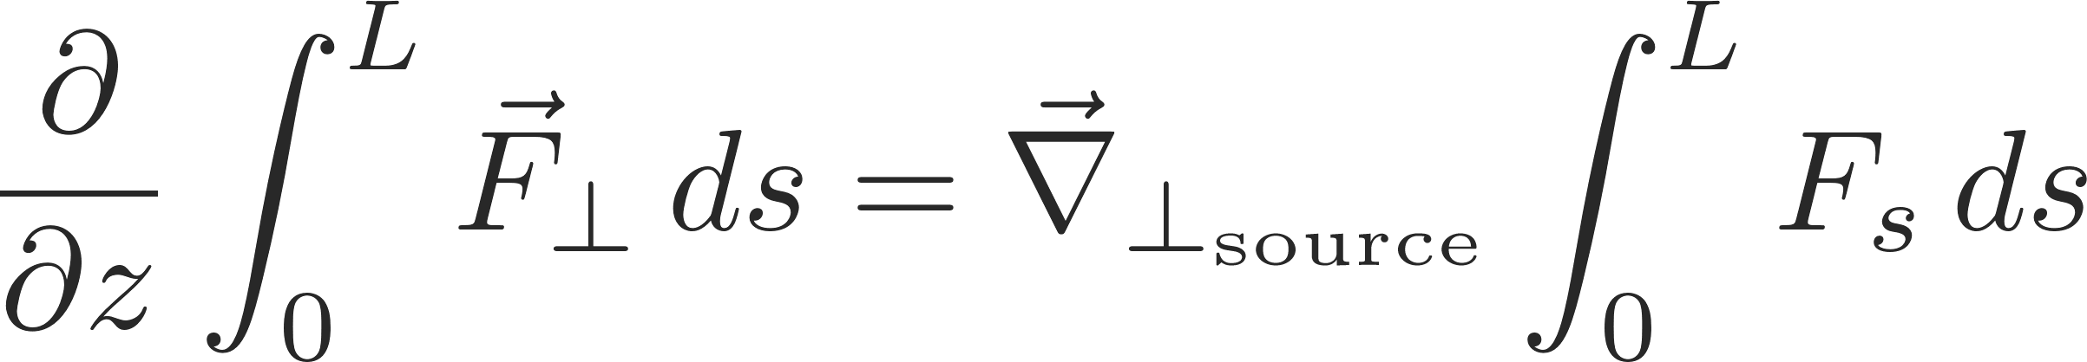
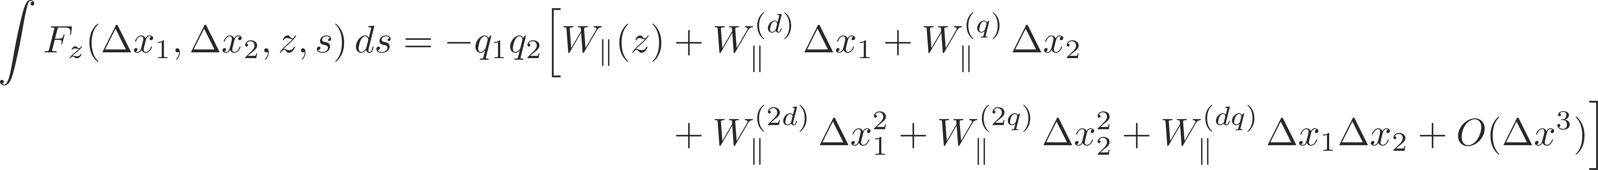
Panofsky-Wenzel Theorem
Longitudinal and transverse wake fields and impedances are tightly related via Maxwell’s equations by means of the Panofsky-Wenzel theorem, which states that:
Remembering that:

Slide 56
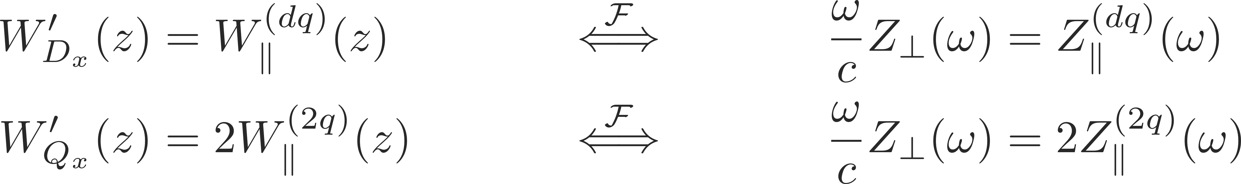
Panofsky-Wenzel Theorem
Longitudinal and transverse wake fields and impedances are tightly related via Maxwell’s equations by means of the Panofsky-Wenzel theorem, which states that:
Remembering that:
It follows for the longitudinal and transverse wake fields and impedances that:
The longitudinal and transverse wake functions are not independent, although in general no relation can be established between W||(z) and W_{Dx, Dy}(z), which are the main wakes in the longitudinal and transverse planes, respectively.

Slide 57
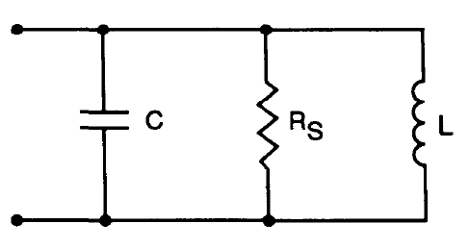
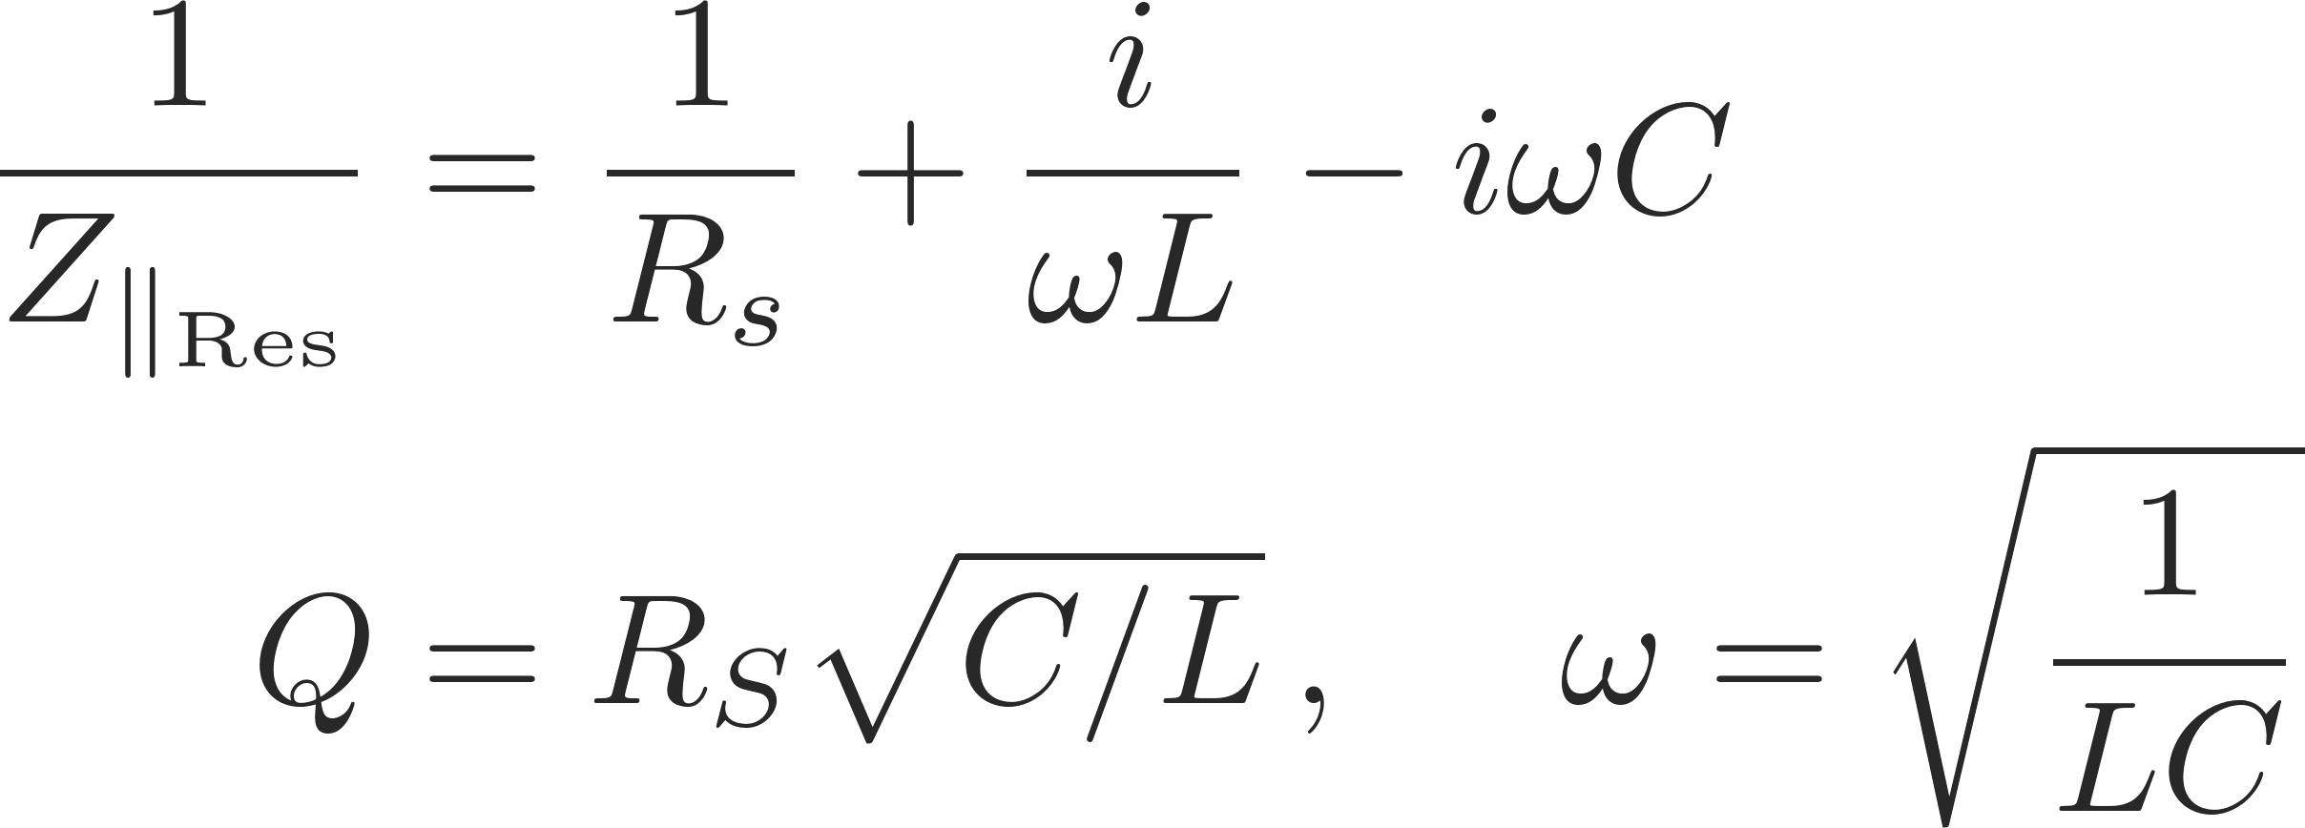
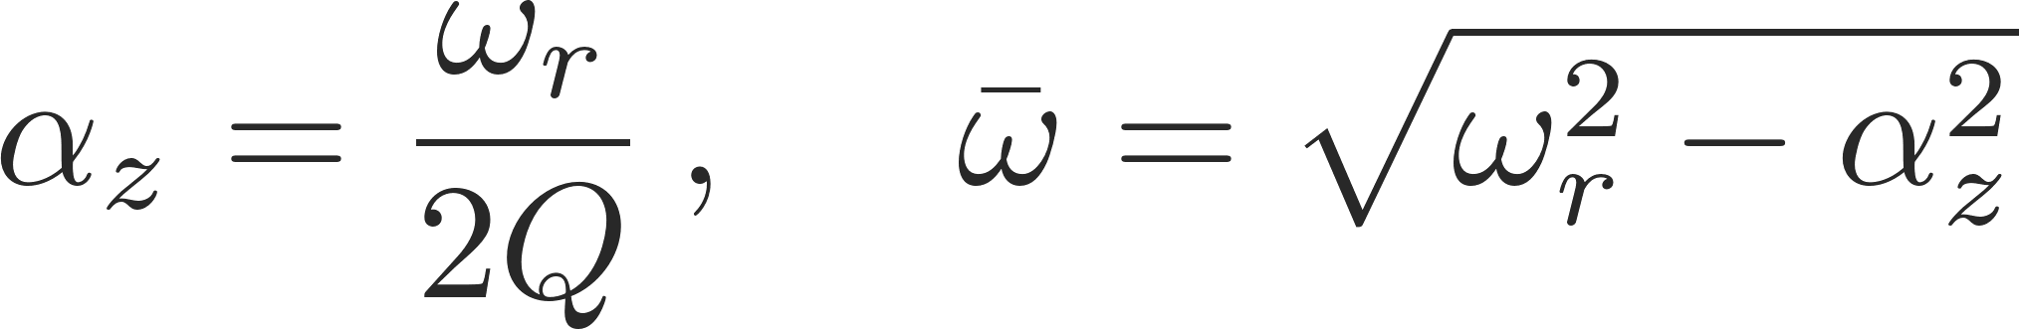
Examples: resonator wakes
Wakefields and/or impedances can be computed by using Maxwell’s equations to compute the impulse response for a given structure either in time domain or in frequency domain, respectively.
Some examples of impedances computed in the ultra-relativistic limit are:
  Resonator impedance

Slide 58
Examples: broadband resonator
Wakefields and/or impedances can be computed by using Maxwell’s equations to compute the impulse response for a given structure either in time domain or in frequency domain respectively.
Some examples of impedances computed in the ultra-relativistic limit are:
  Resonator impedance

Slide 59
Examples: broadband resonator
Wakefields and/or impedances can be computed by using Maxwell’s equations to compute the impulse response for a given structure either in time domain or in frequency domain respectively.
Some examples of impedances computed in the ultra-relativistic limit are:
  Resonator impedance
  Broadband resonator wake:
    Fast decaying fields – short range, mostly single bunch effect. Whether centroid or intra-bunch motion is excited is determined by the resonator frequency and bunch length.

Slide 60
Examples: narrowband resonator
Wakefields and/or impedances can be computed by using Maxwell’s equations to compute the impulse response for a given structure either in time domain or in frequency domain respectively.
Some examples of impedances computed in the ultra-relativistic limit are:
  Resonator impedance

Slide 61
Examples: narrowband resonator
Wakefields and/or impedances can be computed by using Maxwell’s equations to compute the impulse response for a given structure either in time domain or in frequency domain respectively.
Some examples of impedances computed in the ultra-relativistic limit are:
  Resonator impedance
  Broadband resonator wake:
    Slowly decaying fields – long range, coupled bunch effect. Whether coupled centroid or intra-bunch motion is excited is determined by the resonator frequency, bunch spacing and bunch length.

