Slide 1
A first taste of
Non-Linear Beam Dynamics
Hannes Bartosik
Accelerator and Beam Physics group
Beams Department
CERN
CERN Accelerator School
Introduction to Accelerator Physics 2022
Kaunas, Lithuania
18 September – 1 October 2022

Slide 2
Copyright statement and speaker’s release for video publishing
The author consents to the photographic, audio and video recording of this lecture at the CERN Accelerator School. The term “lecture” includes any material incorporated therein including but not limited to text, images and references.
The author hereby grants CERN a royalty-free license to use his image and name as well as the recordings mentioned above, in order to post them on the CAS website.
The author hereby confirms that to his best knowledge the content of the lecture does not infringe the copyright, intellectual property or privacy rights of any third party. The author has cited and credited any third-party contribution in accordance with applicable professional standards and legislation in matters of attribution. Nevertheless the material represent entirely standard teaching material known for more than ten years. Naturally some figures will look alike those produced by other teachers.

Slide 3
Disclaimer
These lectures are largely based on the lectures of A. Wolski (University of Liverpool) from the CAS 2016 on “Introduction to Accelerator Physics” at Budapest, and on the lectures of Y. Papaphilippou on “A first taste of Non-Linear Beam Dynamics” from the CAS 2019 on “Introduction to Accelerator Physics” at Vysoké Tatry.

Slide 4
Purpose of the lecture
Introducing aspects of non-linear dynamics
  Mathematical tools for modelling nonlinear dynamics
    Power series (Taylor) maps and symplectic maps
  Eﬀects of nonlinear perturbations
    Resonances, tune shifts, dynamic aperture
  Analysis methods
    Normal forms, frequency map analysis
Employ two types of accelerator systems for illustrating methods and tools
  Bunch compressor (single-pass system)
  Storage ring (multi-turn system)

Slide 5
Aim of the 2nd Lecture
Describe some of the phenomena associated with nonlinearities in periodic beamlines (such as storage rings)
Explain signiﬁcance of symplectic maps, and describe some of the challenges in calculating and applying symplectic maps
Outline some of the analysis methods that can be used to characterise nonlinear beam dynamics in periodic beamlines.

Slide 6
Example of a
periodic system:
a simple storage ring

Slide 7
A simple storage ring
As example, consider the transverse dynamics in a simple storage ring, assuming:
  The storage ring is constructed from some number of identical cells consisting of dipoles, quadrupoles and sextupoles.
  The phase advance per cell can be tuned from close to zero, up to about 0.5×2π.
  There is one sextupole per cell, which is located at a point where the horizontal beta function is 1 m, and the alpha function is zero.
  Usually, storage rings will contain (at least) two sextupoles per cell, to correct horizontal and vertical chromaticity. To keep things simple, we will use only one sextupole per cell.

Slide 8
Linear dynamics in a storage ring
The chromaticity, and hence the sextupole strength, will normally be a function of the phase advance
To investigate the nonlinear eﬀects of sextupoles, we shall keep the sextupole strength ﬁxed, and change only the phase advance
We can assume that the map from one sextupole to the next is linear, and corresponds to a rotation in phase space through an angle equal to the phase advance:
Again to keep things simple, we shall consider only horizontal motion, and assume that the vertical co-ordinate
In the “thin lens” approximation, the deﬂection of a particle passing through the sextupole of length is

Slide 9
Nonlinear transfer map: sextupole
The map for a particle moving through a short sextupole can be represented by a “kick” in the horizontal momentum:
Let us choose a ﬁxed value , and look at the eﬀects of the maps for diﬀerent phase advances.
For each case, we construct a phase space portrait by plotting the values of the dynamical variables after repeated application of the map (rotation + sextupole) for a range of initial conditions.
First, let us look at the phase space portraits for a range of phase advances from 0.2 × 2π to 0.5 × 2π

Slide 10
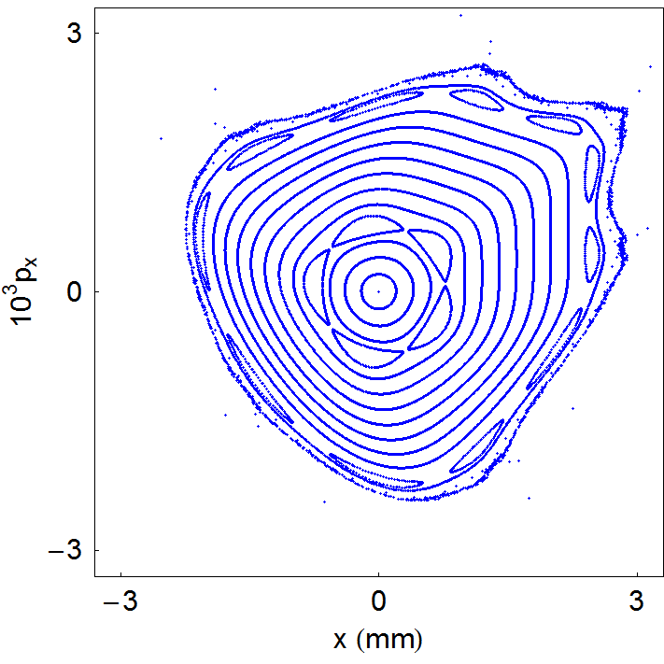
Example of a simple storage ring

Slide 11
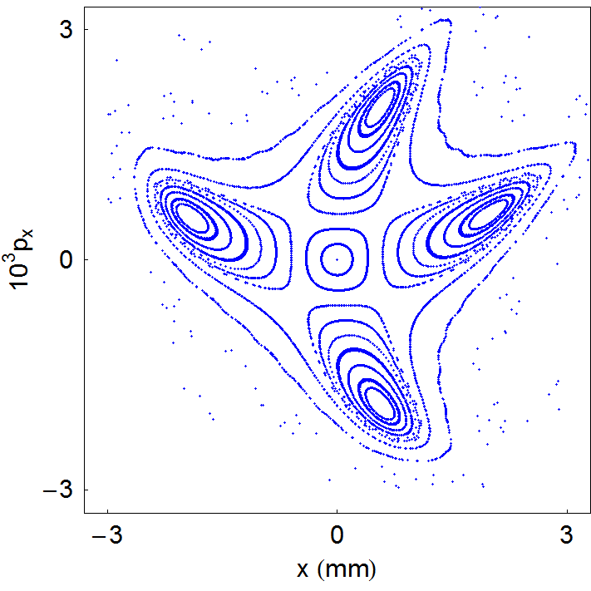
Example of a simple storage ring

Slide 12
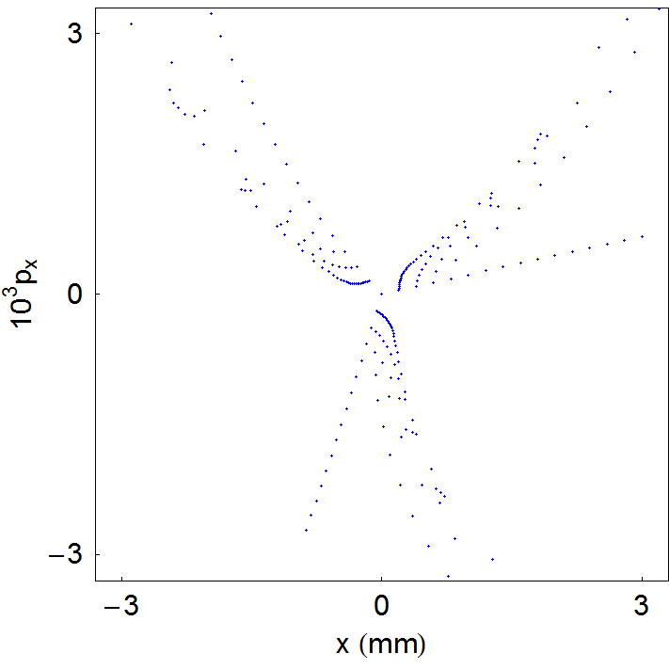
Example of a simple storage ring

Slide 13
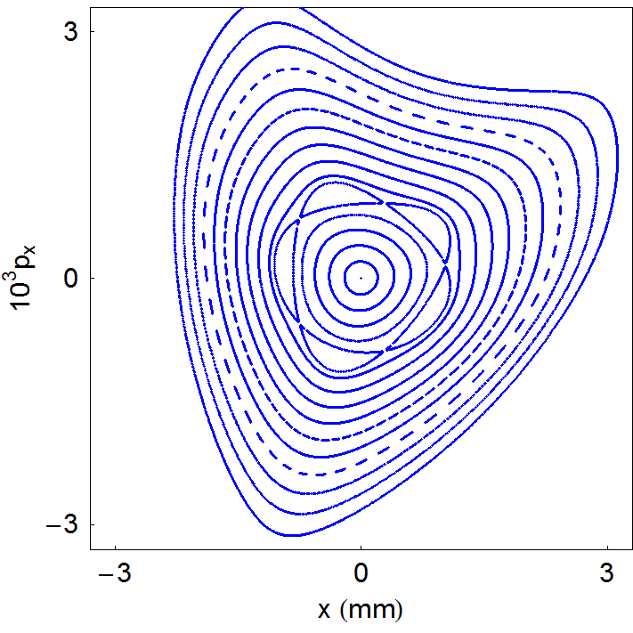
Example of a simple storage ring

Slide 14
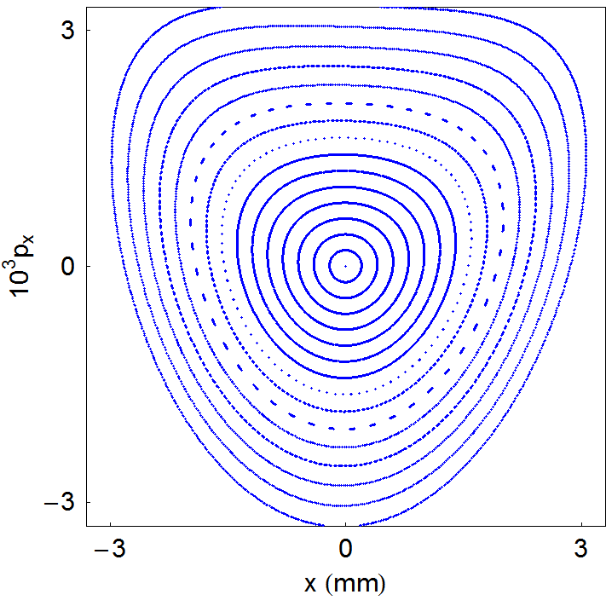
Example of a simple storage ring

Slide 15
Some observations
There are some interesting features in these phase space portraits to which it is worth drawing attention:
  For small amplitudes (small x and p_{x}), particles trace out closed loops around the origin: this is what we expect for a linear map
  As the amplitude is increased, “islands” appear in phase space: the phase advance (for the linear map) is often close to m/p where m is an integer and p is the number of islands
  Sometimes, a larger number of islands appears at larger amplitude
  Usually, there is a closed curve that divides a region of stable motion from a region of unstable motion. Outside that curve, the amplitude of particles increases without limit as the map is repeatedly applied
  The area of the stable region depends strongly on the phase advance: for a phase advance close to 2π/3, it appears that the stable region almost vanishes altogether
  As the phase advance is increased towards π, the stable area becomes large, and distortions from the linear ellipse become small

Slide 16
Eﬀect of phase advance on nonlinear dynamics

Slide 17
Effect of phase advance
An important observation is that the eﬀect of the sextupole in the periodic cell depends strongly on the phase advance across the cell
We can start to understand the signiﬁcance of the phase advance by considering two special cases:
  Phase advance equal to an integer times 2π
  Phase advance equal to a half integer times 2π

Slide 18
Integer tune
  Let us consider ﬁrst a phase advance equal to an integer times 2π. In that case, the linear part of the map is just the identity
The combined eﬀect of the linear map and the sextupole kick is:
Clearly, the horizontal momentum will increase without limit
There are no stable regions of phase space, apart from

Slide 19
Half-Integer tune
Now consider what happens if the phase advance of a cell is a half integer times 2π, so the linear part of the map is just a rotation through π
If a particle starts at the entrance of a sextupole with and , then at the exit of that sextupole:
Then, after passing to the entrance of the next sextupole, the co-ordinates will be:

Slide 20
Half-Integer tune
Finally, on passing through the second sextupole:
In other words, the momentum kicks from the two sextupoles cancel each other exactly
The resulting map is a purely linear phase space rotation by π.
In this situation, we expect the motion to be stable (and periodic), no matter what the amplitude

Slide 21
Impact of phase advance
The eﬀect of the phase advance on the sextupole “kicks” is similar to the eﬀect on perturbations arising from dipole and quadrupole errors in a storage ring
In the case of dipole errors, the kicks add up if the phase advance is an integer, and cancel if the phase advance is a half integer

Slide 22
Impact of phase advance
In the case of quadrupole errors, the kicks add up if the phase advance is a half integer times 2π
Higher-order multipoles drive higher-order resonances but the eﬀects are less easily illustrated on a phase space diagram

Slide 23
Resonances

Slide 24
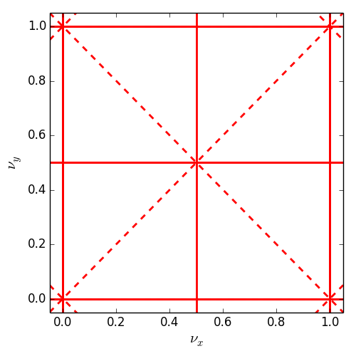
Resonances
If we include vertical as well as horizontal motion, then we find that resonances occur when the tunes satisfy
where m_{x}, m_{y} and l are integers; resonance is of order |m_{x}| + |m_{y}|
Resonances up to order 2
normal resonances
(= even m_{y})
skew resonances
(= odd m_{y})

Slide 25
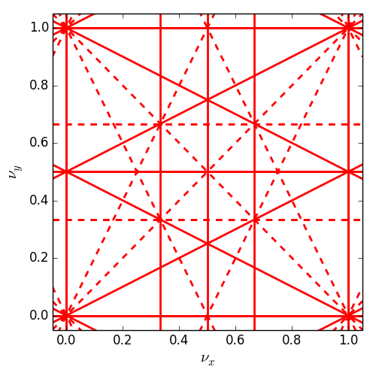
Resonances
If we include vertical as well as horizontal motion, then we find that resonances occur when the tunes satisfy
where m_{x}, m_{y} and l are integers; resonance is of order |m_{x}| + |m_{y}|
Resonances up to order 3
normal resonances
(= even m_{y})
skew resonances
(= odd m_{y})

Slide 26
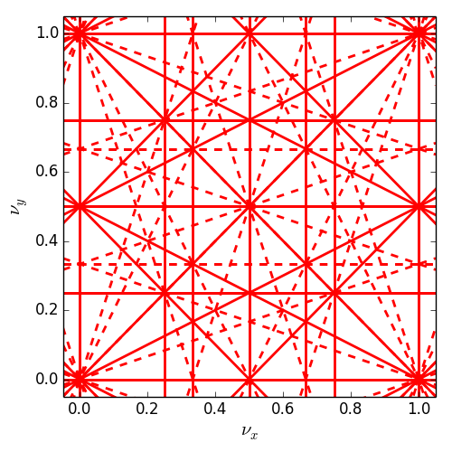
Resonances
If we include vertical as well as horizontal motion, then we find that resonances occur when the tunes satisfy
where m_{x}, m_{y} and l are integers; resonance is of order |m_{x}| + |m_{y}|
Resonances up to order 4
normal resonances
(= even m_{y})
skew resonances
(= odd m_{y})

Slide 27
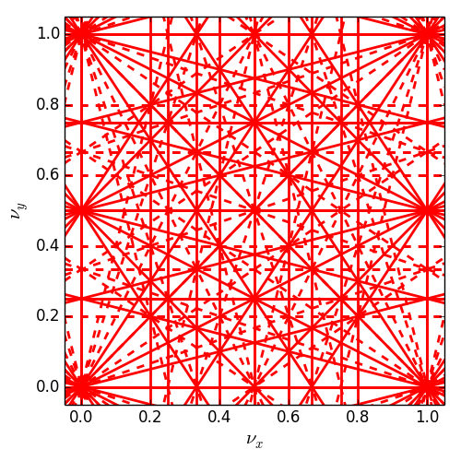
Resonances
If we include vertical as well as horizontal motion, then we find that resonances occur when the tunes satisfy
where m_{x}, m_{y} and l are integers; resonance is of order |m_{x}| + |m_{y}|
Resonances up to order 5
normal resonances
(= even m_{y})
skew resonances
(= odd m_{y})

Slide 28
Resonances
Resonances are associated with chaotic motion for particles in storage rings
However, the number of resonance lines in tune space is inﬁnite: any point in tune space will be close to a resonance of some order
This observation raises two questions:
  How do we know what the real eﬀect of any given resonance line will be?
  How can we design a storage ring to minimise the adverse eﬀects of resonances?

Slide 29
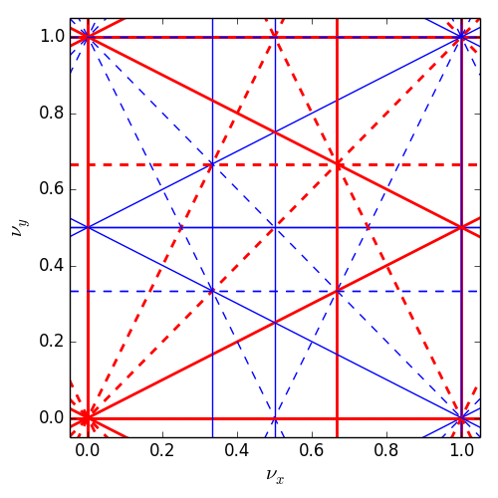
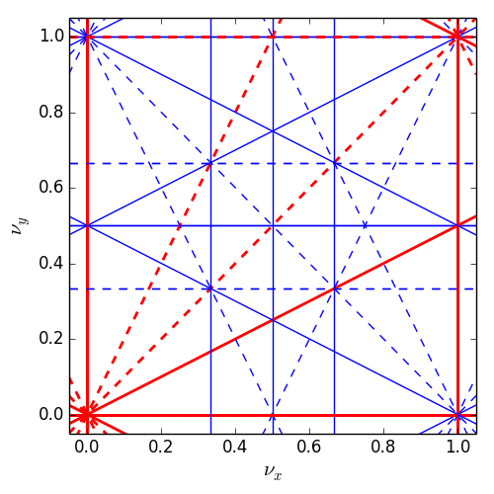
Resonance cancellation by periodicity
By imposing a periodicity P in the lattice (i.e. building a machine from P identical cells), the resonance condition becomes
  … the resonance condition needs to be satisfied by each cell, as conceptually there is no difference between passing one cell P turns or passing a lattice consisting of P identical cells only once
Resonances for which l is integer → systematic
If l is NOT integer the resonance cancels → non-systematic
→
periodicity P=1
periodicity P=2
periodicity P=3
solid lines: normal resonances dashed lines: skew resonances

Slide 30
Real life example for periodicity: ALS
Advanced Light Source, design lattice periodicity: 12
Measurement of beam loss as function of tune
Synchrotron light beam spot
Uncorrected optics
Corrected optics
72 = 6*12
Beta beating
Before optics correction: ~30%
After optics correction: <1%
Simulated phase space
  D. Robin, C. Steier, J. Safranek, W. Decking, “Enhanced performance of the ALS through periodicity restoration of the lattice”, proc. EPAC 2000.

Slide 31
Non-linear map representation

Slide 32
Taylor maps
For any dynamical variable the Taylor map up to 3rd order can be written as
Taylor series provide a convenient way of systematically representing transfer maps for beamline components, or sections of beamline
The main drawback of Taylor series is that in general, transfer maps can only be represented exactly by series with an inﬁnite number of terms
In practice, we have to truncate a Taylor map at some order, and we then lose certain desirable properties of the map
In particular, a truncated map will be usually non-symplectic

Slide 33
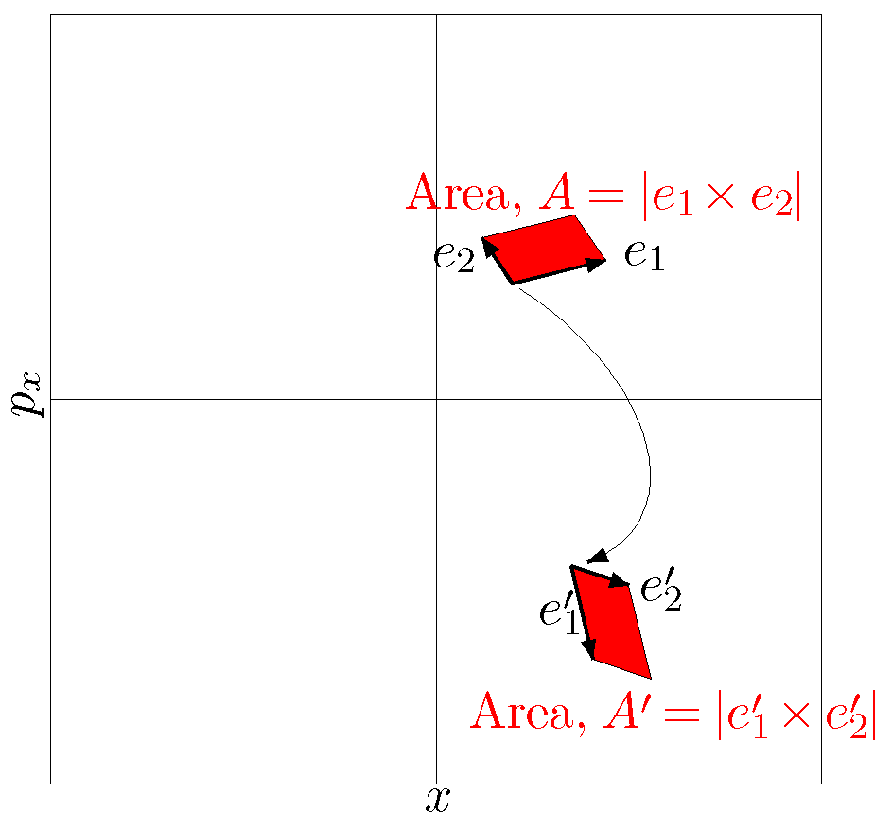
Symplectic maps
Consider two sets of canonical variables , , which represent the evolution of the system between two points in phase space
A map describes the transformation from one set to the other
This map is symplectic, i.e. it conserves phase space volumes, if
symplecticity condition
Jacobian matrix
of the map
antisymmetric matrix
with block diagonals
… this is Liouville’s theorem, and is a property of charged particles moving in electromagnetic ﬁelds, in the absence of radiation

Slide 34
Symplectic maps
The eﬀect of losing symplecticity becomes apparent if we compare phase space portraits constructed using symplectic (below, left) and non-symplectic (below, right) transfer maps.
Modelling a storage ring using non-symplectic maps can lead to an inaccurate estimate of the dynamic aperture and the beam lifetime

Slide 35
Symplectic integration
Consider a sextupole with equations of motion:
Exact solutions using some elementary functions do not exist
By splitting integration into three steps, it is possible to write an explicit and symplectic approximate solution
This an example of a symplectic integrator known as a “drift–kick–drift” approximation

Slide 36
Analytical methods for nonlinear dynamics

Slide 37
Analytical methods
There are two approaches widely used in accelerator physics: perturbation theory and normal form analysis
In both these techniques, the goal is to construct a quantity that is invariant under application of the single-turn transfer map. Unfortunately, in both cases the mathematics is complicated and fairly cumbersome
In the case of a single sextupole in a storage ring, we ﬁnd from normal form analysis the following expression for the betatron action as a function of the betatron phase (angle variable):
where is a constant (an invariant of the motion), is the angle variable, and is the phase advance per cell
The second term becomes very large when is close to third integer

Slide 38
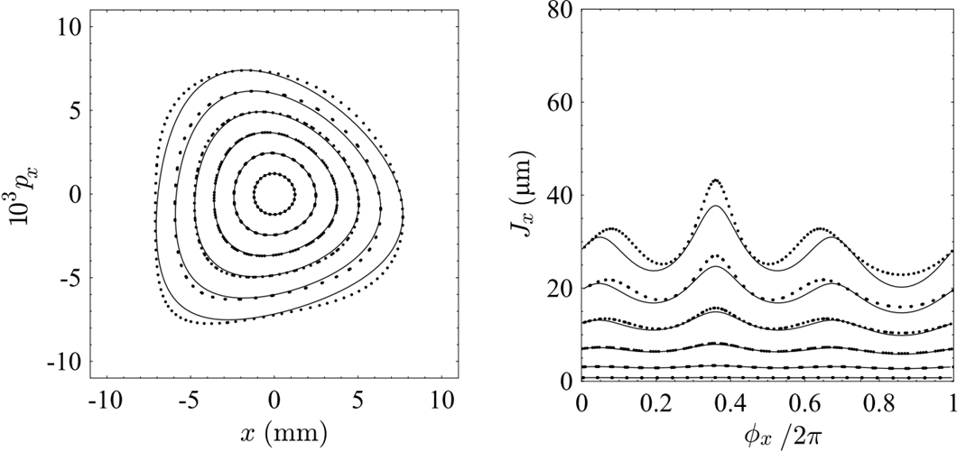
Normal form for sextupole

Slide 39
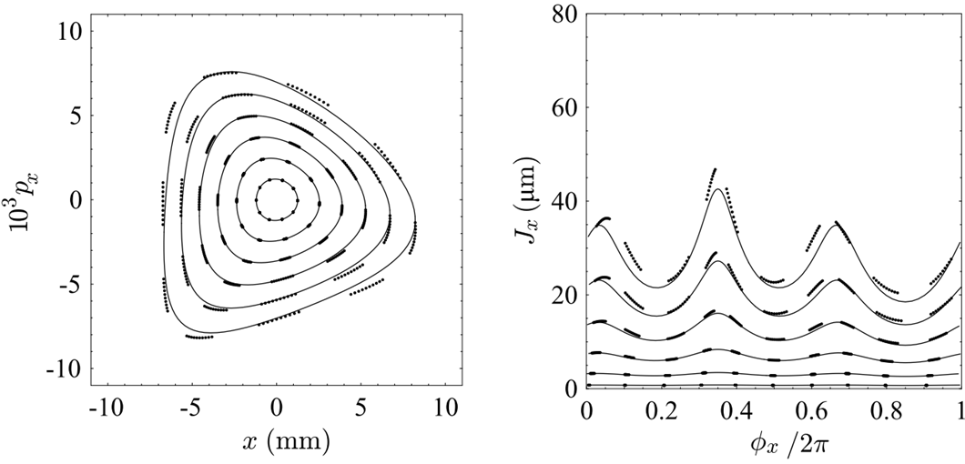
Normal form for sextupole

Slide 40
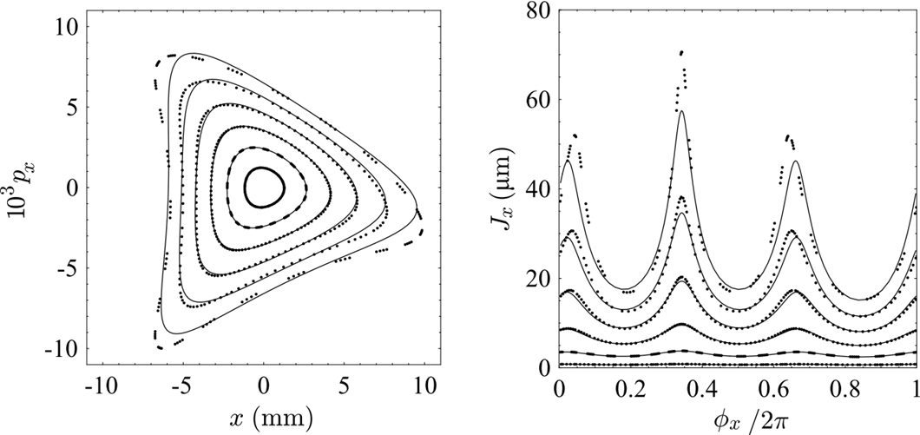
Normal form for sextupole

Slide 41
Tune-shift with amplitude
Close inspection of the plots on the previous slides reveals another eﬀect, in addition to the obvious distortion of the phase space ellipses: the phase advance per turn (i.e. the tune) varies with increasing betatron amplitude
Normal form analysis (and perturbation theory) can be used to obtain estimates for the tune shift with amplitude
In the case of a sextupole, the tune shift is higher-order in the sextupole strength
An octupole, however, does have a tune shift with amplitude in ﬁrst-order of the octupole strength, given by:

Slide 42
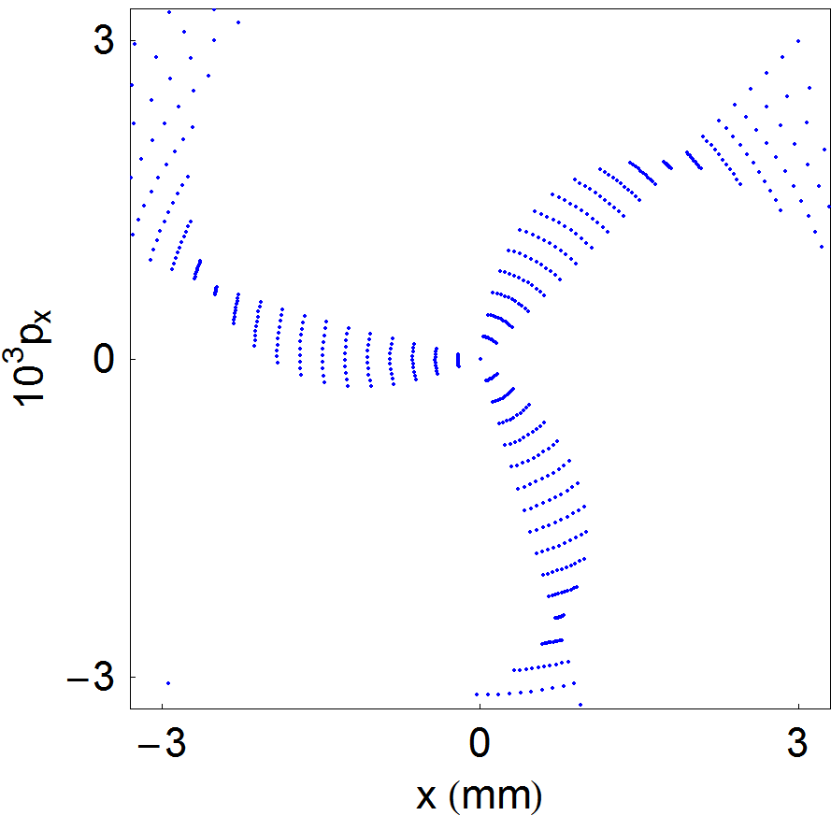
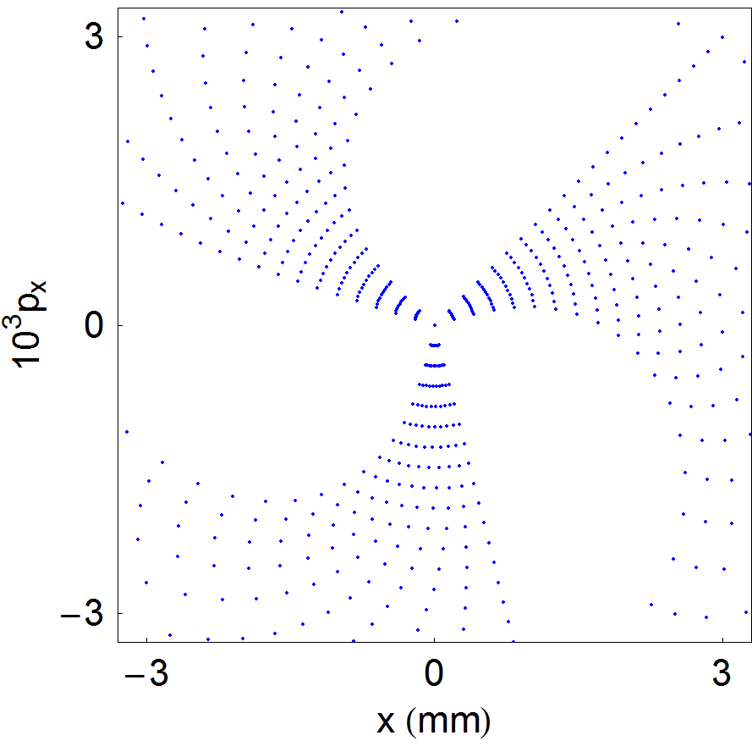
Tune-shift with amplitude
The tune shift with amplitude becomes obvious if we track a small number of turns (30) in a lattice with a single octupole.

Slide 43
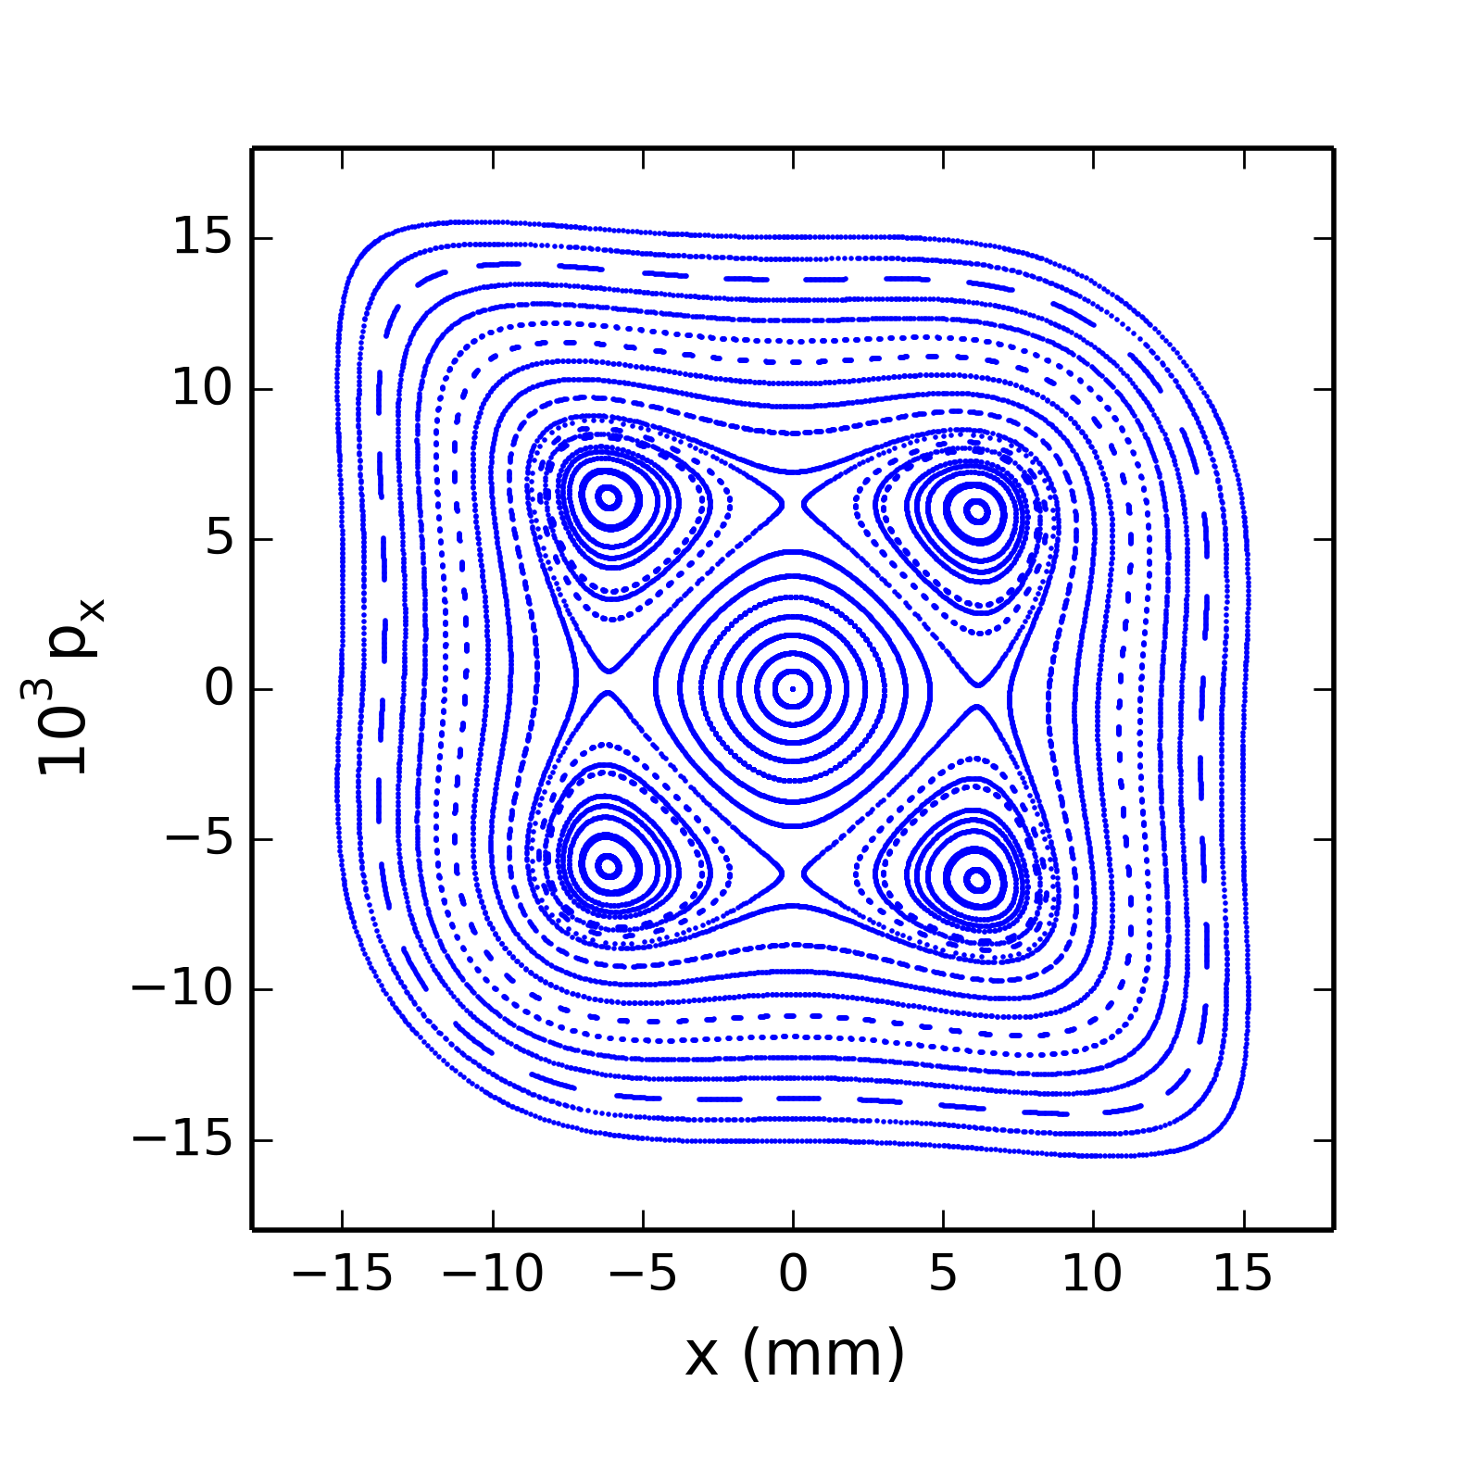
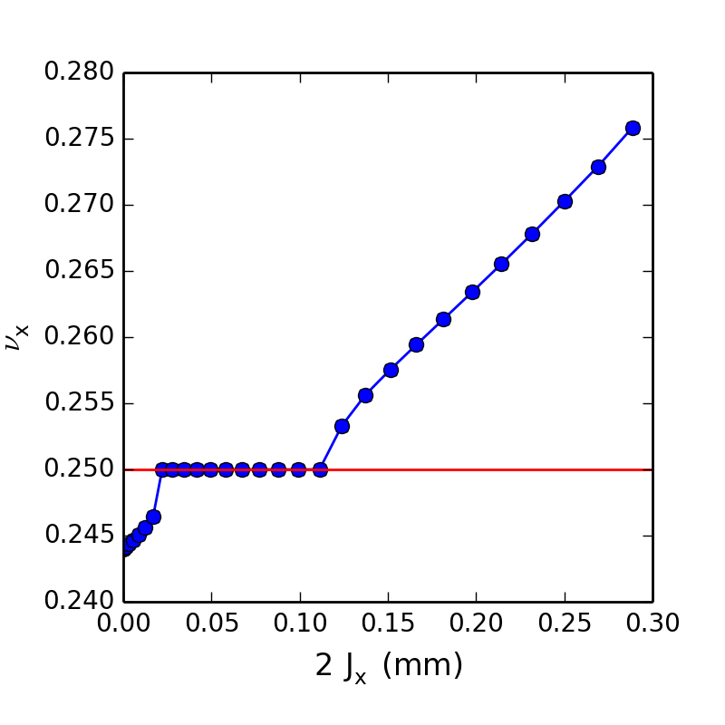
Resonant islands of 4th order resonance
Simulation of simple storage ring with a single octupole close to 4th order resonance
Detuning with amplitude (linear in action)
Particles in the stable islands have a tune locked to the resonance

Slide 44
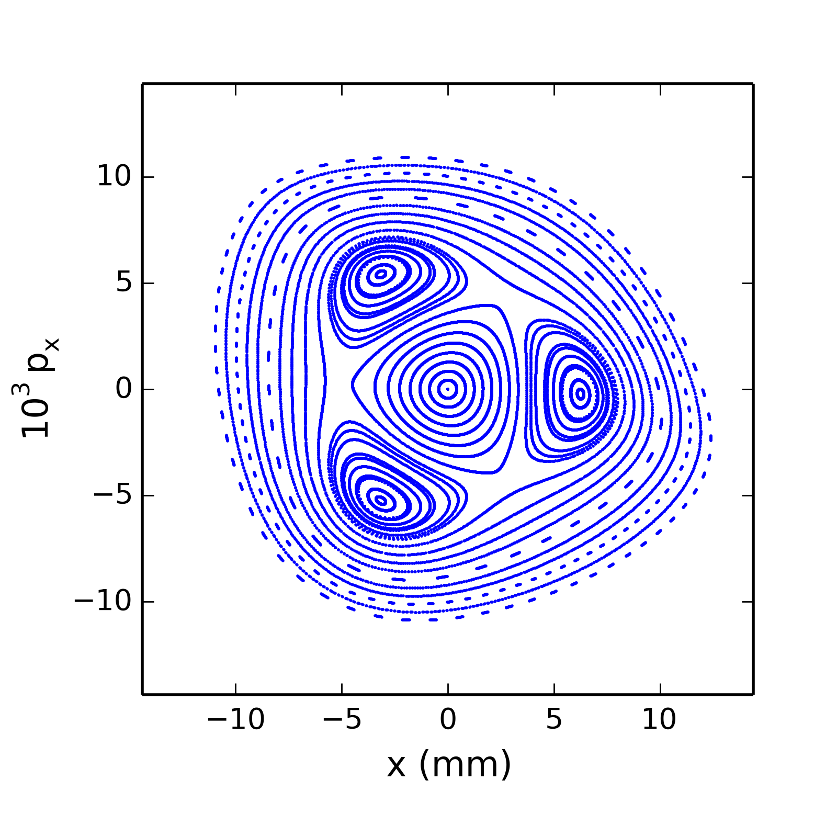
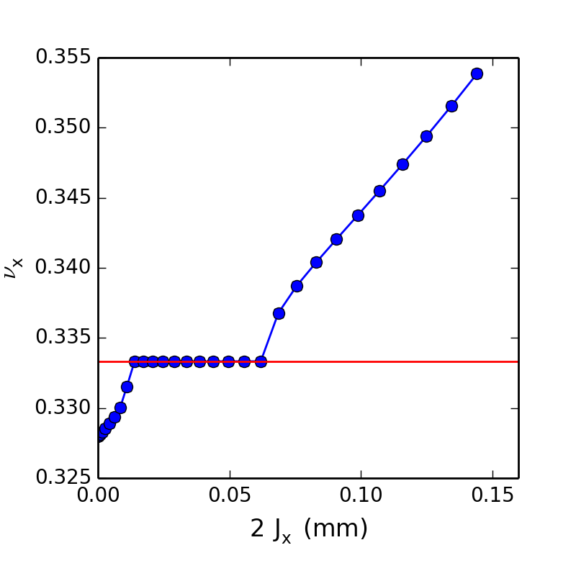
Resonant islands of 3rd order resonance
Simulation of simple storage ring with a sextupole and an octupole close to 3rd order resonance
The amplitude detuning induced by the octupole can create stable islands even for the 3rd order resonance (recall the phase-space plot for the case of a single sextupole)

Slide 45
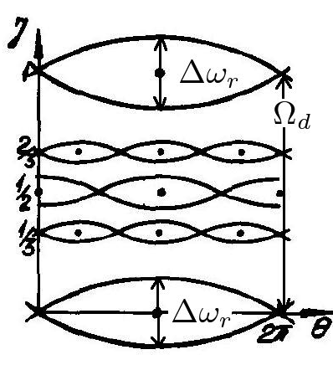
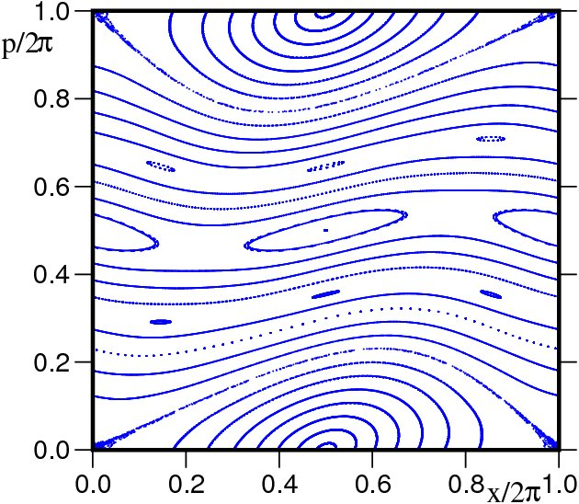
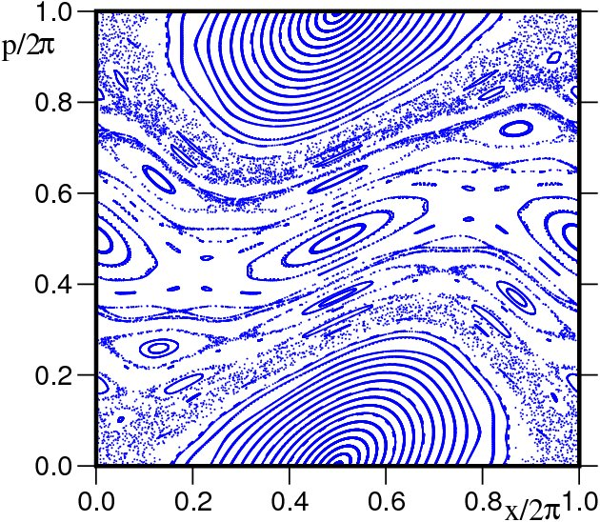
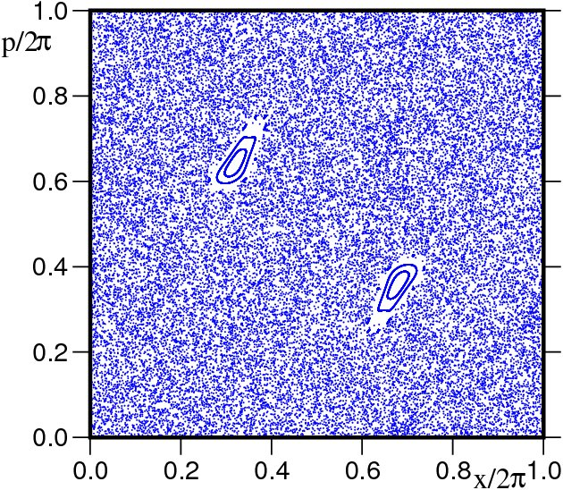
Onset of chaos and loss of stability
Perturbation theory and normal form analysis depend on the existence of constants of motion in the presence of nonlinear perturbations
  Constants of motion can exist in the presence of nonlinear perturbations as a consequence of the Kolmogorov–Arnold–Moser (KAM) theorem
Resonances do not invariably result in loss of stability
  Resonances will usually tend to drive the amplitudes of particles with a particular tune to large amplitudes
  For sufficiently large tune-shift with amplitude, it is possible for there to be a stable region at amplitudes larger than that at which resonance occurs
The overlap of two resonances is associated with a transition from regular to chaotic motion: the Chirikov criterion describes the parameter range over which the particle motion becomes chaotic

Slide 46
Numerical methods:
Dynamic aperture (DA) and Frequency map analysis (FMA)

Slide 47
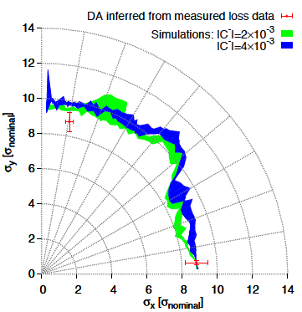
Dynamic aperture
The most direct way to evaluate the non-linear dynamics performance of a ring is the computation of Dynamic Aperture (short: DA), which is the boundary of the stable region in co-ordinate space
Need a symplectic tracking code to follow particle trajectories (a lot of initial conditions) for a number of turns until the particles start getting lost → this boundary defines the Dynamic aperture
DA of the LHC
… very good agreement between tracking simulations and measurements in the machine
E.Mclean, PhD thesis, 2014

Slide 48
Frequency Map (example for ALS)
J. Laskar, “Frequency map analysis and particle accelerators”, PAC 2003
Numerically integrate the phase space trajectories through the lattice for sufficient number of turns (i.e. perform particle tracking)
Compute through advanced Fourier methods ν_{x} and ν_{y} after sufficient number of turns, and plot the tune variation by color code in the configuration space x-y (left) and the tune space ν_{x}-ν_{y} (right)
  regular motion corresponds to small tune diffusion)
  Chaotic motion associated with large tune diffusion, occurs at the dynamic aperture of the machine
  Resonances appear as curves in initial condition space

Slide 49
Conclusions and Summary

Slide 50
Summary
Nonlinear dynamics appear in a wide variety of accelerator systems, including single-pass systems (such as bunch compressors) and multi-turn systems (such as storage rings)
It is possible to model nonlinear dynamics in a given component or section of beamline by representing the transfer map as a power series
Conservation of phase space volumes is an important feature of the beam dynamics in many systems. To conserve phase space volumes, transfer maps must be symplectic
In general, (truncated) power series maps are not symplectic
To construct a symplectic transfer map, the equations of motion in a given accelerator component must be solved using a symplectic integrator (e.g. the “drift–kick–drift” approximation for a multipole magnet)

Slide 51
Summary
Common features of nonlinear dynamics in accelerators include phase space distortion, tune shifts with amplitude, resonances, and chaotic particle trajectories at large amplitudes (dynamic aperture limits)
Analytical methods such as perturbation theory and normal form analysis can be used to estimate the impact of nonlinear perturbations in terms of quantities such as resonance strengths and tune shifts with amplitude
Frequency map analysis provides a useful numerical tool for characterising tune shifts and resonance strengths from tracking data
This can give some insight into limitations on the dynamic aperture

