Slide 2
EP R&D Project on Noble Liquid Calorimetry
Development of High-Density Signal Feedthroughs for LAr Calorimeters
Maria Barba, Michel Chalifour, Johan Bremer, Martin Aleksa
Meeting on FCC Noble Liquid Calorimetry
January 27th, 2022
WP3: Calorimetry and Light-based detectors

Slide 3
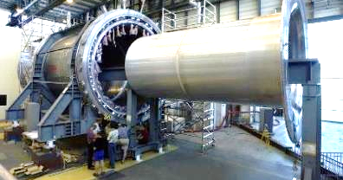
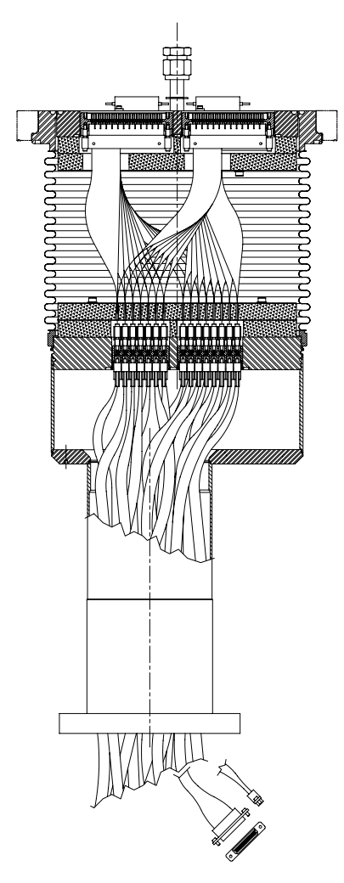
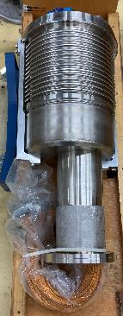
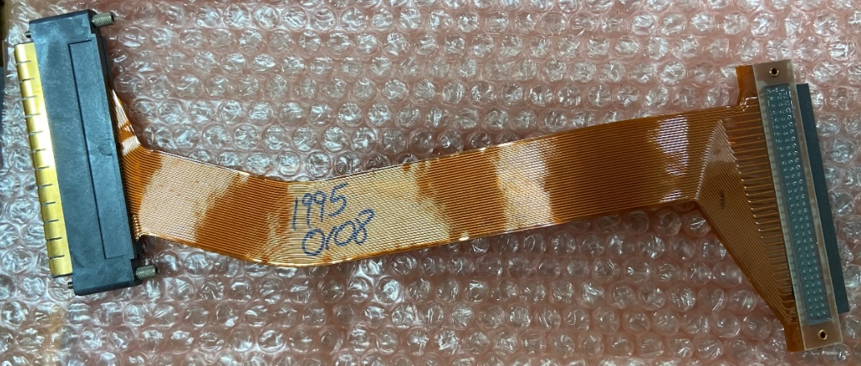
High-density signal feedthroughs
Reference: signal feedthroughs of the ATLAS LAr EM calorimeters
Goal: ~20 000 signal wires per feedthrough
ATLAS Cryostat for the barrel calorimeter
Ø = 30 cm
300 K
Pumping connection
Vacuum
Warm flange
Bellows
Vacuum cables
Cold flange
Pigtail cables
LAr (87 K)
0.7 m
connector
32 shielded signal wires x2
connector
Signal feedthrough

Slide 4

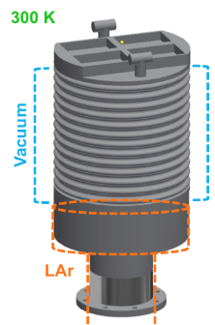
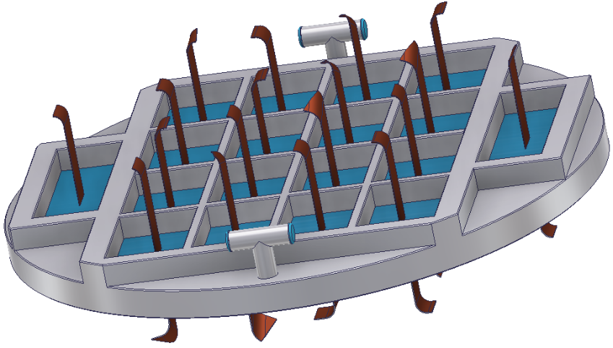
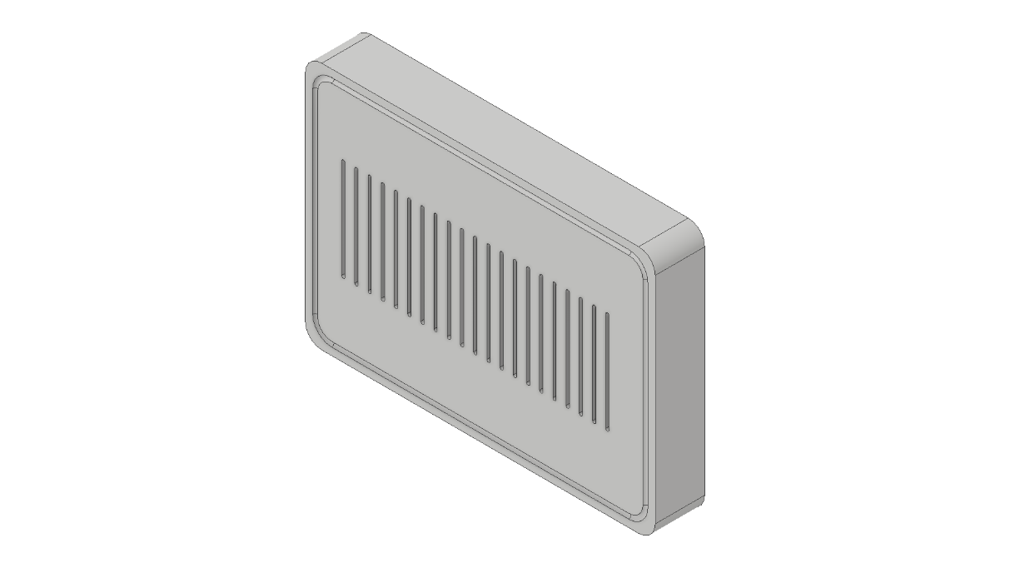
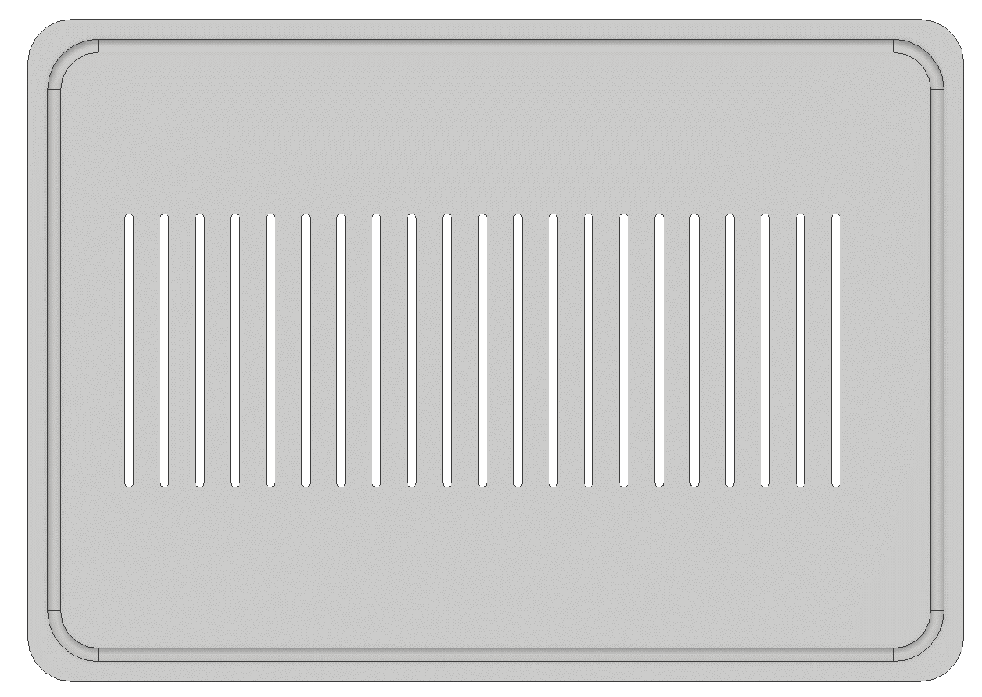
High-density signal feedthroughs
Solution developed: high-density flanges
Purpose: get rid of the use of connectors
Stainless steel body flange:
(⌀ = 600 mm, thickness = 20 mm)
Space for heaters
Pumping connection
Main components:
Structural material
2 Sealing solutions (to ensure leak-tightness)
  Seal cable/structure
  Seal structure/body flange
Main steps:
Tests under extreme conditions
Final design and stress simulations
Cable design (B. François)
87 K
Kapton strip cable
Structural material:
Thickness 15 – 17 mm
Slits (1 mm)

Slide 5
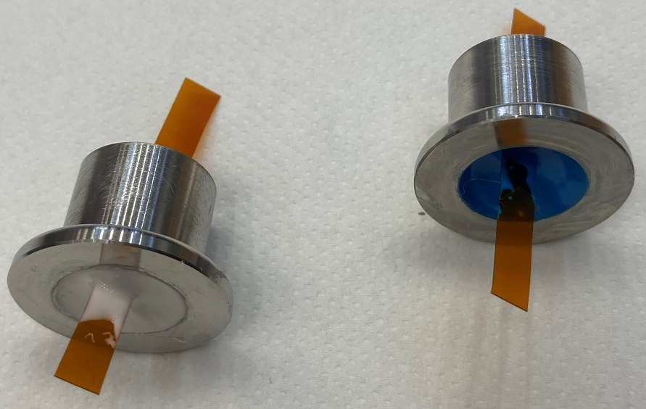
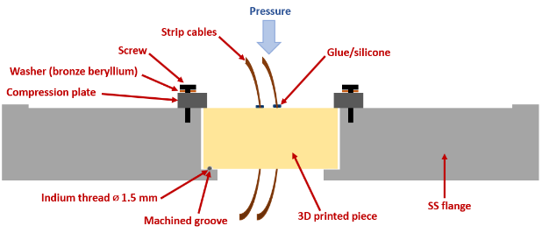
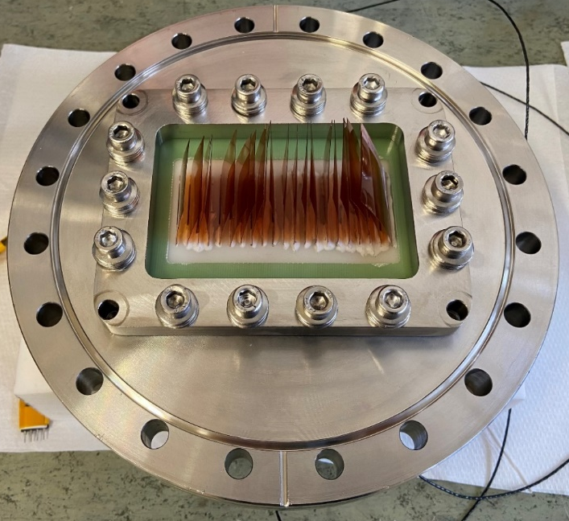
High-density signal feedthroughs
Selection of components:
Structural material selection:
Samples thermally shocked and
3D Computed Tomography before and after
Accura 25
SilasticM
MY750
G11
G10
More than 6 candidates from literature and CERN experiments
Glue selection:
Samples thermally shocked (77 K) and
leak tested at room Tº
Epo-tek T7110
Araldite 2011 A/B
More than 7 candidates from literature and CERN experiments
Cracks
Kapton strip
Accura48
Sealing solutions:
Indium seal with compression plate
Welding

Slide 6
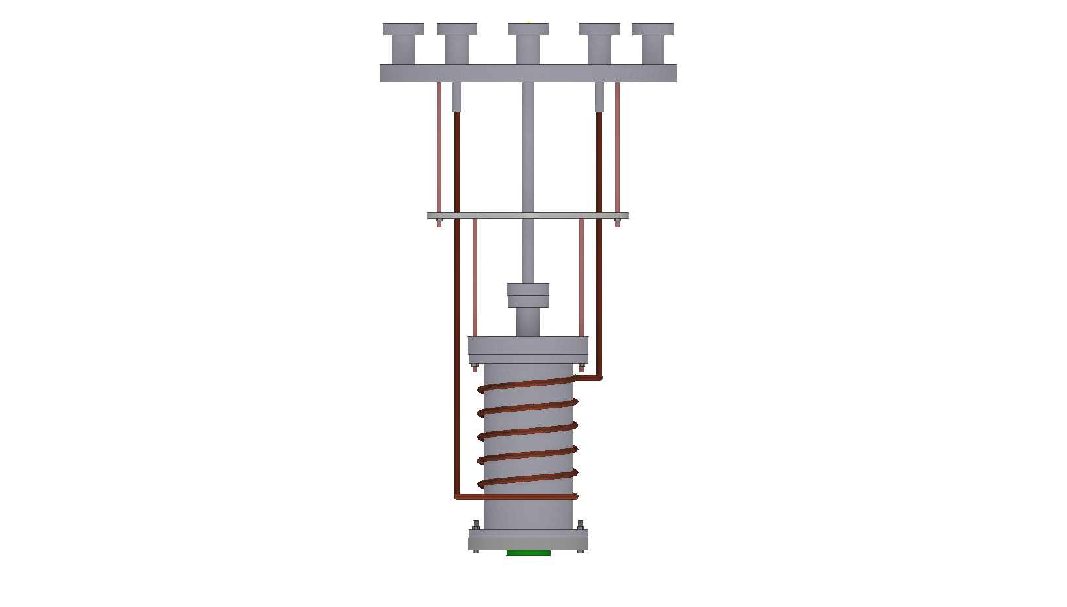
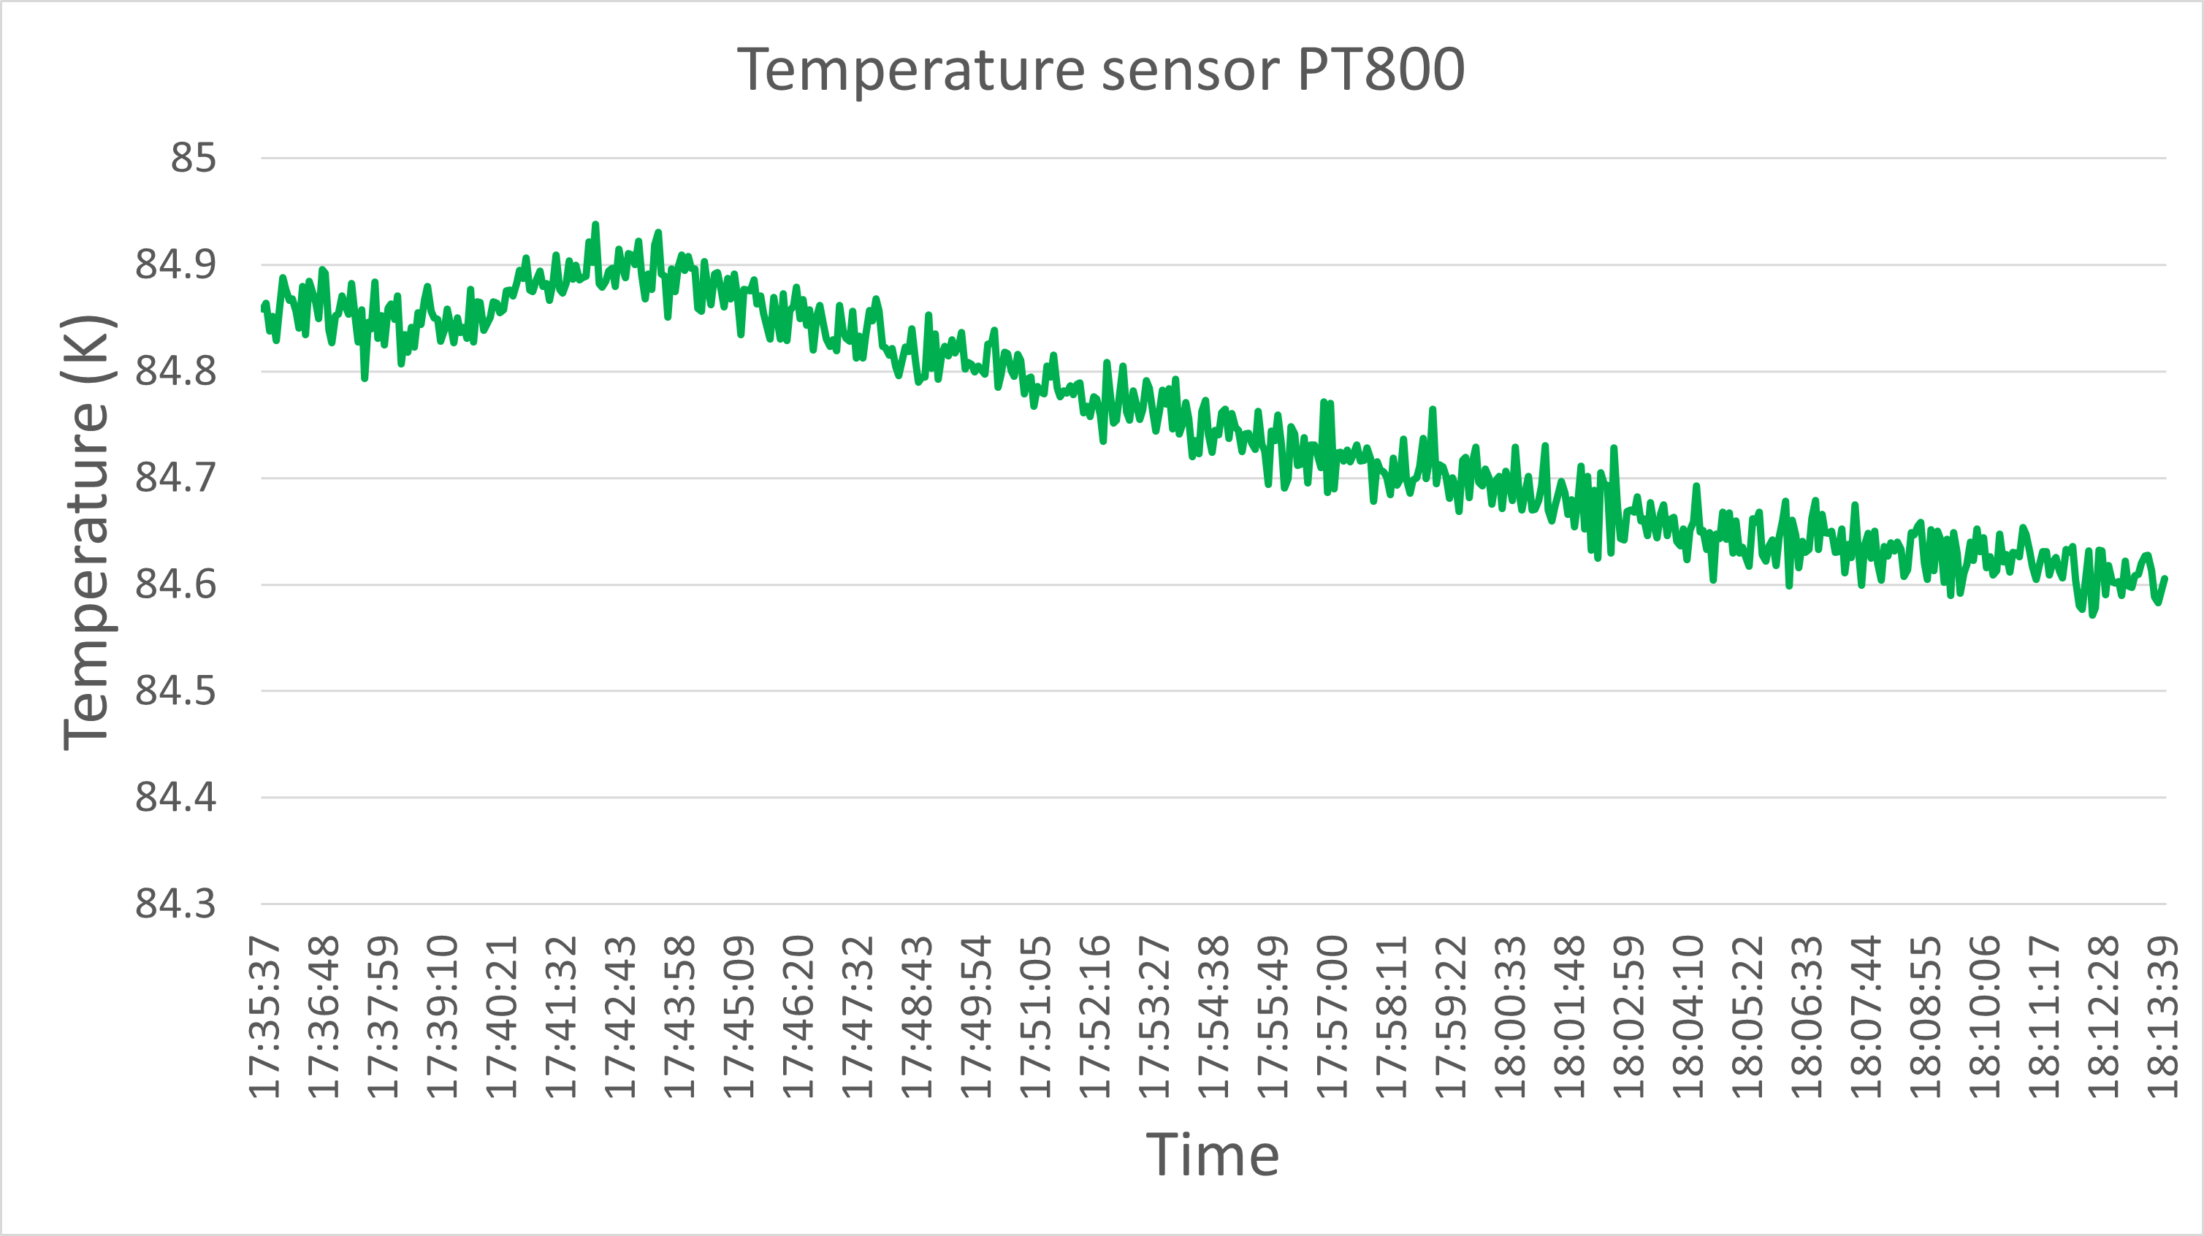
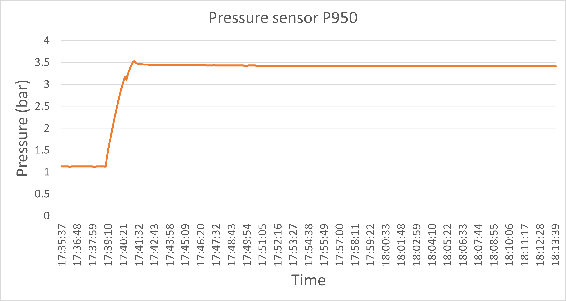
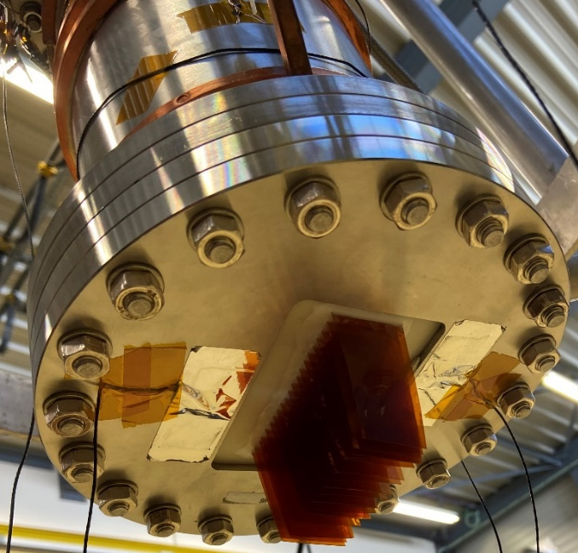
High-density signal feedthroughs
Experimental tests:
Pumping system and leak detector
LN2
GHe
LN2
DAQ
Pressure test at low T°
Temperature sensor TT800
P950
Operating conditions:
87 K and 1 bar (Ref: ATLAS)
Breaking vacuum accident:
3.5 bar at 87 to 300 K (Ref: ATLAS)
Test (30 min)
LN2
circuit
Vacuum: 1.05x10⁻⁶ mbar
Leak rate: 3x10⁻⁹ mbar.l/s
Vacuum: 8.23x10⁻⁷ mbar
Leak rate: 3.3x10⁻⁹ mbar.l/s
Pressure sensor P950
Test (30 min)
GHe
vessel
TT800
Sample: G10 + epo-tek (glue) + Kapton strips + indium seal

Slide 7
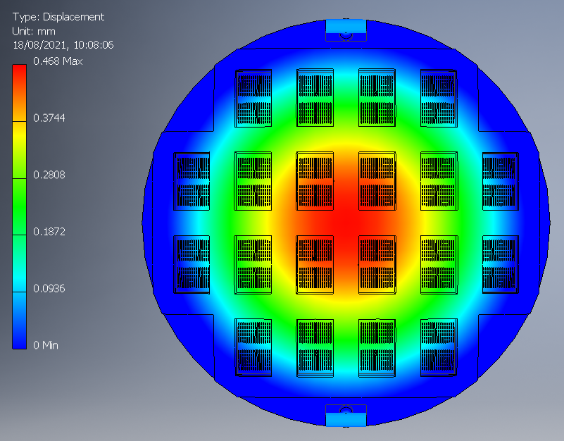
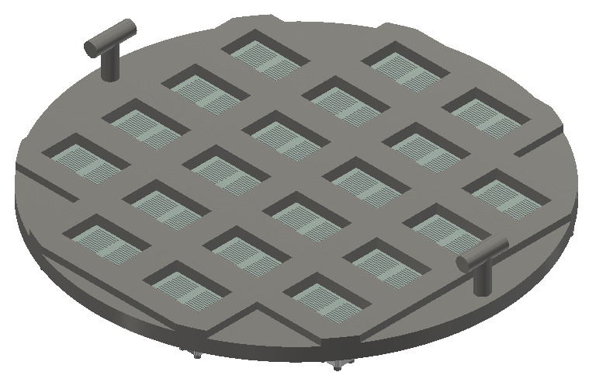
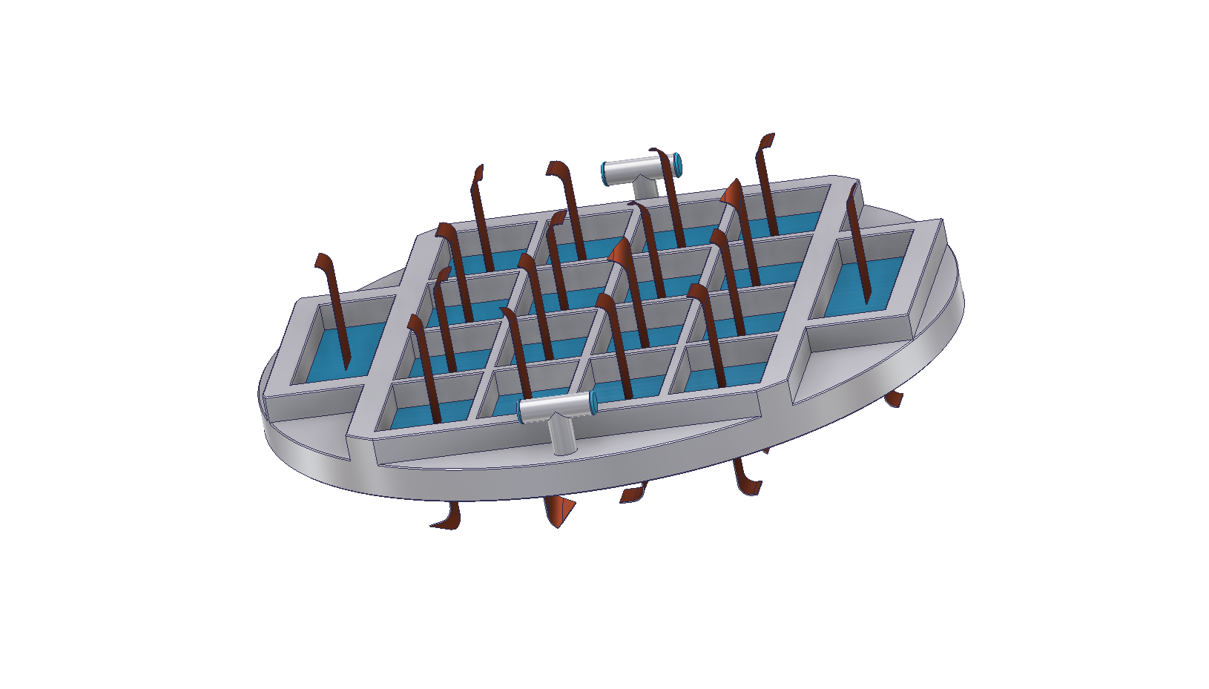
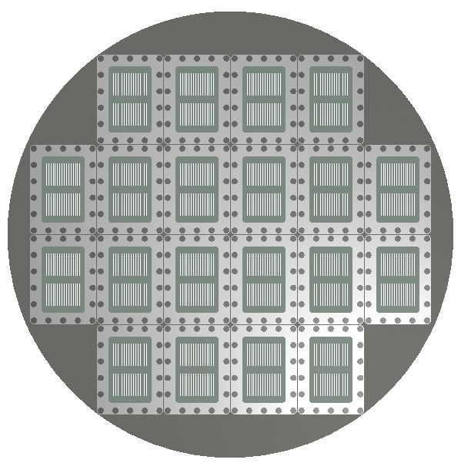
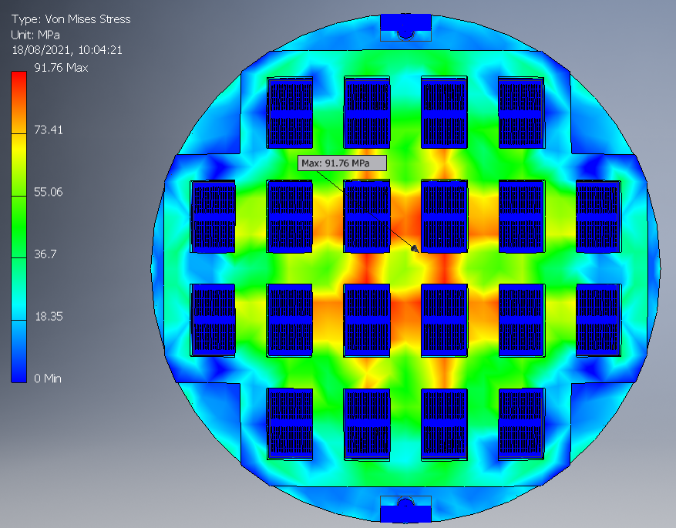
High-density signal feedthroughs
Mechanical stress simulations of final flange designs:
4 designs studied: 16 000 – 20 000 signal wires/flange
Mechanical simulations at room and low temperature :
Max. deflection: 0.79 mm (ATLAS FT 0.68 mm)
Max. Von Mises Stress: 143 MPa (below yield and tensile strength of components)
SS 304L
G10
Olivia Reinicke (TUB Berlin)

Slide 8

High-density signal feedthroughs
Experiments:
G10 + epo-tek glue + Kapton strips + indium seal
  Leak and pressure tests at room and low temperature
  Thermal shocks in liquid nitrogen and leak test
Accura25 + epo-tek glue + Kapton strips + indium seal
  Thermal shocks in liquid nitrogen and leak test
  Leak and pressure tests at room and low temperature
MY750 + epo-tek glue + Kapton strips + indium seal
  Thermal shocks in liquid nitrogen and leak test
  Leak and pressure tests at room and low temperature
ATLAS strips cables
  Leak and pressure tests at room and low temperature
G11 + epo-tek glue + Kapton strips and ATLAS strip cables + indium seal
  Leak and pressure tests at room and low temperature
  Thermal shocks in liquid nitrogen and leak test
SS + epo-tek glue + Kapton strips and ATLAS strip cables + welding
  Leak and pressure tests at room and low temperature
  Thermal shocks in liquid nitrogen and leak test
CTE measurements
3D Computed Tomography scan
Ongoing
Ongoing

Slide 9
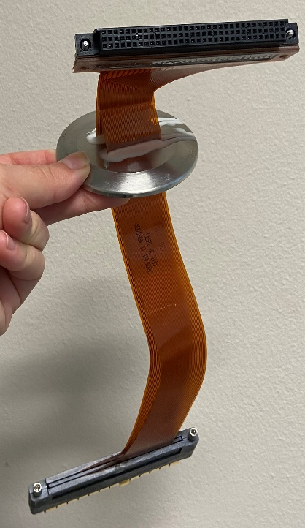
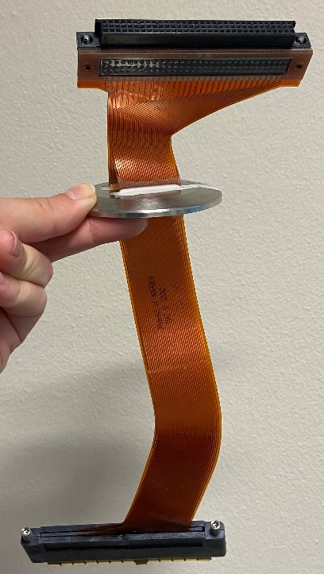
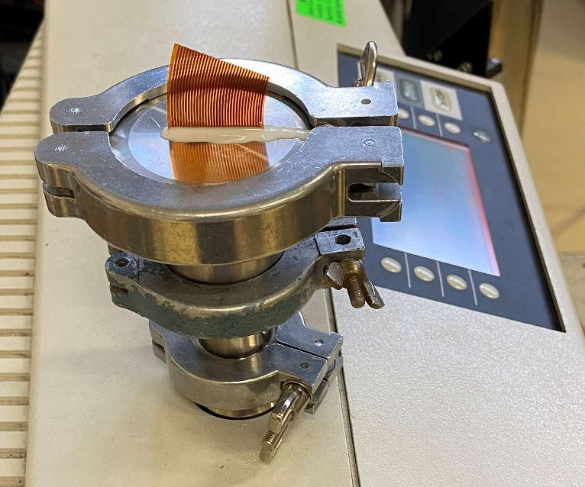
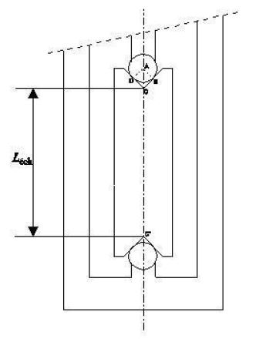
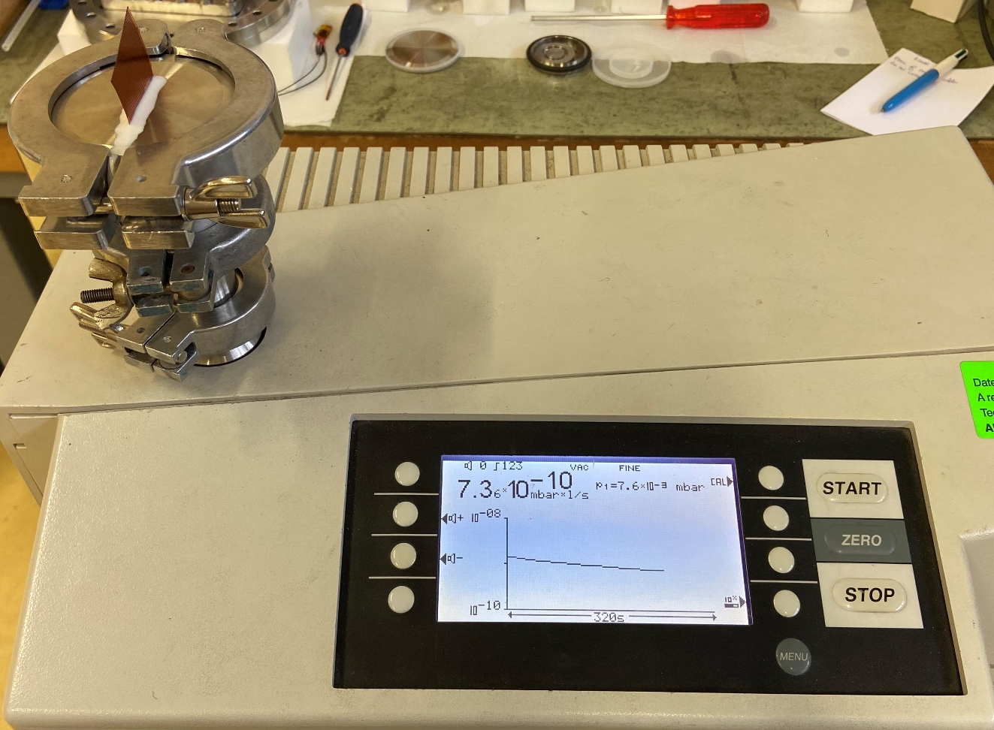
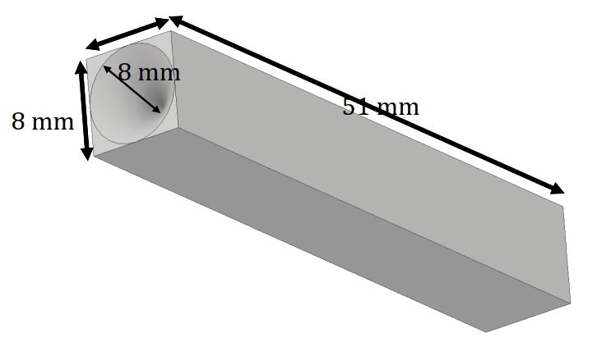
High-density signal feedthroughs
Experiments:
CTE measurements:
Accura25 between 300 and 77 K
MY750 between 300 and 77 K
Epo-tek T7110 between 300 and 77 K
Accura25 between 77 and 4.2 K
MY750 between 77 and 4.2 K
Epo-tek T7110 between 77 and 4.2 K
ATLAS cables:
Paper ongoing…

Slide 10
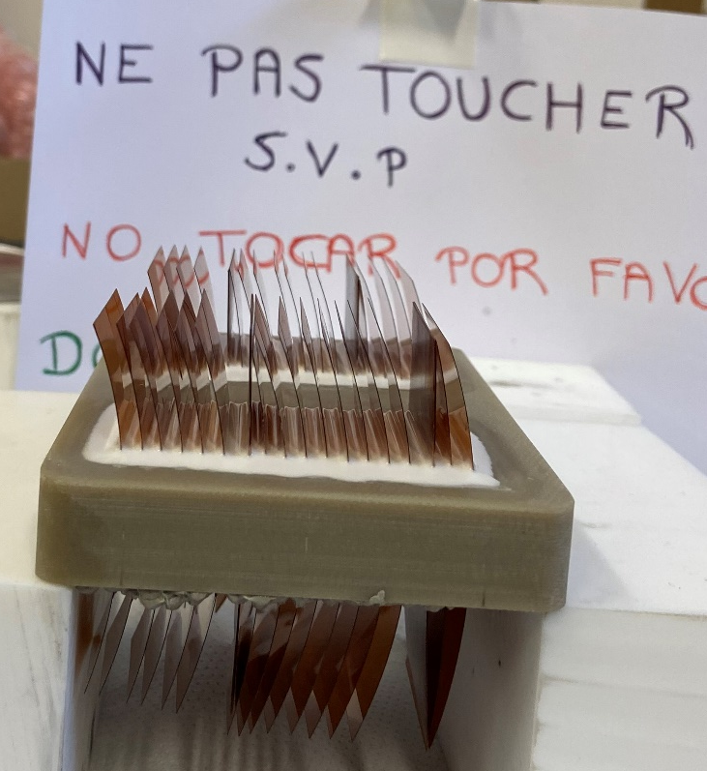
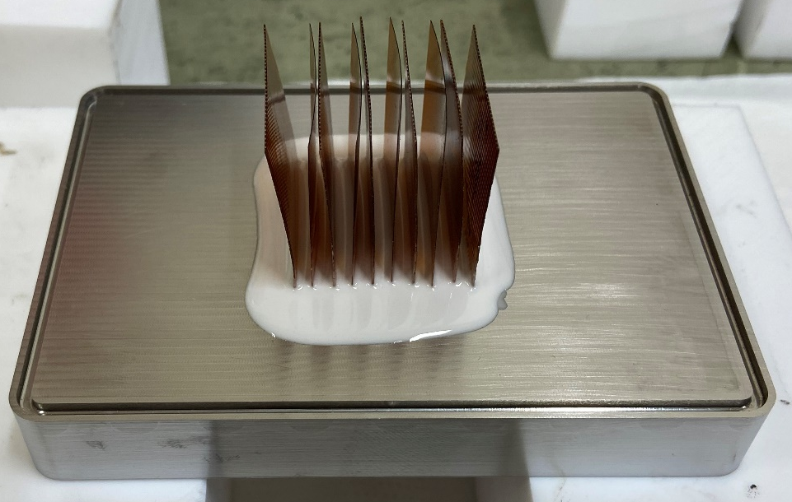
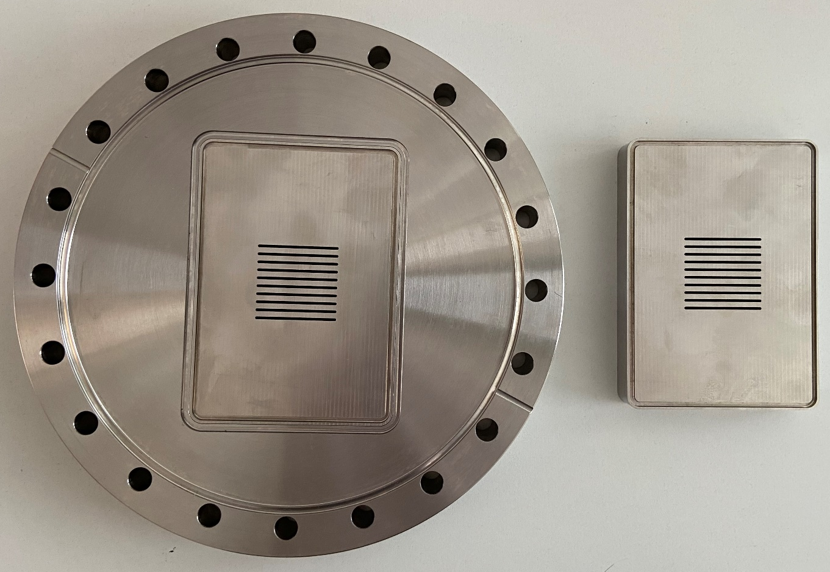
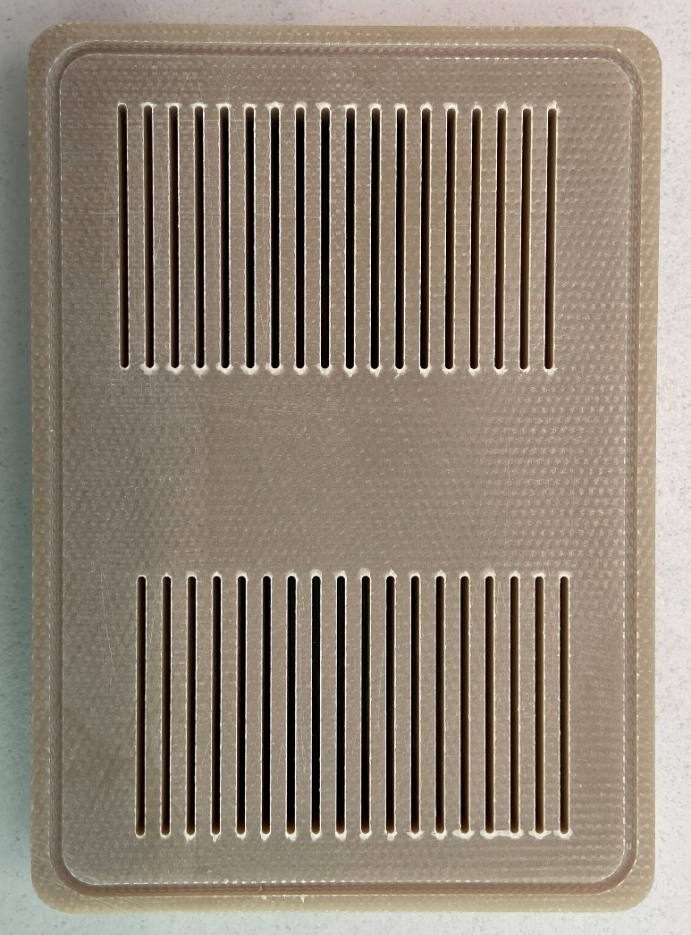
High-density signal feedthroughs
Experiments:
SS + epo-tek glue + Kapton strips and ATLAS strip cables + welding
G11 + epo-tek glue + Kapton strips and ATLAS strip cables + indium seal
Final design

Slide 11
High-density signal feedthroughs
Summary:
Tests of other structural materials and sealing solutions ongoing until end of February 2022
Study of not successful candidates to better understand
(CTE measurements + 3D CT scans)
Papers ongoing:
  Cryogenics → CTE measurements
  Journal of Instrumentation → Feedthroughs
  FCC notes → Project
Next steps:
Final 3D feedthrough design
Testing final cables (B. François)
Interfaces study?

Slide 12
Thank you for your attention!
Questions?

