Slide 1
153rd FCC-ee Optics Design Meeting
Minutes from 152nd meeting
FCC Week 2022 Accelerator Programme
FCC-ee tuning & alignment mini-workshop
FCCIS status
Frank Zimmermann, 21 April 2022

Slide 2
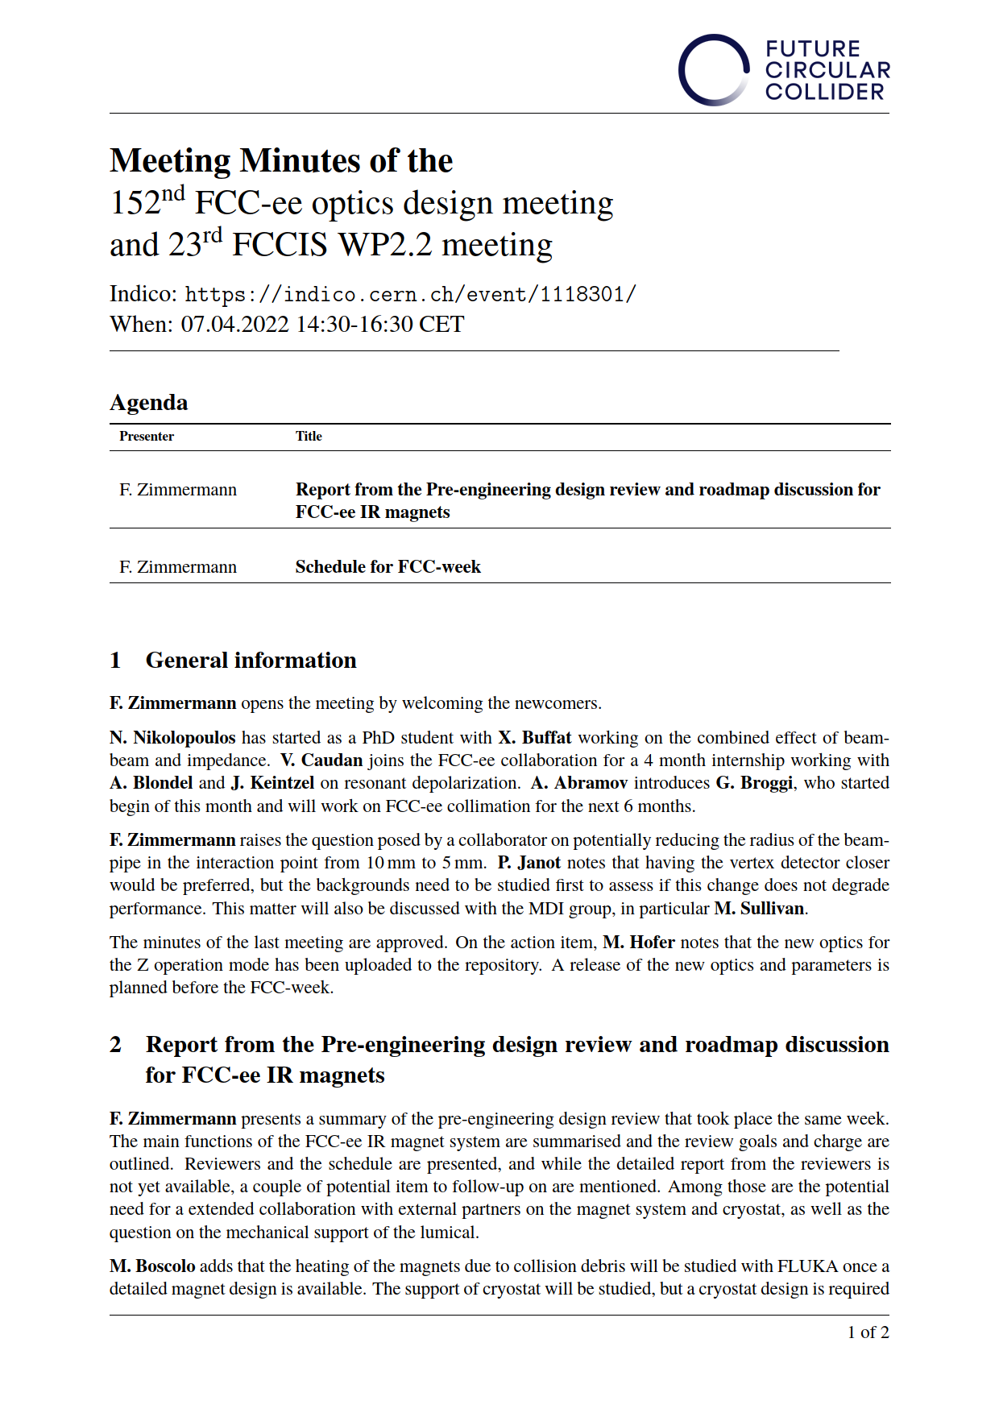
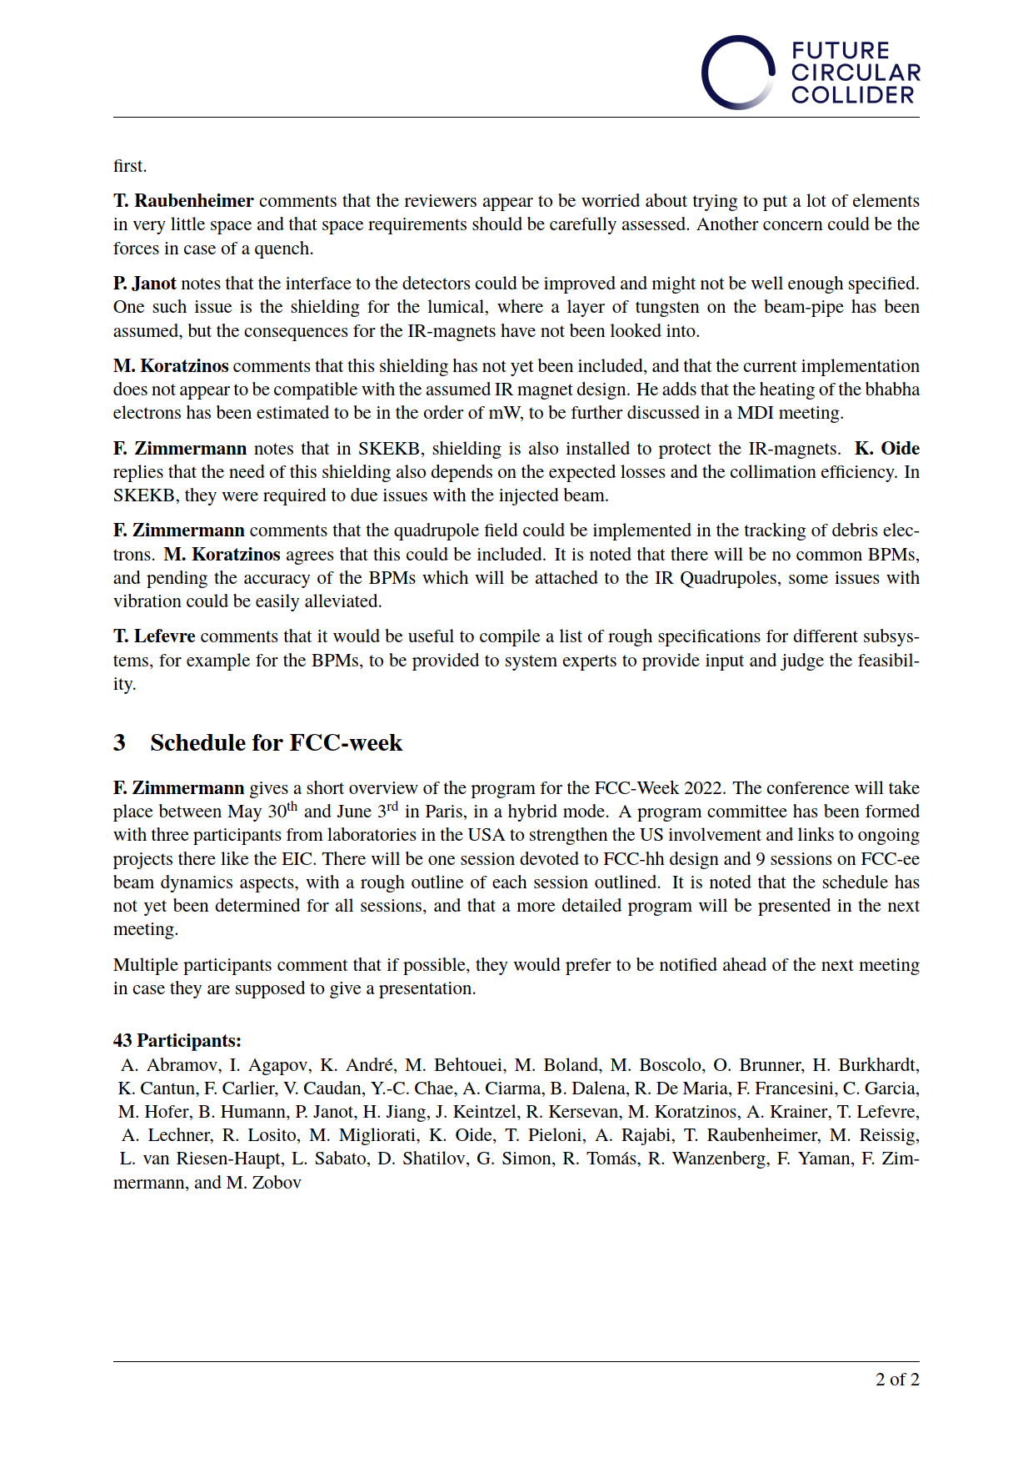
many thanks to Michael Hofer !

Slide 3
questions from integration studies (Fani Valchkova & Klaus Hanke)
does RF cavity voltage need to be the same in straights H and L for ttbar operation?
what is the minimum acceptable horizontal distance of booster from IP?

Slide 4
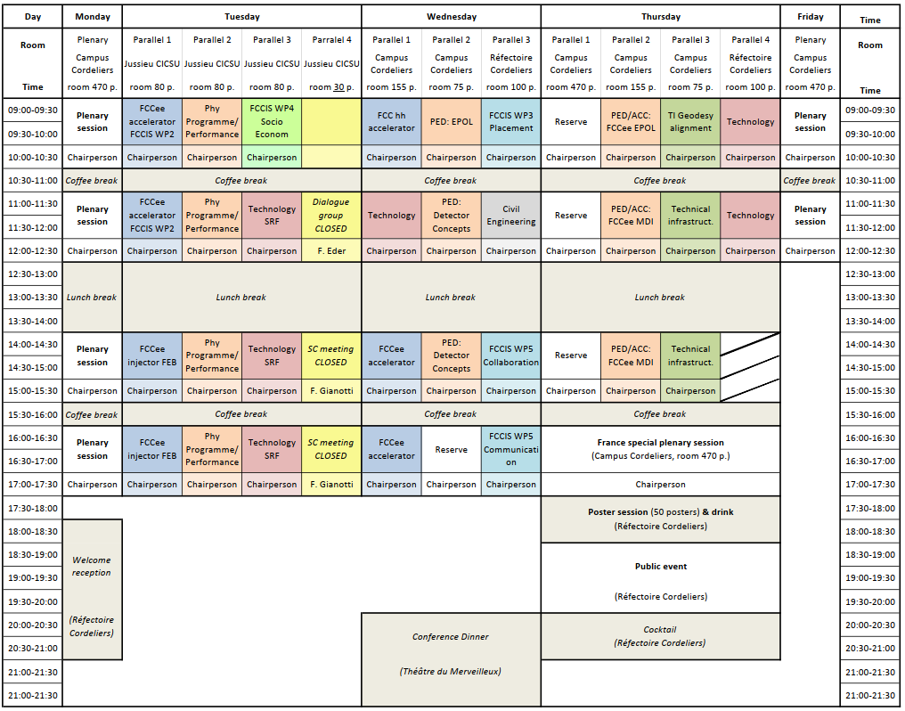
FCC Week 2022 Draft Program
Accelerator sessions developed
with
Tor Raubenheimer,
Katsunobu Oide,
Alexej Grudiev,
Paolo Craievich,
Massimo Giovannozzi,
Michael Hofer,
Manuela Boscolo,
Alain Blondel,
Ilya Agapov,
Olivier Brunner,
Michiko Minty,
Sergei Nagaitsev, et al

Slide 5
FCC Pillar | Accelerator
FCC Pillar Coordinator | Tor Raubenheimer, Frank Zimmermann
Name of the Session | FCC-ee Accelerator FCCIS WP2 - 1
Name and institute of the Chairperson | Tor Raubenheimer, SLAC
Date and time | Tuesday, 31 May 2022, 9h00-10h30
Speaker (name and institution) | Contribution title | Time (minutes) | Incl. Time for discussion (minutes)
D. Shatilov, CERN | FCC-ee parameter optimisation | 30 | 5
M. Hofer, CERN | New optics baseline | 20 | 3
T. Charles, U. Liverpool | Optics correction studies | 20 | 3
P. Hunchak, CLS | Top-up injection | 20 | 3
Name of the session | FCC-ee Accelerator FCCIS WP2 - 2
Name and institute of the Chairperson | Frank Zimmermann, CERN
Date and time | Tuesday, 31 May 2022, 11h00-12h30
Speaker (name and institution) | Contribution title | Time (minutes) | Incl. Time for discussion (minutes)
M. Migliorati, Sapienza | Single-beam collective effects | 20 | 3
E. Carideo, Sapienza & CERN | TMCI threshold & collimator impedance | 15 | 2
A. Rajabi, DESY | Resistive-wall impedance | 20 | 3
Y. Zhang, IHEP | Combined effect beam-beam & impedance | 20 | 3
F. Yaman, IIT | Electron cloud | 15 | 2

Slide 6
Name of the session | Top-up, booster, pre-injector layout and linacs
Name and institute of the Chairperson | Alexej Grudiev, CERN
Date and time | Tuesday, 31 May 2022, 14h00-15+B56h30
Speaker (name and institution) | Contribution title | Time (minutes) | Incl. Time for discussion (minutes)
A. Chance, CEA | booster design | 25 | 4
P. Craievich, PSI | pre-injector layout and parameters | 20 | 3
S. Bettoni, PSI | electron beam dynamics in linacs | 15 | 2
M. Schaer, PSI | positron Beam dynamics in linac 1 | 15 | 2
H. Pommerenke, CERN | RF design of the linacs | 15 | 2
Name of the session | e+ source, DR, transfer lines, and P3
Name and institute of the Chairperson | Iryna Chaikovska, IJCLab
Date and time | Tuesday, 31 May 2022, 16h00-17h30
Speaker (name and institution) | Contribution title | Time (minutes) | Incl. Time for discussion (minutes)
Y. Zhao, CERN | Positron capture simulations | 15 | 2
B. Humann, CERN | Radiation environment and shielding simulations | 15 | 2
M. Duda, PSI | HTS solenoid for positron source experiment at PSI | 15 | 2
A. De Santis, INFN-LNF | DR Design | 15 | 2
R. Ramjiawan, CERN | eTL design | 15 | 2
N. Vallis, PSI | PSI Positron production (P^3) project in SwissFEL | 15 | 2

Slide 7
Name of the session | FCC-hh
Name and institute of the Chairperson | Sergei Nagaitsev, FNAL
Date and time | Wednesday, 1 June 2022, 09h00-10h30
Guilherme Telles (Barcellona | Contribution title | Time (minutes) | Incl. Time for discussion (minutes)
M. Giovannozzi, CERN | FCC-hh optics & layout adaptations | 25 | 5
R. Bruce, CERN | FCC-hh collimation | 20 | 3
Guilherme Telles, Barcelona | HTS coating of beam screen | 20 | 3
W. Bartmann, CERN | Injectors, injection, extraction, transfer lines | 20 | 3
Name of the session | FCC-ee - 1 correction, stability, alignment, parameters
Name and institute of the Chairperson | Angeles Faus-Golfe, IJCLab
Date and time | Wednesday, 1 June 2022, 14h00-15h30

Slide 8
Name of the session | FCC-ee - 1 correction, stability, alignment, parameters
Name and institute of the Chairperson | Angeles Faus-Golfe, IJCLab
Date and time | Wednesday, 1 June 2022, 14h00-15h30
Speaker (name and institution) | Contribution title | Time (minutes) | Incl. Time for discussion (minutes)
R. Tomas, CERN | Correction and tuning | 20
E. Montbarbon, LAPP | Stability simulations | 15 | 3
G. Gassner, SLAC | Alignment scheme & expected tolerances | 20
E. Musaf , DESY | Tuning studies at DESY | 15
S. Liuzzo, ESRF | ESRF optics correction tools | 20 | 2
Name of the session | FCC-ee - 2 code development & modelling+B66+B78
Name and institute of the Chairperson | Yunhai Cai, SLAC
Date and time | Wednesday, 1 June 2022, 16h00-17h30
Speaker (name and institution) | Contribution title | Time (minutes) | Incl. Time for discussion (minutes)
T. Pieloni & F. Carlier, EPFL | FCCee code development overview | 20 | 2
Peter Kisciny, EPFL & CERN | beam-beam code development | 15 | 2
A. Abramov, CERN | FCCee collimation studies | 20 | 2
L. Van Riesen Haupt, CERN | MAD-X Code development & benchmarking | 15 | 2
H. Burkhardt, U Freiburg | IR solenoid modelling | 20 | 2

Slide 9
Name of the session | FCC-ee -EPOL 1
Name and institute of the Chairperson | Eliana Gianfelice, FNAL
Date and time | Wednesday, 1 June 2022, 09h00-10h30
Speaker (name and institution) | Contribution title | Time (minutes) | Incl. Time for discussion (minutes)
A. Blondel, U. Geneva | EPOL Status | 30 | 5
J. Keintzel, CERN | RF and loss effects, boosts and control | 20 | 3
S. Muchnoi, | polarimeter 3D mesuremnet precision | 20 | 3
A. Martens, CNRS | laser and laser control for polarimeter | 20 | 3
Name of the session | FCC-ee -EPOL 2
Name and institute of the Chairperson | Ferdinand Willeke, BNL
Date and time | Thursday, 2 June 2022, 09h00-10h30
Speaker (name and institution) | Contribution title | Time (minutes) | Incl. Time for discussion (minutes)
Y. Wu, EPFL or E. Gianfelice, FNAL | status of simulations of polarization and depolarization | 20 | 3
I. Koop, BINP or V. Causan, Lyon | study of the depolarization process, possible biases | 15 | 2
K. Oide, KEK & U. Geneva? | Polarization wigglers and impact | 20 | 3
D. Shatilov, CERN | control of beam-beam offsets and related ECM biases | 20 | 3
P. Raimondi, SLAC or A. Faus-Golfe, IJCLab | monochromatization | 15 | 2

Slide 10
Name of the session | FCC-ee - MDI 1
Name and institute of the Chairperson | John Seeman, SLAC
Date and time | Thursday, 2 June 2022, 11h00-12h30
Speaker (name and institution) | Contribution title | Time (minutes) | Incl. Time for discussion (minutes)
M. Boscolo, INFN-LNF | MDI overview | 20 | 5
L. Pellegrino, INFN-LNF | IR integration | 20 | 3
F. Francesini and Stefano Lauciani , INFN | IR chamber & Calculations | 20 | 3
L. Brunetti or S. Grabon, LAPP | support & stabilisation | 15 | 3
L. Watrelot, CNAM & CERN | IR alignment | 15
Name of the session | FCC-ee - MDI 2
Name and institute of the Chairperson | Bernhard Auchmann, PSI or Steve Gourlay, LBNL
Date and time | Thursday, 2 June 2022, 14h00-15h30
Speaker (name and institution) | Contribution title | Time (minutes) | Incl. Time for discussion (minutes)
M. Koratzinos, MIT | IR Magnet concepts | 20 | 3
J. Seeman, SLAC | IR Magnet review | 15 | 5
A. Ciarma, CERN | Beamstrahlung and background simulations | 20 | 3
K. Andre, CERN | SR background studies | 15 | 3
A. Perillo Marcone, CERN | Challenges for instrumented beamstrahlung | 20

Slide 11
feedback from Michiko Minty:
impact of ground motion
  - LAPP team ?
effects of the moon / tides
  - energy calibration team ?

Slide 12
FCC-ee optics tuning & alignment mini-workshop 11-12 May 2022
zoom/hybrid format (organisers T. Raubenheimer, R. Tomas, F. Zimmermann)
Motivation & scope: Achieving the target vertical emittance and adequate dynamic aperture in presence of realistic errors is important for achieving the FCC-ee design luminosity.
This mini-workshop is split in two blocks. The first block will start by reviewing the present assumptions on alignment errors and lattice configurations, the applied optics corrections and the resulting performance. Additional or different corrections could be considered. In this regard, tuning methods developed at storage-ring light sources could be of interest, including, possibly, beam-based alignment techniques.
The second block will focus on the magnet alignment. The real alignment errors might differ from the assumptions both in magnitude and in correlations. Alignment errors will depend on the cell length and girder strategy, grow with distance, and may exhibit local variations. Learning from the experience at various large facilities may provide guidance towards a possibly more realistic model for the element misalignments.
Also the strategy for short girders, housing quadrupoles, BPM and sextupoles, may need to be validated, refined or modified.

Slide 13
FCC-ee optics tuning & alignment mini-workshop 11-12 May 2022
Draft schedule
Block 1: 11 May | chair: Pantaleo Raimondi, SLAC
14:30 | Rogelio Tomas, CERN | Intro and plan
14:55 | Tessa Charles, U Liverpool – tbc | Status of FCC-ee optics tuning simulations
15:20 | Michael Hofer, CERN – tbc | Dynamic aperture, sextupoles, etc.
15:40 | Leon van Riesen Haupt, CERN – tbc | Towards a technical lattice
16:00 | Break
16:30 | Jacqueline Keintzel, CERN | Measurement techniques
16:50 | Simone Liuzzo, ESRF | ESRF tuning algorithms
17:10 | Andrea Franchi, ESRF | Optics measurements and correction in the old ESRF storage ring
17:30 | Discussion
Block 2: 12 May | chair: Johan Wickstroem, PSI – tbc
14:30 | Katsunobu Oide, CERN & UNIGE | FCC-ee alignment requirements
15:00 | Helene Mainaud Durand, CERN | survey & alignment experience from LEP & LHC, expectation for FCC
15:30 | Mika Masuzawa, KEK | SuperKEKB alignment experience
16:00 | Ilya Agapov, DESY | PETRA 4 alignment and correction studies
16:30 | break
17:00 | Georg Gassner, SLAC | SLAC alignment techniques and results
17:30 | David Martin, ESRF - tbc | ESRF alignment techniques and results
18:00 | discussion

