Slide 1
Beam-stay-clear in the FCC-ee and aperture constraints from top-up injection
A. Abramov, M. Boscolo, R. Bruce, M. Hofer, M. Moudgalya, K. Oide, F. Zimmermann

Slide 2
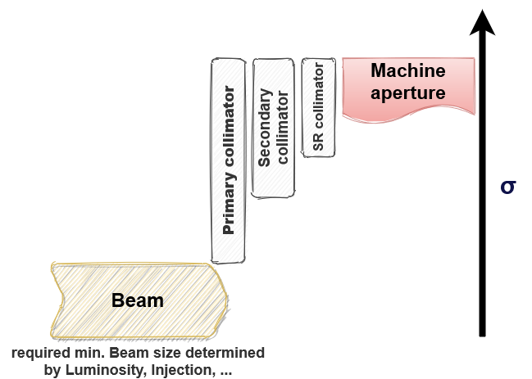
Introduction
Studies looking into defining collimation system in the FCC-ee
Collimation hierarchy bounded by two constraints
To protect machine aperture, max. collimator opening smaller than aperture bottleneck
Min. collimator opening determined by collider performance

Slide 3
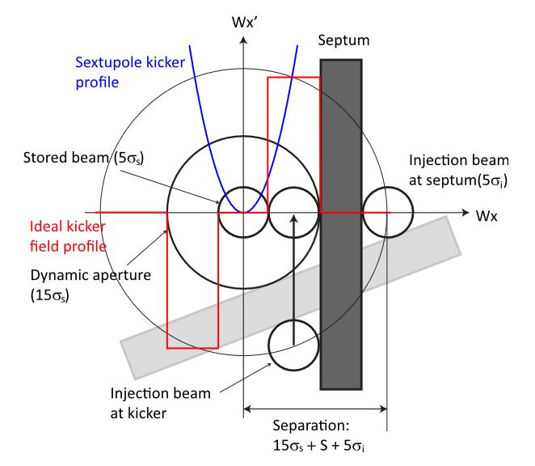
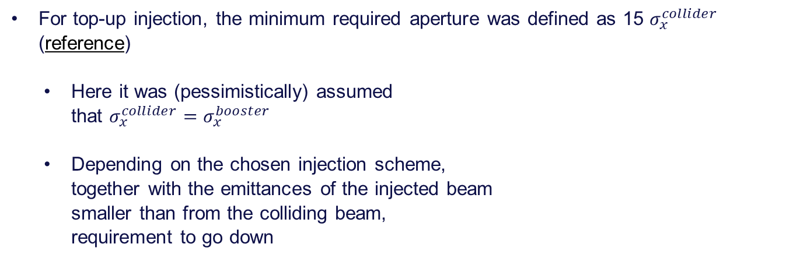
Aperture constraint from injection
For top-up injection, the minimum required aperture was defined as 15 $σ_{x}^{collider}$ (reference)
Here it was (pessimistically) assumed that $σ_{x}^{collider}=σ_{x}^{booster}$
Depending on the chosen injection scheme, together with the emittances of the injected beam smaller than from the colliding beam, requirement to go down
From M.Aiba et. al.,Top-up injection schemes for future circular lepton collider, NIM A 880 (2018)

Slide 4
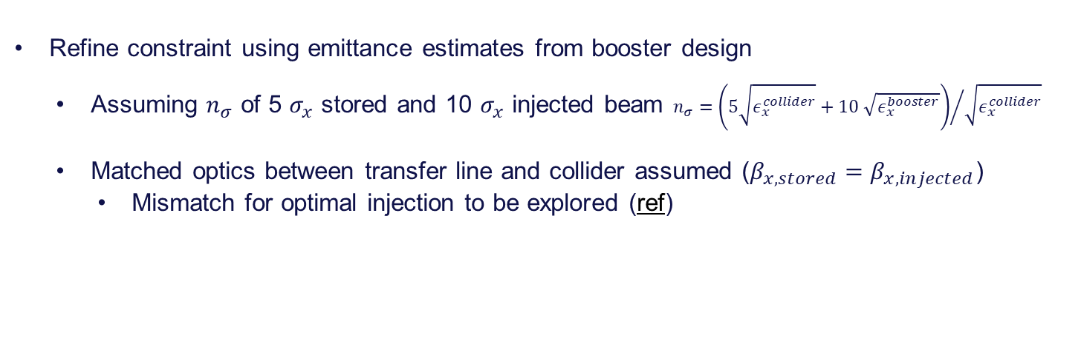
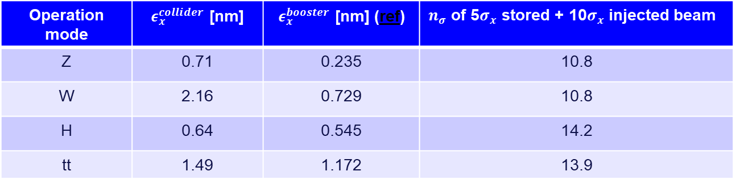
Updated injection constraint
Refine constraint using emittance estimates from booster design
Assuming $n_{σ}$ of 5 $σ_{x}$ stored and 10 $σ_{x}$ injected beam $n_{σ}={\left(5\sqrt{ε_{x}^{collider}}+10 \sqrt{ε_{x}^{booster}}\right)}/{\sqrt{ε_{x}^{collider}}}$
Matched optics between transfer line and collider assumed ($β_{x,stored}=β_{x, injected}$)
Mismatch for optimal injection to be explored (ref)
Operation mode | $ε_{x}^{collider}$ [nm] | $ε_{x }^{booster}$ [nm] (ref) | $n_{σ}$ of 5$σ_{x}$ stored + 10$σ_{x}$ injected beam
Z | 0.71 | 0.235 | 10.8
W | 2.16 | 0.729 | 10.8
H | 0.64 | 0.545 | 14.2
tt | 1.49 | 1.172 | 13.9

Slide 5
Aperture Model
Define apertures for all elements in the FCC-ee model to study minimum beam-stay-clear and as input for tracking studies
Use MAD-X APERTURE module to evaluate the beam stay clear around the ring including tolerances
Element type | Transverse misalignment [μm] | Tilt [μrad]
Arc quadrupole and arc sextupole | 50 | 100
Dipoles | 1000 | 0
IR quadrupole and sextupoles | 100 | 100
Aperture parameter
Radial closed orbit uncertainty | 250 μm
β-beating | 20%
Parasitic dispersion | 0

Slide 6
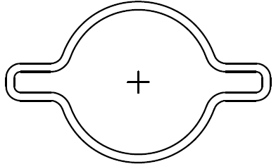

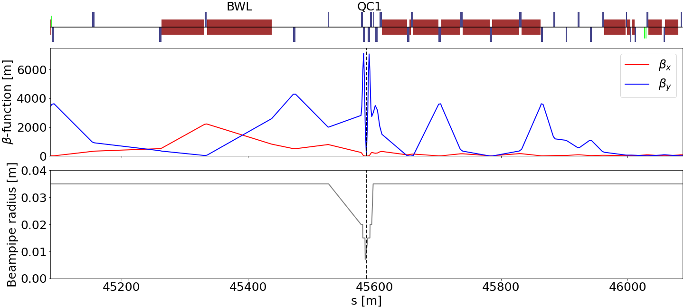
Aperture around the IP
r=35mm
For most elements, circular beampipe with 35mm radius assumed
Smaller beampipe radius in final focus quadrupoles and central chamber
Aperture bottlenecks found around the IP in all operation modes
Following plots only focus on 500m around the IP
Water-cooled SR absorber
Plot adapted from R. Kersevan, “Vacuum system”, at FCC November Week 2020

Slide 7
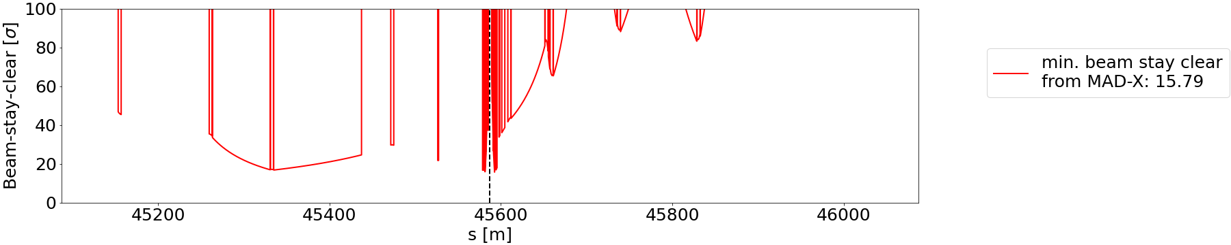

Aperture in Z-lattice
Using latest Z optics with $β_{x}^{∗}=10cm$, the aperture bottleneck is found in the final focus quadrupole

Slide 8
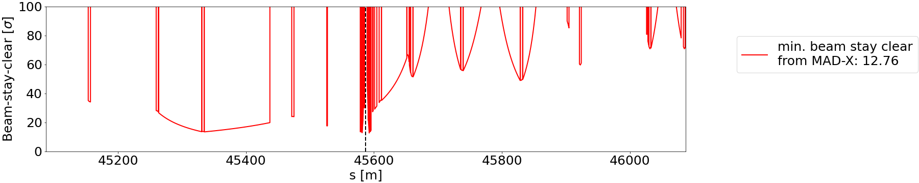
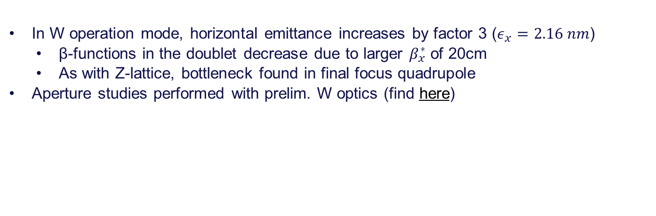
Aperture in W-lattice
In W operation mode, horizontal emittance increases by factor 3 ($ε_{x}=2.16 nm$)
β-functions in the doublet decrease due to larger $β_{x}^{∗}$ of 20cm
As with Z-lattice, bottleneck found in final focus quadrupole
Aperture studies performed with prelim. W optics (find here)

Slide 9
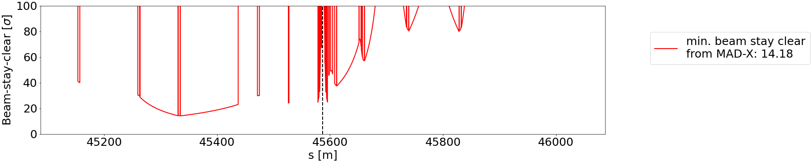
Aperture in H-lattice
Aperture studies performed with prelim. H optics (find here)
Bottleneck found in dipole upstream of IP and beam-stay-clear equal to injection requirement

Slide 10
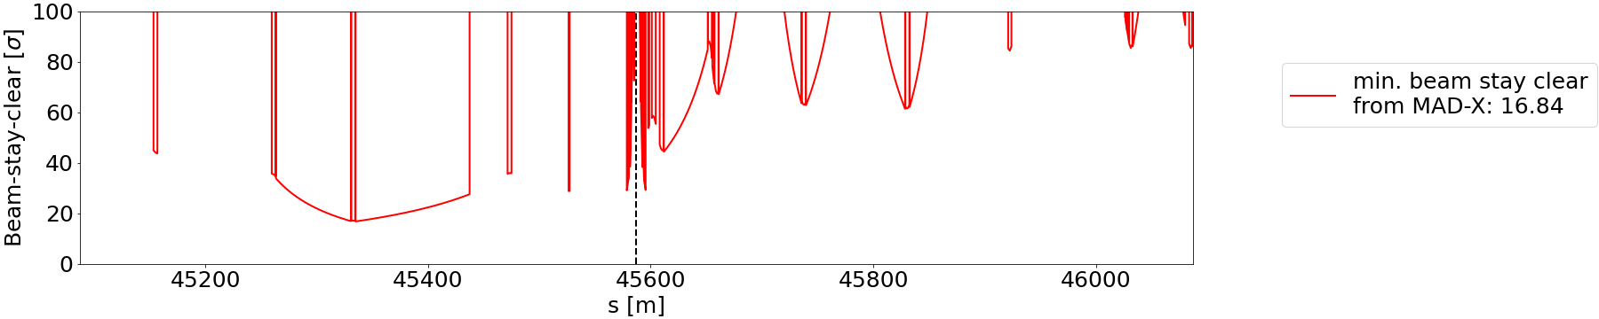
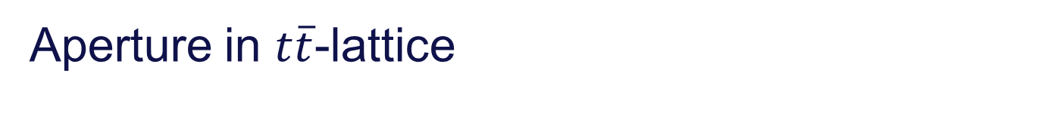

Aperture in $t\overline{t}$-lattice
As in H optics, bottleneck for $t\overline{t}$ operation also found in dipole upstream of IP
Horizontal emittance increases by factor 2 compared to H, but optics around IP more relaxed ($β_{x}^{∗}=1m$)

Slide 11
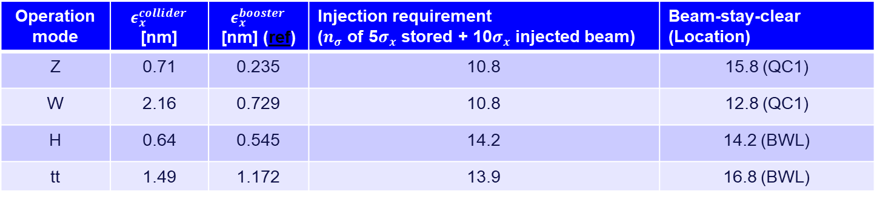
Comparison
Primary and secondary collimator settings between injection requirement and beam-stay-clear
In W and H operation mode little to no space available
Operation mode | $ε_{x}^{collider}$ [nm] | $ε_{x }^{booster}$ [nm] (ref) | Injection requirement ($n_{σ}$ of 5$σ_{x}$ stored + 10$σ_{x}$ injected beam) | Beam-stay-clear (Location)
Z | 0.71 | 0.235 | 10.8 | 15.8 (QC1)
W | 2.16 | 0.729 | 10.8 | 12.8 (QC1)
H | 0.64 | 0.545 | 14.2 | 14.2 (BWL)
tt | 1.49 | 1.172 | 13.9 | 16.8 (BWL)

Slide 12
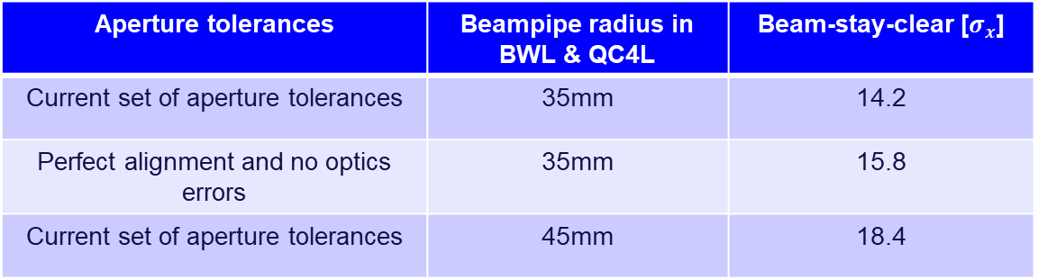
Mitigations
H-lattice was used to study effect of mitigation measures
Tighter tolerances on alignment, beta-beating, or closed orbit
Increase beam screen diameter locally in BWL and QC4L
Aperture tolerances | Beampipe radius in BWL & QC4L | Beam-stay-clear [$σ_{x}$]
Current set of aperture tolerances | 35mm | 14.2
Perfect alignment and no optics errors | 35mm | 15.8
Current set of aperture tolerances | 45mm | 18.4

Slide 13
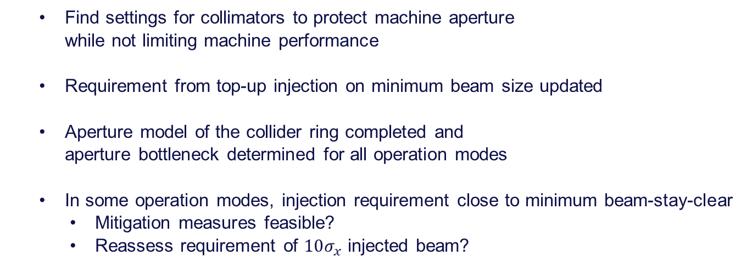
Conclusions
Find settings for collimators to protect machine aperture while not limiting machine performance
Requirement from top-up injection on minimum beam size updated
Aperture model of the collider ring completed and aperture bottleneck determined for all operation modes
In some operation modes, injection requirement close to minimum beam-stay-clear
Mitigation measures feasible?
Reassess requirement of $10σ_{x}$ injected beam?

Slide 14
Thanks for your attention!

