Slide 1
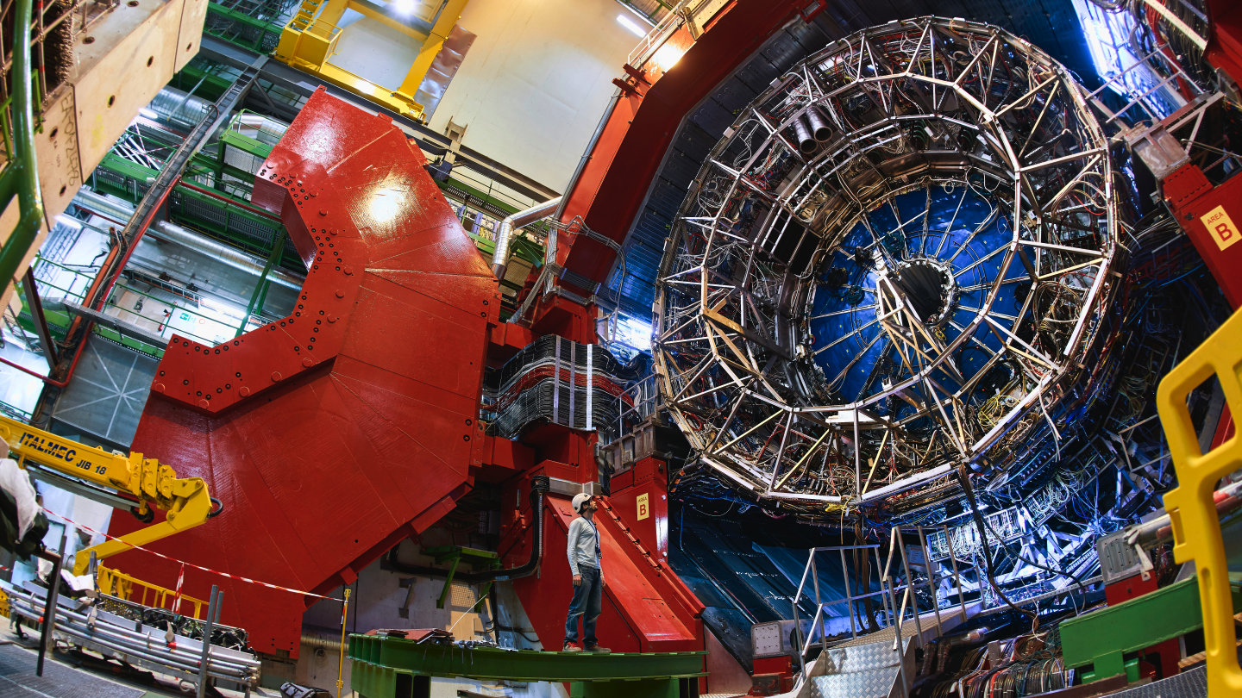

India-ALICE@CERN-LHC
Bedanga Mohanty
(NISER, India)
bedanga@niser.ac.in

Slide 2
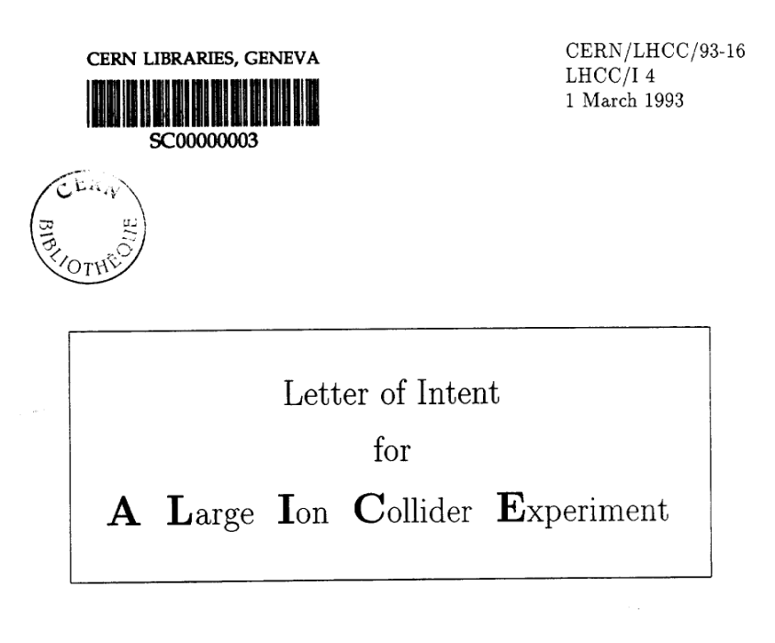
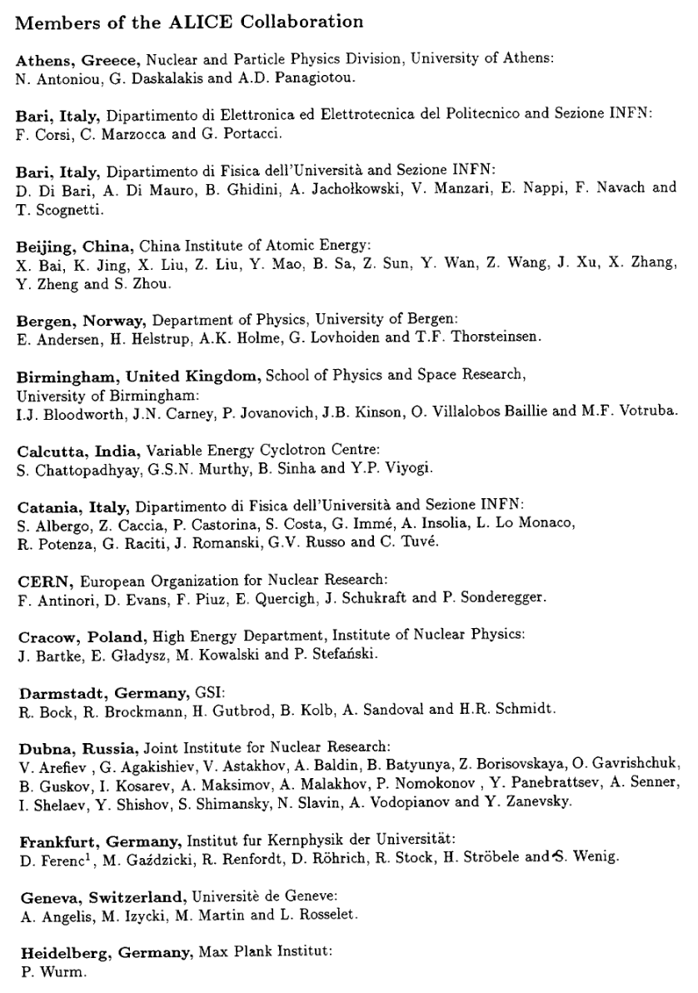
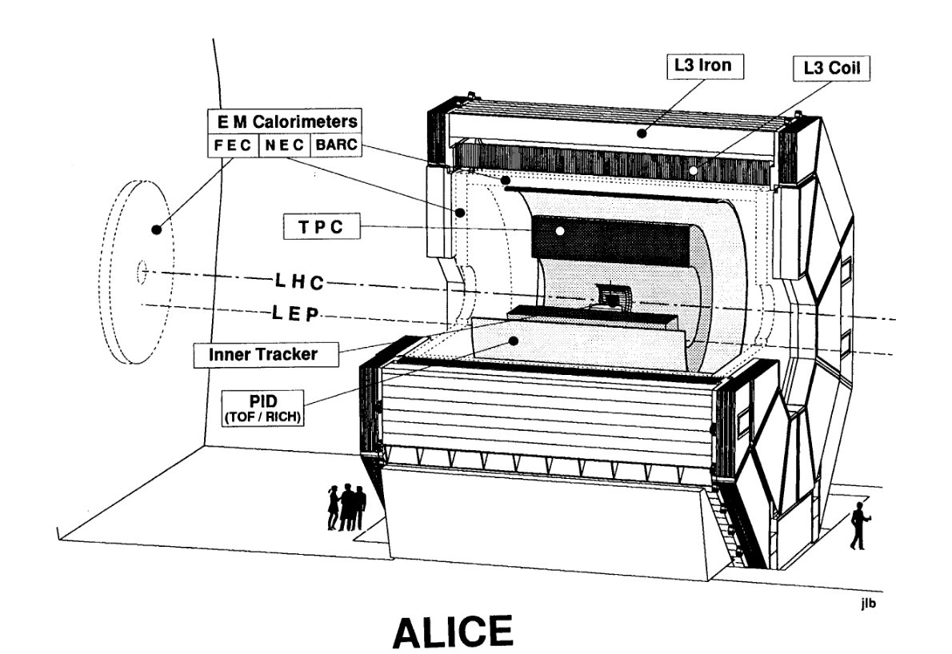





India-ALICE@CERN-LHC
India founding member of ALICE
Outline
Physics Goals
Institutes/Universities
Publications and Human Resource Developments
Scientific assignments/managements
Contribution to detectors
Industry participation
Summary of contributions 2021
Other recent contributions
Contribution to WLCG
Outlook
India is Associate Member of CERN
India-ALICE@CERN-LHC funded by DAE-India and DST-India

Slide 3
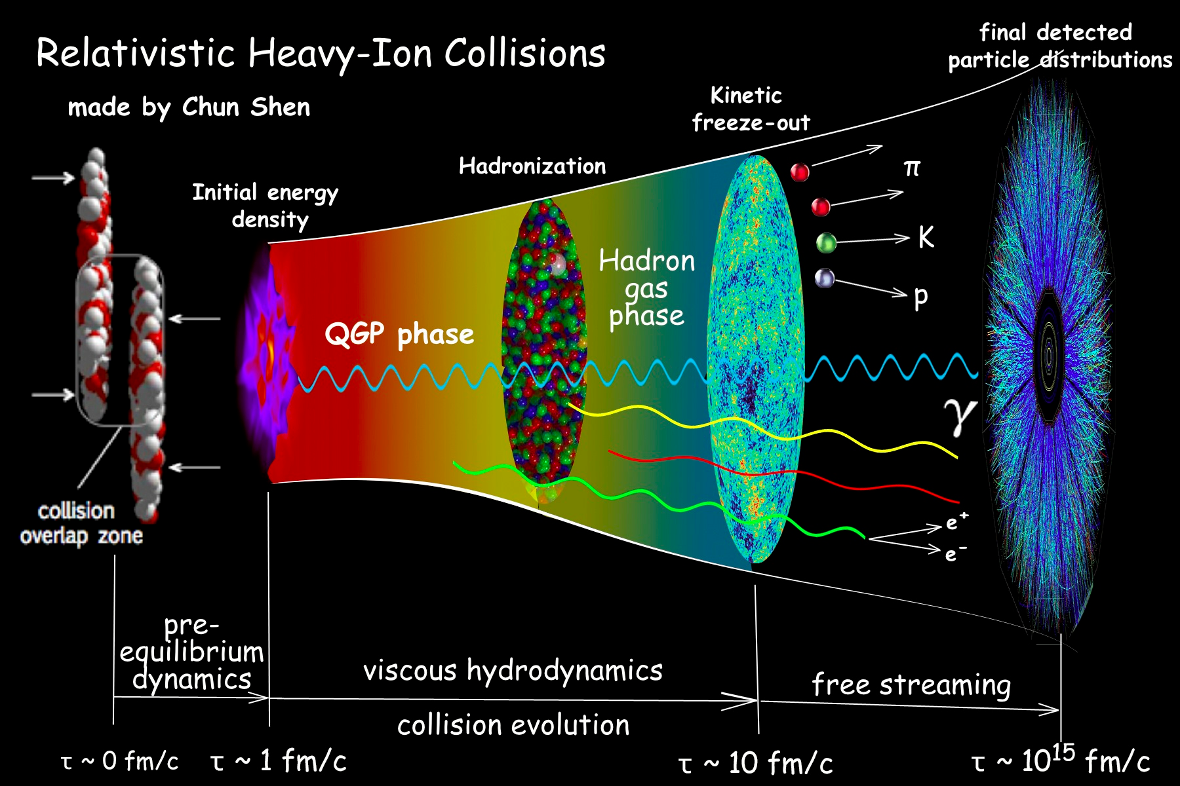
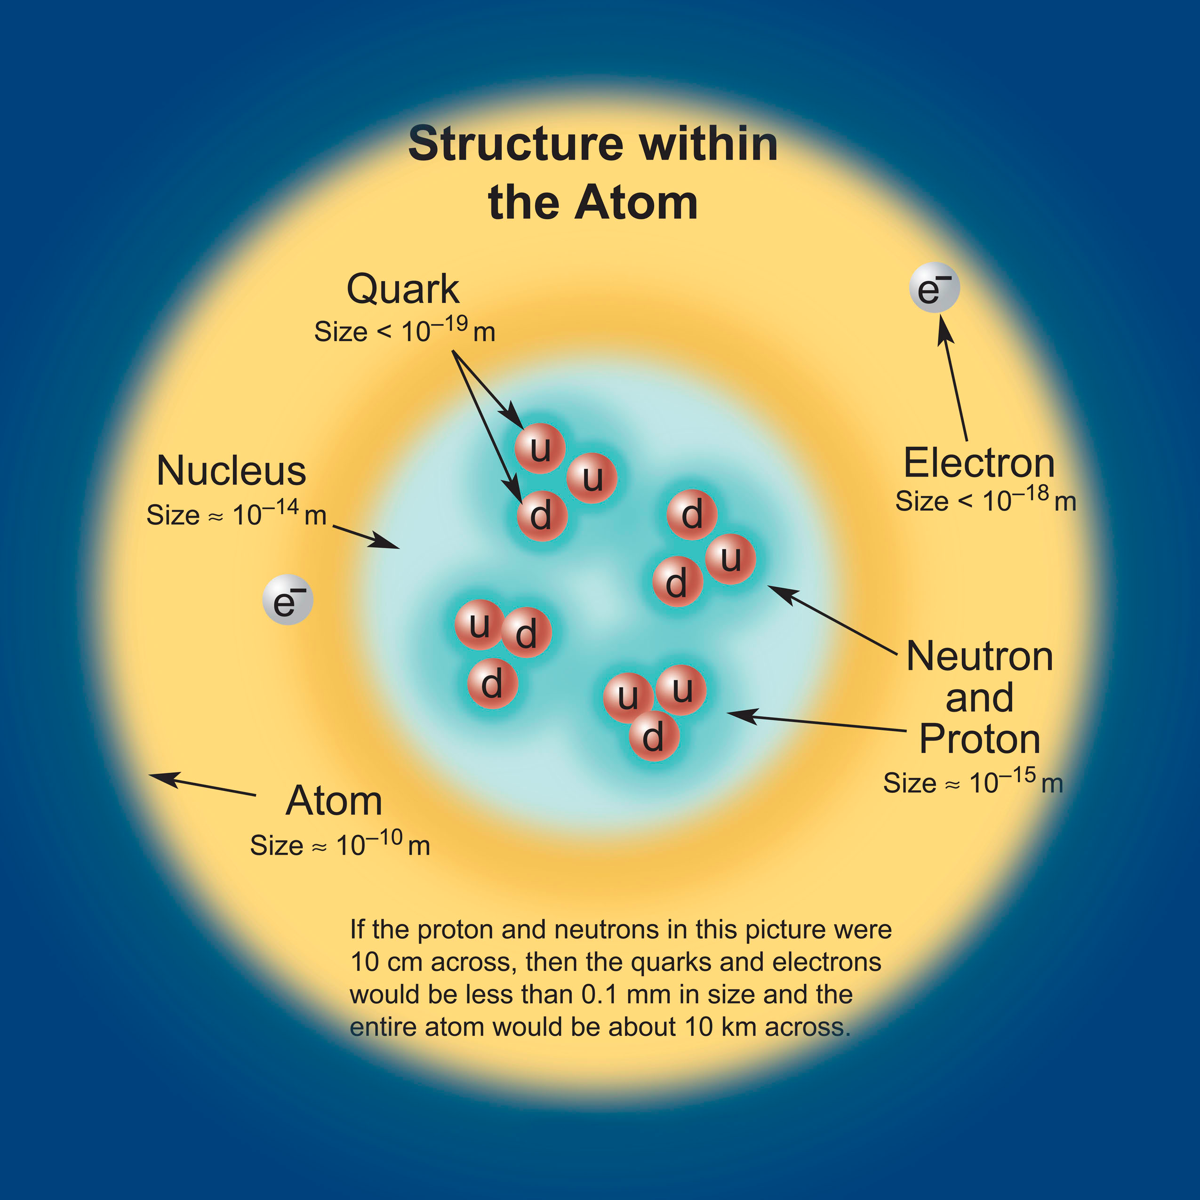
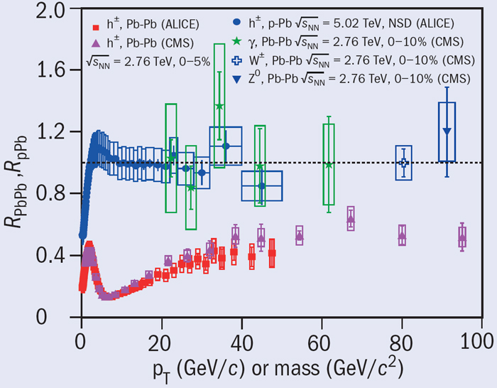
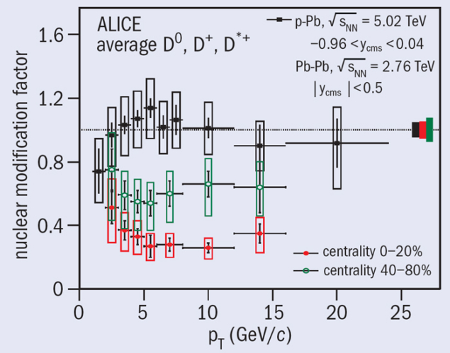
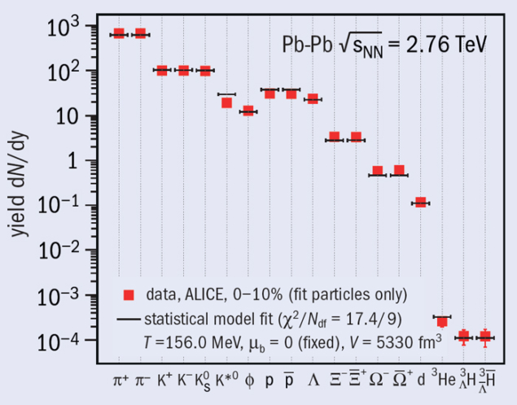
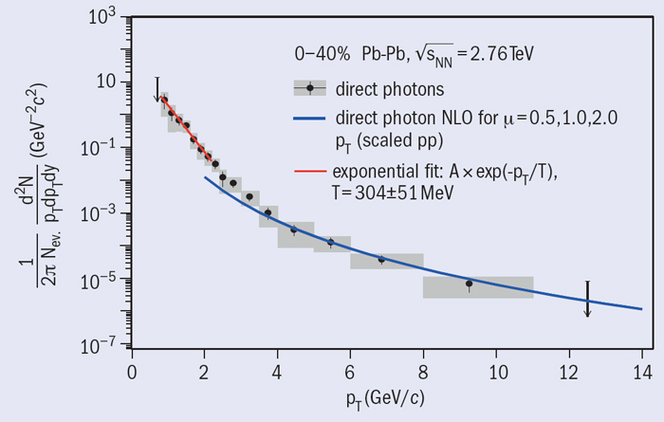
Quark Gluon Plasma produced at LHC
Quark and Gluon confined inside hadrons – Aim to have free Quark Gluon Plasma (Early Universe) – Deconfinement transition
Quark mass fraction of proton < 2%
Chiral symmetry breaking – Aim to create a Chiral transition
Experimental signature of Quark Gluon Plasma produced at LHC
Quark Matter 2014 – CERN Courier 22 May 2014, 27 September 2013 Andreas Morsch, CERN,

Slide 4
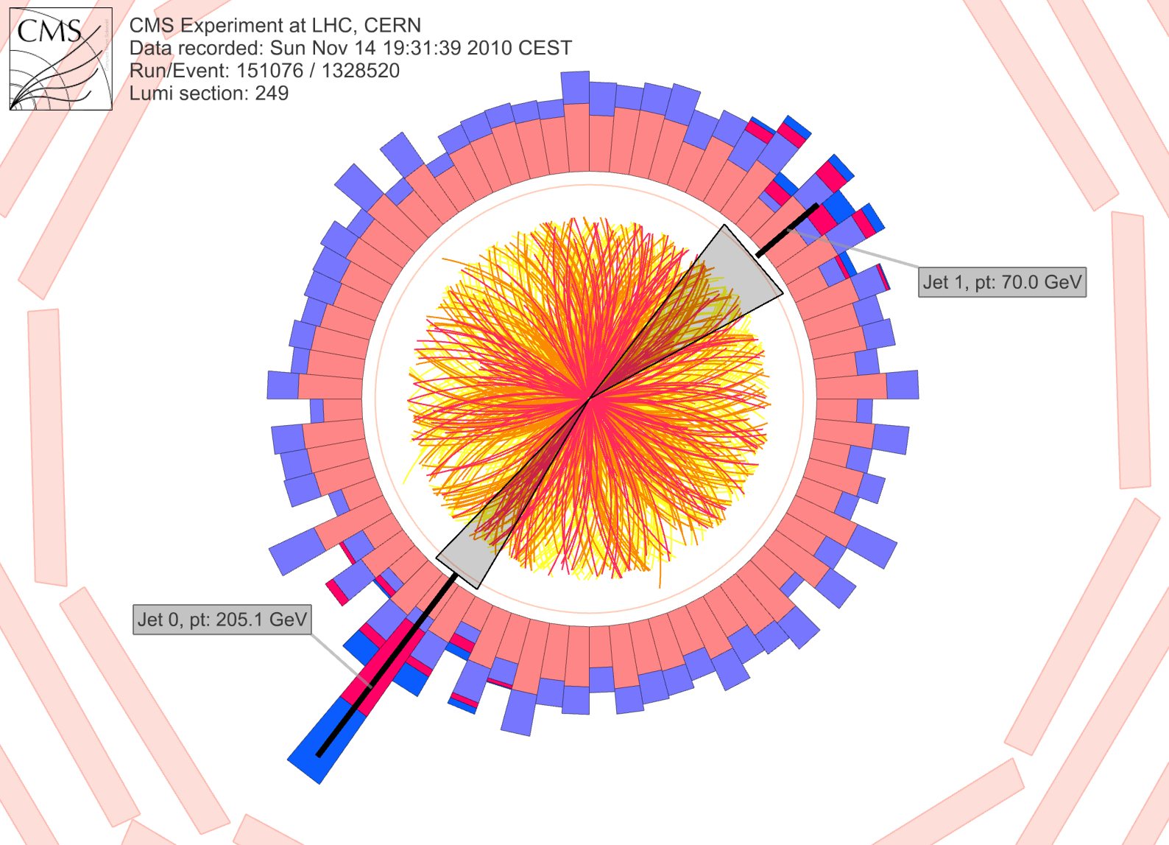
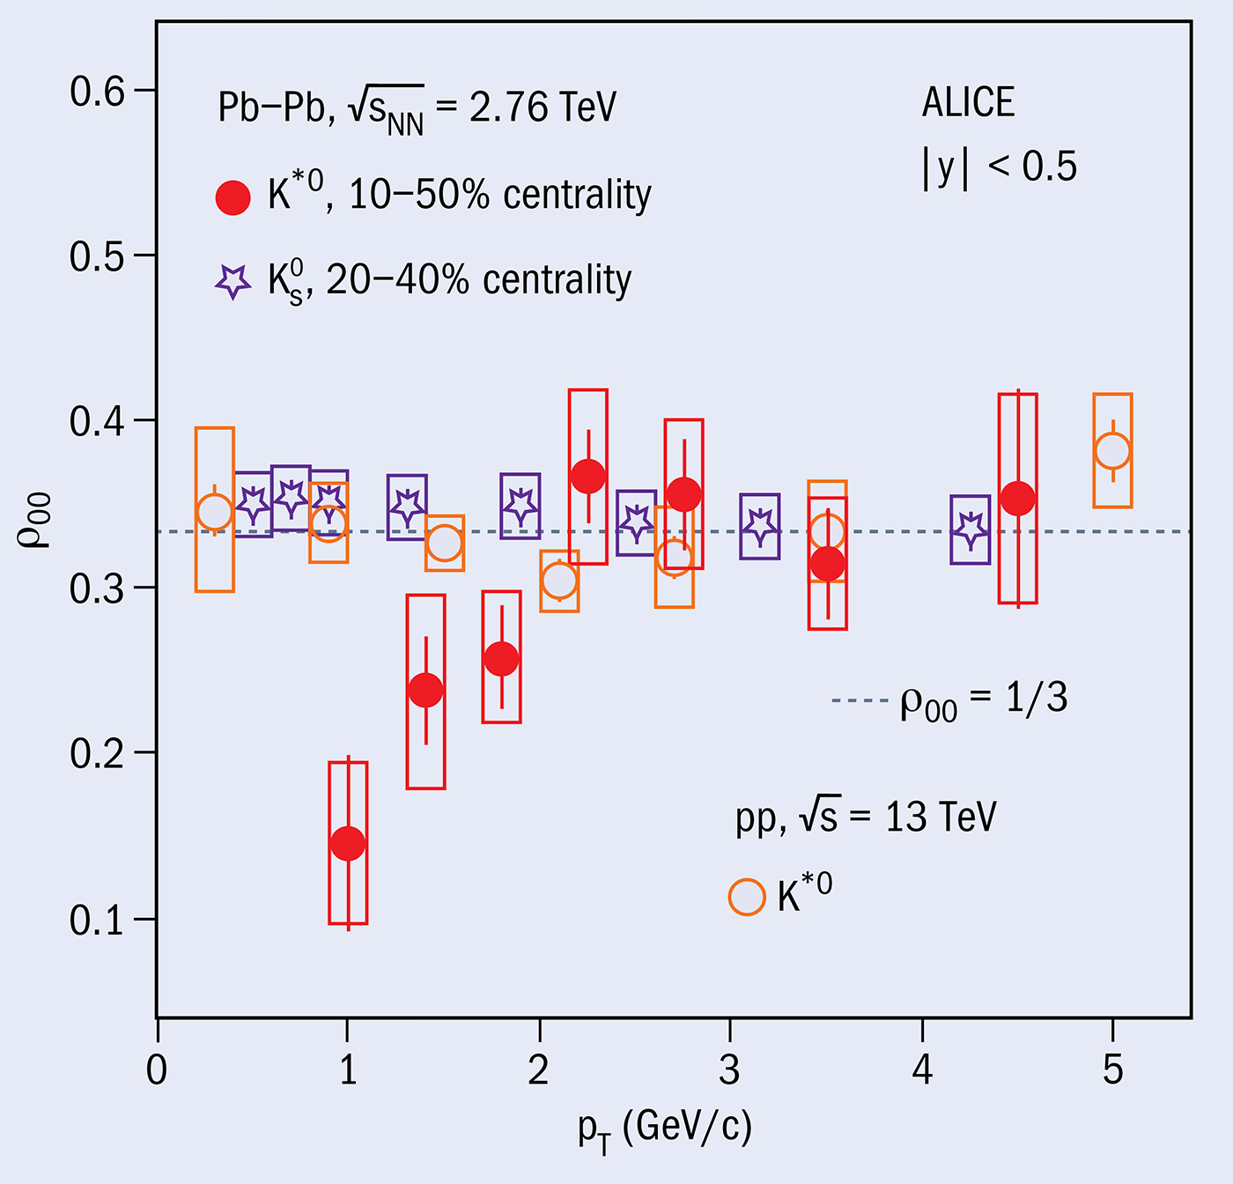
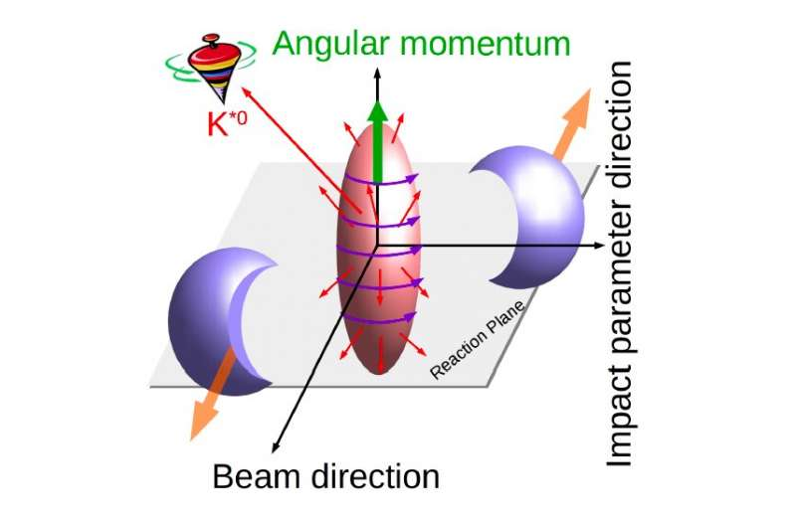
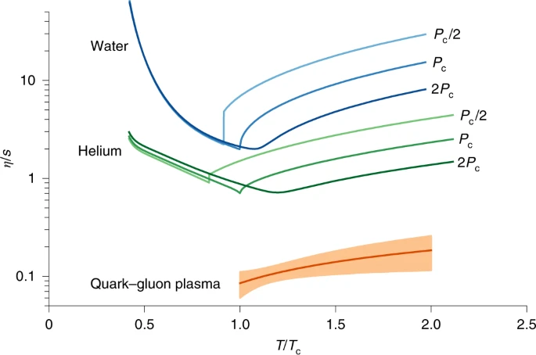
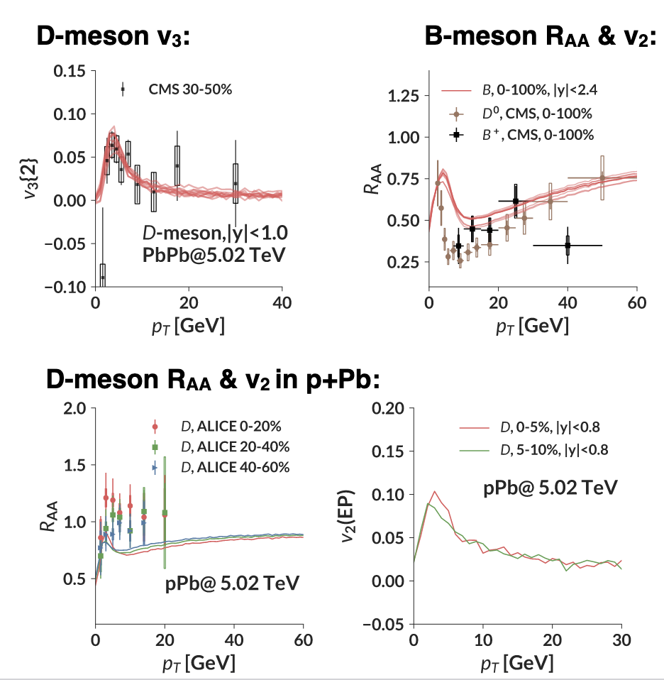
Quark Gluon Plasma properties
Phys.Rev.Lett. 125 (2020) 1, 012301
Perfect Fluid (shear viscosity to entropy density)
Polarized Plasma (polarization of hyperons and vector mesons)
High Opacity (Jet quenching)
Diffusion coefficient (need precision data in heavy quark sector)
Nature Physics, 15, 1113 (2019)
S. Bass @ ALICE3
4/26

Slide 5
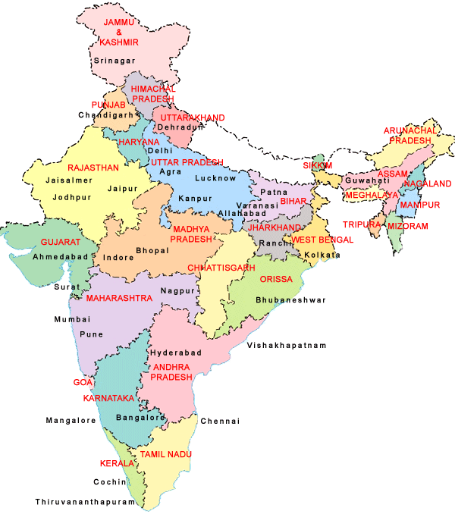
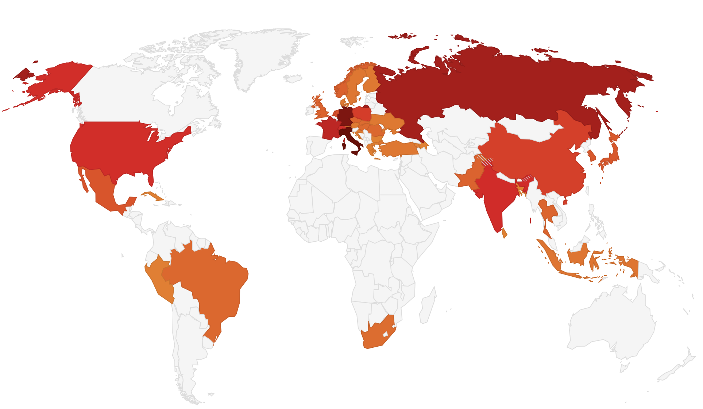
India-ALICE-CERN
Indian Institutes in ALICE
Kolkata: VECC
Kolkata: SINP
Kolkata: Bose Institute
Kolkata: University of Calcutta*
Kolkata; Jadavpur University*
Aligarh: Aligarh Muslim University
Bhubaneswar: Institute of Physics
Bhubaneswar: NISER
Chandigarh: Panjab University
Guahati: University of Guwahati
Indore: IIT
Jammu: University of Jammu
Mumbai: IIT, Bombay
Mumbai: BARC*
* Associate members
Jammu (Jammu Univ.)
Chandigarh (Panjab Univ.)
Aligarh (AMU)
Indore (IIT)
Guwahati
(Univ. of Guwahati)
Kolkata
(VECC, SINP, Bose Inst., Calcutta Uni.)
Mumbai
(IIT-B,
BARC)
42 Countries, 173 Institutes
1946 Members
about 1000 signing authors
Bhubaneswar
(IOP,NISER)
Due to interesting physics program, we are expanding – proposals from new institutes from West, South and East part of India have been received
India in ALICE
125 members
51 Ph.D. scientists
37 authors
India is a major partner in ALICE since its inception
Largest non-European participation

Slide 6
India participation in ALICE-physics @CERN-LHC
Study of quark gluon plasma and its properties
Involvement in almost all physics working groups
Physics WG | ~ Indians involved | Analysis work carried out by Indian groups
PWG-MM | 8 | Analysis of the PMD data
PWG-CF | 14 | EbyE fluctuations, higher moments, intermittency, Particle correlations, Flow, and HBT
PWG-LF | 18 | Spectra, All hadronic resonances: K*, φ, Λ*, … Nuclei and exotica
PWG-DQ | 10 | J/ψ production, Inclusive production of Upsilon(1S), Upsilon(2S) and Upsilon(3S) Heavy Flavour muons
PWG-JE | 5 | Jet shape, jet properties
PWG-GA | 2 | Neutral pions, isolated photons
PWG-HF | 18 | Hadronic decays of heavy flavour Heavy flavour leptons Correlations and jets
Slide from L. Musa (CERN) – CERN-India - 2 September 2021

Slide 7
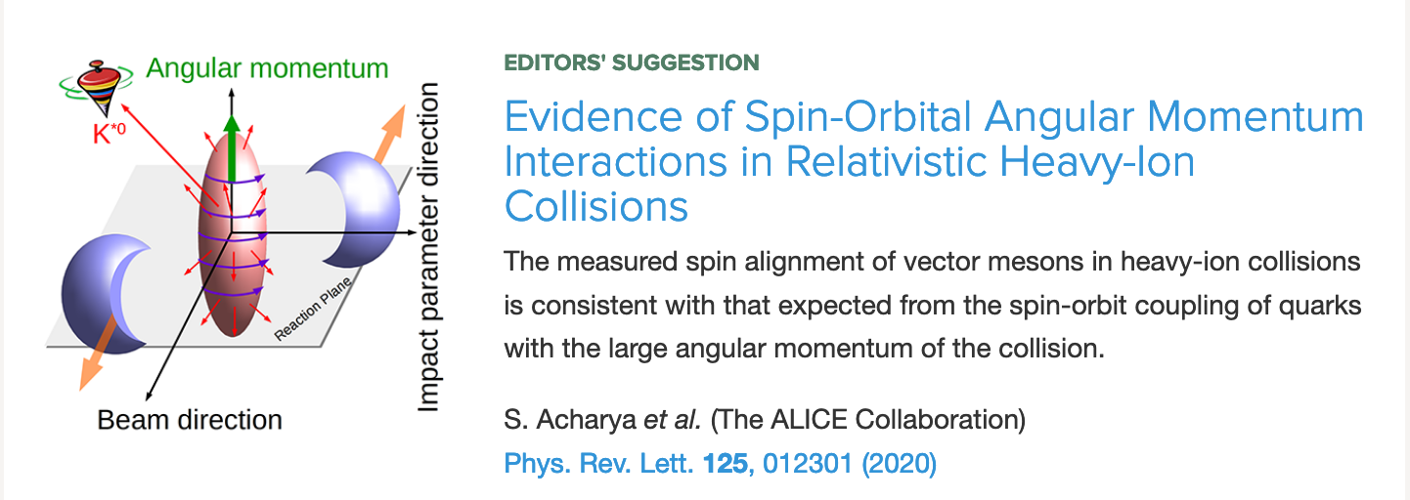
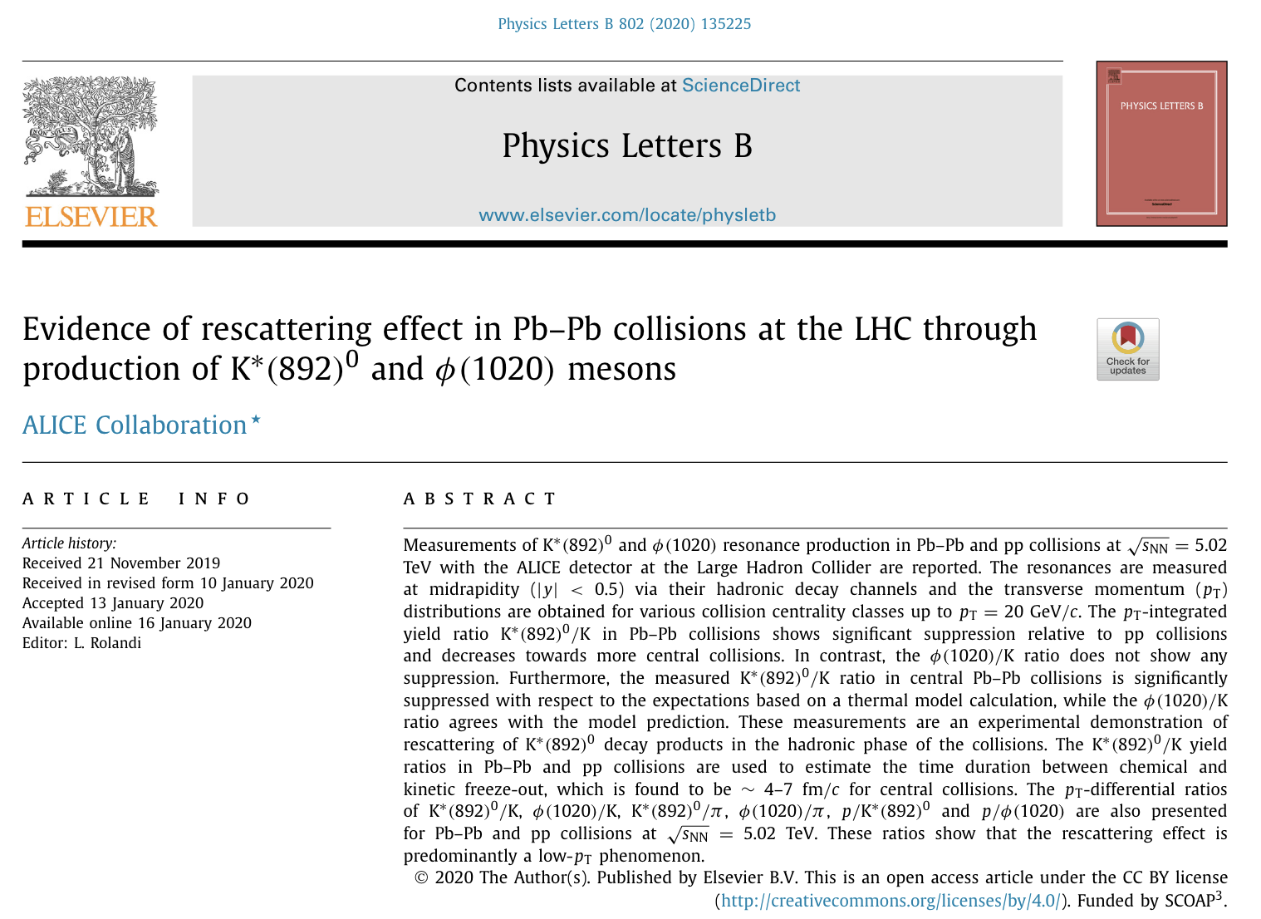
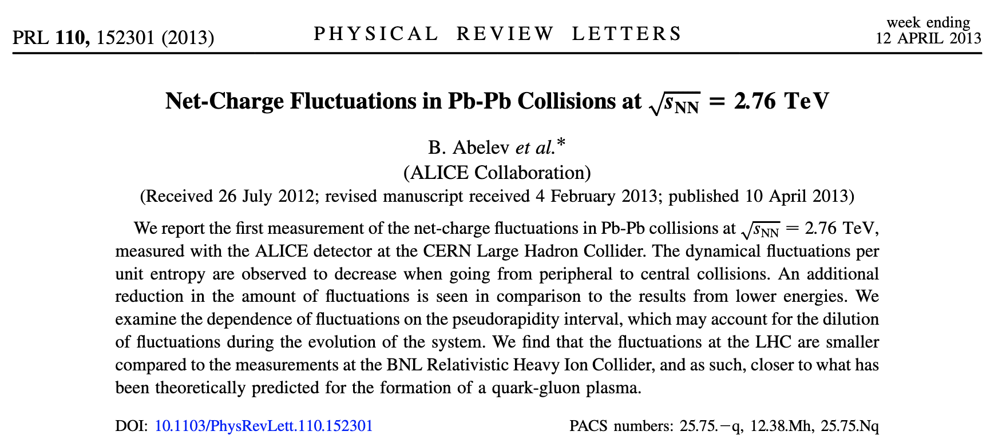
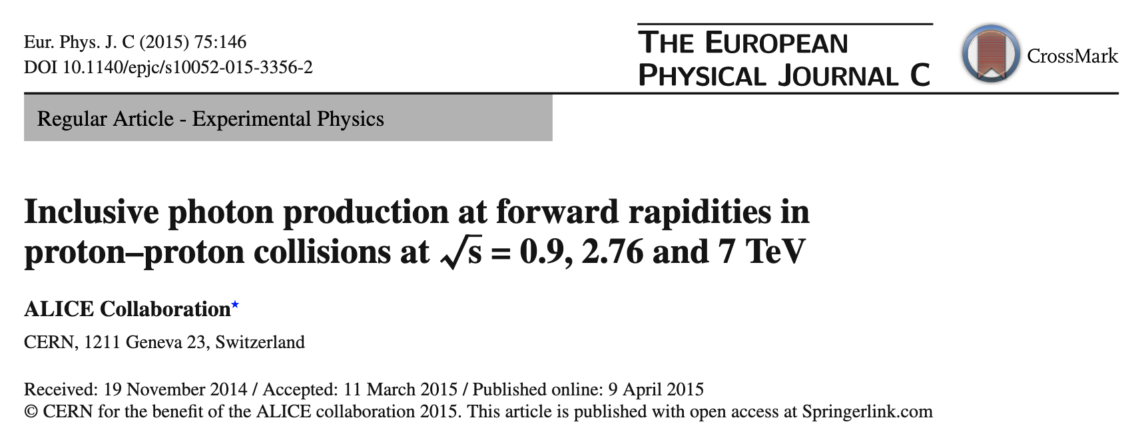
India participation in ALICE-physics @CERN-LHC
Selected – physics results with India only involvement

Slide 8
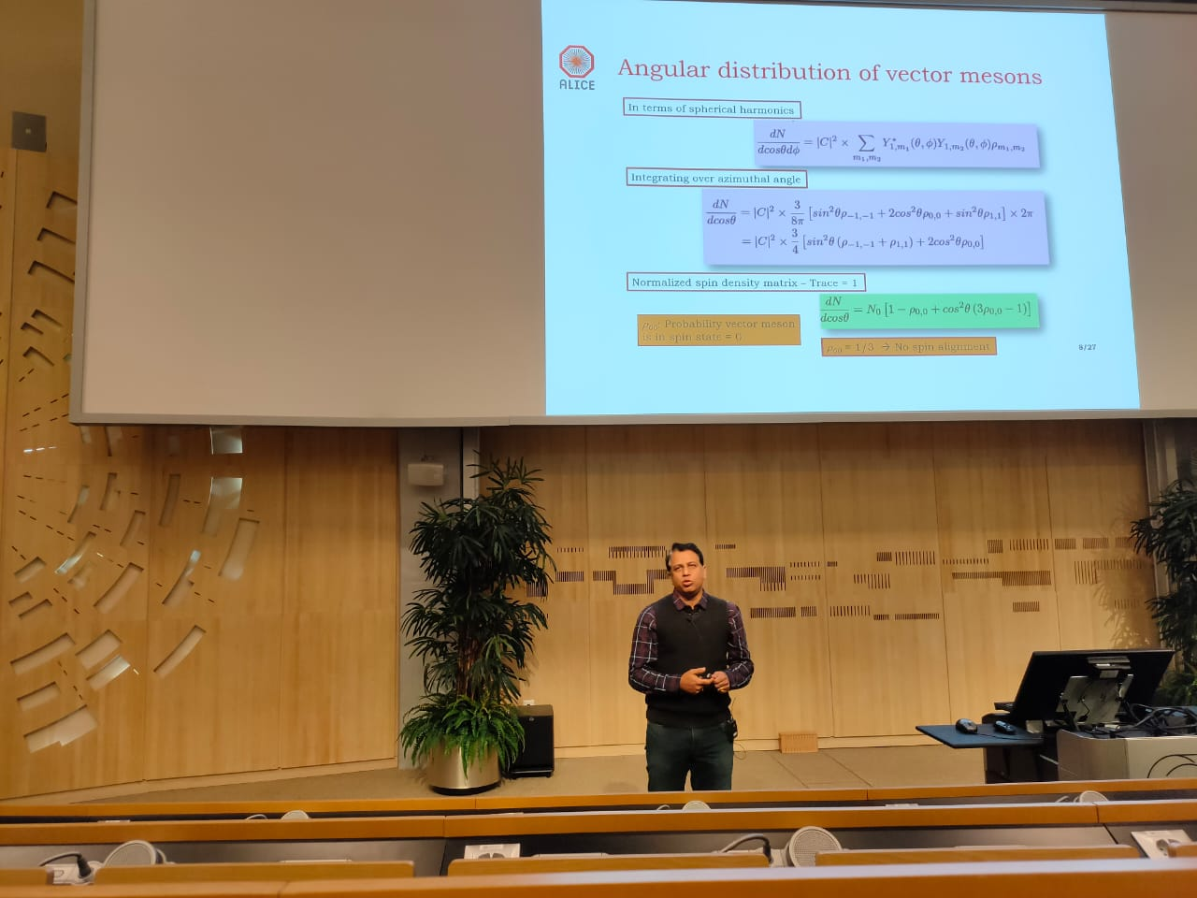
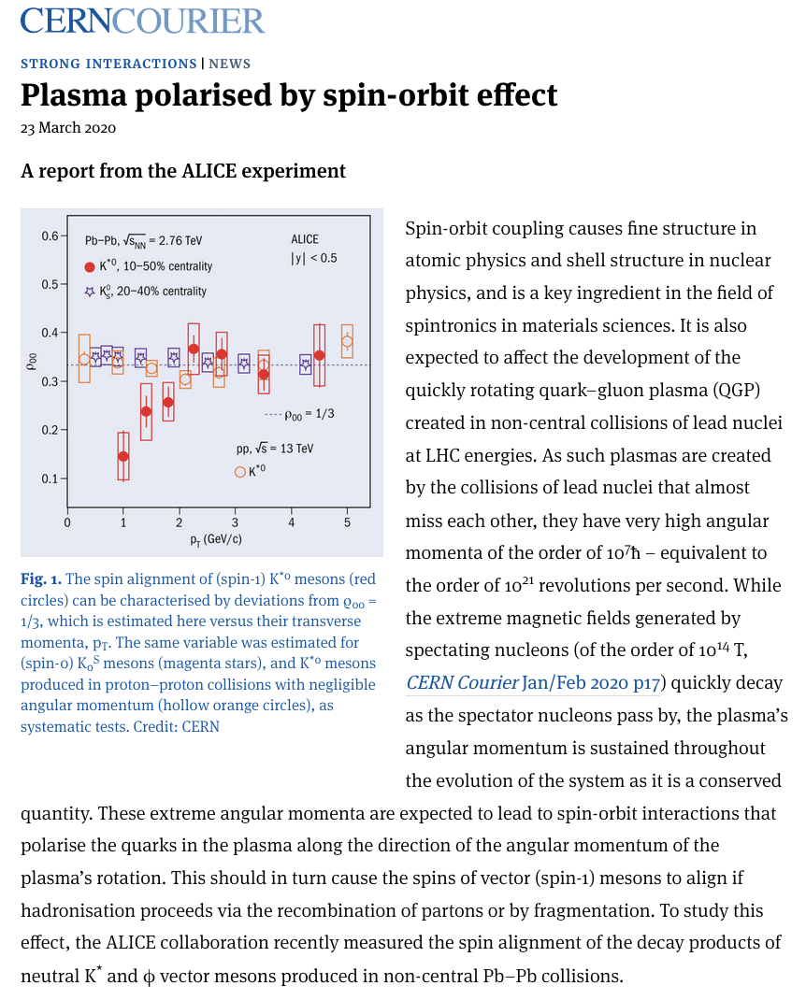
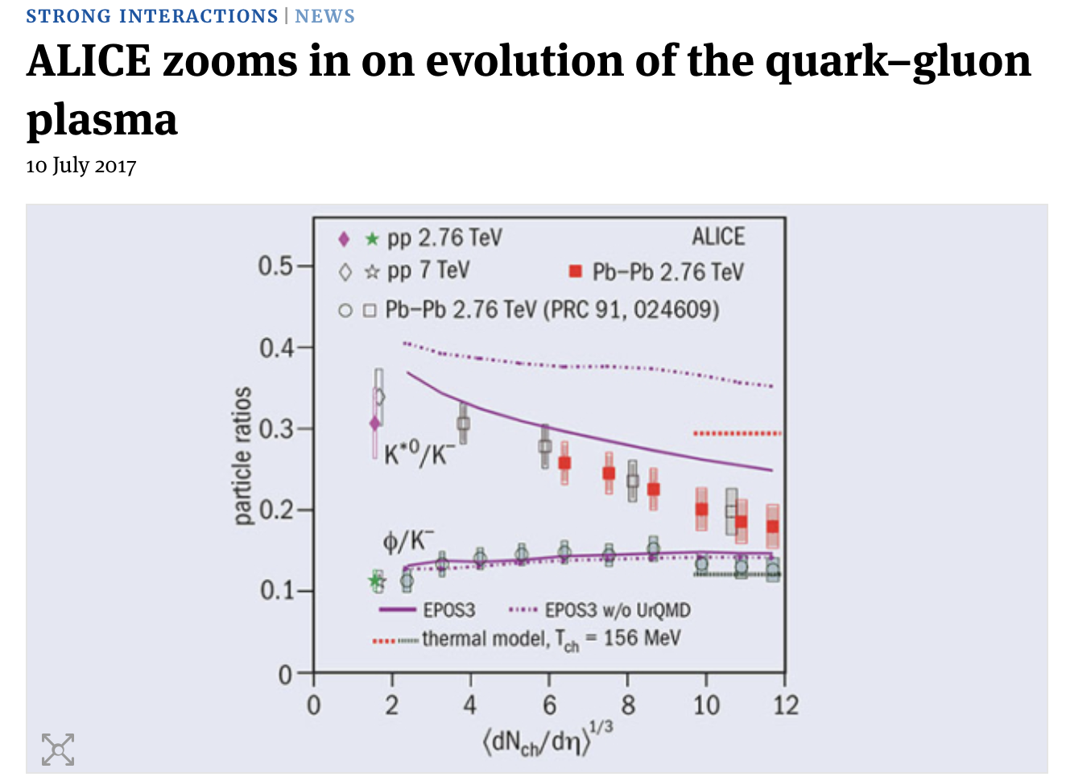
Publications and Human Resource Developments in ALICE and recognitions
Physics highlighted in CERN Courier and Talks in LHC seminars (selected examples)
Published in Journals : 50
PhD graduated: 55
Masters Thesis: 08
Scientific recognitions due to contributions in ALICE Physics (partial list)
Four members from India-ALICE preparing Nuclear Physics Mega Science Vision Document 2035, organized by PSA office, GOI
One member received the INFOSYS & SSB Prize in Physical Sciences
4 Members are Fellow of National Academies in India
IAC members in QM/SQM/ATHIC, ACCU member, Organizing committee DAE-NP Symp.,
ex-PhD students INSA young scientist
Scientific Associates@CERN & CERN Fellow.

Slide 9
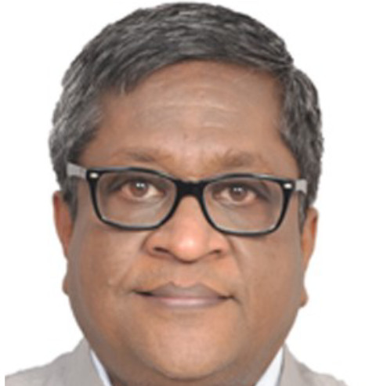
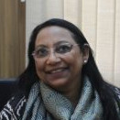
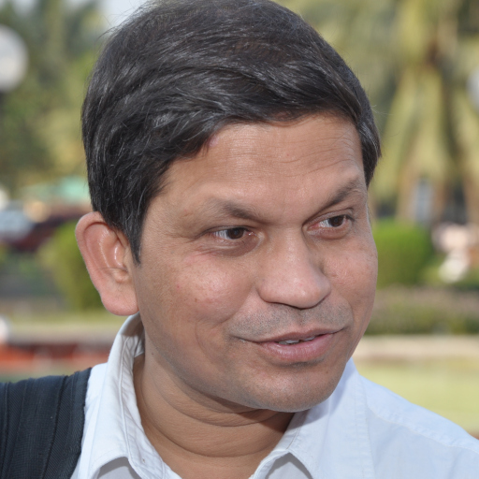

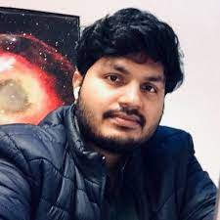
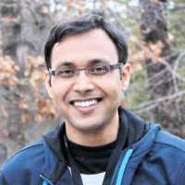
Scientific positions/management in ALICE
(partial list)
Tapan Kumar Nayak
Was Deputy Spokesperson
and currently E-by-E PAG Co-ordinator
Bedangadas Mohanty
is currently Conference Committee member and was Editorial Board Member
Sudhir Raniwala
Was Conference Committee, Editorial Board and Thesis Committee Member
Anju Bhasin
Was Management Board Member
Sushant Tripathy
Ex-PhD students in leadership role
as Physics Analysis Group Coordinator
Rihan Haque

Slide 10
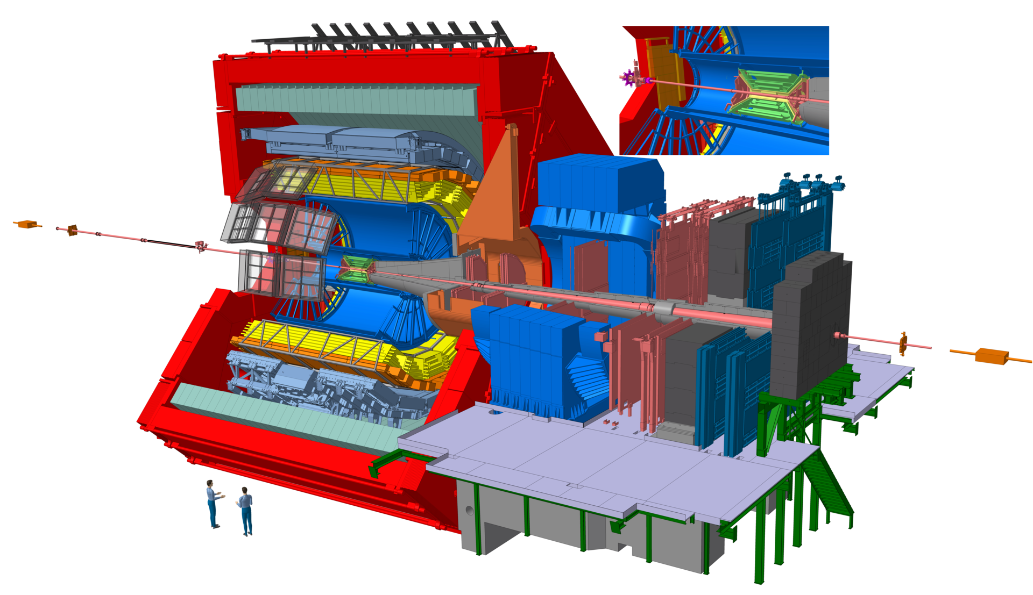
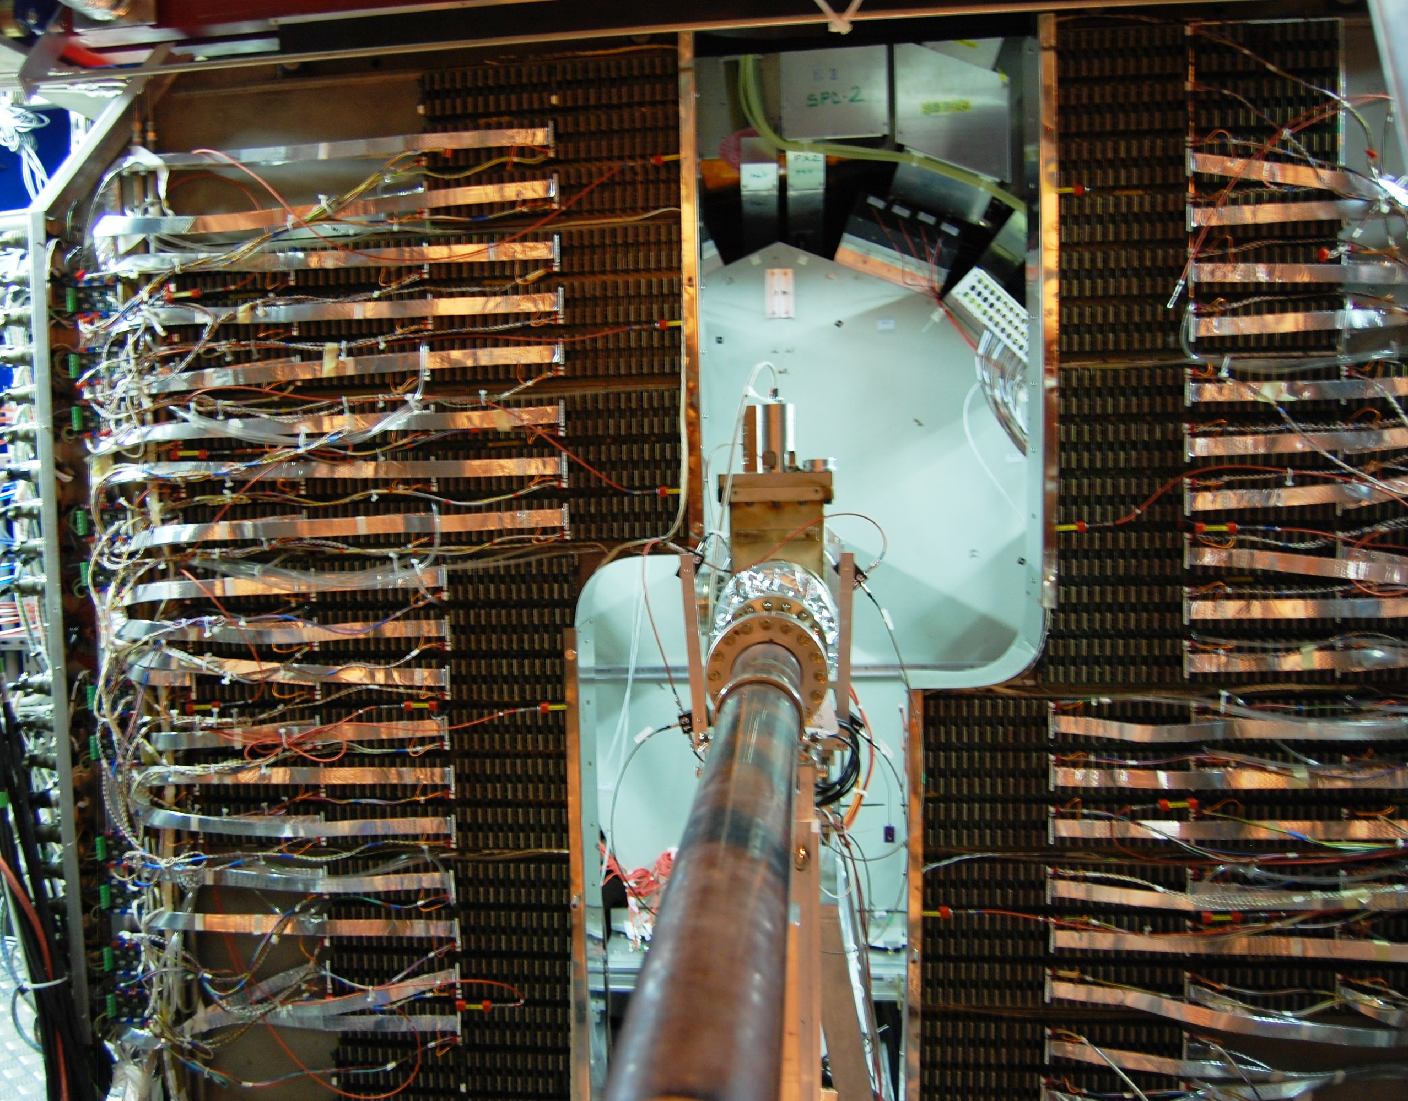

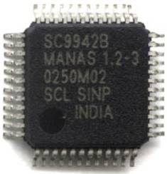
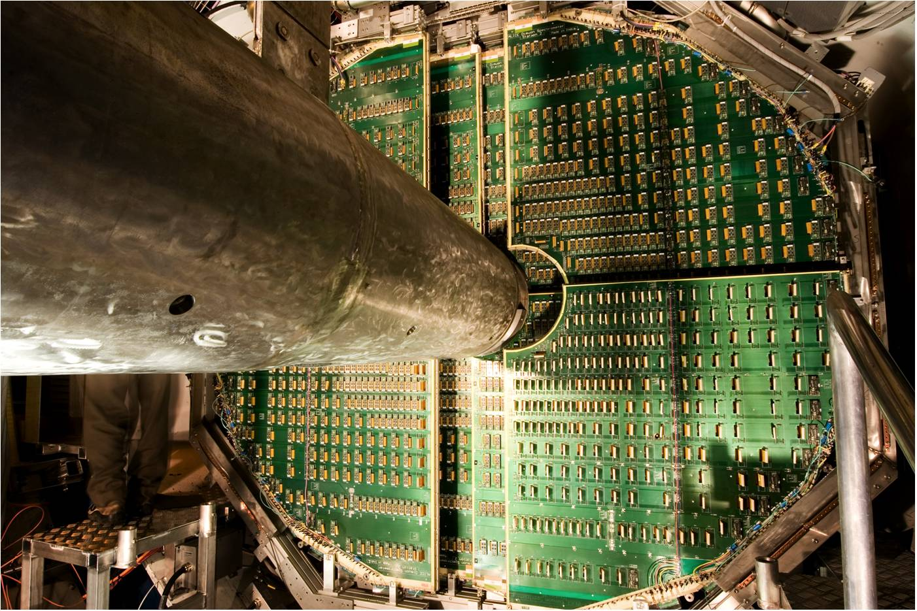
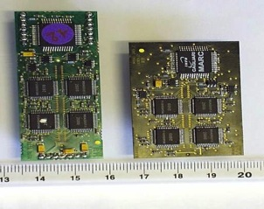
India participation in ALICE-detector@CERN-LHC
PMD: 100 % Indian effort: from conception to commissioning (design, fabrication, installation, controls, DAQ)
48 Modules with 221,184 gas cells
MUON arm
μ-pairs
PMD
photons
Station-2 of Muon arm Collaboration France, India, Italy and Russia
Cathode Pad Chambers ~100m²
1.1x10⁶ channels, occupancy < 5% (in Pb+Pb)
Read out rate:1 kHz
Chamber material thickness: ~ 3% X0
Spatial resolution: ~50 μm
MANAS: 16-channel shaping-amplifier and track-and-hold
MANU board: readout of 1.1 million-channel
First large-scale production of ASICs in India

Slide 11
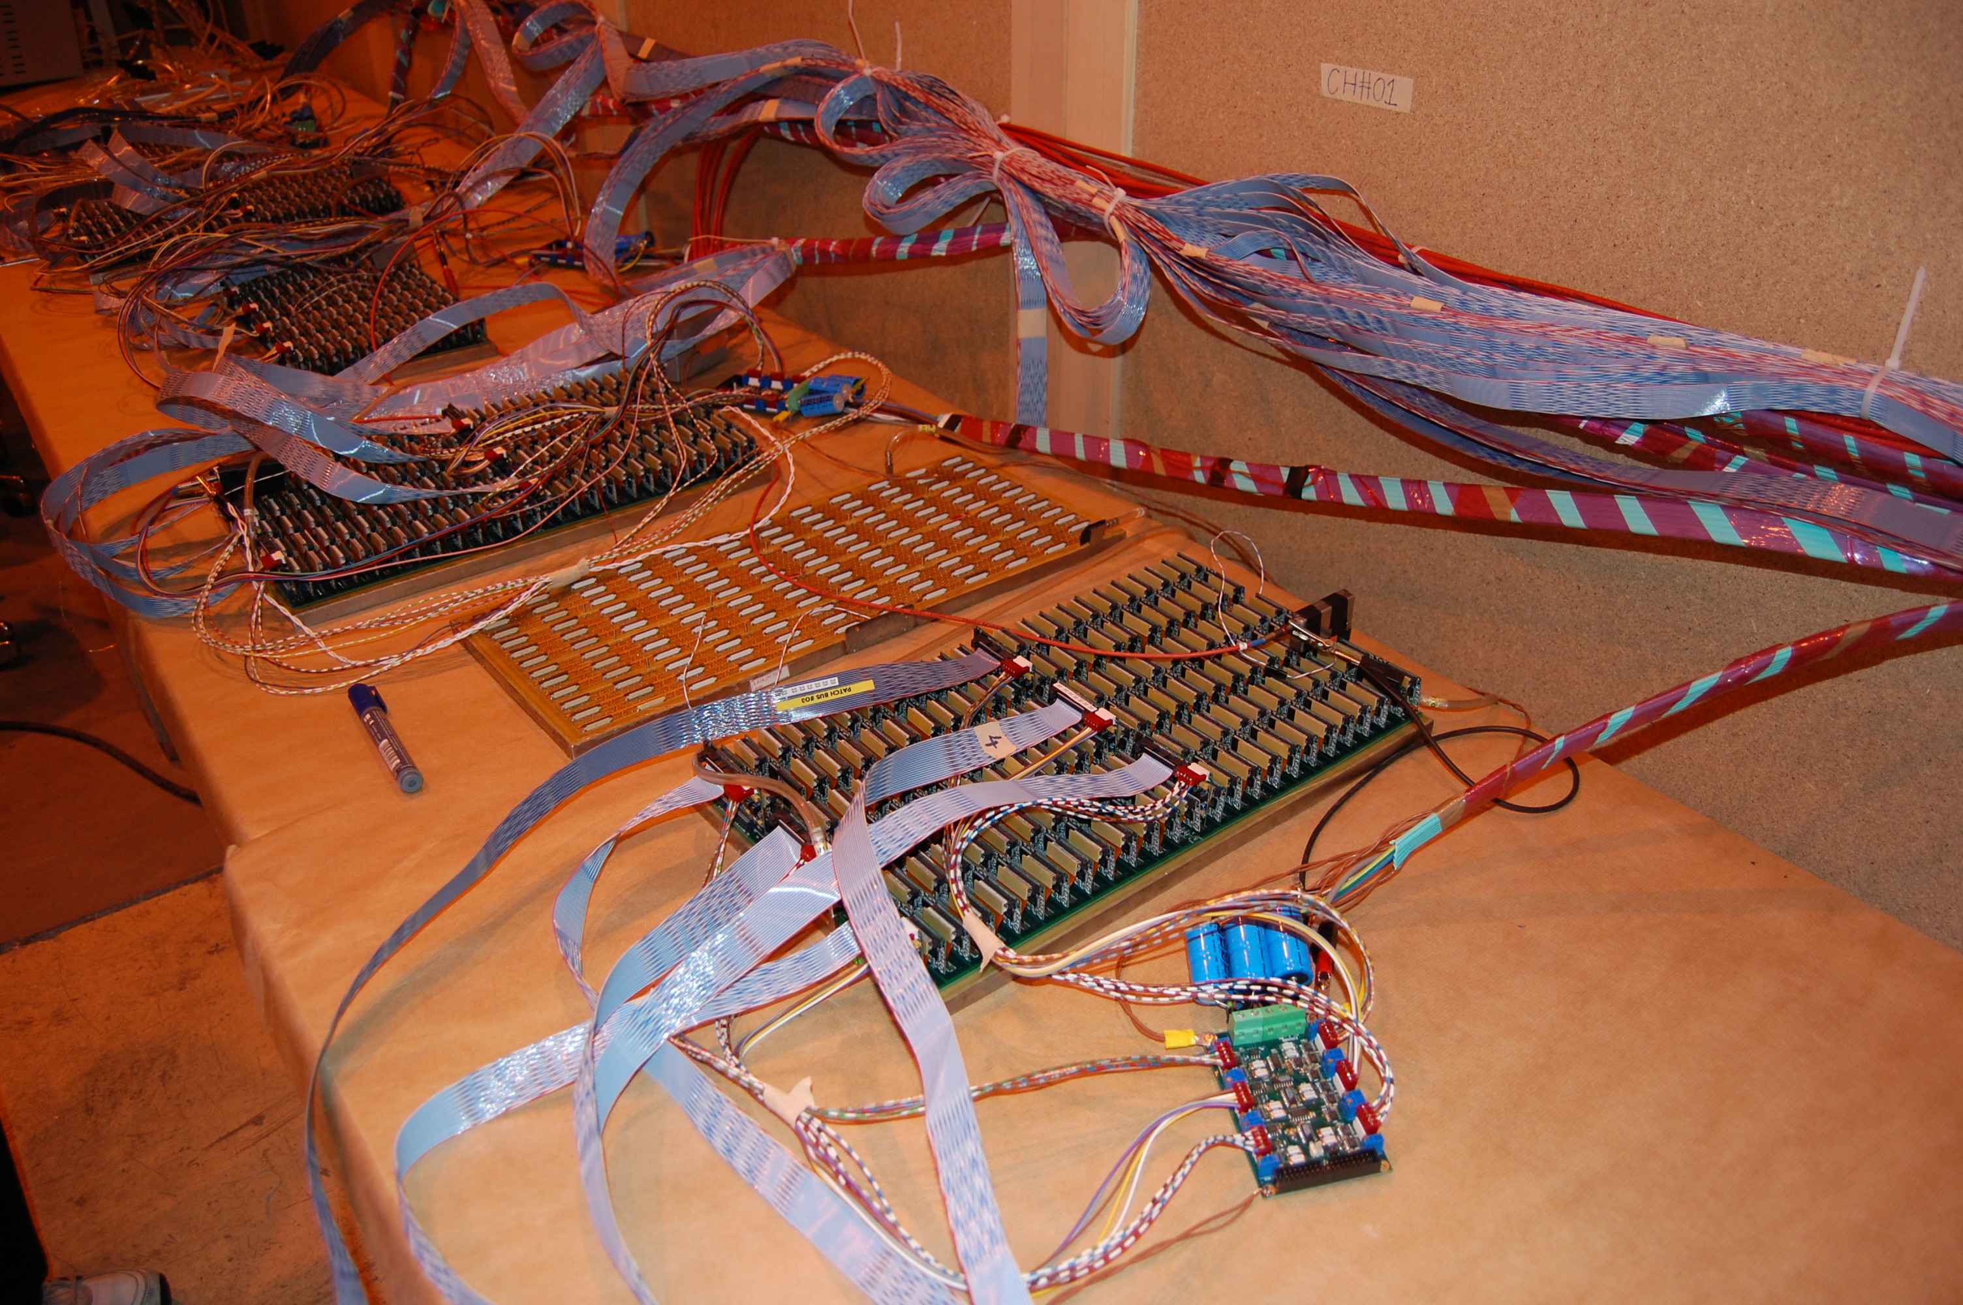
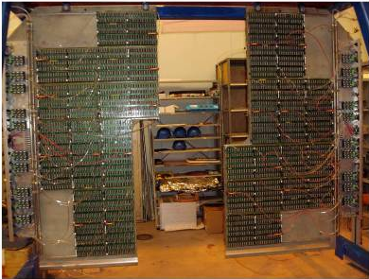
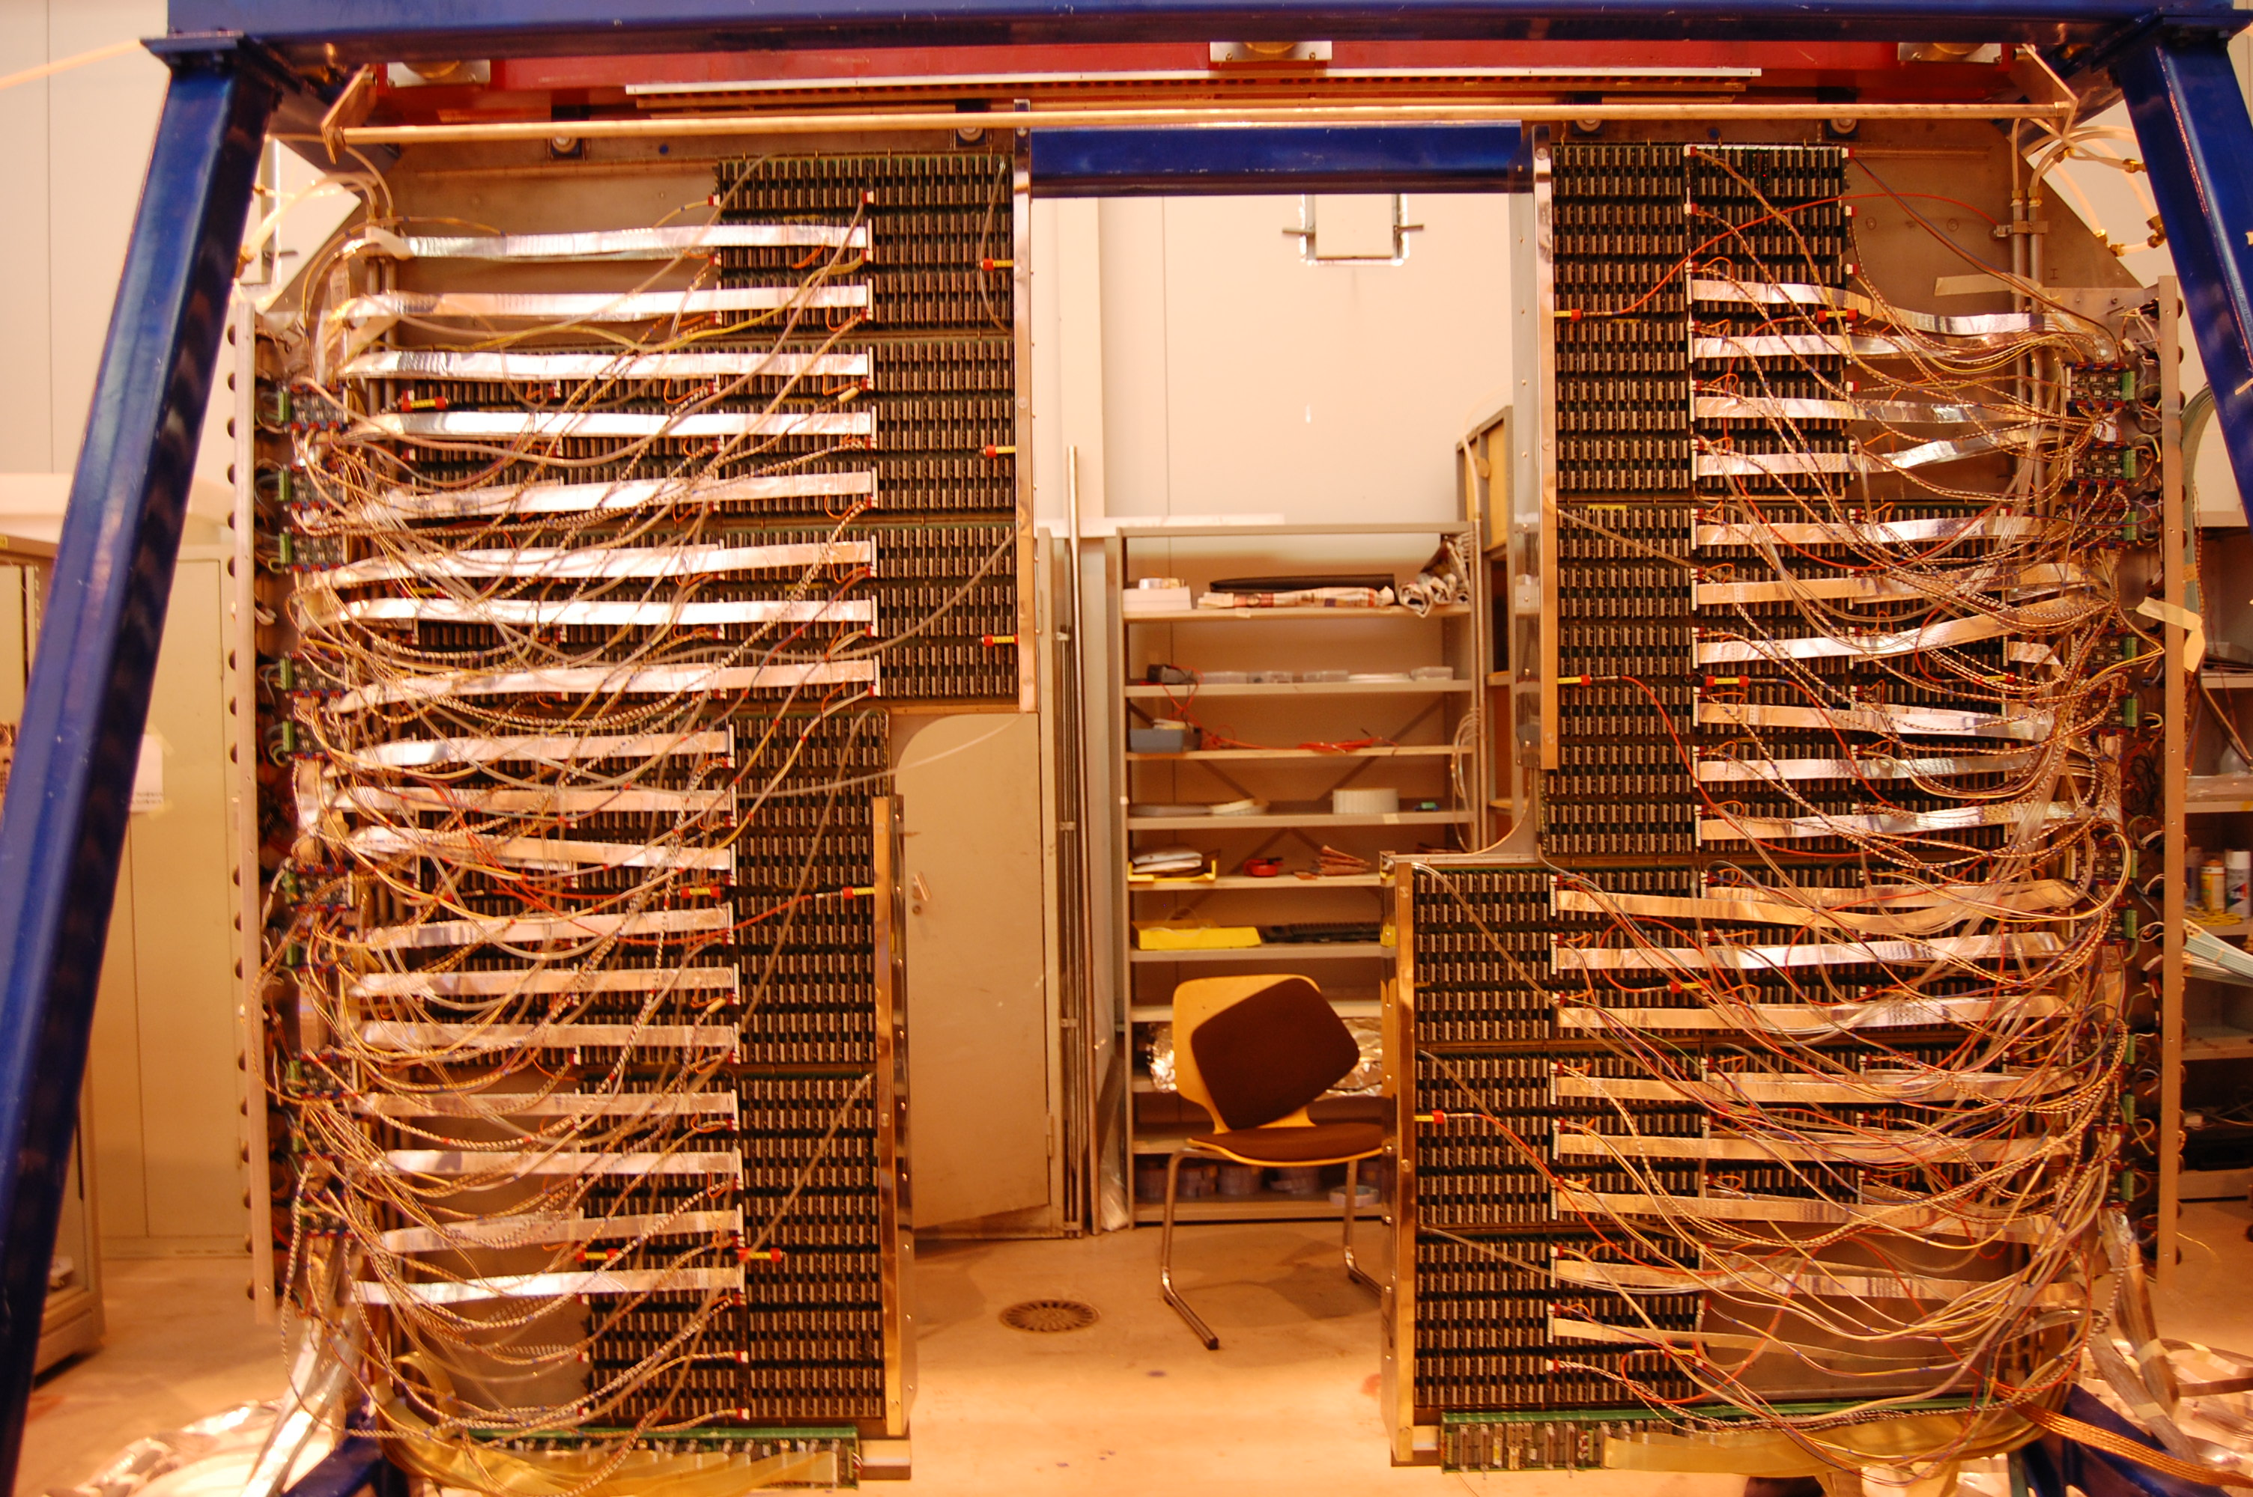
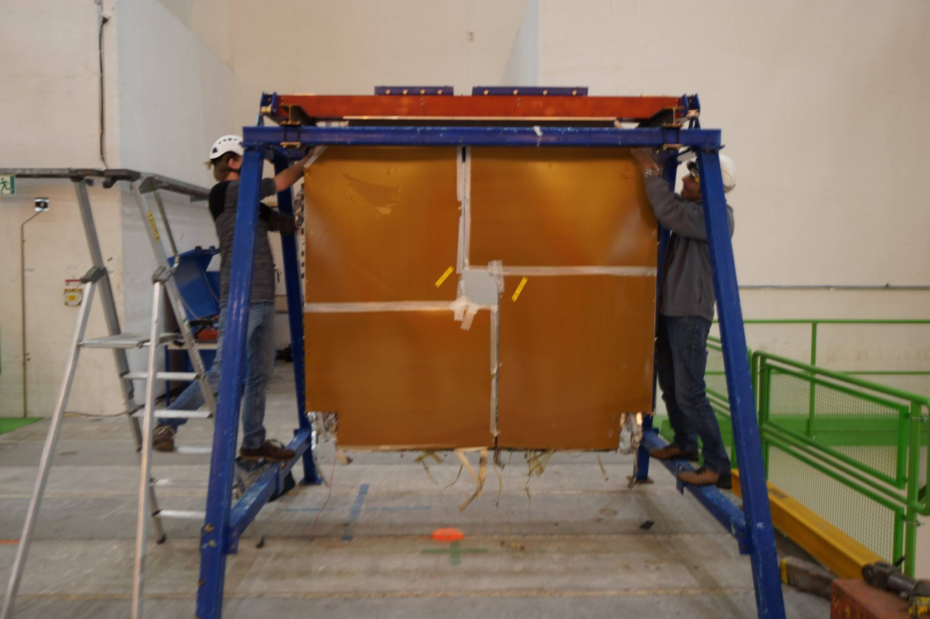
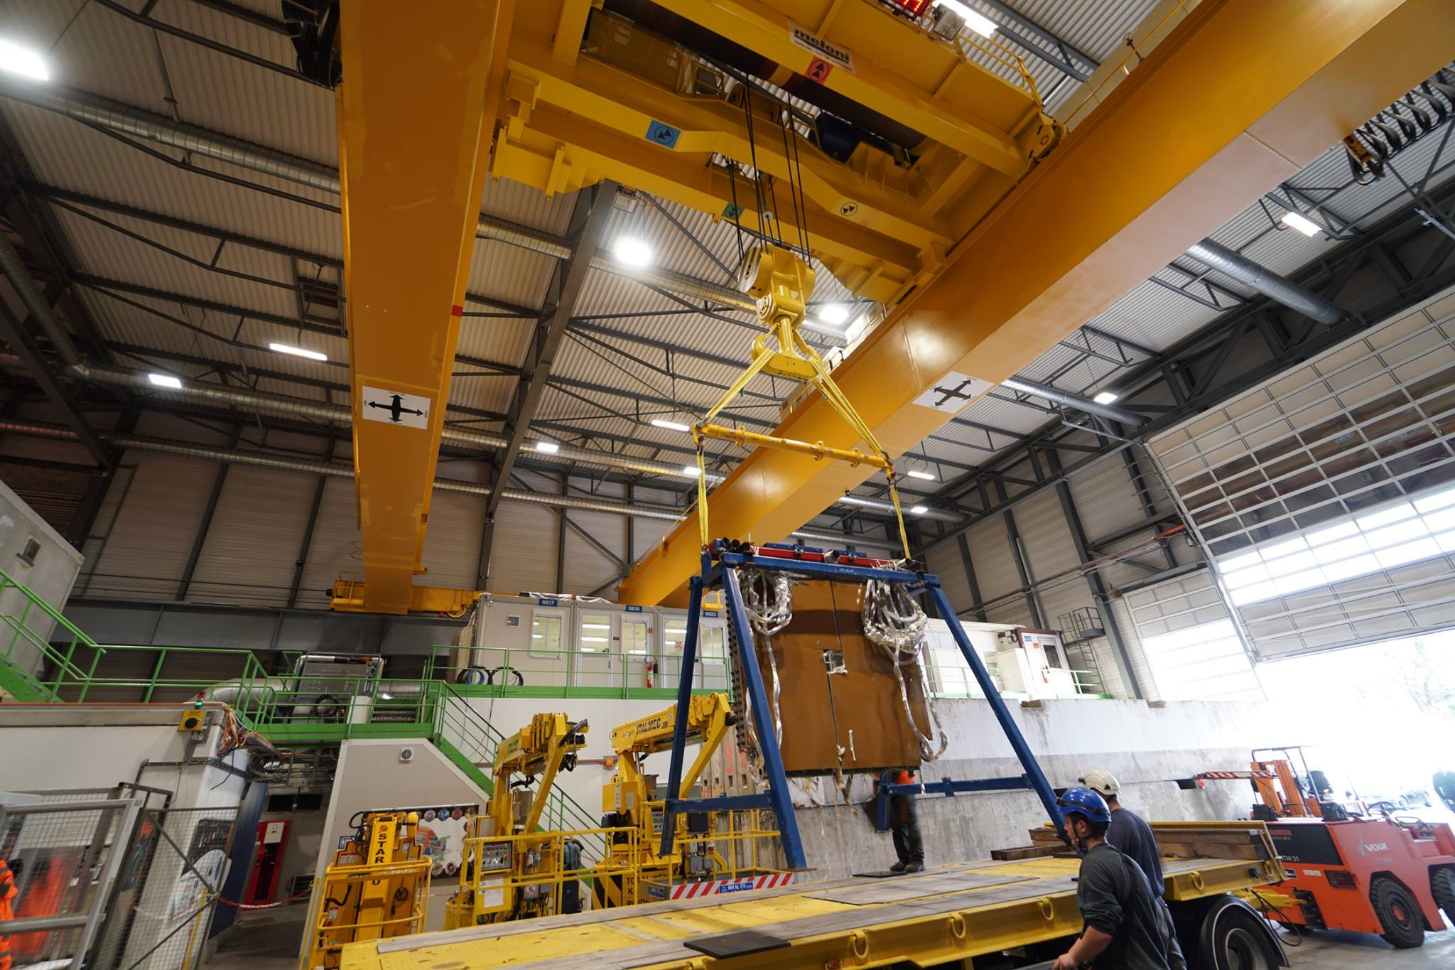
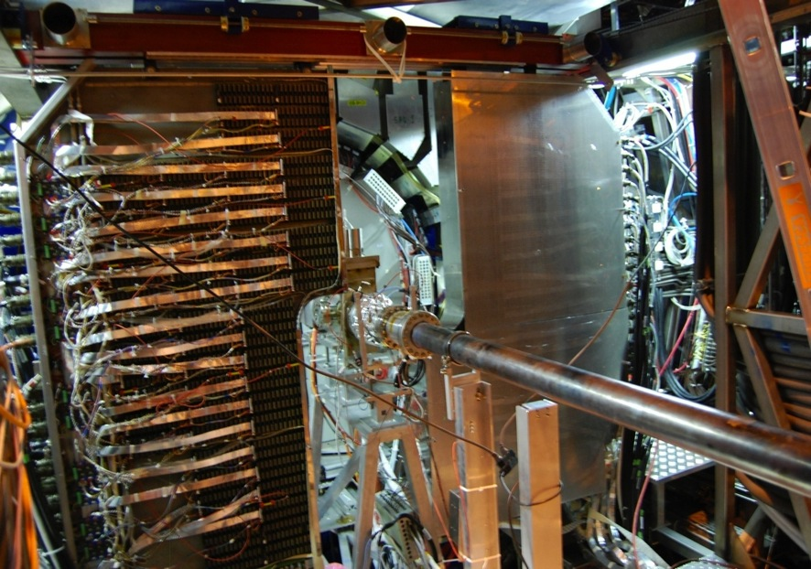
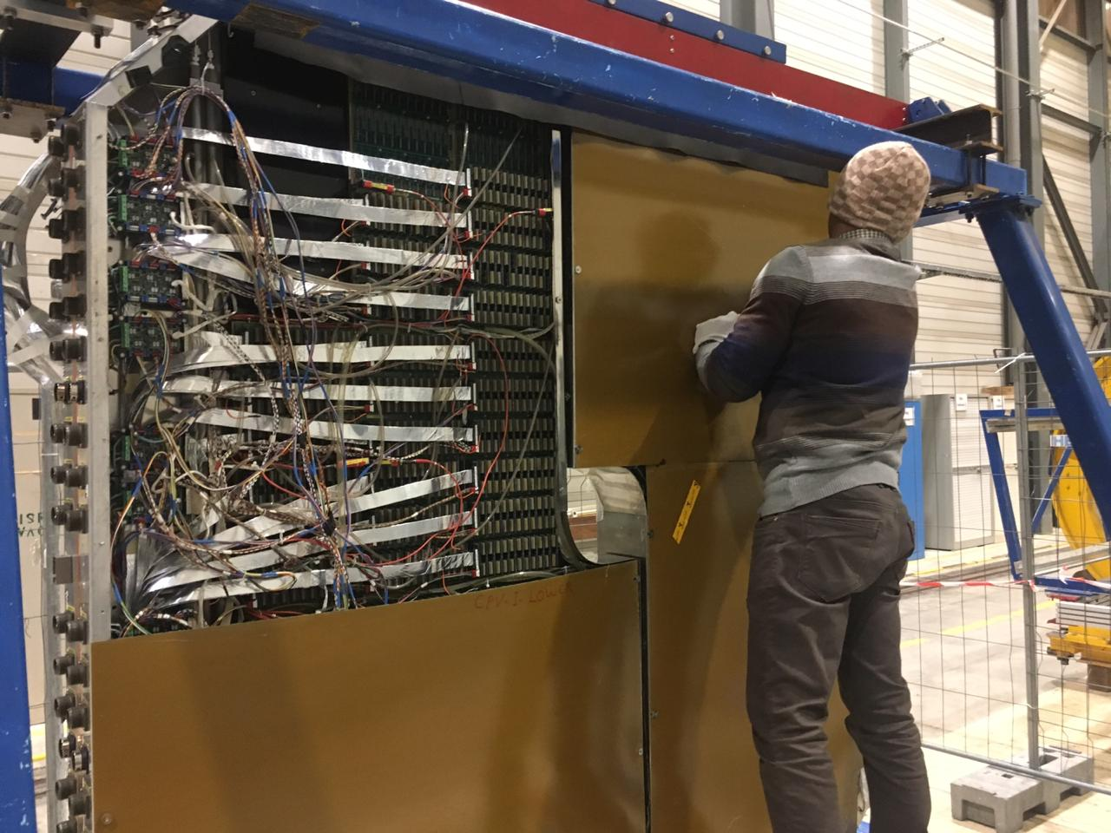
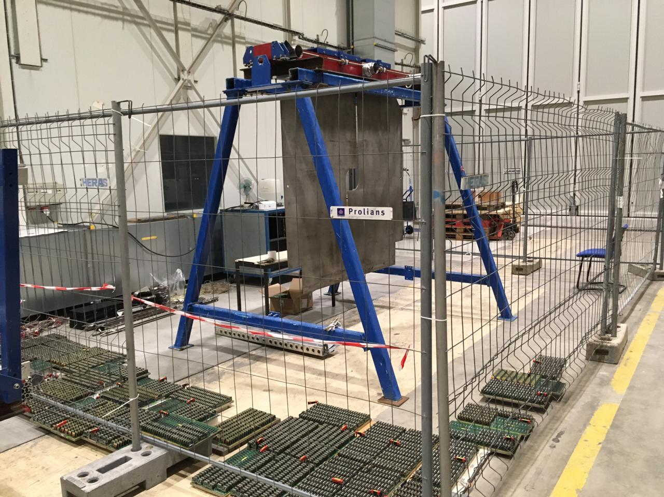
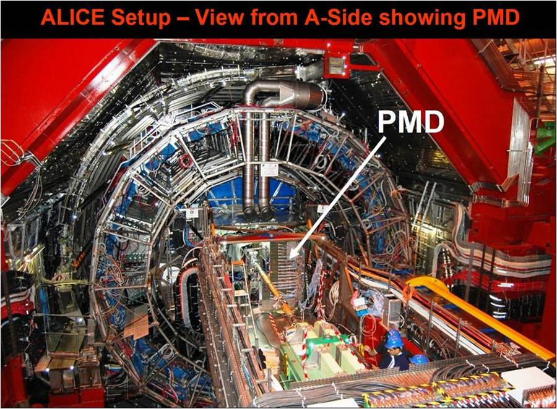
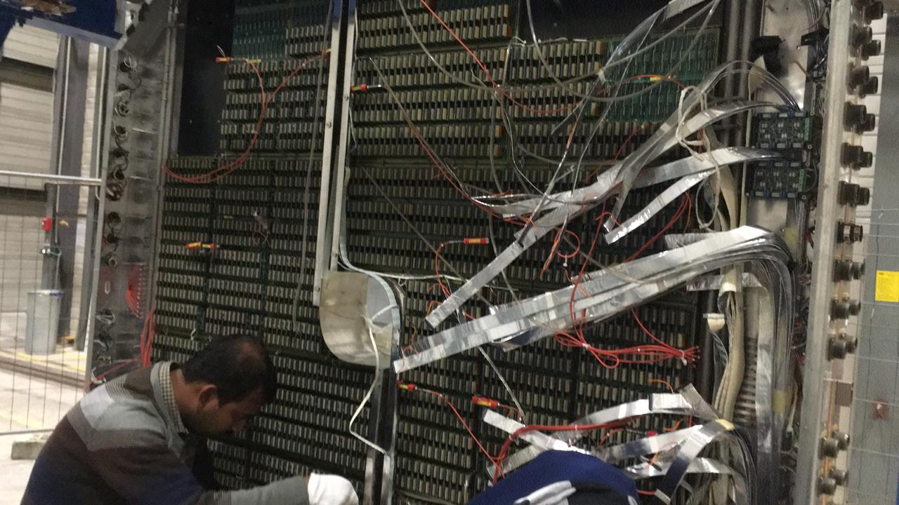
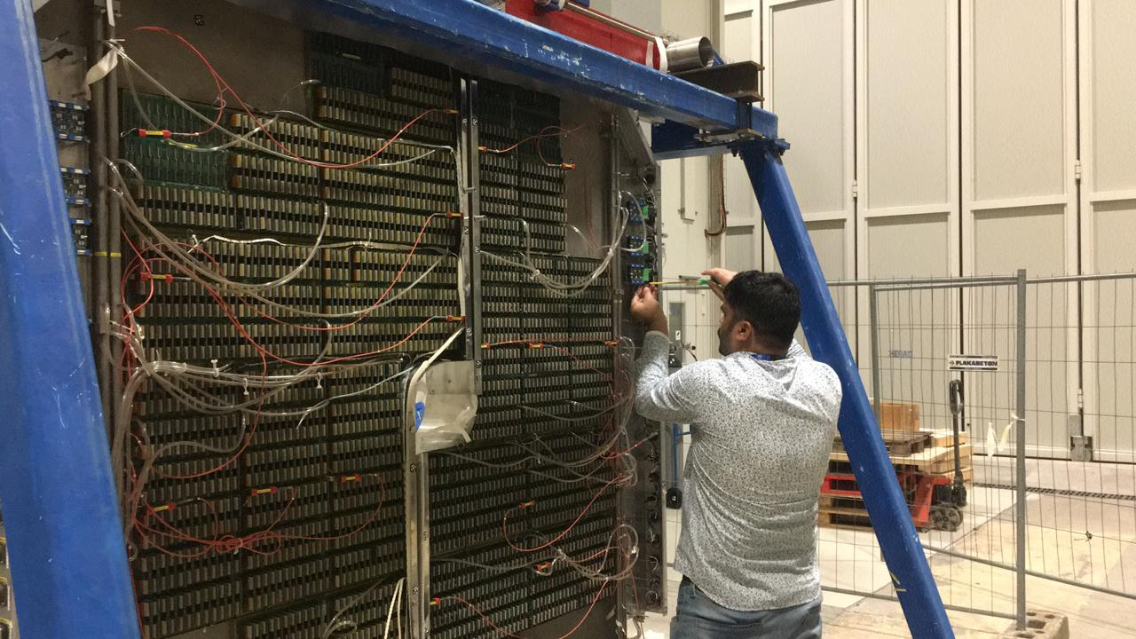
PMD Commissioning - August 2008
PMD De-commissioning - December 2018
Placing on record thanks to ALICE:
Technical Coordination
Run Coordination
Offline Coordination
Physics Coordination
ALICE Management

Slide 12
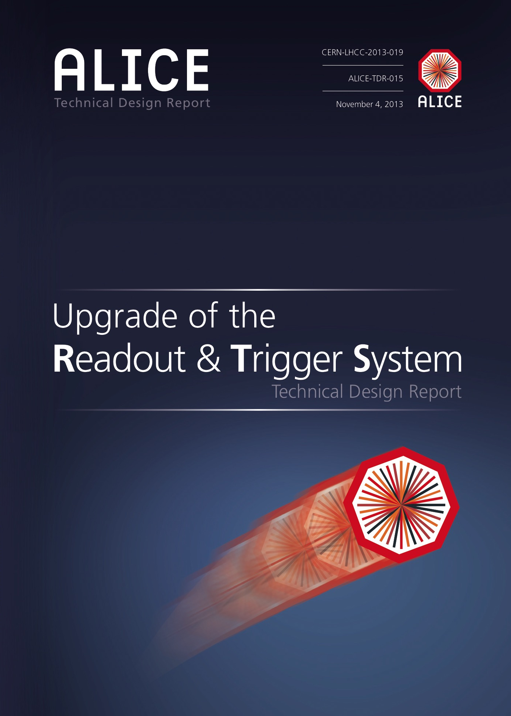
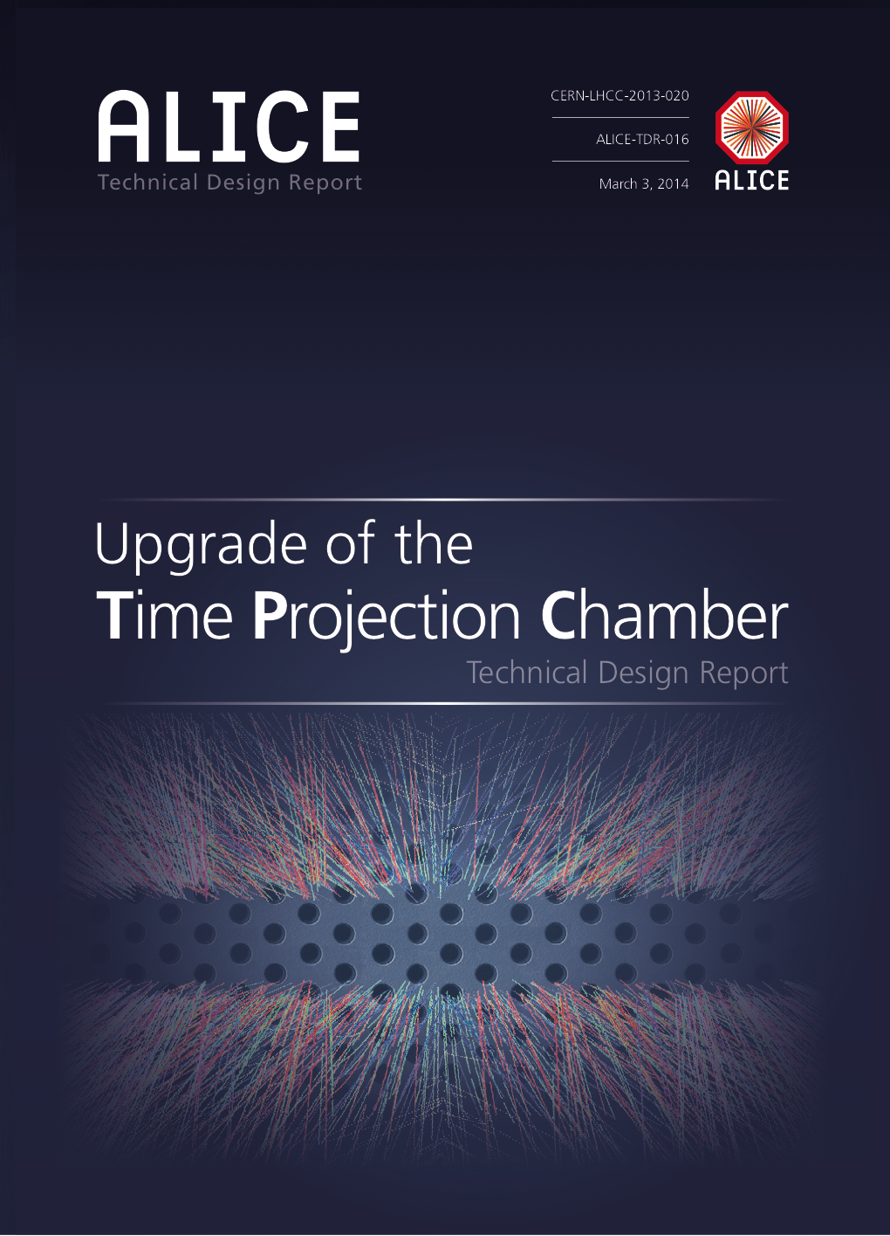

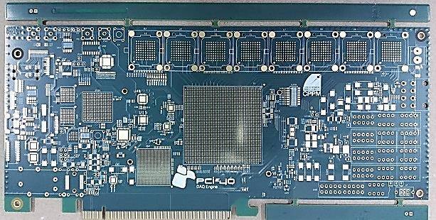
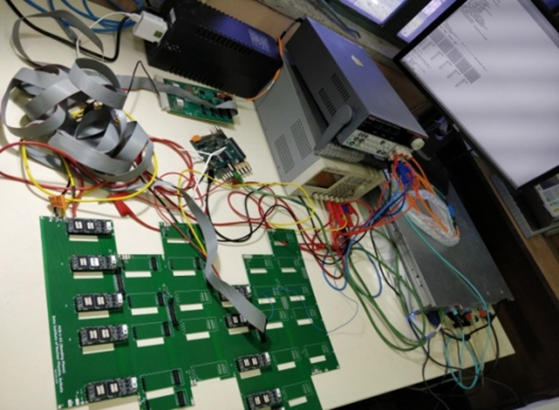
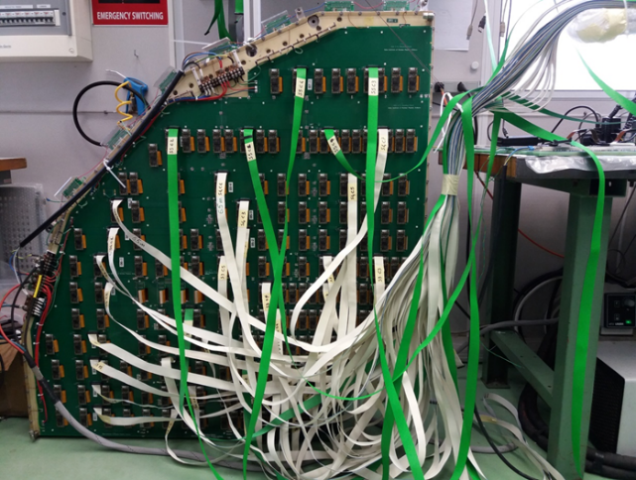
India participation in ALICE-2.0@CERN-LHC
Indian contribution
Common Readout Unit (CRU)
TPC – GEM detectors
Muon Forward Tracker (MFT)
GEM detector for
ALICE TPC
Dec 2016 - PCIe40 BOARD IMAGES, First PCB@VECC
NOV 2013
MAR 2014
MAY 2015
May 12, 2017: First CRU
Board@VECC

Slide 13







India participation in ALICE-2.1@CERN-LHC
Beam
(1) Developed full-depth (~ 19 X₀) prototype detectors using W-absorber and n-type Si with maximum wafer size 4-inch as detection elements
(2) A range of ASICs i.e, MANAS (64 ch), ANUSANSKAR (32 ch) & ANUINDRA (32 ch) have been used for reading out the detectors that were exposed to pion and electron beam of a range of energy (5→120 GeV).
FOrwad CALorimeter
(FOCAL) – 2025/2026
with Si readout
LoI ALICE-PUBLIC-2019-005
Indian participation
(3) Simulations for LOI

Slide 14

Indian Industry and India-ALICE
Photo from CERN
14/26

Slide 15


Industry involvement – India-ALICE
FOCAL Project in collaboration with:
BEL: Bharat Electronics Limited (BEL) is a state-owned electronics company with about nine factories
Also exploring SCL: Semiconductor Complex Limited, a public sector undertaking of the Government of India.

Slide 16






Summary of contribution in 2021
New Analysis Notes | Conference presentations | Presentations in collaboration | Scientific work in collaboration | Public Lectures | Non-ALICE papers | Conference Proceedings
10 | 23 | 100 | 25 | 10 | 14 | 10
Production of light-flavor hadrons in pp collisions at √s = 7 and 13 TeV, Eur.Phys.J.C 81 (2021) 3, 256
Measurement of K^{*+-} production in inelastic pp collisions at the LHC, 2105.05760
Production of K* and f in pp and Pb-Pb collisions at √s_{NN} =5.02 TeV, 2106.13113
Investigating charm production and fragmentation via azimuthal correlations of prompt D mesons with charged particles in pp collisions at √s = 13 TeV, 2110.10043
K∗ (892) & f (1020) production in p–Pb collisions at √s_{NN} = 8.16 TeV”, 2110.10042
Inclusive quarkonium production in pp collisions at √s_{NN} = 5.02 TeV, 2109.15240
Prompt D⁰, D⁺, and D^{*+} production in Pb-Pb collisions at √s_{NN} = 5.02 TeV, 2110.09420
The upgrade of the ALICE TPC with GEMs and continuous read out, JINST 16 (2021) P03022.
Neutral to charged kaon yield fluctuations in Pb-Pb collisions at √s_{NN} = 2.76 TeV, 2112.09482
Forward rapidity J/Y production as a function of charged-particle multiplicity in pp collisions at √s₌ 5.02 and 13 TeV, 2112.09433
Measurements of the groomed and ungroomed jet angularities in pp collisions at √s = 5.02 TeV, 2107.11303
6 students graduated with PhD
and 5 students with Masters degree

Slide 17







Other contributions to the experiment
Hyperloop Train System
Motivation: To run users’ analysis in a more automated and efficient way on Grid
Hyperloop train system: Built for central operators run by a number of institutes. Full time and efficient operation profited from the institutes in different time zones: America – 1, Europe -2 and Asia -1
Institute:
US: Lawrence Berkeley National Laboratory Berkeley
Coordinated by Mateusz Andrzej Ploskon
India: National Institute of Science Education and Research (NISER), Coordinated by Ranbir Singh
Europe: 1. Universita degli Studi di Pavia Pavia/
Universita di Brescia, Coordinated by
Ramona Lea
2. St. Petersburg State University
Coordinated by Igor Altsybeev
18 weeks of data taking shifts
3 centers for online shifts
NISER
Jammu University
Bose Institute

Slide 18










Outreach
Writing popular articles (examples)
India Joined IPPOG
Organizing Events
DG CERN at Vigyan Samagam, Bangalore
18/26

Slide 19

Worldwide LHC Computing Grid and India

Slide 20

Tier-0: CERN Data Centre has all data from the LHC but provides only 20% of the total compute capacity. Responsible for the safe-keeping of the raw data, first pass reconstruction, distribution of raw data and reconstruction output to the Tier 1s.
Tier 1: Thirteen large computer centres with sufficient storage capacity and with round-the-clock support for the Grid. Responsible for the safe-keeping of a proportional share of raw and reconstructed data, large-scale reprocessing and safe-keeping of corresponding output, distribution of data to Tier 2s and safe-keeping of a share of simulated data produced at these Tier 2s.
Tier 2: Universities and other scientific institutes, they handle analysis requirements and proportional share of simulated event production and reconstruction. There are currently around 160 Tier 2 sites covering most of the globe.
Tier 3
Individual scientists will access these facilities through local computing resources. There is no formal engagement between WLCG and Tier 3 resources.
Source: https://wlcg-public.web.cern.ch/tier-centres

Slide 21

India-ALICE and Grid Computing-LHC
India has 2 Tier-2 centres
VECC, Kolkata for ALICE
TIFR, Mumbai for CMS
Resources for ALICE in 2021
Total cores = 3976 (HT)
Total storage = 1.28 PB
Network 10 Gbps

Slide 22












Evolution with time
(2002 – 2021) - example (VECC, Kolkata)
2002
  2 Desktop Machine
  512MB HD in Desktop Machine
  128Kbps network shared link
2003
  2 Tower Like Servers
  40GB as DAS
  512Kbps Network
2004
  9 HP 1U Servers
  400GB in HP MSA 500
  2Mbps Dedicated Link
2009
  8 Quad Core HP Blades
  25 TB i-SCSI storage
  100Mbps from VSNL (ERNET)
2008
  40 Dual Core HP Blades
  108TB HP EVA SAN storage
  30Mbps WAN from Reliance
2006
  17 Wipro 1U Servers Single Core
  2TB Wipro NAS storage
  4Mbps WAN Network from Bharti
2017-2021
  More than100 nos of servers
  More than 80 TFlops of computing
  10Gbps WAN network and 40 Gbps intranet.
  15 Million ALICE Jobs completed.
  More than 3 PB disk servers
  Low-cost storage solution via EOS RAIN-6
2010 - 2012
  32 Dual Processor Blades
  200TB IBM DS 5100 storage
  300 Mbps WAN from NKN
  Cold aisle cooling solution
  Efficient cooling (1.47 PUE)
2012 -2016
  Accelerated computing with Tesla 2075 GPU
  Heterogeneous computing for CBM via GPU
  1Gbps NKN WAN under LHCONE
  148 TB of disk based storage
  Intel Xeon-phi co-processor for computing
Source: V. Singhal

Slide 23
Grid Computing and trigger of developments in India
Milestone (Achievement) | Triggering developments and knowledge gained
Grid Computing Facility and Awareness. Started 2002, achieved expertise. | DAE Grid --- Between DAE Units Health Grid --- For health purpose and related. EUIndia Grid --- European Indian Grid. Expanded the knowledge of GRID Computing and related technology.
High Speed Network Infrastructure and National Knowledge Network (NKN) | In 2011 NKN established. Direct 10G link between India and CERN Europe.
In 2011 NKN established. Direct 10G link between India and CERN Europe. | Due to requirement for ALICE only, Indian Grid Certification Authority (IGCA established). Knowledge of Digital and Grid Certificate.
Asian Tier Centre Forum | Networking and data exchange between Asian countries.
Tier-3 Cluster for Collaborators and supporting STAR, ALICE, CBM, Medical Imaging, INO | More than 25+ PhD thesis completed using Grid Computing Facility of VECC. Trained more than 30 graduate student for working in HPC community. (Can Participate in National Super Computing Mission) 100% utilized by Indian Collaborators.
Video Conferencing Tool | Low-cost solution, Ready to use solution, Daily having video meetings from across the globe.
Open Source Software and developed by CERN | WLCG Community uses all the Open Source Software and the developed software are available within the collaboration.
23/26

Slide 24
India@ALICE-CERN-LHC
At the core of the technology
Front-end electronics VLSI full-custom design and manufacturing: MANAS chip (for Muon Station & PMD)
High tech PMD: 100% Indian Project
Muon Spectrometer: Worldwide collaboration, with India as major player, Station 2 construction
High Level Trigger development
Tier-2 Grid computing Centre
India a major partner in ALICE since the very beginning (early 1990s)
Major contributions to detector design, construction, maintenance and operation
Major contributions to physics data analysis and dissemination of the results
Next big detector project is FOCAL
Plans to join efforts on next generation heavy-ion collision program at CERN-LHC has started.

Slide 25

LHC timelines
Indian active participation continues and
We are planning to become part of the program for the
next generation Heavy Ion Experiment (Run 5 and beyond)
https://indico.cern.ch/event/1106493/contributions/4655056/attachments/2372828/4052648/Fabiola-Jan-2022.pdf
https://lhc-commissioning.web.cern.ch/schedule/LHC-long-term.htm

Slide 26




Thanks
Concept of ALICE 3 detector. Source: LOI
Past India-ALICE Spokespersons
Y. P. Viyogi
T. K. Nayak
S. Chattopadhyay
26/26

