Slide 1

Procurement Overview for India(Associate Member State)
Anders Unnervik
11 February 2022

Slide 2
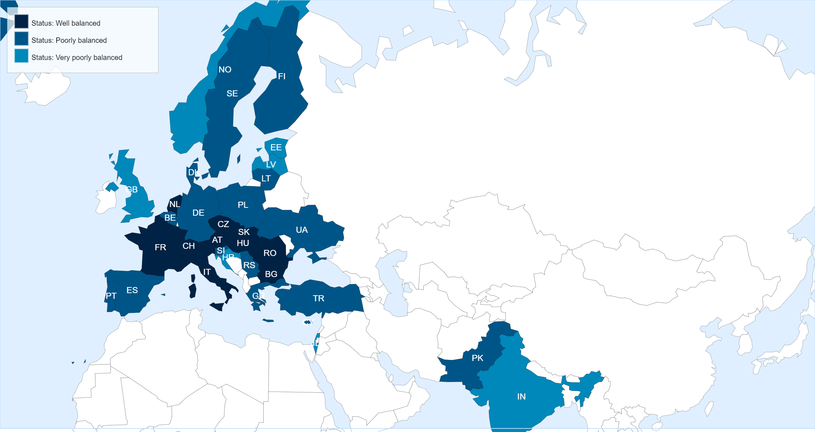
Status of Member States (For Supply contracts from 01.03.2021 until end of February 2022)
Key Figures for India
* Data not available in the DWH yet.
No. of suppliers registered on eProcurement
78
No. of contracts active in 2021
6
No. of contracts awarded in 2021
3
No. of firms contacted for MS dispatched in 2021
64
No. of firms contacted for IT dispatched in 2021
5
No. of firms contacted for PE dispatched in 2021
22

Slide 3
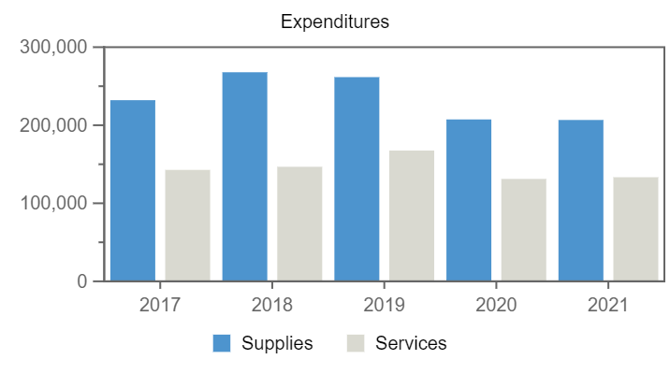
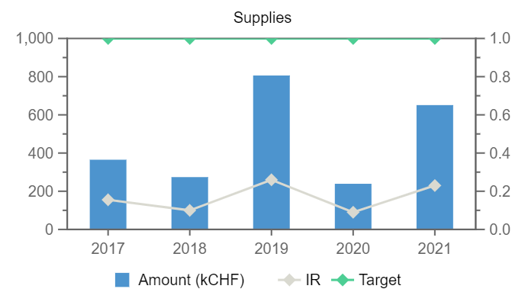

Expenditures (India, kCHF)
Year
Supplies
Services
2017
365
–
2018
274
–
2019
806
–
2020
239
–
2021
651
–
*Provisional figure
Annual contributions and industrial returns for India
Contributions (kCHF)
Expenditures (All countries totals, kCHF)
Expenditures (India, kCHF)
Year
Country Contribution
All Countries
%
Year
Supplies
Services
Year
Remaining
Procurement**
Personnel
2017
11 589
1 142 179
1.01
2017
232 087
142 732
2017
10 480
365
744
2018
12 272
1 148 237
1.07
2018
267 860
146 760
2018
10 237
279
1 756
2019
13 812
1 171 420
1.18
2019
261 610
167 528
2019
10 429
810
2 572
2020
15 294
1 196 893
1.28
2020
207 407
131 216
2020
12 194
240
2 860
2021
16 212
1 199 321
1.35
2021
206 717
133 358
2021
11 827
656
3 729
2022
16 838
1 205 987
1.4
2022*
13 145
–
3 693
Industrial Return
Annual Industrial Return
Supplies
Services
Year
Ratio
Target
Ratio
Target
2017
0.16
1
–
0.4
2018
0.1
1
–
0.4
2019
0.26
1
–
0.4
2020
0.09
1
–
0.4
2021
0.23
1
–
0.4

Slide 4
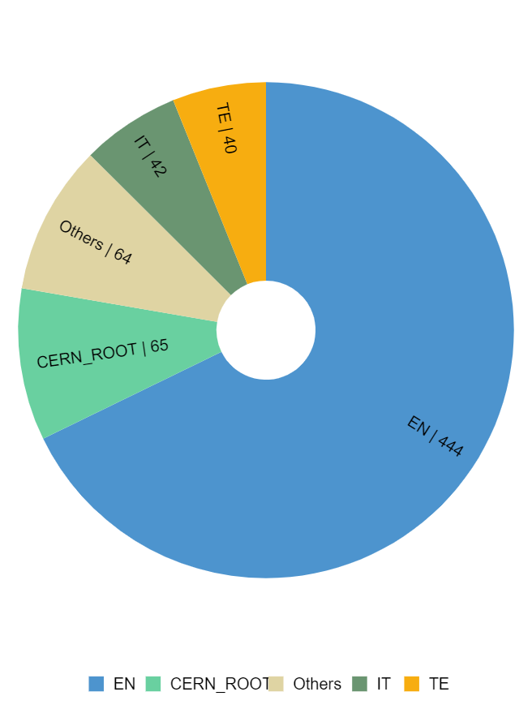
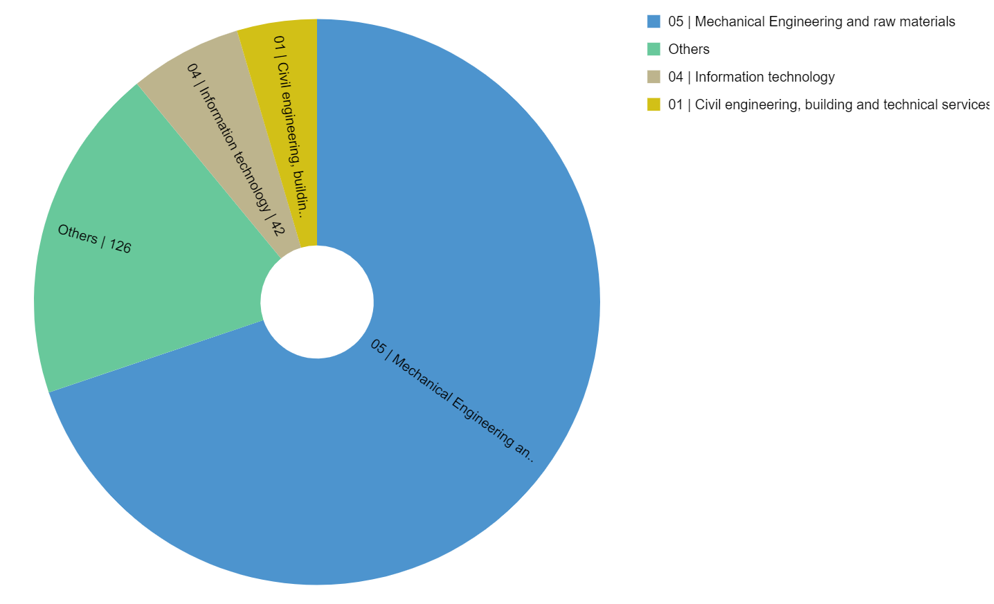
Expenditure by department and procurement codes for India
Expenditure by Department (kCHF)
Expenditure by (Activity|Procurement) Code (kCHF)

Slide 5
Top Suppliers in India
By Country of Supplier
By Country of Origin
Supplier Name
Town
No. Orders
CERN Budget (CHF)
Teams Budget (CHF)
Supplier Name
Supplier Country
No. Orders
% IN
CERN (CHF)
Teams (CHF)
INOX INDIA PVT LTD
Vadodara,Gujarat
6
402 517
82 638
INOX INDIA PVT LTD
IN
6
100
402 517
82 638
MICROPACK LIMITED
Bangalore
4
2 658
23 457
CA EUROPE SARL
CH
1
100
43 500
–
DECO VINYL PRIVATE LIMITED
Haryana
1
21 326
–
MICROPACK LIMITED
IN
4
100
2 658
23 457
METALLIC BELLOWS INDIA PRIVATE LIMITED
Tamil Nadu
3
18 899
–
DECO VINYL PRIVATE LIMITED
IN
1
100
21 326
–
THE MATHWORKS
CH
2
10
20 450
–
HARDCOATS INDIA PVT LTD
Miraroad
1
7 462
–
METALLIC BELLOWS INDIA PRIVATE LIMITED
IN
3
100
18 899
–
LOGICA ENGINEERING AND MANUFACTURING INDIA PVT LTD
Pune
1
7 265
–
SCHNEIDER ELECTRIC FRANCE
FR
4
2
18 825
–
POLYCAB INDIA LIMITED
Mumbai
2
6 608
–
RS COMPONENTS
FR
11 363
1
11 089
2 150
PENINSULA ELECTRONICS
Bangalore
2
–
6 240
IGM SRL UNIPERSONALE
IT
2
100
12 046
–
MACSEAL ENGINEERING INDUSTRIES
Navi Mumbai
2
6 153
–
ROCH SA
CH
3
80
12 042
–
RITINOX OVERSEAS
Maharashtra
2
4 141
–

Slide 6
List of contract/orders with the highest turnover in 2021 for India
Contract/Order
Description
Supplier
Amount (CHF)
CD8278987
J3063741/42/43, SERV. MODULE VAC. VESSEL
INOX
391 817
CA8352547
SPECTRUM + CAPC + NFA MAINTENANCE
CA EUROPE SARL
43 500
CA8597580
SURGICAL MASKS TYPE I
DECO VINYL PRIVATE LIMITED
21 326
X155
CERN MATHWORKS SITE LICENCE
THE MATHWORKS
20 450
CA8068205
4486/HL-LHC BELLOWS FOR TRIPLETS
METALLIC BELLOWS INDIA PRIVATE LIMITED
18 139
CA8775805
SCHNEIDER REAP STK MINI (PO-18197)
SCHNEIDER ELECTRIC
15 761
B1663
SUPPLY OF GARNET SAND
IGM SRL UNIPERSONALE
12 046
CA8947014
ROCH SA REAP SF8(PO-18548)
ROCH SA
11 560
B1516
ELECTRONIC COMPONENTS/TOOLS
RS COMPONENTS
11 089
B1615
SCREWS AND BOLTS
SFS UNIMARKET *** DUPLICATE *** SEE SFS-20
10 219
New contracts
Cadillac Filters contract F765 is approx approx. 60 million Indian rupees. A milestone contract as it is work on CERN site
PolyCAB contract B1661/SCE approx. 4 million USD

Slide 7
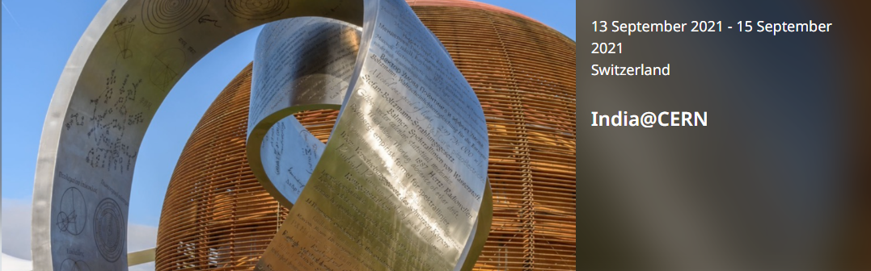
INDIA @ CERN
13 – 15 September 2021

Slide 8

INDIA@CERN 13 -15 September 2021
18 Companies
Outcome: Orders
        Metallic Bellows pvt: Long term needs
    Saarloha Advanced Materials: Discussions in progress

Slide 9
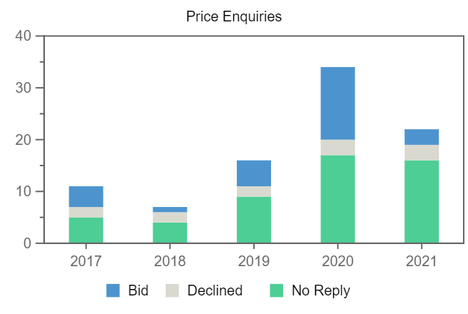
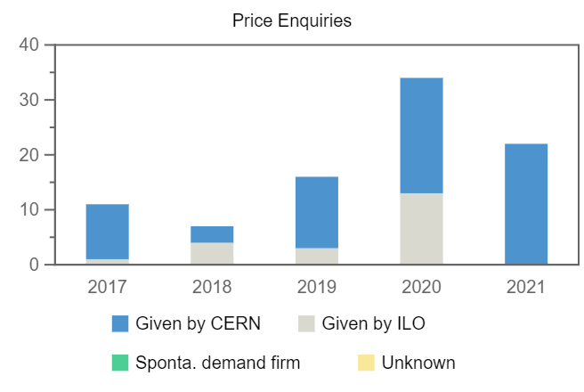
Price Enquiries above 50k CHF for India
Number of firms contacted
Origin of firms contacted
Year
Firms Contacted
RANK (1)
RANK (2)
RANK (3)
2017
11
1
1
–
2018
7
–
–
–
2019
16
1
1
–
2020
34
1
4
2
2021
22
–
1
–

Slide 10
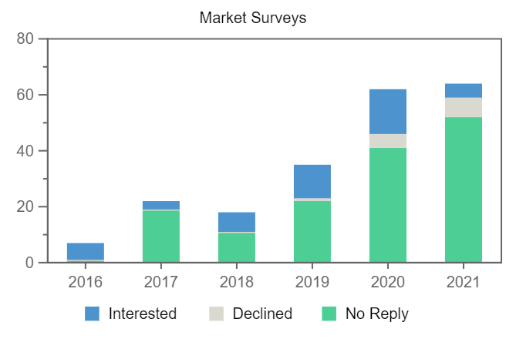
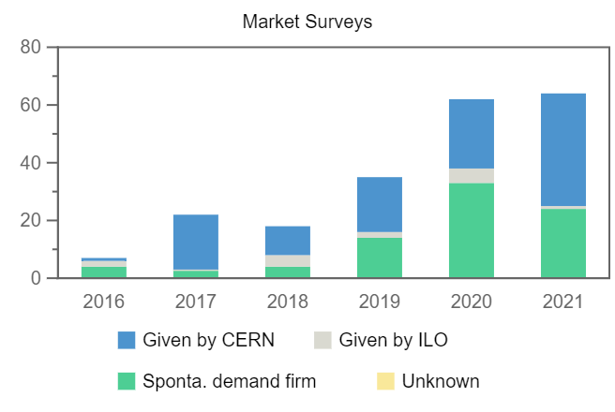
Market Surveys for India
Number of firms contacted
Origin of firms contacted
Year
Firms Contacted
Interested
Declined
No Reply
Selected
2016
7
6
–
1
1
2017
22
3
–
19
–
2018
18
7
–
11
5
2019
35
12
1
22
5
2020
62
16
5
41
5
2021
64
5
7
52
1

Slide 11
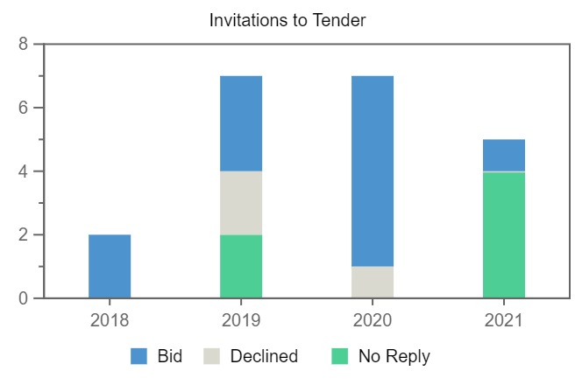
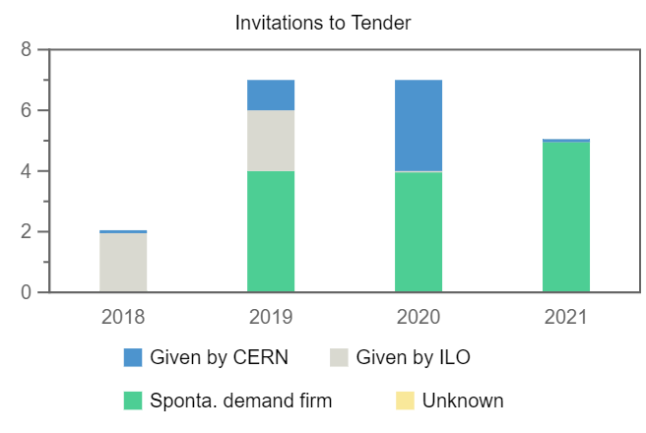
Invitations to Tender for India
Number of firms contacted
Origin of firms contacted
Year
Firms Contacted
RANK (1)
RANK (2)
RANK (3)
2018
2
1
–
–
2019
7
1
1
–
2020
7
1
1
–
2021
5
1
–
–

