Slide 1
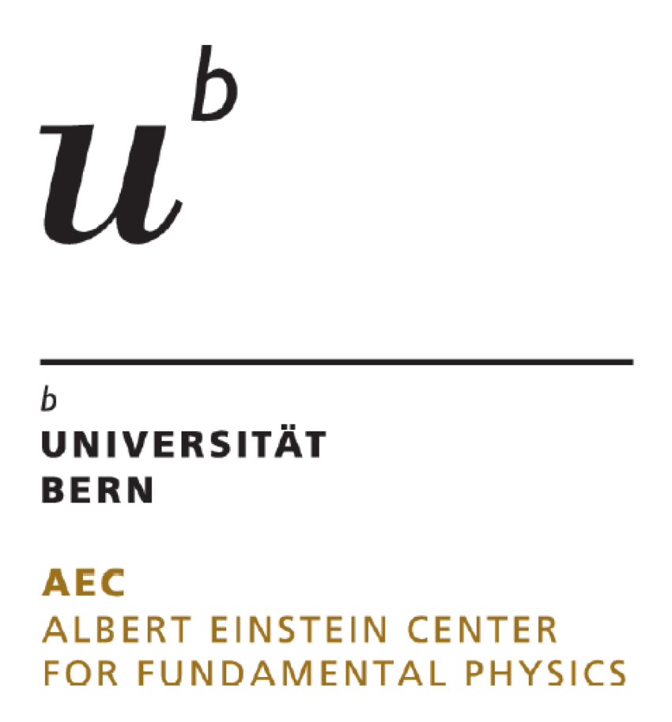


The n2EDM experiment
A new high-sensitivity search for the neutron electric dipole moment
Anastasio Fratangelo on behalf of the n2EDM collaboration
SPS 2022 Conference – Fribourg, Switzerland

Slide 2
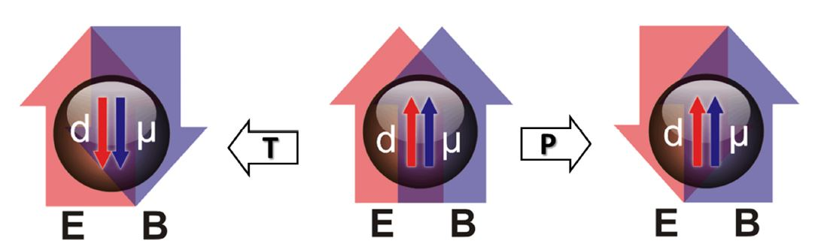
Why measure the neutron Electric Dipole Moment?
An Electric Dipole Moment (EDM) of the neutron:
violates the Time-reversal (T) symmetry
assuming CPT conservation, it follows the CP violation
Implications:
New sources of CP violation are required to understand the Baryon asymmetry in the Universe (Sakharov conditions)
T
E
B
E
B
Notes:
Remember that the nEDM may come from the Strong CP problem (strong sector), weak sector and Beyond Standard Model
Reminder: the 3 Sakharov conditions to explain the Barion asymmetry in the universe are: non conservation of the Baryon number, C symmetry and CP symmetry violation; deviation from thermal equilibrium in the early universe

Slide 3
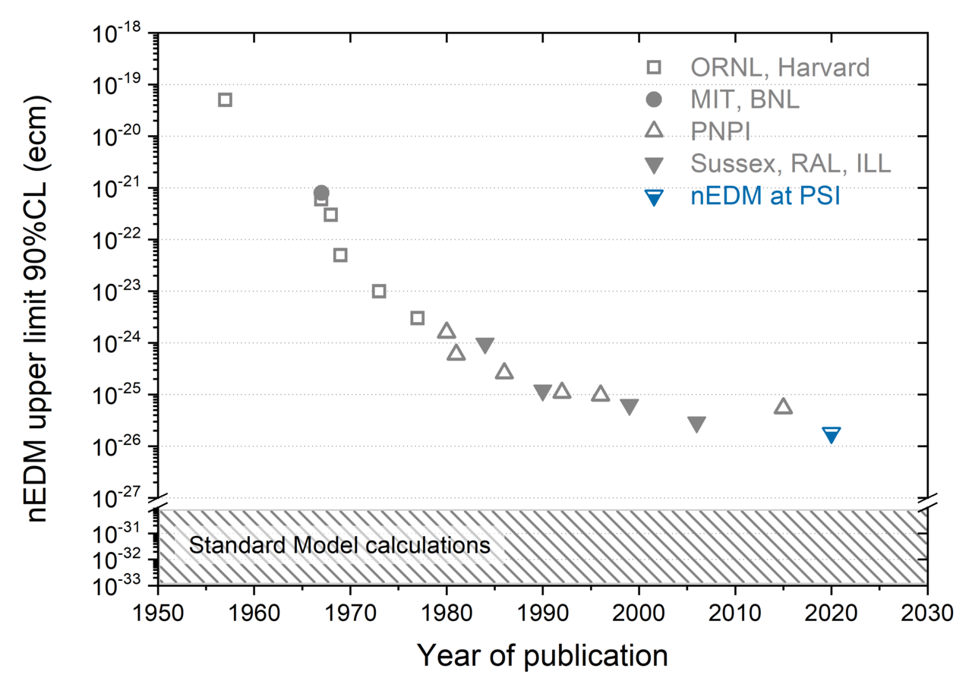
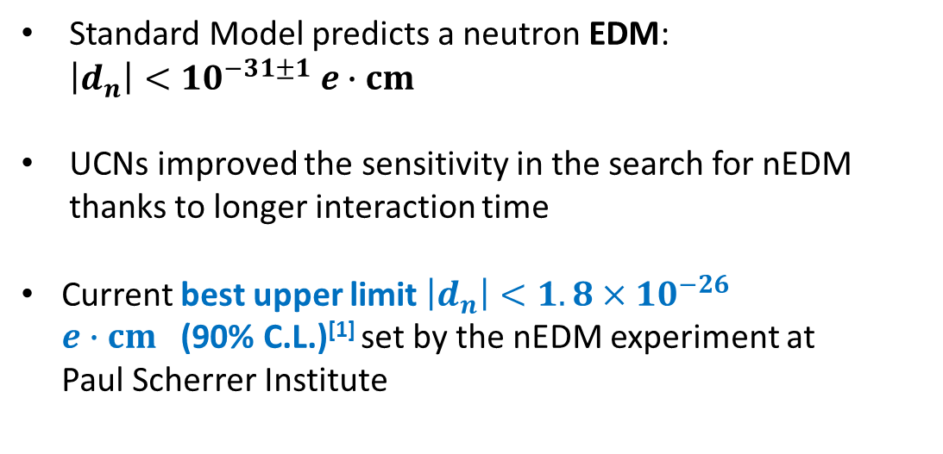
State of the art
Standard Model predicts a neutron EDM: $\left|d_{n}\right|<{10}^{−31±1} e∙cm$
UCNs improved the sensitivity in the search for nEDM thanks to longer interaction time
Current best upper limit $\left|d_{n}\right|<1.8×{10}^{−26}$
$e∙cm \text{(90\% }\text{C}\text{.}\text{L}\text{.)}\text{[1]}$set by the nEDM experiment at
Paul Scherrer Institute
Beam
UCN
$\text{[}\text{1}\text{]}$Abel, C. et al. Phys. Rev. Lett. 124, 081803 (2020)
Notes:
This research is not new, in fact it has started more than 60years ago

Slide 4
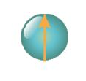



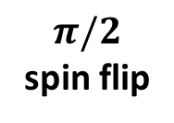
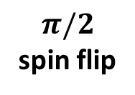

Ramsey’s technique
Polarized
Ultracold Neutrons
Final spin states
UP
OR
DOWN
B₀
B₀
+B_{rf}
B₀
E
B₀
+B_{rf}
$π/2$
spin flip
$π/2$
spin flip
free precession
time
$$f_{n}=\left|\frac{γ_{n}}{2π}B_{0}\right|± \frac{d_{n}}{πℏ}E$$

Slide 5
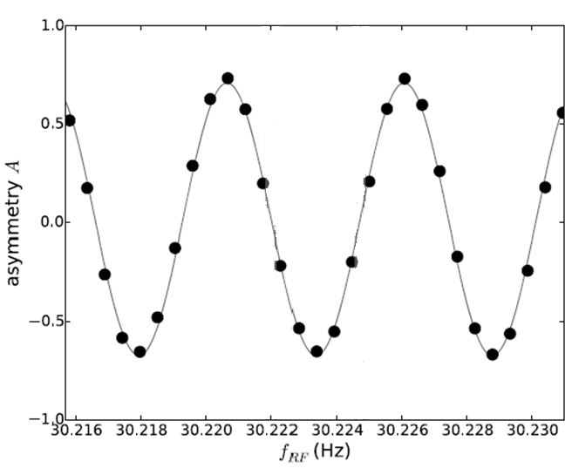

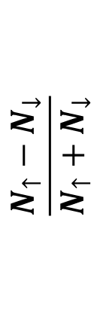
Ramsey signal
$$\frac{N_{↑}−N_{↓}}{N_{↑}+N_{↓}}$$
$$f_{n}=\left|\frac{γ_{n}}{2π}B_{0}\right|± \frac{d_{n}}{πℏ}E$$

Slide 6
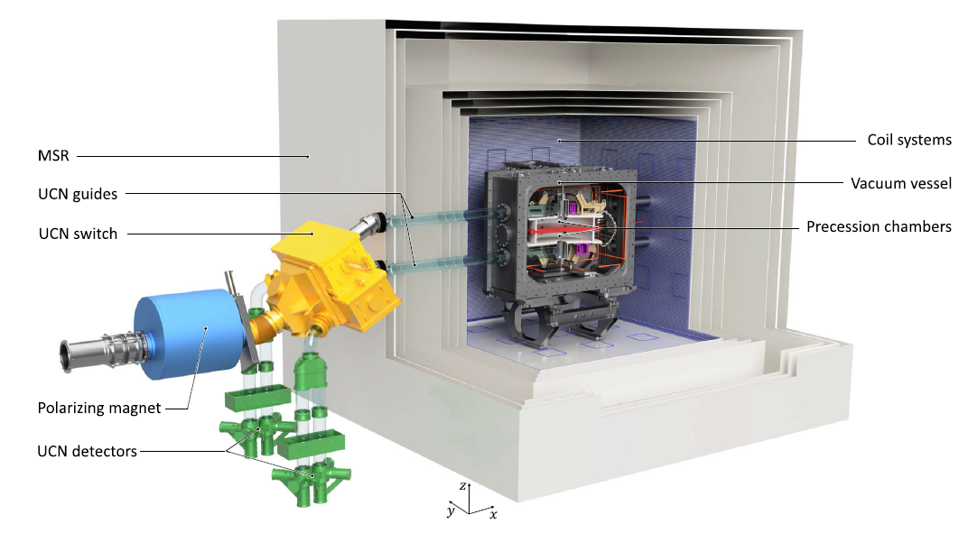
Experimental apparatus
B₀
UCNs
5.2 m
5.2 m
Notes:
- 5T superconducting magnet
- Neutron guides made of coated glass tubes with ultralow surface roughness (Ni-Mo coating: transmission above 97%)

Slide 7
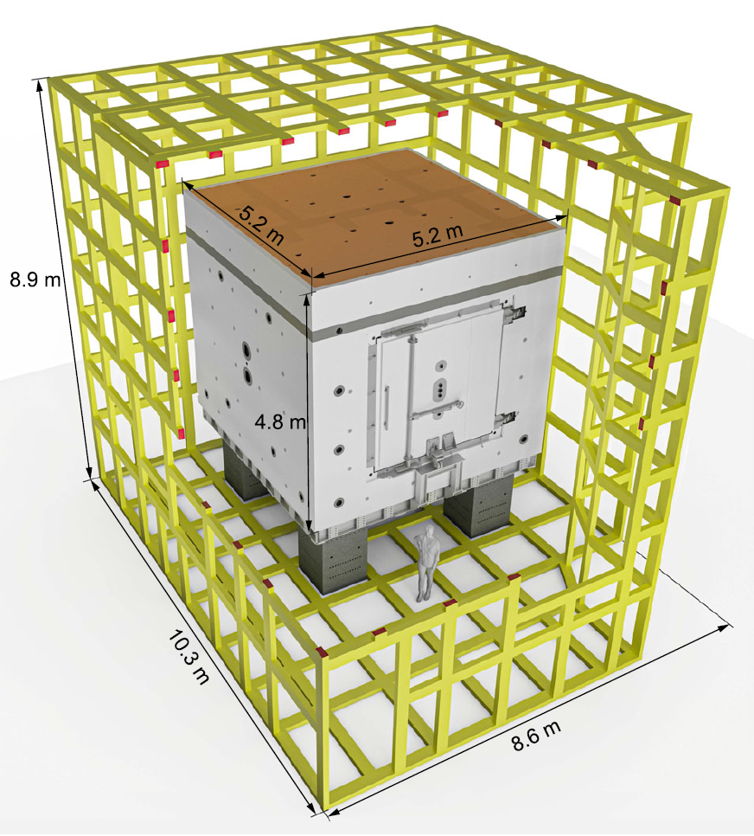
Magnetic shielding
Magnetically shielded room
Passive magnetic shield:
  6 cubic layers of MuMetal and 1 layer of Aluminum for RF shielding
  Shielding factor of 10⁵ at 0.01 Hz
  Residual magnetic field in the central region B_{x} ,B_{y} ,B_{z} < 150pT
Active magnetic shield:
  system of actively controlled coils to compensate for external magnetic fields
Notes:
MSR – residual magnetic field < 150pT
The coil geometry is designed to optimized to compensate for external magnetic fields in the middle of the cube

Slide 8
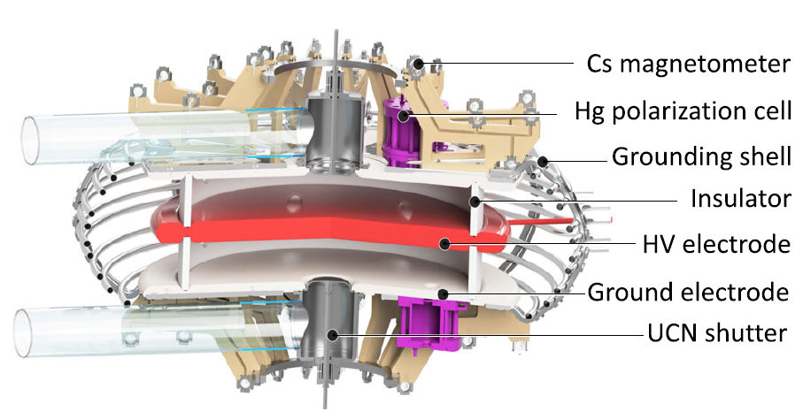
Precession chambers
UCNs
40 cm
B₀ = 1 µT
12 cm
E = 15 kV/cm
UCNs
Notes:
Mention: aluminum electrodes coated with DLC (reminder: high neutron optical potential Vdlc = 230 neV - this is good for containing UCNs and also good to avoid the amalgamation of the Hg with the aluminum)

Slide 9
Cesium magnetometers
The Cesium magnetometers for the magnetic field gradients calculation.
  Array of 112 Cs sensors
  Optical pumping of the Cs vapor
  Accuracy goal below 5 pT
More information in Victoria Kletzl’s talk

Slide 10
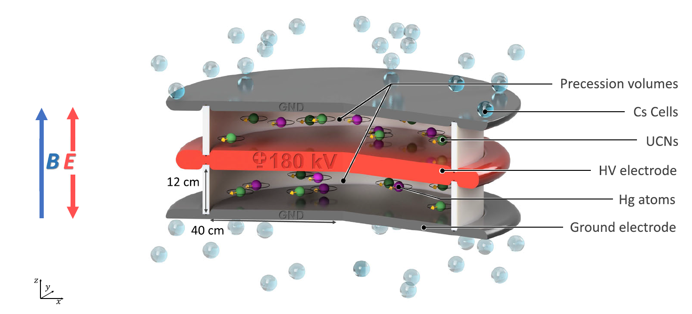
Hg co-magnetometer
The magnetic field measurement in the precession volume:
Atomic vapor of ¹⁹⁹Hg polarized by optical pumping
π/2 pulse to flip the mercury spins
Photodetector records the intensity of a beam of a UV laser light traversing the chamber
Expected sensitivity of 25 fT per cycle
Precession volume
UV laser
UCN
HV
UV laser
Hg
Notes:
The Hg co-magnetometer is based on the principle of orientation-dependent absorption of circular polarized light by spin polarized atoms. Depending on the orientation of the atomic spin with respect to the light vector, the light is absorbed or not.
UV laser used to polarize the Hg state FROM 6^1S_0,F=1/2,m_f=-1/2 TO 6^3P_1,F=1/2,m_f=+1/2.
Advantages of Hg:
- long relaxation times (in certain wall coatings)
- Small electric dipole moment
- Direct measurement of the precession frequency averaged over the storage time
Mercury can be polarized in a small chamber and then transferred in the precession chamber where a pi half pulse is applied and a second analyzing beam at the Hg precession is recorded
Co stands for cohabiting !!!

Slide 11
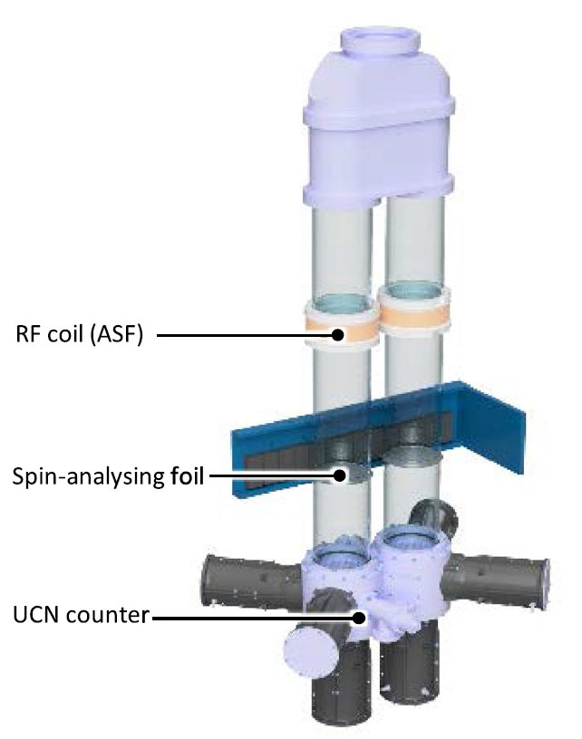
UCN detection
Two identical spin-sensitive detection systems for each precession chamber:
  RF coils to flip the neutrons spin
  Magnetized iron foil which selects one spin state and reflects the opposite
  Fast gaseous detector with ³He and CF₄ mixture as UCN counter
Spin up
Spin down
Notes:
The neutron spin sensitive detection is realized with a system of Adiabatic Spin Flipper (RF coil), a spin analyzing foil and a UCN counter.
For each chamber two of these systems are built: the rf coil is ON in one arm and OFF the second arm. The rf coil is used to flip the neutrons spin which is then analyzed by the spin analyzing foils which are magnetized iron foils. These analyzers allow to cross only UCNs with kinetic energy higher than a threshold which depends on their spin states: one spin state is allowed through the foil and the opposite is reflected.
In the end, a fast neutron counter detects the neutron for each arm, thanks to 3He capture of the neutron which emits proton and 3H (triton) cause scintillation in the CF4. The scintillation light is then detected by PMTs.

Slide 12
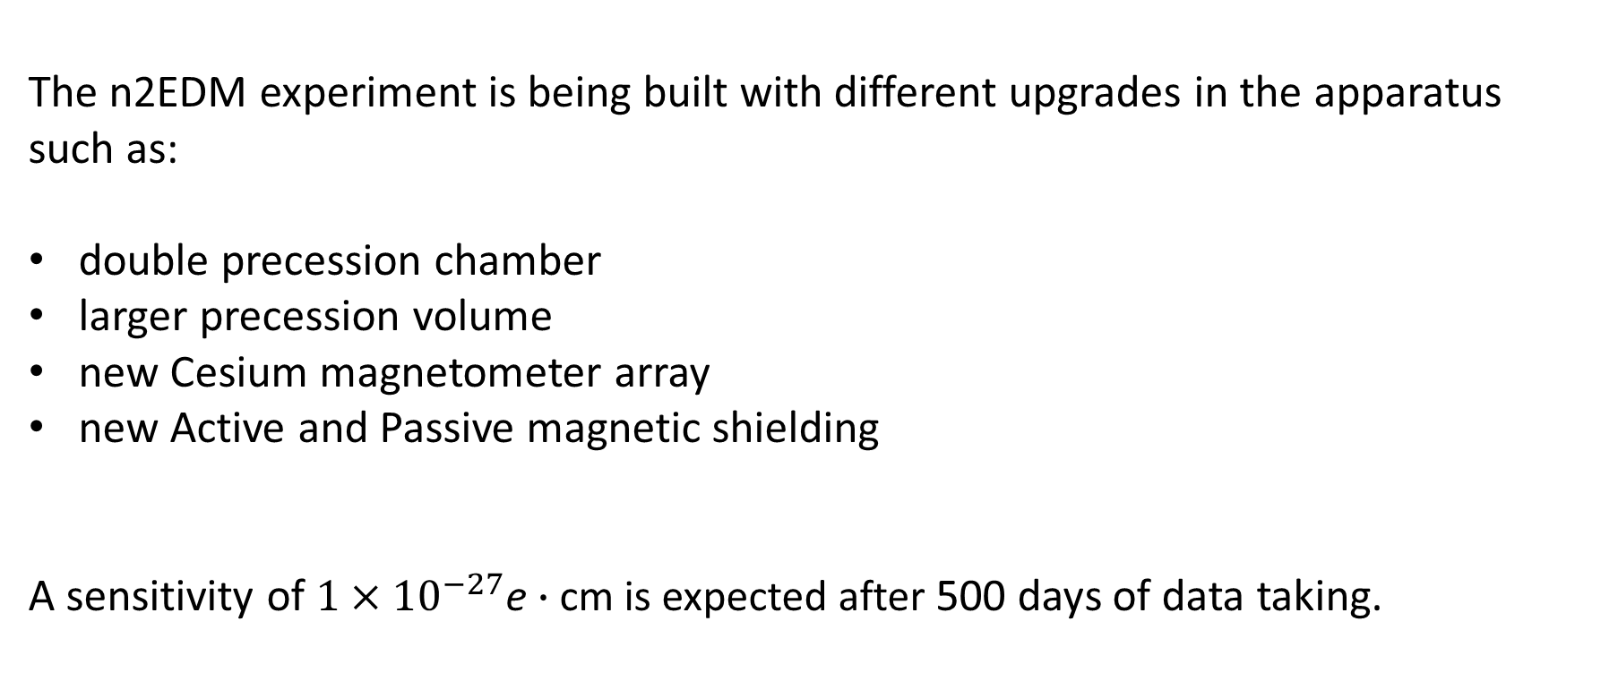
Conclusions
The n2EDM experiment is being built with different upgrades in the apparatus
such as:
double precession chamber
larger precession volume
new Cesium magnetometer array
new Active and Passive magnetic shielding
A sensitivity of $1×{10}^{−27}$e $∙$cm is expected after 500 days of data taking.
Notes:
Improved statistics: 121.000 estimated UCNs per cycle vs 15.000 UCNs per cycle
Double precession chamber instead of only one precession chamber, each of which is larger than the previous (80 cm vs 47 cm )
112 array of Cesium cells for magnetometry vs 15 cells
6 MuMetal layers shield vs 4 MuMetal layers shield

Slide 13
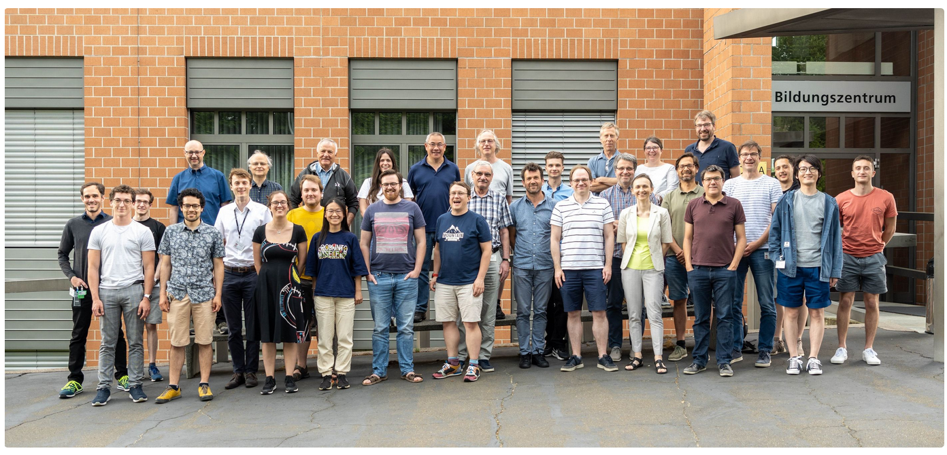
Thanks for your attention

Slide 14
BACK UP SLIDES

Slide 15
Precession chambers

Slide 16
nEDM vs n2EDM
nEDM experiment at PSI
15.000 neutrons every 300 s
One precession chamber of 47 cm diameter
4 MuMetal layers shield
15 Cesium magnetometers
n2EDM experiment at PSI
121.000 neutrons every 300 s
Double precession chamber of 80 cm diameter
6 MuMetal layers
112 Cesium magnetometers
Notes:
SHOW electrodes pictures with somebody close in order to give the idea of the dimensions
Improved statistics: 121.000 estimated UCNs per cycle vs 15.000 UCNs per cycle
Double precession chamber instead of only one precession chamber, each of which is larger than the previous (80 cm vs 47 cm )
112 array of Cesium cells for magnetometry vs 15 cells
6 MuMetal layers shield vs 4 MuMetal layers shield
MOVE THIS SLIDE AT THE END
PUT THE EXPECTED LIMIT

Slide 17
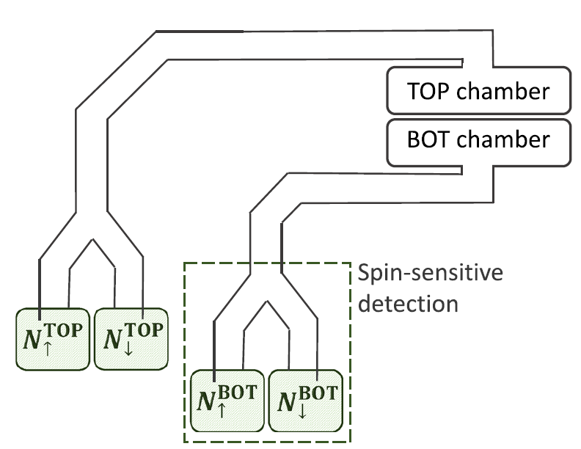
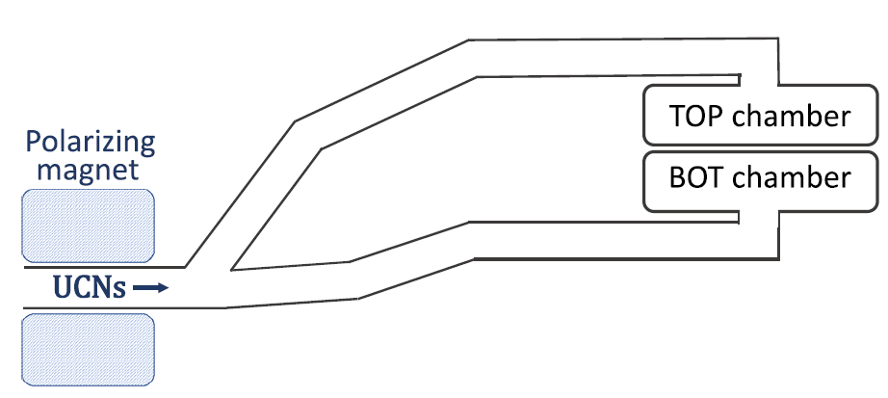
Measurement schematic
Step 1: filling the precession chambers with UCNs and applying the Ramsey’s technique
Step 2: emptying the precession chambers and detect the neutrons in each spin state
Notes:
CHANGE TEXT otherwise is not clear

Slide 18
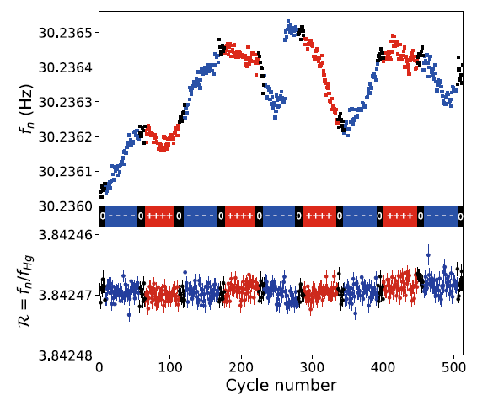
Sequence of data (nEDM)
Notes:
SHOW electrodes pictures with somebody close in order to give the idea of the dimensions

Slide 19
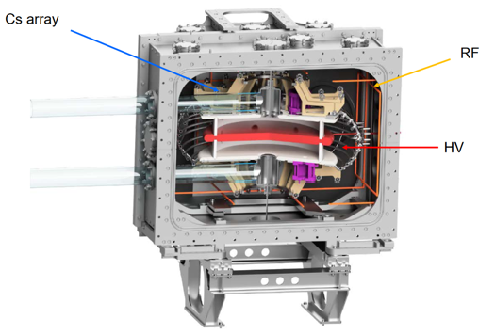
Vacuum vessel
Notes:
SLIDE NOT NECESSARY
At the center of the magnetically shielded room there is the vacuum vessel which contains the core of the experiment, the precession chambers. One can see the UCN guides which bring the UCNs in the precession chambers. The HV voltage electrode is highlighted in red and the ground electrodes are in white. On one side of the vacuum vessel there can be noticed the RF coil in orange, which is used to apply the oscillating signal to flip the neutrons spins.

Slide 20
Electrodes
Notes:
SHOW electrodes pictures with somebody close in order to give the idea of the dimensions

Slide 27
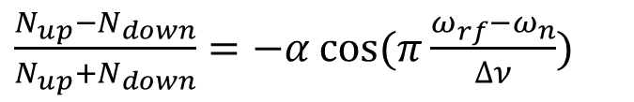
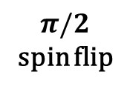
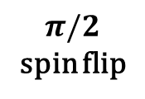
How to measure the neutron EDM?
Polarized
Ultracold Neutrons
Final spin states
UP
OR
DOWN
B₀
B₀
+B_{rf}
B₀
E
B₀
+B_{rf}
$π/2$
spin flip
$π/2$
spin flip
free precession
t
$\frac{N_{up}−N_{down}}{N_{up}+N_{down}}=−α\cos{(π\frac{ω_{rf}−ω_{n}}{∆ν})}$

