Slide 1
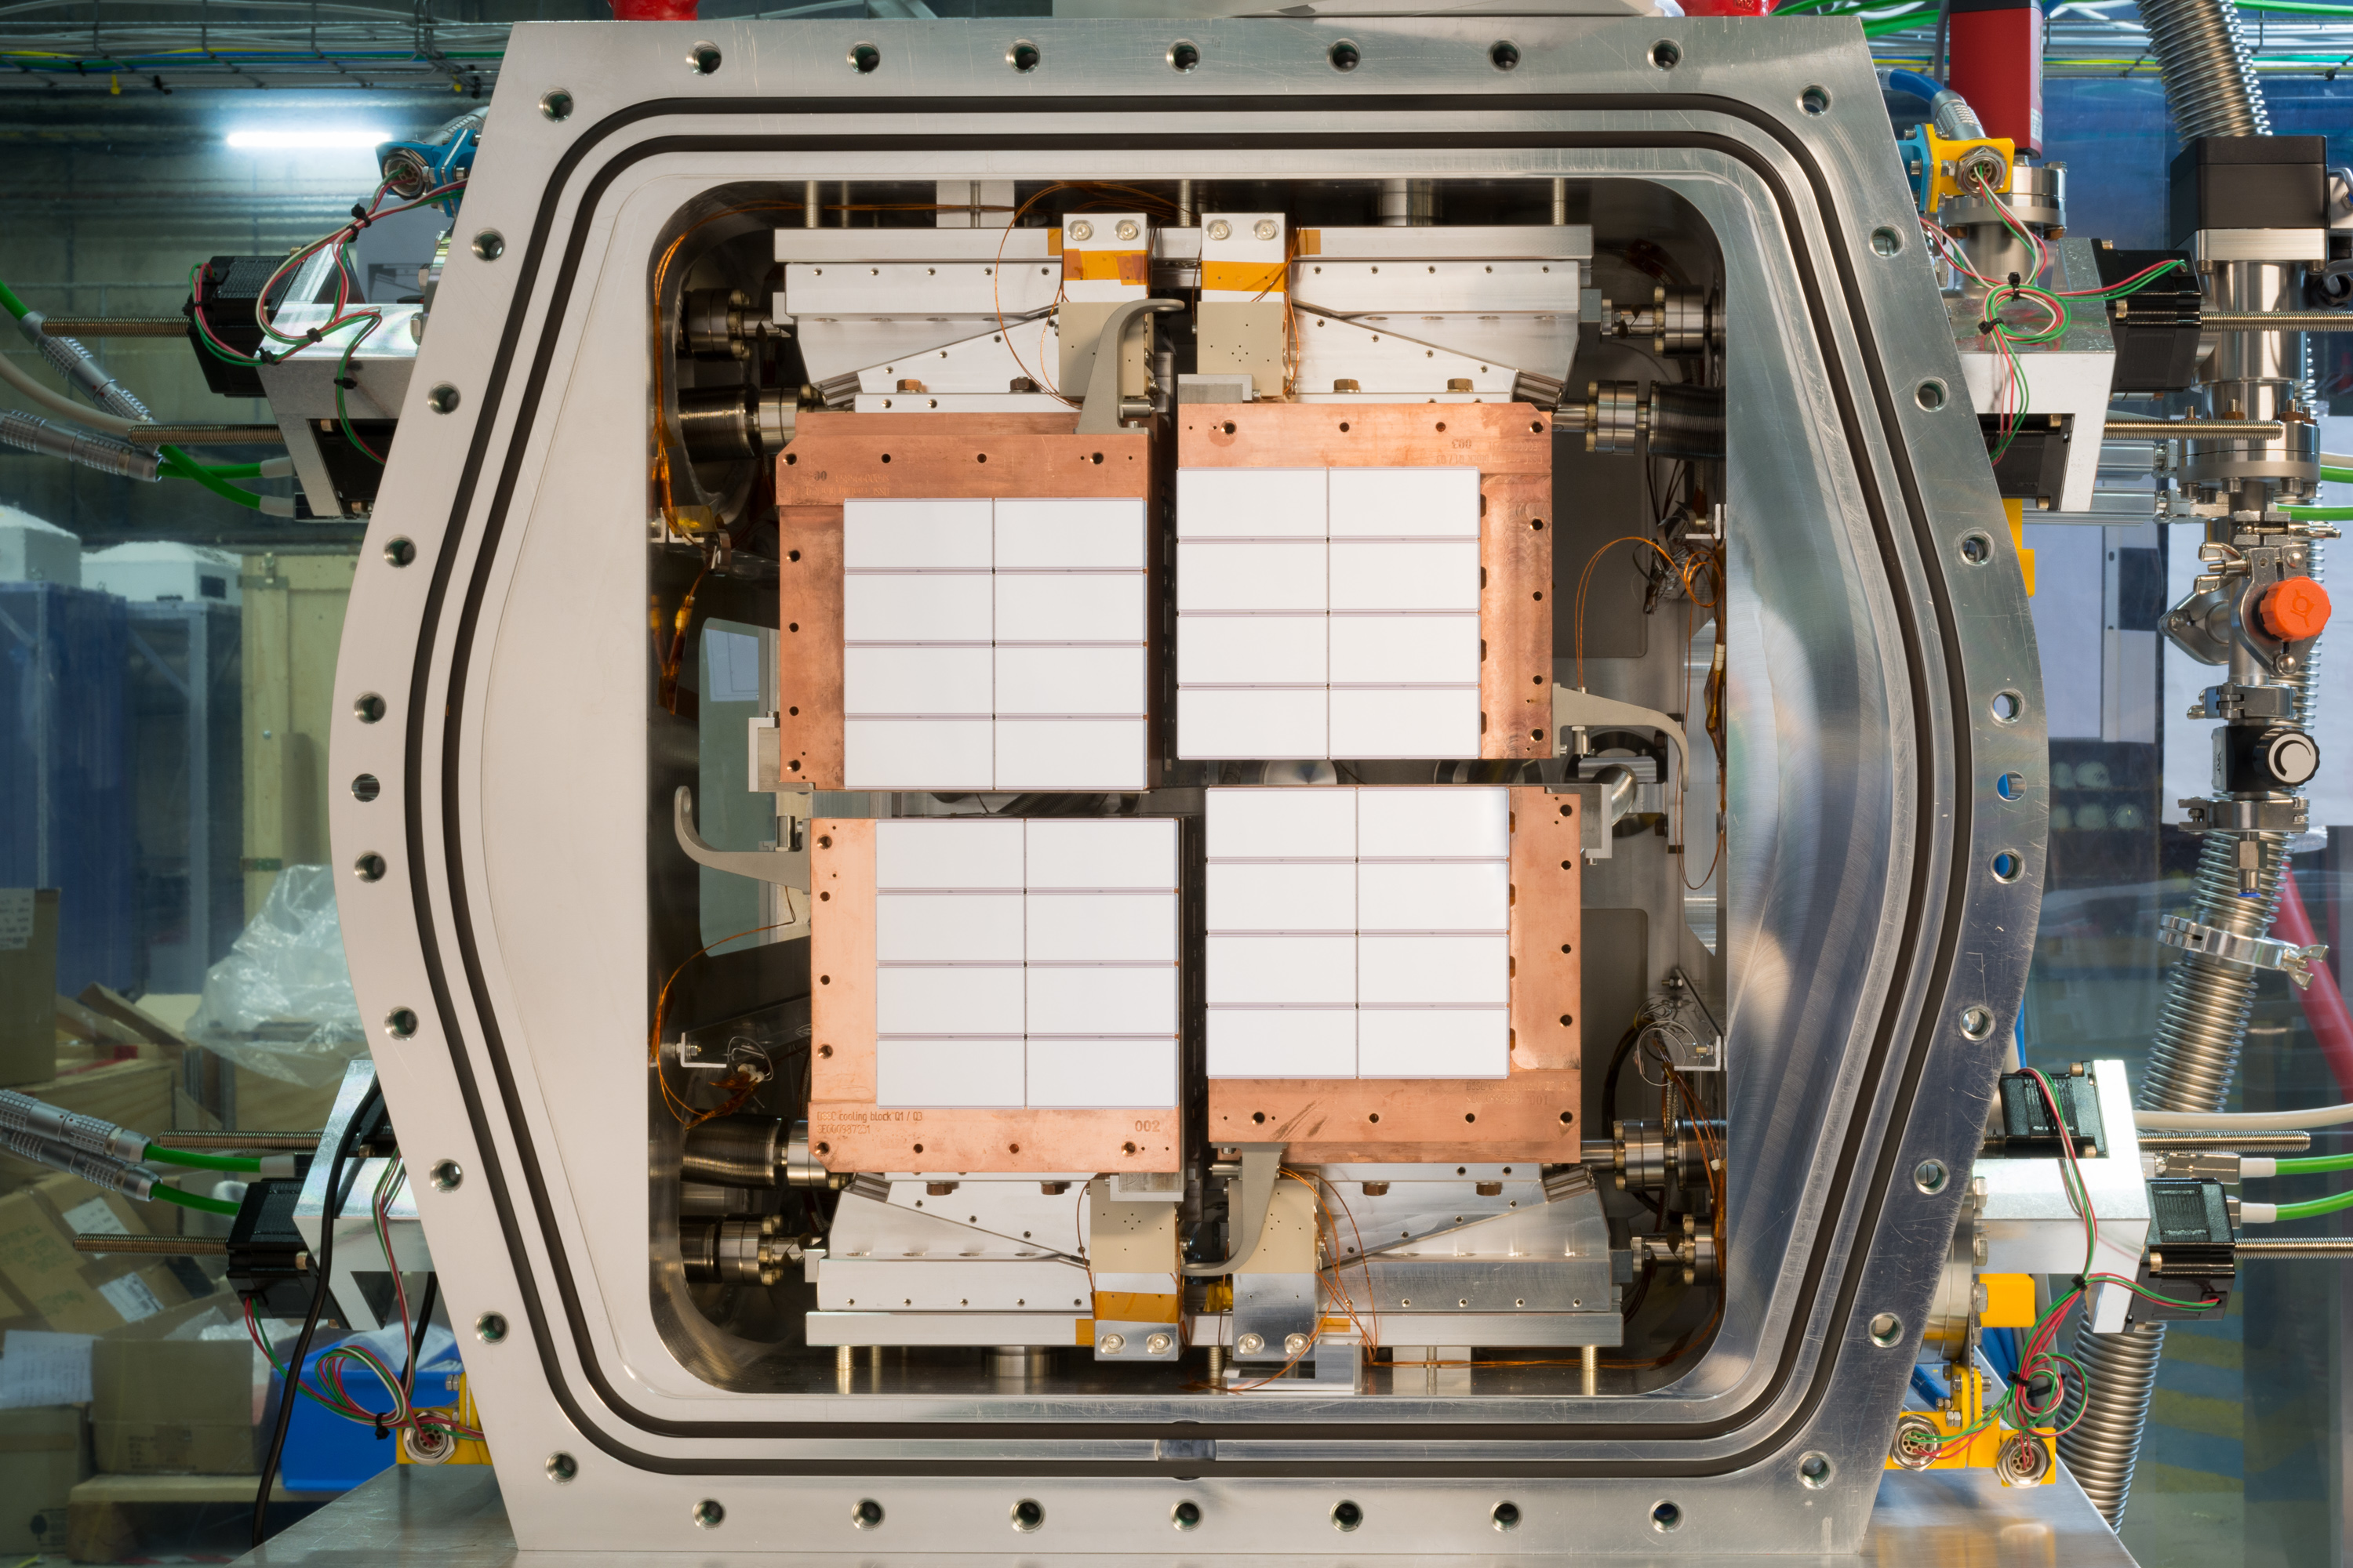

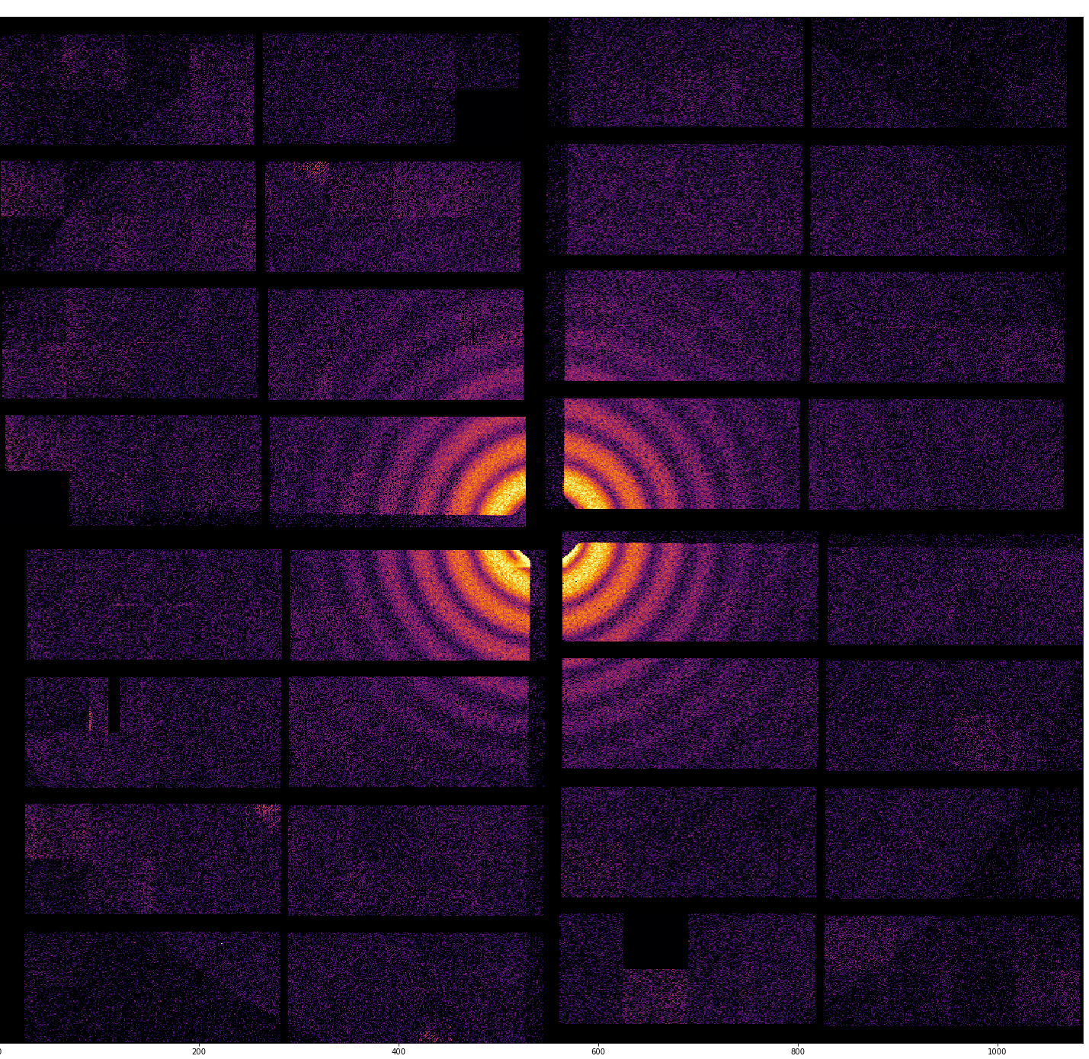
The DSSC soft X-ray Detectors with Mega-frame Readout Capability for the European XFEL
23rd International Workshop on Radiation Imaging Detectors
Riva del Garda, Italy
Sensors I, 29.06.2022
Matteo Porro on behalf of the DSSC Collaboration

Slide 2







M. Porro^{1,9}, L. Andricek², S. Aschauer³, A. Castoldi^{4,5}, M. Donato¹, J. Engelke¹, F. Erdinger⁷, C. Fiorini^{4,5}, P. Fischer⁷, H. Graafsma⁸, A. Grande⁴, C. Guazzoni^{4,5}, K. Hansen⁸, S. Hauf, P. Kalavakuru⁸, H. Klaer⁹, M. Kirchgessner⁷, A. Kugel⁷, M. Kuster¹, P. Lechner², D. Lomidze¹, S. Maffessanti⁸, M. Manghisoni⁶, S. Nidhi⁷, V. Re⁶, C. Reckleben⁸, E. Riceputi⁶, R. Richter², A. Samartsev¹, J. Soldat⁸, L. Strueder³, M. Turcato¹, G. Weidenspointner¹, C. Wunderer⁸
1) European XFEL GmbH, Schenefeld, Germany
2) MPG Halbleiterlabor, Muenchen, Germany
3) PNSensor GmbH, Muenchen, Germany
4) Dipartimento di Elettronica e Informazione, Politecnico di Milano, Milano, Italy
5) Sezione di Milano, Italian National Institute of Nuclear Physics (INFN), Milano, Italy
6) Dipartimento di ingegneria industriale, Università di Bergamo, Bergamo, Italy
7) Zentrales Institut für Technische Informatik, Universitaet Heidelberg, Heidelberg, Germany
8) Deutsches Elektronen-Synchrotron DESY, Hamburg, Germany
9) Department of Molecular Sciences and Nanosystems, Ca’ Foscari University of Venice, 30172 Venezia, Italy
P.I.: M. Porro

Slide 3
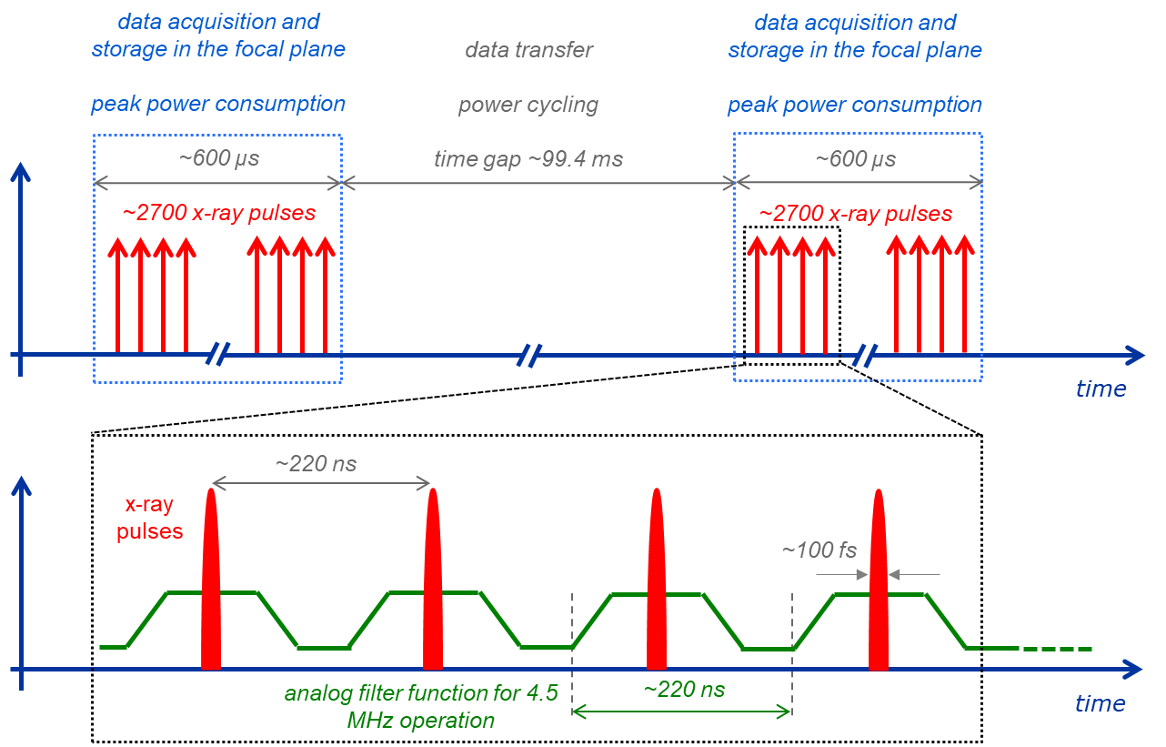
DSSC Detector System Overview 1/2
1 Megapixel camera 4.5 MHz peak frame rate
4 quadrants (512 x 512)
16 ladders (512 x 128)
32 monolithic sensors 128x256
256 Readout ASICs 64 x64
Sensors:
MiniSDD arrays 1st camera
DEPFET arrays 2nd camera
Readout concept
Full parallel readout
In pixel analog to digital conversion
In pixel digital storage (800 frames) with the possibility to overwrite non-valid frames (VETO)
Output average data rate: 134.4 Gbit/s
Power cycling
  The camera is fully powered only during X-ray arrival
  total Power Dissipation 263 W (250 µW per Pixel)
  Coolant Load in Vacuum 149 W (142 µW per Pixel)
Parameter |  | Value
Target energy range |  | 0.25 keV – 6 keV
Pixel count |  | 1024 × 1024
Pixel shape |  | hexagonal
Sensor pixel pitch |  | ~204 µm × 236 µm
Active area |  | ~ 21 cm × 21 cm
Input photon range / pixel / pulse ^{(*)} | MiniSDD | 2^{n} × N -1
 | DEPFET | >10⁴
Achievable noise | MiniSDD | ~ 60 e- r.m.s.
 | DEPFET | ~ 10 e- r.m.s.
Peak frame rate |  | 4.5 MHz
Stored frames per X-ray train |  | 800
Average / peak data rate |  | 134/ 144 Gbit / s
Average power consumption |  | ~ 260 W
Operating temperature |  | -20º C optimum, room T possible

Slide 4
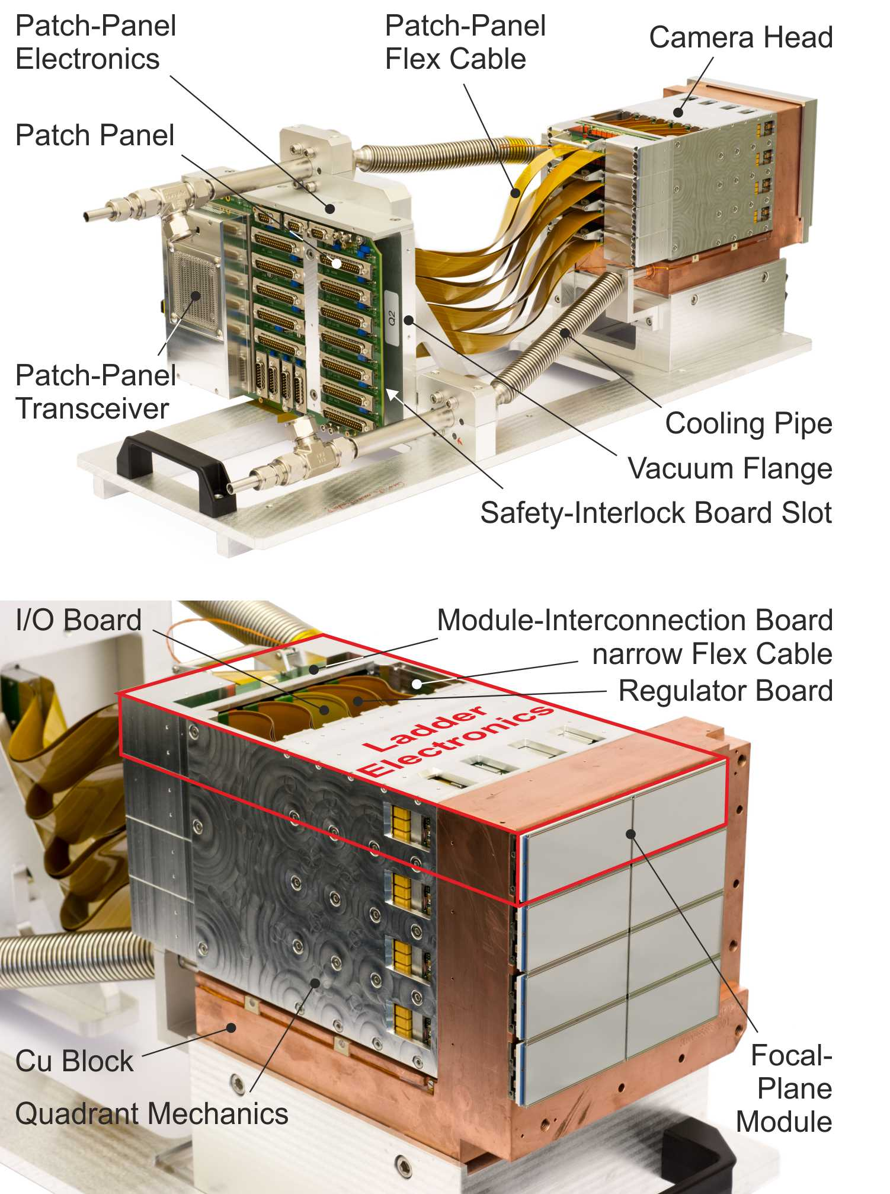
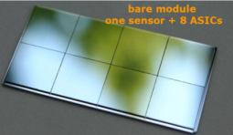
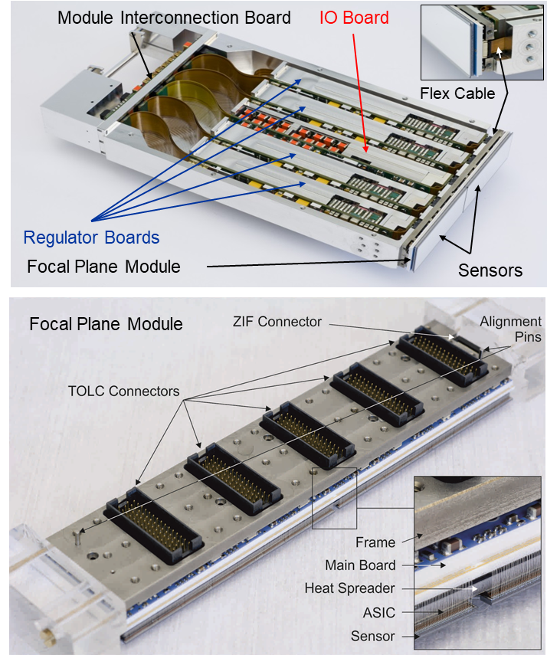
DSSC Detector System Overview 2/2
ladder
Movable quadrants
“service position’ in the pic
Total active area ~ 505 cm²
Minimum insensitive area ~15%

Slide 5
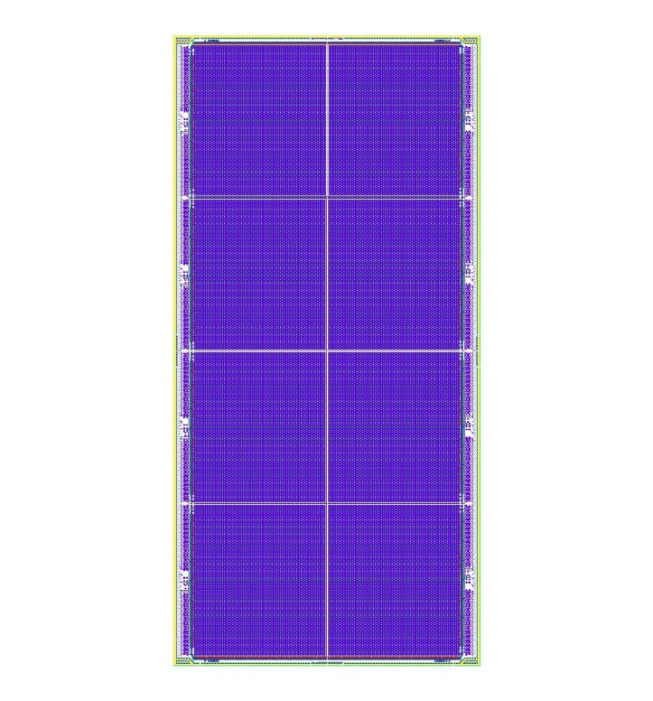
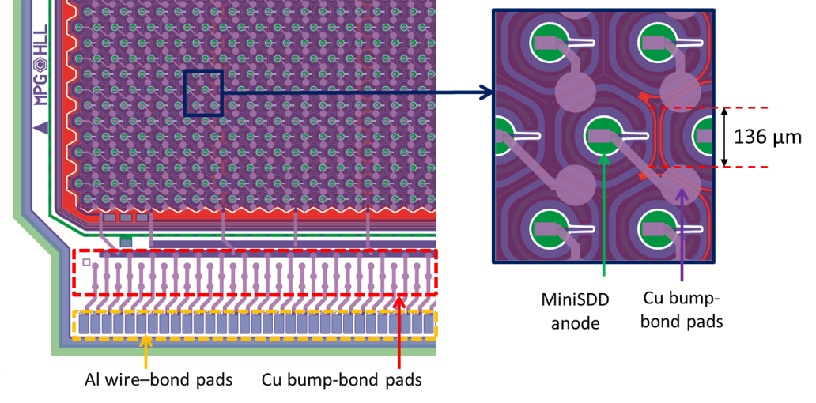
MiniSDD Sensor
6.2 cm
3 cm
128 x 256
pixels
Large area monolithic Mini Silicon Drift Detector Arrays produced at the Semiconductor Laboratory of the Max Planck Society (MPI-HLL)
128 x 256 hexagonal pixels; hexagon side 136 µm; pixel pitches 204 x 236 µm
450 µm thickness
passive collecting anode
1 Alu layer, Cu layer
Every pixel is bumped to the input of one CSA on the readout ASIC
the system is linear
Energy range and dynamic range are given by the gain of the ASIC and the ADC resolution (8/9 bit)

Slide 6
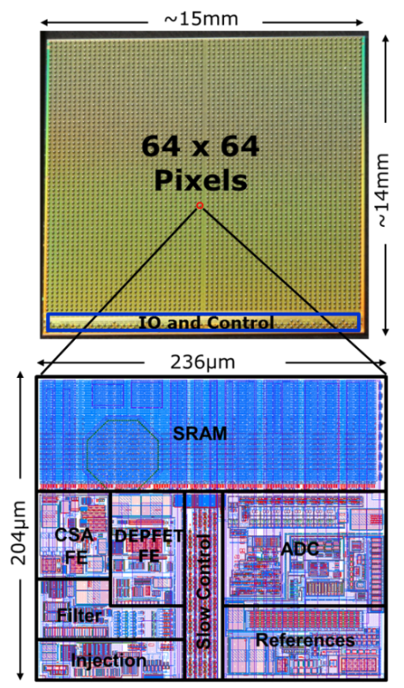
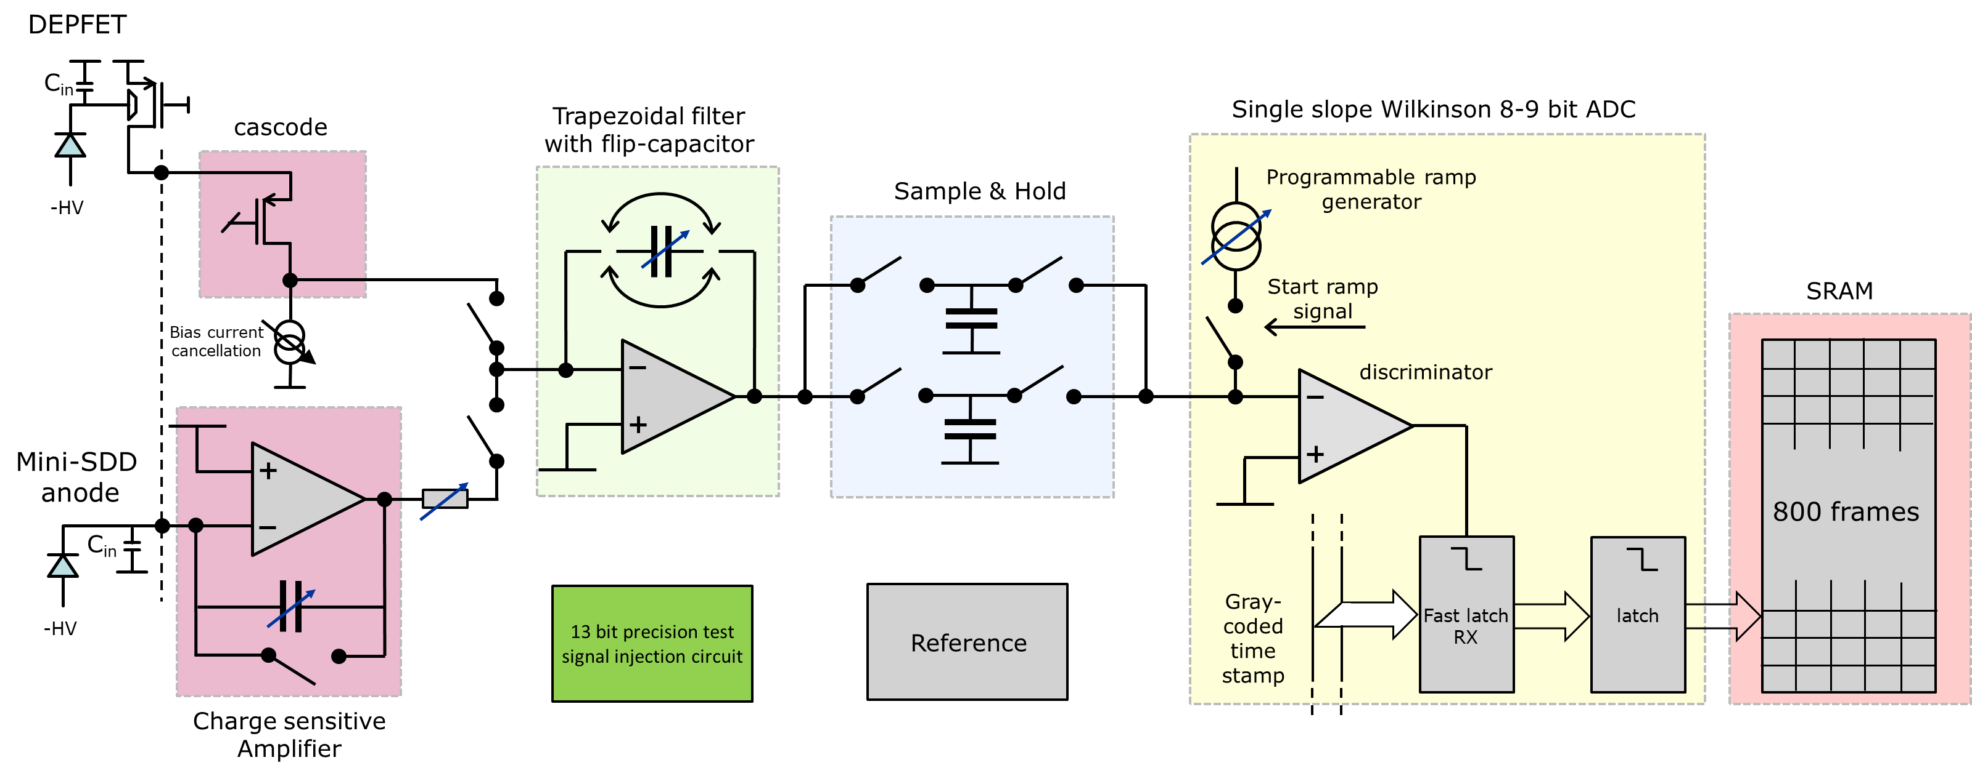
Full Format Readout ASIC
C_{FCF}
I_{RAMP}
C_{CSA}
R_{V2I}
  Gain and offset can be adjusted pixel-wise:
  11 bits of coarse gain setting for ph. energy and input range selection
  6 bits of gain fine trimming (nominal accuracy 2%)
  4 bits for offset trimming (1.5 LSB range with 8% of granularity)
Pixel-wise coarse gain parameters
Pixel-wise fine gain trimming
130 nm CMOS Process with C4 bumps
$$\frac{keV}{ADU}∝C_{CSA}∙R_{V2I}∙C_{FCF}∙\frac{1}{t_{filt}}∙\frac{1}{C_{S\&H}}∙I_{ramp}∙\frac{1}{2∙f_{clock}}$$

Slide 7
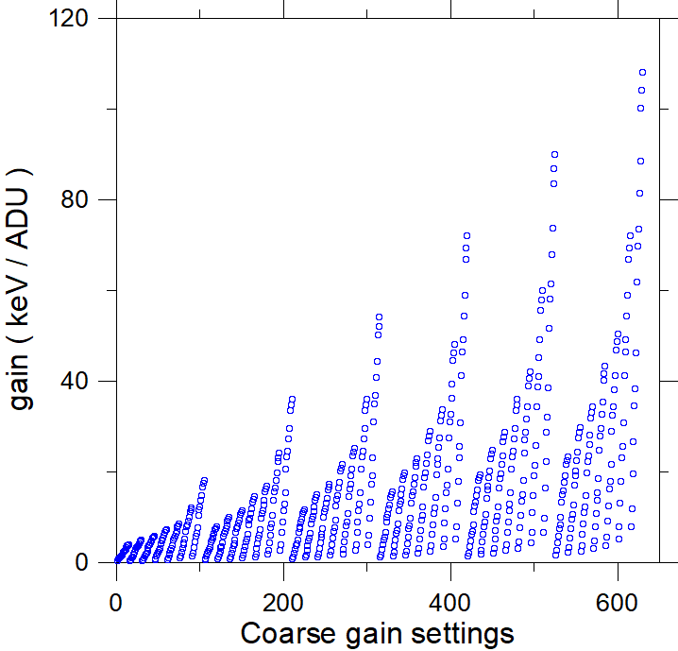
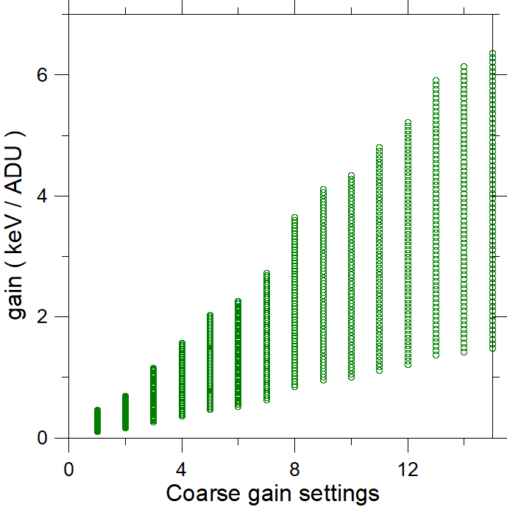
Fine Gain Trimming and Energy Range
pixel-wise coarse gain settings make it possible
to operate with photons of different energies
to define the input dynamic range, associating a defined number of photons to a single ADU
Pixel wise fine-gain trimming is needed
To equalize the gain dispersion over the pixels of the matrix
To have a precise association of number of photons and ADUs
Pixel-wise offset trimming is needed to place the signal produced by one photon in the middle of one ADU (minimization of error count rate)
The overall gain settings are overlapping and have a granularity <1%
Possible to define precisely the gain for any arbitrary energy for 0.5 keV ≤ E_{ph} ≤ 10 keV
It is possible to set different gains in different regions of the detector
Coarse gain
(C_{CSA}, R_{V2I}, C_{FCF})
C_{CSA}=60fF
R_{V2I}=3.2 kΩ
64 fine gain settings for each coarse gain value
1 ph/ADU @ 1 keV
2 ph/ADU @ 0.5 keV

Slide 8
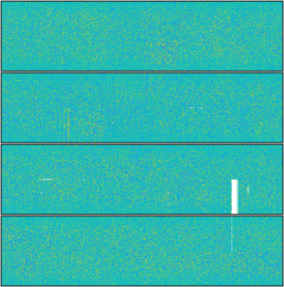
Fine Gain Trimming and Energy Range
pixel-wise coarse gain settings make it possible
to operate with photons of different energies
to define the input dynamic range, associating a defined number of photons to a single ADU
Pixel wise fine-gain trimming is needed
To equalize the gain dispersion over the pixels of the matrix
To have a precise association of number of photons and ADUs
Pixel-wise offset trimming is needed to place the signal produced by one photon in the middle of one ADU (minimization of error count rate)
The overall gain settings are overlapping and have a granularity <1%
Possible to define precisely the gain for any arbitrary energy for 0.5 keV ≤ E_{ph} ≤ 10 keV
It is possible to set different gains in different regions of the detector
5 ph / ADU
1280 ph
5 ph / ADU
1280 ph
3 ph /ADU
768 ph
3 ph /ADU
768 ph
1 ph /ADU
256 ph
1 ph /ADU
256 ph

Slide 9
DSSC 1 Megapixel Camera
Gain
ENC
average: 382.9 ± 3.6 (1.0%)
average σ: 17.3 (4.5%)
average: 57.6 ± 2.5 (4.4%)
average σ: 16.1 (27.9%)
Failure Rate: 3 ASICs out of 256 are concerned (< 2 %)
Camera calibration @XFEL with pulsed X-ray source PulXar
Average gain ~400 eV/ADU (un-trimmed) and ENC ~58 e- @ 4.5 MHz
Good uniformity for the 16 ladders
Dark-Image Test
w/o active Cooling at RT
default Gain/Offset Settings

Slide 10
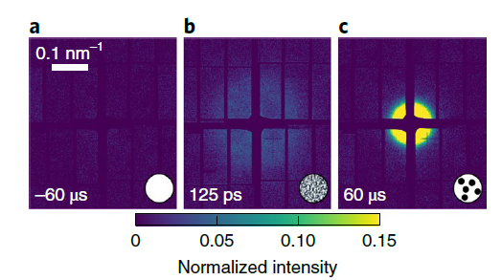
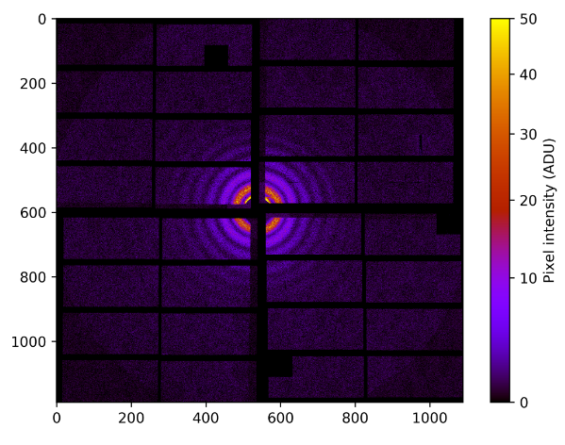
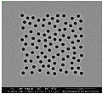
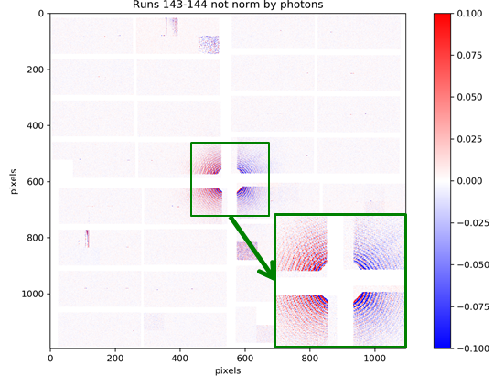
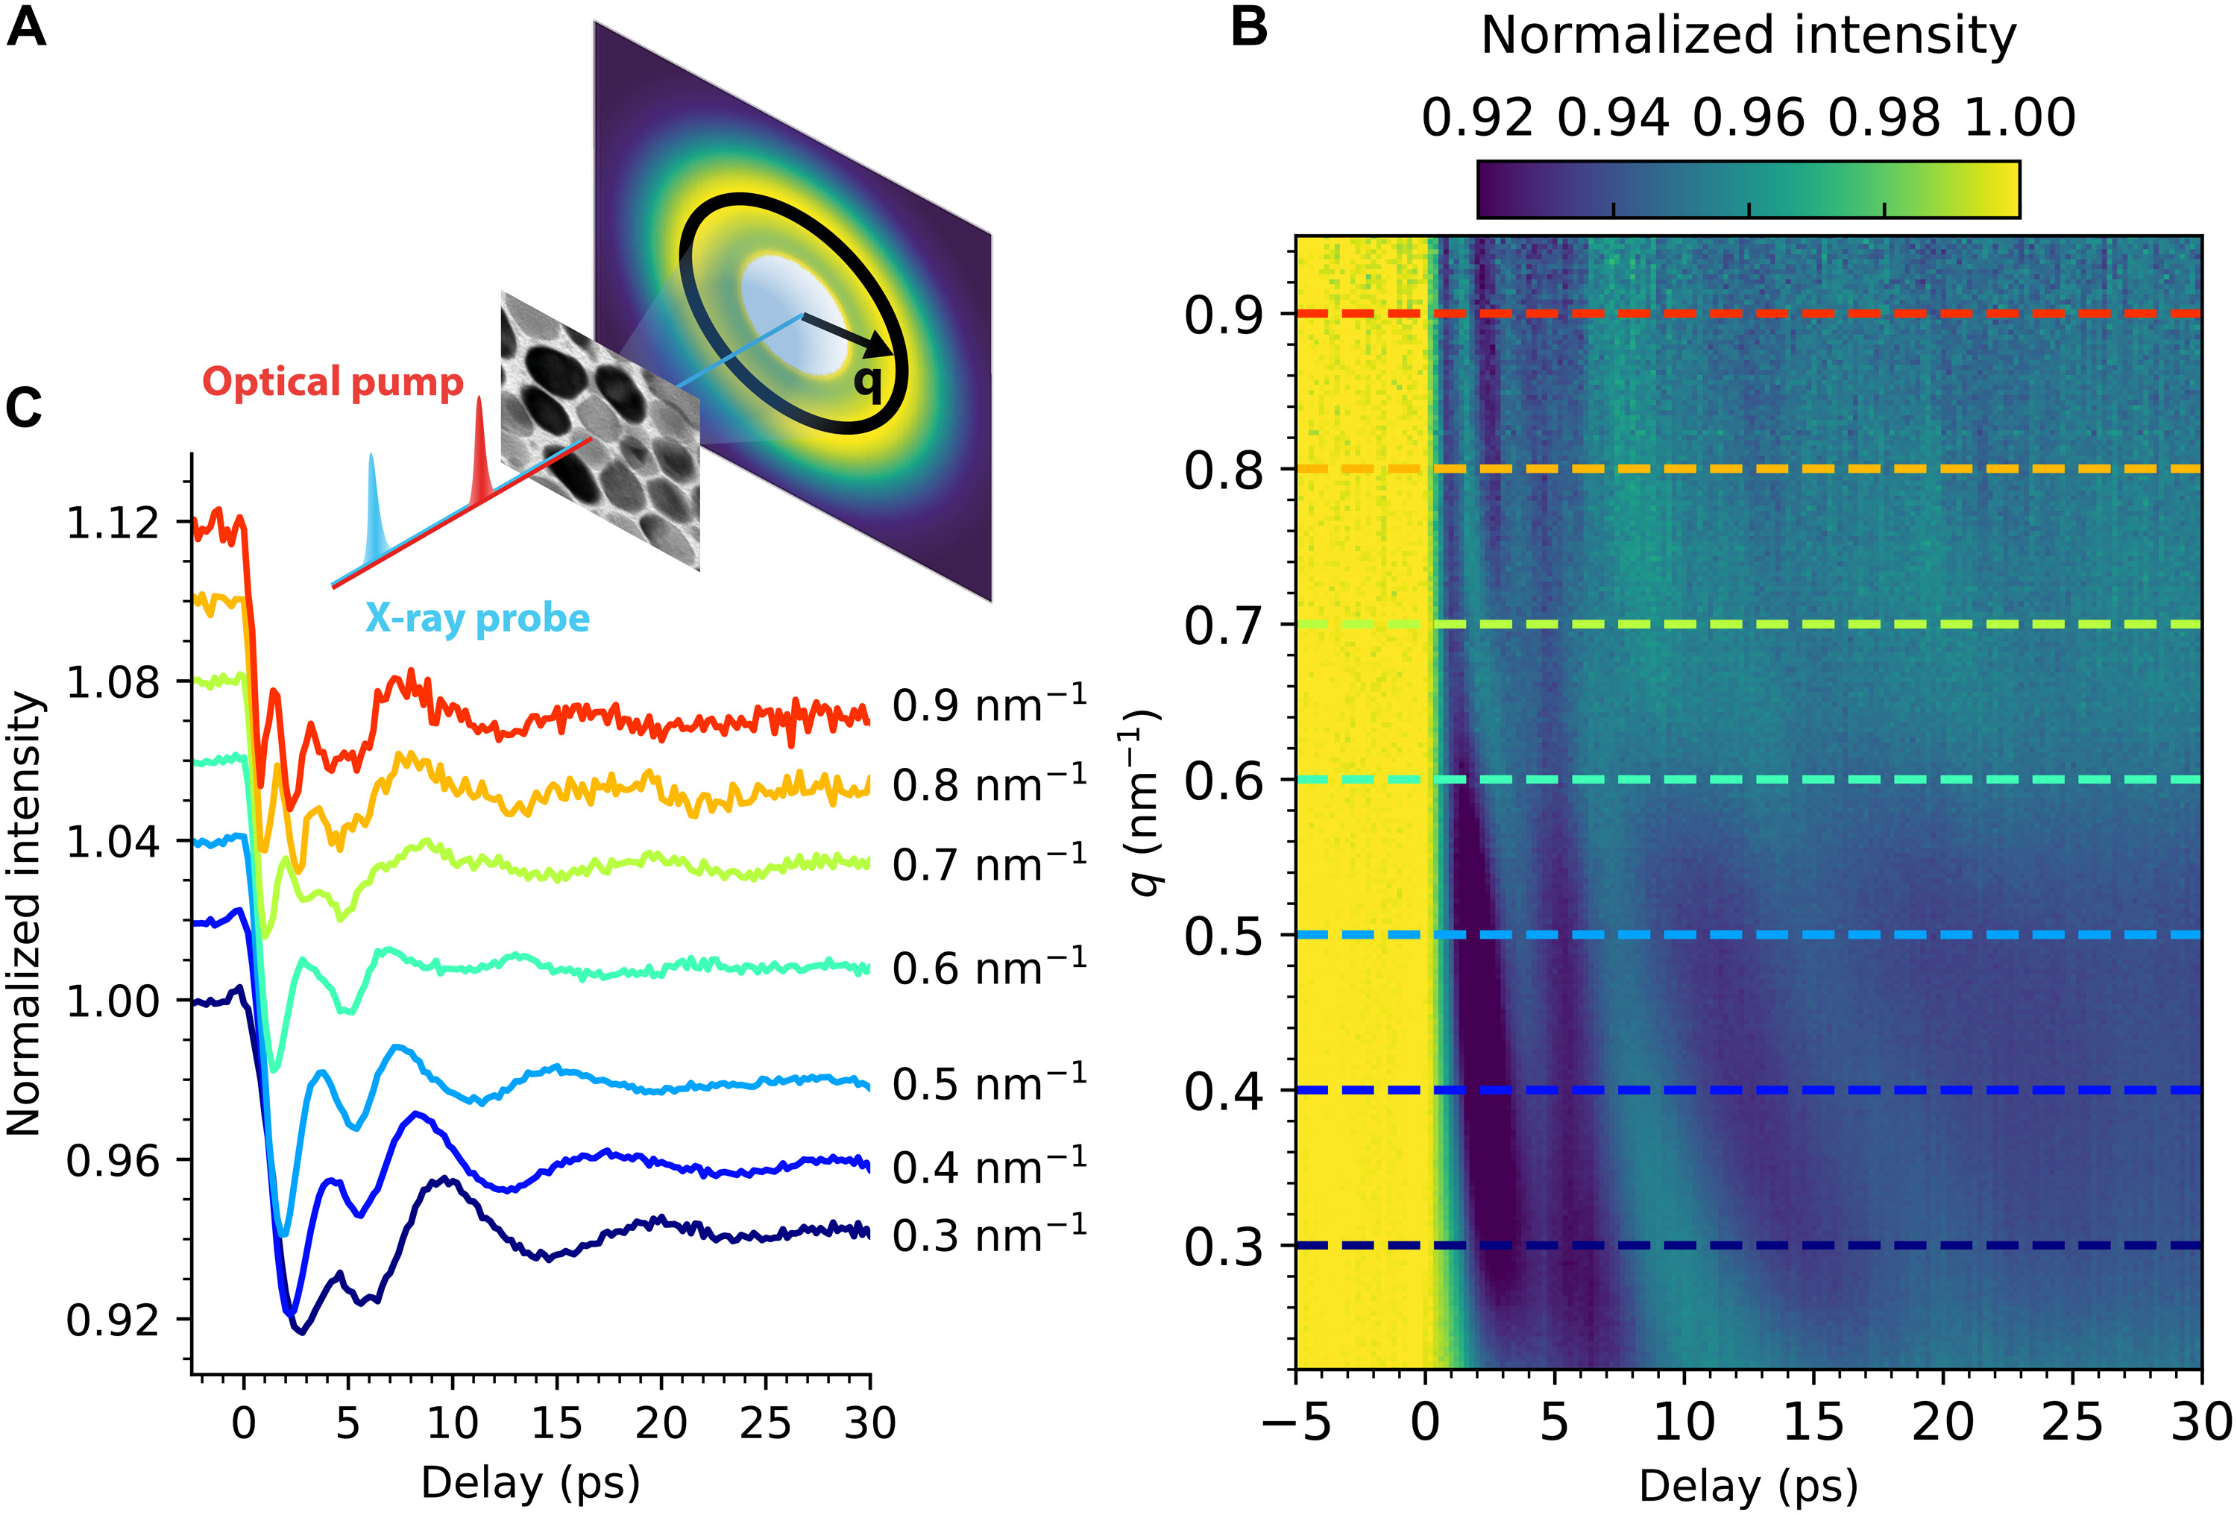
Commissioning & Users’ Experiments
Installation in May 2019 @ Spectroscopy and Coherent Scattering (SCS) Instrument
First user experiment May 28, 2019
Since installation (to Dec 2021):
  17 user experiments at SCS:
    8 Time resolved scattering
    7 Time resolved XAS
    2 Time resolved Holography
  DSSC commissioned and installed at Small Quantum Systems (SQS) Instrument in 2021
  First experiment performed: "High-repetition rate 3D X-ray imaging of single proteins“, PI: F. Maia, August 2021
[1]
2) P.I.: F. Büttner , G. Beach, M.I.T.
E = 778 eV (Co L3-edge)
Single-shot diffraction image of pinholes with 707 eV photons @ 4.5 MHz
[2]
[3]
[1] Büttner, F; et al. Observation of fluctuation-mediated picosecond nucleation of a topological phase. Nat. Mater. 20, 30–37 (2021). doi:10.1038/s41563-020-00807-1
[2] Hagström, N. Z.; et al. Megahertz-rate Ultrafast X-ray Scattering and Holographic Imaging at the European XFEL. arXiv (2022). doi:10.48550/arXiv.2201.06350
[3] Turenne, D.; et al. Nonequilibrium Sub–10 Nm Spin-Wave Soliton Formation in FePt Nanoparticles. Sci. Adv. 2022, 8, eabn0523. doi:10.1126/sciadv.abn0523

Slide 11
Towards the DEPFET 1 megapixel camera

Slide 12
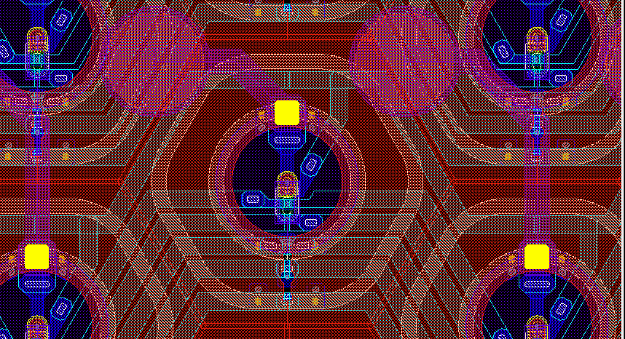
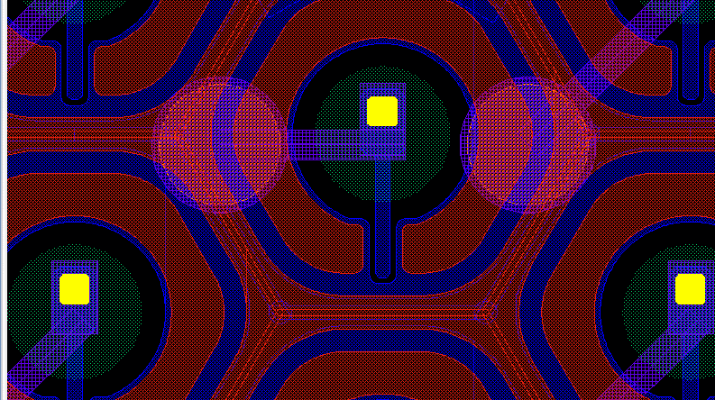
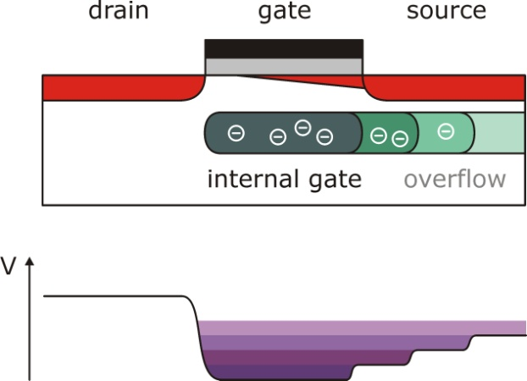
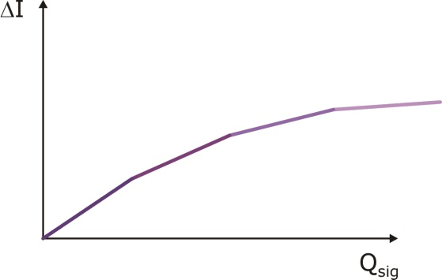
DEPFET sensors
In the second DSSC camera the MiniSDD sensors will be replaced by DEPFET arrays
  Fully compatible ladder electronics, additional components installed for sensor operation
  ASIC includes DEPFET FE
  Sensors are produced in a CMOS foundry (IMS) and at PNSensors
  8 inch wafers
  750 µm thickness
  <400 V depletion voltage
DEPFETs are active pixels that provide a non linear response
Low noise for single photon detection
High dynamic range
The DEPFET arrays are compatible with the existing DSSC system
Common-source configuration, I_{DRAIN} readout
Clear gate
Source
136 µm
136 µm
Gate
Clear
Internal gate
MiniSDD with passive collecting anode
Drain
DEPFET Active Pixel
Lechner, P.; et al. DEPFET active pixel sensor with non-linear amplification, 2011 IEEE Nuclear Science Symposium Conference Record, 2011, pp. 563-568, doi:10.1109/NSSMIC.2011.6154112.
Aschauer, S.; et al. First Results on DEPFET Active Pixel Sensors Fabricated in a CMOS Foundry - a Promising Approach for New Detector Development and Scientific Instrumentation. J. Inst. 2017, 12, P11013–P11013. doi:10.1088/1748-0221/12/11/p11013

Slide 13
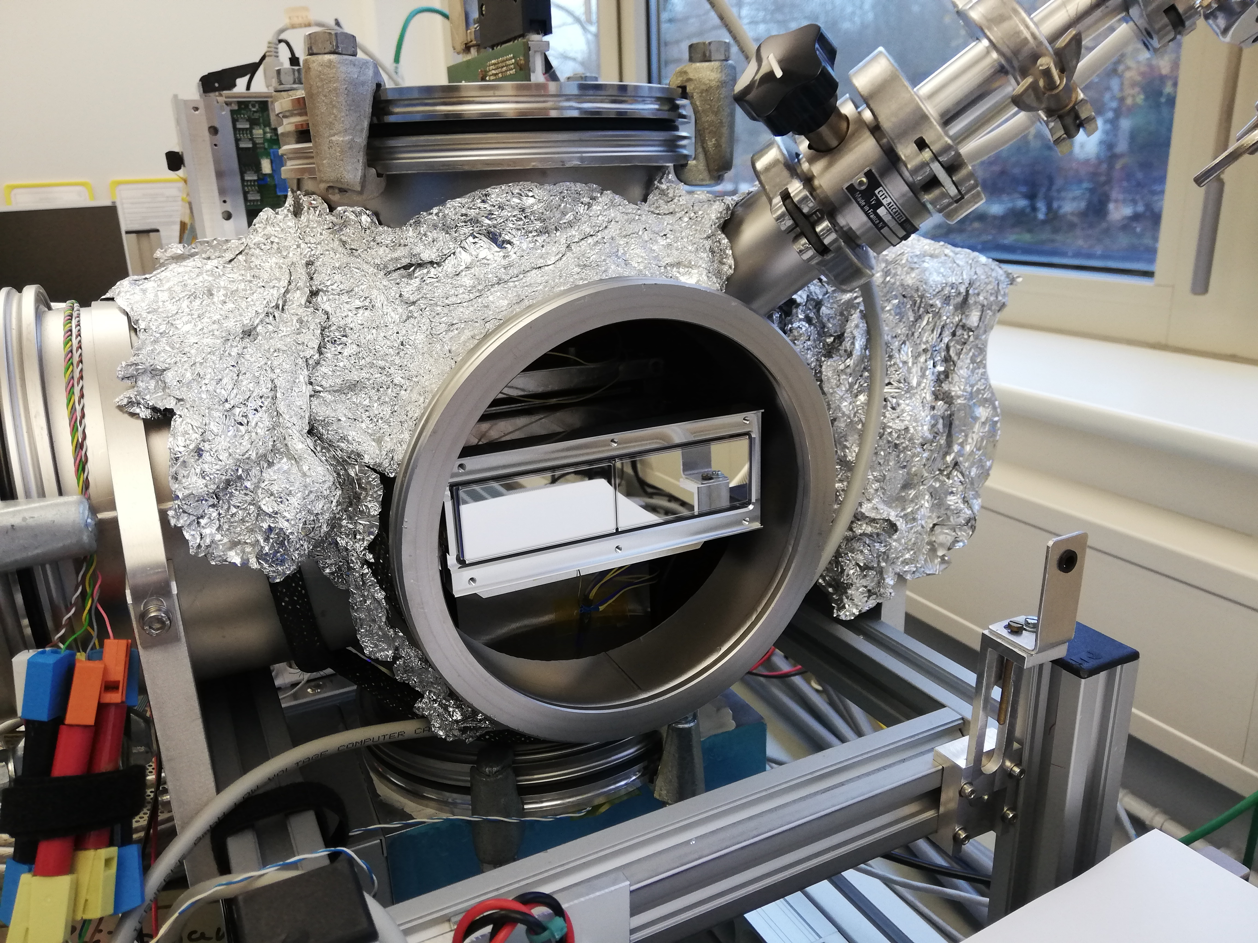
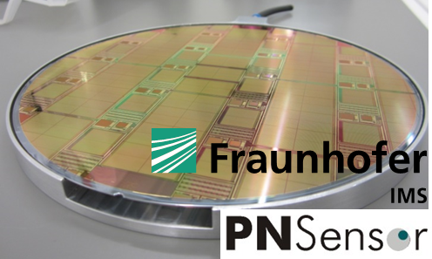
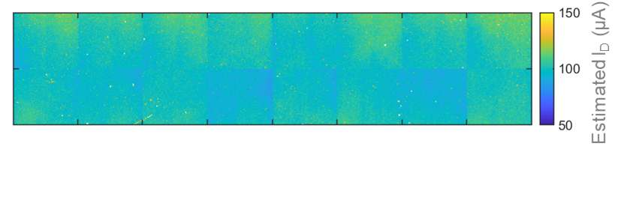
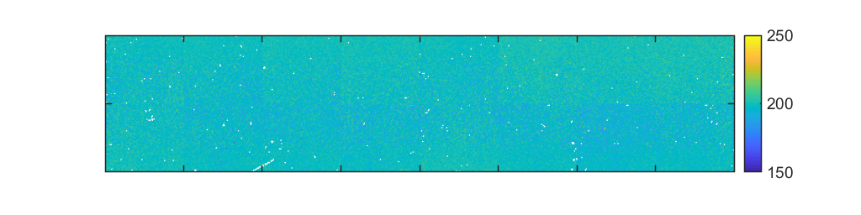
DEPFET-ladder prototype: linear range
1st prototype characterization in the linear range with lab-setup at DESY
100 µA/pixel average DEPFET-bias current
ENC 18 e- rms with T_{int} = 50 ns (2.25 MHz), 200 eV/ADU
Down to 9.8 e- rms with T_{int} = 300 ns (1.125 MHz operation), 37.3 eV/ADU
Near room-temperature conditions
V_{SOURCE} = 5V, V_{GATE 1/2} = 2.52/2.57V
I_{D, S1} = 100.1 µA ± 5.5 %
I_{D, S2} = 100.5 µA ± 5.7 %
Test setup at DESY-FEC
Sensor-wise DEPFET-drain current trimming capabilities, dispersion below 6%
Sensitivity: 198.3 eV/ADU ± 2.2%
White pixels: 0.4% (Backside scratch, High leakage pixels, pixel artifacts)
Sensitivity
(eV/ADU)
Pixel-wise gain trimming reduces dispersion below 2.2% on the full matrix

Slide 14
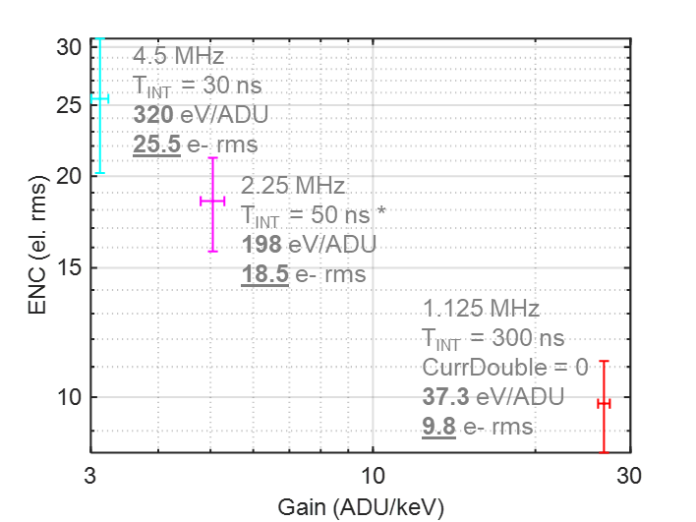
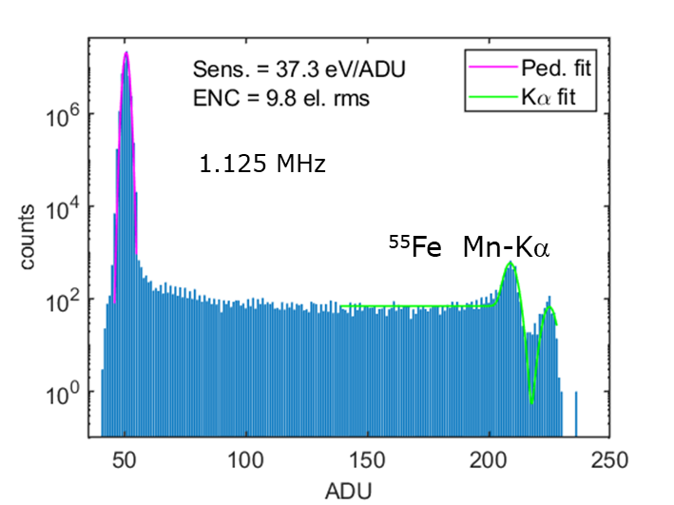
DEPFET-ladder prototype: linear range
1st prototype characterization in the linear range with lab-setup at DESY
100 µA/pixel average DEPFET-bias current
ENC 18 e- rms with T_{int} = 50 ns (2.25 MHz), 200 eV/ADU
Down to 9.8 e- rms with T_{int} = 300 ns (1.125 MHz operation), 37.3 eV/ADU
Near room-temperature conditions

Slide 15
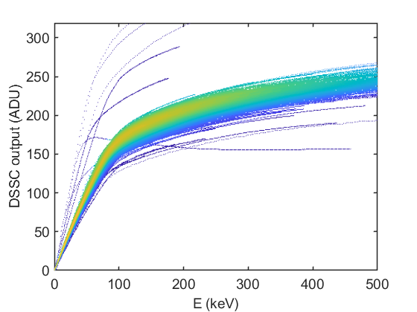
DEPFET-ladder prototype: NL curve
Non linear characteristics evaluation
150 nm thick Al layer on entrance window
laser pulser: 905 nm, 25 W
Integrating charge into DEPFET internal gate, no clear between acquisition cycles
Curve scan with 400 pulses in singe integration mode
50 ns integration time
Dynamic range of several thousands 1 keV photons
DEPFET signal current
ADC sampling point
Filter output
FE reset
LED pulse
clear
clear
1st kink Energy:
  80.6 ± 5.4 keV
Gain (linear):
  473 eV/ADU

Slide 16
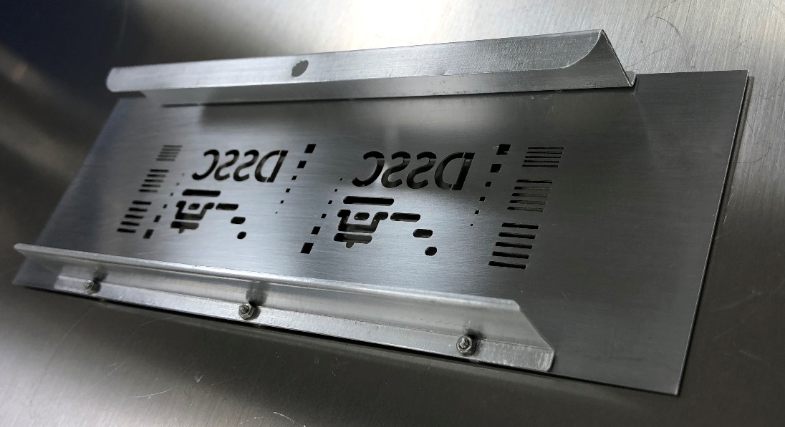
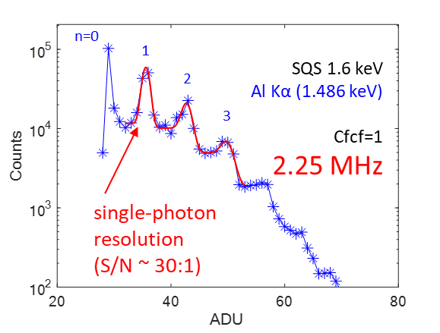
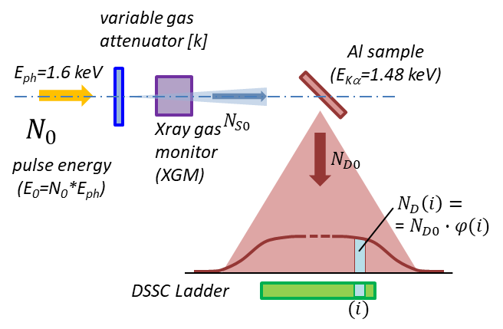
DEPFET-ladder prototype: beamline tests
1st prototype characterization at Small Quantum System (SQS) Instrument @ EuXFEL
50 ns integration time, 2.25 MHz operation (beam at 1.1MHz)
Al fluorescence (1.486 keV)
Single photon resolution with S/N ~ 30
Near room temperature operation
Slit 0.36 mm
Gap 0.65 mm
2.5 mm
2 mm
1.1 mm
Slit 0.60 mm
Gap 0.90 mm
1. mm
0.750 mm
0.373 mm
Steel, 0.5 mm
Slit 0.85 mm
Gap 1.16 mm
Run167, E~2 MeV/pixel
Details are given in the following talk:
A. Castoldi, “Qualification and Modeling of the Non-Linear Response of the First Large-Area DEPFET Pixel Sensors with Internal Signal Compression”

Slide 17
Summary & Conclusions
The first 4.5 MHz - 1 M-Pixel MiniSDD-based DSSC camera has been completed and successfully installed at the Spectroscopy and Coherent scattering (SCS) and the Small Quantum Systems (SQS) scientific instruments of the European XFEL
The performance figures of the detector system are in excellent agreement with expectations and confirm the results obtained on the prototype module
The second 1-Mpixel camera will be based on CMOS-DEPFET active pixel sensors that allow single photon detection and high dynamic range simultaneously. The camera will be available in the first half of 2023
First operation of a CMOS-DEPFET ladder confirms the expected improvements given by the DEPFET technology
ENC can be as low as to 9.8 e- rms at 1.1 MHz
Dynamic range is of several thousands 1 keV photons

Slide 18
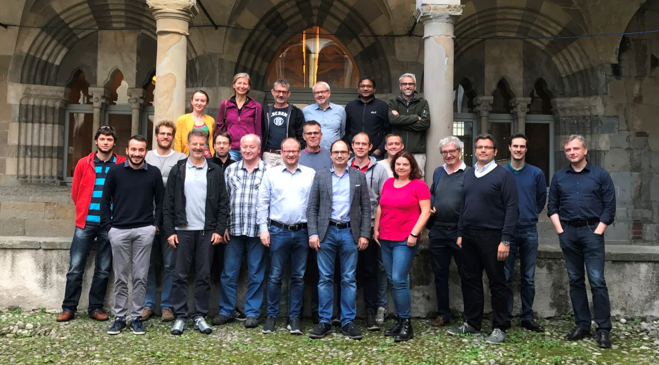
DSSC Consortium
Thank you
for your attention

Slide 19
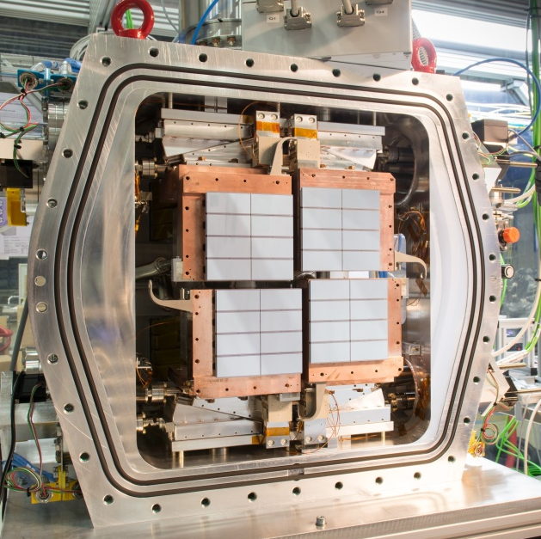
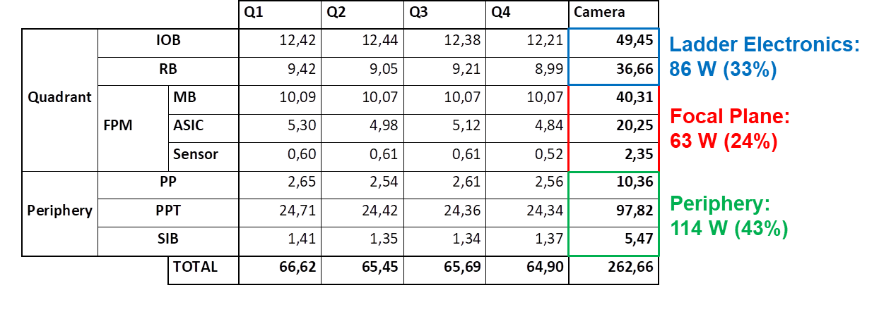
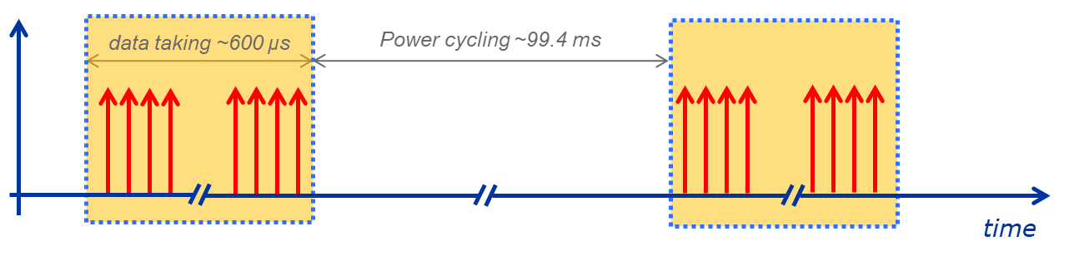
Camera Performance: Power Consumption
© DESY
Power Cycling: total Power Dissipation 263 W (250 µW per Pixel)
Coolant Load in Vacuum 149 W (142 µW per Pixel)
In Agreement with Calculations & Expectations

Slide 20
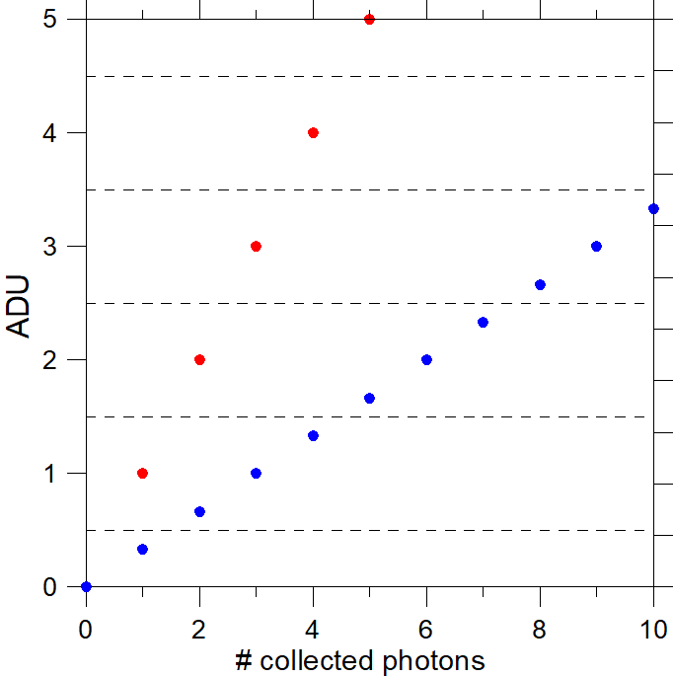
Gain Settings & Input Dynamic Range
pixel-wise coarse gain settings make it possible
to operate with photons of different energies
to define the input dynamic range, associating a defined number of photons to a single ADU
Pixel wise fine-gain trimming is needed
To equalize the gain dispersion over the pixels of the matrix
To have a precise association of number of photons and ADUs
Pixel-wise offset trimming is needed to place the signal produced by one photon in the middle of one ADU (minimization of error count rate)
photons / ADU (minimum detectable input) | Maximum signal in photons (8 bit - 4.5 MHz)
10 | 2560
5 | 1280
3 | 768
1 | 256
0.5 | 128
single photon detection
distance in V between two photons
1 ph / ADU
ADU size
3 ph / ADU

Slide 21
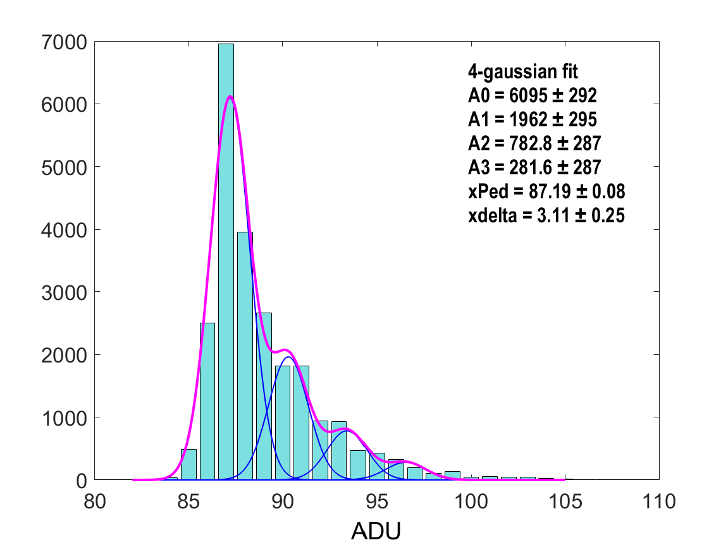
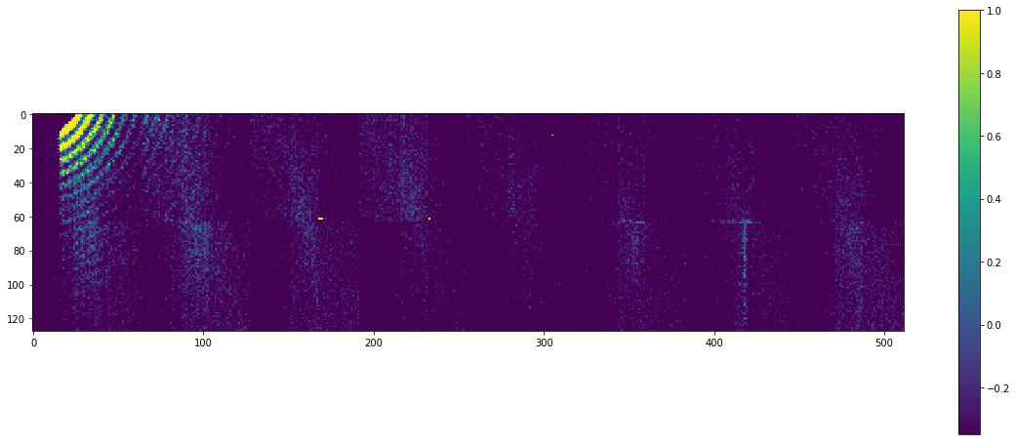
First Diffraction Patterns at SCS 2/2
Results are preliminary
photon energy 707eV, 133 pulses/train
low photon multiplicity on DSSC, acquisitions done at high gain 3 bin/ph (i.e. 0.236 keV/ADU)
DSSC acquiring at 4.5MHz, 400 frames/train
Spectrum of one pixel - 24000 frames
single pixel spectra
run#32 – ladder#0
4-gaussian fit with free amplitudes (all sigma’s fixed at Pedestal sigma)
delta between centroids 3.11± 0.25 ADU, compatible with calibration (3 ADU)
amplitudes nicely follow Poisson (λ=0.38)

