Slide 1

Qualification and Modeling of the Non-Linear Response of the First Large-Area DEPFET Pixel Sensors with Internal Signal Compression
A. Castoldi, C. Guazzoni, M. Ghisetti, Politecnico di Milano & INFN
S. Maffessanti, K. Hansen, DESY
S. Aschauer, L. Strüder, PNSensor GmbH
Y. Ovcharenko, D. Lomidze, M. Porro, European XFEL GmbH
+ acknowledments to many people at XFEL and DSSC Consortium

Slide 2

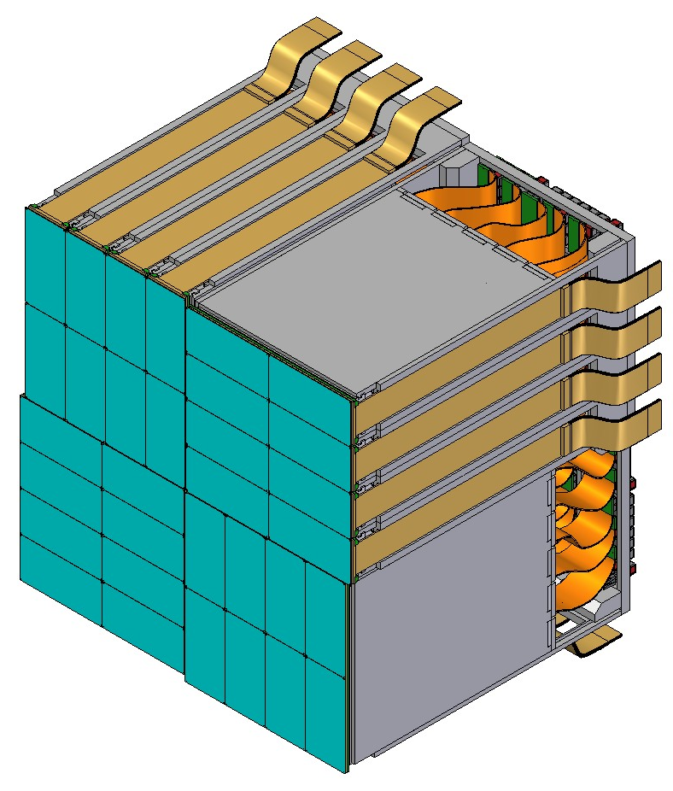





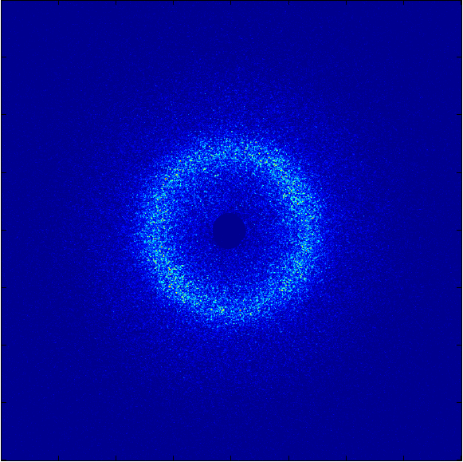



DEPFET Sensor with Signal Compression (DSSC) 1 Mpix camera
Main features
based on non-linear DEPFET sensors
200 µm hex pixel (1024 x 1024)
photon energy 0.5-6 keV
single-photon sensitivity
dynamic range 10,000 ph
frame rate 0.9 – 4.5 MHz
digitization/storage during bunch train
~800 stored frames/macrobunch
Power
Module Box
Board Cooling
P < 27 W
Chip Cooling
21 cm (1024 pixels)
Ladder
P < 4.5 W
Signals
& Clocks
256x128
unscattered beam
Quadrant
 accurate calibration of multiple DSSC properties is requested (gain, offset, QE, charge-sharing, etc)
 of particular importance is the qualification of the NL system response over the full dynamic range
x-y Gap
128 x 256 Pixel Sensor
Power cycling
11 kW peak power
240 W average power

Slide 3
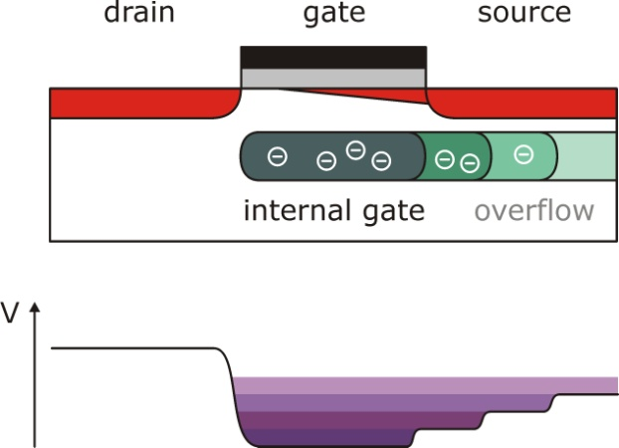
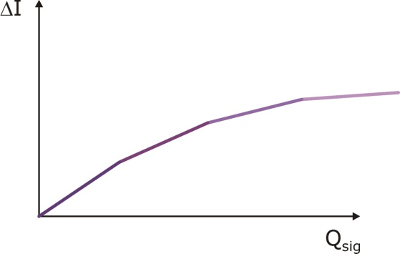
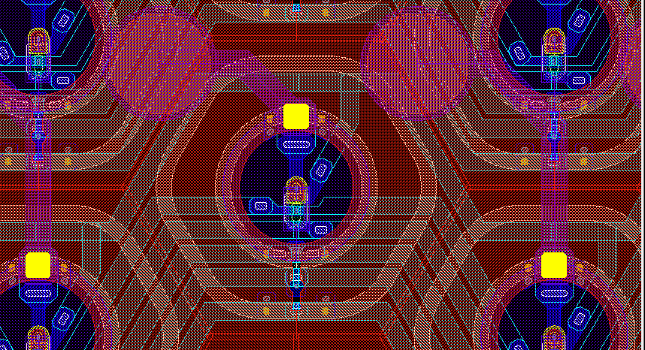
Signal compression at sensor level
DSSC adaptation of the DEPFET concept:
 internal gate extends under the source
 at high levels, signal charges gradually spread under source
 non-linear ΔI/Q_{sig} curve
 gain curve engineering by dose & geometry of implantations
Low noise (low capacitance)
Fast collection
Signal compression
(but internal gate not accessible from ASIC)
CMOS-foundry DEPFET technology (PNSensor GmbH)
Aschauer, et al. JINST (2017)
136 µm
High dynamic range & single photon sensitivity
DePFET:
NL pixel response
ASIC:
linear response
DSSC:
NL system response
DEPFET Active Pixel

Slide 4
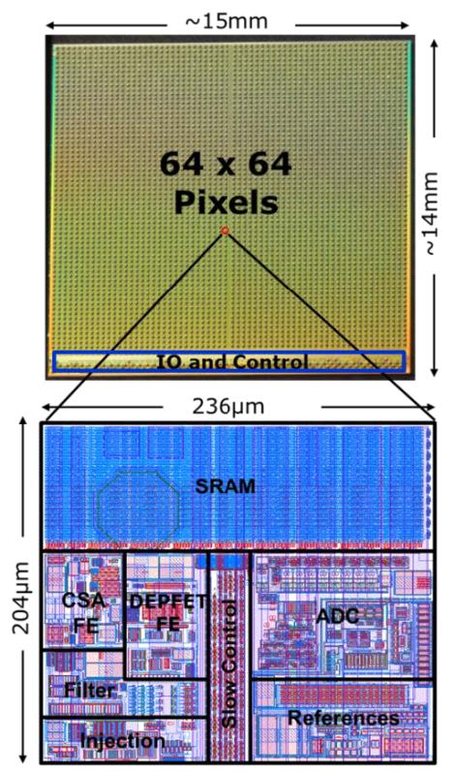
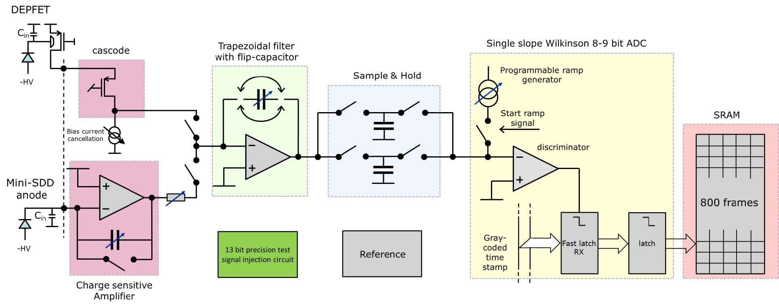

Pixel readout channel
E_{ph}
C_{FCF} (11)
I_{RAMP} (64)
PxDelay (16)
C_{S&H}
Readout concept
Full-parallel readout
Analog shaping
In-pixel 8-bit digitization (9-bit @ f<4.5MHz)
In-pixel SRAM (800 frames/burst)
Data transmission during gaps
Gain and offset adjustable pixel-wise
11 settings of Cfcf (coarse gain) for photon energy/dyn. range selection
6 bits of ADC gain fine trimming (nominal accuracy 2%)
4 bits for offset trimming (1.5 LSB range with 8% granularity)
$$Gain∝g_{Q} \frac{1}{C_{FCF}} \frac{1}{I_{RAMP}}\left(t_{INT}∙C_{S\&H}\right) \left(2∙f_{clock}\right)$$
  limited ADC resolution
  possibility of fine gain trimming @pixel level

Slide 5
Single photon sensitivity & high dynamic range
Signal compression
Under the constraints of maximum dynamic range and 8-bit resolution, single-photon counting is possible by setting DEPFET signal for 1 photon equal to 1 (or n) ADC bin
  signal compression will extend the DR
offset and gain in the read-out ASIC must be set for the correct incident photon energy before a scientific experiment is performed
  not possible to re-gain single photon counting by a re-calibration of the data
inevitable process variations in the sensor as well as in the read-out ASIC
  each DSSC pixel must be calibrated individually (~1% accuracy)
Linear region
ADC bins (ADU)
0
1
2
3
# photons
(n-1)
n
(n+1)
gain=1 ADU/Eph
Analog signal
Energy

Slide 6
Calibration strategy
Two-step procedure:
calibration of gain/offset in the linear region for all settings
qualification of the shape of non-linear (NL) DePFET response.
Detailed tasks:
hard X-ray spectra, high-gain mode setting (Cfcf=1)
  DSSC-PulXar setup
LookUpTable of ASIC gain values (gain ratios)
  charge-injection circuit (13bit)
  Cfcf=11 settings, ADC fine gain (2x64 settings)
qualification of the NL response
  few options: optical (LED/laser), leakage current, XFEL beam
  only 1 gain setting
ADU
# photons
ADCFine=1:64
Cfcf=1
ADU
Cfcf=2
Cfcf=3
...
# photons
ADU
  validation of the calibration procedure at ladder level
# photons

Slide 7
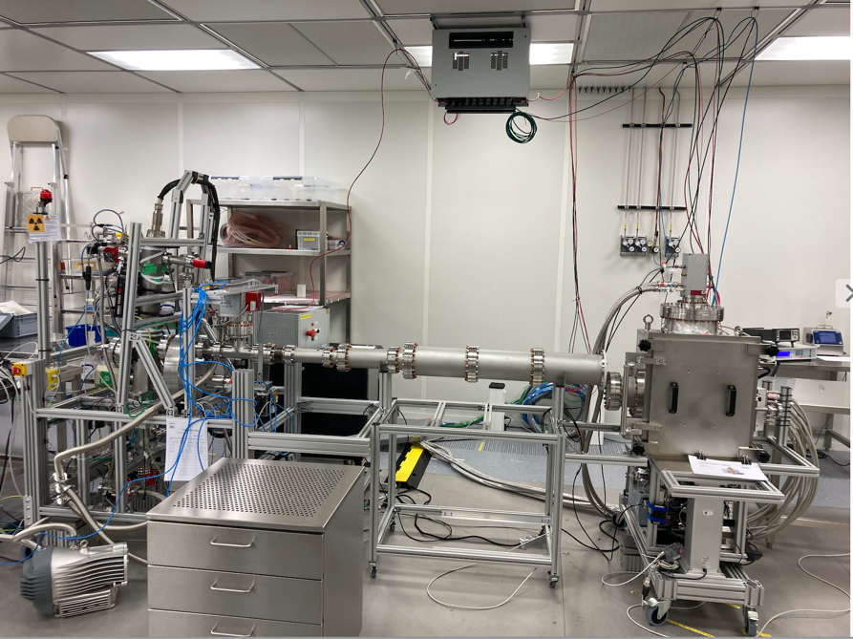
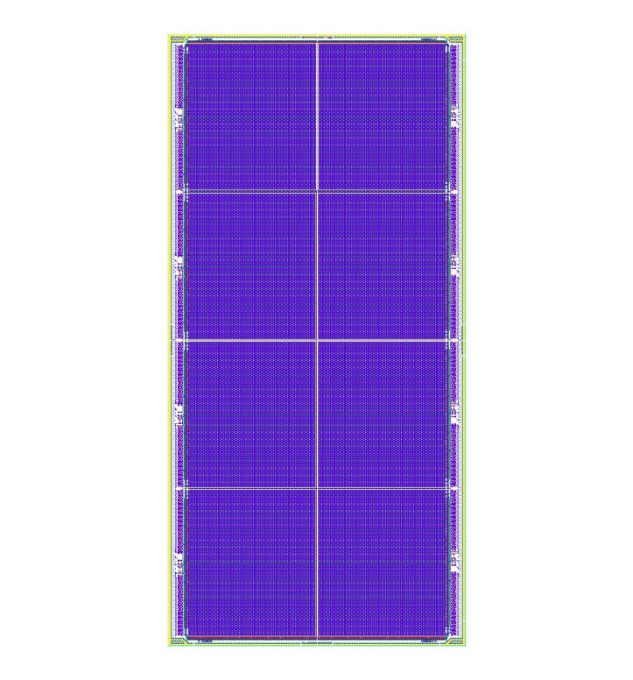
Calibration campaign of the 1st DEPFET ladder with X-rays
PulXar source @XFEL DET Group
600 pulses @ 50ns @ f=2.25 MHz
Cu anode, 25 kV
Al filter 50 μm
X-ray spectra fitting @ high gain
Cu Kα, Cu Kβ:
(gauss + tail + shelf)
DN160 flange + 2m flight tube in front of DEPFET ladder
Pedestal
Cu Kα
Cu Kβ
bremsstrahl.
+ beam filtration
beam
Cfcf=1
Id=100μA
T=18 C
2.25 MHz
FENICE vessel/DEPFET ladder
8-bit resolution impacts on accuracy of gain/offset determination
characterization/modeling of DEPFET spectral response (high-res 14-bit test bench)
  charge-sharing (i.e. low-energy peak tail)
  bremsstrahlung
  bin integration
gauss fit (magenta):
a1=740541 ± 317
sig1=0.293
xc1=30.657
DEPFET ladder (128 x 512)
impact of bin-integration in Pedestal peak fit
gauss+binint (green):
a1=864818 ± 0.5
sig1=0.2005
xc1=30.718
128 x 256 pixels
128 x 256 pixels

Slide 8
Gain / noise on DEPFET ladder @ high gain (PulXar spectra)
bremsstrahlung (pixel intensity)
kbrems (a.u.)
Gain (ADU)
mean=39.2 ADU
(205 eV/ADU)
kbrems (a.u.), rows 0:4
st.dev=1.4 ADU (3.5 %)
gain
gain (ADU)
Cfcf=1
Id=100μA
T=18 C
2.25 MHz
gain (ADU), rows 0:4
Gain (untrimmed)
small gain spread (3.5%)
std_error(gain) <1%
Noise
ENC 14 ± 4 el rms @2.25 MHz
noise
ENC (electrons)
ENC (el)
mean=14.4 el
st.dev=4.3 el
Cfcf=1
Id=100μA
T= 18 C
2.25 MHz

Slide 9





Qualification of the Non Linear DEPFET response - technique
Constraints
  150nm Al layer on entrance window (optical block)
  technique applicable to 1 Mpix camera
variable
attenuator
[k]
setup @ SQS
(XRF)
sample
~1000x1keV
$$N_{0}$$
gas
monitor
(GM)
$$N_{S0}$$
XFEL beam on target: rationale
  XRF emission proportional to beam intensity
  pulse of N low-energy XRF photons (e.g. 1 keV) produce a “reference line”
  to scan the NL curve we change beam attenuation (i.e. gas transmission)
  irradiation of one full quadrant
pulse energy
(E₀=N₀*E_{ph})
$$N_{D0}$$
$$(i)$$
ADU
$$N_{D}\left(i\right)=$$
= $N_{D0}∙φ(i)$
# photon
DSSC Ladder/Camera
SDD spectra at different beam intensity
Al target
(Al Ka 1.486 keV)
SDD @ 1m (target)
100μm pinhole
gasTx=10%
Feasibility tests @ XFEL SQS beamline
  SDD + pinhole to define photon flux
  high spectroscopy resolution allows accurate intensity calibration (photon# peaks)
  verified linearity range of (XRF counts vs. beam intensity)
gasTx=30%

Slide 10
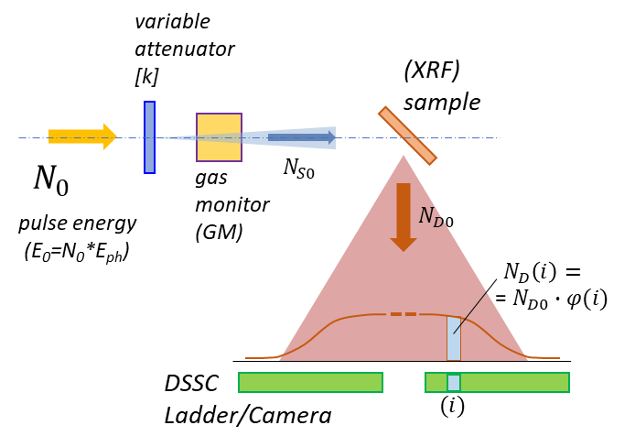
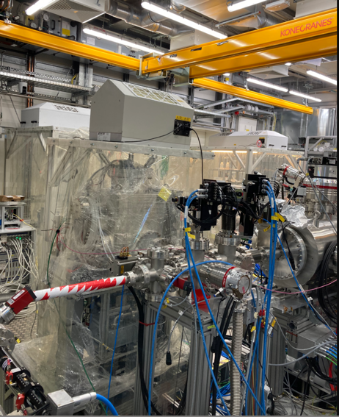
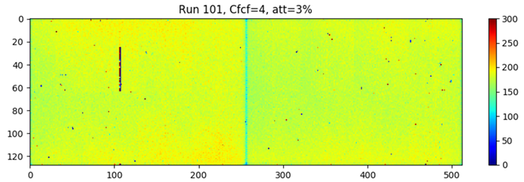
Beam time @ SQS beam line (Oct. 2021)
Goal: verification of NL response measurement technique
DSSC mounted @ 40cm from Al target to maximize photon rate
SQS instrument must provide a stable beam
reference monitor of beam intensity (x-ray gas monitor)
FENICE vessel
(DEPFET ladder)
Tests at low intensity & high gain setting (linear region)
XFEL beam
Al Ka
Energy spectrum Al Ka photons
Al target
n=0
SQS 1.6 keV
Al Ka (1.486 keV)
Cfcf=1
2.25 MHz
irradiation profile of Al Ka photons
1
2
3
nice flat profile
→ possible irradiation of 1 quadrant (=4 ladders)
single-photon resolution
(S/N ~ 30:1)
single-photon resolution: Al Ka photon peaks well separated (signal/noise ~30:1)
ENC from SQS spectra (14.1 el.) confirm values obtained from PulXar (14.4 el.)

Slide 11
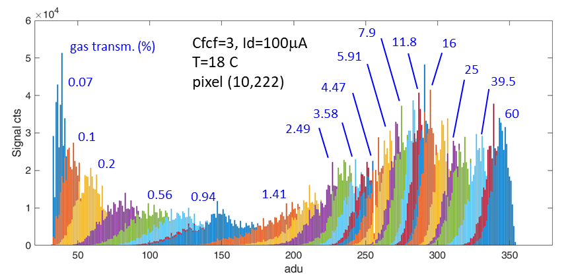
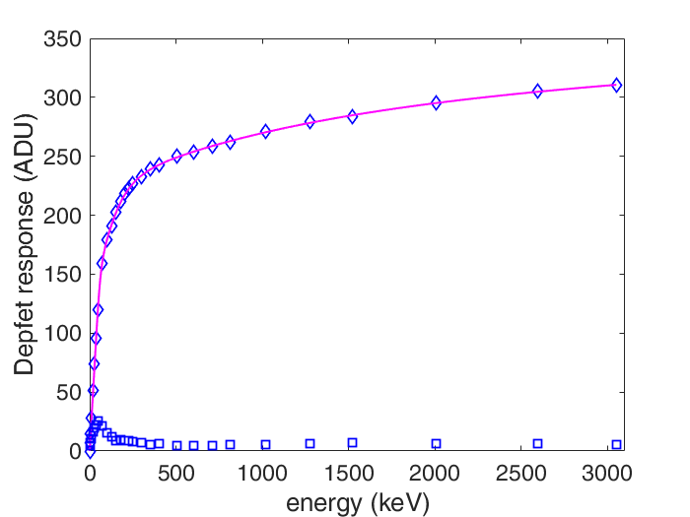
Non linear response of DEPFET pixel
Intensity ”scan”
histograms of a single pixel (all runs)
acquisition of flat-field images of Al Ka photons vs. gasTx
X-ray Gas Monitor tracks beam intensity incident on the target
  XGM data (electron-based): fast (single-frame)
  XGM data (ion-based): slow (20s), accurate (down to few keV/pixel)
  non-negligible beam intensity variations (“blue” weeks @ XFEL)
energy calibration obtained by matching the response in the linear region with the measured DEPFET gain (from X-ray spectra)
run 54-84
pixel (10,400)
gain setting Cfcf=3
readout rate 2.25 MHz
NL response curve vs. deposited energy
single-frame data (50 trains/run)
histogram
centroid (mean)
fit line
successful qualification of the whole compression curve
maximum deposited energy about 3 MeV (~2000 Al Ka/pixel)
DEPFET
Cfcf=3, Id=100μA
T=18 C
pixel (10,222)
XGM
(ion-data)
histogram
st.dev.
XGM (el-data)

Slide 12
Fitting model of the NL response
DePFET Signal + fit line (green)
E1a
E1b
DePFET Gain + fit line (green)
CMOS-DEPFET technology
E1a
E2a
E2b
gain (running avg.)
E3a
E1b
E2b
E3a
E2a
fit line
signal current (ADU)
-qϕ(x)
xof₁
xof₂
xof₃
I_{d}=100 µA
V_{ds}=-3 V
V_{back}=-200 V
T=-20 C
qΔϕ₃
qΔϕ₂
1d cut
along the
IG implant
(qualitative)
qΔϕ₁
Δx₁
Δx₂
Δx₃
deposited energy (keV)
deposited energy (keV)
A single gain step described by an elementary function with 3 fit variables (E_{a}, E_{b}, n), representing energy boundaries and amplitude of the gain step
good-of-fitness: rmse <0.02 ADU, R2bar=1.0000, std error of fit variables <1%
link from NL response model to DEPFET technology qualification
gain step parameters
n
E_{a}
E_{b}

Slide 13
NL response – all DEPFET ladder
NL response curves of all ladder
data analysis/calibration over all pixels
non-linear fit function
extraction of all fit parameters pixel-wise
average curve
entries: 63429 pixels
gain: Cfcf=3, Id=100μA
T=18 C
Ek1 (keV):
mean=81.1
st.dev.=5.82
(7.2%)
first compression “kink” (E_{k1}) of the NL curve
E_{k1} (keV)
mean value (81.1 keV) in line with lab tests
nice uniformity: 7% spread over the ladder

Slide 14
Dynamic range
  maximum #photons at full scale of ADC, e.g. for 8 bit resolution @256ADU (or 512ADU if f ≤ 2.25 MHz)
  maximum #photons for which ADC resolution equals Poisson noise
E.g. photon energy 0.5 keV
bin=256
E_{ph}=0.5 keV
gain=1 ph/ADU
I_{D}=100uA
~7500 ph @ 285 bin
1410 keV/0.5 keV
=2820 ph
~2820 ph @256 bin
Poisson noise (#ph rms)
gain=1 ph/ADU
pix 10,400
I_{D}=100uA
ADC bin width (#ph rms)
ADC bin width =f(E)
NL response more compressed than ideal shape (sqrt(x)), marginal increase of quantization noise
single-photon counting -> gain = 1 photon/ADU (0.5 keV/ADU in the linear region)
 DR = 2820 photons @ 4.5 MHz (7500 photons @ 2.25 MHz)

Slide 15
Conclusions and outlook
combination of single-photon counting & high dynamic range with limited ADC resolution reflects in a significant challenge for calibration, directly linked to the performance of the DSSC detector
the experimental qualification of first DEPFET ladder gave a very successful feedback:
  noise level of 10-20 el rms
  gain/noise accurate calibration from PulXar spectra @ Cu Ka (8 keV), confirmed at SQS @ Al Ka (1.48 keV)
qualification technique of the NL response @ SQS (XFEL beam on Al target) successful
  fulfilled required intensity (~3 MeV/pixel), quadrant-size field of illumination
  DEPFET response qualified over the whole ladder
  beam intensity variations observed (“blue week” not “user week”), XGM data and correction techniques under study to minimize impact
dynamic range @ 0.5 keV photon energy: DR~3000 ph @ 4.5 MHz or ~8000 ph at 2.25 MHz.
so far so good, but a lot to do next...
  sensor response as a function of photon energy (< 1 keV), correction for ADC DNL, optimization of the compression shape vs. DEPFET operating conditions, imaging properties, etc.

Slide 16
spares

Slide 17
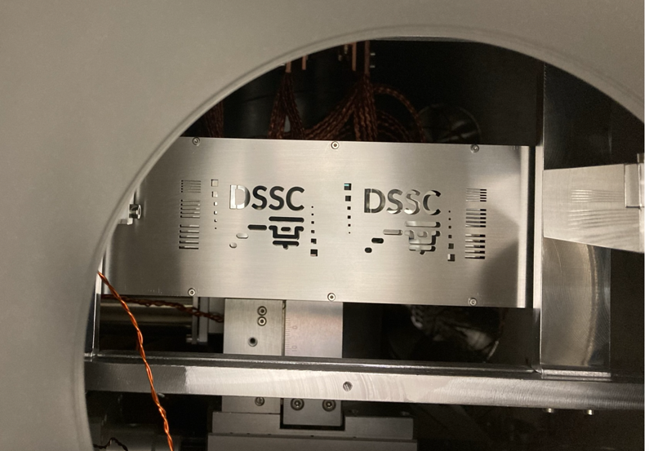
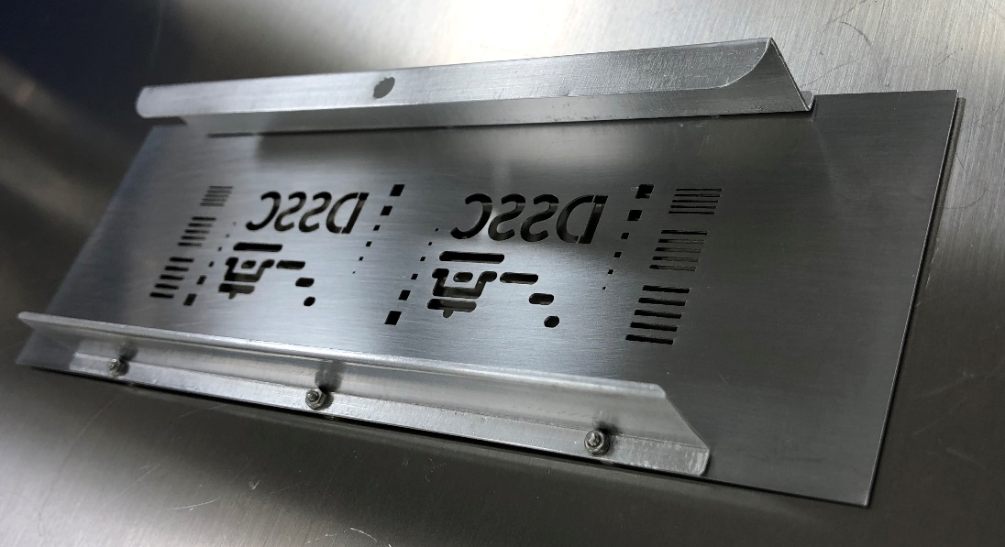
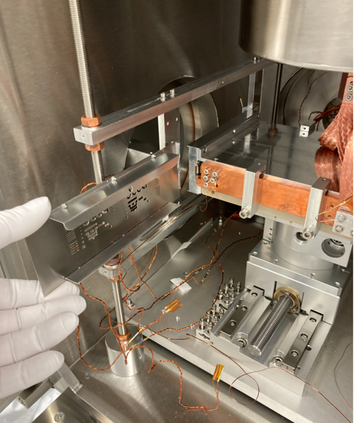
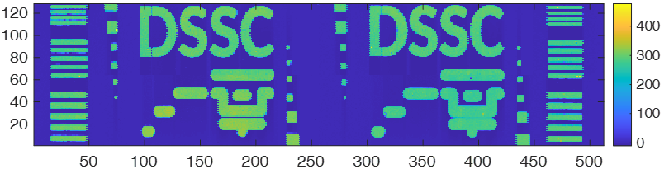
Imaging properties at 1.48 keV (Al Ka photons @ SQS) - preliminary
Run 160 gasTx 0.1% (~7keV/pix)
Slit 0.36 mm
Gap 0.65 mm
2.5 mm
2 mm
average of 25 cols
erf fit: σ=0.31 pix
1.1 mm
Slit 0.60 mm
Gap 0.90 mm
1. mm
0.750 mm
0.373 mm
Steel, 0.5 mm
Slit 0.85 mm
Gap 1.16 mm
Run161, E~31 keV/pixel
Pix 37449 (73,73)
Run175
(~5.4 MeV/pxl)
Run167, E~2 MeV/pixel
Run167
(~2 MeV/pxl)
Run161
(~31 keV/pxl)
gain Cfcf3
~46 ph/pxl @gasTx=1%
Run175, E~5.4 MeV/pixel
image details well resolved for all intensities up to 5.4 MeV (colormap rescaled)
work in progress

