Slide 1



Gain, noise, and collection efficiency of
GaAs SAM-APDs with staircase structure by means of synchrotron radiation
Colja M.^{*,1}, Cautero M.¹ , Steinhartová T.^{2,8}, Pilotto A.^{3,6}, Antonelli M.⁴ , Cautero G.^{4,5} , Menk R. H.^{4,5,7},
Arfelli F.^{4,9}, Dal Zilio S.² , Biasiol G.² , Gianoncelli A.⁵ , Bonanni V.⁵ , Palestri P.³ , Driussi F.³
¹ DIA, University of Trieste, 34127 Trieste, Italy
² IOM CNR, Laboratorio TASC, Area Science Park Basovizza, 34149 Trieste, Italy
³ DPIA, University of Udine, Udine, Italy
⁴ INFN-Trieste, Padriciano, Trieste, Italy
⁵ Elettra Sincrotrone Trieste S.C.p.A., Area Science Park Basovizza, 34149 Trieste, Italy
⁶ C2N, Université Paris-Saclay, 10 Boulevard Thomas Gobert, 91120 Palaiseau, France
⁷ Department of Medical Imaging, University of Saskatchewan, Saskatoon, Canada SK S7N 5A2
⁸ Infineon Technologies, Siemensstraße 2, 9500 Villach, Austria 9. DF, University of Trieste, 34127 Trieste, Italy
matija.colja@elettra.eu
28/06/2022

Slide 2
Introduction
increasing demand for fast and efficient X-ray detectors
silicon-based detectors widely employed, but are not efficient in hard X-ray range
we are developing
research of new materials
(Ge, compound semiconductors, …)
GaAs SAM-APDs
with staircase structure

Slide 3
Why GaAs?
GaAs SAM-APDs with staircase structure
 | Si | Ge | GaAs
density [g/cm³] | 2.33 | 5.323 | 5.32
effective atomic number | 14 | 32 | 32
electric-breakdown field [V/cm] | 3×10⁵ | 1×10⁵ | 4×10⁵
electron mobility [cm²/Vs] | 1350 | 3900 | 8000
band-gap [eV] | 1.12 | 0.66 | 1.42
shorter attenuation length
shorter response time
possibility to operate at room temperature

Slide 4
GaAs SAM-APDs with staircase structure
Why avalanche?
low fluxes / single photon detection
very weak signals (thousands of electrons)
need for amplification
impact ionization = internal amplification

Slide 5
Why Separate Absorption and Multiplication?
GaAs SAM-APDs with staircase structure
photon absorption in a region with a high electric field = noise contribution
region for photon absorption (with low electric field)
ABSORPTION LAYER
separation is obtained by a
highly doped layer
CHARGE LAYER
region for electrons multiplication (with high electric field)
MULTIPLICATION LAYER
photon
absorption
region
mult
sub
charge
Electric field
Depth

Slide 6
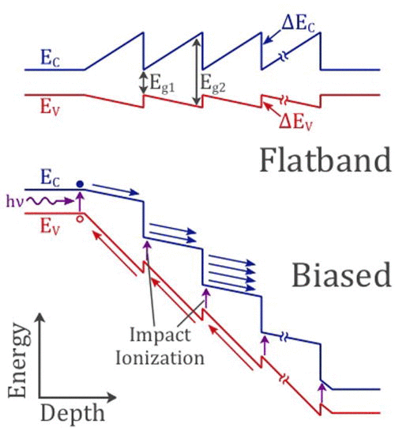

Why staircase structure?
GaAs SAM-APDs with staircase structure
multiplication in a region with similar electron/hole ionization coefficients
=
noise contribution
𝛼/𝛽_{GaAs} ≅ 1 high noise
to reduce noise: band-gap engineering
staircase structure
(impact ionization of electrons at discrete locations)
[David, J. The staircase photodiode.
Nature Photon 10, 364–366 (2016)]

Slide 7
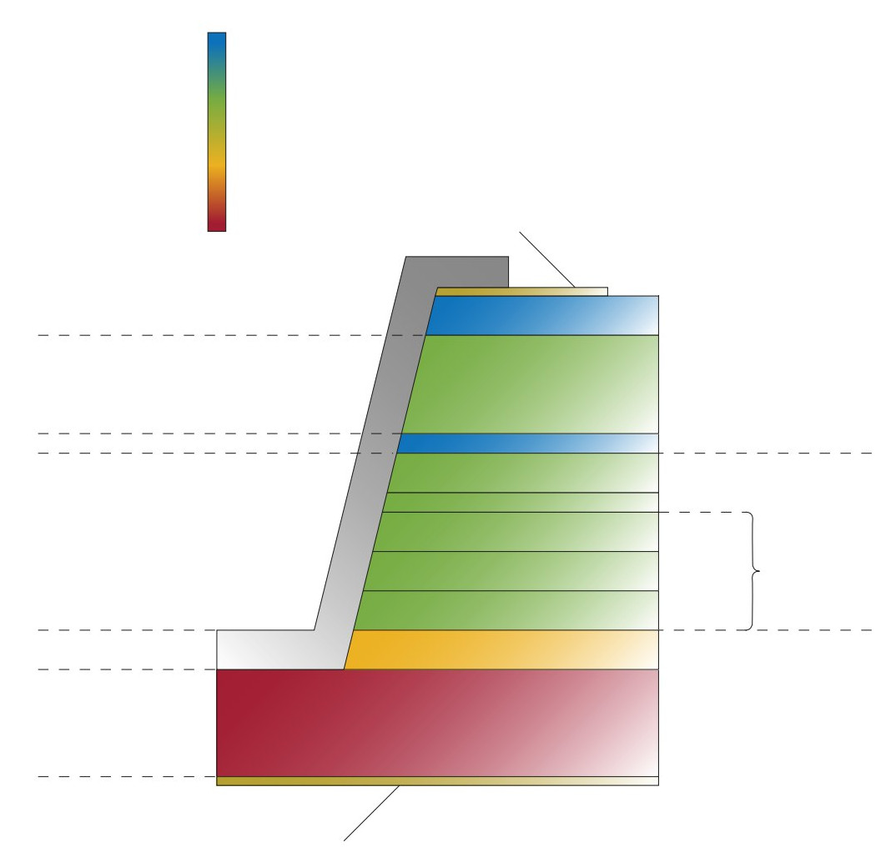
The detector – cross section
Doping concentration [cm⁻³]
5×10¹⁸
2×10¹⁶
-5×10¹⁷
-2×10¹⁸
Cr/Au contact
p-GaAs
200 nm
Absorption region
GaAs
300/4500/15000 nm
Charge layer
Digital alloy
aluminum content changes
from 45 % to 1 %
ẟ p-doping
GaAs
35 nm
…
Multiplication region
Al_{x}Ga_{1-x}As
20 nm
1 um
25 nm
Al_{0.45}Ga_{0.55}As
×12
GaAs
35 nm
n-GaAs
100 nm
Substrate
n-GaAs
500 um
Ge-Au/Ni/Au n-contact

Slide 8

The detector – cross section
Doping concentration [cm⁻³]
5×10¹⁸
2×10¹⁶
PROTOTYPES
-5×10¹⁷
not sufficiently thick for hard X-rays
expressly developed to investigate recombination in:
  metal-semiconductor interface
  absorption region
-2×10¹⁸
Cr/Au contact
p-GaAs
200 nm
Absorption region
GaAs
300/4500/15000 nm
Charge layer
Digital alloy
aluminum content changes
from 45 % to 1 %
ẟ p-doping
GaAs
35 nm
…
Multiplication region
Al_{x}Ga_{1-x}As
20 nm
1 um
25 nm
Al_{0.45}Ga_{0.55}As
×12
GaAs
35 nm
n-GaAs
100 nm
Substrate
n-GaAs
500 um
Ge-Au/Ni/Au n-contact

Slide 9
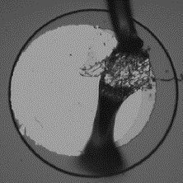
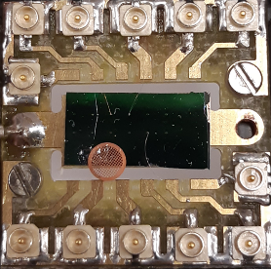
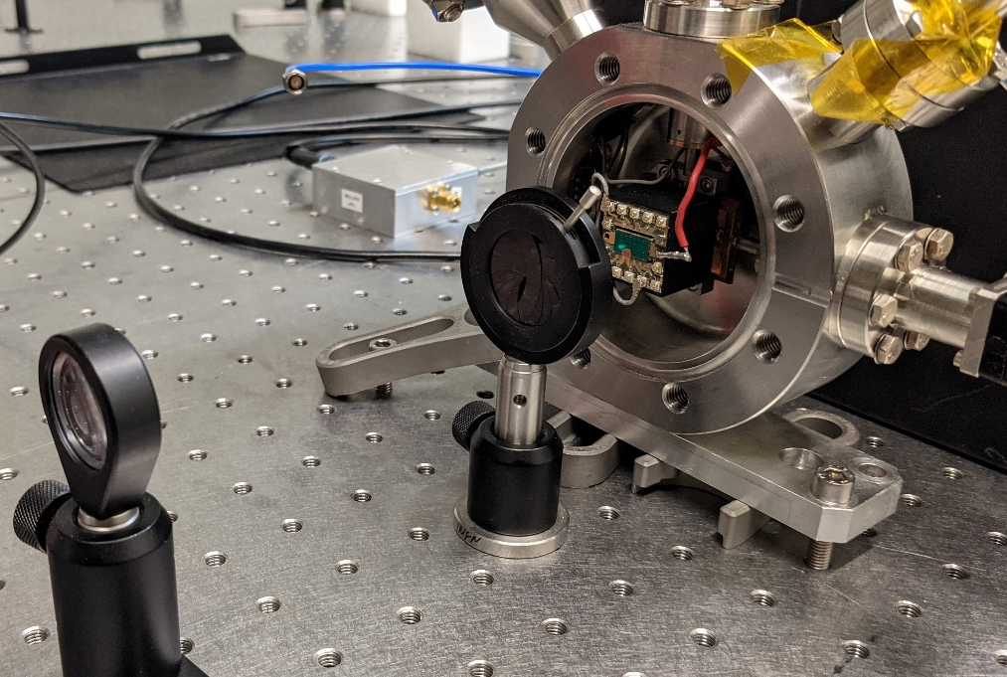
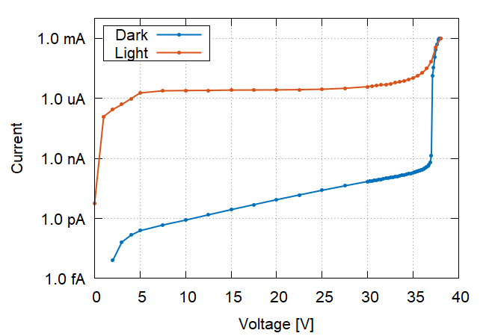
Characterization with laser
200 um
single e/h pair production
no photogeneration in the multiplication layer
Eph = 2.33 eV
initial exponential current growth due to lowering of the charge layer potential barrier
V_{breakdown} = 37 V
multiplication from 25 V to breakdown
multiplication
exponential trend
exponential trend
breakdown

Slide 10


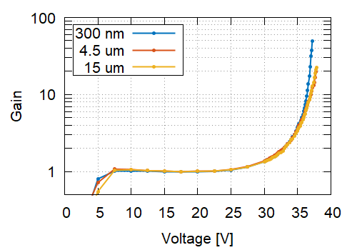
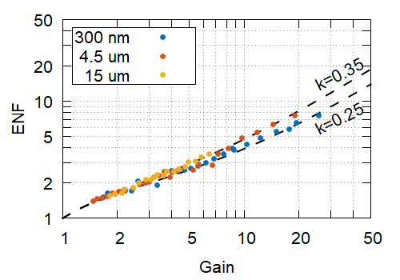
Gain
Excess Noise Factor
a and b are extracted from I-V measurements interpolating the initial exponential growth
M_{max} = 50
S_{i}: measured current spectral density
I_{ph}: DC value of photo-current with M = 1
B: system bandwidth
𝛼/𝛽 = k ∊ [0.25, 0.35]

Slide 11
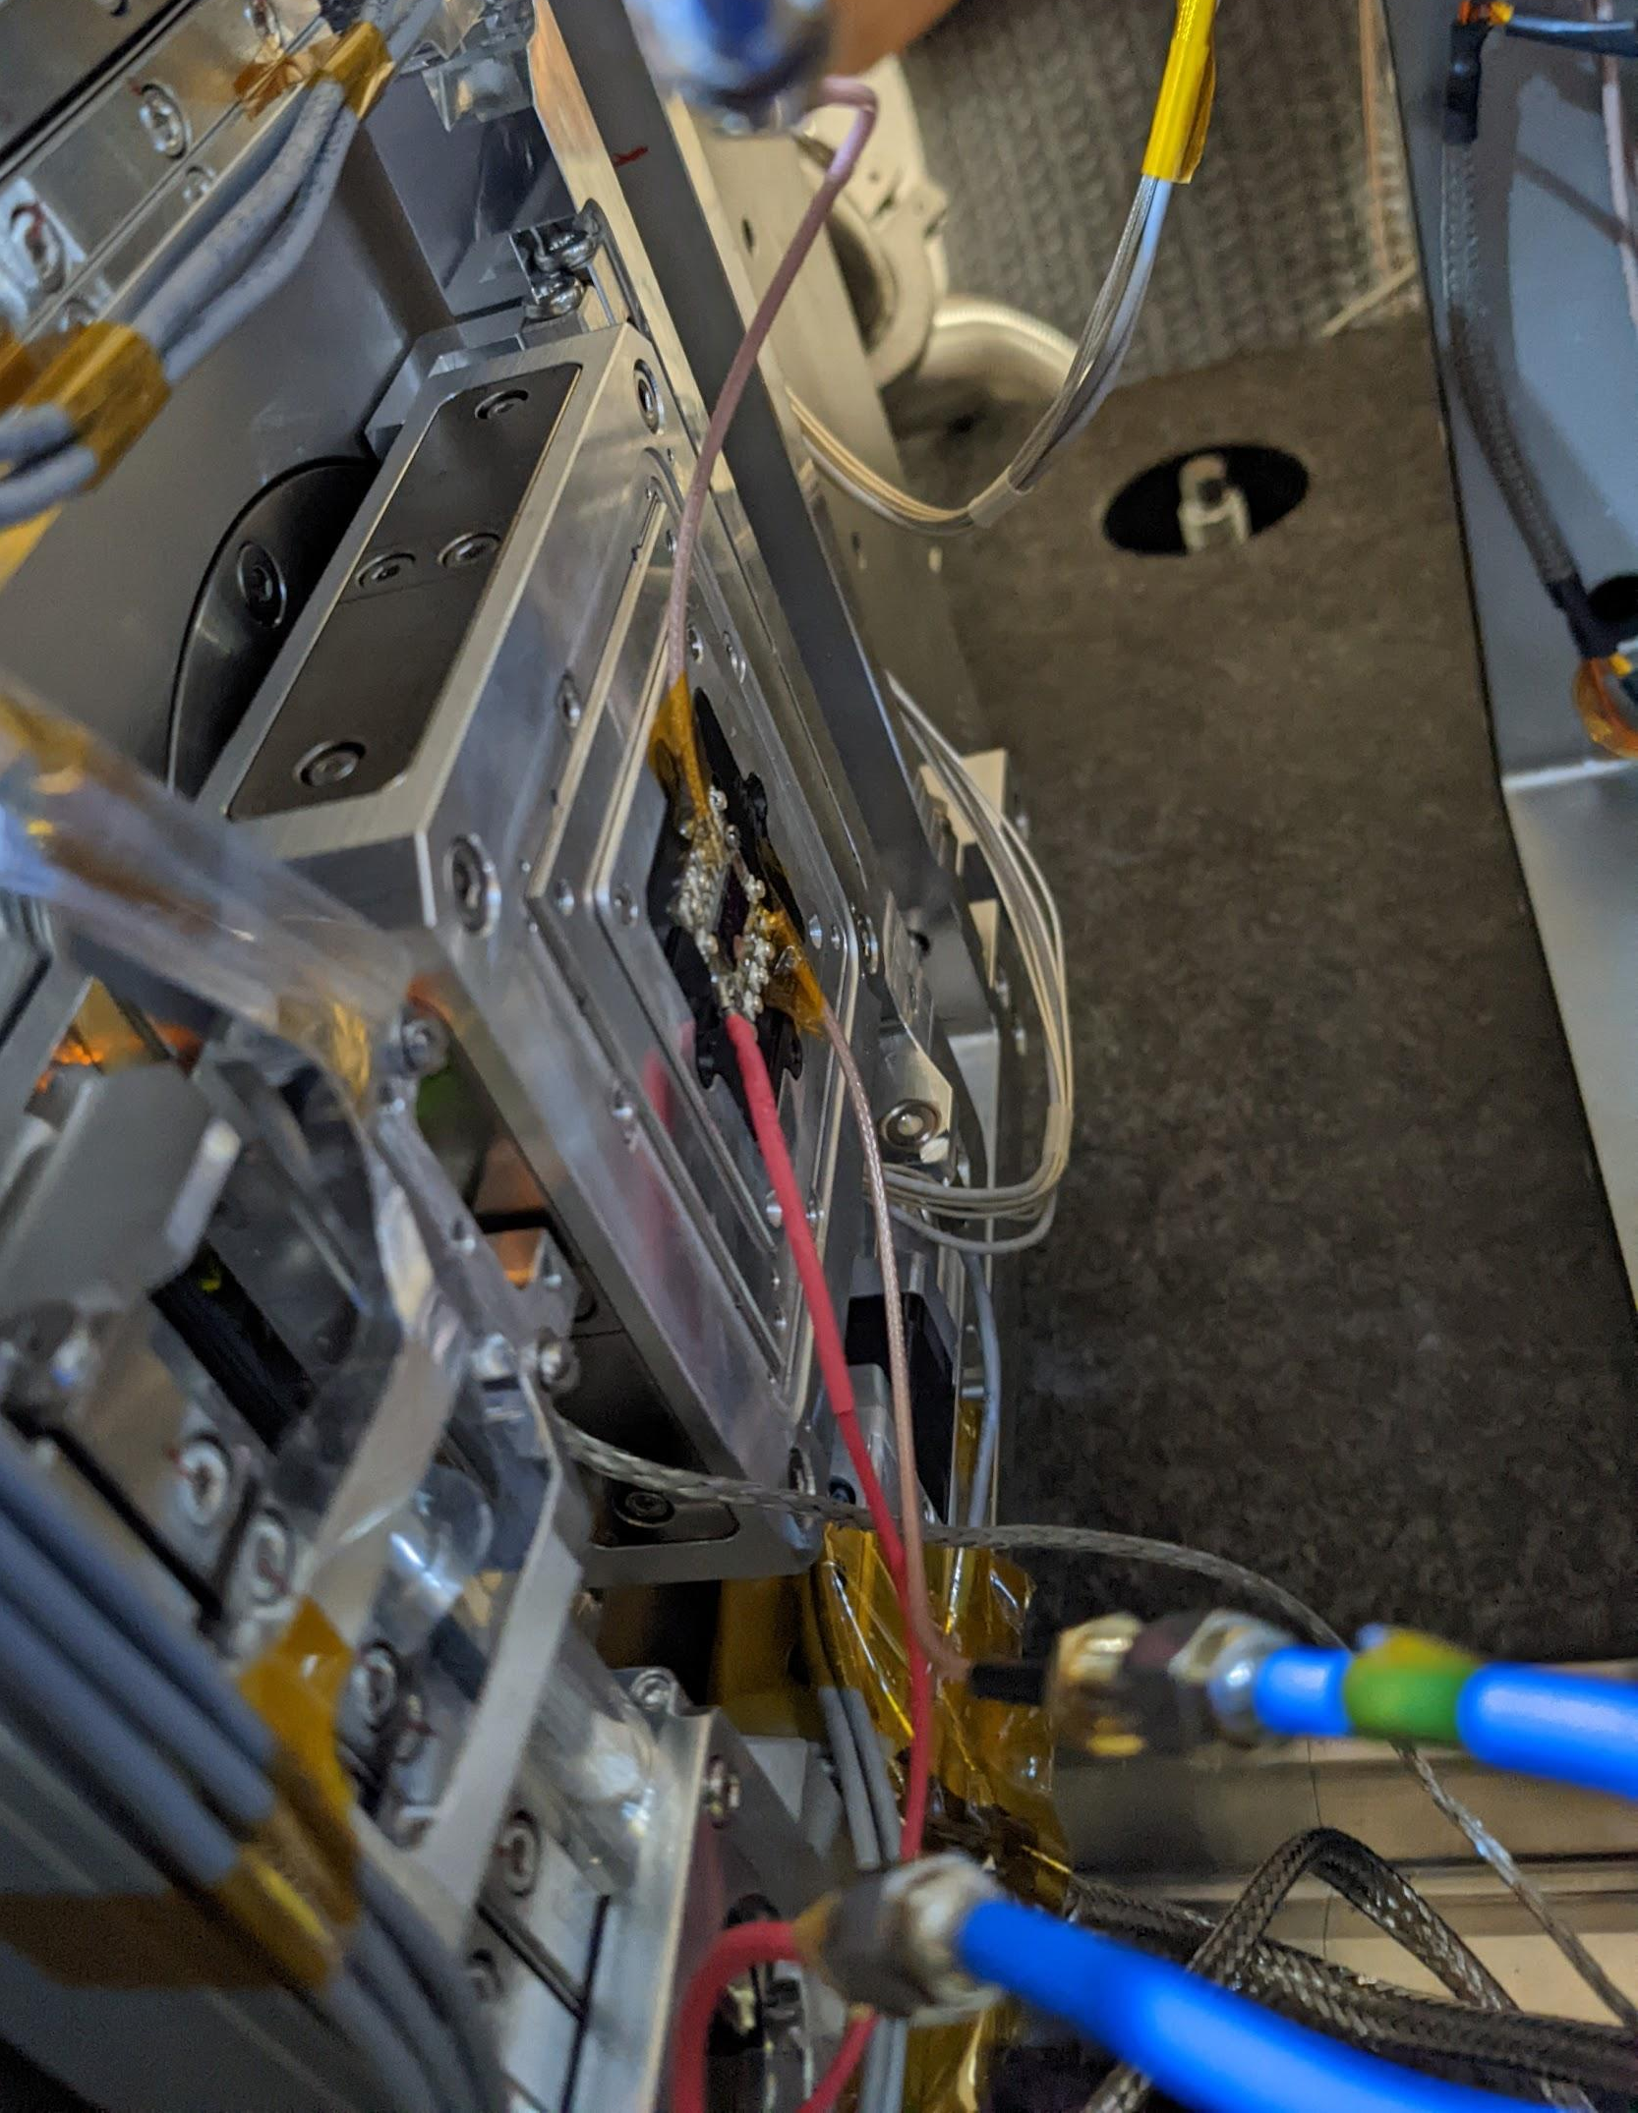
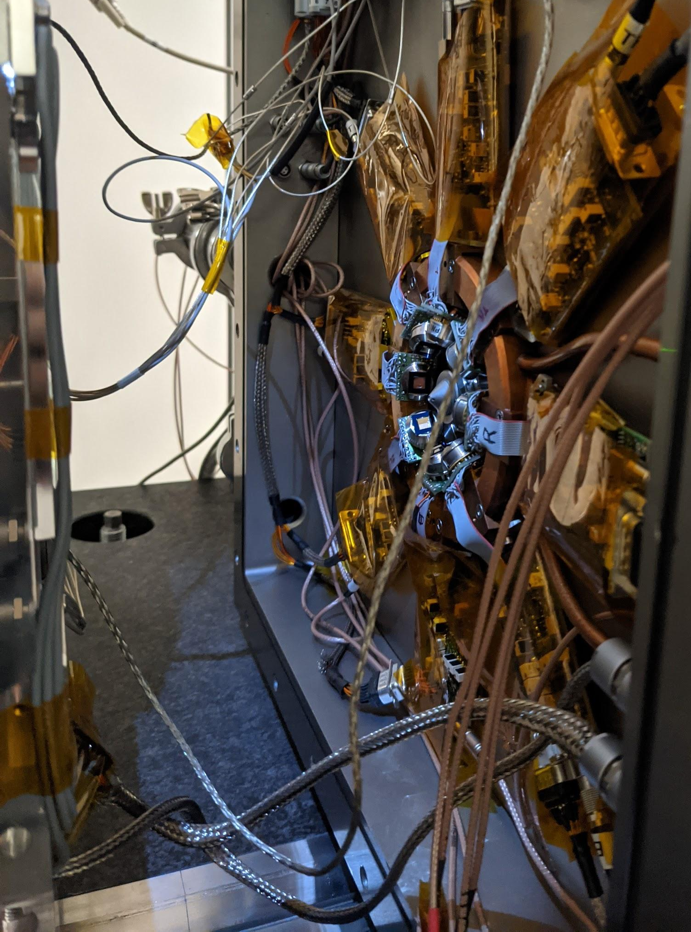
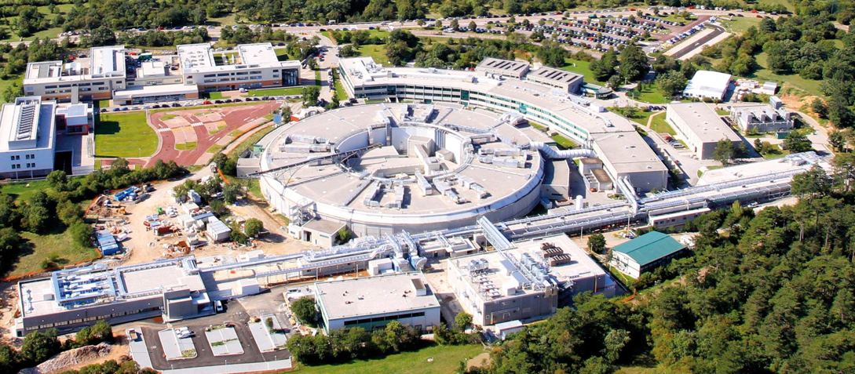
Synchrotron radiation measurements
investigation of recombination in:
  metal-semiconductor interface
  absorption region
TwinMic beamline (Elettra Sincrotrone)
  photon energies = [400 eV, 2200 eV]
  sub-micrometric monochromatic beam
APDs
TwinMic experimental chamber
beam

Slide 12
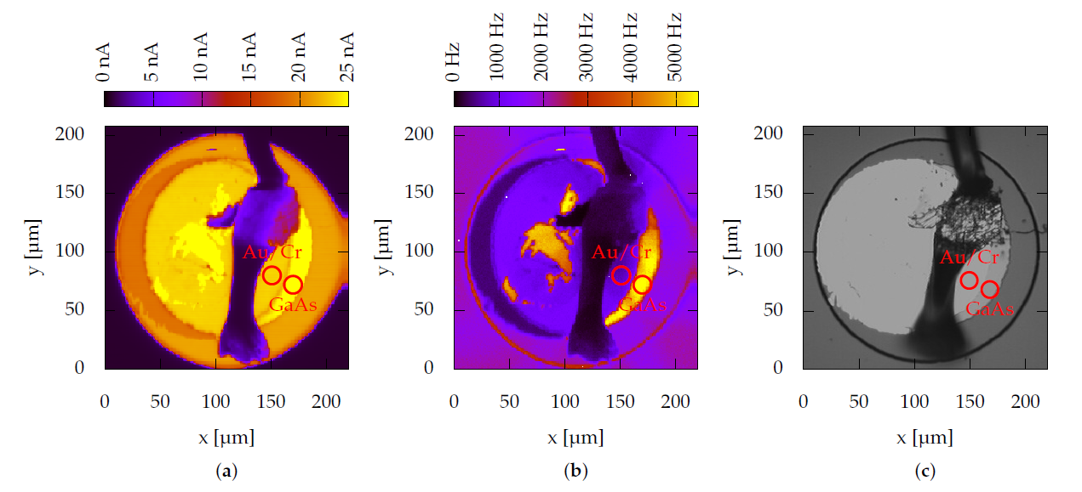
Metal-semiconductor interface (1)
chemical characterisation (As fluorescence)
identification of areas not covered by top contact
Entry window only partially covered by the top contact
photo-current
As fluorescence
optical

Slide 13
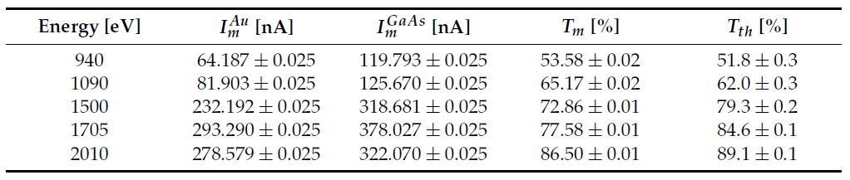
Metal-semiconductor interface (2)
current measured when the radiation entered:
  through Cr/Au
  directly in GaAs
measured and theoretical transmissions have a similar trend and their values are comparable
traps and defects at the interface have a small effect in the charge loss

Slide 14
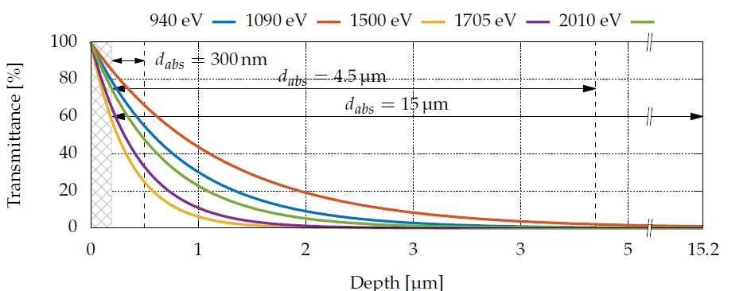

Recombination in absorption region (1)
5 energies (940 eV, 1090 eV, 1500 eV, 1705 eV, 2010 eV)
measurements on 4.5 and 15 um-thick devices only
expected current
transmittance as a function of depth
carriers produced at different distances from the multiplication layer
Φ₀: photon flux [photons/s]
E_{ph}: photon energy [eV]
E_{e-h}: average energy to produce e-h

Slide 15
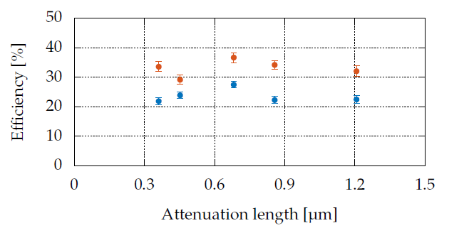
Recombination in absorption region (2)
no dependence on the attenuation length -> negligible recombination during electron travelling through the absorption region
variations due to systematic error (reposition of the sample)

Slide 16
Conclusion
GaAs valid alternative to Si, but careful design required for noise reduction
ENF can be greatly reduced by band-gap engineering
negligible effect in charge collection efficiency of:
  recombination in metal-semiconductor interface
  recombination in absorption region

Slide 17
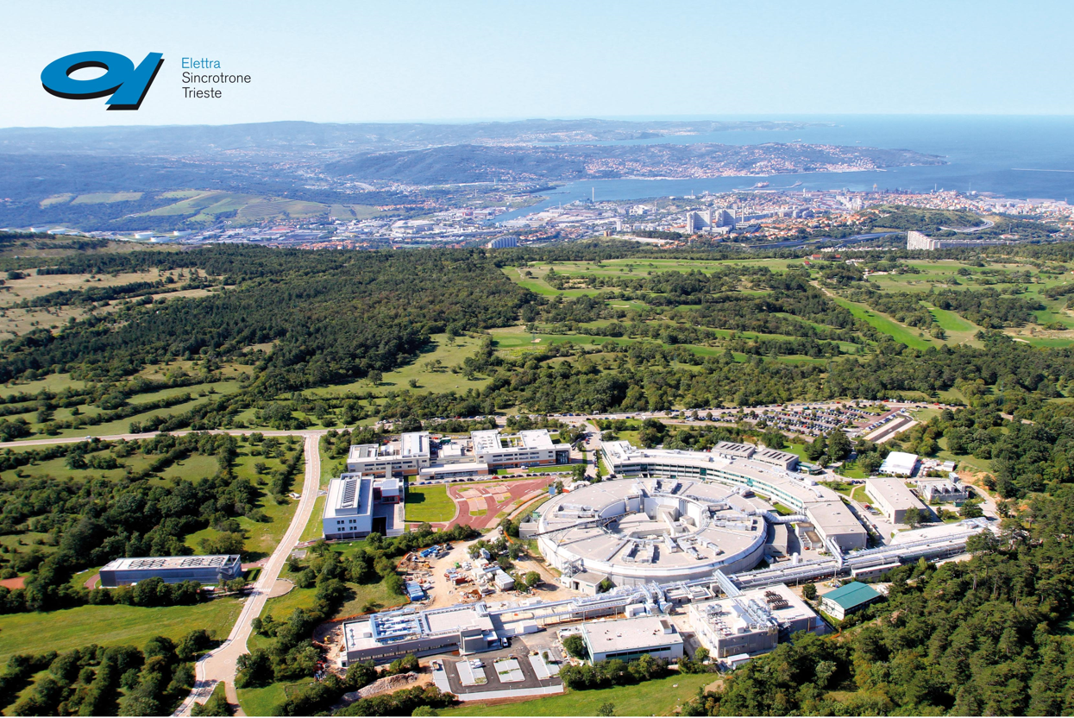

Thank you for your attention

