Slide 1








First tracks and initial timing results with Timepix4 detectors
Martin van Beuzekom
27 June 2022
Riva del Garda

Slide 2

Introduction & Motivation
DUT
Beam telescopes will be used for characterization
of novel sensors, in view of LHC upgrades
After successful Timepix3 beam telescope, upgrade based on Timepix4
Main improvement (and challenge) is a better track time resolution
  Timepix3 telescope achieved 236 ps after long and careful tuning
Aim for (about) 20 ps track time resolution
  If using fast sensors and reference timing layer
Maintain excellent pointing resolution of (about) 2 μm
Operation at ‘high’ rate (> 1 Mtracks/s)
Timepix4 is an excellent candidate chip for a beam telescope
  Large area, high resolution time stamping, large design team and user community
This work shows the first testbeam results; step-1 on the way to a full telescope

Slide 3
Timepix4 main specifications
65 nm CMOS
Matrix of 512 x 448 pixels
55 x 55 um² pixels
  Electronics in 55 x 51.4 um²
Active area 6.94 cm²
4-side buttable, using redistribution layer
Many modes, for telescope: simultaneous Time-Of-Arrival and Time-Over-Threshold
195 ps TDC bins
Data driven readout: 16 x 10.24 Gbps
Min. threshold: ~500 e-
24.64 mm
Pixel electronics
28.16 mm
Peripheral circuits
Wire bond extenders
(can be diced off)
X. Llopart et al. 2022 JINST 17 C01044

Slide 4
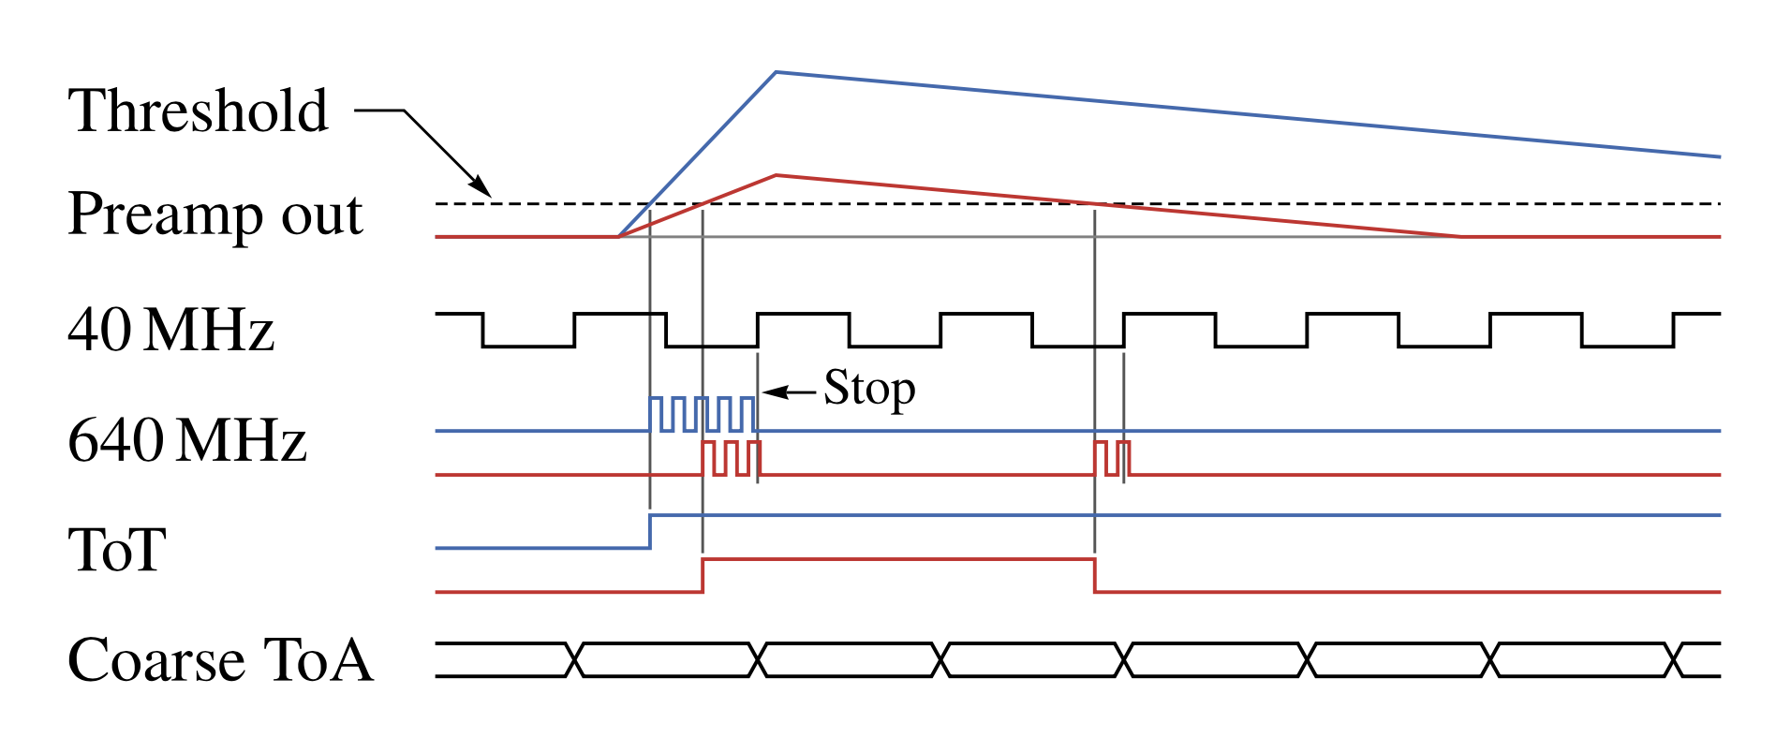
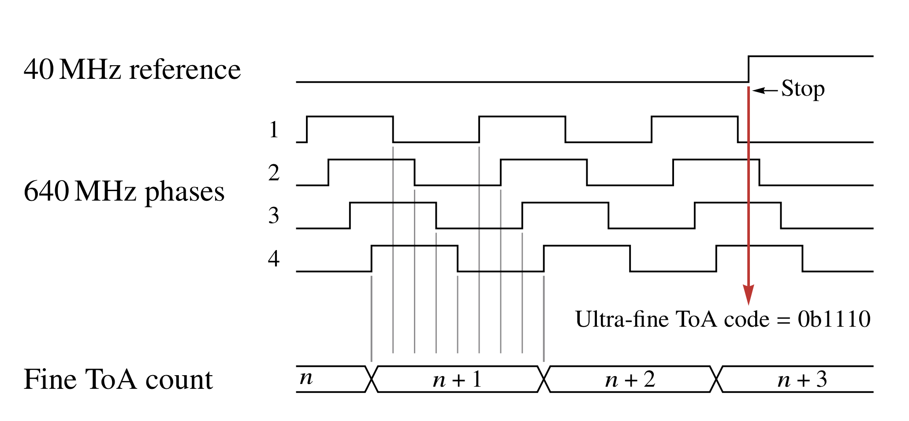
Timepix4 time measurement
Base clock of 40 MHz
Hit starts 640 MHz oscillator
  1.56 ns bins
  Count #clock cycles (like in Tpx3)
  Oscillator shared by 8 pixels in superpixel
Oscillator is stopped by first rising edge of 40 MHz clock
In addition the internal state of ring oscillator (VCO) is captured –> 195 ps bins
Back edge of Time-over-Threshold signal is measured with a high time resolution
  Improved ToT measurement

Slide 5
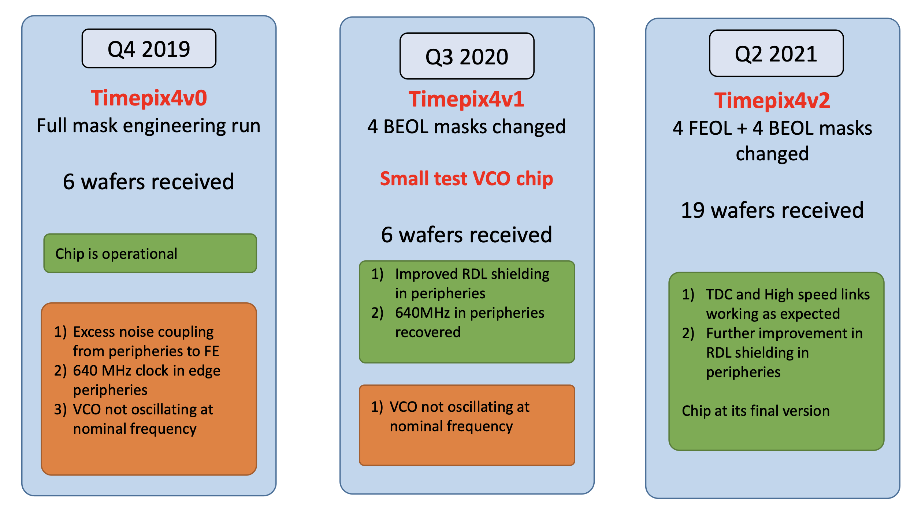
Timepix4 versions
Version1 with sensor used in testbeam
  Voltage Controlled Oscillator running 25% too fast
  And not properly locked to its reference oscillator
Version2 (still) without sensor used for lab measurements
More Timepix4 info in Xavi Llopart’s seminar: https://indico.cern.ch/event/1121147/

Slide 6
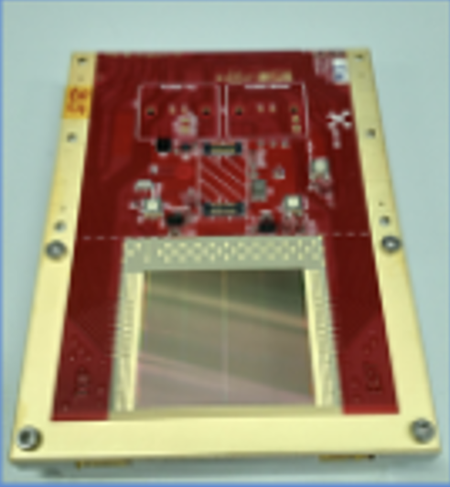
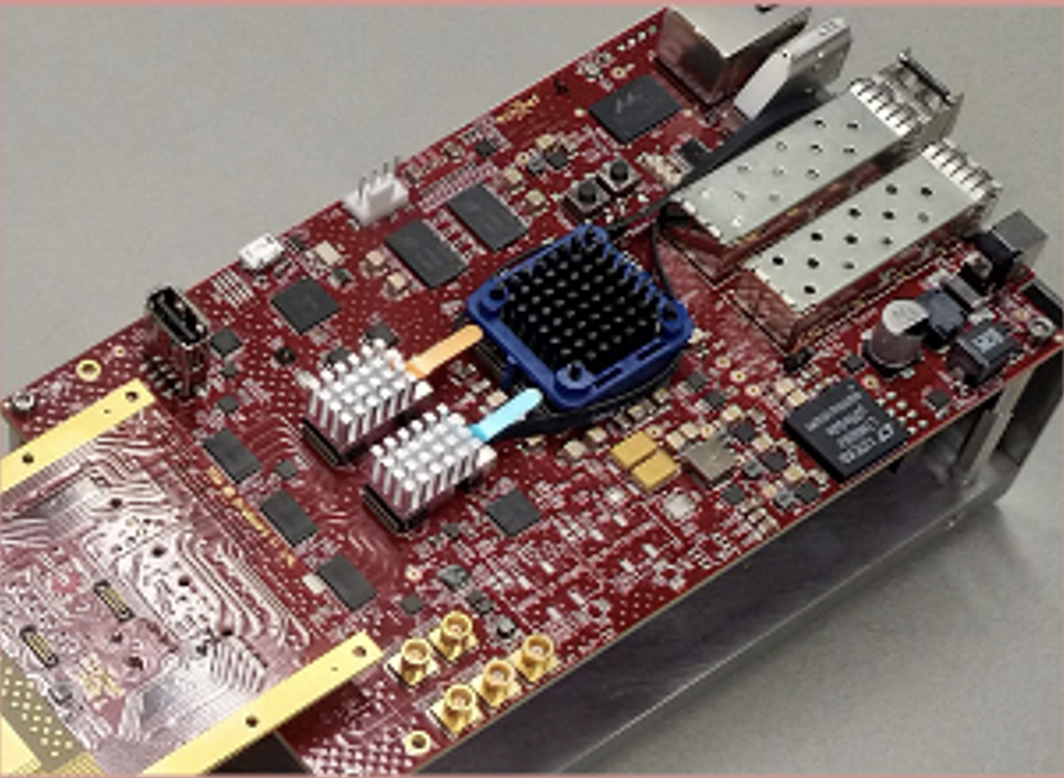
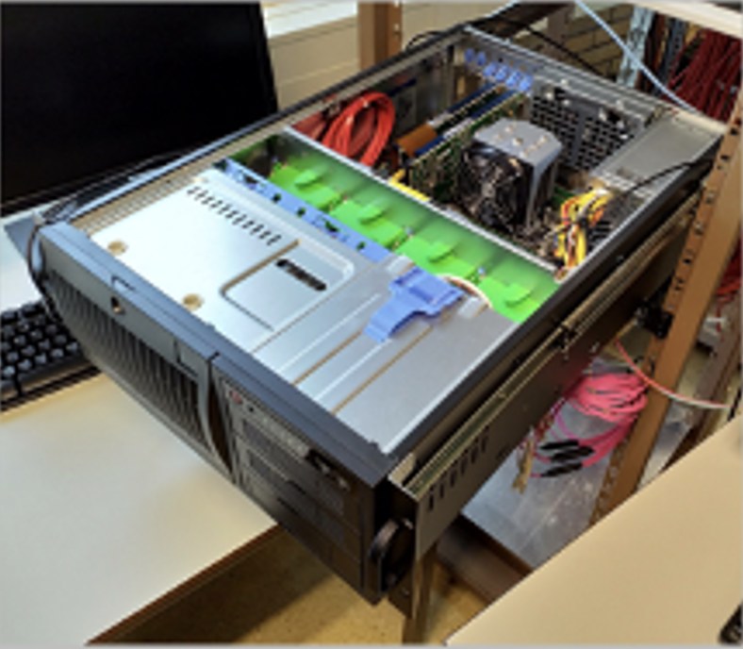

SPIDR4 readout
External clock/timing
(optional)
Timepix4 chipboard
Control board
Clock / Timing
Config. / status
Config. / Control
gRPC, 1 Gb Ethernet
Pixel data
Data
10 Gb Ethernet
Off–the-shelf
computer
Raw data (64b/66b)
160 Gbit/s
Readout specifically for Timepix4
Default: 10 Gbits/s readout
  More than sufficient for typical testbeam
Supports full bandwidth of chip (160 Gbit/s) with optional DAQ server
Optional DAQ server
Config. / Control
Data access

Slide 7
Configuration
upstream
scintillators
100 μm sensors
300 μm sensors
downstream
scintillator
N30
N29
N23
N28
Particle beam
180 GeV/c (π,p,K)
CFD
CFD
SPIDR4
SPIDR4
SPIDR4
SPIDR4
CFD
TLU
40 MHz
t₀-sync
10 GbE
DAQ
SlowCtrl
1 GbE
RunCtrl
All sensors are n-on-p (e- collecting)

Slide 8
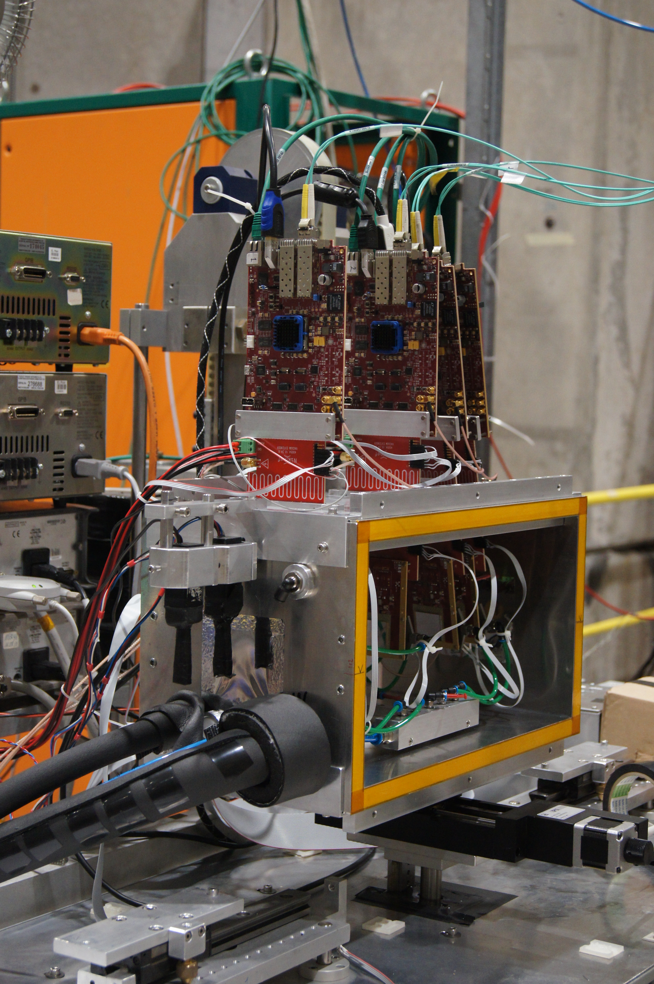
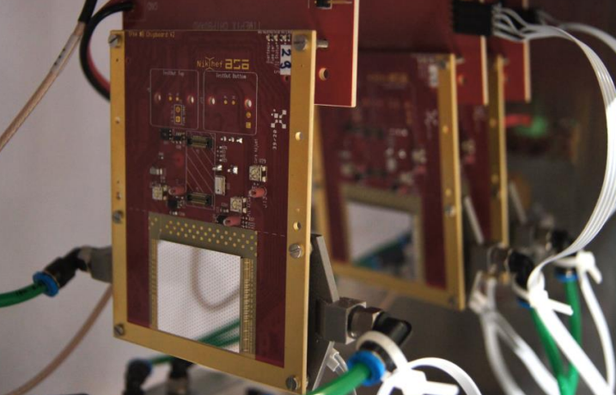
SPIDR4
scintillators
Detector Box
Timepix4-v1

Slide 9
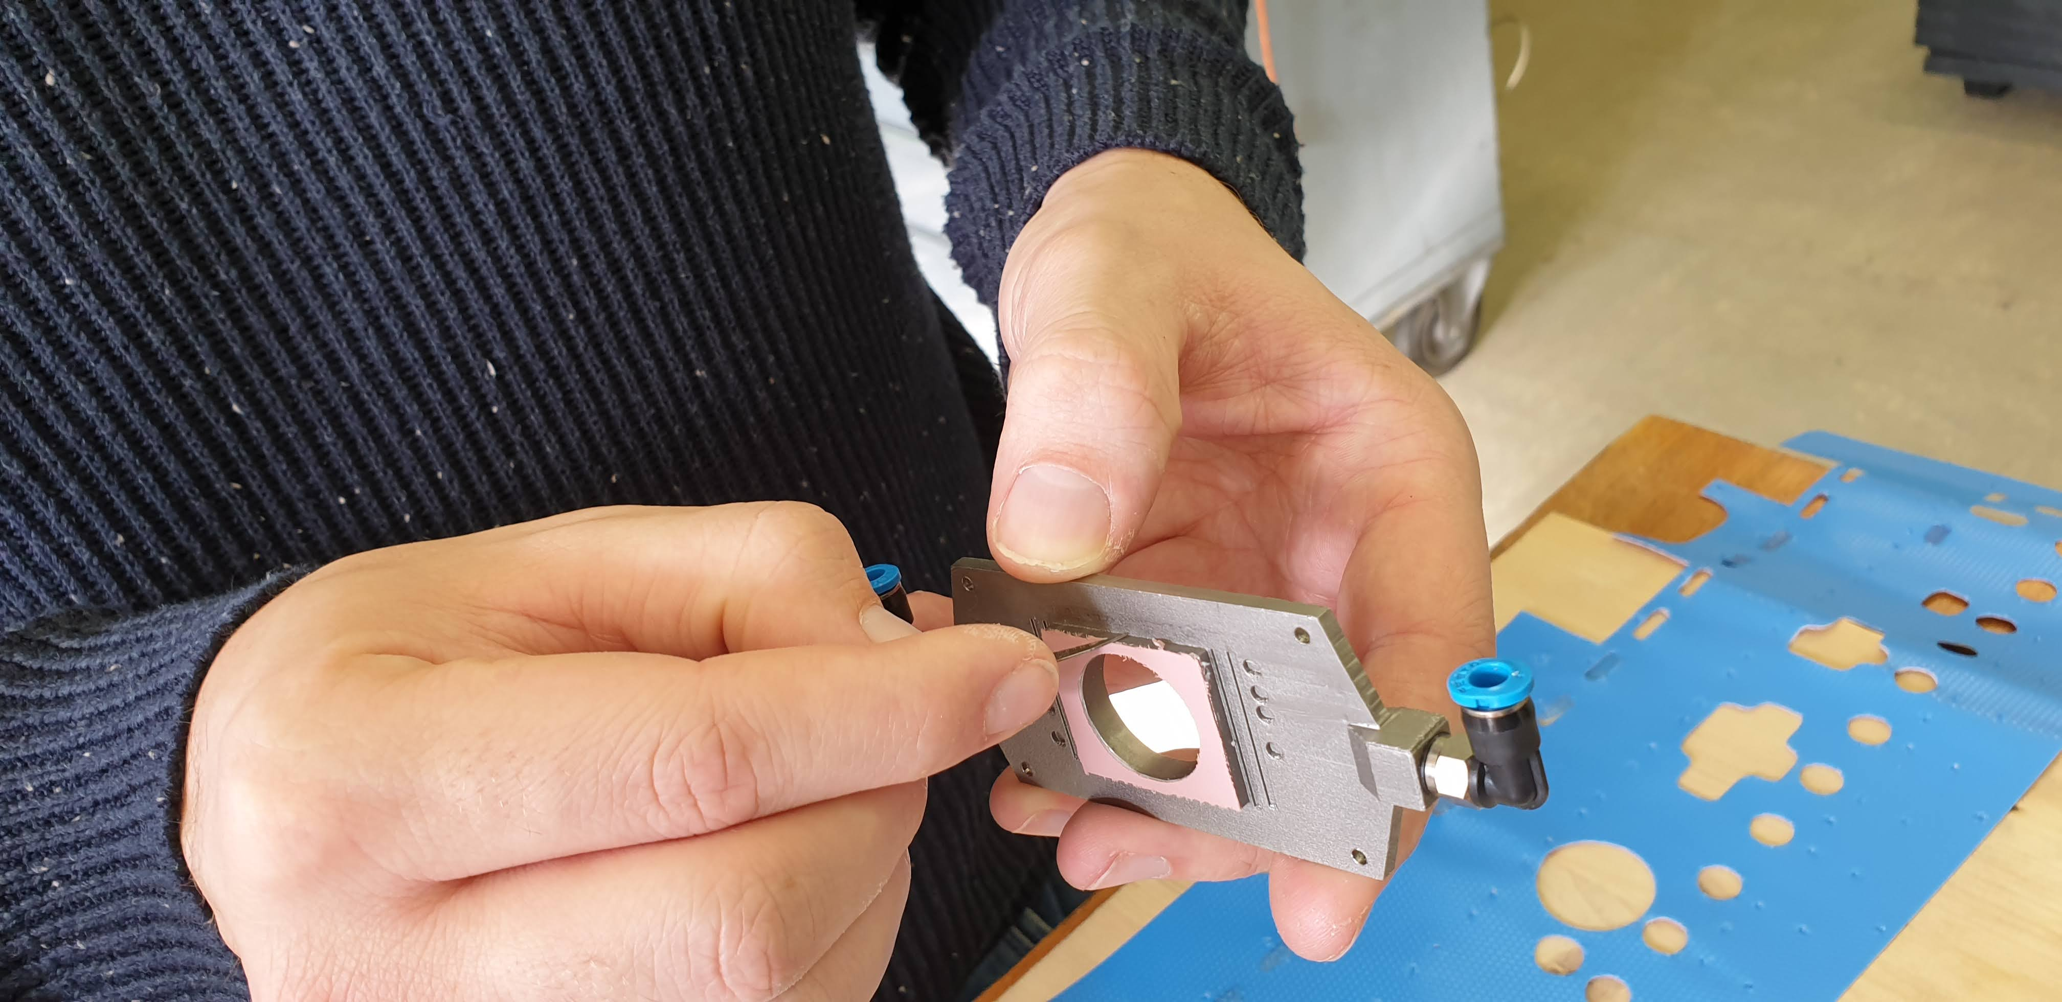
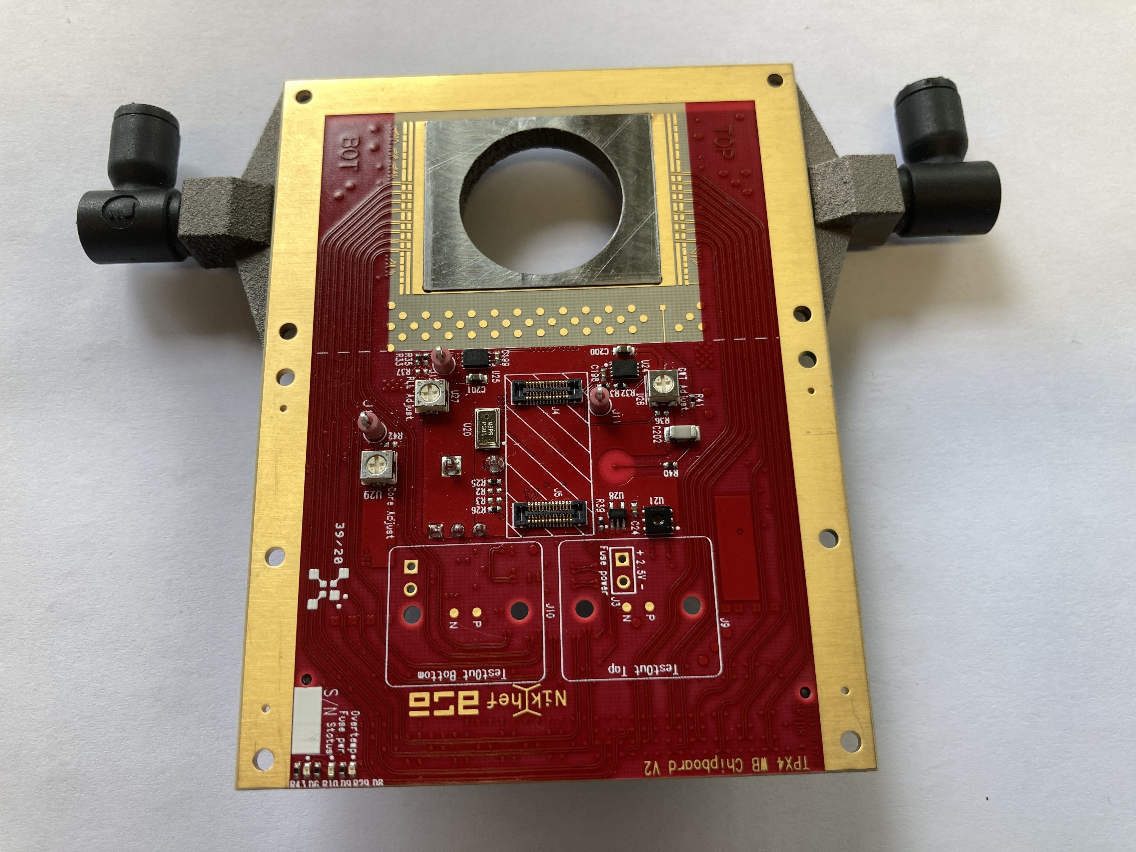
Cooling
Power consumption of few Watts per Timepix4
All chips/PCBs attached to 3D printed titanium cooling block
Glycol used to cool chips to about room temperature
Ready to go colder
Current
cooling
Silicon
Envisioned
cooling
PCB
Silicon
Ti
Ti
PCB

Slide 10
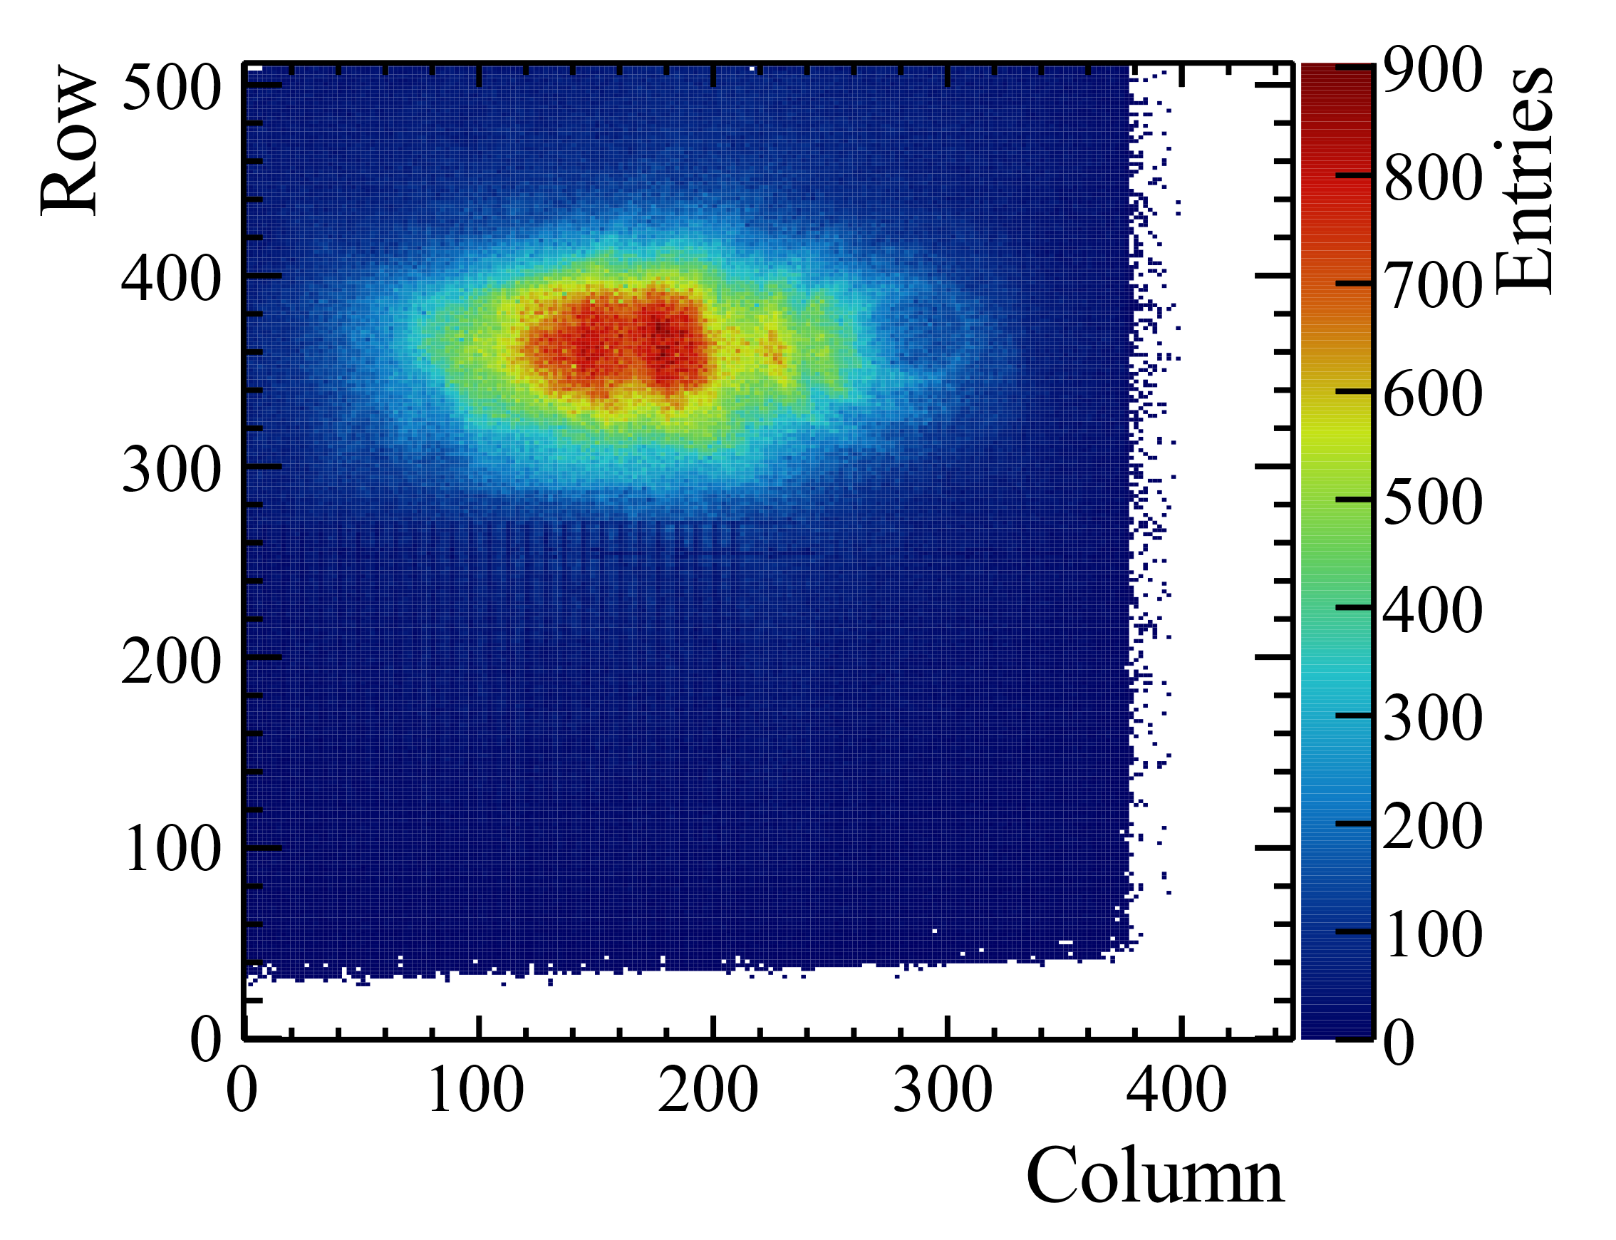
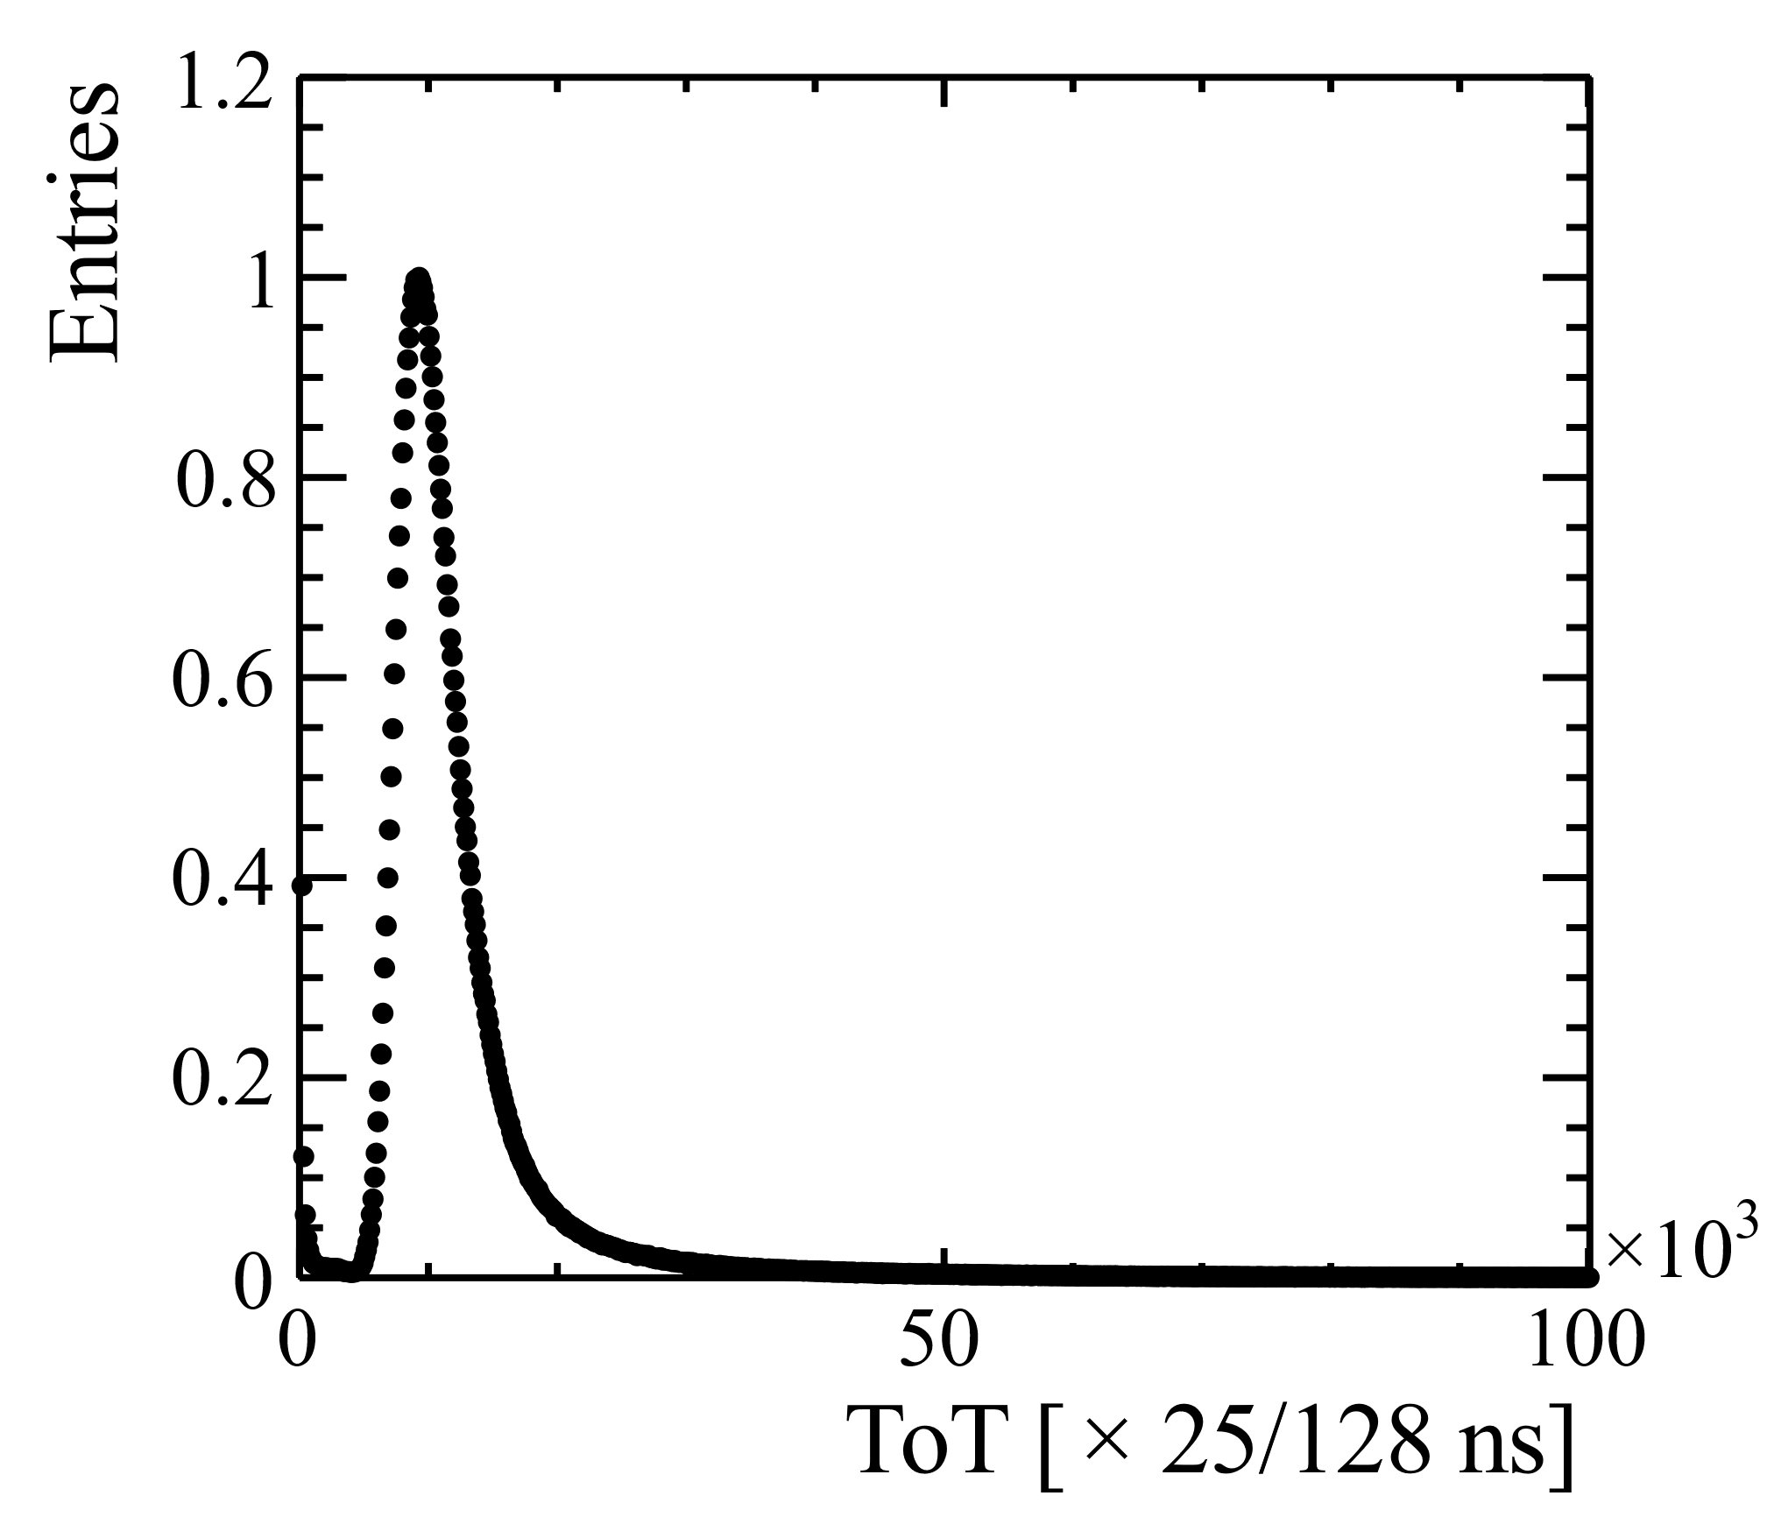
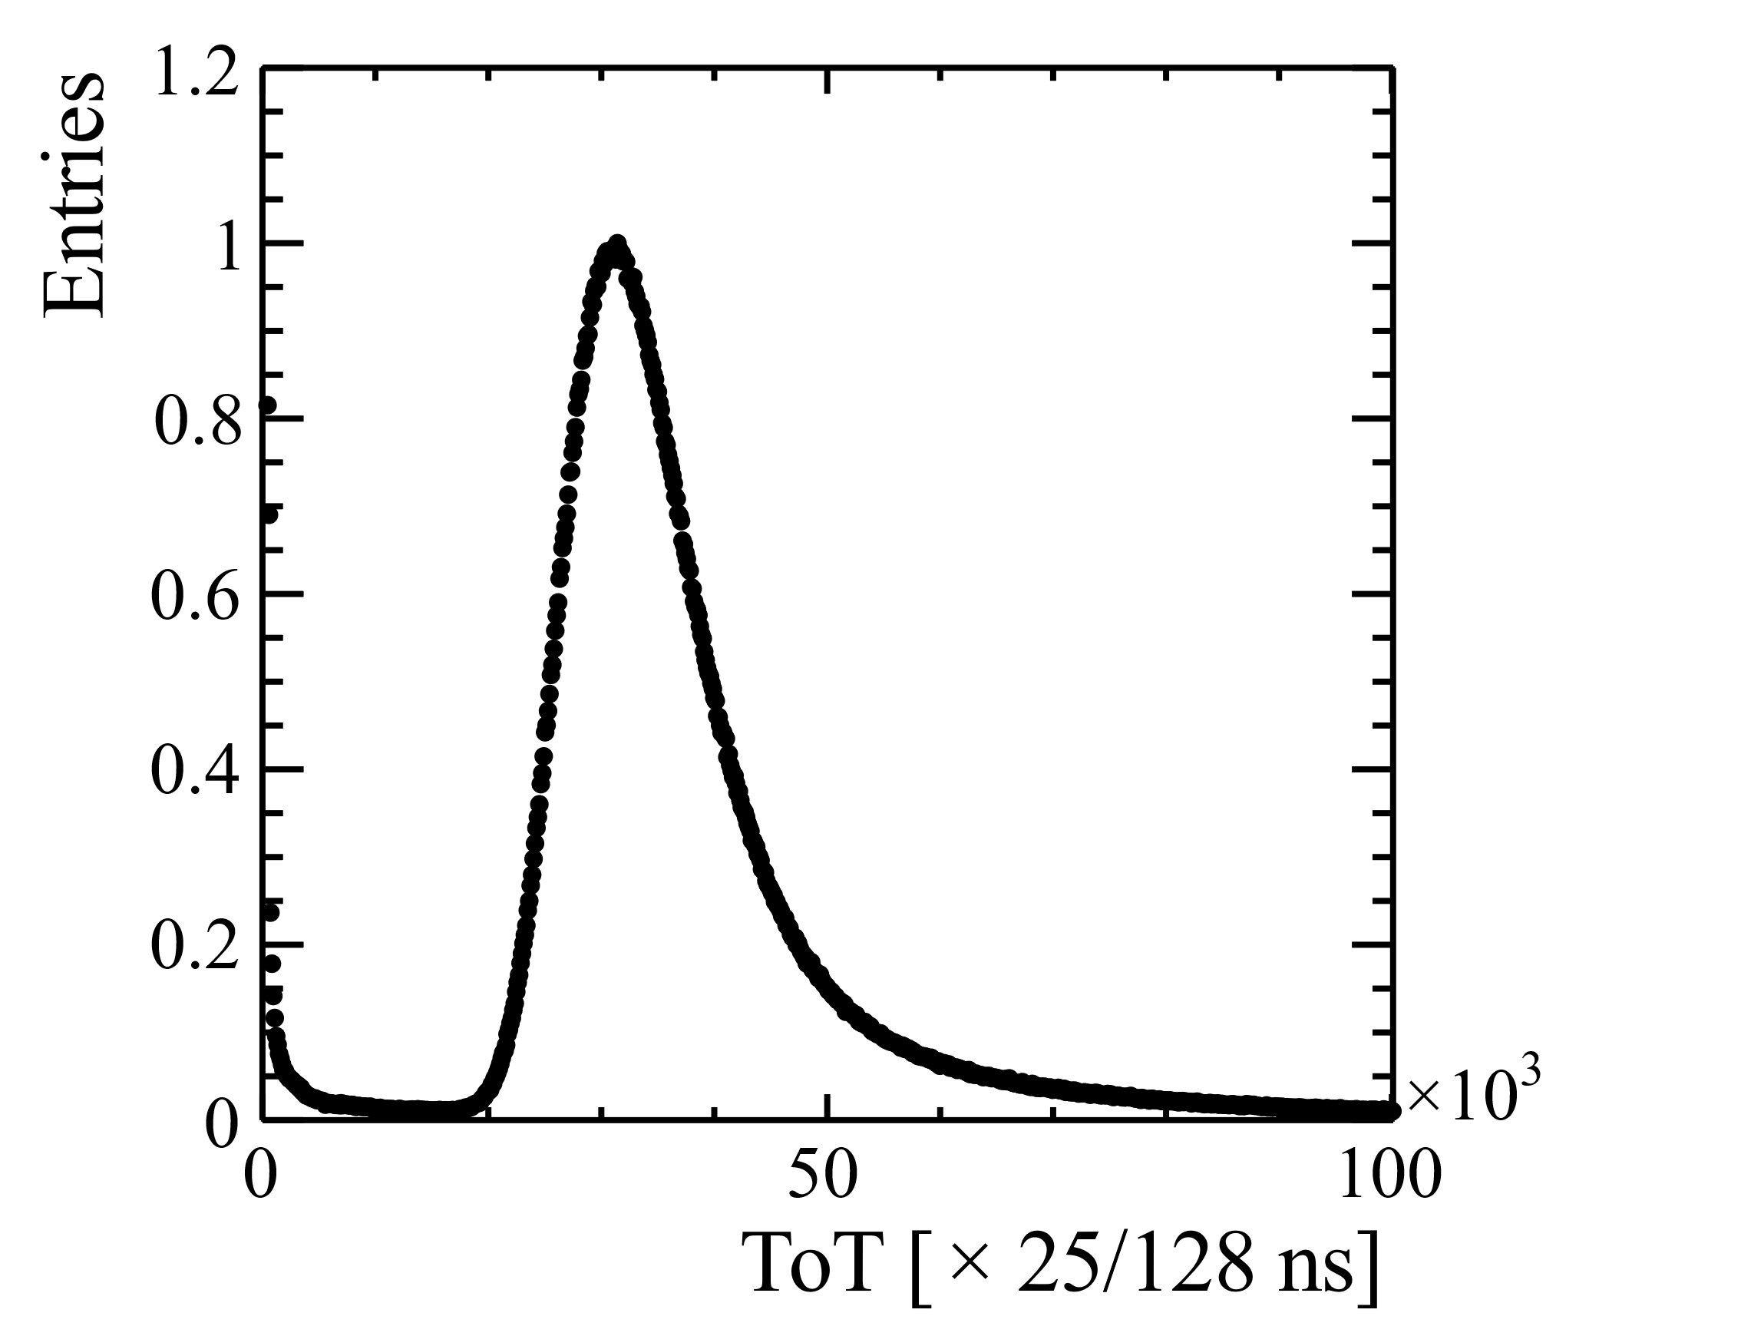
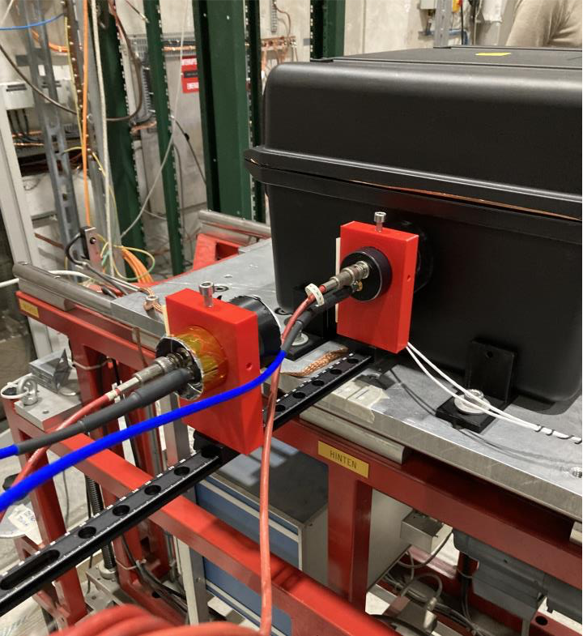
First beam on Timepix4
Hitmap of associated clusters to a track on a single plane
✔️ DAQ and synchronization works
✔️ Online monitoring works
✔️ Offline analysis using the LHCb’s Kepler framework works
-> ToT and hitmap look as expected
TOT/Charge distribution for the two sensor variants
100 μm
300 μm
10

Slide 11




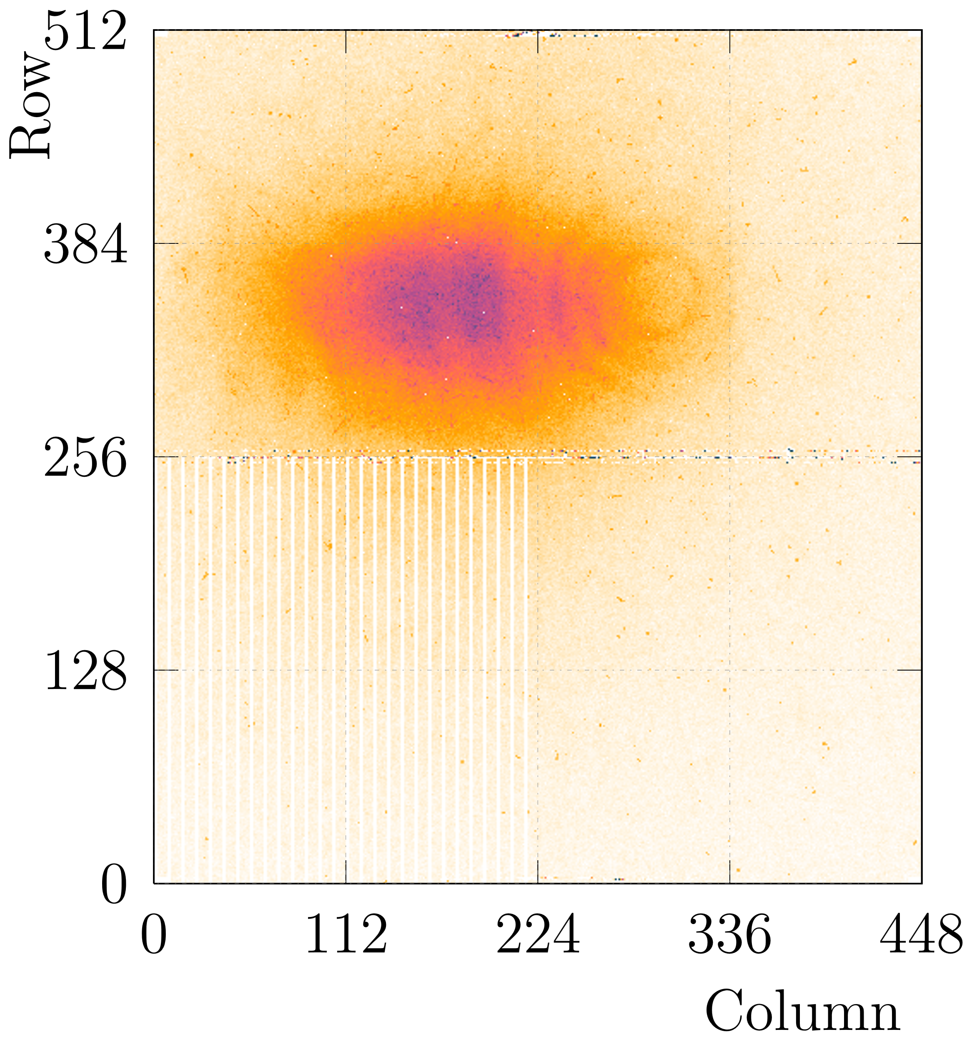
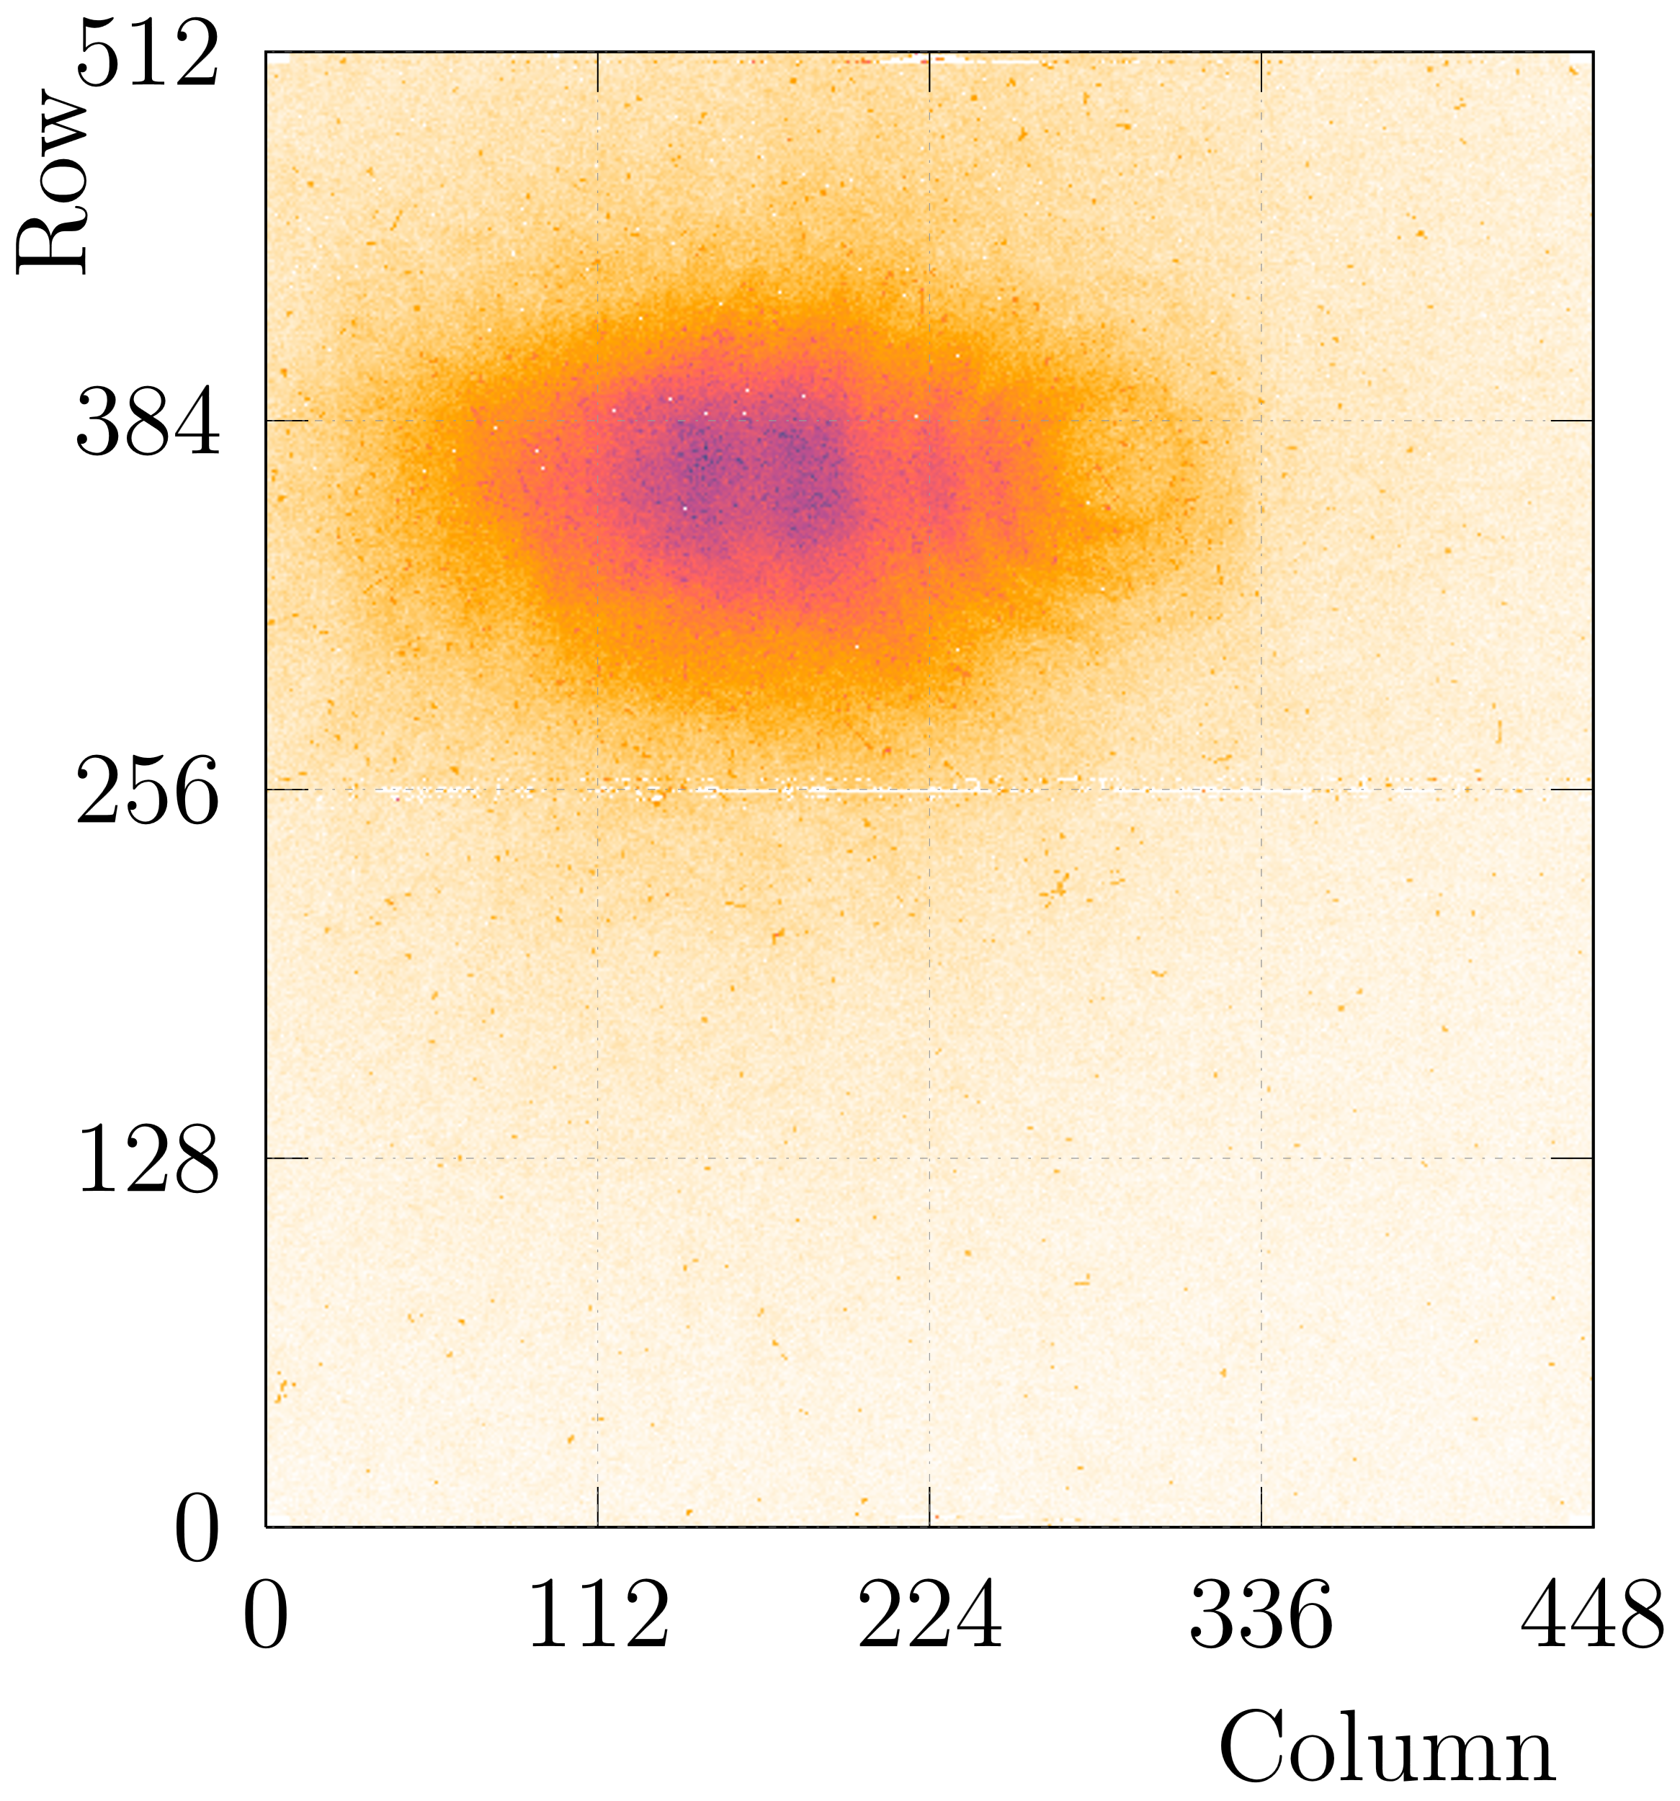
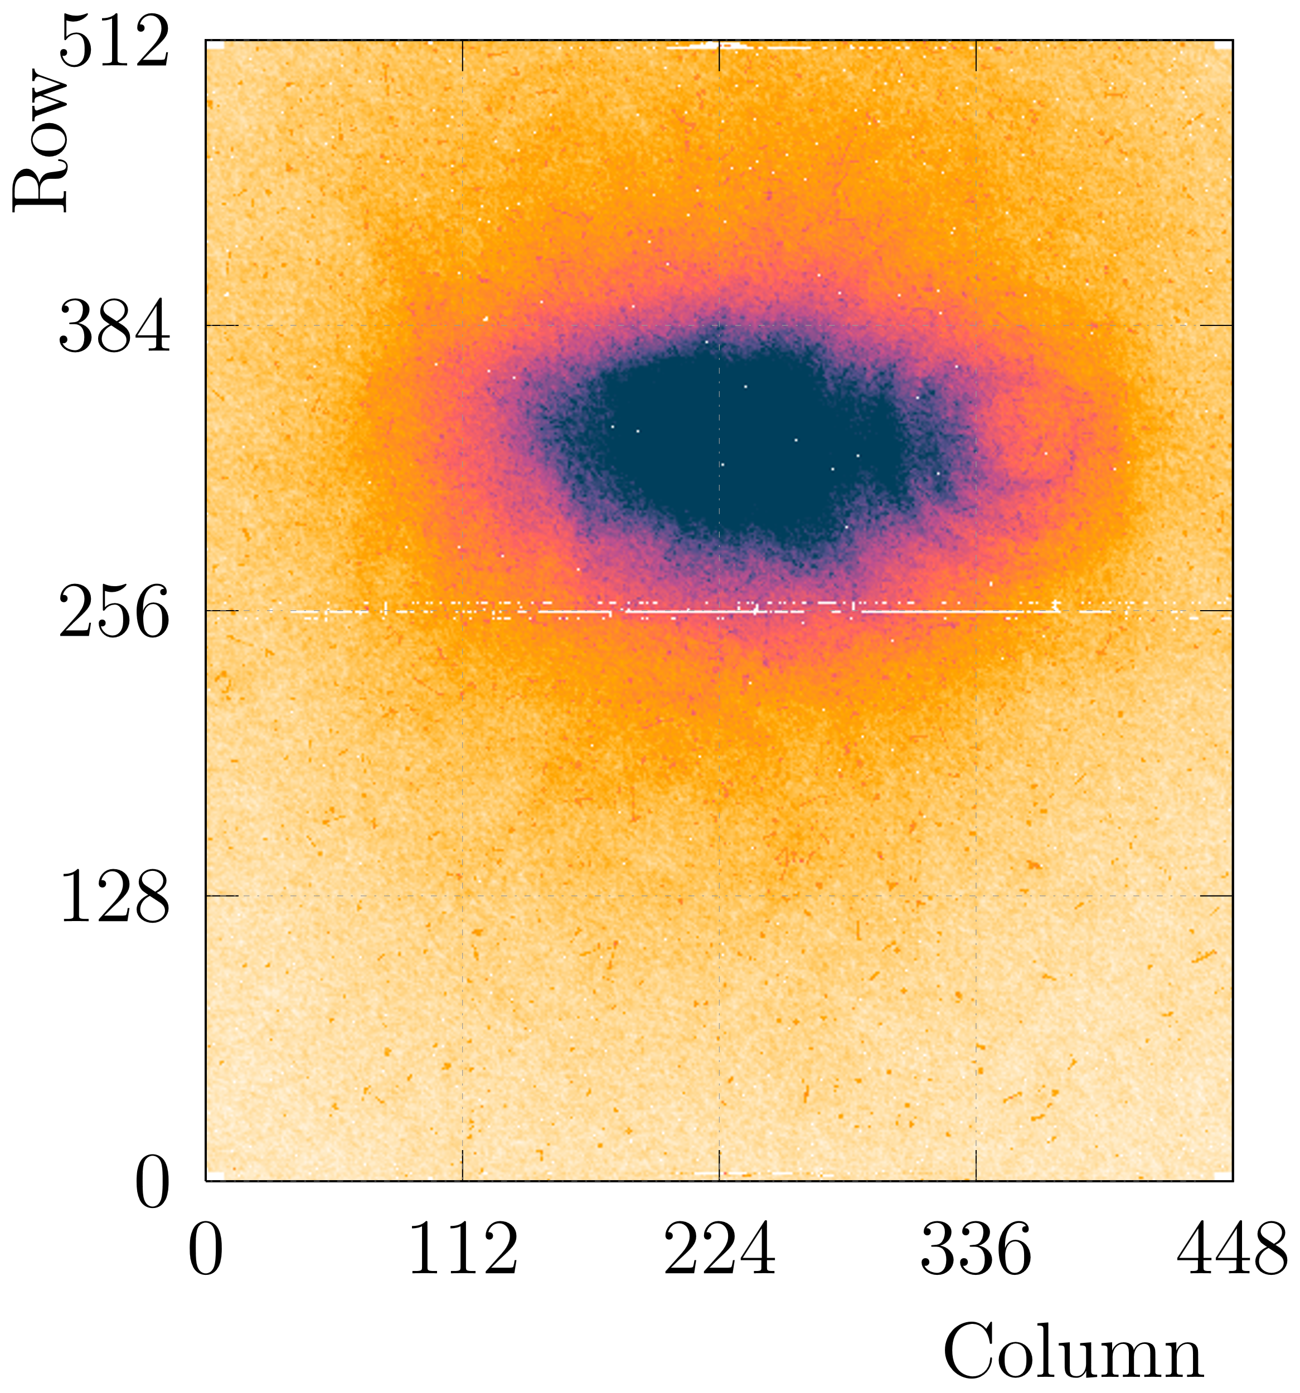
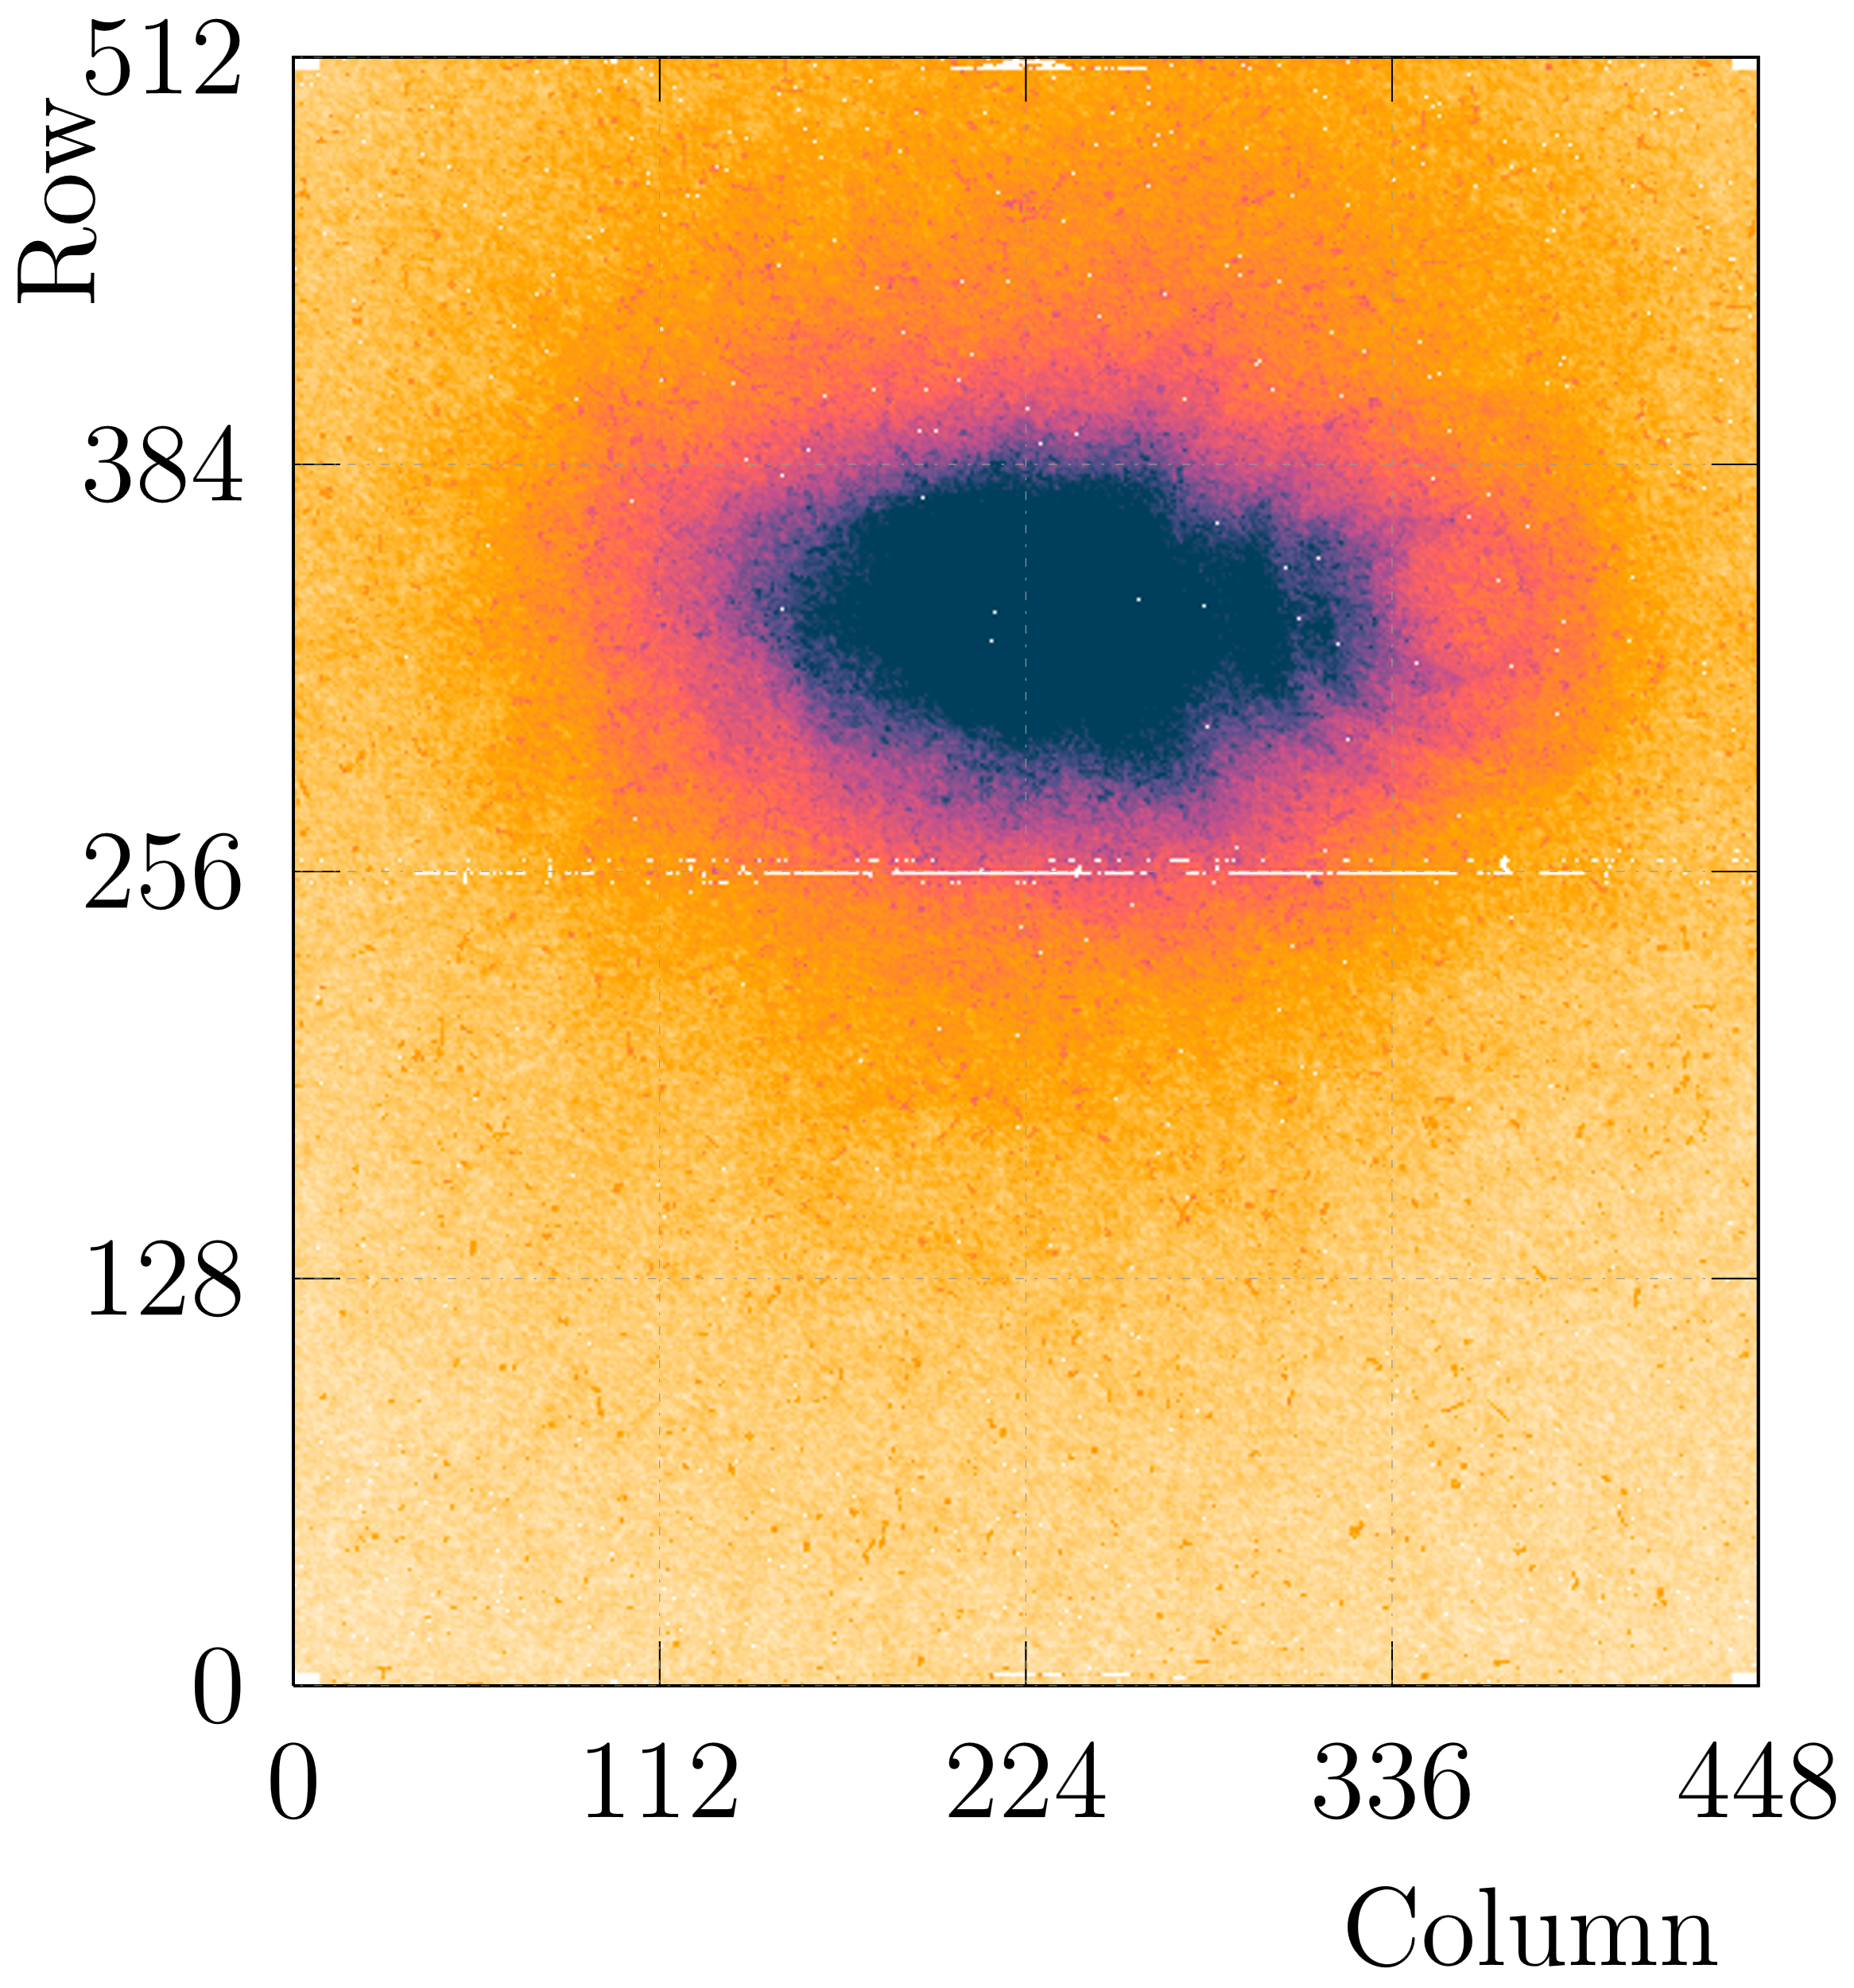




Efficiencies
”Out of the box” efficiencies
Not yet optimized (but anyhow, >> 90% sufficient for telescope)

Slide 12
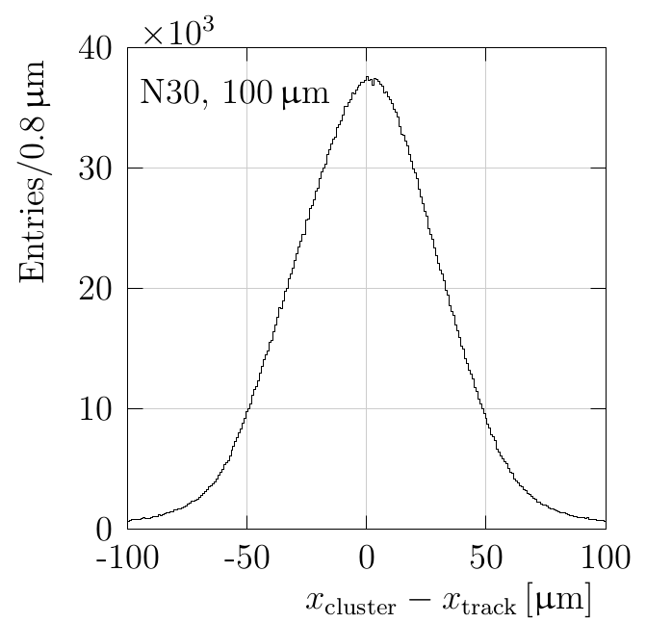
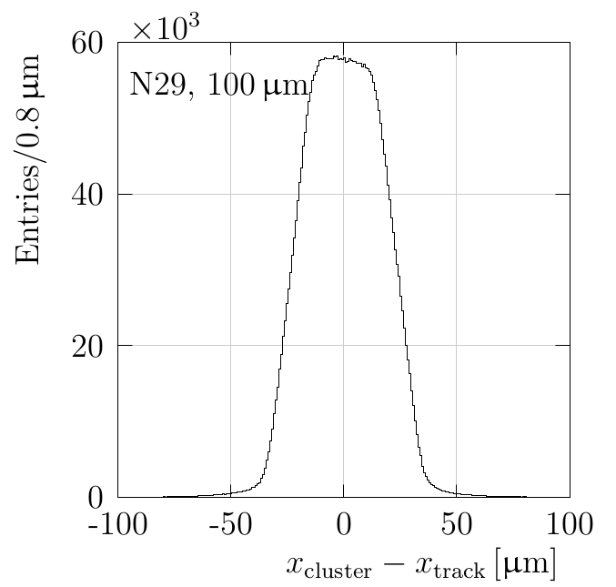
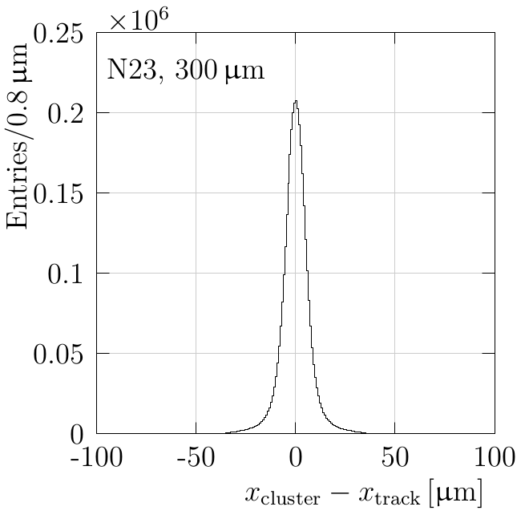
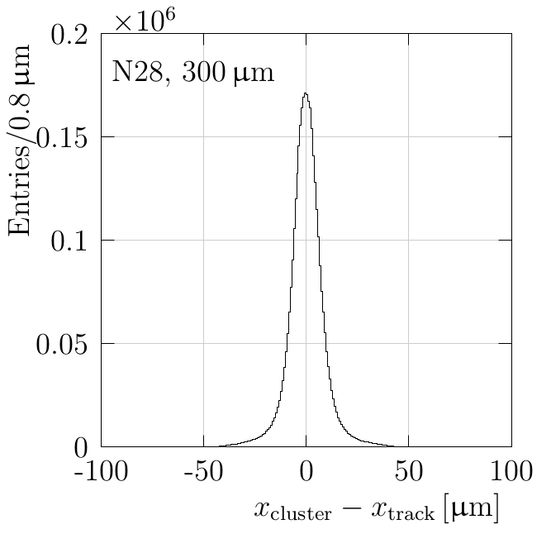




Spatial residual distributions
$$σ=30.8 μm$$
$$σ=15.6 μm$$
$$σ=6.4 μm$$
$$σ=7.8 μm$$
Beam direction
Unbiased residuals, measured by extrapolating tracks made with the other 3 detectors
The pointing resolution is not subtracted from these values, hence the huge variation between similar planes
Results in line with expectation

Slide 13
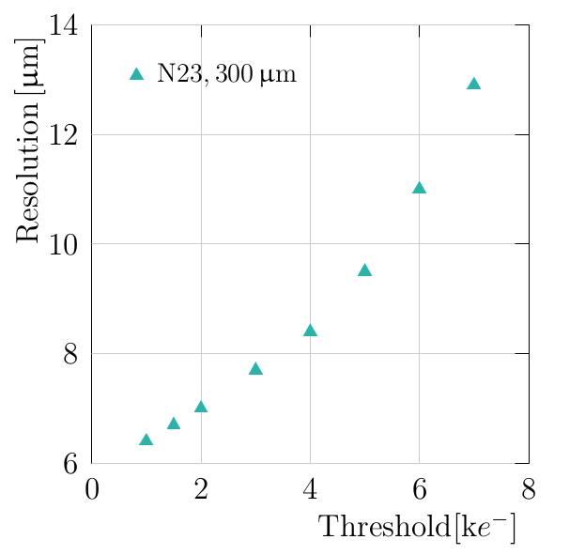
Optimizing for spatial resolution
The 300 μm sensors are placed at a 9° pitch and yaw angle w.r.t. beam
Improves spatial resolution to ~ 6 μm
  Binary resolution 55 μm / sqrt(12) = 15.9 μm
Low threshold operation is beneficial for spatial resolution
  ~600 e- seems feasible with careful tuning
Find balance between optimization for spatial resolution and for timing

Slide 14
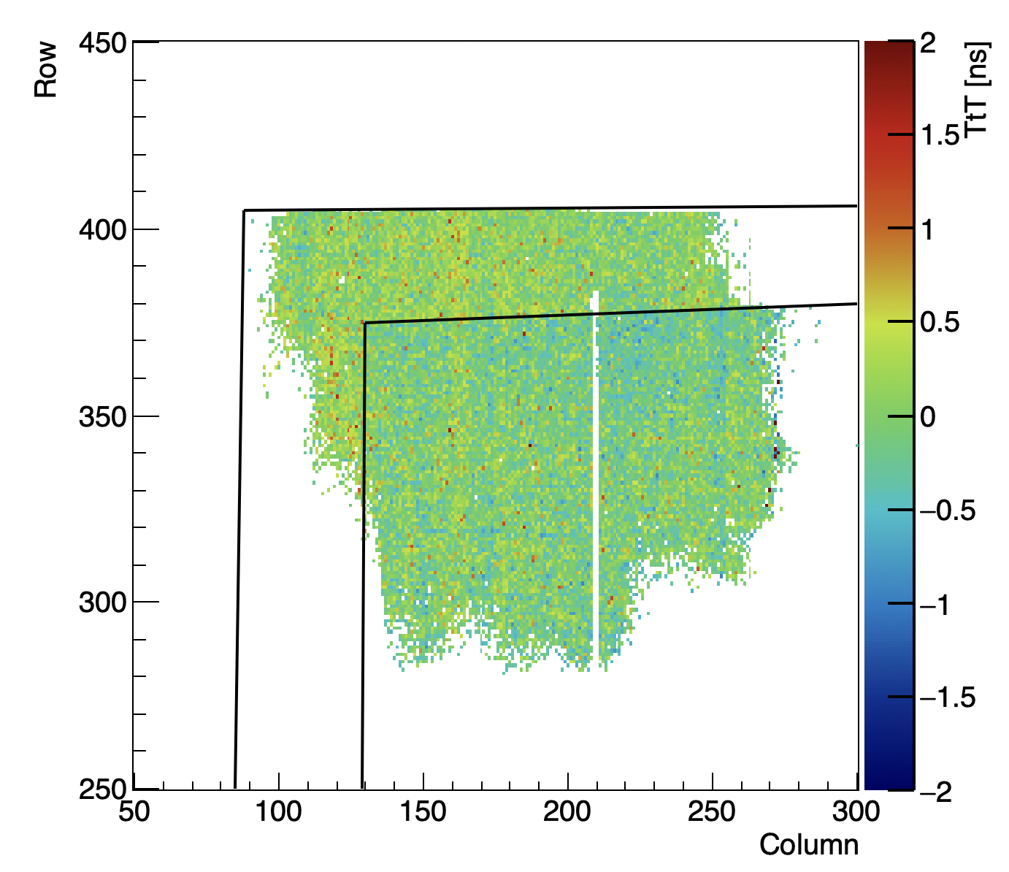
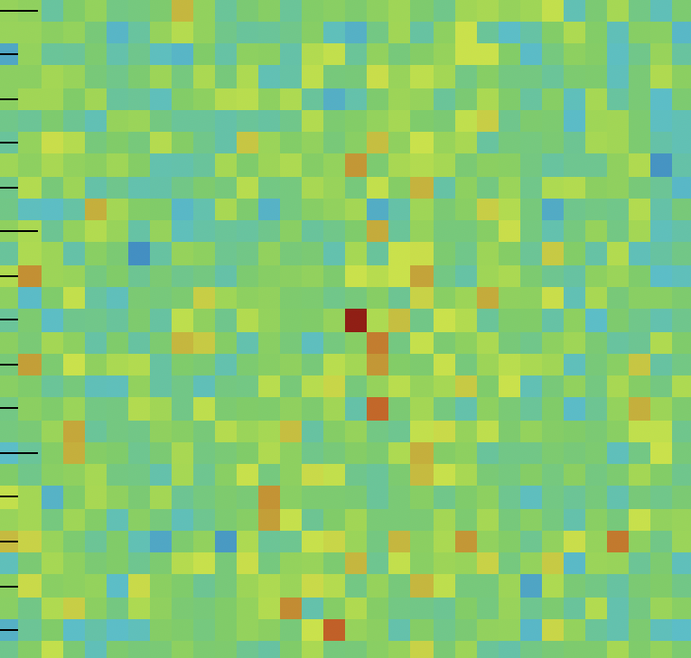
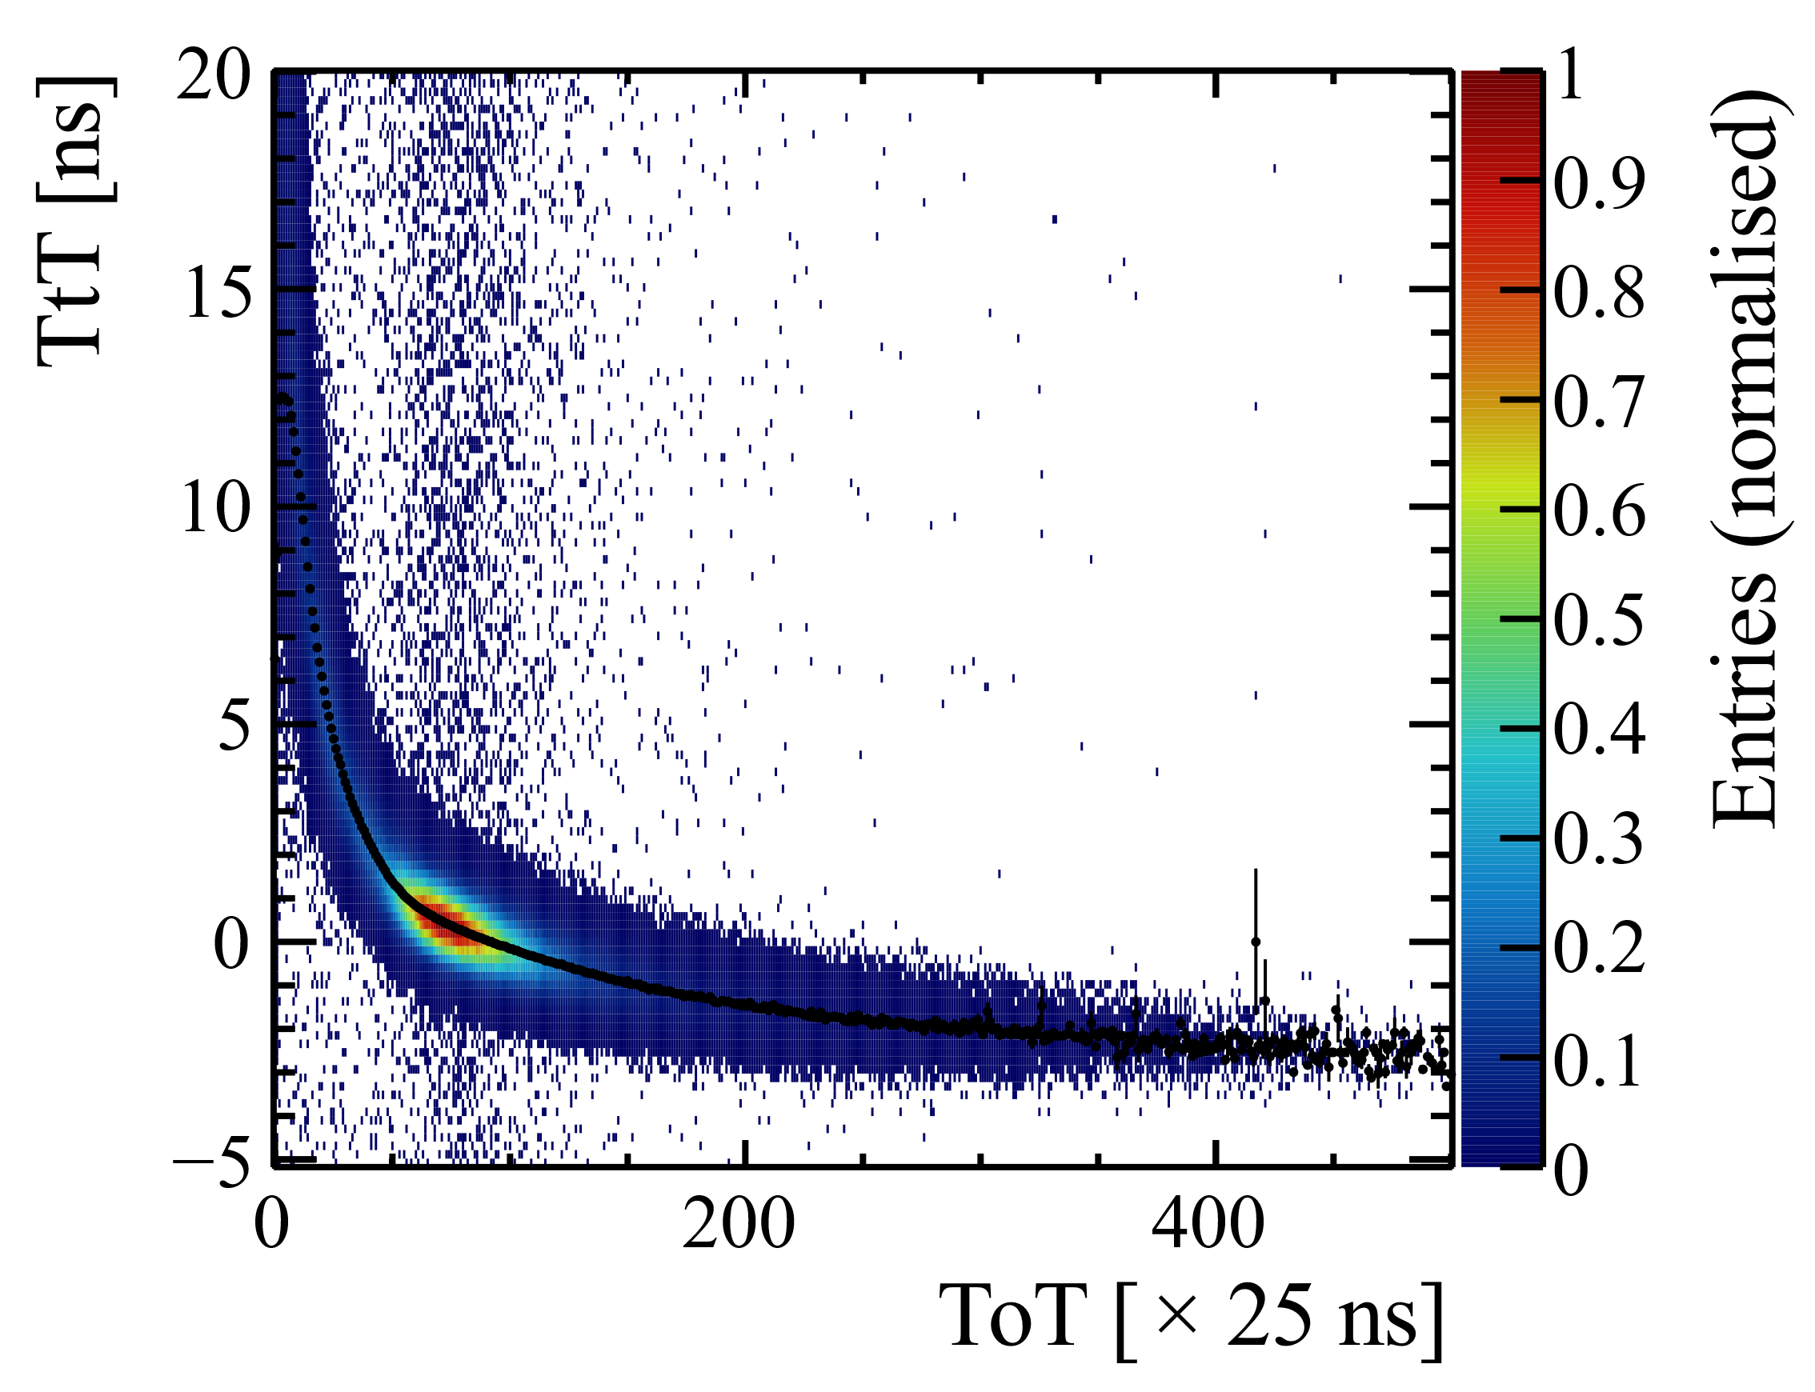
Optimization for timing
Time offset per pixel
‘Standard’ time-walk correction for thin perpendicular sensors
Currently using Time-over-Threshold, accurate charge calibration not yet available
Time offset per pixel determined via time-to-threshold measurement
Planned for final telescope: per-TDC-bin offset correction
  Requires substantial statistics

Slide 15
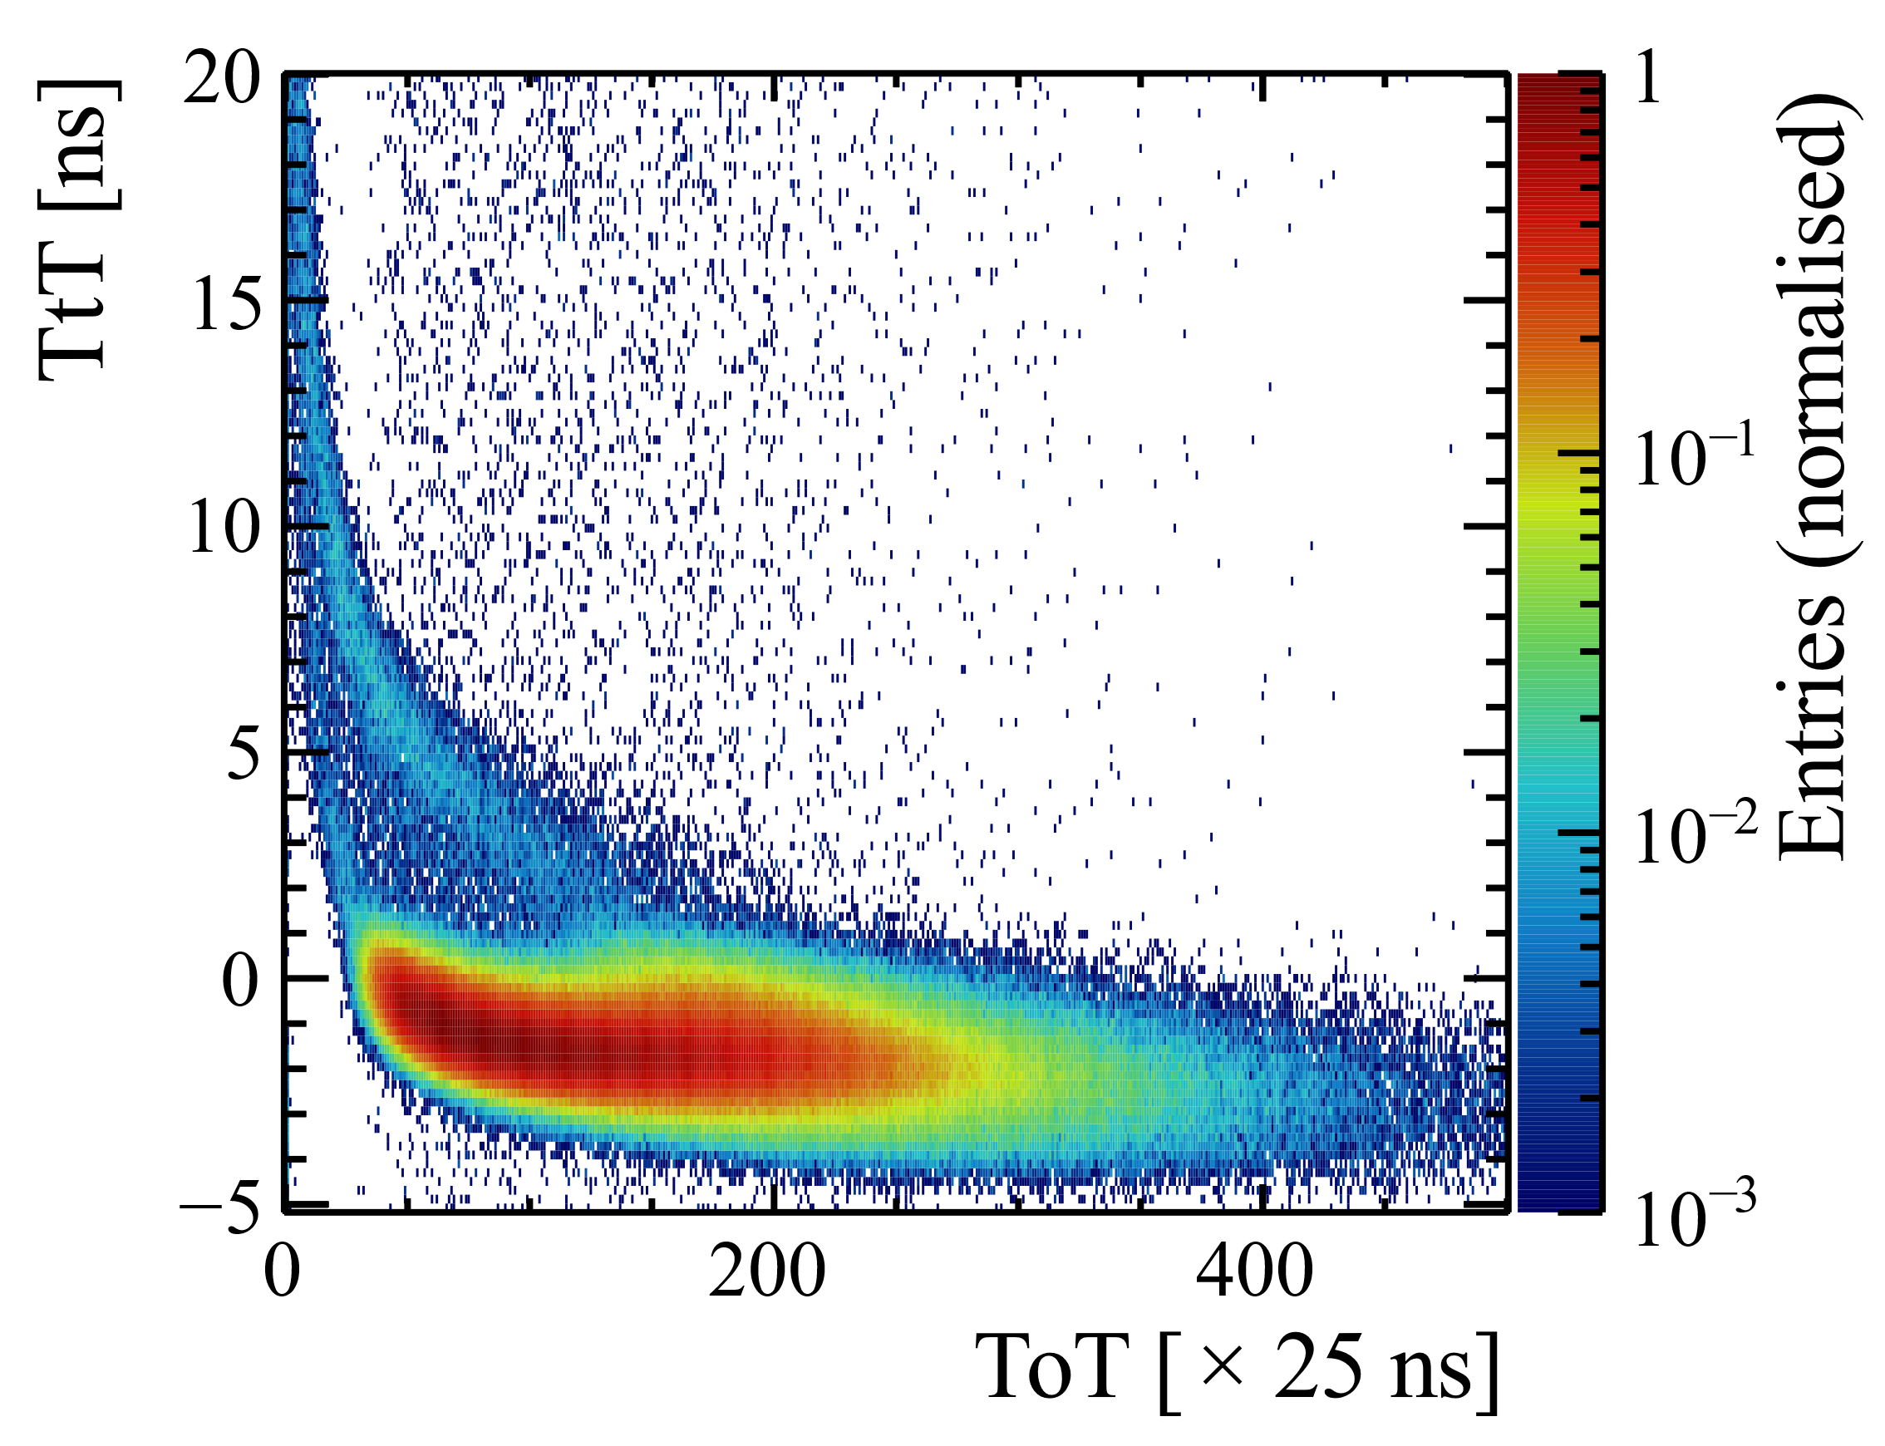
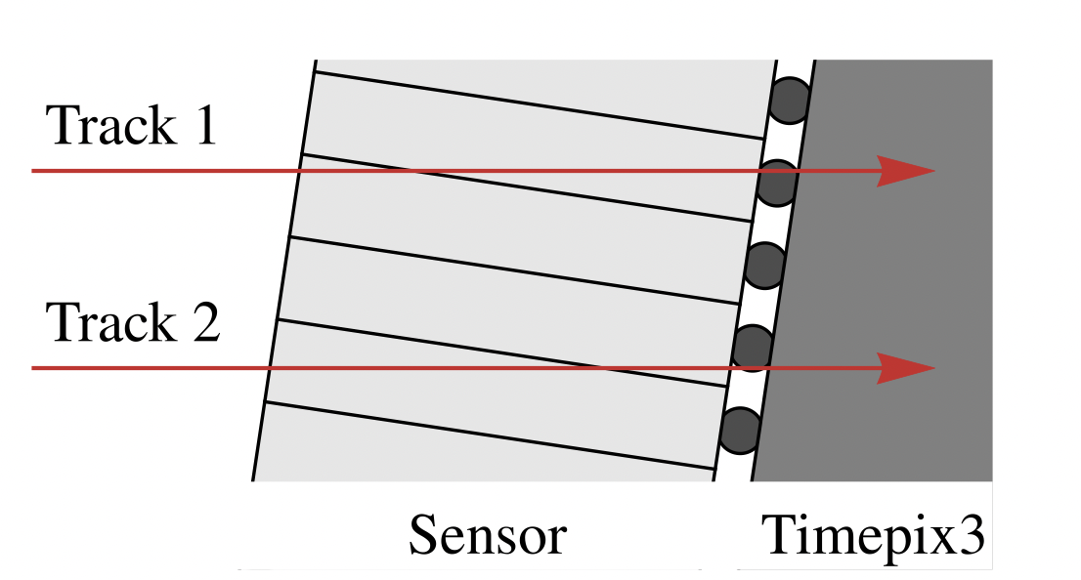
Timewalk correction for thick tilted planes
Tilting sensors is beneficial for spatial resolution, but affects time resolution
Timewalk plot for tilted thick sensor shows multi-band structure
Requires timewalk correction based on track topology, currently limited by statistics
4
More details: K. Heijhoff https://doi.org/10.1088/1748-0221/15/09/P09035

Slide 16
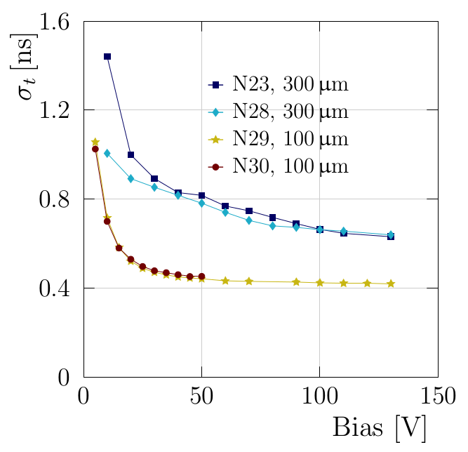
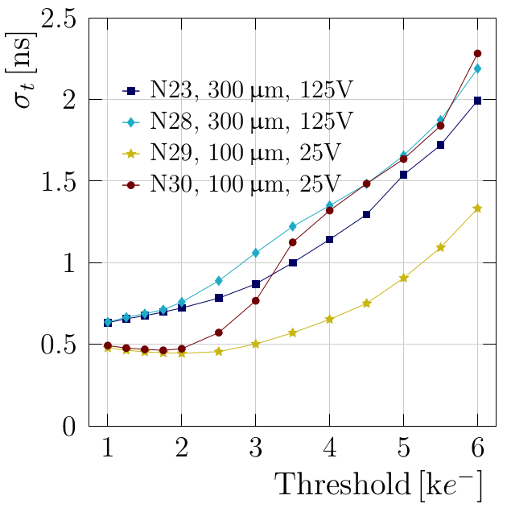
Temporal resolution of individual planes
Limited by bias voltage on sensor
Lower threshold for 300 μm sensors might improve time resolution

Slide 17
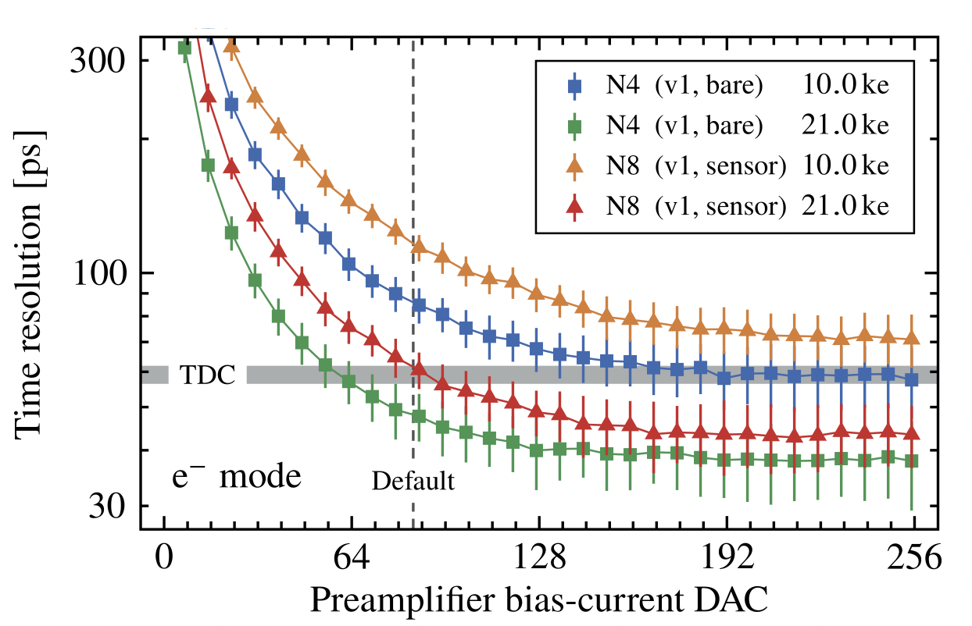
Track time resolution
Current track time resolution is (‘only’) 340 ps
Improvements expected from:
  More layers: at least 8, maybe 10 or 12
  Operation at higher bias voltage
  Timepix4v2, with locked TDC oscillators
  Higher preamplifier current
  Cluster time instead of hit time
  Better track topology based timewalk correction (suffering from limited statistics)
Major improvement will come from faster sensors: LGAD, (trench) 3D
Time resolution of TPX4 analog front-end,
with testpulse
K. Heijhoff: arXiv:2203.15912 (accepted by JINST)

Slide 18
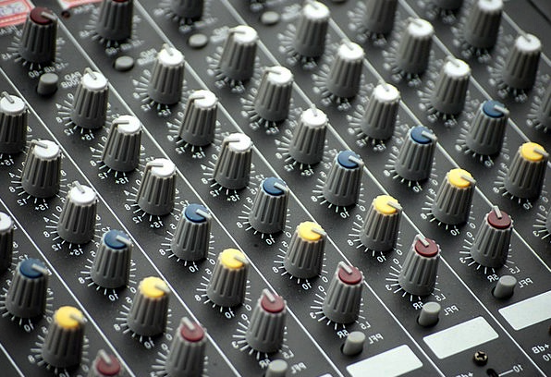
Summary and outlook
Reconstructed first tracks through Timepix4 !
Successful first testbeam, many things tested/learnt:
  Mechanics and cooling
  Slow control and online monitoring
  Synchronisation
  Track reconstruction
  Experience with Timepix4, SPIDR4 etc.
Performance in line with expectation
Track time resolution so far: 340 ps
Many ‘knobs’ we can turn to improve time resolution
  Tuning, corrections, and more corrections
Next testbeam in about 3 weeks from now
  8 layers: 4 x Timepix4v2, 4 x Timepix4v1

Slide 19
Thank you

