Slide 1



Development of Low Noise Pixels and Readout Architectures for Scientific Applications in a 180nm CMOS Image Sensor Process
28/06/2022
Iain Sedgwick, Seddik Benhammadi, Nicola Guerrini, Ben Marsh
UKRI-STFC Rutherford Appleton Laboratory
Notes:
The abstract pattern can be removed or repositioned if required. Be careful to ‘Send to Back’ so that it does not obscure any important information.

Slide 2
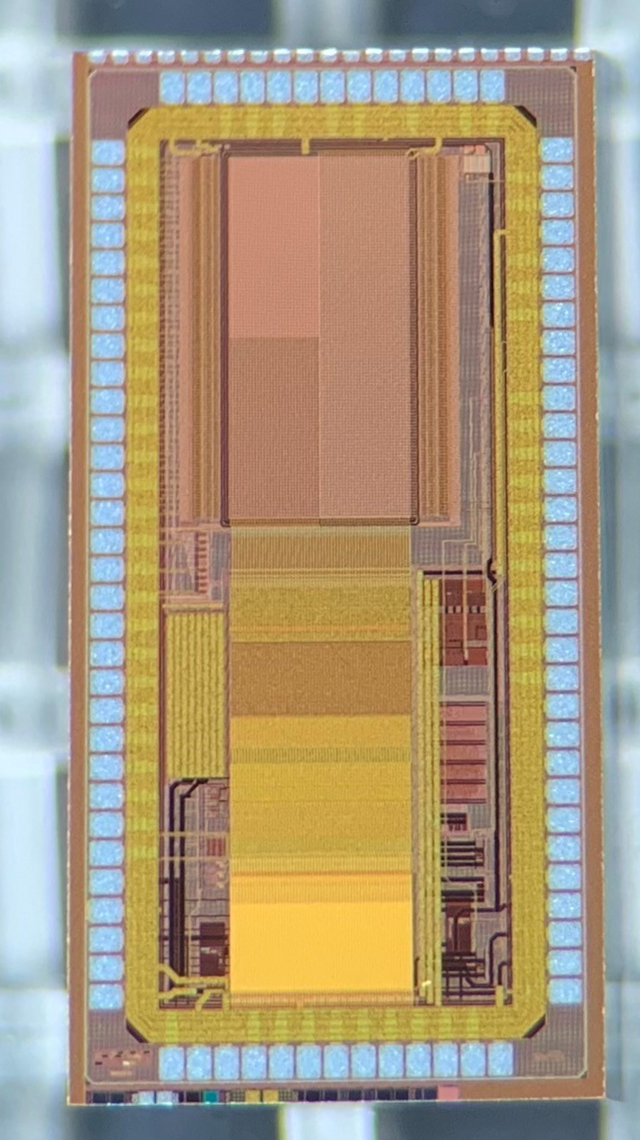
Introduction
Outline
  Motivation
  Chip overview
  Test results
    High Gain Pixels
    Programmable Gain Amplifier
    ADC
  Application to lower gain pixels
  Conclusion
Pixel Array
Analogue Readout Chain
Sigma-Delta ADC
5Gbps Serialiser
(not in this talk)

Slide 3
Introduction
Background
  ASIC development is high risk – prepare IP in advance
  Much work recent on very low noise CMOS pixels [1-4] – exploit for different applications
  High speed data links also key, but for another day…
Pixel Array
Analogue Readout Chain
PRECISE
  Various pixel types – 4T, PMOS SF, 3T, gated diode
  Programmable Gain Amplifier and averaging stage
  Sigma-Delta ADC
Sigma-Delta ADC
5Gbps Serialiser
(not in this talk)

Slide 4

Chip Overview

Slide 5
Chip Overview
Pixels
  Chip has 4T and 3T flavours
  4T
    Standard gain 4T pixel
    High conversion gain 4T pixel
    High conversion gain 4T pixel with PMOS SF
  3T
    Gated diode
    Overflow for HDR
Pixel Array
Analogue Readout Chain
Sigma-Delta ADC
5Gbps Serialiser

Slide 6
Chip Overview
Analogue Readout Chain
  Capacitive PGA
  Averaging Stage
  Correlated Double Sampling (CDS) Amplifier/ADC Buffer
Pixel Array
Analogue Readout Chain
Sigma-Delta ADC
5Gbps Serialiser

Slide 7
Chip Overview
Amplifier
  2-stage
  Miller compensated with nulling resistor
  PMOS input to match expected pixel range
  Output clamp
Averaging Stage
  Based on "Experimental Verification of the Impact of Analog CMS on CIS Readout Noise” [5]
  Allows averaging 2,4,8,16 samples
  Only tested up to 2 so far (see following slides)

Slide 8
Chip Overview
Sigma-Delta ADC
Advantages over ramp topologies:
    Low Noise
    Highly digital – ease of integration
    Low sensitivity to analogue components – good for large sensor and arrays
Pixel Array
Analogue Readout Chain
Sigma-Delta ADC
5Gbps Serialiser

Slide 9
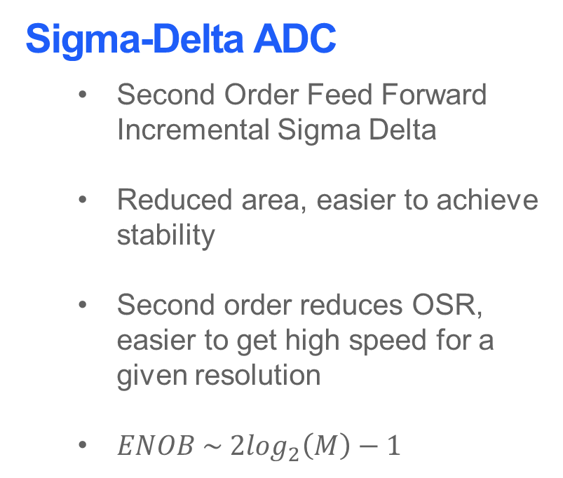
Chip Overview
Sigma-Delta ADC
  Second Order Feed Forward Incremental Sigma Delta
  Reduced area, easier to achieve stability
  Second order reduces OSR, easier to get high speed for a given resolution
  $ENOB \sim 2\log_{2}\left(M\right)−1$
Over Sampling Ratio M and Speed
  12 bit resolution implies M>=91
  Select 100
  ADC clock of 100MHz for 1MSPS
  Supplied by on-chip PLL
  Max bit depth 17, variable just by changing number of cycles (with speed penalty)

Slide 10
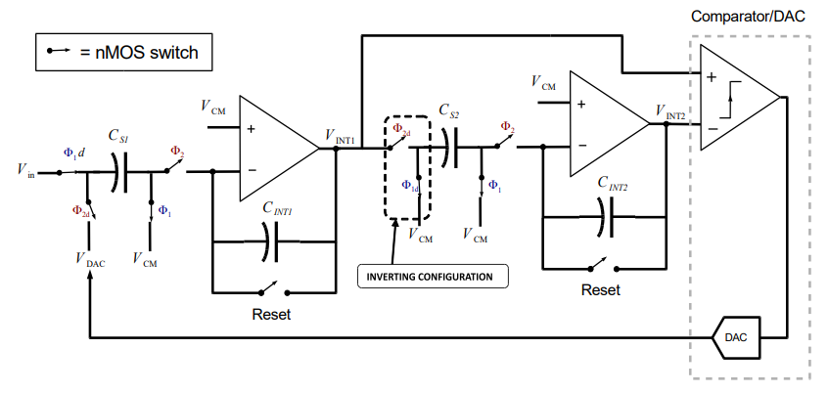
Chip Overview
Sigma-Delta ADC
  Second Order Feed Forward Incremental Sigma Delta
  Reduced area, easier to achieve stability
  Second order reduces OSR, easier to get high speed for a given resolution
  $ENOB \sim 2\log_{2}\left(M\right)−1$
Over Sampling Ratio M and Speed
  12 bit resolution implies M>=91
  Select 100
  ADC clock of 100MHz for 1MSPS
  Supplied by on-chip PLL
  Max bit depth 17, variable just by changing number of cycles (with speed penalty)

Slide 11
Testing

Slide 12
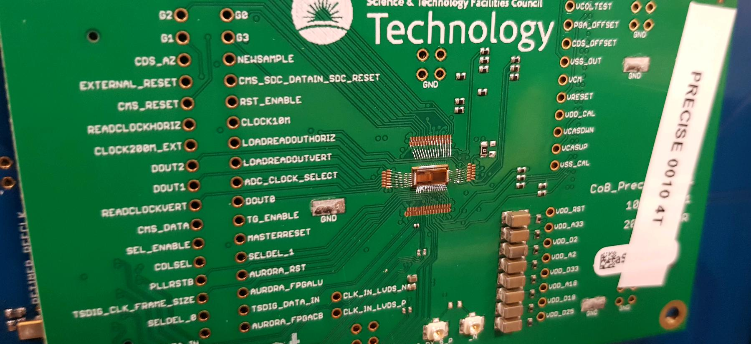
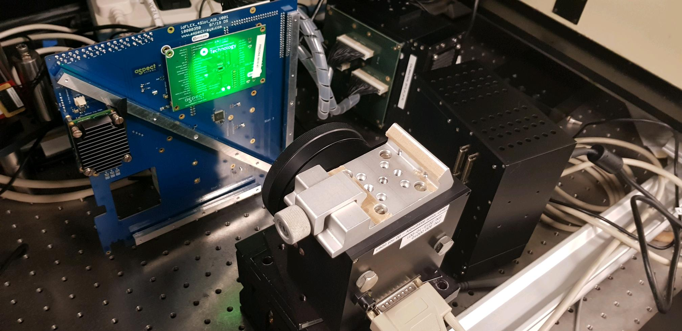
Outline and Test Set-up
Outline
  Test set-up
  ADC Testing
  Analogue Chain Testing
  Pixel Testing
    4T Pixels
    3T Pixels

Slide 13
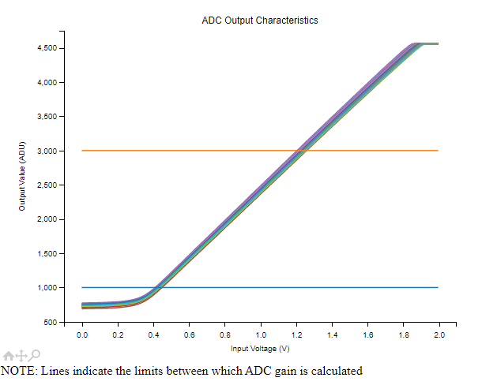
ADC Testing
Quantity | Unit | Value
Gain | ADU/V | 2470 ± 20
Max DNL | ADU | 1.24
Min DNL | ADU | -0.82
Max INL | ADU | 2.26
Min INL | ADU | -7.53
Average Noise | uV rms | 323

Slide 14
ADC Testing

Slide 15
ADC Testing
Operating point for following tests

Slide 16
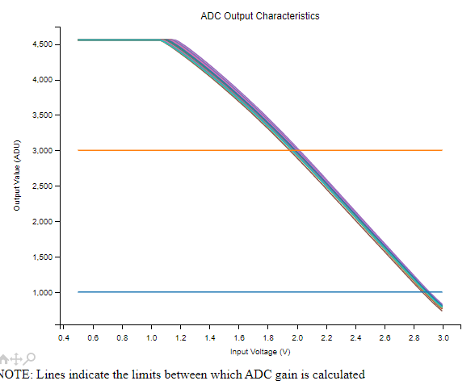
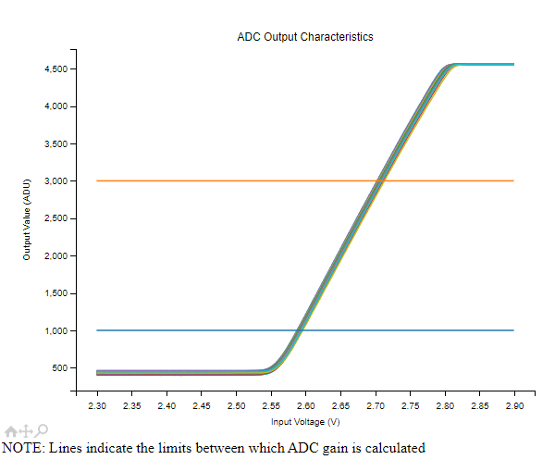
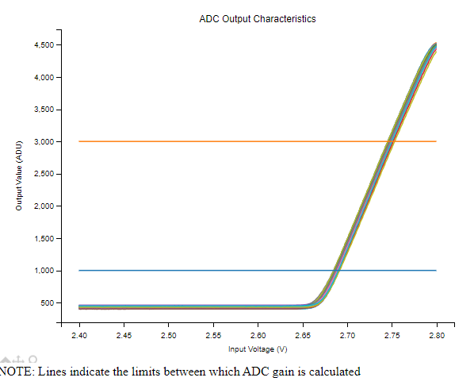
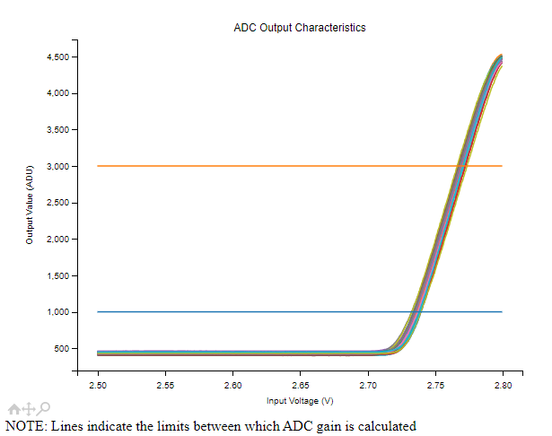
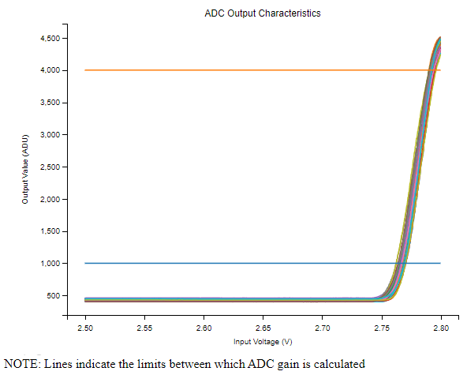
Analogue Chain Testing
G1
G2
Analogue Chain
  5 gains. Nominally:
    G1 – 1
    G2 – 8
    G3 – 16
    G4 – 32
    G5 - 128
G3
G4
G5

Slide 17
Analogue Chain Testing
Reduced Nominal Gain x128 due to systemic error

Slide 18
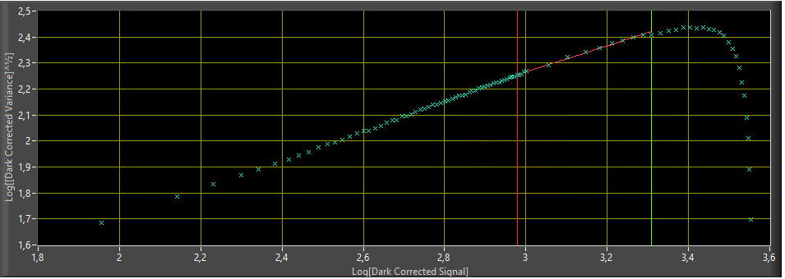
Pixel Testing – 4T
4T Pixels
  2 types – different conversion gains
  Tested for all gains of the PGA
  Best noise level < 2e-
Photon Transfer Curve – 4T HCG Pixel using G5

Slide 19
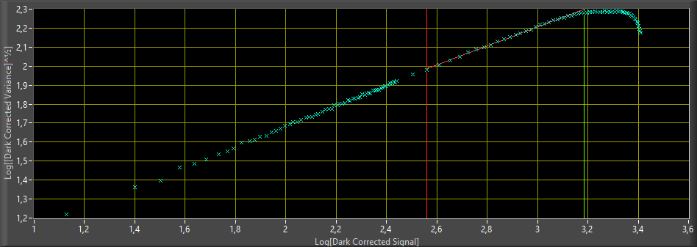
Pixel Testing – 4T
Averaging Stage
  Sampling the pixel twice and averaging allows the noise to be reduced to almost 1.5e-
  Gain is slightly reduced when averaging
Photon Transfer Curve – 4T HCG Pixel using G5 and CMS2

Slide 20
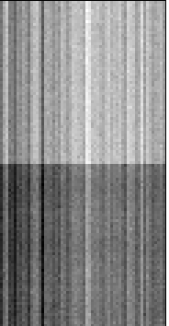
Pixel Testing – 3T
3T Pixels
  Pixel targeting radiation hardened designs:
    Gated diode [7,8], large transistors
    Leads to low conversion gain
  Use techniques from previous slides to reduce noise in spite of low conversion gain
Additional Techniques
  Off-chip CDS
    Read reset level, then signal level one frame later
  Row Noise Correction
    Use dark pixels at row edges to measure row noise, then subtract from image

Slide 21
Pixel Testing – 3T
Noise Improvement
  Standard readout – 42e-
  Off-chip CDS – 38.7e-
  Off-chip CDS plus row noise correction – 36.2e-
  2 sample averaging – 30.7e-
  27% improvement. Also c.f. 30e- noise at room temp with similar designs – 35e-[9], 80e-[10]

Slide 22
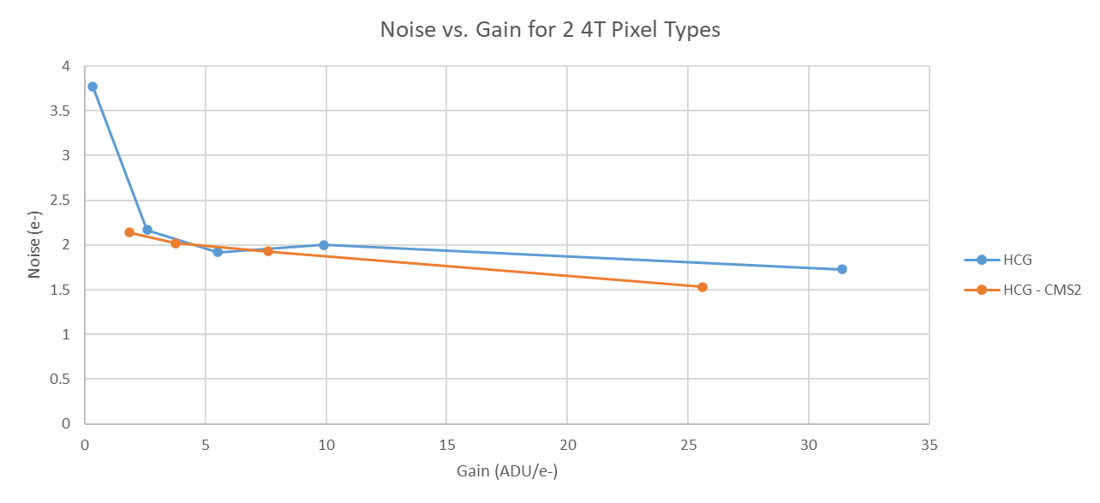
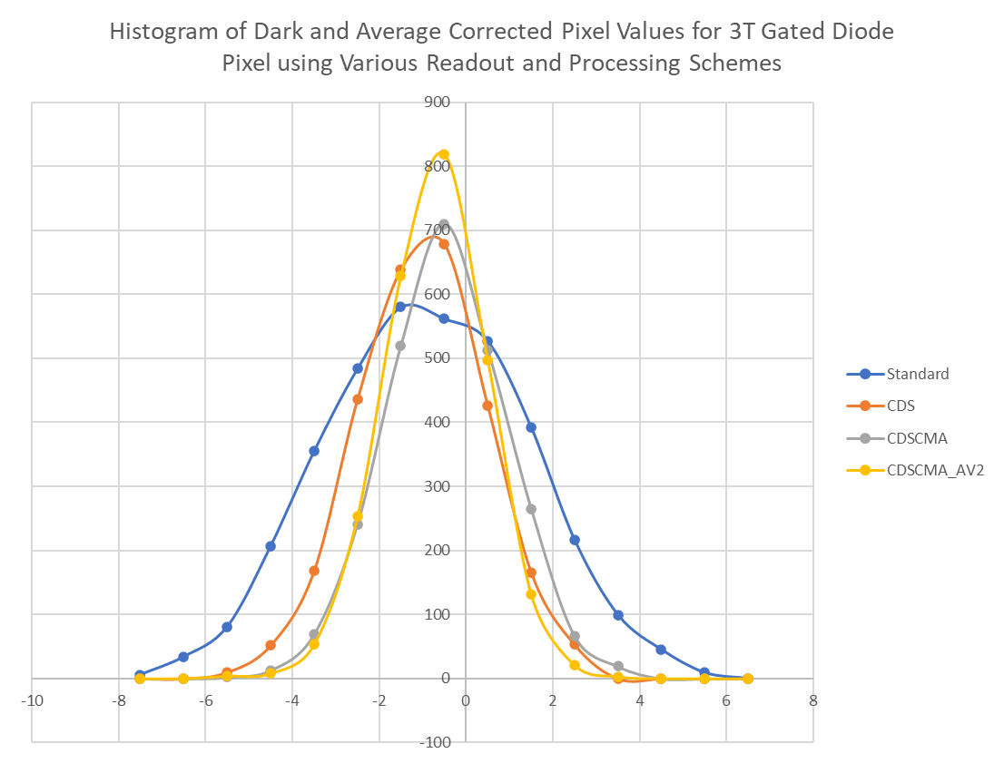
Conclusions
Noise Performance
  1.5e- for highest gain pixel in best performing configuration
  27% improvement in noise of lower conversion gain pixel
Motivation
  Goal is to develop the circuit blocks for low noise, high speed future sensors
  Will help to de-risk future projects
Circuit Blocks
  Sigma-Delta ADC: 12 bit, 322uV noise >1MSPS, 15um pitch
  Programmable Gain Amplifier: Gains 1-128, IR noise <150uV
  Averaging Stage
  Multiple pixel types, including radiation hardened design

Slide 23
Extra Slides

Slide 24
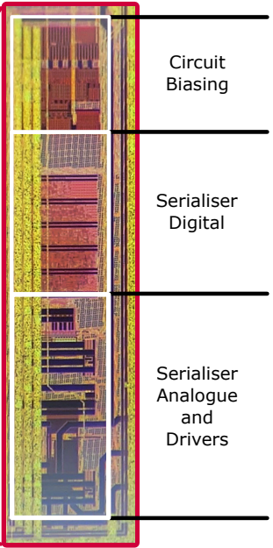
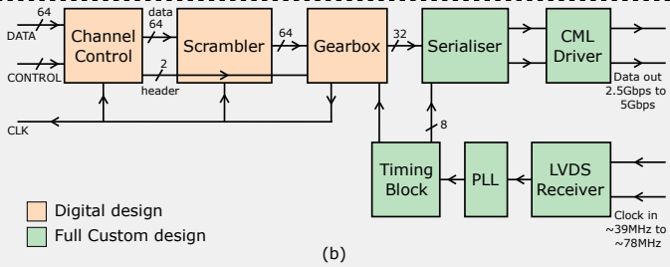
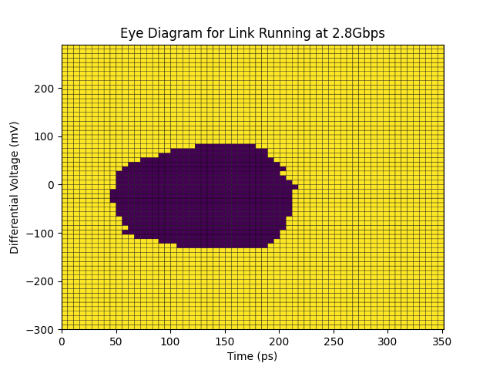
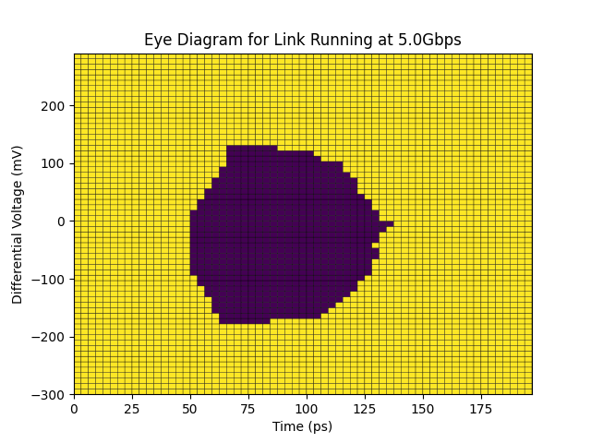
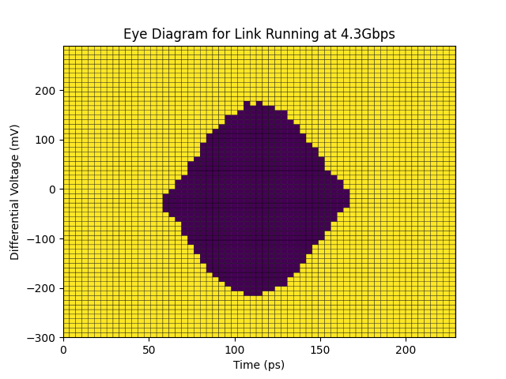
5Gbps Serialiser
Pixel Array
Analogue Readout Chain
Sigma-Delta ADC
5Gbps Serialiser

Slide 25
References

Slide 26
[1] A. Boukhayma, A. Peizerat and C. Enz, "A Sub-0.5 Electron Read Noise VGA Image Sensor in a Standard CMOS Process", IEEE Journal of Solid-State Circuits, vol. 51, no. 9, pp. 2180-2191, 2016. https://doi.org/10.1109/JSSC.2016.2579643
[2] Min-Woong Seo, S. Kawahito, K. Kagawa and K. Yasutomi, "A 0.27e-rms Read Noise 220-μV/e-Conversion Gain Reset-Gate-Less CMOS Image Sensor With 0.11-μm CIS Process", IEEE Electron Device Letters, vol. 36, no. 12, pp. 1344-1347, 2015. https://doi.org/10.1109/LED.2015.2496359
[3] J. Ma and E. Fossum, "Quanta Image Sensor Jot With Sub 0.3e- r.m.s. Read Noise and Photon Counting Capability", IEEE Electron Device Letters, vol. 36, no. 9, pp. 926-928, 2015. Available: 10.1109/led.2015.2456067.
[4] X. Ge and A. J. P. Theuwissen, "A 0.5e_{rms}⁻ Temporal Noise CMOS Image Sensor With Gm-Cell-Based Pixel and Period-Controlled Variable Conversion Gain," in IEEE Transactions on Electron Devices, vol. 64, no. 12, pp. 5019-5026, Dec. 2017, doi: 10.1109/TED.2017.2759787
[5] R. Capoccia, A. Boukhayma and C. Enz, "Experimental Verification of the Impact of Analog CMS on CIS Readout Noise", IEEE Transactions on Circuits and Systems I: Regular Papers, vol. 67, no. 3, pp. 774-784, 2020. https://doi.org/10.1109/TCSI.2019.2951663
[6] M. Sannino, "Sigma-Delta analogue-to-digital converter for column-parallel CMOS image sensors", Masters, Politecnico Milano, 2016, http://hdl.handle.net/10589/123470
[7] B. Hancock, T. Cunningham, K. McCarty, G. Yang, C. Wrigley, P. Ringold, R. Stirbl and B. Pain, "Multi-megarad (Si) radiation-tolerant integrated CMOS imager", SPIE Proceedings, 2001. https://doi.org/10.1117/12.426989
[8] B. Pain, B. Hancock, T. Cunningham, S. Seshadri, C. Sun, P. Pedadda, C. Wrigley and R. Stirbl, "Hardening CMOS imagers: radhard-by-design or radhard-by-foundry", SPIE Proceedings, 2004. https://doi.org/10.1117/12.512278
[9] D. Contarato, P. Denes, D. Doering, J. Joseph and B. Krieger, "Direct detection in Transmission Electron Microscopy with a pitch CMOS pixel sensor", Nuclear Instruments and Methods in Physics Research Section A: Accelerators, Spectrometers, Detectors and Associated Equipment, vol. 635, no. 1, pp. 69-73, 2011. https://doi.org/10.1016/j.nima.2011.01.087
[10] N. Guerrini, R. Turchetta, G. Hoften, R. Henderson, G. McMullan and A. Faruqi, "A high frame rate, 16 million pixels, radiation hard CMOS sensor", Journal of Instrumentation, vol. 6, no. 03, pp. C03003-C03003, 2011. https://www.imagesensors.org/Past%20Workshops/2011%20Workshop/2011%20Papers/R47_Guerrini_RadiationHardTEM.pdf

