Slide 1


ARCADIA MAPS process qualification through the electrical characterization of passive pixel arrays
Thomas Corradino, Gian-Franco Dalla Betta, Coralie Neubüser, and Lucio Pancheri,
on behalf of the ARCADIA collaboration
Advanced Readout CMOS Architectures with Depleted Integrated sensor Arrays
Notes:
Today, I will speak on behalf of the ARCADIA collaboration
What I’m going to talk about today is the current status of the characterization of the passive pixel arrays included in the first engineering run of the ARCADIA project showing a comparison between experimental data and TCAD simulation results

Slide 2
Outline
Sensor concept
ARCADIA test structures
Electrical characterization
Laser characterization
Conclusions
Notes:
I’ve divided my talk in the following way:
1) First, I will give you an overview of the ARCADIA project and of the sensor concept
2) then, I will show you the layouts of the measured test structures and produced wafer types
3) and we will have a look at some simulation and experimental results concerning the electrical and the laser characterization of the devices
5)Finally I will draw my conclusions highlighting some relevant results we obtained
So, let’s begin with an overview of the ARCADIA project ->

Slide 3
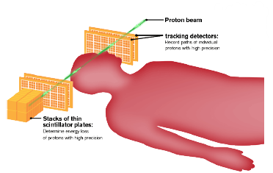
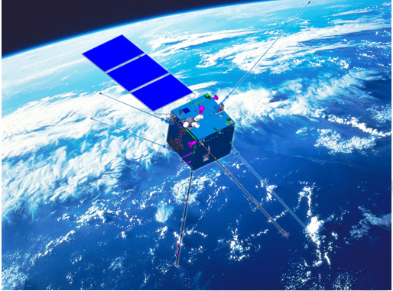
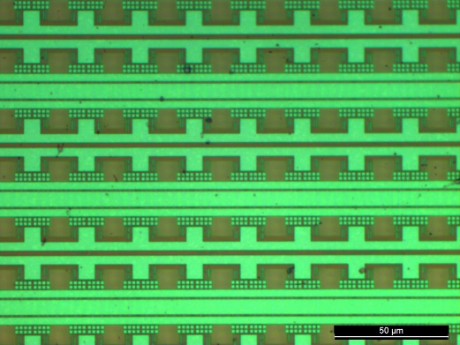
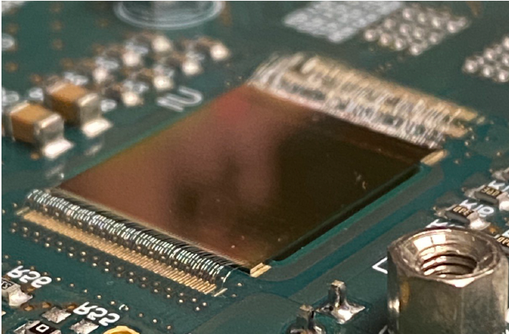
ARCADIA Project
Fully depleted MAPS
Target applications:
  medical imaging (e.g. PCT)
  particle detection on satellites
  HEP experiments
Piero Giubilato
Andrea Paternò, Vertex 2021
ARCADIA MD1 chip
CSES-01
http://cses.roma2.infn.it
Main Demonstrator (MD1) with sensor array composed of 512x512 pixels with 25µm pixel pitch
Embedded analog and digital frontend electronics
Samples from 1st engineering run (mid 2021), 2nd engineering run (beginning of 2022), 3rd engineering run submission (mid 2022)
MD1 chip micrograph
Notes:
The design of the first engineering run focused on some Target applications -> A main demonstrator chip is currently under test and includes a matrix composed by ¼ megapixels with embedded analog and digital frontend electronics
Now, let’s have a look at the sensor concept –>

Slide 4
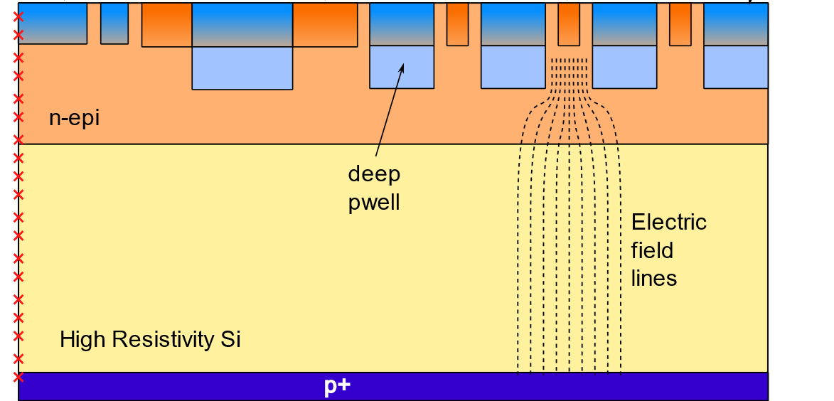
Sensor concept
N-collection electrodes
Produced with commercial CMOS 110nm process (LFoundry)
High resistivity silicon substrates
N-type epitaxial layer to delay the onset of the punch through
Operation in full depletion condition
Independent frontside and backside bias electrodes
External pwell
N-guard rings
Internal
pwell
Notes:
The sensor technology is fully compatible with a commercial 110nm CMOS production process. This tech. Was developed in collab. with LFoundry
In the figure at the left representing a schematic cross section of the sensor, we can observe that on top of…

Slide 5
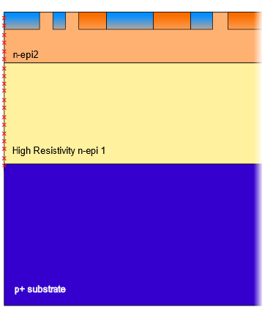
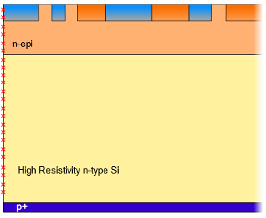
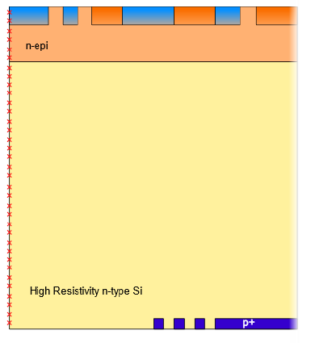


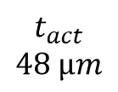
Substrate types
Type 1
Type 2
Type 3
$$t_{act}$$
$$48 µm$$
$$t_{act}$$
$$100 µm$$
$$t_{act}$$
$$200 µm$$
Bias only from the bottom
Possibility to apply the bias from the top and from the bottom
Notes:
Wafers with three different substrate types have been produced
Type 1 -> p+ substrate + nepi
Type 2 -> n substrate + p+ implant on back
Type 3 -> n substrate + backside litography
I will now show you how the layout of the produced passive pixel arrays looks like

Slide 6
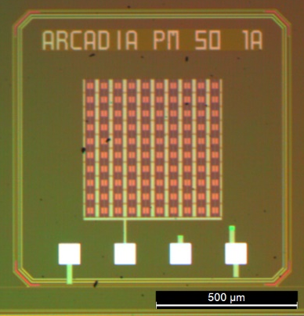
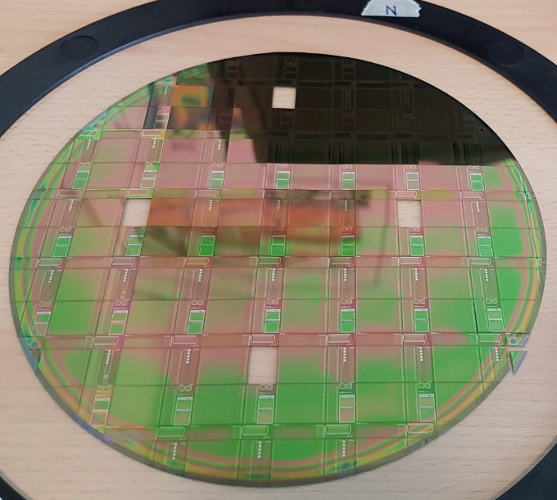
ARCADIA Test Structures
Chip frontside electrodes
  External pwell
  N-type sensor nodes
  Internal pwell
  N-guard rings
N
4 different positions:
N, E, S and W
Evaluate the variability
due to the production
process
W
E
S
Passive TS chip
  50µm pixel matrices
  25µm pixel matrices
Notes:
Electrodes description -> test matrices with differents pixel size and layout were included on a test chip where we characterized Pix. Arrays with diff. pix. Pitch and layouts
After showing you the layout of the tested chips, I will present you the results obtained from the electr. Charact. Of the large pixel arrays with 50 and 25 um pitch->

Slide 7
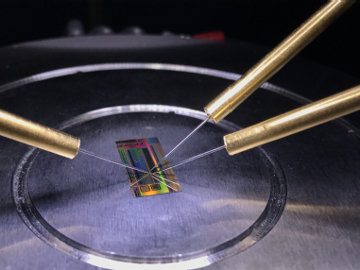
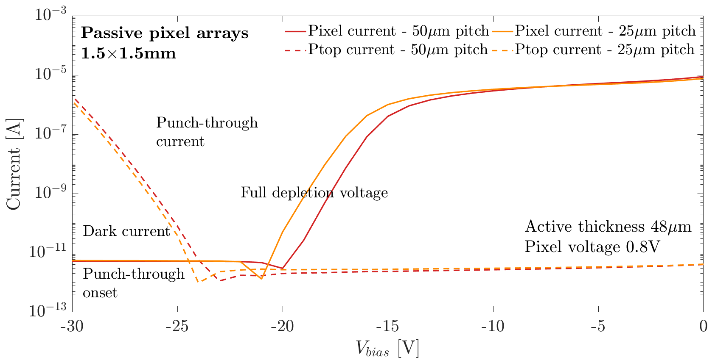
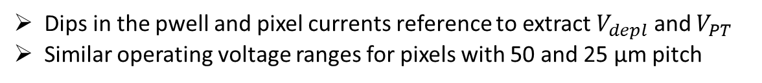
Electrical characterization – IV curves
Dips in the pwell and pixel currents reference to extract $V_{depl}$ and $V_{PT}$
Similar operating voltage ranges for pixels with 50 and 25 µm pitch
2
Coralie Neubüser, TIFPA-INFN
Operating range
Notes:
In the plots at the right side of the slide is reported as an example a comparison of the IV curves of the frontside n sensor nodes and of the frontsdie internal pwell for the TM With 50um and 25um pix. Pitch coming from waf. with 48um substrate thickness
Dip in the curves taken as ref for the PT and full depletion extr.
Operating voltage range -> difference punch through voltage and depletion voltage

Slide 8
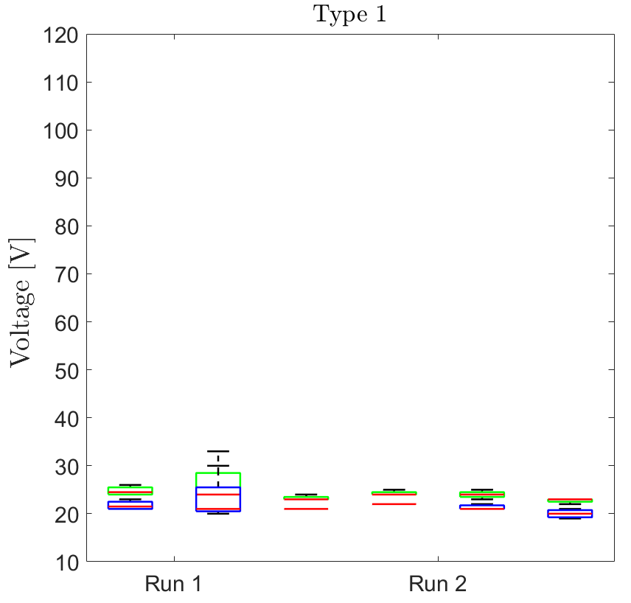
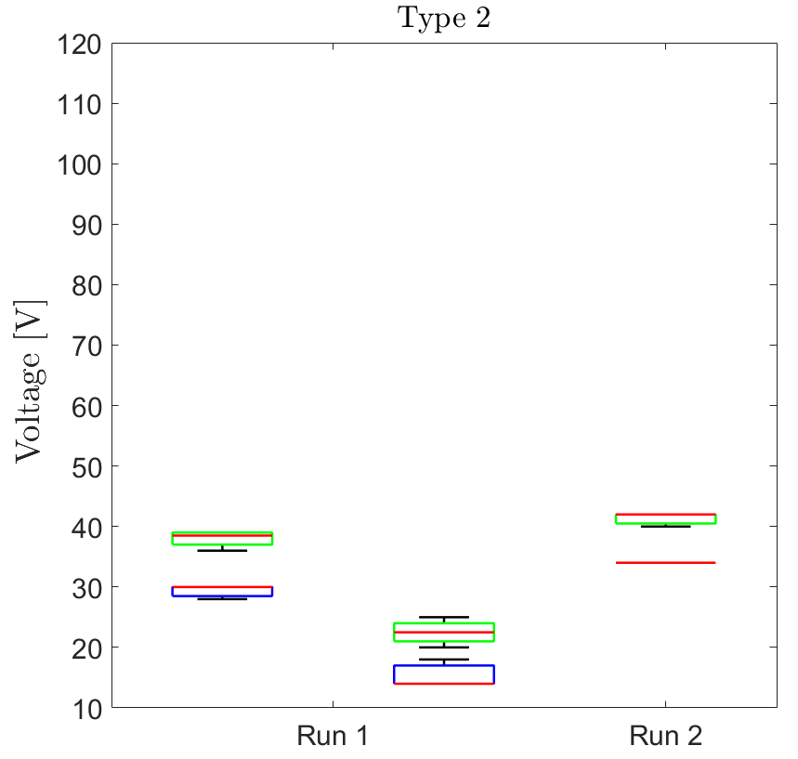
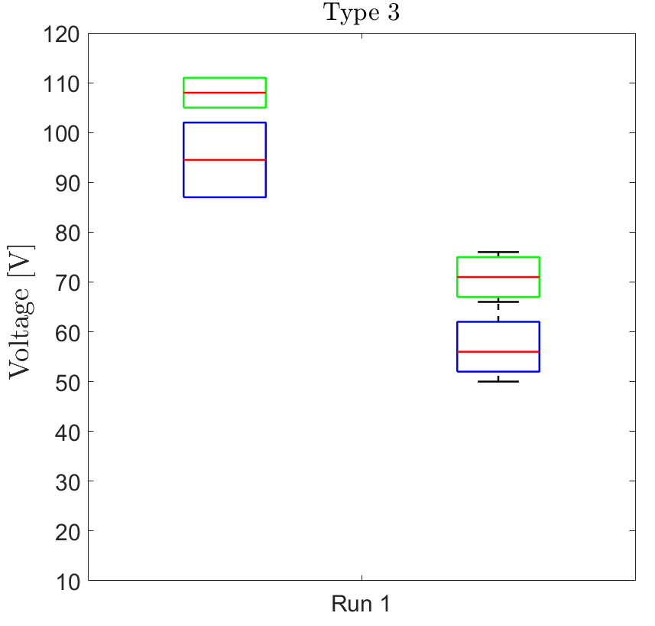



PT and Depl. – Bias from bottom
$$V_{bias}$$
$$V_{bias}$$
$$V_{bias}$$
Two different epitaxial layer thicknesses in Type 2 and Type 3 wafers of Run 1
Type 1 wafers showed low $V_{depl}$ and $V_{PT}$ variability
Notes:
Boxplots showing the variability in the measured PT and full depletion voltages for the wafers of the three different types produced in both eng. Runs
The values reported in the plots refer to measurements with the bias applied to the bottom electrodes
Computing the difference between the obtained Vpt and Vdepl -> extract the operating voltage range

Slide 9
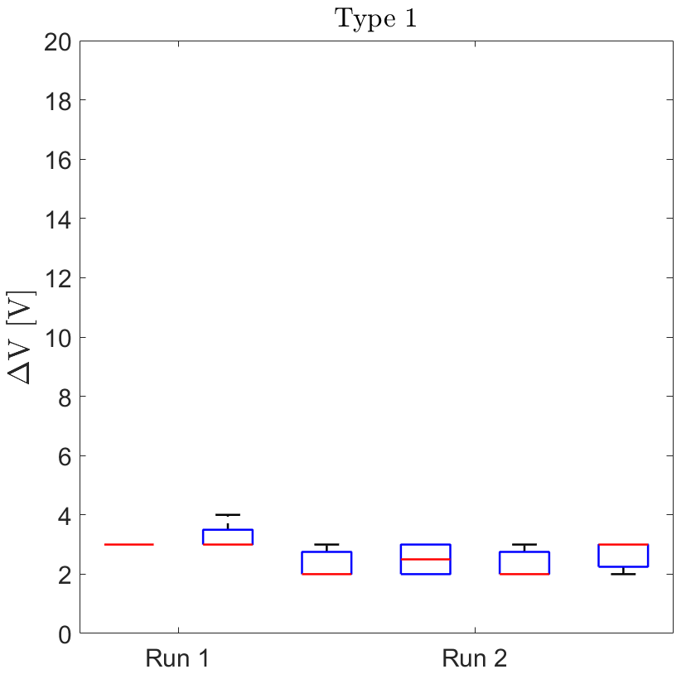
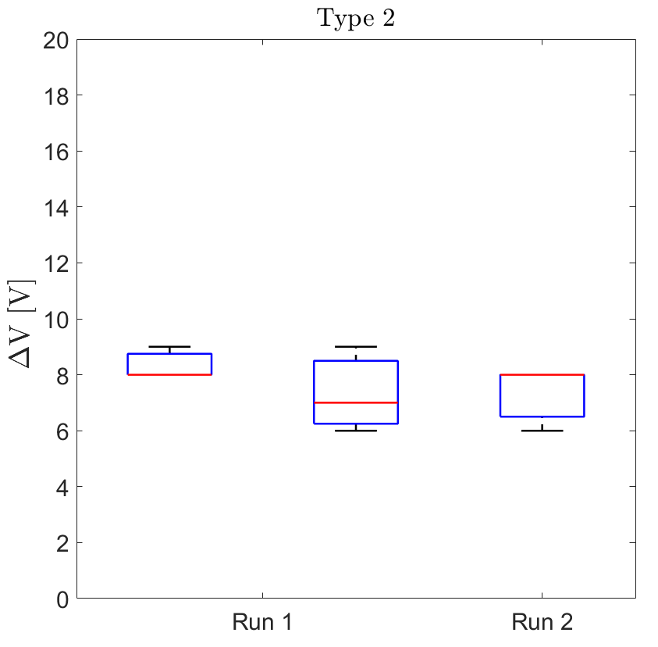
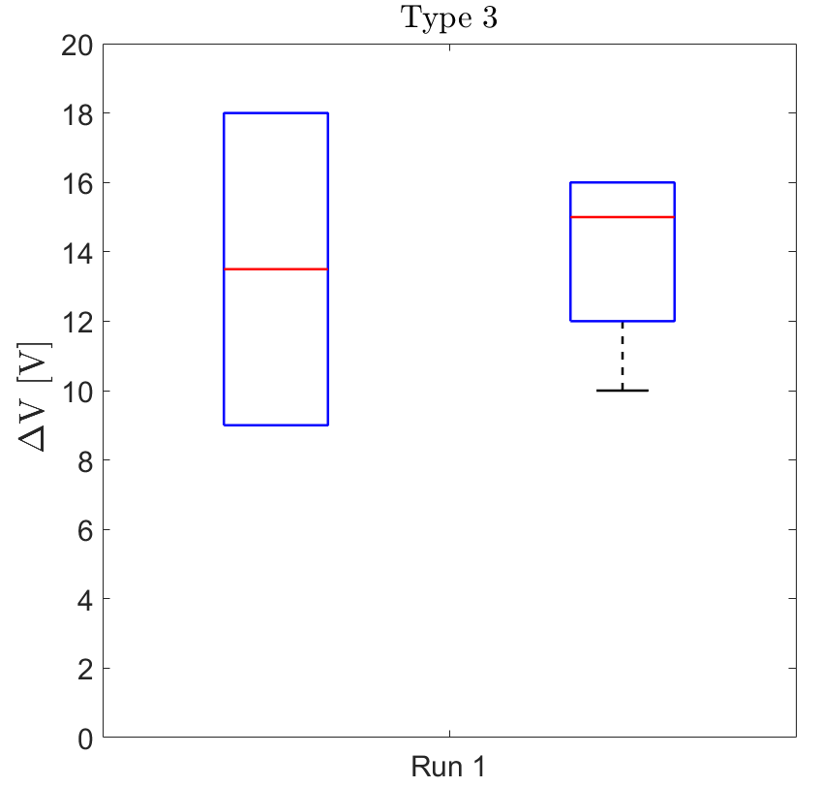


Operating range – Bias from bottom
$$V_{bias}$$
$$V_{bias}$$
$$V_{bias}$$
Larger operating voltage range for increasing substrate thicknesses

Slide 10
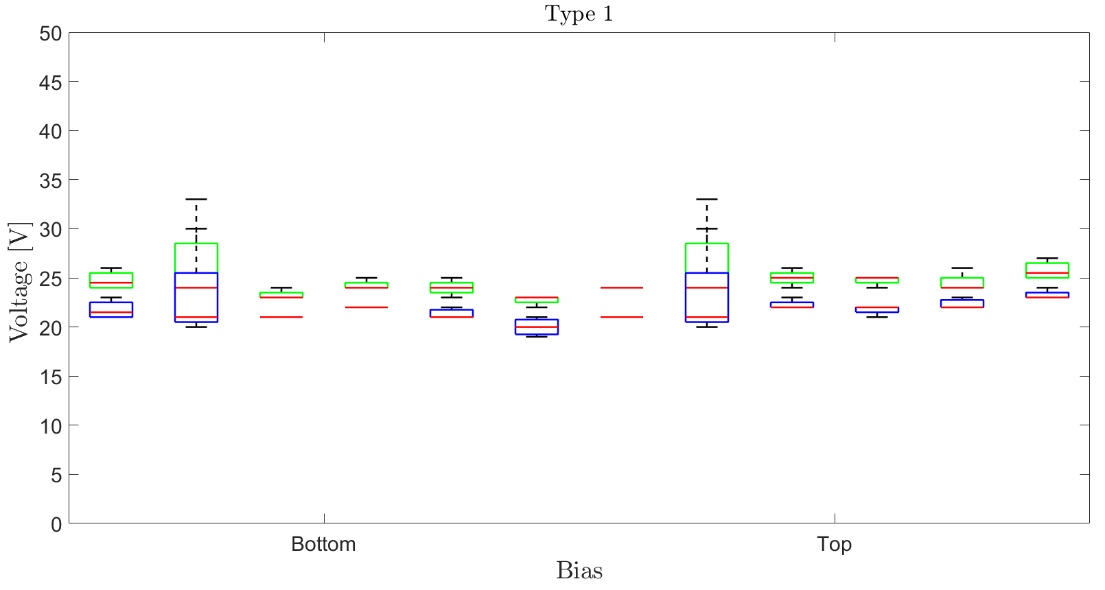
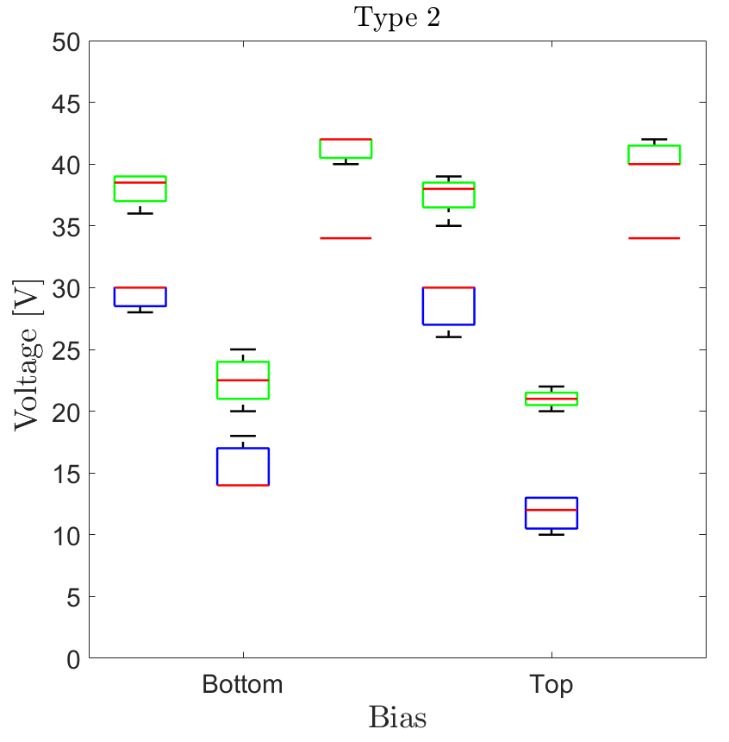





PT and Depl. – Comparison of biasing schemes
$$V_{bias}$$
$$V_{bias}$$
$$V_{bias}$$
$$V_{bias}$$
Small differences in the obtained $V_{depl}$ and $V_{PT}$ for the two considered biasing schemes

Slide 11
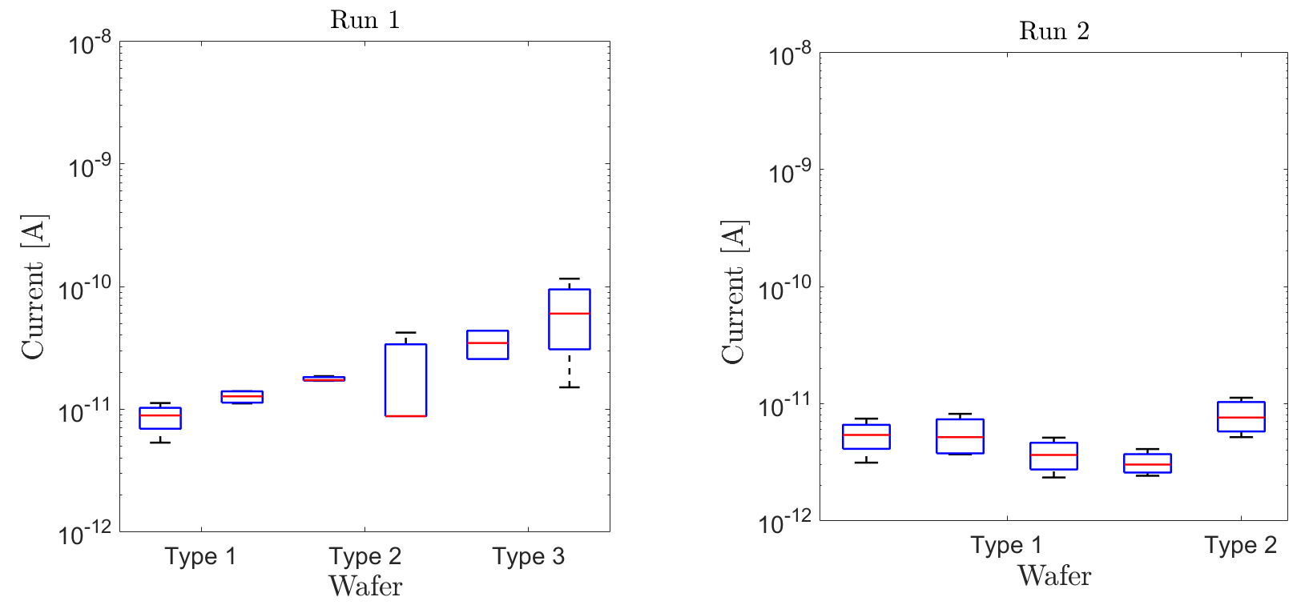
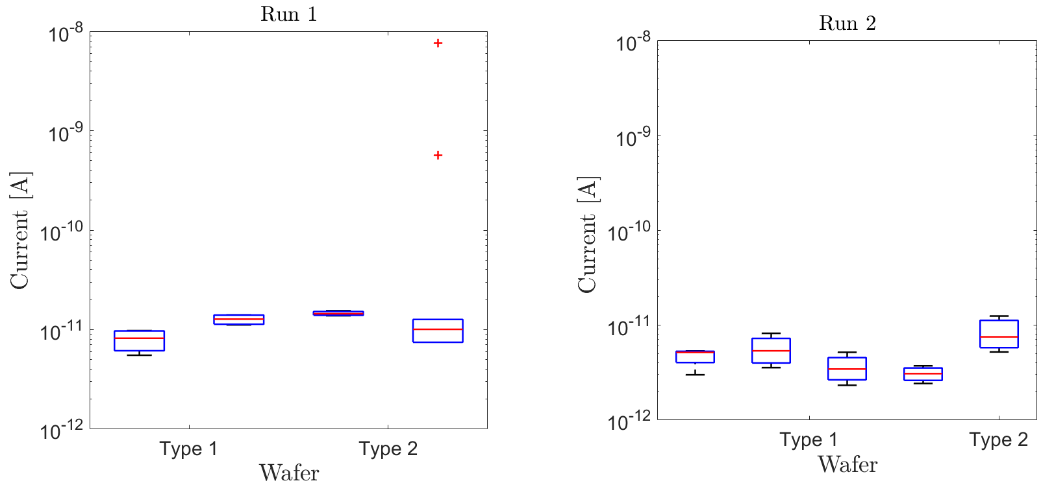
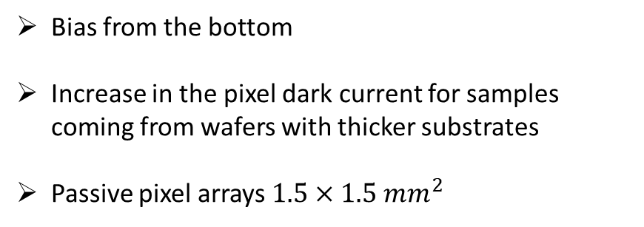
Pixel dark current
Bias from the top
Good uniformity in the dark current values measured in samples coming from wafers of same type
Bias from the bottom
Increase in the pixel dark current for samples coming from wafers with thicker substrates
Passive pixel arrays $1.5×1.5 mm^{2}$

Slide 12
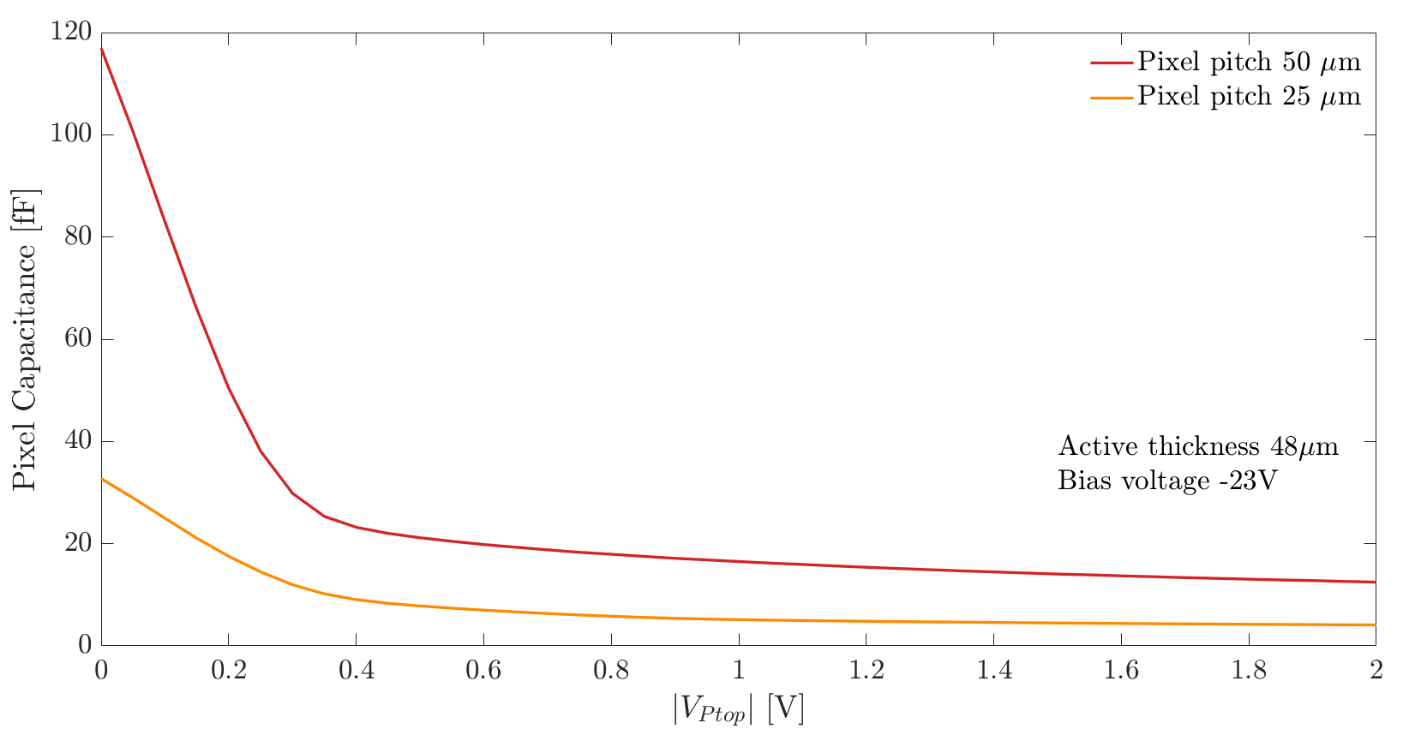


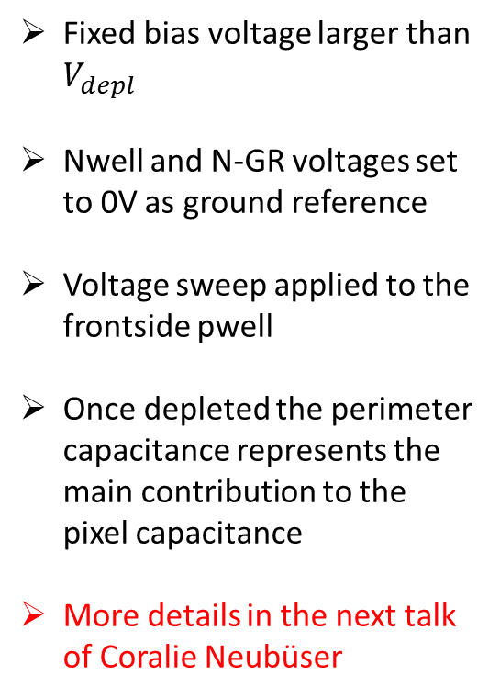


Electrical characterization – CV curves
Fixed bias voltage larger than $V_{depl}$
Nwell and N-GR voltages set to 0V as ground reference
Voltage sweep applied to the frontside pwell
Once depleted the perimeter capacitance represents the main contribution to the pixel capacitance
More details in the next talk of Coralie Neubüser
$$V_{NGR}$$
$$V_{Pwell}$$
$$V_{Nwell}$$
$$V_{bias}$$

Slide 13
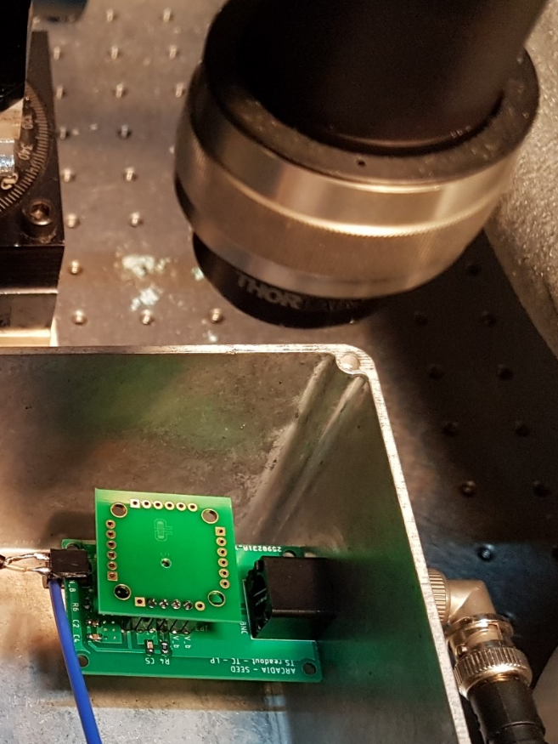
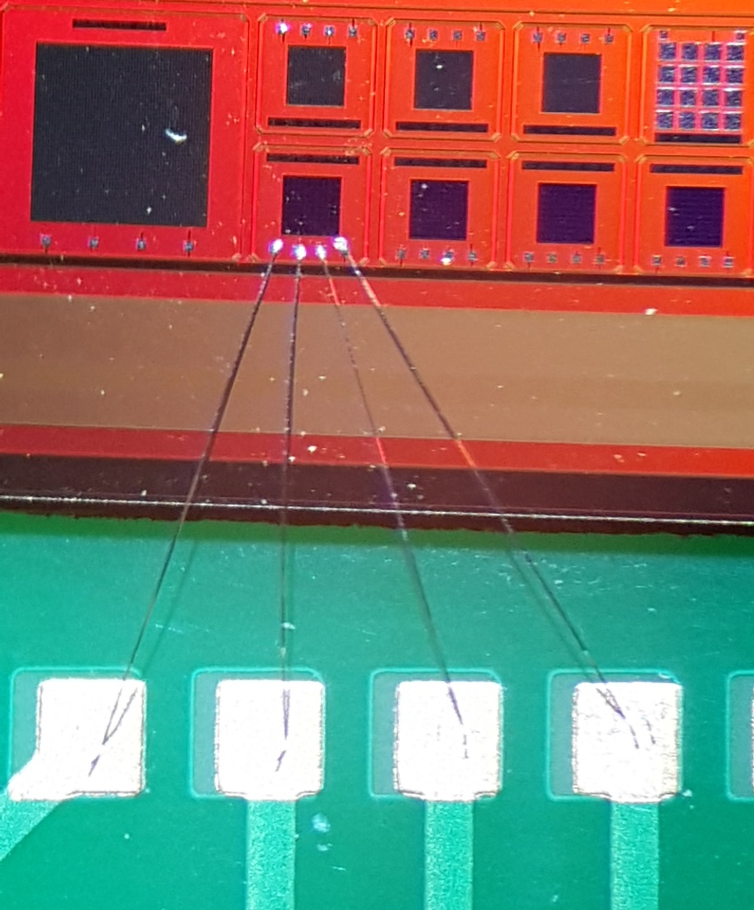
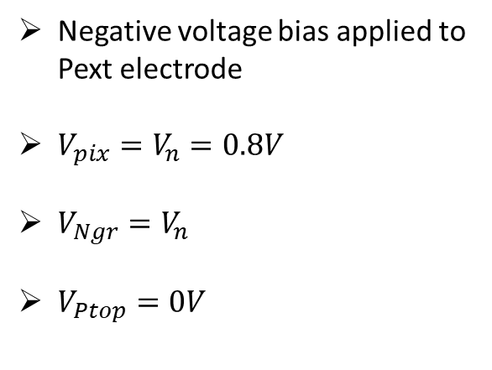
Biasing scheme & Laser setup
Negative voltage bias applied to Pext electrode
${V_{pix}=V}_{n}=0.8V$
$V_{Ngr}=V_{n}$
$V_{Ptop}=0V$
Red laser (660nm) with 350ps pulse
at FWHM
Infrared laser (1060nm) with < 100ps pulse at FWHM (Alphalas)
External commercial amplifier with 1GHz bandwidth
Pext
Pix
Ptop
Ngr
Notes:
Chip bonded with wire bonding on passive pcb and then we applied through the PCB the biasing scheme that is reported in the slide
Employing the described test setup we evaluated the dynamic behaviour of the devices with different pixel pitch and layouts ->

Slide 14
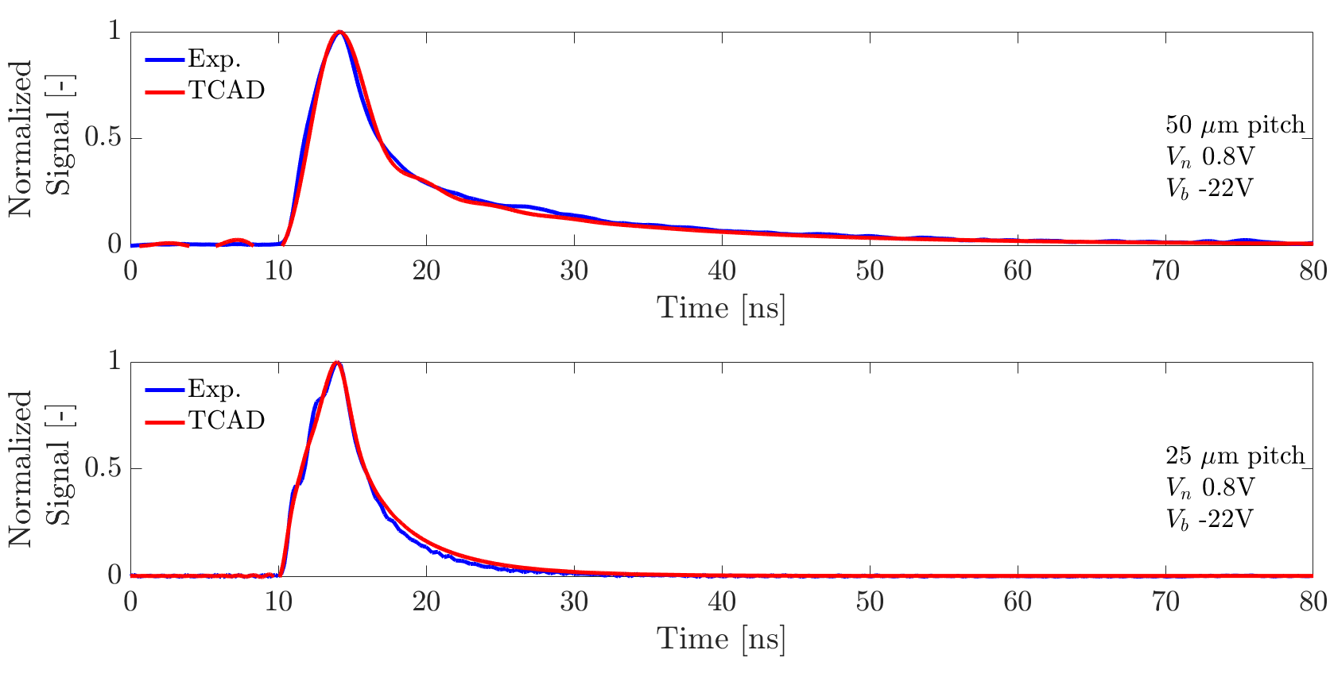
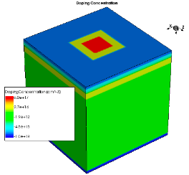
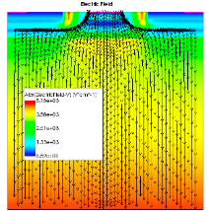
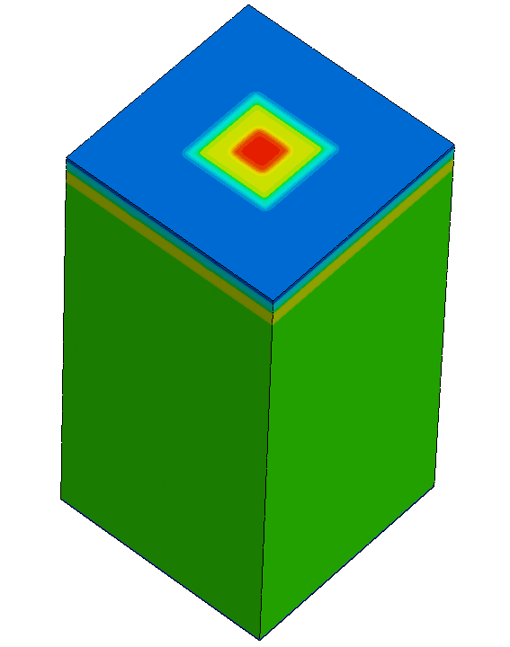
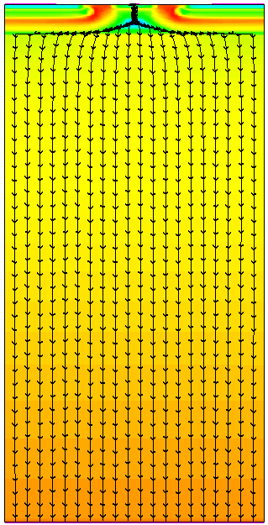
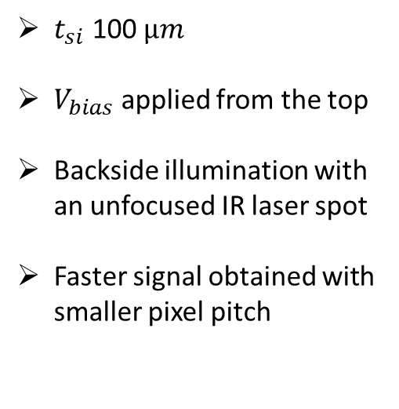
IR laser - PM 50 & PM 25
$t_{si}$ 100 $µm$
$V_{bias}$ applied from the top
Backside illumination with an unfocused IR laser spot
Faster signal obtained with smaller pixel pitch
Notes:
we illuminated the pixel arrays from the backside Using an unfocused laser spot with an unfocused IR laser spot which covers a significative amount of the matrix area
We compared the measured signals with the ones obtained from TCAD simulatons where a monochromatic light source, with same wavelenght of the laser, was used to illuminate the backside of a 3D single pixel domain
We applied then a digital filter on the simulated data in order to reproduce the internal lowpass filter of the digital oscilloscope and of the amplifier
Looking at the comparison in the graph we can state that we obtained an excellent agreement between the simulated and measured signals

Slide 15
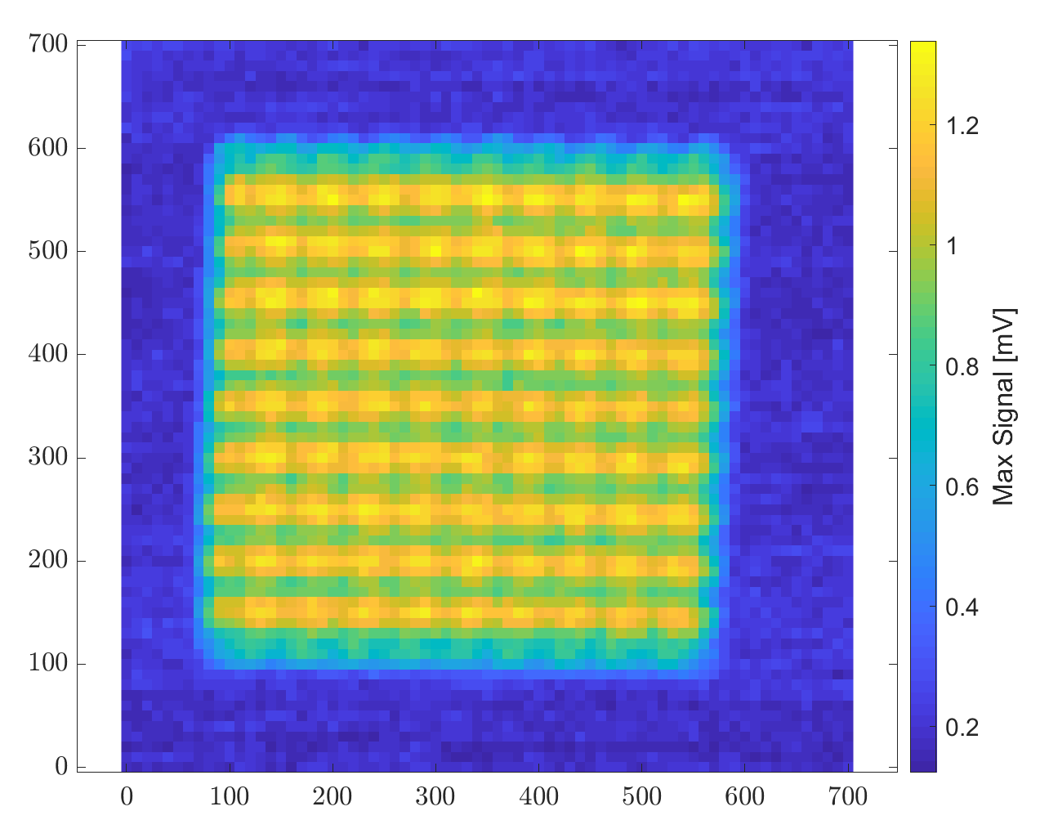
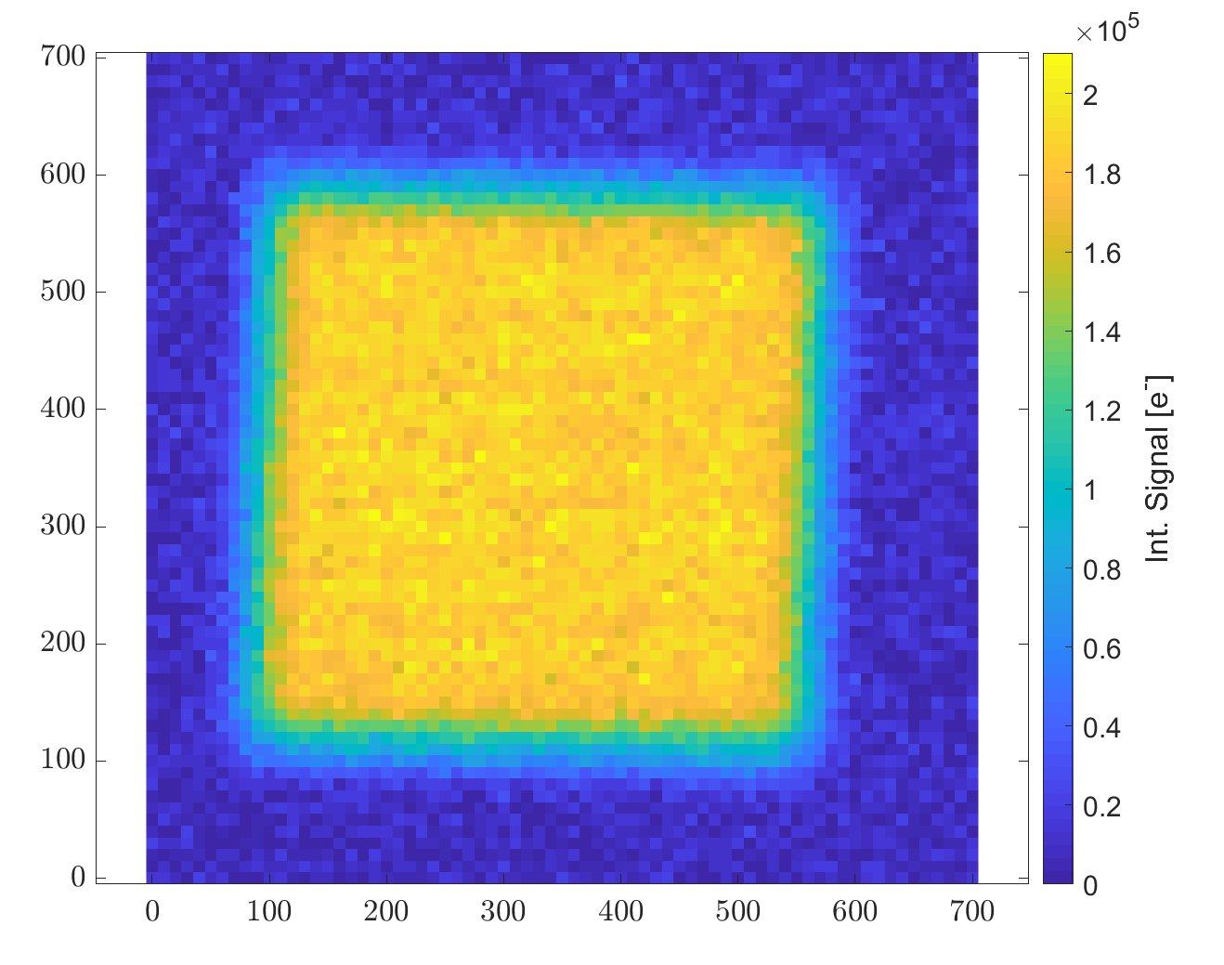
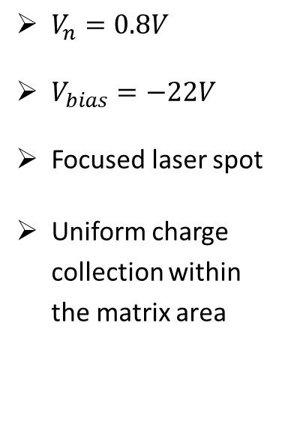
Red laser scan - PM 50
Maximum signal
Integrated signal
$V_{n}=0.8V$
$V_{bias}=−22V$
Focused laser spot
Uniform charge collection within the matrix area
10 µm motor step
Notes:
The resulting maps show a better contrast between the signals acquired at the pixel centre and side and the charge collection proved to be uniform within the matrix area if we look at the map of the integr. signal
So, this brings me to my conclusions

Slide 16
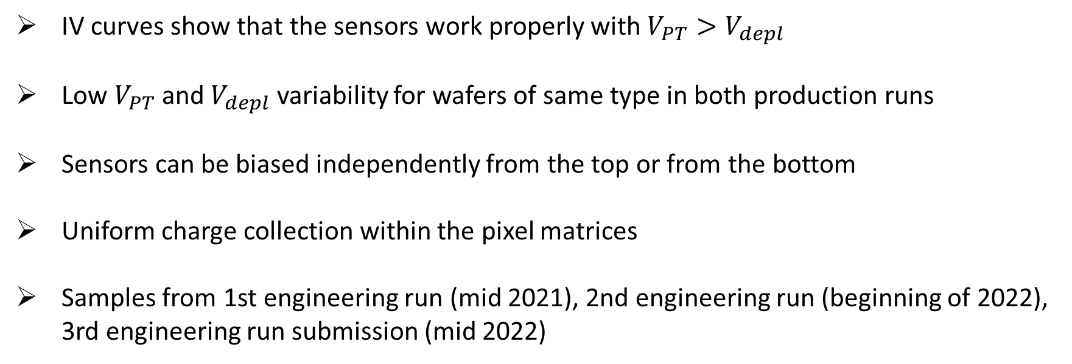
Conclusions
IV curves show that the sensors work properly with $V_{PT}>V_{depl}$
Low $V_{PT}$ and $V_{depl}$ variability for wafers of same type in both production runs
Sensors can be biased independently from the top or from the bottom
Uniform charge collection within the pixel matrices
Samples from 1st engineering run (mid 2021), 2nd engineering run (beginning of 2022), 3rd engineering run submission (mid 2022)
Notes:
The sensors proved to work properly showing a Vpt > than Vdepl
The measurements showed a low Vpt and Vdepl variability
Both biasing schemes worked properly
Uniform charge collection within the pixel matrix
I would like to conclude saying thanks to the members of the ARCADIA collaboration for their contributions and thaks for your attention!

Slide 17
The ARCADIA collaboration
F. Alfonsi, G. Ambrosi, A. Andreazza, G. Andrini, E. Bianco, G. Balbi, M. Barbanera, S. Beolè, C. Bonini, J. Cai, M. Caccia, A. Candelori, D. Chiappara, F. Cossio, S. Cometti, T. Corradino, T. Croci, M. Da Rocha Rolo, G. F. Dalla Betta, A. De Angelis, G. Dellacasa, N. Demaria, L. De Cilladi, B. Di Ruzza, A. Di Salvo, S. Durando, D. Falchieri, C. Ferrero, A. Gabrielli, L. Gaioni, S. Garbolino, G. Gebbia, R. A. Giampaolo, N. Giangiacomi , P. Giubilato, R. Iuppa, M. Mandurrino, M. Manghisoni, M. Mignone, S. Mattiazzo, C. Neubüser, F. Nozzoli, L. Pancheri, D. Passeri, A. Paternò, M. Pezzoli, P. Placidi, L. Ratti, E. Ricci, S. B. Ricciarini, A. Rivetti, R. Santoro, L. Servoli, S. Tedesco, G. Torilla, G. Traversi, C. Vacchi, R. Wheadon, J. Wyss, P. Zuccon
Thank you for your attention!
Notes:
If you have any question please ask me.

Slide 18
Backup
Notes:
If you have any question please ask me.

Slide 19
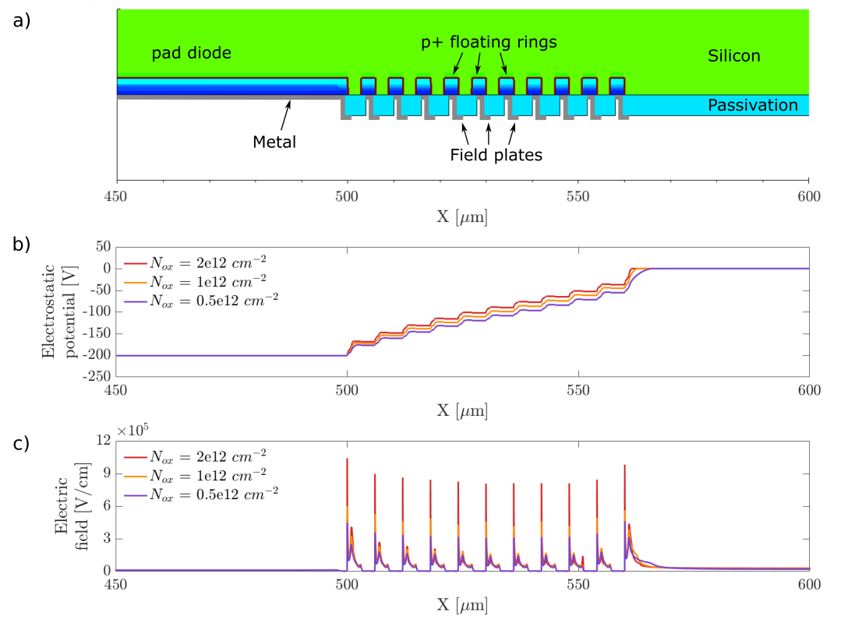
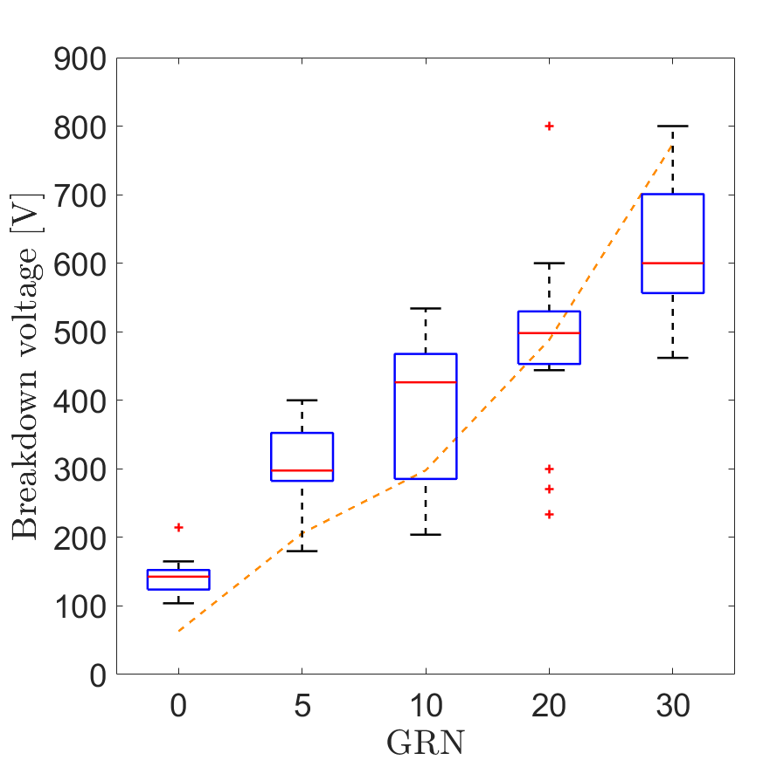
Electrical characterization – Breakdown
Sensors 2021, 21, 3809
Backside diodes with
variable guard ring
number
Good agreement
between simulations
and experimental
results
Sensors 2021, 21, 3809
Notes:
TCAD simulations with variable backside floating guard ring number have been performed -> smoother transition of electrostatic potential and electric field peaks in correspondence of the field plates ends
A group of backside diodes with variable floating guard ring number has been tested to determine the breakdown voltage of the backside junction and compare the experimantal results with TCAD simulations

