Slide 1
Results from Single Event Effect Tests with MIMOSIS-1
Benedict Arnoldi-Meadows
for the CBM-MVD Collaboration
IWORID2022, June 28th, 2022.

Slide 2
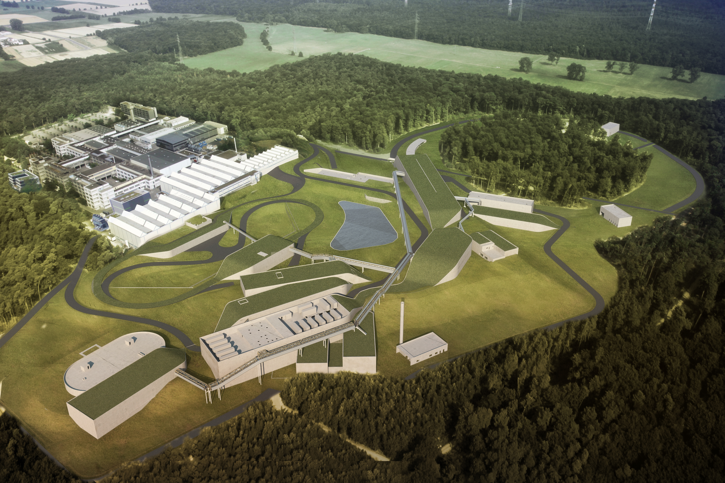
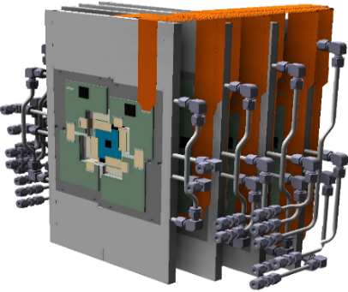
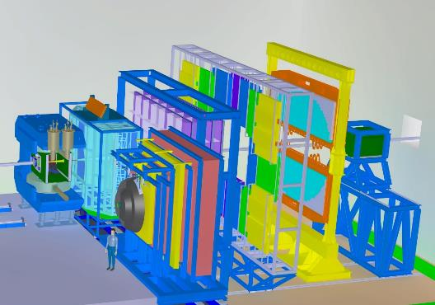
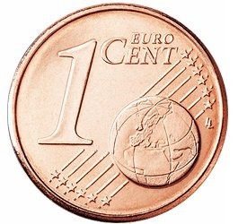
The CBM Micro Vertex Detector (MVD)
CBM-MVD
CBM
The CBM – MVD will operate at:
100 kHz Au+Au collisions (10 MHz beam)
10 MHz p + Au collisions
Beam hole: 11mm
Todays topics:
What if the beam ions miss the hole?

Slide 3
Requirements on the MIMOSIS sensors
 | Requirement
Spatial / time resolution | ~5 µm / 5 µs
Sensor thickness | ~50 µm
Radiation doses (non-ionizing) | ~ 7 x 10¹³ n_{eq}/cm²
Radiation doses (ionizing) | ~ 5 MRad
Rate capability (mean/peak) | (20/80) MHz/cm²
Readout mode | Continuous
Established by ALPIDE
(Sensor of ALICE ITS2 upgrade)
~10 x ALPIDE
Incompatible with ALPIDE
> 20x internal bandwidth needed
Idea:
Get inspiration from ALPIDE:
Re-use pixel analog front-end.
Re-use priority encoder.
Complement design with:
High bandwidth internal DAQ.
Fully depleted pixels ( > 20 V top bias).
…
MIMOSIS-0 (2018)
Confirm (depleted) pixels and priority encoder
MIMOSIS-1 (2020)
Full size prototype, this work
MIMOSIS-2 (2022)
Advanced rad. hardening, data compression…
MIMOSIS-3 (2023/24)
Final sensor

Slide 4
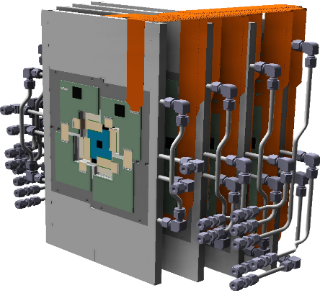
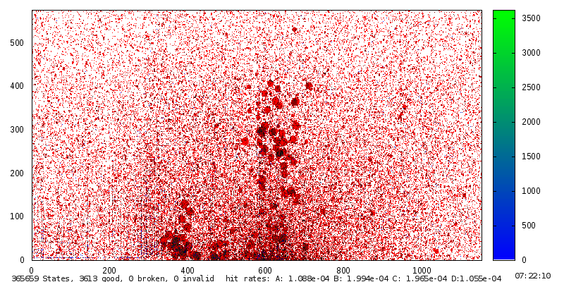
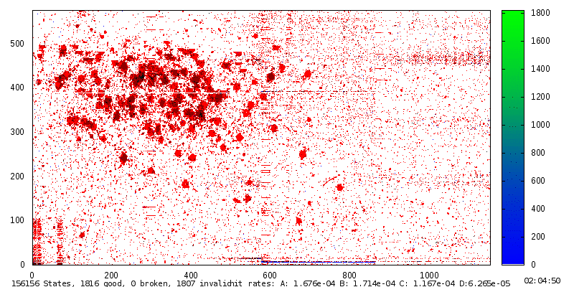
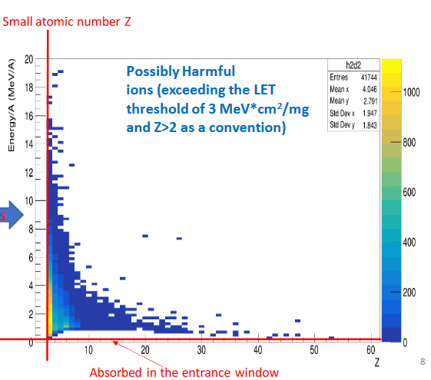
Origin of heavy ion impacts
Beam halo
Origin: Limited focus - few ions miss hole all the time.
Our assumptions:
  Geometry still (measured at SPS – NA61/SHINE)
  Assume 1 kHz/cm² thanks to collimators.
1 cm
Beam
~2x2 mm
M. Deveaux for NA61/SHINE, SQM 2017
Heavy ion:
~200 fired pixels
Beam hole: 11 mm
MIP (proton)
~2 fired pixels
SPS Pb beam halo @ NA61/SHINE
as seen with MIMOSA-26
Beam loss
Direct beam impact to MVD due to steering fail.
Highest rate: ~300 MHz/cm² Au ions in MVD
Target fragments
Nuclear fragments kicked out of target by beam.
Very slow: Absorbed by first station.
Highest energy transfer: 35 MeV cm²/mg
More information on simulation:
H. Darwish, CBM Progress Report 2020

Slide 5
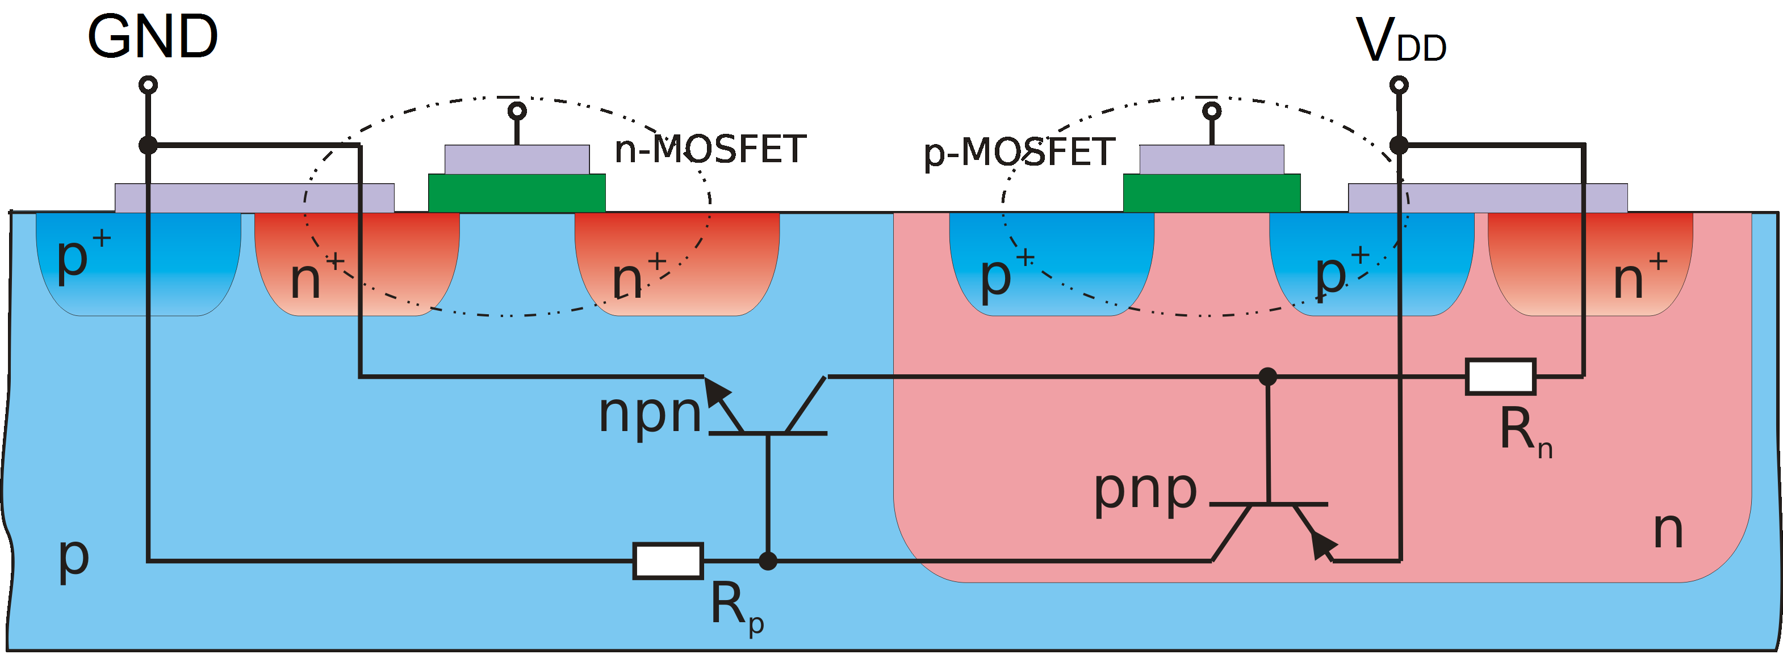
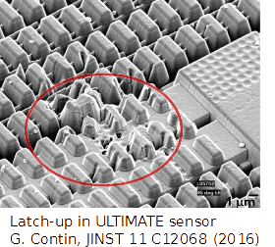
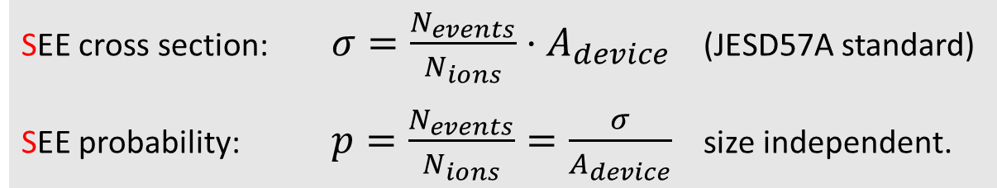
Effect of heavy ion hits on electronics
Heavy ions show high dE/dx or LET:
Scales with z² of the projectile => Au = 6200 M.I.P
Bethe Bloch: "Slow" ions create higher LET than relativistic ions.
Latch-up: Vulnerable structure
Unwanted current
Minority charge carriers excited by ions may:
Break transistor gates => Gate rupture
Switch digital electronics => Bit flip
Open unwanted conduction paths => Latch-up
(like short cut, extinguish by power cycle)
Macroscopic damage by individual ion: Single Event Effect.
Irreversible destruction
Malfunction if ignored
Thermal destruction if ignored
SEE cross section: $σ=\frac{N_{events}}{N_{ions}}⋅A_{device}$ (JESD57A standard)
SEE probability: $p=\frac{N_{events}}{N_{ions}}=\frac{σ}{A_{device}}$ size independent.

Slide 6
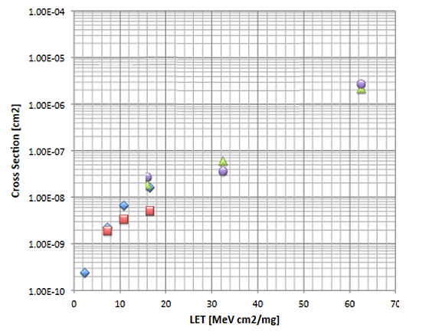
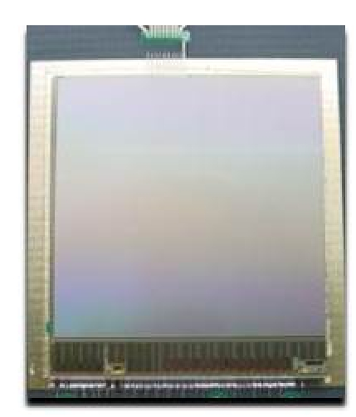
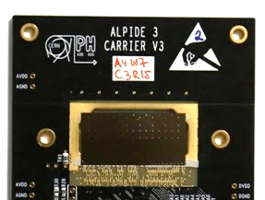

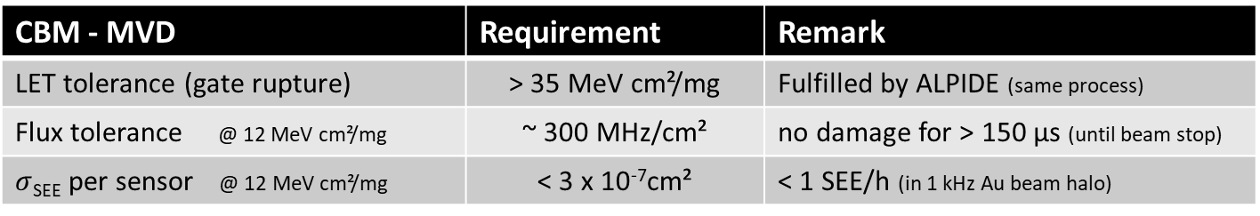

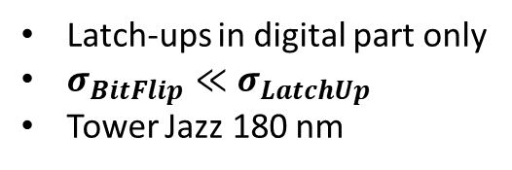
What do we know?
ULTIMATE for STAR PXL detector
ALPIDE for ALICE-ITS2
Data: ALPIDE measured
(may not represent final sensor)
CBM: Min LET
CBM: Max $σ_{SEE}$
Latch-ups for particles with
LET > 3 MeV cm²/mg.
Sensor destruction during experiment observed.
Old AMS 0.35 µm process
H. Hillemanns, https://tinyurl.com/23dn8pdy, retrieved 10.06.2022
Latch-ups in digital part only
$σ_{BitFlip}≪σ_{LatchUp}$
Tower Jazz 180 nm
CBM - MVD | Requirement | Remark
LET tolerance (gate rupture) | > 35 MeV cm²/mg | Fulfilled by ALPIDE (same process)
Flux tolerance @ 12 MeV cm²/mg | ~ 300 MHz/cm² | no damage for > 150 µs (until beam stop)
$σ$_{SEE} per sensor @ 12 MeV cm²/mg | < 3 x 10⁻⁷cm² | < 1 SEE/h (in 1 kHz Au beam halo)
ALPIDE: Valuable guideline (same Tower Jazz 180 nm process as MIMOSIS).
But: MIMOSIS has different digital electronics => Must remeasure.

Slide 7
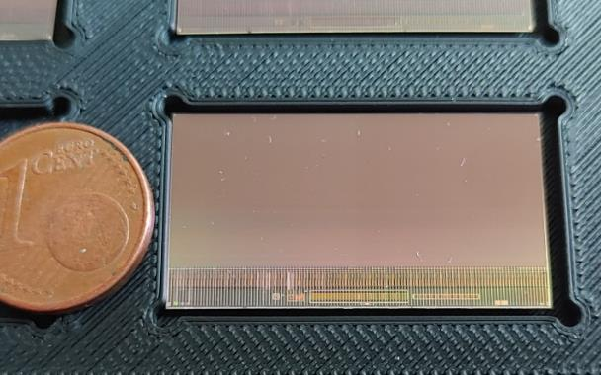

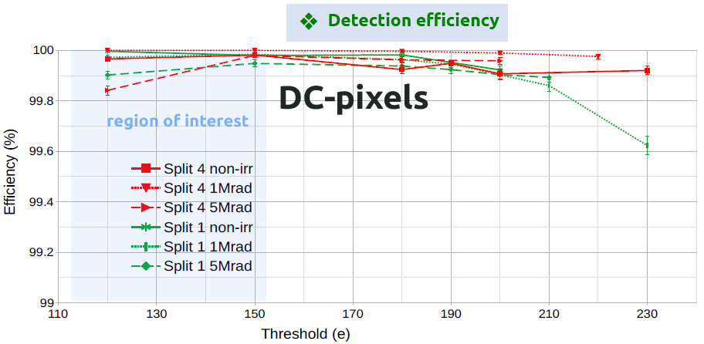
The sensor under test: MIMOSIS-1
MIMOSIS – 1 in-beam performance
MIMOSIS-1, 60µm thick
produced in TowerJazz CIS 180nm process
Dark rate: < 1e-6
 | MIMOSIS - 1
Spatial/time resolution | ~5 µm/5 µs
Thickness | 60 µm
Rate (average/peak) | 20 / 80 MHz/cm²
Pixel | > 20V top bias fully depleted
More Details: H. Darwish, poster 137, this conference.
Hardening strategy for MIMOSIS:
"Latch up" protective design rules.
Bit error correction for important status registers (Hamming encoding).
Triple retundancy of important state machines (future MIMOSIS-2).
Data registers remain unprotected.

Slide 8
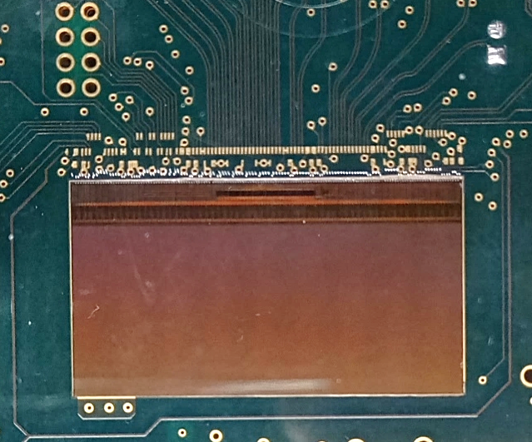
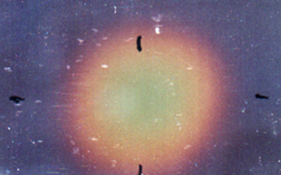
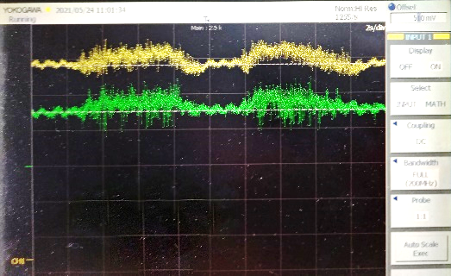
Initial experimental strategy
Approx.
Beam spot
Information available to experimenters
PC
Current [a.u.]
Dosimetry foil
Time [2s/div]
Oscilloscope
Slow control
I_{Digital}
Latch-up protection PCB
Voltage signal proportional to currents
I_{Analog}
Latch-up detection/protection:
Over-current detection.
Automatic shut down, manual counting.
Bit flip detection:
No/few bit flips expected.
Manual read-back of slow control data.
Beam line | Beam | LET
GSI (mCBM) | Pb, 1.05 A GeV | 12 MeV cm² / mg
GSI (mCBM) | Xe, 1.3 A GeV | 5 MeV cm² / mg
Few hours in
Parasitic mode
Beam intensity up to 20 MHz/cm²
Dosimetry: Beam instrumentation, foil (both not really accurate)

Slide 9
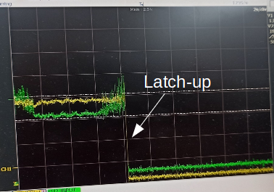
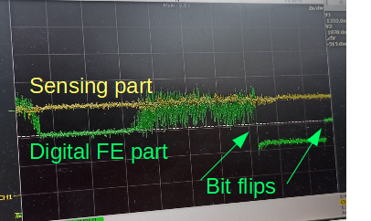
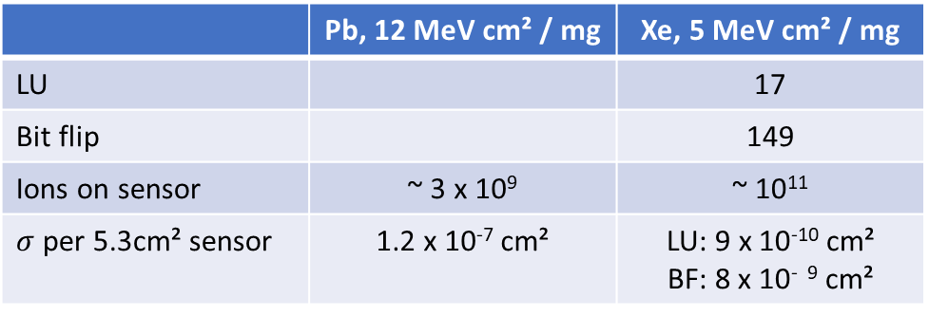
Observations (~ 1 A GeV ions)
Expected:
"Latch-ups"
Not expected:
Bit flips exist and modify currents.
=> False LU – signatures?
I
10s
t
 | Pb, 12 MeV cm² / mg | Xe, 5 MeV cm² / mg
LU |  | 17
Bit flip |  | 149
Ions on sensor | ~ 3 x 10⁹ | ~ 10¹¹
$σ$ per 5.3cm² sensor | 1.2 x 10⁻⁷ cm² | LU: 9 x 10⁻¹⁰ cm² BF: 8 x 10⁻ ⁹ cm²
71
LU if not recoverable with soft reset.
BF if recoverable with soft reset.
Uncertainty rough factor 3 (dosimetry)
preliminary
LU cross section seems in acceptable range.
High bit flip cross-section.
Bug in Hamming Code implementation. Fixed in MIMOSIS-2.
Recovery may require hard reset…
Results match requirements. Sensor bug spotted and fixed.
Hard to distinguish BF and LU, major bias possible.

Slide 10
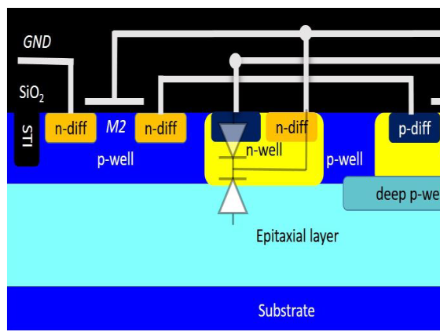

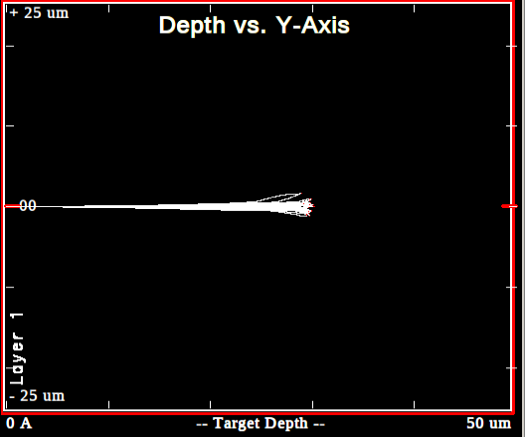
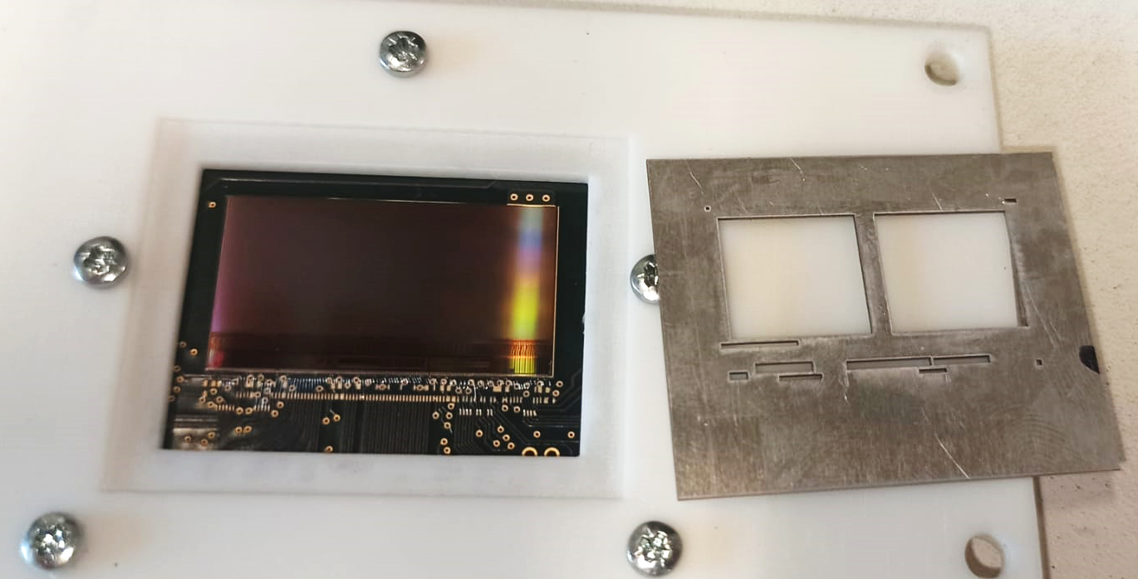
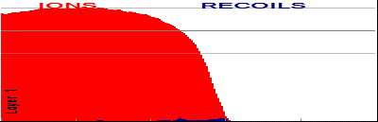
Test at GSI - M3 beam line
 | M3 @ GSI UNILAC
Energy / ion type | 3.2 A MeV Ca
Beam spot | 1.5 x 1.5 cm² mostly uniform
Beam time structure | 5 Hz pulses of 6 ms
Beam intensity (mean) | ~ 10⁷ Hz/cm²
Beam intensity (pulse) | 400 MHz/cm²
Dosimetry | Dedicated installation
Substrate
Not fully to scale
Low beam energy: Sufficient to reach vulnerable structures?
OK
500
3.3 AMeV Ca
on Si (SRIM)
LET [eV/Å]
ROI
0
New strategy:
Use masks to isolate building blocks (most sensitive and representative as chosen by the designers)

Slide 11
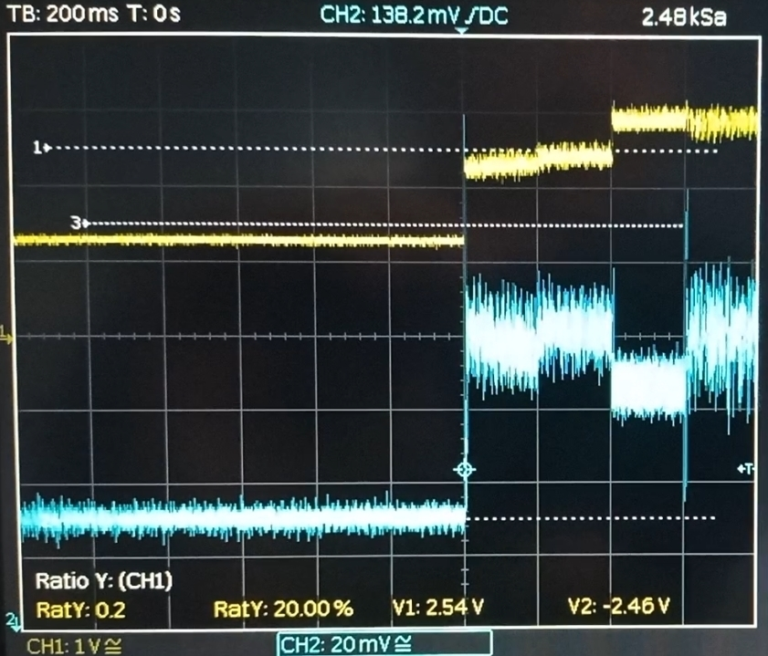
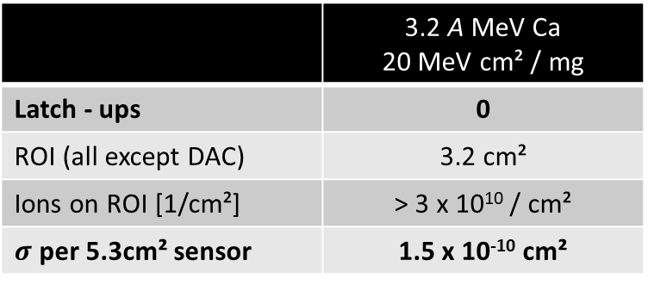
Results
Latch-up:
 | 3.2 A MeV Ca 20 MeV cm² / mg
Latch - ups | 0
ROI (all except DAC) | 3.2 cm²
Ions on ROI [1/cm²] | > 3 x 10¹⁰ / cm²
$σ$ per 5.3cm² sensor | 1.5 x 10⁻¹⁰ cm²
preliminary
No latch-ups observed (but sensor senses ions).
=> Why discrepancy with previous results?
MIMOSIS-1
ROI = DAC
Observation on DAC:
Bit flips in DAC generate current fluctuation.
  will shrink after Hamming code bug fix.
Cross-section not acceptable
  will shrink after Hamming code bug fix.
System instable, no detailed study possible.
No beam
Pulses: Few 10⁶/cm²
Previous observed latch-ups likely falsely interpreted bit flips in DAC.
Latch-up cross-section orders of magnitude better than required (all structurs except DAC) .

Slide 12
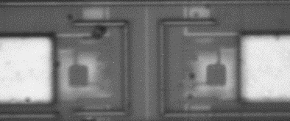
Outlook: Bit flip cross-sections
Beamline: GSI UNILAC X0
Beam: 4.8 A MeV Ca
Beam intensity: ~120 Hz
Beam diameter: 500 nm, raster scan possible.
Mode: Write and read back RAM.
Beam diameter (500 nm)
ca. 30 µm
Micro-Beam: Microscope view of the pixel area
Block | Window size | Ions | Bit flips to (1/0) | p [1]
DAC digital part | 320 x 40 µm² | 148/µm² | 1140/902 | 1 x 10⁻⁴
RAM | 50 x 80 µm² | 528/µm² | 3030/4278 | 6 x 10⁻³
Reminder:
Should be 5x10⁻⁸ over full sensor.
Work in progress
Result depends on good choice of window. => Numbers subject to update.
Further data analysis needed (e.g. consider surface of RAM cells, beam to device alignment etc.)
Preliminary conclusion:
Protection of status registers indeed required.
Expect <200 data errors /s and sensor in the MVD.

Slide 13
Summary
MIMOSIS will be the sensor of the CBM-MVD.
5 µs, 5µm resolution, 80 MHz/cm² peak rate, continuous readout.
1024 x 504 pixels of 27x30 µm² pixels (fully depleted).
MIMOSIS-1 was tested for its tolerance to heavy ion impacts at GSI.
Latch-up cross section <1.5 x 10⁻¹⁰ cm² at LET 20 MeV cm²/mg
Beam intensity similar to beam loss scenario => successfully tested
Unexpectedly many bit flips:
  Bug in the Hamming code protection of status registers found and fixed.
  Expect problem solved for MIMOSIS-2
Data for measuring bit flip cross-sections was taken, analysis under progress.
So far: MIMOSIS-1 matches the requirements of the CBM-MVD.

Slide 14








CBM-MVD collaboration members
Supported by:
Julio Andary¹, Benedict Arnoldi-Meadows¹, Ole Artz¹, Jérôme
Baudot², Grégory Bertolone², Auguste Besson², Norbert Bialas¹,
Roma Bugiel², Gilles Claus², Claude Colledani², Hasan
Darwish^{1,2,3}, Michael Deveaux³, Andrei Dorokhov², Guy Dozière²,
Ziad El Bitar², Ingo Fröhlich^{1,3}, Mathieu Goffe², Fabian
Hebermehl¹, Abdelkader Himmi², Christine Hu-Guo², Kimmo
Jaaskelainen², Oliver Michael Keller⁶, Michal Koziel¹, Franz
Matejcek¹, Jan Michel¹, Frédéric Morel², Christian Müntz¹, Hung
Pham², Christian Joachim Schmidt³, Stefan Schreiber¹, Matthieu
Specht², Dennis Spicker¹, Joachim Stroth^{1,3,4}, Isabelle Valin², Yue
Zhao², Roland Weirich¹ and Marc Winter^{2,5}
¹Goethe-Universität Frankfurt, Germany
²Université de Strasbourg, CNRS, IPHC UMR 7178, Strasbourg, France
³GSI Helmholtzzentrum für Schwerionenforschung GmbH, Germany
⁴Helmholtz Forschungsakademie Hessen für FAIR, Germany
⁵IJCLab, UMR9012 – CNRS / Université Paris-Saclay / Université de Paris, France
⁶Facility for Antiproton and Ion Research in Europe GmbH,Germany
(05P19RFFC1)

