Slide 1




3D localization of radioactive sources by triangulation method using a single gamma camera
28/06/2022
Kamel BENMAHI^{i}, Vincent SCHOEPFF^{i}, Frédérick CARREL^{i}, Guillaume AMOYAL^{i}
(i) University of Paris-Saclay, CEA, List, F-91120 Palaiseau, France.

Slide 2
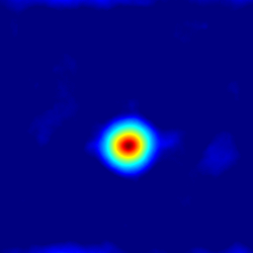
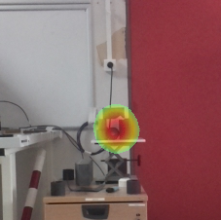
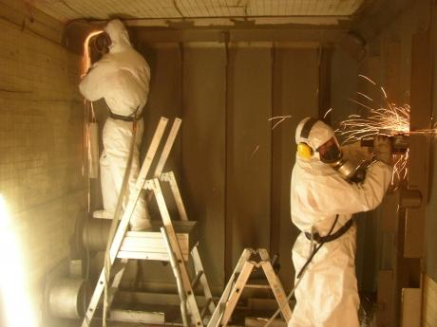
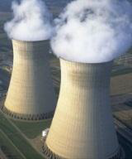
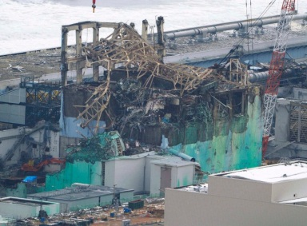
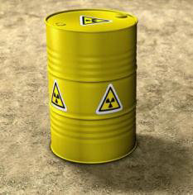
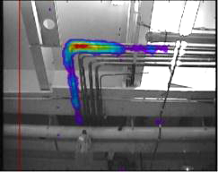
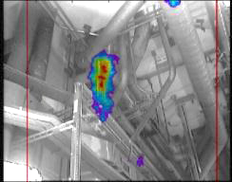
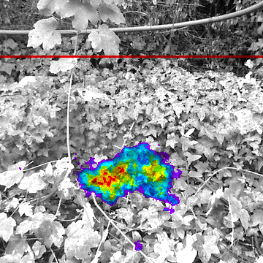
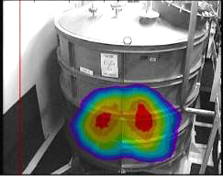
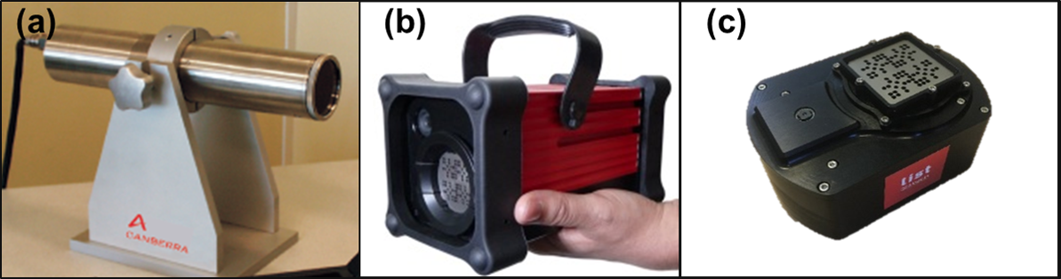
Introduction, context, purposes
Localization of radiological hot spots
  Superimposing a gamma image on a visible image
  Respecting ALARA* principle
Applications:
  Nuclear decommissioning
  Radiation protection
  Accidental situations
  Nuclear waste management applications
(a)
(b)
  (a): Hot spot reconstruction using the coded-aperture method via Nanopix. (b): Superimposition of a gamma image on a visible image to locate the hot spot.
  Gamma imagers pictures (a) CARTOGAM. (b) IPIX. (c) Nanopix.
* As Low As Reasonably Achievable
Notes:
The context is about ionizing radiation imaging, this technique is used to localize and visualize a radioactive source by superimposing a visible image on a gamma image in near and far field, which reduces the dose received by operators respecting by the way the ALARA principle.
…..
In such applications, the radiological environments sometimes impose some challenges to overcome.

Slide 3
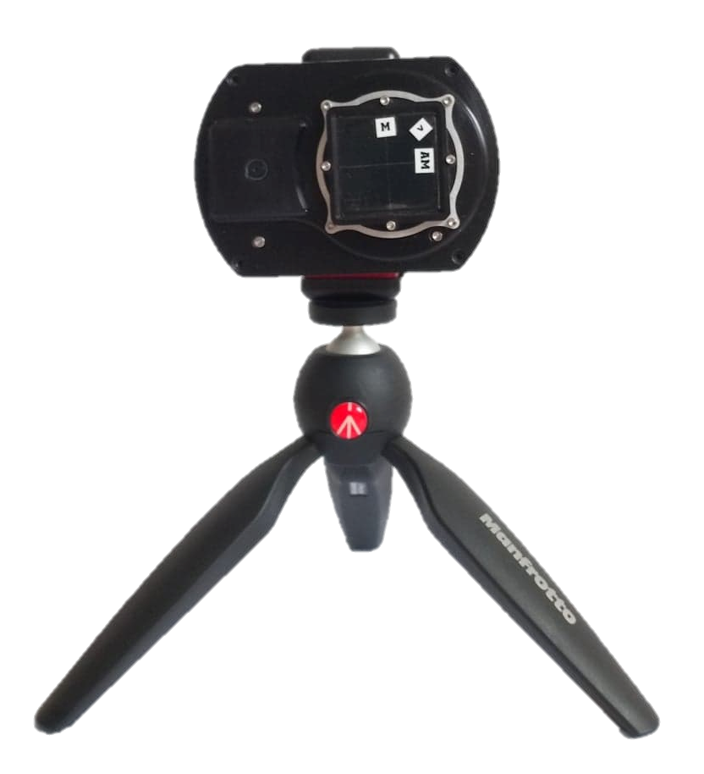
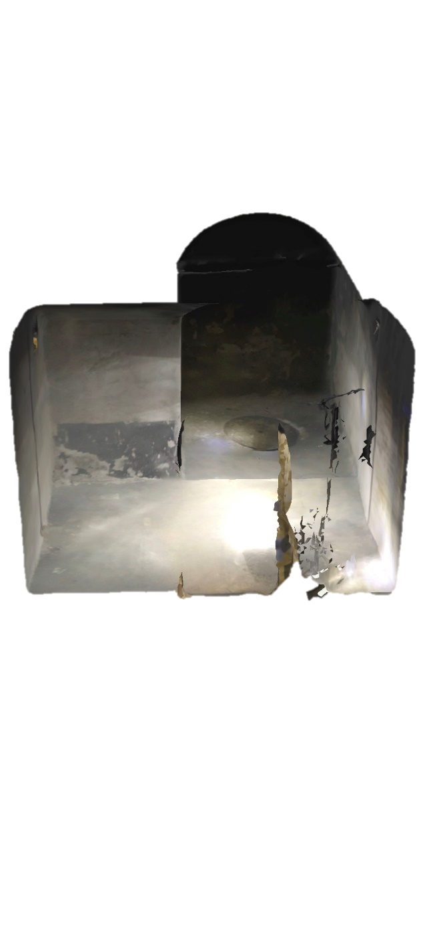
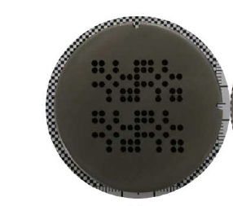
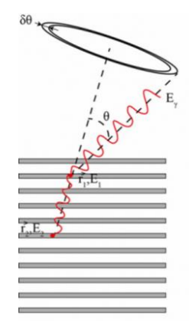
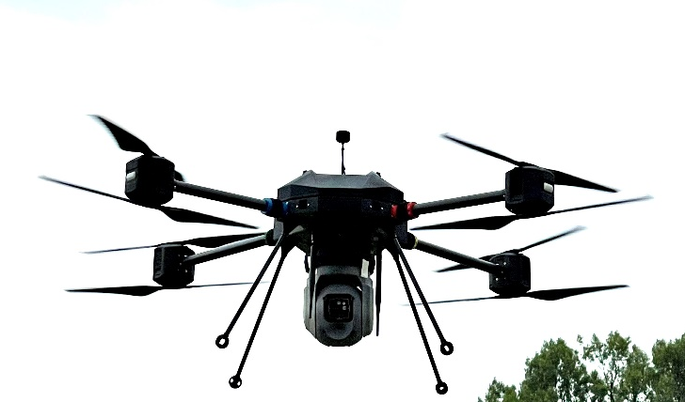
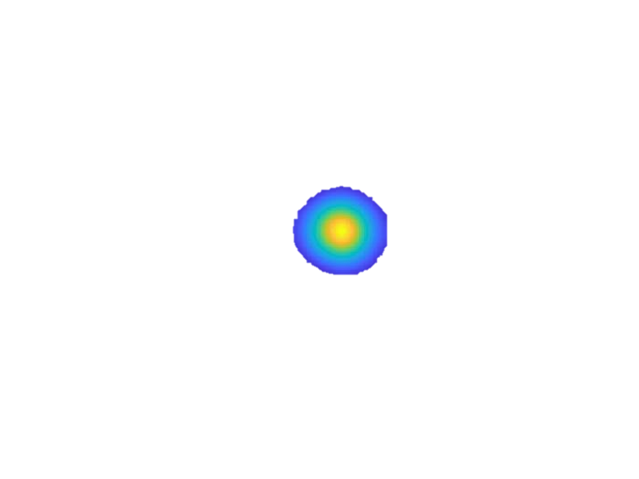
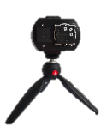
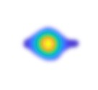
Introduction, context, purposes
Localization in our current compact imaging systems:
  Stationary measurements;
  Two distinct 2D localization techniques.
    Coded-aperture;
    Compton scattering.
Development of a new generation of gamma imager:
  Moving system
  3D localization
Source to detector distance ??
Gamma camera Nanopix
Extracted from: http://www.univearths.fr/
Notes:
In fact, localization of radiological hot spot with our current imaging system is carry out with measurements in a fixed position …
…
This second point is the object of this presentation.

Slide 4
Table of contents
Imaging techniques
Imaging systems
3D imaging: triangulation method
Simulation validation
Conclusions & outlooks

Slide 5
Table of contents
Imaging techniques
Imaging systems
3D imaging: triangulation method
Simulation validation
Conclusions & outlooks

Slide 6
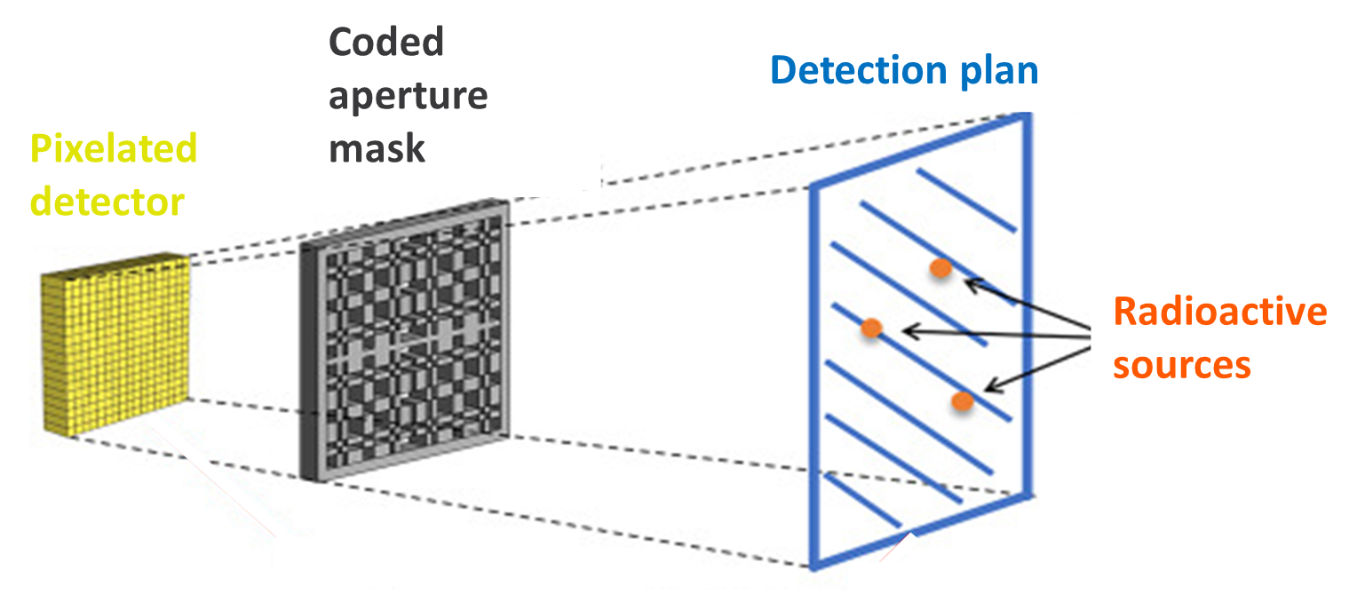
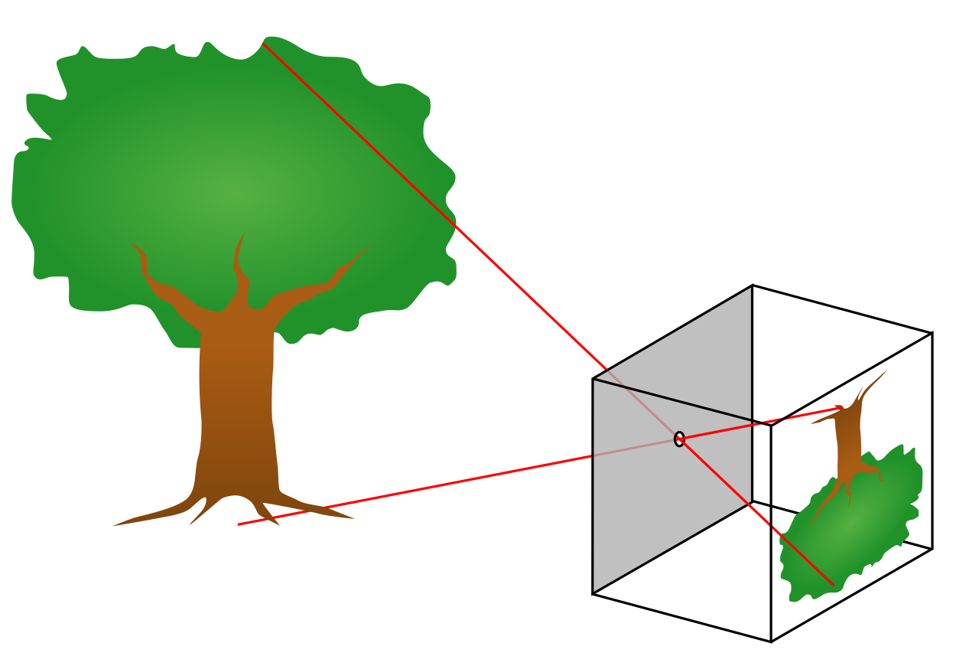
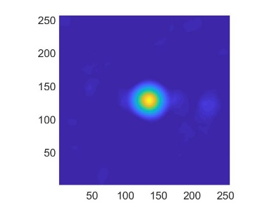
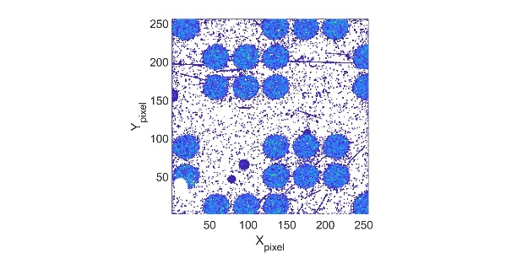
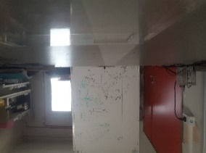
Imaging techniques
Coded-aperture imaging:
  Pinhole camera
  Spatial modulation of the incoming flux of γ-rays and x-rays
  Masks: multi-holes collimators
  Projection on the pixelated detector
  Decoding the pattern of the projected shadow
Extracted from: https://en.wikipedia.org/
Decoding
Notes:
This technique is inspired from the pinhole camera that allows the photons to focus within a limited space and allows the formation of a clear image.

Slide 7
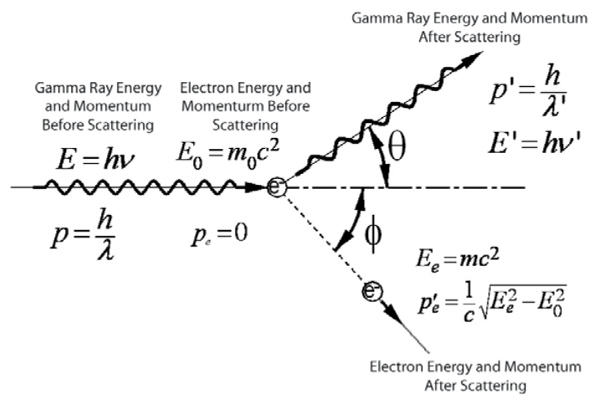
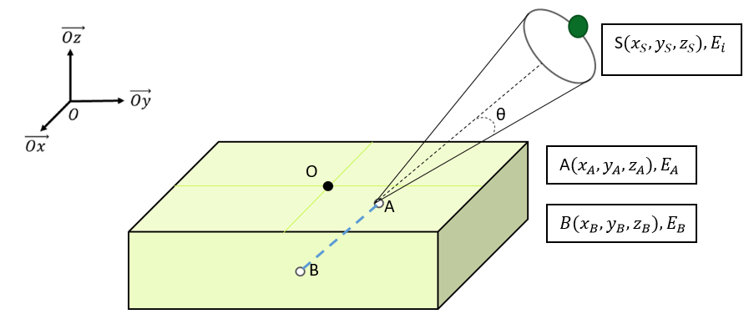
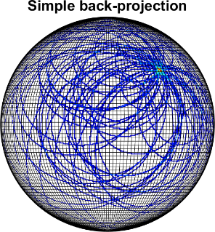

Imaging techniques
Compton imaging:
  Compton scattering
  Information preserved: energy and direction of the γ-ray.
  Calculation of scattering angle
  Intersection of cones
$$\cos\left(θ\right)=1+\frac{m_{e}c²}{E_{i}} − \frac{m_{e}c²}{E_{a}}$$
Compton scattering diagram showing the interaction between the incident photon and electron initially at rest to the scattered photon and electron given kinetic energy [1]
[1] J. Parks, “The Compton Effect-- Compton Scattering and Gamma Ray Spectroscopy,” 2009.
Notes:
…
These two techniques are used currently in different imaging systems.

Slide 8
Table of contents
Imaging techniques
Imaging systems
3D imaging: triangulation method
Simulation validation
Conclusions & outlooks

Slide 9
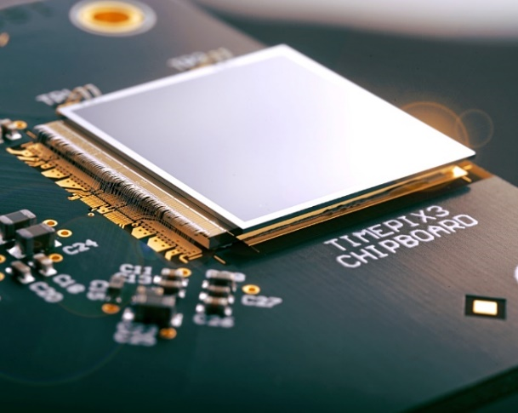
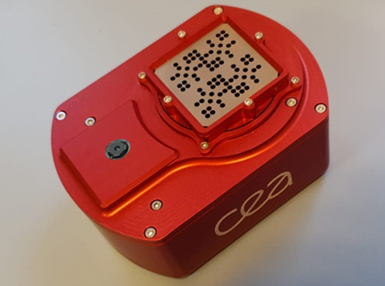
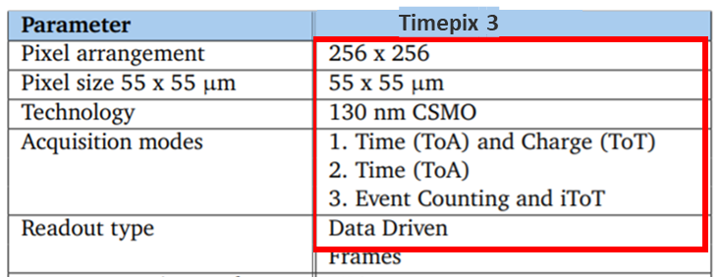
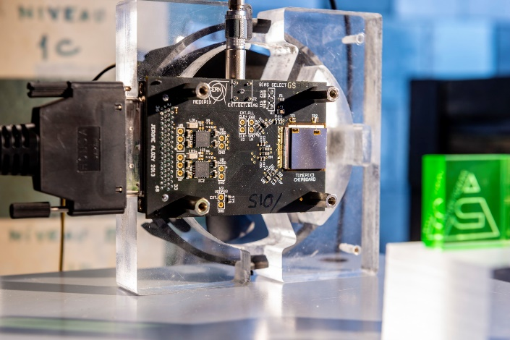
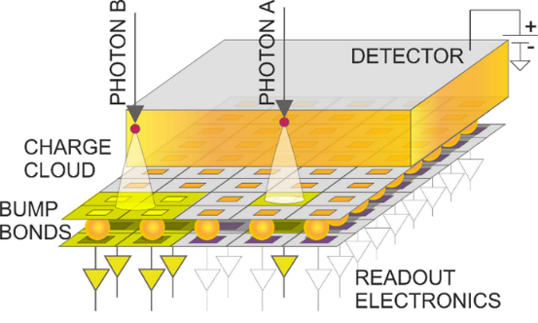
Imaging system
The operating gamma imagers:
Gamma Imager | Imaging technique | Detector
Nanopix | Coded aperture masks | Timepix + 1 mm CdTe
Compton imager | Compton imaging | Timepix3 + 1 mm CdTe
Timepix3 © CERN
Extracted from: A. Krzyzanowska et al., Characterization of the Photon Counting CHASE Jr., Chip Built in a 40-nm CMOS Process with a Charge Sharing Correction Algorithm Using a Collimated X-Ray Beam, IEEE Trans. Nucl. Sci. 64 (2017).
Nanopix © CEA List
Compton imager prototype © CEA List
7
Notes:
…
Using these systems we built algorithm in the aim to perform 3D imagig that is the topic of the next chapter.

Slide 10
Table of contents
Imaging techniques
Imaging systems
3D imaging: triangulation method
Simulation validation
Conclusions & outlooks

Slide 11
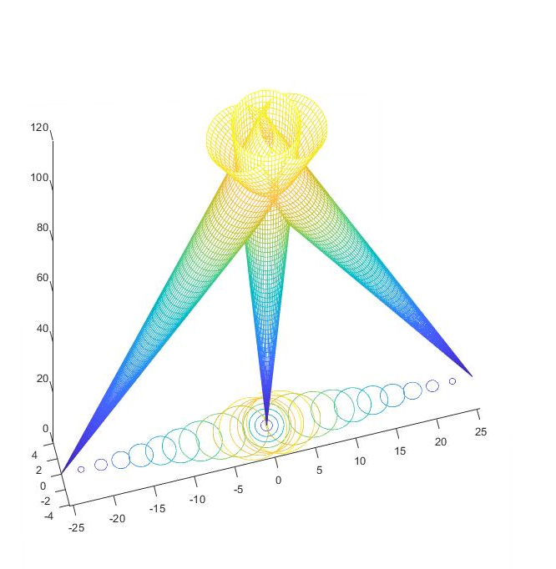
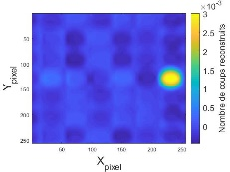
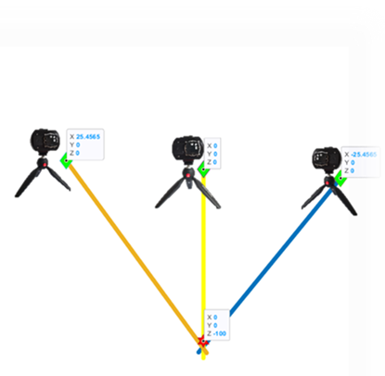
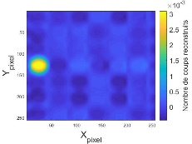
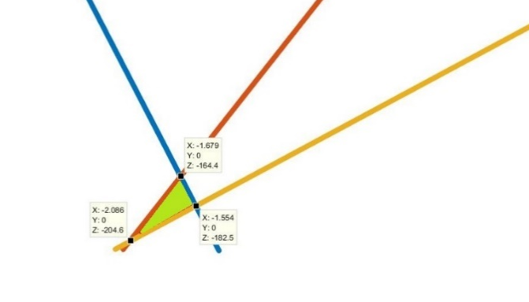
3D imaging: triangulation method
Radioactive source
Triangulation method using a single detector
  Moving the detector to different positions
  Recording the coordinates of each position of detector
  Performing several gamma images
  Calculating the director vectors
  Defining and characterizing the region of uncertainty
Detector
1st position (x₁,y₁,z₁)
2nd position (x₂,y₂,z₂)
8
Notes:
In 3D localization : The method used to achieve this technical purpose is called triangulation inspired from stereoscopic cameras but in our case we use only a single detector.
The idea is to move the detector into different positions while recording every single positon reached.
Every position is then followed with a measure to perform gamma images that give us the radioactive source direction in every time.
We use then all the informations we obtain from theses gamma images and the coordinates of all the associated positions to calculate the director vectors according to x position. The intersection of these vectors will form a region we call uncertainty region that we characterize mathematically to have the source to detector distance and its uncertainty.
So, to validate this method functioning we used simulation.

Slide 12
Table of contents
Imaging techniques
Imaging systems
3D imaging: triangulation method
Simulation validation
Conclusions & outlooks

Slide 13
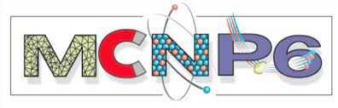
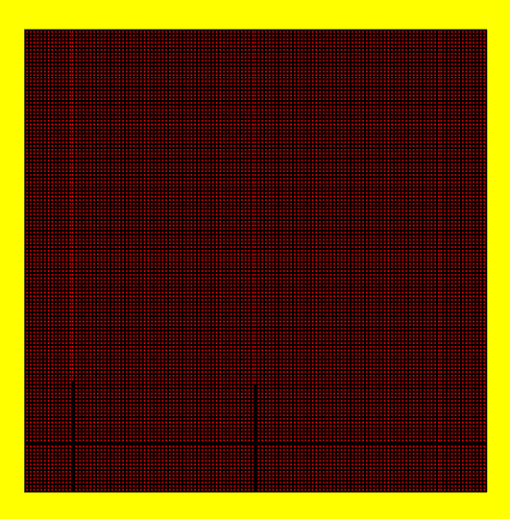
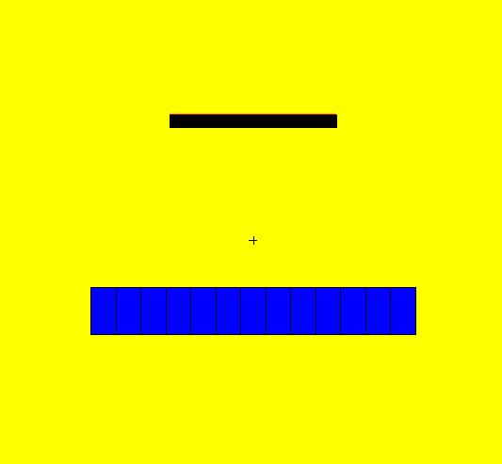
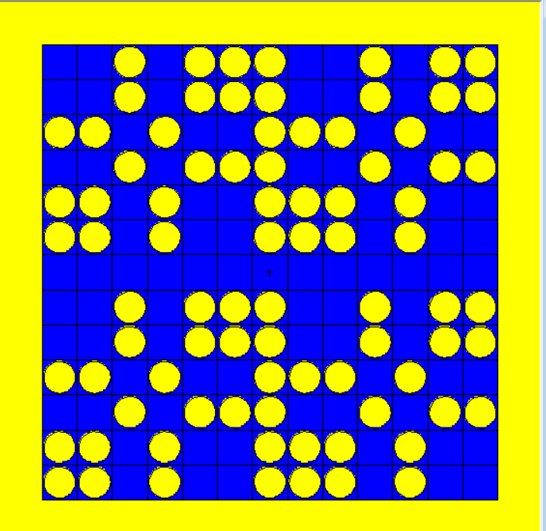


Simulation validation
Gamma imaging simulation
Pixelated detector
Coded-aperture mask
Z
Y
X
X
14.08 mm
27.3 mm
Z
Y
1 mm
X
X
14.08 mm
27.3 mm
9

Slide 14
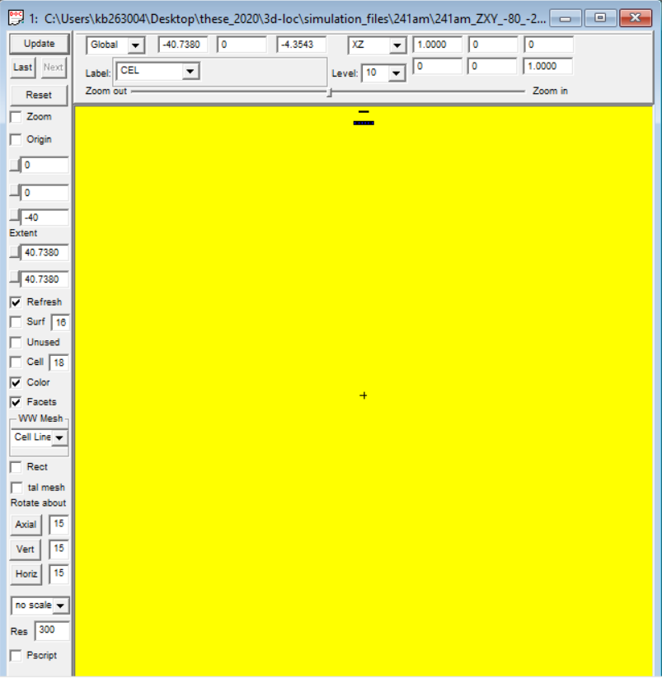
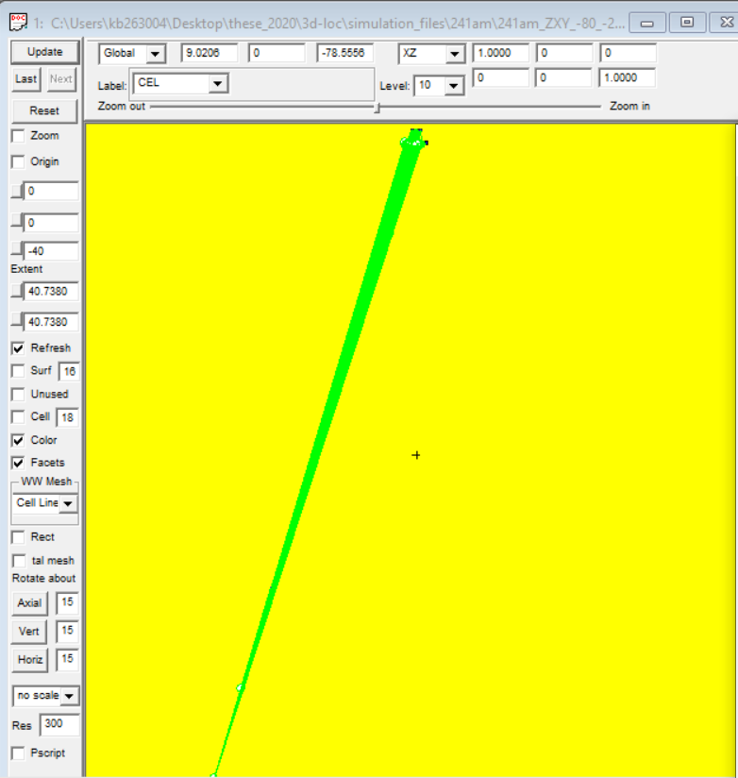
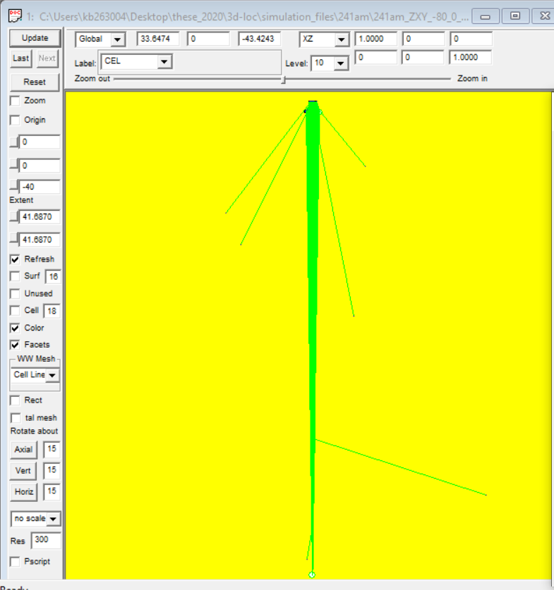
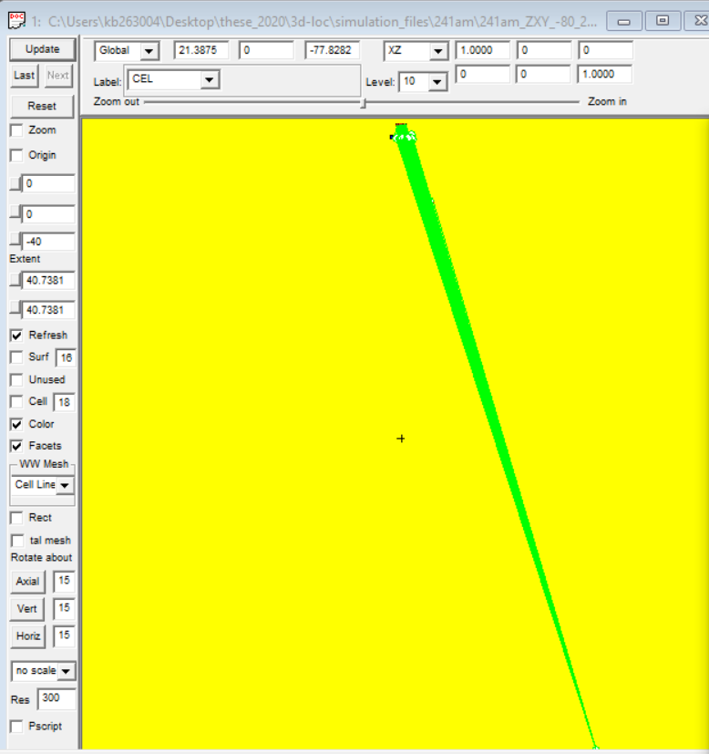
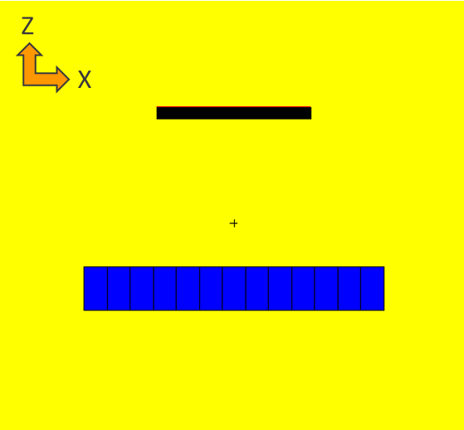
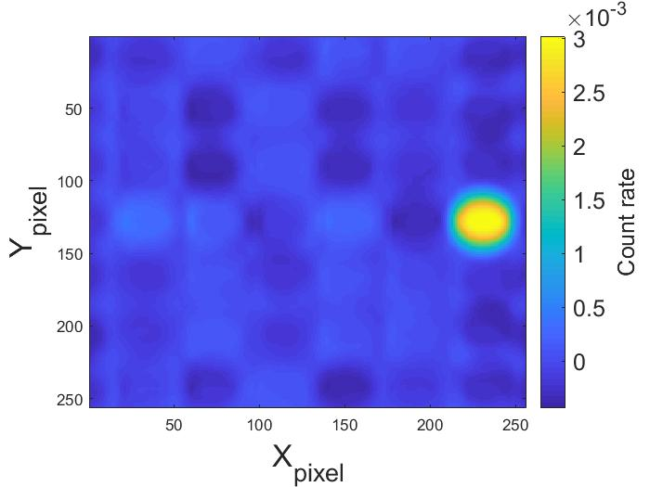
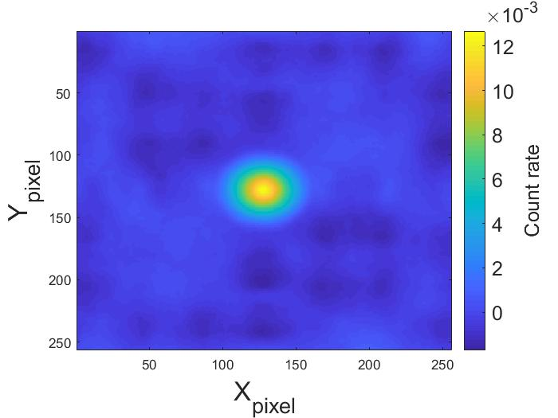
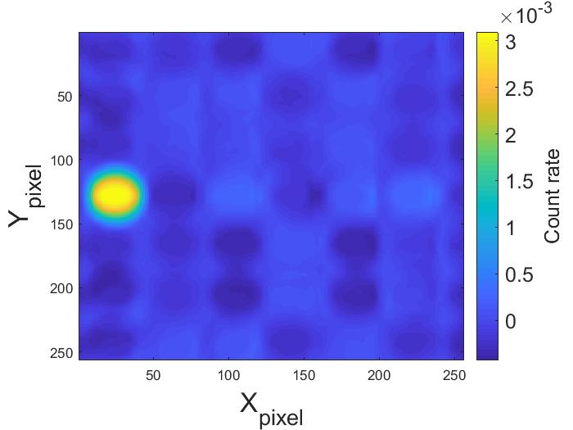
Simulation validation
Gamma imaging simulation
  Moving vertically the source from 60 cm to 500 cm
  Moving horizontally the source: left, center, right
  Varying the displacement step
10

Slide 15
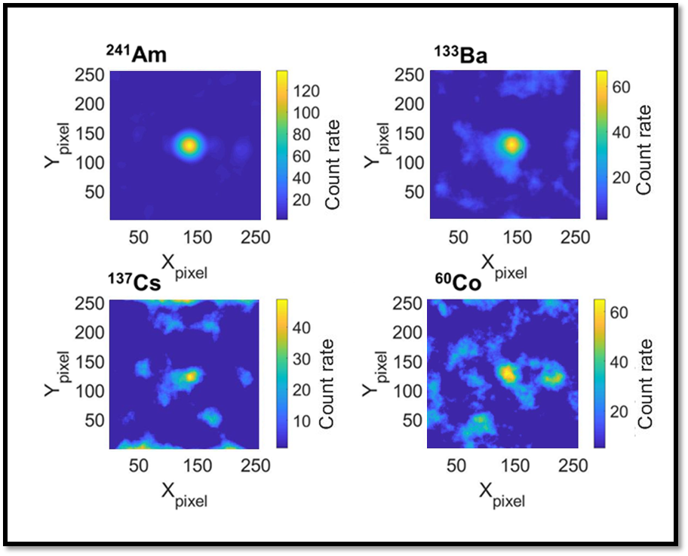






Simulation validation
Gamma imaging simulation: results
  Increase in uncertainties:
  Degradation of the angular resolution due to the increase in energy
Decrease the displacement step to 25 cm
Decrease the dose rate (20 times lower)
  Increase in uncertainties:
  Degradation of the angular resolution due to low count rate and the displacement step.
²⁴¹Am (59,6 keV)
¹³³Ba
([81, 276, 302 ,356, 383] keV)
¹³⁷Cs (662 keV)
Coverage factor K = 2
11
Notes:
In order to estimate the source to detector distance using triangulation method, we simulated three different sources with different energies of the the gamma emitted. 241Am, 133Ba, and 137cs.
The results obtained are illustrated in the graphs here, and represent the distance source to detector estimated according to the distance simulated.
. For the same dose rate and the same displacement step of the source, we notice an increase in the uncertainties on the estimated source to detector distance with the increase of the energy. This was actually expected.
In fact, the estimation of distances depend partially on the angular resolutions of the gamma images reconstructed. Therefore, when the energy of incoming gamma photons into the coded aperture increases, transparency of this one will also increase, background noise increase and angular resolution is degraded.. However, the maximum uncertainty remains less than 10% in any case.
Otherwise, when the displacement step is shortened and the rate dose is decreased by 20 times compared to the first simulations, we notice a drastic increase of uncertainties as shown in the two examples ahead. This was due to the degradation of the angular resolution of the gamma images reconstructed. That’s due in turn to two main reasons: first low count rate because of the rate dose reduction. Secondly, because of the displacement step.

Slide 16
Simulation validation
Gamma imaging simulation: results
  Studying the impact of displacement step: FOV* ; triangulation calculations
Radioactive source
Detector
Displacement step a
Displacement step b
Displacement step c
* Field Of View
12
Notes:
And this last point, about the impact of displacement step on the estimation of the localization of hot spot is under study. to initiate this study, we adopted the same simulation model as presented earlier. but this time the displacement step values were varied more than 5 times according to the field of view of the detector.

Slide 17

Simulation validation
Gamma imaging simulation: results
  Studying the impact of displacement step: FOV* ; triangulation calculations
  Ratios ≈ 1
  Increase with displacement step
  Degradation of the angular resolution
Evolution of the ratios of estimated source-detector distances to simulated source-detector distances according to the displacement step values.
* Field Of View
13
Notes:
the aim was to observe how the displacement step of our measured source would impact the triangulation calculation. as shown in the graph ahead, the ratio between the distances estimated and the ones simulated according the displacements step, is about 1 fluctuating between 0.96 and 1.08. However, we notice that at big displacement steps relatively to the distances ranged, ratios tend to increase. this was explained by the fact that the closer the source get to edges of the FOV, the most is degraded the angular resolution. To avoid this type of problem, this study will be enhanced by taking into account another parameter, which is the detector direction.

Slide 18
Table of contents
Imaging techniques
Imaging systems
3D imaging: triangulation method
Simulation validation
Conclusions & outlooks

Slide 19



Conclusions and outlooks
3D localization using a single gamma imaging system based on a coded-aperture mask using triangulation method
  Localization estimated from 60 cm up to 500 cm.
  Relative uncertainties < 10 % (K = 2).
A 3D system based on Compton imaging technique
3D hot spot reconstruction
P1, T1, D1
P1, T1, D1
P1, T1, D1
P1,T1
P2,T2
P3,T3
Displacement of the detector (position, time, direction)
14
Notes:
In conclusion, the study carried out here, allowed us to prove the ability to localize in 3D a hot spot with a single detector using triangulation method. In addition, many experiment works in our laboratory, not presented here, has been conducted to validate the triangulation algorithms we built using nanopix.
In outlooks, we aim to the adapt this triangulation method to Compton imaging systems,
In the same way as in the coded aperture systems. the imager will have to be moved in all directions in 3D. In this case, all the Compton events detected will be assigned to three parameters that are : positions in space, orientation of the detector and time of event detection. This will allow to reconstructs cones according to all of these informations and then they will be projected in space to determine the 3d localization of a hot spot and not only its direction.
other outlooks concern 3D reconstructions of radioactives source, the purpose is to be able to reconstruct the radioacives source in 3D from different projections. some expamples has been initiated, as shown in the images ahead, using tomographique algorthims.

Slide 20
Thank you !
28/06/2022
Kamel BENMAHI

